Slide 1
The African Monsoon Recent Evolution and Current Status Include Week-1 and Week-2 Outlooks
Update prepared by
18 October 2021
For more information, visit:
http://www.cpc.ncep.noaa.gov/products/Global_Monsoons/African_Monsoons/precip_monitoring.shtml

Slide 2
Outline
Highlights
Recent Evolution and Current Conditions
NCEP GEFS Forecasts
Summary

Slide 3
Highlights: Last 7 Days
During the past 7 days, local areas in central Chad observed moisture surpluses of over 100 mm. Weekly rainfall totals reached 100 mm across local areas in central and southwestern Nigeria, northern Congo, local areas in DRC, southern Sudan, South Sudan, and northwestern Ethiopia (moisture surpluses of over 50 mm). Moisture deficits of 50-100 mm were present across southeastern Nigeria, portions of Cameroon, Equatorial Guinea, and Gabon.
The week-1 outlooks depict an increased chance for above-average rainfall across southern Guinea, Sierra Leone, Liberia, Côte d’Ivoire, Ghana, Togo, eastern Nigeria, Cameroon, Namibia and South Africa. Conversely, there is an increased chance for below-average rainfall across Senegal, southwestern Mali, northeastern Uganda, Kenya, southern Somalia, northeastern South Africa, south Zimbabwe, southern Mozambique and southwestern Madagascar.
The week-2 outlooks call for an increased chance for above-average rainfall across southern Guinea, Sierra Leone, Liberia, Côte d’Ivoire, Ghana, Togo, southern Ethiopia, and South Africa. In contrast, there is an increased chance for below-average rainfall across Central African Republic, western South Sudan, northeastern DR Congo, southern Somalia, Kenya, northeastern Uganda, and southern Madagascar.

Slide 4
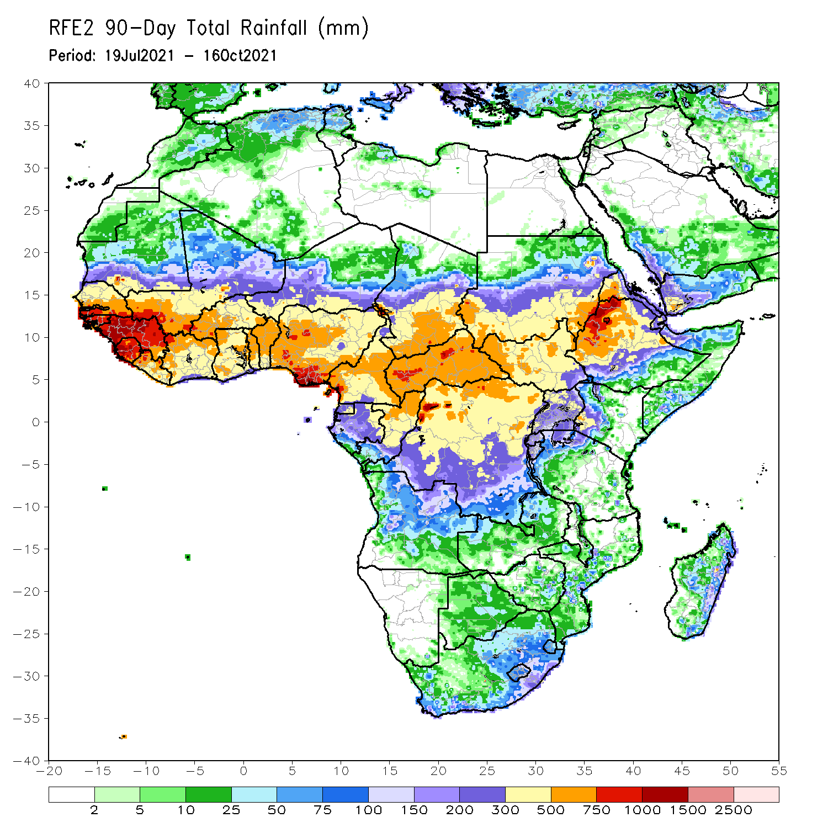
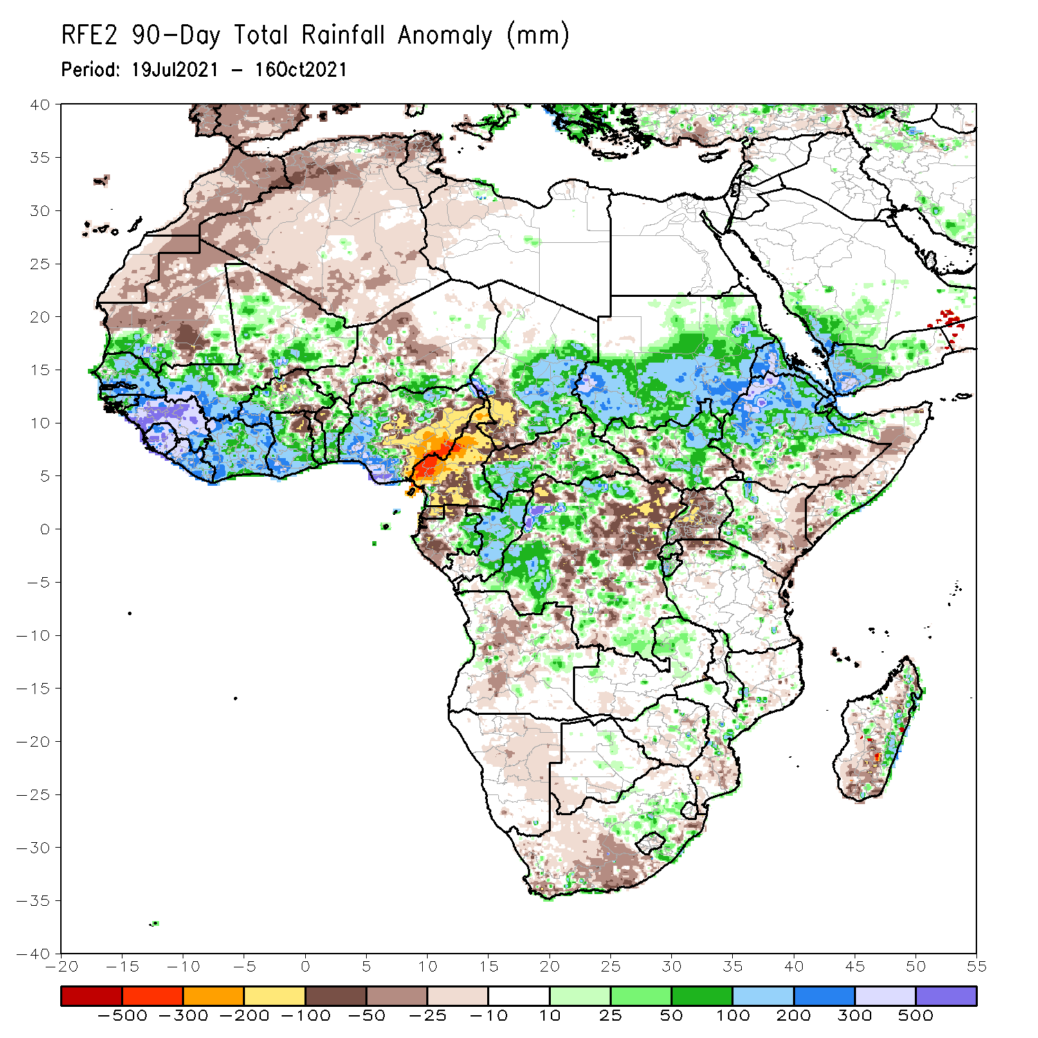
Rainfall Patterns: Last 90 Days
Over the past 90 days, in West Africa, rainfall totals exceeded 1000 mm across Guinea, Sierra Leone, and coastline of Nigeria (moisture surpluses of over 500 mm). Positive precipitation anomalies of over 200 mm were found across southern Senegal, southwestern Mali, Liberia, southwestern Burkina Faso, portions of Côte d’Ivoire, southwestern Ghana, and southwestern Nigeria. Conversely, local areas in northern Burkina Faso, northeastern Ghana, northwestern Benin, and central and eastern Nigeria experienced moisture deficits of over 100 mm. In particular, eastern Nigeria experienced negative precipitation anomalies of over 300 mm.
In Central Africa, the western border of Chad and Cameroon and local areas in northwestern DRC received precipitation in excess of 500 mm. Moisture surpluses of over 100 mm were found over southeastern Chad, portions of CAR, southeastern Cameroon, eastern Gabon, Congo, and local areas in western DRC. Large moisture deficits of over 100 mm were observed in Cameroon, southwestern Chad, Equatorial Guinea, and local areas in Gabon, northwestern CAR and DRC. In particular, western Cameroon experienced moisture deficits of 300-500 mm.
In East Africa, northwestern Ethiopia received heavy rainfall amounts of over 1000 mm (more than 300 mm above the mean). Heavy rainfall was also found over western and eastern Sudan, western Eritrea, and northern Ethiopia. Uganda continued to experience sustained negative precipitation anomalies of over 50 mm.
In southern Africa, pocket areas across the central part of Mozambique and the eastern coast of Madagascar registered rainfall amounts of over 200 mm (moisture surpluses of over 100 mm). Precipitation was also well above-average across the northeastern part of South Africa. Light moisture deficits of 10-50 mm were present across much of western South Africa, and portions of Madagascar.
Notes:
4

Slide 5
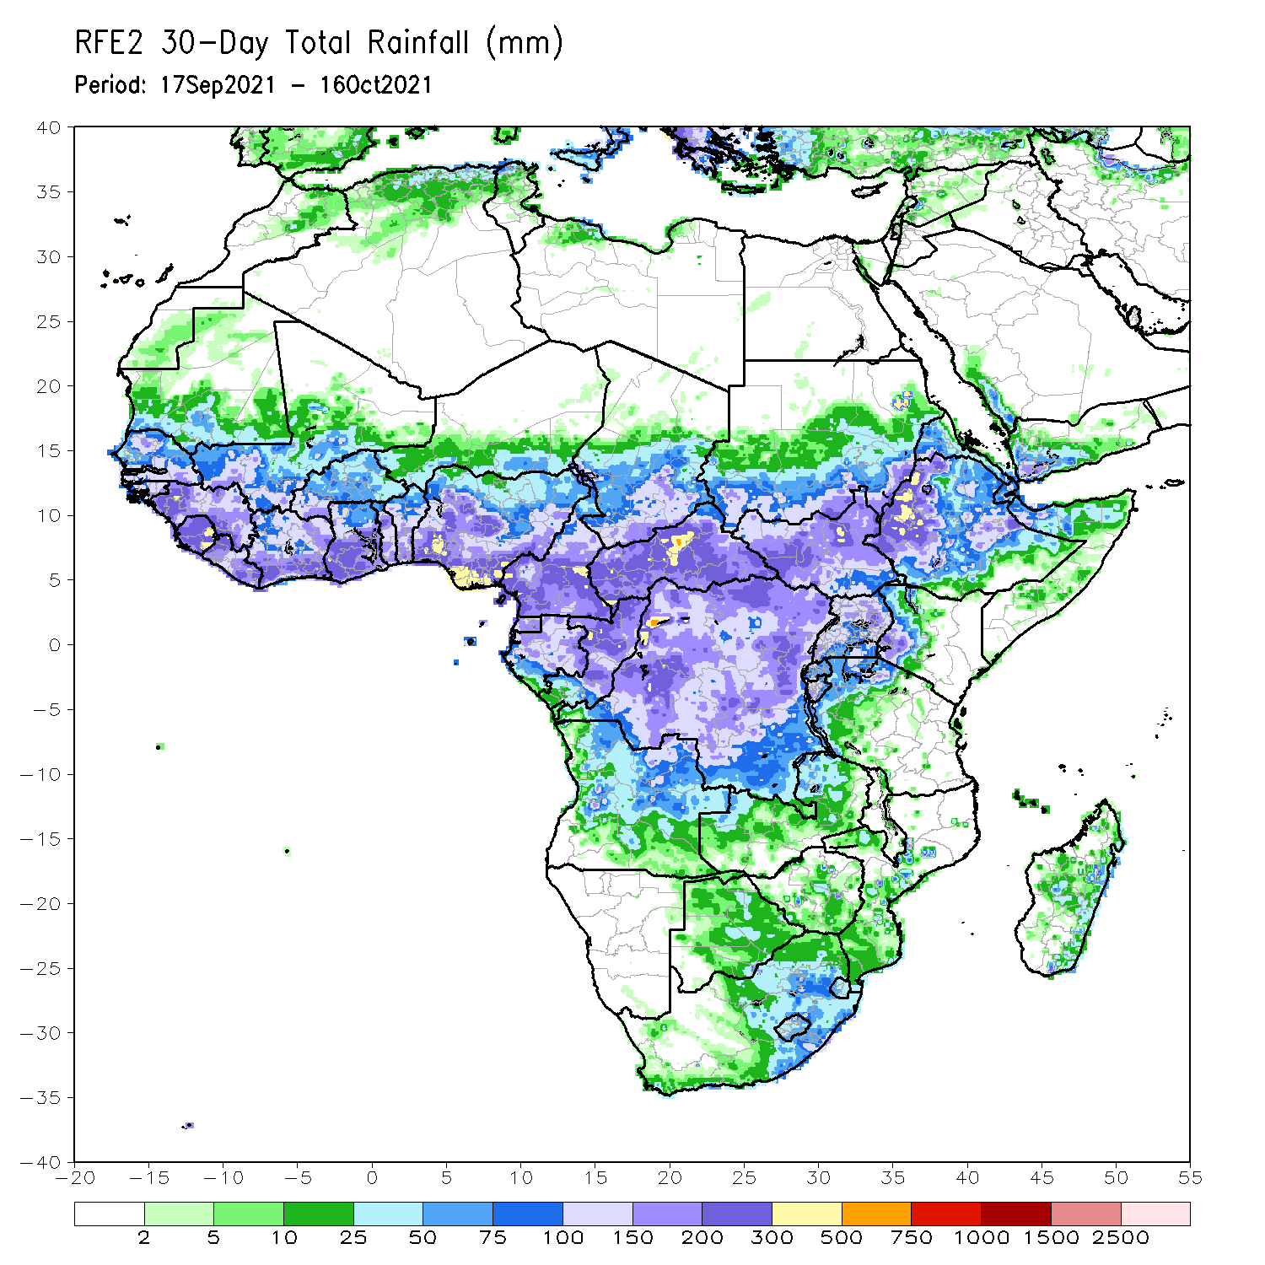
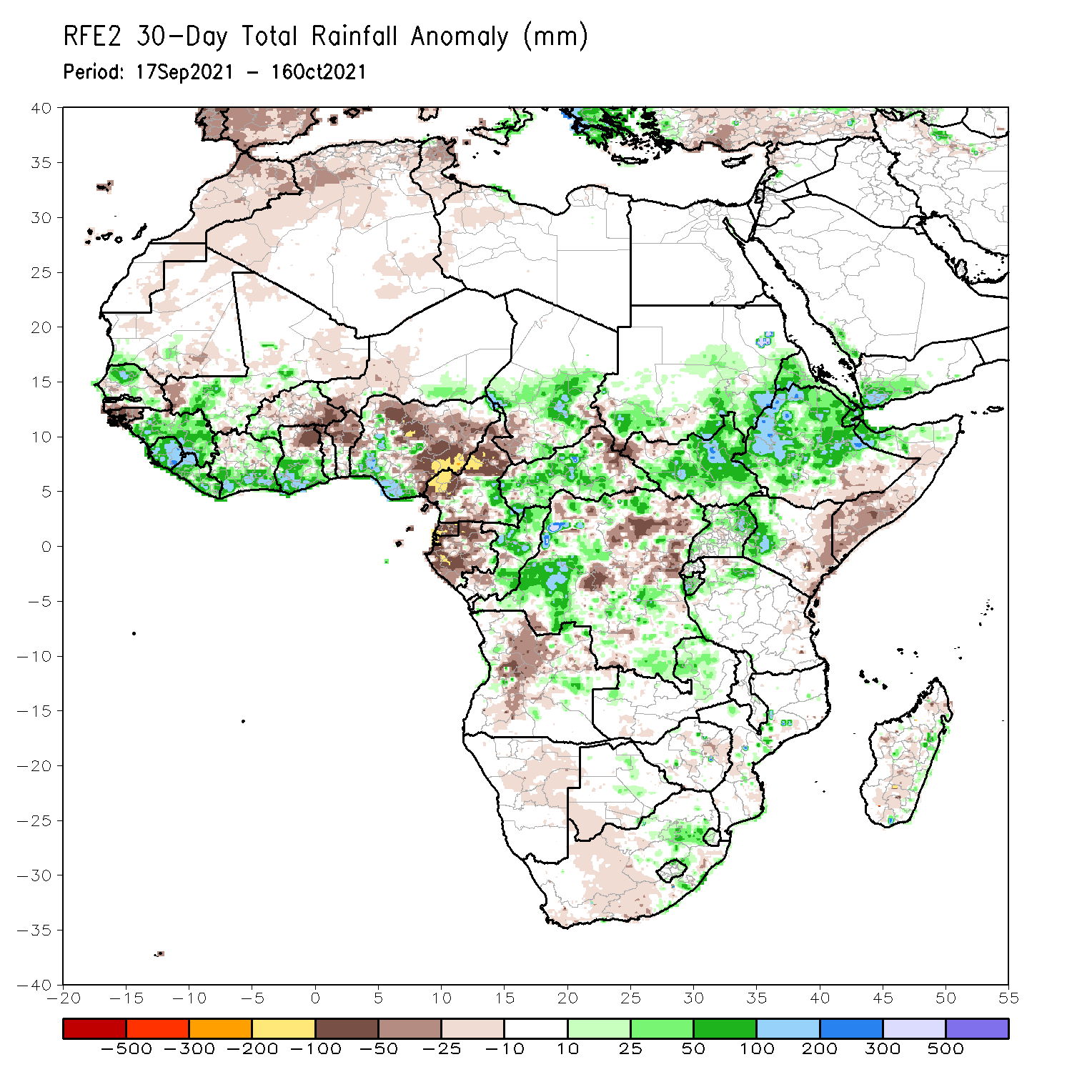
Rainfall Patterns: Last 30 Days
During the past 30 days, in West Africa, moisture surpluses of over 100 mm were present over northern Senegal, parts of Guinea, Sierra Leone, Liberia, southern Côte d’Ivoire, southern Ghana, and western and southern Nigeria. Light rains resulted in negative precipitation anomalies of 50-100 mm across southwestern Senegal, Guinea-Bissau, southeastern Burkina Faso, northern Ghana, Togo, and Benin, and many parts of Nigeria. Moisture surpluses of over 100 mm were observed over central and eastern Nigeria.
In Central Africa, precipitation was 100 mm above the mean across local areas in western and central Chad, southeastern Cameroon, portions of CAR, Congo, and western DRC. Northern Cameroon, Equatorial Guinea, and western Gabon received below-average rainfall (more than 100 mm below the mean).
In East Africa, rainfall amounts reached 300-500 mm in northwestern Ethiopia. Moisture surpluses of over 100 mm were found across parts of southern Sudan, South Sudan, Eritrea, Ethiopia, northern Somalia, eastern Uganda, western Kenya, and northern Tanzania. Moisture deficits of over 25 mm were observed over the southwestern border of Sudan and South Sudan, southern Ethiopia, eastern Kenya, and southern Somalia.
In Southern Africa, the eastern part of South Africa, central Mozambique, and the eastern coastline of Madagascar observed above-average rainfall (more than 25 mm above the mean).
Notes:
5

Slide 6
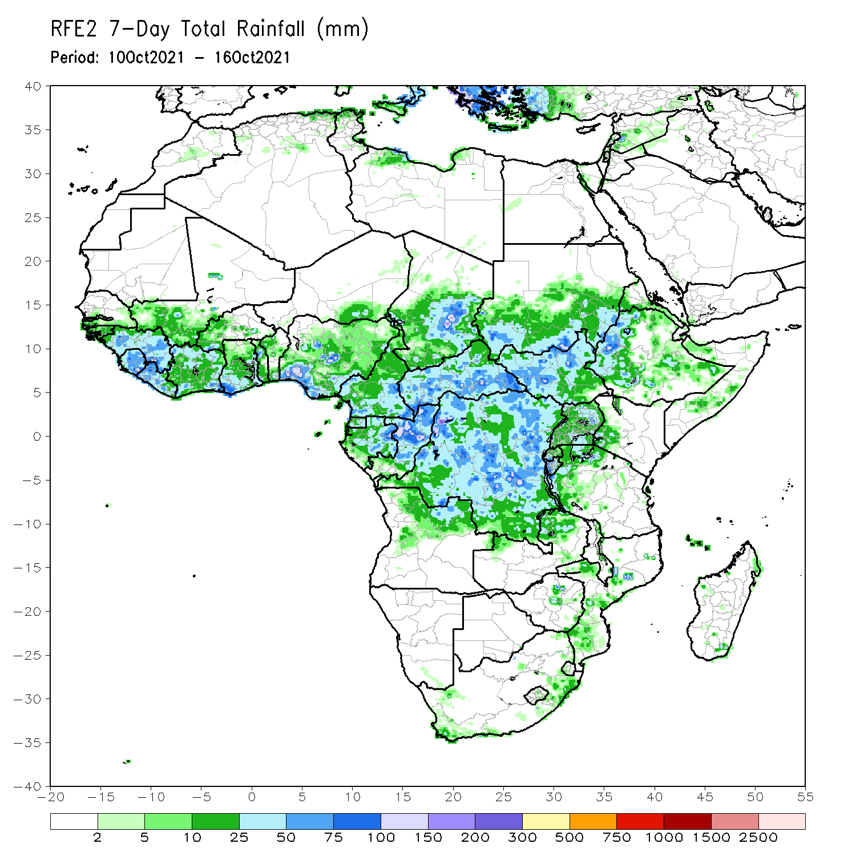
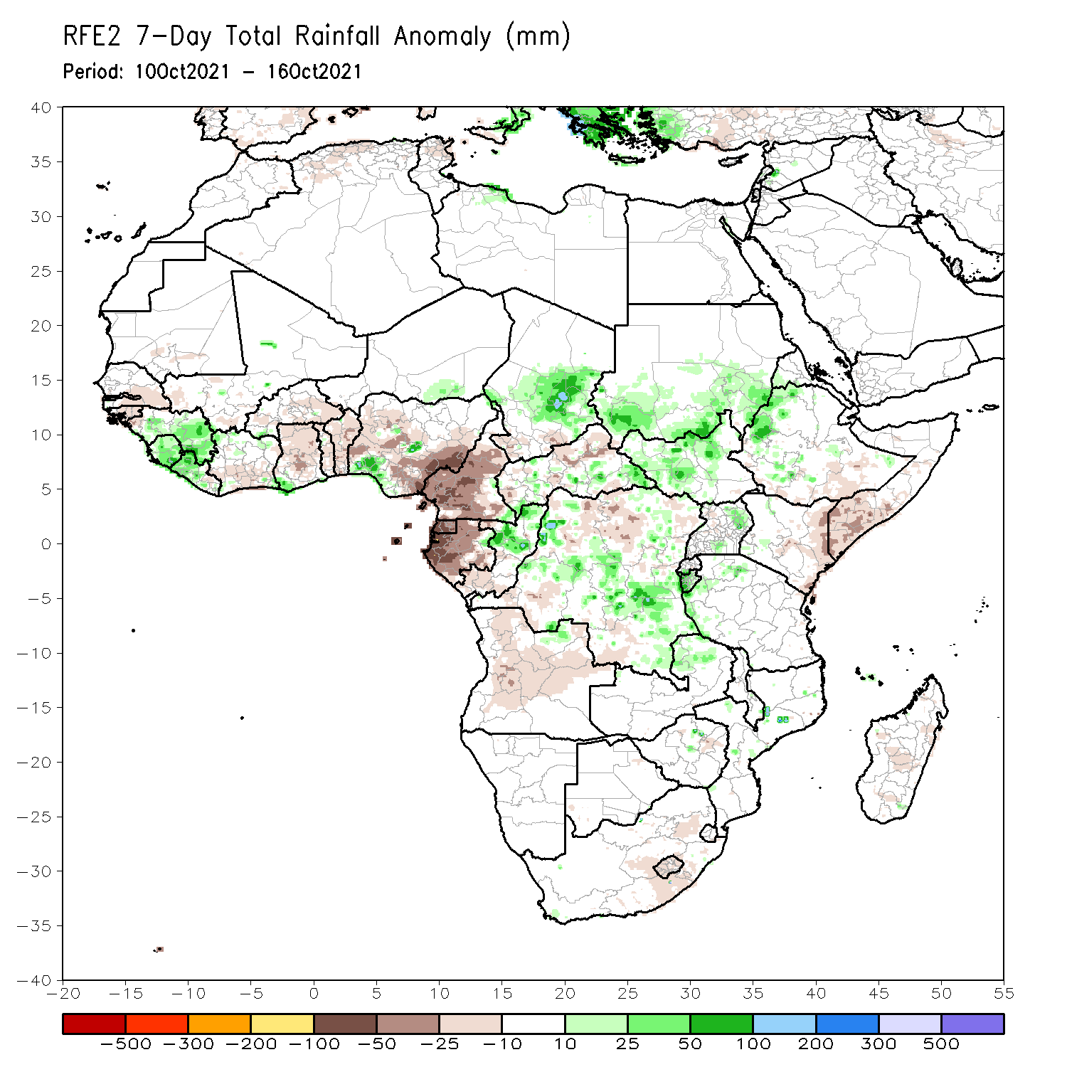
Rainfall Patterns: Last 7 Days
During the past 7 days, in West Africa, Guinea, Sierra Leone, much of Liberia, northern Côte d’Ivoire, southwestern Ghana, and local areas in central and southern Nigeria experienced above-average rainfall, with moisture surpluses of over 25 mm. Moisture deficits of 50-100 mm were found across southeastern Nigeria.
In Central Africa, rainfall totals exceeded 100 mm over central Chad, northern Congo, and pocket areas in DRC (moisture surpluses of over 100 mm). Light rains resulted in negative precipitation anomalies of over 50 mm across Cameroon, Equatorial Guinea, and Gabon.
In East Africa, precipitation was above-average over southern Sudan, South Sudan, western Eritrea, western Ethiopia, portions of Uganda, Rwanda, Burundi, and western Tanzania. Negative precipitation anomalies of 25-50 mm were observed over eastern Kenya and southern Somalia.

Slide 7
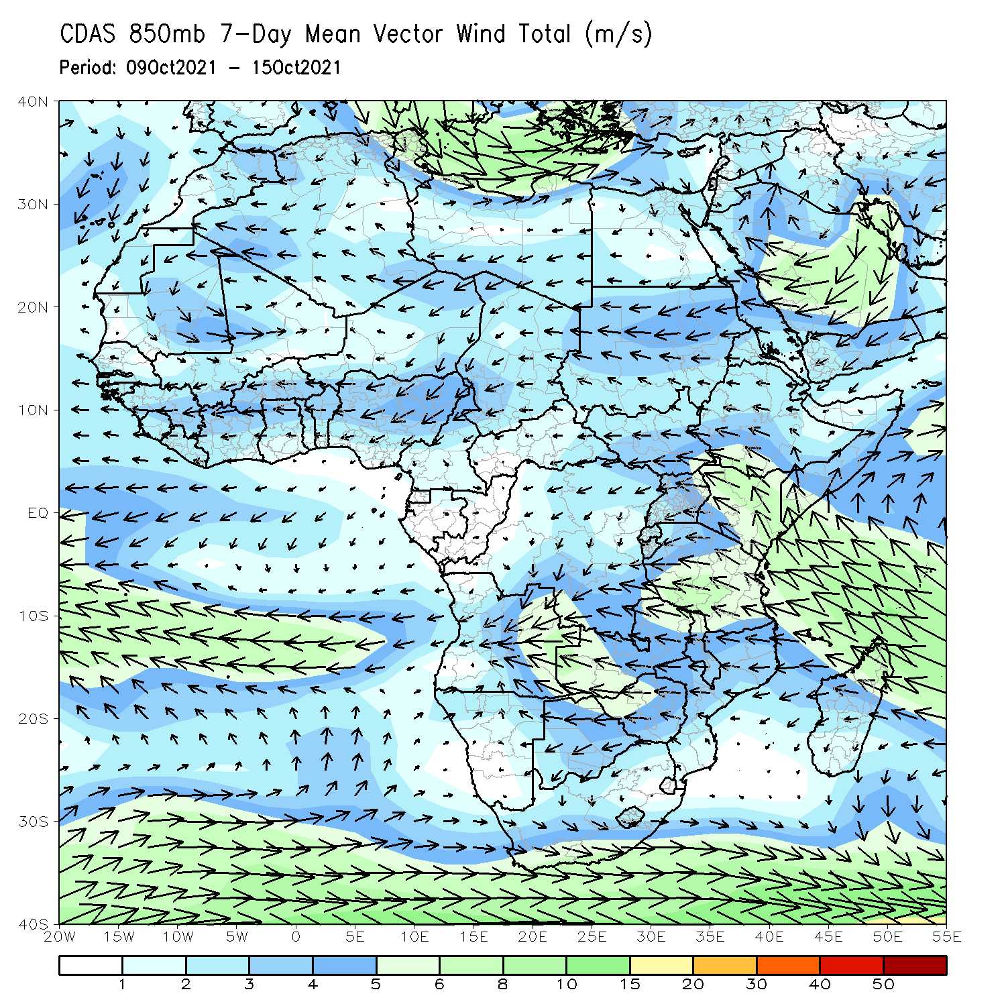
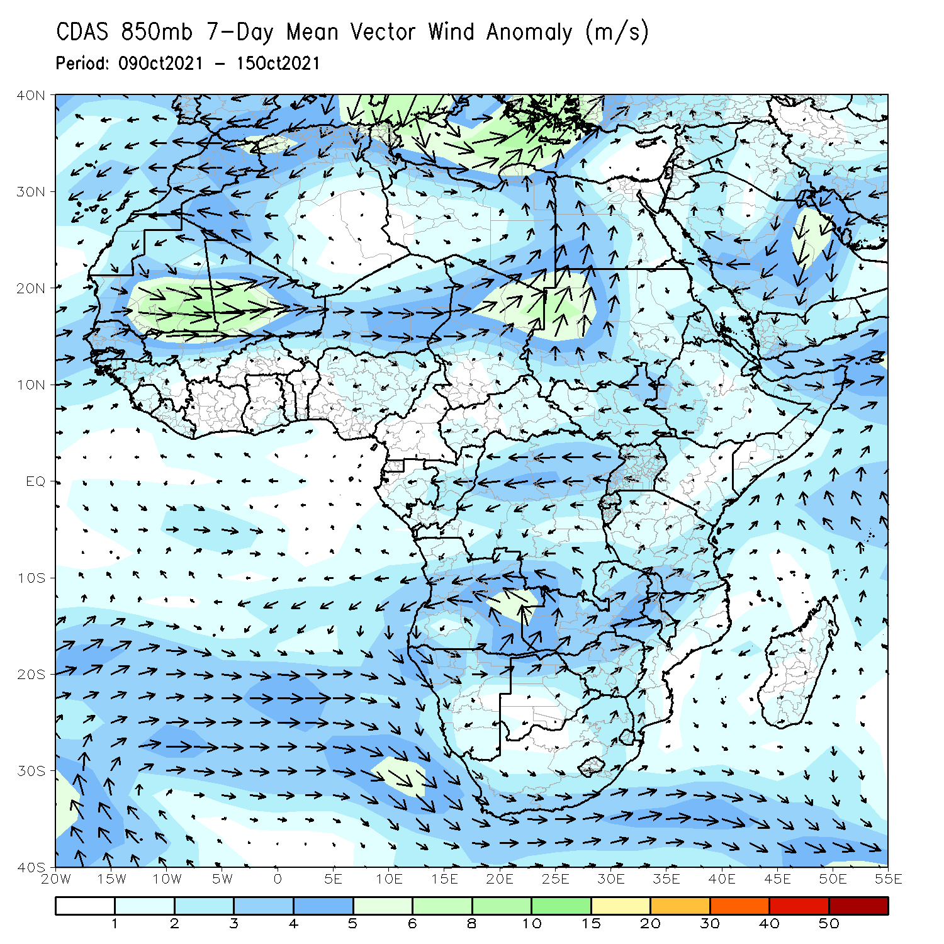
Atmospheric Circulation: Last 7 Days
The 850-hPa atmospheric circulation pattern features an anomalous cyclonic circulation over Mauritania and Mali.
A strong anomalous northwesterly flow was present over Chad and Sudan.

Slide 8
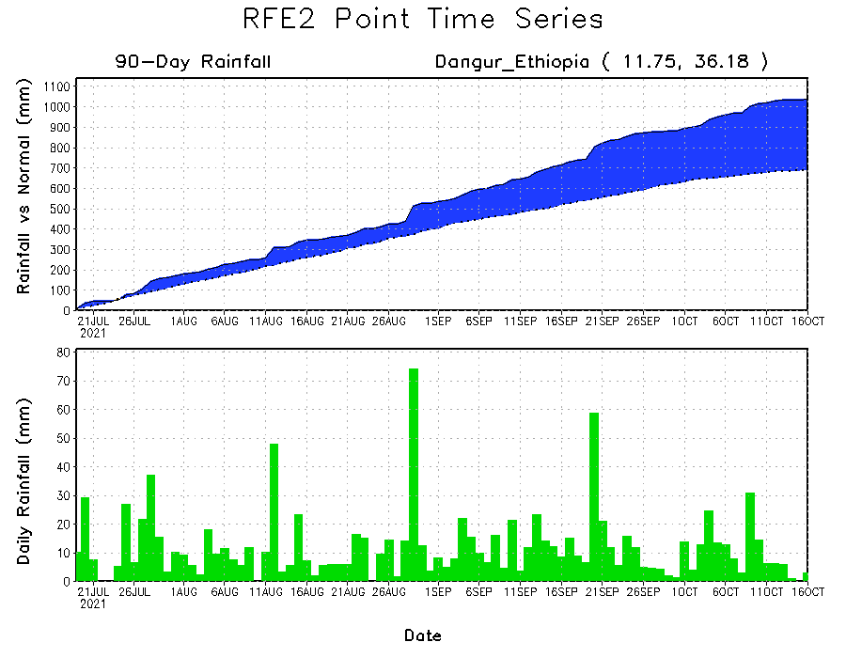
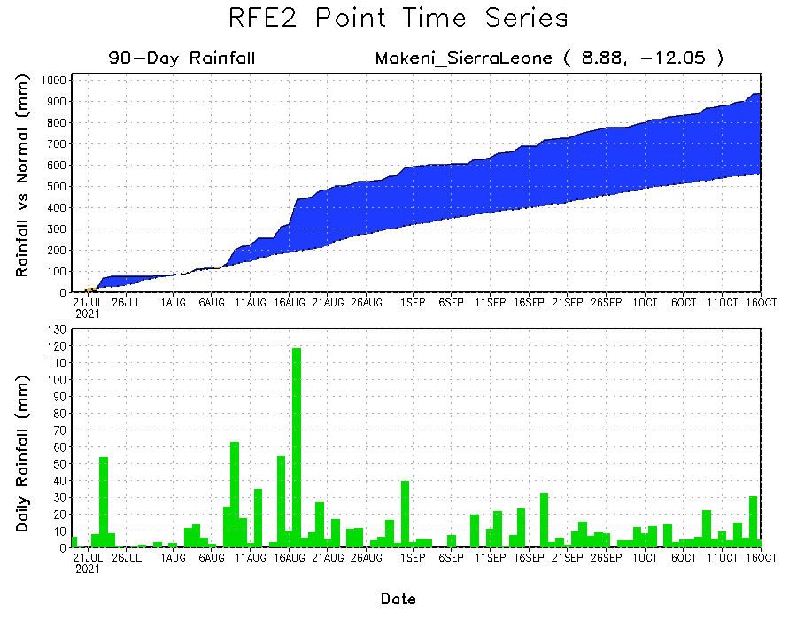
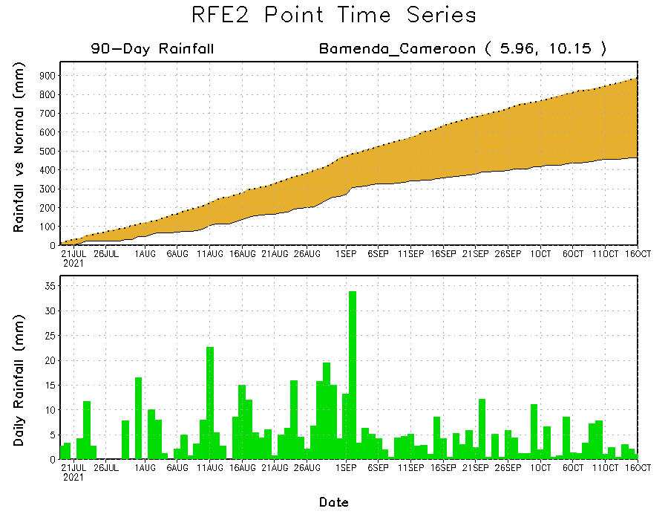
Rainfall Evolution
Daily evolution of rainfall over the last 90 days at selected locations shows moderate to heavy rainfall sustained moisture surpluses over Sierra Leone (bottom left) and northwestern Ethiopia (top right). In contrast, seasonal total rainfall remained below-average over southwestern Cameroon despite recent rainfall (bottom right).

Slide 9
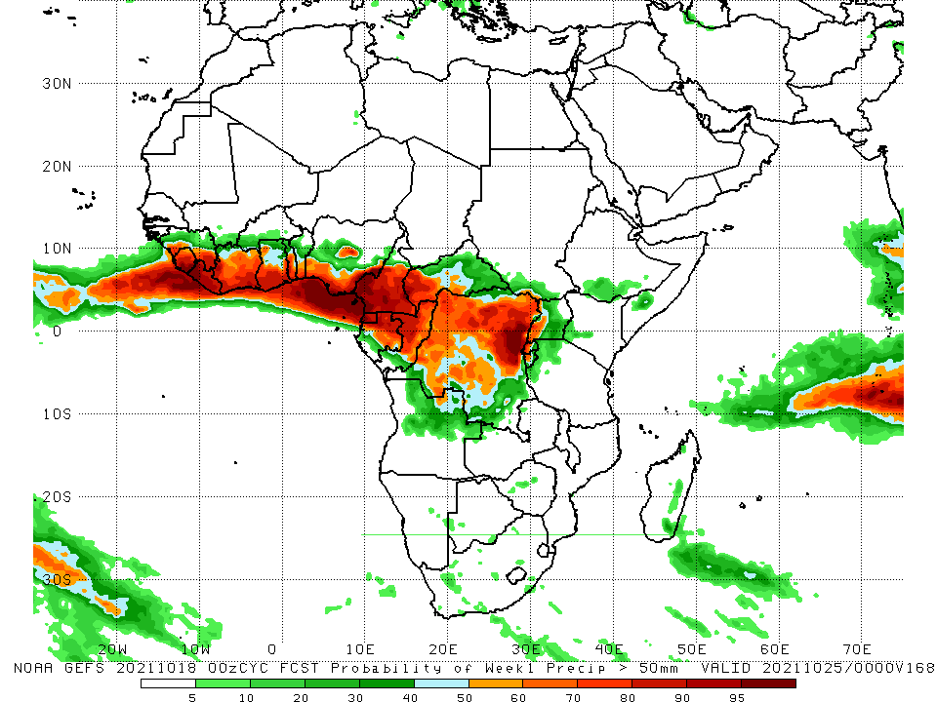
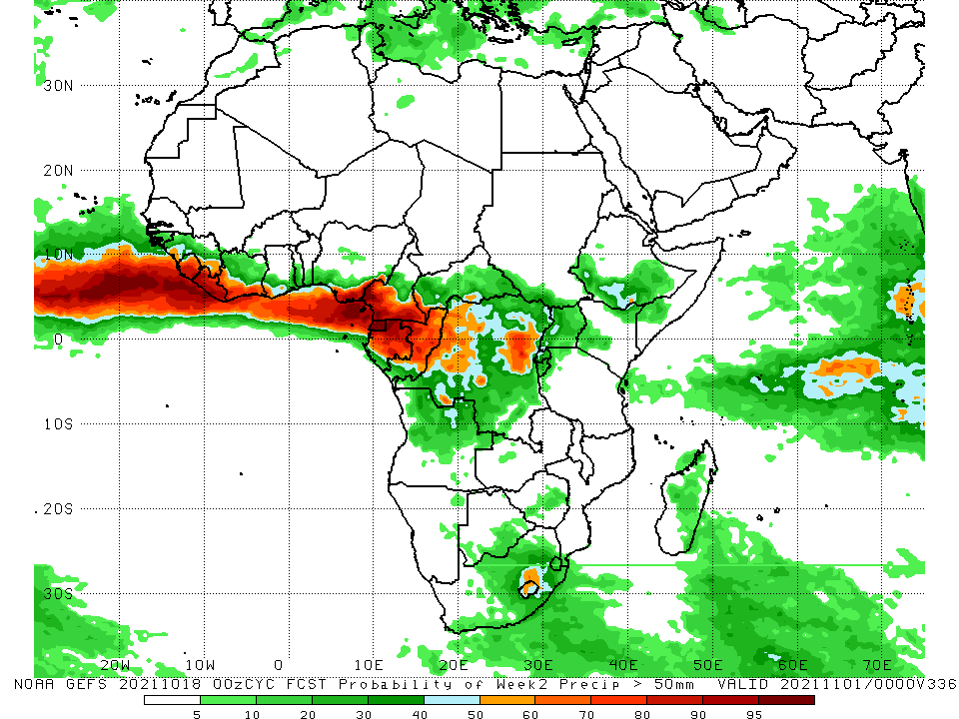
NCEP GEFS Model Forecasts Non-Bias Corrected Probability of precipitation exceedance
Week-1, Valid: 19 – 25 October 2021
Week-2, Valid: 26 October – 1 November 2021
For week-1 (left panel) and week-2 (right panel) , the NCEP GEFS forecasts indicate a moderate to high chance (over 70%) for rainfall to exceed 50 mm over the Gulf of Guinea countries, Cameroon, Equatorial Guinea, Gabon, Congo, and portions of CAR and DRC.
Notes:
9

Slide 10
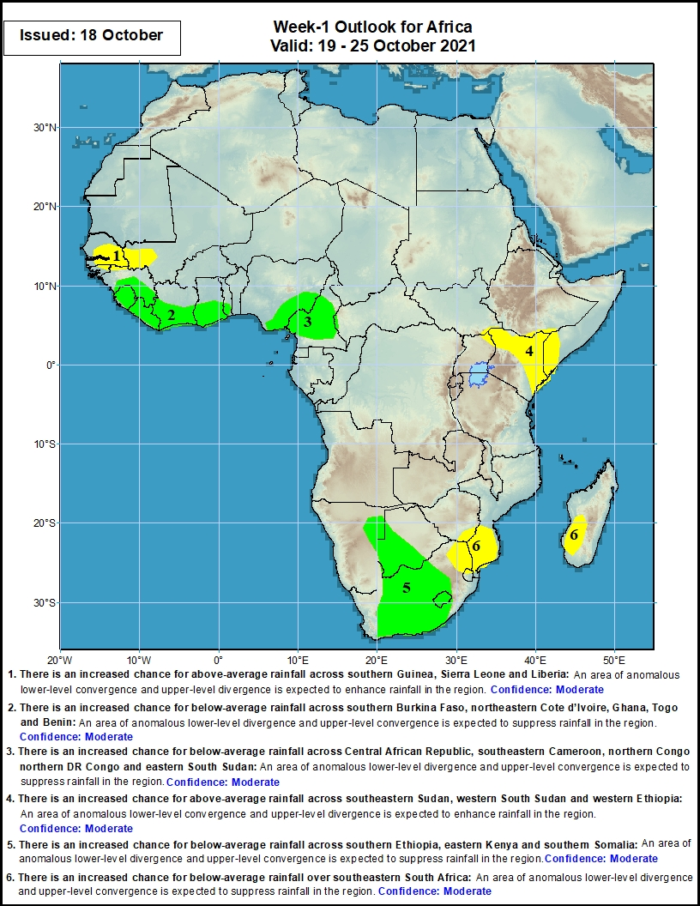
Week-1 Precipitation Outlooks
19 – 25 October 2021
There is an increased chance for below-average rainfall across Senegal and southwestern Mali: An area of anomalous lower-level divergence and upper-level convergence is expected to suppress rainfall in the region. Confidence: Moderate
There is an increased chance for above-average rainfall across southern Guinea, Sierra Leone, Liberia, Cote d’Ivoire, Ghana and Togo: An area of anomalous lower-level convergence and upper-level divergence is expected to enhance rainfall in the region. Confidence: Moderate
There is an increased chance for above-average rainfall across eastern Nigeria and Cameroon: An area of anomalous lower-level convergence and upper-level divergence is expected to enhance rainfall in the region. Confidence: Moderate
There is an increased chance for below-average rainfall across northeastern Uganda, Kenya and southern Somalia: An area of anomalous lower-level divergence and upper-level convergence is expected to suppress rainfall in the region. Confidence: Moderate
There is an increased chance for above-average rainfall across Namibia and South Africa: An area of anomalous lower-level convergence and upper-level divergence is expected to enhance rainfall in the region. Confidence: Moderate
There is an increased chance for below-average rainfall across northeastern South Africa, south Zimbabwe, southern Mozambique and southwestern Madagascar: An area of anomalous lower-level divergence and upper-level convergence is expected to suppress rainfall in the region. Confidence: Moderate
Notes:
10

Slide 11
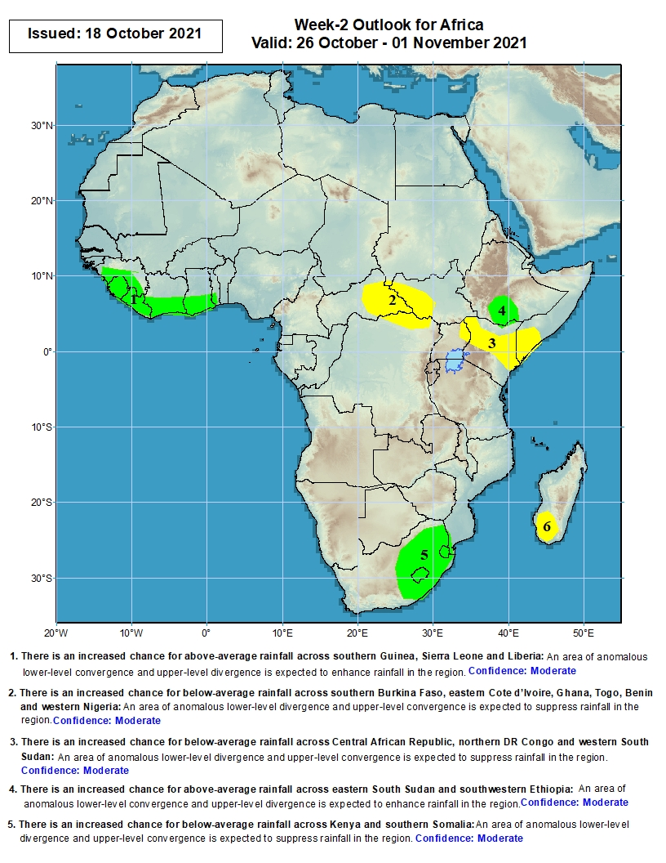
Week-2 Precipitation Outlooks
26 October – 1 November 2021
There is an increased chance for above-average rainfall across southern Guinea, Sierra Leone, Liberia, Cote d’Ivoire, Ghana and Togo: An area of anomalous lower-level convergence and upper-level divergence is expected to enhance rainfall in the region. Confidence: Moderate
There is an increased chance for below-average rainfall across Central African Republic, western South Sudan and northeastern DR Congo: An area of anomalous lower-level divergence and upper-level convergence is expected to suppress rainfall in the region. Confidence: Moderate
There is an increased chance for below-average rainfall across southern Somalia, Kenya and northeastern Uganda: An area of anomalous lower-level divergence and upper-level convergence is expected to suppress rainfall in the region. Confidence: Moderate
There is an increased chance for above-average rainfall over southern Ethiopia: An area of anomalous lower-level convergence and upper-level divergence is expected to enhance rainfall in the region. Confidence: Moderate
There is an increased chance for above-average rainfall over South Africa: An area of anomalous lower-level convergence and upper-level divergence is expected to enhance rainfall in the region. Confidence: Moderate
There is an increased chance for below-average rainfall over southern Madagascar: An area of anomalous lower-level divergence and upper-level convergence is expected to suppress rainfall in the region. Confidence: Moderate
Notes:
11

Slide 12
Summary
During the past 30 to 90 days, in West Africa, portions of Senegal, southwestern Mali, southwestern Burkina Faso, Guinea, Sierra Leone, Liberia, southern Côte d’Ivoire, southern Ghana, and southern Nigeria observed above-average rainfall. Central and eastern Nigeria continued to experience large negative precipitation anomalies. In Central Africa, moisture surpluses were found across eastern Chad, much of CAR, southeastern Cameroon, Congo, and portions of DRC. Moisture deficits were found across southwestern Chad, Cameroon, Equatorial Guinea, much of Gabon, and portions of DRC. In East Africa, above-average rainfall prevailed in Sudan, parts of South Sudan, Eritrea, Ethiopia, and northern Somalia. The eastern part of South Africa and the eastern coastline of Madagascar experienced above-average rainfall.
During the past 7 days, in West Africa, Guinea, Sierra Leone, Liberia, northern Côte d’Ivoire, southern Ghana, and local areas in central and southern Nigeria received well above-average rainfall. Eastern Nigeria observed moisture deficits of 50-100 mm. In Central Africa, local areas in central Chad, northern Congo, and DRC experienced moisture surpluses of over 100 mm. Cameroon, Equatorial Guinea, and western Gabon observed moisture deficits of 50-100 mm. In East Africa, Sudan, South Sudan, and northwestern Ethiopia received well above-average rainfall. Eastern Kenya and southern Somalia experienced light negative precipitation anomalies.
The week-1 outlooks depict an increased chance for above-average rainfall across southern Guinea, Sierra Leone, Liberia, Côte d’Ivoire, Ghana, Togo, eastern Nigeria, Cameroon, Namibia and South Africa. Conversely, there is an increased chance for below-average rainfall across Senegal, southwestern Mali, northeastern Uganda, Kenya, southern Somalia, northeastern South Africa, south Zimbabwe, southern Mozambique and southwestern Madagascar.
The week-2 outlooks call for an increased chance for above-average rainfall across southern Guinea, Sierra Leone, Liberia, Côte d’Ivoire, Ghana, Togo, southern Ethiopia, and South Africa. In contrast, there is an increased chance for below-average rainfall across Central African Republic, western South Sudan, northeastern DR Congo, southern Somalia, Kenya, northeastern Uganda, and southern Madagascar.

