Slide 1
The African Monsoon Recent Evolution and Current Status Include Week-1 and Week-2 Outlooks
Update prepared by
25 October 2021
For more information, visit:
http://www.cpc.ncep.noaa.gov/products/Global_Monsoons/African_Monsoons/precip_monitoring.shtml

Slide 2
Outline
Highlights
Recent Evolution and Current Conditions
NCEP GEFS Forecasts
Summary

Slide 3
Highlights: Last 7 Days
During the past 7 days, local areas in northwestern DRC observed moisture surpluses of over 100 mm. Weekly rainfall totals reached 100 mm across pocket areas in southern Ghana, Cameroon, southern Chad, CAR, Congo, and DRC (moisture surpluses of over 50 mm).
The week-1 outlooks depict an increased chance for above-average rainfall across southern Guinea, Sierra Leone, Liberia, Cote d’Ivoire, southwestern Ghana, northeastern Namibia, Botswana and South Africa. Conversely, there is an increased chance for below-average rainfall across western Ethiopia, South Sudan, Uganda, Kenya, Somalia, western Tanzania, and southwestern Madagascar.
The week-2 outlooks call for an increased chance for below-average rainfall across Ethiopia, eastern South Sudan, northwestern Uganda, Kenya, Somalia, Zambia, southern DR Congo, southeastern Angola, northeastern Namibia, Botswana, Zimbabwe, western Mozambique, northern South Africa, and Madagascar.

Slide 4
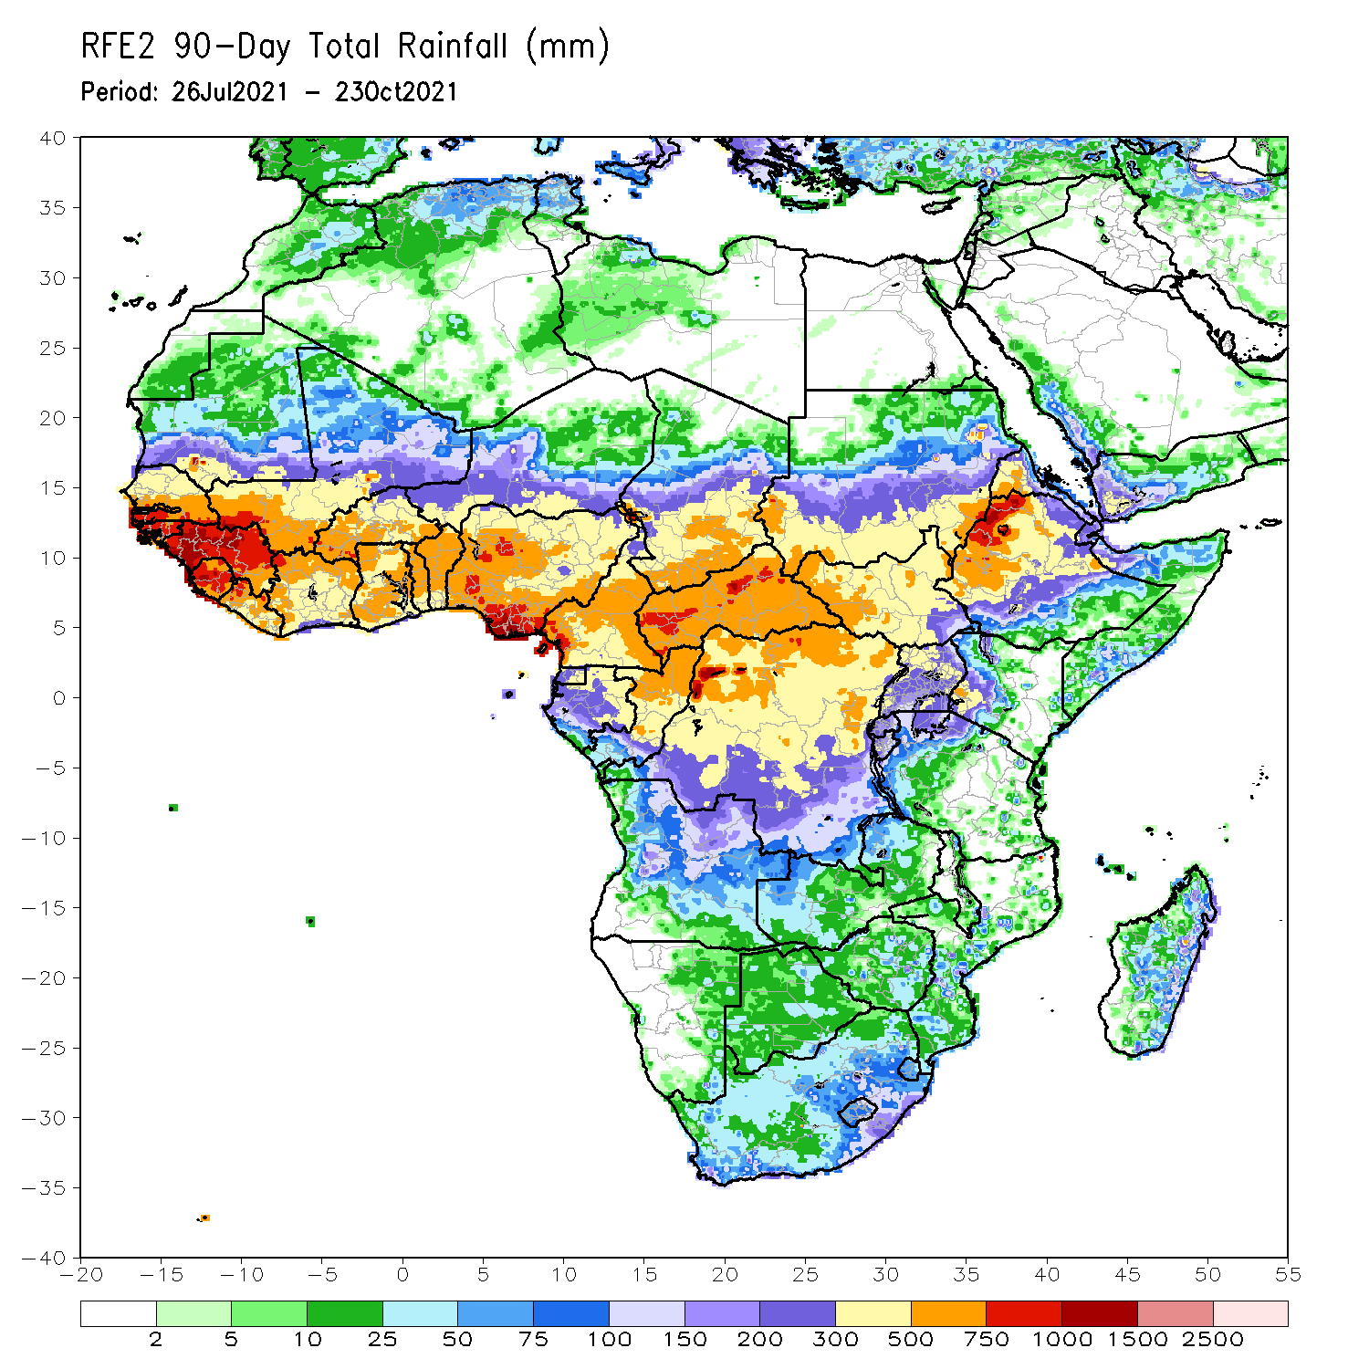
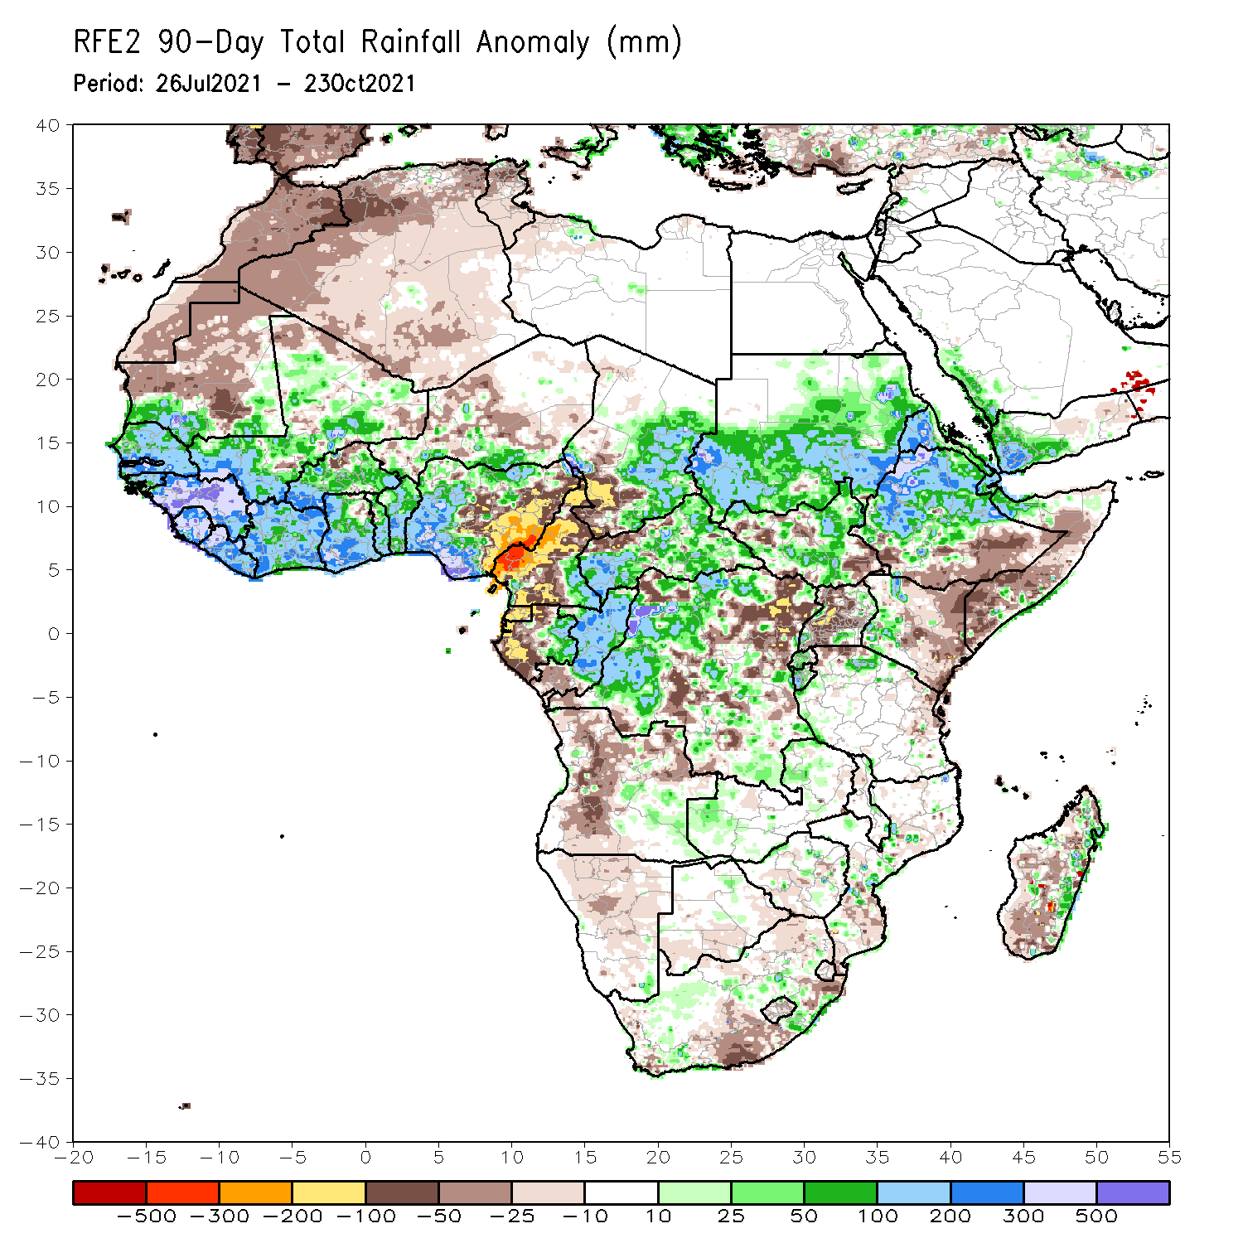
Rainfall Patterns: Last 90 Days
Over the past 90 days, in West Africa, rainfall totals exceeded 750 mm across southern Senegal, southwestern Mali, Guinea-Bissau, Guinea, Sierra Leone, northern Liberia, northwestern Côte d’Ivoire, and portions of Nigeria (moisture surpluses of over 300 mm). Positive precipitation anomalies of over 500 mm were found across Guinea and southern Nigeria. Conversely, central and eastern Nigeria experienced moisture deficits of over 100 mm.
In Central Africa, local areas across the western border of Chad and northern Cameroon and northwestern DRC received precipitation in excess of 500 mm. Moisture surpluses of over 100 mm were found over southeastern Chad, portions of CAR and DRC, southeastern Cameroon, eastern Gabon, and Congo. Large moisture deficits of over 300 mm were observed in western Cameroon. Below-average precipitation conditions (more than 100 mm below the mean) were also found across southwestern Chad, many parts of Cameroon, Equatorial Guinea, western Gabon, and northeastern DRC.
In East Africa, northwestern Ethiopia received heavy rainfall amounts of over 750 mm (more than 300 mm above the mean). Heavy rainfall was also found over Sudan, western Eritrea, northern Ethiopia, and northern Somalia. Uganda continued to experience sustained negative precipitation anomalies of over 100 mm.
Notes:
4

Slide 5
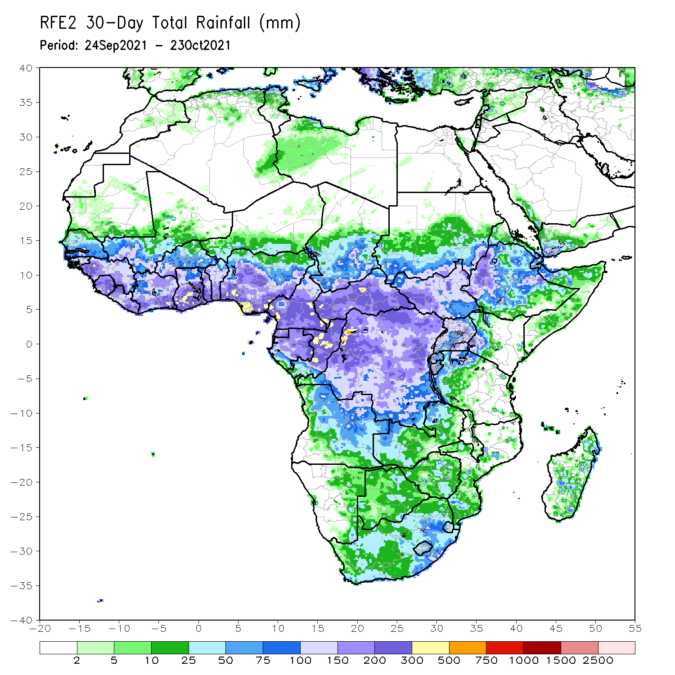
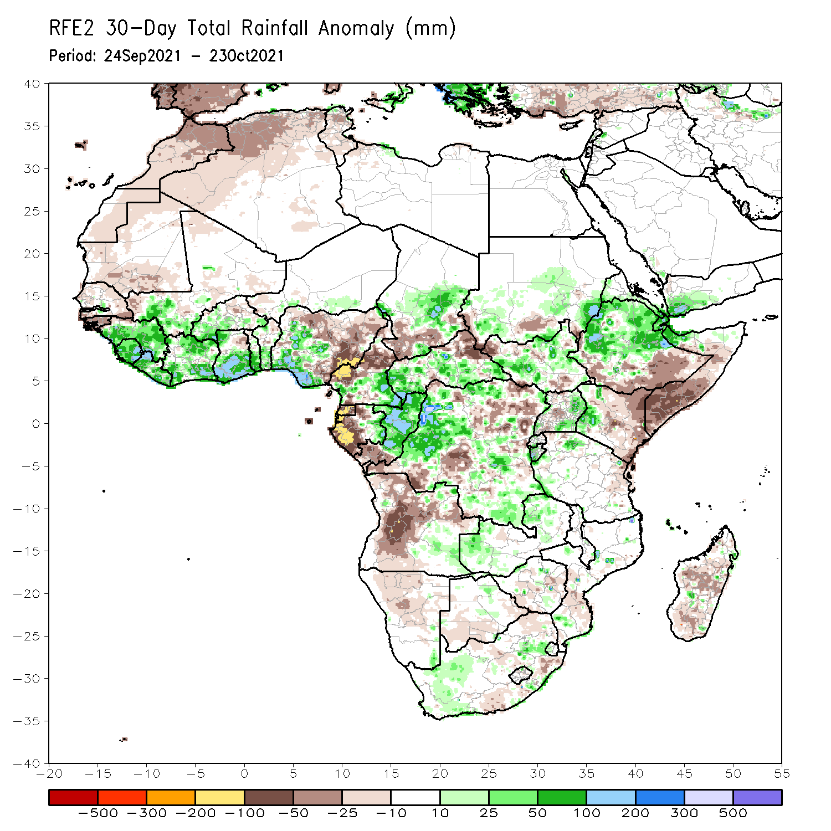
Rainfall Patterns: Last 30 Days
During the past 30 days, in West Africa, rainfall totals exceeding 200 mm led to moisture surpluses of over 100 mm across western Guinea, Sierra Leone, northern and southern Liberia, southern Côte d’Ivoire, southern Ghana, and parts of Nigeria. Light rains resulted in moisture deficits of over 100 mm across eastern Nigeria. Below-average precipitation prevailed in Mauritania, Senegal, Guinea-Bissau, and northern and eastern Nigeria.
In Central Africa, precipitation was 100 mm above the mean across local areas in western and central Chad, southeastern Cameroon, portions of CAR, eastern Gabon, Congo, and western DRC. Western Cameroon, Equatorial Guinea, and western Gabon received below-average rainfall, with negative precipitation anomalies of over 100 mm.
In East Africa, moisture surpluses of over 100 mm were found across eastern Sudan, local areas in South Sudan, northern Ethiopia, northern Somalia, and western Kenya. Moisture deficits of over 50 mm were observed over northwestern South Sudan, eastern Kenya, and southern Somalia.
Notes:
5

Slide 6
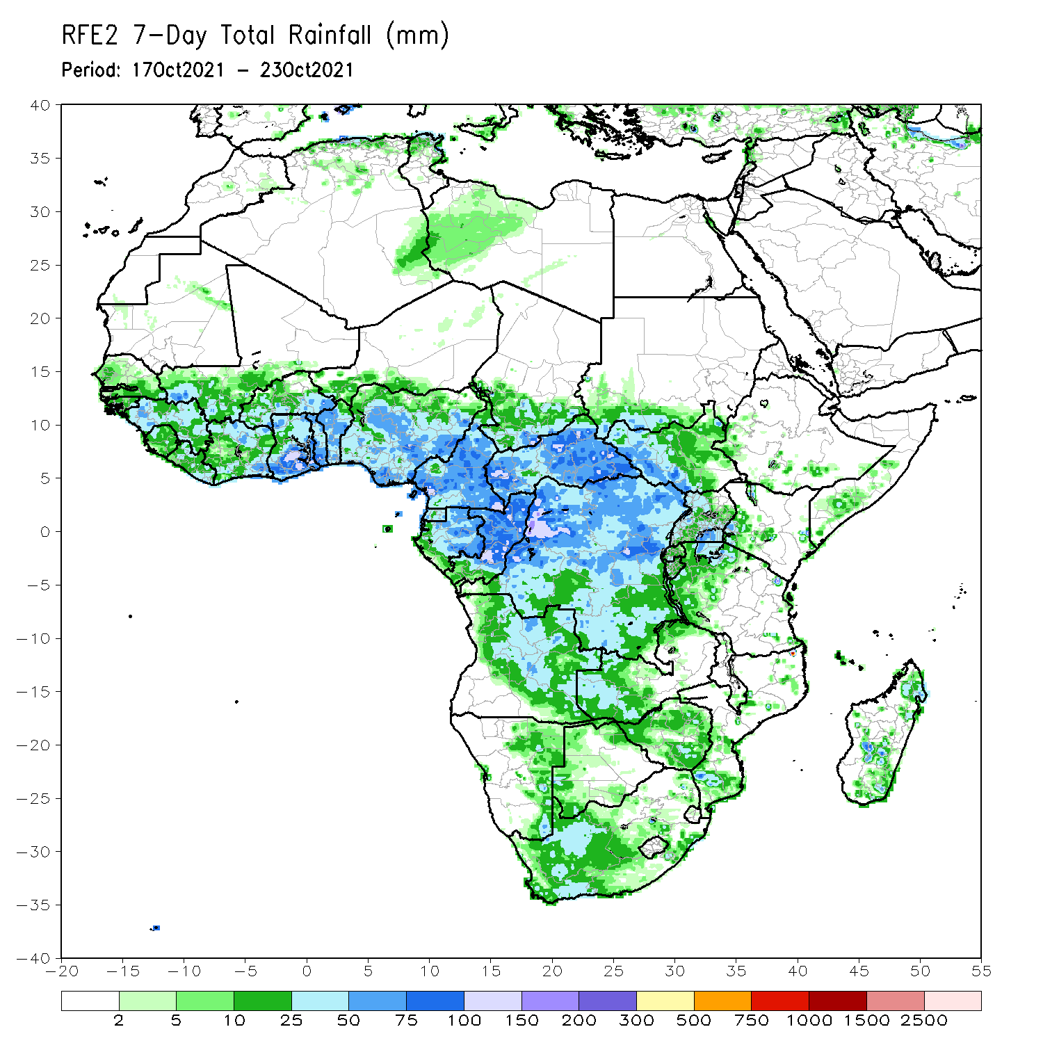
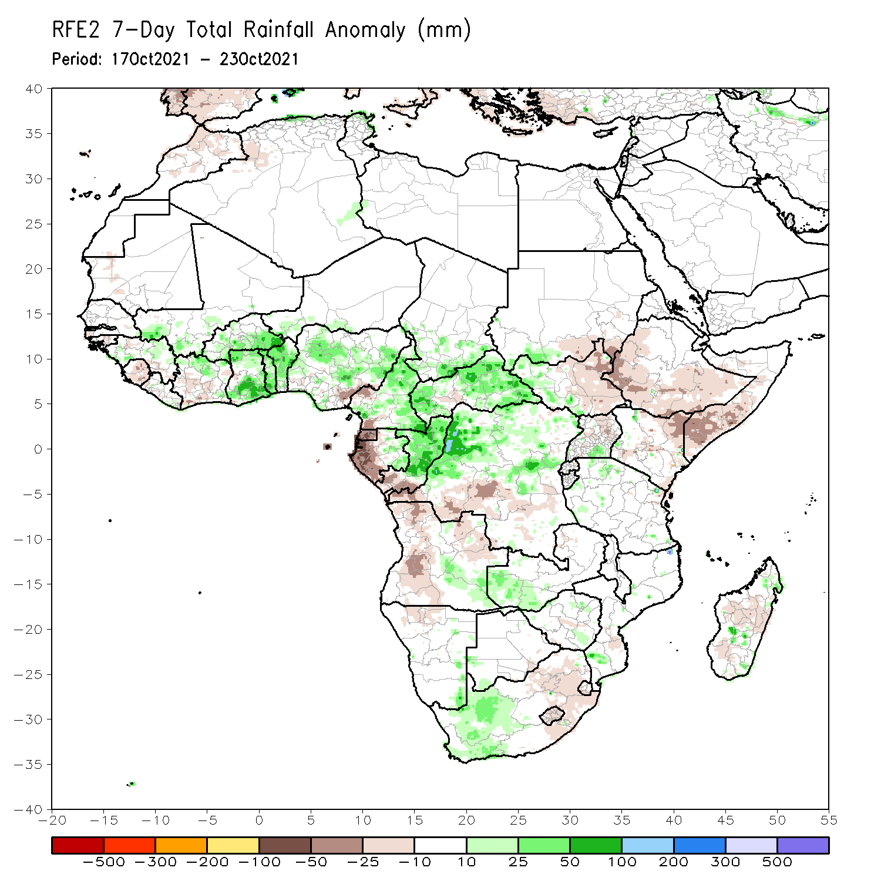
Rainfall Patterns: Last 7 Days
During the past 7 days, in West Africa, southern Mali, northern Côte d’Ivoire, Burkina Faso, Ghana, Togo, Benin, and much of Nigeria experienced above-average rainfall, with moisture surpluses of over 25 mm. Light moisture deficits of 25-50 mm were found across southeastern Nigeria.
In Central Africa, precipitation was above-average across southern Chad, much of Cameroon, eastern Gabon, central and northern Gabon, CAR, and northern DRC. Positive precipitation anomalies of 100-200 mm were observed across local areas in northwestern DRC. Conversely, negative precipitation anomalies of over 25 mm were found across western Cameroon, Equatorial Guinea, western Gabon, southern Congo, and southern DRC.
In East Africa, below-average precipitation conditions prevailed in the Greater Horn of Africa, except across southwestern Sudan, western South Sudan, and pocket areas in southern Uganda and Tanzania.

Slide 7
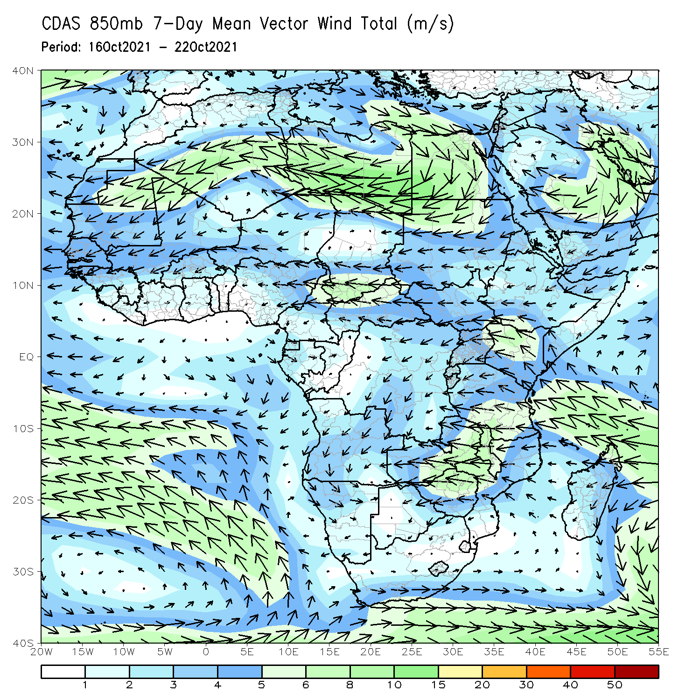
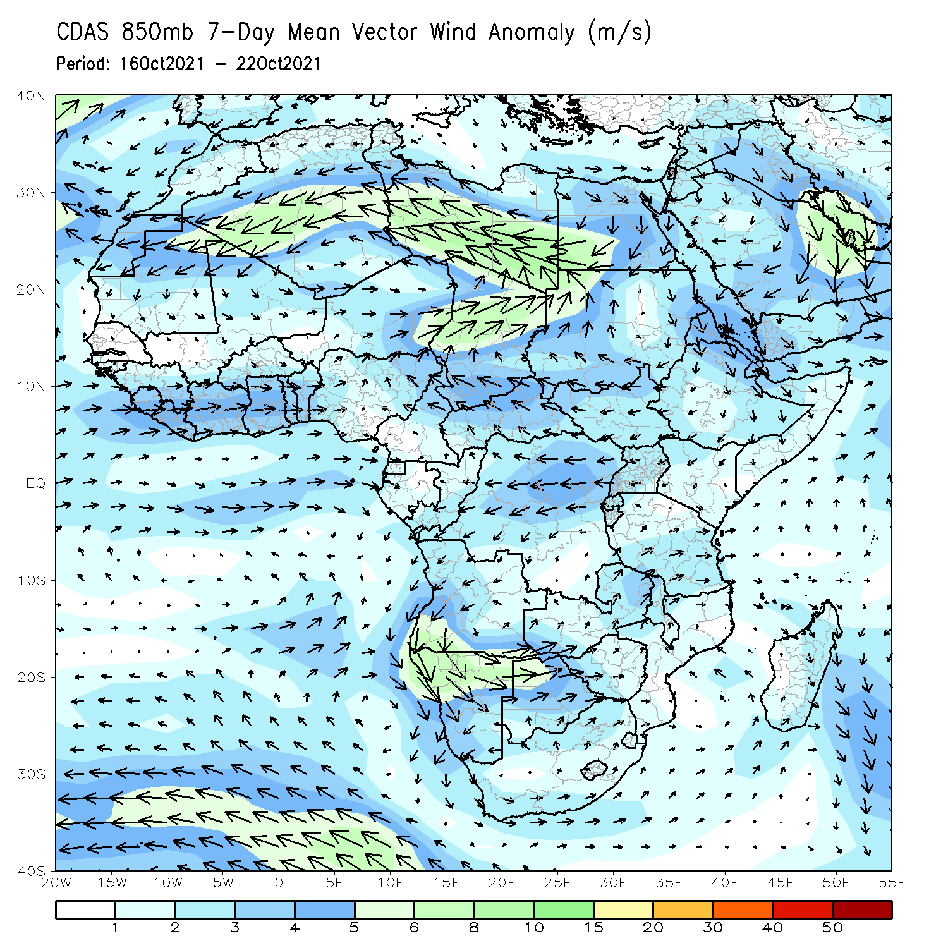
Atmospheric Circulation: Last 7 Days
The 850-hPa atmospheric circulation pattern features an anomalous westerly flow over the Gulf of Guinea region. This moisture-laden flow may have contributed to enhanced rainfall in those areas.

Slide 8
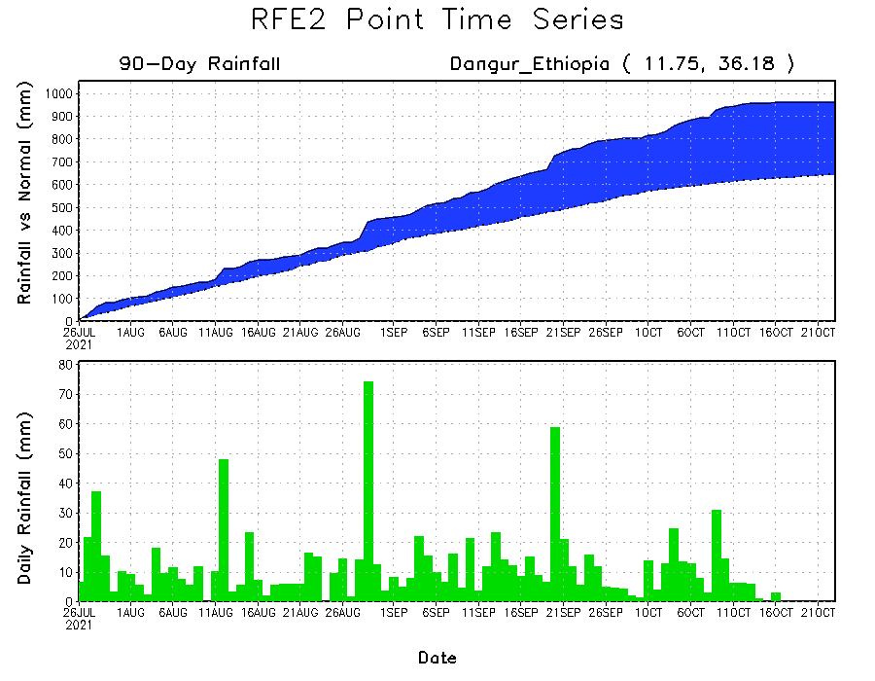
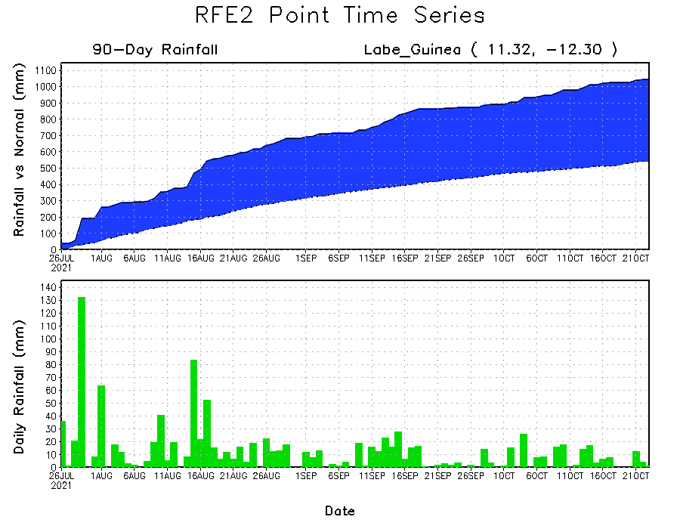
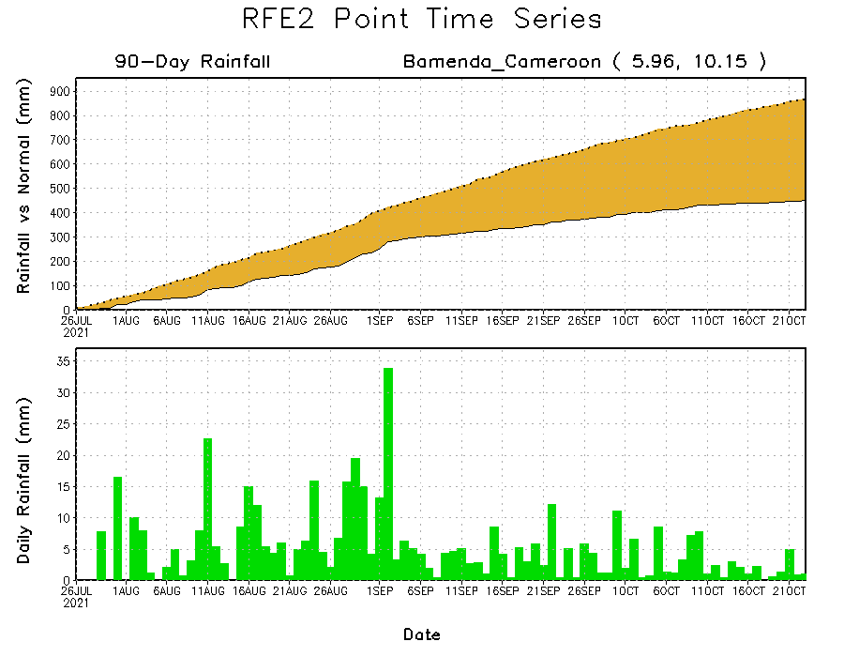
Rainfall Evolution
Daily evolution of rainfall over the last 90 days at selected locations shows moderate to heavy rainfall sustained moisture surpluses over Guinea (bottom left) and northwestern Ethiopia (top right). In contrast, seasonal total rainfall remained below-average over southwestern Cameroon despite recent rainfall (bottom right).

Slide 9
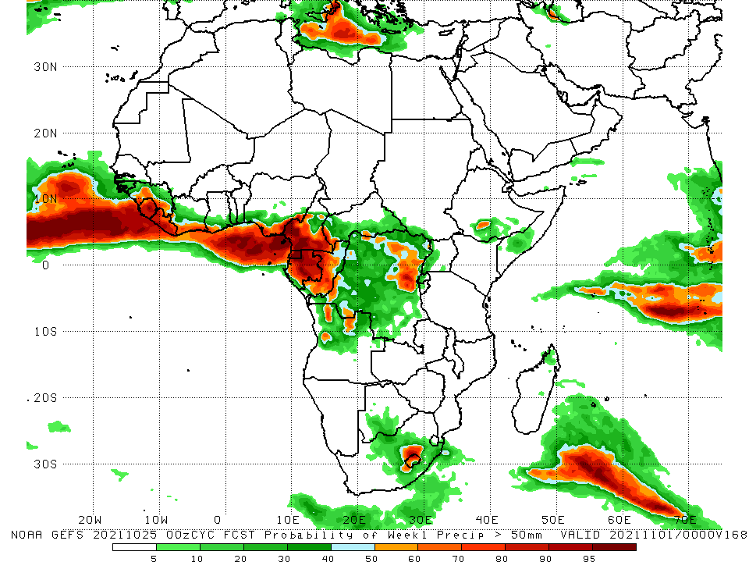
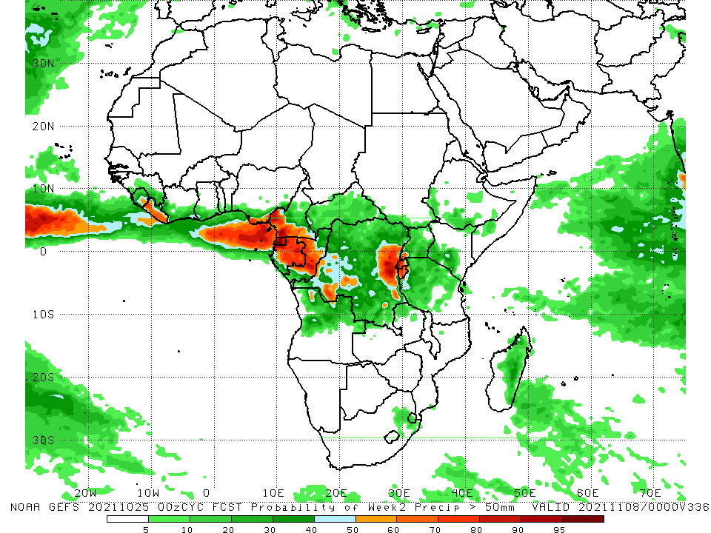
NCEP GEFS Model Forecasts Non-Bias Corrected Probability of precipitation exceedance
Week-1, Valid: 26 October – 1 November 2021
Week-2, Valid: 2 – 8 November 2021
For week-1 (left panel) , the NCEP GEFS forecasts indicate a moderate to high chance (over 70%) for rainfall to exceed 50 mm over Guinea, Sierra Leone, Liberia, southern Côte d’Ivoire, southern Ghana, southern Nigeria, Cameroon, Equatorial Guinea, Gabon, Congo, parts of CAR and DRC, and local areas across northern Angola, southern Ethiopia, South Africa, and Lesotho.
The week-2 forecast (right panel) indicates an increased chance (over 70%) for weekly rainfall to exceed 50 mm across Sierra Leone, Liberia, southeastern Nigeria, southern Cameroon, Equatorial Guinea, much of Gabon and Congo, western and eastern DRC, southwestern Uganda, Rwanda and Burundi.
Notes:
9

Slide 10
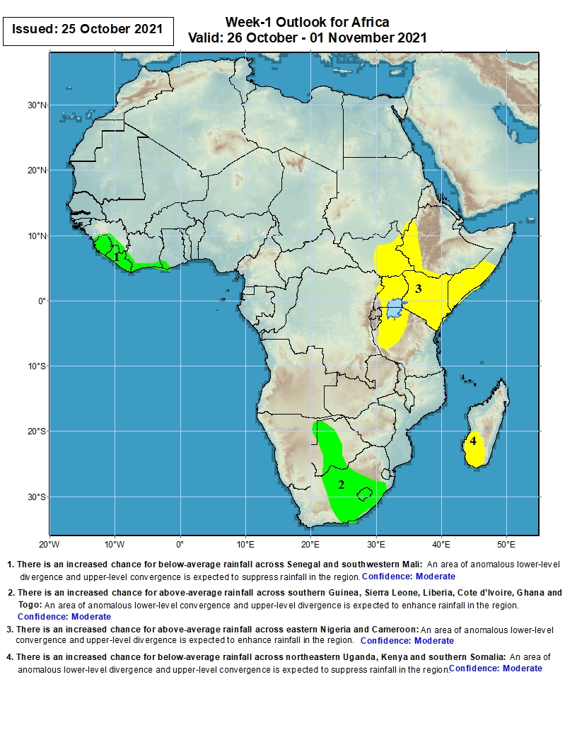
Week-1 Precipitation Outlooks
26 October – 1 November 2021
There is an increased chance for above-average rainfall across southern Guinea, Sierra Leone, Liberia, Côte d’Ivoire and southwestern Ghana: An area of anomalous lower-level convergence and upper-level divergence is expected to enhance rainfall in the region. Confidence: Moderate
There is an increased chance for above-average rainfall across northeastern Namibia, Botswana and South Africa: An area of anomalous lower-level convergence and upper-level divergence is expected to enhance rainfall in the region. Confidence: Moderate
There is an increased chance for below-average rainfall across western Ethiopia, South Sudan, Uganda, Kenya, Somalia and western Tanzania: An area of anomalous lower-level divergence and upper-level convergence is expected to suppress rainfall in the region. Confidence: Moderate
There is an increased chance for below-average rainfall over southwestern Madagascar: An area of anomalous lower-level divergence and upper-level convergence is expected to suppress rainfall in the region. Confidence: Moderate
Notes:
10

Slide 11
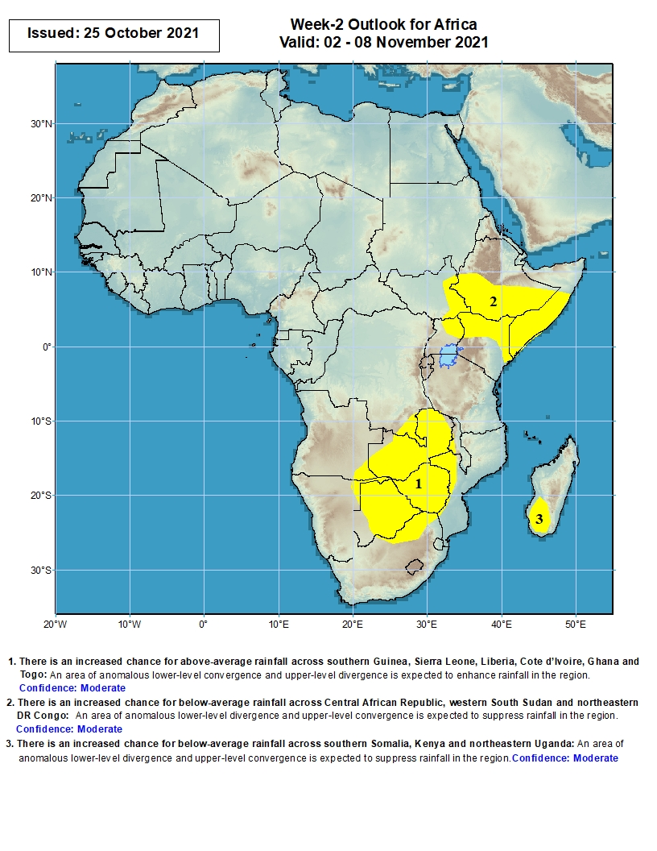
Week-2 Precipitation Outlooks
2 – 8 November 2021
There is an increased chance for below-average rainfall across Ethiopia, eastern South Sudan, northwestern Uganda, Kenya and Somalia: An area of anomalous lower-level divergence and upper-level convergence is expected to suppress rainfall in the region. Confidence: Moderate
There is an increased chance for below-average rainfall across Zambia, southern DR Congo, southeastern Angola, northeastern Namibia, Botswana, Zimbabwe, western Mozambique and northern South Africa: An area of anomalous lower-level divergence and upper-level convergence is expected to suppress rainfall in the region. Confidence: Moderate
There is an increased chance for below-average rainfall over Madagascar: An area of anomalous lower-level divergence and upper-level convergence is expected to suppress rainfall in the region. Confidence: Moderate
Notes:
11

Slide 12
Summary
During the past 30 to 90 days, in West Africa, southwestern Mali, Guinea, Sierra Leone, Liberia, Côte d’Ivoire, Ghana, Togo, Benin, and southwestern Nigeria observed above-average rainfall. Eastern Nigeria continued to experience negative precipitation anomalies. In Central Africa, moisture surpluses were found across eastern Chad, much of CAR, southeastern Cameroon, much of Congo, and many parts of DRC. Moisture deficits were found across southwestern Chad, Cameroon, Equatorial Guinea, western Gabon, southern Congo, and portions of DRC. In East Africa, above-average rainfall prevailed in Eritrea, northern Ethiopia, and northern Somalia. Southern Ethiopia, much of Kenya and Somalia observed below-average rainfall.
During the past 7 days, in West Africa, Guinea, southern Mali, Burkina Faso, southern Niger, northern Côte d’Ivoire, Ghana, Togo, Benin, and much of Nigeria received above-average rainfall. In Central Africa, local areas across northwestern DRC experienced moisture surpluses of over 100 mm, while Equatorial Guinea and western Gabon observed moisture deficits of 50-100 mm. In East Africa, below-average rainfall conditions prevailed in the Greater Horn of Africa, except across southwestern Sudan and western South Sudan.
The week-1 outlooks depict an increased chance for above-average rainfall across southern Guinea, Sierra Leone, Liberia, Côte d’Ivoire, southwestern Ghana, northeastern Namibia, Botswana and South Africa. Conversely, there is an increased chance for below-average rainfall across western Ethiopia, South Sudan, Uganda, Kenya, Somalia, western Tanzania, and southwestern Madagascar.
The week-2 outlooks call for an increased chance for below-average rainfall across Ethiopia, eastern South Sudan, northwestern Uganda, Kenya, Somalia, Zambia, southern DR Congo, southeastern Angola, northeastern Namibia, Botswana, Zimbabwe, western Mozambique, northern South Africa, and Madagascar.

