Slide 1
The African Monsoon Recent Evolution and Current Status Include Week-1 and Week-2 Outlooks
Update prepared by
8 November 2021
For more information, visit:
http://www.cpc.ncep.noaa.gov/products/Global_Monsoons/African_Monsoons/precip_monitoring.shtml

Slide 2
Outline
Highlights
Recent Evolution and Current Conditions
NCEP GEFS Forecasts
Summary

Slide 3
Highlights: Last 7 Days
During the past 7 days, local areas in CAR, southern Gabon, central Congo, and western and eastern DRC received precipitation totals of over 150 mm. This rainfall patterns resulted in moisture surpluses of over 100 mm.
The week-1 outlooks depict an increased chance for above-average rainfall across Cameroon, Gabon, and Congo. Conversely, there is an increased chance for below-average rainfall across Botswana, South Africa, Lesotho, eastern Uganda, Kenya, Somalia, eastern DR Congo, Rwanda, Burundi, Tanzania, Zambia, northern Zimbabwe, western Mozambique, and northeastern Madagascar.
The week-2 outlooks call for an increased chance for above-average rainfall across Gabon, Congo, western DR Congo, northwestern Angola, Lesotho, eastern South Africa and Eswatini. There is an increased chance for below-average rainfall across eastern DR Congo, South Sudan, Uganda, western Kenya, Rwanda, Burundi, Tanzania, Zambia, northern Zimbabwe, western Mozambique and Malawi.

Slide 4
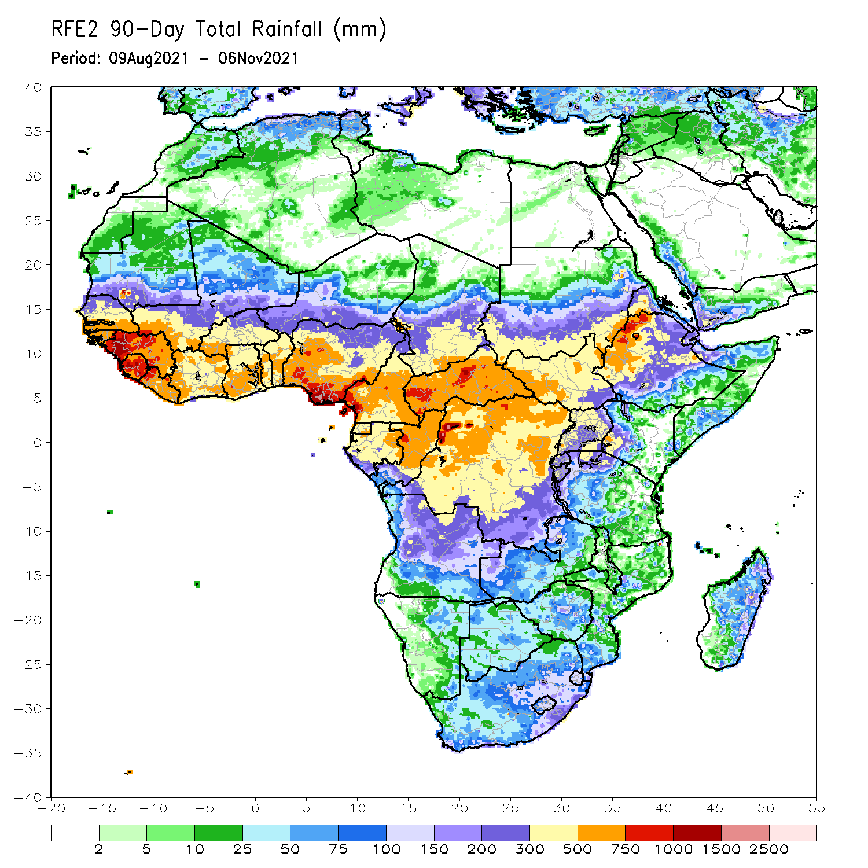
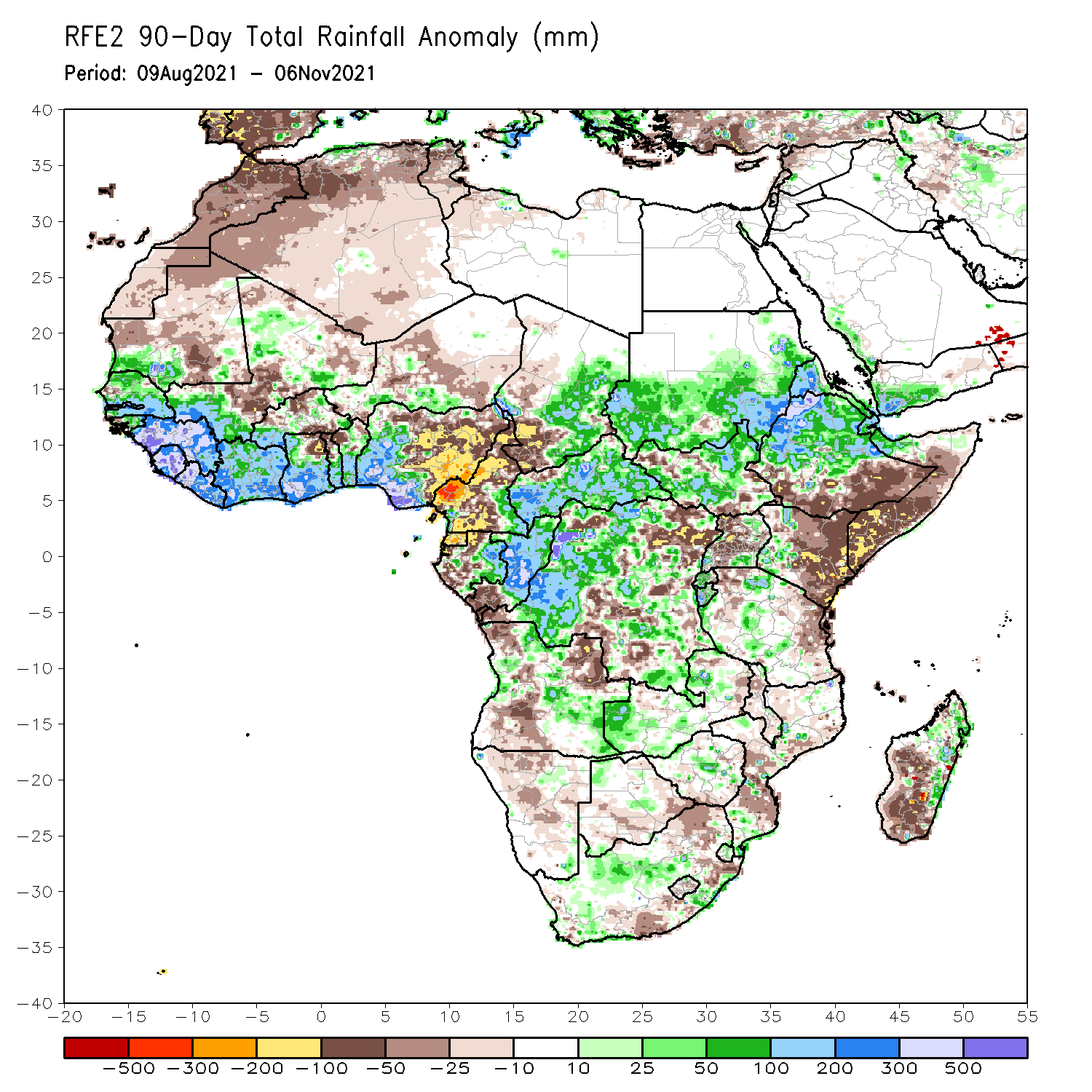
Rainfall Patterns: Last 90 Days
Over the past 90 days, in West Africa, rainfall totals exceeding 1000 mm led to moisture surpluses of over 500 mm across local areas in western Guinea, central Sierra Leone, and southeastern Nigeria. Precipitation was in excess of 100 mm in southern Senegal, southwestern Mali, Guinea, Sierra Leone, Liberia, Côte d’Ivoire, southwestern Burkina Faso, southern and western Ghana, southern Togo, southern Benin, and southern Nigeria. Moisture deficits of over 100 mm were observed across pocket areas in northeastern Ghana and eastern Nigeria.
In Central Africa, precipitation was well above-average across western and eastern Chad, much of CAR, southeastern Cameroon, eastern Gabon, much of Congo, and portions of DRC (positive precipitation anomalies of over 100 mm). Below-average precipitation conditions (more than 100 mm below the mean) were found across southwestern Chad, many parts of Cameroon, Equatorial Guinea, northern Gabon, and northeastern DRC. Large moisture deficits of 300-500 mm were observed in western Cameroon.
In East Africa, northwestern Ethiopia received heavy rainfall amounts of over 750 mm (more than 300 mm above the mean). Heavy rainfall was also found over Sudan, parts of South Sudan, western Eritrea, northern Ethiopia, and northern Somalia. Negative precipitation anomalies of over 50 mm were observed over southern Ethiopia, Uganda, and much of Kenya and Somalia.
In Southern Africa, local areas in Angola, Zambia, Zimbabwe, and eastern Madagascar registered high moisture surpluses of over 100 mm. Conversely, moisture deficits of over 50 mm were present across portions of Angola and western Madagascar.
Notes:
4

Slide 5
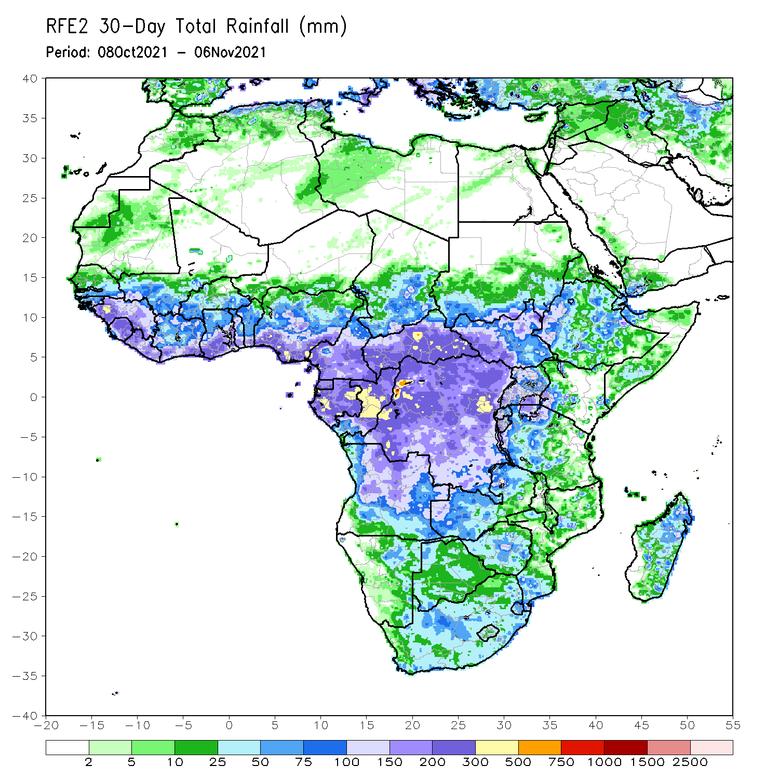
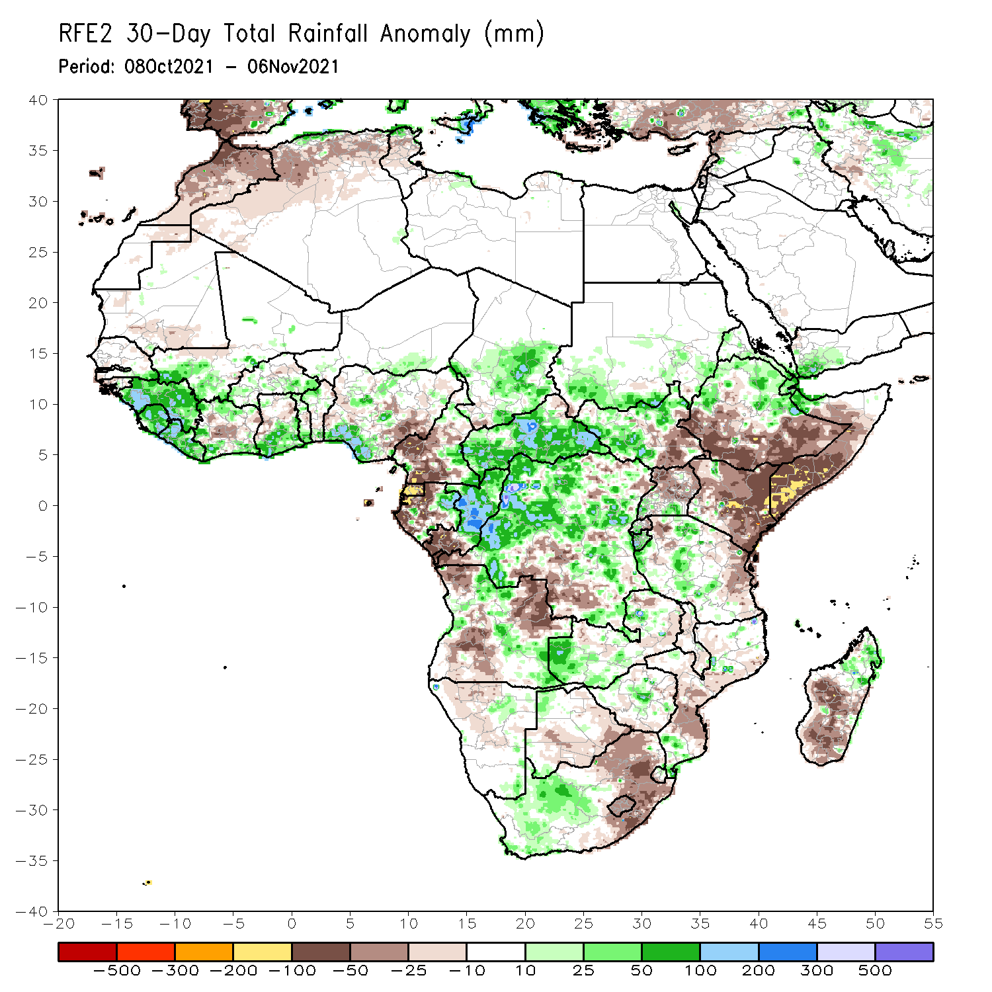
Rainfall Patterns: Last 30 Days
During the past 30 days, in West Africa, rainfall totals exceeded 150 mm in Guinea, Sierra Leone, Liberia, southern Côte d’Ivoire, southern Ghana, southern Togo, southern Benin, and southern Nigeria. Positive precipitation anomalies of over 100 mm were found across local areas in southwestern Mali, Guinea, Sierra Leone, Liberia, southern Guinea, and southern Nigeria. Central Côte d’Ivoire and eastern Nigeria observed moisture deficits of 25-50 mm.
In Central Africa, precipitation was 100 mm above the mean across local areas in central Chad, portions of CAR, eastern Gabon, Congo, and DRC. Below-average precipitation prevailed in Cameroon, Equatorial Guinea, western Gabon, and southern Congo. Local areas in western Cameron and Equatorial Guinea experienced negative precipitation anomalies of over 100 mm.
In East Africa, precipitation was above-average across southern Sudan, much of South Sudan, Eritrea, northern Ethiopia, and northern Somalia. Moisture deficits of over 100 mm were observed over southern Somalia and central and eastern Kenya.
In Southern Africa, portions of Angola, western Zambia, and central Zimbabwe received rainfall amounts of over 100 mm. The northern part of Madagascar experienced above-average rainfall, while the central and southern part of Madagascar experienced below-average rainfall.
Notes:
5

Slide 6
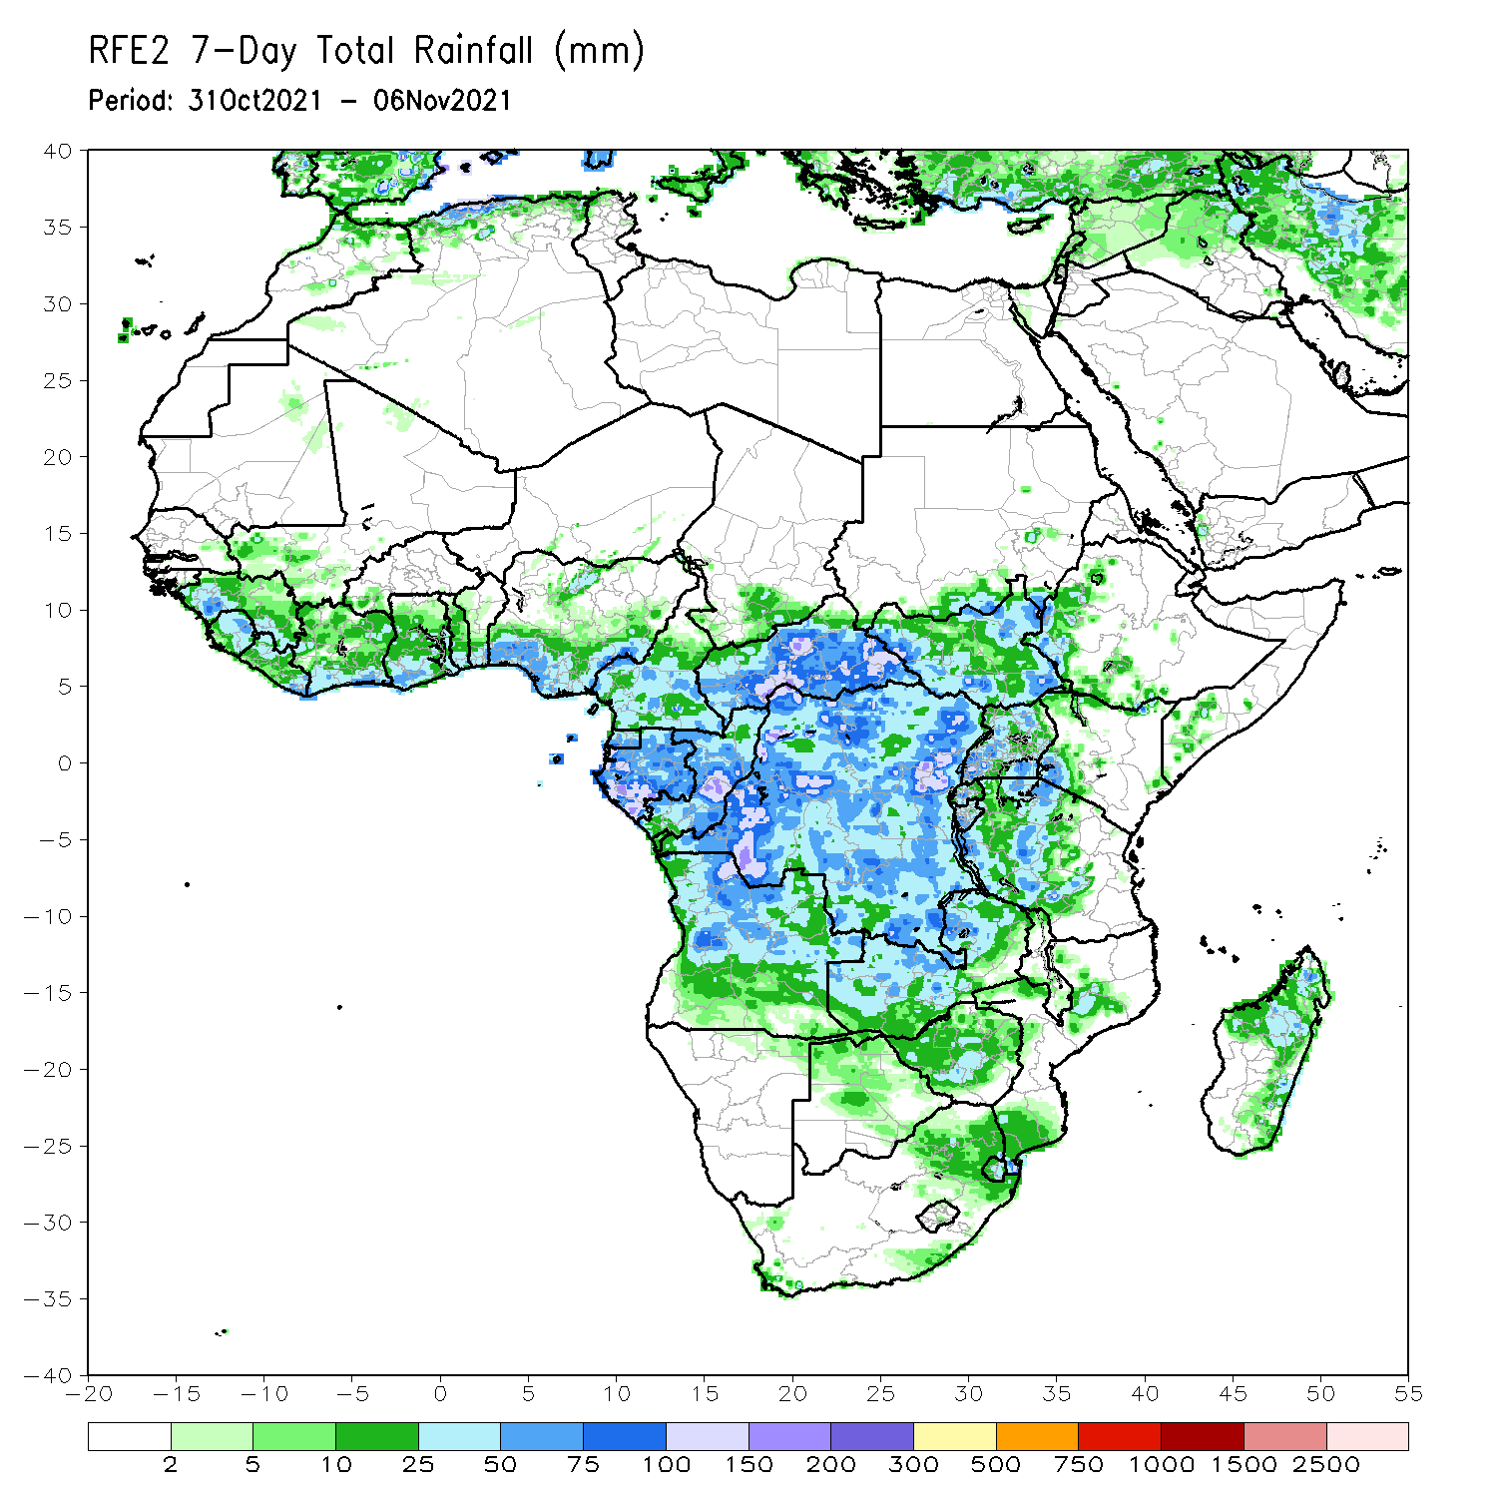
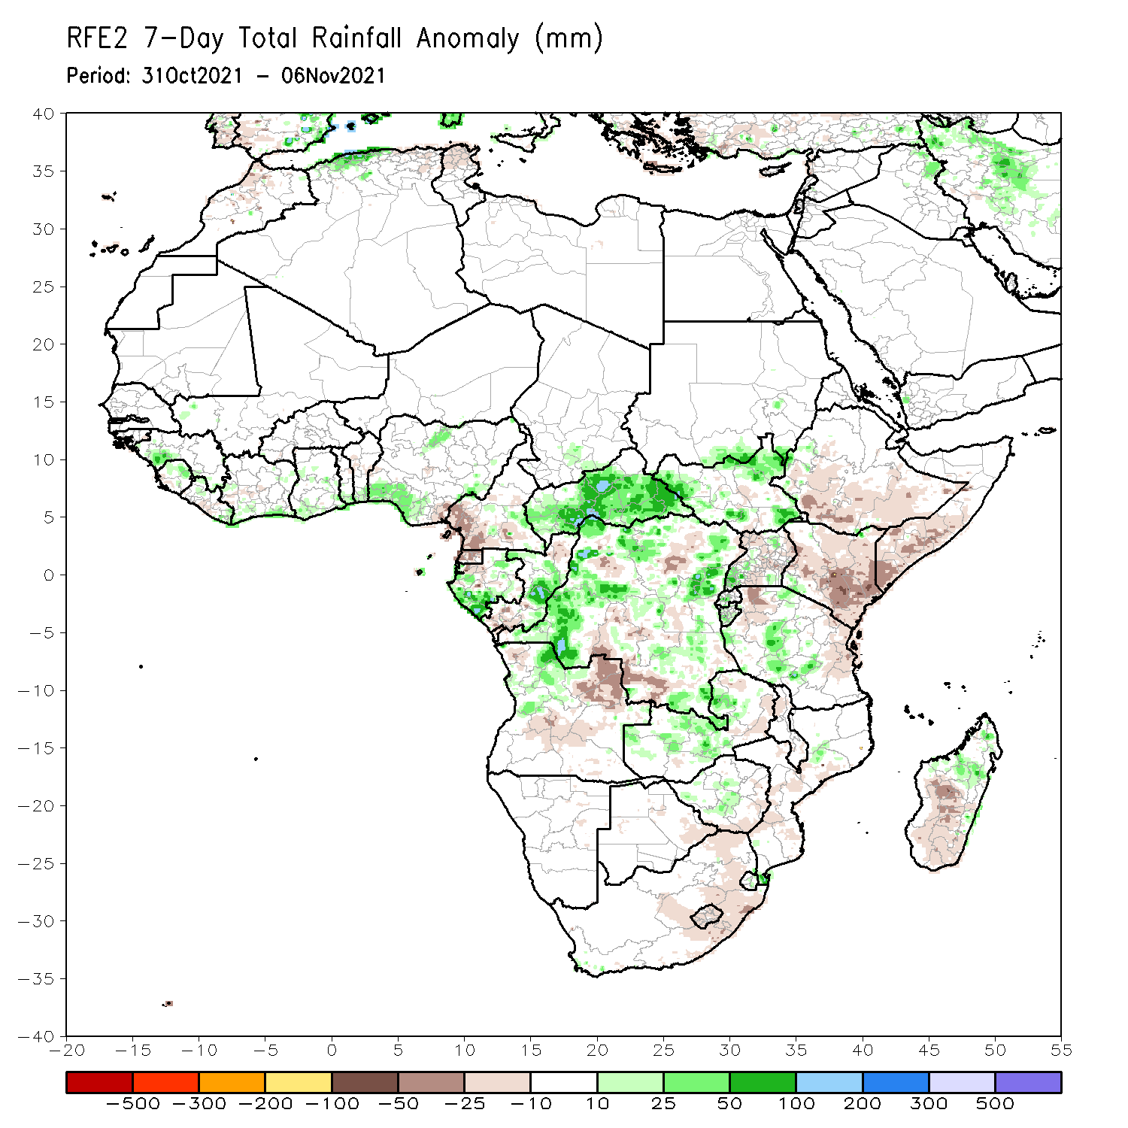
Rainfall Patterns: Last 7 Days
During the past 7 days, near-normal precipitation conditions prevailed in West Africa. Local areas in Guinea, Sierra Leone, Liberia, Côte d’Ivoire, Ghana, southern Togo, southern Benin, and Nigeria experienced light moisture surpluses of over 10 mm.
In Central Africa, local areas in CAR, southern Gabon, central Congo, and portions of DRC received precipitation totals of over 100 mm (more than 100 mm above the mean). Western Cameroon and Equatorial Guinea continued to observed moisture deficits of 25-50 mm.
In East Africa, southern Sudan, portions of South Sudan, Rwanda, Burundi and central Tanzania experienced above-average rainfall. Conversely, southern Ethiopia, southern Somalia, and Kenya observed light moisture deficits.
In Southern Africa, northern Angola, Zambia, and eastern Madagascar received rainfall totals of over 25 mm.

Slide 7
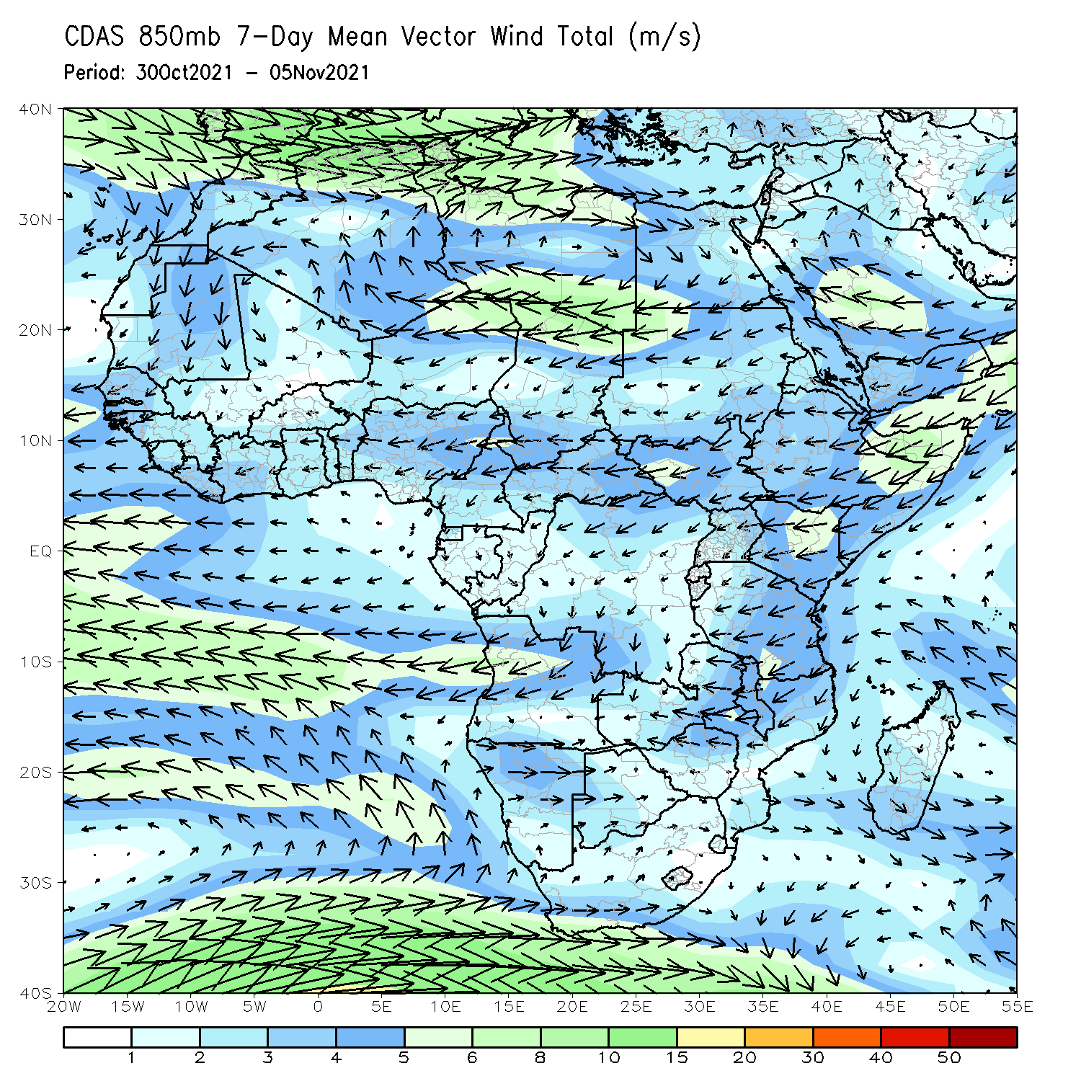
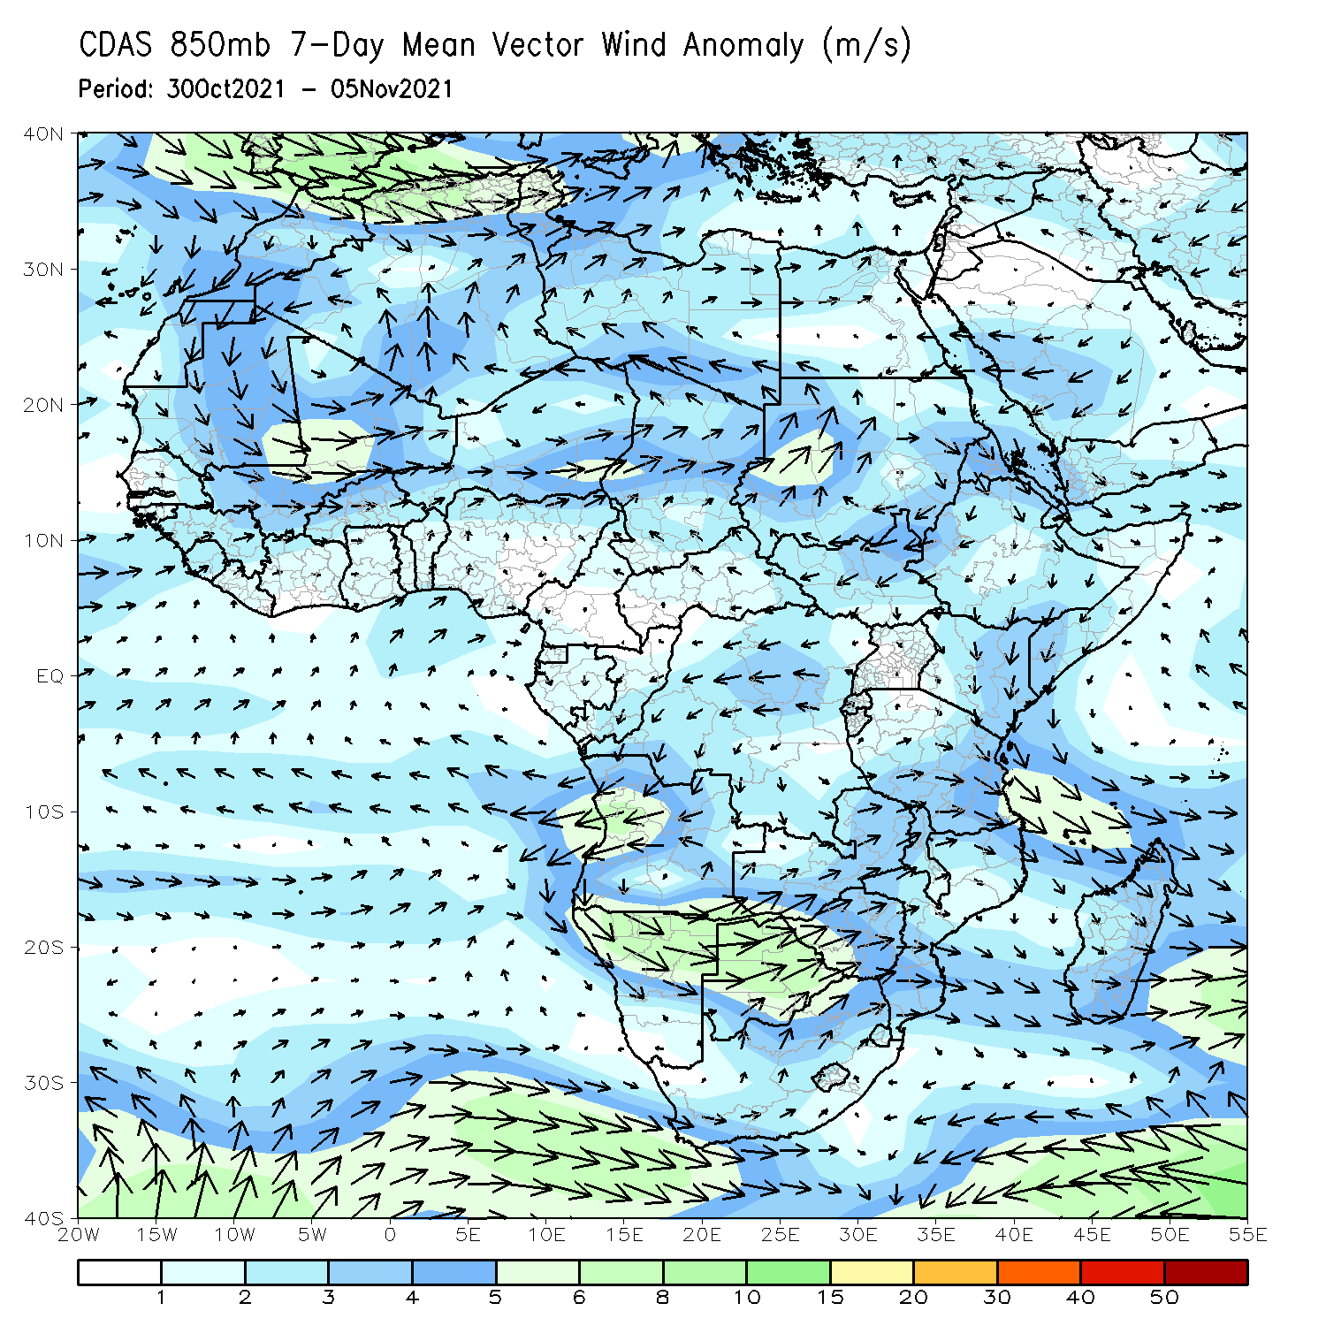
Atmospheric Circulation: Last 7 Days
The 850-hPa atmospheric circulation pattern features anomalous cyclonic circulations over DRC and Angola. This pattern may have contributed to enhanced rainfall in those areas.

Slide 8
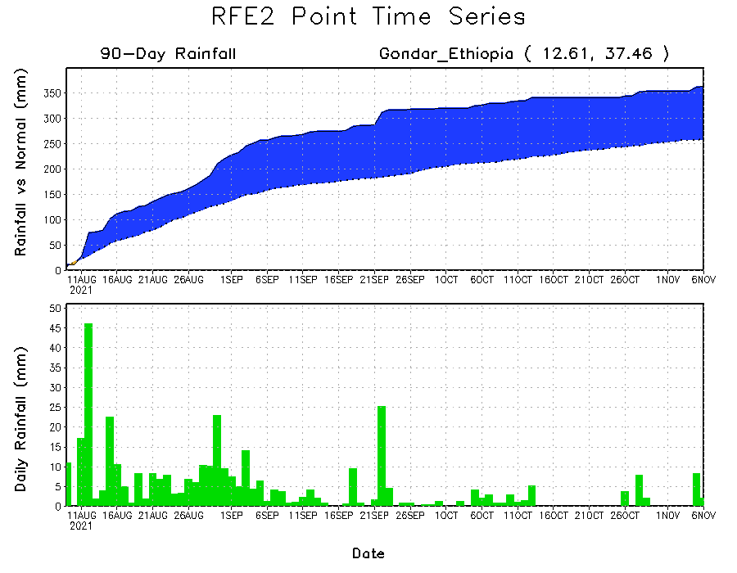
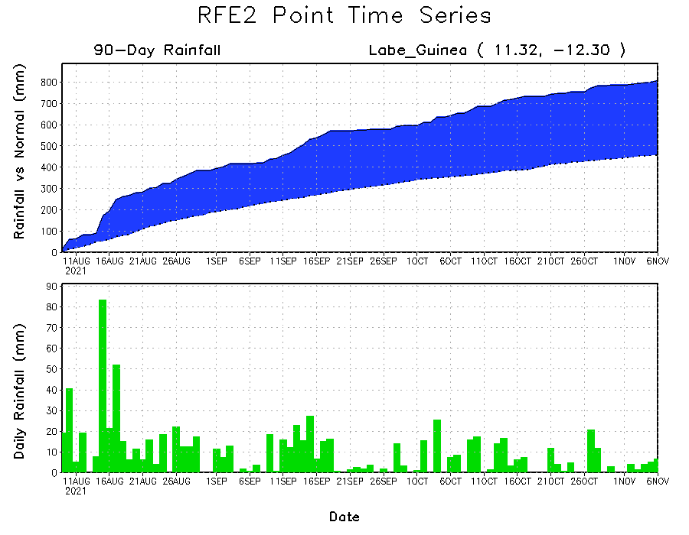
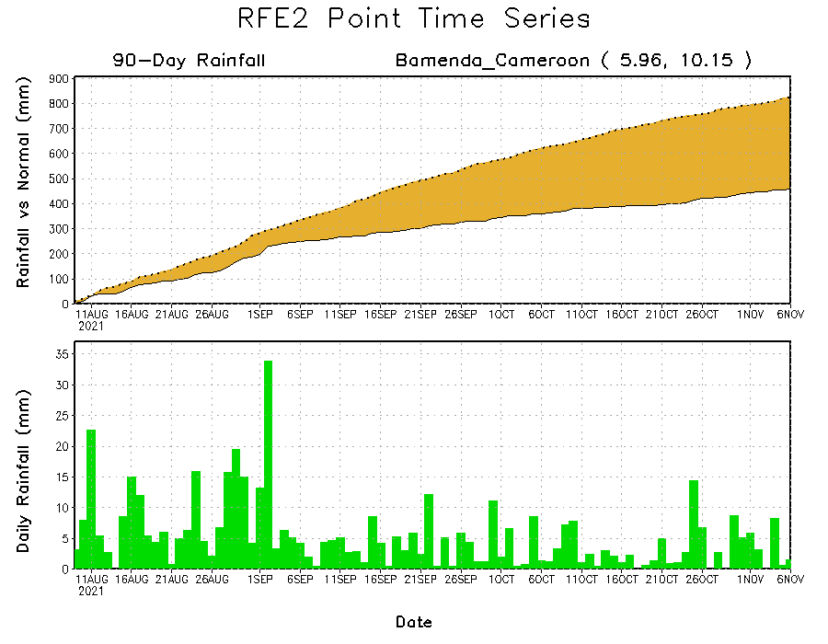
Rainfall Evolution
Daily evolution of rainfall over the last 90 days at selected locations shows sustained moisture surpluses over Guinea (bottom left) and northwestern Ethiopia (top right). In contrast, seasonal total rainfall remained below-average over southwestern Cameroon despite recent rainfall (bottom right).

Slide 9
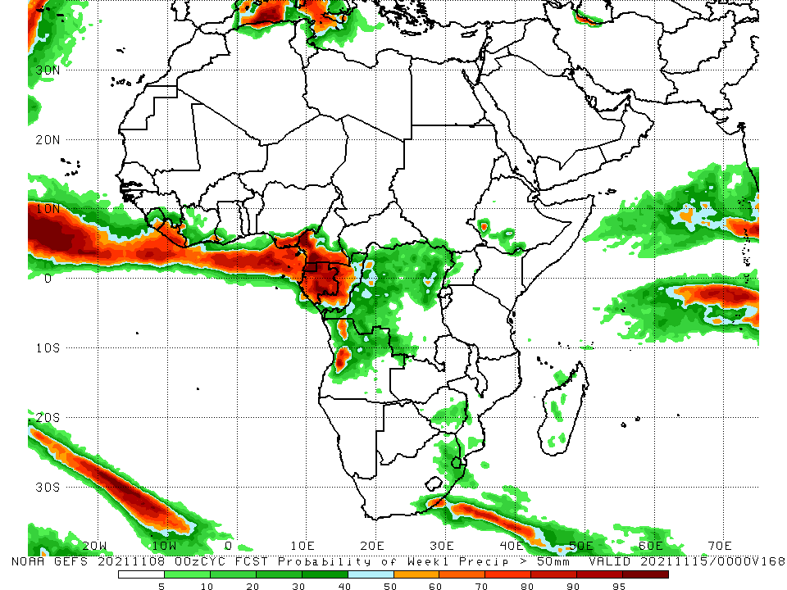
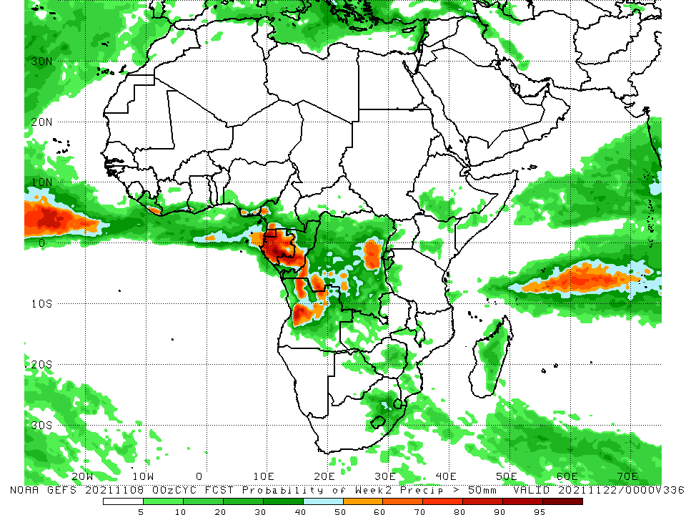
NCEP GEFS Model Forecasts Non-Bias Corrected Probability of precipitation exceedance
Week-1, Valid: 9 – 15 November 2021
Week-2, Valid: 16 – 22 November 2021
For week-1 (left panel) and week-2 forecast (right panel), the NCEP GEFS forecasts indicate a moderate to high chance (over 70%) for rainfall to exceed 50 mm over portions of southern Liberia, southern Nigeria, western Cameroon, Equatorial Guinea, Gabon, Congo, portions of DRC, and Angola.
In addition, the week-1 forecast indicates an increased chance (over 70%) for weekly rainfall to exceed 50 mm across Sierra Leone, southwestern and southeastern Côte d’Ivoire, and pocket areas in southern Ethiopia, and the southern part of South Africa.
Notes:
9

Slide 10
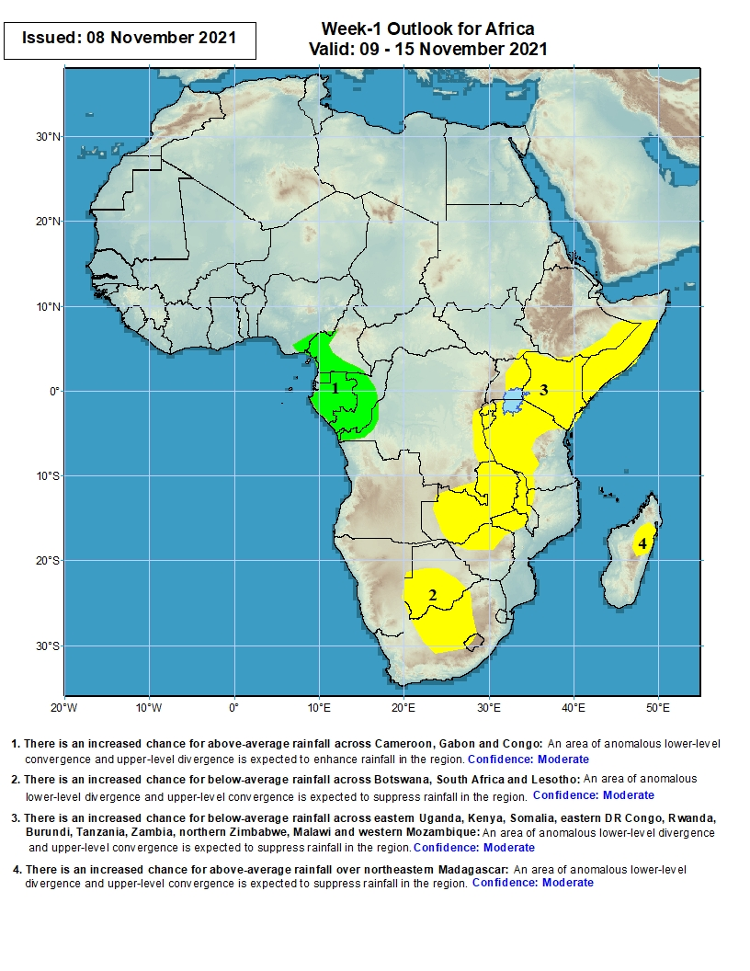
Week-1 Precipitation Outlooks
9 – 15 November 2021
There is an increased chance for above-average rainfall across Cameroon, Gabon and Congo: An area of anomalous lower-level convergence and upper-level divergence is expected to enhance rainfall in the region. Confidence: Moderate
There is an increased chance for below-average rainfall across Botswana, South Africa and Lesotho: An area of anomalous lower-level divergence and upper-level convergence is expected to suppress rainfall in the region. Confidence: Moderate
There is an increased chance for below-average rainfall across eastern Uganda, Kenya, Somalia, eastern DR Congo, Rwanda, Burundi, Tanzania, Zambia, northern Zimbabwe, and western Mozambique: An area of anomalous lower-level divergence and upper-level convergence is expected to suppress rainfall in the region. Confidence: Moderate
There is an increased chance for below-average rainfall over northeastern Madagascar: An area of anomalous lower-level divergence and upper-level convergence is expected to suppress rainfall in the region. Confidence: Moderate
Notes:
10

Slide 11
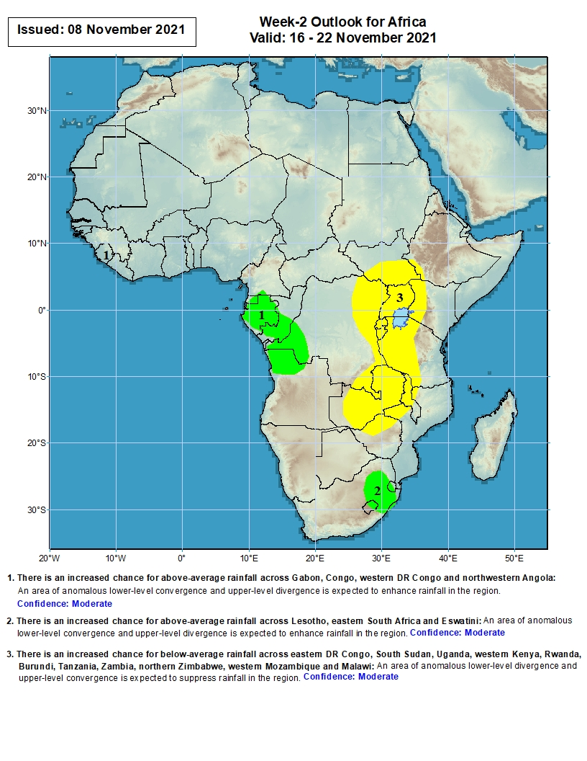
Week-2 Precipitation Outlooks
16 – 22 November 2021
There is an increased chance for above-average rainfall across Gabon, Congo, western DR Congo, and northwestern Angola: An area of anomalous lower-level convergence and upper-level divergence is expected to enhance rainfall in the region. Confidence: Moderate
There is an increased chance for above-average rainfall across Lesotho, eastern South Africa and Eswatini: An area of anomalous lower-level convergence and upper-level divergence is expected to enhance rainfall in the region. Confidence: Moderate
There is an increased chance for below-average rainfall across eastern DR Congo, South Sudan, Uganda, western Kenya, Rwanda, Burundi, Tanzania, Zambia, northern Zimbabwe, western Mozambique and Malawi: An area of anomalous lower-level divergence and upper-level convergence is expected to suppress rainfall in the region. Confidence: Moderate
Notes:
11

Slide 12
Summary
During the past 30 to 90 days, in West Africa, southwestern Mali, southwestern Burkina Faso, Guinea, Sierra Leone, Liberia, southern Ghana, southern Togo, southern Benin, and southern Nigeria observed above-average rainfall. Eastern Nigeria continued to experience negative precipitation anomalies. In Central Africa, moisture surpluses were found across eastern Chad, much of CAR, southeastern Cameroon, eastern Gabon, much of Congo, and many parts of DRC. Moisture deficits were found across much of Cameroon, Equatorial Guinea, western Gabon, and southern Congo. In East Africa, above-average rainfall prevailed in Eritrea, northern Ethiopia, northern Somalia, and much of South Sudan. Southern Ethiopia, Uganda, Kenya, and southern Somalia observed below-average rainfall. Western Zambia experienced well above-average rainfall. Northern Madagascar observed above-average rainfall, while the central and southern part of the country experienced below-average rainfall.
During the past 7 days, near-normal precipitation conditions prevailed in West Africa. Light moisture surpluses were found across local areas in Guinea, Sierra Leone, Liberia, Côte d’Ivoire, Ghana, southern Togo, southern Benin, and Nigeria. In Central Africa, positive precipitation anomalies of over 100 mm were found in CAR, southern Gabon, central Congo, and western and eastern DRC. Cameroon and Equatorial Guinea continued to experienced moisture deficits. In East Africa, southern Sudan, South Sudan, and parts of Tanzania experienced above-average rainfall. Light negative precipitation anomalies were present across Ethiopia. Kenya, and southern Somalia. In Southern Africa, northwestern Angola, much of Zambia, and northern Madagascar observed above-average rainfall. Moisture deficits of 25-50 mm were found across northeastern Angola and central Madagascar,
The week-1 outlooks depict an increased chance for above-average rainfall across Cameroon, Gabon, and Congo. Conversely, there is an increased chance for below-average rainfall across Botswana, South Africa, Lesotho, eastern Uganda, Kenya, Somalia, eastern DR Congo, Rwanda, Burundi, Tanzania, Zambia, northern Zimbabwe, western Mozambique, and northeastern Madagascar.
The week-2 outlooks call for an increased chance for above-average rainfall across Gabon, Congo, western DR Congo, northwestern Angola, Lesotho, eastern South Africa and Eswatini. There is an increased chance for below-average rainfall across eastern DR Congo, South Sudan, Uganda, western Kenya, Rwanda, Burundi, Tanzania, Zambia, northern Zimbabwe, western Mozambique and Malawi.

