Slide 1
The African Monsoon Recent Evolution and Current Status Include Week-1 and Week-2 Outlooks
Update prepared by
15 November 2021
For more information, visit:
http://www.cpc.ncep.noaa.gov/products/Global_Monsoons/African_Monsoons/precip_monitoring.shtml

Slide 2
Outline
Highlights
Recent Evolution and Current Conditions
NCEP GEFS Forecasts
Summary

Slide 3
Highlights: Last 7 Days
During the past 7 days, in East Africa, rainfall was above-average over pockets of western Ethiopia. Below-average rainfall was observed over portions of South Sudan, Uganda, Somalia, Kenya, Rwanda, Burundi and Tanzania. In Central Africa, rainfall was above-average over southern Cameroon, pockets of Gabon, northern Congo, CAR, and pockets of western DRC. Rainfall was below-average over pockets of Gabon, southern Congo, central and southern DRC. In Southern Africa, rainfall was above-average over portions of southern Angola, pockets of Namibia, eastern South Africa, pockets of Mozambique and parts of Madagascar. Below-average rainfall was observed over northern Angola, Zambia and parts of Madagascar. In West Africa, above-average rainfall was observed over much of the Gulf of Guinea region.
Week-1 and Week-2 outlooks call for an increased chance for above-average rainfall across southern Cameroon, Equatorial Guinea, Gabon, Congo, the far western DRC and northwestern Angola. In contrast, the outlooks call for an increased chance for below-average rainfall across much of East Africa, and the northern portions of Southern Africa.

Slide 4
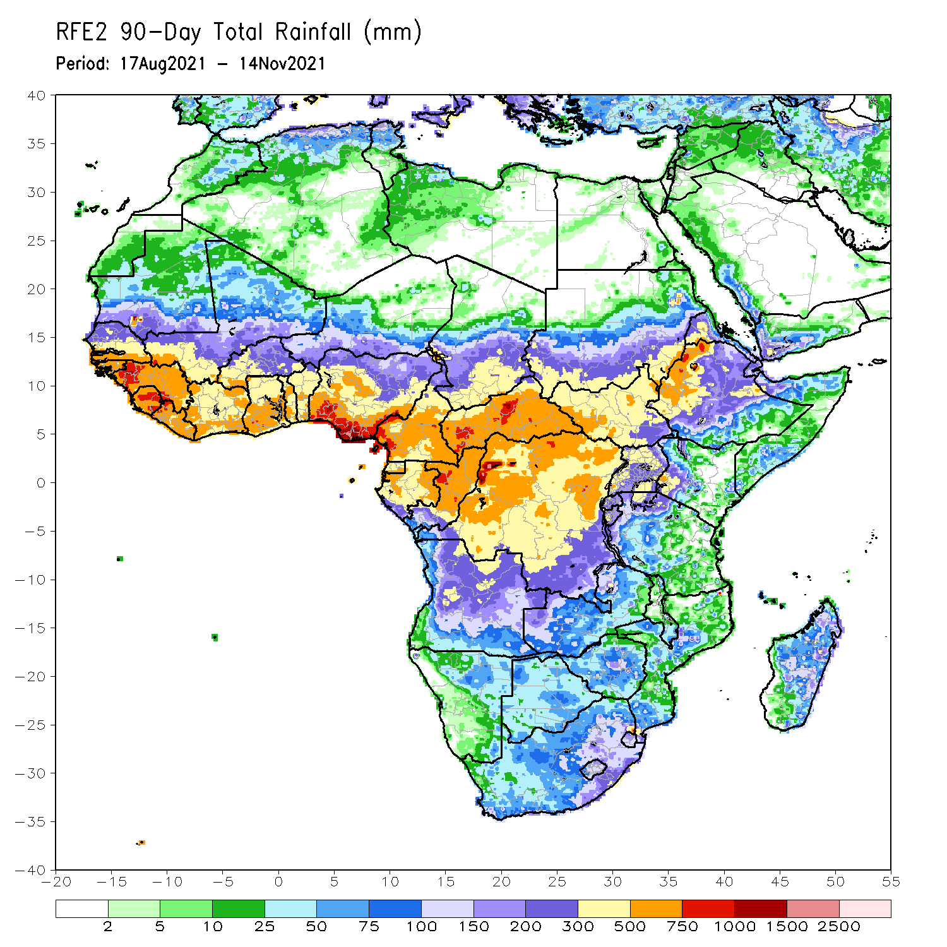
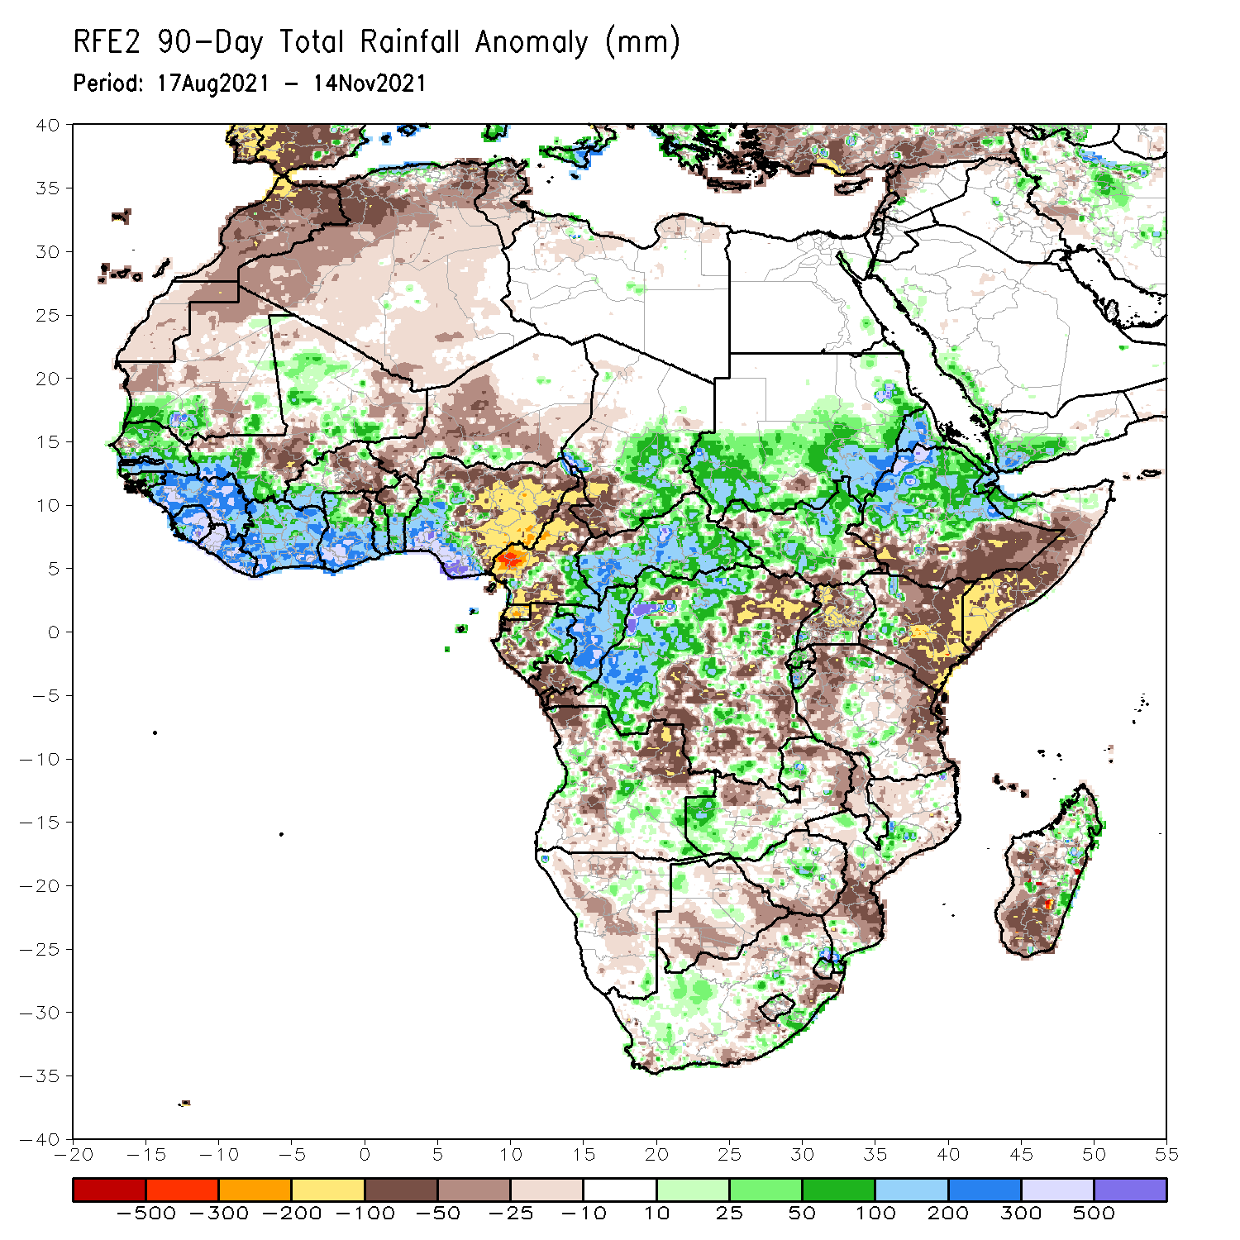
Rainfall Patterns: Last 90 Days
Over the past 90 days, in East Africa, above-average rainfall was observed over western and northern Ethiopia, Eritrea, much of South Sudan and southern and eastern Sudan. Rainfall was below-average over the far southern Ethiopia, much of Somalia and Kenya, and portions of Uganda and Tanzania. In southern Africa, above-average rainfall was observed over pockets of western Zambia and South Africa. Below-average rainfall was observed over pockets of Angola, central and eastern Zambia, Namibia, Botswana, pockets of South Africa, Mozambique and western and southern Madagascar. In Central Africa, rainfall was above-average over western and northern DRC, eastern Gabon, Congo, much of CAR, and southeastern Chad. Rainfall was below-average over portions of central and eastern DRC, Equatorial Guinea, western Gabon, northern Cameroon and southwestern Chad. In West Africa, rainfall was above-average over much of the Gulf of Guinea region, Senegal, parts of southern Mauritania and southwestern Mali. Below-average rainfall was observed over central Mali, pockets of Burkina Faso and northeastern Ghana, parts of Niger, and eastern Nigeria.
Notes:
4

Slide 5
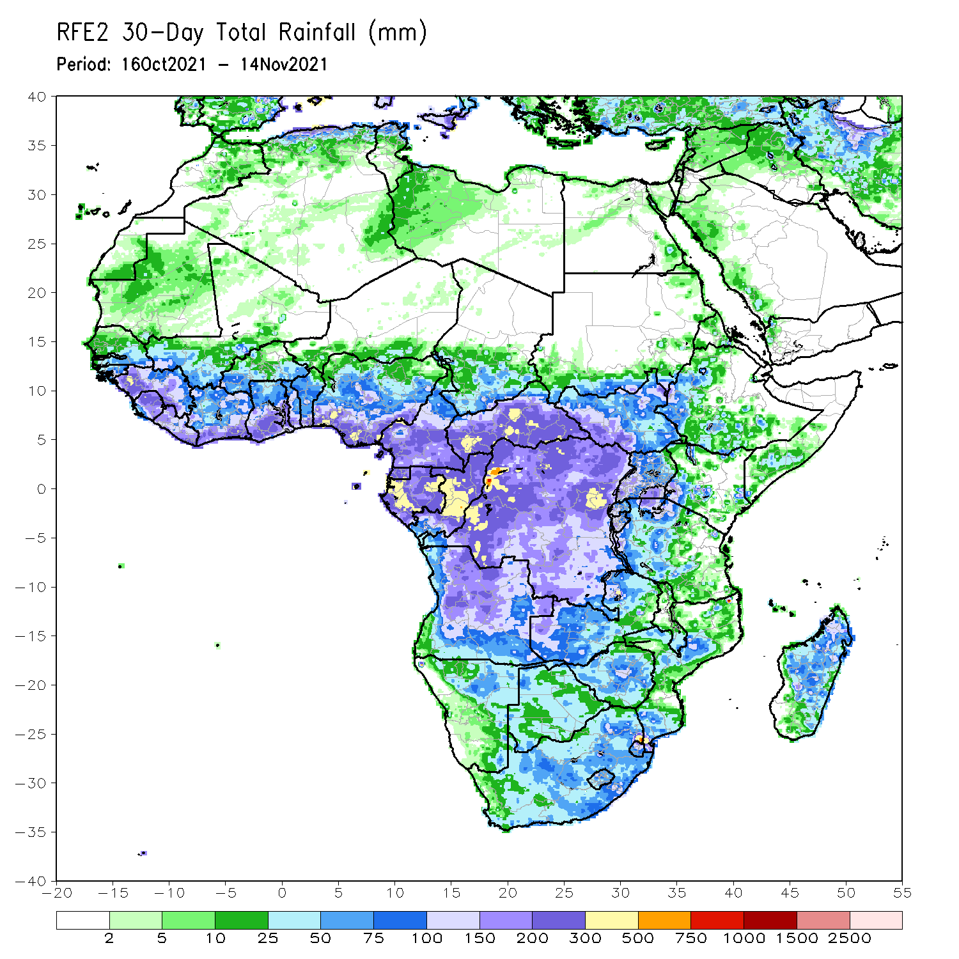
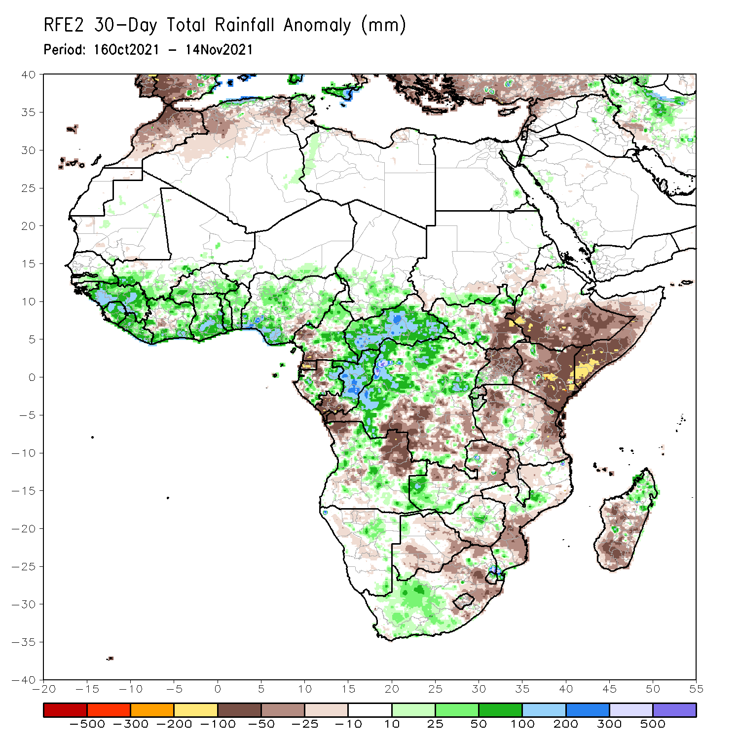
Rainfall Patterns: Last 30 Days
During the past 30 days, in East Africa, above-average rainfall was observed over portions of South Sudan, and pockets of Tanzania. Rainfall was below-average over southern Ethiopia, much of Somalia, Kenya Uganda and portions of Tanzania. In Central Africa, rainfall was below-average over portions of southern and eastern DRC, southern Congo, Equatorial Guinea, and parts of southern Cameroon. Rainfall was above-average over northern and eastern Cameroon, much of CAR, central and northern Congo, western and northern DRC. In West Africa, rainfall was above-average over much of the Gulf of Guinea region. Below-average rainfall was observed over pockets of eastern Nigeria. In Southern Africa, above-average rainfall was observed over pockets of Angola, western Zambia, western South Africa, pockets of Zimbabwe, pockets of Mozambique, and northern Madagascar. Below-average rainfall was observed over portions of Angola, central and eastern Zambia, Botswana, eastern South Africa, parts of Mozambique and Mali, and central and southern Madagascar.
Notes:
5

Slide 6
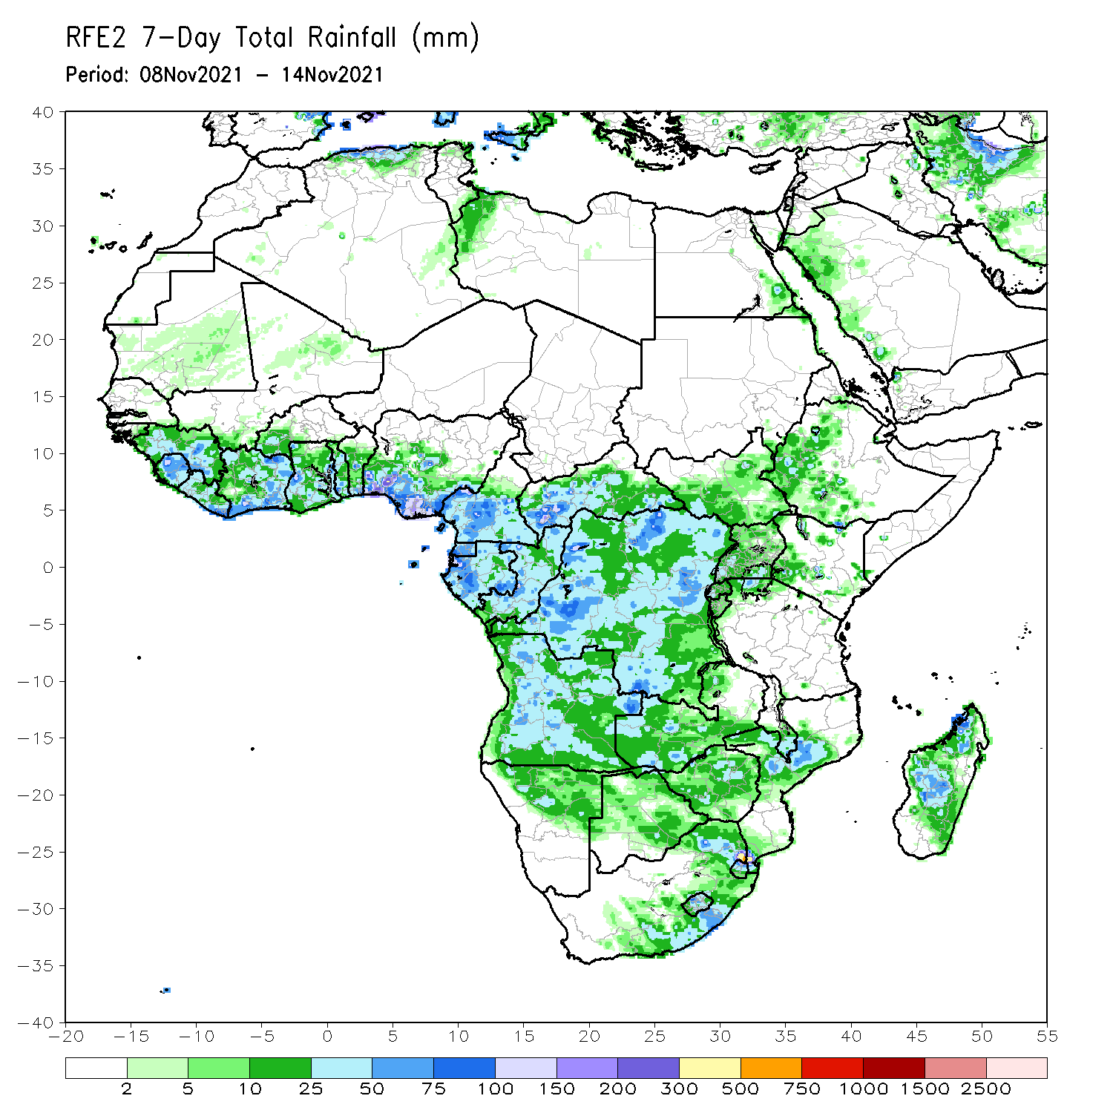
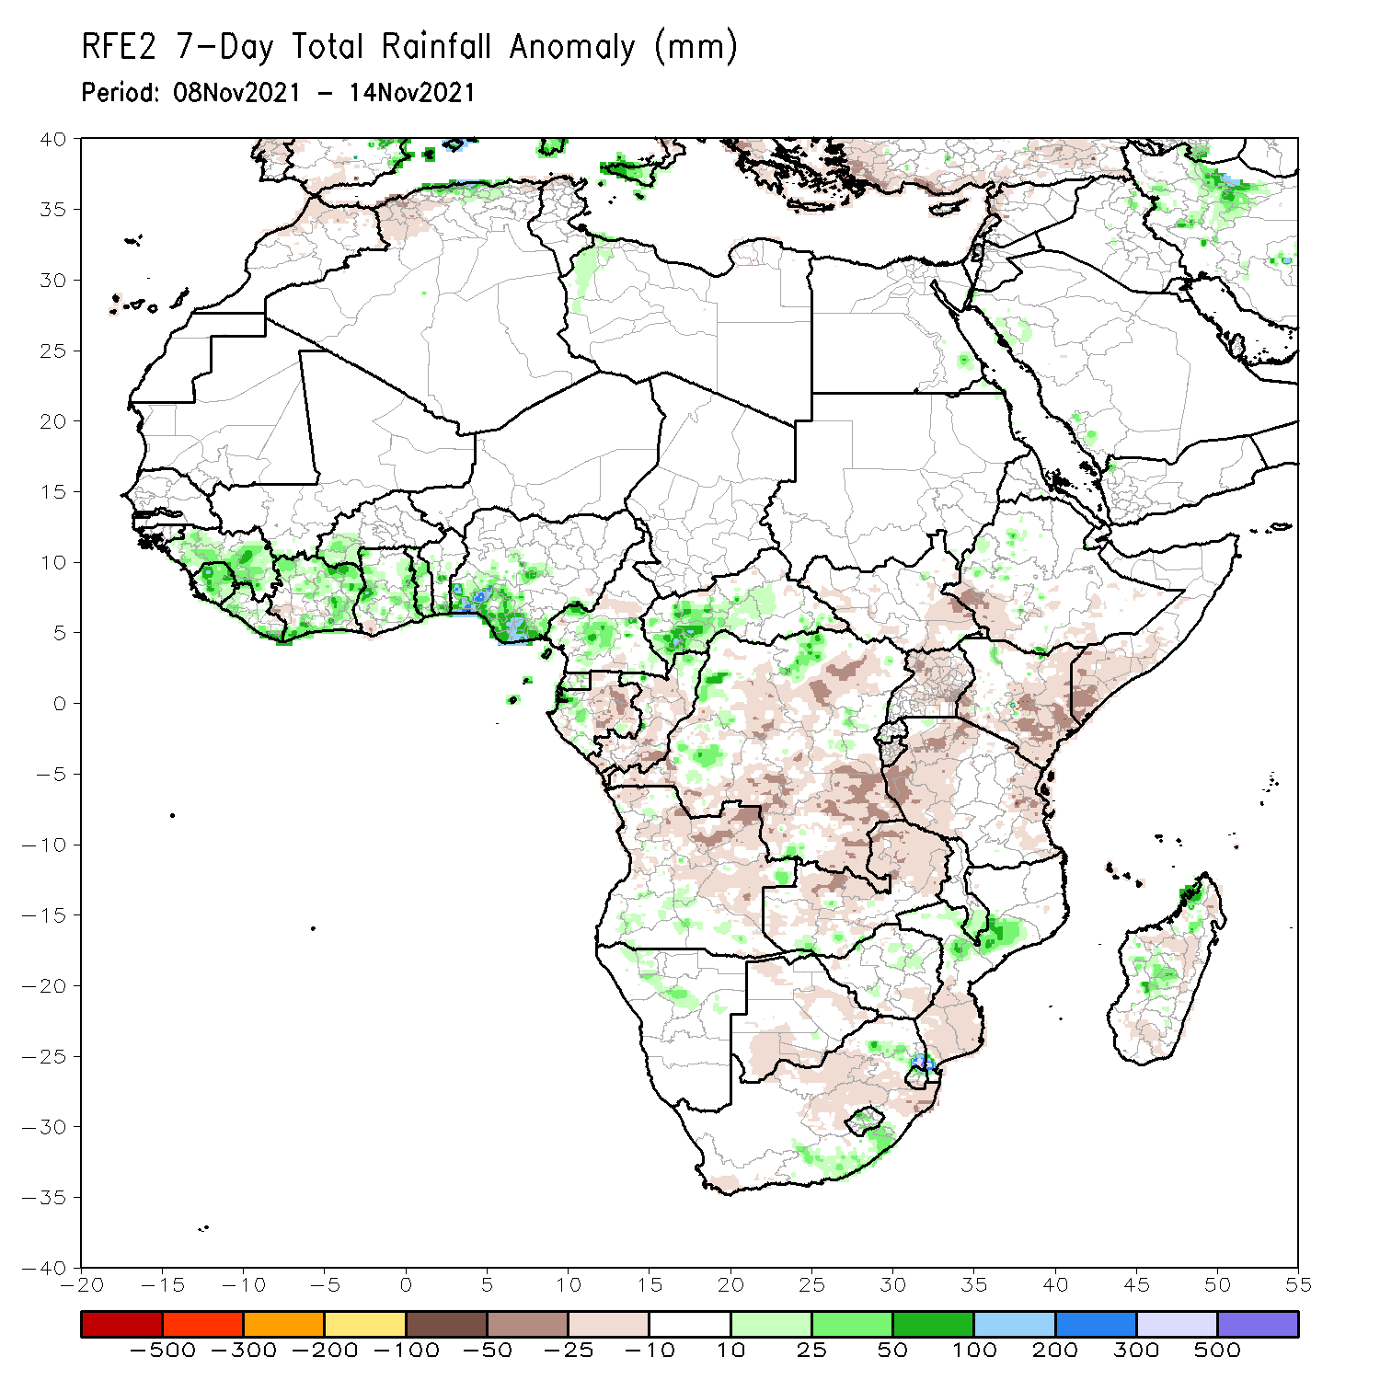
Rainfall Patterns: Last 7 Days
During the past 7 days, in East Africa, rainfall was above-average over pockets of western Ethiopia. Below-average rainfall was observed over portions of South Sudan, Uganda, Somalia, Kenya, Rwanda, Burundi and Tanzania. In Central Africa, rainfall was above-average over southern Cameroon, pockets of Gabon, northern Congo, CAR, and pockets of western DRC. Rainfall was below-average over pockets of Gabon, southern Congo, central and southern DRC. In Southern Africa, rainfall was above-average over pockets of southern Angola, Namibia, South Africa, Mozambique and adagascar. Below-average rainfall was observed over northern Angola, Zambia and parts of Madagascar. In West Africa, above-average rainfall was observed over much of the Gulf of Guinea region.

Slide 7
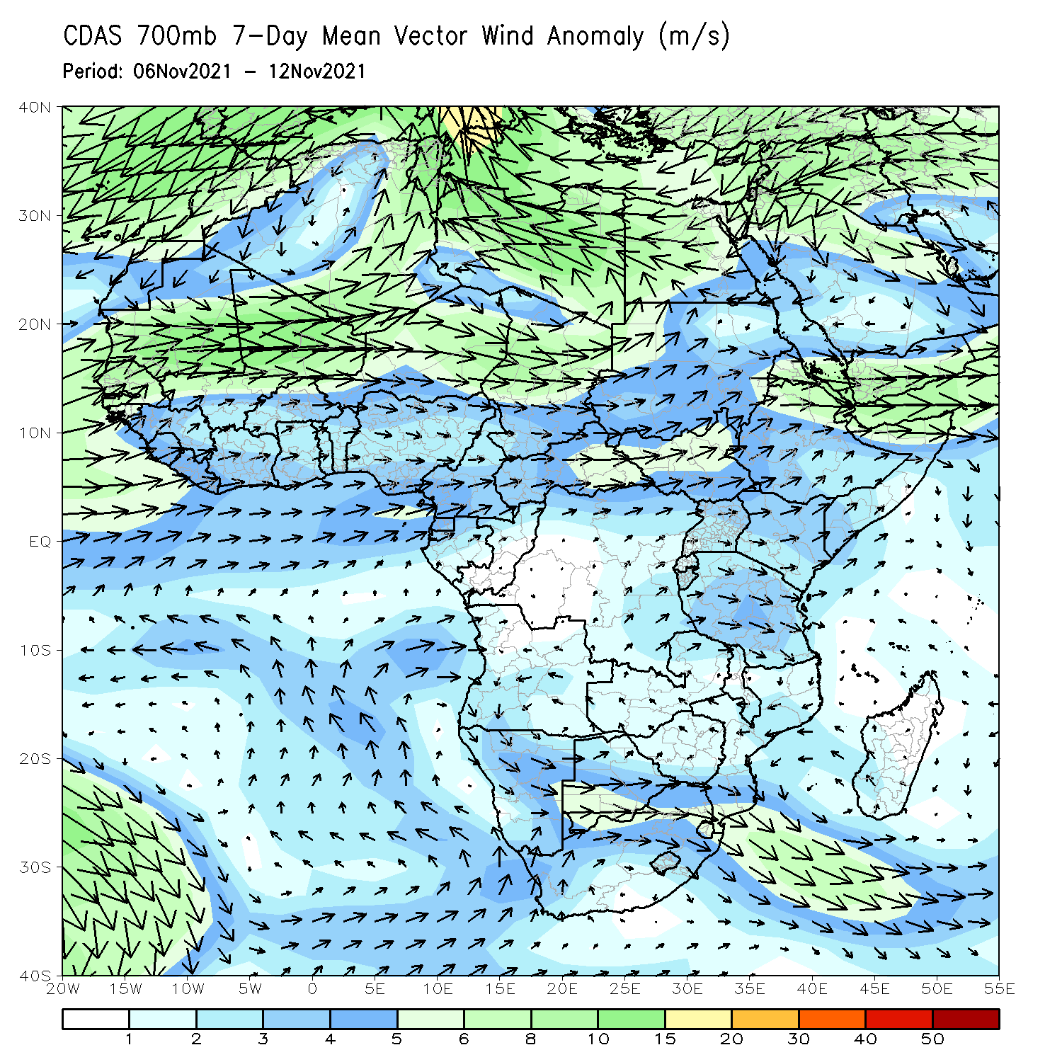
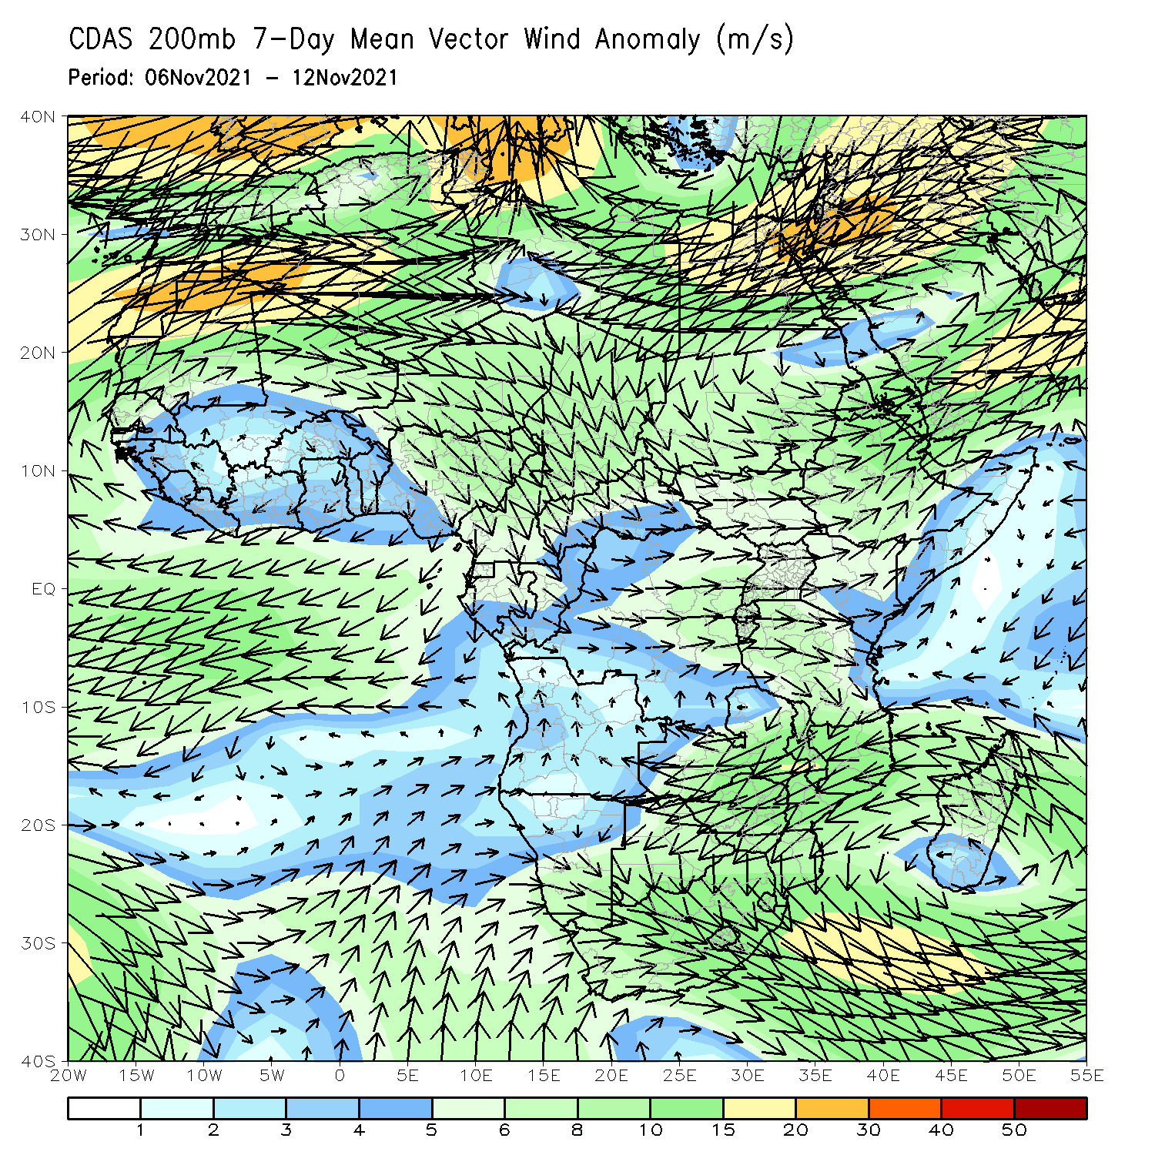
Atmospheric Circulation: Last 7 Days
At 700-hPa level (left panel), anomalous offshore flow prevailed over much of East Africa.

Slide 8
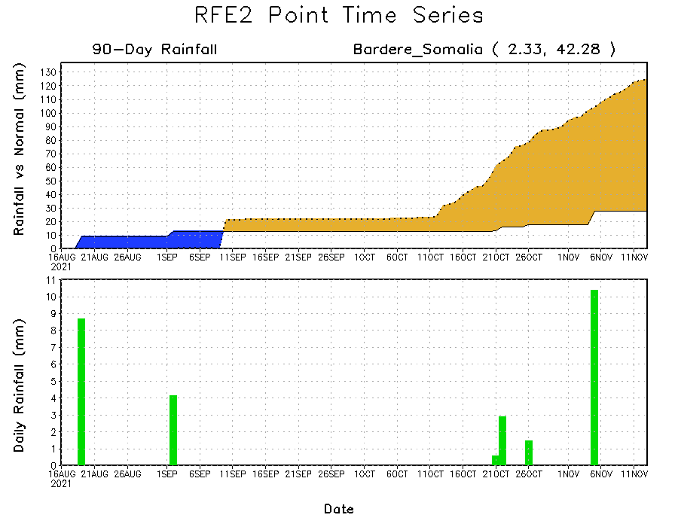
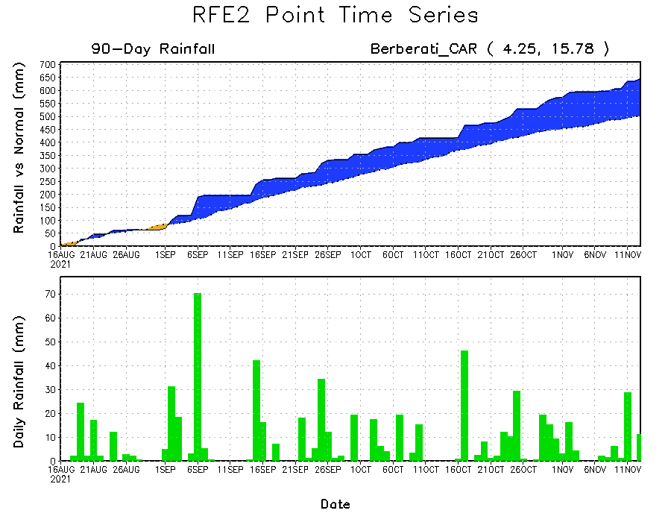
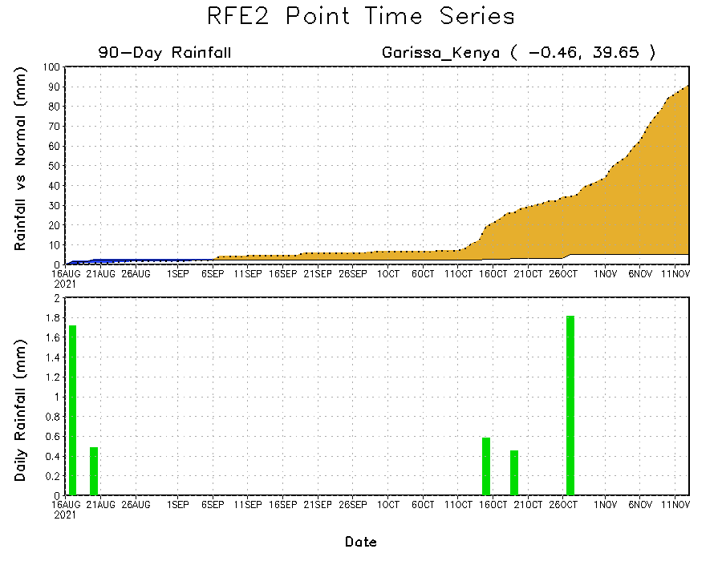
Rainfall Evolution
Daily evolution of rainfall over the last 90 days at selected locations shows moderate sustained moisture surpluses over parts of CAR (bottom left). In contrast, seasonal total rainfall remained below-average over many parts of Somalia (top right) and Kenya (bottom right).

Slide 9
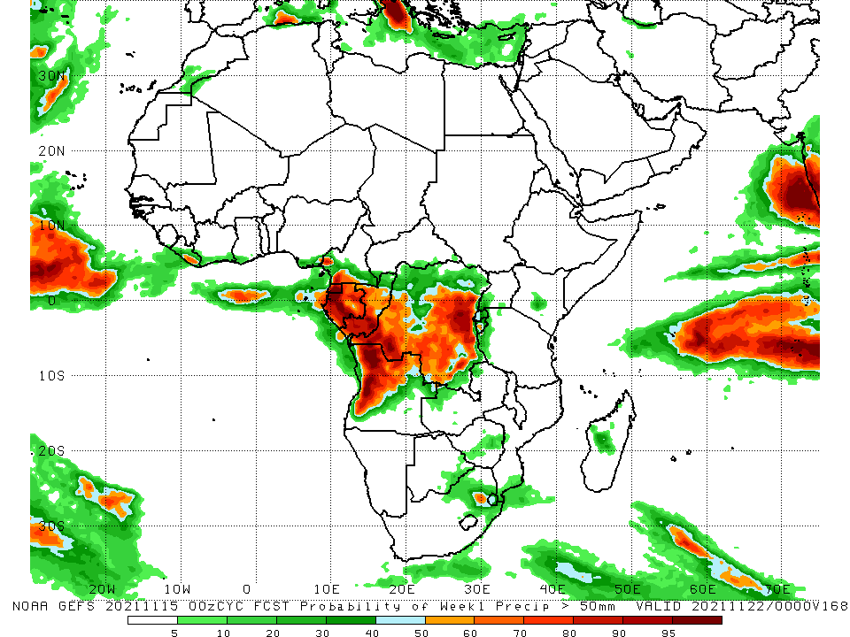
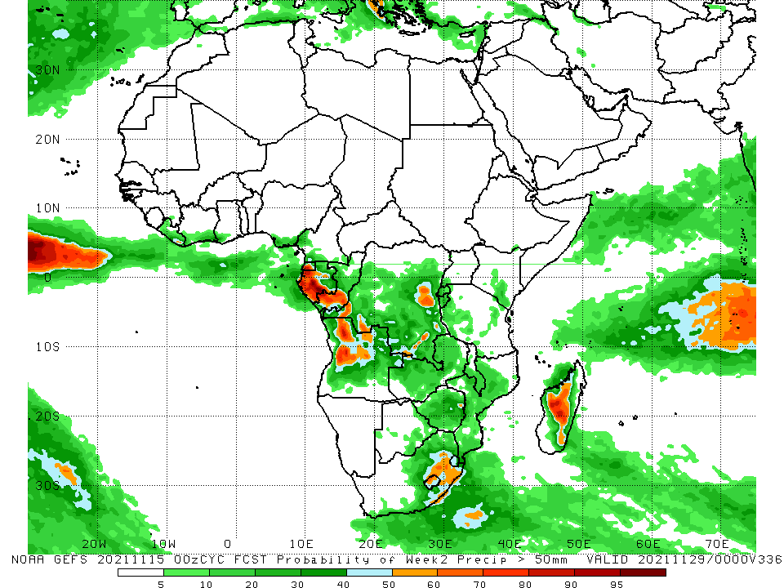
NCEP GEFS Model Forecasts Non-Bias Corrected Probability of precipitation exceedance
Week-1, Valid: 16 - 22 November, 2021
Week-2, Valid: 23 – 29 November, 2021
For week-1 (left panel), the NCEP GEFS indicates a moderate to high chance (over 70%) for rainfall to exceed 50 mm over much of Equatorial Guinea, Gabon, Congo, parts of southern Cameroon, and portions of Angola and DRC.
For week-2 (right panel), a moderate to high chance for rainfall to exceed 50mm across Equatorial Guinea, western Gabon, southern Congo, and pockets of Angola, DRC and South Africa.
Notes:
9

Slide 10
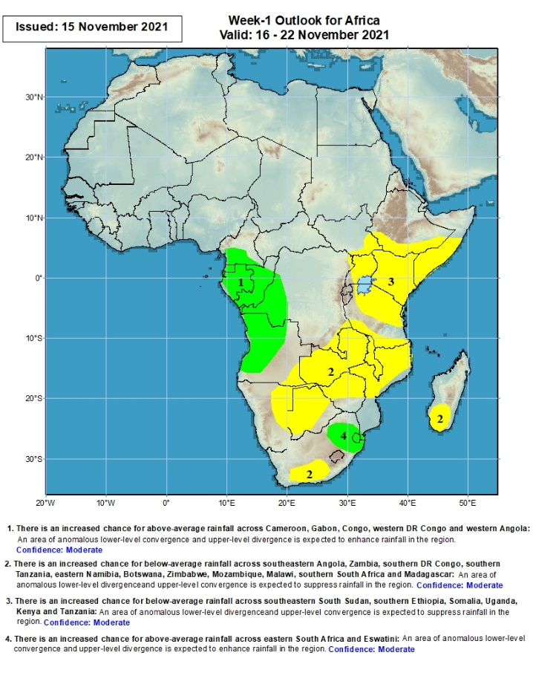
Week-1 Precipitation Outlooks
16 – 22 November, 2021
There is an increased chance for above-average rainfall across southern Cameroon, Gabon, Congo, western DR Congo and western Angola: An area of anomalous lower-level convergence and upper-level divergence is expected to enhance rainfall in the region. Confidence: Moderate
There is an increased chance for below-average rainfall across southeastern Angola, Zambia, southern DR Congo, southern Tanzania, eastern Namibia, Botswana, Zimbabwe, Mozambique, Malawi, southern South Africa and southern Madagascar: An area of anomalous lower-level divergence and upper-level convergence is expected to suppress rainfall in the region. Confidence: Moderate
There is an increased chance for below-average rainfall across southeastern South Sudan, southern Ethiopia, Somalia, Uganda, Kenya and Tanzania: An area of anomalous lower-level divergence and upper-level convergence is expected to suppress rainfall in the region. Confidence: Moderate
There is an increased chance for above-average rainfall across eastern South Africa, and Eswatini: An area of anomalous lower-level convergence and upper-level divergence is expected to enhance rainfall in the region. Confidence: Moderate
Notes:
10

Slide 11
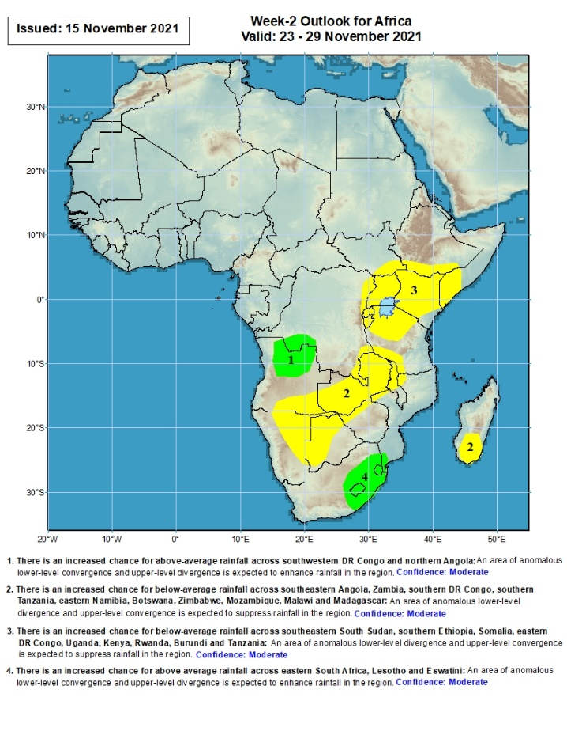
Week-2 Precipitation Outlooks
23 – 29 November, 2021
There is an increased chance for above-average rainfall across southwestern DR Congo and northern Angola: An area of anomalous lower-level convergence and upper-level divergence is expected to enhance rainfall in the region. Confidence: Moderate
There is an increased chance for below-average rainfall across southeastern Angola, Zambia, southern DR Congo, southern Tanzania, eastern Namibia, Botswana, Zimbabwe, Mozambique, Malawi and southern Madagascar: An area of anomalous lower-level divergence and upper-level convergence is expected to suppress rainfall in the region. Confidence: Moderate
There is an increased chance for below-average rainfall across southeastern South Sudan, southern Ethiopia, Somalia, eastern DR Congo, Uganda, Kenya, Rwanda, Burundi and Tanzania: An area of anomalous lower-level divergence and upper-level convergence is expected to suppress rainfall in the region. Confidence: Moderate
There is an increased chance for above-average rainfall across eastern South Africa, Lesotho and Eswatini: An area of anomalous lower-level convergence and upper-level divergence is expected to enhance rainfall in the region. Confidence: Moderate
Notes:
11

Slide 12
Summary
During the past 30 to 90 days, in East Africa, above-average rainfall was observed over portions of South Sudan, and pockets of Tanzania. Rainfall was below-average over southern Ethiopia, much of Somalia, Kenya Uganda and portions of Tanzania. In Central Africa, rainfall was below-average over portions of southern and eastern DRC, southern Congo, Equatorial Guinea, and parts of southern Cameroon. Rainfall was above-average over northern and eastern Cameroon, much of CAR, central and northern Congo, western and northern DRC. In West Africa, rainfall was above-average over much of the Gulf of Guinea region. Below-average rainfall was observed over pockets of eastern Nigeria. In Southern Africa, above-average rainfall was observed over pockets of Angola, western Zambia, western South Africa, pockets of Zimbabwe, pockets of Mozambique, and northern Madagascar. Below-average rainfall was observed over portions of Angola, central and eastern Zambia, Botswana, eastern South Africa, parts of Mozambique and Mali, and central and southern Madagascar.
During the past 7 days, in East Africa, rainfall was above-average over pockets of western Ethiopia. Below-average rainfall was observed over portions of South Sudan, Uganda, Somalia, Kenya, Rwanda, Burundi and Tanzania. In Central Africa, rainfall was above-average over southern Cameroon, pockets of Gabon, northern Congo, CAR, and pockets of western DRC. Rainfall was below-average over pockets of Gabon, southern Congo, central and southern DRC. In Southern Africa, rainfall was above-average over portions of southern Angola, pockets of Namibia, eastern South Africa, pockets of Mozambique and parts of Madagascar. Below-average rainfall was observed over northern Angola, Zambia and parts of Madagascar. In West Africa, above-average rainfall was observed over much of the Gulf of Guinea region.
Week-1 and Week-2 outlooks call for an increased chance for above-average rainfall across southern Cameroon, Equatorial Guinea, Gabon, Congo, the far western DRC and northwestern Angola. In contrast, the outlooks call for an increased chance for below-average rainfall across much of East Africa, and the northern portions of Southern Africa.

