Slide 1
The African Monsoon Recent Evolution and Current Status Include Week-1 and Week-2 Outlooks
Update prepared by
29 November 2021
For more information, visit:
http://www.cpc.ncep.noaa.gov/products/Global_Monsoons/African_Monsoons/precip_monitoring.shtml

Slide 2
Outline
Highlights
Recent Evolution and Current Conditions
NCEP GEFS Forecasts
Summary

Slide 3
Highlights: Last 7 Days
During the past 7 days, in East Africa, rainfall was below-average over pockets of Tanzania. Above-average rainfall was observed over Uganda, western Tanzania, and pockets of Kenya Somalia. In Central Africa, rainfall was above-average over parts of southern Gabon, southern Congo, and portions of DRC. Rainfall was below-average over southern Cameroon, Equatorial Guinea, Gabon, central and northern Congo, and portions of DRC. In Southern Africa, rainfall was above-average over northern Angola, eastern Zambia, southern Botswana, pockets of Mozambique, northern Madagascar and many parts of South Africa. Below-average rainfall was observed over central and southern Angola, Namibia, Botswana, Zimbabwe, and parts of southern Madagascar. In West Africa, above-average rainfall was observed along coastal Nigeria.
Week-1 and week-2 outlooks call for an increased chance for below-average rainfall over much of equatorial East Africa, and the eastern portions of Southern Africa. There is also an increased chance for below-average rainfall over parts of southern Angola and southern Madagascar. In contrast, the outlooks call for an increased chance for above-average rainfall over northern Angola and eastern South Africa.

Slide 4
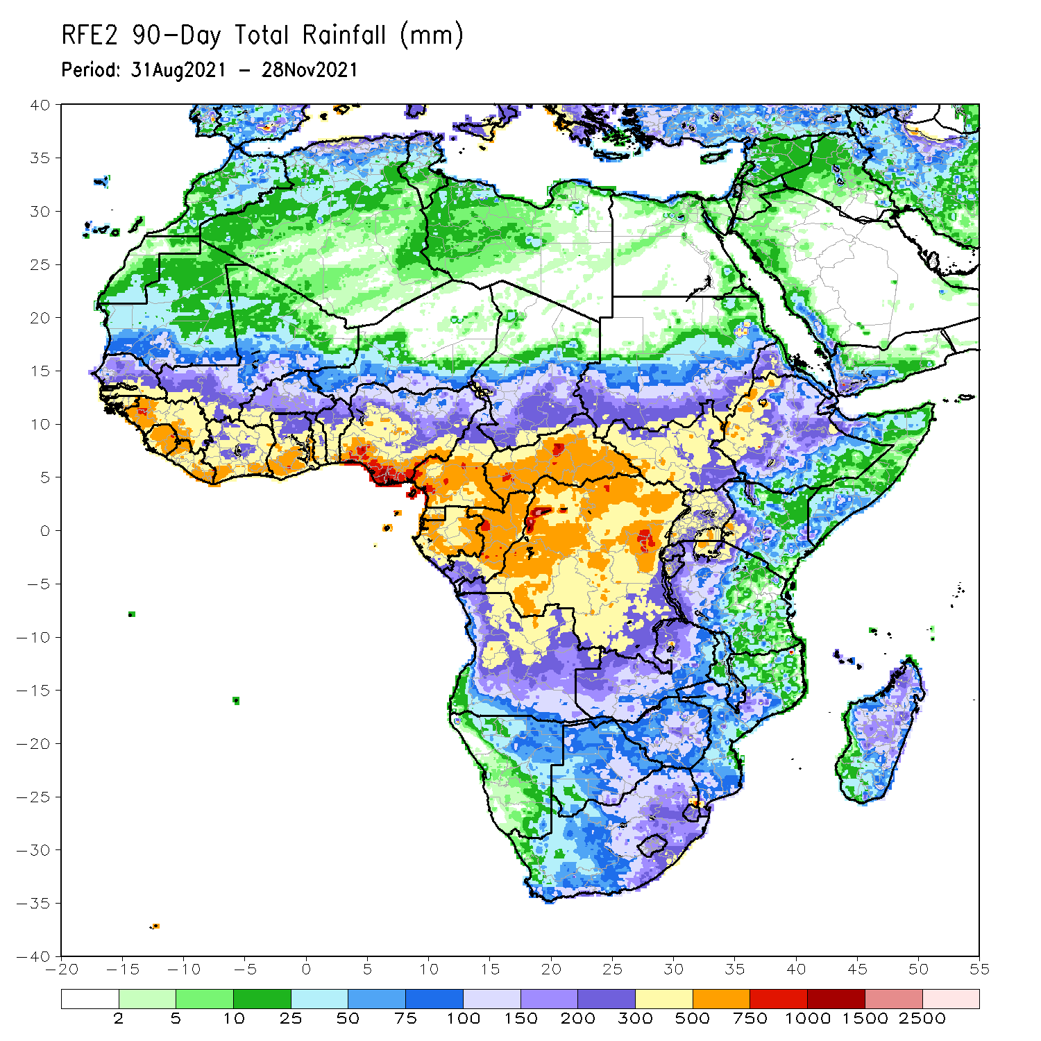
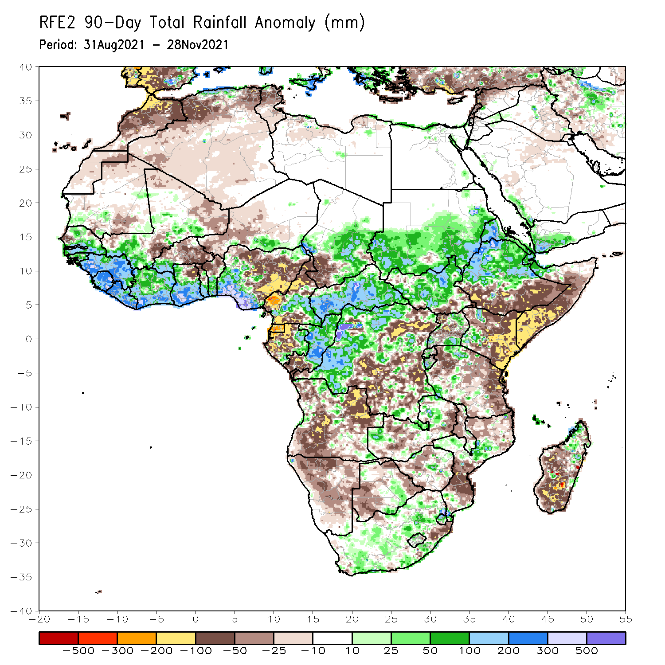
Rainfall Patterns: Last 90 Days
Over the past 90 days, in East Africa, above-average rainfall was observed over central and northern Ethiopia, Eritrea, much of South Sudan and southern and eastern Sudan. Rainfall was below-average over the far southern Ethiopia, much of Somalia and Kenya, and portions of Uganda and Tanzania. In southern Africa, above-average rainfall was observed over pockets of Zambia, Botswana, Zimbabwe, and Mozambique, and many parts of South Africa. Below-average rainfall was observed over much of Angola, portions of Zambia, much of Namibia, parts of Botswana and Zambia, pockets of South Africa, Mozambique and much of Madagascar. In Central Africa, rainfall was above-average over western and northern DRC, eastern Gabon, Congo, much of CAR, and southeastern Chad. Rainfall was below-average over portions of central and eastern DRC, Equatorial Guinea, western Gabon, northern Cameroon and southwestern Chad. In West Africa, rainfall was above-average over much of the Gulf of Guinea region, Senegal, parts of southern Mauritania and southwestern Mali. Below-average rainfall was observed over central Mali, much of Burkina Faso and northeastern Ghana, parts of Niger, and northern and eastern Nigeria.
Notes:
4

Slide 5
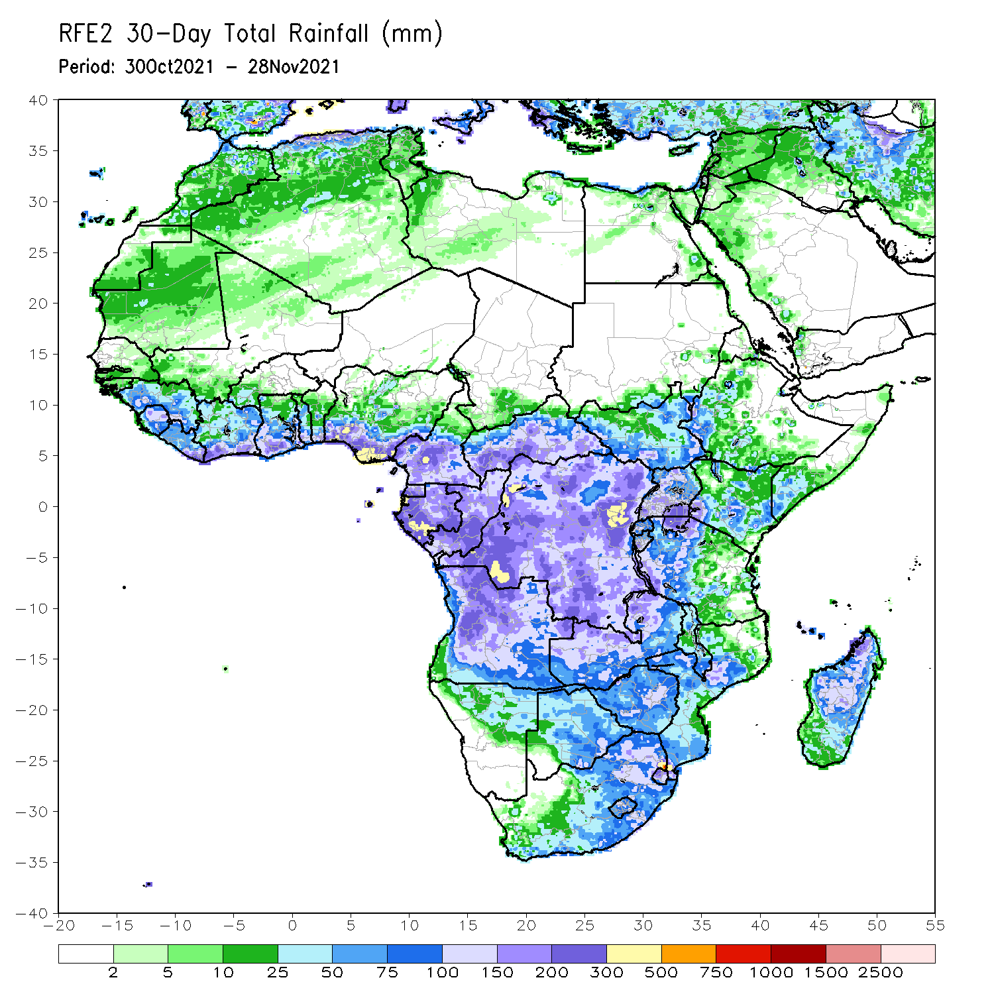
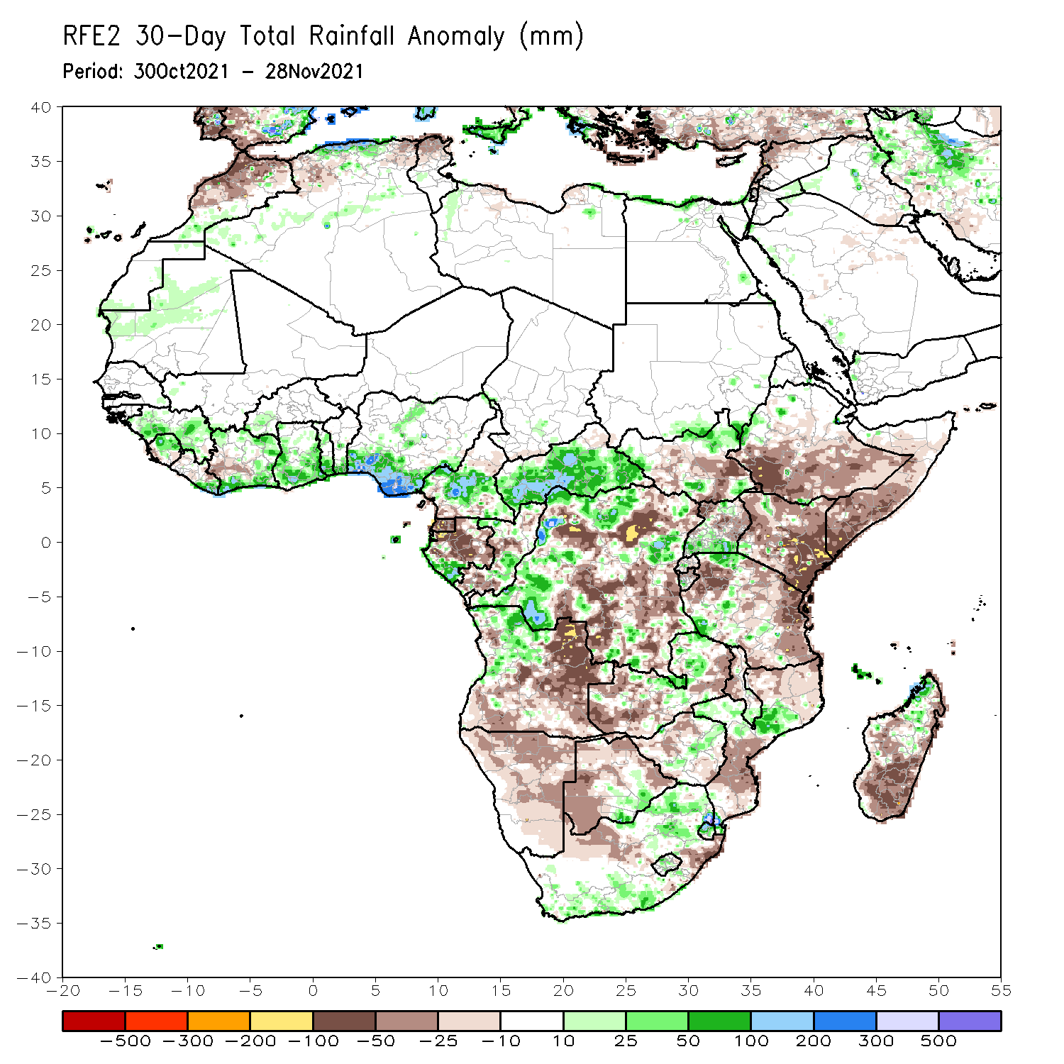
Rainfall Patterns: Last 30 Days
During the past 30 days, in East Africa, above-average rainfall was observed over pockets of South Sudan, Uganda and Tanzania. Rainfall was below-average over southern Ethiopia, much of Somalia, Kenya, Uganda and much of Tanzania. In Central Africa, rainfall was below-average over portions of southern and eastern DRC, southern Congo, Equatorial Guinea, and Gabon. Rainfall was above-average over portions of Cameroon, much of CAR, central and northern Congo, western and northern DRC. In West Africa, rainfall was above-average over much of the Gulf of Guinea region. Below-average rainfall was observed over pockets of eastern Cote d’Ivoire. In Southern Africa, above-average rainfall was observed over portions of northwestern Angola, pockets of Zambia, many parts of South Africa, pockets of Mozambique, and northern Madagascar. Below-average rainfall was observed over southern and eastern Angola, portions of Zambia, Botswana, Zimbabwe, pockets of South Africa, parts of Mozambique and Malawi, and central and southern Madagascar.
Notes:
5

Slide 6
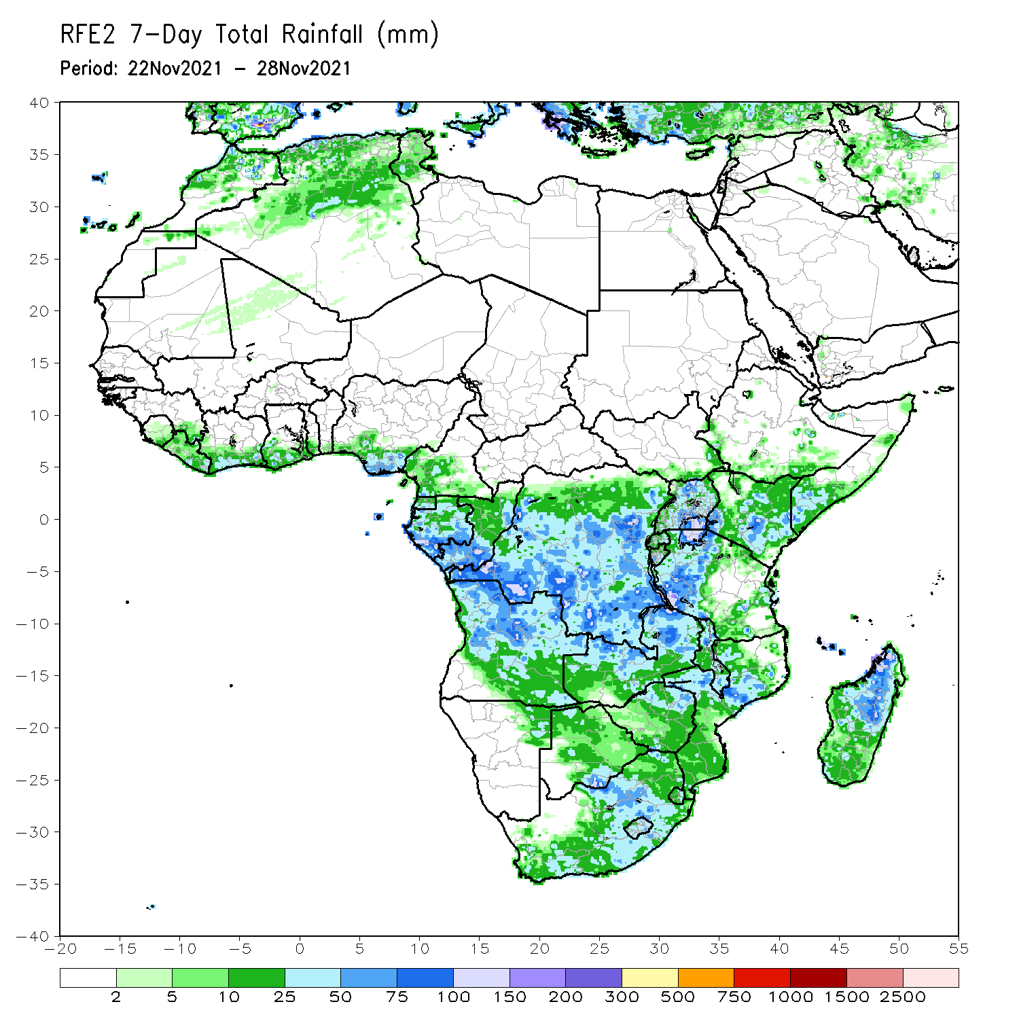
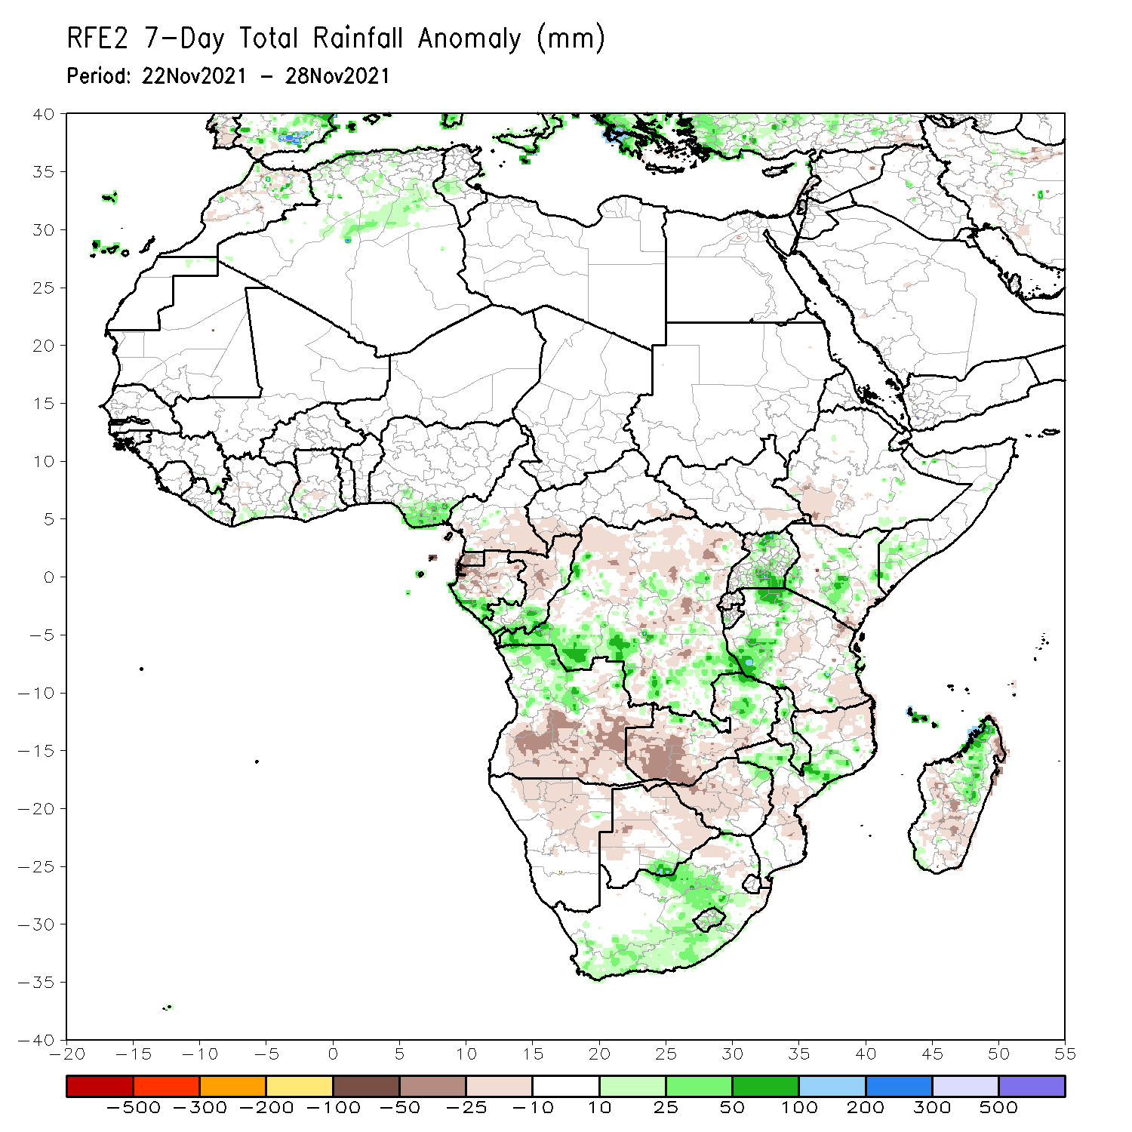
Rainfall Patterns: Last 7 Days
During the past 7 days, in East Africa, rainfall was below-average over pockets of Tanzania. Above-average rainfall was observed over Uganda, western Tanzania, and pockets of Kenya Somalia. In Central Africa, rainfall was above-average over parts of southern Gabon, southern Congo, and portions of DRC. Rainfall was below-average over southern Cameroon, Equatorial Guinea, Gabon, central and northern Congo, and portions of DRC. In Southern Africa, rainfall was above-average over northern Angola, eastern Zambia, southern Botswana, pockets of Mozambique, northern Madagascar and many parts of South Africa. Below-average rainfall was observed over central and southern Angola, Namibia, Botswana, Zimbabwe, and parts of southern Madagascar. In West Africa, above-average rainfall was observed along coastal Nigeria.

Slide 7
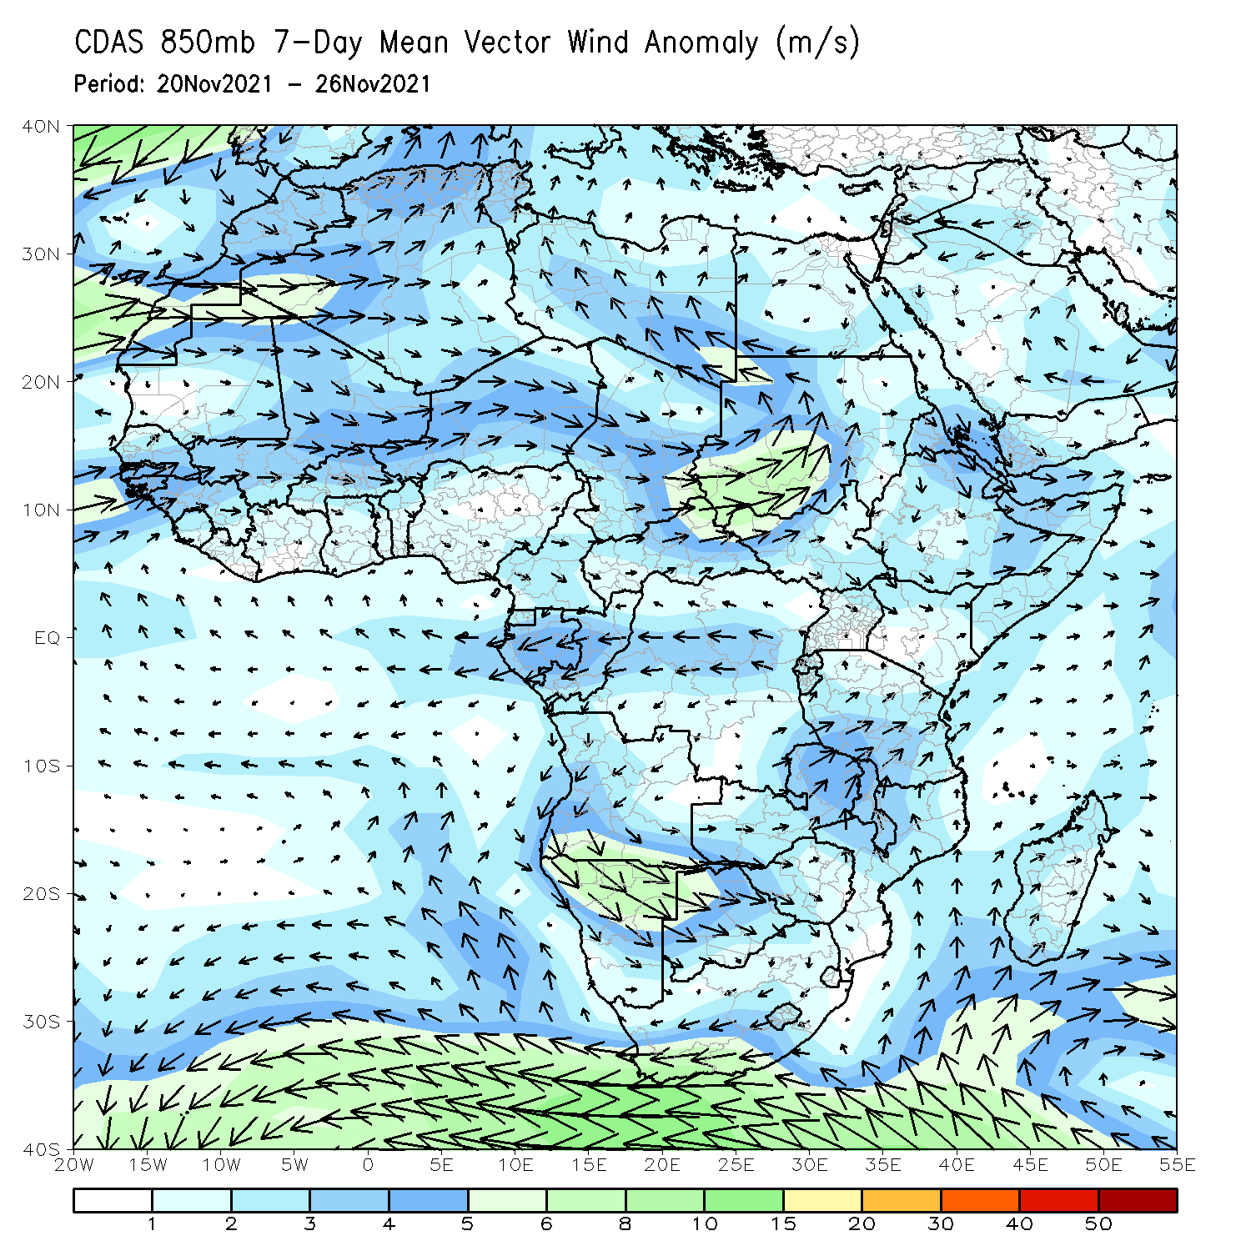
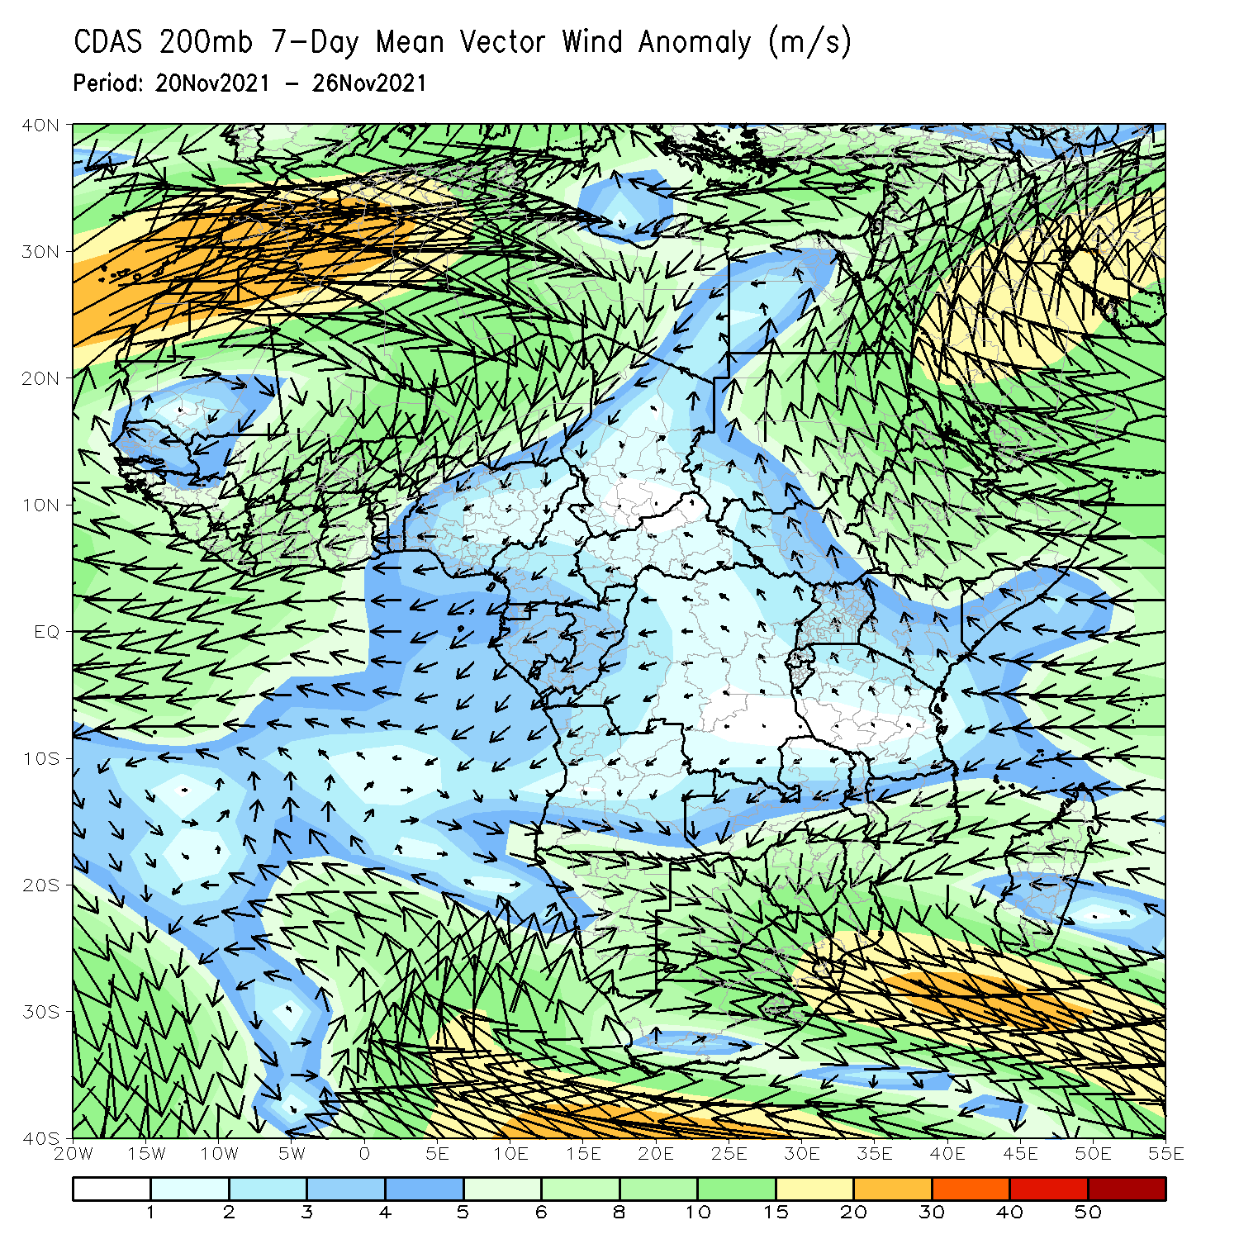
Atmospheric Circulation: Last 7 Days
At 850-hPa level (left panel), anomalous offshore flow prevailed across East Africa.

Slide 8
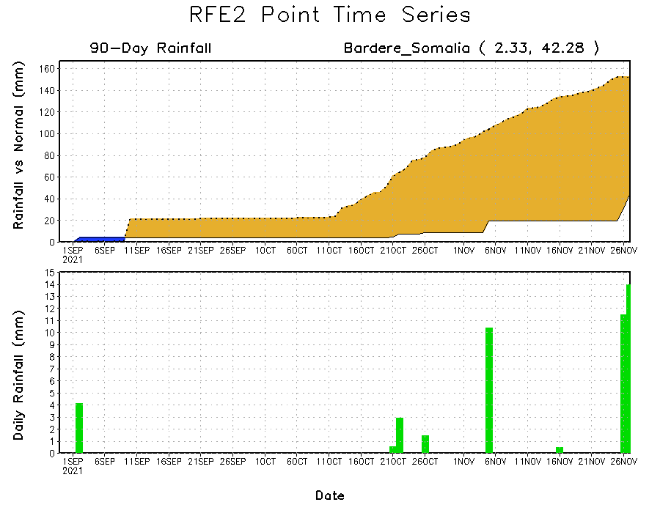
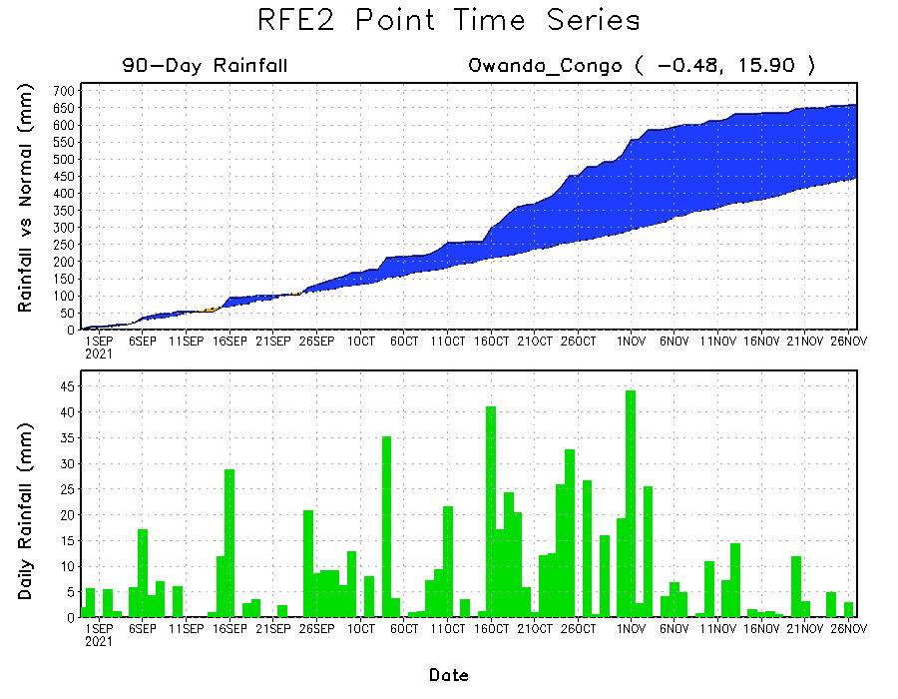
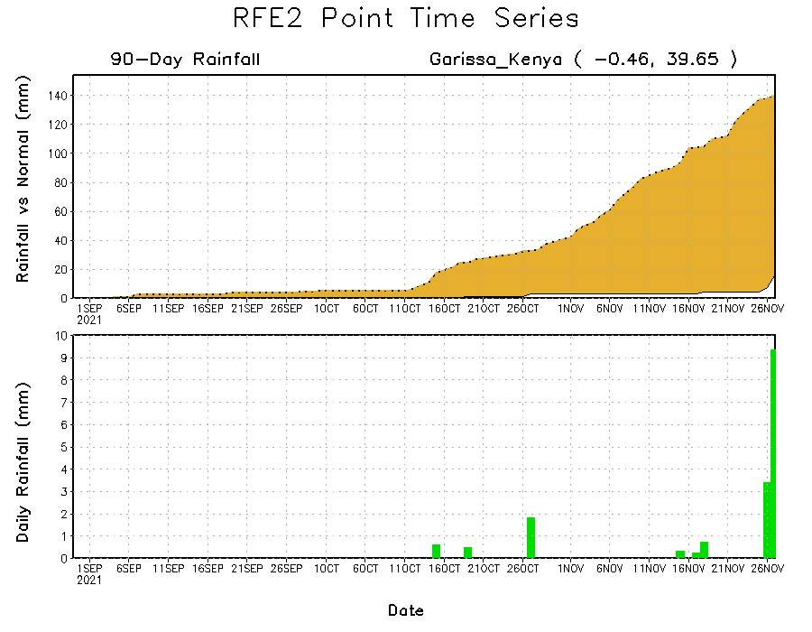
Rainfall Evolution
Daily evolution of rainfall over the last 90 days at selected locations shows moderate sustained moisture surpluses over parts of Congo (bottom left). In contrast, seasonal total rainfall remained below-average over many parts of Somalia (top right) and Kenya (bottom right).

Slide 9
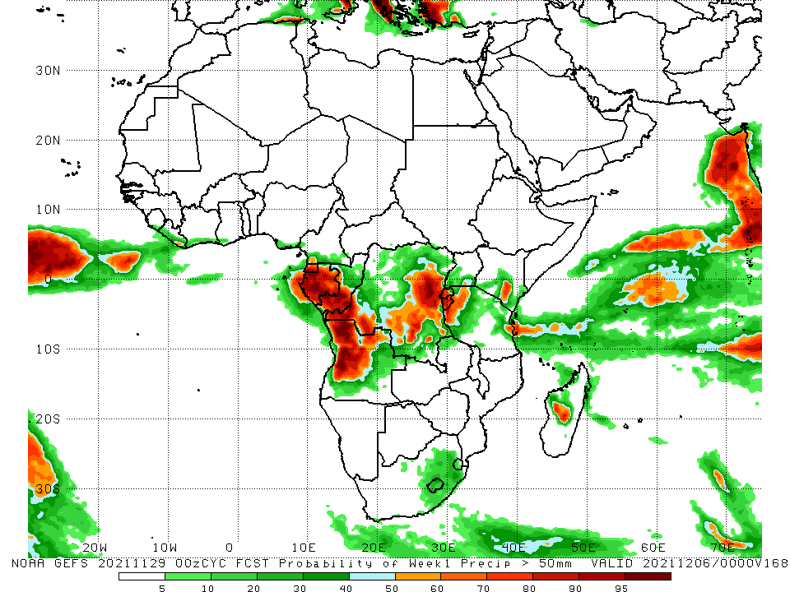
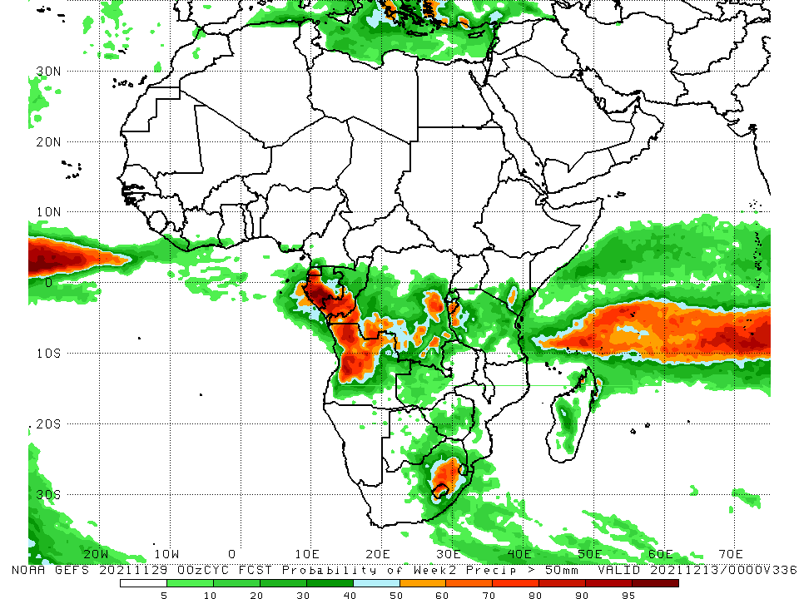
NCEP GEFS Model Forecasts Non-Bias Corrected Probability of precipitation exceedance
Week-1, Valid: 30 Nov – 06 Dec, 2021
Week-2, Valid: 07 – 13 December, 2021
For week-1 (left panel), week-2 (right panel), the NCEP GEFS indicates a moderate to high chance (over 70%) for rainfall to exceed 50 mm over Equatorial Guinea, Gabon, southern Congo, northern Angola, southern and eastern DRC, and pockets of Kenya, Tanzania and South Africa.
Notes:
9

Slide 10
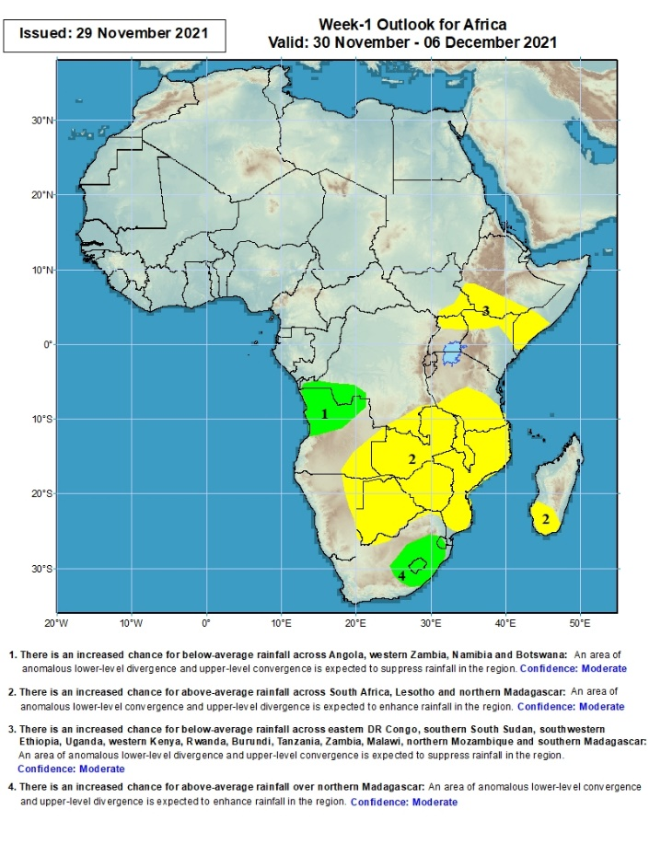
Week-1 Precipitation Outlooks
30 Nov – 06 Dec, 2021
There is an increased chance for above-average rainfall across northern Angola and western DR Congo: An area of anomalous lower-level convergence and upper-level divergence is expected to enhance rainfall in the region. Confidence: Moderate
There is an increased chance for below-average rainfall across the far southern DR Congo, Tanzania, eastern Angola, Zambia, Malawi, Mozambique, Namibia, Botswana, Zimbabwe and southern Madagascar: An area of anomalous lower-level divergence and upper-level convergence is expected to suppress rainfall in the region. Confidence: Moderate
There is an increased chance for below-average rainfall across southeastern South Sudan, southern Ethiopia, northern Uganda, Kenya and Somalia: An area of anomalous lower-level divergence and upper-level convergence is expected to suppress rainfall in the region. Confidence: Moderate
There is an increased chance for above-average rainfall across South Africa, Lesotho and Eswatini: An area of anomalous lower-level convergence and upper-level divergence is expected to enhance rainfall in the region. Confidence: Moderate
Notes:
10

Slide 11
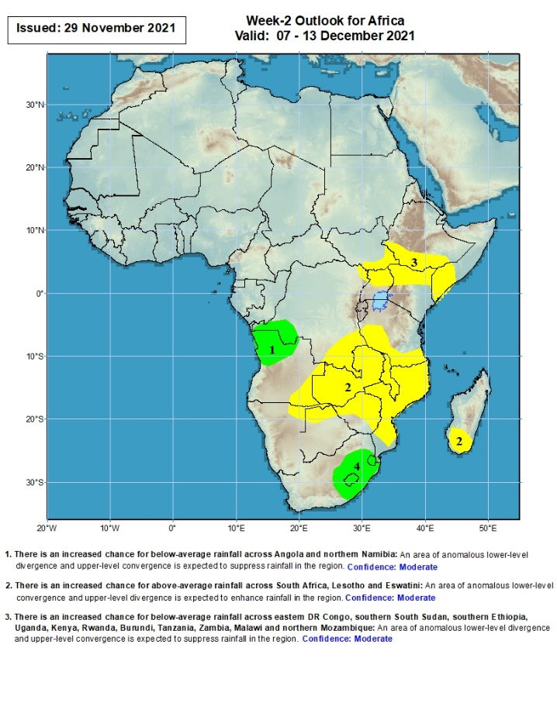
Week-2 Precipitation Outlooks
07 – 13 Dec, 2021
There is an increased chance for above-average rainfall across northern Angola and western DR Congo: An area of anomalous lower-level convergence and upper-level divergence is expected to enhance rainfall in the region. Confidence: Moderate
There is an increased chance for below-average rainfall across southern DR Congo Tanzania, eastern Angola, Zambia, Malawi, Mozambique, northeastern Namibia, northern Botswana, Zimbabwe and southern Madagascar: An area of anomalous lower-level divergence and upper-level convergence is expected to suppress rainfall in the region. Confidence: Moderate
There is an increased chance for below-average rainfall across southeastern South Sudan, southern Ethiopia, northern Uganda, Kenya and Somalia: An area of anomalous lower-level divergence and upper-level convergence is expected to suppress rainfall in the region. Confidence: Moderate
There is an increased chance for above-average rainfall across South Africa, Lesotho and Eswatini: An area of anomalous lower-level convergence and upper-level divergence is expected to enhance rainfall in the region. Confidence: Moderate
Notes:
11

Slide 12
Summary
During the past 30 days, in East Africa, above-average rainfall was observed over pockets of South Sudan, Uganda and Tanzania. Rainfall was below-average over southern Ethiopia, much of Somalia, Kenya, Uganda and much of Tanzania. In Central Africa, rainfall was below-average over portions of southern and eastern DRC, southern Congo, Equatorial Guinea, and Gabon. Rainfall was above-average over portions of Cameroon, much of CAR, central and northern Congo, western and northern DRC. In West Africa, rainfall was above-average over much of the Gulf of Guinea region. Below-average rainfall was observed over pockets of eastern Cote d’Ivoire. In Southern Africa, above-average rainfall was observed over portions of northwestern Angola, pockets of Zambia, many parts of South Africa, pockets of Mozambique, and northern Madagascar. Below-average rainfall was observed over southern and eastern Angola, portions of Zambia, Botswana, Zimbabwe, pockets of South Africa, parts of Mozambique and Malawi, and central and southern Madagascar.
During the past 7 days, in East Africa, rainfall was below-average over pockets of Tanzania. Above-average rainfall was observed over Uganda, western Tanzania, and pockets of Kenya Somalia. In Central Africa, rainfall was above-average over parts of southern Gabon, southern Congo, and portions of DRC. Rainfall was below-average over southern Cameroon, Equatorial Guinea, Gabon, central and northern Congo, and portions of DRC. In Southern Africa, rainfall was above-average over northern Angola, eastern Zambia, southern Botswana, pockets of Mozambique, northern Madagascar and many parts of South Africa. Below-average rainfall was observed over central and southern Angola, Namibia, Botswana, Zimbabwe, and parts of southern Madagascar. In West Africa, above-average rainfall was observed along coastal Nigeria.
Week-1 and week-2 outlooks call for an increased chance for below-average rainfall over much of equatorial East Africa and the neighboring areas of Southern Africa. There is also an increased chance for below-average rainfall over parts of southern Angola and southern Madagascar. In contrast, the outlooks call for an increased chance for above-average rainfall over northern Angola and eastern South Africa.

