Slide 1
The African Monsoon Recent Evolution and Current Status Include Week-1 and Week-2 Outlooks
Update prepared by
20 December 2021
For more information, visit:
http://www.cpc.ncep.noaa.gov/products/Global_Monsoons/African_Monsoons/precip_monitoring.shtml

Slide 2
Outline
Highlights
Recent Evolution and Current Conditions
NCEP GEFS Forecasts
Summary

Slide 3
Highlights: Last 7 Days
During the past 7 days, in East Africa, rainfall was below-average over parts of central Tanzania. Above-average rainfall was observed over pockets of southern Ethiopia eastern Kenya, and along coastal Tanzania. In Central Africa, rainfall was above-average over portions of DRC. Rainfall was below-average over western Gabon, parts of Congo and pockets of DRC. In Southern Africa, rainfall was above-average over Botswana, South Africa and southern Mozambique. Below-average rainfall was observed over parts of Angola, much of Zambia, Malawi, northern Mozambique and Madagascar.
Week-1 and week-2 outlooks call for an increased chance for below-average rainfall over portions of Angola, Namibia, Zambia, Tanzania, Malawi and Mozambique. In contrast, the outlooks call for an increased chance for above-average rainfall over southeastern Kenya, southern Zimbabwe, and eastern South Africa.

Slide 4
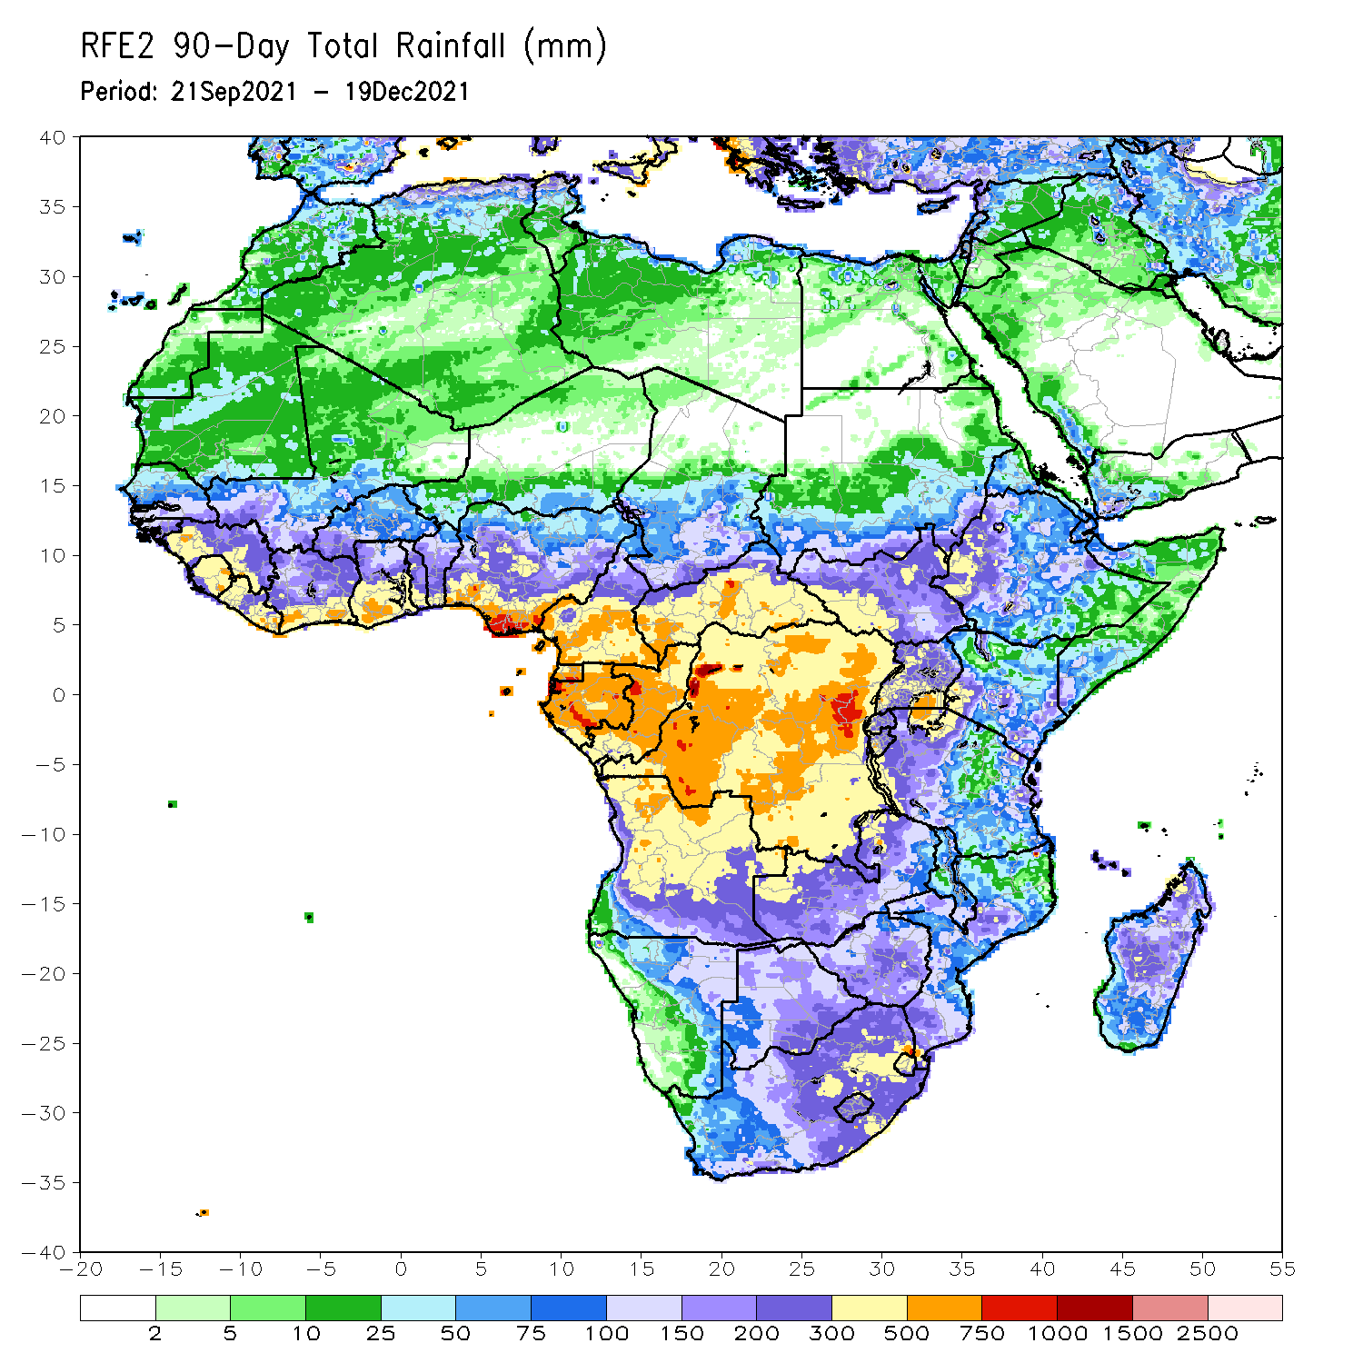
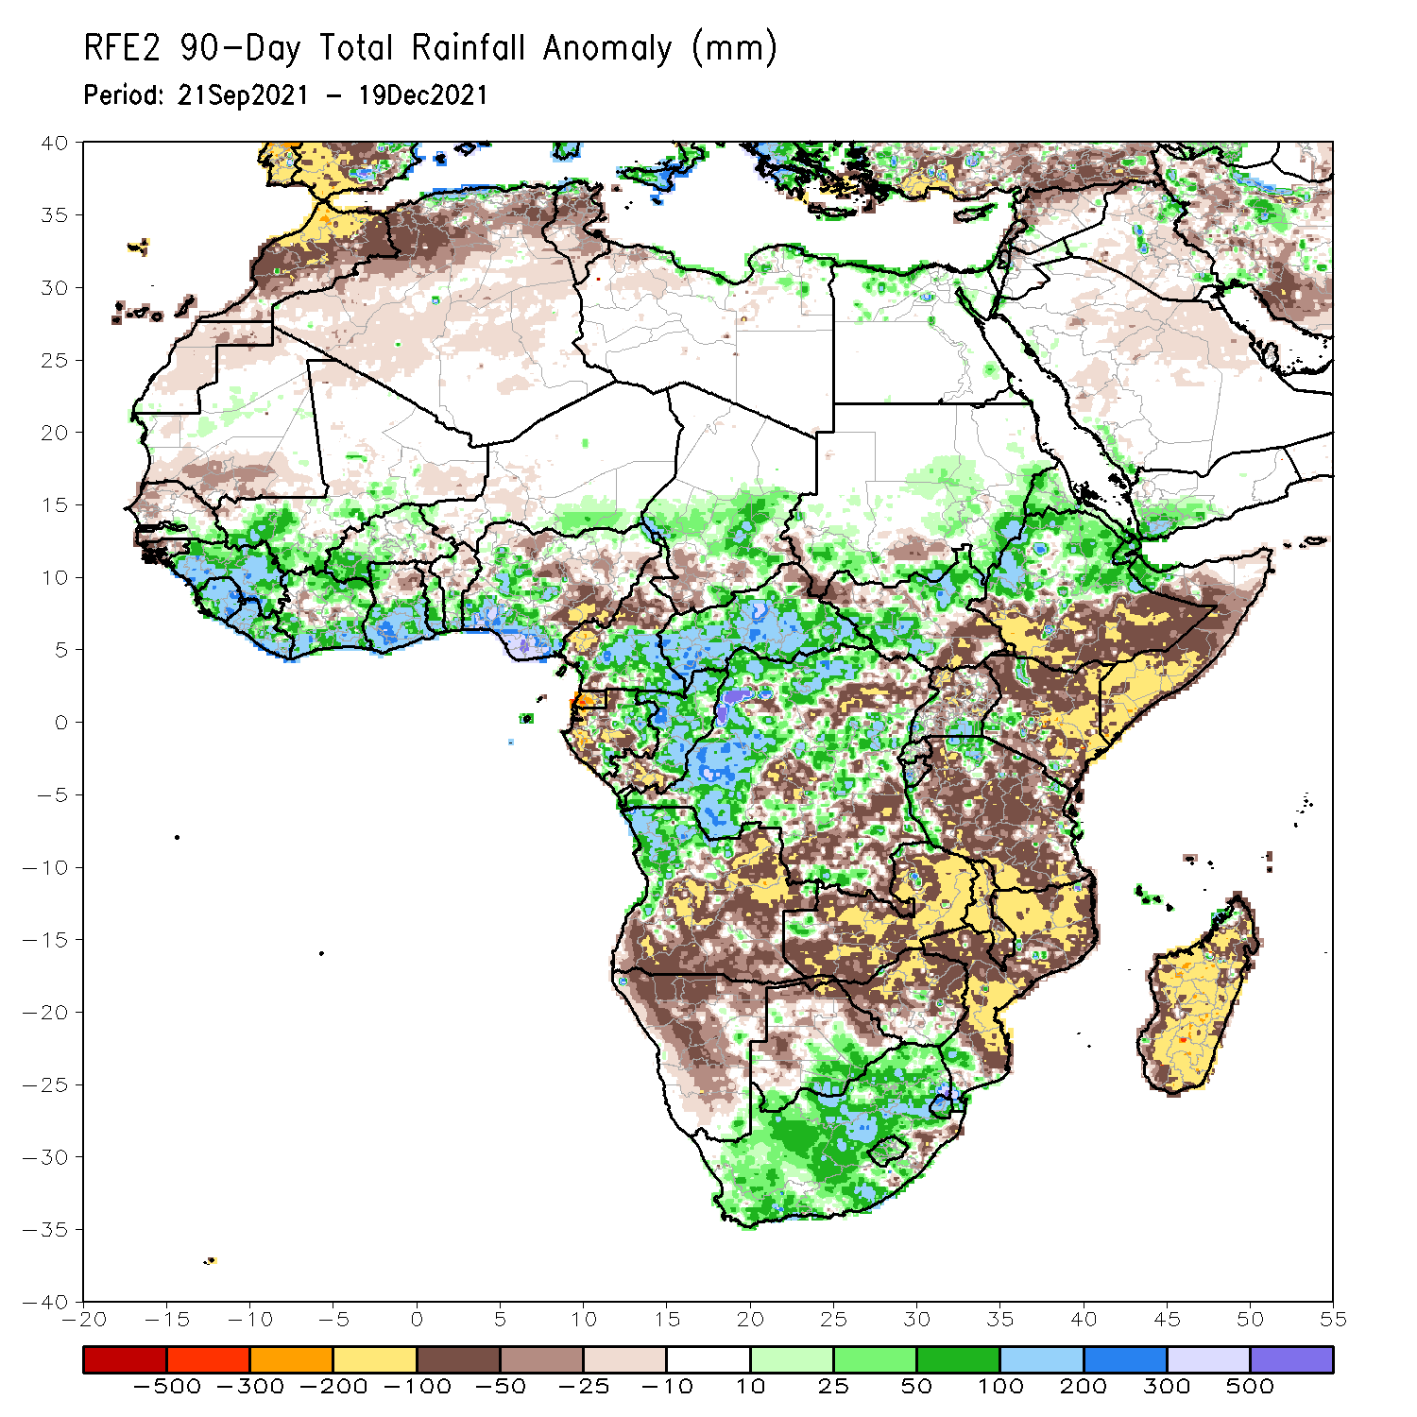
Rainfall Patterns: Last 90 Days
Over the past 90 days, in East Africa, above-average rainfall was observed over central and northern Ethiopia, Eritrea, much of South Sudan, and parts of southern and eastern Sudan. Rainfall was below-average over southern Ethiopia, much of Somalia and Kenya, and many parts of Uganda and Tanzania. In southern Africa, above-average rainfall was observed over northern Angola, pockets of Zambia, and much of South Africa. Below-average rainfall was observed over central and southern Angola, Zambia, much of Namibia, Botswana, Zimbabwe, Mozambique and much of Madagascar. In Central Africa, rainfall was above-average over western and northern DRC, eastern Gabon, central and northern Congo, much of CAR, and southeastern Chad. Rainfall was below-average over portions of central and eastern DRC, Equatorial Guinea, western Gabon, northern Cameroon and southwestern Chad. In West Africa, rainfall was above-average over much of the Gulf of Guinea region. Below-average rainfall was observed over pockets of northeastern Ghana, parts of Togo and Benin, and northern and eastern Nigeria.
Notes:
4

Slide 5
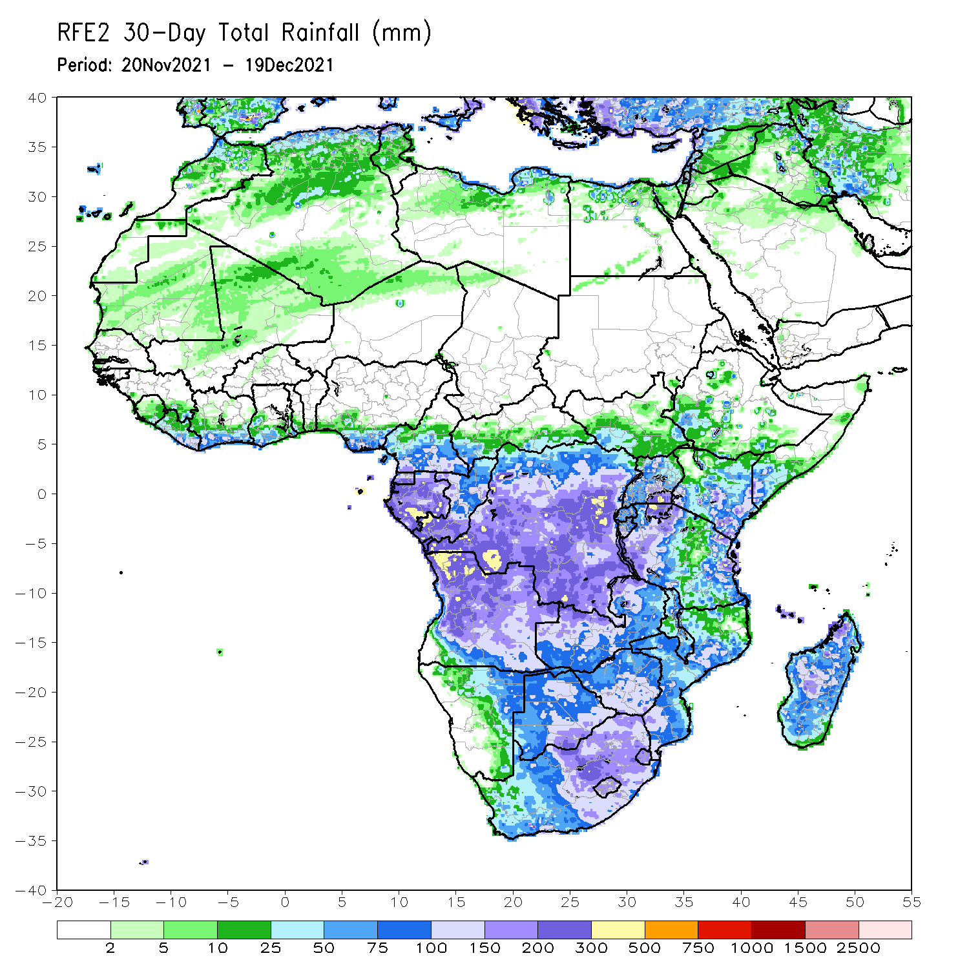
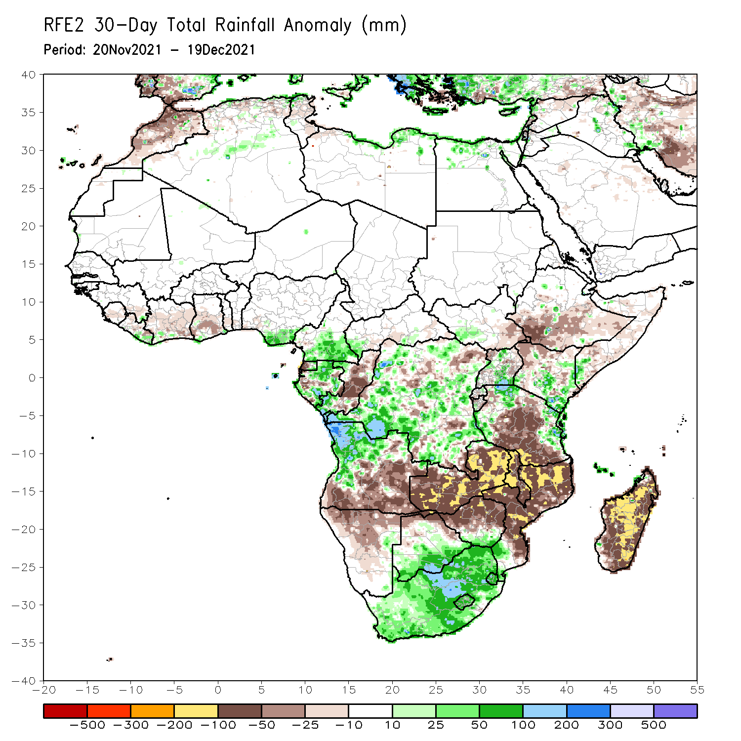
Rainfall Patterns: Last 30 Days
During the past 30 days, in East Africa, above-average rainfall was observed over pockets of Uganda and southern Kenya, and parts of western and eastern Tanzania. Rainfall was below-average over southern Ethiopia, parts of Somalia and northern Kenya, and many parts of Tanzania. In Central Africa, rainfall was below-average pockets of DRC and northern Congo. Rainfall was above-average over southern Cameroon, Equatorial Guinea and Gabon.. In Southern Africa, above-average rainfall was observed over portions of northwestern Angola and much of South Africa. Below-average rainfall was observed over southern and eastern Angola, Zambia, Botswana, Zimbabwe, many parts of Mozambique, Malawi, and much of Madagascar.
Notes:
5

Slide 6
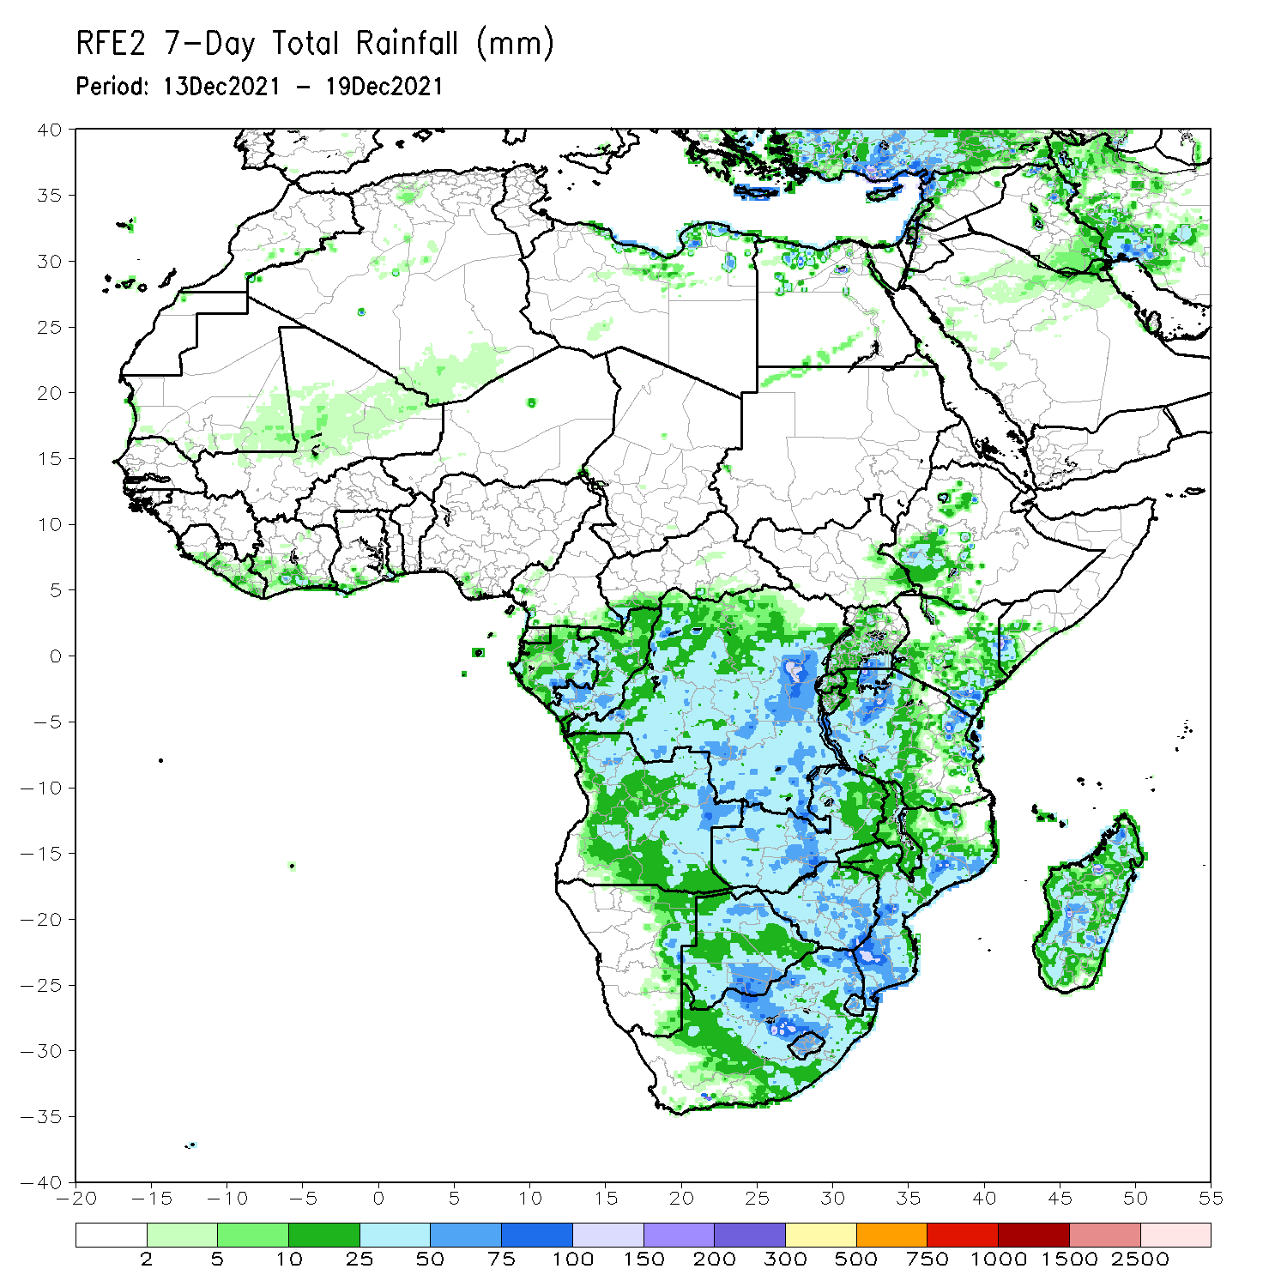
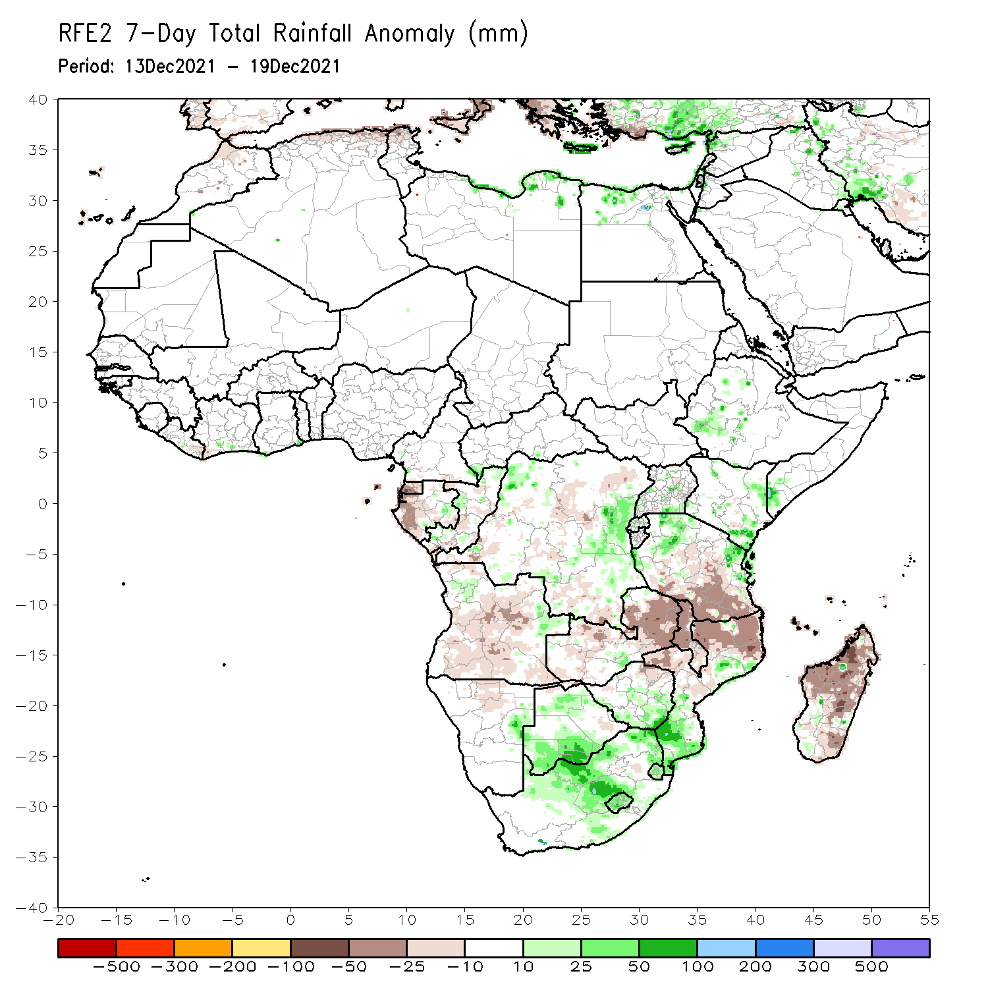
Rainfall Patterns: Last 7 Days
During the past 7 days, in East Africa, rainfall was below-average over parts of central Tanzania. Above-average rainfall was observed over pockets of southern Ethiopia eastern Kenya, and along coastal Tanzania. In Central Africa, rainfall was above-average over portions of DRC. Rainfall was below-average over western Gabon, parts of Congo and pockets of DRC. In Southern Africa, rainfall was above-average over Botswana, South Africa and southern Mozambique. Below-average rainfall was observed over parts of Angola, much of Zambia, Malawi, northern Mozambique and Madagascar.

Slide 7
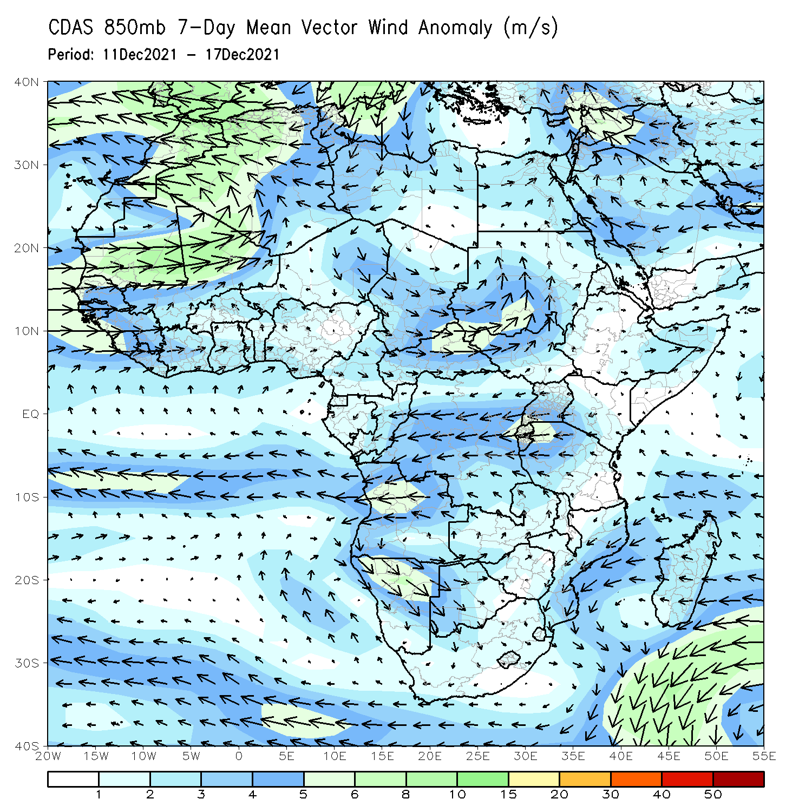
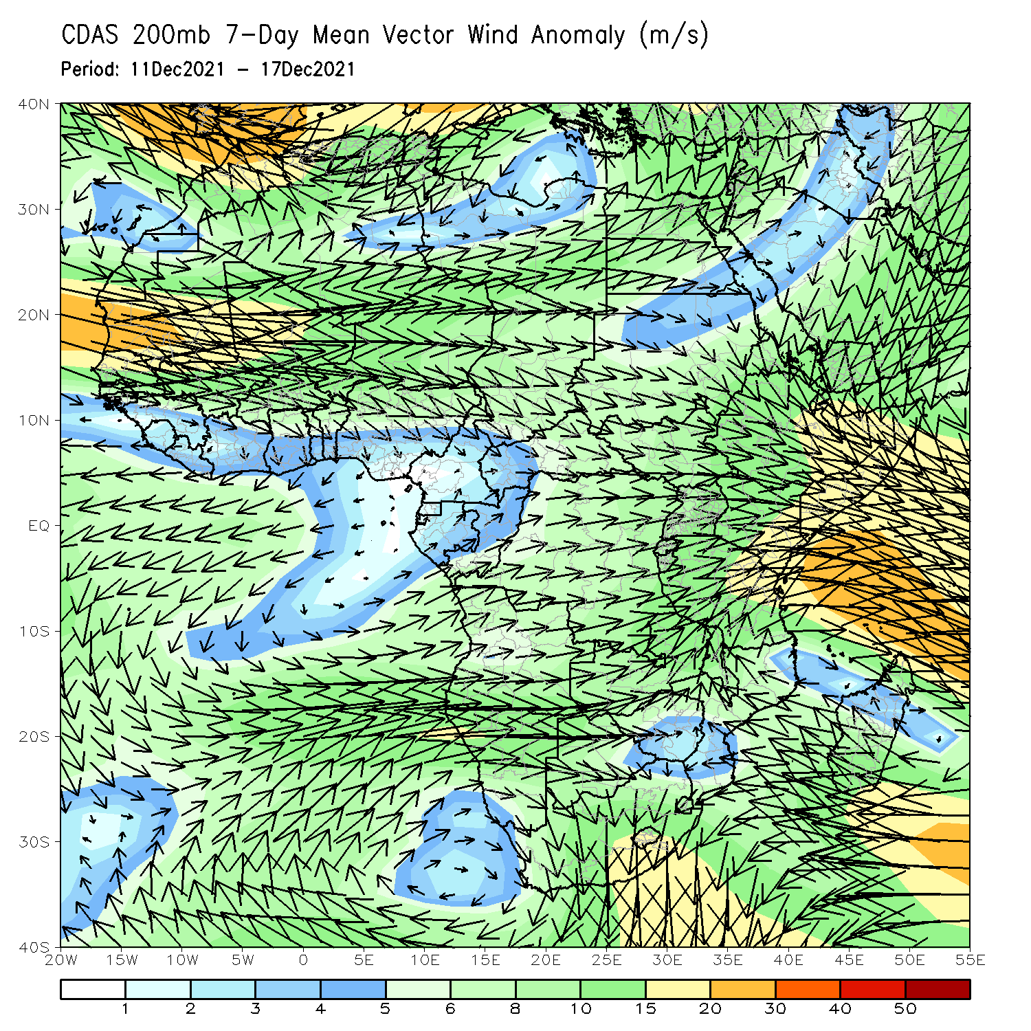
Atmospheric Circulation: Last 7 Days
At 850-hPa level (left panel), anomalous anticyclonic flow prevailed across portions of Southern Africa.

Slide 8
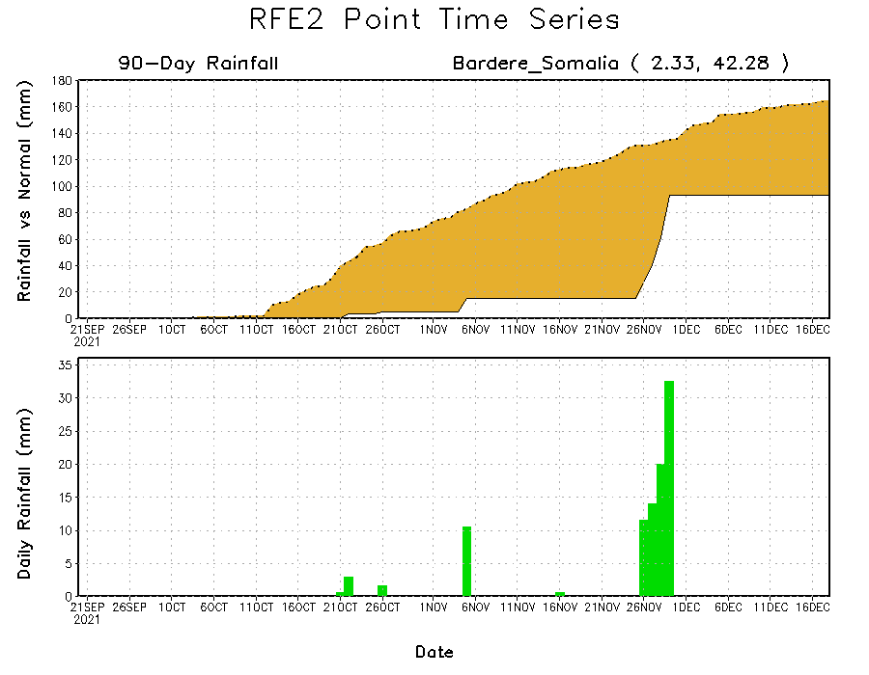
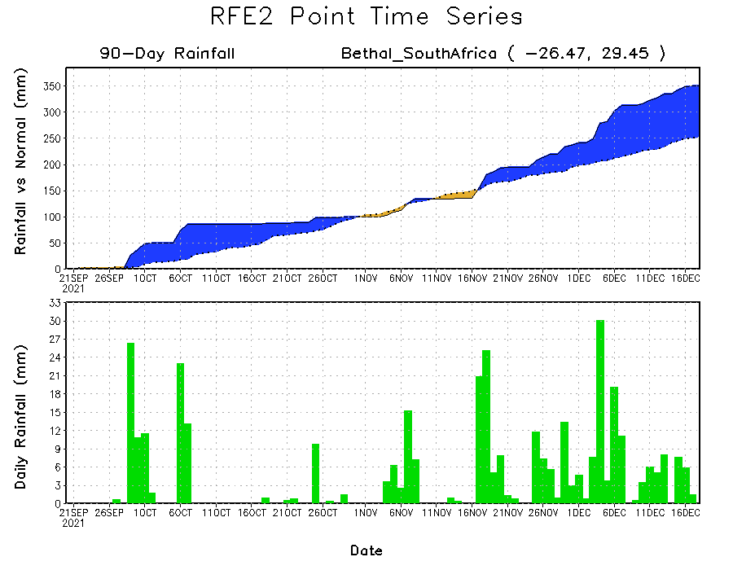
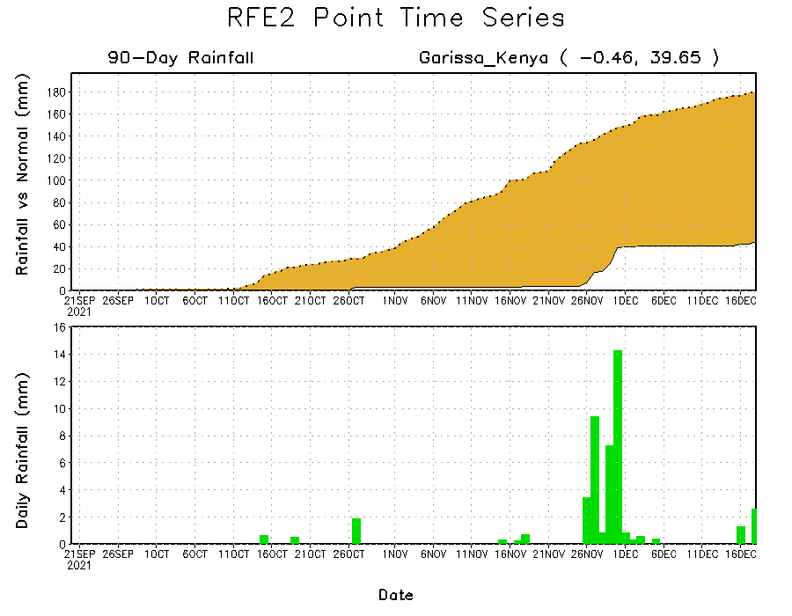
Rainfall Evolution
Daily evolution of rainfall over the last 90 days at selected locations shows moderate sustained moisture surpluses over parts of eastern South Africa (bottom left). The seasonal total rainfall remained below-average over many parts of Somalia (top right) and Kenya (bottom right).

Slide 9
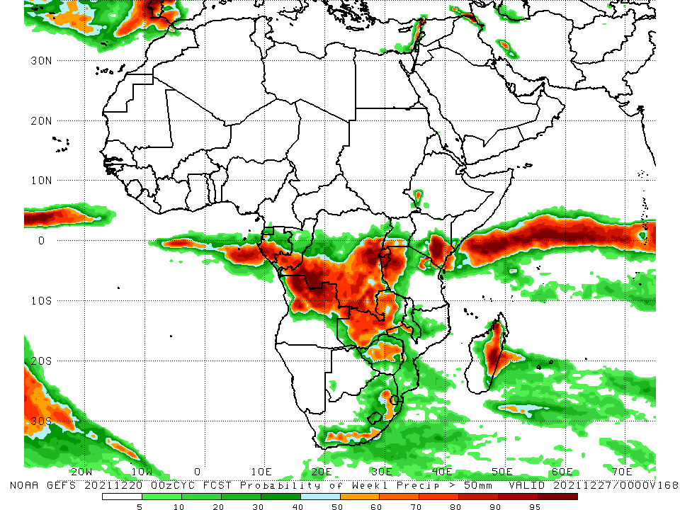
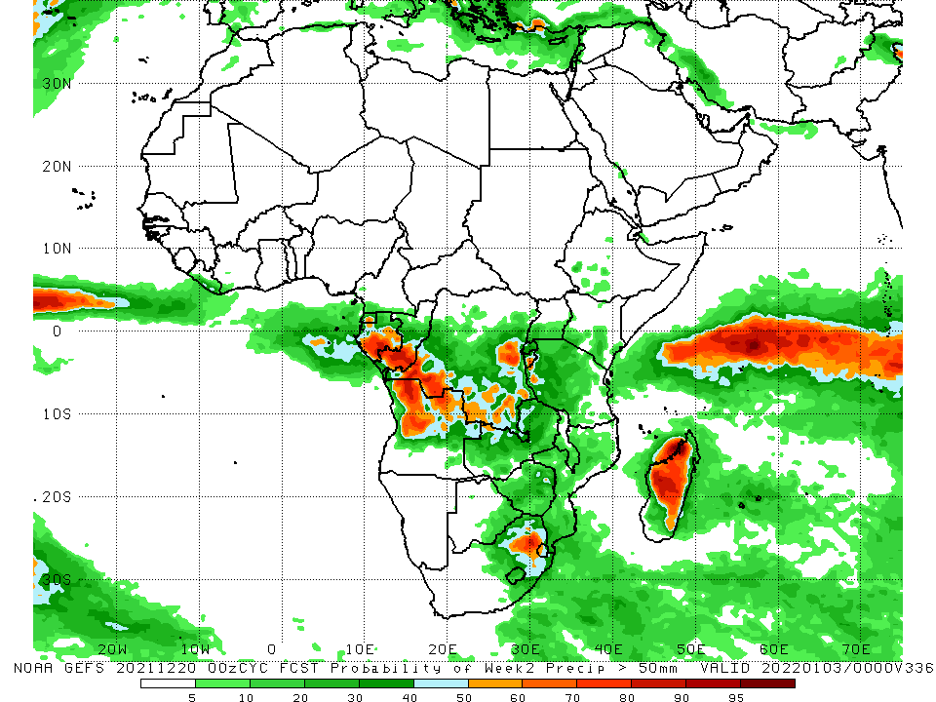
NCEP GEFS Model Forecasts Non-Bias Corrected Probability of precipitation exceedance
Week-1, Valid: 21 – 27 December, 2021
Week-2, Valid: 28 Dec 2021 – 03 Jan, 2022
For week-1 (left panel), week-2 (right panel), the NCEP GEFS indicates a moderate to high chance (over 70%) for rainfall to exceed 50 mm over parts of Gabon, southern Congo, northern Angola, parts of southern and eastern DRC, eastern South Africa and Madagascar.
Notes:
9

Slide 10
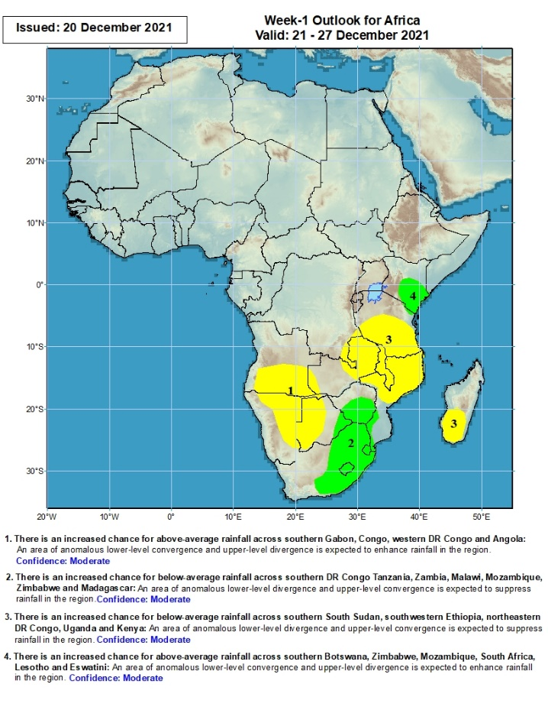
Week-1 Precipitation Outlooks
21 – 27 December, 2021
There is an increased chance for below-average rainfall across southern Angola, eastern Zambia, Namibia and western Botswana: An area of anomalous lower-level divergence and upper-level convergence is expected to suppress rainfall in the region. Confidence: Moderate
There is an increased chance for above-average rainfall across eastern Botswana, southern Zimbabwe, parts of western Mozambique, eastern South Africa, Lesotho and Eswatini: An area of anomalous lower-level convergence and upper-level divergence is expected to enhance rainfall in the region. Confidence: Moderate
There is an increased chance for below-average rainfall across parts of southern DR Congo, southern Tanzania, eastern Zambia, Malawi, northern Mozambique and southern Madagascar: An area of anomalous lower-level divergence and upper-level convergence is expected to suppress rainfall in the region. Confidence: Moderate
There is an increased chance for above-average rainfall over southeastern Kenya: An area of anomalous lower-level convergence and upper-level divergence is expected to enhance rainfall in the region. Confidence: Moderate
Notes:
10

Slide 11
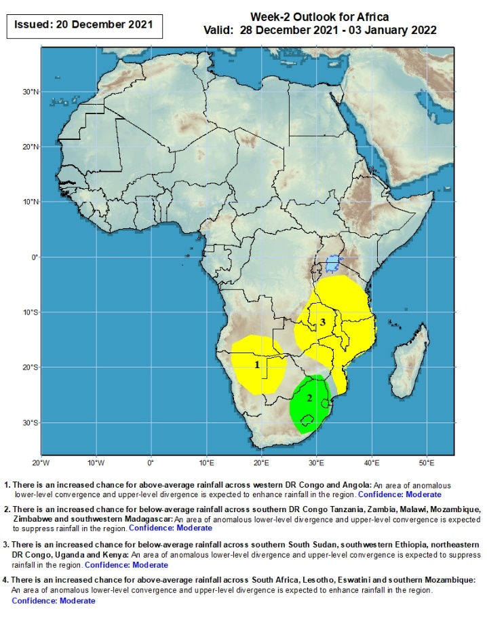
Week-2 Precipitation Outlooks
28 Dec 2021 – 03 Jan, 2022
There is an increased chance for below-average rainfall across southern Angola and Namibia and western Botswana: An area of anomalous lower-level divergence and upper-level convergence is expected to suppress rainfall in the region. Confidence: Moderate
There is an increased chance for above-average rainfall across eastern southern South Africa, Lesotho and Eswatini: An area of anomalous lower-level convergence and upper-level divergence is expected to enhance rainfall in the region. Confidence: Moderate
There is an increased chance for below-average rainfall across southeastern DR Congo, Tanzania, Zambia, Malawi, Mozambique and northern Zimbabwe: An area of anomalous lower-level divergence and upper-level convergence is expected to suppress rainfall in the region. Confidence: Moderate
Notes:
11

Slide 12
Summary
During the past 30 days, in East Africa, above-average rainfall was observed over pockets of Uganda and southern Kenya, and parts of western and eastern Tanzania. Rainfall was below-average over southern Ethiopia, parts of Somalia and northern Kenya, and many parts of Tanzania. In Central Africa, rainfall was below-average pockets of DRC and northern Congo. Rainfall was above-average over southern Cameroon, Equatorial Guinea and Gabon.. In Southern Africa, above-average rainfall was observed over portions of northwestern Angola and much of South Africa. Below-average rainfall was observed over southern and eastern Angola, Zambia, Botswana, Zimbabwe, many parts of Mozambique, Malawi, and much of Madagascar.
During the past 7 days, in East Africa, rainfall was below-average over parts of central Tanzania. Above-average rainfall was observed over pockets of southern Ethiopia eastern Kenya, and along coastal Tanzania. In Central Africa, rainfall was above-average over portions of DRC. Rainfall was below-average over western Gabon, parts of Congo and pockets of DRC. In Southern Africa, rainfall was above-average over Botswana, South Africa and southern Mozambique. Below-average rainfall was observed over parts of Angola, much of Zambia, Malawi, northern Mozambique and Madagascar.
Week-1 and week-2 outlooks call for an increased chance for below-average rainfall over portions of Angola, Namibia, Zambia, Tanzania, Malawi and Mozambique. In contrast, the outlooks call for an increased chance for above-average rainfall over southeastern Kenya, southern Zimbabwe and eastern South Africa.

