Slide 1
The African Monsoon Recent Evolution and Current Status Include Week-1 and Week-2 Outlooks
Update prepared by
27 December 2021
For more information, visit:
http://www.cpc.ncep.noaa.gov/products/Global_Monsoons/African_Monsoons/precip_monitoring.shtml

Slide 2
Outline
Highlights
Recent Evolution and Current Conditions
NCEP GEFS Forecasts
Summary

Slide 3
Highlights: Last 7 Days
During the past 7 days, in East Africa, rainfall was below-average over parts of central Tanzania. Above-average rainfall was observed over southern Ethiopia eastern Kenya, parts of southern Somalia, and western Tanzania. In Central Africa, rainfall was above-average over eastern Gabon, Congo and many parts of DRC. Rainfall was below-average over pockets of DRC. In Southern Africa, rainfall was above-average over northern Angola, western Zambia, parts of Botswana, Zimbabwe, portions of South Africa, central Mozambique and eastern Madagascar. Below-average rainfall was observed over central and southern Angola, eastern Zambia, Malawi, northern Mozambique and western Madagascar.
Week-1 and week-2 outlooks call for an increased chance for below-average rainfall over portions of southern Angola, Namibia, parts of Zambia, southern Tanzania, Malawi, Mozambique and southern Madagascar. In contrast, the outlooks call for an increased chance for above-average rainfall over parts of Gabon, Congo, western DRC, the Lake Victoria region, southern Kenya, eastern South Africa, and northern Madagascar.

Slide 4
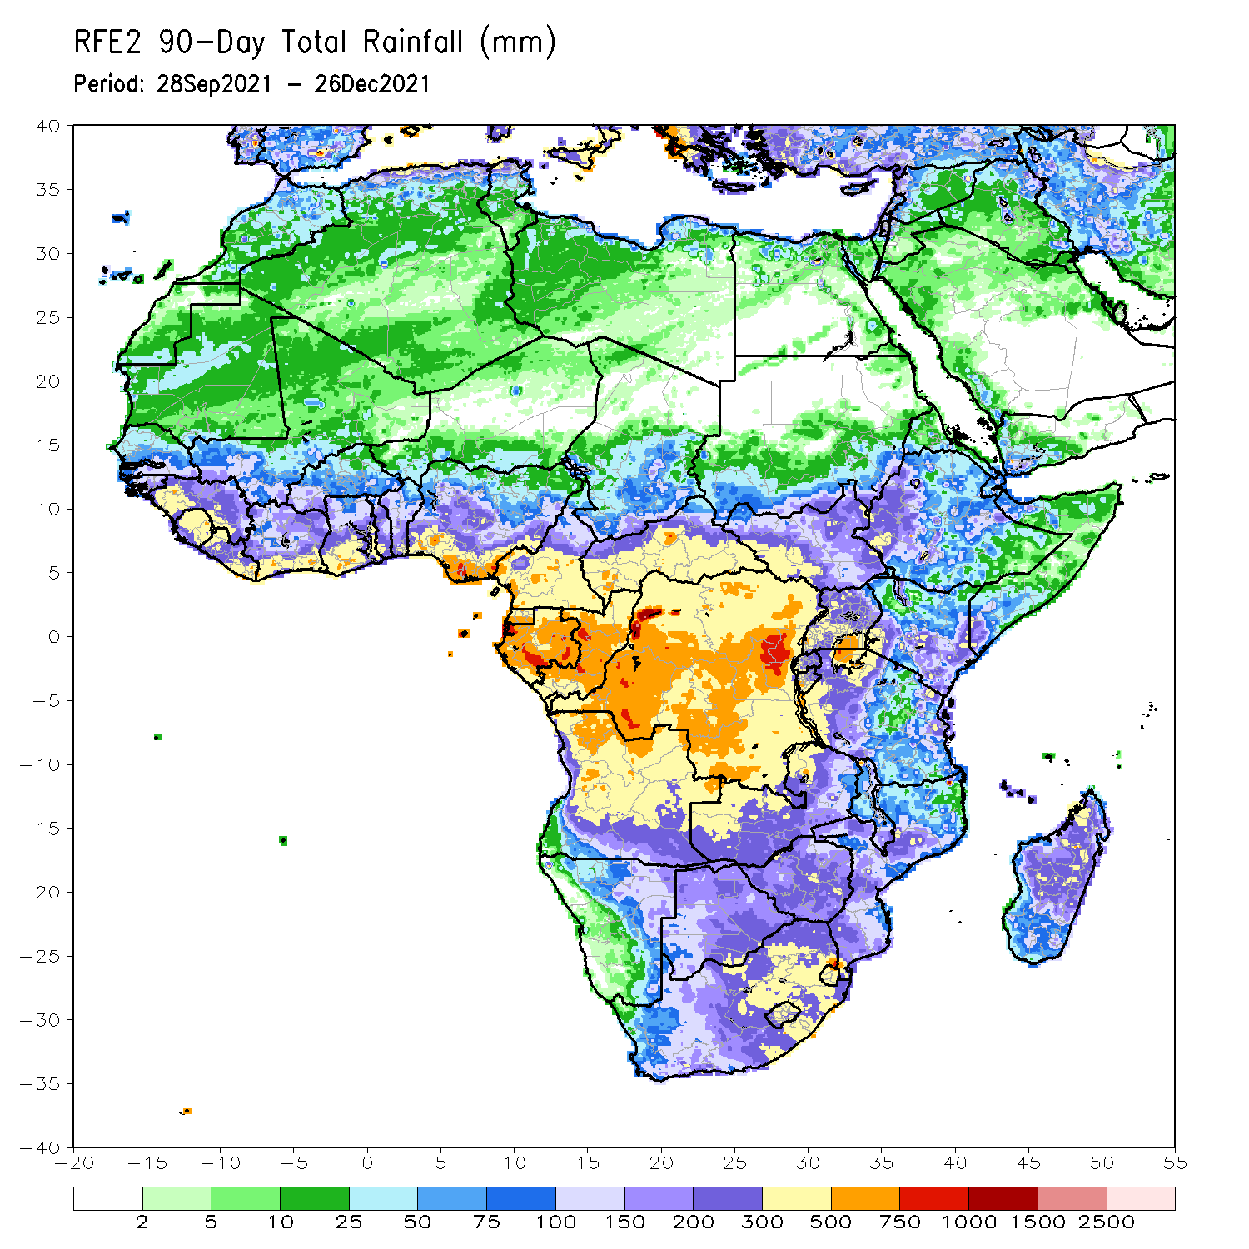
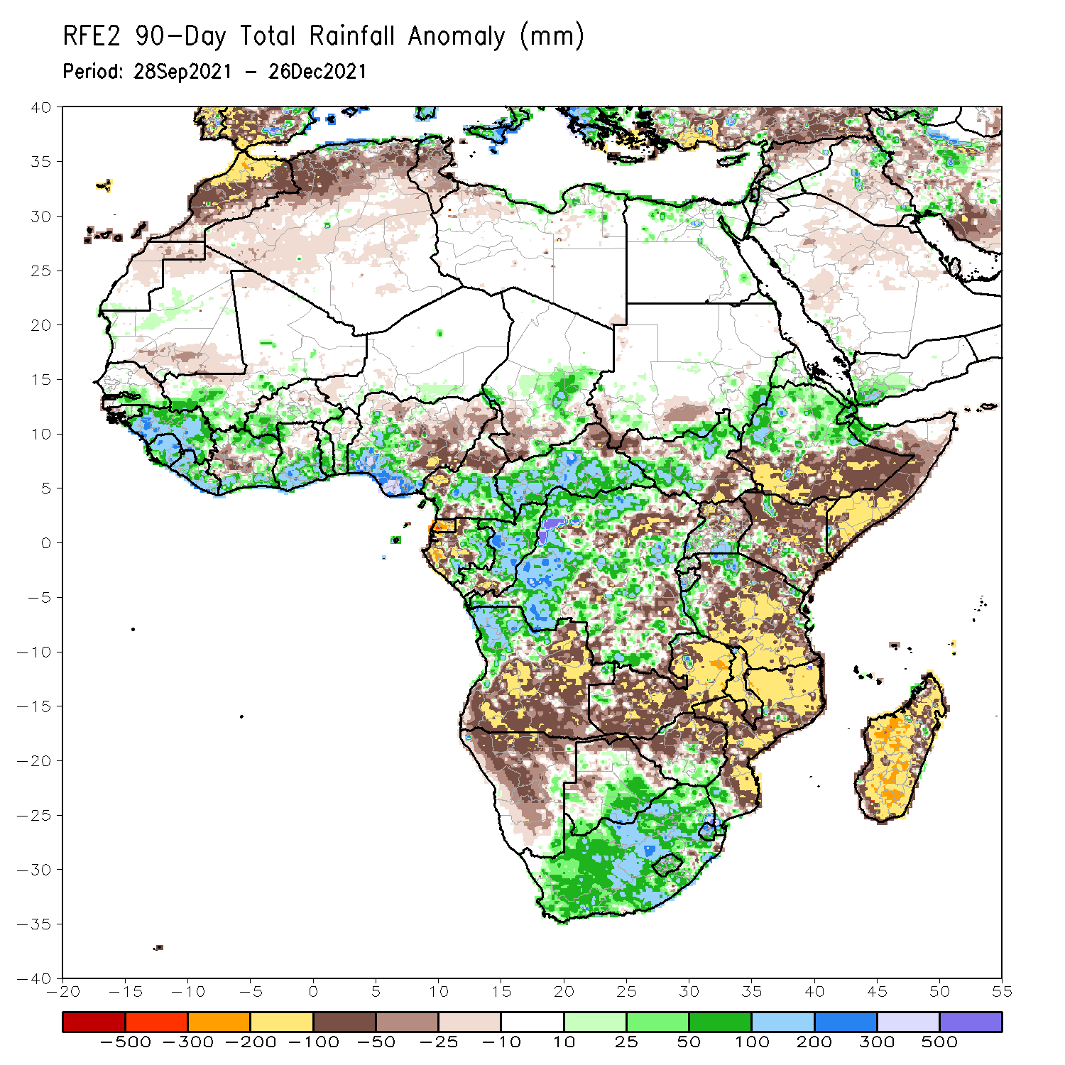
Rainfall Patterns: Last 90 Days
Over the past 90 days, in East Africa, above-average rainfall was observed over central and northern Ethiopia, and near Uganda Tanzania border. Rainfall was below-average over southern Ethiopia, much of Somalia and Kenya, northern Uganda and many parts of Tanzania. In southern Africa, above-average rainfall was observed over northern Angola, southern Botswana, southern Zimbabwe and much of South Africa. Below-average rainfall was observed over central and southern Angola, Zambia, much of Namibia, northern Botswana, northern Zimbabwe, Malawi, Mozambique and much of Madagascar. In Central Africa, rainfall was above-average over many parts of DRC, eastern Gabon, central and northern Congo, much of CAR, and southeastern Chad. Rainfall was below-average over pockets of DRC, Equatorial Guinea, western Gabon, northern Cameroon and southwestern Chad. In West Africa, rainfall was above-average over much of the Gulf of Guinea region. Below-average rainfall was observed over pockets of pockets of Cote d’Ivoire, and northern and eastern Nigeria.
Notes:
4

Slide 5
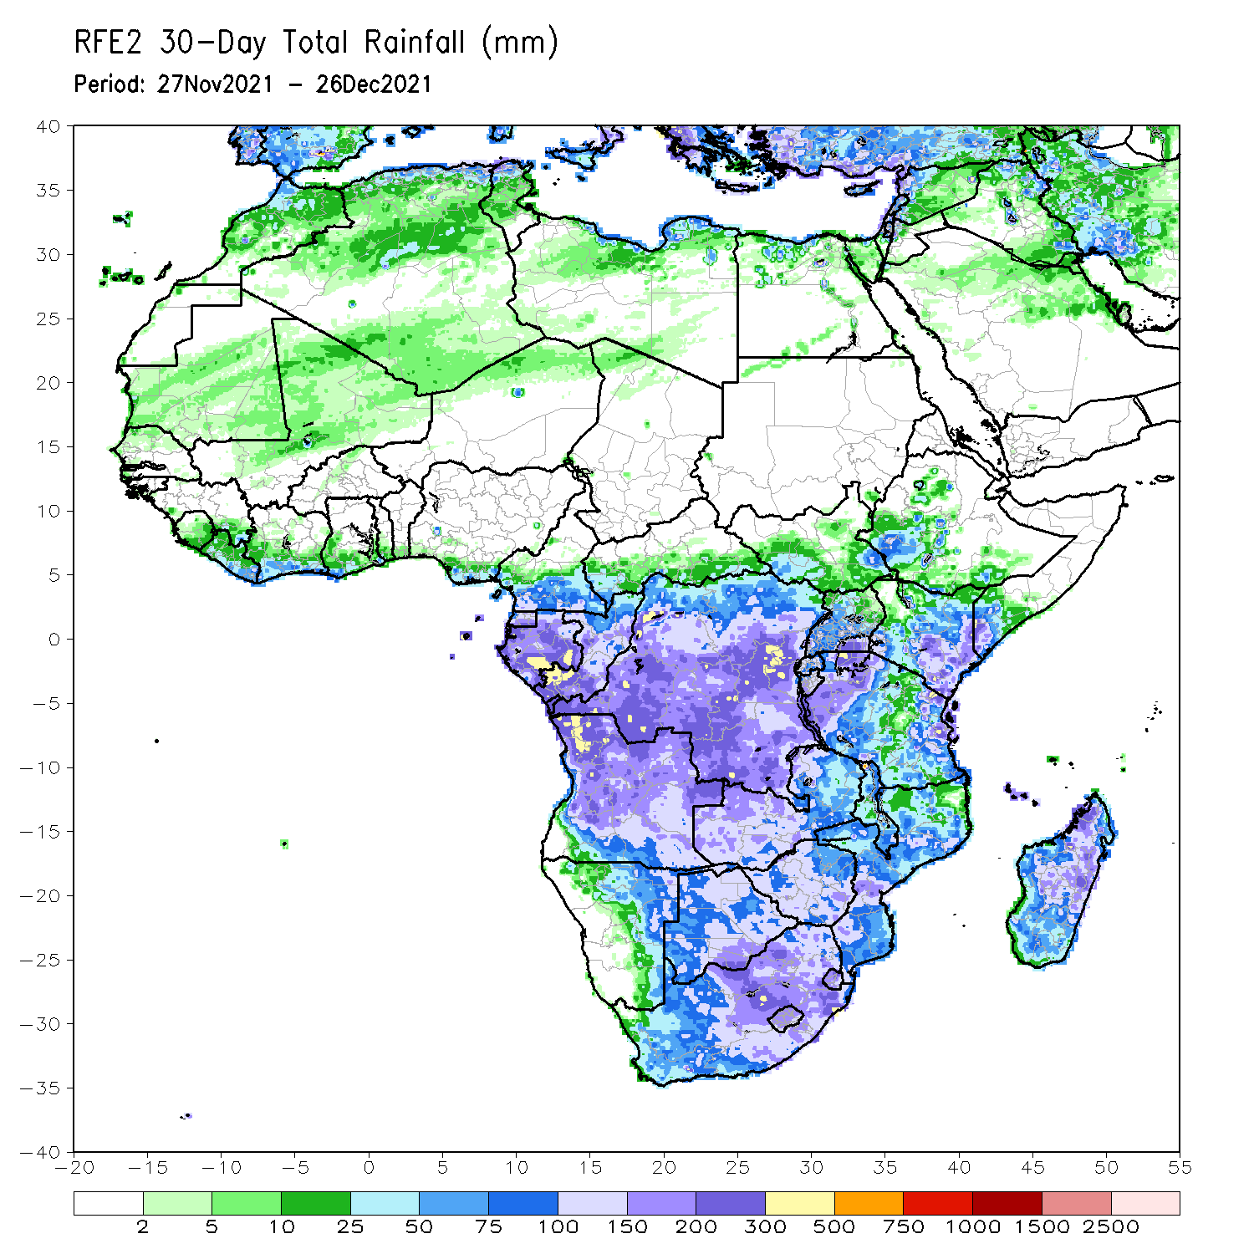
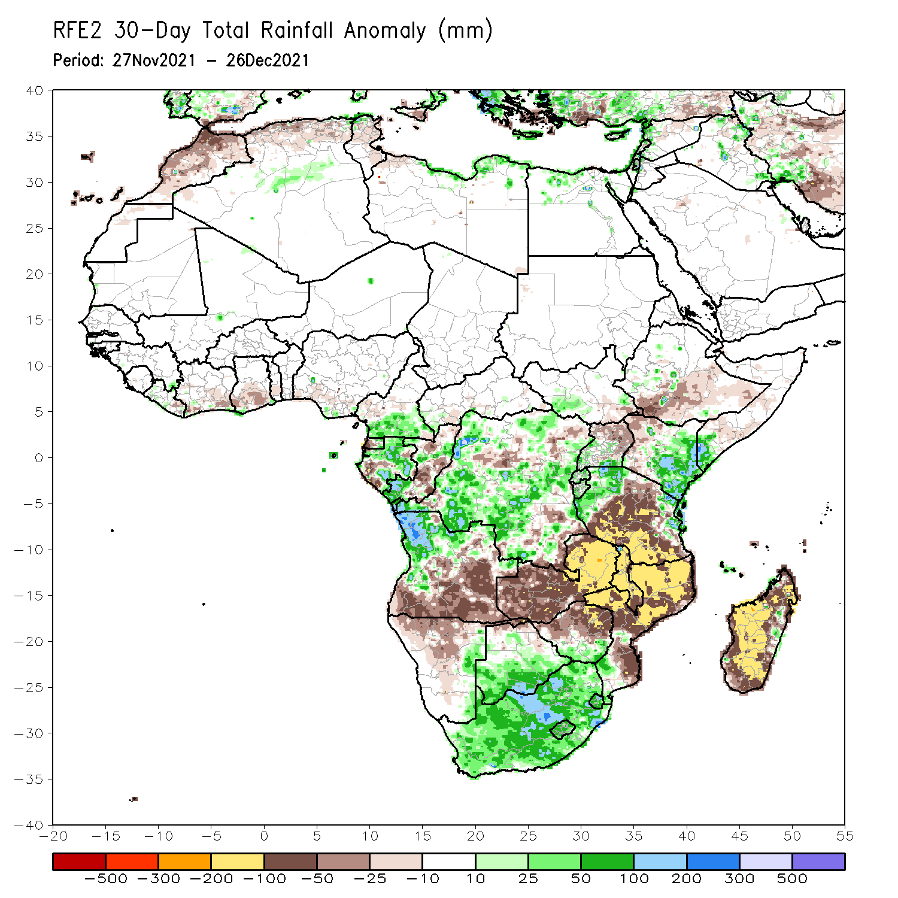
Rainfall Patterns: Last 30 Days
During the past 30 days, in East Africa, above-average rainfall was observed over pockets of Uganda, eastern Kenya and the neighboring areas of southern Somalia, and parts of western and eastern Tanzania. Rainfall was below-average over southern Ethiopia, parts of Somalia and northwestern Kenya, northern Uganda, and central and southern Tanzania. In Central Africa, rainfall was below-average pockets of DRC and Congo. Rainfall was above-average over southern Cameroon, Equatorial Guinea and Gabon and many parts of DRC. In Southern Africa, above-average rainfall was observed over northern Angola, parts of southern Botswana, southern Zimbabwe, and much of South Africa. Below-average rainfall was observed over southern and eastern Angola, Namibia, Zambia, northern Botswana, northern Zimbabwe, many parts of Mozambique, Malawi, and much of Madagascar.
Notes:
5

Slide 6
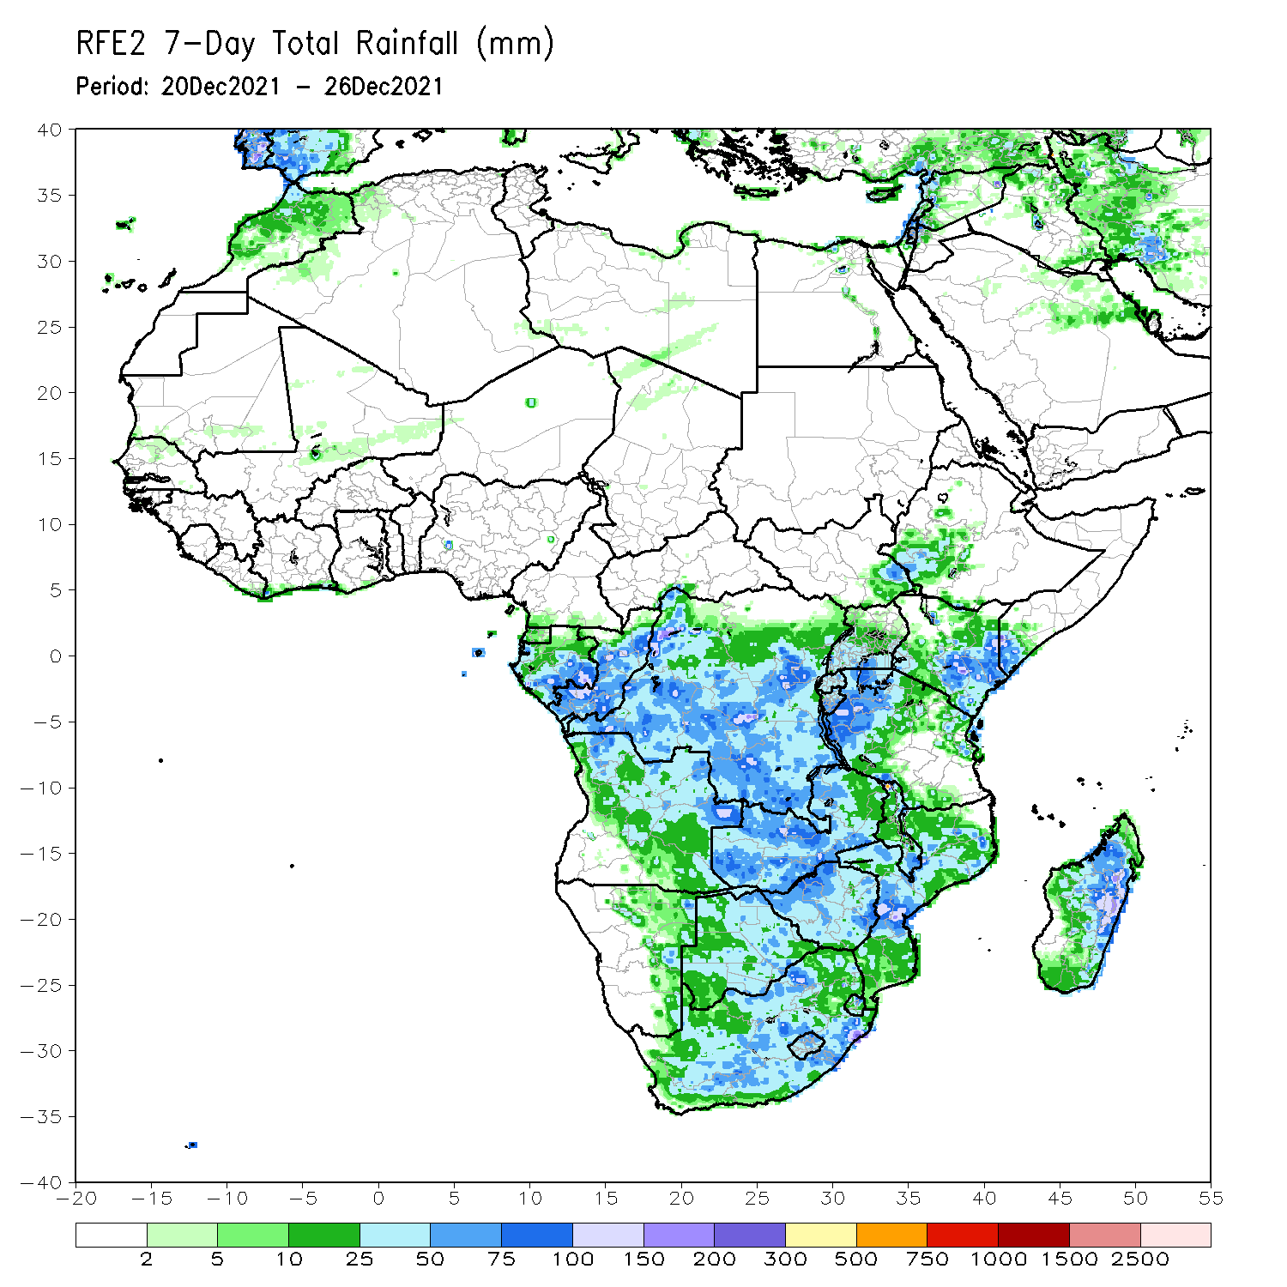
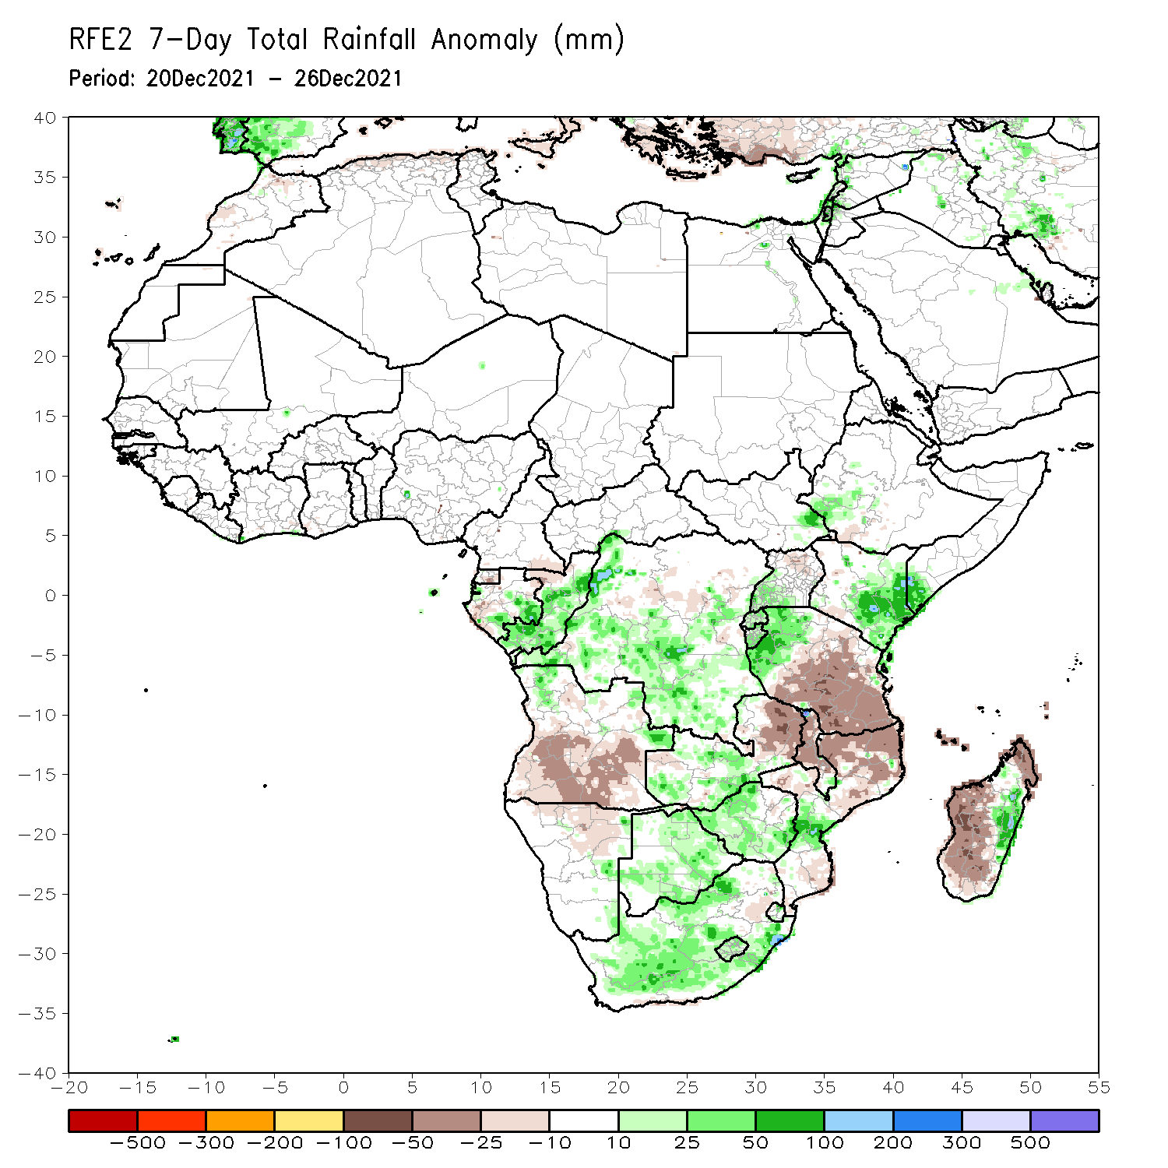
Rainfall Patterns: Last 7 Days
During the past 7 days, in East Africa, rainfall was below-average over parts of central Tanzania. Above-average rainfall was observed over southern Ethiopia eastern Kenya, parts of southern Somalia, and western Tanzania. In Central Africa, rainfall was above-average over eastern Gabon, Congo and many parts of DRC. Rainfall was below-average over pockets of DRC. In Southern Africa, rainfall was above-average over northern Angola, western Zambia, parts of Botswana, Zimbabwe, portions of South Africa, central Mozambique and eastern Madagascar. Below-average rainfall was observed over central and southern Angola, eastern Zambia, Malawi, northern Mozambique and western Madagascar.

Slide 7
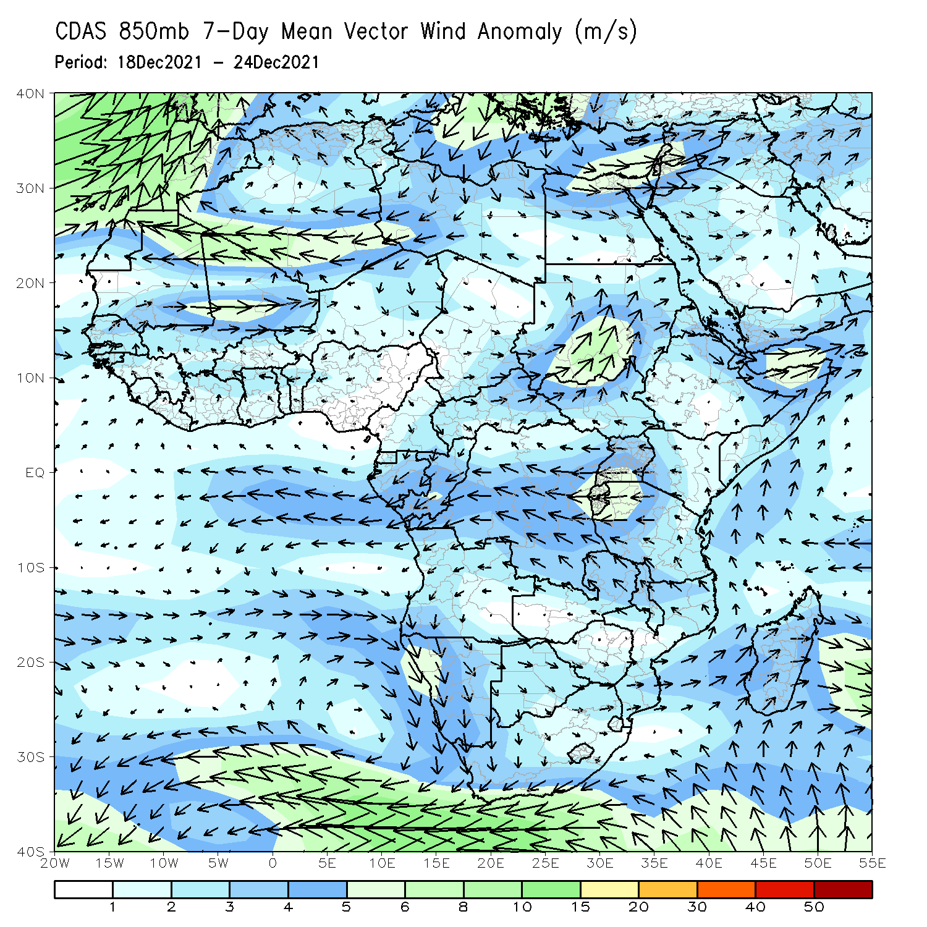
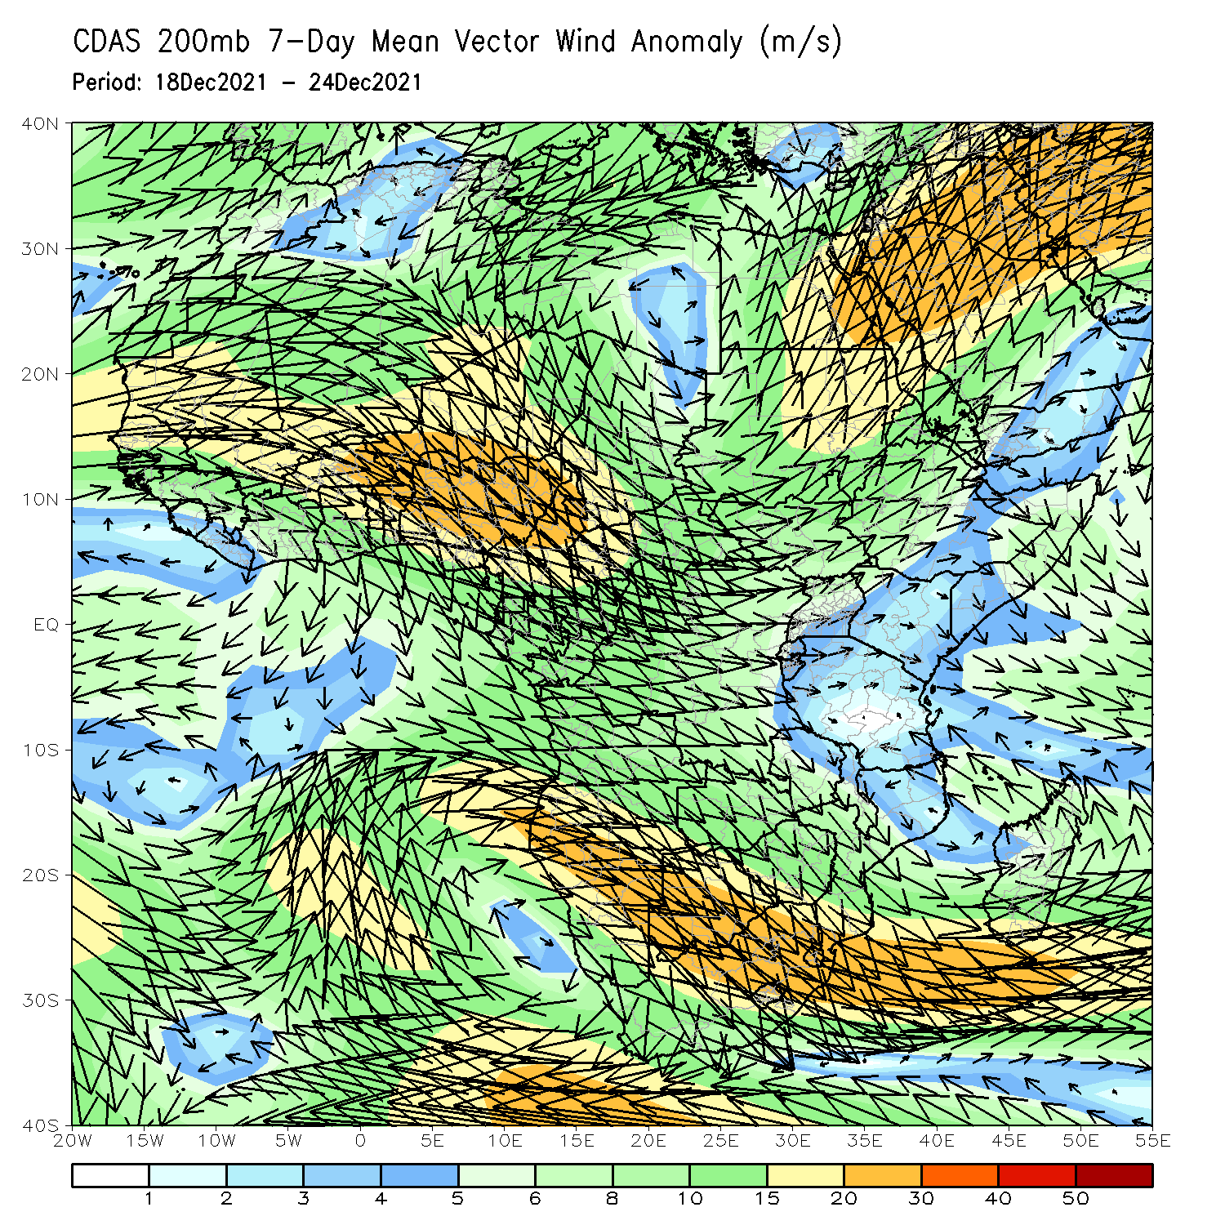
Atmospheric Circulation: Last 7 Days
At 850-hPa level (left panel), anomalous anticyclonic flow prevailed across portions of Southern Africa.

Slide 8
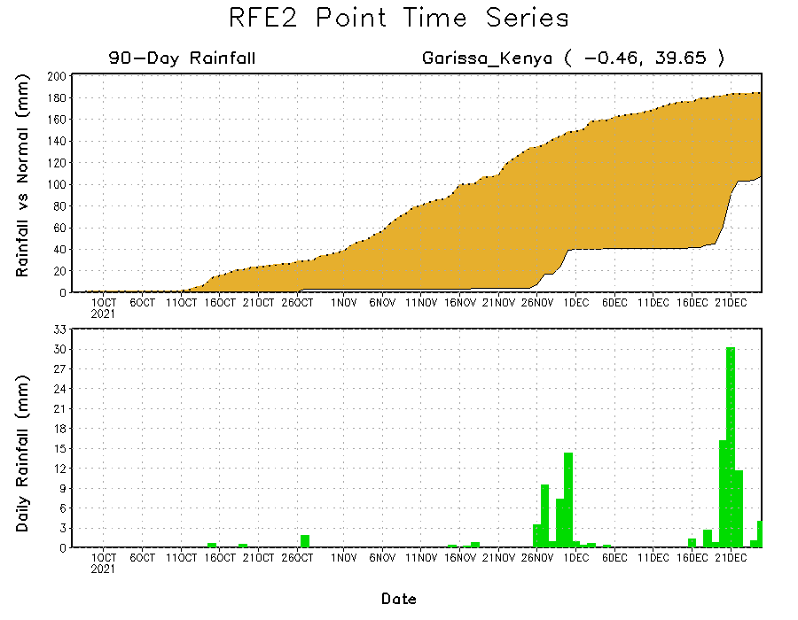
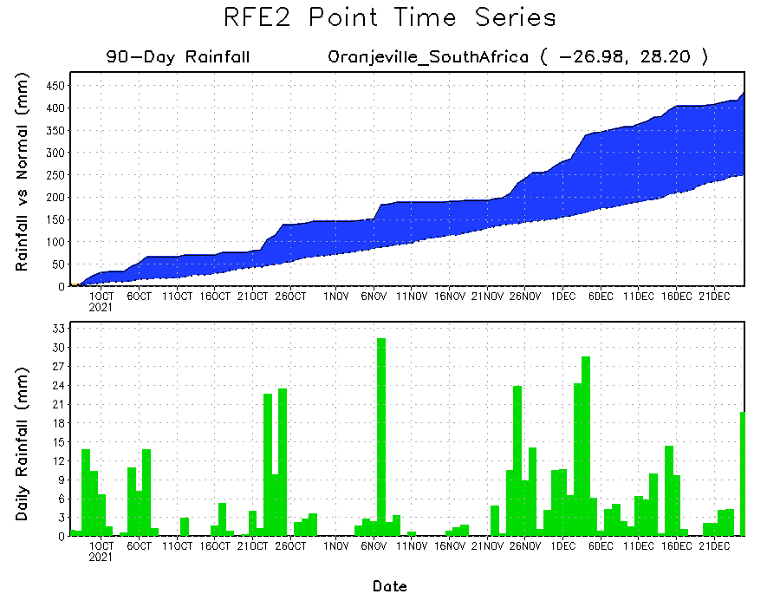
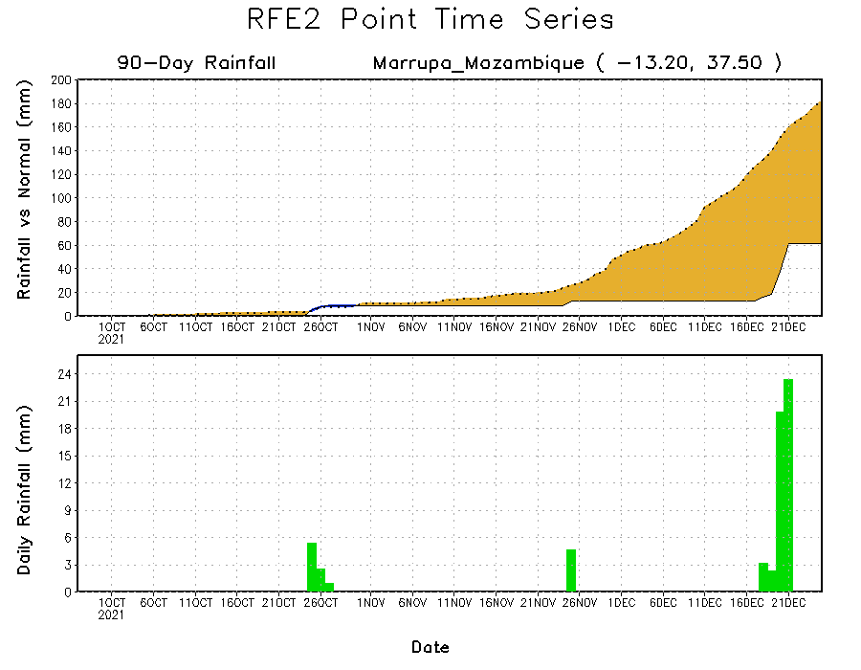
Rainfall Evolution
Daily evolution of rainfall over the last 90 days at selected locations shows moderate sustained moisture surpluses over parts of eastern South Africa (bottom left). The seasonal total rainfall remained below-average over many parts of Kenya (top right) and northern Mozambique (bottom right).

Slide 9
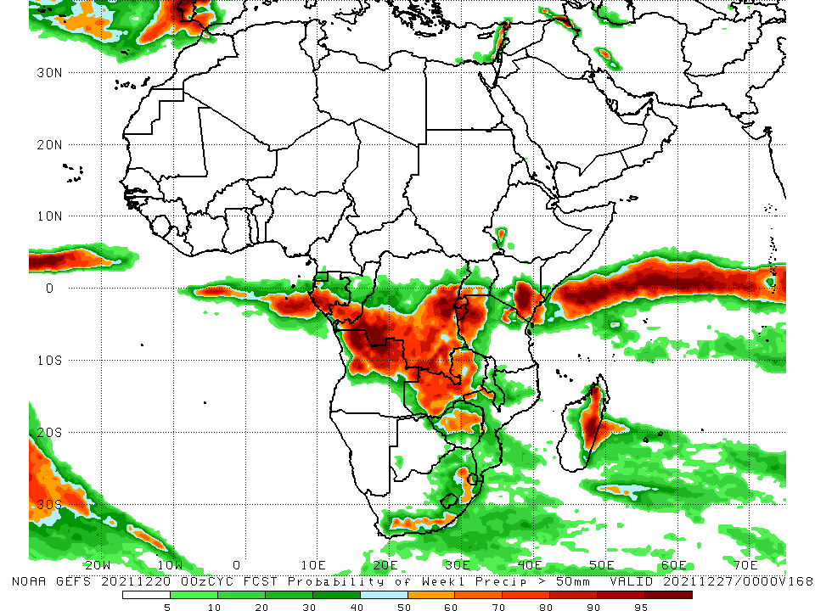
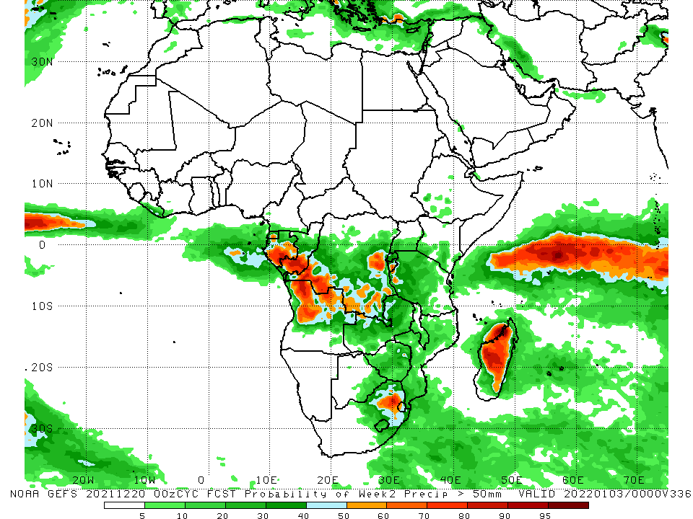
NCEP GEFS Model Forecasts Non-Bias Corrected Probability of precipitation exceedance
Week-1, Valid: 28 Dec 2021 – 03 Jan, 2022
Week-2, Valid: 04 – 10 Jan, 2022
For week-1 (left panel), week-2 (right panel), the NCEP GEFS indicates a moderate to high chance (over 70%) for rainfall to exceed 50 mm over southern Gabon, southern Congo, northern Angola, southern and eastern DRC, western Tanzania, Rwanda, Burundi, eastern Kenya, eastern South Africa, and eastern Madagascar.
Notes:
9

Slide 10
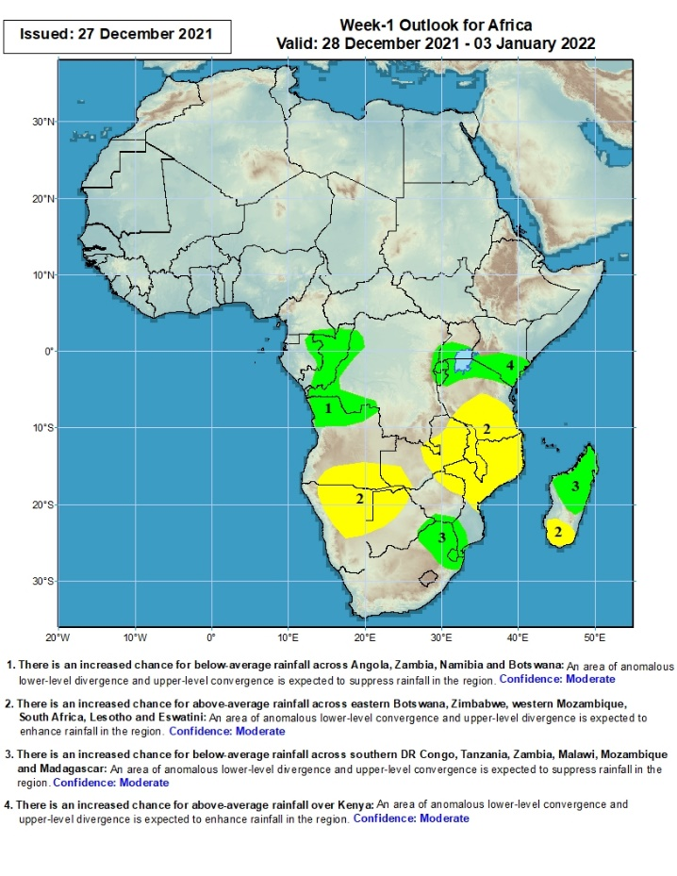
Week-1 Precipitation Outlooks
28 Dec 2021 – 03 Jan, 2022
There is an increased chance for above-average rainfall across eastern Gabon, Congo, western DR Congo, and northern Angola: An area of anomalous lower-level convergence and upper-level divergence is expected to enhance rainfall in the region. Confidence: Moderate
There is an increased chance for below-average rainfall across southern Angola, parts of Zambia, Namibia, northern Botswana, southern Tanzania, eastern Zimbabwe, Malawi, northern Mozambique and southern Madagascar: An area of anomalous lower-level divergence and upper-level convergence is expected to suppress rainfall in the region. Confidence: Moderate
There is an increased chance for above-average rainfall across parts of southern Zimbabwe, Mozambique, eastern South Africa, Eswatini and northern Madagascar: An area of anomalous lower-level convergence and upper-level divergence is expected to enhance rainfall in the region. Confidence: Moderate
There is an increased chance for above-average rainfall across southern Uganda, Rwanda, Burundi, northern Tanzania and southern Kenya: An area of anomalous lower-level convergence and upper-level divergence is expected to enhance rainfall in the region. Confidence: Moderate
Notes:
10

Slide 11
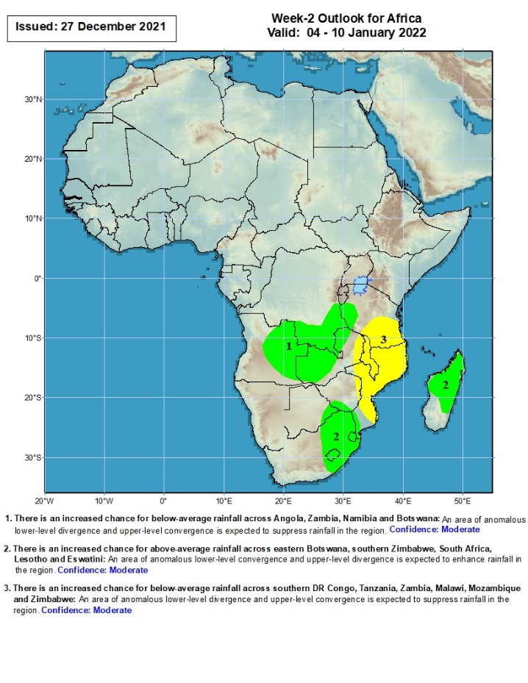
Week-2 Precipitation Outlooks
04 – 10 Jan, 2022
There is an increased chance for above-average rainfall across eastern Angola, southern DR Congo, western Tanzania and western Zambia: An area of anomalous lower-level convergence and upper-level divergence is expected to enhance rainfall in the region. Confidence: Moderate
There is an increased chance for above-average rainfall across parts of eastern Botswana, southern Zimbabwe, eastern South Africa, Lesotho, Eswatini, parts of southern Mozambique and northern Madagascar: An area of anomalous lower-level convergence and upper-level divergence is expected to enhance rainfall in the region. Confidence: Moderate
There is an increased chance for below-average rainfall across eastern Zambia, southern Tanzania, Malawi, Mozambique and eastern Zimbabwe: An area of anomalous lower-level divergence and upper-level convergence is expected to suppress rainfall in the region. Confidence: Moderate
Notes:
11

Slide 12
Summary
During the past 30 days, in East Africa, above-average rainfall was observed over pockets of Uganda, eastern Kenya and the neighboring areas of southern Somalia, and parts of western and eastern Tanzania. Rainfall was below-average over southern Ethiopia, parts of Somalia and northwestern Kenya, northern Uganda, and central and southern Tanzania. In Central Africa, rainfall was below-average pockets of DRC and Congo. Rainfall was above-average over southern Cameroon, Equatorial Guinea and Gabon and many parts of DRC. In Southern Africa, above-average rainfall was observed over northern Angola, parts of southern Botswana, southern Zimbabwe, and much of South Africa. Below-average rainfall was observed over southern and eastern Angola, Namibia, Zambia, northern Botswana, northern Zimbabwe, many parts of Mozambique, Malawi, and much of Madagascar.
During the past 7 days, in East Africa, rainfall was below-average over parts of central Tanzania. Above-average rainfall was observed over southern Ethiopia eastern Kenya, parts of southern Somalia, and western Tanzania. In Central Africa, rainfall was above-average over eastern Gabon, Congo and many parts of DRC. Rainfall was below-average over pockets of DRC. In Southern Africa, rainfall was above-average over northern Angola, western Zambia, parts of Botswana, Zimbabwe, portions of South Africa, central Mozambique and eastern Madagascar. Below-average rainfall was observed over central and southern Angola, eastern Zambia, Malawi, northern Mozambique and western Madagascar.
Week-1 and week-2 outlooks call for an increased chance for below-average rainfall over portions of southern Angola, Namibia, parts of Zambia, southern Tanzania, Malawi, Mozambique and southern Madagascar. In contrast, the outlooks call for an increased chance for above-average rainfall over parts of Gabon, Congo, western DRC, the Lake Victoria region, southern Kenya, eastern South Africa, and northern Madagascar.

