Slide 1
The African Monsoon Recent Evolution and Current Status Include Week-1 and Week-2 Outlooks
Update prepared by
18 January 2022
For more information, visit:
http://www.cpc.ncep.noaa.gov/products/Global_Monsoons/African_Monsoons/precip_monitoring.shtml

Slide 2
Outline
Highlights
Recent Evolution and Current Conditions
NCEP GEFS Forecasts
Summary

Slide 3
Highlights: Last 7 Days
During the past 7 days, in East Africa, rainfall was below-average over portions of Tanzania. Above-average rainfall was observed over parts of southern South Sudan, and southeastern Tanzania. In Central Africa, rainfall was above-average over parts of DRC and Congo. Rainfall was below-average over pocket areas of Gabon, Congo and DRC. In Southern Africa, rainfall was above-average over much of Zambia, central and southern Namibia, Malawi, Zimbabwe, northern Mozambique, much of South Africa, and much of Madagascar. Below-average rainfall was observed over much of Angola, parts of northern Namibia, parts of Botswana, and northern Madagascar.
Week-1 and week-2 outlooks call for an increased chance for above-average rainfall across the northern portions of Southern Africa and the neighboring areas of East Africa. In contrast, there is an increased chance for below-average rainfall over the southern portions of Southern Africa, and portions of the Lake Victoria region.

Slide 4
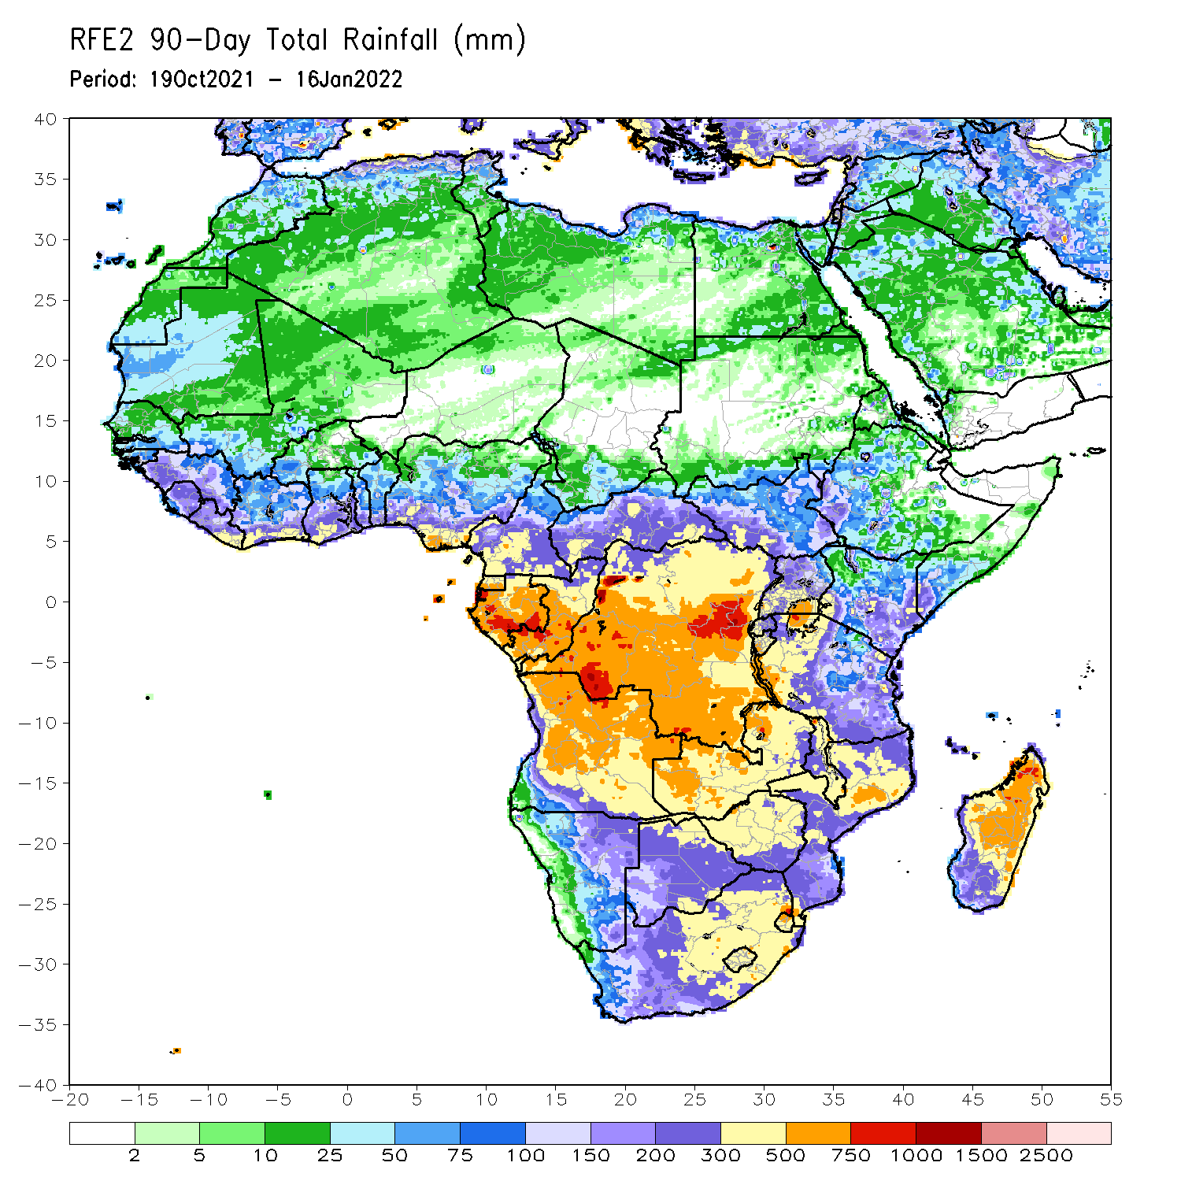
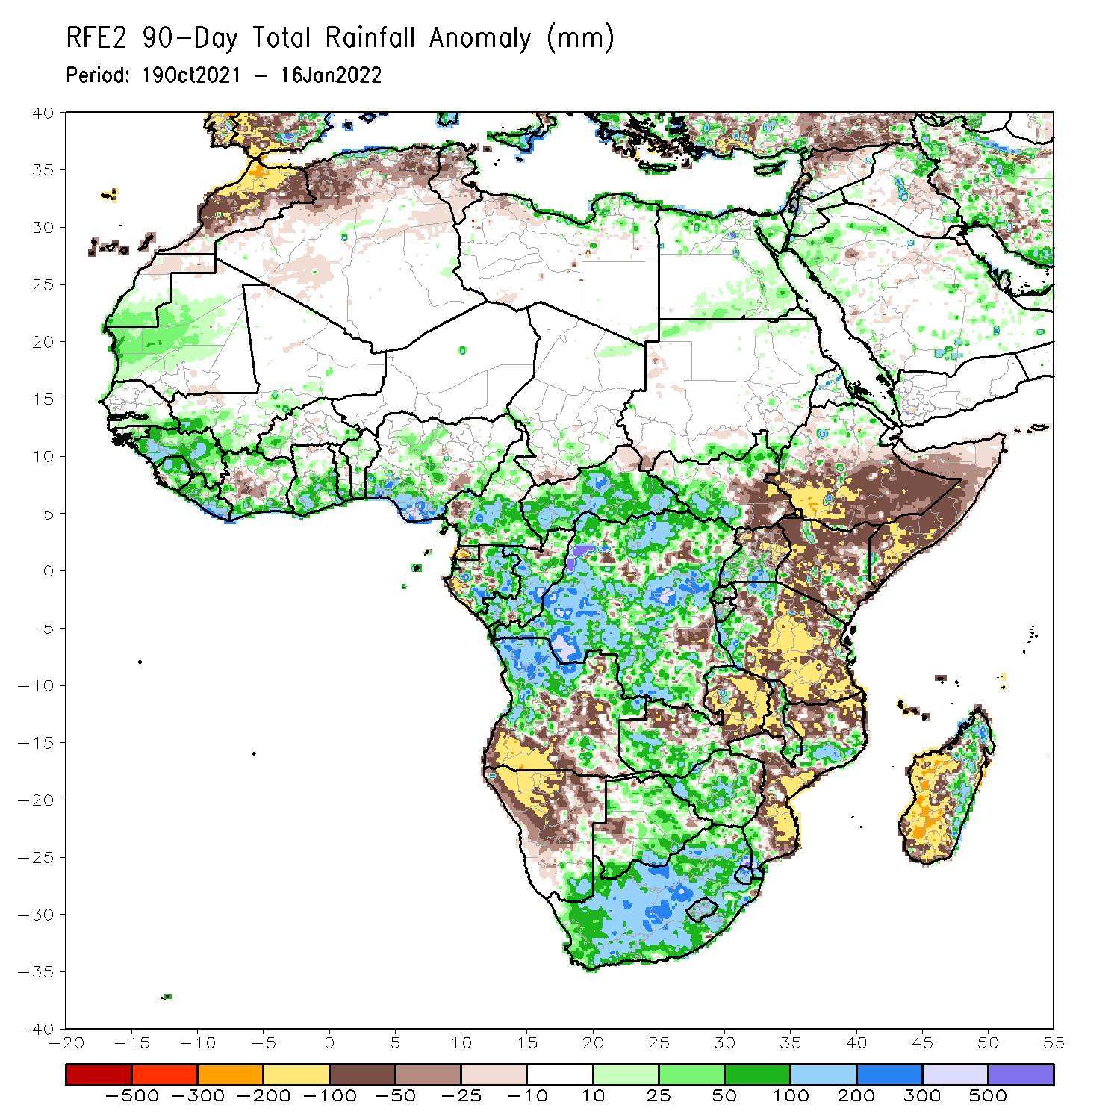
Rainfall Patterns: Last 90 Days
Over the past 90 days, in East Africa, above-average rainfall was observed over parts of northern Ethiopia, South Sudan, Rwanda, Burundi, southern Uganda and western Tanzania. Rainfall was below-average over southern Ethiopia, much of Somalia and Kenya, northern Uganda, and central and southern Tanzania. In southern Africa, above-average rainfall was observed over northern Angola, Botswana, Zimbabwe, western Zambia, parts of northern Mozambique, eastern Madagascar and much of South Africa. Below-average rainfall was observed over central and southern Angola, eastern Zambia, much of Namibia, western Botswana, pockets of northern Zimbabwe, Malawi, Mozambique and much of Madagascar. In Central Africa, rainfall was above-average over many parts of DRC, Gabon, much of Congo, and much of CAR Rainfall was below-average over pockets of DRC, Equatorial Guinea, and pockets of western Gabon. In West Africa, rainfall was above-average over much of the Gulf of Guinea region. Below-average rainfall was observed over pockets of Cote d’Ivoire, and eastern Nigeria.
Notes:
4

Slide 5
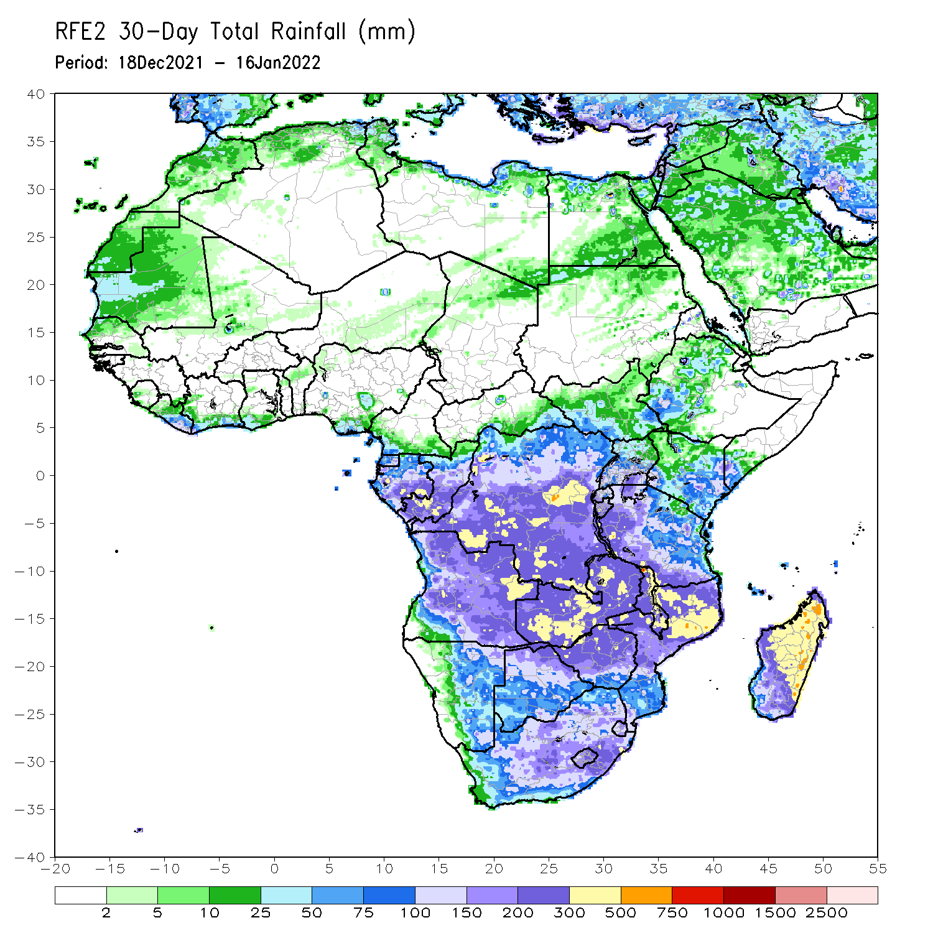
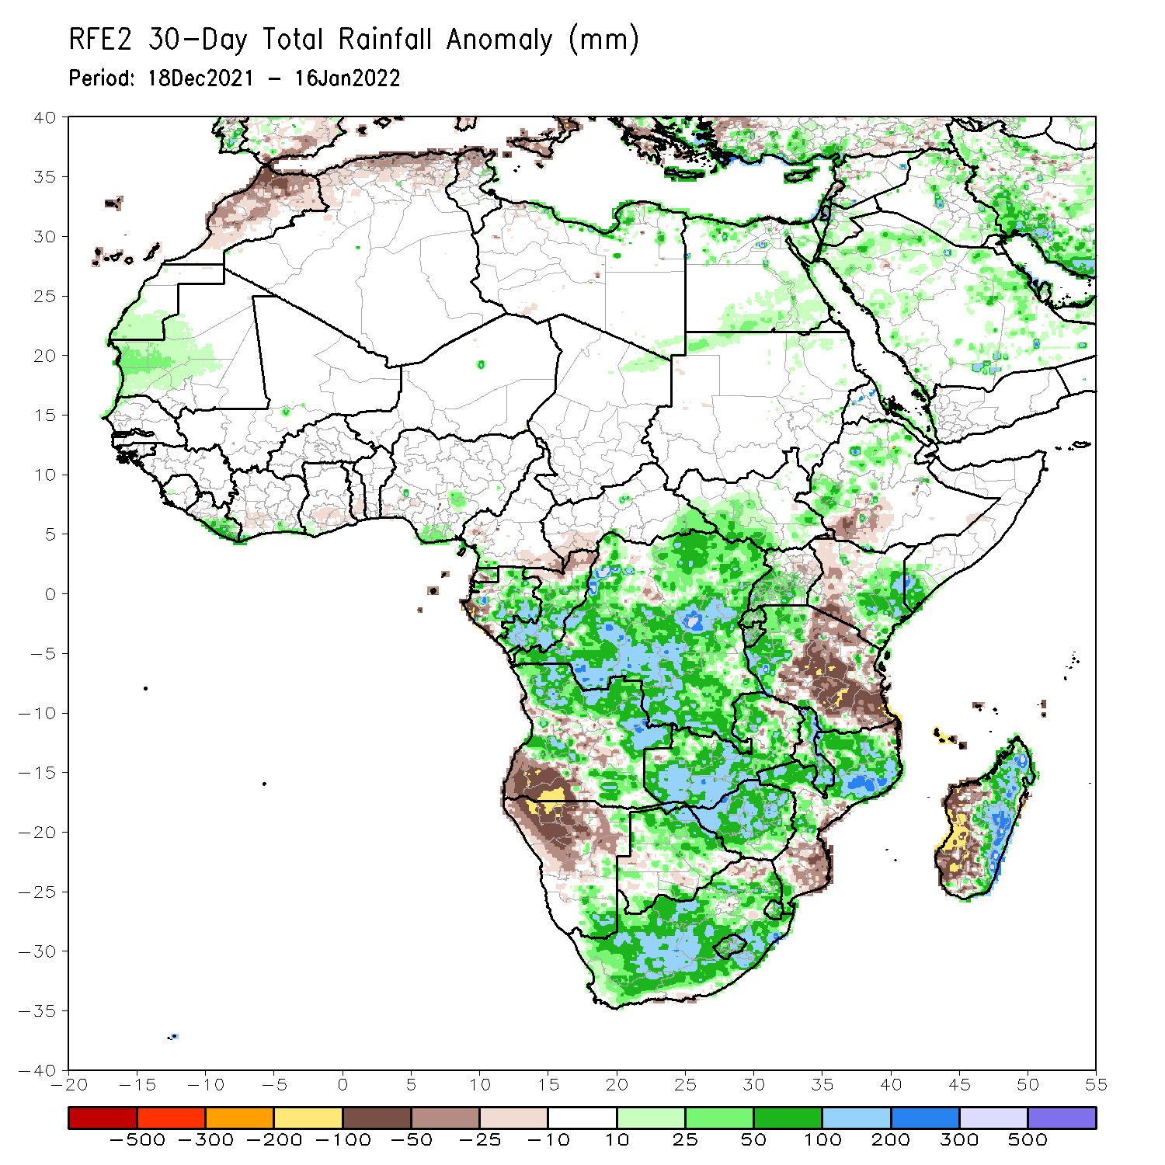
Rainfall Patterns: Last 30 Days
During the past 30 days, in East Africa, above-average rainfall was observed over parts of western and northern Ethiopia, southern Uganda, Rwanda, Burundi, eastern Kenya and the neighboring areas of southern Somalia, and parts of western Tanzania. Rainfall was below-average over parts of southern Ethiopia, western Kenya, northern Uganda, and central and southern Tanzania. In Central Africa, rainfall was below-average pockets of northern DRC and northern Congo. Rainfall was above-average over Equatorial Guinea and Gabon and many parts of DRC. In Southern Africa, above-average rainfall was observed over northern and eastern Angola, much of Botswana and Zimbabwe, Zambia, Malawi, northern Mozambique, eastern Madagascar and much of South Africa. Below-average rainfall was observed over southwestern Angola, Namibia, southern Mozambique, and western Madagascar.
Notes:
5

Slide 6
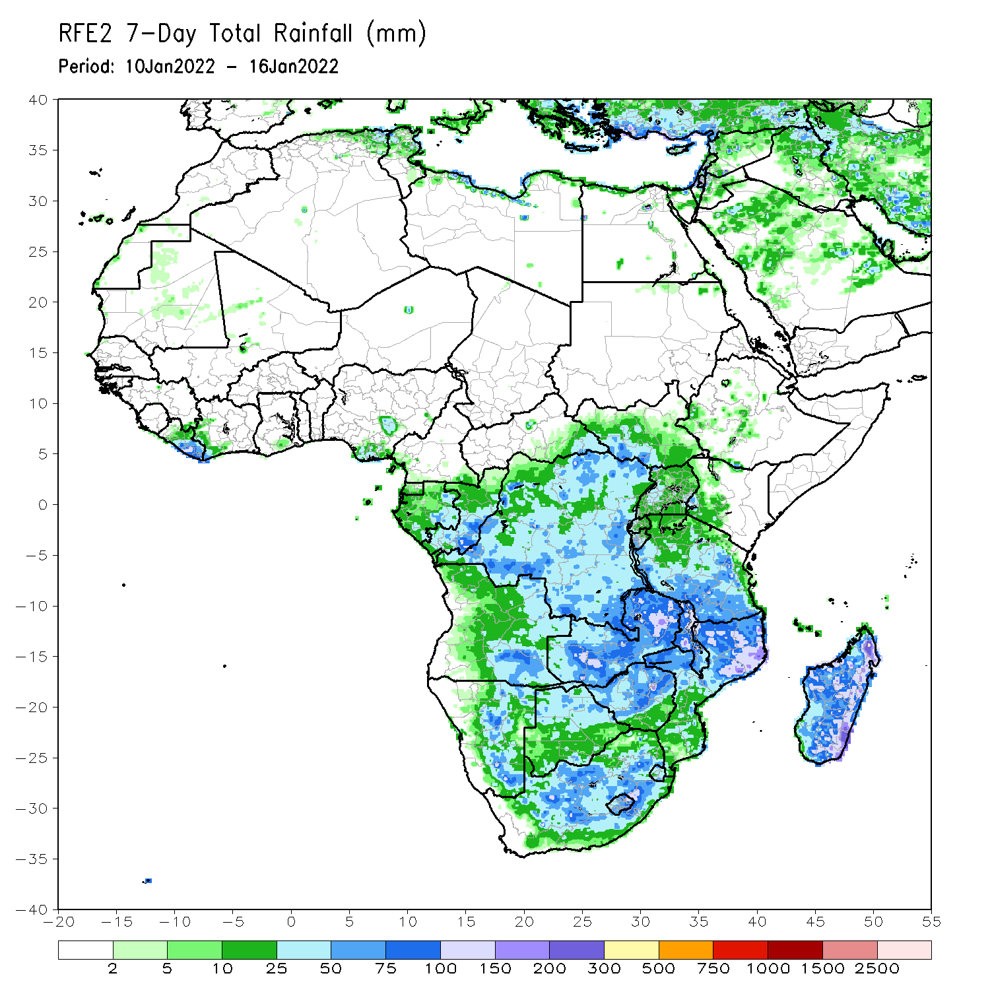
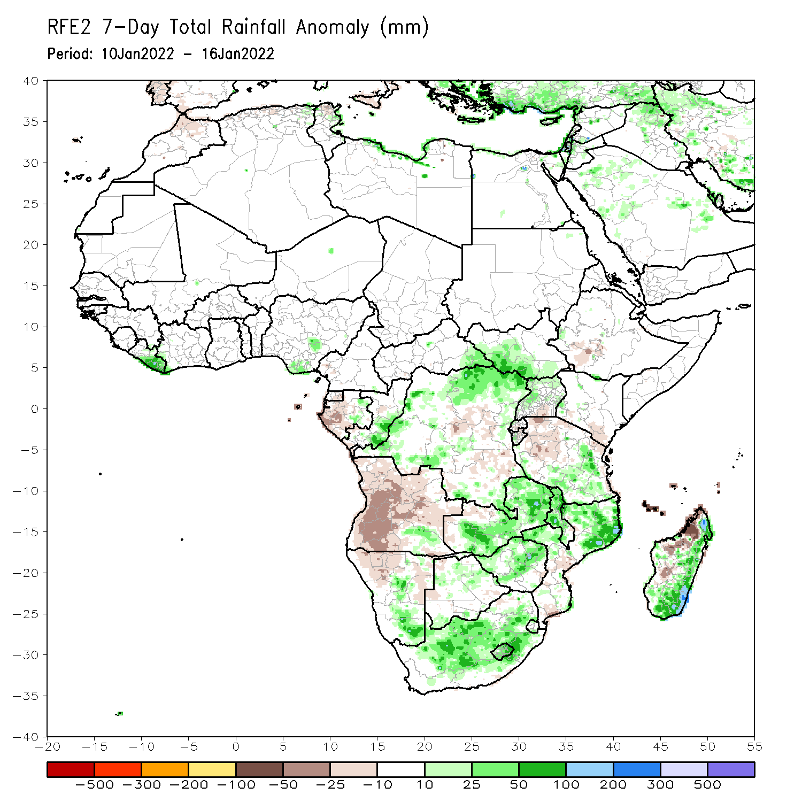
Rainfall Patterns: Last 7 Days
During the past 7 days, in East Africa, rainfall was below-average over portions of Tanzania. Above-average rainfall was observed over parts of southern South Sudan, and southeastern Tanzania. In Central Africa, rainfall was above-average over parts of DRC and Congo. Rainfall was below-average over pocket areas of Gabon, Congo and DRC. In Southern Africa, rainfall was above-average over much of Zambia, central and southern Namibia, Malawi, Zimbabwe, northern Mozambique, much of South Africa, and much of Madagascar. Below-average rainfall was observed over much of Angola, parts of northern Namibia, parts of Botswana, and northern Madagascar.

Slide 7
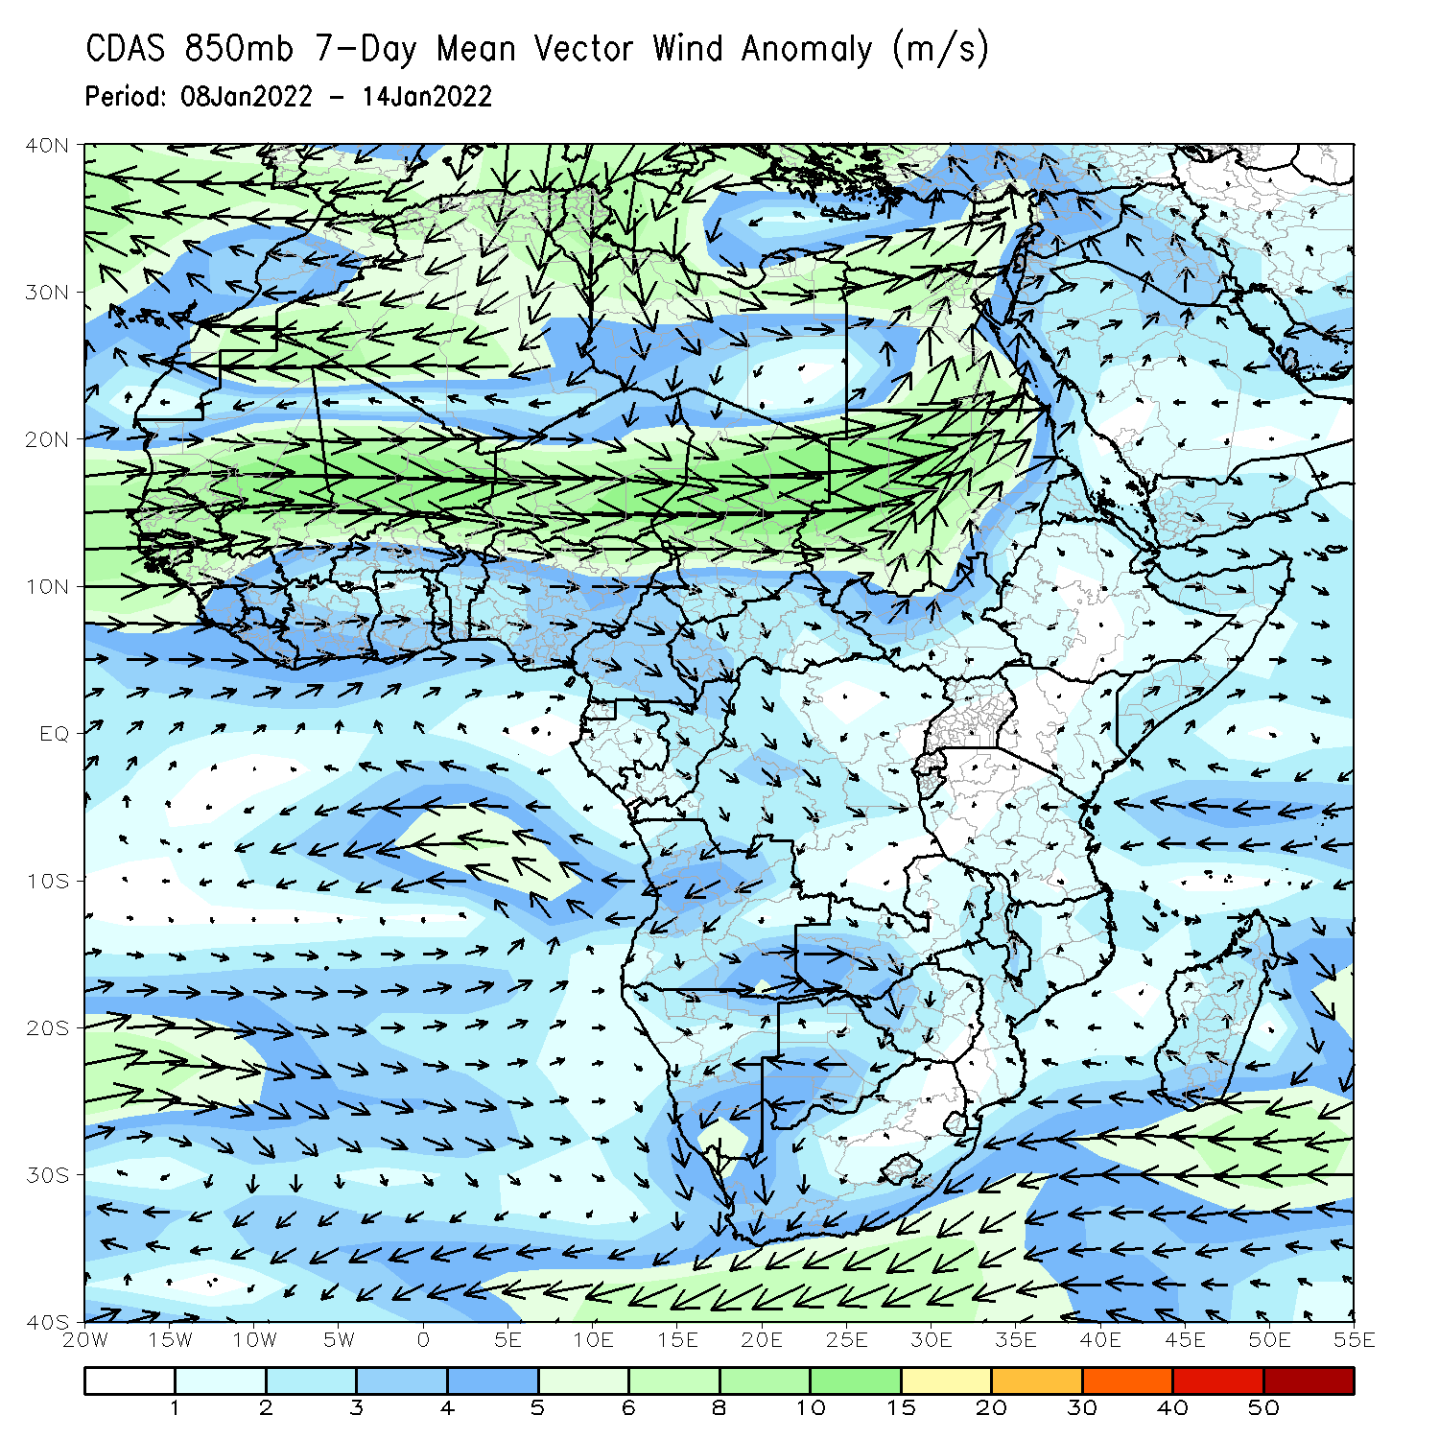
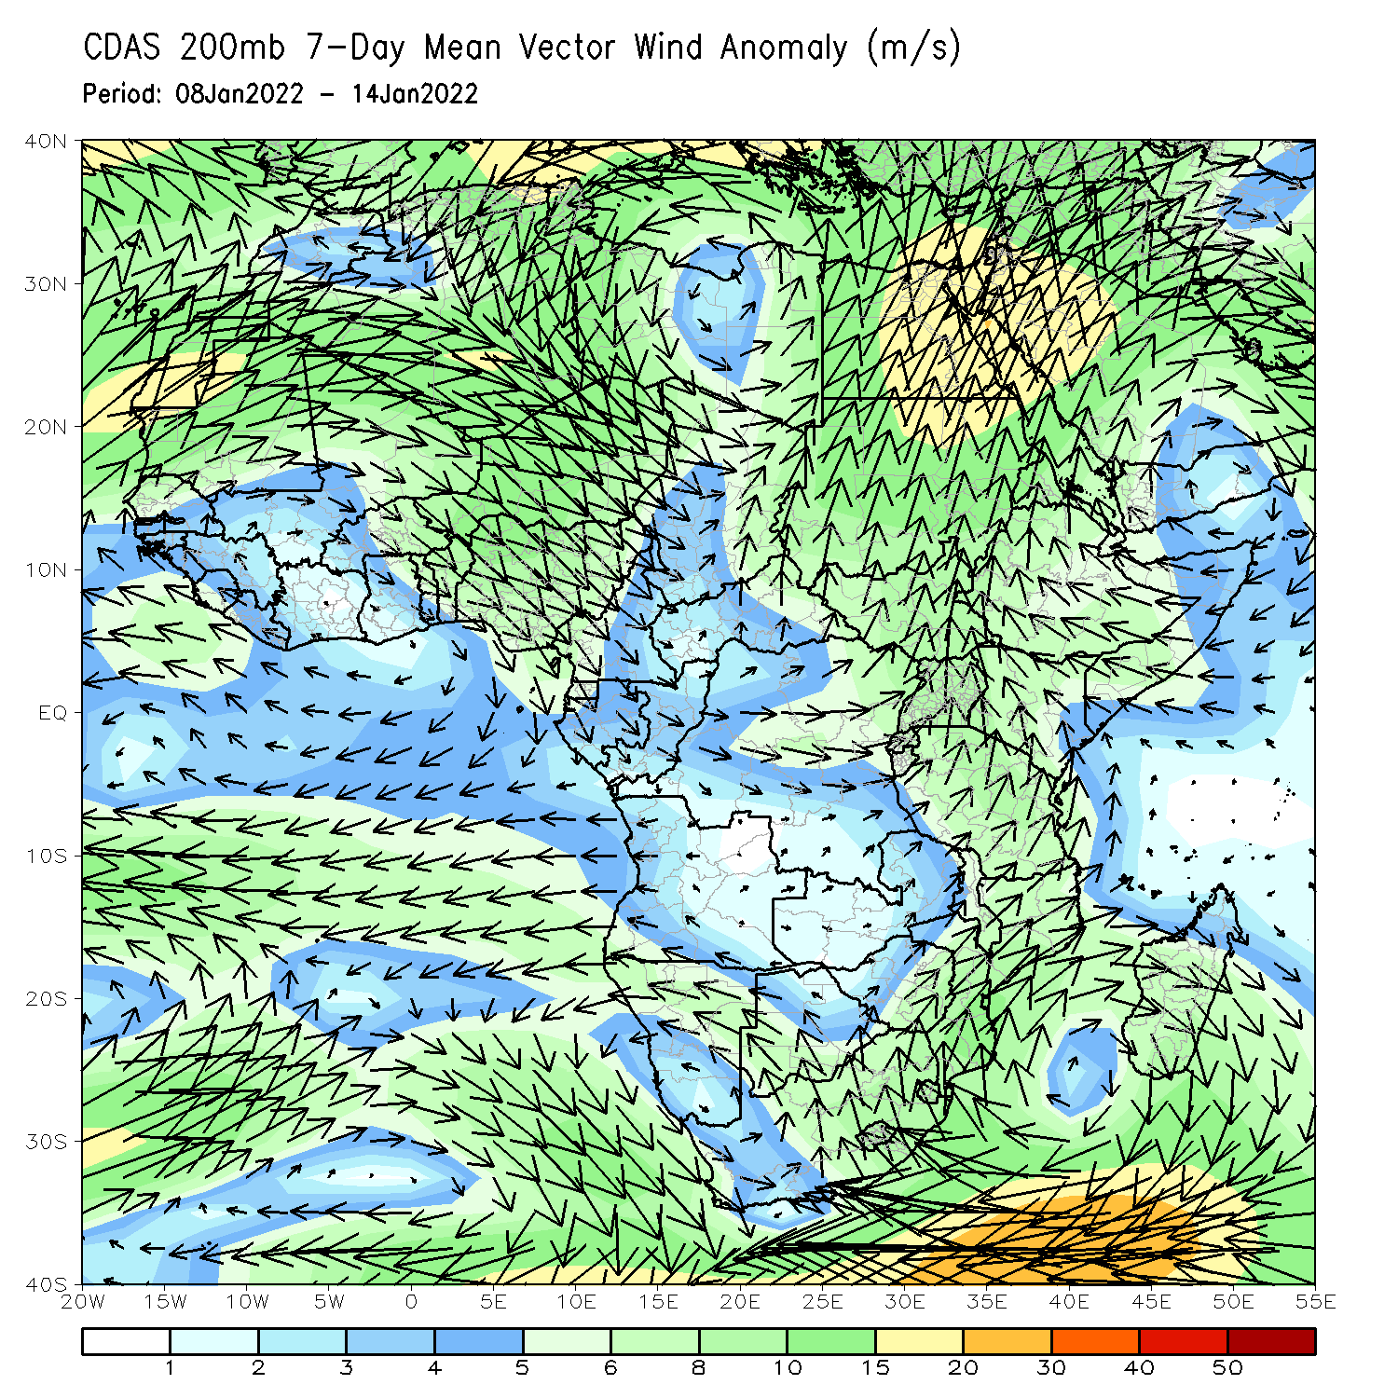
Atmospheric Circulation: Last 7 Days
At 850-hPa level (left panel), anomalous cyclonic flow prevailed across the northern portions of Southern Africa.

Slide 8
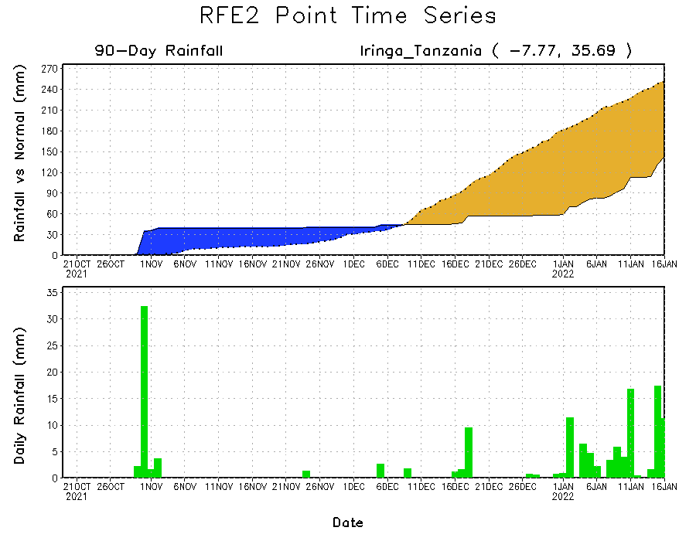
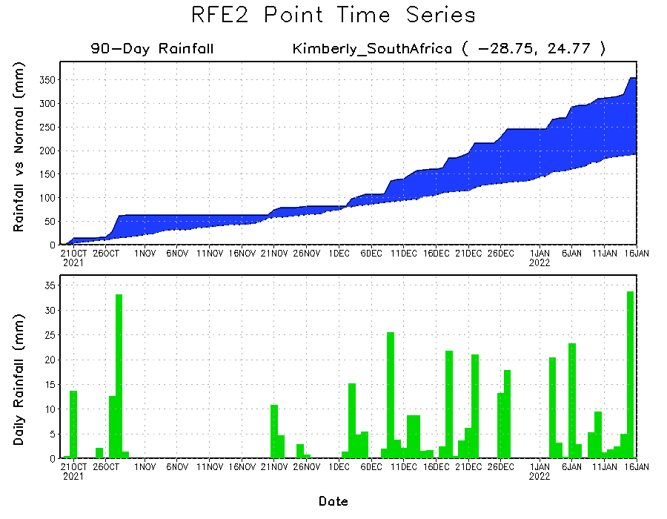
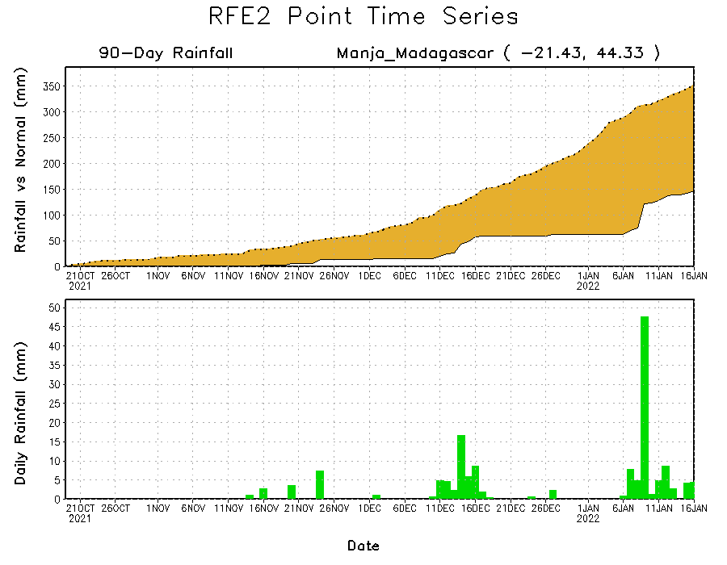
Rainfall Evolution
Daily evolution of rainfall over the last 90 days at selected locations shows moderate sustained moisture surpluses over parts of South Africa (bottom left). The seasonal total rainfall remained below-average over parts of Tanzania (top right) and western Madagascar (bottom right).

Slide 9
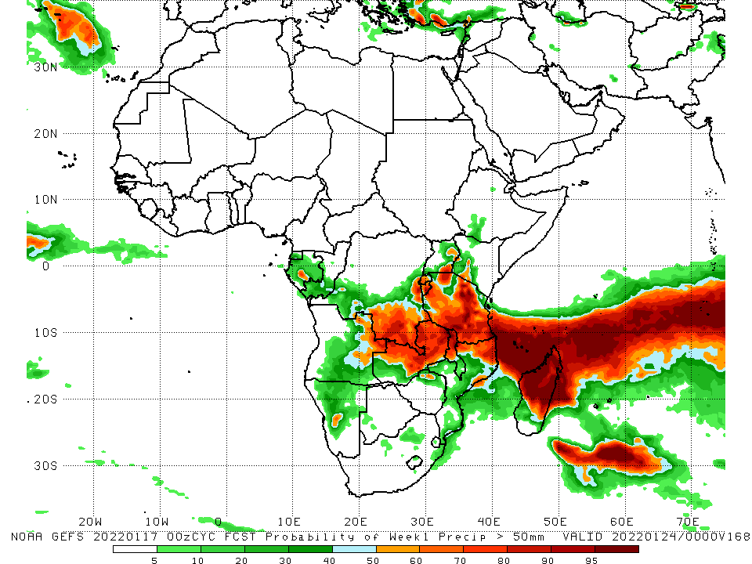
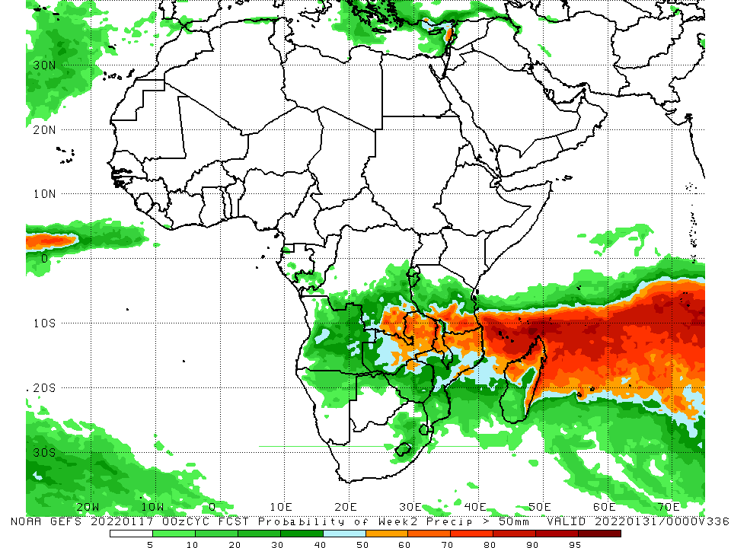
NCEP GEFS Model Forecasts Non-Bias Corrected Probability of precipitation exceedance
Week-1, Valid: 18 – 24 Jan, 2022
Week-2, Valid: 25 – 31 Jan, 2022
For week-1 (left panel), week-2 (right panel), the NCEP GEFS indicates a moderate to high chance (over 70%) for rainfall to exceed 50 mm over southern and eastern DRC, Tanzania, Rwanda, Burundi, Zamba, Malawi. Northern Mozambique and northern Madagascar.
Notes:
9

Slide 10
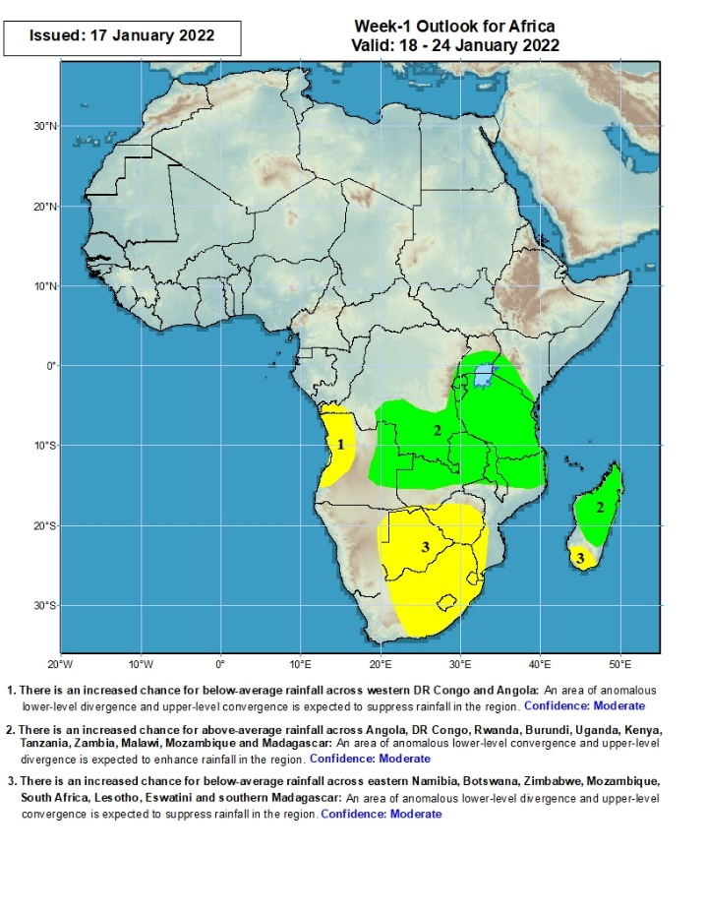
Week-1 Precipitation Outlooks
18 – 24 Jan, 2022
There is an increased chance for below-average rainfall across western Angola and the neighboring areas of DR Congo: An area of anomalous lower-level divergence and upper-level convergence is expected to suppress rainfall in the region. Confidence: Moderate
There is an increased chance for above-average rainfall across eastern Angola, southern and eastern DR Congo, Rwanda, Burundi, southern Uganda, southern Kenya, Tanzania, Zambia, Malawi, northern Mozambique, and central and northern Madagascar: An area of anomalous lower-level convergence and upper-level divergence is expected to enhance rainfall in the region. Confidence: Moderate
There is an increased chance for below-average rainfall across eastern Namibia, Botswana, Zimbabwe, Mozambique, South Africa, Lesotho, Eswatini and southern Madagascar: An area of anomalous lower-level divergence and upper-level convergence is expected to suppress rainfall in the region. Confidence: Moderate
Notes:
10

Slide 11
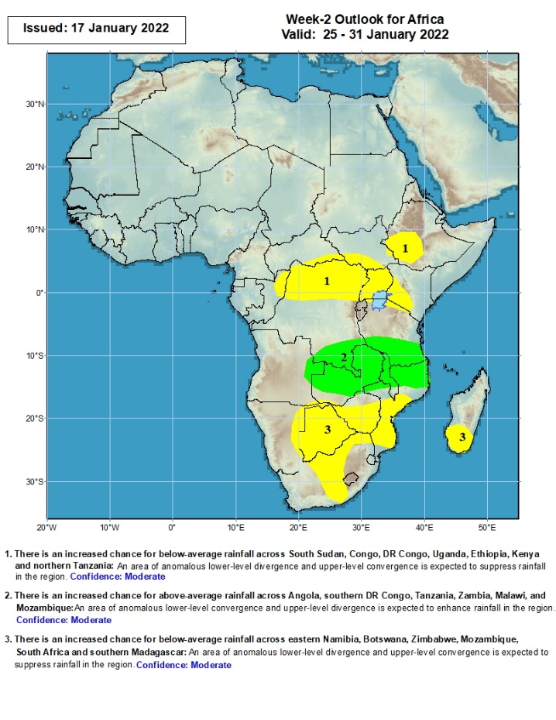
Week-2 Precipitation Outlooks
25 – 31 Jan, 2022
There is an increased chance for below-average rainfall across parts of southern South Sudan, northern Congo, northern DR Congo, Uganda, southwestern Ethiopia, southwestern Kenya and parts of northern Tanzania: An area of anomalous lower-level divergence and upper-level convergence is expected to suppress rainfall in the region. Confidence: Moderate
There is an increased chance for above-average rainfall across parts of eastern Angola, southern DR Congo, southern Tanzania, Zambia, Malawi, and northern Mozambique: An area of anomalous lower-level convergence and upper-level divergence is expected to enhance rainfall in the region. Confidence: Moderate
There is an increased chance for below-average rainfall across eastern Namibia, Botswana, Zimbabwe, Mozambique, South Africa and southern Madagascar: An area of anomalous lower-level divergence and upper-level convergence is expected to suppress rainfall in the region. Confidence: Moderate
Notes:
11

Slide 12
Summary
During the past 30 days, in East Africa, above-average rainfall was observed over parts of western and northern Ethiopia, southern Uganda, Rwanda, Burundi, eastern Kenya and the neighboring areas of southern Somalia, and parts of western Tanzania. Rainfall was below-average over parts of southern Ethiopia, western Kenya, northern Uganda, and central and southern Tanzania. In Central Africa, rainfall was below-average pockets of northern DRC and northern Congo. Rainfall was above-average over Equatorial Guinea and Gabon and many parts of DRC. In Southern Africa, above-average rainfall was observed over northern and eastern Angola, much of Botswana and Zimbabwe, Zambia, Malawi, northern Mozambique, eastern Madagascar and much of South Africa. Below-average rainfall was observed over southwestern Angola, Namibia, southern Mozambique, and western Madagascar.
During the past 7 days, in East Africa, rainfall was below-average over portions of Tanzania. Above-average rainfall was observed over parts of southern South Sudan, and southeastern Tanzania. In Central Africa, rainfall was above-average over parts of DRC and Congo. Rainfall was below-average over pocket areas of Gabon, Congo and DRC. In Southern Africa, rainfall was above-average over much of Zambia, central and southern Namibia, Malawi, Zimbabwe, northern Mozambique, much of South Africa, and much of Madagascar. Below-average rainfall was observed over much of Angola, parts of northern Namibia, parts of Botswana, and northern Madagascar.
Week-1 and week-2 outlooks call for an increased chance for above-average rainfall across the northern portions of Southern Africa and the neighboring areas of East Africa. In contrast, there is an increased chance for below-average rainfall over the southern portions of Southern Africa, and portions of the Lake Victoria region.

