Slide 1
The African Monsoon Recent Evolution and Current Status Include Week-1 and Week-2 Outlooks
Update prepared by
24 January 2022
For more information, visit:
http://www.cpc.ncep.noaa.gov/products/Global_Monsoons/African_Monsoons/precip_monitoring.shtml

Slide 2
Outline
Highlights
Recent Evolution and Current Conditions
NCEP GEFS Forecasts
Summary

Slide 3
Highlights: Last 7 Days
During the past 7 days, in East Africa, rainfall was above-average over parts of southern Ethiopia, Rwanda, Burundi, Kenya, Uganda, and much of Tanzania. In central Africa, rainfall was above-average over much of DRC and parts of Congo. Rainfall was below-average over Equatorial Guinea, Gabon and southern Congo. In Southern Africa, rainfall was above-average over northern and eastern Zambia, central and southern Namibia, northern Malawi, northern Mozambique, much of South Africa, and Madagascar. Below-average rainfall was observed over much of Angola, parts of northern Namibia, western Zambia, Botswana, Zimbabwe, southern Malawi, northeastern South Africa, southern Mozambique, and pockets of southwestern Madagascar .
Week-1 and week-2 outlooks call for an increased chance for above-average rainfall across the northern portions of Southern Africa. In contrast, there is an increased chance for below-average rainfall over the southern portions of Southern Africa, and equatorial Central Africa.

Slide 4
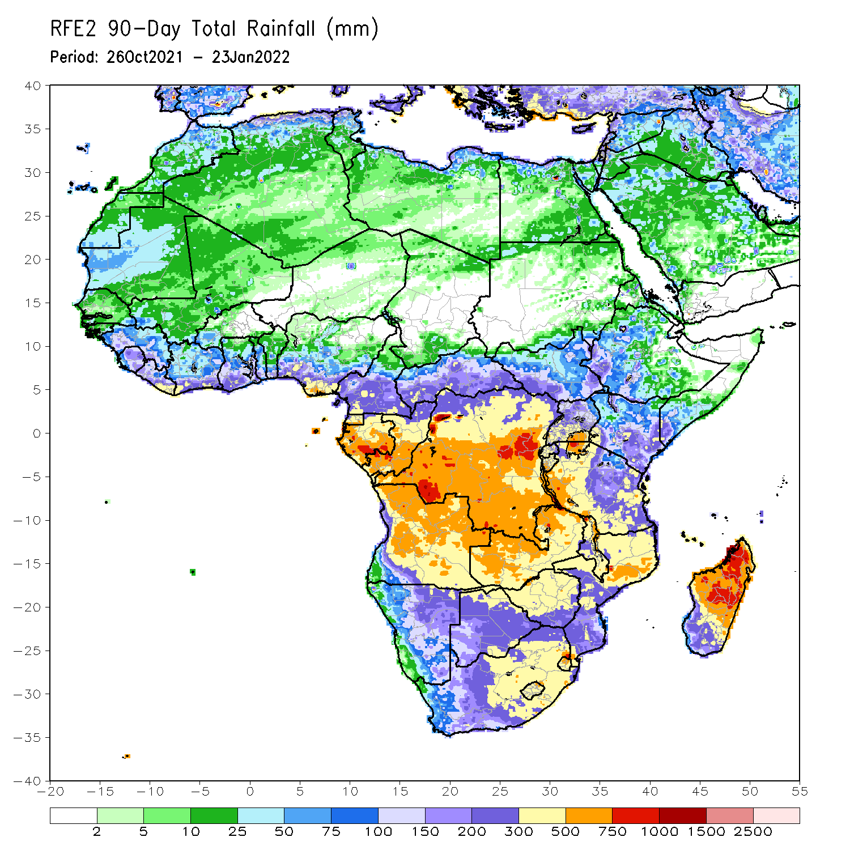
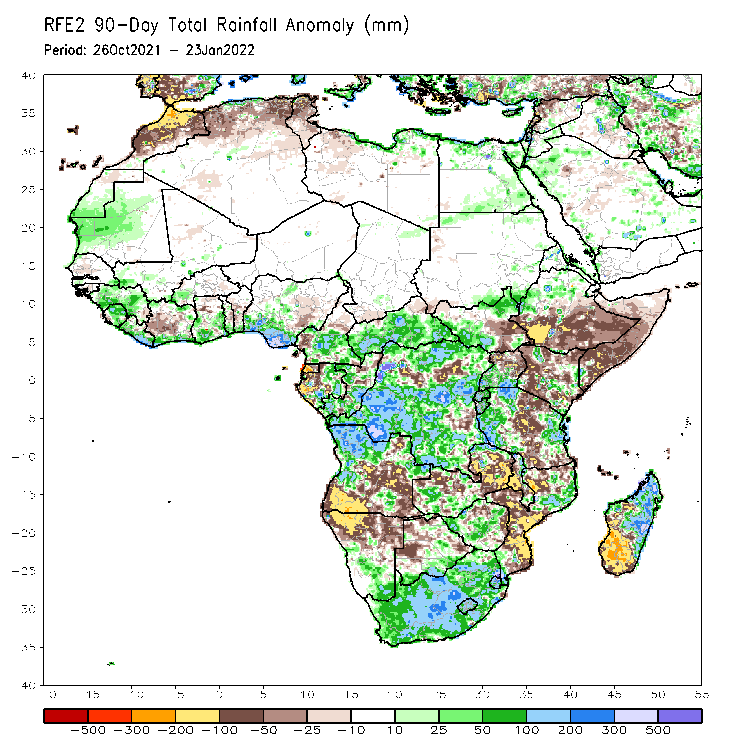
Rainfall Patterns: Last 90 Days
Over the past 90 days, in East Africa, above-average rainfall was observed over parts of northern Ethiopia, South Sudan, Rwanda, Burundi, southern Uganda, and parts of western and eastern Tanzania. Rainfall was below-average over southern Ethiopia, much of Somalia and Kenya, northern Uganda, and parts of Tanzania. In southern Africa, above-average rainfall was observed over northern Angola, Botswana, Zimbabwe, western Zambia, parts of northern Mozambique, eastern Madagascar and much of South Africa. Below-average rainfall was observed over central and southern Angola, eastern Zambia, much of Namibia, western Botswana, pockets of northern Zimbabwe, Malawi, Mozambique and much of Madagascar. In Central Africa, rainfall was above-average over much of DRC, Gabon, Congo, and much of CAR Rainfall was below-average over pockets of DRC and northern Congo. In West Africa, rainfall was above-average over much of the Gulf of Guinea region. Below-average rainfall was observed over pockets of Cote d’Ivoire, and eastern Nigeria.
Notes:
4

Slide 5
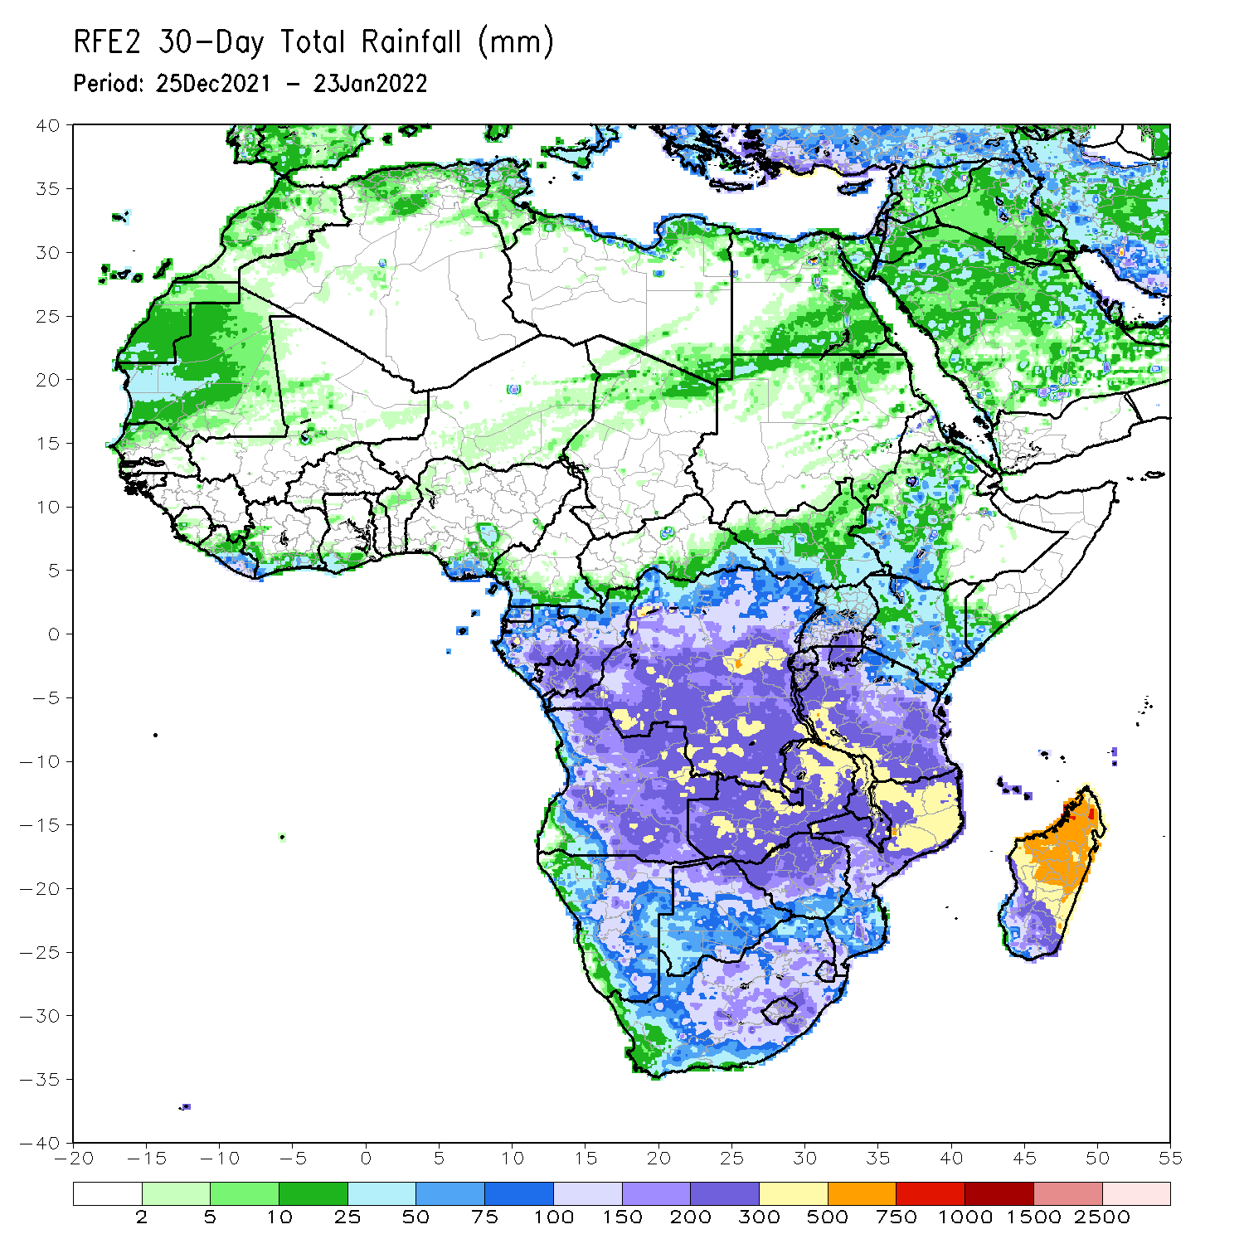
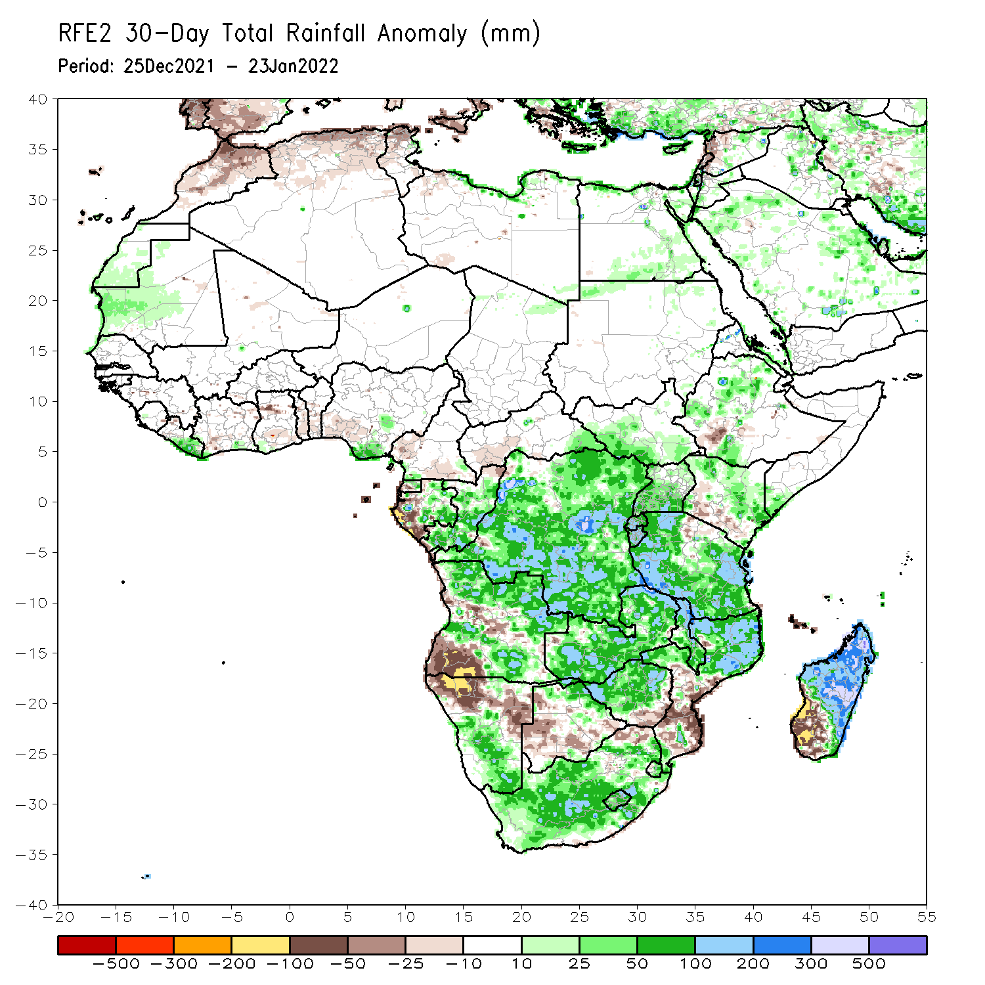
Rainfall Patterns: Last 30 Days
During the past 30 days, in East Africa, above-average rainfall was observed over parts of western and northern Ethiopia, southern Uganda, Rwanda, Burundi, central and eastern Kenya, parts of southern Somalia, and many parts of Tanzania. Rainfall was below-average over parts of southwestern Ethiopia, southern Kenya, pockets of northern Uganda, and northcentral Tanzania. In Central Africa, rainfall was below-average over western Gabon. Rainfall was above-average over Equatorial Guinea, Gabon and much of DRC. In Southern Africa, above-average rainfall was observed over many parts of Angola, portions of Namibia, Zimbabwe, Zambia, Malawi, northern Mozambique, central and northern Madagascar and much of South Africa. Below-average rainfall was observed over southwestern Angola, northeastern Namibia, Botswana, southern Mozambique, and southwestern Madagascar.
Notes:
5

Slide 6
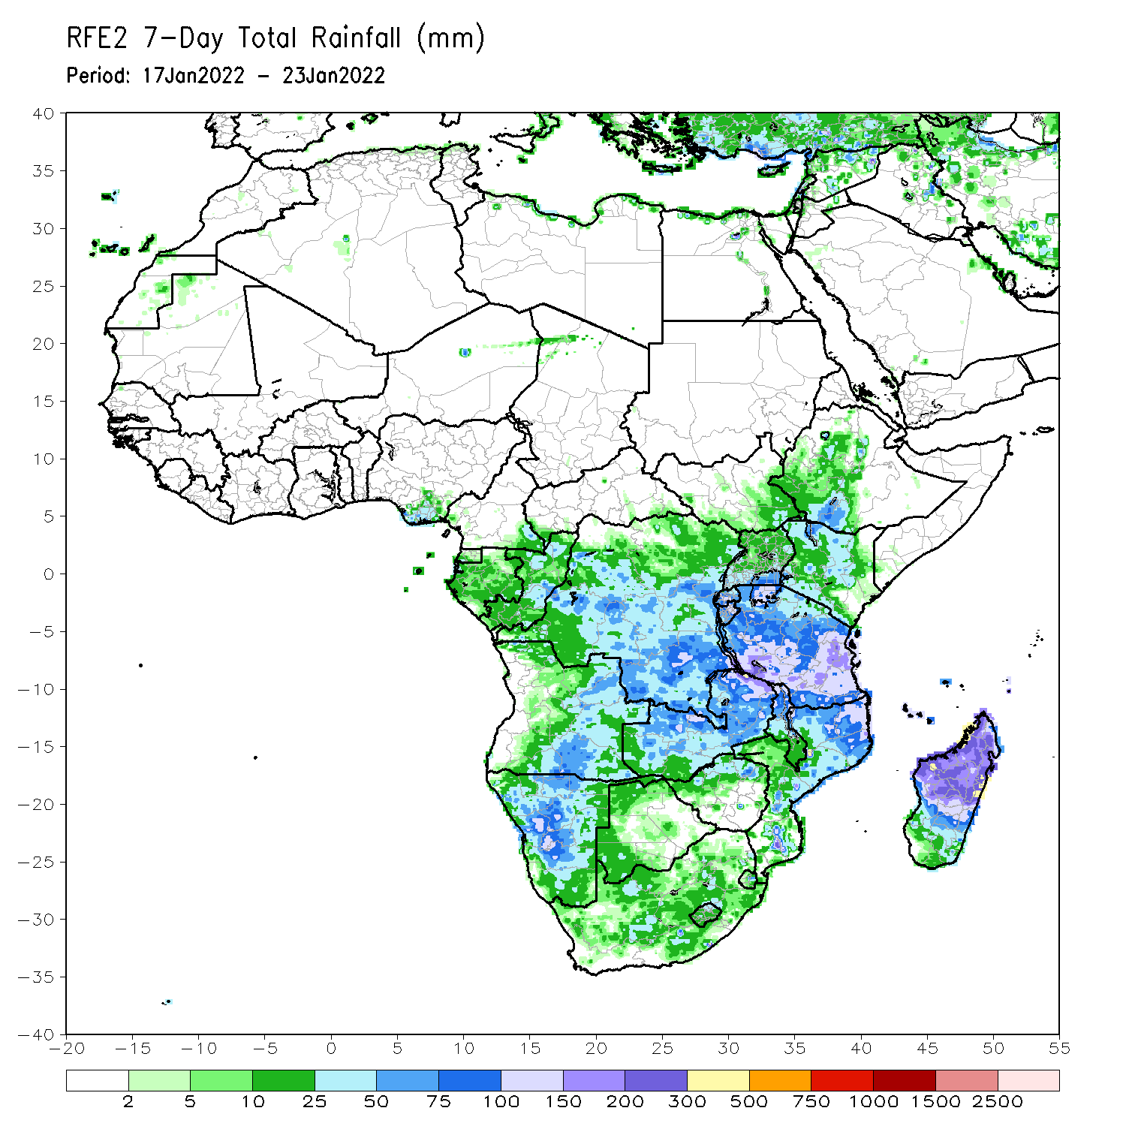
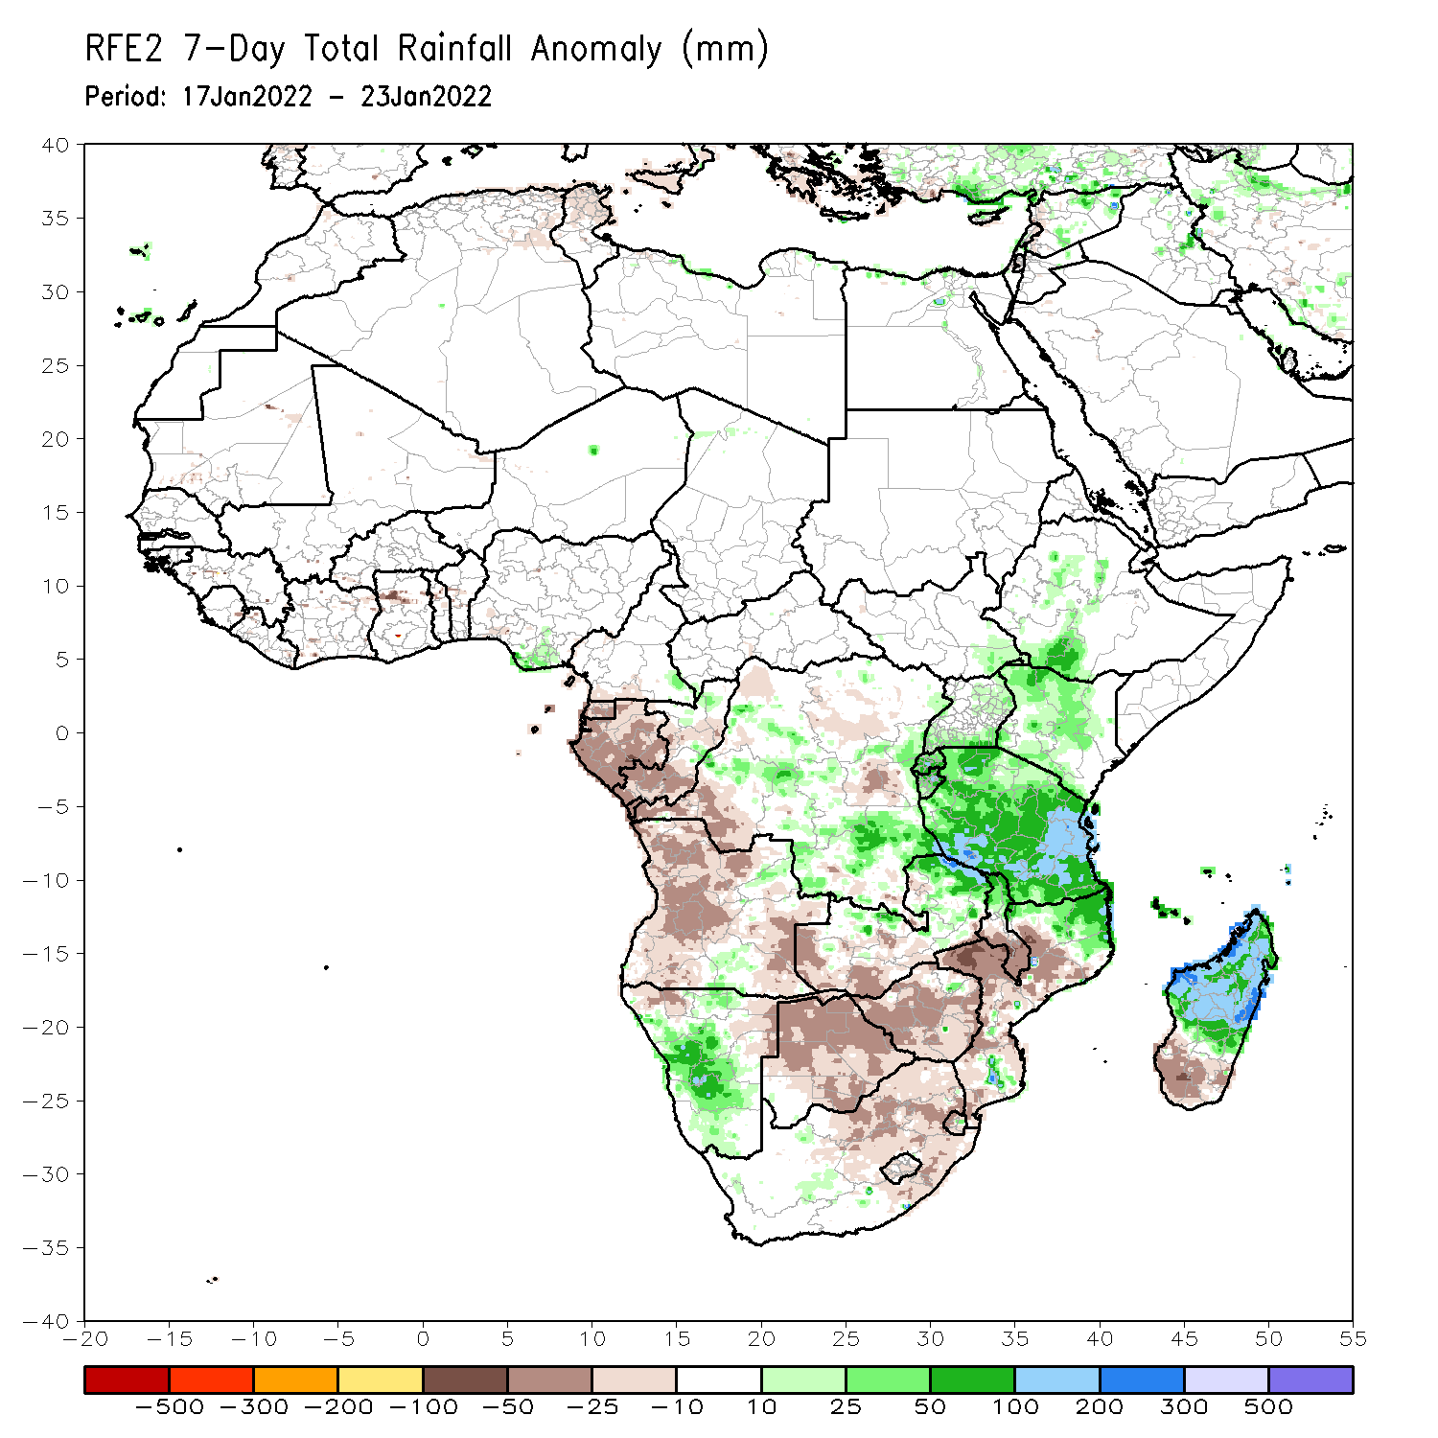
Rainfall Patterns: Last 7 Days
During the past 7 days, in East Africa, rainfall was above-average over parts of southern Ethiopia, Rwanda, Burundi, Kenya, and much of Tanzania. In central Africa, rainfall was above-average over pockets of DRC. Rainfall was below-average over Equatorial Guinea, Gabon and southern Congo. In Southern Africa, rainfall was above-average over eastern Zambia, central and southern Namibia, northern Malawi, northern Mozambique, and central and northern Madagascar. Below-average rainfall was observed over much of Angola, parts of northern Namibia, western and southern Zambia, Botswana, Zimbabwe, southern Malawi, eastern South Africa, southern Mozambique, and pockets of southwestern Madagascar.

Slide 7
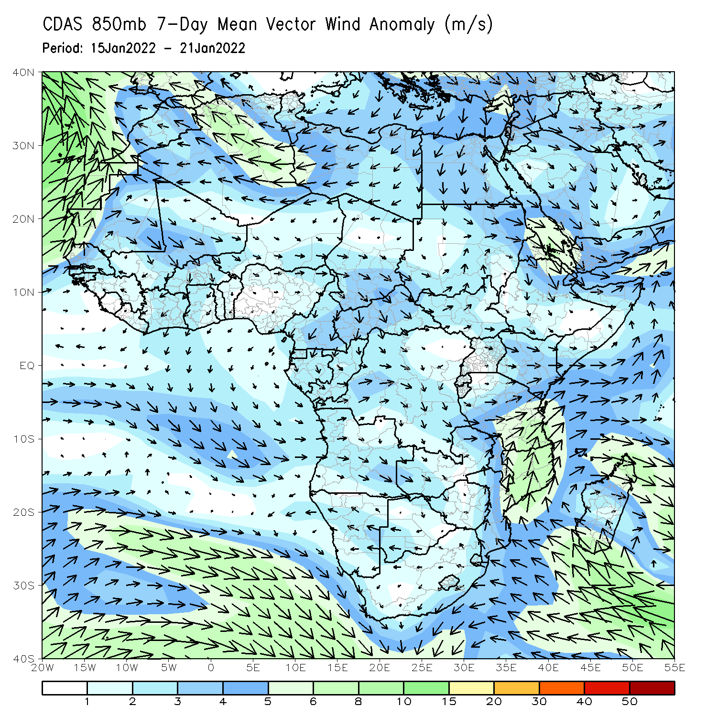
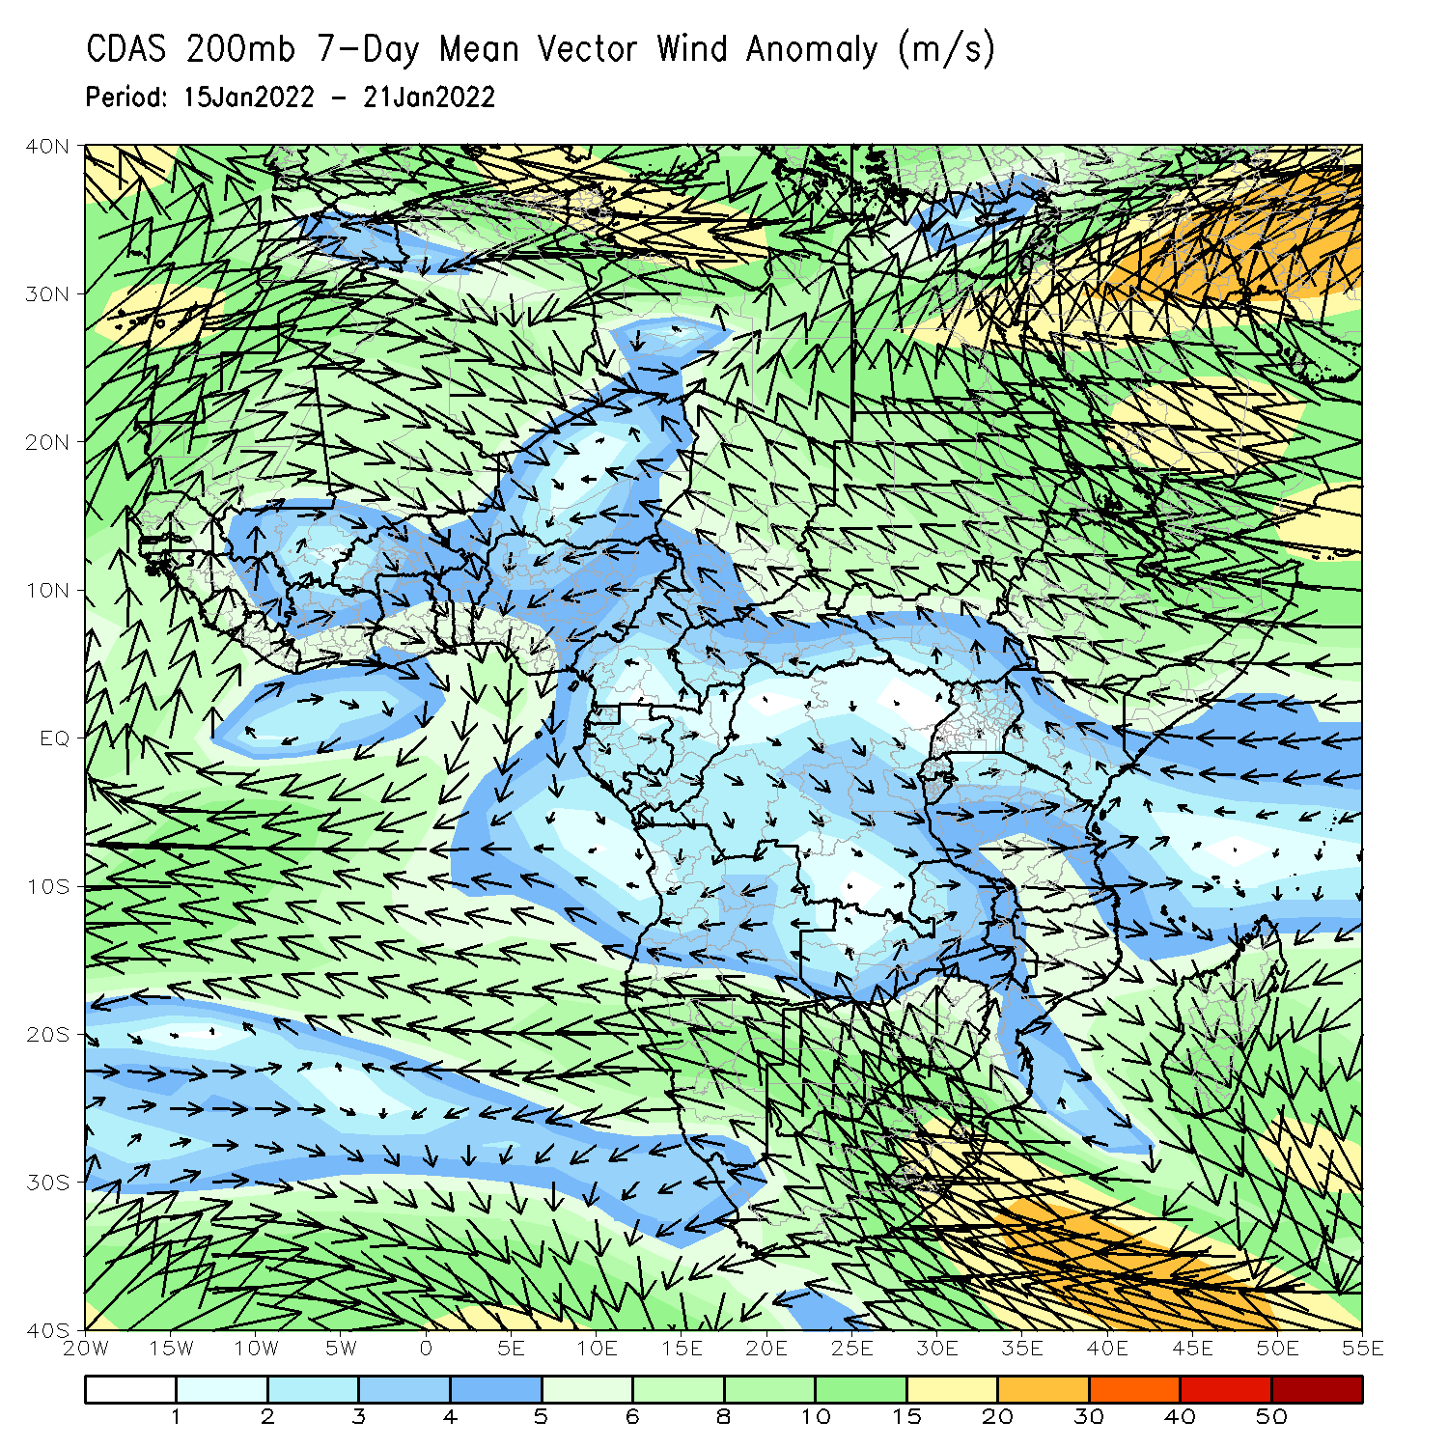
Atmospheric Circulation: Last 7 Days
At 850-hPa level (left panel), anomalous wind convergence is observed across southeastern Africa.

Slide 8
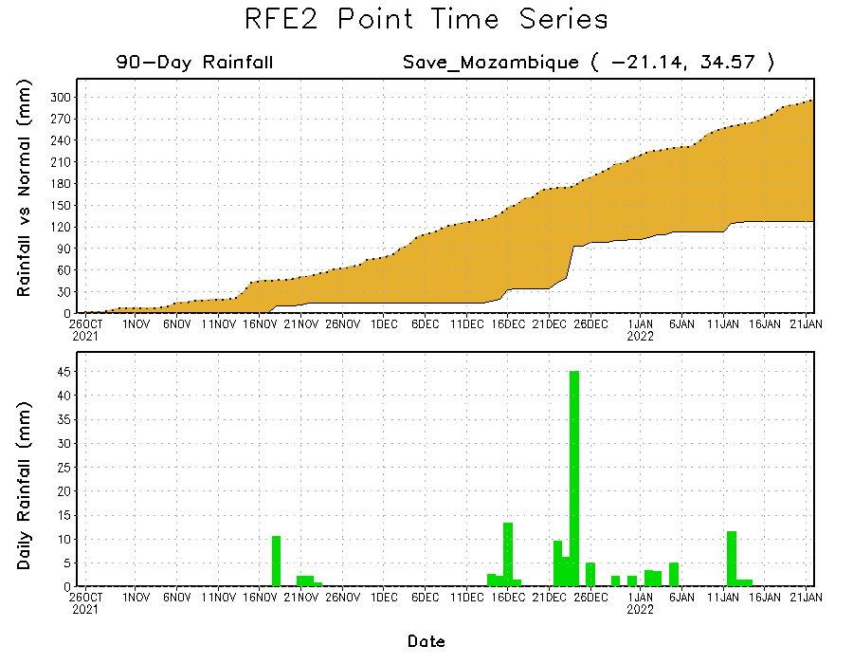
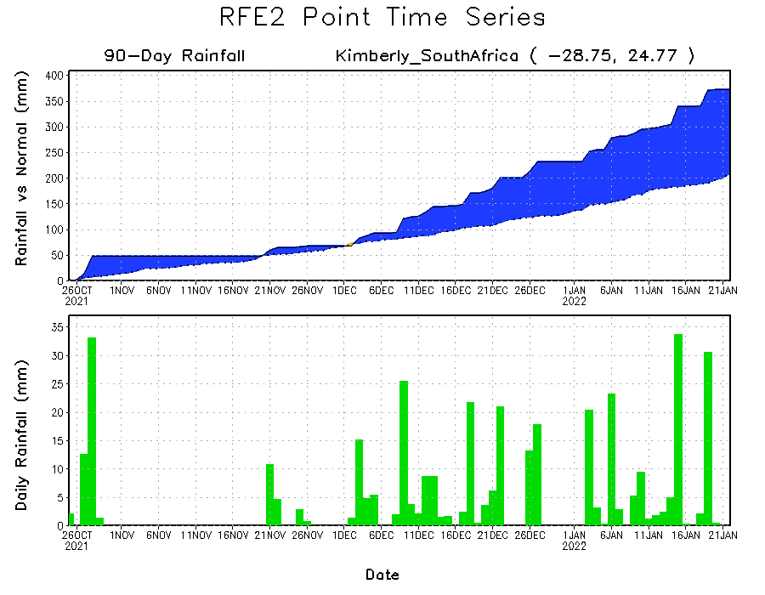
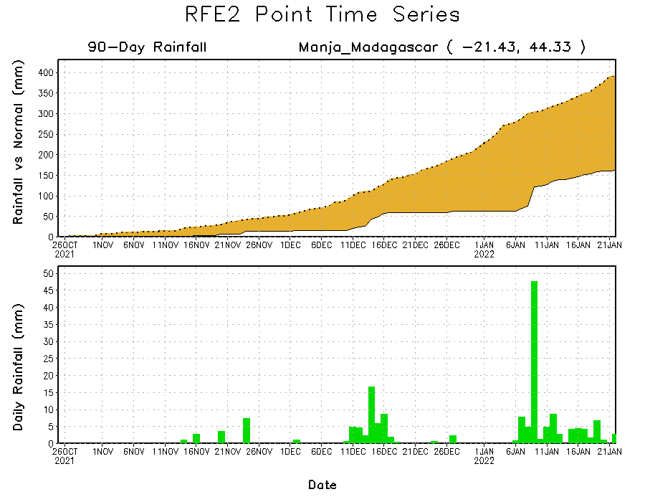
Rainfall Evolution
Daily evolution of rainfall over the last 90 days at selected locations shows moderate sustained moisture surpluses over parts of South Africa (bottom left). The seasonal total rainfall remained below-average over southern Mozambique (top right) and southwestern Madagascar (bottom right).

Slide 9
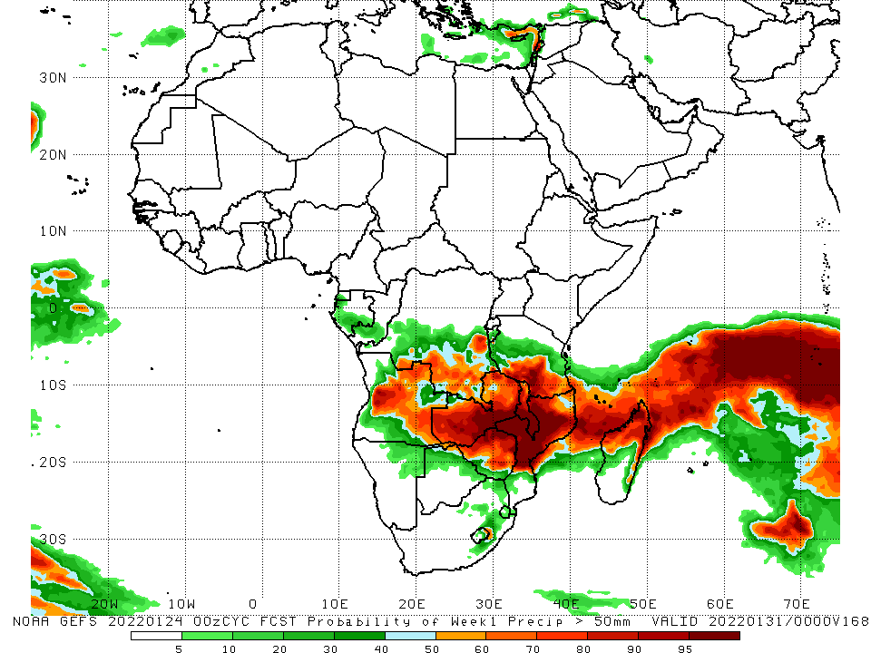
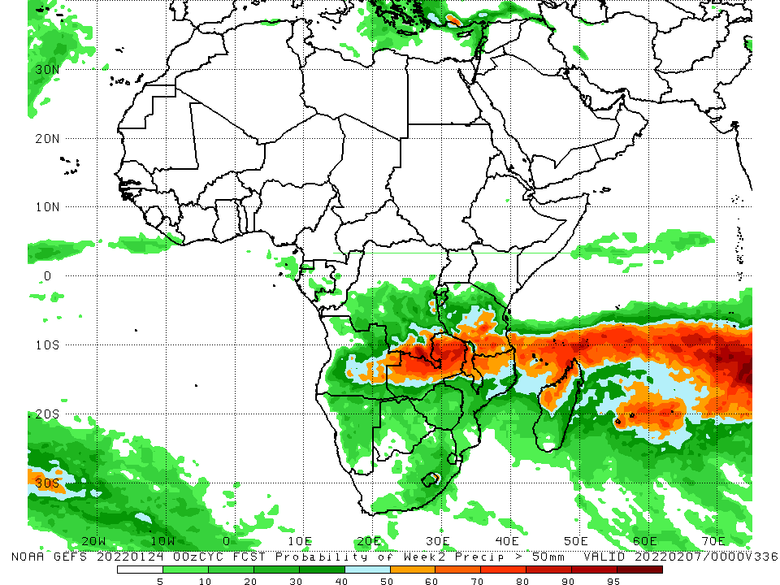
NCEP GEFS Model Forecasts Non-Bias Corrected Probability of precipitation exceedance
Week-1, Valid: 25 – 31 Jan, 2022
Week-2, Valid: 01 – 07 Feb, 2022
For week-1 (left panel), week-2 (right panel), the NCEP GEFS indicates a moderate to high chance (over 70%) for rainfall to exceed 50 mm over across the northern portions of Southern Africa, including northern Madagascar.
Notes:
9

Slide 10
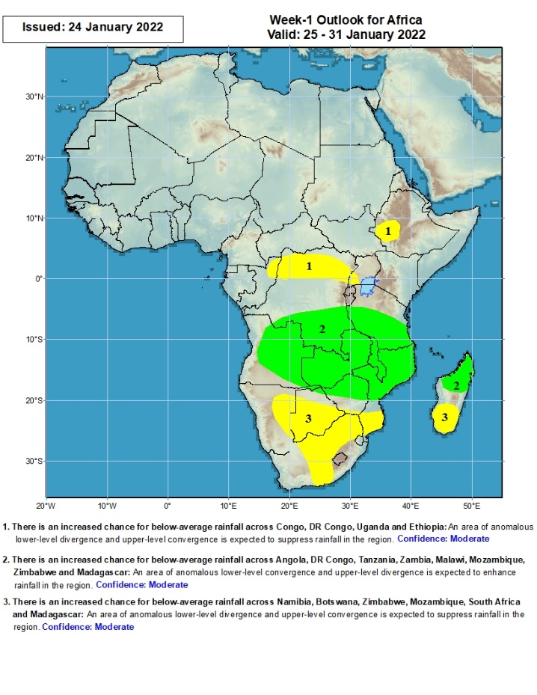
Week-1 Precipitation Outlooks
25 – 31 Jan, 2022
There is an increased chance for below-average rainfall across Congo, DR Congo, Uganda and Ethiopia: An area of anomalous lower-level divergence and upper-level convergence is expected to suppress rainfall in the region. Confidence: Moderate
There is an increased chance for above-average rainfall across Angola, DR Congo, Tanzania, Zambia, Malawi, Mozambique, Zimbabwe and Madagascar: An area of anomalous lower-level convergence and upper-level divergence is expected to enhance rainfall in the region. Confidence: Moderate
There is an increased chance for below-average rainfall across Namibia, Botswana, Zimbabwe, Mozambique, South Africa and Madagascar: An area of anomalous lower-level divergence and upper-level convergence is expected to suppress rainfall in the region. Confidence: Moderate
Notes:
10

Slide 11
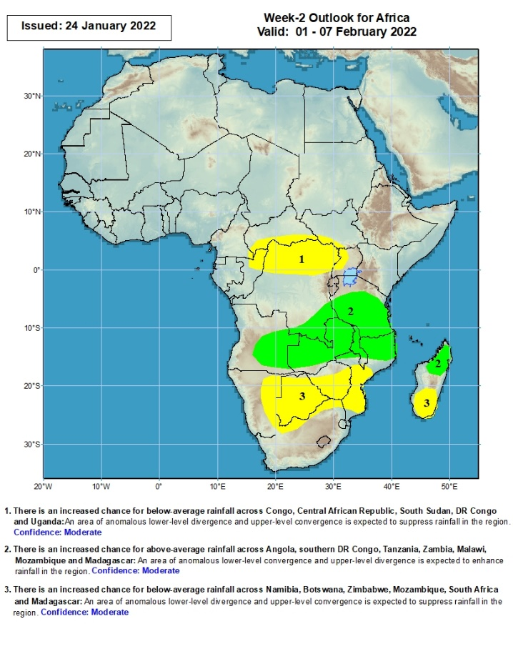
Week-2 Precipitation Outlooks
1 – 7 Feb, 2022
There is an increased chance for below-average rainfall across Congo, Central African Republic, South Sudan, DR Congo and Uganda: An area of anomalous lower-level divergence and upper-level convergence is expected to suppress rainfall in the region. Confidence: Moderate
There is an increased chance for above-average rainfall across Angola, southern DR Congo, Tanzania, Zambia, Malawi, Mozambique and Madagascar: An area of anomalous lower-level convergence and upper-level divergence is expected to enhance rainfall in the region. Confidence: Moderate
There is an increased chance for below-average rainfall across Namibia, Botswana, Zimbabwe, Mozambique, South Africa and Madagascar: An area of anomalous lower-level divergence and upper-level convergence is expected to suppress rainfall in the region. Confidence: Moderate
Notes:
11

Slide 12
Summary
During the past 30 days, in East Africa, above-average rainfall was observed over parts of western and northern Ethiopia, southern Uganda, Rwanda, Burundi, eastern Kenya and the neighboring areas of southern Somalia, and parts of western Tanzania. Rainfall was below-average over parts of southern Ethiopia, western Kenya, northern Uganda, and central and southern Tanzania. In Central Africa, rainfall was below-average pockets of northern DRC and northern Congo. Rainfall was above-average over Equatorial Guinea and Gabon and many parts of DRC. In Southern Africa, above-average rainfall was observed over northern and eastern Angola, much of Botswana and Zimbabwe, Zambia, Malawi, northern Mozambique, eastern Madagascar and much of South Africa. Below-average rainfall was observed over southwestern Angola, Namibia, southern Mozambique, and western Madagascar.
During the past 7 days, in East Africa, rainfall was above-average over parts of southern Ethiopia, Rwanda, Burundi, Kenya, Uganda, and much of Tanzania. In central Africa, rainfall was above-average over much of DRC and parts of Congo. Rainfall was below-average over Equatorial Guinea, Gabon and southern Congo. In Southern Africa, rainfall was above-average over northern and eastern Zambia, central and southern Namibia, northern Malawi, northern Mozambique, much of South Africa, and Madagascar. Below-average rainfall was observed over much of Angola, parts of northern Namibia, western Zambia, Botswana, Zimbabwe, southern Malawi, northeastern South Africa, southern Mozambique, and pockets of southwestern Madagascar .
Week-1 and week-2 outlooks call for an increased chance for above-average rainfall across the northern portions of Southern Africa. In contrast, there is an increased chance for below-average rainfall over the southern portions of Southern Africa, and equatorial Central Africa.

