Slide 1
The African Monsoon Recent Evolution and Current Status Include Week-1 and Week-2 Outlooks
Update prepared by
14 March 2022
For more information, visit:
http://www.cpc.ncep.noaa.gov/products/Global_Monsoons/African_Monsoons/precip_monitoring.shtml

Slide 2
Outline
Highlights
Recent Evolution and Current Conditions
NCEP GEFS Forecasts
Summary

Slide 3
Highlights: Last 7 Days
During the past 7 days, in East Africa, rainfall was above-average over parts of southern Tanzania. Below-average was observed over parts of southern Ethiopia, Uganda, and northern Tanzania. In central Africa, rainfall was above-average over Cameroon and over northern Congo and northern DRC. Rainfall was below-average over Equatorial Guinea, Gabon, southern Congo, and central and southern DRC. In Southern Africa, rainfall was above-average over many parts of Angola, Botswana, northern and western Zambia, western and central South Africa, northern Mozambique and northern Madagascar. Below-average rainfall was observed over southwestern and northwestern Angola, southern Zambia, parts of Namibia, Zimbabwe, and central and southern Mozambique, and southern Madagascar. In West Africa, above-average rainfall was observed over parts of Liberia and Cote d’Ivoire.
Week-1 outlooks call for an increased chance for above-average rainfall across the eastern portion of Southern Africa, including Madagascar, while there is an increased chance for below-average rainfall over portions of Central and East Africa. Week-2 outlooks call for an increased chance for below-average rainfall over much of Central Africa, Ethiopia, and portions of Southern Africa, while there is an increased chance for above-average rainfall over parts of Angola and Tanzania.

Slide 4
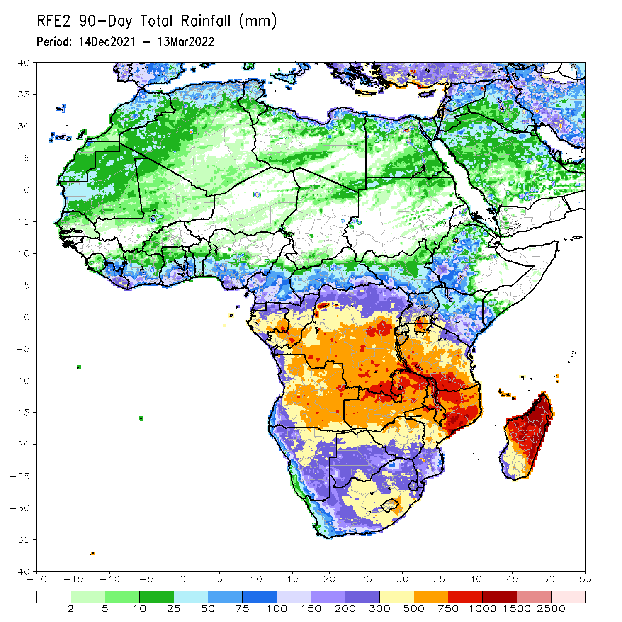
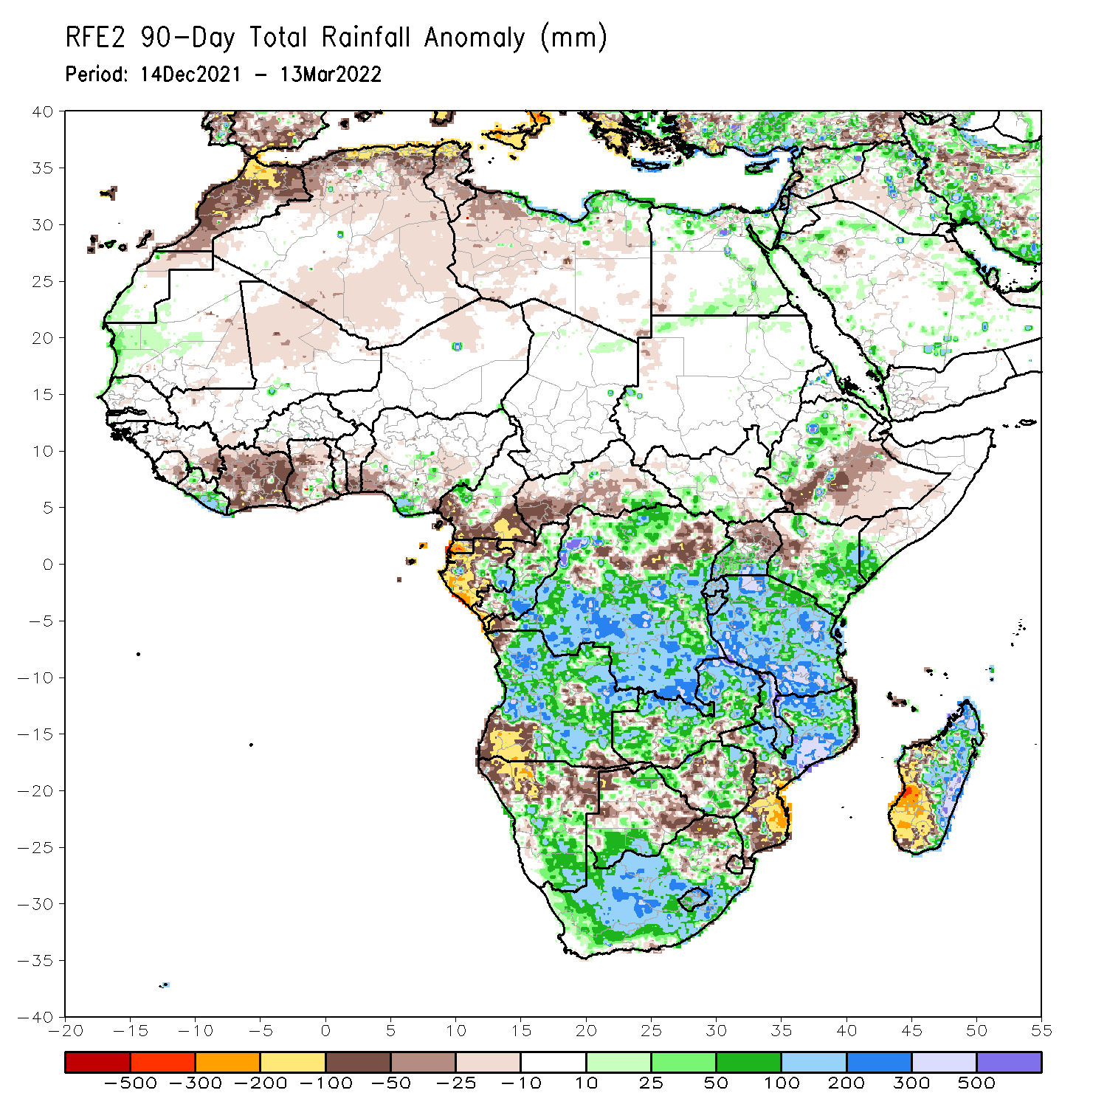
Rainfall Patterns: Last 90 Days
Over the past 90 days, in East Africa, above-average rainfall was observed over parts of northern and western Ethiopia, Rwanda, Burundi, southern Uganda, eastern and southern Kenya, southwestern Somalia, and much of Tanzania. Rainfall was below-average over southern Ethiopia, parts of western Kenya, and northern Uganda. In southern Africa, above-average rainfall was observed over many parts of Angola, parts of Botswana, central and southern Namibia, portions of Zimbabwe and Zambia, Malawi, northern Mozambique, eastern Madagascar and much of South Africa. Below-average rainfall was observed over eastern and southwestern Angola, northern Namibia, pockets of Zambia, central and northern Botswana, parts of Zimbabwe, southern Mozambique and western Madagascar. In Central Africa, rainfall was above-average over many parts of DRC, eastern Gabon, and Congo. Rainfall was below-average over southern Cameroon, parts of northern DRC, Equatorial Guinea, western Gabon, much of CAR, and the far northern Congo. In West Africa, rainfall was below-average over many places in the Gulf of Guinea region, while above-average rainfall was observed over much of Liberia.
Notes:
4

Slide 5
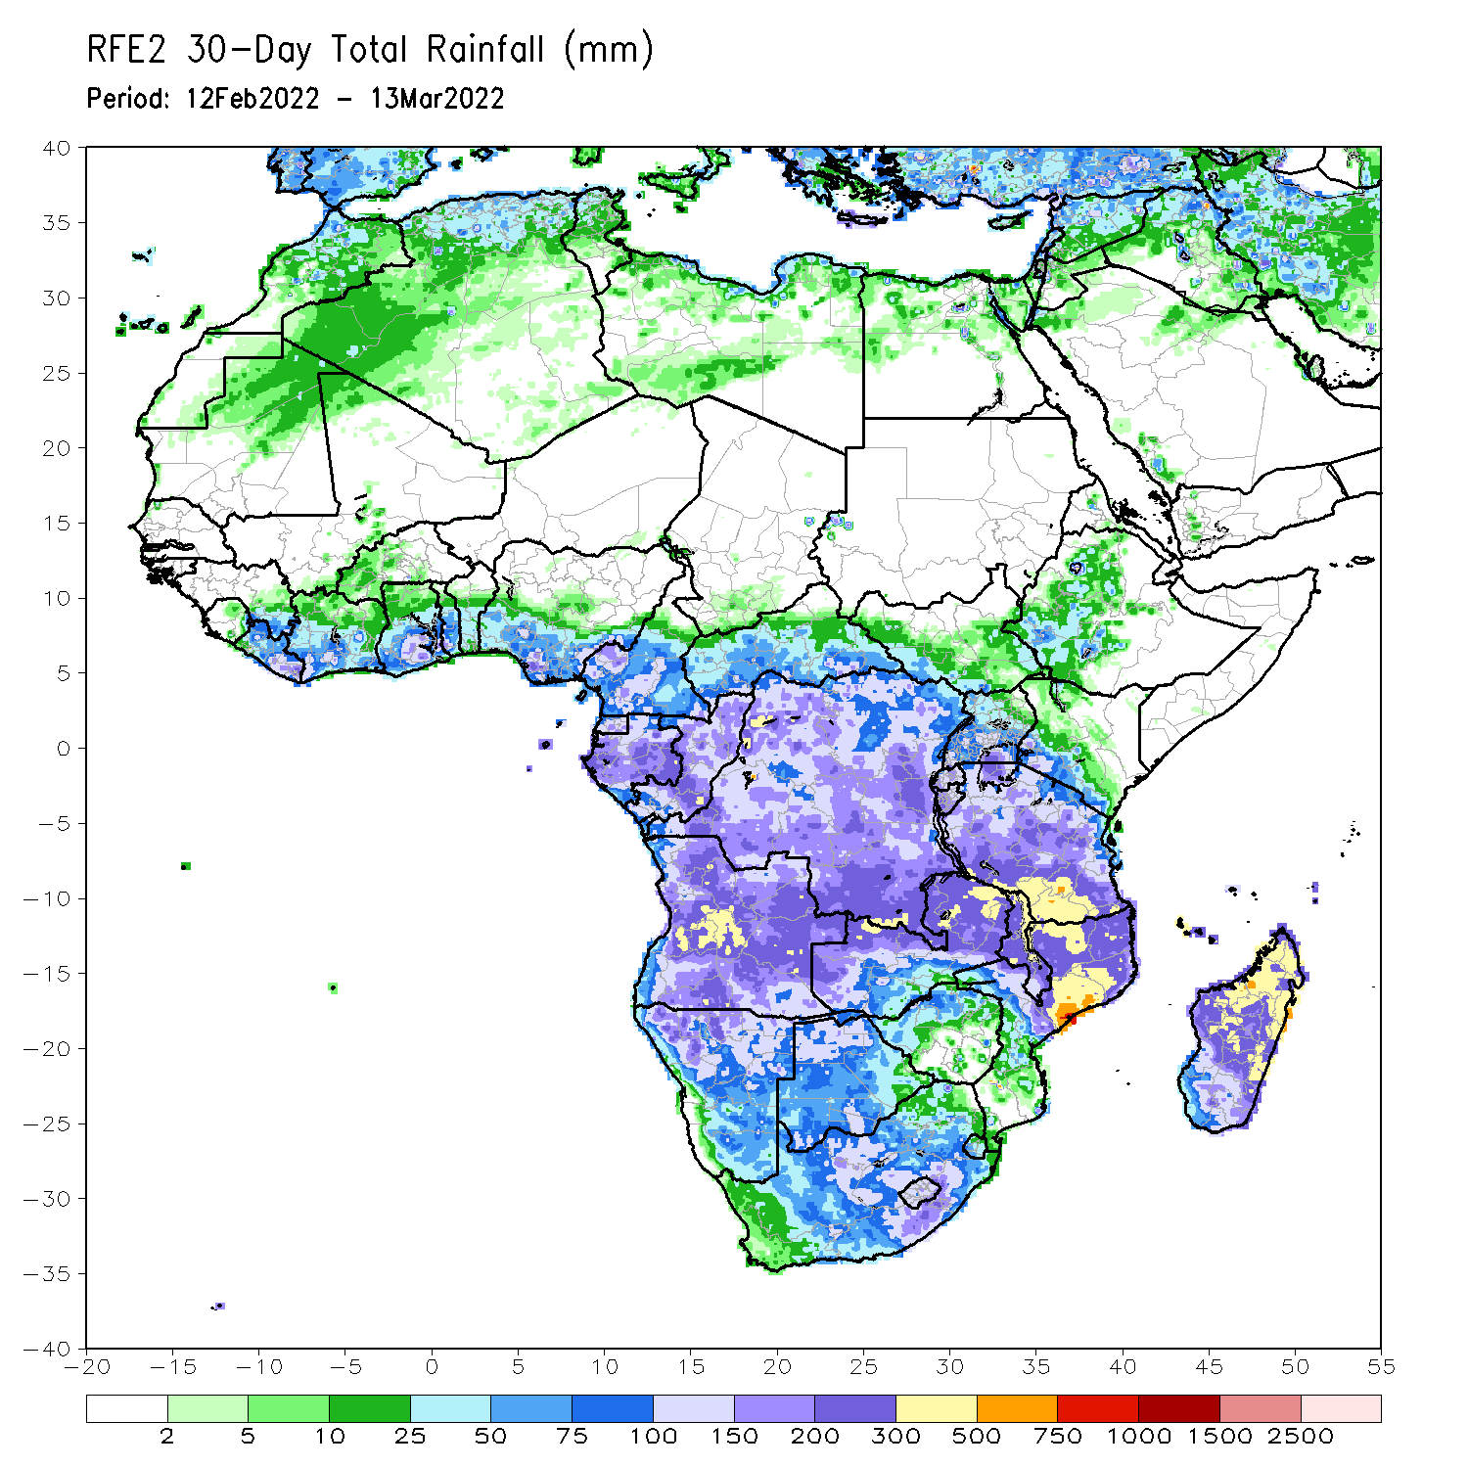
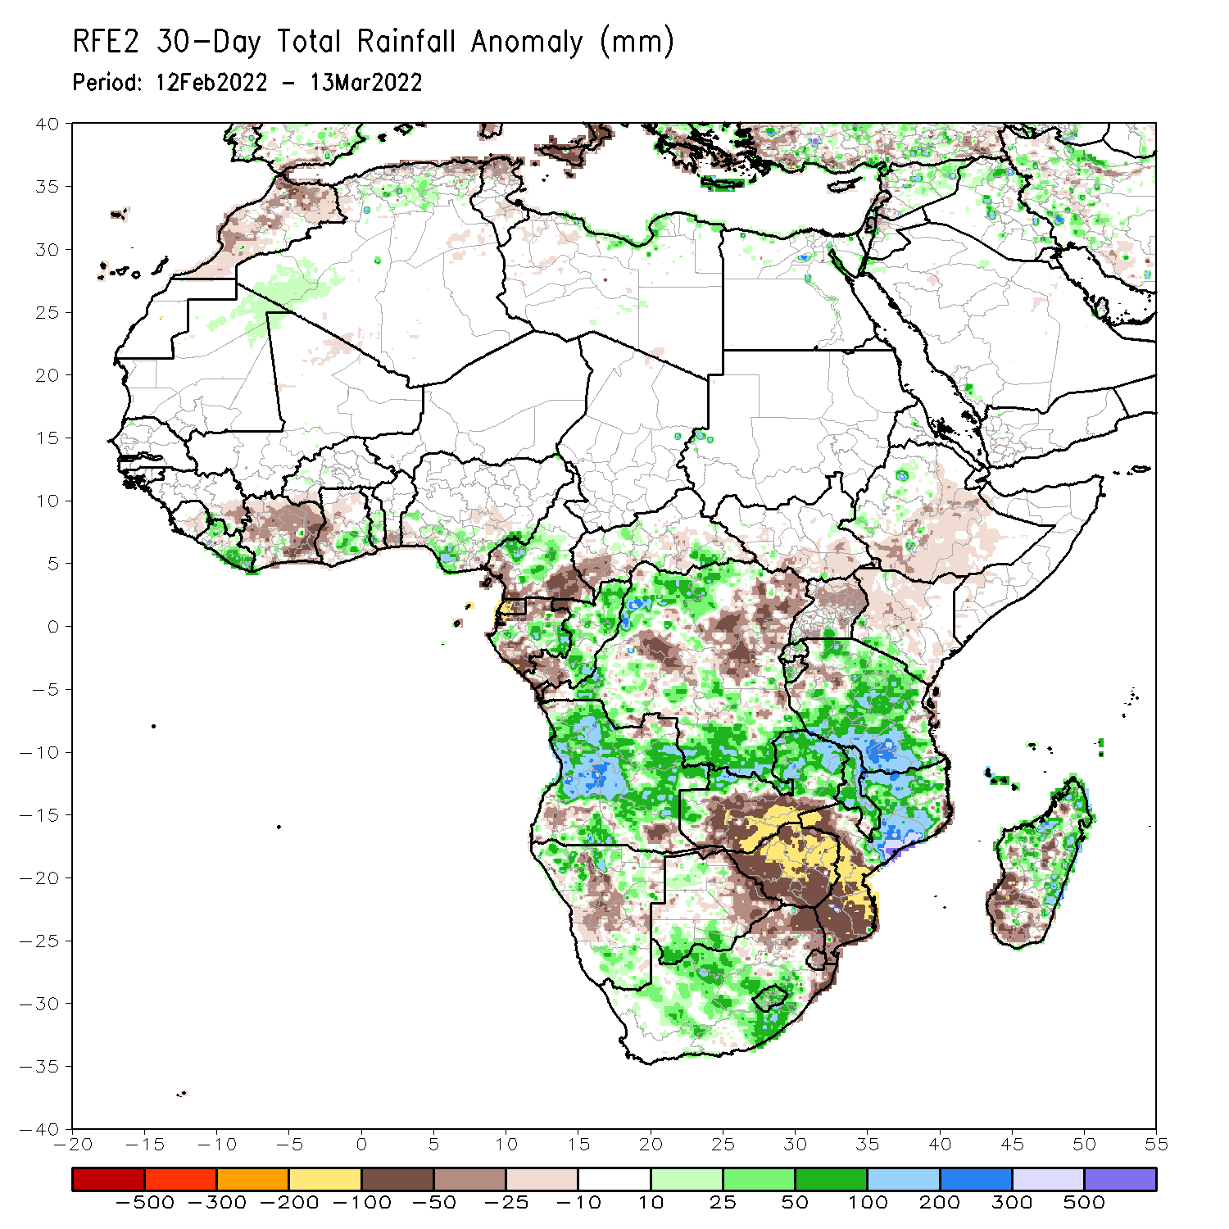
Rainfall Patterns: Last 30 Days
During the past 30 days, in East Africa, above-average rainfall was observed over pocket of northwestern Ethiopia, and much of Tanzania. Rainfall was below-average over parts of central and eastern Ethiopia, southern South Sudan, Kenya and Uganda. In Central Africa, rainfall was below-average over southern Cameroon, Equatorial Guinea, parts of Gabon, southern Congo, CAR and many parts of DRC. Rainfall was above-average over eastern Gabon, central and northern Congo, and the far northern southern DRC. In Southern Africa, above-average rainfall was observed over much of Angola, northwestern and southern Namibia, northern and eastern Zambia, Malawi, northern Mozambique, central and northern Madagascar, and eastern South Africa. Below-average rainfall was observed over parts of southern Angola, central and eastern Namibia, eastern Botswana, southwestern Zambia, much of Zimbabwe, northeastern South Africa, southern Mozambique and southwestern Madagascar. In West Africa, rainfall was above-average over pockets of Liberia, southern Ghana and southern Nigeria. Below-average rainfall was observed over much of Cote d’Ivoire and parts of Ghana.
Notes:
5

Slide 6
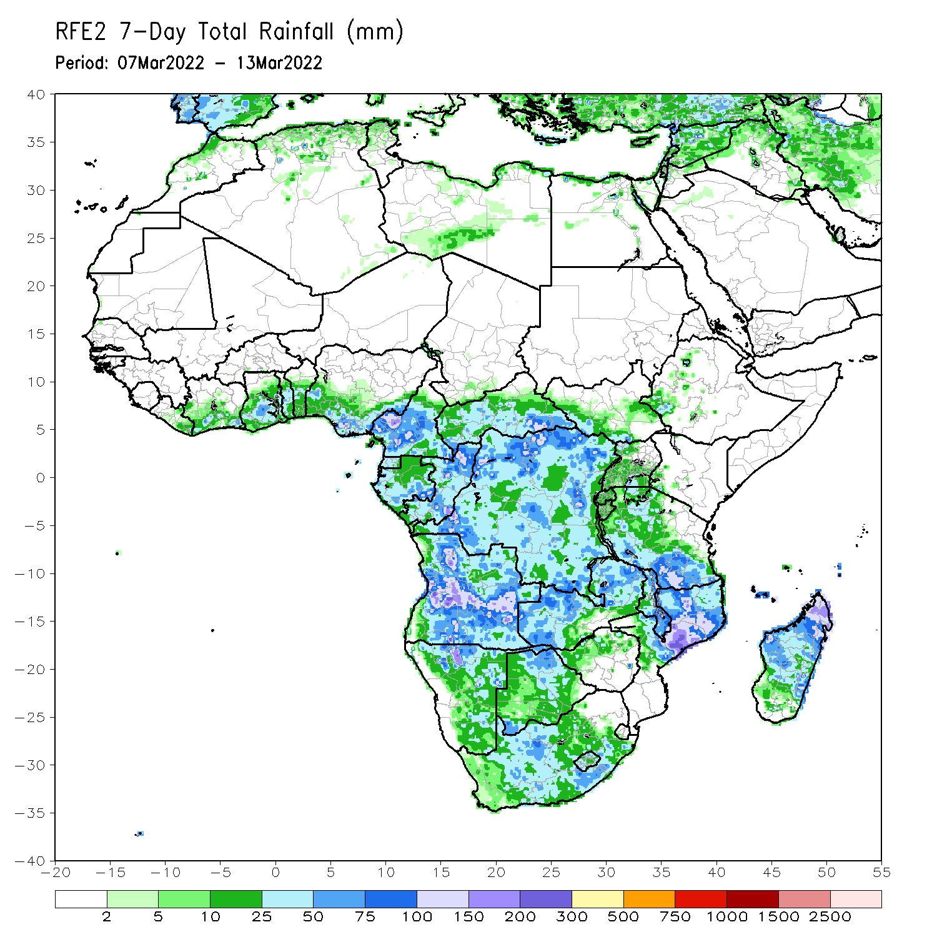
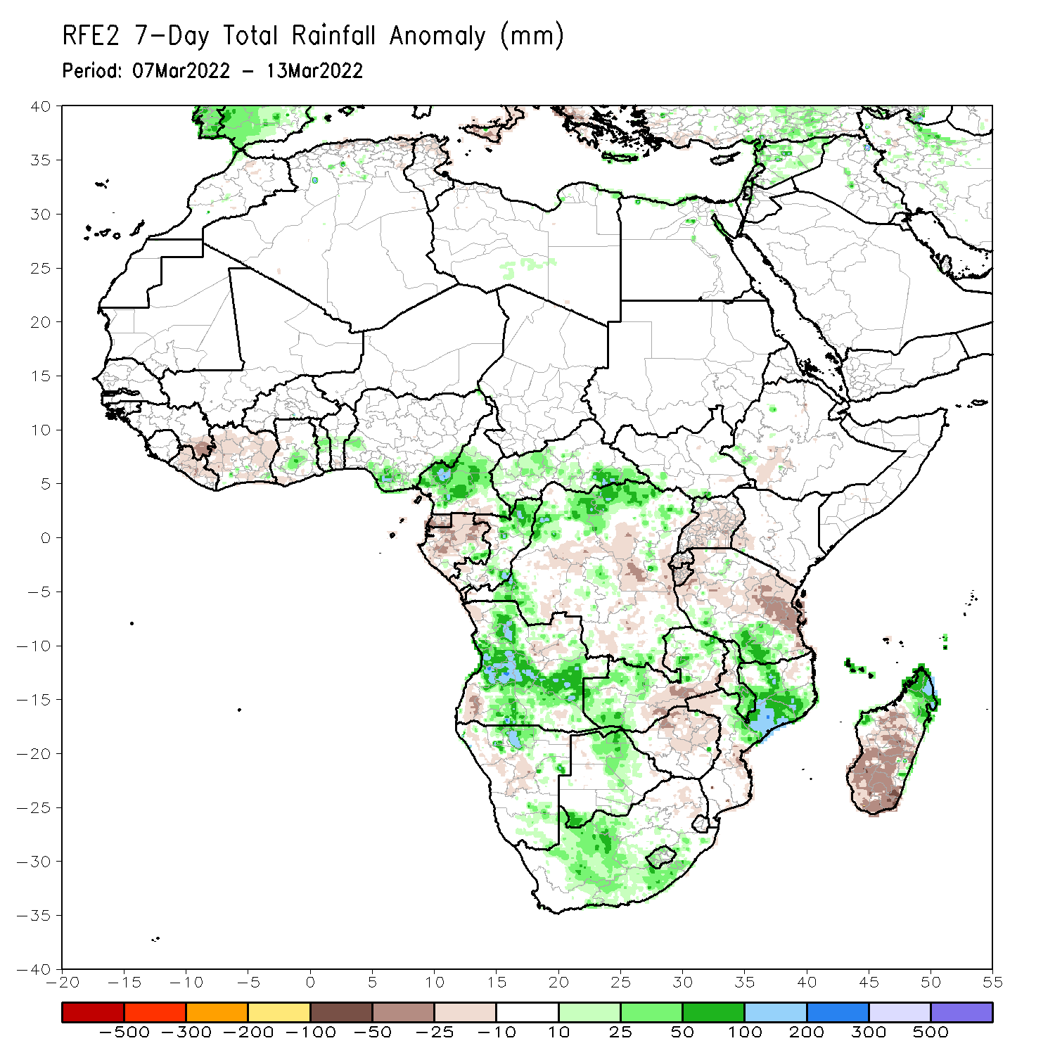
Rainfall Patterns: Last 7 Days
During the past 7 days, in East Africa, rainfall was above-average over parts of southern Tanzania. Below-average was observed over parts of southwestern Ethiopia, Uganda, and northern Tanzania. In central Africa, rainfall was above-average over Cameroon and northern Congo and northern DRC. Rainfall was below-average over Equatorial Guinea, Gabon, southern Congo, and central and southern DRC. In Southern Africa, rainfall was above-average over many parts of Angola, Botswana, northern and western Zambia, western and central South Africa, northern Mozambique and northern Madagascar. Below-average rainfall was observed over pockets of southwestern and northwestern Angola, southern Zambia, parts of Namibia, Zimbabwe, central and southern Mozambique, and southern Madagascar. In West Africa, above-average rainfall was observed over parts of southern Ghana and southern Nigeria.

Slide 7
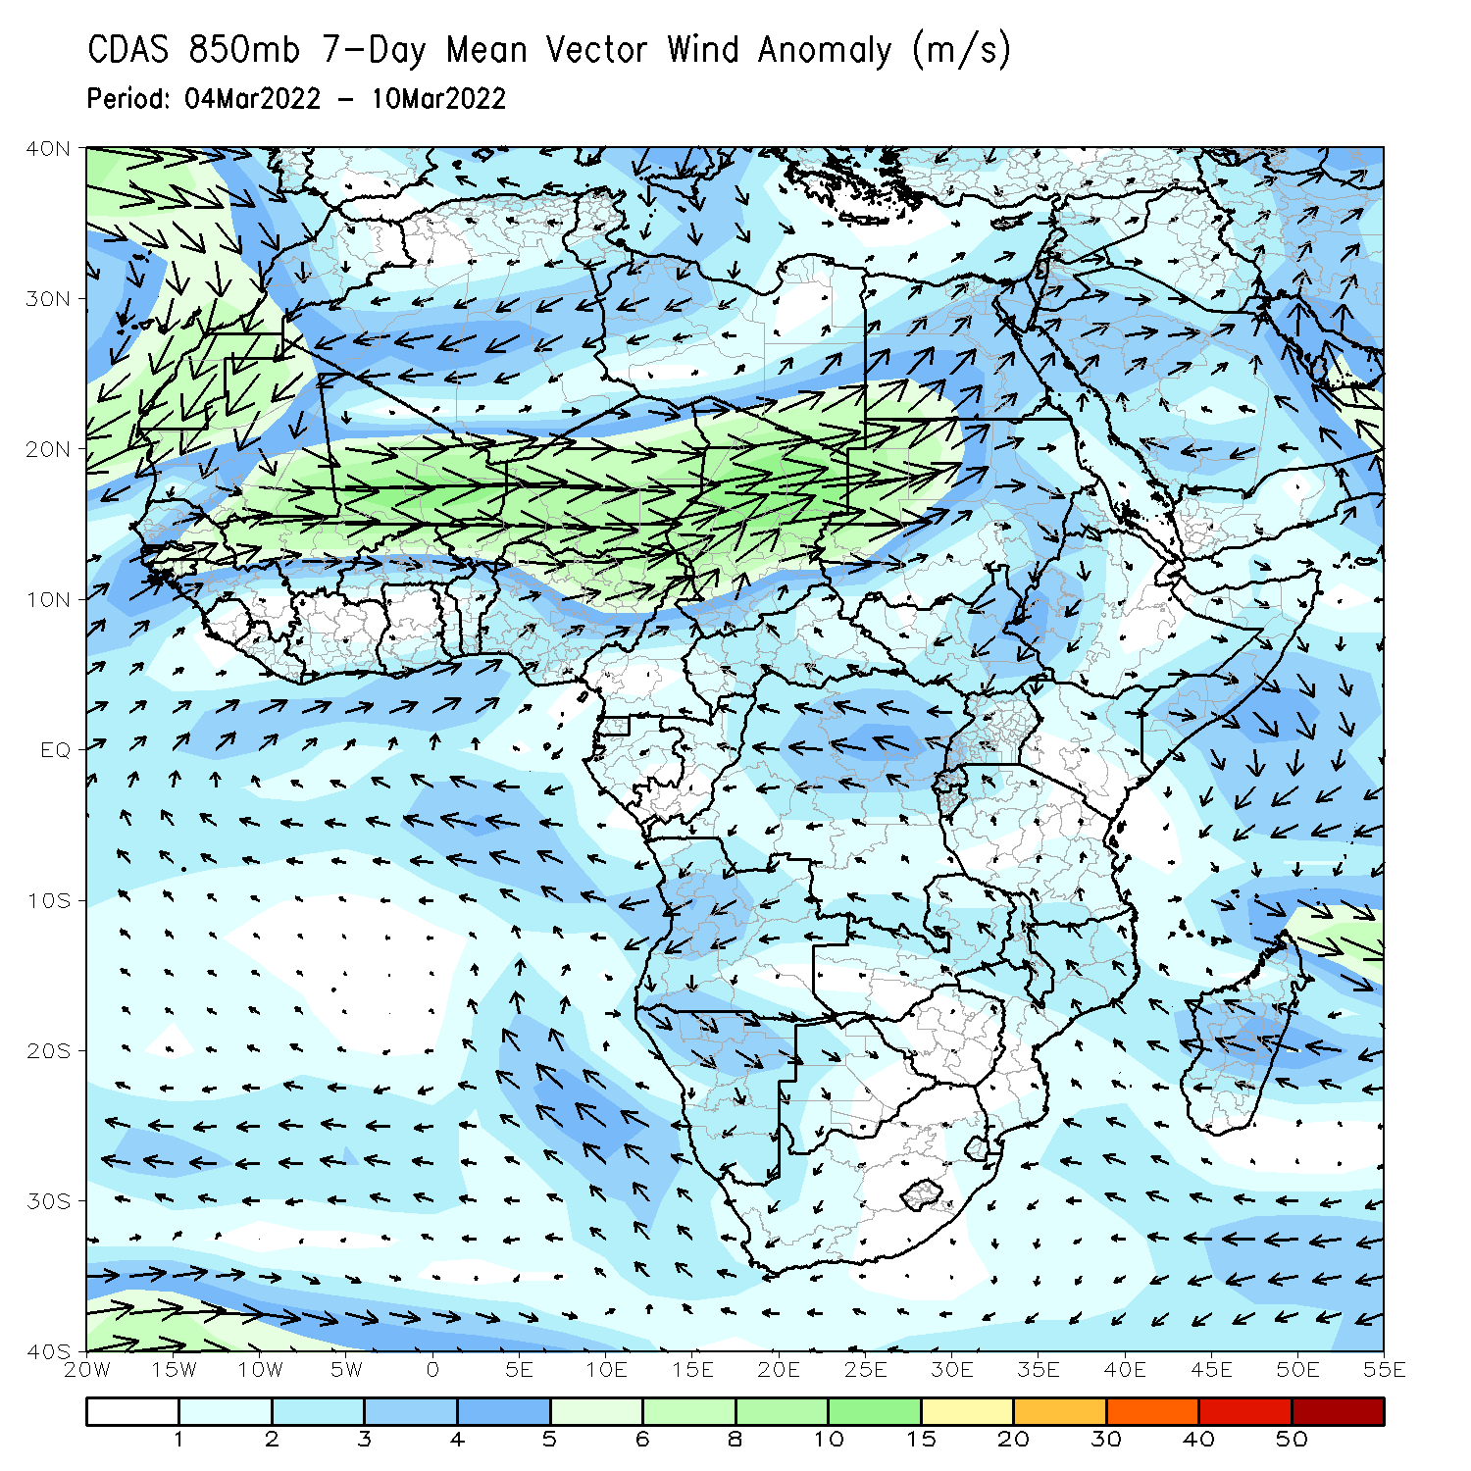
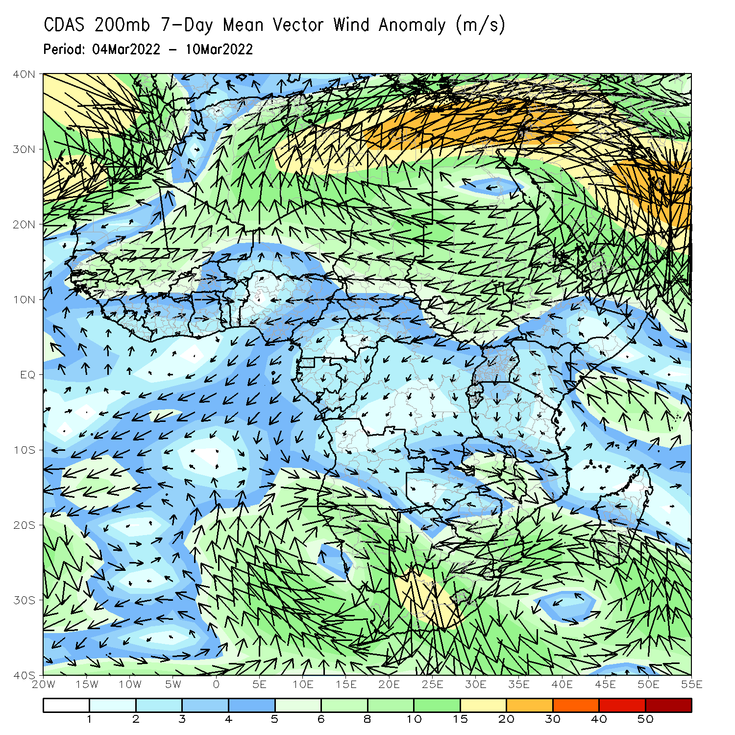
Atmospheric Circulation: Last 7 Days
At 850-hPa level (left panel), an area of anti-cyclonic circulation was observed across portions of Southern Africa.

Slide 8
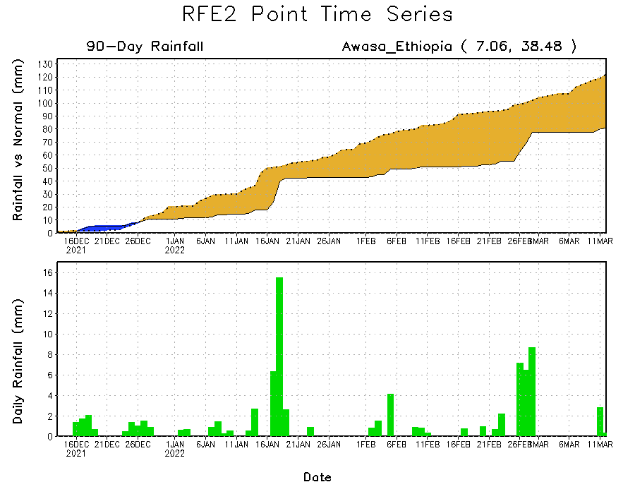
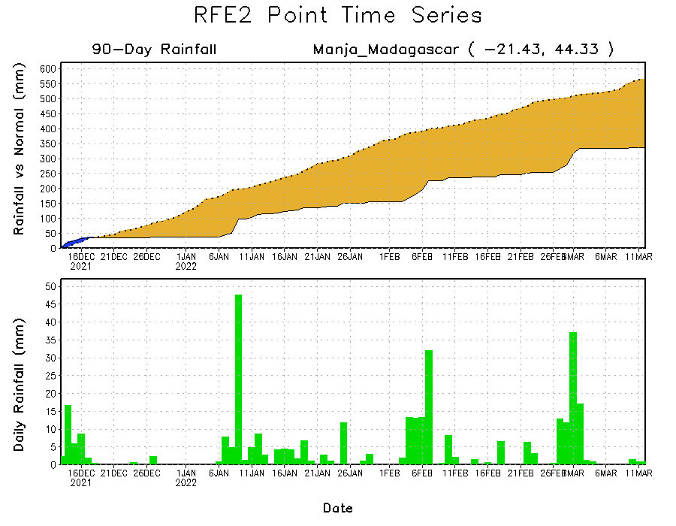
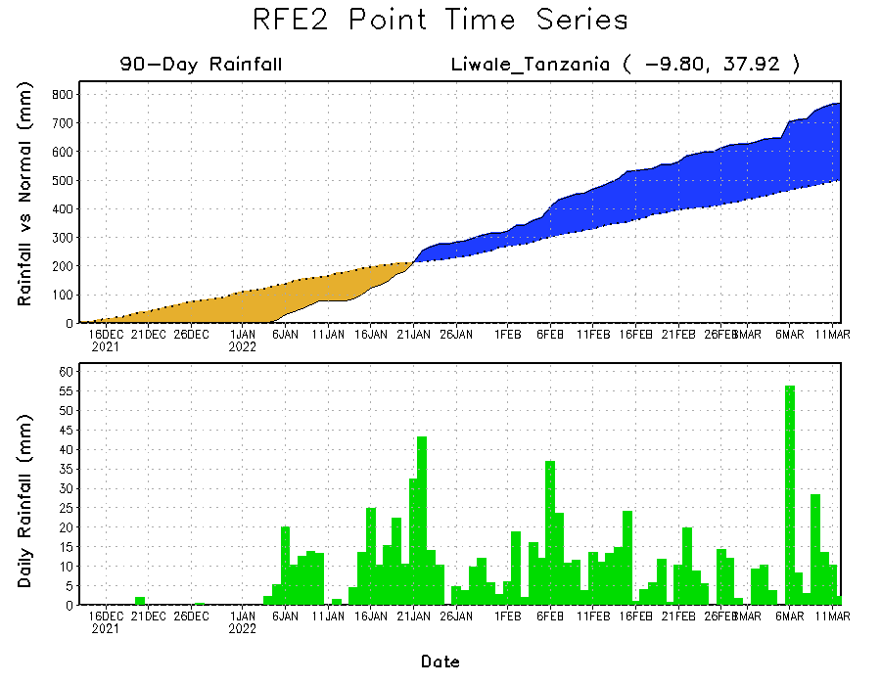
Rainfall Evolution
Daily evolution of rainfall over the last 90 days at selected locations shows moderate sustained moisture surpluses over parts of Tanzania (bottom right). The seasonal total rainfall remained below-average over parts of southern Madagascar (bottom left) and southern Ethiopia (top right).

Slide 9
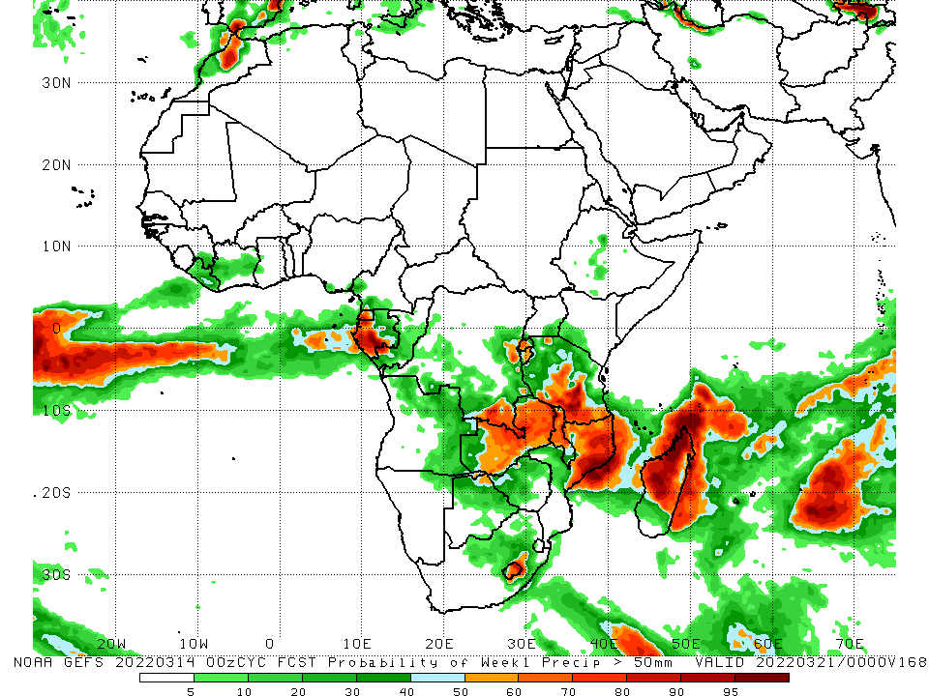
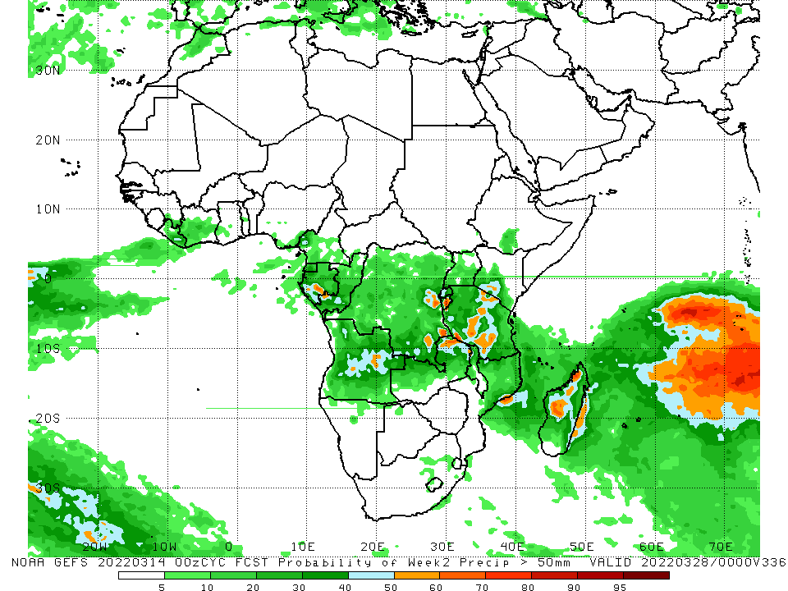
NCEP GEFS Model Forecasts Non-Bias Corrected Probability of precipitation exceedance
Week-1, Valid: 15 – 21 Mar, 2022
Week-2, Valid: 22 – 28 Mar, 2022
For week-1 (left panel), the NCEP GEFS indicates a moderate to high chance (over 70%) for rainfall to exceed 50 mm over the eastern portion of Southern Africa, including Madagascar.
Notes:
9

Slide 10
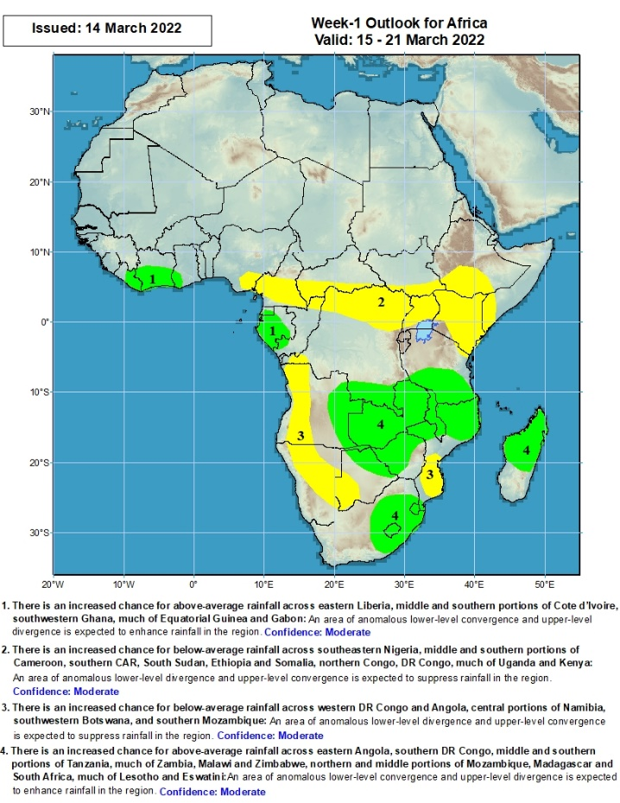
Week-1 Precipitation Outlooks
15 – 21 Mar, 2022
There is an increased chance for above-average rainfall across eastern Liberia, middle and southern portions of Cote d’Ivoire, southwestern Ghana, much of Equatorial Guinea and Gabon: An area of anomalous lower-level convergence and upper-level divergence is expected to enhance rainfall in the region. Confidence: Moderate
There is an increased chance for below-average rainfall across southeastern Nigeria, middle and southern portions of Cameroon, southern CAR, South Sudan, Ethiopia and Somalia, northern Congo, DR Congo, much of Uganda and Kenya: An area of anomalous lower-level divergence and upper-level convergence is expected to suppress rainfall in the region. Confidence: Moderate
There is an increased chance for below-average rainfall across western DR Congo and Angola, central portions of Namibia, southwestern Botswana, and southern Mozambique: An area of anomalous lower-level divergence and upper-level convergence is expected to suppress rainfall in the region. Confidence: Moderate
There is an increased chance for above-average rainfall across eastern Angola, southern DR Congo, middle and southern portions of Tanzania, much of Zambia, Malawi and Zimbabwe, northern and middle portions of Mozambique, Madagascar and South Africa, much of Lesotho and Eswatini: An area of anomalous lower-level convergence and upper-level divergence is expected to enhance rainfall in the region. Confidence: Moderate
Notes:
10

Slide 11
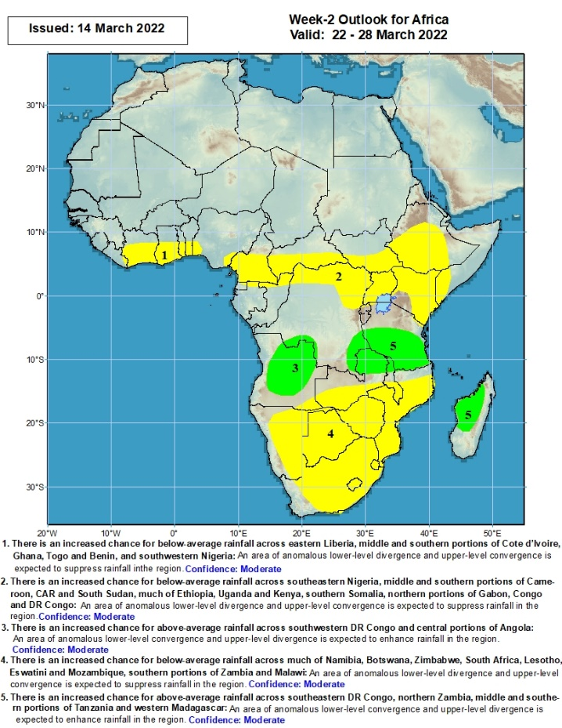
Week-2 Precipitation Outlooks
22 – 28 Mar, 2022
There is an increased chance for below-average rainfall across eastern Liberia, middle and southern portions of Cote d’Ivoire, Ghana, Togo and Benin, and southwestern Nigeria: An area of anomalous lower-level divergence and upper-level convergence is expected to suppress rainfall in the region. Confidence: Moderate
There is an increased chance for below-average rainfall across southeastern Nigeria, middle and southern portions of Cameroon, CAR and South Sudan, much of Ethiopia, Uganda and Kenya, southern Somalia, northern portions of Gabon, Congo and DR Congo: An area of anomalous lower-level divergence and upper-level convergence is expected to suppress rainfall in the region. Confidence: Moderate
There is an increased chance for above-average rainfall across southwestern DR Congo and central portions of Angola: An area of anomalous lower-level convergence and upper-level divergence is expected to enhance rainfall in the region. Confidence: Moderate
There is an increased chance for below-average rainfall across much of Namibia, Botswana, Zimbabwe, South Africa, Lesotho, Eswatini and Mozambique, southern portions of Zambia and Malawi: An area of anomalous lower-level divergence and upper-level convergence is expected to suppress rainfall in the region. Confidence: Moderate
There is an increased chance for above-average rainfall across southeastern DR Congo, northern Zambia, middle and southern portions of Tanzania and western Madagascar: An area of anomalous lower-level convergence and upper-level divergence is expected to enhance rainfall in the region. Confidence: Moderate
Notes:
11

Slide 12
Summary
During the past 30 days, in East Africa, above-average rainfall was observed over pocket of northwestern Ethiopia, and much of Tanzania. Rainfall was below-average over parts of central and eastern Ethiopia, southern South Sudan, Kenya and Uganda. In Central Africa, rainfall was below-average over southern Cameroon, Equatorial Guinea, parts of Gabon, southern Congo, CAR and many parts of DRC. Rainfall was above-average over eastern Gabon, central and northern Congo, and the far northern southern DRC. In Southern Africa, above-average rainfall was observed over much of Angola, northwestern and southern Namibia, northern and eastern Zambia, Malawi, northern Mozambique, central and northern Madagascar, and eastern South Africa. Below-average rainfall was observed over parts of southern Angola, central and eastern Namibia, eastern Botswana, southwestern Zambia, much of Zimbabwe, northeastern South Africa, southern Mozambique and southwestern Madagascar. In West Africa, rainfall was above-average over pockets of Liberia, southern Ghana and southern Nigeria. Below-average rainfall was observed over much of Cote d’Ivoire and parts of Ghana.
During the past 7 days, in East Africa, rainfall was above-average over parts of southern Tanzania. Below-average was observed over parts of southern Ethiopia, Uganda, and northern Tanzania. In central Africa, rainfall was above-average over Cameroon and over northern Congo and northern DRC. Rainfall was below-average over Equatorial Guinea, Gabon, southern Congo, and central and southern DRC. In Southern Africa, rainfall was above-average over many parts of Angola, Botswana, northern and western Zambia, western and central South Africa, northern Mozambique and northern Madagascar. Below-average rainfall was observed over southwestern and northwestern Angola, southern Zambia, parts of Namibia, Zimbabwe, and central and southern Mozambique, and southern Madagascar. In West Africa, above-average rainfall was observed over parts of Liberia and Cote d’Ivoire.
Week-1 outlooks call for an increased chance for above-average rainfall across the eastern portion of Southern Africa, including Madagascar, while there is an increased chance for below-average rainfall over portions of Central and East Africa. Week-2 outlooks call for an increased chance for below-average rainfall over much of Central Africa, Ethiopia, and portions of Southern Africa, while there is an increased chance for above-average rainfall over parts of Angola and Tanzania.

