Slide 1
The African Monsoon Recent Evolution and Current Status Include Week-1 and Week-2 Outlooks
Update prepared by
02 May 2022
For more information, visit:
http://www.cpc.ncep.noaa.gov/products/Global_Monsoons/African_Monsoons/precip_monitoring.shtml

Slide 2
Outline
Highlights
Recent Evolution and Current Conditions
NCEP GEFS Forecasts
Summary

Slide 3
Highlights: Last 7 Days
During the past 7 days, in East Africa, rainfall was above-average over eastern South Sudan, portions of Ethiopia, pockets of Uganda, Kenya and Somalia, and parts of Tanzania. Below-average rainfall was observed over the southern portion of South Sudan. In Central Africa, rainfall was above-average over pockets of Cameroon, CAR, Congo and eastern DRC. Below-average rainfall was observed over southern Gabon, and parts of DRC. In West Africa, above-average rainfall was observed over parts of Ghana, and southern Nigeria.
Week-1 and Week-2 outlooks call for an increased chance for below-average rainfall over the eastern and southern portions of the Greater Horn of Africa. In contrast, there is an increased chance for above-average rainfall over parts of Central Africa.

Slide 4
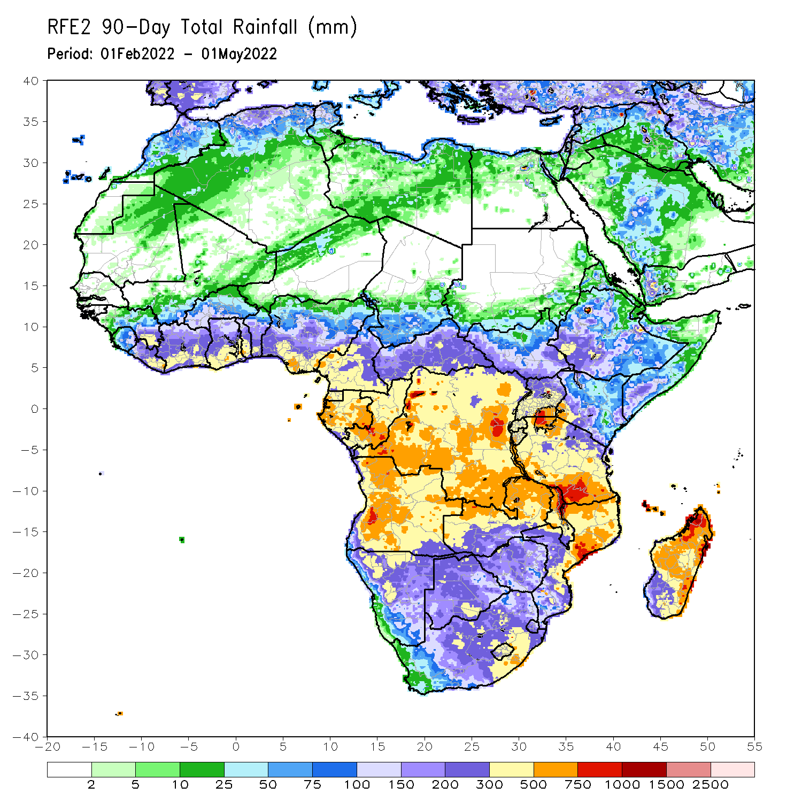
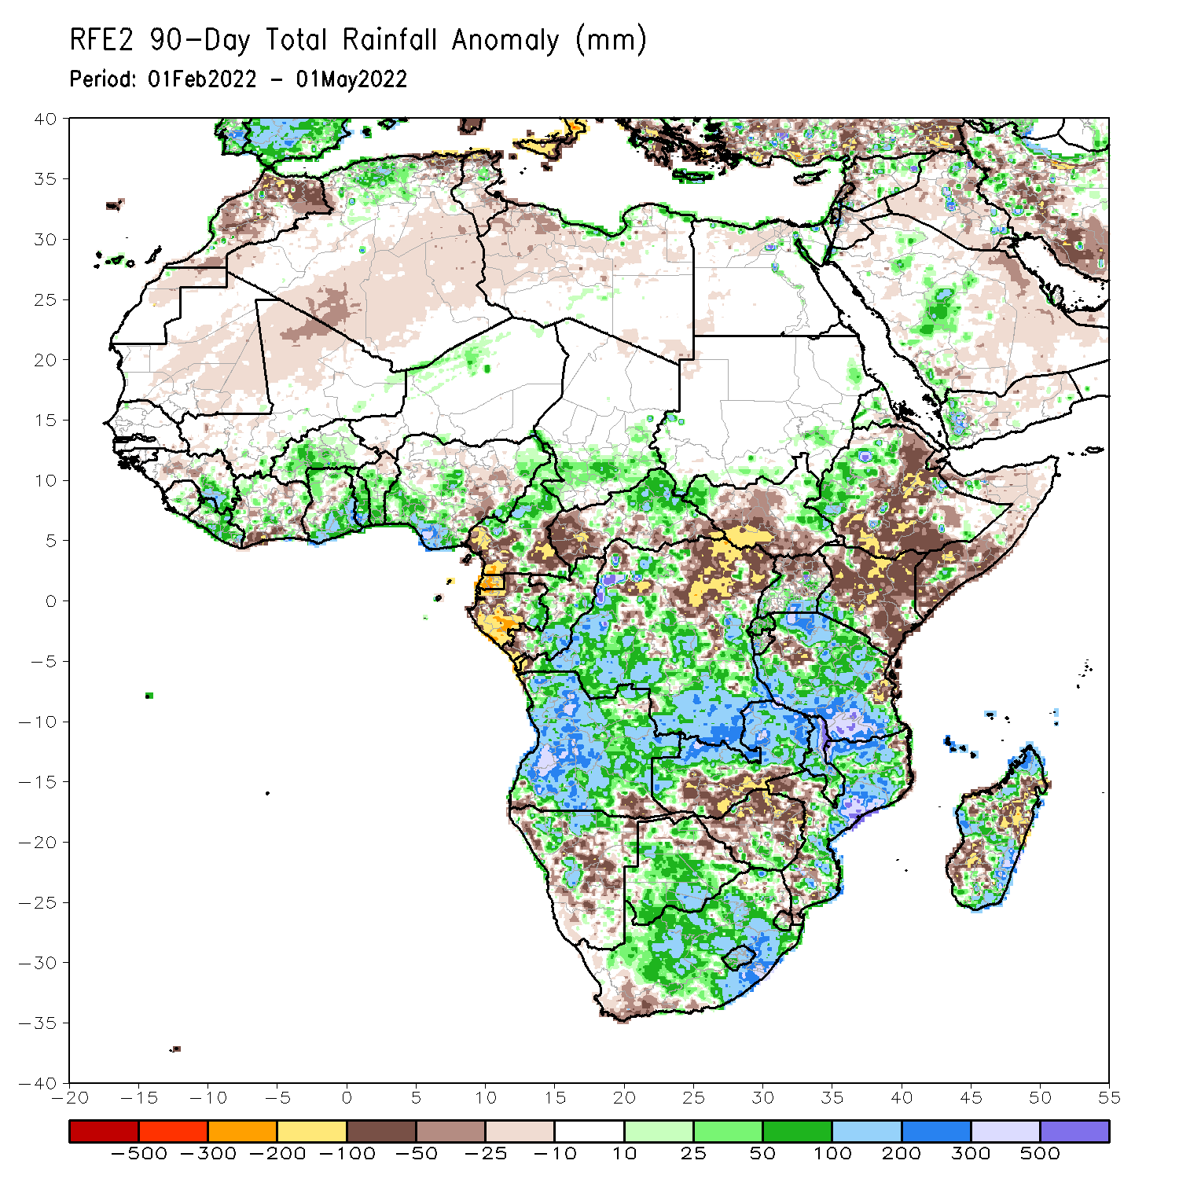
Rainfall Patterns: Last 90 Days
Over the past 90 days, in East Africa, above-average rainfall was observed over parts of western Ethiopia and Eritrea, Rwanda, Burundi, southern Uganda, and much of Tanzania. Rainfall was below-average over central, southern and eastern Ethiopia, much of Kenya, Somalia, and northern Uganda. In southern Africa, above-average rainfall was observed over much of Angola, Botswana, many parts of Namibia, parts of southern Zimbabwe, central and northern Zambia, Malawi, much of Mozambique, many parts of Madagascar, and much of South Africa. Below-average rainfall was observed over pockets of Angola and Namibia, southern Zambia, northern Botswana, much of Zimbabwe, pockets of southern Mozambique and portions of Madagascar. In Central Africa, rainfall was above-average over eastern CAR, many parts of DRC and Congo. Rainfall was below-average over southern Cameroon, northern DRC, Equatorial Guinea, much of Gabon, and western CAR. In West Africa, rainfall was above-average over much of the Gulf of Guinea region, while rainfall was below-average over pockets of Nigeria.
Notes:
4

Slide 5
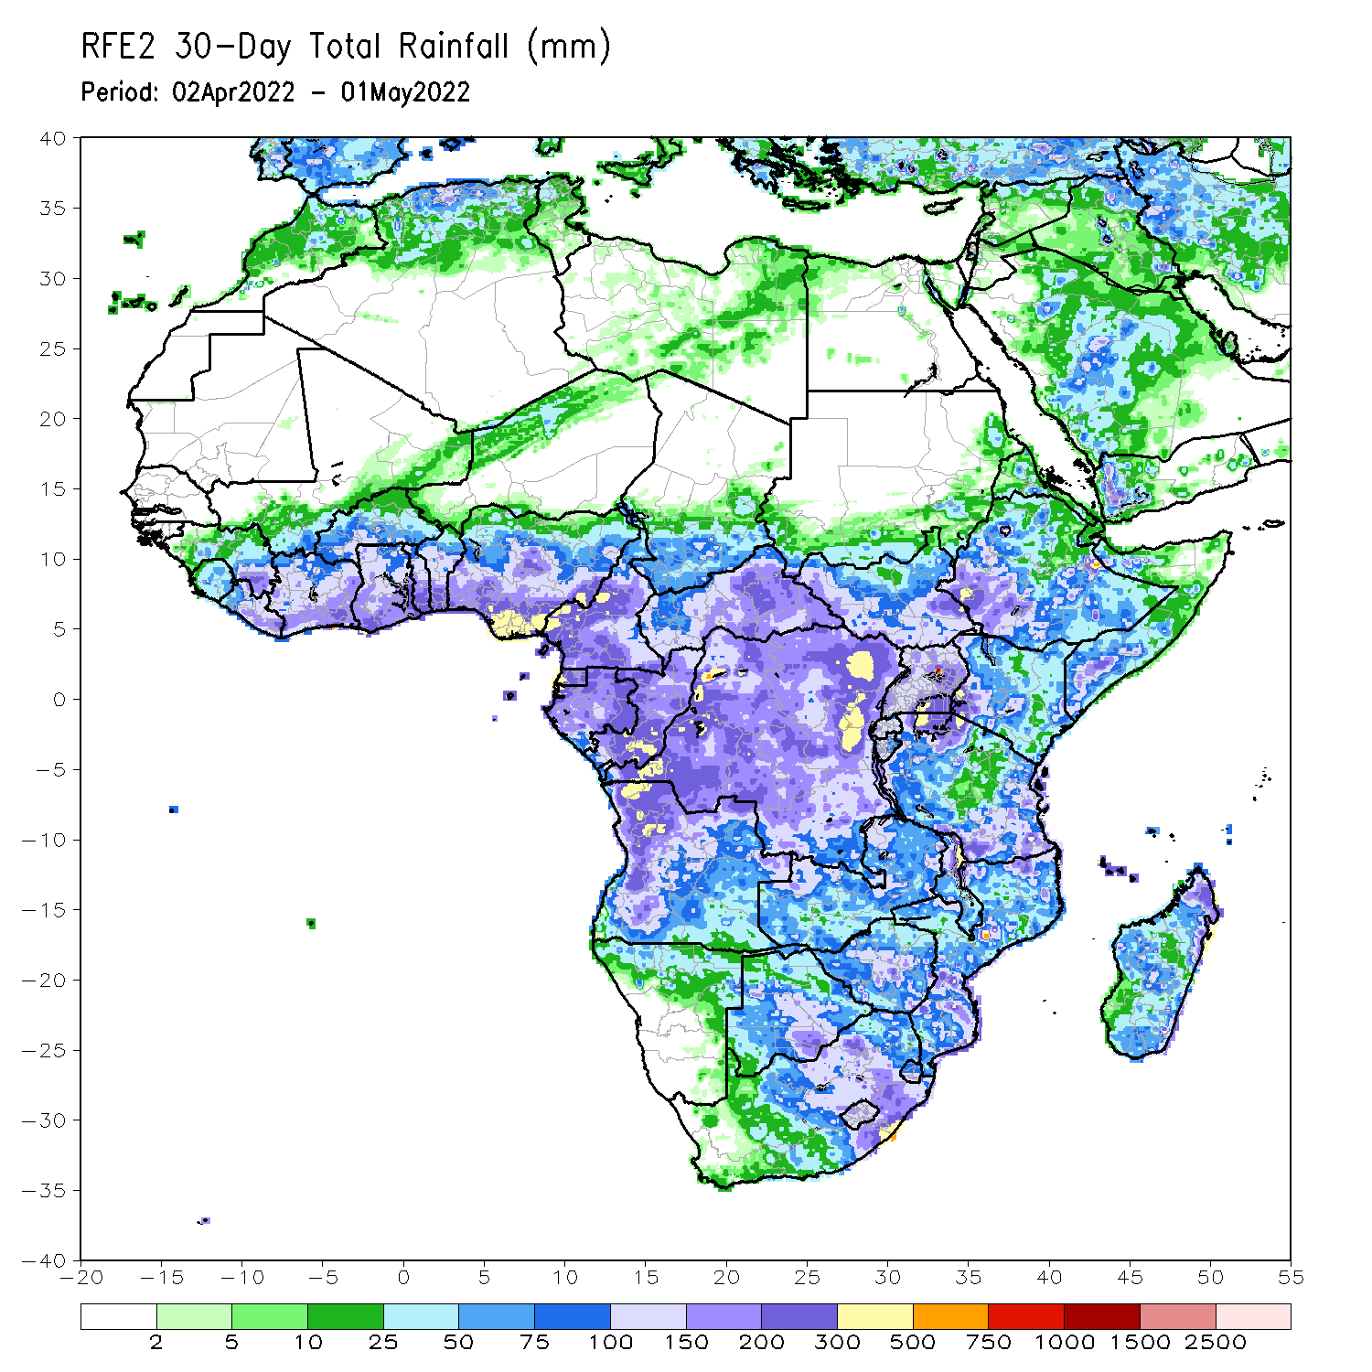
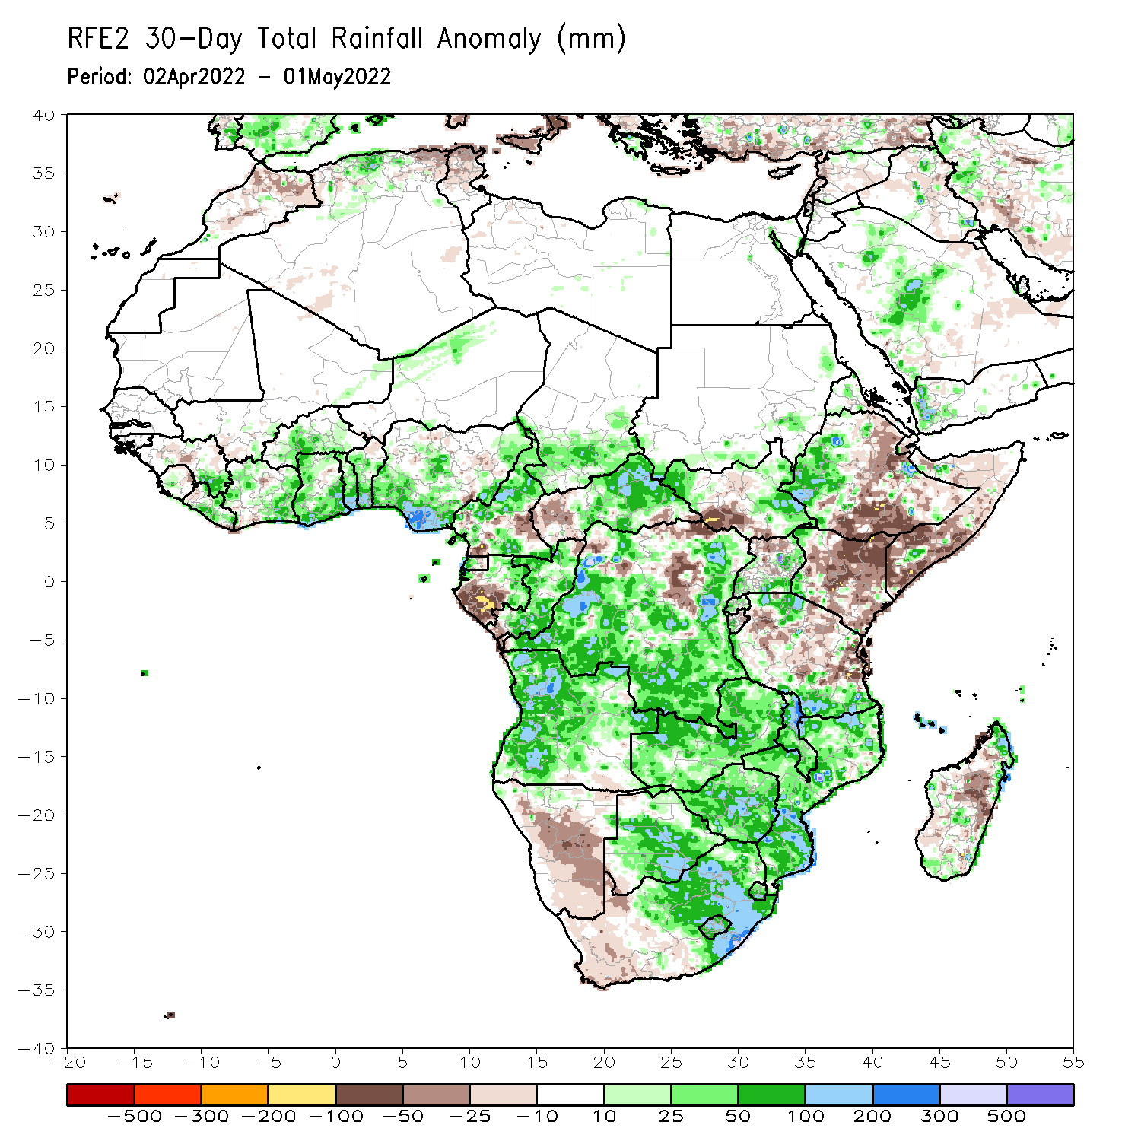
Rainfall Patterns: Last 30 Days
During the past 30 days, in East Africa, above-average rainfall was observed over parts of western Ethiopia, pockets of South Sudan, southern Uganda, and the far northern and southern Tanzania. Rainfall was below-average over southern, central and eastern Ethiopia, pockets of southern South Sudan, much of Kenya, Somalia, and many parts of Tanzania. In Central Africa, rainfall was above-average over much of Cameroon, Equatorial Guinea, Gabon, Congo, central and eastern CAR, and many parts of DRC. Rainfall was below-average over pockets of Cameroon, western CAR, and northern DRC. In Southern Africa, above-average rainfall was observed over much of Angola and Zambia, Malawi, Mozambique, Botswana and South Africa. Below-average rainfall was observed over Namibia, western South Africa, pockets of Madagascar. In West Africa, rainfall was above-average over much of the Gulf of Guinea region.
Notes:
5

Slide 6
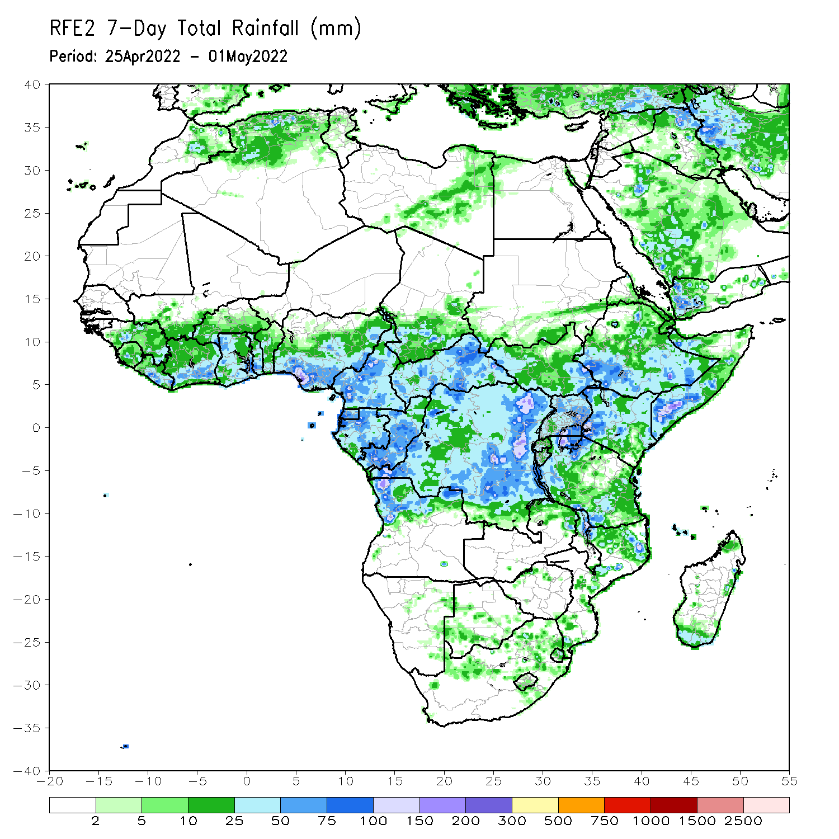
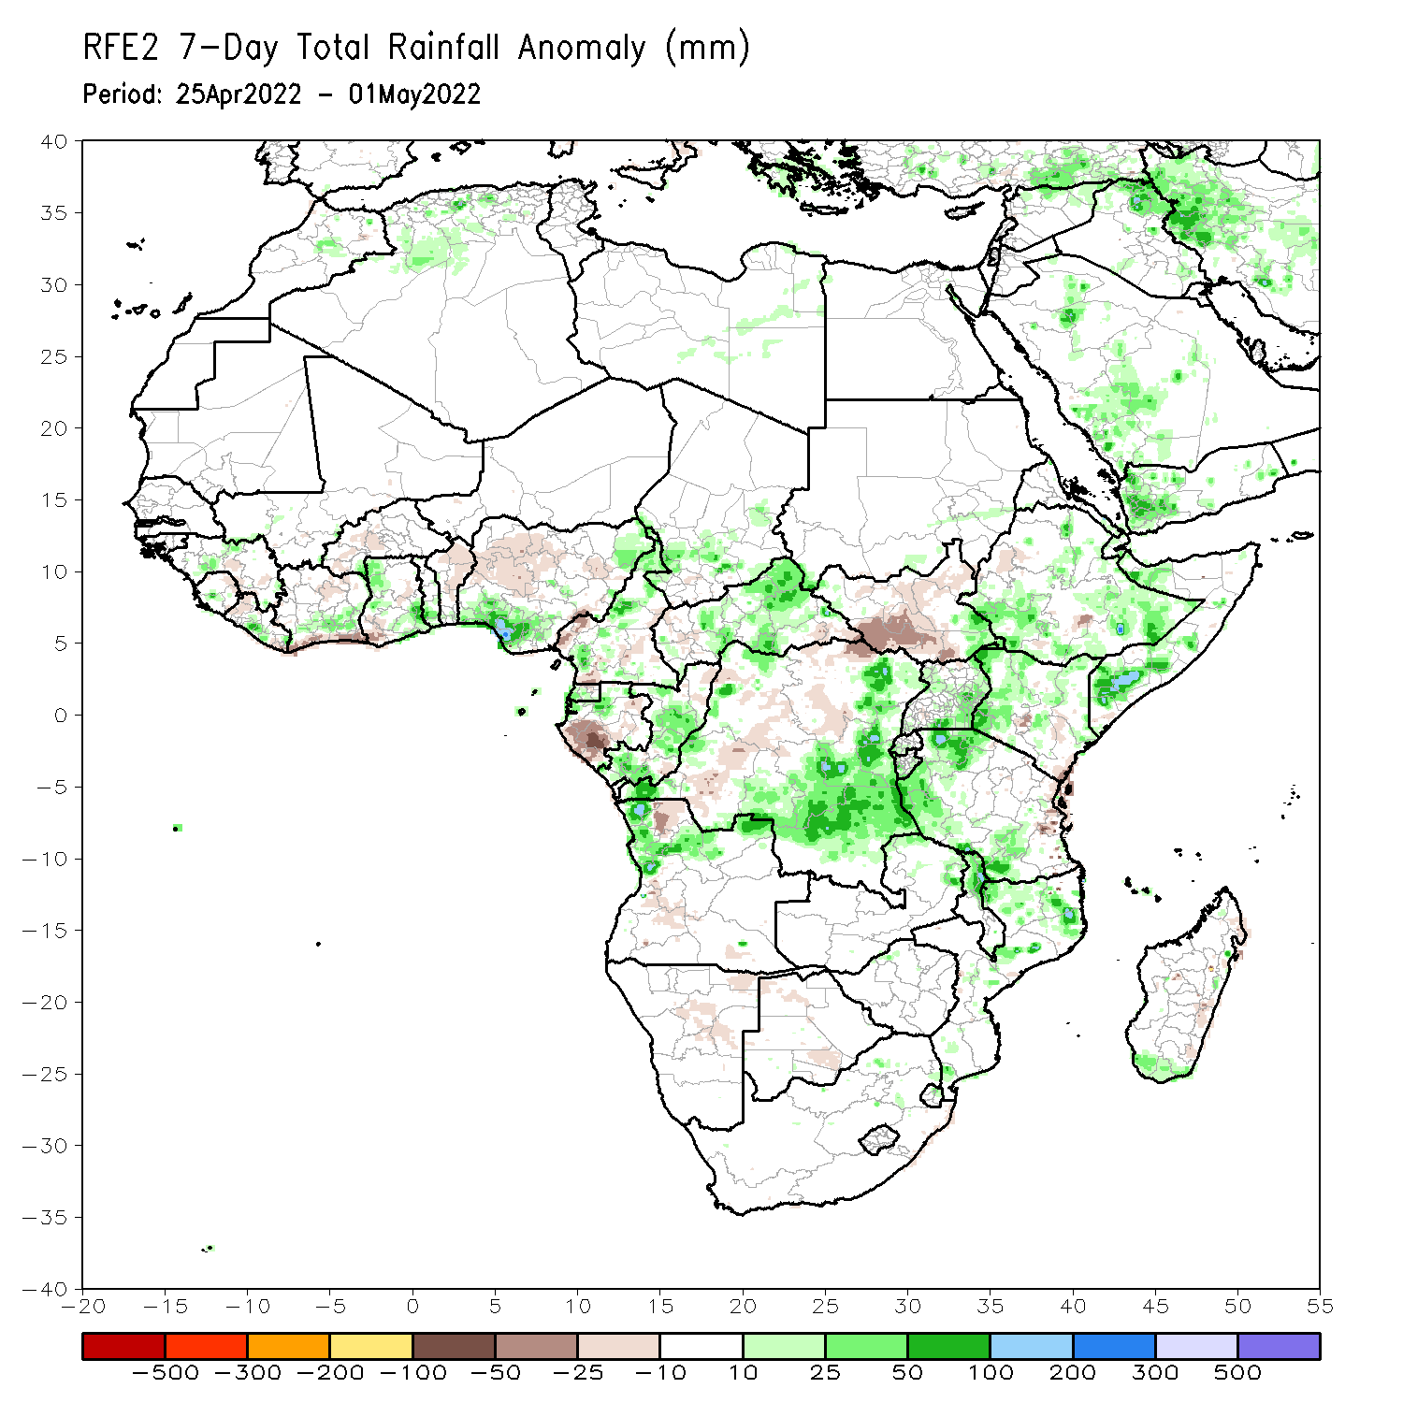
Rainfall Patterns: Last 7 Days
During the past 7 days, in East Africa, rainfall was above-average over eastern South Sudan, portions of Ethiopia, pockets of Uganda, Kenya and Somalia, and parts of Tanzania. Below-average rainfall was observed over the southern portion of South Sudan. In Central Africa, rainfall was above-average over pockets of Cameroon, CAR, Congo and eastern DRC. Below-average rainfall was observed over southern Gabon, and parts of DRC. In West Africa, above-average rainfall was observed over parts of Ghana, and southern Nigeria.

Slide 7
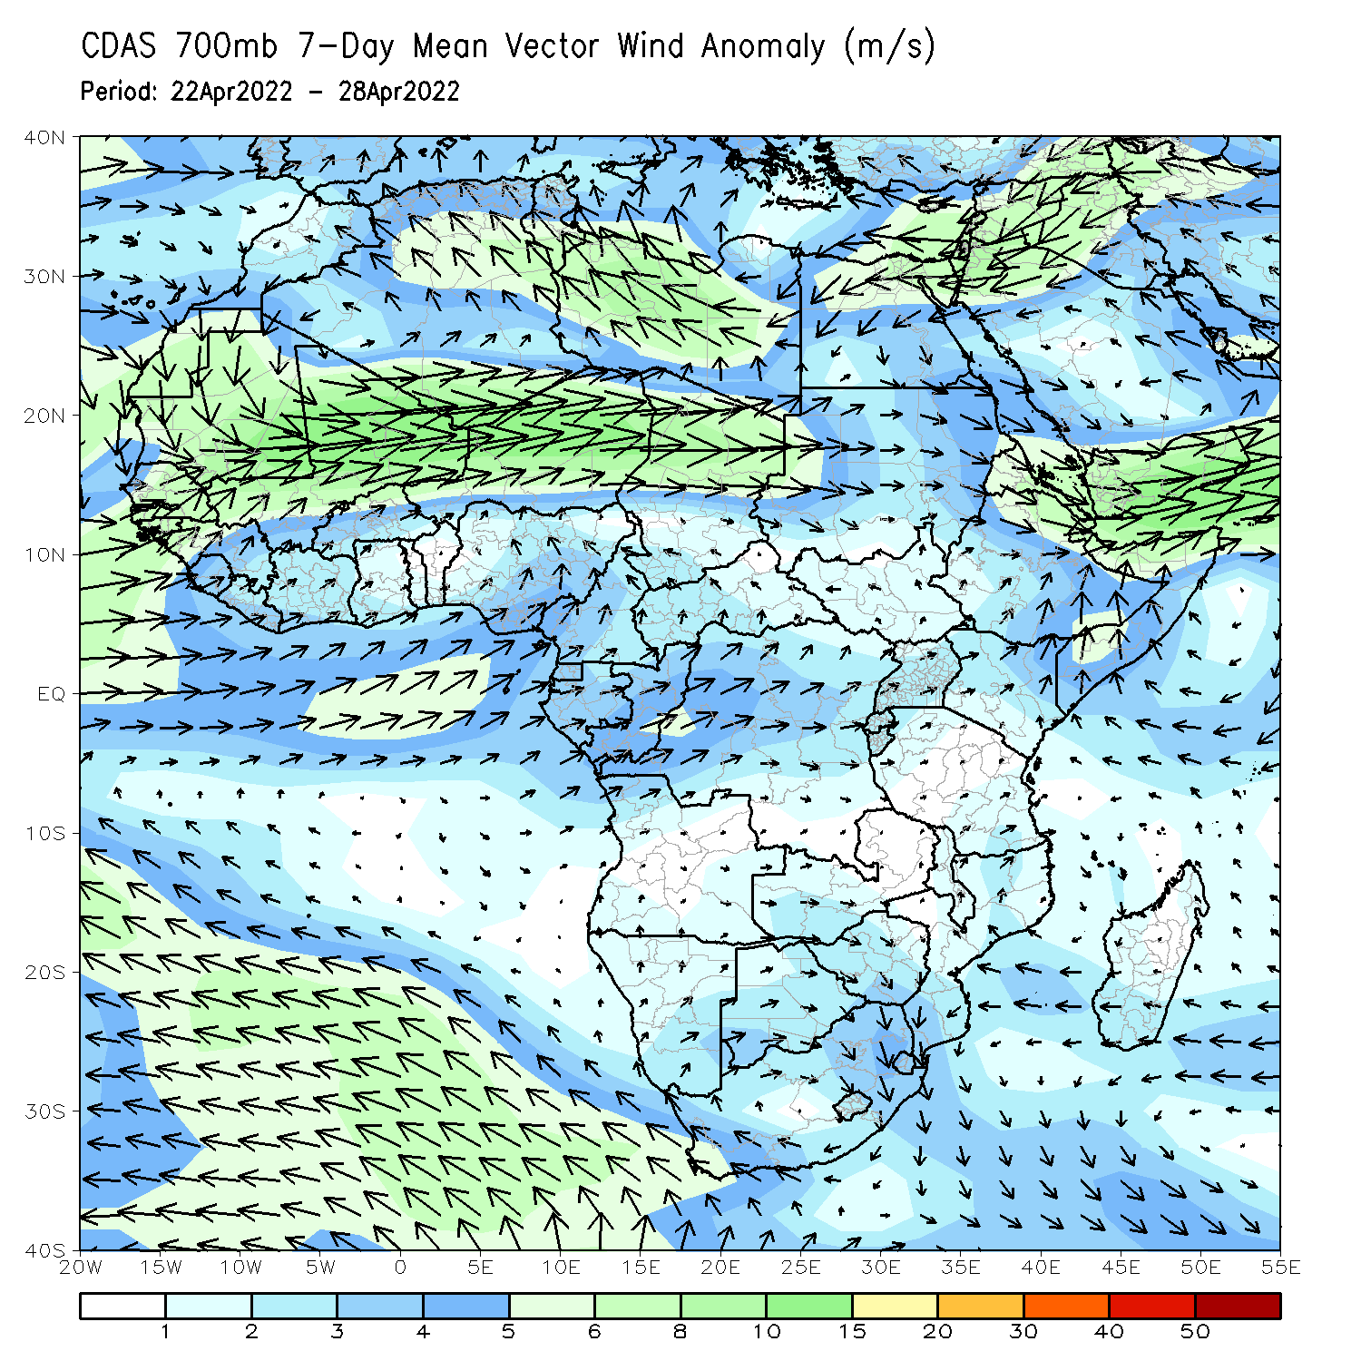
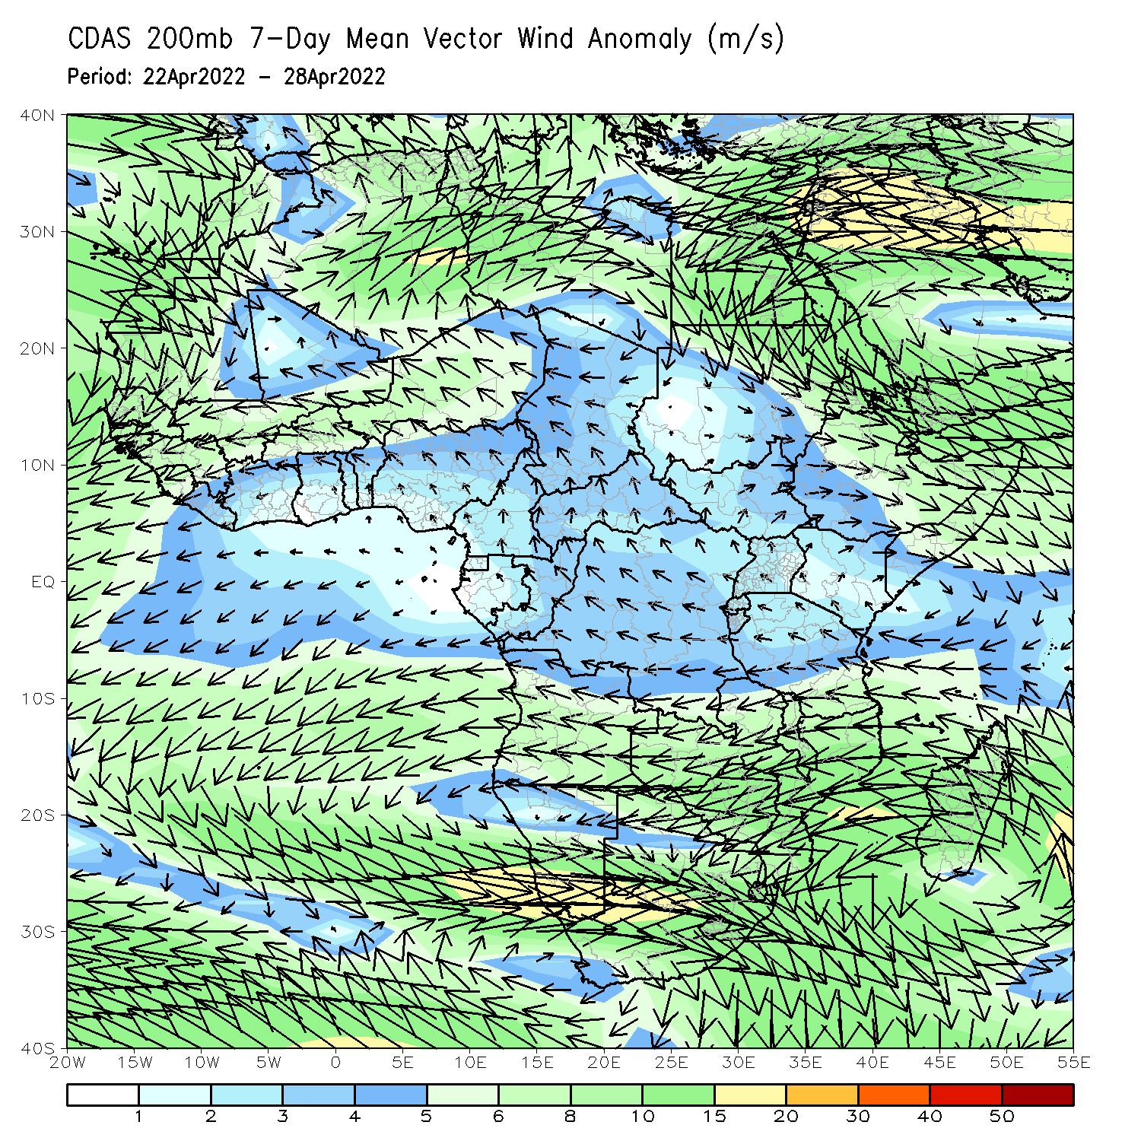
Atmospheric Circulation: Last 7 Days
At 700-hPa level (left panel), anomalous wind convergence may have contributed to the observed rainfall increases across East Africa.

Slide 8
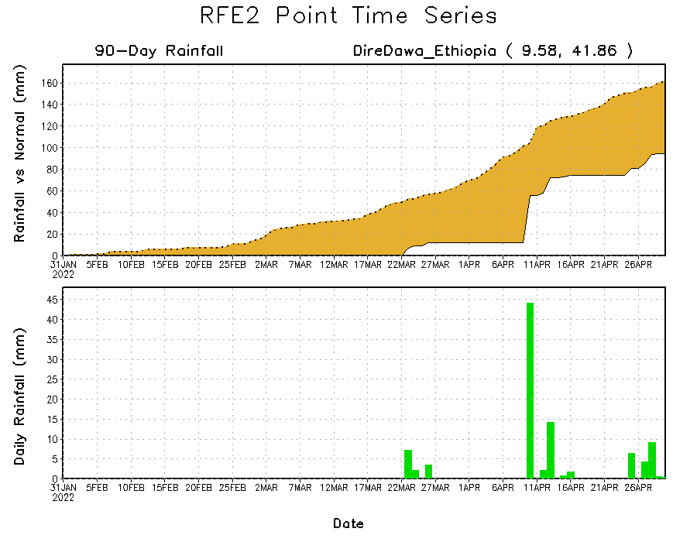
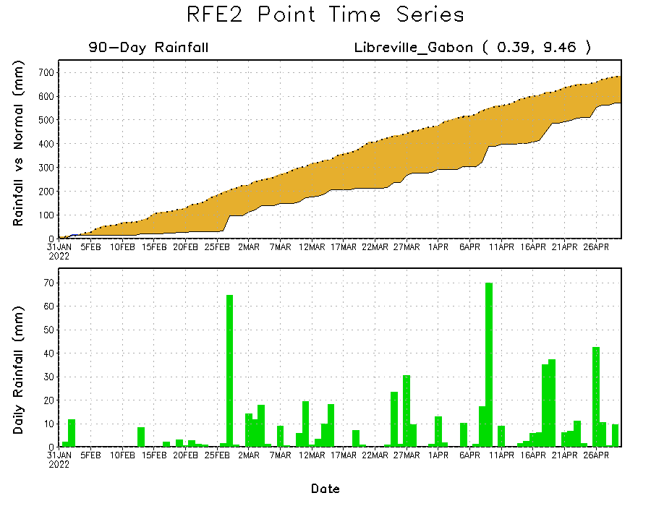
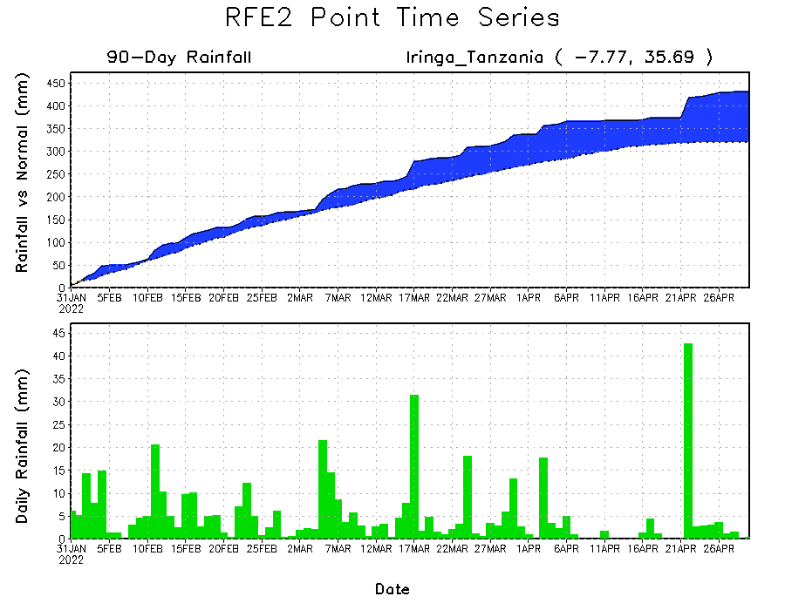
Rainfall Evolution
Daily evolution of rainfall over the last 90 days at selected locations shows moderate to heavy rainfall sustained moisture surpluses over parts of South Africa (bottom right). Seasonal total rainfall remained below-average over parts of Ethiopia (top right) and Gabon (bottom left).

Slide 9
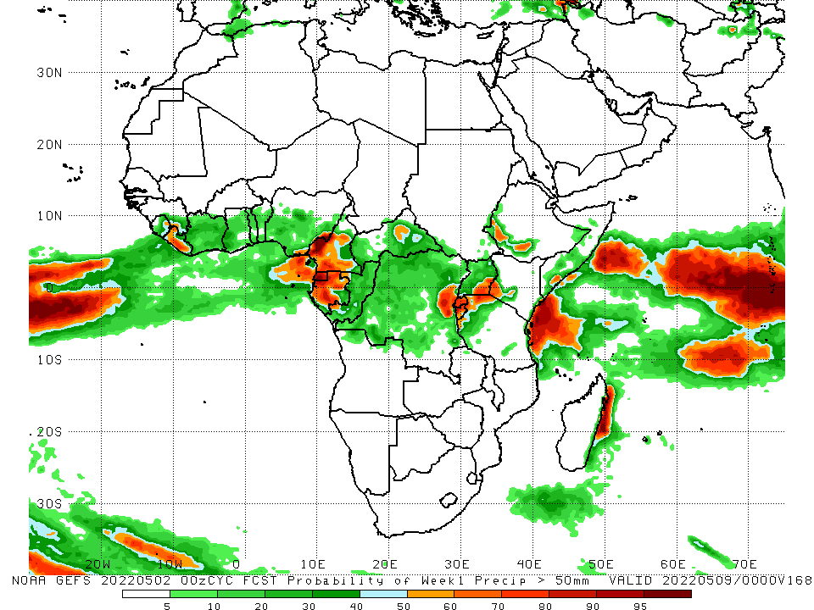
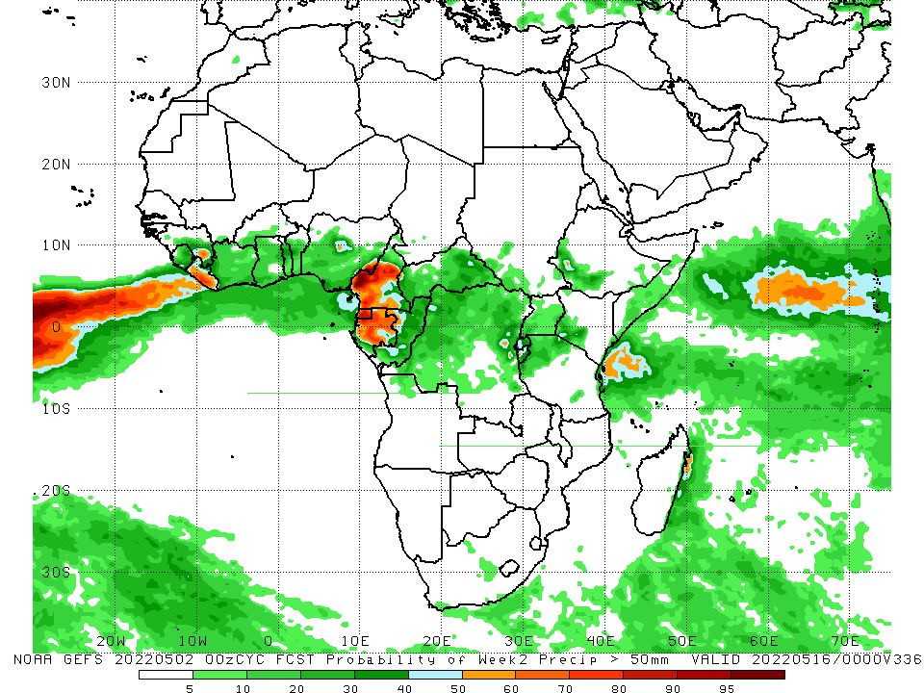
NCEP GEFS Model Forecasts Non-Bias Corrected Probability of precipitation exceedance
Week-1, Valid: 03 – 09 May, 2022
Week-2, Valid: 10 – 16 May, 2022
For week-1 (left panel), the NCEP GEFS indicates a moderate to high chance (over 70%) for rainfall to exceed 50 mm over much of Liberia, Cameroon, Gabon and the Lake Victoria region.
Notes:
9

Slide 10
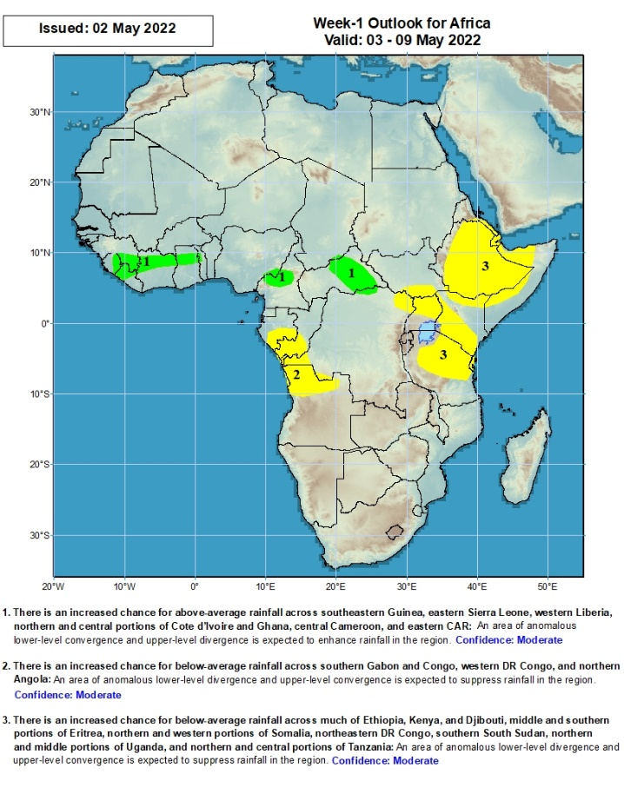
Week-1 Precipitation Outlooks
03 – 09 May, 2022
There is an increased chance for above-average rainfall across southeastern Guinea, eastern Sierra Leone, western Liberia, northern and central portions of Cote d’Ivoire and Ghana, central Cameroon, and eastern CAR: An area of anomalous lower-level convergence and upper-level divergence is expected to enhance rainfall in the region. Confidence: Moderate
There is an increased chance for below-average rainfall across southern Gabon and Congo, western DR Congo, and northern Angola: An area of anomalous lower-level divergence and upper-level convergence is expected to suppress rainfall in the region. Confidence: Moderate
There is an increased chance for below-average rainfall across much of Ethiopia, Kenya, and Djibouti, middle and southern portions of Eritrea, northern and western portions of Somalia, northeastern DR Congo, southern South Sudan, northern and middle portions of Uganda, and northern and central portions of Tanzania: An area of anomalous lower-level divergence and upper-level convergence is expected to suppress rainfall in the region. Confidence: Moderate
Notes:
10

Slide 11
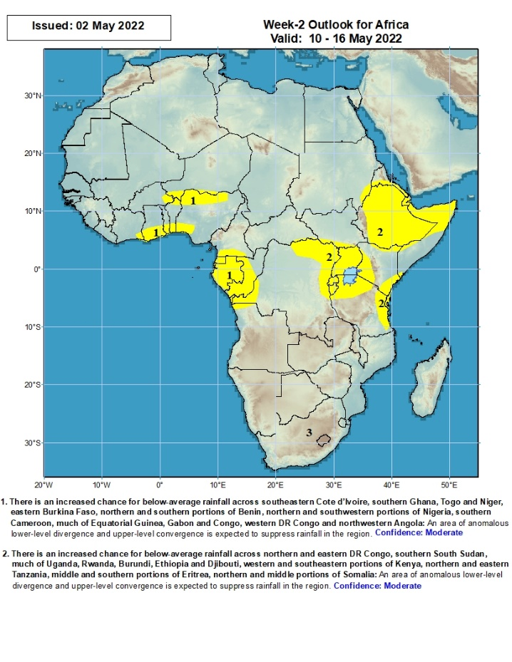
Week-2 Precipitation Outlooks
10 – 16 May, 2022
There is an increased chance for below-average rainfall across southeastern Cote d’Ivoire, southern Ghana, Togo and Niger, eastern Burkina Faso, northern and southern portions of Benin, northern and southwestern portions of Nigeria, southern Cameroon, much of Equatorial Guinea, Gabon and Congo, western DR Congo and northwestern Angola: An area of anomalous lower-level divergence and upper-level convergence is expected to suppress rainfall in the region. Confidence: Moderate
There is an increased chance for below-average rainfall across northern and eastern DR Congo, southern South Sudan, much of Uganda, Rwanda, Burundi, Ethiopia and Djibouti, western and southeastern portions of Kenya, northern and eastern Tanzania, middle and southern portions of Eritrea, northern and middle portions of Somalia: An area of anomalous lower-level divergence and upper-level convergence is expected to suppress rainfall in the region. Confidence: Moderate
Notes:
11

Slide 12
Summary
During the past 30 days, in East Africa, above-average rainfall was observed over parts of western Ethiopia, pockets of South Sudan, southern Uganda, and the far northern and southern Tanzania. Rainfall was below-average over southern, central and eastern Ethiopia, pockets of southern South Sudan, much of Kenya, Somalia, and many parts of Tanzania. In Central Africa, rainfall was above-average over much of Cameroon, Equatorial Guinea, Gabon, Congo, central and eastern CAR, and many parts of DRC. Rainfall was below-average over pockets of Cameroon, western CAR, and northern DRC. In Southern Africa, above-average rainfall was observed over much of Angola and Zambia, Malawi, Mozambique, Botswana and South Africa. Below-average rainfall was observed over Namibia, western South Africa, pockets of Madagascar. In West Africa, rainfall was above-average over much of the Gulf of Guinea region.
During the past 7 days, in East Africa, rainfall was above-average over eastern South Sudan, portions of Ethiopia, pockets of Uganda, Kenya and Somalia, and parts of Tanzania. Below-average rainfall was observed over the southern portion of South Sudan. In Central Africa, rainfall was above-average over pockets of Cameroon, CAR, Congo and eastern DRC. Below-average rainfall was observed over southern Gabon, and parts of DRC. In West Africa, above-average rainfall was observed over parts of Ghana, and southern Nigeria.
Week-1 and Week-2 outlooks call for an increased chance for below-average rainfall over the eastern and southern portions of the Greater Horn of Africa. In contrast, there is an increased chance for above-average rainfall over parts of Central Africa.

