Slide 1
The African Monsoon Recent Evolution and Current Status Include Week-1 and Week-2 Outlooks
Update prepared by
16 May 2022
For more information, visit:
http://www.cpc.ncep.noaa.gov/products/Global_Monsoons/African_Monsoons/precip_monitoring.shtml

Slide 2
Outline
Highlights
Recent Evolution and Current Conditions
NCEP GEFS Forecasts
Summary

Slide 3
Highlights: Last 7 Days
During the past 7 days, in East Africa, rainfall was below-average over parts of South Sudan, southern Ethiopia, Uganda, and western Kenya, while above average rainfall was observed over pockets of southern Sudan and western Ethiopia. In Central Africa, rainfall was above-average over eastern Gabon, Congo, western DRC, pockets of CAR, southern Chad and western DRC. Below-average rainfall was observed over much of Cameroon and parts of eastern DRC. In West Africa, above-average rainfall was observed over pockets of Cote d’Ivoire and Burkina Faso, while rainfall was below-average over central Cote d’Ivoire, Ghana, and Nigeria.
Week-1 and Week-2 outlooks call for an increased chance for above-average rainfall over parts of Central Africa. In contrast, there is an increased chance for below-average rainfall over the eastern portion of the Greater Horn of Africa.

Slide 4
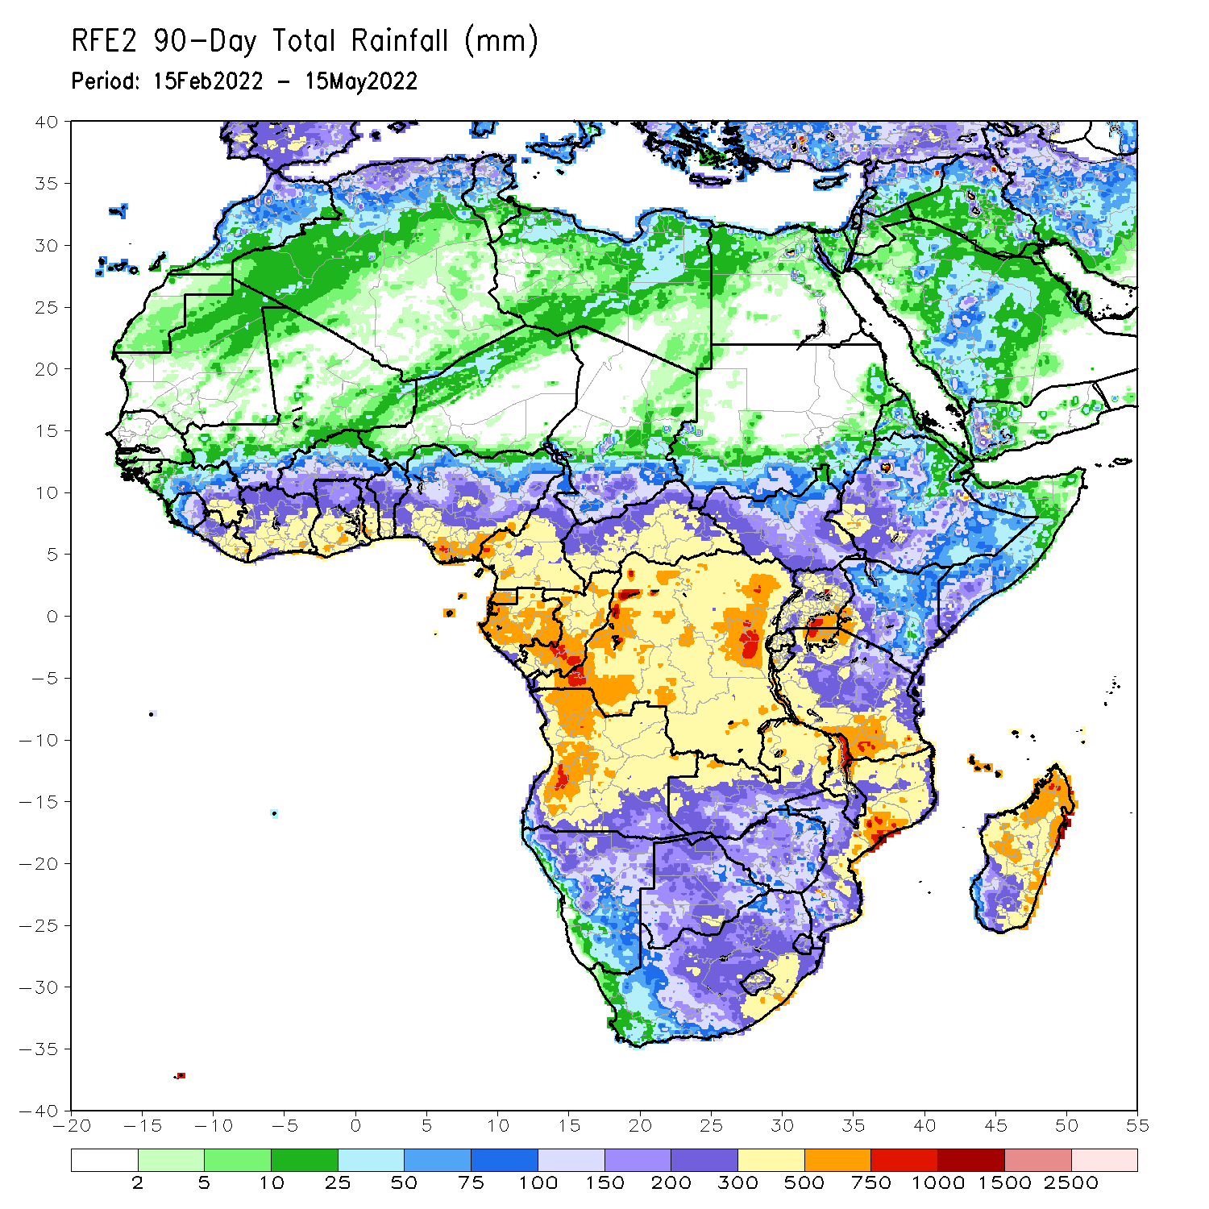
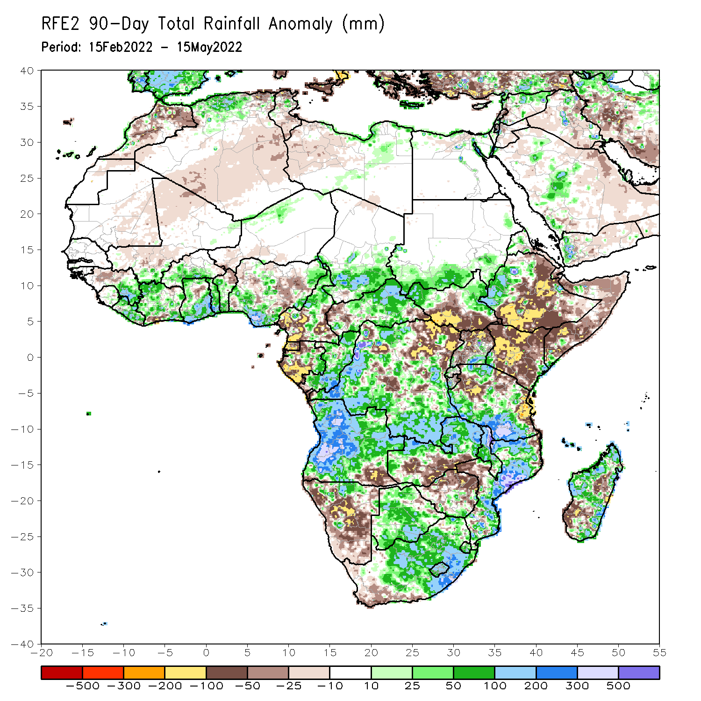
Rainfall Patterns: Last 90 Days
Over the past 90 days, in East Africa, above-average rainfall was observed over parts of South Sudan, western Ethiopia, Eritrea, southern Uganda, and much of Tanzania. Rainfall was below-average over central, southern and eastern Ethiopia, central and southern South Sudan, much of Kenya, Somalia, and northern Uganda. In southern Africa, above-average rainfall was observed over much of Angola, Botswana, northern Namibia, northern Zambia, Malawi, much of Mozambique, many parts of Madagascar and South Africa. Below-average rainfall was observed over pockets of Angola, western and southern Namibia, southern Zambia, much of Zimbabwe, and pockets of Madagascar. In Central Africa, rainfall was above-average over central and eastern CAR, many parts of DRC and Congo. Rainfall was below-average over southern Cameroon, parts of central and eastern DRC, Equatorial Guinea, much of Gabon, and western CAR. In West Africa, rainfall was above-average over much of the Gulf of Guinea region, while below-average rainfall was observed over pockets of Nigeria.
Notes:
4

Slide 5
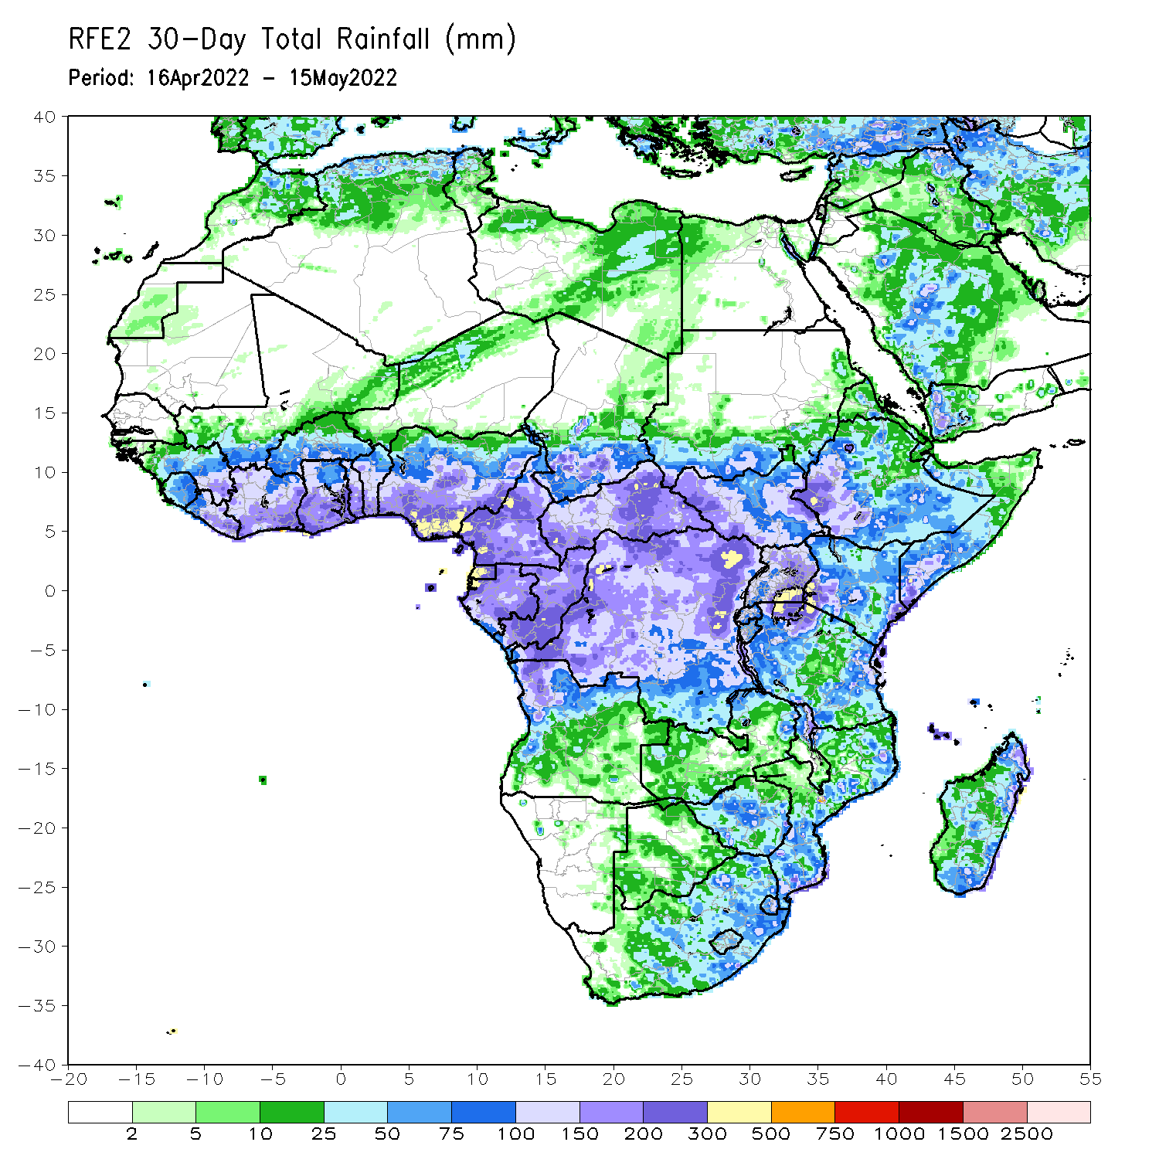
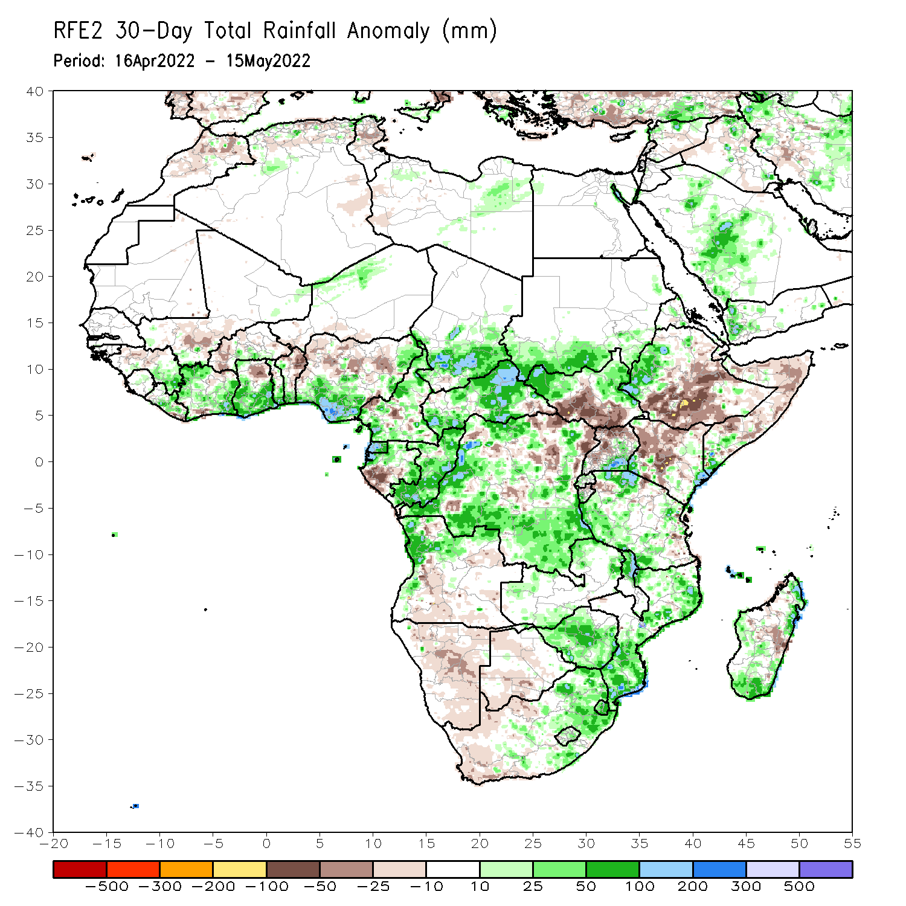
Rainfall Patterns: Last 30 Days
During the past 30 days, in East Africa, above-average rainfall was observed over western Ethiopia, northern and eastern South Sudan, Uganda, and parts of Tanzania. Rainfall was below-average over eastern and southern Ethiopia, pockets of central and southern South Sudan, much of Kenya, and Somalia. In Central Africa, rainfall was above-average over much of Cameroon, Equatorial Guinea, northern and eastern Gabon, Congo, much of CAR, and western and southern DRC. Rainfall was below-average over pockets of central and northern DRC. In Southern Africa, above-average rainfall was observed over western and northern Angola, parts of Zambia, Malawi, Mozambique, Zimbabwe and eastern South Africa. Below-average rainfall was observed over parts of Angola, Namibia, western South Africa, and pockets of Madagascar. In West Africa, rainfall was above-average over much of the Gulf of Guinea region, while below-average rainfall was observed over northern Ghana, and northern Nigeria.
Notes:
5

Slide 6
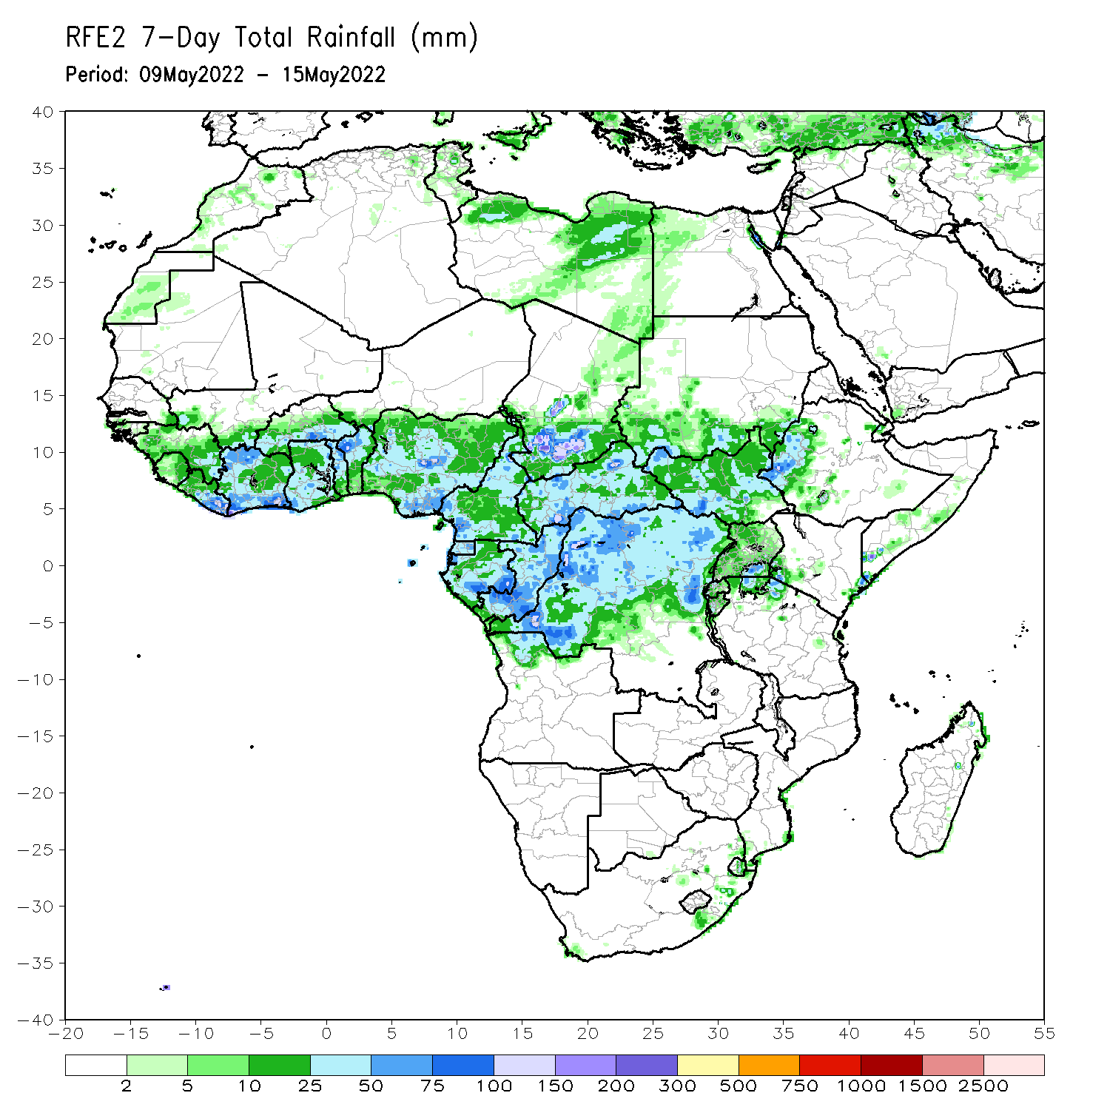
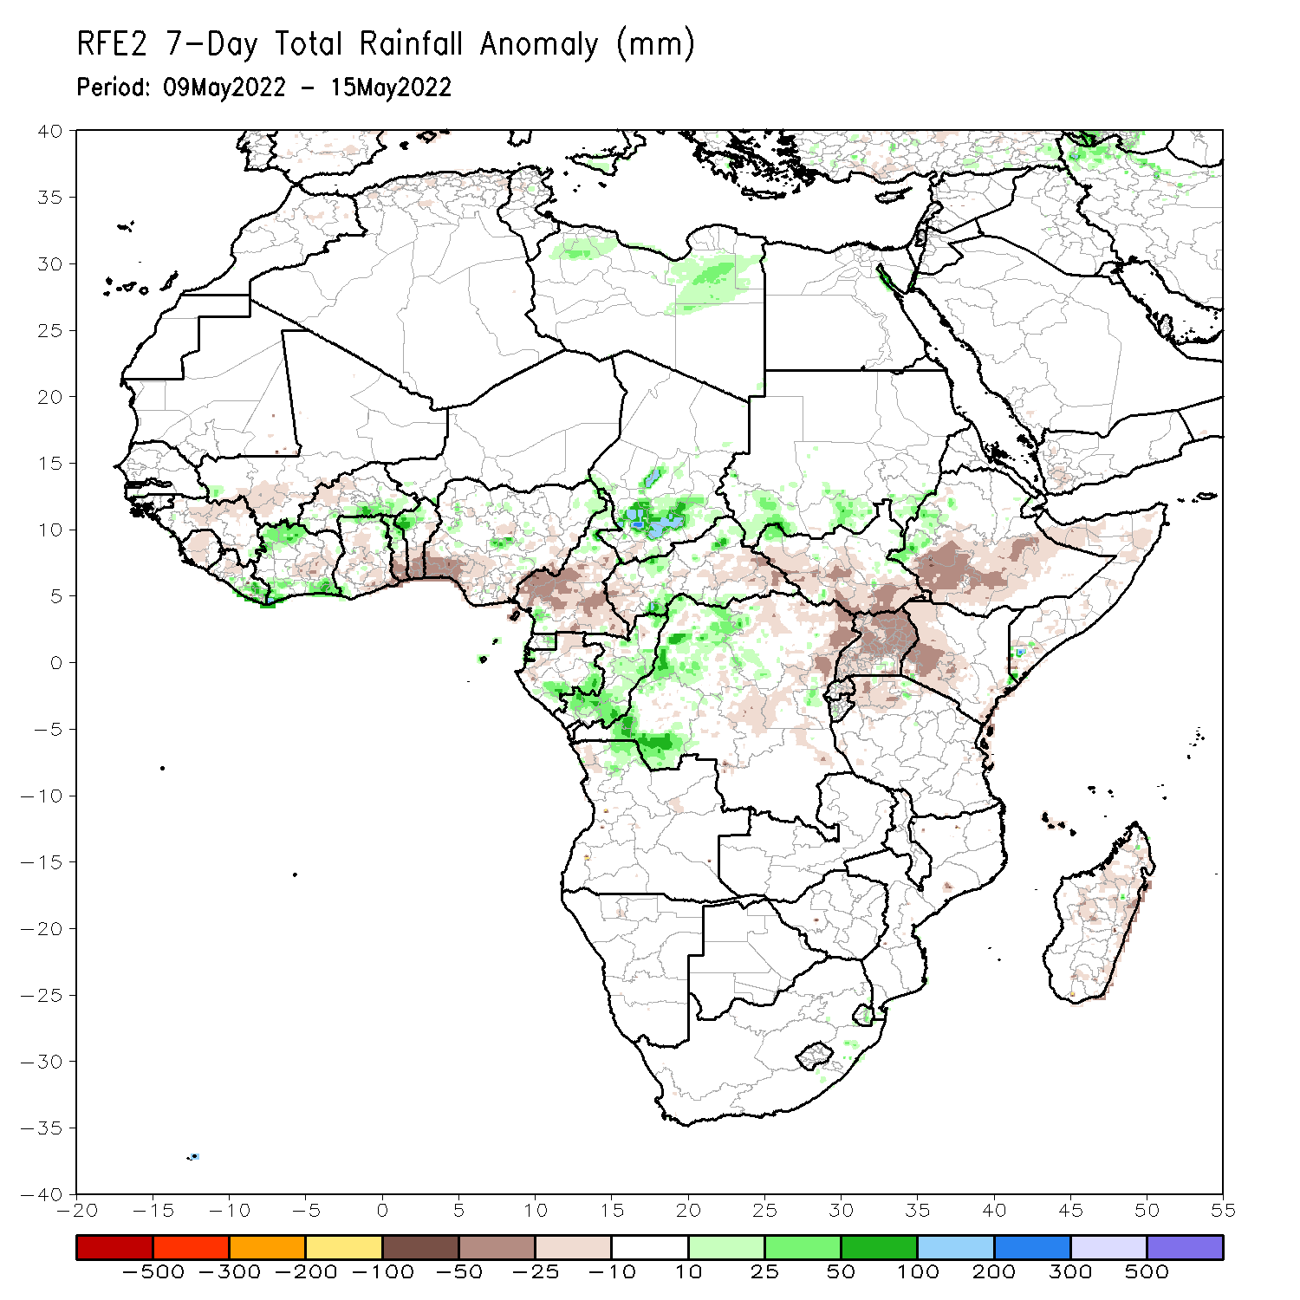
Rainfall Patterns: Last 7 Days
During the past 7 days, in East Africa, rainfall was below-average over parts of South Sudan, southern Ethiopia, Uganda, and western Kenya, while above average rainfall was observed over pockets of southern Sudan and western Ethiopia. In Central Africa, rainfall was above-average over eastern Gabon, Congo, western DRC, pockets of CAR, southern Chad and western DRC. Below-average rainfall was observed over much of Cameroon and parts of eastern DRC. In West Africa, above-average rainfall was observed over pockets of Cote d’Ivoire and Burkina Faso, while rainfall was below-average over central Cote d’Ivoire, Ghana, and Nigeria.

Slide 7
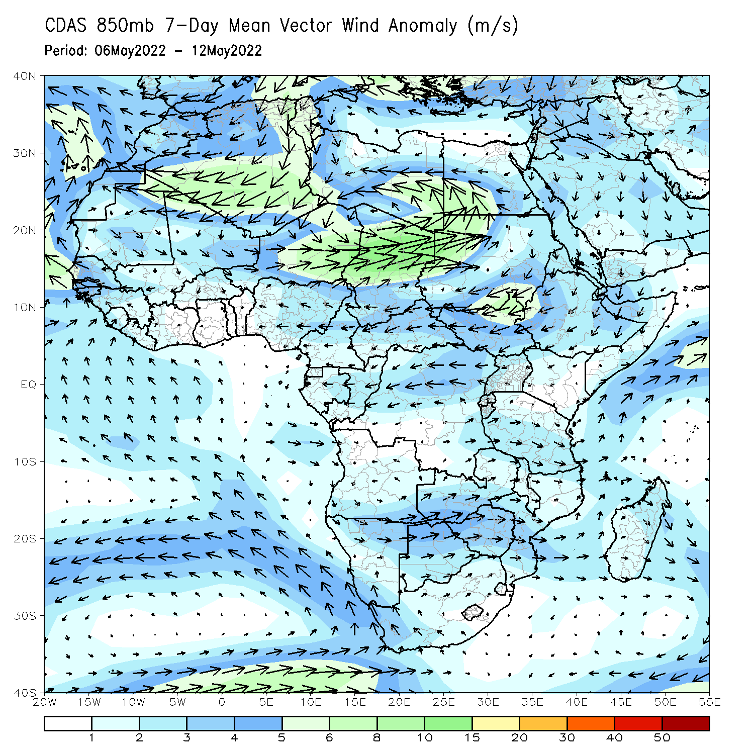
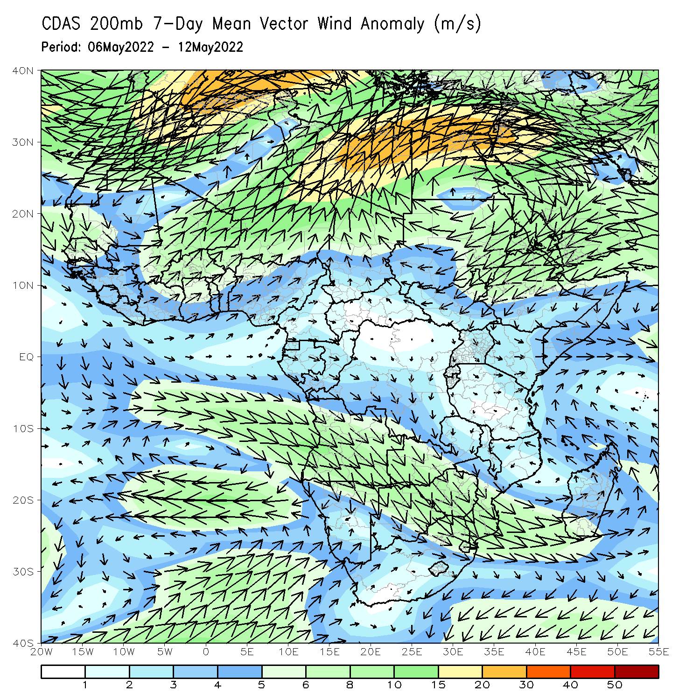
Atmospheric Circulation: Last 7 Days
At 850-hPa level (left panel), anomalous easterly flow with its associated lower-level speed divergence may have contributed to the observed below-average rainfall over parts of East Africa.

Slide 8
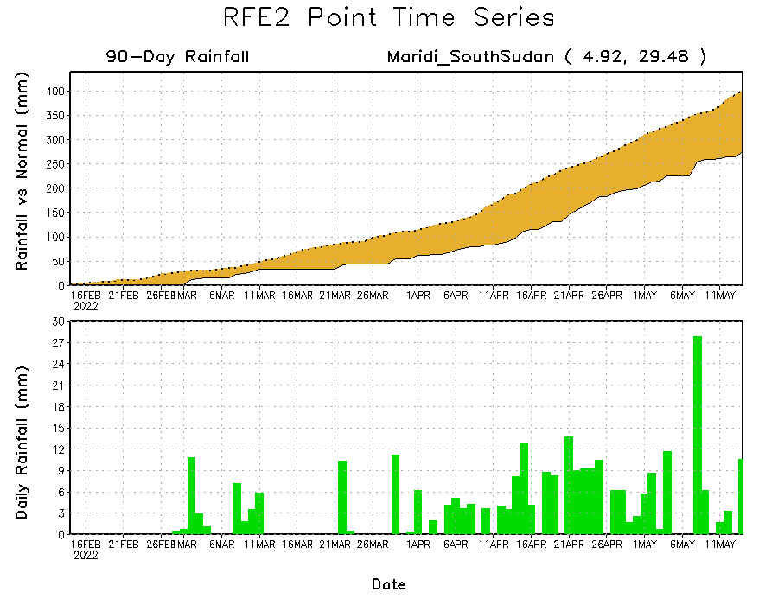
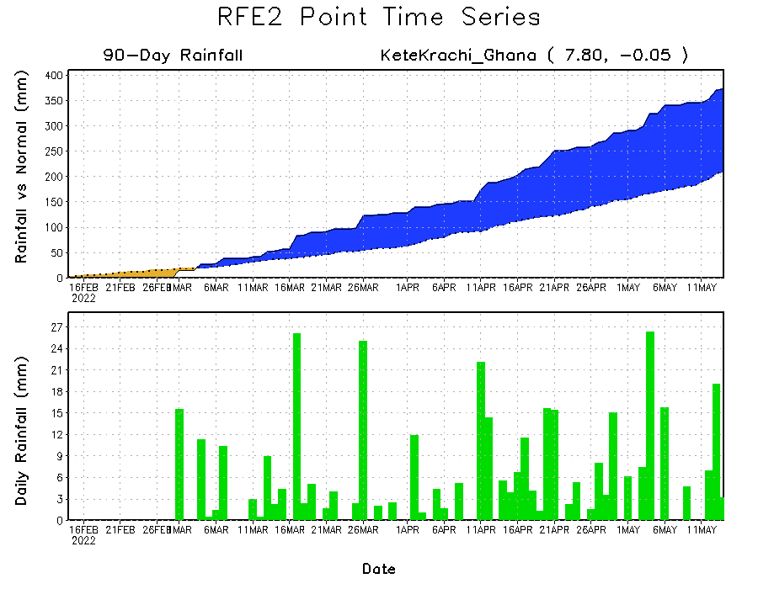
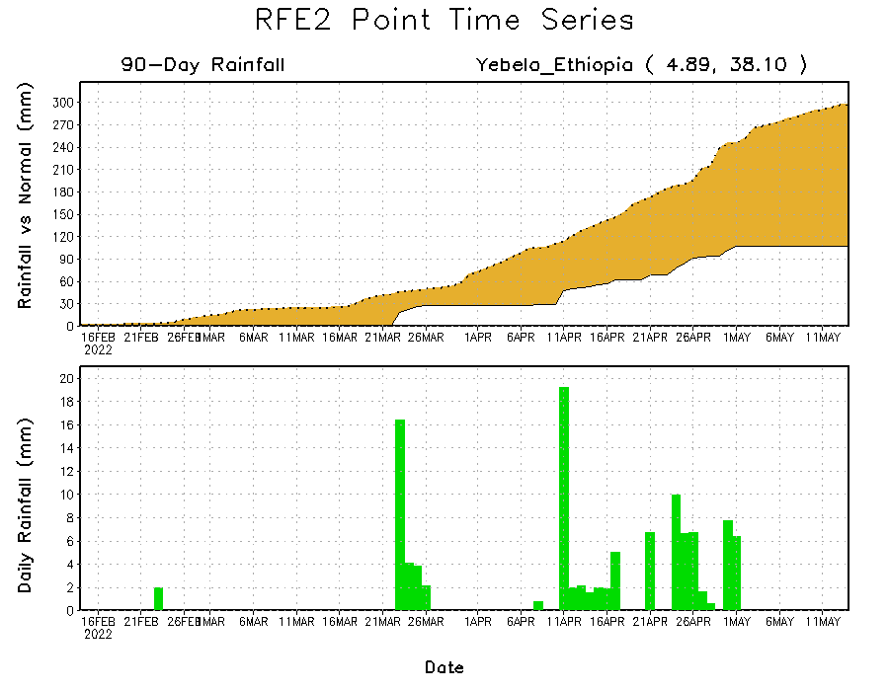
Rainfall Evolution
Daily evolution of rainfall over the last 90 days at selected locations shows moderate to heavy rainfall sustained moisture surpluses over parts of southern Ghana (bottom left). Seasonal total rainfall remained below-average over parts of southern South Sudan (top right) and southern Ethiopia (bottom right).

Slide 9
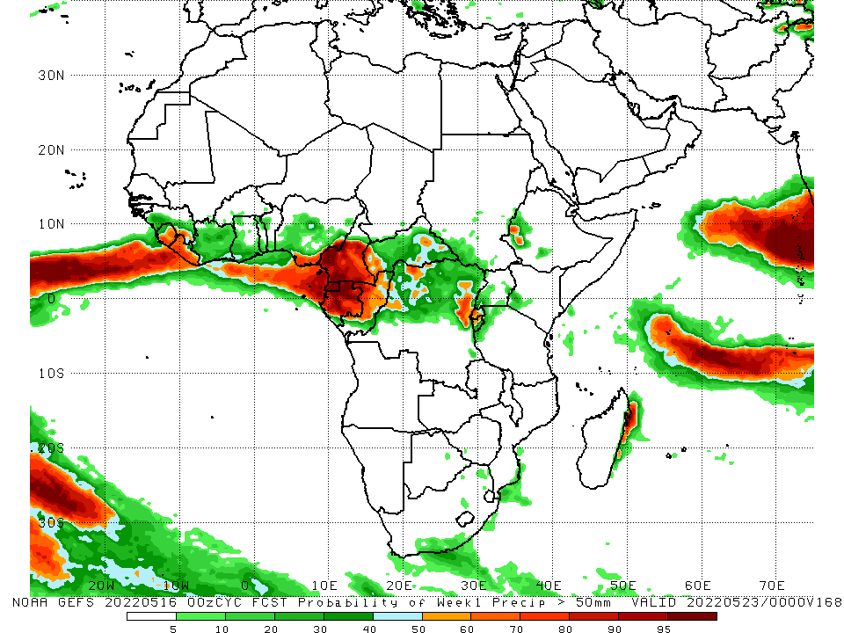
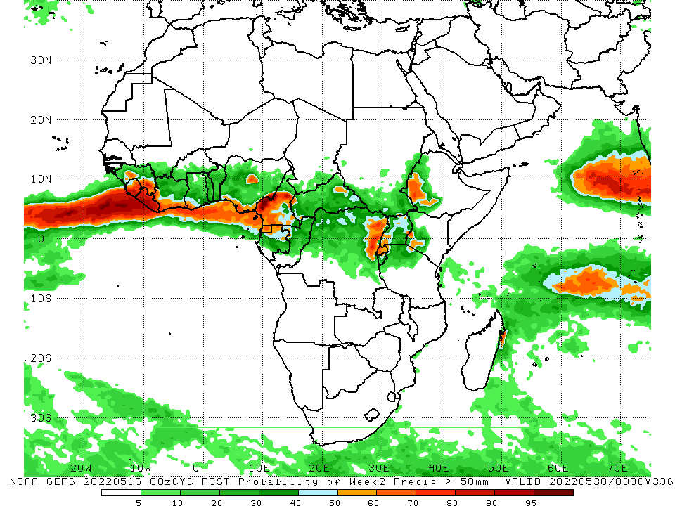
NCEP GEFS Model Forecasts Non-Bias Corrected Probability of precipitation exceedance
Week-1, Valid: 17 – 23 May, 2022
Week-2, Valid: 24 – 30 May, 2022
For week-1 (left panel) and week-2 (right panel), the NCEP GEFS indicates a moderate to high chance (over 70%) for rainfall to exceed 50 mm over Cameroon, Gabon, Equatorial Guinea, northeastern DRC and southwestern Ethiopia.
Notes:
9

Slide 10
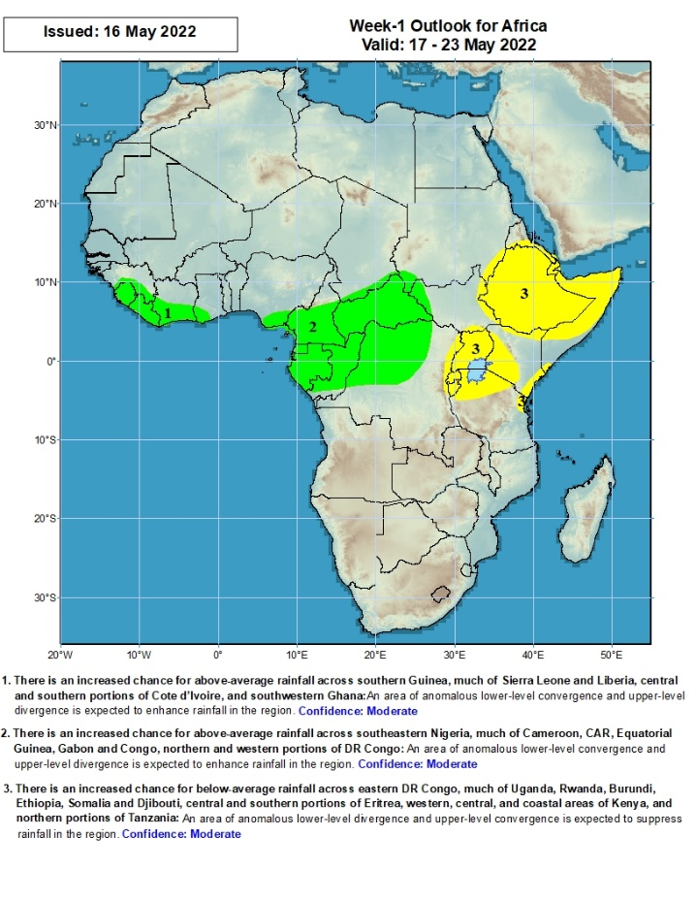
Week-1 Precipitation Outlooks
17 – 23 May, 2022
There is an increased chance for above-average rainfall across southern Guinea, much of Sierra Leone and Liberia, central and southern portions of Cote d’Ivoire, and southwestern Ghana: An area of anomalous lower-level convergence and upper-level divergence is expected to enhance rainfall in the region. Confidence: Moderate
There is an increased chance for above-average rainfall across southeastern Nigeria, much of Cameroon, CAR, Equatorial Guinea, Gabon and Congo, northern and western portions of DR Congo: An area of anomalous lower-level convergence and upper-level divergence is expected to enhance rainfall in the region. Confidence: Moderate
There is an increased chance for below-average rainfall across eastern DR Congo, much of Uganda, Rwanda, Burundi, Ethiopia, Somalia and Djibouti, central and southern portions of Eritrea, western, central, and coastal areas of Kenya, and northern portions of Tanzania: An area of anomalous lower-level divergence and upper-level convergence is expected to suppress rainfall in the region. Confidence: Moderate
Notes:
10

Slide 11
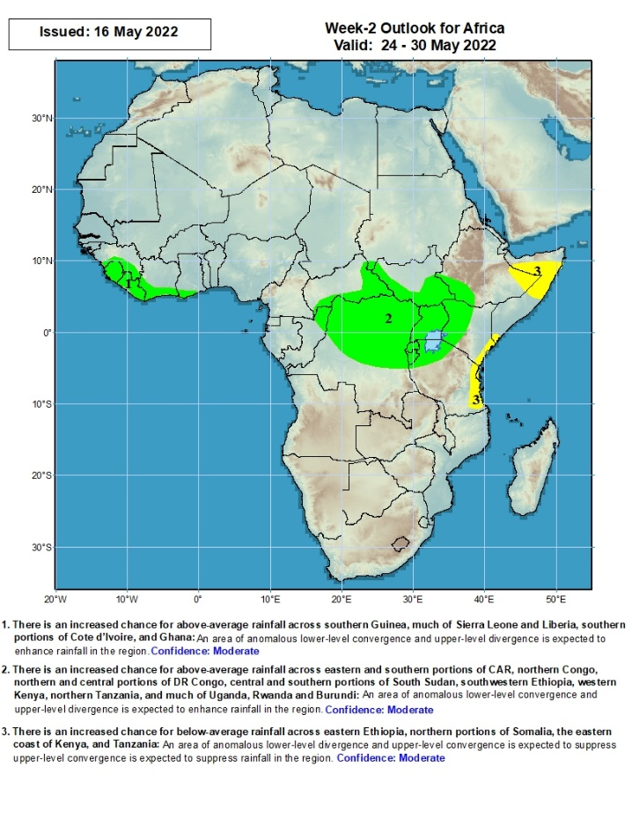
Week-2 Precipitation Outlooks
24 – 30 May, 2022
There is an increased chance for above-average rainfall across southern Guinea, much of Sierra Leone and Liberia, southern portions of Cote d’Ivoire, and Ghana: An area of anomalous lower-level convergence and upper-level divergence is expected to enhance rainfall in the region. Confidence: Moderate
There is an increased chance for above-average rainfall across eastern and southern portions of CAR, northern Congo, northern and central portions of DR Congo, central and southern portions of South Sudan, southwestern Ethiopia, western Kenya, northern Tanzania, and much of Uganda, Rwanda and Burundi: An area of anomalous lower-level convergence and upper-level divergence is expected to enhance rainfall in the region. Confidence: Moderate
There is an increased chance for below-average rainfall across eastern Ethiopia, northern portions of Somalia, the eastern coast of Kenya, and Tanzania: An area of anomalous lower-level divergence and upper-level convergence is expected to suppress rainfall in the region. Confidence: Moderate
Notes:
11

Slide 12
Summary
During the past 30 days, in East Africa, above-average rainfall was observed over western Ethiopia, northern and eastern South Sudan, Uganda, and parts of Tanzania. Rainfall was below-average over eastern and southern Ethiopia, pockets of central and southern South Sudan, much of Kenya, and Somalia. In Central Africa, rainfall was above-average over much of Cameroon, Equatorial Guinea, northern and eastern Gabon, Congo, much of CAR, and western and southern DRC. Rainfall was below-average over pockets of central and northern DRC. In Southern Africa, above-average rainfall was observed over western and northern Angola, parts of Zambia, Malawi, Mozambique, Zimbabwe and eastern South Africa. Below-average rainfall was observed over parts of Angola, Namibia, western South Africa, and pockets of Madagascar. In West Africa, rainfall was above-average over much of the Gulf of Guinea region, while below-average rainfall was observed over northern Ghana, and northern Nigeria.
During the past 7 days, in East Africa, rainfall was below-average over parts of South Sudan, southern Ethiopia, Uganda, and western Kenya, while above average rainfall was observed over pockets of southern Sudan and western Ethiopia. In Central Africa, rainfall was above-average over eastern Gabon, Congo, western DRC, pockets of CAR, southern Chad and western DRC. Below-average rainfall was observed over much of Cameroon and parts of eastern DRC. In West Africa, above-average rainfall was observed over pockets of Cote d’Ivoire and Burkina Faso, while rainfall was below-average over central Cote d’Ivoire, Ghana, and Nigeria.
Week-1 and Week-2 outlooks call for an increased chance for above-average rainfall over parts of Central Africa. In contrast, there is an increased chance for below-average rainfall over the eastern portion of the Greater Horn of Africa.

