Slide 1
The African Monsoon Recent Evolution and Current Status Include Week-1 and Week-2 Outlooks
Update prepared by
11 July 2022
For more information, visit:
http://www.cpc.ncep.noaa.gov/products/Global_Monsoons/African_Monsoons/precip_monitoring.shtml

Slide 2
Outline
Highlights
Recent Evolution and Current Conditions
NCEP GEFS Forecasts
Summary

Slide 3
Highlights: Last 7 Days
During the past 7 days, in East Africa, rainfall was above-average over parts of western central and northern Ethiopia, pockets of southern and eastern Sudan and western South Sudan. In Central Africa, rainfall was above-average over pockets of Cameroon, western CAR, and northern Congo, and northwestern DRC. Below-average rainfall was observed over eastern CAR, eastern Chad and parts of northern DRC. In West Africa, above-average rainfall was observed over parts of western Guinea, western Liberia, southern Cote d’Ivoire, Burkina Faso, Togo, and southern Nigeria. Meanwhile, rainfall was below-average over parts of Mali, eastern Liberia, Benin, and central and northern Nigeria.
Week-1 and week-2 outlooks call for an increased chance for above-average rainfall over the far western West Africa, and parts of Central Africa, eastern Sudan and western Ethiopia. In contrast, the outlooks call for an increased chance for below-average rainfall over Sierra Leone, Liberia, southern Nigeria and southern Cameroon .

Slide 4
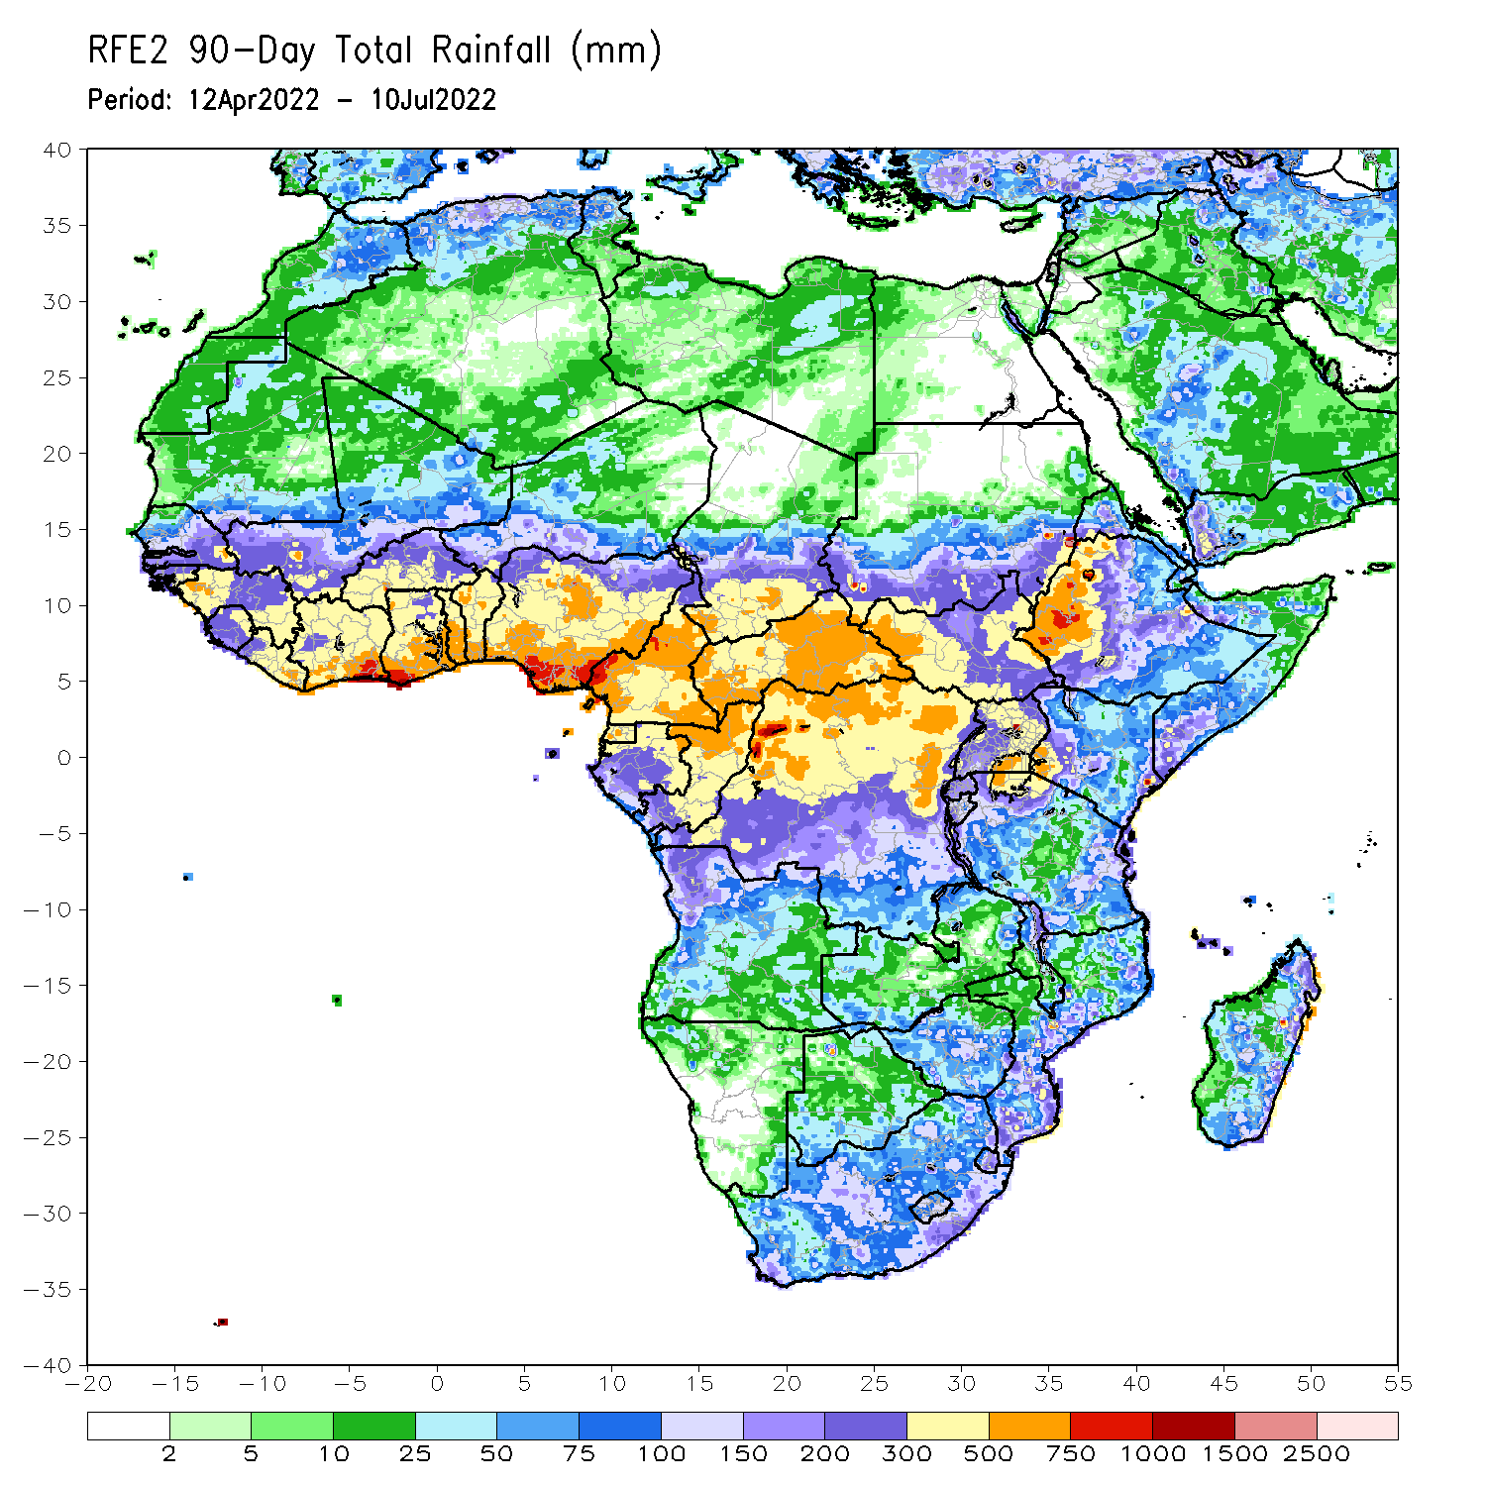
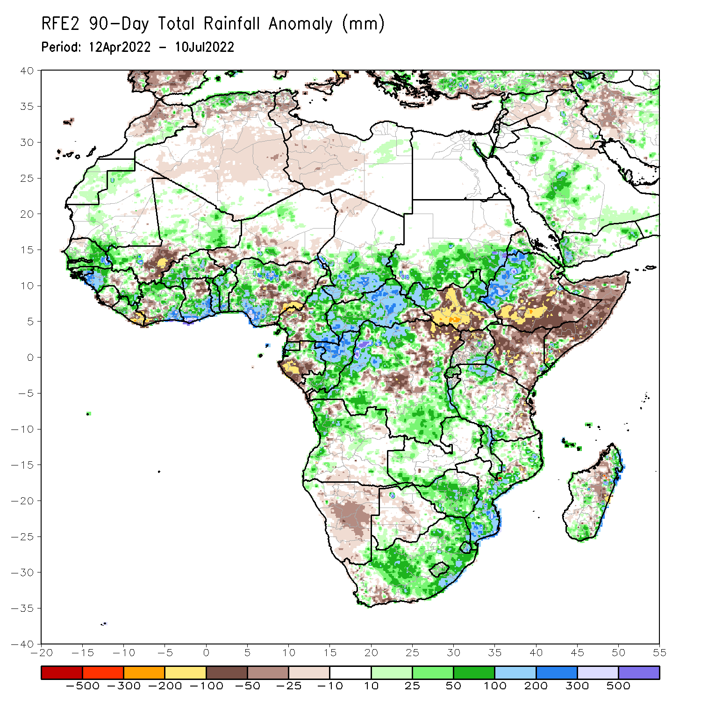
Rainfall Patterns: Last 90 Days
Over the past 90 days, in East Africa, above-average rainfall was observed over southern and eastern Sudan, the western and eastern portions of South Sudan, western Ethiopia, and parts of Uganda and Tanzania. Rainfall was below-average over southern and eastern Ethiopia, central and southern South Sudan, much of Kenya, Somalia, northern Uganda, as well as pockets of Tanzania. In southern Africa, above-average rainfall was observed over western and northern Angola, parts of Zambia, much of Zimbabwe, Malawi, South Africa, Mozambique and pockets of Madagascar. Below-average rainfall was observed over parts of Angola, much of Namibia, Botswana, the far western South Africa, and pockets of Madagascar. In Central Africa, rainfall was above-average over central and eastern Cameroon, much of CAR, northern Gabon, Congo, and parts of DRC. Rainfall was below-average over pockets of western Cameroon, parts of central and eastern DRC, and southern Gabon. In West Africa, rainfall was above-average over much of the Gulf of Guinea region, as well as eastern and southern Senegal, and the Gambia, while below-average rainfall was observed over pockets of central Mali, Niger Cote d’Ivoire and Nigeria.
Notes:
4

Slide 5
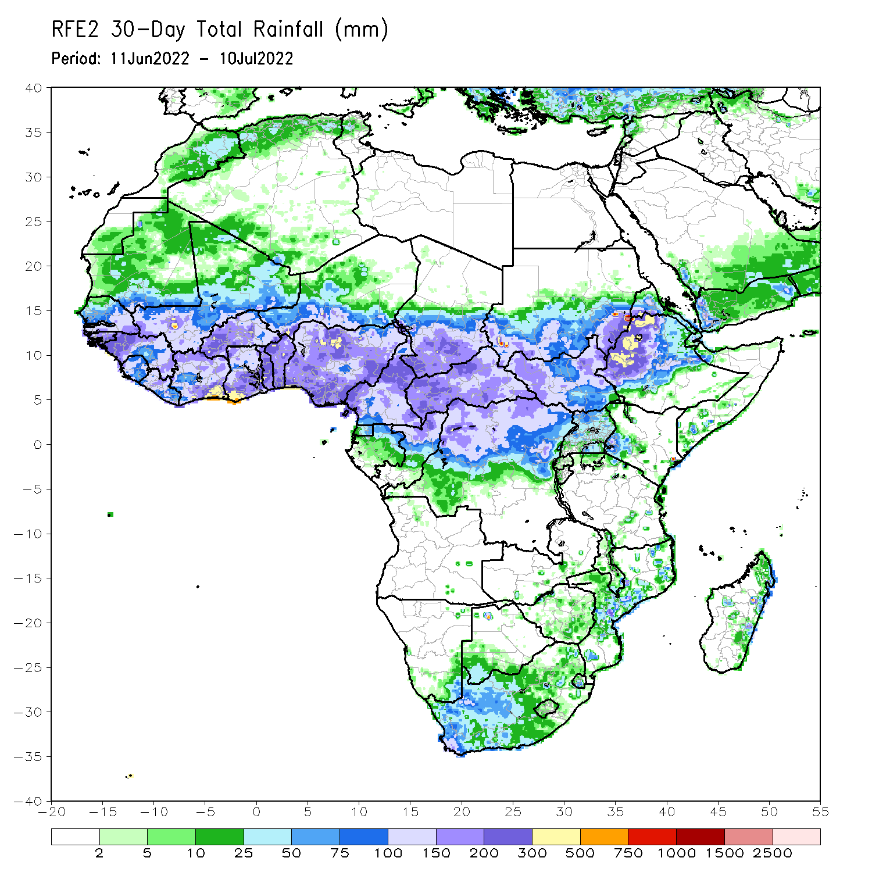
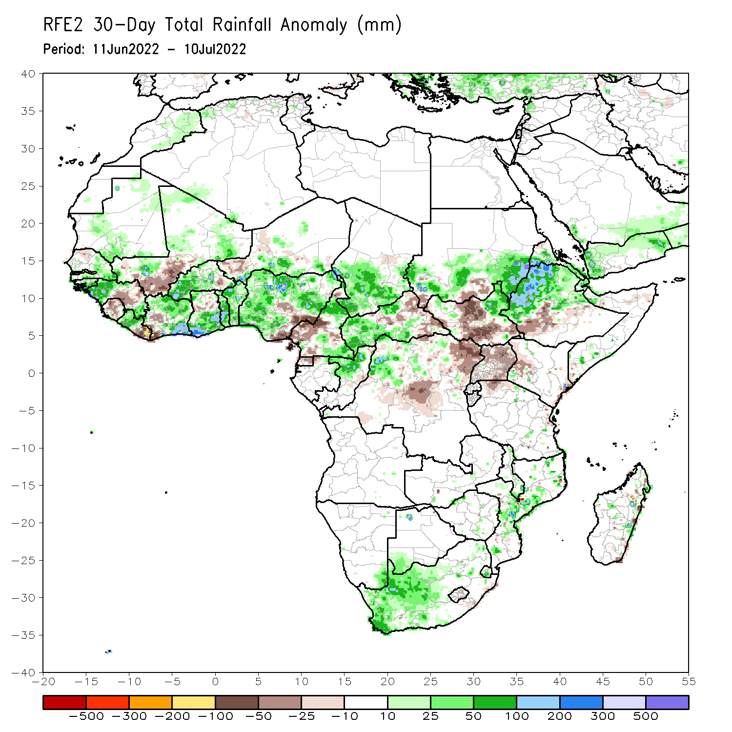
Rainfall Patterns: Last 30 Days
During the past 30 days, in East Africa, above-average rainfall was observed over southern and eastern Sudan, parts of western and eastern South Sudan, and western, central and northern Ethiopia. Rainfall was below-average over the central and southern parts of South Sudan, Uganda, and parts of Kenya and southern Ethiopia. In Central Africa, rainfall was above-average over parts of northern and eastern Cameroon, northern Congo, western CAR and pockets of northwestern DRC. Rainfall was below-average over eastern CAR and central and northeastern DRC. In Southern Africa, above-average rainfall was observed over the western portion of South Africa, and pockets of Mozambique. In West Africa, rainfall was above-average over eastern Senegal, western Guinea, western Liberia, western and central Burkina Faso, Cote d’Ivoire, Ghana, Togo and Benin, parts of southern Niger and several portions of Nigeria. In contrast, parts of central and southern Mali, southwestern Cote D’ivoire, western Niger and southeastern Nigeria received below-average rainfall.
Notes:
5

Slide 6
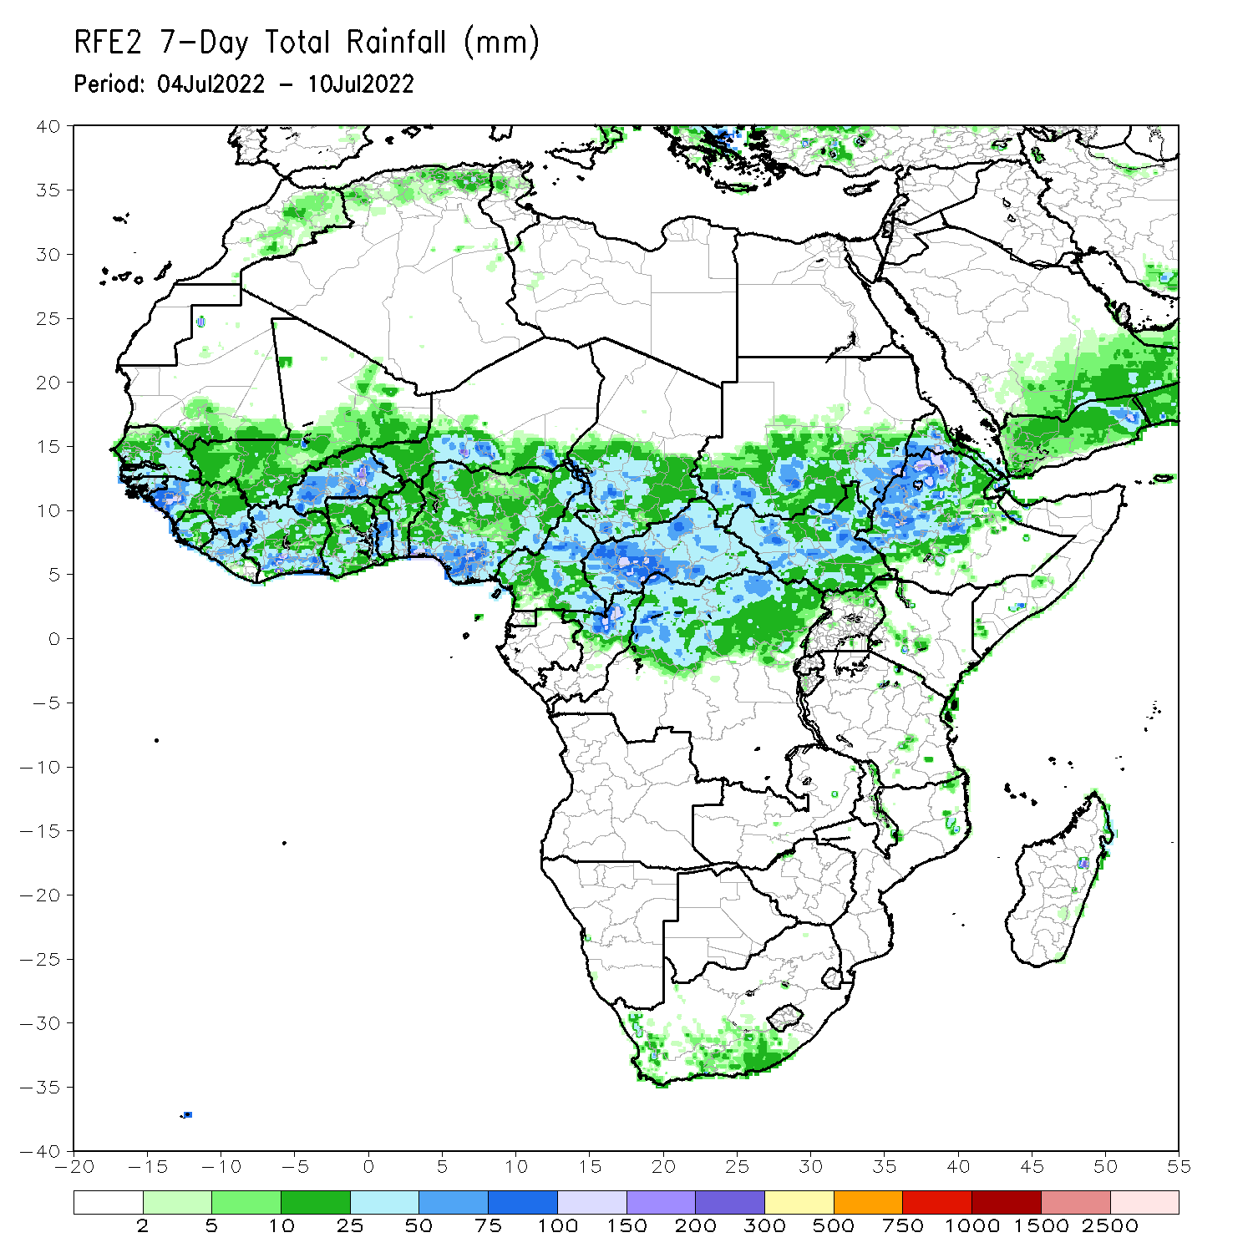
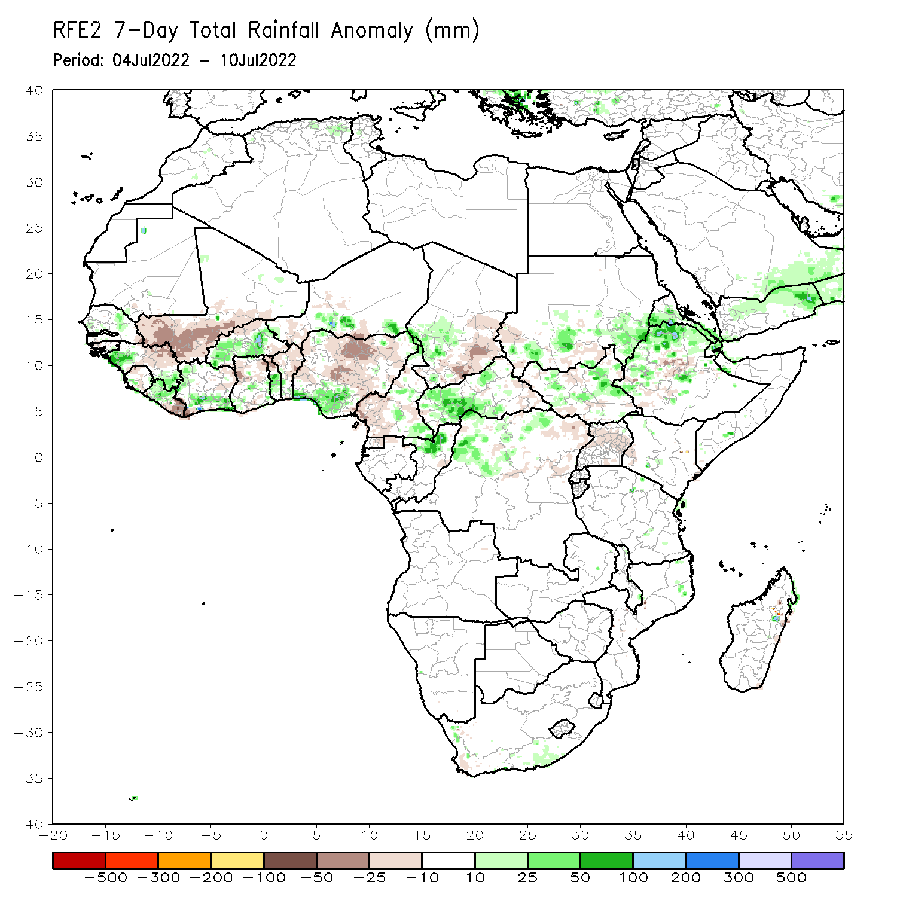
Rainfall Patterns: Last 7 Days
During the past 7 days, in East Africa, rainfall was above-average over parts of western central and northern Ethiopia, pockets of southern and eastern Sudan and western South Sudan. In Central Africa, rainfall was above-average over pockets of Cameroon, western CAR, and northern Congo, and northwestern DRC. Below-average rainfall was observed over eastern CAR, eastern Chad and parts of northern DRC. In West Africa, above-average rainfall was observed over parts of western Guinea, western Liberia, southern Cote d’Ivoire, Burkina Faso, Togo, and southern Nigeria. Meanwhile, rainfall was below-average over parts of Mali, eastern Liberia, Benin, and central and northern Nigeria.

Slide 7
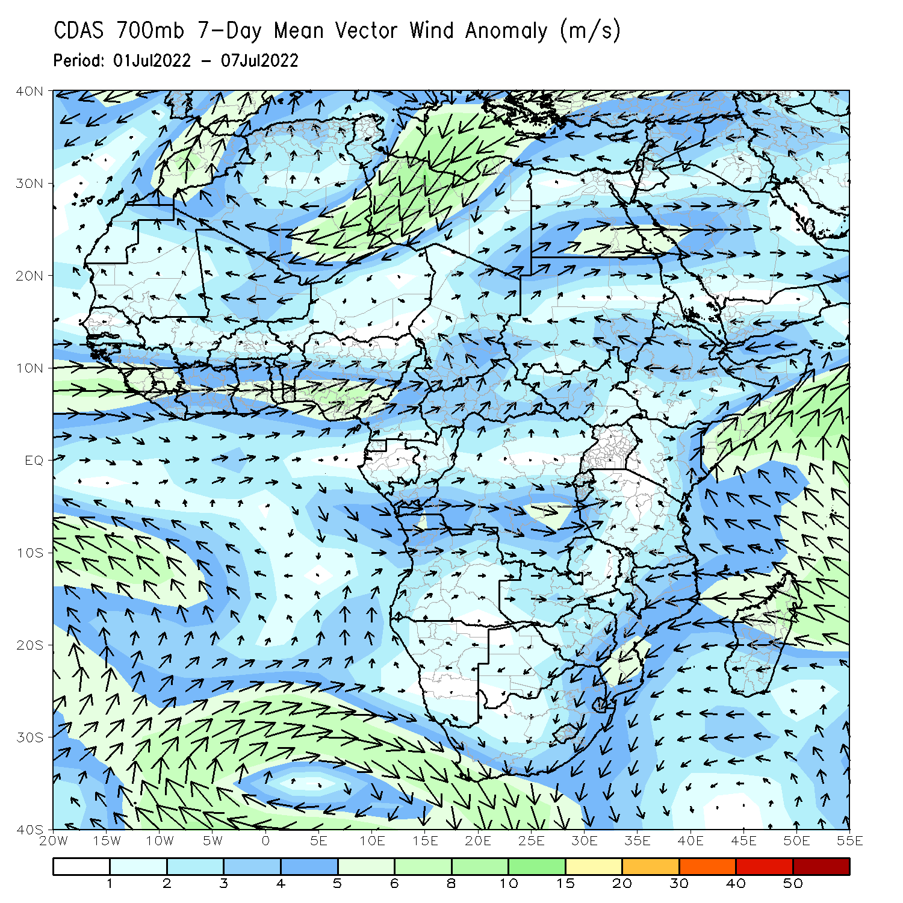
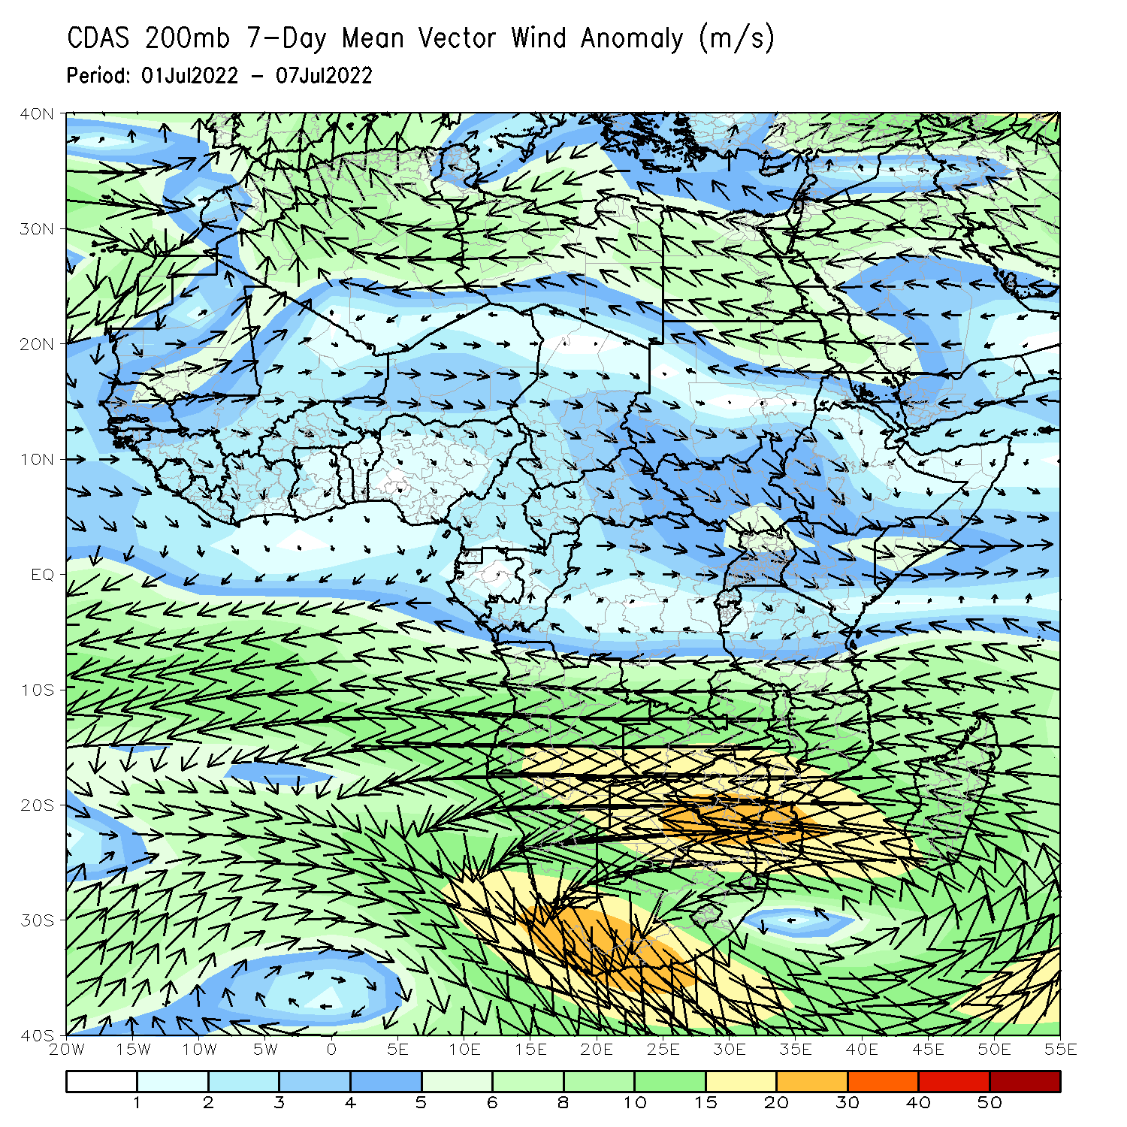
Atmospheric Circulation: Last 7 Days
At 700-hPa level (left panel), anomalous cyclonic shear was observed across West Africa.

Slide 8
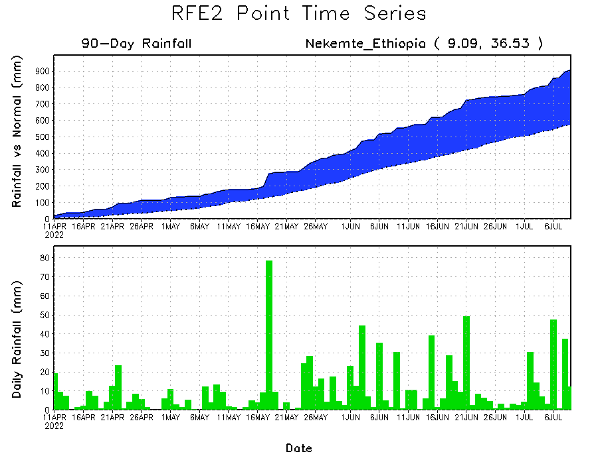
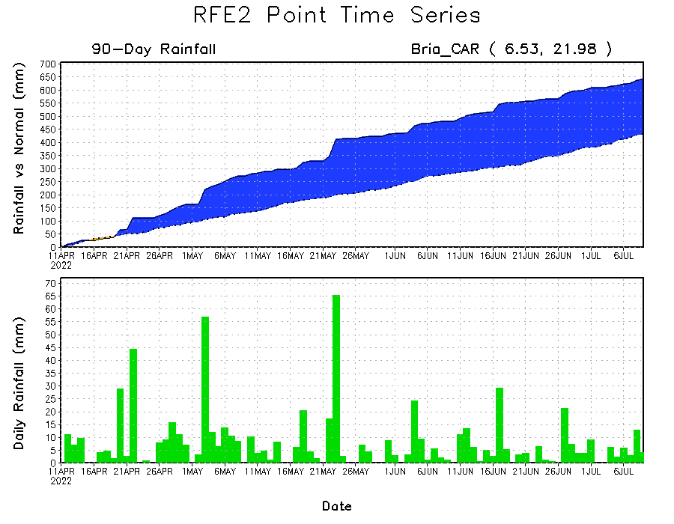
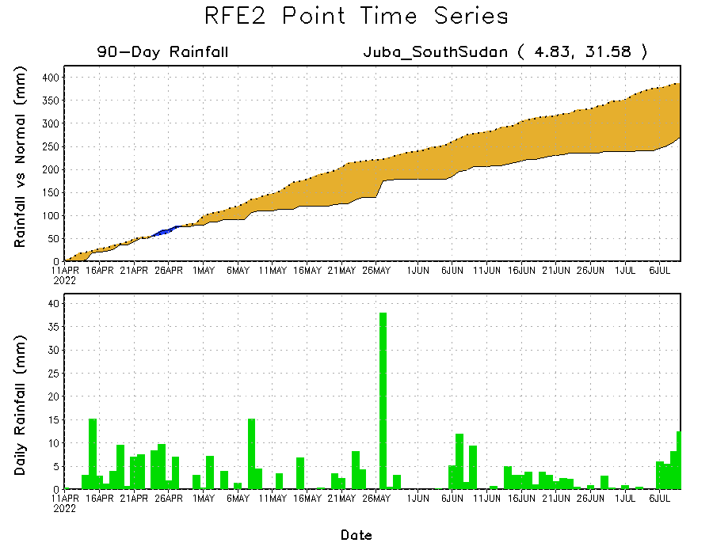
Rainfall Evolution
Daily evolution of rainfall over the last 90 days at selected locations shows increasing moisture deficits over parts of South Sudan (bottom right). Consistent heavy rains have kept significant moisture surpluses over parts of Central African Republic (bottom left) and western Ethiopia (top right).

Slide 9
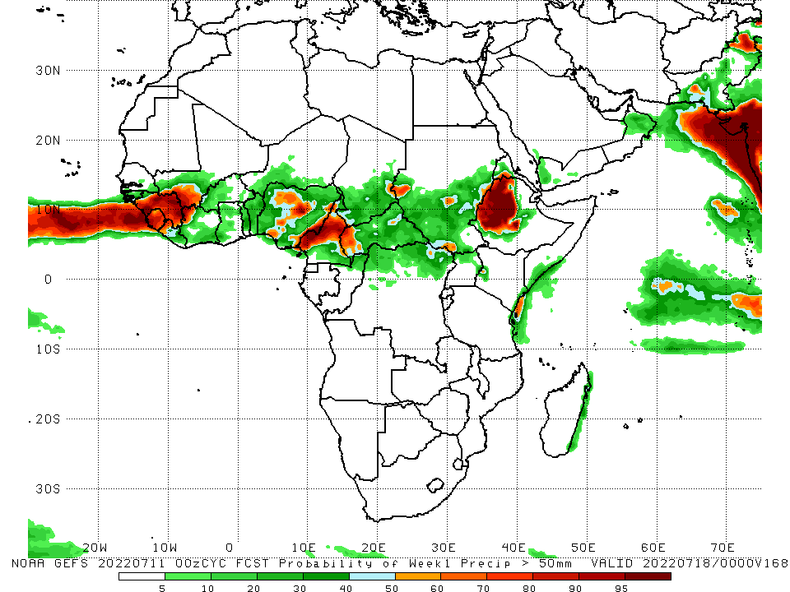
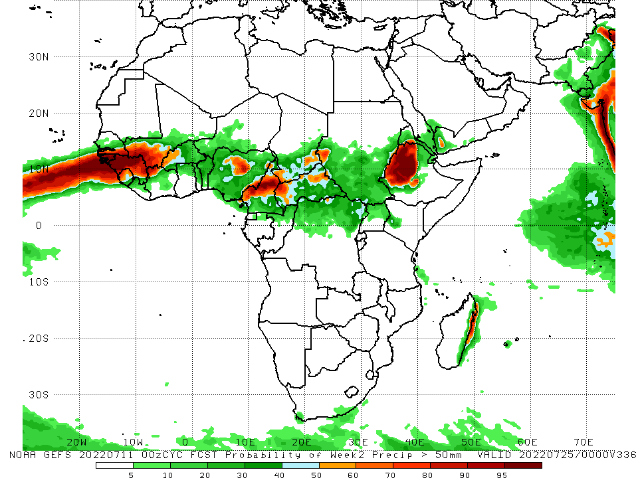
NCEP GEFS Model Forecasts Non-Bias Corrected Probability of precipitation exceedance
Week-1, Valid: 12 - 18 July, 2022
Week-2, Valid: 19 - 25 July, 2022
For week-1 (left panel) and week-2 (right panel) the NCEP GEFS indicates a moderate to high chance (over 70%) for rainfall to exceed 50 mm over Guinea, Sierra Leone, Liberia, pockets of Nigeria, Cameroon and western Ethiopia.
Notes:
9

Slide 10
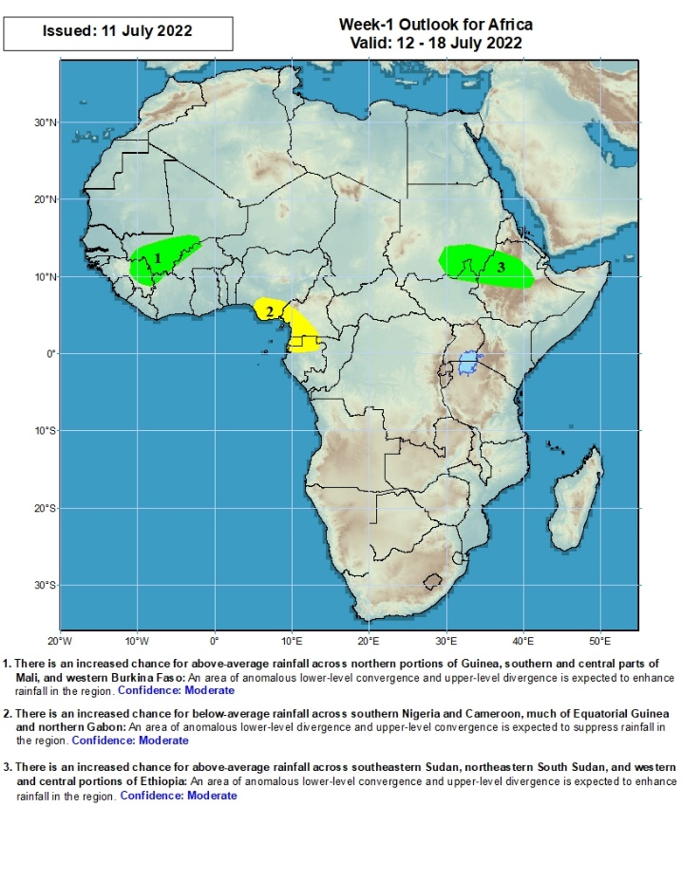
Week-1 Precipitation Outlooks
12 – 18 July, 2022
There is an increased chance for above-average rainfall across northern portions of Guinea, southern and central parts of Mali, and western Burkina Faso: An area of anomalous lower-level convergence and upper-level divergence is expected to enhance rainfall in the region. Confidence: Moderate
There is an increased chance for below-average rainfall across southern Nigeria and Cameroon, much of Equatorial Guinea and northern Gabon: An area of anomalous lower-level divergence and upper-level convergence is expected to suppress rainfall in the region. Confidence: Moderate
There is an increased chance for above-average rainfall across southeastern Sudan, northeastern South Sudan, and western and central portions of Ethiopia: An area of anomalous lower-level convergence and upper-level divergence is expected to enhance rainfall in the region. Confidence: Moderate
Notes:
10

Slide 11
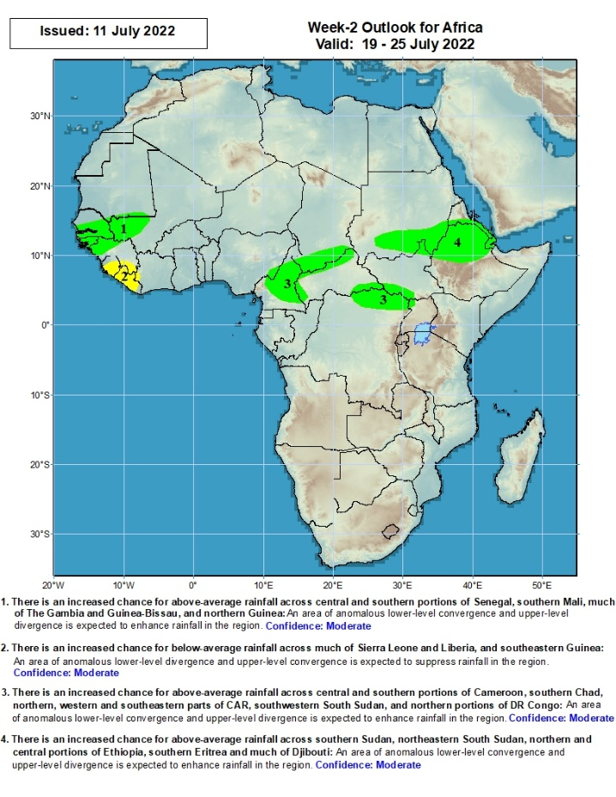
Week-2 Precipitation Outlooks
19 - 25 July, 2022
There is an increased chance for above-average rainfall across central and southern portions of Senegal, southern Mali, much of The Gambia and Guinea-Bissau, and northern Guinea: An area of anomalous lower-level convergence and upper-level divergence is expected to enhance rainfall in the region. Confidence: Moderate
There is an increased chance for below-average rainfall across much of Sierra Leone and Liberia, and southeastern Guinea: An area of anomalous lower-level divergence and upper-level convergence is expected to suppress rainfall in the region. Confidence: Moderate
There is an increased chance for above-average rainfall across central and southern portions of Cameroon, southern Chad, northern, western and southeastern parts of CAR, southwestern South Sudan, and northern portions of DR Congo: An area of anomalous lower-level convergence and upper-level divergence is expected to enhance rainfall in the region. Confidence: Moderate
There is an increased chance for above-average rainfall across southern Sudan, northeastern South Sudan, northern and central portions of Ethiopia, southern Eritrea and much of Djibouti: An area of anomalous lower-level convergence and upper-level divergence is expected to enhance rainfall in the region. Confidence: Moderate
Notes:
11

Slide 12
Summary
During the past 30 days, in East Africa, above-average rainfall was observed over southern and eastern Sudan, western and eastern South Sudan, and western and central Ethiopia. Rainfall was below-average over the central and southern parts of South Sudan. In Central Africa, rainfall was above-average over pockets of Cameroon, northern Gabon, northern Congo, pockets of CAR and parts of northern. Rainfall was below-average over parts of CAR and DRC. In Southern Africa, above-average rainfall was observed over the western portion of South Africa, and pockets of Mozambique and Madagascar. In West Africa, rainfall was above-average over eastern Senegal, Guinea, western Liberia, western Burkina Faso, Cote d’Ivoire, Ghana, Togo and Benin and several portions of Nigeria. In contrast, parts of central Mali, southwestern Cote d’Ivoire, and many parts of Nigeria received below-average rainfall.
During the past 7 days, in East Africa, rainfall was above-average over parts of western central and northern Ethiopia, pockets of southern and eastern Sudan and western South Sudan. In Central Africa, rainfall was above-average over pockets of Cameroon, western CAR, and northern Congo, and northwestern DRC. Below-average rainfall was observed over eastern CAR, eastern Chad and parts of northern DRC. In West Africa, above-average rainfall was observed over parts of western Guinea, western Liberia, southern Cote d’Ivoire, Burkina Faso, Togo, and southern Nigeria. Meanwhile, rainfall was below-average over parts of Mali, eastern Liberia, Benin, and central and northern Nigeria.
Week-1 and week-2 outlooks call for an increased chance for above-average rainfall over the far western West Africa, and parts of Central Africa, eastern Sudan and western Ethiopia. In contrast, the outlooks call for an increased chance for below-average rainfall over Sierra Leone, Liberia, southern Nigeria and southern Cameroon.

