Slide 1
The African Monsoon Recent Evolution and Current Status Include Week-1 and Week-2 Outlooks
Update prepared by
25 July 2022
For more information, visit:
http://www.cpc.ncep.noaa.gov/products/Global_Monsoons/African_Monsoons/precip_monitoring.shtml

Slide 2
Outline
Highlights
Recent Evolution and Current Conditions
NCEP GEFS Forecasts
Summary

Slide 3
Highlights: Last 7 Days
During the past 7 days, in East Africa, rainfall was above-average over parts of southern Sudan, western South Sudan and western Ethiopia. Below-average rainfall was observed over pockets of central South Sudan and eastern Ethiopia. In Central Africa, rainfall was above-average over northern and eastern Cameroon, southern Chad, much of CAR, and northern DRC. Below-average rainfall was observed over pockets of Cameroon. In West Africa, above-average rainfall was observed over much of Senegal, western Guinea, Sierra Leone, central and eastern Burkina Faso, northern Ghana, and parts of northern Nigeria. Meanwhile, rainfall was below-average along the Gulf of Guinea coast.
Week-1 outlooks call for an increased chance for below-average rainfall over the far western West Africa. In contrast, there is an increased chance for above-average rainfall over portions of Central Africa, much of South Sudan, the southern and eastern portions of Sudan, and western Ethiopia. Week-2 outlooks call for an increased chance for above-average rainfall over the western portions of the Gulf of Guinea region, and the central portion of Sahel. There is an increased chance for below-average rainfall across the eastern portion of the Gulf of Guinea and the neighboring areas of Central Africa.

Slide 4
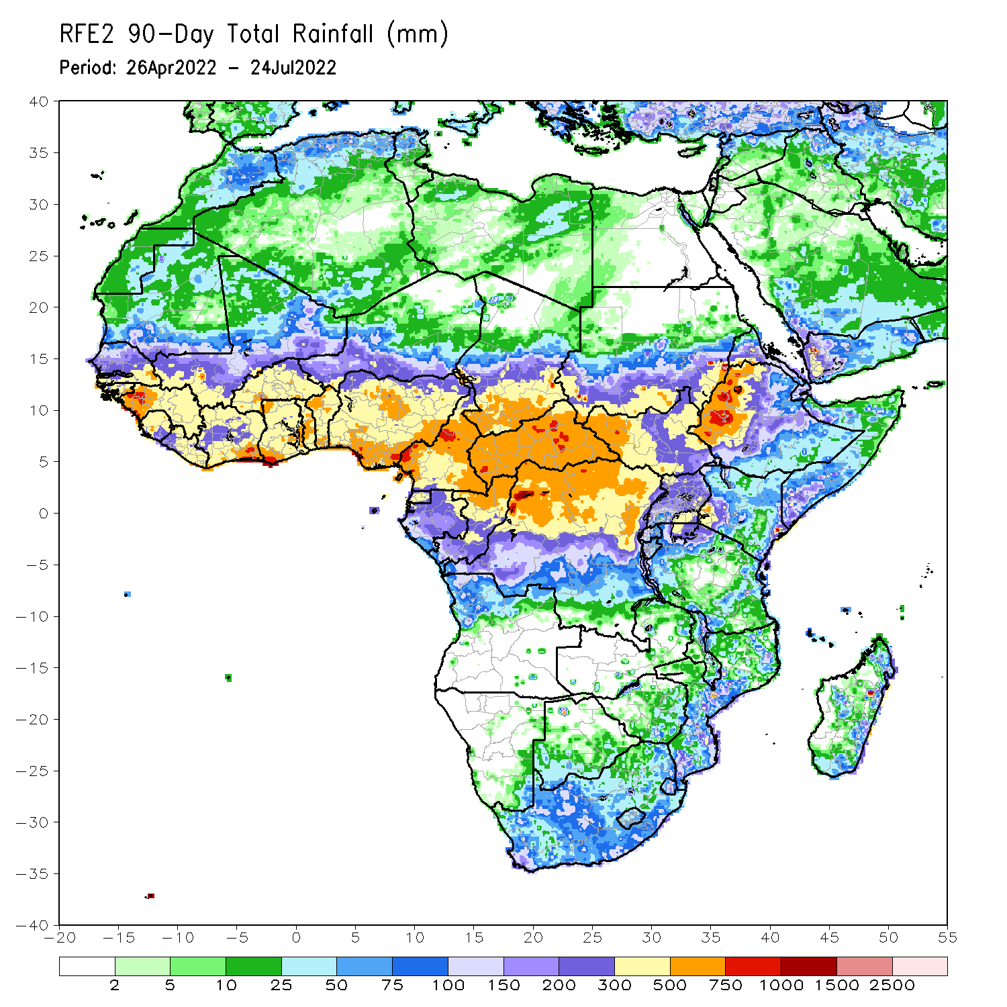
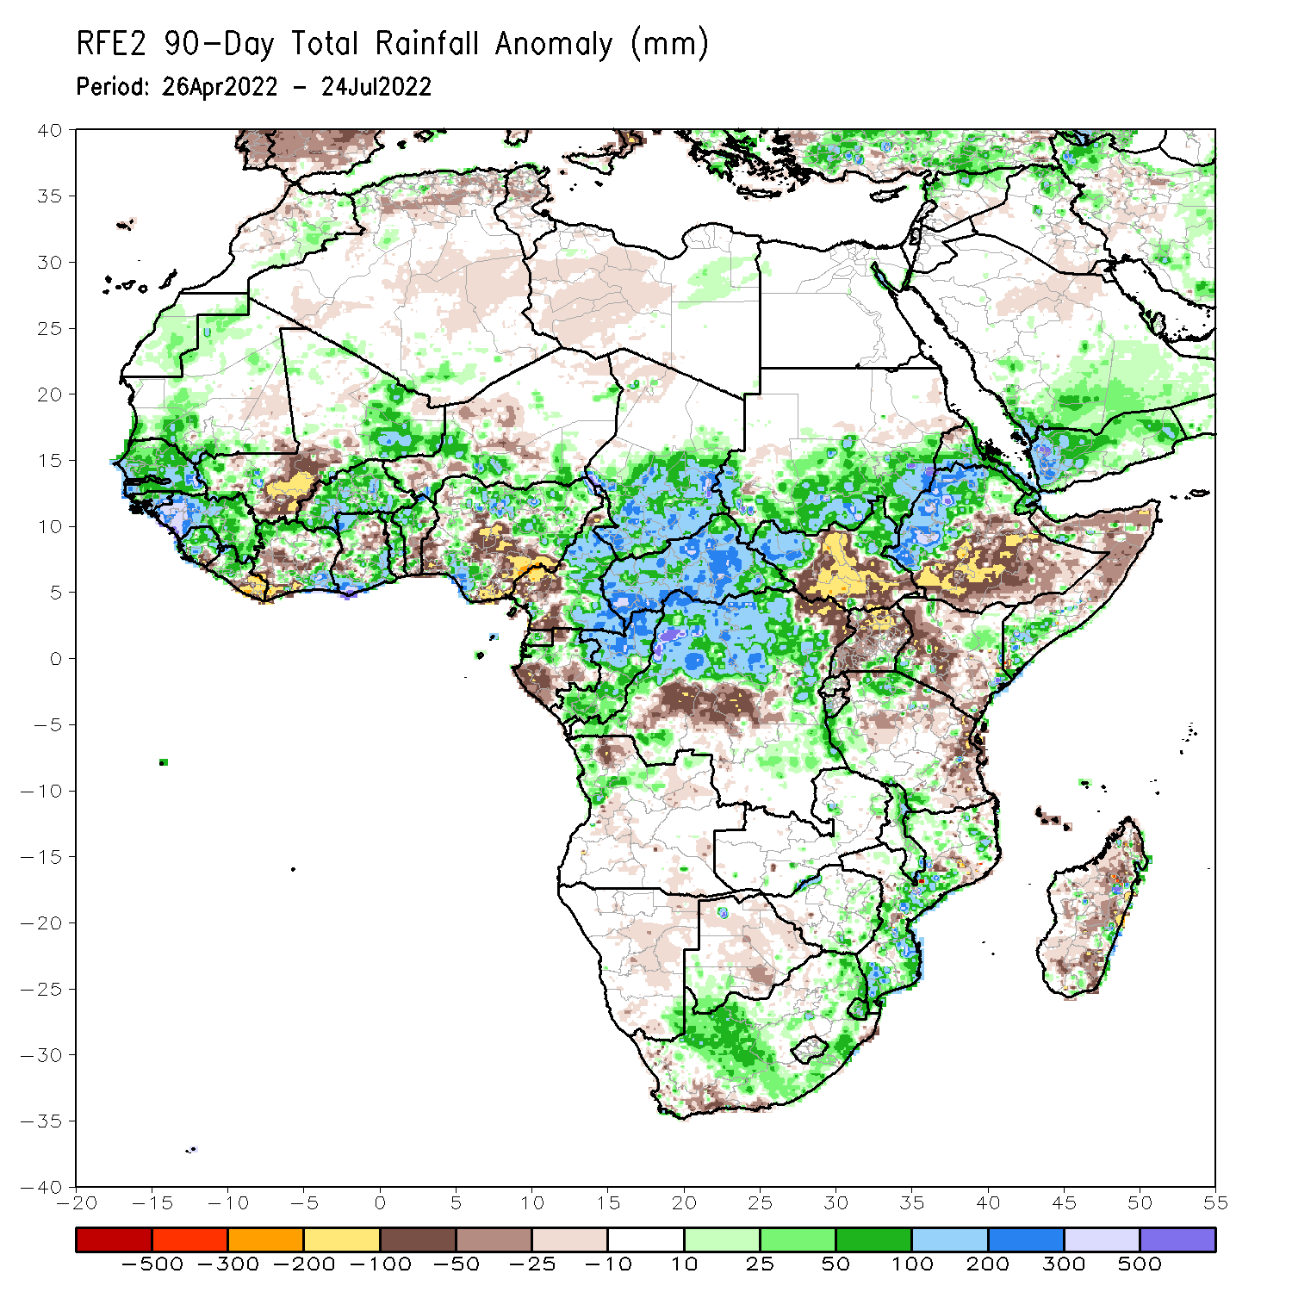
Rainfall Patterns: Last 90 Days
Over the past 90 days, in East Africa, above-average rainfall was observed over southern and eastern Sudan, the western and eastern portions of South Sudan, western Ethiopia, and parts of southern Somalia, western and northern Tanzania and pockets of western and eastern Kenya. Rainfall was below-average over southern and eastern Ethiopia, central and southern South Sudan, much of Kenya, central and northern Somalia, Uganda, as well as pockets of eastern Tanzania. In southern Africa, above-average rainfall was observed over northern Angola, northern Malawi, parts of South Africa and Mozambique. Below-average rainfall was observed over pockets of Botswana and much of Madagascar. In Central Africa, rainfall was above-average over central and eastern Cameroon, much of CAR, northern and eastern Gabon, Congo, and northern DRC. Rainfall was below-average over pockets of western Cameroon, parts of central DRC, and southern Gabon. In West Africa, rainfall was above-average over much of the Gulf of Guinea region, as well as Senegal, while below-average rainfall was observed over central Mali, eastern Liberia, parts of Cote D’Ivoire, pockets of northeastern Ghana, and parts of Nigeria.
Notes:
4

Slide 5
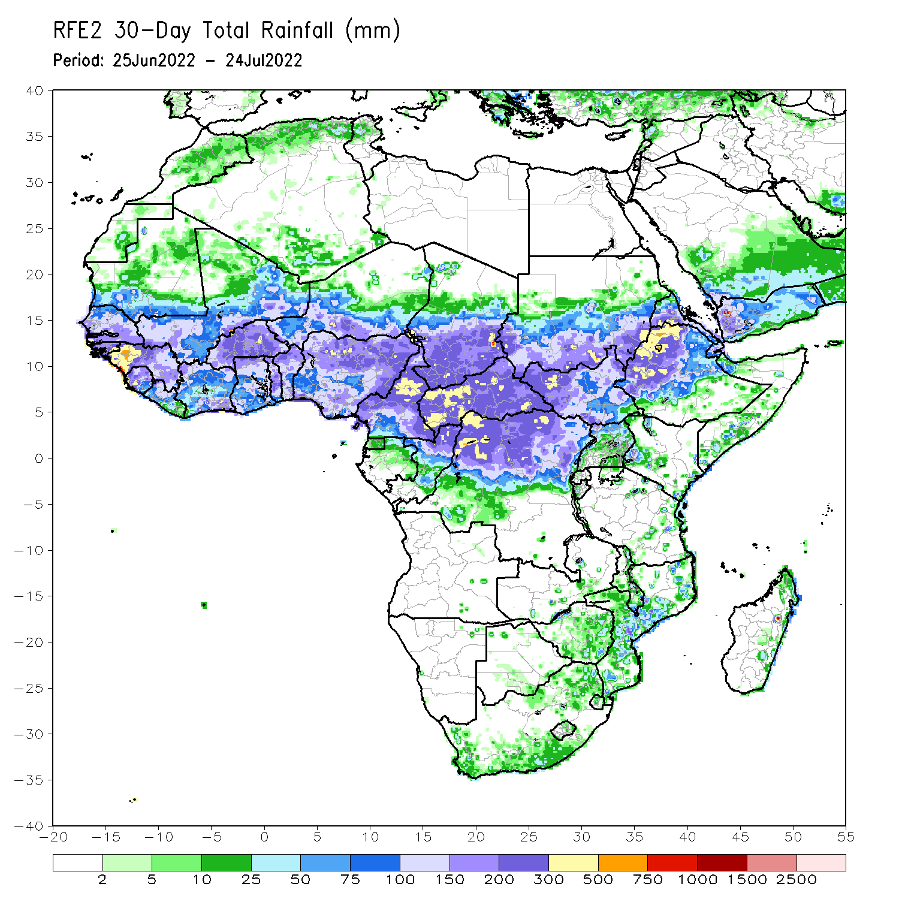
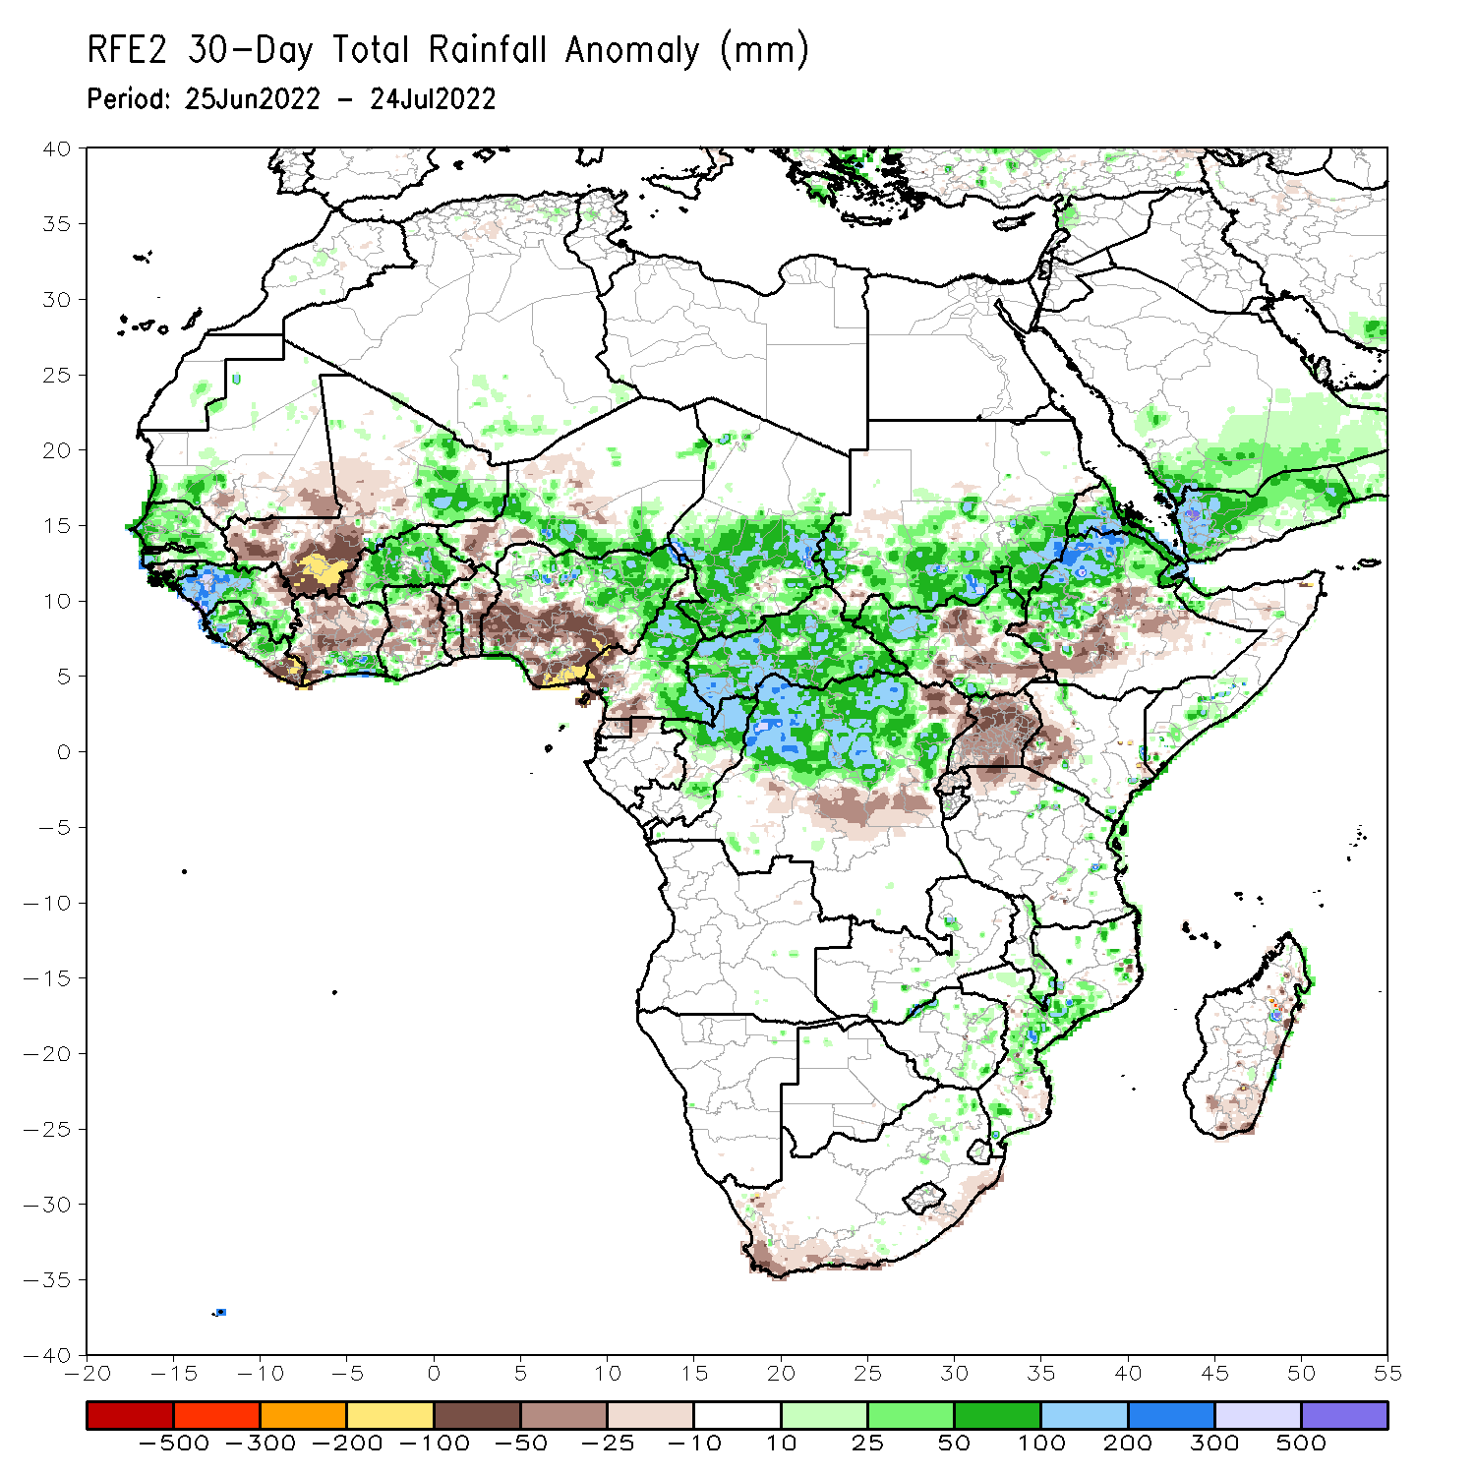
Rainfall Patterns: Last 30 Days
During the past 30 days, in East Africa, above-average rainfall was observed over southern and eastern Sudan, parts of western and eastern South Sudan, and western, central and northern Ethiopia. Rainfall was below-average over the central and southern parts of South Sudan, Uganda, and pockets of western Kenya and southern Ethiopia. In Central Africa, rainfall was above-average over parts of northern and eastern Cameroon, northern Congo, much of CAR, southern Chad and northern DRC. Rainfall was below-average over Equatorial Guinea, southern Cameroon, and pockets of central DRC. In Southern Africa, above-average rainfall was observed over parts of central Mozambique. In West Africa, rainfall was above-average over southern Senegal, western and central Guinea, Sierra Leone, western Liberia, Burkina Faso, coastal Cote d’Ivoire, parts of southern Niger and northern Nigeria. In contrast, central and southern Mali, eastern Liberia, portions of Cote D’ivoire, western Niger and southeern Nigeria received below-average rainfall.
Notes:
5

Slide 6
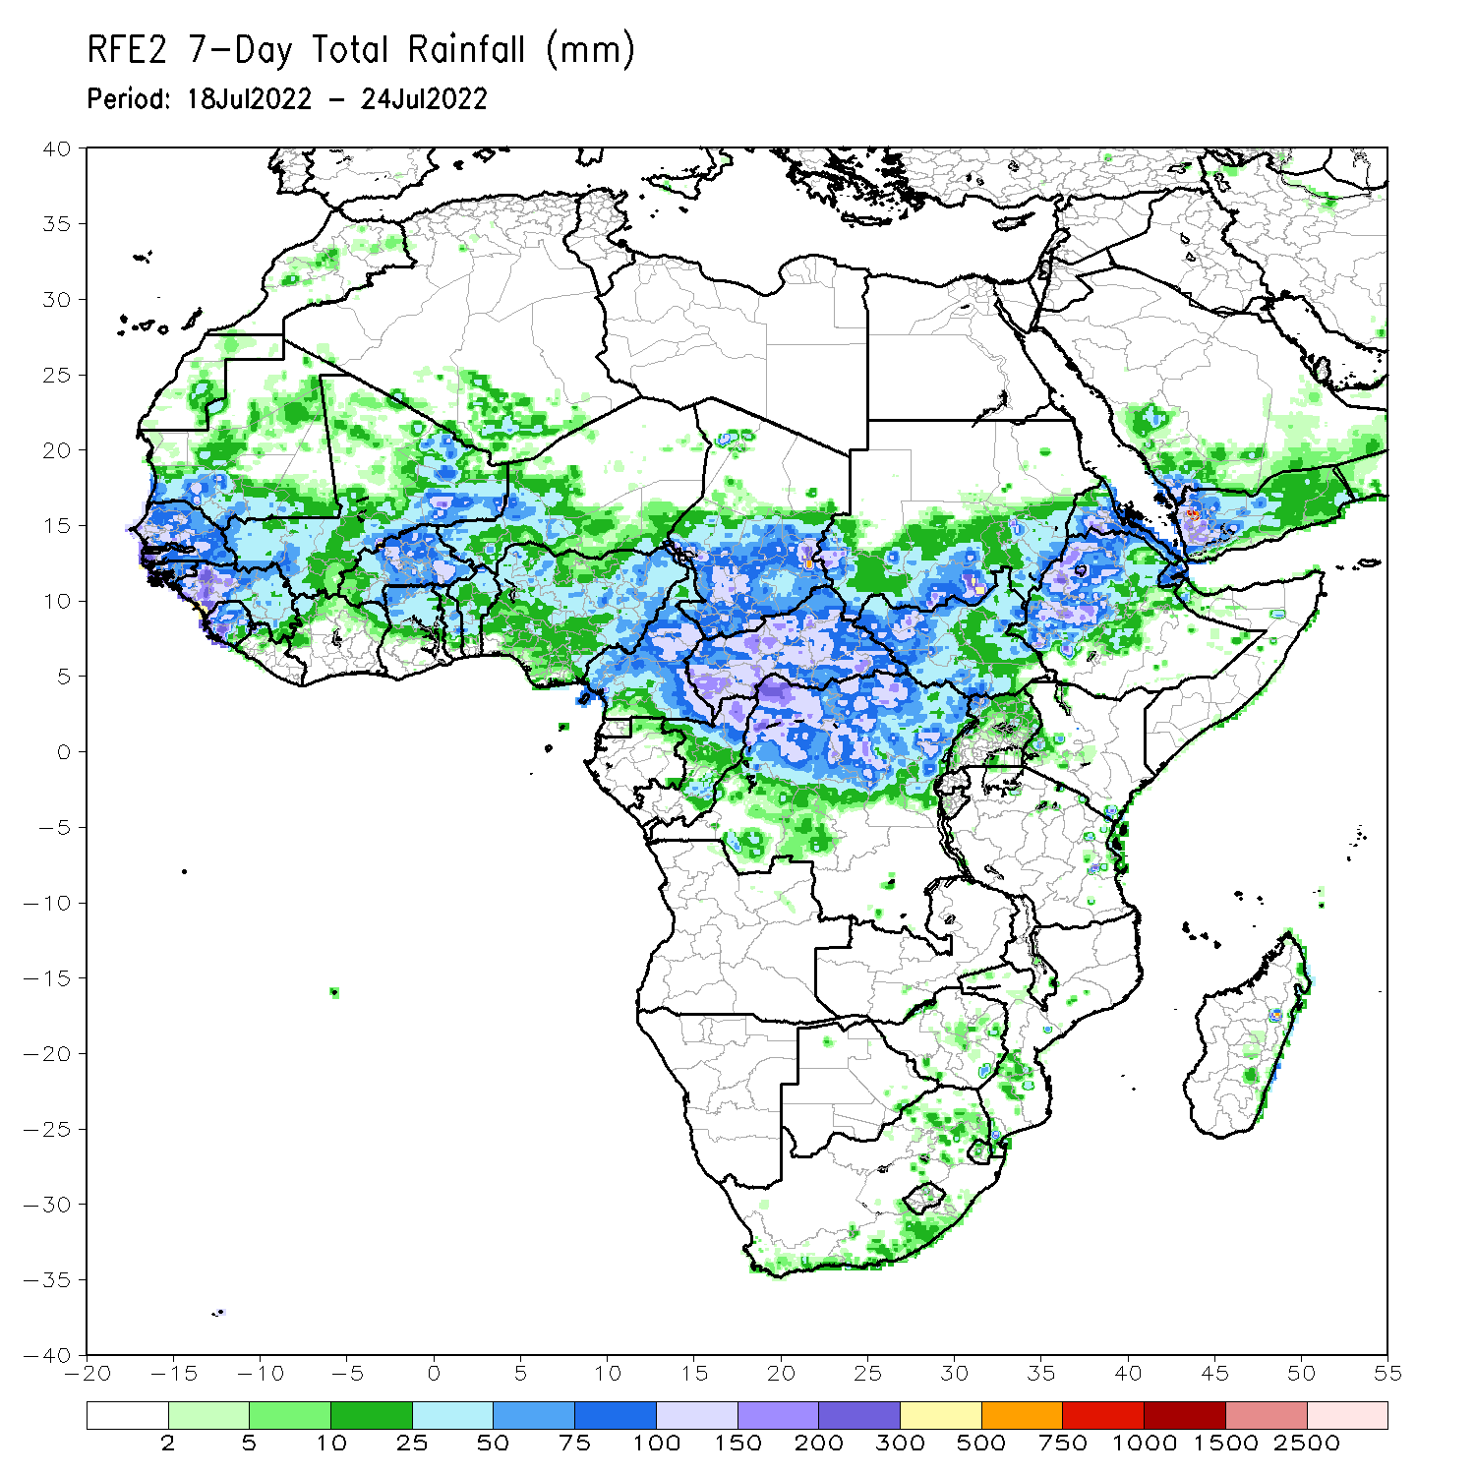
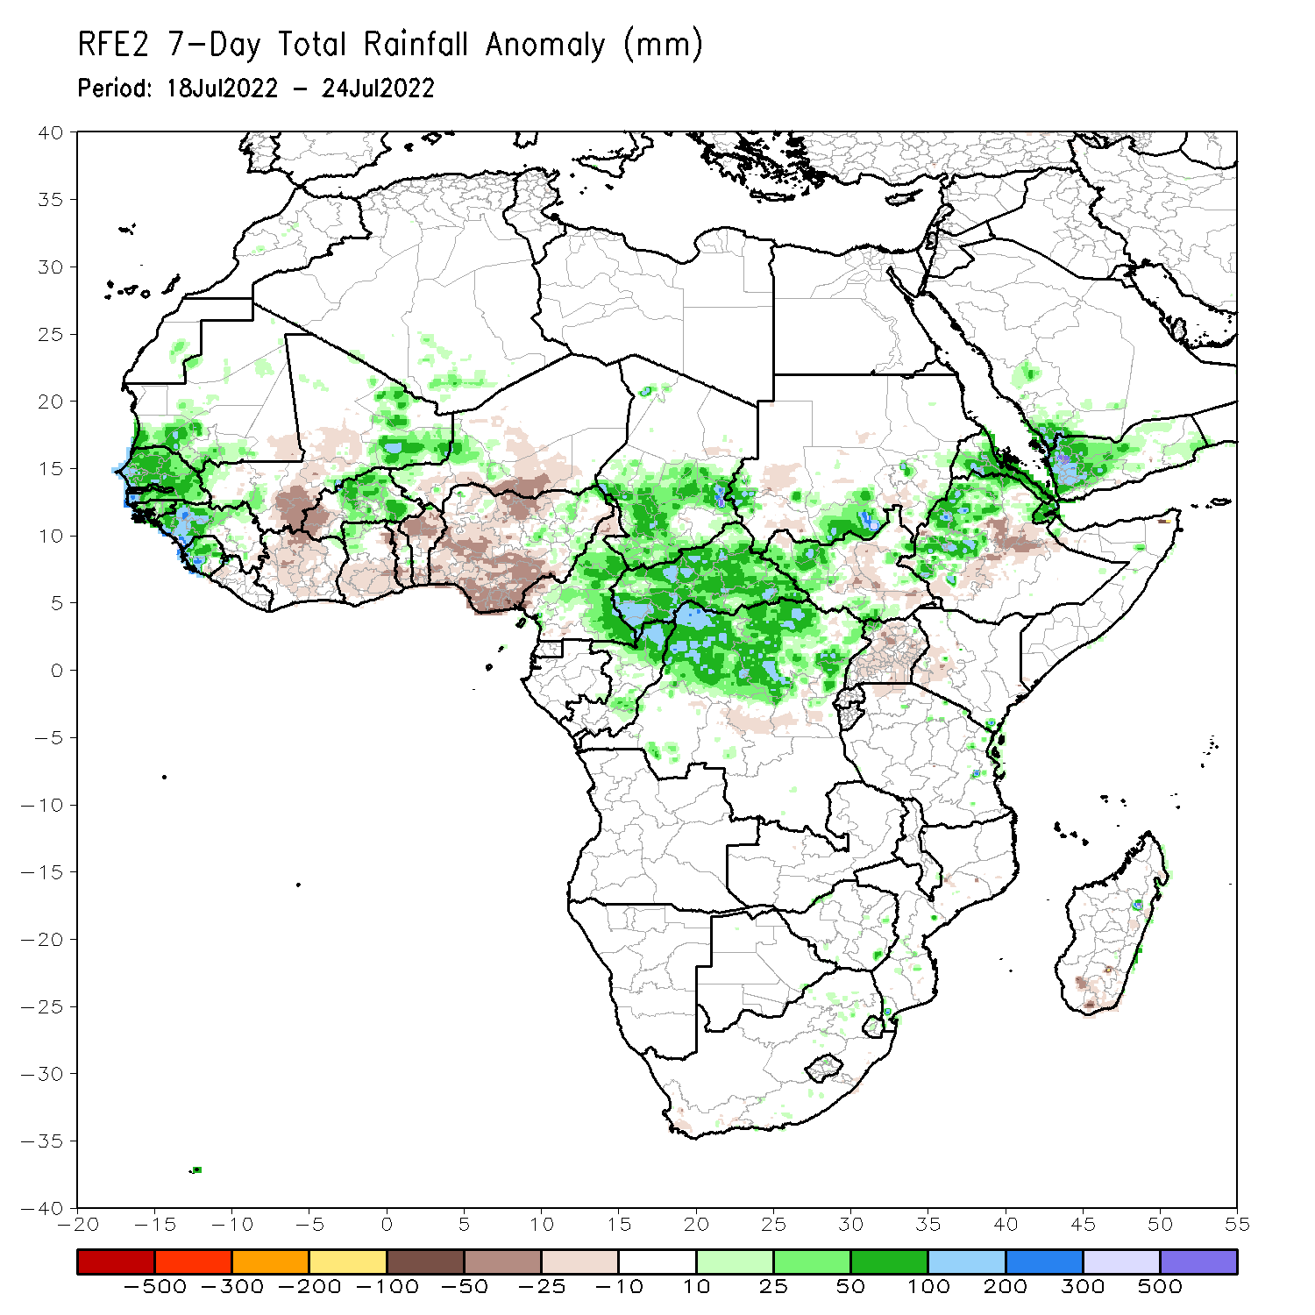
Rainfall Patterns: Last 7 Days
During the past 7 days, in East Africa, rainfall was above-average over parts of southern Sudan, western South Sudan and western Ethiopia. Below-average rainfall was observed over pockets of central South Sudan and eastern Ethiopia. In Central Africa, rainfall was above-average over northern and eastern Cameroon, southern Chad, much of CAR, and northern DRC. Below-average rainfall was observed over pockets of Cameroon. In West Africa, above-average rainfall was observed over much of Senegal, western Guinea, Sierra Leone, central and eastern Burkina Faso, northern Ghana, and parts of northern Nigeria. Meanwhile, rainfall was below-average along the Gulf of Guinea coast.

Slide 7
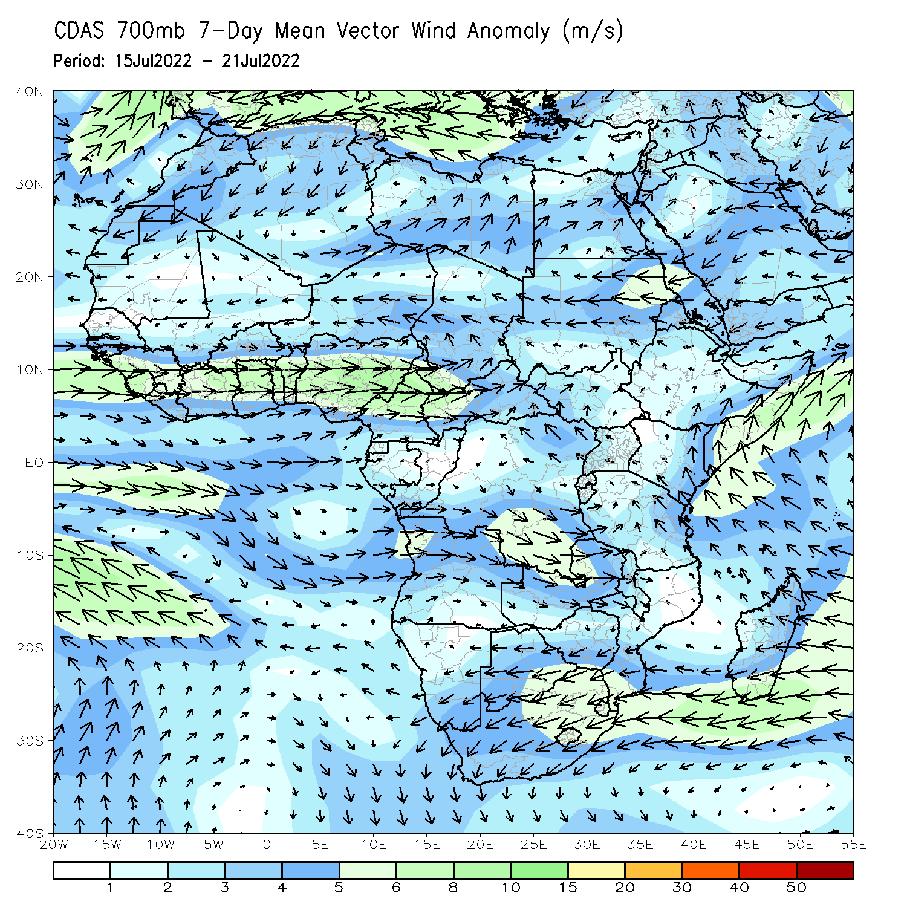
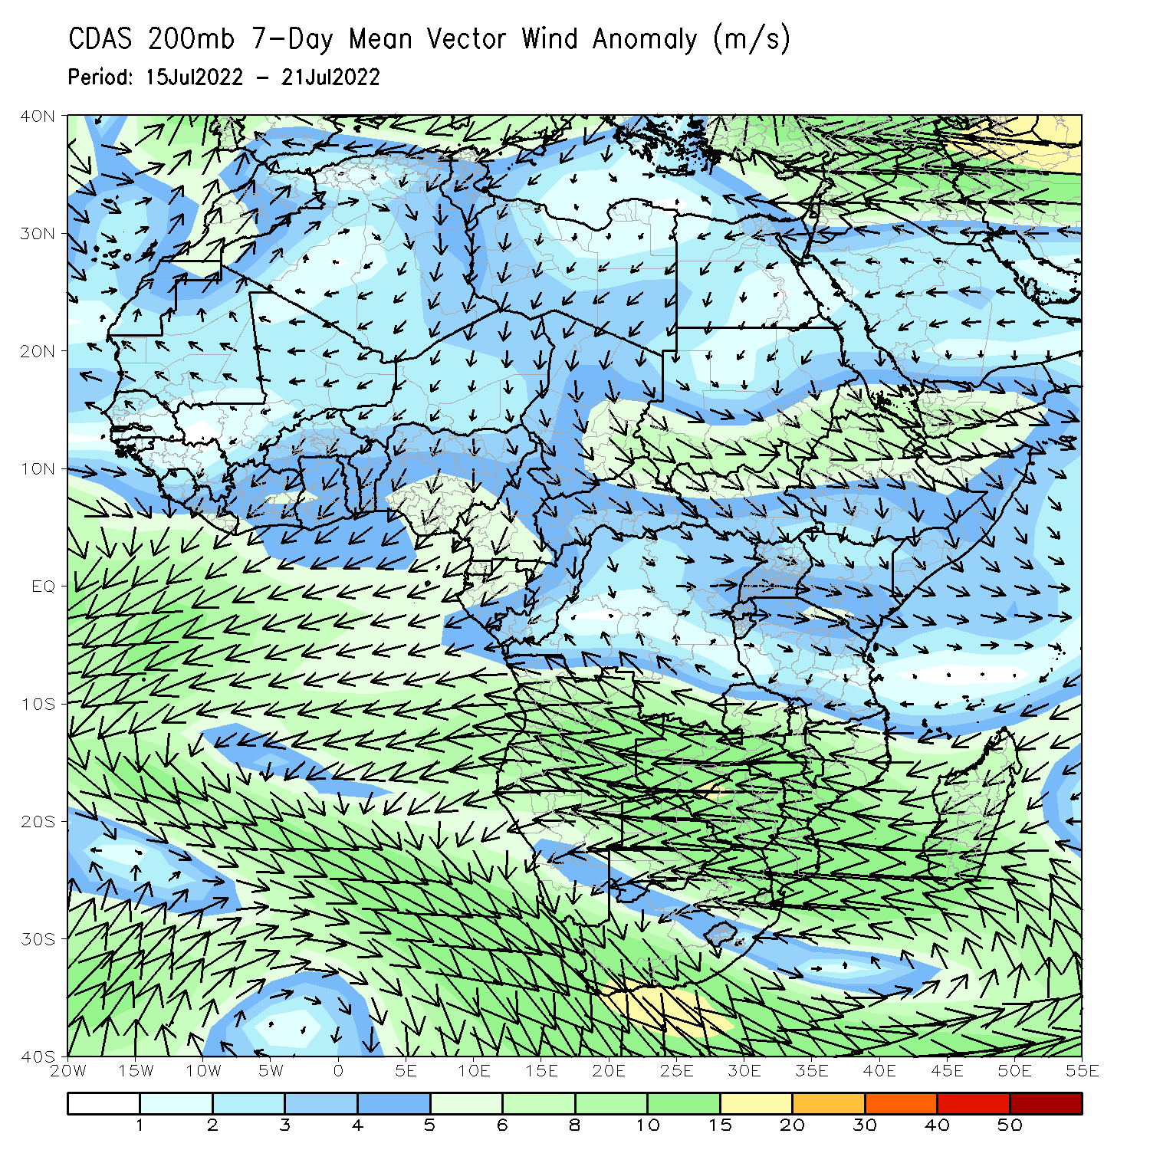
Atmospheric Circulation: Last 7 Days
At 700-hPa level (left panel), anomalous westerly flow with its associated cyclonic shear was observed across West Africa.

Slide 8
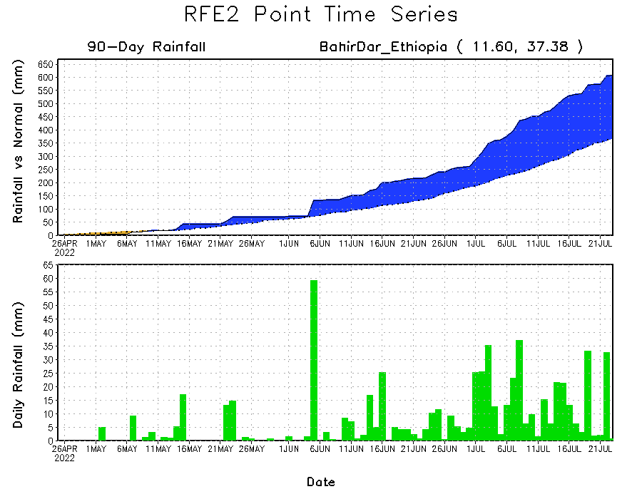
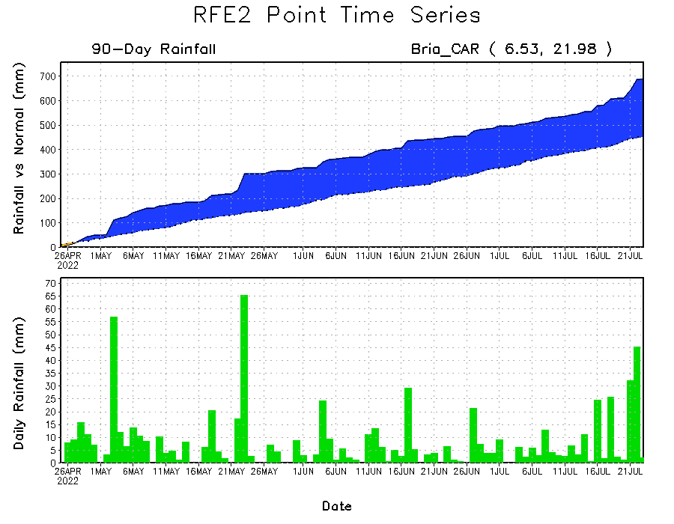
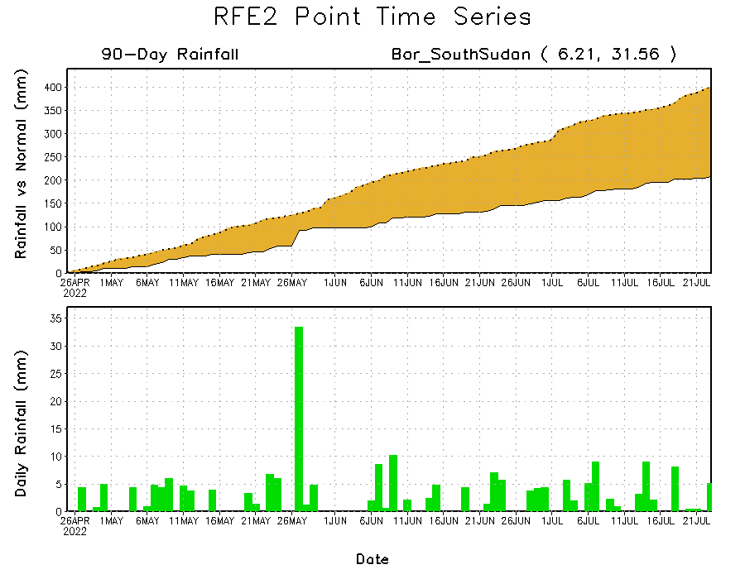
Rainfall Evolution
Daily evolution of rainfall over the last 90 days at selected locations shows increasing moisture deficits over parts of South Sudan (bottom right). Consistent heavy rains have kept significant moisture surpluses over parts of Central African Republic (bottom left) and western Ethiopia (top right).

Slide 9
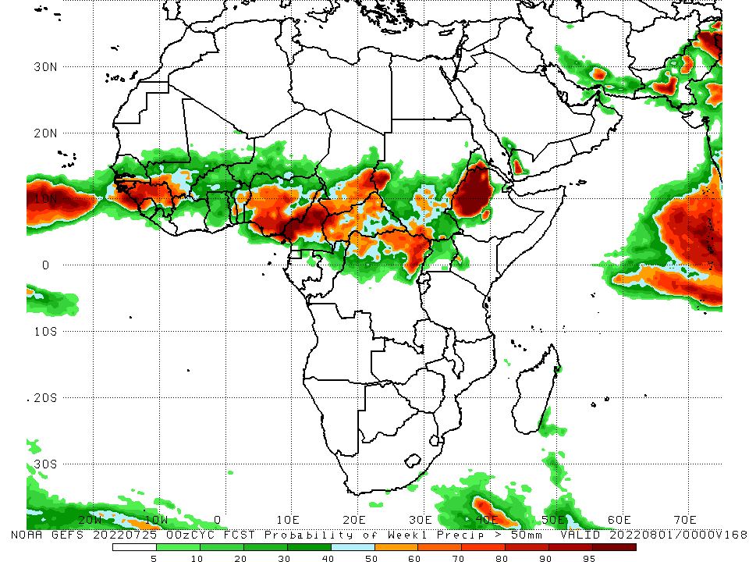
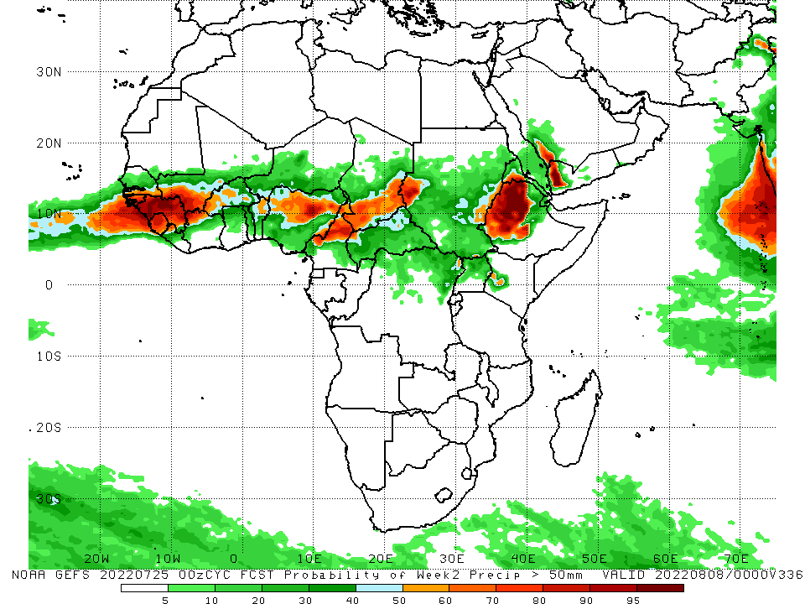
NCEP GEFS Model Forecasts Non-Bias Corrected Probability of precipitation exceedance
Week-1, Valid: 26 July - 1 August, 2022
Week-2, Valid: 2 – 8 August, 2022
For week-1 (left panel) and week-2 (right panel) the NCEP GEFS indicates a moderate to high chance (over 70%) for rainfall to exceed 50 mm over the western and eastern portions of the Gulf of Guinea region, parts of central Africa and western Ethiopia.
Notes:
9

Slide 10
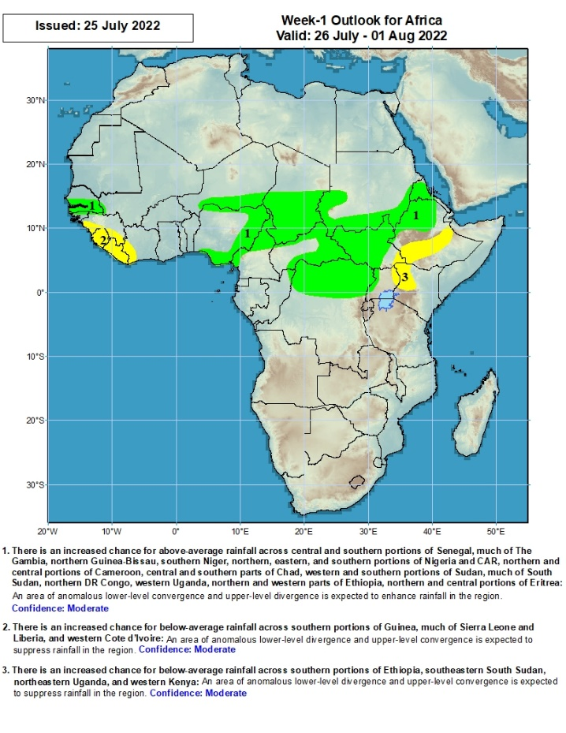
Week-1 Precipitation Outlooks
26 July - 1 August, 2022
There is an increased chance for above-average rainfall across central and southern portions of Senegal, much of The Gambia, northern Guinea-Bissau, southern Niger, northern, eastern, and southern portions of Nigeria and CAR, northern and central portions of Cameroon, central and southern parts of Chad, western and southern portions of Sudan, much of South Sudan, northern DR Congo, western Uganda, northern and western parts of Ethiopia, northern and central portions of Eritrea: An area of anomalous lower-level convergence and upper-level divergence is expected to enhance rainfall in the region. Confidence: Moderate
There is an increased chance for below-average rainfall across southern portions of Guinea, much of Sierra Leone and Liberia, and western Cote d’Ivoire: An area of anomalous lower-level divergence and upper-level convergence is expected to suppress rainfall in the region. Confidence: Moderate
There is an increased chance for below-average rainfall across southern portions of Ethiopia, southeastern South Sudan, northeastern Uganda and western Kenya: An area of anomalous lower-level divergence and upper-level convergence is expected to suppress rainfall in the region. Confidence: Moderate
Notes:
10

Slide 11
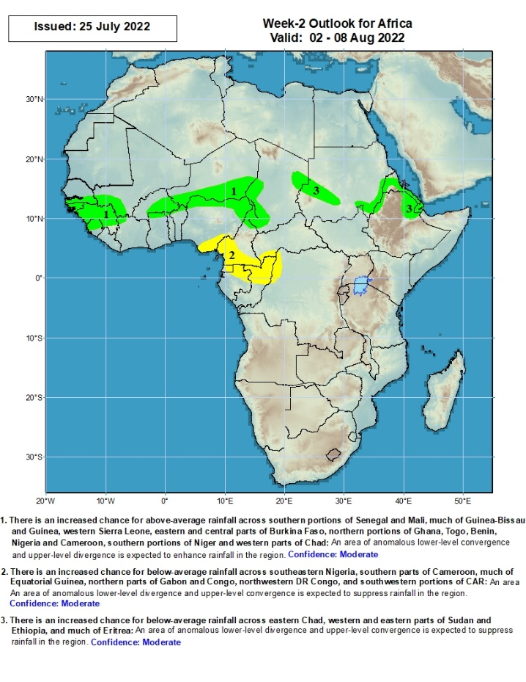
Week-2 Precipitation Outlooks
2 - 8 August, 2022
There is an increased chance for above-average rainfall across southern portions of Senegal and Mali, much of Guinea-Bissau and Guinea, western Sierra Leone, eastern and central parts of Burkina Faso, northern portions of Ghana, Togo, Benin, Nigeria and Cameroon, southern portions of Niger and western parts of Chad: An area of anomalous lower-level convergence and upper-level divergence is expected to enhance rainfall in the region. Confidence: Moderate
There is an increased chance for below-average rainfall across southeastern Nigeria, southern parts of Cameroon, much of Equatorial Guinea, northern parts of Gabon and Congo, northwestern DR Congo, and southwestern portions of CAR: An area of anomalous lower-level divergence and upper-level convergence is expected to suppress rainfall in the region. Confidence: Moderate
There is an increased chance for above-average rainfall across eastern Chad, western and eastern parts of Sudan and Ethiopia, and much of Eritrea: An area of anomalous lower-level convergence and upper-level divergence is expected to enhance rainfall in the region. Confidence: Moderate
Notes:
11

Slide 12
Summary
Over the past 90 days, in East Africa, above-average rainfall was observed over southern and eastern Sudan, the western and eastern portions of South Sudan, western Ethiopia, and parts of southern Somalia, western and northern Tanzania and pockets of western and eastern Kenya. Rainfall was below-average over southern and eastern Ethiopia, central and southern South Sudan, much of Kenya, central and northern Somalia, Uganda, as well as pockets of eastern Tanzania. In southern Africa, above-average rainfall was observed over northern Angola, northern Malawi, parts of South Africa and Mozambique. Below-average rainfall was observed over pockets of Botswana and much of Madagascar. In Central Africa, rainfall was above-average over central and eastern Cameroon, much of CAR, northern and eastern Gabon, Congo, and northern DRC. Rainfall was below-average over pockets of western Cameroon, parts of central DRC, and southern Gabon. In West Africa, rainfall was above-average over much of the Gulf of Guinea region, as well as Senegal, while below-average rainfall was observed over central Mali, eastern Liberia, parts of Cote D’Ivoire, pockets of northeastern Ghana, and parts of Nigeria.
During the past 7 days, in East Africa, rainfall was above-average over parts of southern Sudan, western South Sudan and western Ethiopia. Below-average rainfall was observed over pockets of central South Sudan and eastern Ethiopia. In Central Africa, rainfall was above-average over northern and eastern Cameroon, southern Chad, much of CAR, and northern DRC. Below-average rainfall was observed over pockets of Cameroon. In West Africa, above-average rainfall was observed over much of Senegal, western Guinea, Sierra Leone, central and eastern Burkina Faso, northern Ghana, and parts of northern Nigeria. Meanwhile, rainfall was below-average along the Gulf of Guinea coast.
Week-1 outlooks call for an increased chance for below-average rainfall over the far western West Africa. In contrast, there is an increased chance for above-average rainfall over portions of Central Africa, much of South Sudan, the southern and eastern portions of Sudan, and western Ethiopia. Week-2 outlooks call for an increased chance for above-average rainfall over the western portions of the Gulf of Guinea region, and the central portion of Sahel. There is an increased chance for below-average rainfall across the eastern portion of the Gulf of Guinea and the neighboring areas of Central Africa.

