Slide 1
The African Monsoon Recent Evolution and Current Status Include Week-1 and Week-2 Outlooks
Update prepared by
22 August 2022
For more information, visit:
http://www.cpc.ncep.noaa.gov/products/Global_Monsoons/African_Monsoons/precip_monitoring.shtml

Slide 2
Outline
Highlights
Recent Evolution and Current Conditions
NCEP GEFS Forecasts
Summary

Slide 3
Highlights: Last 7 Days
During the past 7 days, in East Africa, rainfall was above-average over the northwestern portion of South Sudan, western and eastern Sudan, Eritrea, northern Ethiopia and Uganda. Below-average rainfall was observed over pockets of South Sudan, southern Sudan, and parts of Ethiopia. In Central Africa, rainfall was above-average over the far eastern Cameroon, Chad, northern CAR, and parts of northern DRC. Below-average rainfall was observed over western Cameroon, and parts of CAR and DRC. In West Africa, above-average rainfall was observed over much of Senegal, Guinea, Sierra Leone, Liberia, eastern Mali, eastern Burkina Faso, western Niger and northern Nigeria. In contrast, parts of southwestern Mali, and many parts of Nigeria received below-average rainfall.
Week-1 and week-2 outlooks call for an increased chance for above-average rainfall over the western and eastern portions of the Sahel region, parts of Central Africa, southern Sudan, much of South Sudan and western Ethiopia. In contrast, there is an increased chance for below-average rainfall along the Gulf Guinea coast.

Slide 4
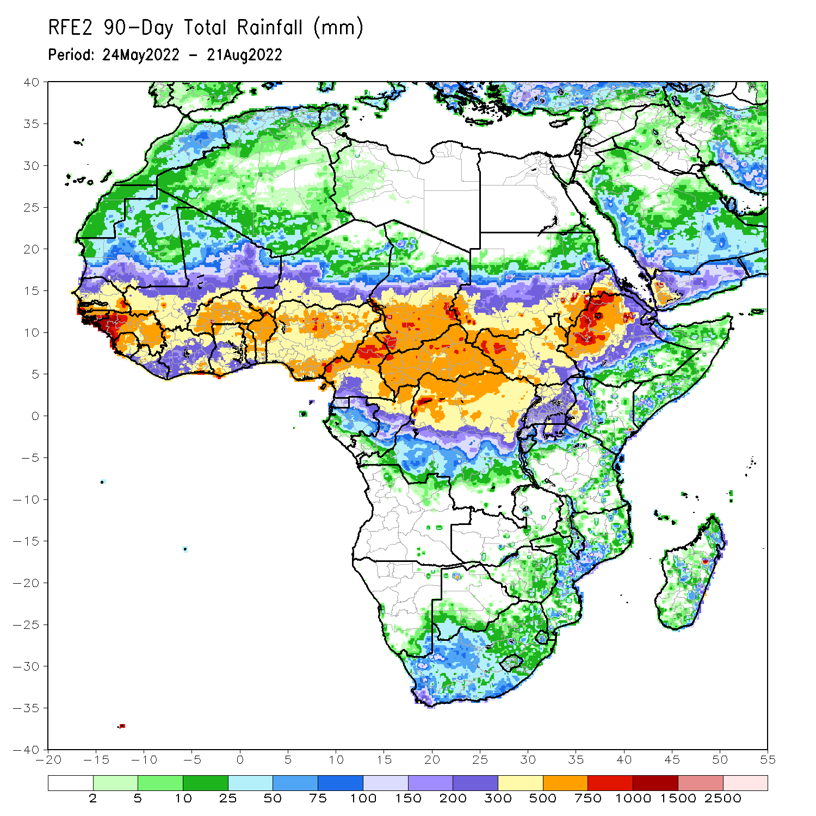
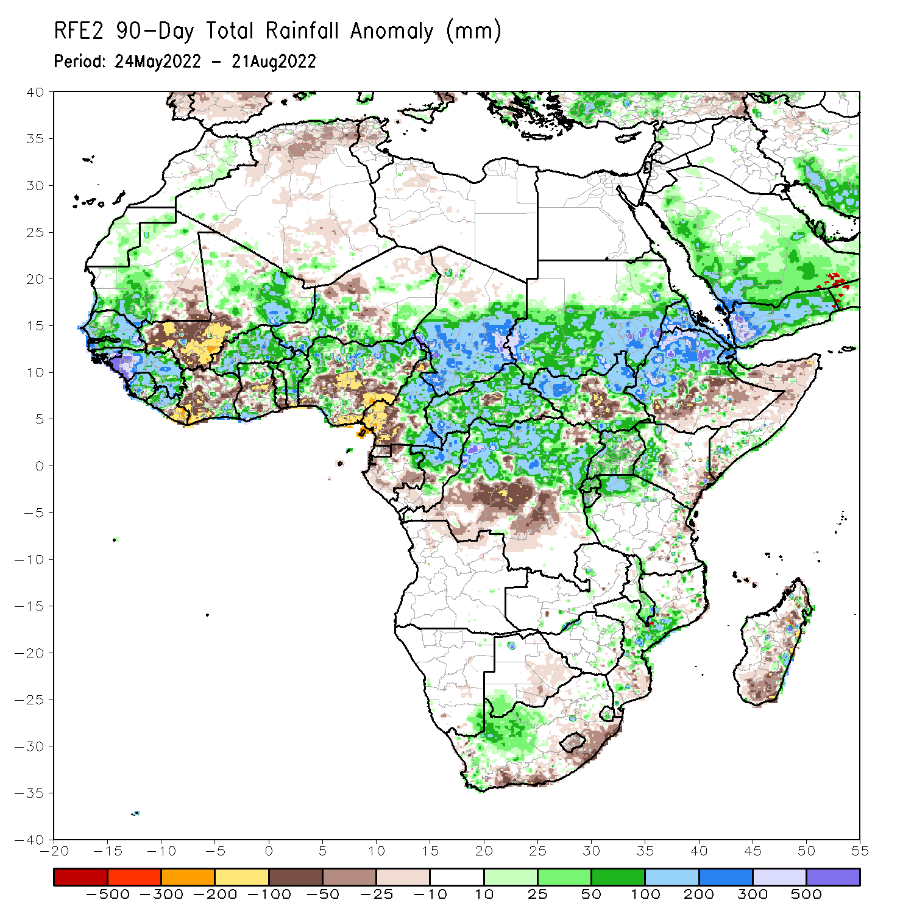
Rainfall Patterns: Last 90 Days
Over the past 90 days, in East Africa, above-average rainfall was observed over southern and eastern Sudan, the western and eastern portions of South Sudan, western, central and northern Ethiopia, Uganda, western Kenya, northern Tanzania and much of Eritrea. Rainfall was below-average over southern Ethiopia, central and southern South Sudan, and parts of Kenya. In southern Africa, above-average rainfall was observed over parts of South Africa and Mozambique. Below-average rainfall was observed over pockets of coastal South Africa and much of Madagascar. In Central Africa, rainfall was above-average over central and eastern Cameroon, much of CAR, northeastern Gabon, northern Congo, and northern DRC. Rainfall was below-average over pockets of western Cameroon, pockets of Gabon, southern Congo, and parts of central DRC. In West Africa, rainfall was above-average over southern Mauritania, Senegal, Guinea-Bissau, Guinea, Sierra Leone, western Liberia, northeastern Mali, Burkina Faso, parts of Ghana, Togo, Benin, and parts of Niger and western and northern Nigeria. In contrast, below-average rainfall was observed over western and central Mali, eastern Liberia, parts of Cote D’Ivoire, and parts of central and southern Nigeria.
Notes:
4

Slide 5
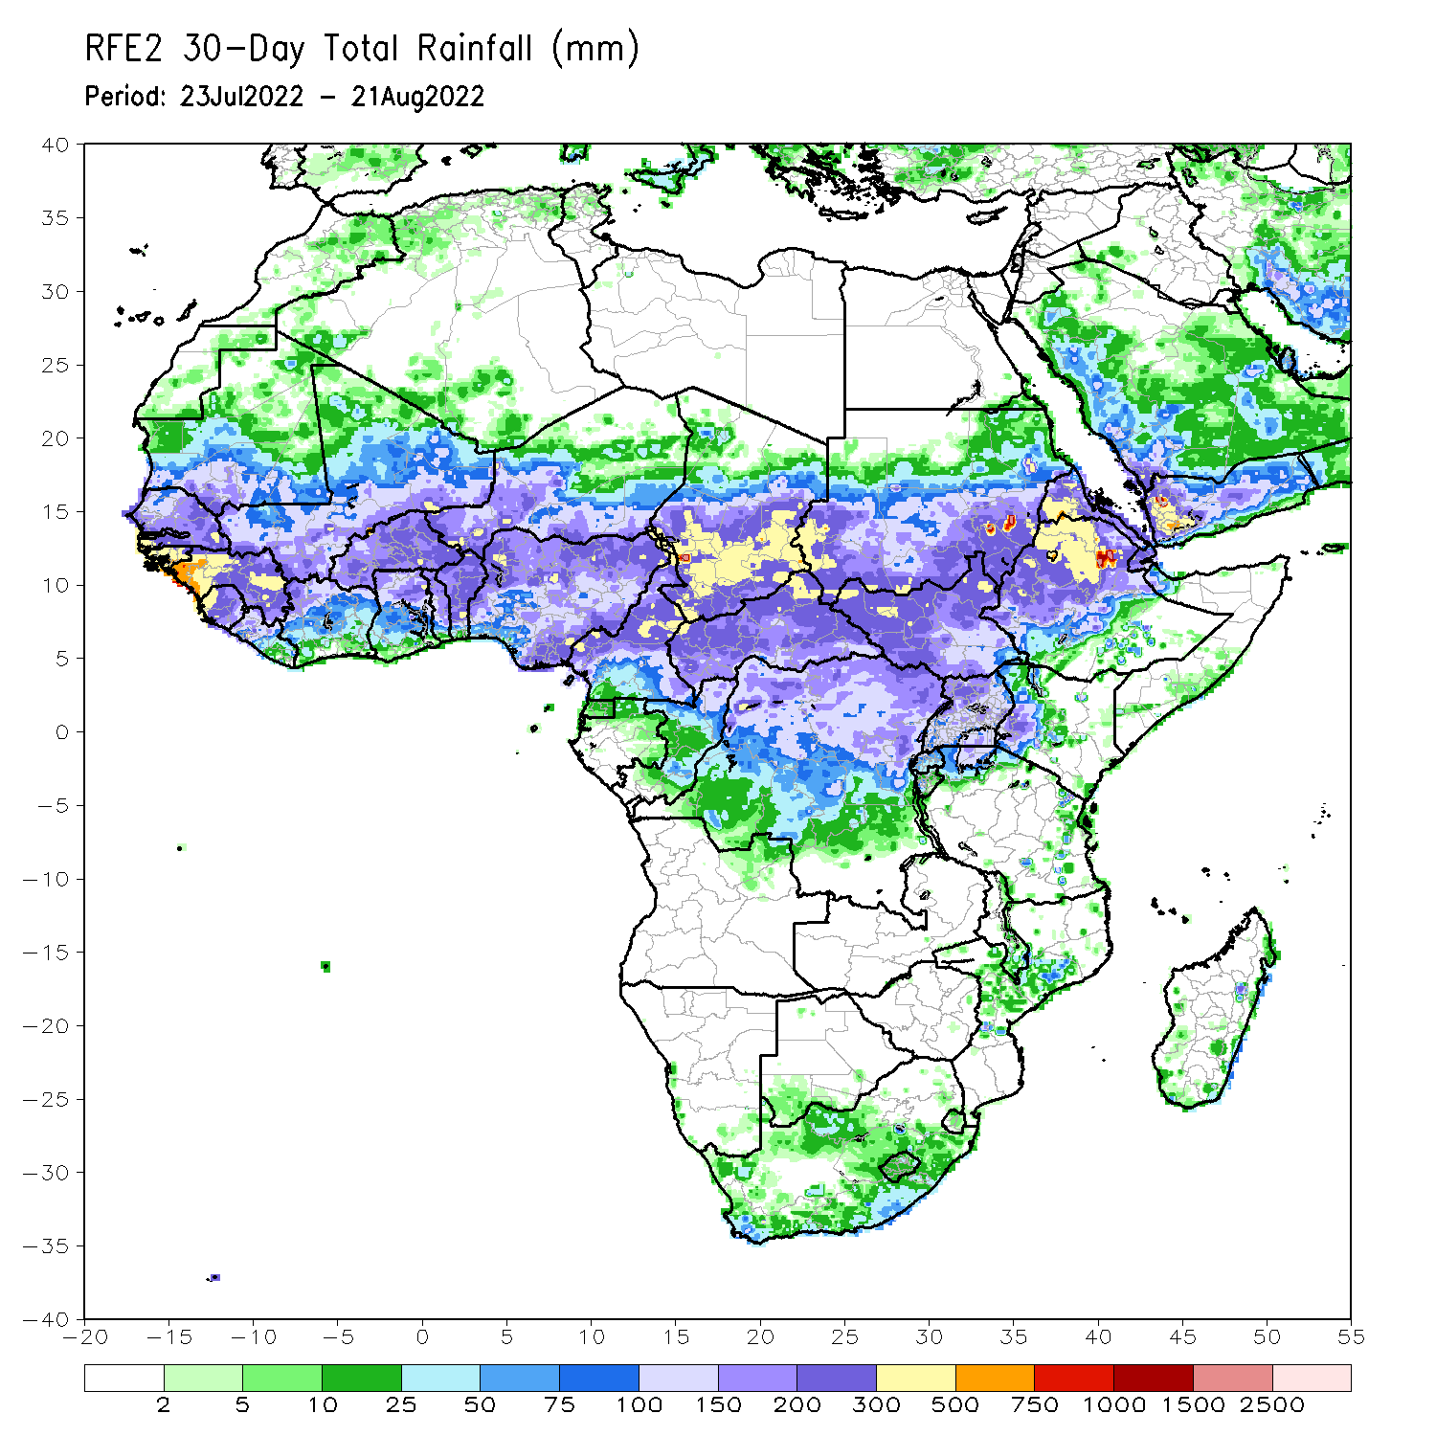
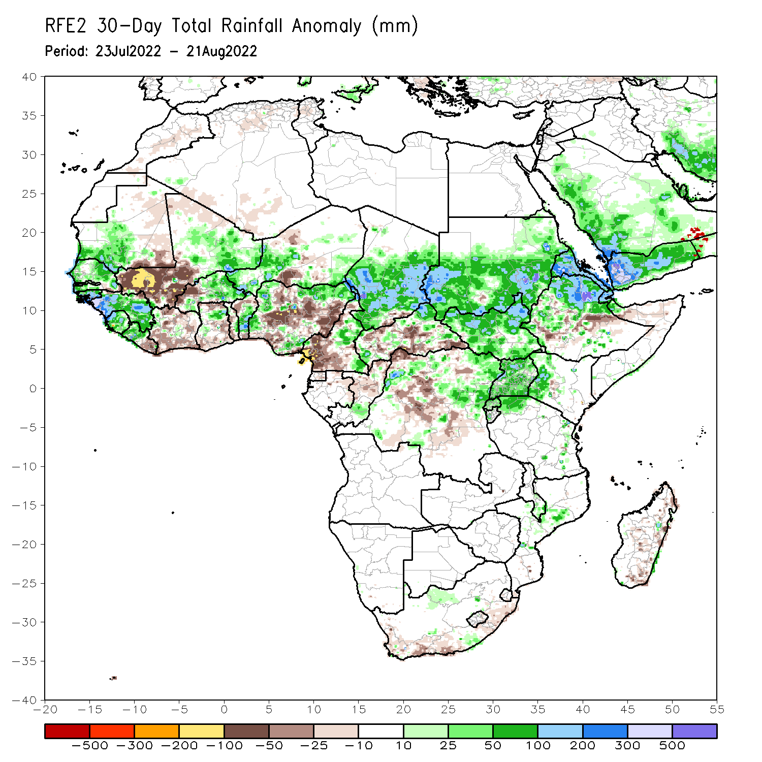
Rainfall Patterns: Last 30 Days
During the past 30 days, in East Africa, above-average rainfall was observed over southern and eastern Sudan, much of South Sudan, Eritrea, and central and northern Ethiopia. Rainfall was below-average over pockets of eastern Ethiopia. In Central Africa, rainfall was above-average over parts of northern and eastern Cameroon, northern Congo, much of CAR, central and southern Chad, and northern DRC. Rainfall was below-average over Equatorial Guinea, southern Cameroon, central Congo and pockets of central DRC. In West Africa, rainfall was above-average over southern Mauritania, Senegal, Guinea-Bissau, Guinea, Sierra Leone, western Liberia, Burkina Faso, northern Ghana, Togo, Benin, parts of Niger and western Nigeria. In contrast, central and southern Mali, eastern Liberia, Cote d’Ivoire, southern Ghana, and parts of Nigeria received below-average rainfall.
Notes:
5

Slide 6
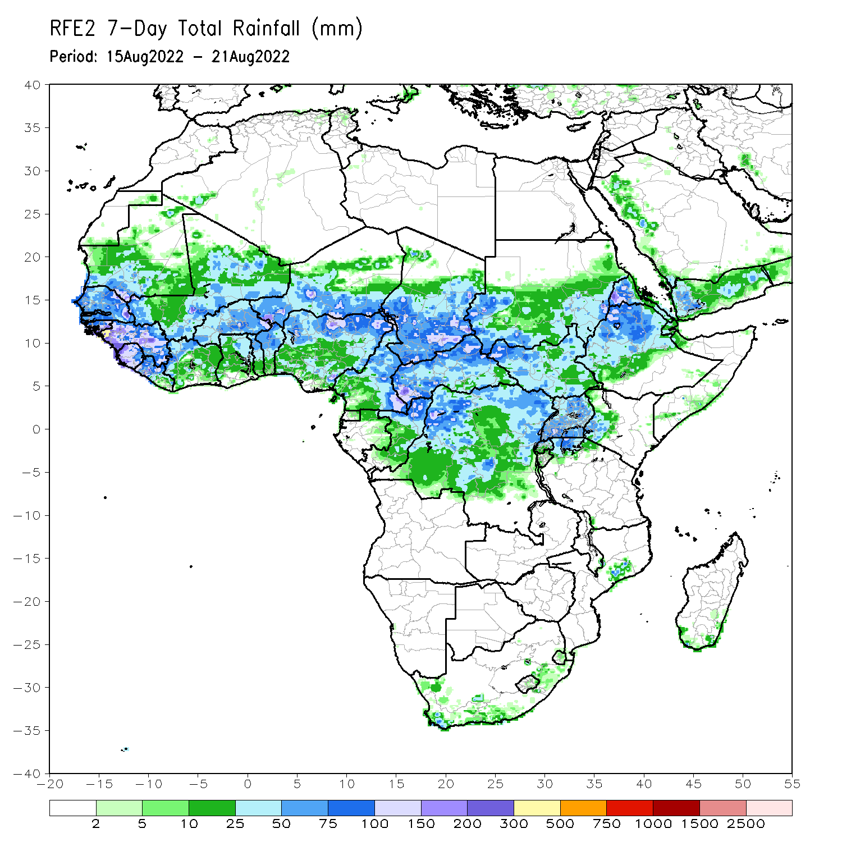
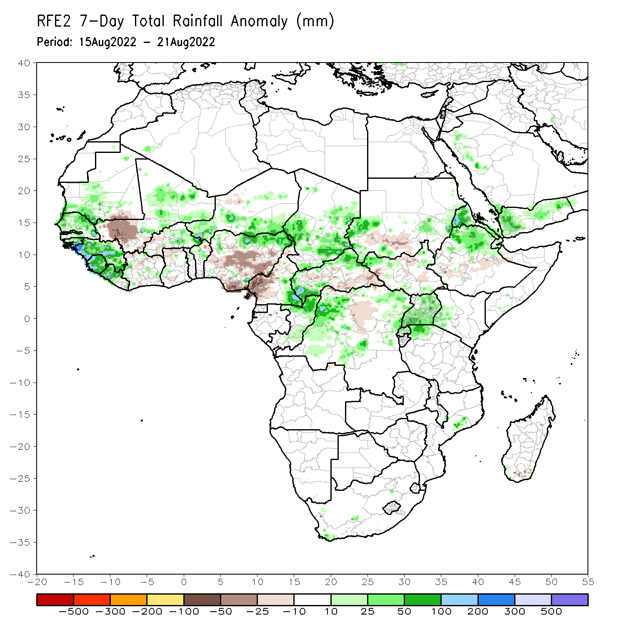
Rainfall Patterns: Last 7 Days
During the past 7 days, in East Africa, rainfall was above-average over the northwestern portion of South Sudan, western and eastern Sudan, Eritrea, northern Ethiopia and Uganda. Below-average rainfall was observed over pockets of South Sudan, southern Sudan, and parts of Ethiopia. In Central Africa, rainfall was above-average over the far eastern Cameroon, Chad, northern CAR, and parts of northern DRC. Below-average rainfall was observed over western Cameroon, and parts of CAR and DRC. In West Africa, above-average rainfall was observed over much of Senegal, Guinea, Sierra Leone, Liberia, eastern Mali, eastern Burkina Faso, western Niger and northern Nigeria. In contrast, parts of southwestern Mali, and many parts of Nigeria received below-average rainfall.

Slide 7
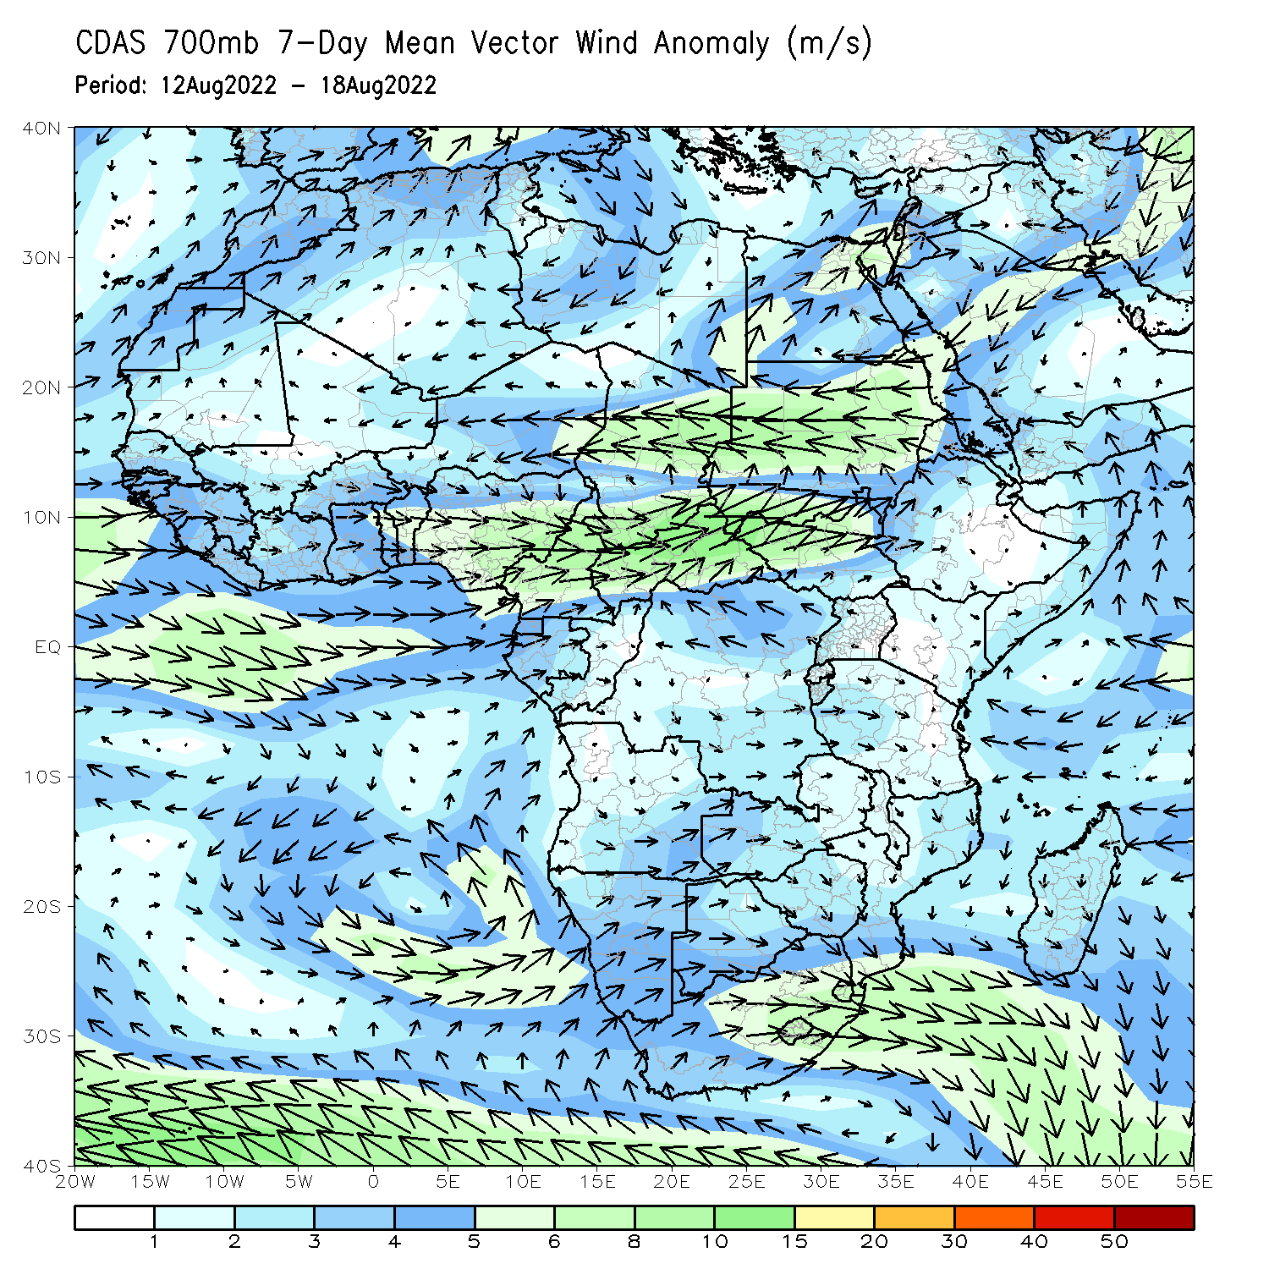
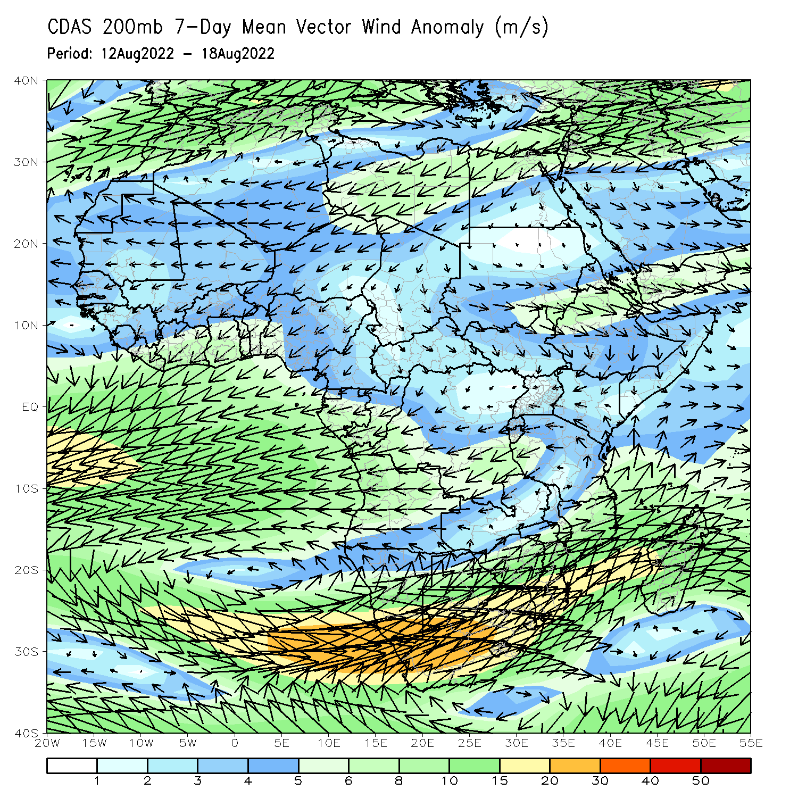
Atmospheric Circulation: Last 7 Days
At 700-hPa level (left panel), a broad area of anomalous cyclonic flow was observed across the eastern portion of the Sahel, including Sudan.

Slide 8
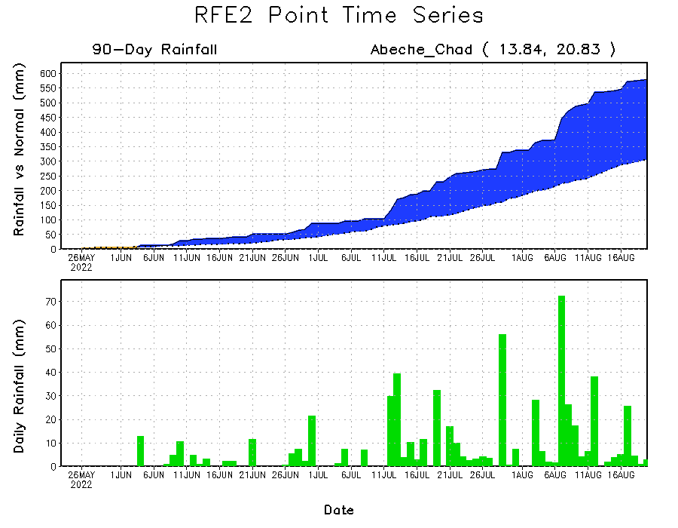
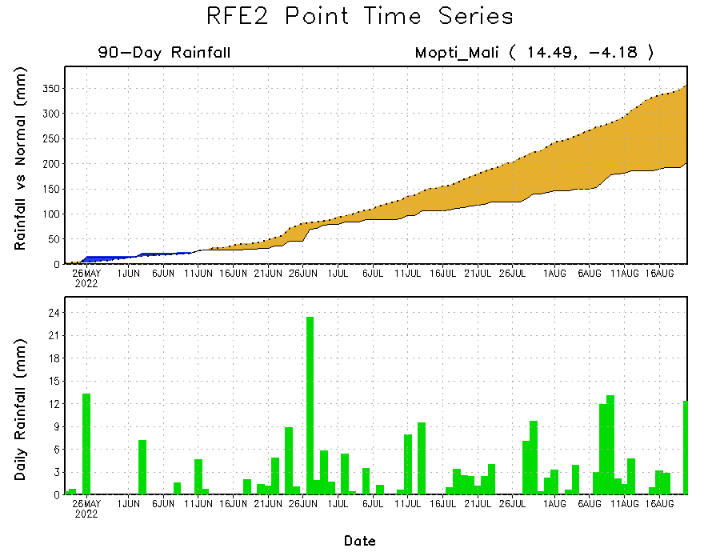
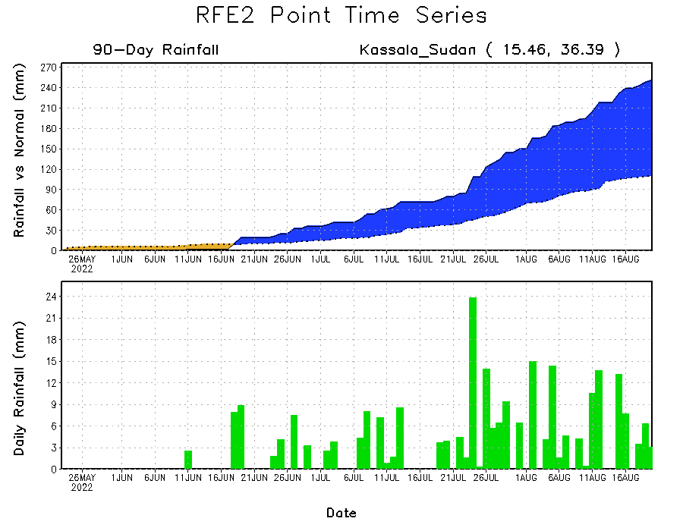
Rainfall Evolution
Daily evolution of rainfall over the last 90 days at selected locations shows increasing moisture deficits over parts of central and southern Mali (bottom left). Consistent heavy rains have kept significant moisture surpluses over parts of Chad (top right) and eastern Sudan (bottom right).

Slide 9
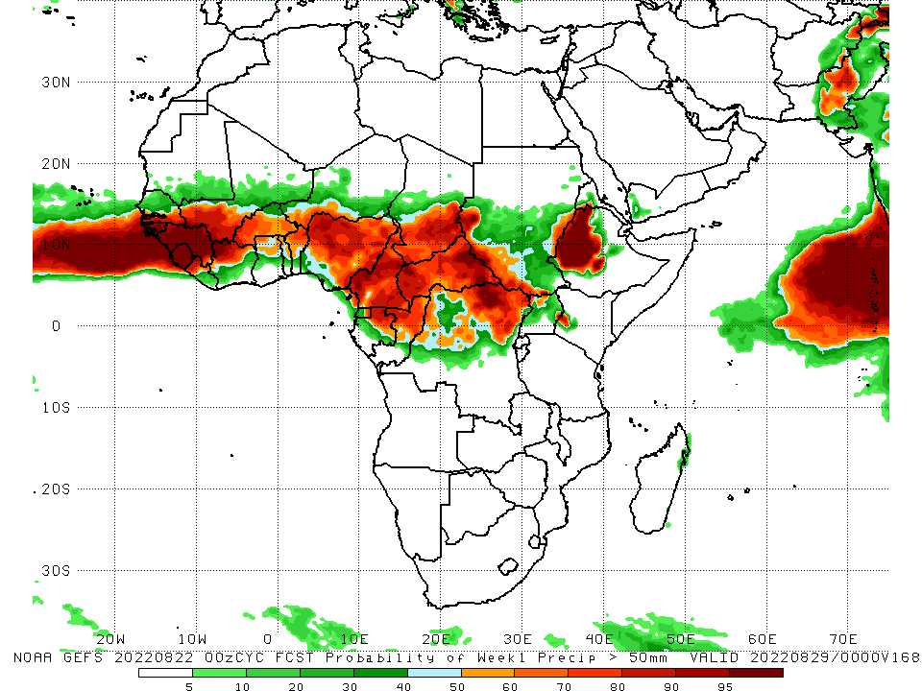
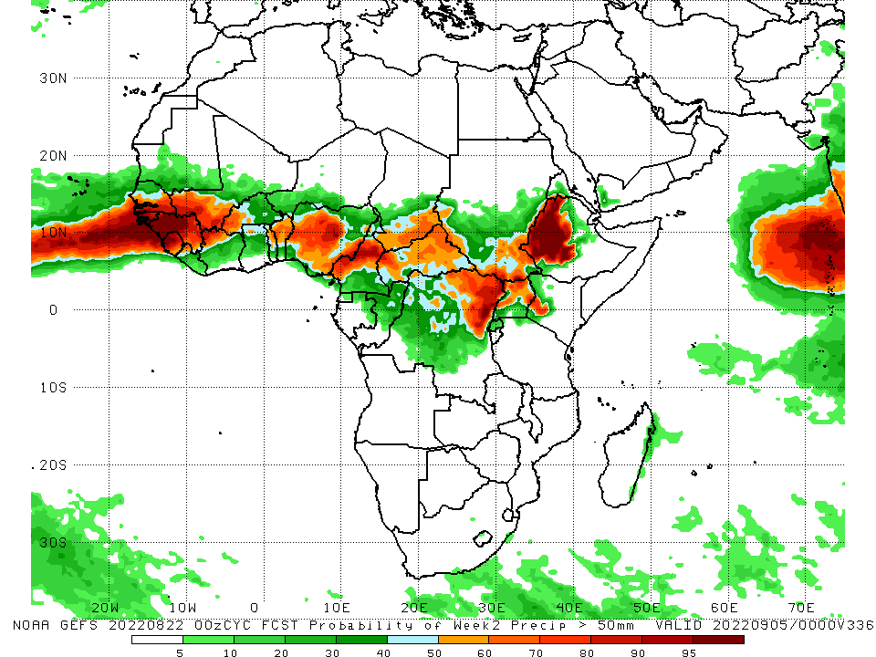
NCEP GEFS Model Forecasts Non-Bias Corrected Probability of precipitation exceedance
Week-1, Valid: 23 – 29 August, 2022
Week-2, Valid: 30 Aug – 5 September, 2022
For week-1 (left panel) and week-2 (right panel) the NCEP GEFS indicates a moderate to high chance (over 70%) for rainfall to exceed 50 mm over parts of West and Central Africa, and western Ethiopia.
Notes:
9

Slide 10
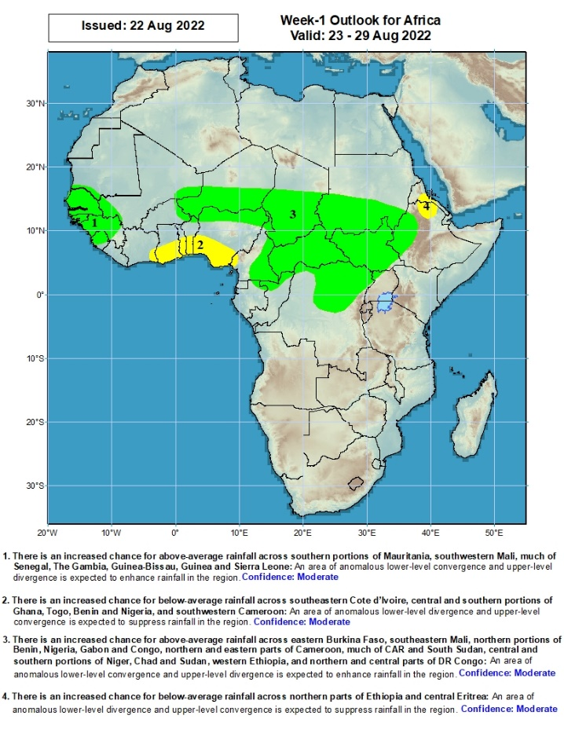
Week-1 Precipitation Outlooks
23 - 29 August, 2022
There is an increased chance for above-average rainfall across southern portions of Mauritania, southwestern Mali, much of Senegal, The Gambia, Guinea-Bissau, Guinea and Sierra Leone: An area of anomalous lower-level convergence and upper-level divergence is expected to enhance rainfall in the region. Confidence: Moderate
There is an increased chance for below-average rainfall across southeastern Cote d’Ivoire, central and southern portions of Ghana, Togo, Benin and Nigeria, and southwestern Cameroon: An area of anomalous lower-level divergence and upper-level convergence is expected to suppress rainfall in the region. Confidence: Moderate
There is an increased chance for above-average rainfall across eastern Burkina Faso, southeastern Mali, northern portions of Benin, Nigeria, Gabon and Congo, northern and eastern parts of Cameroon, much of CAR and South Sudan, central and southern portions of Niger, Chad and Sudan, western Ethiopia, and northern and central parts of DR Congo: An area of anomalous lower-level convergence and upper-level divergence is expected to enhance rainfall in the region. Confidence: Moderate
There is an increased chance for below-average rainfall across northern parts of Ethiopia and central Eritrea: An area of anomalous lower-level divergence and upper-level convergence is expected to suppress rainfall in the region. Confidence: Moderate
Notes:
10

Slide 11
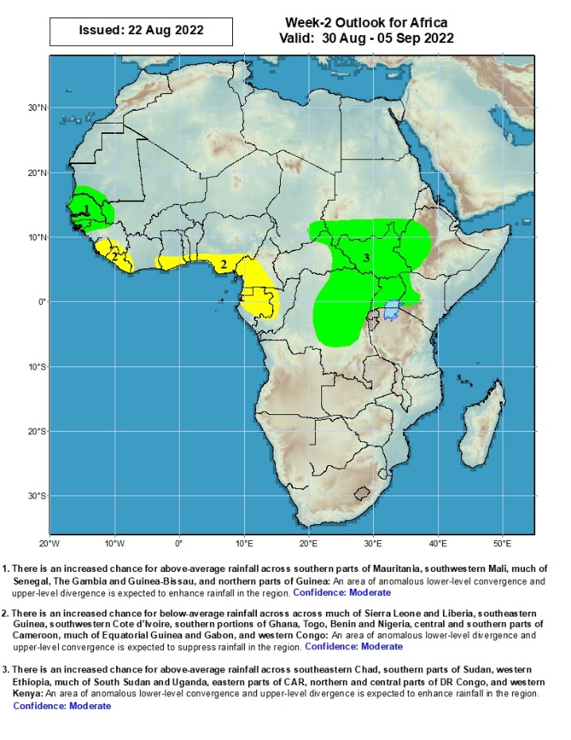
Week-2 Precipitation Outlooks
30 August - 5 September, 2022
There is an increased chance for above-average rainfall across southern parts of Mauritania, southwestern Mali, much of Senegal, The Gambia and Guinea-Bissau, and northern parts of Guinea: An area of anomalous lower-level convergence and upper-level divergence is expected to enhance rainfall in the region. Confidence: Moderate
There is an increased chance for below-average rainfall across much of Sierra Leone and Liberia, southeastern Guinea, southwestern Cote d’Ivoire, southern portions of Ghana, Togo, Benin and Nigeria, central and southern parts of Cameroon, much of Equatorial Guinea and Gabon, and western Congo: An area of anomalous lower-level divergence and upper-level convergence is expected to suppress rainfall in the region. Confidence: Moderate
There is an increased chance for above-average rainfall across southeastern Chad, southern parts of Sudan, western Ethiopia, much of South Sudan and Uganda, eastern parts of CAR, northern and central parts of DR Congo, and western Kenya: An area of anomalous lower-level convergence and upper-level divergence is expected to enhance rainfall in the region. Confidence: Moderate
Notes:
11

Slide 12
Summary
During the past 30 days, in East Africa, above-average rainfall was observed over southern and eastern Sudan, much of South Sudan, Eritrea, and central and northern Ethiopia. Rainfall was below-average over pockets of eastern Ethiopia. In Central Africa, rainfall was above-average over parts of northern and eastern Cameroon, northern Congo, much of CAR, central and southern Chad, and northern DRC. Rainfall was below-average over Equatorial Guinea, southern Cameroon, central Congo and pockets of central DRC. In West Africa, rainfall was above-average over southern Mauritania, Senegal, Guinea-Bissau, Guinea, Sierra Leone, western Liberia, Burkina Faso, northern Ghana, Togo, Benin, parts of Niger and western Nigeria. In contrast, central and southern Mali, eastern Liberia, Cote d’Ivoire, southern Ghana, and parts of Nigeria received below-average rainfall.
During the past 7 days, in East Africa, rainfall was above-average over the northwestern portion of South Sudan, western and eastern Sudan, Eritrea, northern Ethiopia and Uganda. Below-average rainfall was observed over pockets of South Sudan, southern Sudan, and parts of Ethiopia. In Central Africa, rainfall was above-average over the far eastern Cameroon, Chad, northern CAR, and parts of northern DRC. Below-average rainfall was observed over western Cameroon, and parts of CAR and DRC. In West Africa, above-average rainfall was observed over much of Senegal, Guinea, Sierra Leone, Liberia, eastern Mali, eastern Burkina Faso, western Niger and northern Nigeria. In contrast, parts of southwestern Mali, and many parts of Nigeria received below-average rainfall.
Week-1 and week-2 outlooks call for an increased chance for above-average rainfall over the western and eastern portions of the Sahel region, parts of Central Africa, southern Sudan, much of South Sudan and western Ethiopia. In contrast, there is an increased chance for below-average rainfall along the Gulf Guinea coast.

