Slide 1
The African Monsoon Recent Evolution and Current Status Include Week-1 and Week-2 Outlooks
Update prepared by
05 September 2022
For more information, visit:
http://www.cpc.ncep.noaa.gov/products/Global_Monsoons/African_Monsoons/precip_monitoring.shtml

Slide 2
Outline
Highlights
Recent Evolution and Current Conditions
NCEP GEFS Forecasts
Summary

Slide 3
Highlights: Last 7 Days
During the past 7 days, in East Africa, rainfall was above-average over western and eastern South Sudan, southern and eastern Sudan, western and central Ethiopia, Uganda, Rwanda, Burundi and pockets of northwest Tanzania. Below-average rainfall was observed over pockets of northern Ethiopia and central Eritrea. In Central Africa, rainfall was above-average over much of CAR, southern Chad, central and western DRC, northern, central, and eastern parts of Cameroon, and central and northern Congo. Below-average rainfall was observed over pockets of western Cameroon, northern Gabon, Equatorial Guinea, and pockets of northwest DRC. In West Africa, above-average rainfall was observed over Senegal, Gambia, Guinea Bissau, Guinea, Sierra Leone, Liberia, Cote D’Ivoire, central and southern Ghana, Toga, Benin, northern and central Burkina Faso, pockets of northwest and eastern Nigeria, southern and central Mali, and southern Mauritania. In contrast, parts of southern Burkina Faso, parts of southern Niger, and pockets of central, southeast, and northeast Nigeria received below-average rainfall.
Week-1 outlook calls for an increased chance for above-average rainfall over eastern Guinea, Burkina Faso, central and northern Nigeria, northern Cameroon, CAR, northeast DRC, Uganda, South Sudan, and western Ethiopia. In contrast, there is an increased chance for below-average rainfall along the Gulf Guinea coast, central DRC, and pockets of eastern South Africa. Week-2 outlook suggests an increased chance for above-average rainfall southern Mali, northern Nigeria, southern Chad, CAR, central and northern DRC, South Sudan, Uganda, and western Ethiopia, while below-average rainfall is likely over the southern Ghana, Equatorial Guinea, Gabon, and central Congo.

Slide 4
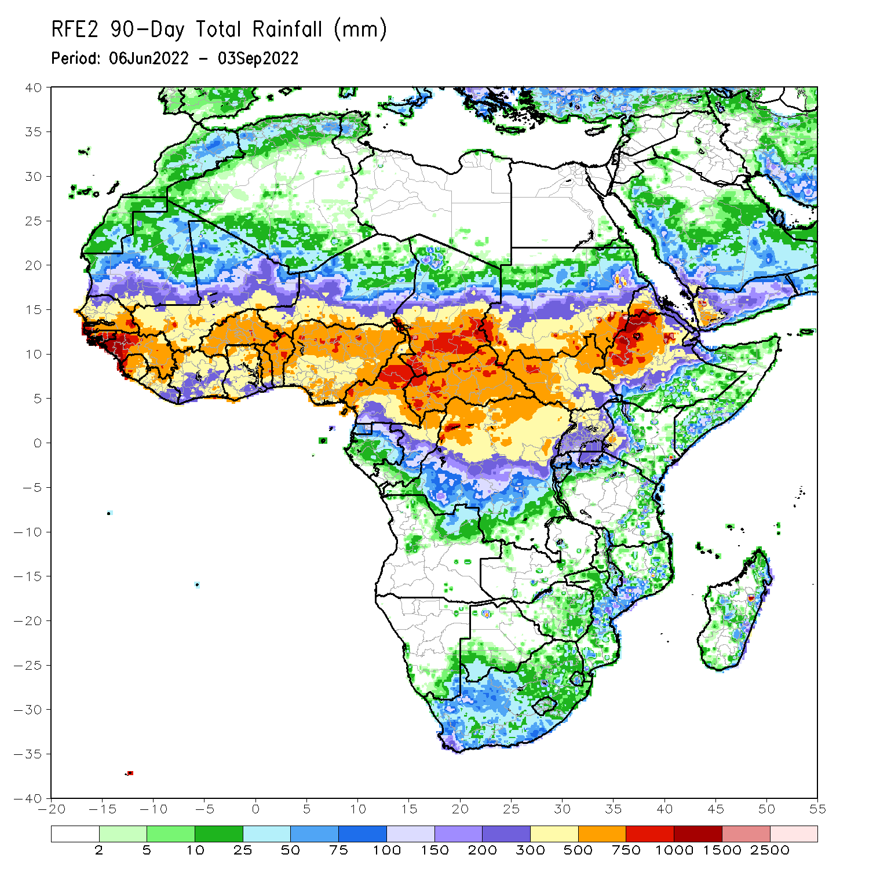
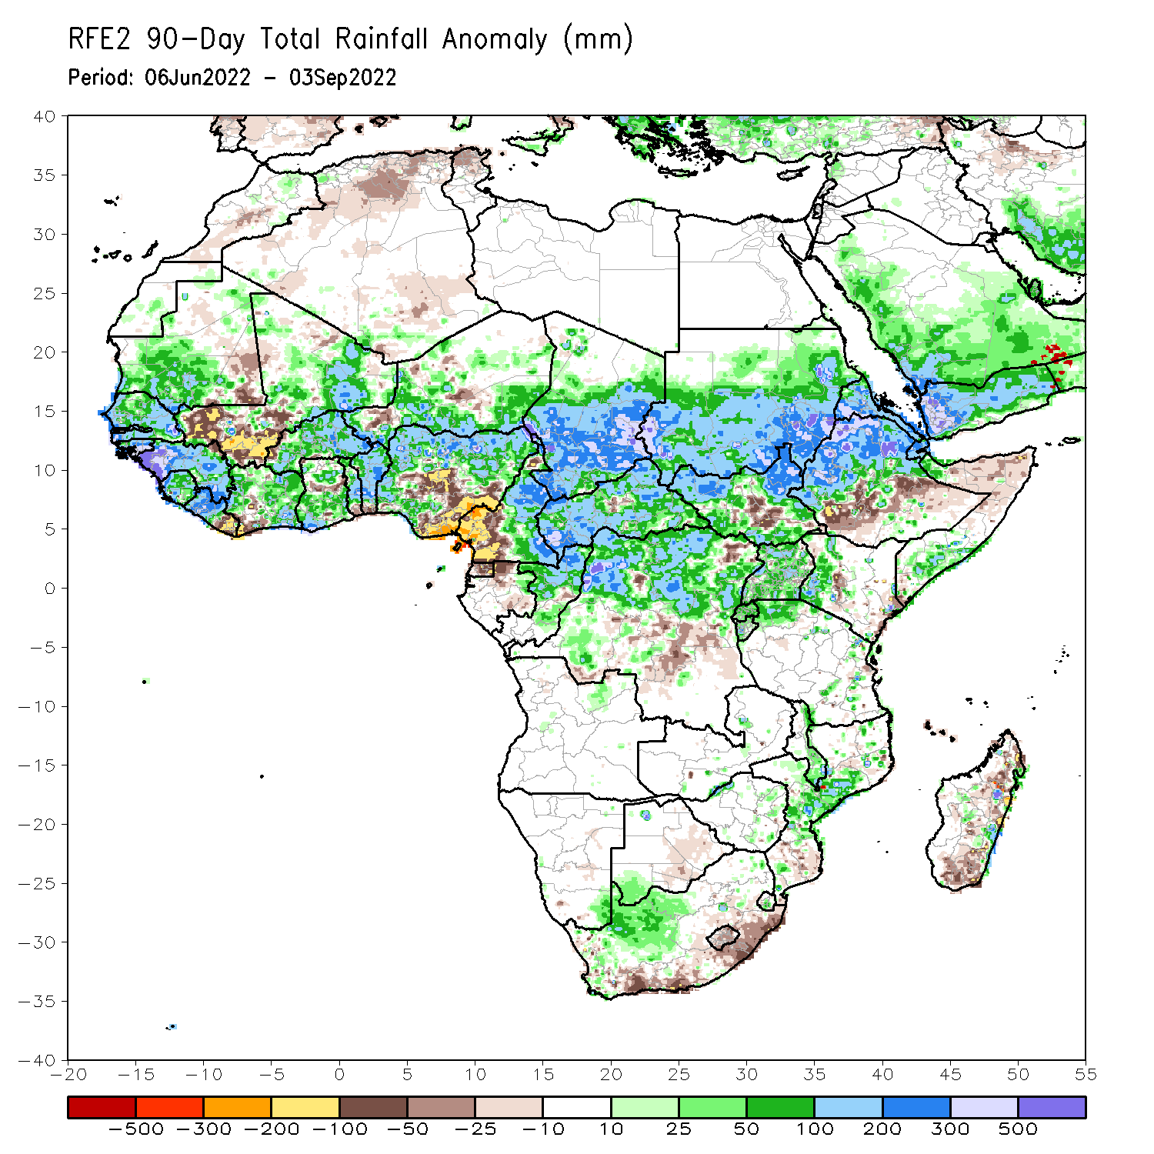
Rainfall Patterns: Last 90 Days
Over the past 90 days, in East Africa, above-average rainfall was observed over southern, central, and eastern Sudan, western and northern portions of South Sudan, western and northern Ethiopia, Eritrea, Djibouti, parts of southern Somalia, Uganda, Rwanda, Burundi, pockets of northwest Tanzania, and western Kenya. Rainfall was below-average over southern Ethiopia, pockets of central South Sudan, and parts of northern Somalia. In southern Africa, above-average rainfall was observed over parts of western South Africa, central Mozambique and southern Malawi. Below-average rainfall was observed over pockets of coastal South Africa, and southern and northern Madagascar. In Central Africa, rainfall was above-average over northern and eastern Cameroon, southern, central, and eastern Chad, much of CAR, northern Congo, and northern DRC. Rainfall was below-average over pockets of western Cameroon, pockets of northern Gabon, Equatorial Guinea, and parts of central DRC. In West Africa, rainfall was above-average over southern Mauritania, Senegal, Gambia, Guinea-Bissau, Guinea, Sierra Leone, western and central Liberia, central and eastern Cote D’Ivoire, parts of northern and southern Ghana, central and northern parts of Togo and Benin, Burkina Faso, northeastern Mali, and parts of southern Niger, and western and northern Nigeria. In contrast, below-average rainfall was observed over southern Mali, eastern Liberia, and parts of central and southeast Nigeria.
Notes:
4

Slide 5
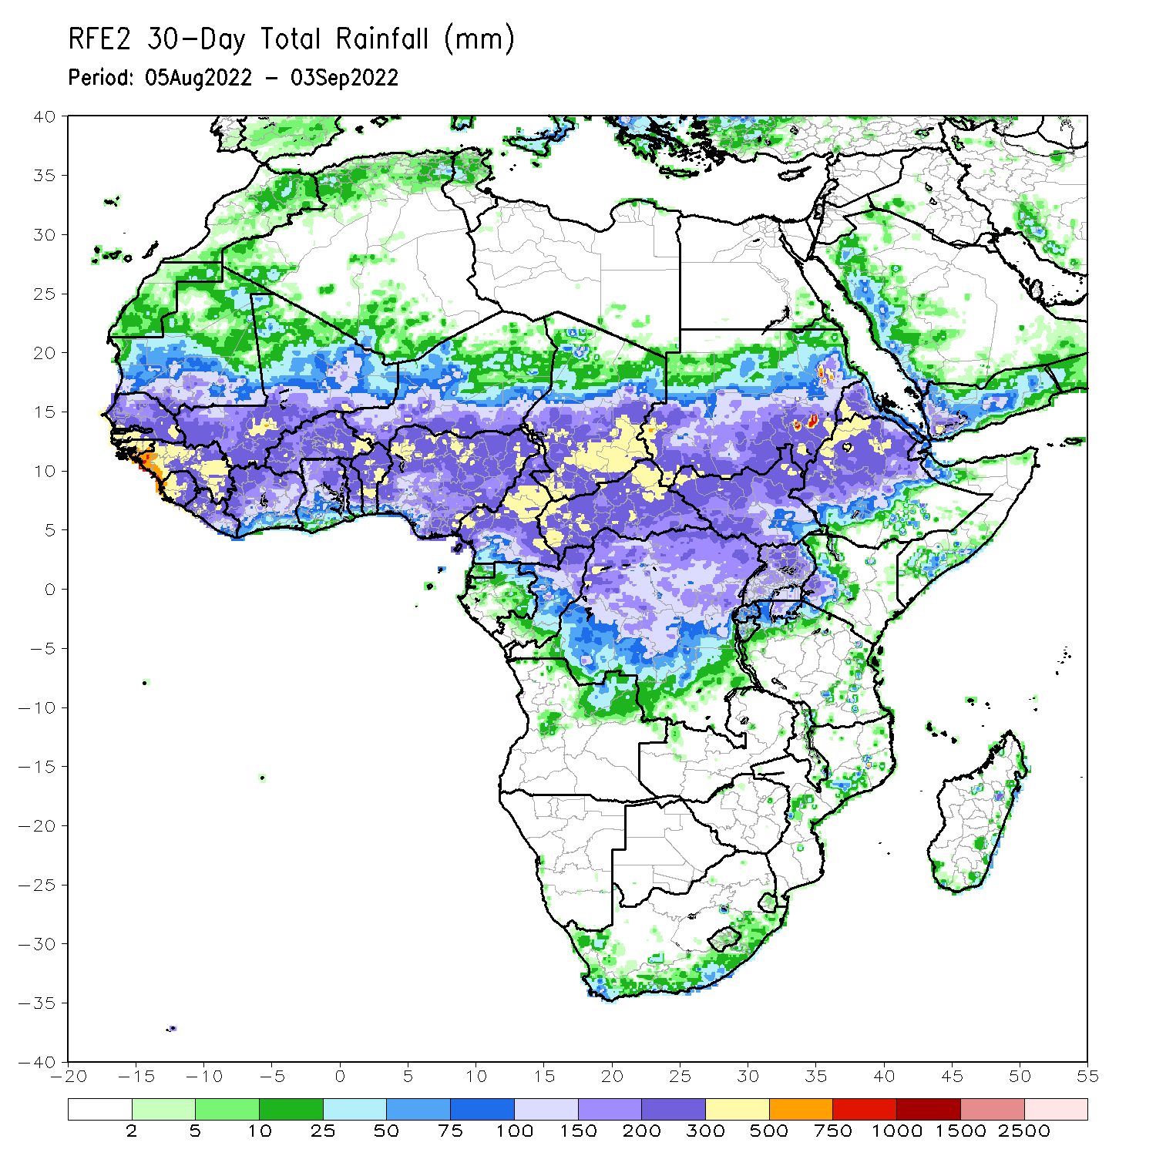
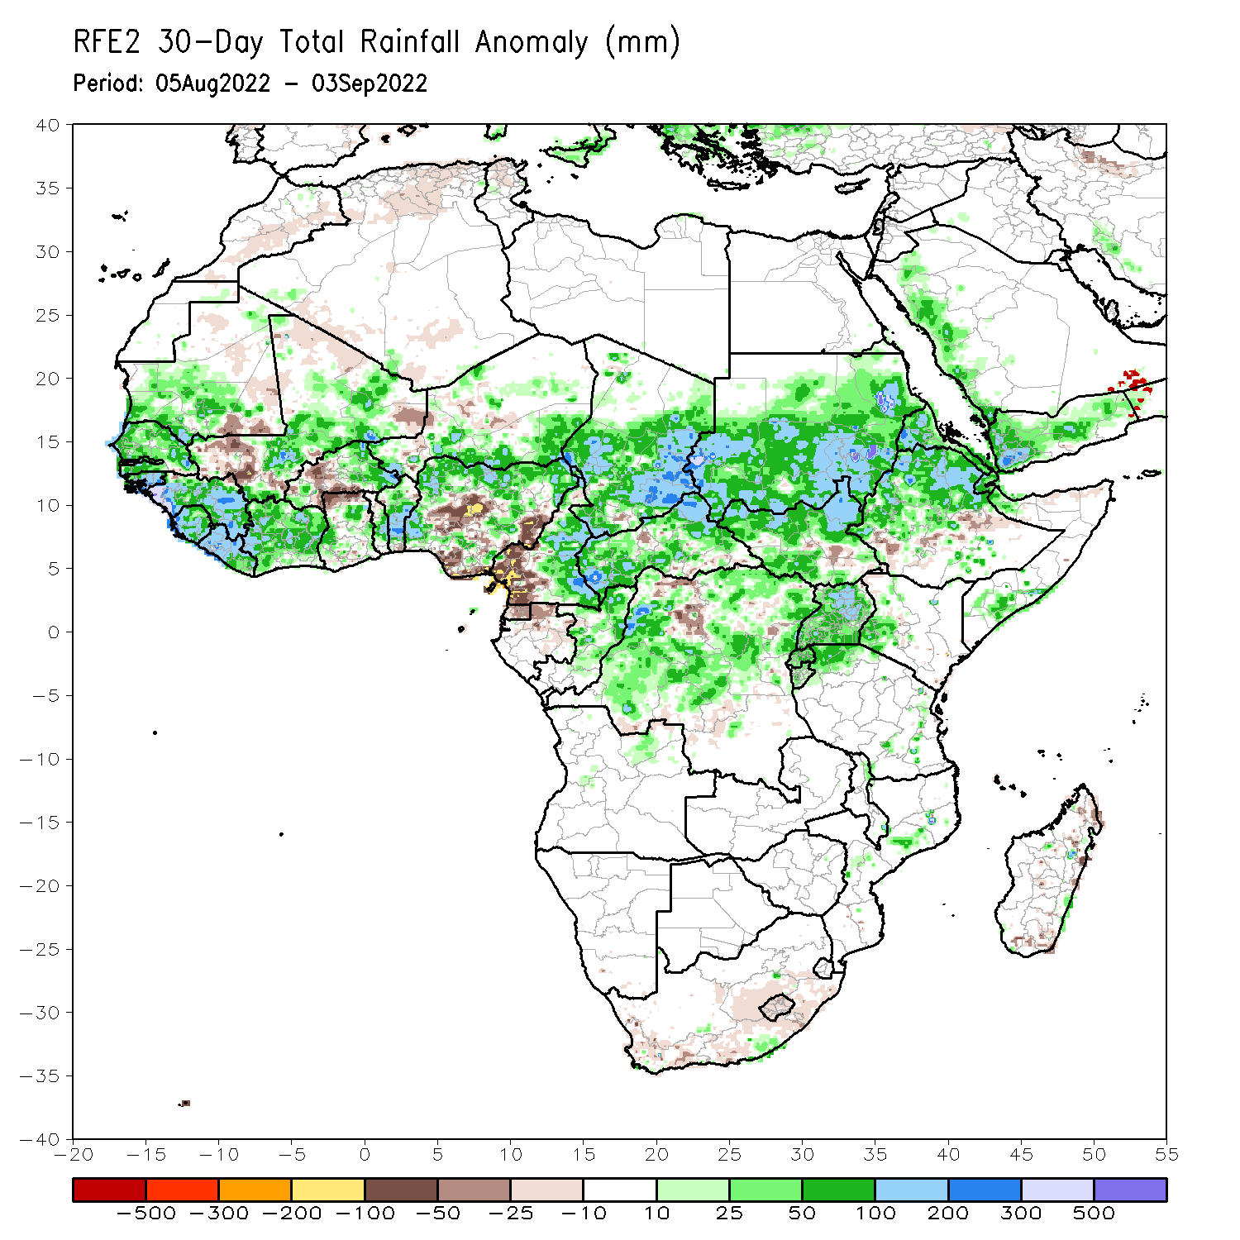
Rainfall Patterns: Last 30 Days
During the past 30 days, in East Africa, above-average rainfall was observed over southern, central, and eastern Sudan, western and northern South Sudan, Eritrea, Djibouti, Uganda, central and northern Ethiopia, pockets of western Kenya, Rwanda, Burundi, and pockets of northwest Tanzania. Rainfall was below-average over pockets of eastern Ethiopia and central South Sudan. In southern Africa, below-average rainfall was observed over pockets of coastal South Africa, and southern and northern Madagascar. In Central Africa, rainfall was above-average over parts of eastern Cameroon, much of CAR, central and southern Chad, pockets of western, central, and northeast DRC, and central and northern Congo. Rainfall was below-average over Equatorial Guinea, northern Gabon, western Cameroon, and pockets of northwest DRC. In West Africa, rainfall was above-average over pockets of southern Mauritania, Senegal, central parts of Togo and Benin, parts of southern Niger, and northern and western parts of Nigeria. In contrast, parts of southern Mali and central Burkina Faso, and parts of central and southeast Nigeria received below-average rainfall.
Notes:
5

Slide 6
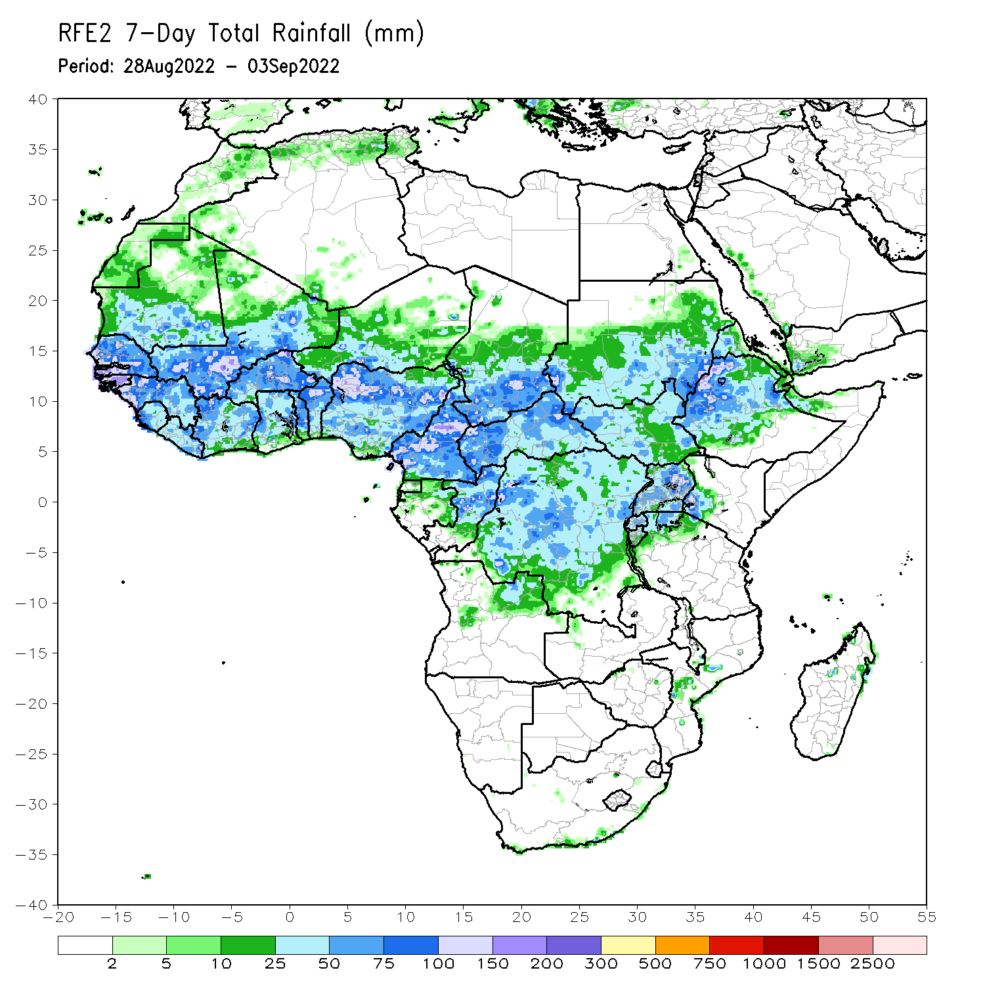
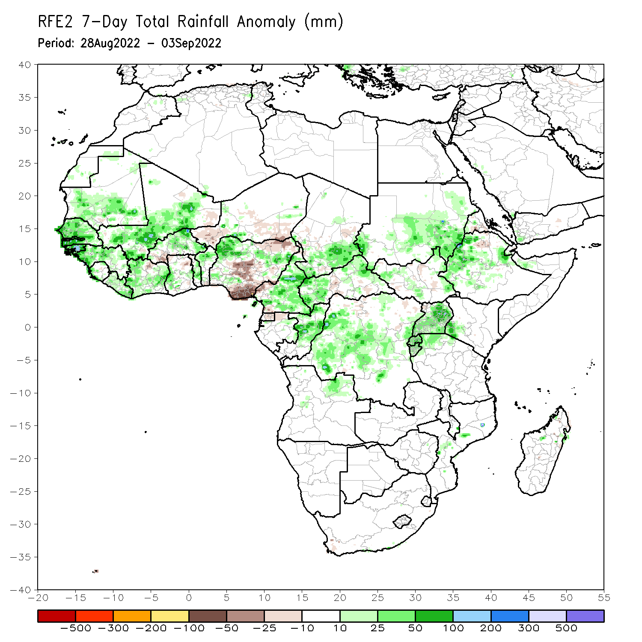
Rainfall Patterns: Last 7 Days
During the past 7 days, in East Africa, rainfall was above-average over western and eastern South Sudan, southern and eastern Sudan, western and central Ethiopia, Uganda, Rwanda, Burundi and pockets of northwest Tanzania. Below-average rainfall was observed over pockets of northern Ethiopia and central Eritrea. In Central Africa, rainfall was above-average over much of CAR, southern Chad, central and western DRC, northern, central, and eastern parts of Cameroon, and central and northern Congo. Below-average rainfall was observed over pockets of western Cameroon, northern Gabon, Equatorial Guinea, and pockets of northwest DRC. In West Africa, above-average rainfall was observed over Senegal, Gambia, Guinea Bissau, Guinea, Sierra Leone, Liberia, Cote D’Ivoire, central and southern Ghana, Toga, Benin, northern and central Burkina Faso, pockets of northwest and eastern Nigeria, southern and central Mali, and southern Mauritania. In contrast, parts of southern Burkina Faso, parts of southern Niger, and pockets of central, southeast, and northeast Nigeria received below-average rainfall.

Slide 7
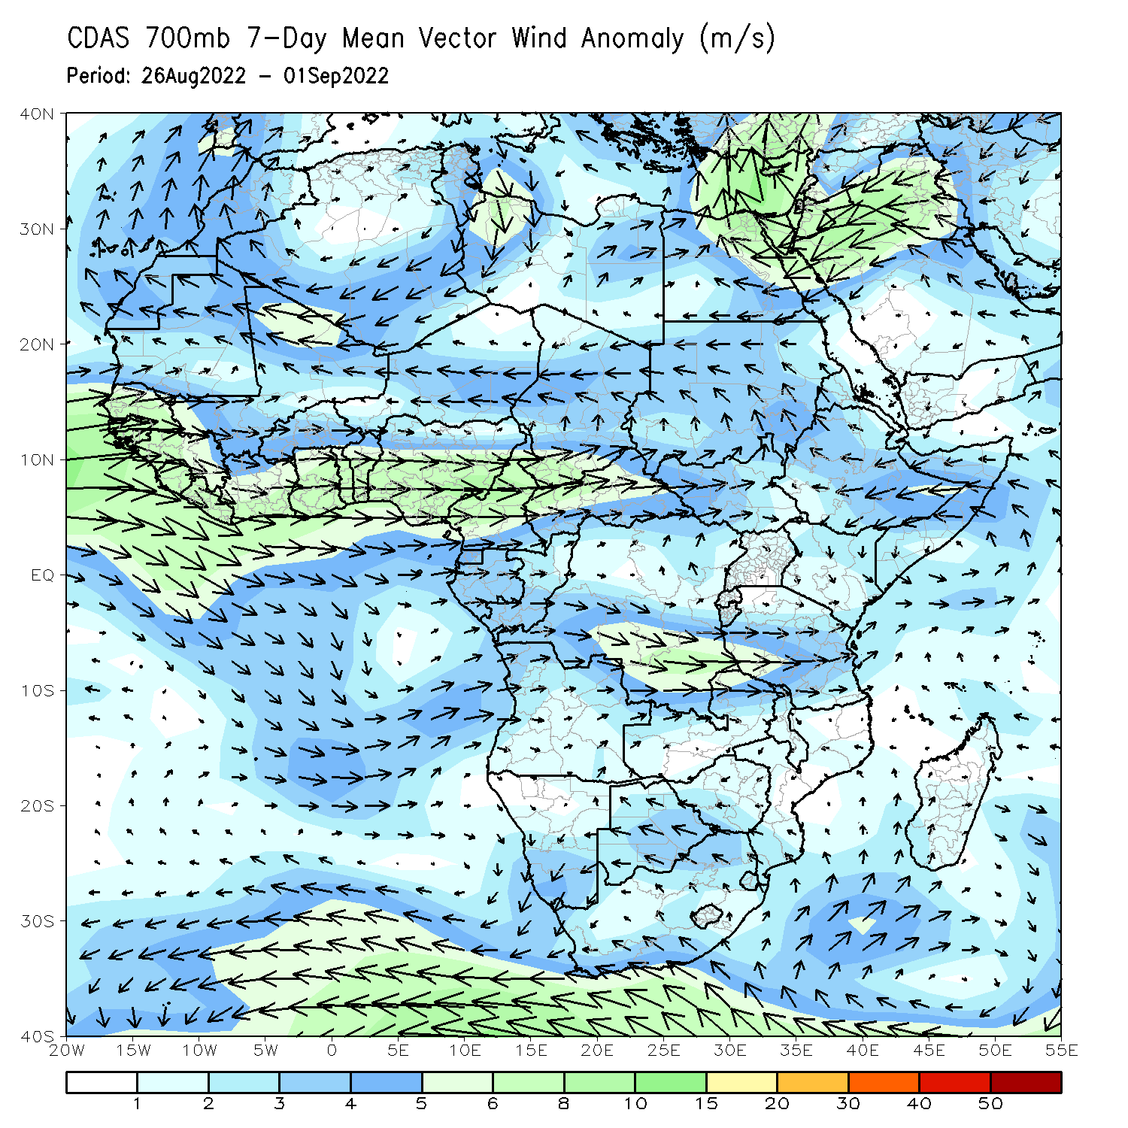
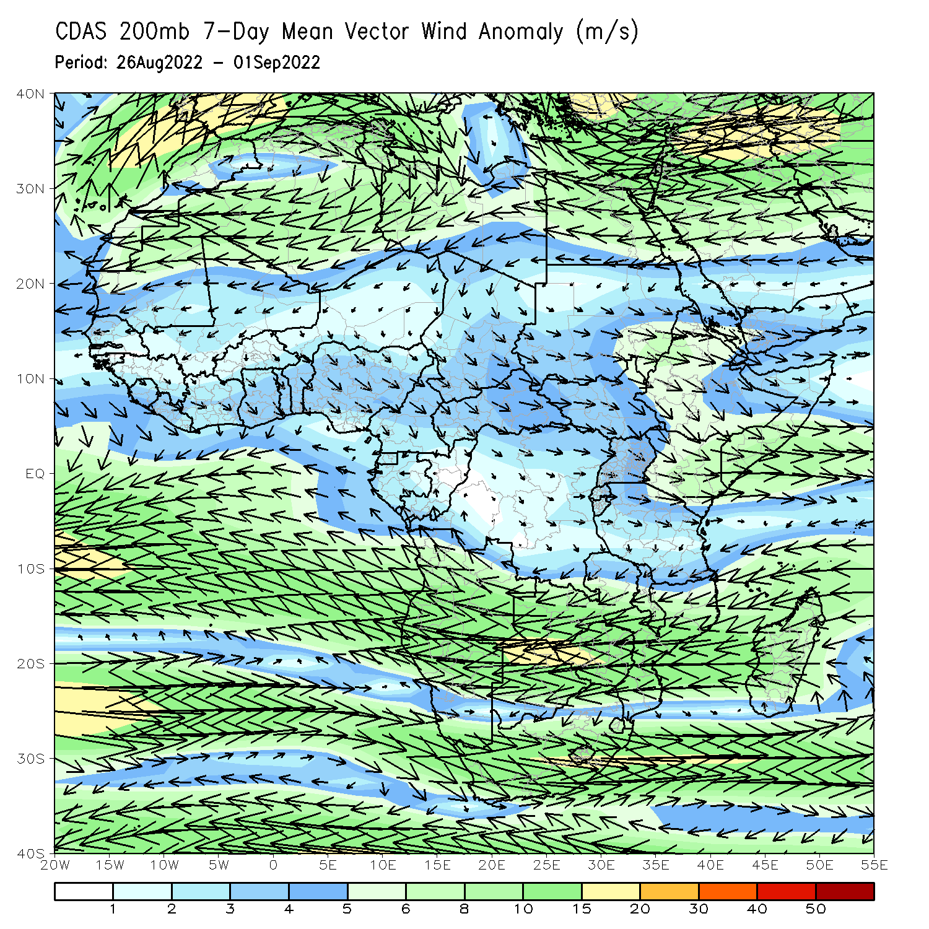
Atmospheric Circulation: Last 7 Days
At 700-hPa level (left panel), anomalous westerly flow with its associated cyclonic shear was observed across the eastern portion of the Sahel, including Sudan and anomalous wind convergence may have contributed to the observed above-average rainfall near Sudan/Ethiopia border. At 200-hPa (right panel), anomalous upper-level speed divergence is observed over near Sudan/Ethiopia border.

Slide 8
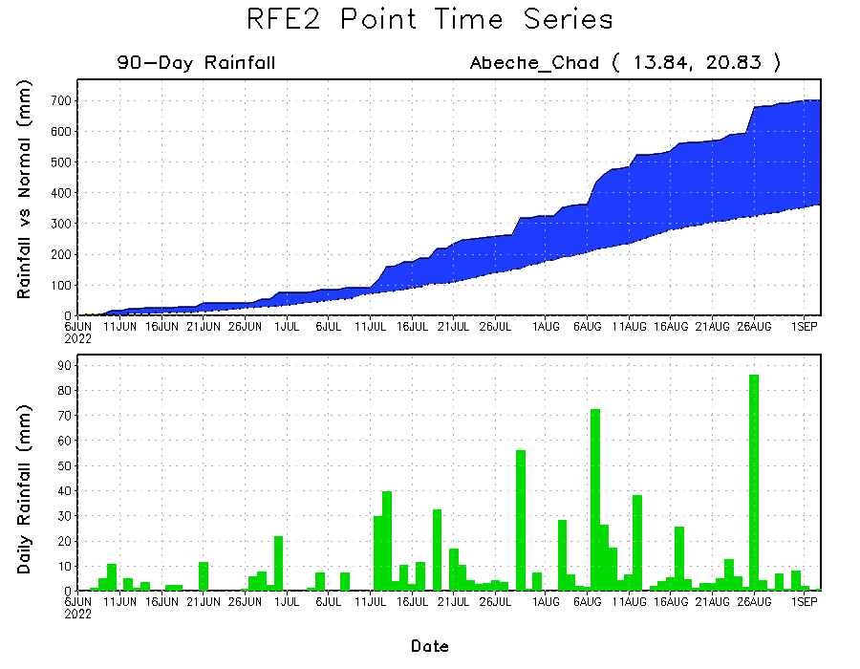
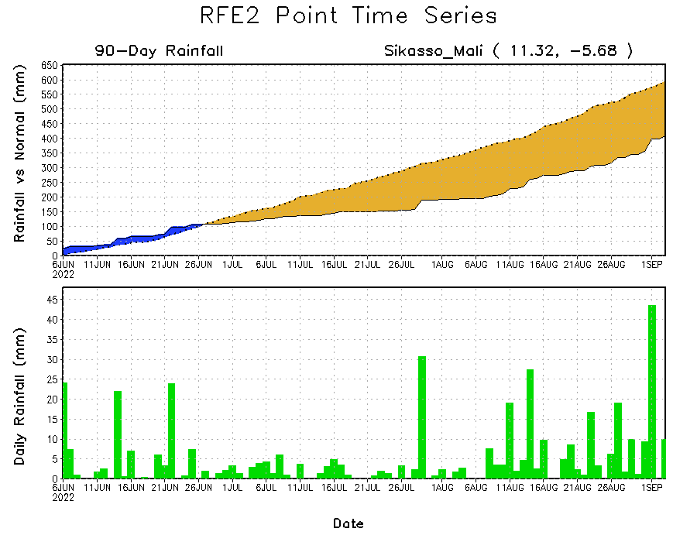
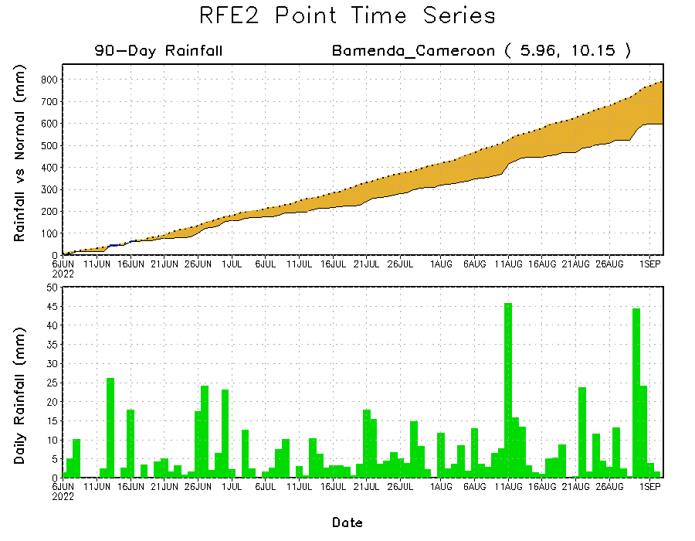
Rainfall Evolution
Daily evolution of rainfall over the last 90 days at selected locations shows increasing moisture deficits over parts of southern Mali (bottom left) and western Cameroon (bottom right). Consistent heavy rains have kept significant moisture surpluses over parts of Chad (top right).

Slide 9
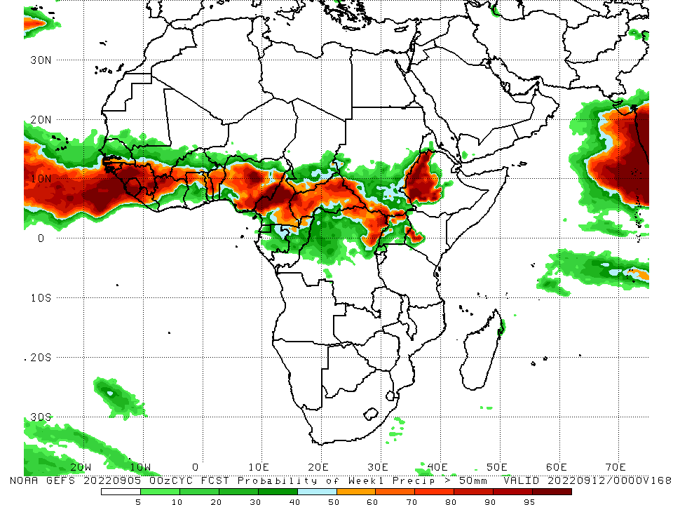
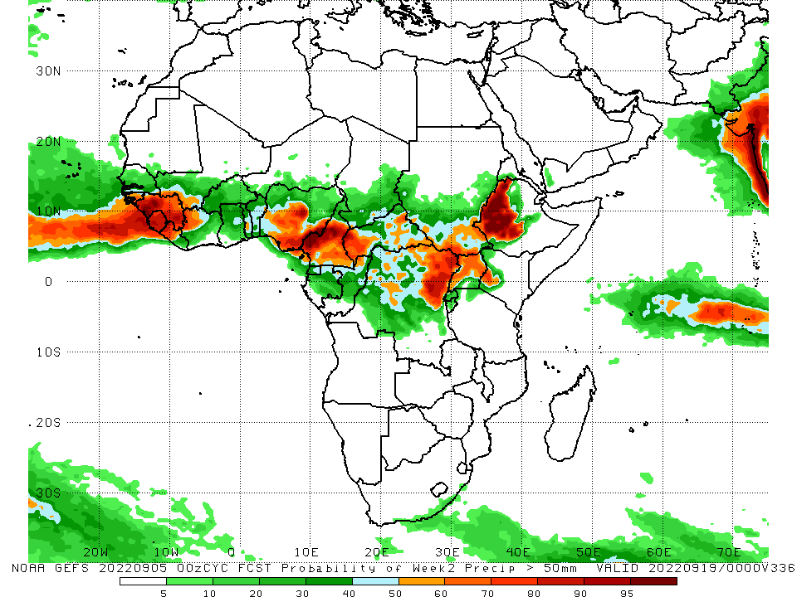
NCEP GEFS Model Forecasts Non-Bias Corrected Probability of precipitation exceedance
Week-1, Valid: 06 – 12 September, 2022
Week-2, Valid: 13 – 19 September, 2022
For week-1 (left panel) the NCEP GEFS indicates a moderate to high chance (over 70%) for rainfall to exceed 50 mm over Guinea Bissau, Guinea, Sierra Leone, western Liberia, northwest Cote D’Ivoire, Toga, Benin, central and southern Nigeria, northern and eastern Cameroon, CAR, northeast DRC, and western Ethiopia. For week-2 (right panel), NCEP GEFS indicates a moderate to high chance (over 70%) for rainfall to exceed 50 mm over Guinea Bissau, Guinea, Sierra Leone, western Liberia, central and southern Nigeria, Cameroon, western CAR, northeast DRC, northern and central Uganda, and western Ethiopia.
Notes:
9

Slide 10
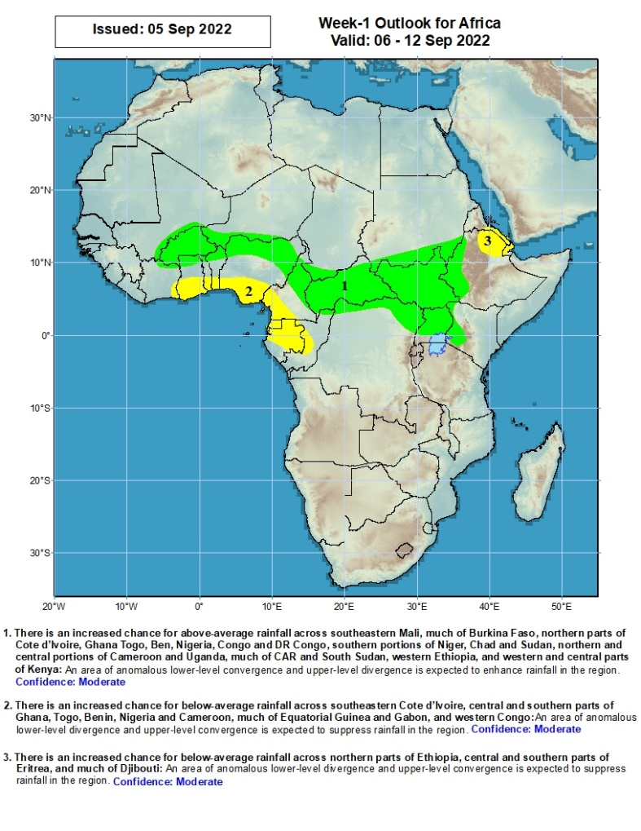
Week-1 Precipitation Outlooks
06 - 12 September, 2022
There is an increased chance for above-average rainfall across southeastern Mali, much of Burkina Faso, northern parts of Cote d’Ivoire, Ghana Togo, Ben, Nigeria, Congo and DR Congo, southern portions of Niger, Chad and Sudan, northern and central portions of Cameroon and Uganda, much of CAR and South Sudan, western Ethiopia, and western and central parts of Kenya: An area of anomalous lower-level convergence and upper-level divergence is expected to enhance rainfall in the region. Confidence: Moderate
There is an increased chance for below-average rainfall across southeastern Cote d’Ivoire, central and southern parts of Ghana, Togo, Benin, Nigeria and Cameroon, much of Equatorial Guinea and Gabon, and western Congo: An area of anomalous lower-level divergence and upper-level convergence is expected to suppress rainfall in the region. Confidence: Moderate
There is an increased chance for below-average rainfall across northern parts of Ethiopia, central and southern parts of Eritrea, and much of Djibouti: An area of anomalous lower-level divergence and upper-level convergence is expected to suppress rainfall in the region. Confidence: Moderate
Notes:
10

Slide 11
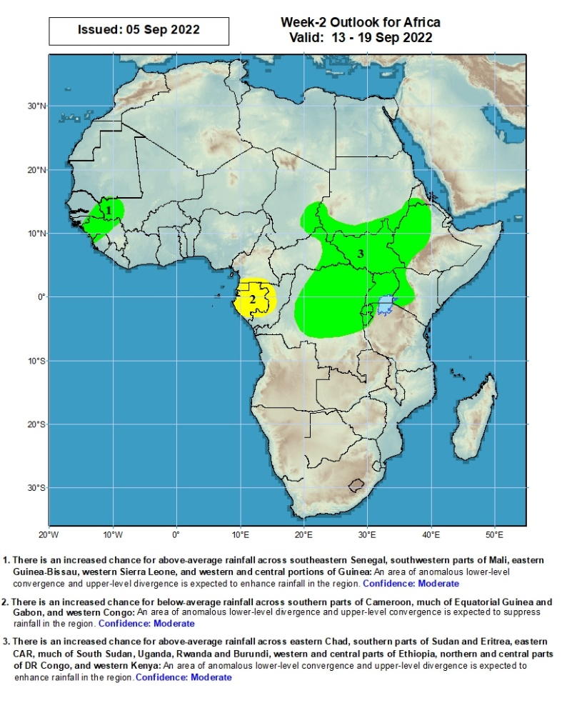
Week-2 Precipitation Outlooks
13 - 19 September, 2022
There is an increased chance for above-average rainfall across southeastern Senegal, southwestern parts of Mali, eastern Guinea-Bissau, western Sierra Leone, and western and central portions of Guinea: An area of anomalous lower-level convergence and upper-level divergence is expected to enhance rainfall in the region. Confidence: Moderate
There is an increased chance for below-average rainfall across southern parts of Cameroon, much of Equatorial Guinea and Gabon, and western Congo: An area of anomalous lower-level divergence and upper-level convergence is expected to suppress rainfall in the region. Confidence: Moderate
There is an increased chance for above-average rainfall across eastern Chad, southern parts of Sudan and Eritrea, eastern CAR, much of South Sudan, Uganda, Rwanda and Burundi, western and central parts of Ethiopia, northern and central parts of DR Congo, and western Kenya: An area of anomalous lower-level convergence and upper-level divergence is expected to enhance rainfall in the region. Confidence: Moderate
Notes:
11

Slide 12
Summary
During the past 30 days, in East Africa, above-average rainfall was observed over southern, central, and eastern Sudan, western and northern South Sudan, Eritrea, Djibouti, Uganda, central and northern Ethiopia, pockets of western Kenya, Rwanda, Burundi, and pockets of northwest Tanzania. Rainfall was below-average over pockets of eastern Ethiopia and central South Sudan. In southern Africa, below-average rainfall was observed over pockets of coastal South Africa, and southern and northern Madagascar. In Central Africa, rainfall was above-average over parts of eastern Cameroon, much of CAR, central and southern Chad, pockets of western, central, and northeast DRC, and central and northern Congo. Rainfall was below-average over Equatorial Guinea, northern Gabon, western Cameroon, and pockets of northwest DRC. In West Africa, rainfall was above-average over pockets of southern Mauritania, Senegal, central parts of Togo and Benin, parts of southern Niger, and northern and western parts of Nigeria. In contrast, parts of southern Mali and central Burkina Faso, and parts of central and southeast Nigeria received below-average rainfall.
During the past 7 days, in East Africa, rainfall was above-average over western and eastern South Sudan, southern and eastern Sudan, western and central Ethiopia, Uganda, Rwanda, Burundi and pockets of northwest Tanzania. Below-average rainfall was observed over pockets of northern Ethiopia and central Eritrea. In Central Africa, rainfall was above-average over much of CAR, southern Chad, central and western DRC, northern, central, and eastern parts of Cameroon, and central and northern Congo. Below-average rainfall was observed over pockets of western Cameroon, northern Gabon, Equatorial Guinea, and pockets of northwest DRC. In West Africa, above-average rainfall was observed over Senegal, Gambia, Guinea Bissau, Guinea, Sierra Leone, Liberia, Cote D’Ivoire, central and southern Ghana, Toga, Benin, northern and central Burkina Faso, pockets of northwest and eastern Nigeria, southern and central Mali, and southern Mauritania. In contrast, parts of southern Burkina Faso, parts of southern Niger, and pockets of central, southeast, and northeast Nigeria received below-average rainfall.
WWeek-1 outlook calls for an increased chance for above-average rainfall over eastern Guinea, Burkina Faso, central and northern Nigeria, northern Cameroon, CAR, northeast DRC, Uganda, South Sudan, and western Ethiopia. In contrast, there is an increased chance for below-average rainfall along the Gulf Guinea coast, central DRC, and pockets of eastern South Africa. Week-2 outlook suggests an increased chance for above-average rainfall southern Mali, northern Nigeria, southern Chad, CAR, central and northern DRC, South Sudan, Uganda, and western Ethiopia, while below-average rainfall is likely over the southern Ghana, Equatorial Guinea, Gabon, and central Congo.

