Slide 1
The African Monsoon Recent Evolution and Current Status Include Week-1 and Week-2 Outlooks
Update prepared by
12 September 2022
For more information, visit:
http://www.cpc.ncep.noaa.gov/products/Global_Monsoons/African_Monsoons/precip_monitoring.shtml

Slide 2
Outline
Highlights
Recent Evolution and Current Conditions
NCEP GEFS Forecasts
Summary

Slide 3
Highlights: Last 7 Days
During the past 7 days, in East Africa, rainfall was above-average over western and eastern South Sudan, southern Sudan, western and northern Ethiopia, pockets of central and southern Eritrea, Djibouti, northeast Uganda, western Kenya, and pockets of northern Tanzania. Below-average rainfall was observed over western Uganda, Rwanda, and Burundi. In Central Africa, rainfall was above-average over western and eastern CAR, central Chad, northwest DRC, central Cameroon, and northern Congo. Below-average rainfall was observed over pockets of western and southern Cameroon, northern Gabon, Equatorial Guinea, pockets of southern Chad, and central and eastern DRC. In southern Africa, below-average rainfall was observed over pockets of northeast South Africa. In West Africa, above-average rainfall was observed over pockets of southeast Senegal, Guinea Bissau, Guinea, Sierra Leone, western Liberia, northern Cote D’Ivoire, central and southern Mali, southern Burkina Faso, southern Niger, and northern Nigeria. In contrast, parts of northern and western Senegal, Gambia, southern Cote D’Ivoire, central and southern Ghana, Toga, Benin, central and northern Nigeria received below-average rainfall.
Week-1 outlook calls for an increased chance for above-average rainfall over Guinea, Sierra Leone, southern Mali, central Nigeria, southern Chad, northeast Cameroon, CAR, South Sudan, southern Sudan, western Ethiopia, Uganda, Rwanda, Burundi, and central, eastern and northern DRC. In contrast, there is an increased chance for below-average rainfall along the Gulf Guinea coast regions. Week-2 outlook suggests an increased chance for above-average rainfall Guinea Bissau, northern Guinea, southern Mali, Burkina Faso, Nigeria, northern Cameroon, southern Chad, CAR, northern Congo, central, northern, and eastern DRC, Uganda, Rwanda, Burundi, southern Sudan, western Ethiopia, and eastern South Africa, while below-average rainfall is likely along Sierra Leone, Liberia, southern Cote D’Ivoire, southern regions of Ghana, Togo and Benin, western Cameroon, Equatorial Guinea, and Gabon.

Slide 4
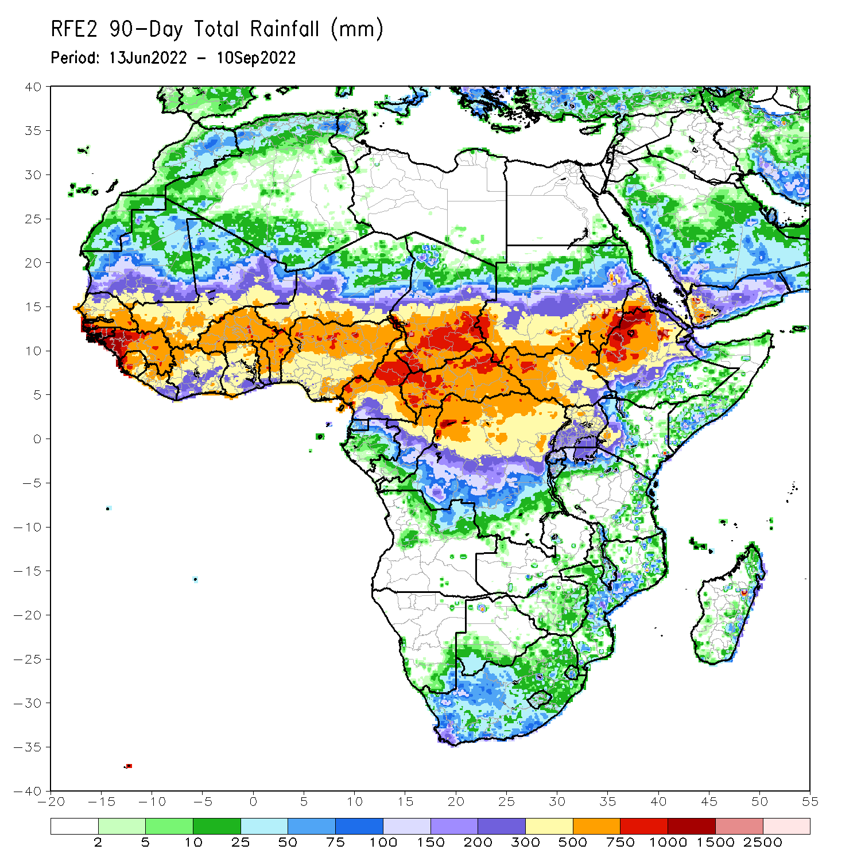
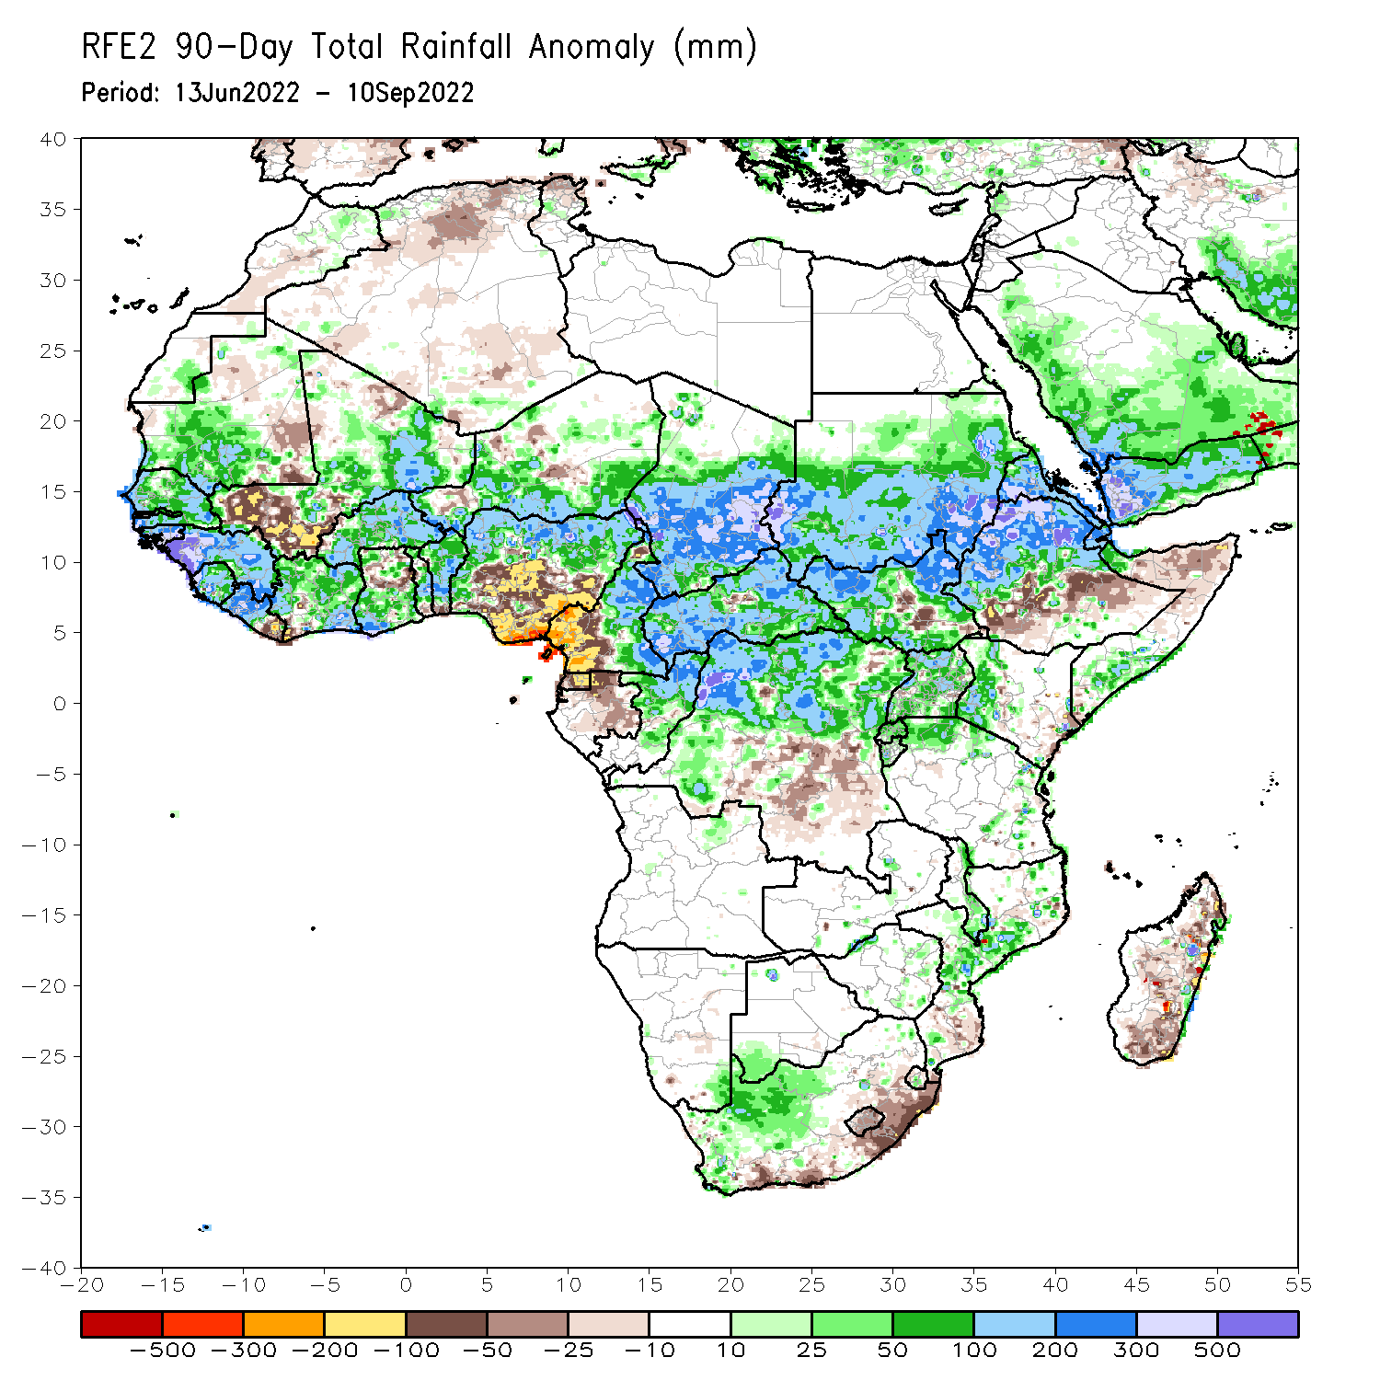
Rainfall Patterns: Last 90 Days
Over the past 90 days, in East Africa, above-average rainfall was observed over southern, central, and eastern Sudan, western and northern portions of South Sudan, western and northern Ethiopia, Eritrea, Djibouti, parts of southern Somalia, Uganda, Rwanda, Burundi, pockets of northwest Tanzania, and western Kenya. Rainfall was below-average over pockets of southern and central Ethiopia, pockets of central South Sudan, and parts of northern Somalia. In southern Africa, above-average rainfall was observed over parts of western South Africa, central Mozambique, southern Malawi, and pockets of southern Botswana and southeast Namibia. Below-average rainfall was observed over pockets of coastal South Africa, and southern, central, and northern Madagascar. In Central Africa, rainfall was above-average over northern and eastern Cameroon, southern, central, and eastern Chad, much of CAR, northern Congo, and northern and northwest DRC. Rainfall was below-average over western Cameroon, pockets of northern Gabon, Equatorial Guinea, and parts of central DRC. In West Africa, rainfall was above-average over southern Mauritania, Senegal, Gambia, Guinea-Bissau, Guinea, Sierra Leone, western and central Liberia, central and eastern Cote D’Ivoire, parts southern Ghana, central and northern parts of Togo and Benin, Burkina Faso, northeastern Mali, and parts of southern Niger and western and northern Nigeria. In contrast, below-average rainfall was observed over southeast Mauritania, western and southern parts of Mali, eastern Liberia, and parts of central and southeast Nigeria.
Notes:
4

Slide 5
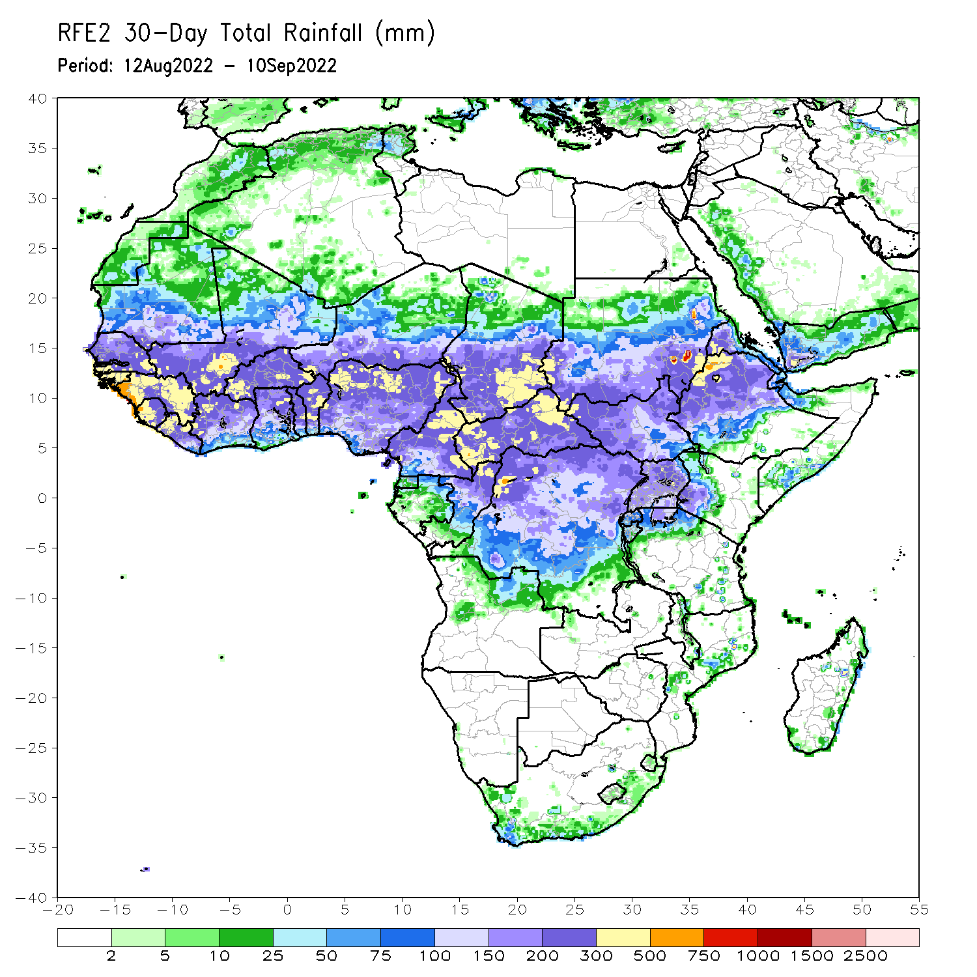
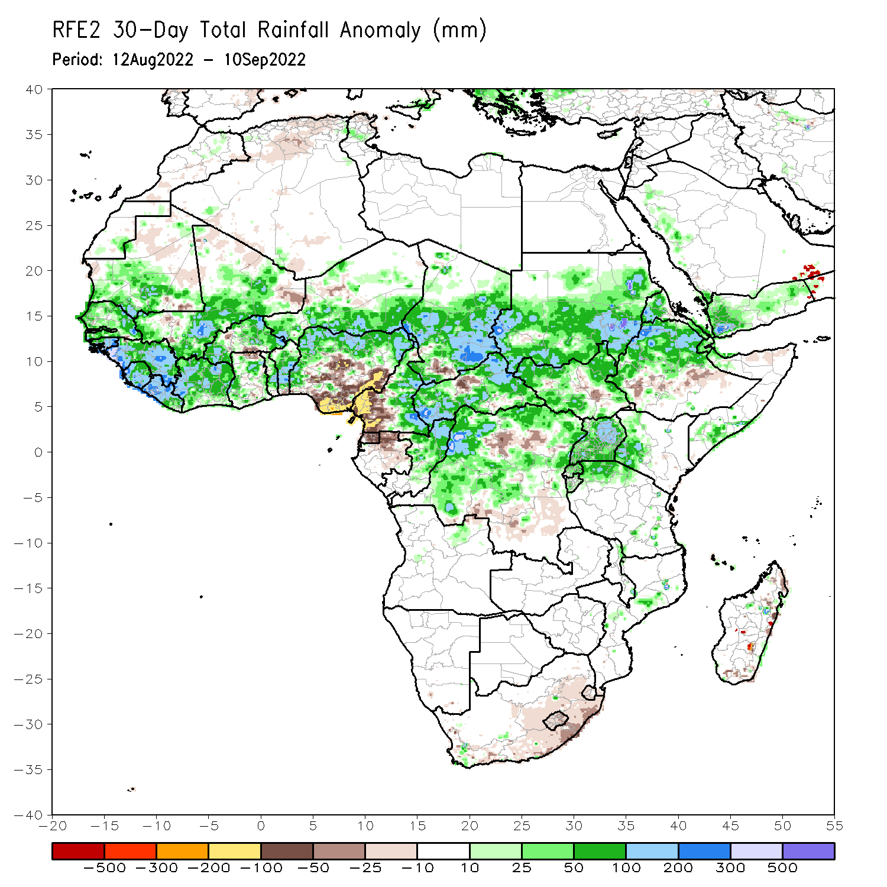
Rainfall Patterns: Last 30 Days
During the past 30 days, in East Africa, above-average rainfall was observed over southern, central, and eastern Sudan, western and northern South Sudan, Eritrea, Djibouti, Uganda, western and northern Ethiopia, pockets of western Kenya, Rwanda, Burundi, and pockets of northwest Tanzania. Rainfall was below-average over pockets of central Ethiopia and central South Sudan. In southern Africa, below-average rainfall was observed over eastern South Africa, and pockets of southern and northern Madagascar. In Central Africa, rainfall was above-average over parts of eastern Cameroon, western and eastern CAR, central and southeast Chad, pockets of western, central, and northeast DRC, and central and northern Congo. Rainfall was below-average over Equatorial Guinea, northern Gabon, western Cameroon, and pockets of northern DRC and central CAR. In West Africa, rainfall was above-average over southern Mauritania, Senegal, Gambia, Guinea-Bissau, Guinea, Sierra Leone, Liberia, much of Cote D’Ivoire, parts central Ghana, central Togo and central Benin, western and northern Burkina Faso, parts of central and southeast Mali, southern Niger, and northern and western Nigeria. In contrast, pockets of western Mali and southern Burkina Faso, and parts of central and southeast Nigeria received below-average rainfall.
Notes:
5

Slide 6
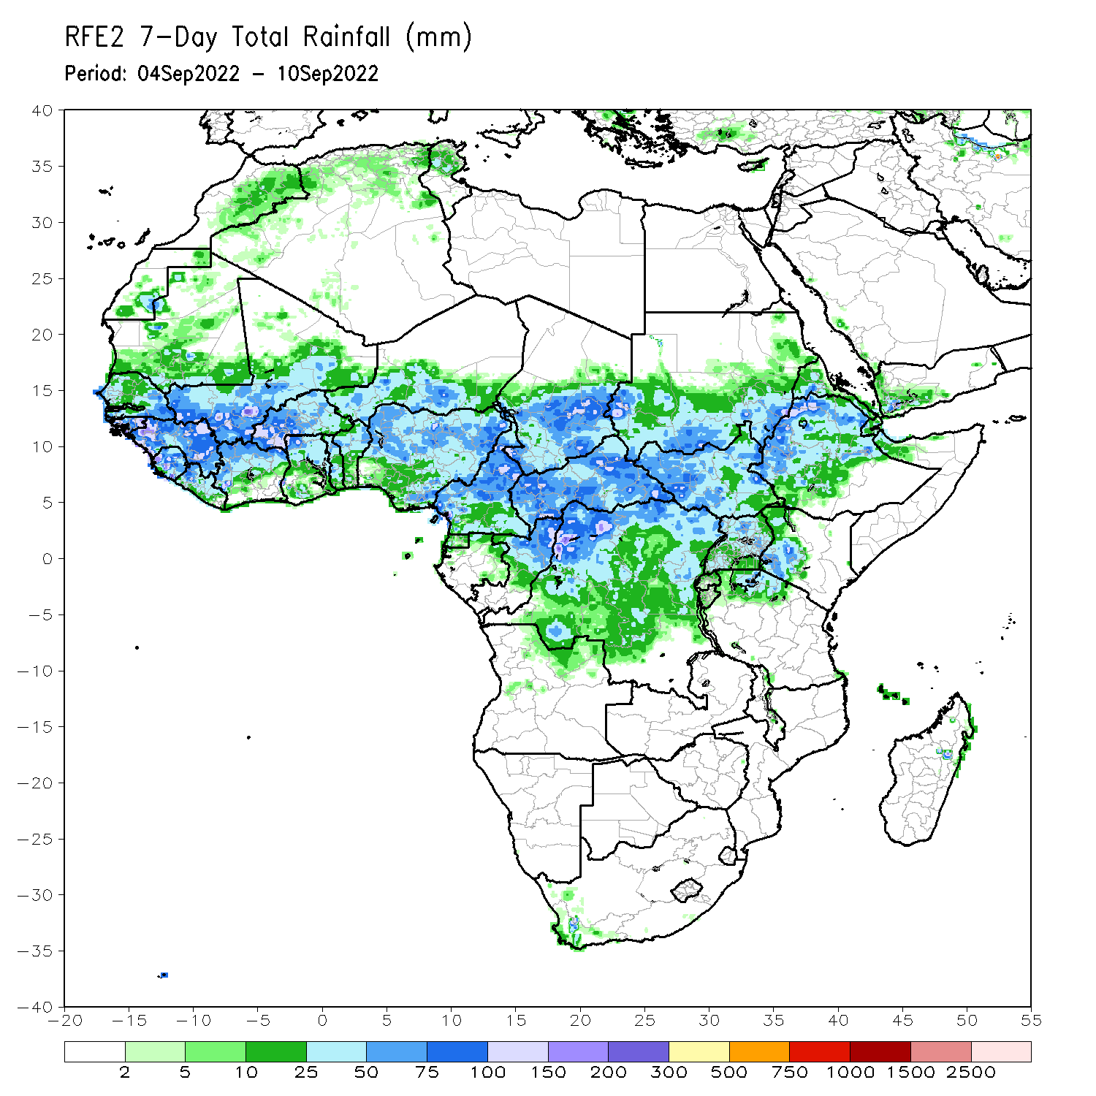
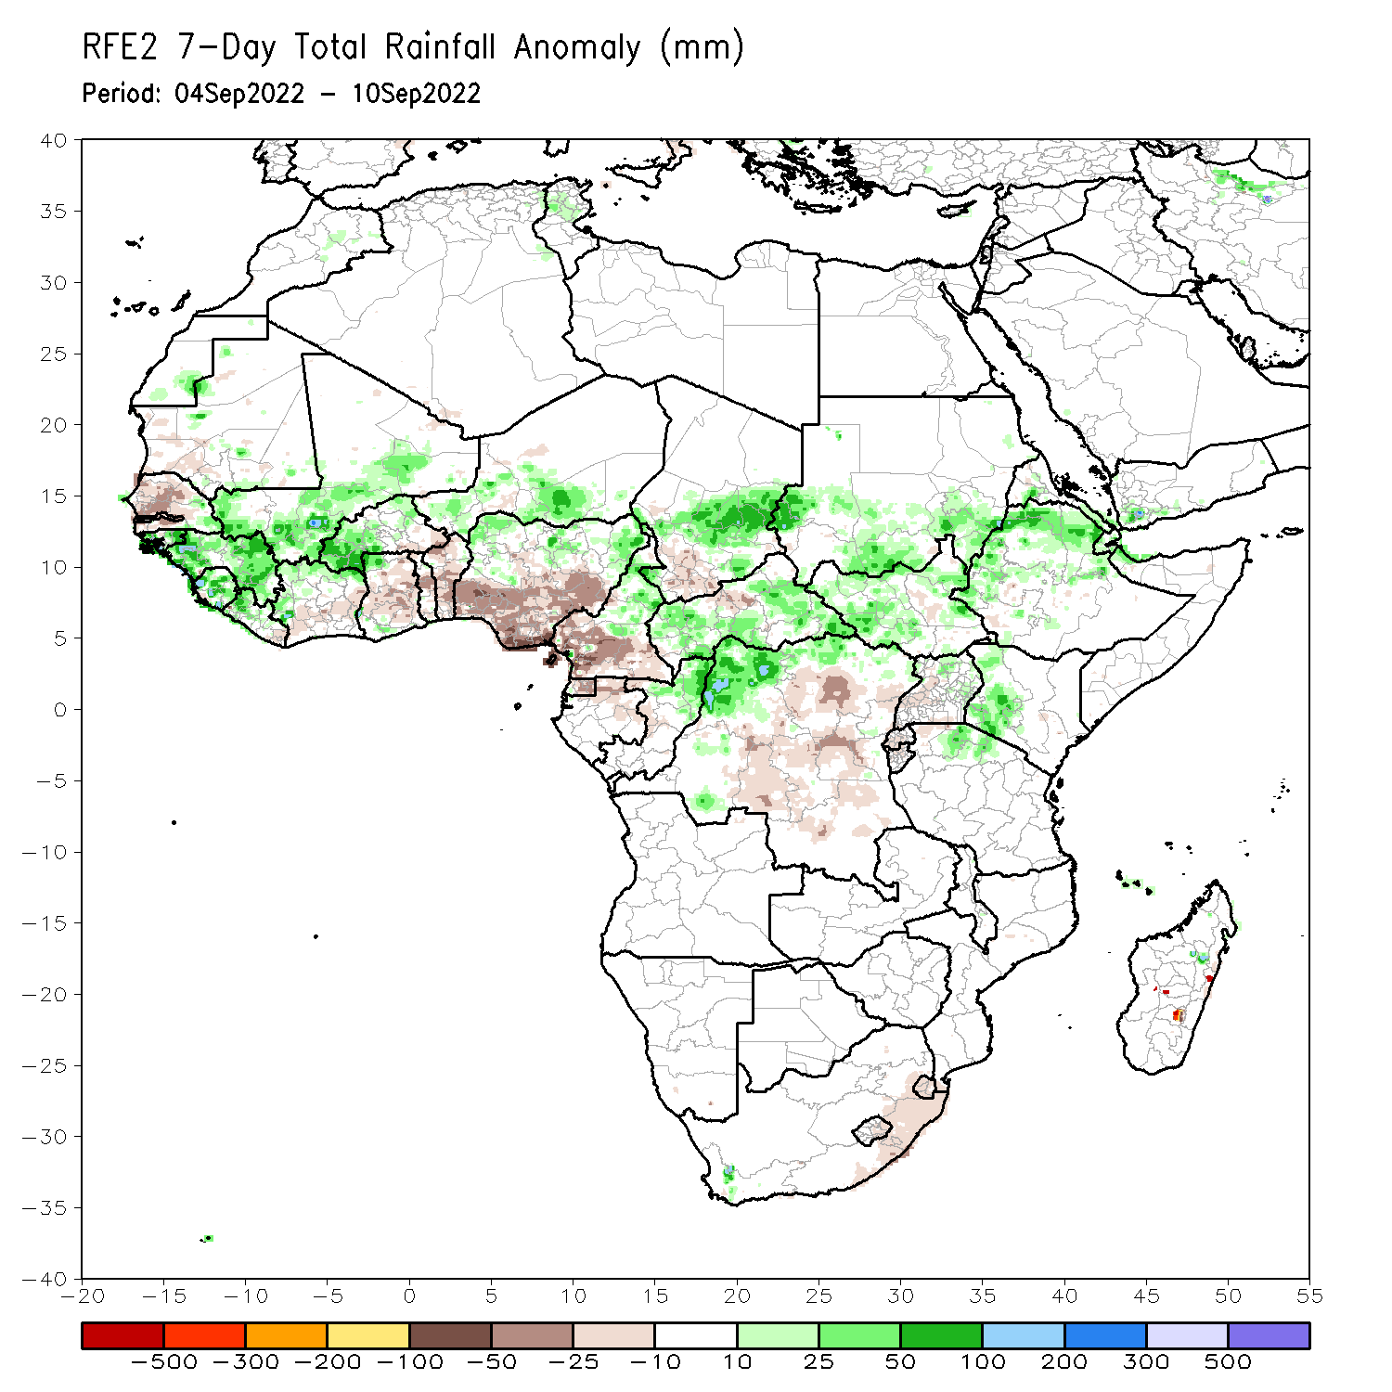
Rainfall Patterns: Last 7 Days
During the past 7 days, in East Africa, rainfall was above-average over western and eastern South Sudan, southern Sudan, western and northern Ethiopia, pockets of central and southern Eritrea, Djibouti, northeast Uganda, western Kenya, and pockets of northern Tanzania. Below-average rainfall was observed over western Uganda, Rwanda, and Burundi. In Central Africa, rainfall was above-average over western and eastern CAR, central Chad, northwest DRC, central Cameroon, and northern Congo. Below-average rainfall was observed over pockets of western and southern Cameroon, northern Gabon, Equatorial Guinea, pockets of southern Chad, and central and eastern DRC. In southern Africa, below-average rainfall was observed over pockets of northeast South Africa. In West Africa, above-average rainfall was observed over pockets of southeast Senegal, Guinea Bissau, Guinea, Sierra Leone, western Liberia, northern Cote D’Ivoire, central and southern Mali, southern Burkina Faso, southern Niger, and northern Nigeria. In contrast, parts of northern and western Senegal, Gambia, southern Cote D’Ivoire, central and southern Ghana, Toga, Benin, central and northern Nigeria received below-average rainfall.

Slide 7
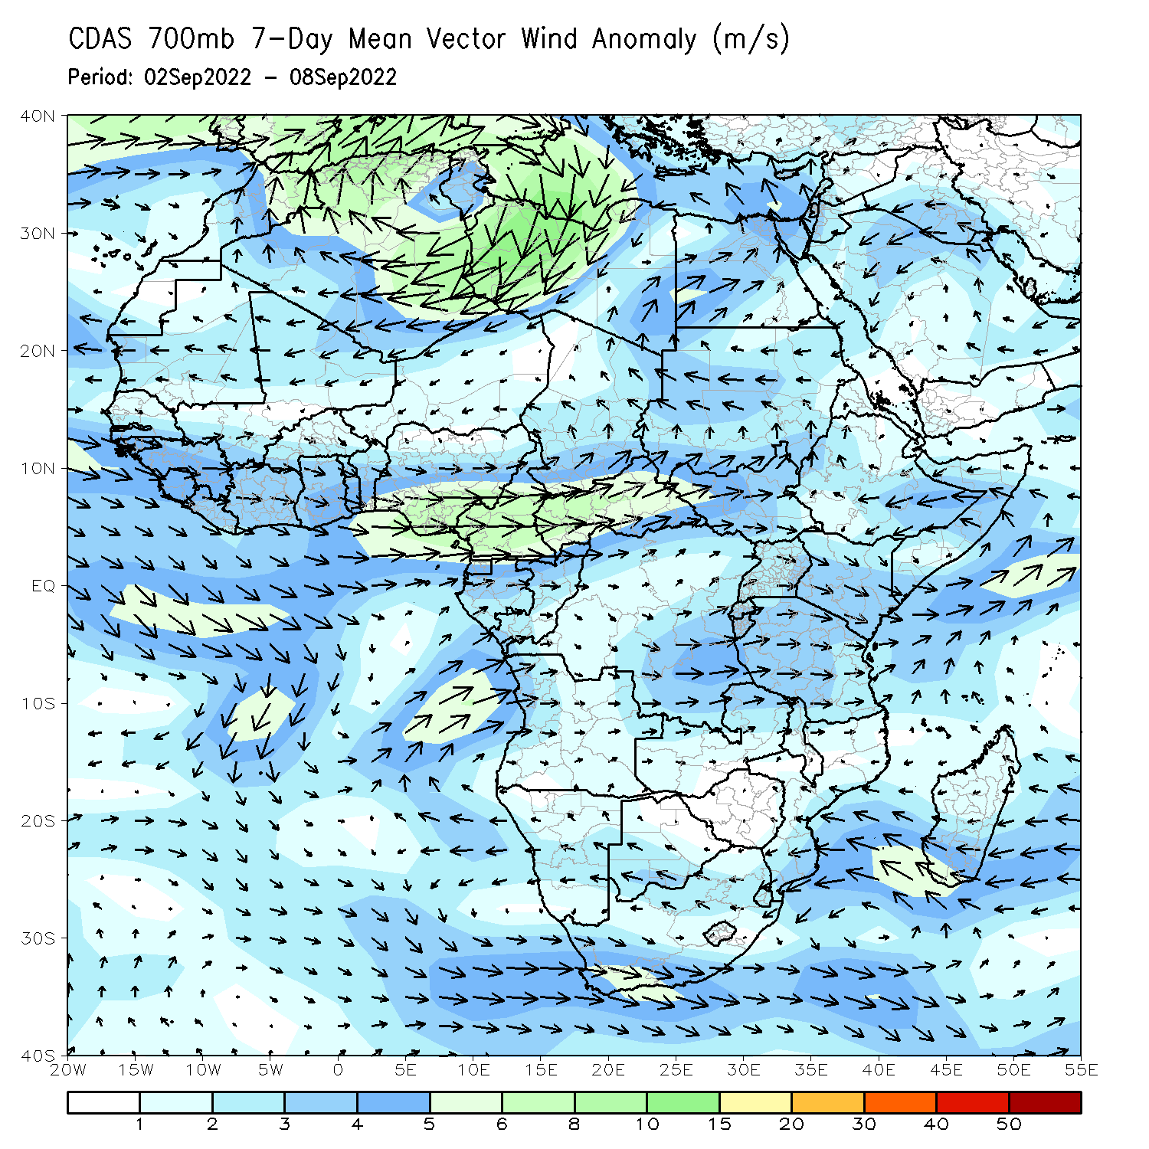
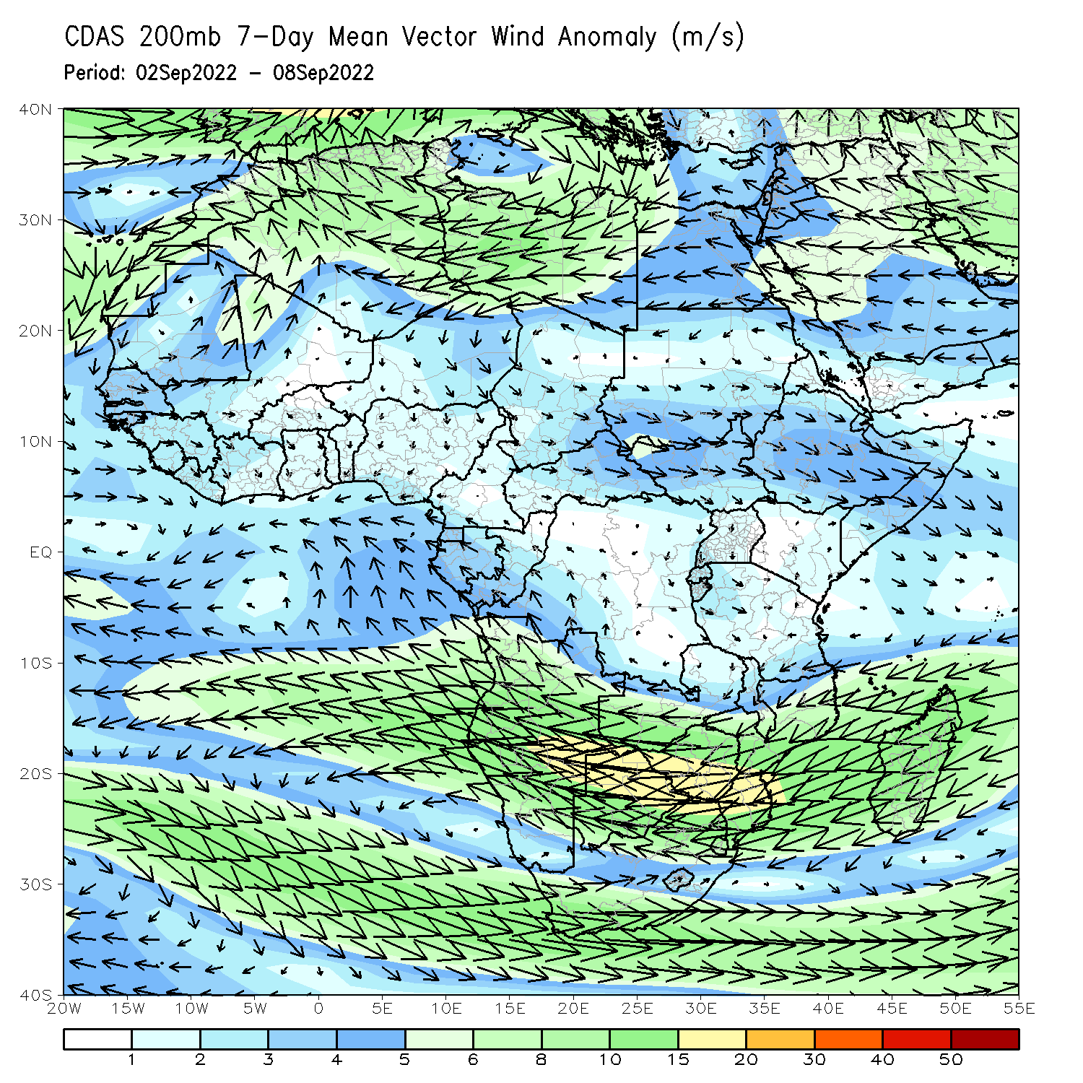
Atmospheric Circulation: Last 7 Days
At 700-hPa level (left panel), anomalous westerly flow was observed across much of the Sahel region and its associated cyclonic shear was observed across the eastern portion of the Sahel, including Sudan. Anomalous wind convergence at 700-hPa level may have contributed to the observed above-average rainfall near Sudan/Ethiopia border. At 200-hPa (right panel), anomalous upper-level speed divergence is observed over near Sudan/Ethiopia border.

Slide 8
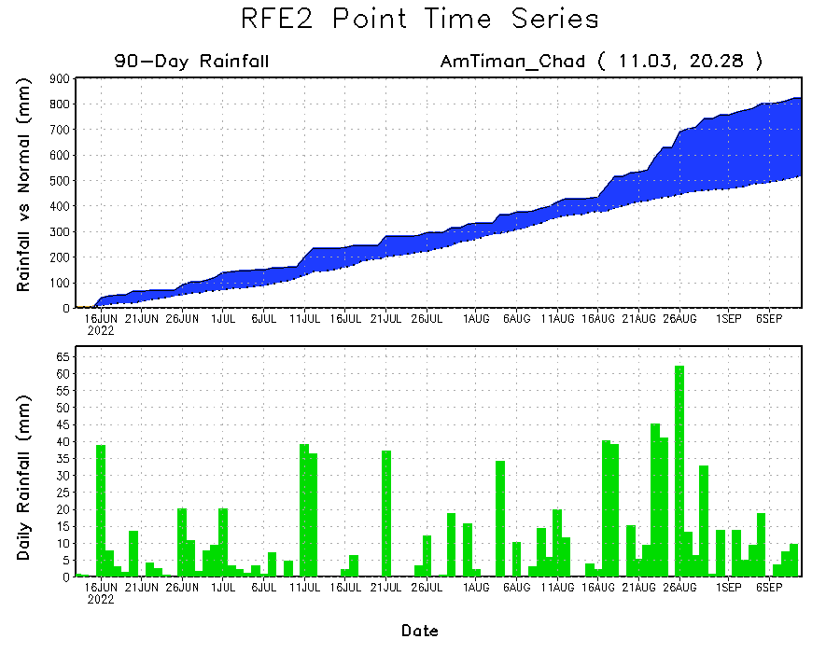
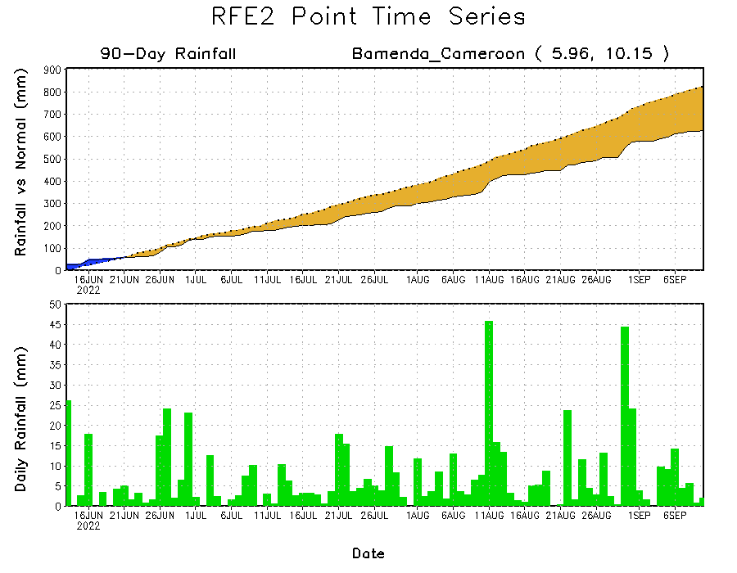
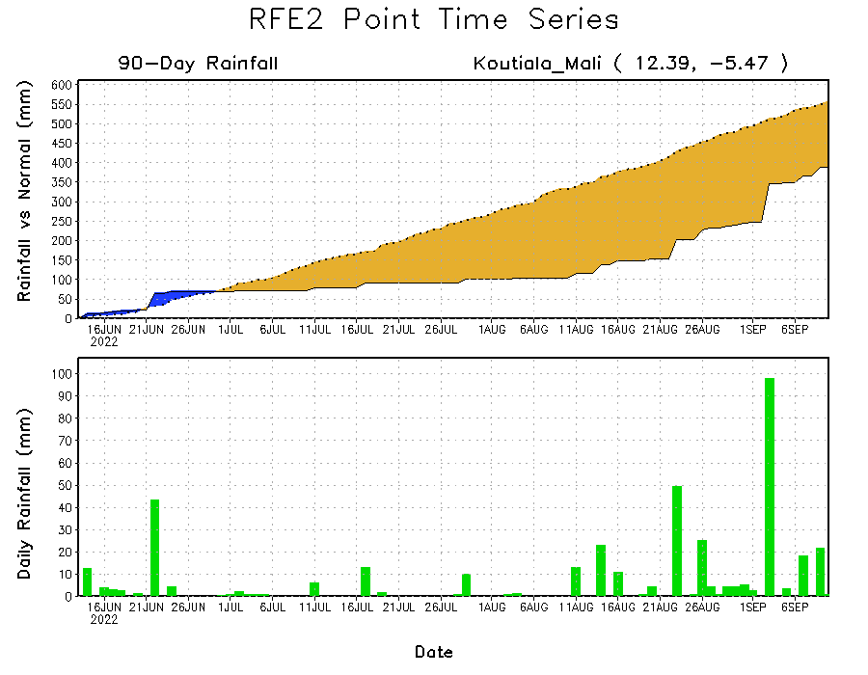
Rainfall Evolution
Daily evolution of rainfall over the last 90 days at selected locations shows increasing moisture deficits over parts of southern Mali (bottom left) and western Cameroon (bottom right). Consistent heavy rains have kept significant moisture surpluses over parts of Chad (top right).

Slide 9
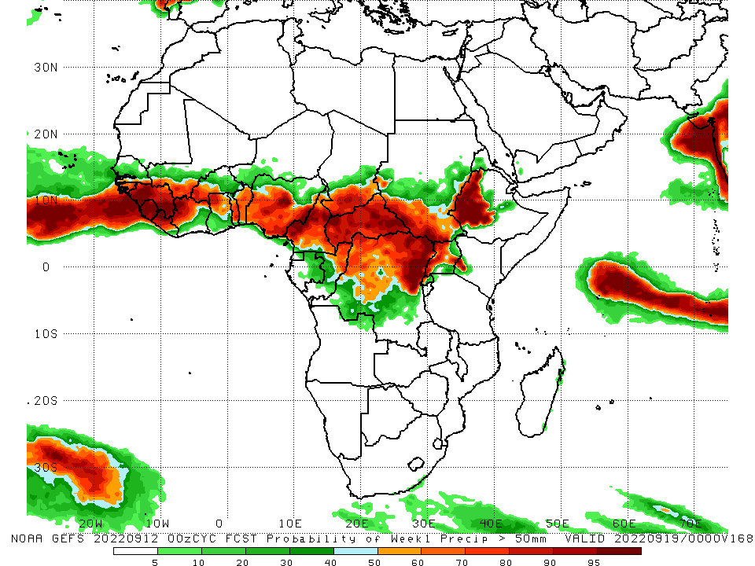
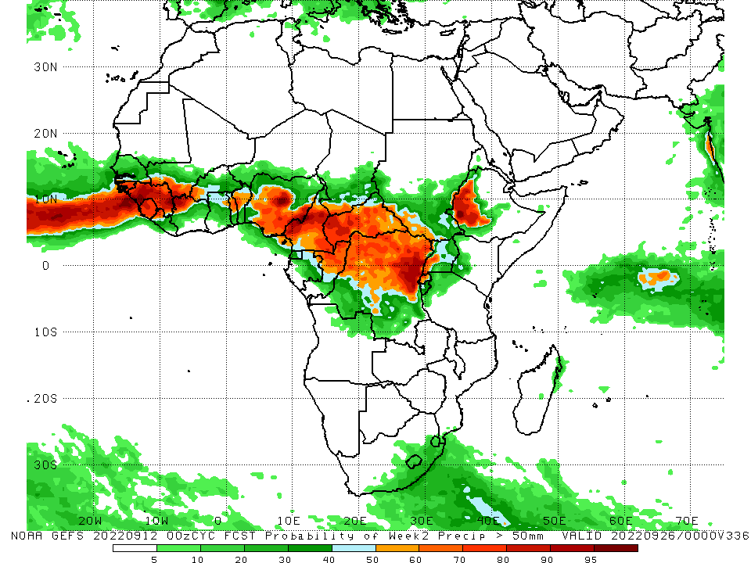
NCEP GEFS Model Forecasts Non-Bias Corrected Probability of precipitation exceedance
Week-1, Valid: 13 – 19 September, 2022
Week-2, Valid: 20 – 26 September, 2022
For week-1 (left panel) the NCEP GEFS indicates a moderate to high chance (over 70%) for rainfall to exceed 50 mm over Guinea Bissau, Guinea, Sierra Leone, western and eastern Liberia, northwest Cote D’Ivoire, western Burkina Faso, Toga, Benin, central and southern Nigeria, much of Cameroon, CAR, norther and northeast DRC, western Uganda, and western Ethiopia. For week-2 (right panel), NCEP GEFS indicates a moderate to high chance (over 70%) for rainfall to exceed 50 mm over Guinea Bissau, Guinea, Sierra Leone, northwest Liberia, central and southern Nigeria, Cameroon, western and southern CAR, northern and northeast DRC, northern Congo, and western Ethiopia.
Notes:
9

Slide 10
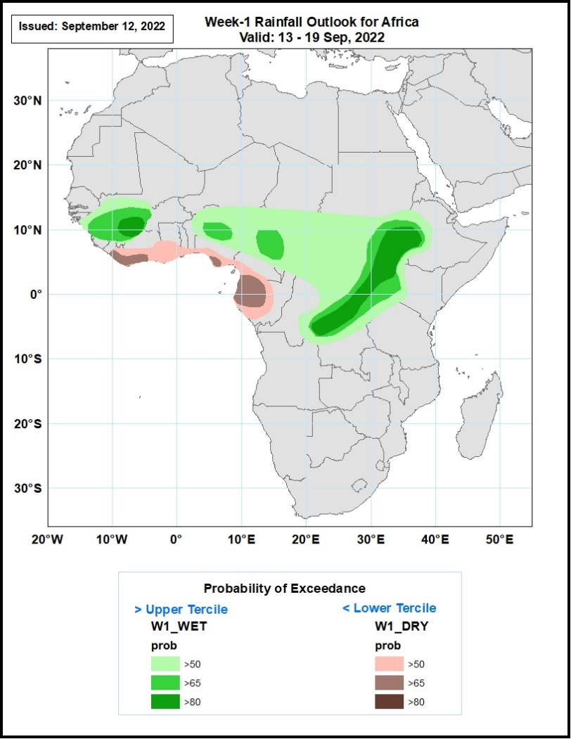
Week-1 Precipitation Outlooks
13 - 19 September, 2022
The consolidated probabilistic forecasts suggest above 50% chance for weekly rainfall to be below-normal (below the lower tercile) over much of Liberia, southern portions of Ghana, Togo, Benin, Nigeria, Cameroon, much of Gabon and western Congo. The forecast suggest above 65% chance for the weekly total rainfall to be below-normal over southern parts of Cote d’Ivoire, Nigeria, much of Equatorial Guinea, and northern parts of Gabon.
The forecast suggests above 50% chance for weekly total rainfall to be above-normal (above the upper tercile) over much of Guinea, southern parts of Mali, eastern Burkina Faso, northern Nigeria and Cameroon, much of CAR and Uganda, northern and central parts of DR Congo, southern Niger, Chad and Sudan, and western Ethiopia. In particular, there is above 80% chance for rainfall to be above-normal over eastern Guinea and northwestern Cote d’Ivoire, eastern South Sudan, northern Uganda, and northeastern, eastern and central parts of DR Congo.
Notes:
10

Slide 11
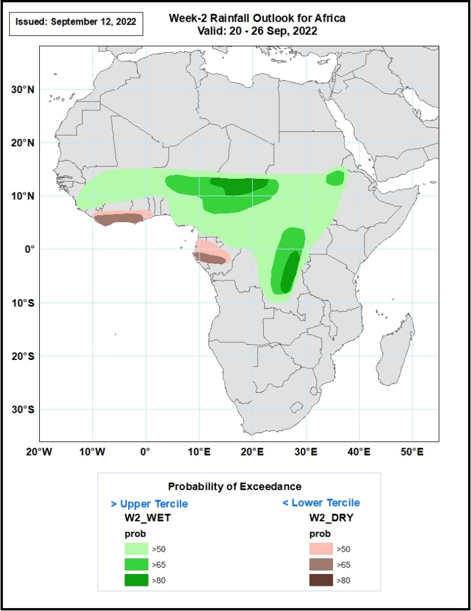
Week-2 Precipitation Outlooks
20 - 26 September, 2022
The consolidated probabilistic forecasts suggest above 50% chance for weekly rainfall to be below-normal (below the lower tercile) over southern portions of Liberia, Cote d’Ivoire, Ghana and Gabon, much of Equatorial Guinea, and western Congo. The forecast suggest above 65% chance for the weekly total rainfall to be below-normal over southern parts of Cote d’Ivoire and Gabon, and southwestern Liberia and Ghana.
The forecast suggests above 50% chance for weekly total rainfall to be above-normal (above the upper tercile) over much of Guinea, Burkina Faso, Nigeria, Cameroon, South Sudan and CAR, southern parts of Mali, western Uganda, southern parts of and central parts of DR Congo, southern parts of Niger, Chand and Sudan, and western Ethiopia. In particular, there is above 80% chance for rainfall to be above-normal over southern Chad, northeastern and eastern parts of DR Congo.
Notes:
11

Slide 12
Summary
During the past 30 days, in East Africa, above-average rainfall was observed over southern, central, and eastern Sudan, western and northern South Sudan, Eritrea, Djibouti, Uganda, western and northern Ethiopia, pockets of western Kenya, Rwanda, Burundi, and pockets of northwest Tanzania. Rainfall was below-average over pockets of central Ethiopia and central South Sudan. In southern Africa, below-average rainfall was observed over eastern South Africa, and pockets of southern and northern Madagascar. In Central Africa, rainfall was above-average over parts of eastern Cameroon, western and eastern CAR, central and southeast Chad, pockets of western, central, and northeast DRC, and central and northern Congo. Rainfall was below-average over Equatorial Guinea, northern Gabon, western Cameroon, and pockets of northern DRC and central CAR. In West Africa, rainfall was above-average over southern Mauritania, Senegal, Gambia, Guinea-Bissau, Guinea, Sierra Leone, Liberia, much of Cote D’Ivoire, parts central Ghana, central Togo and central Benin, western and northern Burkina Faso, parts of central and southeast Mali, southern Niger, and northern and western Nigeria. In contrast, pockets of western Mali and southern Burkina Faso, and parts of central and southeast Nigeria received below-average rainfall.
During the past 7 days, in East Africa, rainfall was above-average over western and eastern South Sudan, southern Sudan, western and northern Ethiopia, pockets of central and southern Eritrea, Djibouti, northeast Uganda, western Kenya, and pockets of northern Tanzania. Below-average rainfall was observed over western Uganda, Rwanda, and Burundi. In Central Africa, rainfall was above-average over western and eastern CAR, central Chad, northwest DRC, central Cameroon, and northern Congo. Below-average rainfall was observed over pockets of western and southern Cameroon, northern Gabon, Equatorial Guinea, pockets of southern Chad, and central and eastern DRC. In southern Africa, below-average rainfall was observed over pockets of northeast South Africa. In West Africa, above-average rainfall was observed over pockets of southeast Senegal, Guinea Bissau, Guinea, Sierra Leone, western Liberia, northern Cote D’Ivoire, central and southern Mali, southern Burkina Faso, southern Niger, and northern Nigeria. In contrast, parts of northern and western Senegal, Gambia, southern Cote D’Ivoire, central and southern Ghana, Toga, Benin, central and northern Nigeria received below-average rainfall.
Week-1 outlook calls for an increased chance for above-average rainfall over Guinea, Sierra Leone, southern Mali, central Nigeria, southern Chad, northeast Cameroon, CAR, South Sudan, southern Sudan, western Ethiopia, Uganda, Rwanda, Burundi, and central, eastern and northern DRC. In contrast, there is an increased chance for below-average rainfall along the Gulf Guinea coast regions. Week-2 outlook suggests an increased chance for above-average rainfall Guinea Bissau, northern Guinea, southern Mali, Burkina Faso, Nigeria, northern Cameroon, southern Chad, CAR, northern Congo, central, northern, and eastern DRC, Uganda, Rwanda, Burundi, southern Sudan, western Ethiopia, and eastern South Africa, while below-average rainfall is likely along Sierra Leone, Liberia, southern Cote D’Ivoire, southern regions of Ghana, Togo and Benin, western Cameroon, Equatorial Guinea, and Gabon.

