Slide 1
The African Monsoon Recent Evolution and Current Status Include Week-1 and Week-2 Outlooks
Update prepared by
26 September 2022
For more information, visit:
http://www.cpc.ncep.noaa.gov/products/Global_Monsoons/African_Monsoons/precip_monitoring.shtml

Slide 2
Outline
Highlights
Recent Evolution and Current Conditions
NCEP GEFS Forecasts
Summary

Slide 3
Highlights: Last 7 Days
During the past 7 days, in East Africa, rainfall was above-average over south Sudan, northeast parts of South Sudan, northwest and northern Ethiopia, pockets of central Eritrea, and pockets of southern Uganda. Below-average rainfall was observed over pockets of southwest Ethiopia, northern Uganda, and pockets of southern South Sudan and southwest Kenya. In Central Africa, rainfall was above-average over western and northern CAR, central and southern Chad, pockets of western and southern DRC, central Congo, eastern Gabon, and northeast Angola. Below-average rainfall was observed over pockets of western and central Cameroon, western Gabon, Equatorial Guinea, southeast CAR, pockets of northwest and central DRC and pockets of northern Angola. In southern Africa, above-average rainfall was observed over eastern South Africa, Lesotho, Swaziland, southern Mozambique, and northeast Madagascar. In West Africa, above-average rainfall was observed over Senegal, Gambia, Guinea Bissau, much of Guinea, southern Mauritania, southern and central Mali, central Liberia, central and northern Cote D’Ivoire, Ghana, Burkina Faso, pockets of central and northern Togo and Benin, pockets of southern Niger, and western and southwest Nigeria. In contrast, parts of Sierra Leone, eastern Liberia, southern Cote D’Ivoire, and southeast and central Nigeria received below-average rainfall.
Week-1 outlook calls for an increased chance for above-average rainfall across much of the Sahel regions and Gulf Guinea coast, Southern Chad, CAR, western and northern DRC, parts of southern Sudan and western South Sudan, and northwest Ethiopia. In contrast, there is an increased chance for below-average rainfall over pockets of southern and southeast DRC, eastern South Sudan, Uganda, Rwanda, Burundi, eastern Ethiopia, central and northeast South Africa, Lesotho, Swaziland, and central Madagascar. Week-2 outlook suggests an increased chance for above-average rainfall over Guinea Bissau, Guinea, southern Mai, much of Burkina Faso, northern parts of Cote D’Ivoire and Ghana, Togo, Benin, Nigeria, southern Chad, northern Cameroon, CAR, northern Congo, northern DRC, northeast Angola, South Sudan, southern Sudan, northern Uganda, and western Ethiopia, while below-average rainfall is likely along central Senegal, Liberia, southern Cote D’Ivoire, southern Cameroon, Equatorial Guinea, northern Gabon, central and southern DRC, Rwanda, Burundi, eastern Ethiopia, central and northern Somalia, northwest and northeast Kenya, parts of central and northeast South Africa, Swaziland, and central Madagascar.

Slide 4
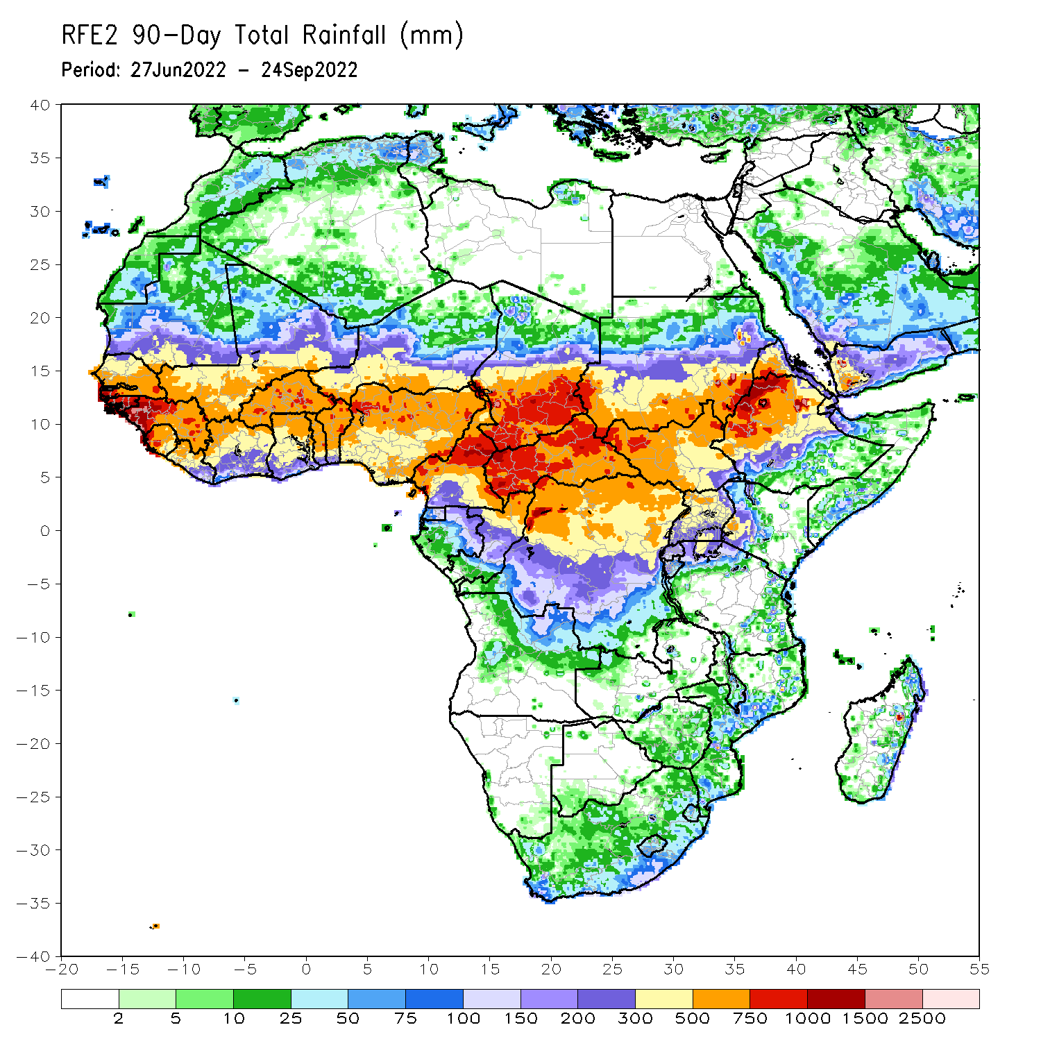
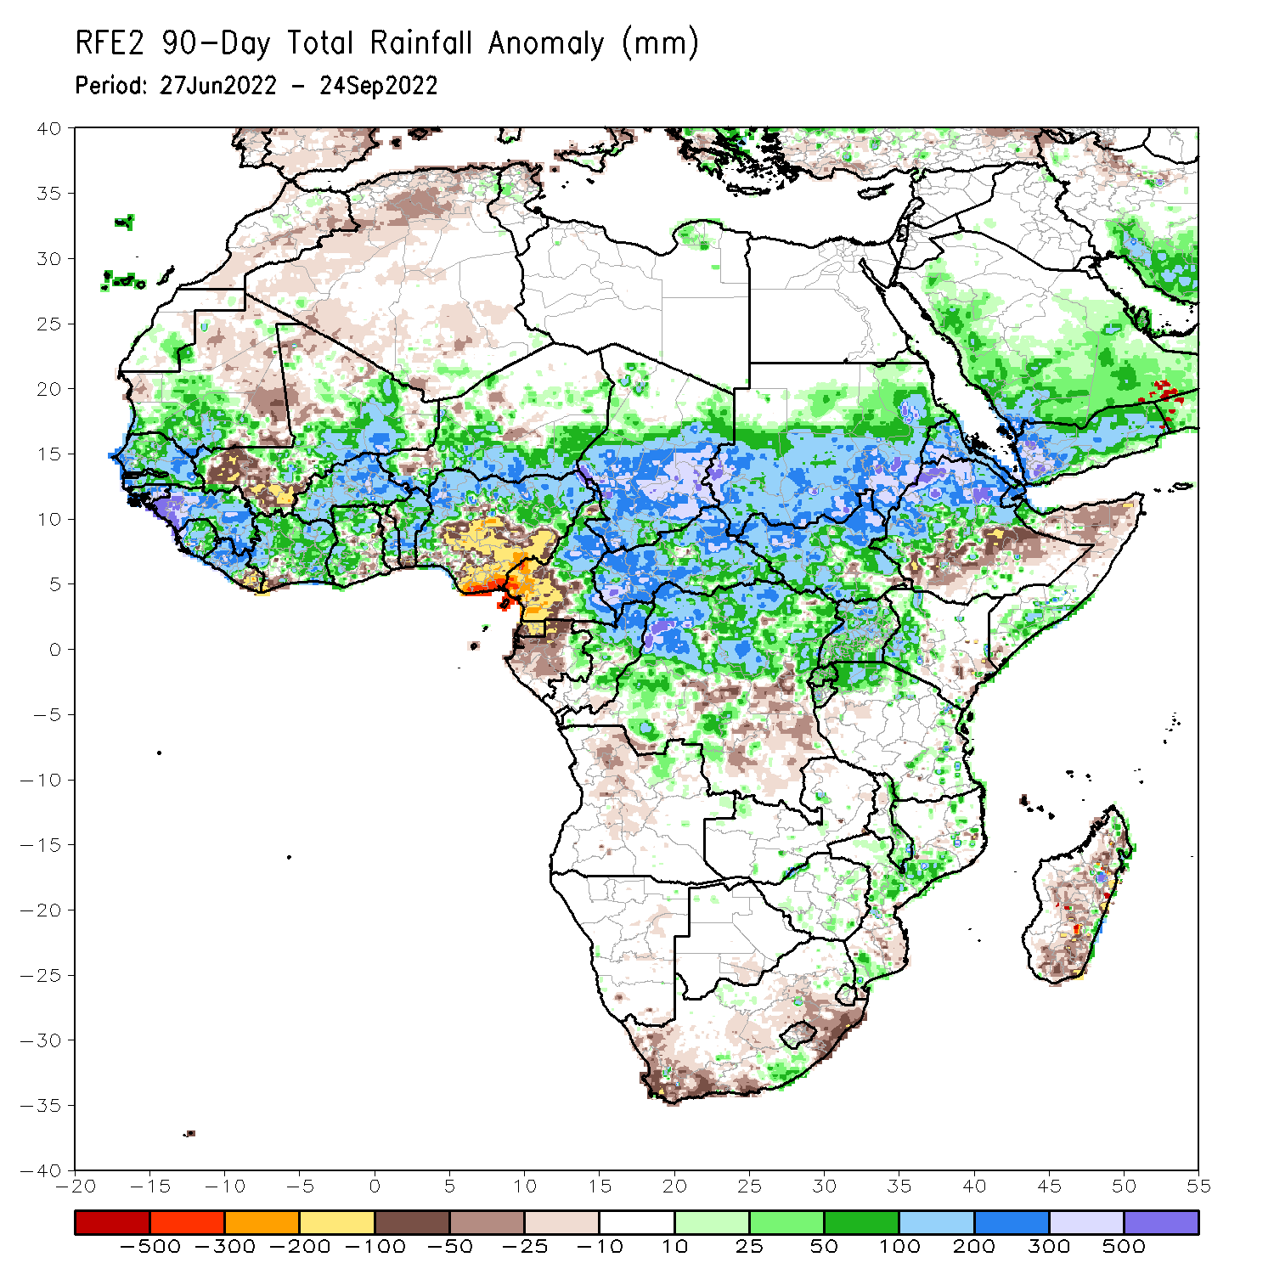
Rainfall Patterns: Last 90 Days
Over the past 90 days, in East Africa, above-average rainfall was observed over southern, central, and eastern parts of Sudan, much of South Sudan, western and northern Ethiopia, Eritrea, Djibouti, parts of southern Somalia, Uganda, Rwanda, Burundi, pockets of northwest and eastern Tanzania, and western Kenya. Rainfall was below-average over pockets of southern and central Ethiopia, and parts of northern Somalia. In southern Africa, above-average rainfall was observed over pockets of eastern South Africa, central Mozambique, southern Malawi, and eastern Zimbabwe. Below-average rainfall was observed over pockets of southern and northeast South Africa, Lesotho, and southern, central, and northern Madagascar. In Central Africa, rainfall was above-average over northern and eastern Cameroon, southern, central, and eastern Chad, CAR, northern Congo, and northern, western and northeast parts of DRC. Rainfall was below-average over western Cameroon, pockets of western, northern and central Gabon, Equatorial Guinea, parts of southeast DRC, and northern Angola. In West Africa, rainfall was above-average over southern Mauritania, Senegal, Gambia, Guinea-Bissau, Guinea, Sierra Leone, western and central Liberia, much of Cote D’Ivoire, parts of western and northern Ghana, central and northern parts of Togo and Benin, Burkina Faso, eastern Mali, and parts of southern Niger and western and northern Nigeria. In contrast, below-average rainfall was observed over east Mauritania, western and southern parts of Mali, eastern Liberia, and parts of central and southeast Nigeria.
Notes:
4

Slide 5
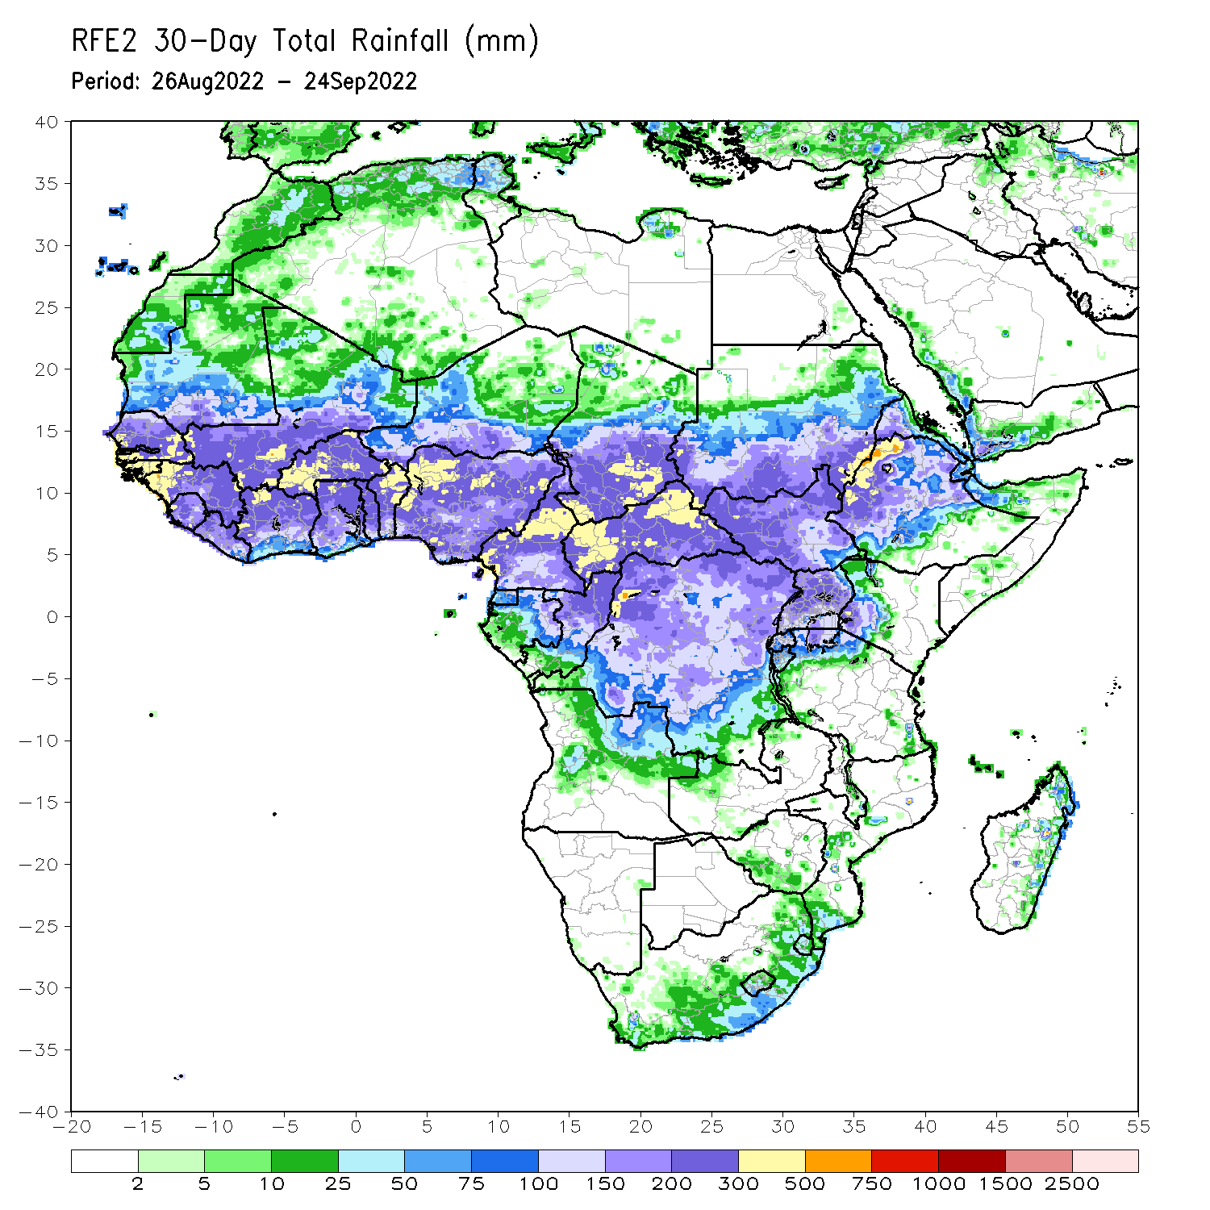
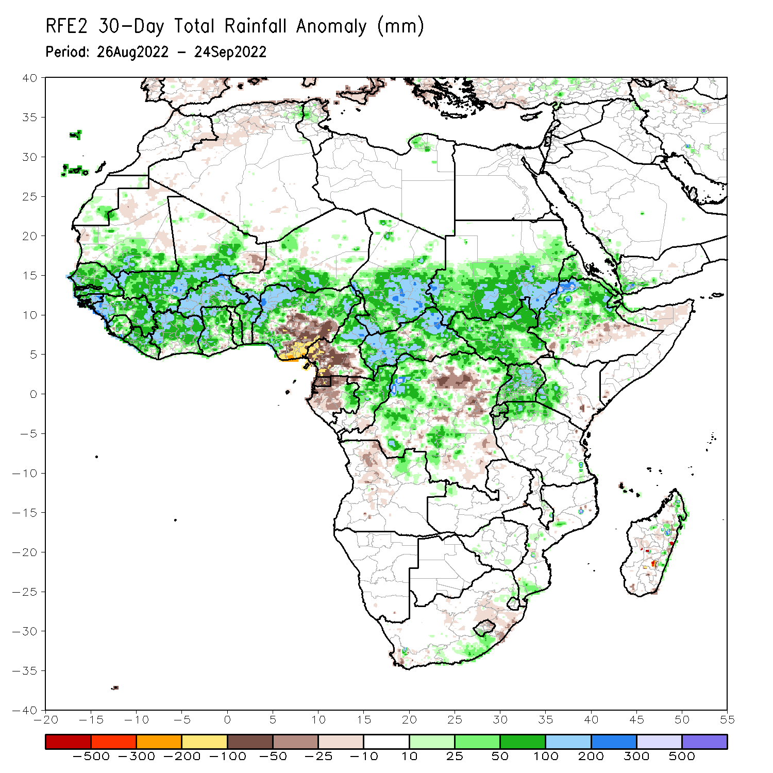
Rainfall Patterns: Last 30 Days
During the past 30 days, in East Africa, above-average rainfall was observed over southern, central, and eastern Sudan, South Sudan, Eritrea, Djibouti, Uganda, western and northern Ethiopia, pockets of western Kenya, Rwanda, Burundi, and pockets of northwest Tanzania. Rainfall was below-average over pockets of central Ethiopia and northern Somalia. In southern Africa, below-average rainfall was observed over pockets of northeast South Africa, northern Lesotho, and pockets of central Madagascar. Rainfall was above-average over pockets of southeast South Africa, southern Mozambique and northern Madagascar. In Central Africa, rainfall was above-average over parts of northern Cameroon, much of CAR, western, central and eastern parts of Chad, pockets of western, southern, and northeast DRC, eastern Gabon, and central and northern Congo. Rainfall was below-average over Equatorial Guinea, western and northern Gabon, western Cameroon, and pockets of central DRC. In West Africa, rainfall was above-average over southern Mauritania, Senegal, Gambia, Guinea-Bissau, Guinea, Sierra Leone, Liberia, much of Cote D’Ivoire, parts western and northern Ghana, much of Togo and Benin, Burkina Faso, parts of western and southern Mali, southern Niger, and northern and western Nigeria. In contrast, pockets of northern and eastern Mauritania, eastern Mali and parts of central and southeast Nigeria received below-average rainfall.
Notes:
5

Slide 6
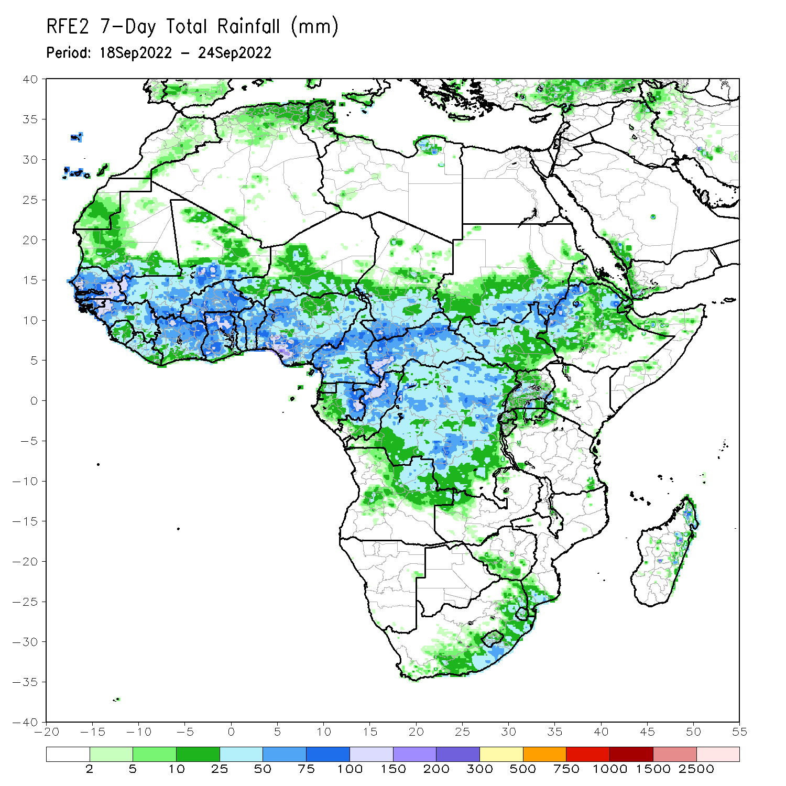
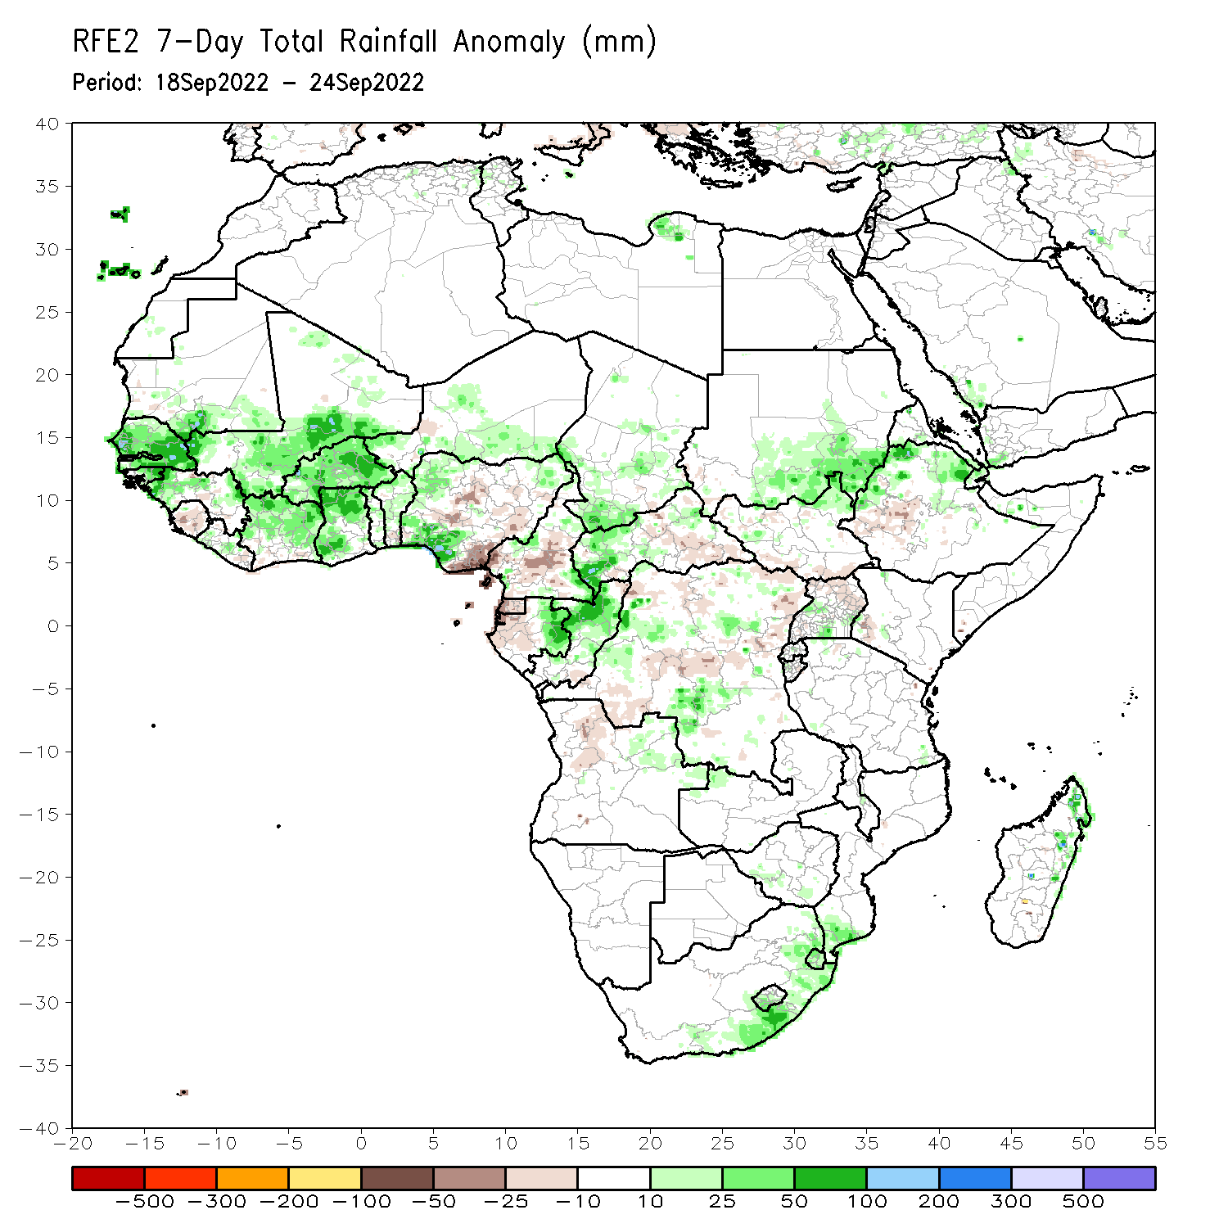
Rainfall Patterns: Last 7 Days
During the past 7 days, in East Africa, rainfall was above-average over south Sudan, northeast parts of South Sudan, northwest and northern Ethiopia, pockets of central Eritrea, and pockets of southern Uganda. Below-average rainfall was observed over pockets of southwest Ethiopia, northern Uganda, and pockets of southern South Sudan and southwest Kenya. In Central Africa, rainfall was above-average over western and northern CAR, central and southern Chad, pockets of western and southern DRC, central Congo, eastern Gabon, and northeast Angola. Below-average rainfall was observed over pockets of western and central Cameroon, western Gabon, Equatorial Guinea, southeast CAR, pockets of northwest and central DRC and pockets of northern Angola. In southern Africa, above-average rainfall was observed over eastern South Africa, Lesotho, Swaziland, southern Mozambique, and northeast Madagascar. In West Africa, above-average rainfall was observed over Senegal, Gambia, Guinea Bissau, much of Guinea, southern Mauritania, southern and central Mali, central Liberia, central and northern Cote D’Ivoire, Ghana, Burkina Faso, pockets of central and northern Togo and Benin, pockets of southern Niger, and western and southwest Nigeria. In contrast, parts of Sierra Leone, eastern Liberia, southern Cote D’Ivoire, and southeast and central Nigeria received below-average rainfall.

Slide 7
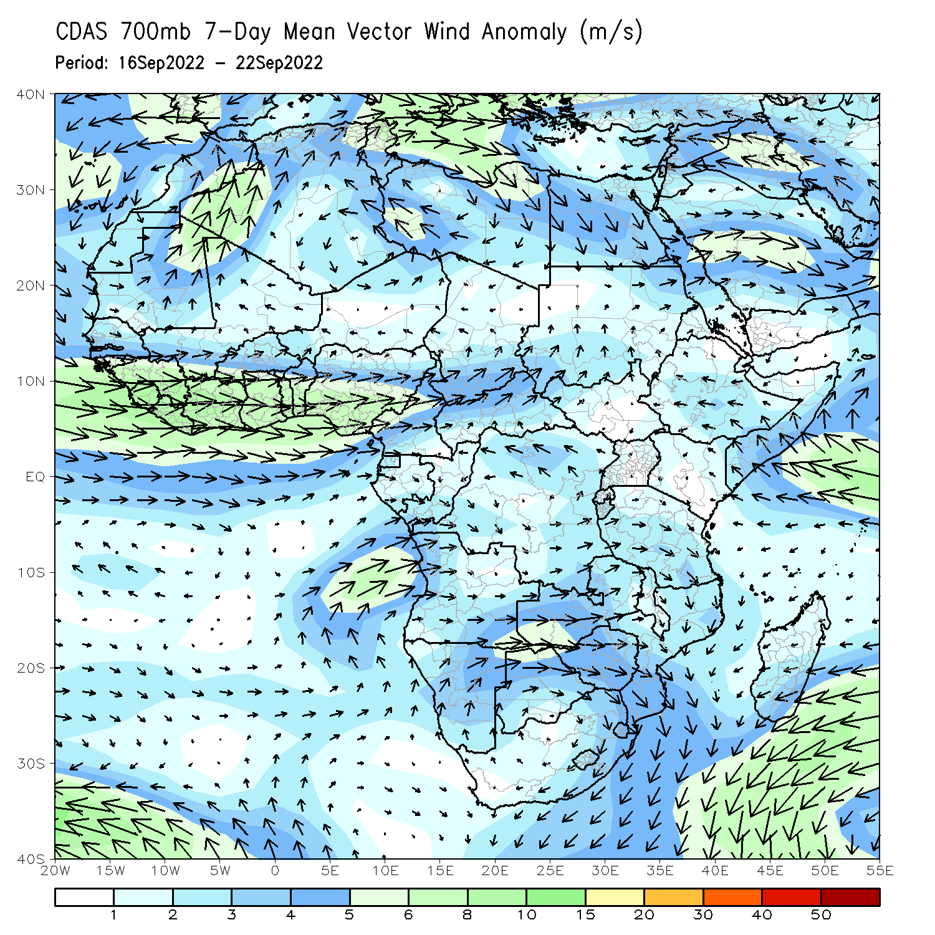
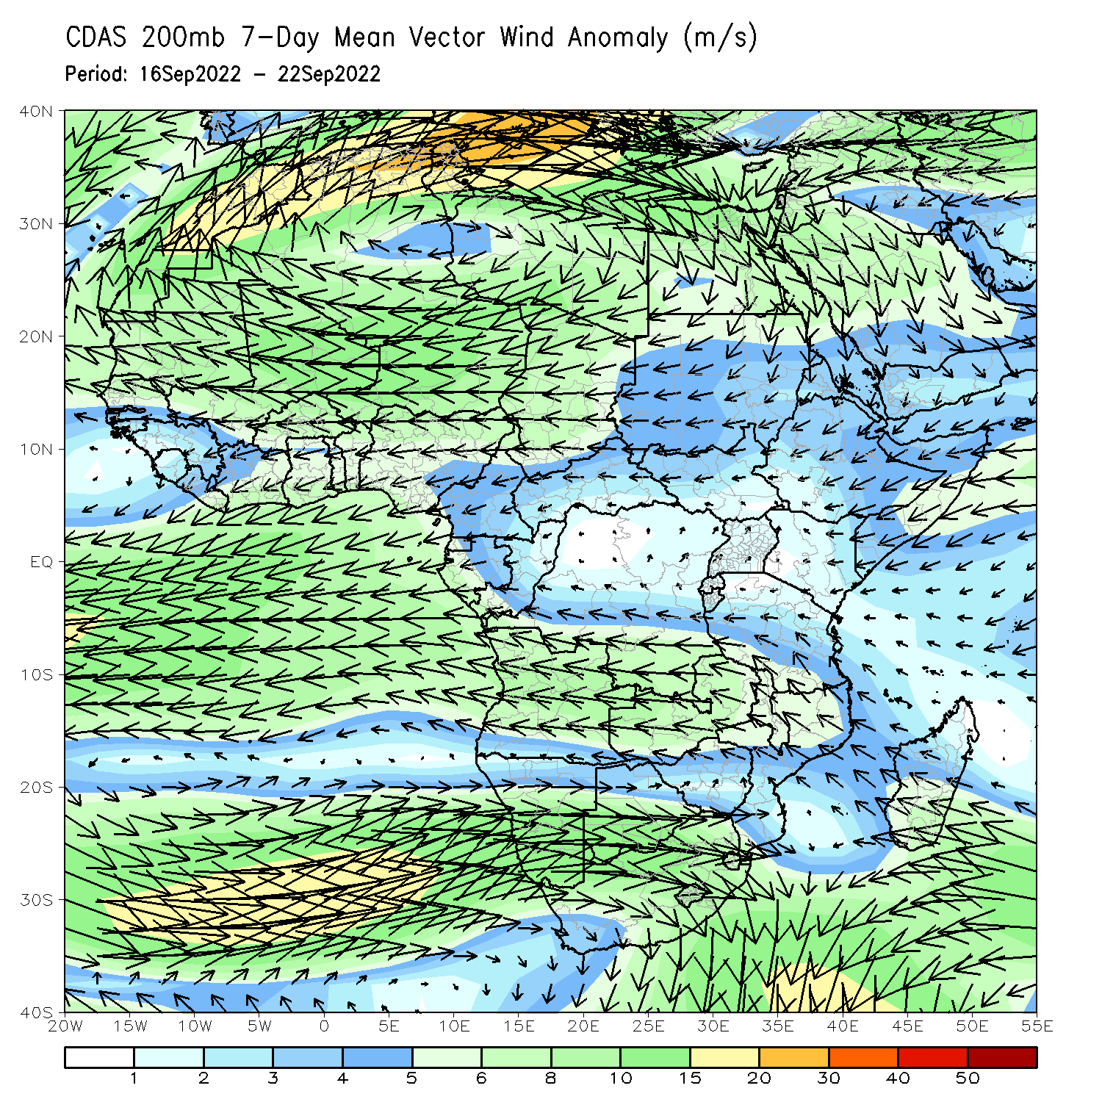
Atmospheric Circulation: Last 7 Days
At 700-hPa level (left panel), anomalous westerly flow was observed across much of the Sahel region and Gulf of Guinea regions .

Slide 8
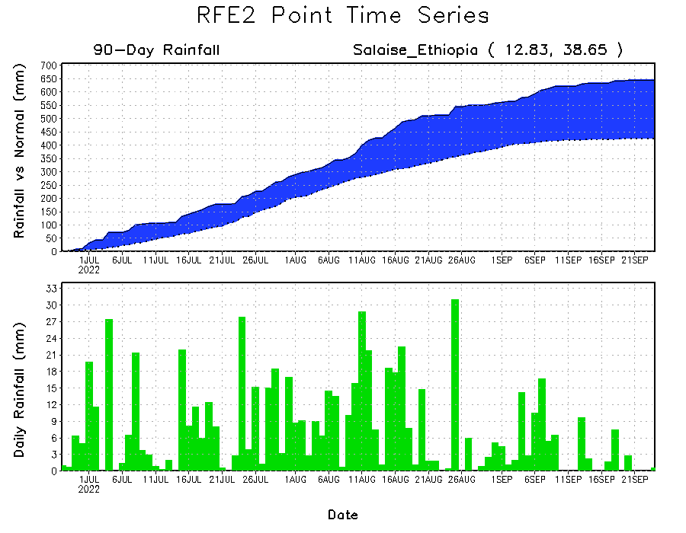
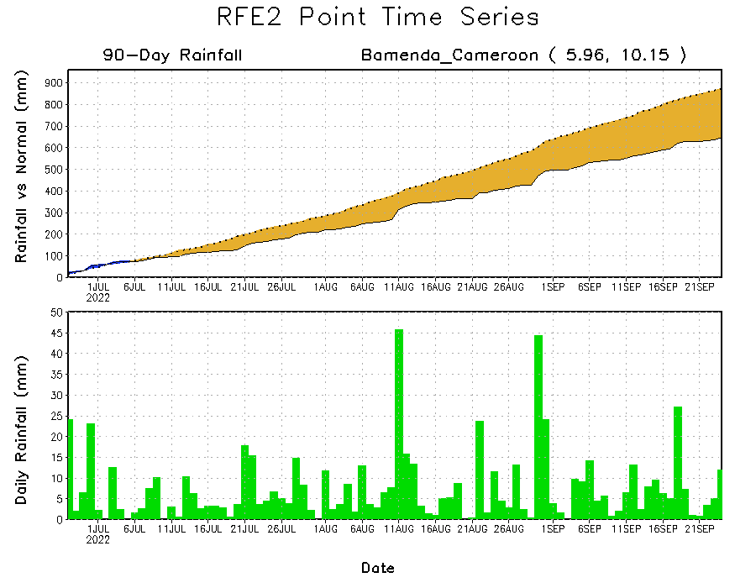
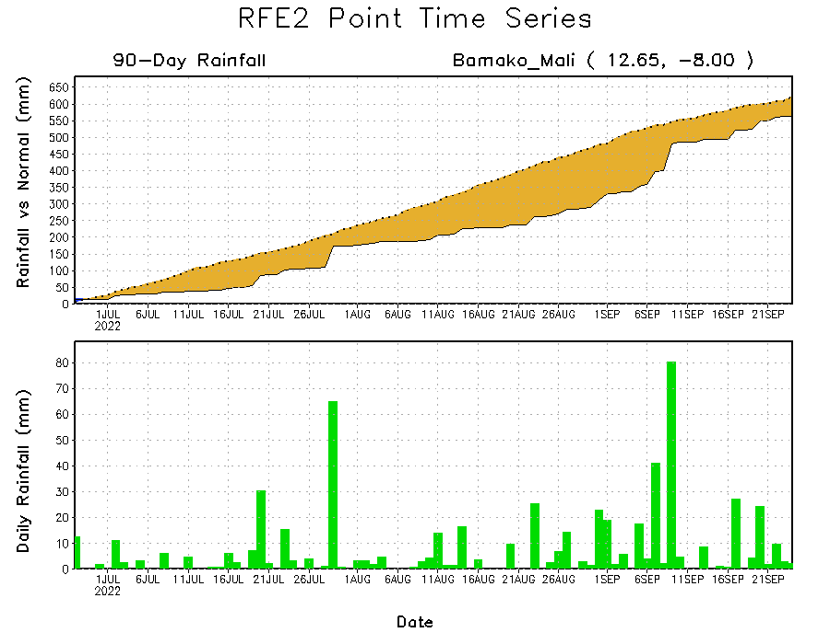
Rainfall Evolution
Daily evolution of rainfall over the last 90 days at selected locations shows increasing moisture deficits over parts of southern Mali (bottom left) and western Cameroon (bottom right). Consistent heavy rains have kept significant moisture surpluses over parts of northern Ethiopia (top right).

Slide 9
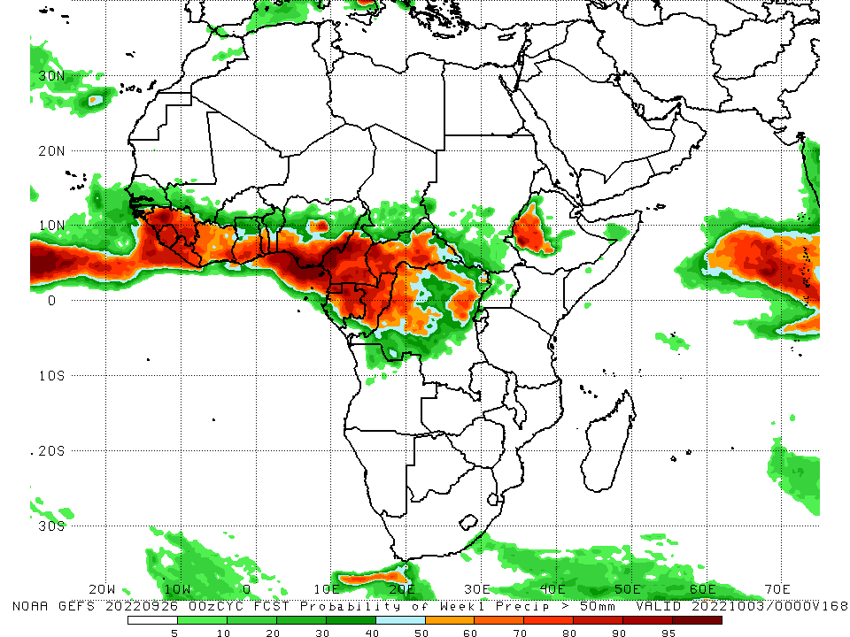
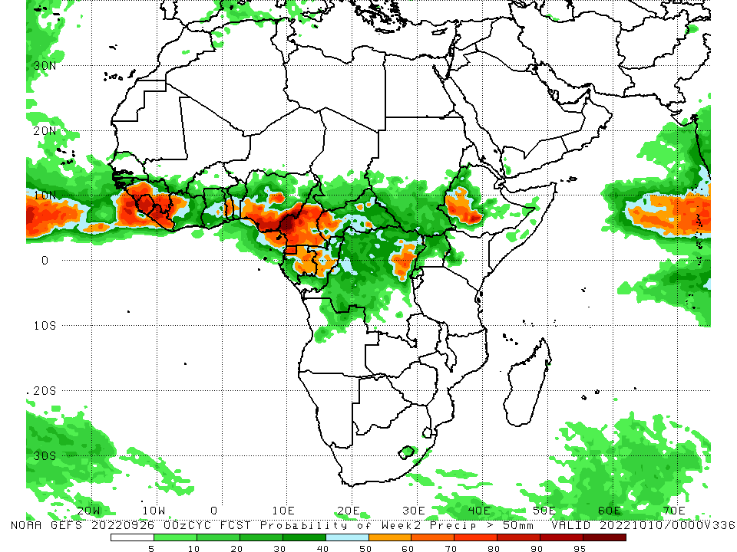
NCEP GEFS Model Forecasts Non-Bias Corrected Probability of precipitation exceedance
Week-1, Valid: 27 Sep – 03 October, 2022
Week-2, Valid: 04 – 10 October, 2022
For week-1 (left panel) the NCEP GEFS indicates a moderate to high chance (over 70%) for rainfall to exceed 50 mm over much of Guinea, Sierra Leone, Liberia, western and southern Cote D’Ivoire, southern parts of Ghana, Togo, Benin, southern Nigeria, central, western and southern Cameroon, Equatorial Guinea, central and northern parts of Gabon and Congo, western and central CAR, pockets of eastern DRC and western Ethiopia. For week-2 (right panel), NCEP GEFS indicates a moderate to high chance (over 70%) for rainfall to exceed 50 mm over western and southern Guinea, Sierra Leone, Liberia, southeast Nigeria, western, southern and western Cameroon, Equatorial Guinea, northern parts of Gabon, and western Ethiopia.
Notes:
9

Slide 10
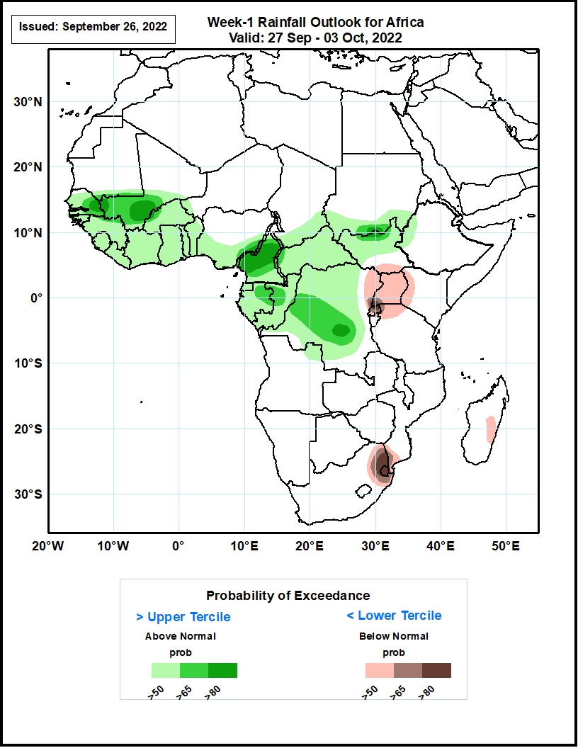
Week-1 Precipitation Outlooks
27 Sep - 03 October, 2022
The consolidated probabilistic forecasts suggest above 50% chance for weekly rainfall to be below-normal (below the lower tercile) over northeastern DR Congo, much of Uganda, western Kenya, southern South Sudan, northern Tanzania, and eastern Madagascar. In particular, there is above 80% chance for weekly rainfall to be below normal over southwestern Uganda and much of Eswatini.
The forecast suggests above 50% chance for weekly total rainfall to be above-normal (above the upper tercile) over much of Senegal, Guinea, Sierra Leone, Liberia, Cote d’Ivoire, Ghana, Togo, Benin, CAR, Equatorial Guinea, Gabon and Congo, southern Nigeria and Chad. In particular, there is above 80% chance for rainfall to be above-normal over eastern Senegal, southern Mali, much of Cameroon, southern DR Congo, southern Sudan and northern South Sudan.
Notes:
10

Slide 11
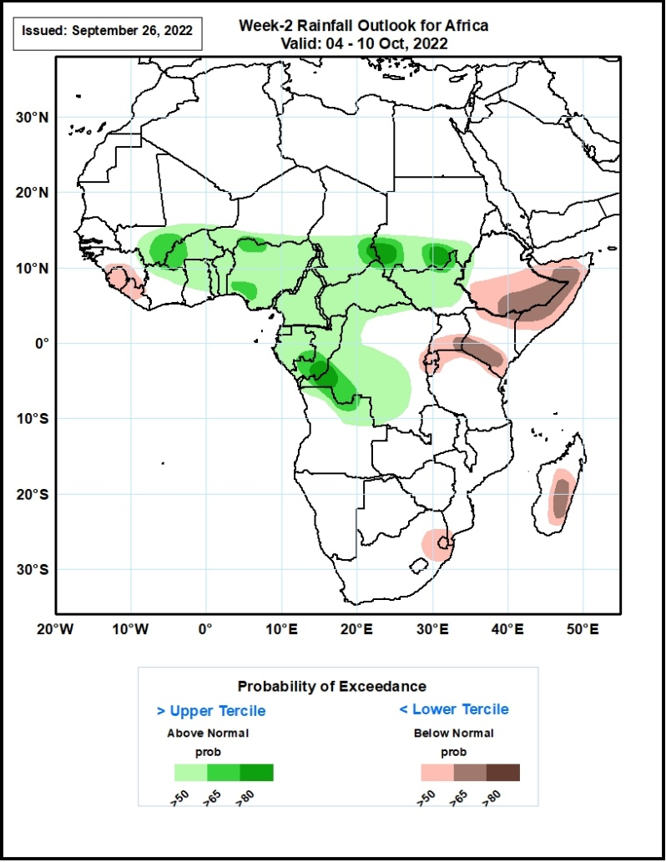
Week-2 Precipitation Outlooks
04 - 10 October, 2022
The consolidated probabilistic forecasts suggest above 50% chance for weekly rainfall to be below-normal (below the lower tercile) over much of Sierra Leone, southern Guinea, western Liberia, southern Uganda, northeastern South Africa and much of Eswatini. In particular, there is above 65% chance for rainfall to be below-normal over southern Ethiopia, much of Somalia, southern Kenya, southeastern Uganda, and central portions of Madagascar.
The forecast suggests above 50% chance for weekly total rainfall to be above-normal (above the upper tercile) over southern Mali, much of Burkina Faso, Nigeria, Cameroon, CAR, South Sudan, Equatorial Guinea, and Congo. In particular, there is above 80% chance for rainfall to be above-normal over southern Sudan, southeastern Chad, southeastern Congo and western portions of DR Congo.
Notes:
11

Slide 12
Summary
During the past 30 days, in East Africa, above-average rainfall was observed over southern, central, and eastern Sudan, South Sudan, Eritrea, Djibouti, Uganda, western and northern Ethiopia, pockets of western Kenya, Rwanda, Burundi, and pockets of northwest Tanzania. Rainfall was below-average over pockets of central Ethiopia and northern Somalia. In southern Africa, below-average rainfall was observed over pockets of northeast South Africa, northern Lesotho, and pockets of central Madagascar. Rainfall was above-average over pockets of southeast South Africa, southern Mozambique and northern Madagascar. In Central Africa, rainfall was above-average over parts of northern Cameroon, much of CAR, western, central and eastern parts of Chad, pockets of western, southern, and northeast DRC, eastern Gabon, and central and northern Congo. Rainfall was below-average over Equatorial Guinea, western and northern Gabon, western Cameroon, and pockets of central DRC. In West Africa, rainfall was above-average over southern Mauritania, Senegal, Gambia, Guinea-Bissau, Guinea, Sierra Leone, Liberia, much of Cote D’Ivoire, parts western and northern Ghana, much of Togo and Benin, Burkina Faso, parts of western and southern Mali, southern Niger, and northern and western Nigeria. In contrast, pockets of northern and eastern Mauritania, eastern Mali and parts of central and southeast Nigeria received below-average rainfall.
During the past 7 days, in East Africa, rainfall was above-average over south Sudan, northeast parts of South Sudan, northwest and northern Ethiopia, pockets of central Eritrea, and pockets of southern Uganda. Below-average rainfall was observed over pockets of southwest Ethiopia, northern Uganda, and pockets of southern South Sudan and southwest Kenya. In Central Africa, rainfall was above-average over western and northern CAR, central and southern Chad, pockets of western and southern DRC, central Congo, eastern Gabon, and northeast Angola. Below-average rainfall was observed over pockets of western and central Cameroon, western Gabon, Equatorial Guinea, southeast CAR, pockets of northwest and central DRC and pockets of northern Angola. In southern Africa, above-average rainfall was observed over eastern South Africa, Lesotho, Swaziland, southern Mozambique, and northeast Madagascar. In West Africa, above-average rainfall was observed over Senegal, Gambia, Guinea Bissau, much of Guinea, southern Mauritania, southern and central Mali, central Liberia, central and northern Cote D’Ivoire, Ghana, Burkina Faso, pockets of central and northern Togo and Benin, pockets of southern Niger, and western and southwest Nigeria. In contrast, parts of Sierra Leone, eastern Liberia, southern Cote D’Ivoire, and southeast and central Nigeria received below-average rainfall.
Week-1 outlook calls for an increased chance for above-average rainfall across much of the Sahel regions and Gulf Guinea coast, Southern Chad, CAR, western and northern DRC, parts of southern Sudan and western South Sudan, and northwest Ethiopia. In contrast, there is an increased chance for below-average rainfall over pockets of southern and southeast DRC, eastern South Sudan, Uganda, Rwanda, Burundi, eastern Ethiopia, central and northeast South Africa, Lesotho, Swaziland, and central Madagascar. Week-2 outlook suggests an increased chance for above-average rainfall over Guinea Bissau, Guinea, southern Mai, much of Burkina Faso, northern parts of Cote D’Ivoire and Ghana, Togo, Benin, Nigeria, southern Chad, northern Cameroon, CAR, northern Congo, northern DRC, northeast Angola, South Sudan, southern Sudan, northern Uganda, and western Ethiopia, while below-average rainfall is likely along central Senegal, Liberia, southern Cote D’Ivoire, southern Cameroon, Equatorial Guinea, northern Gabon, central and southern DRC, Rwanda, Burundi, eastern Ethiopia, central and northern Somalia, northwest and northeast Kenya, parts of central and northeast South Africa, Swaziland, and central Madagascar.

