Slide 1
The African Monsoon Recent Evolution and Current Status Include Week-1 and Week-2 Outlooks
Update prepared by
14 November 2022
For more information, visit:
http://www.cpc.ncep.noaa.gov/products/Global_Monsoons/African_Monsoons/precip_monitoring.shtml

Slide 2
Outline
Highlights
Recent Evolution and Current Conditions
NCEP GEFS Forecasts
Summary

Slide 3
Highlights: Last 7 Days
During the past 7 days, in East Africa, rainfall was above-average over pockets of western Tanzania and southern Uganda. Below-average rainfall was observed over southern Ethiopia, much of South Sudan, Kenya, southern Somalia, Uganda and eastern Tanzania. In Central Africa, rainfall was above-average over southeastern Cameroon, Equatorial Guinea, eastern Gabon, southern and northern Congo, and pockets of northern and southeastern DRC. Below-average rainfall was observed over western and central Gabon, western and central Cameroon, CAR, and many parts of DRC. In West Africa, above-average rainfall was observed over pockets of Cote d’Ivoire and Ghana. Rainfall was below-average over southeastern Nigeria. In southern Africa, rainfall was above-average over Zambia, Malawi, Botswana, Zimbabwe, central and eastern South Africa, Lesotho, Eswatini, southern Mozambique, and southwestern Madagascar. In contrast, rainfall was below average in western Angola and northern Madagascar.
Week-1 outlooks call for an increased chance for below-normal rainfall over portions of southern Cameroon and Gabon, southwestern CAR, northern and southern Congo, northwestern and western DR Congo, western and central parts of Angola and eastern coast of Tanzania. In contrast, there is an increased chance for above-normal rainfall over central and eastern parts of DR Congo, much of Uganda, Rwanda and Burundi, western Kenya, southwestern Ethiopia, western Tanzania, eastern Angola, much of Zambia, Botswana and Zimbabwe, central and northeastern portions of South Africa, southern Mozambique, western and central parts of Madagascar. Week-2 outlooks call for an increased chance for below-normal rainfall over eastern Sierra Leone, much of Liberia, coastal areas of Ghana, Togo, Benin and Nigeria, southeastern Cameroon, southwestern CAR, northern and southern portions of Congo, northwestern and western DR Congo, western Angola and northeastern parts of Madagascar. In contrast, the forecasts call for an increased chance for above-normal rainfall over eastern DR Congo, much of Rwanda and Burundi, eastern and central parts of Tanzania, eastern coast of South Africa, and western parts of Madagascar.

Slide 4
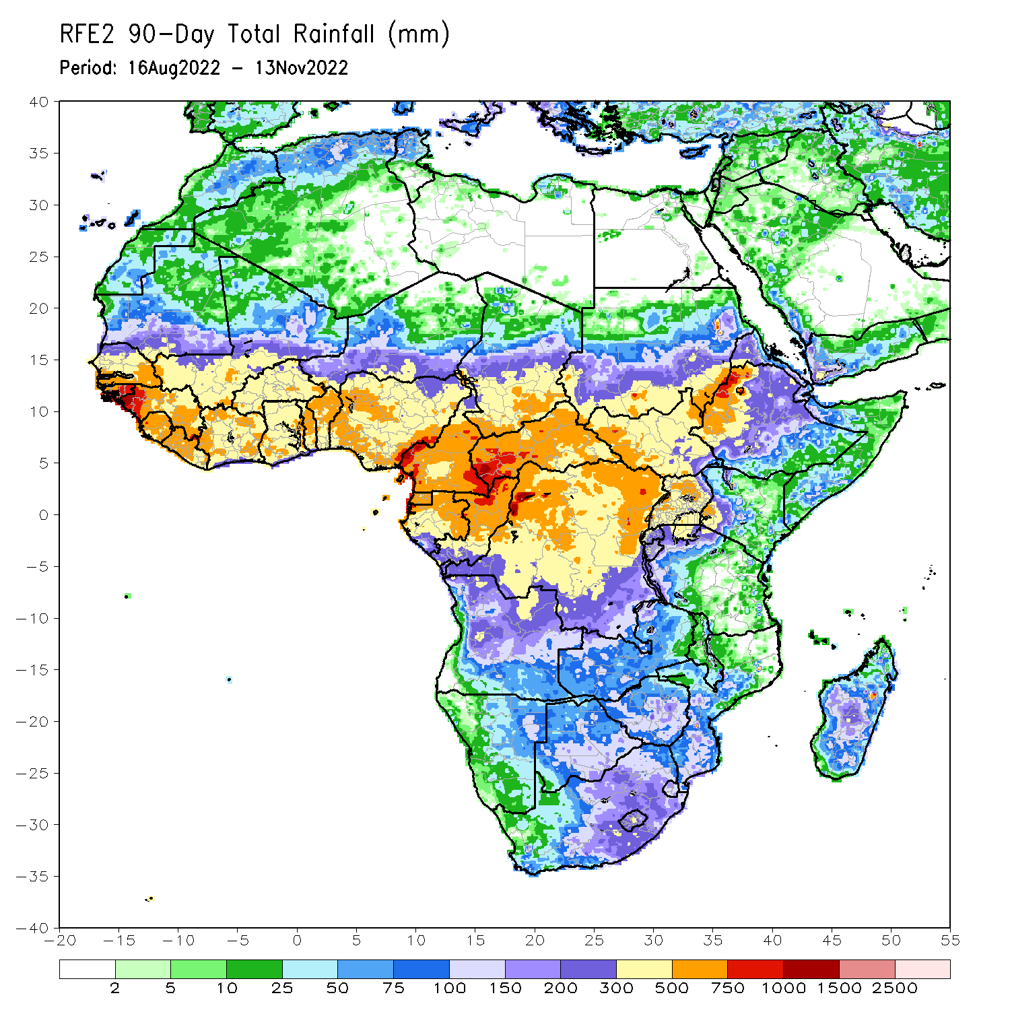
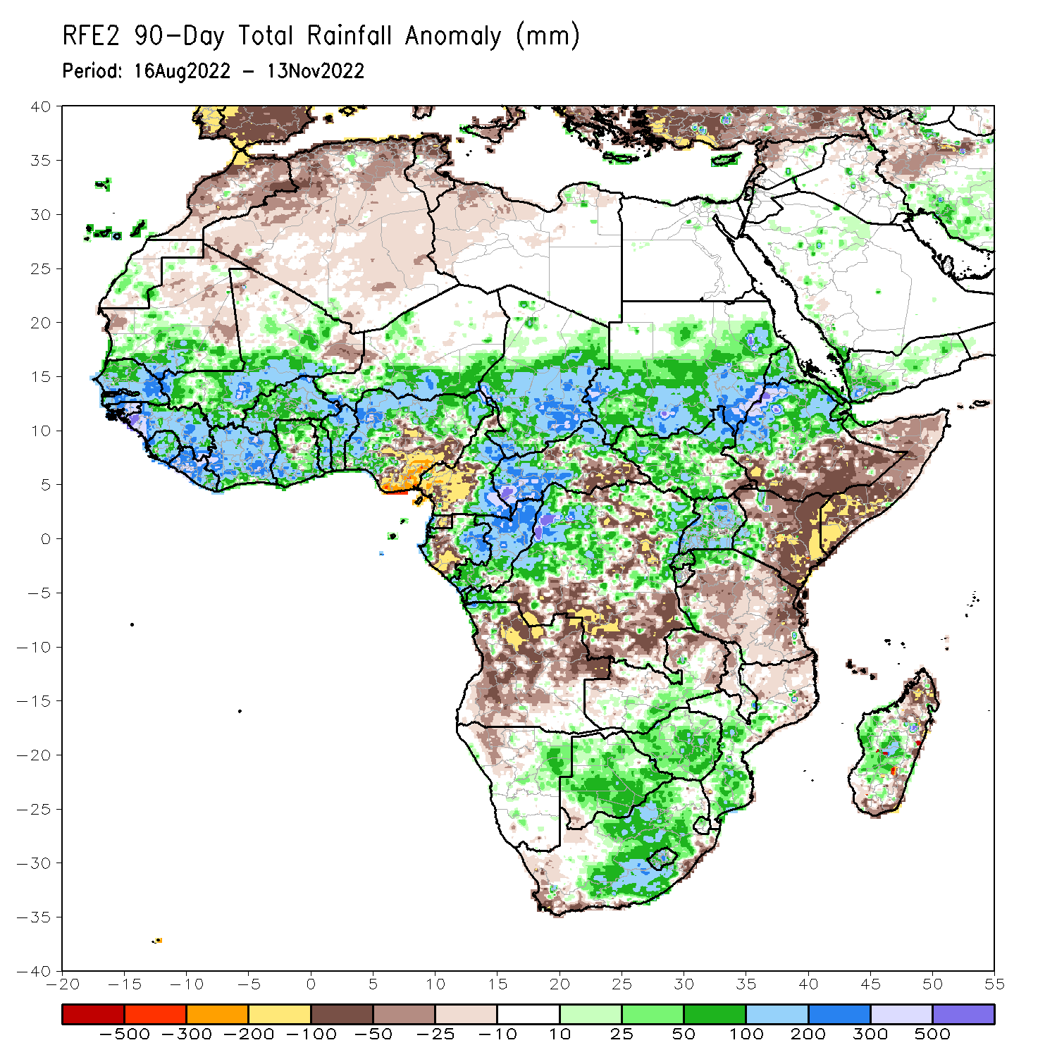
Rainfall Patterns: Last 90 Days
Over the past 90 days, in East Africa, above-average rainfall was observed over the southern and central parts of Sudan, much of South Sudan, central and northern Ethiopia, Eritrea, Djibouti, Uganda, Rwanda, Burundi, the far northern Tanzania, and western Kenya. Rainfall was below-average over southern and southeastern Ethiopia, throughout much of Somalia, central and eastern Kenya, and many parts of Tanzania. In southern Africa, above-average rainfall was observed over southern Zambia, northwestern Angola, northeastern Namibia, much of Botswana, Zimbabwe, central and eastern South Africa, southern Mozambique, and central and southern Madagascar. Below-average rainfall was observed over many parts of Angola, western Namibia, central and northern Zambia, western South Africa, and northern Mozambique and northern Madagascar. In Central Africa, rainfall was above-average over northern and eastern Cameroon, southern and central Chad, western and northern CAR, eastern Gabon, much of Congo, and central and parts of northern DRC. Rainfall was below-average over western Cameroon, western Gabon, Equatorial Guinea, and portions of eastern and southern DRC. In West Africa, rainfall was above-average over southern Mauritania, Senegal, Gambia, Guinea-Bissau, Guinea, Sierra Leone, Liberia, Cote D’Ivoire, much of Ghana, Togo, Benin, Burkina Faso, eastern and southern portions of Mali, southern Niger, and western and northern Nigeria. In contrast, below-average rainfall was observed over northern Mauritania, pockets of northern Mali, and parts of central and southeastern Nigeria.
Notes:
4

Slide 5
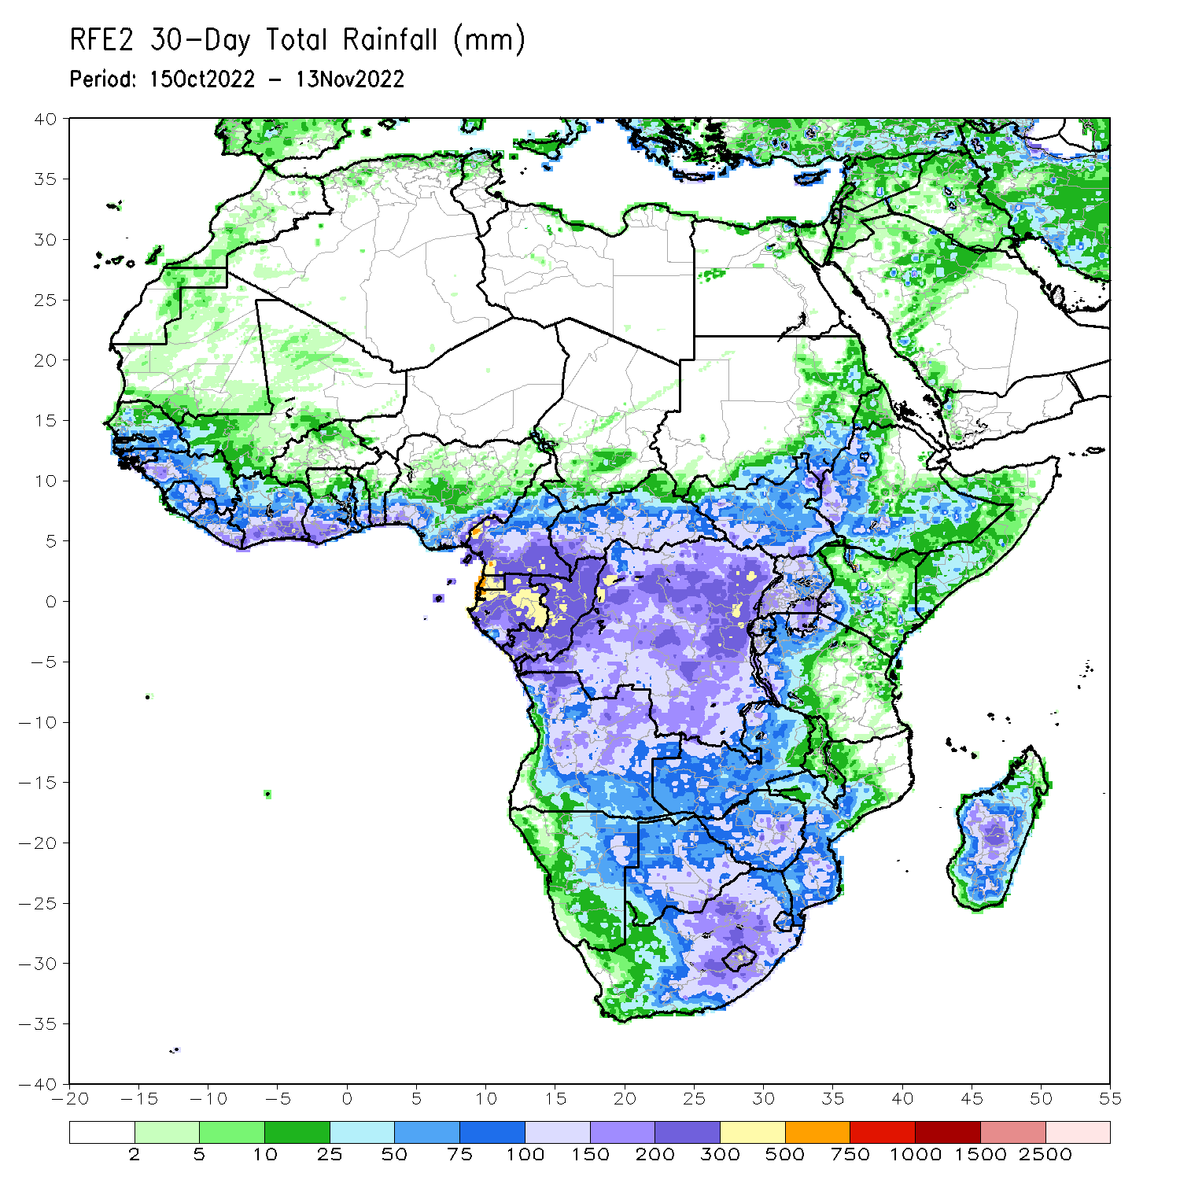
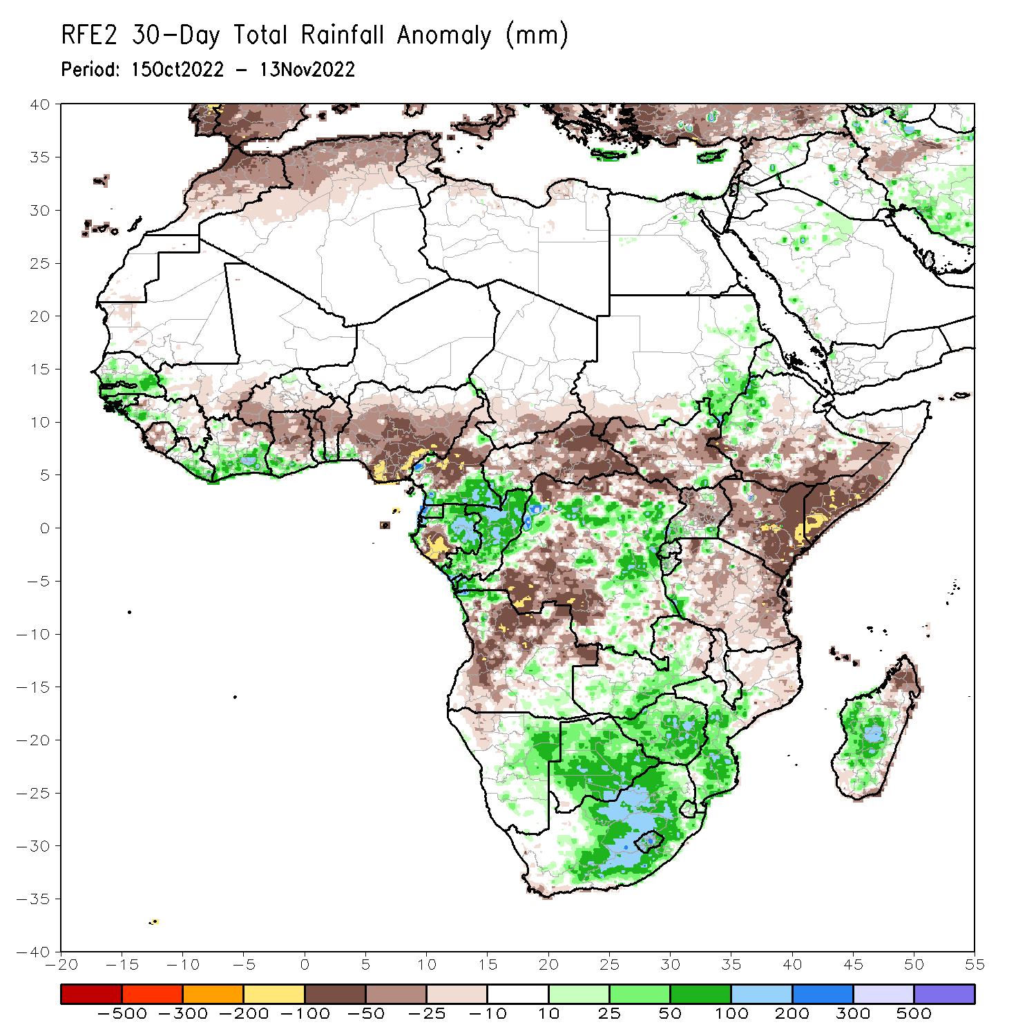
Rainfall Patterns: Last 30 Days
During the past 30 days, in East Africa, above-average rainfall was observed over parts of eastern Sudan and western Ethiopia, and pockets of Uganda. Rainfall was below-average over southern Ethiopia, much of Somalia, Kenya, Tanzania, and many parts of Uganda. In Central Africa, rainfall was above-average over parts of southeastern Cameroon, Equatorial Guinea, central and eastern Gabon, much of Congo, and parts of central and northern DRC. Rainfall was below-average over southwestern Gabon, western and northwestern Cameroon, and the far northern and southwestern DRC. In West Africa, rainfall was above-average over parts of Senegal, Guinea-Bissau, western Guinea, Sierra Leone, Liberia, southern Cote d’Ivoire, and southwestern Ghana. In contrast, southern Mali, central and northern Ghana, Burkina Faso, Togo, Benin, and Nigeria received below-average rainfall. In southern Africa, above-average rainfall was observed over northwestern Angola, eastern Namibia, Botswana, Zimbabwe, South Africa, Lesotho, Eswatini, southern Mozambique, and central Madagascar. Below normal precipitation was observed in central and northern Angola, pockets of northern Zambia, Malawi, northern Mozambique and the far northern Madagascar.
Notes:
5

Slide 6
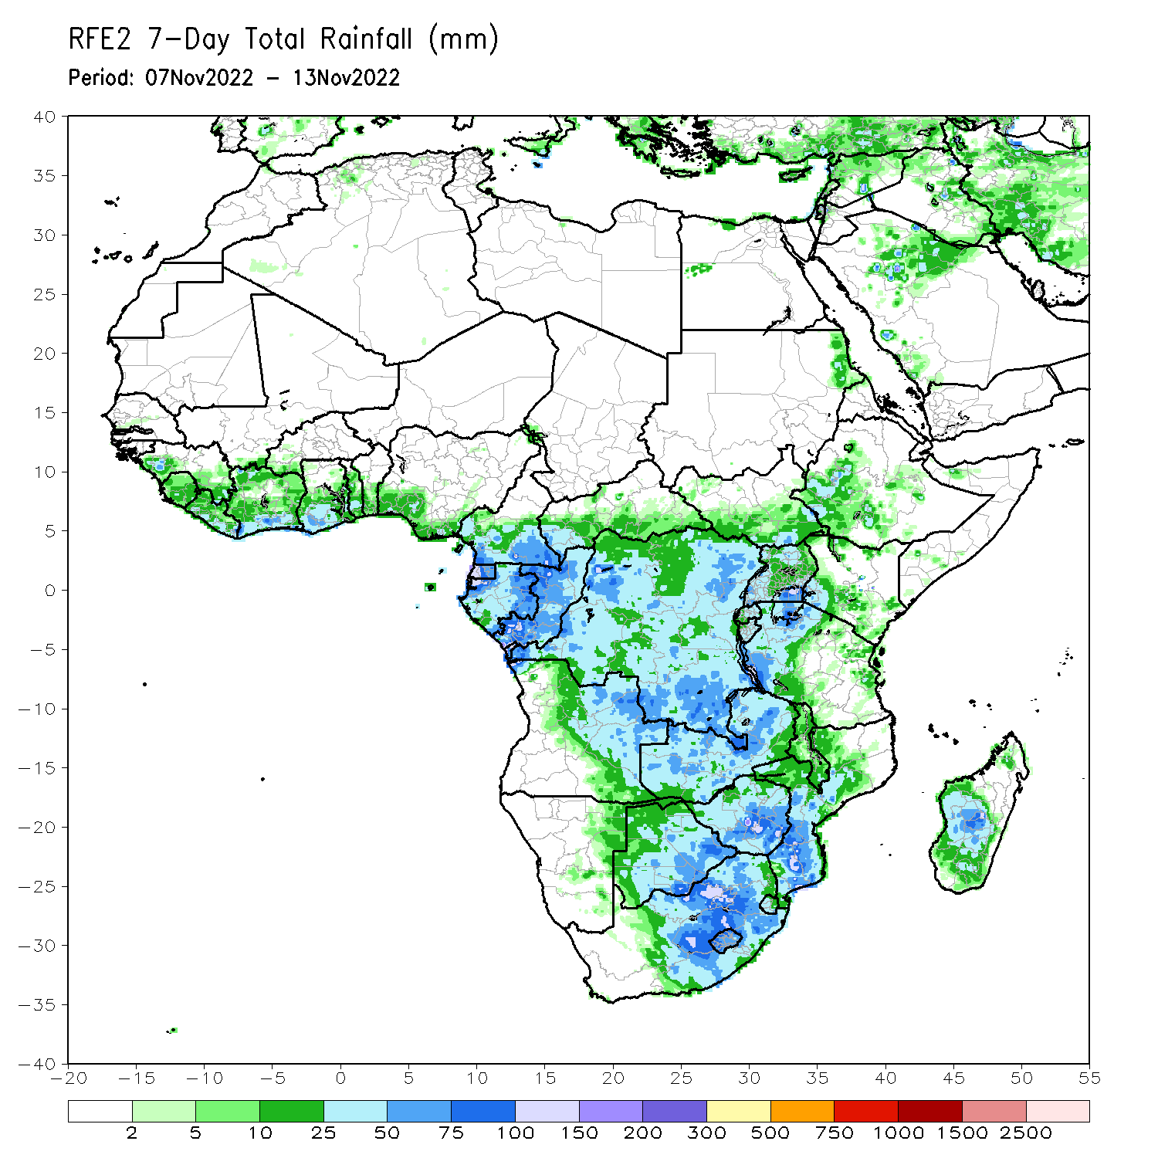
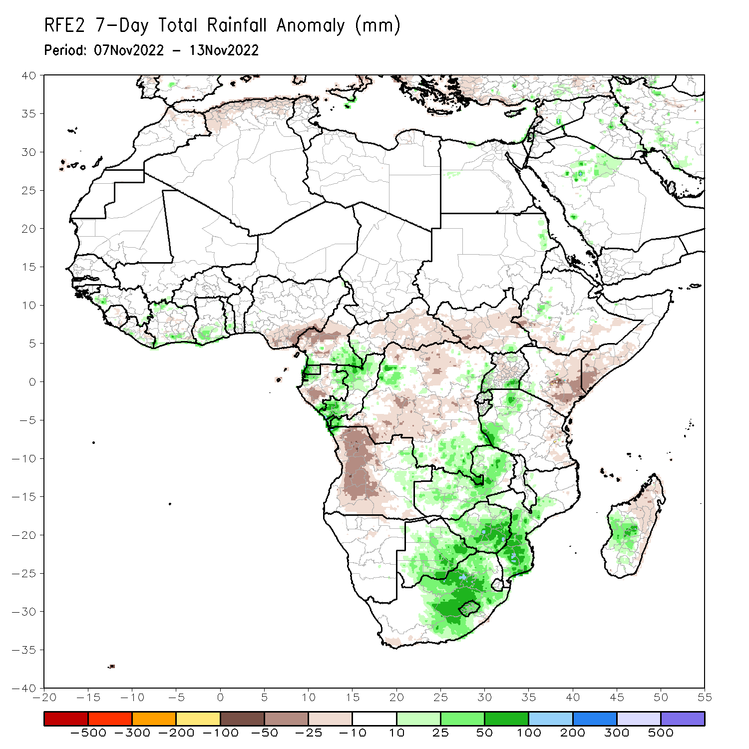
Rainfall Patterns: Last 7 Days
During the past 7 days, in East Africa, rainfall was above-average over pockets of western Tanzania and southern Uganda. Below-average rainfall was observed over southern Ethiopia, much of South Sudan, Kenya, southern Somalia, Uganda and eastern Tanzania. In Central Africa, rainfall was above-average over southeastern Cameroon, Equatorial Guinea, eastern Gabon, southern and northern Congo, and pockets of northern and southeastern DRC. Below-average rainfall was observed over western and central Gabon, western and central Cameroon, CAR, and many parts of DRC. In West Africa, above-average rainfall was observed over pockets of Cote d’Ivoire and Ghana. Rainfall was below-average over southeastern Nigeria. In southern Africa, rainfall was above-average over Zambia, Malawi, Botswana, Zimbabwe, central and eastern South Africa, Lesotho, Eswatini, southern Mozambique, and southwestern Madagascar. In contrast, rainfall was below average in western Angola and northern Madagascar.

Slide 7
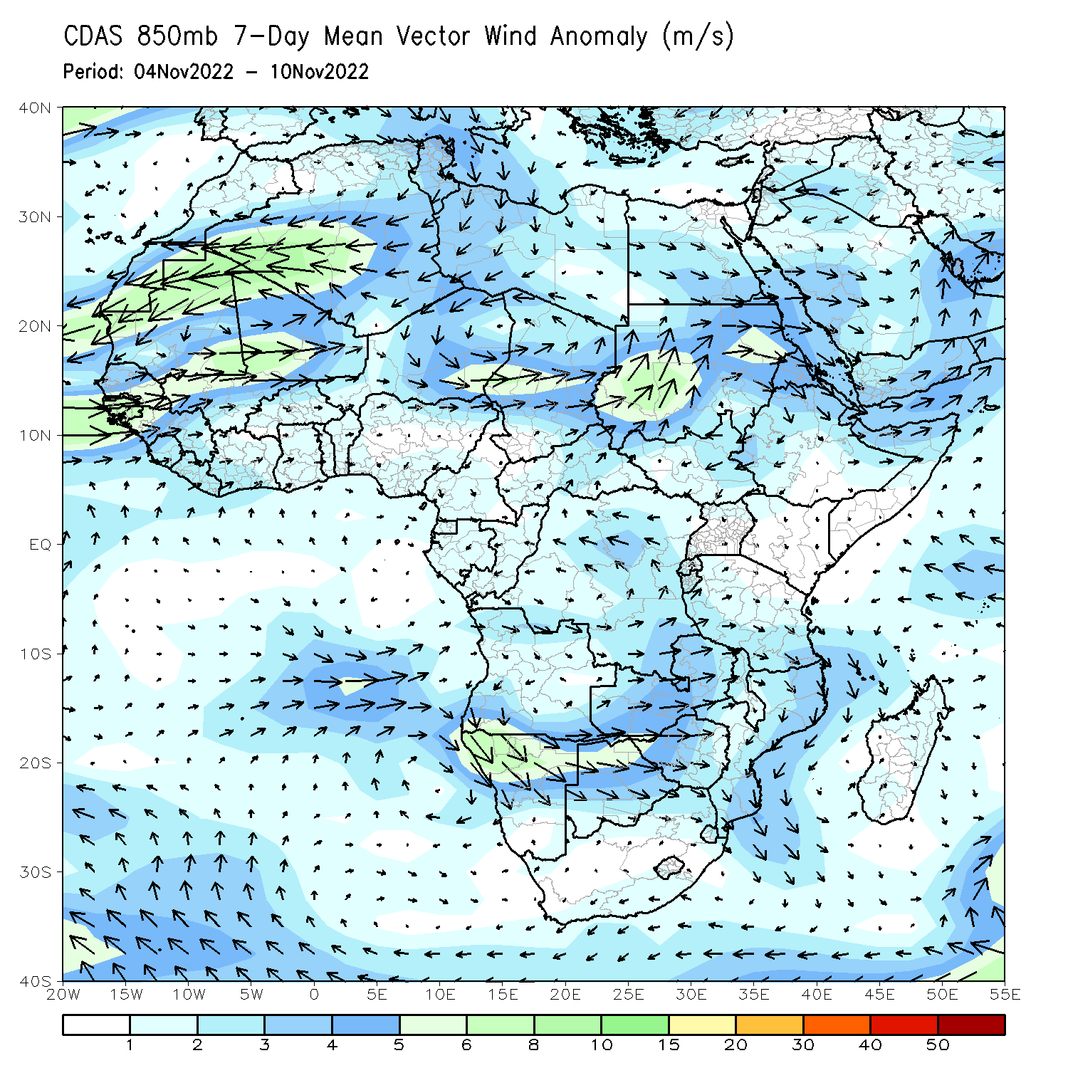
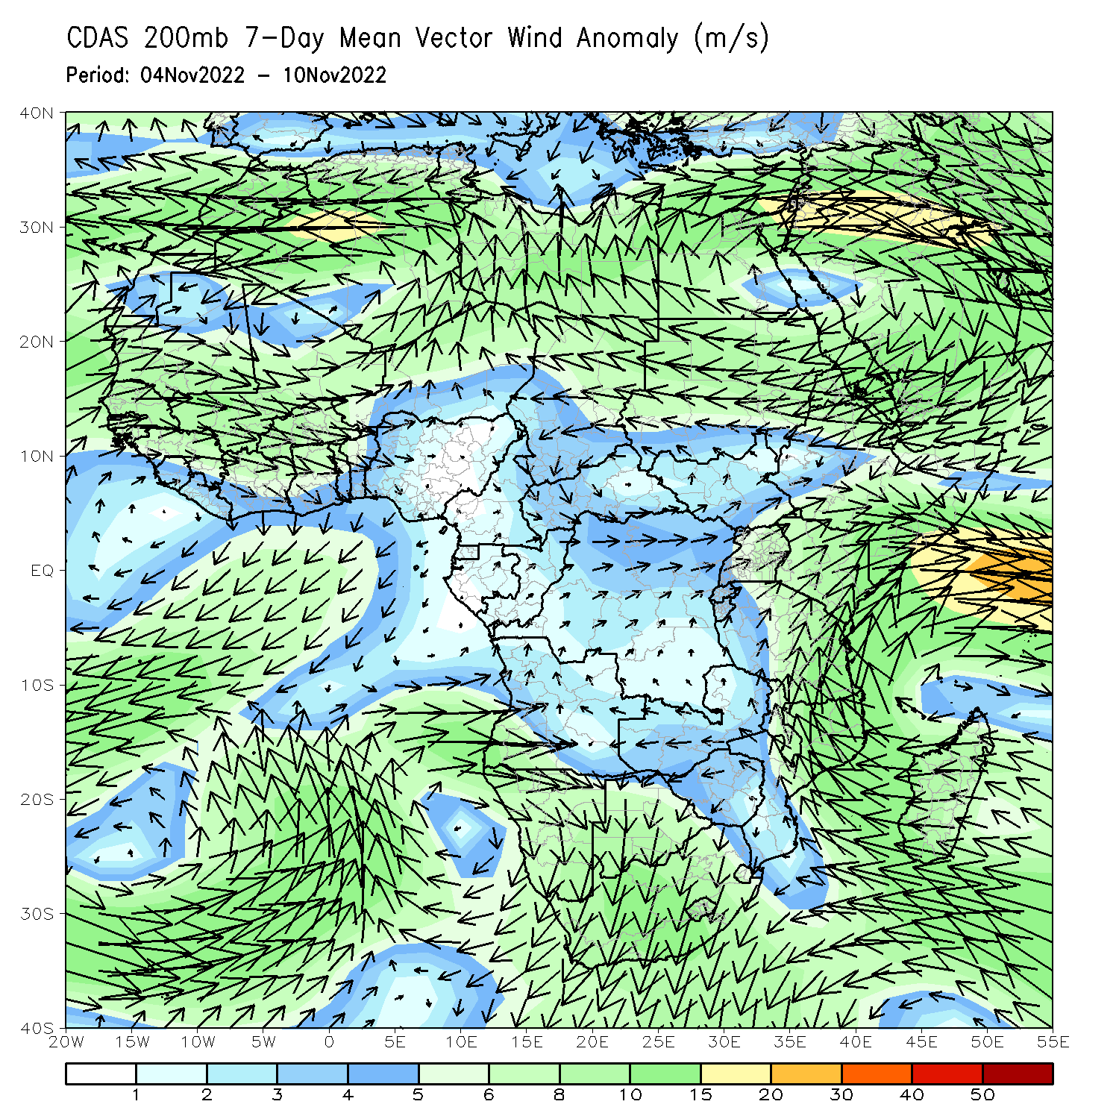
Atmospheric Circulation: Last 7 Days
At 850-hPa level (left panel), anomalous anti-cyclonic shear was observed across Angola and the neighboring areas, while the lower-level circulation anomaly was cyclonic across southeastern Africa.

Slide 8
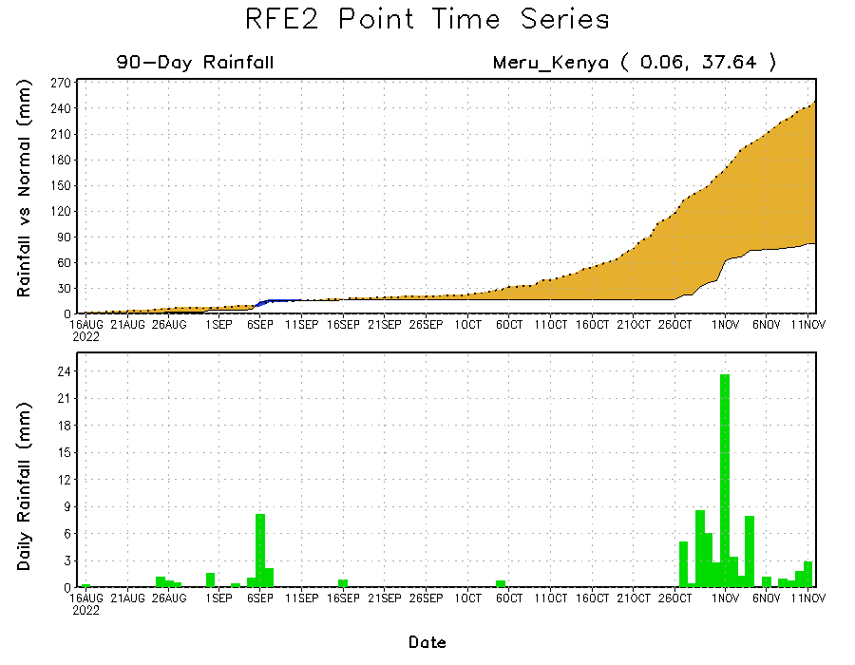
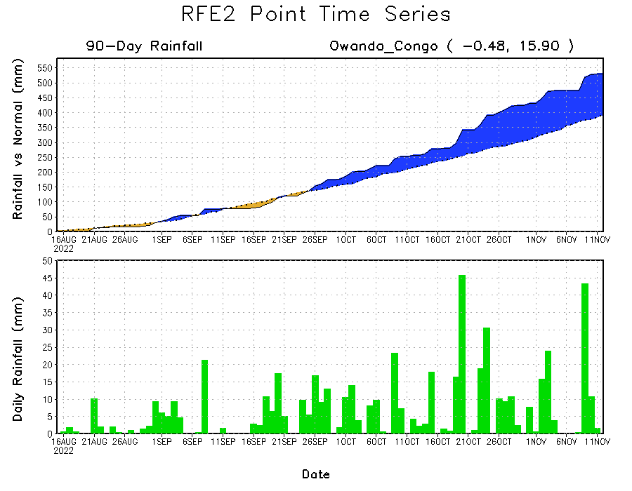
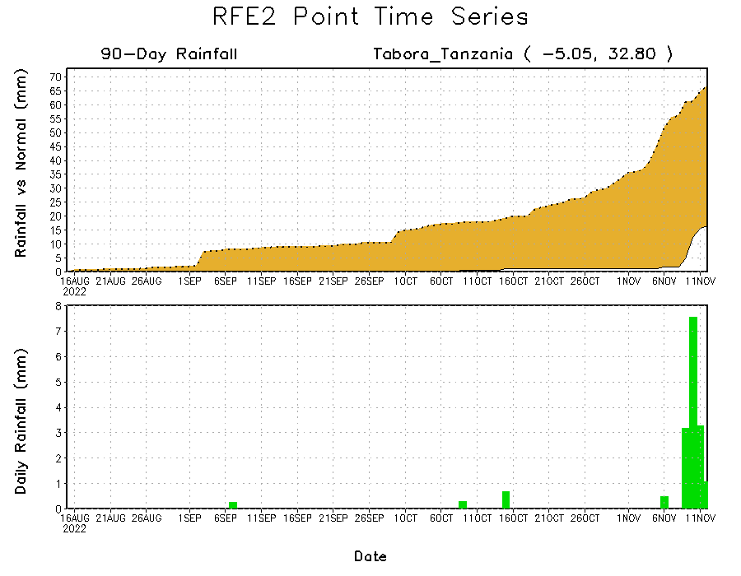
Rainfall Evolution
Daily evolution of rainfall over the last 90 days at selected locations shows continuing moisture surpluses over parts of Congo (bottom left). Rainfall deficits continue in many parts of Kenya (top right) and western Tanzania (bottom right).

Slide 9
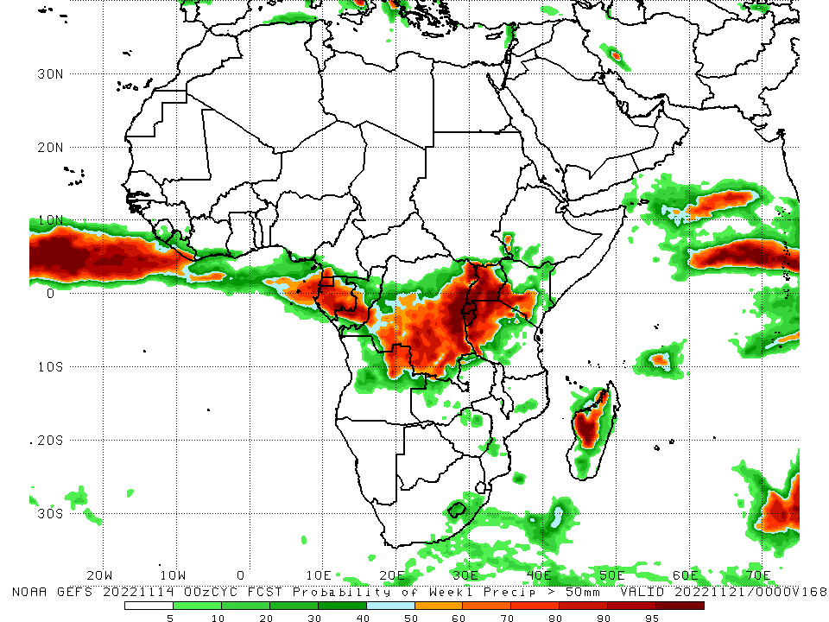
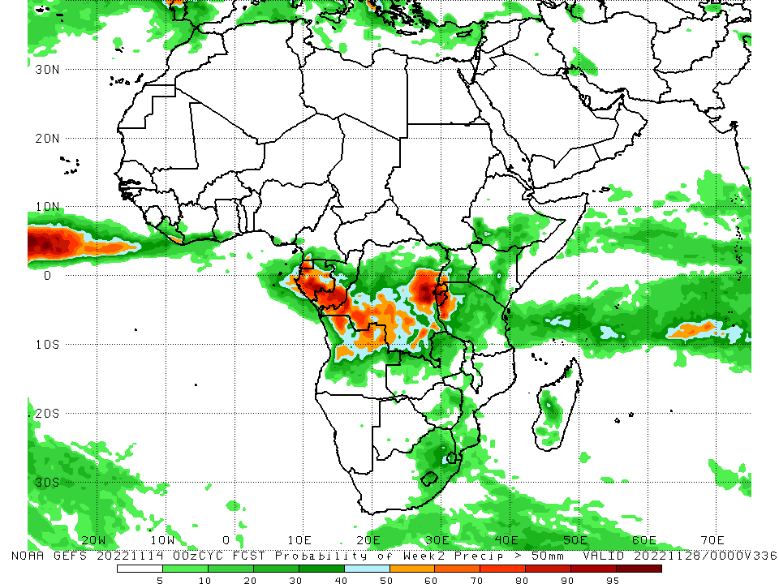
NCEP GEFS Model Forecasts Non-Bias Corrected Probability of precipitation exceedance
Week-1, Valid: 15 – 21 November, 2022
Week-2, Valid: 22 – 28 November, 2022
For week-1 (left panel) and week-2 (right panel), the NCEP GEFS forecasts indicate a moderate to high chance (over 70%) for rainfall to exceed 50 mm over Equatorial Guinea, Gabon, central Congo, many parts of DRC, northern Angola, and the Lake Victoria region.
Notes:
9

Slide 10
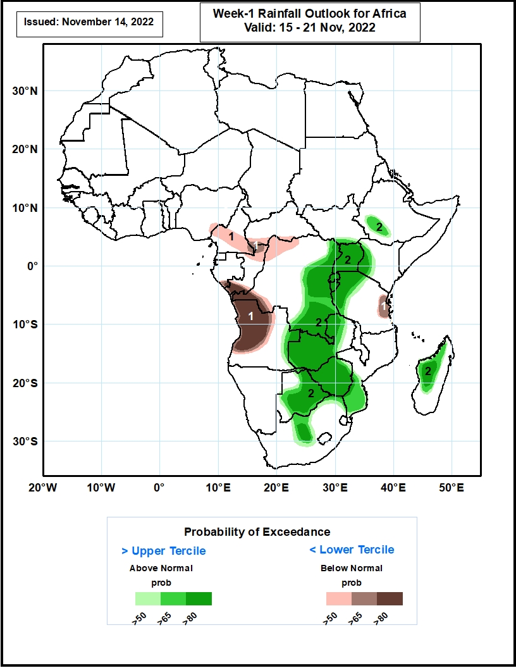
Week-1 Precipitation Outlooks
15 - 21 November, 2022
The consolidated probabilistic forecasts suggest above 50% chance for weekly total rainfall to be below-normal (below the lower tercile) over portions of southern Cameroon and Gabon, southwestern CAR, northern and southern Congo, northwestern and western DR Congo, western and central parts of Angola and eastern coast of Tanzania. In particular, there is above 80% chance for rainfall to be below normal over southern Congo, western DR Congo, western and central parts of Angola.
The forecasts suggest above 50% chance for weekly rainfall to be above-normal (above the upper tercile) over central and eastern parts of DR Congo, much of Uganda, Rwanda and Burundi, western Kenya, southwestern Ethiopia, western Tanzania, eastern Angola, much of Zambia, Botswana and Zimbabwe, central and northeastern portions of South Africa, southern Mozambique, western and central parts of Madagascar. In particular, there is above 80% chance for rainfall to be above-normal over central and eastern parts of DR Congo, much of Uganda, Rwanda and Burundi, southwestern Kenya, western Tanzania, eastern Angola, much of Zambia, Botswana and Zimbabwe, north-central South Africa and western part of Madagascar.
Notes:
10

Slide 11
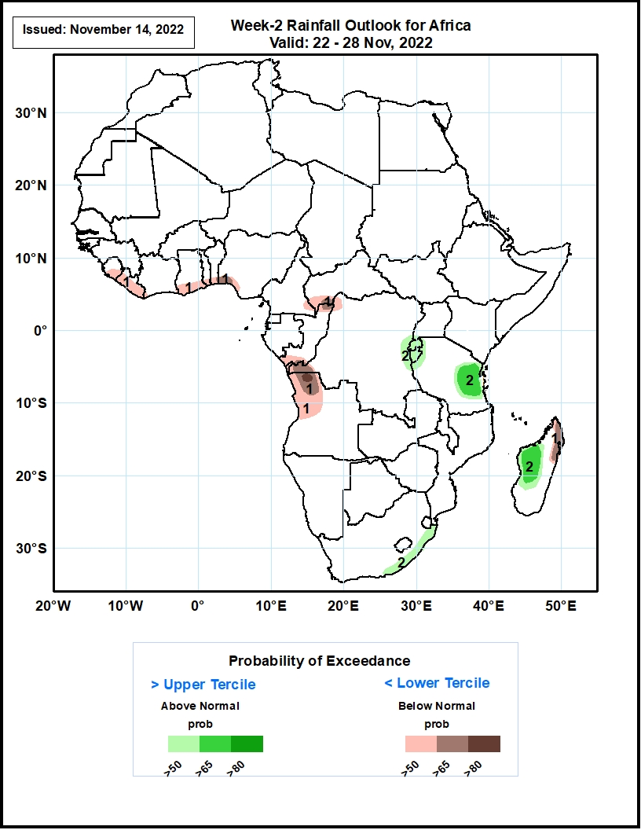
Week-2 Precipitation Outlooks
22 – 28 November, 2022
The consolidated probabilistic forecasts suggest above 50% chance for weekly total rainfall to be below-normal (below the lower tercile) over eastern Sierra Leone, much of Liberia, coastal areas of Ghana, Togo, Benin and Nigeria, southeastern Cameroon, southwestern CAR, northern and southern portions of Congo, northwestern and western DR Congo, western Angola and northeastern parts of Madagascar. In particular, there is above 80% chance for rainfall to be below normal over northwestern parts of Angola.
The forecasts suggest above 50% chance for weekly rainfall to be above-normal (above the upper tercile) over eastern DR Congo, much of Rwanda and Burundi, eastern and central parts of Tanzania, eastern coast of South Africa, and western parts of Madagascar. In particular, there is above 65% chance for rainfall to be above-normal over eastern Tanzania, and western Madagascar.
Notes:
11

Slide 12
Summary
During the past 30 days, in East Africa, above-average rainfall was observed over parts of eastern Sudan and western Ethiopia, and pockets of Uganda. Rainfall was below-average over southern Ethiopia, much of Somalia, Kenya, Tanzania, and many parts of Uganda. In Central Africa, rainfall was above-average over parts of southeastern Cameroon, Equatorial Guinea, central and eastern Gabon, much of Congo, and parts of central and northern DRC. Rainfall was below-average over southwestern Gabon, western and northwestern Cameroon, and the far northern and southwestern DRC. In West Africa, rainfall was above-average over parts of Senegal, Guinea-Bissau, western Guinea, Sierra Leone, Liberia, southern Cote d’Ivoire, and southwestern Ghana. In contrast, southern Mali, central and northern Ghana, Burkina Faso, Togo, Benin, and Nigeria received below-average rainfall. In southern Africa, above-average rainfall was observed over northwestern Angola, eastern Namibia, Botswana, Zimbabwe, South Africa, Lesotho, Eswatini, southern Mozambique, and central Madagascar. Below normal precipitation was observed in central and northern Angola, pockets of northern Zambia, Malawi, northern Mozambique and the far northern Madagascar.
During the past 7 days, in East Africa, rainfall was above-average over pockets of western Tanzania and southern Uganda. Below-average rainfall was observed over southern Ethiopia, much of South Sudan, Kenya, southern Somalia, Uganda and eastern Tanzania. In Central Africa, rainfall was above-average over southeastern Cameroon, Equatorial Guinea, eastern Gabon, southern and northern Congo, and pockets of northern and southeastern DRC. Below-average rainfall was observed over western and central Gabon, western and central Cameroon, CAR, and many parts of DRC. In West Africa, above-average rainfall was observed over pockets of Cote d’Ivoire and Ghana. Rainfall was below-average over southeastern Nigeria. In southern Africa, rainfall was above-average over Zambia, Malawi, Botswana, Zimbabwe, central and eastern South Africa, Lesotho, Eswatini, southern Mozambique, and southwestern Madagascar. In contrast, rainfall was below average in western Angola and northern Madagascar.
Week-1 outlooks call for an increased chance for below-normal rainfall over portions of southern Cameroon and Gabon, southwestern CAR, northern and southern Congo, northwestern and western DR Congo, western and central parts of Angola and eastern coast of Tanzania. In contrast, there is an increased chance for above-normal rainfall over central and eastern parts of DR Congo, much of Uganda, Rwanda and Burundi, western Kenya, southwestern Ethiopia, western Tanzania, eastern Angola, much of Zambia, Botswana and Zimbabwe, central and northeastern portions of South Africa, southern Mozambique, western and central parts of Madagascar. Week-2 outlooks call for an increased chance for below-normal rainfall over eastern Sierra Leone, much of Liberia, coastal areas of Ghana, Togo, Benin and Nigeria, southeastern Cameroon, southwestern CAR, northern and southern portions of Congo, northwestern and western DR Congo, western Angola and northeastern parts of Madagascar. In contrast, the forecasts call for an increased chance for above-normal rainfall over eastern DR Congo, much of Rwanda and Burundi, eastern and central parts of Tanzania, eastern coast of South Africa, and western parts of Madagascar.

