Slide 1
The African Monsoon Recent Evolution and Current Status Include Week-1 and Week-2 Outlooks
Update prepared by
28 November 2022
For more information, visit:
http://www.cpc.ncep.noaa.gov/products/Global_Monsoons/African_Monsoons/precip_monitoring.shtml

Slide 2
Outline
Highlights
Recent Evolution and Current Conditions
NCEP GEFS Forecasts
Summary

Slide 3
Highlights: Last 7 Days
During the past 7 days, in East Africa, rainfall was above-average over pockets of western Ethiopia and Tanzania. Below-average rainfall was observed over parts of southern Ethiopia, Kenya, southern Somalia and parts of Tanzania. In Central Africa, rainfall was above-average over western and eastern Gabon, Congo, and many parts of DRC. Below-average rainfall was observed over parts of Cameroon, Equatorial Guinea, central Gabon, and pockets of eastern and southern DRC. In West Africa, below-average rainfall was observed along the Gulf of Guinea coast. In southern Africa, rainfall was above-average over western Angola, Botswana, eastern South Africa and southern Mozambique. In contrast, rainfall was below-average over eastern Angola, Zambia, Zimbabwe, Malawi, central and northern Mozambique and many parts of Madagascar.
Week-1 outlooks call for an increased chance for above-average rainfall across southern Congo, western and northern Angola, western and northern DRC, and the eastern portion of South Africa, southern Mozambique and southern Madagascar. In contrast, there is an increased chance for below-average rainfall over eastern Angola, western Zambia, and western Madagascar. Week-2 outlooks call for an increased chance for above-average rainfall over western DRC, northern Angola, and the eastern portion of South Africa. In contrast, there is an increased chance for below-average rainfall over central and southern Angola, much of Tanzania, and northern Mozambique.

Slide 4
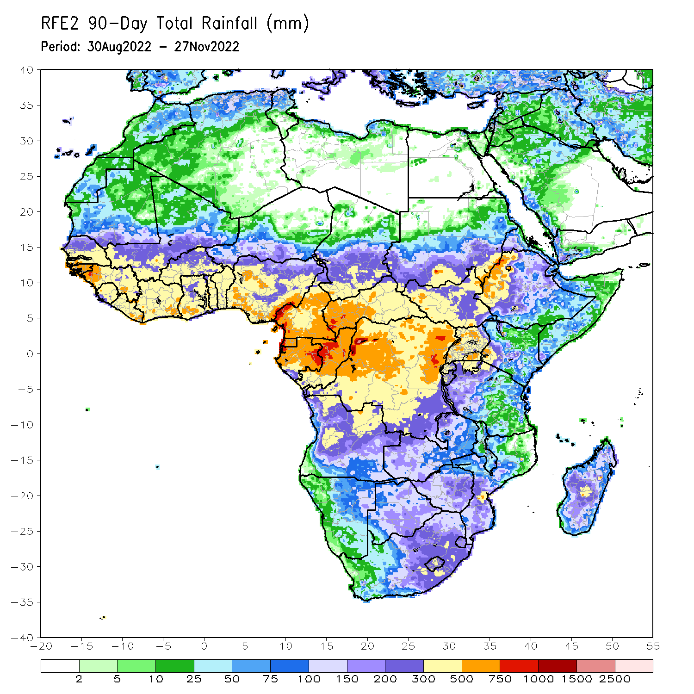
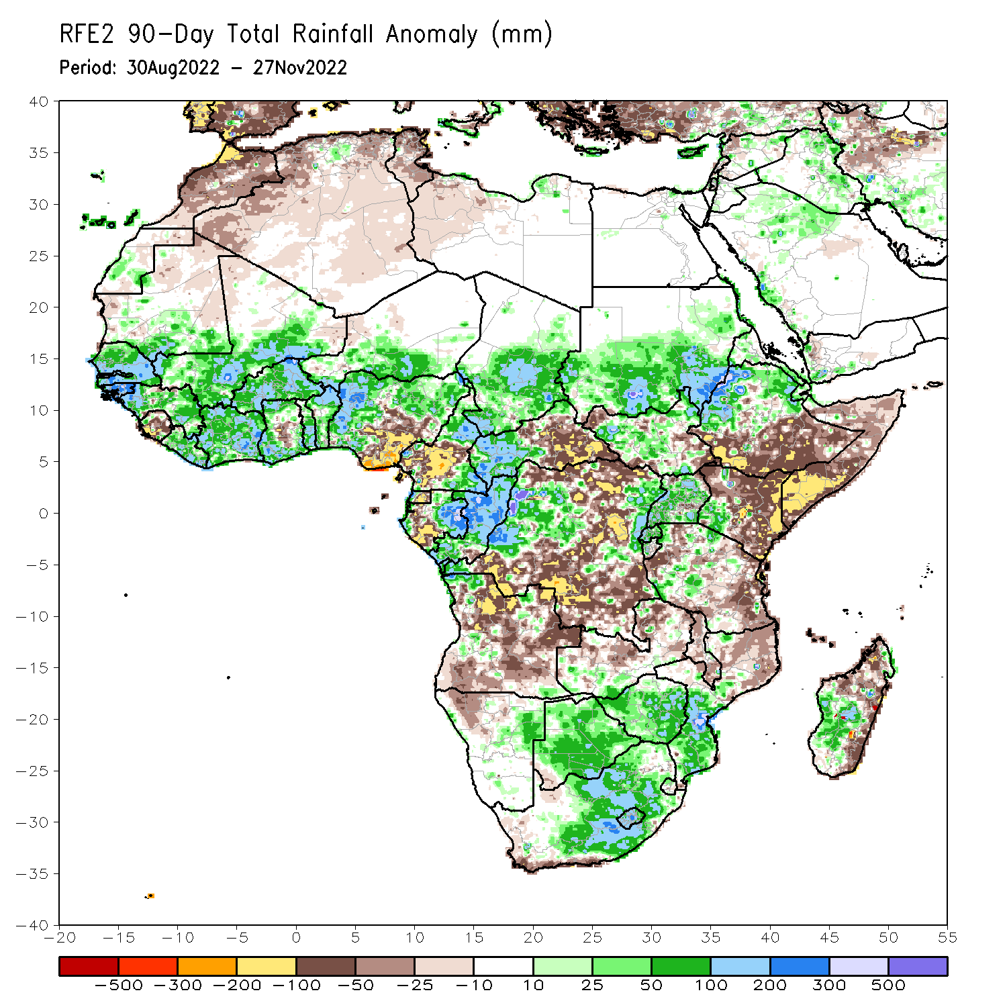
Rainfall Patterns: Last 90 Days
Over the past 90 days, in East Africa, above-average rainfall was observed over the southern and central parts of Sudan, much of South Sudan, central and northern Ethiopia, Eritrea, Djibouti, Uganda, Rwanda, Burundi, pockets of Tanzania, and western Kenya. Rainfall was below-average over southern and southeastern Ethiopia, throughout much of Somalia, central and eastern Kenya, and many parts of Tanzania. In southern Africa, above-average rainfall was observed over pockets of southern Zambia northern northern Angola, northeastern Namibia, much of Botswana, Zimbabwe, central and eastern South Africa, southern Mozambique, and central and western Madagascar. Below-average rainfall was observed over many parts of Angola, western Namibia, central and northern Zambia, western South Africa, and northern Mozambique and northern and the far eastern Madagascar. In Central Africa, rainfall was above-average over northern and eastern Cameroon, southern and central Chad, western CAR, eastern Gabon, much of Congo, and parts of western and eastern DRC. Rainfall was below-average over western Cameroon, western Gabon, Equatorial Guinea, and portions of northern, central and southern DRC. In West Africa, rainfall was above-average over southern Mauritania, Senegal, Gambia, Guinea-Bissau, Guinea, Liberia, Cote D’Ivoire, portions of Ghana, Togo, Benin, Burkina Faso, eastern and southern portions of Mali, southern Niger, and western and northern Nigeria. In contrast, below-average rainfall was observed over northern Mauritania, Sierra Leone, central Ghana, and parts of central and southeastern Nigeria.
Notes:
4

Slide 5
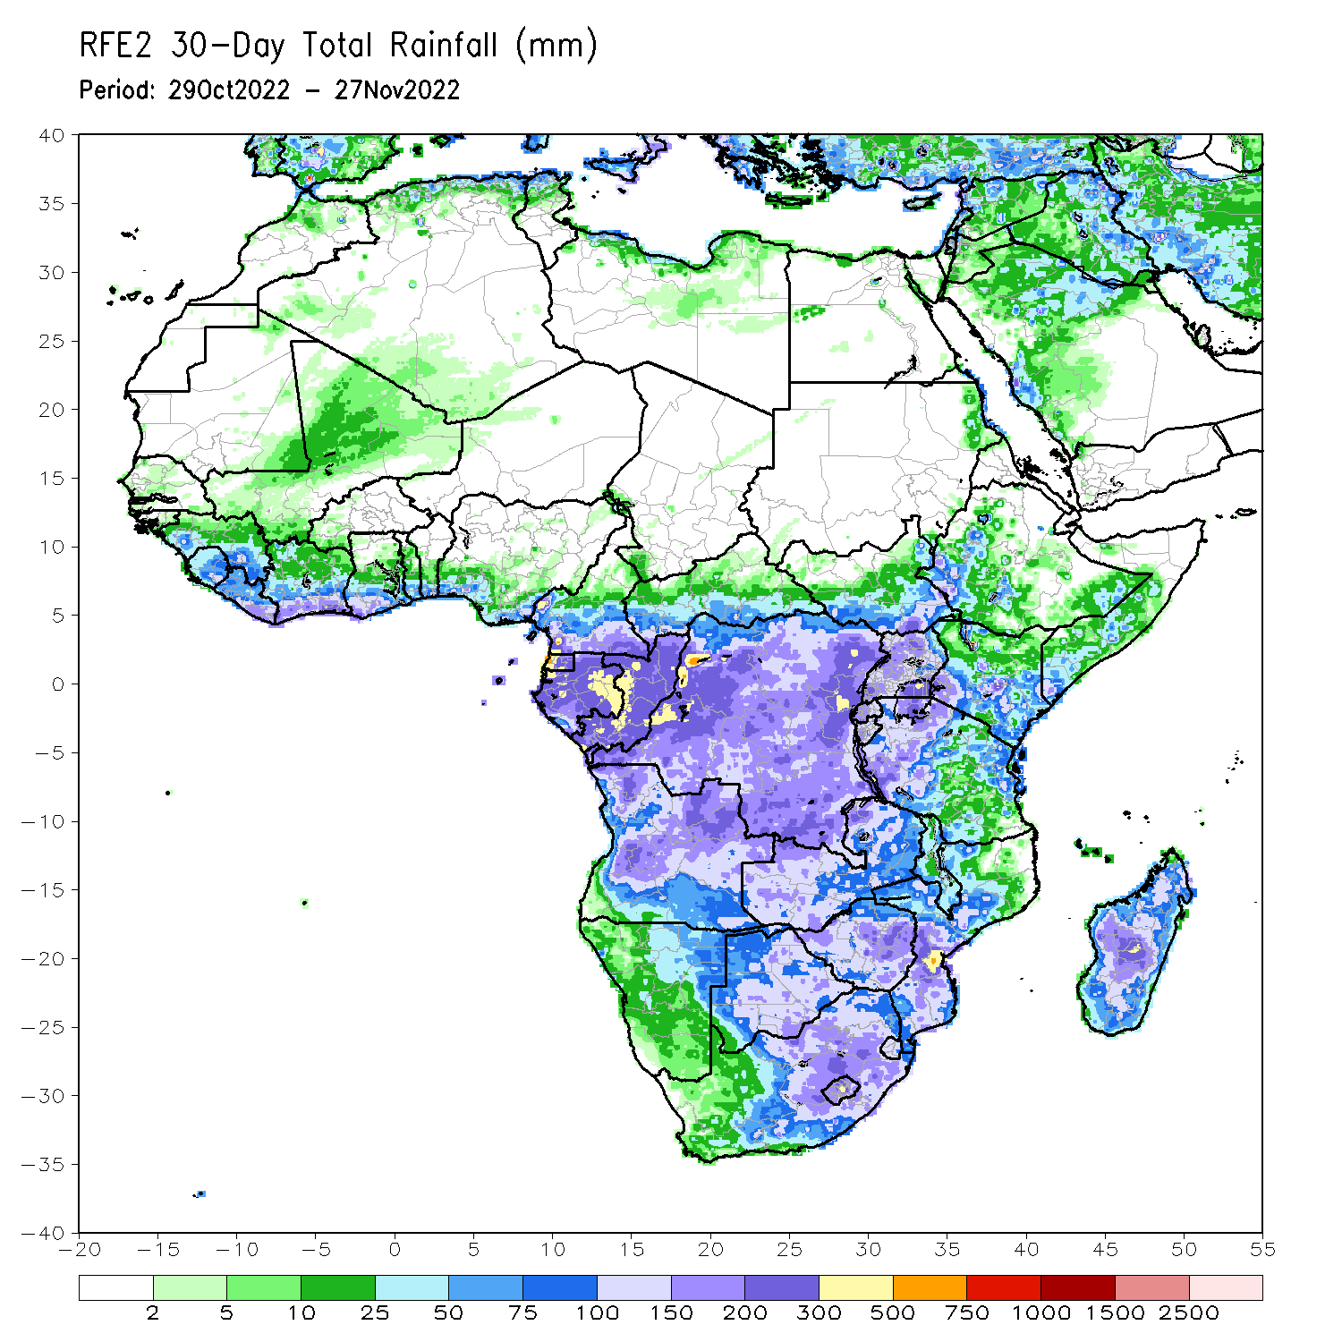
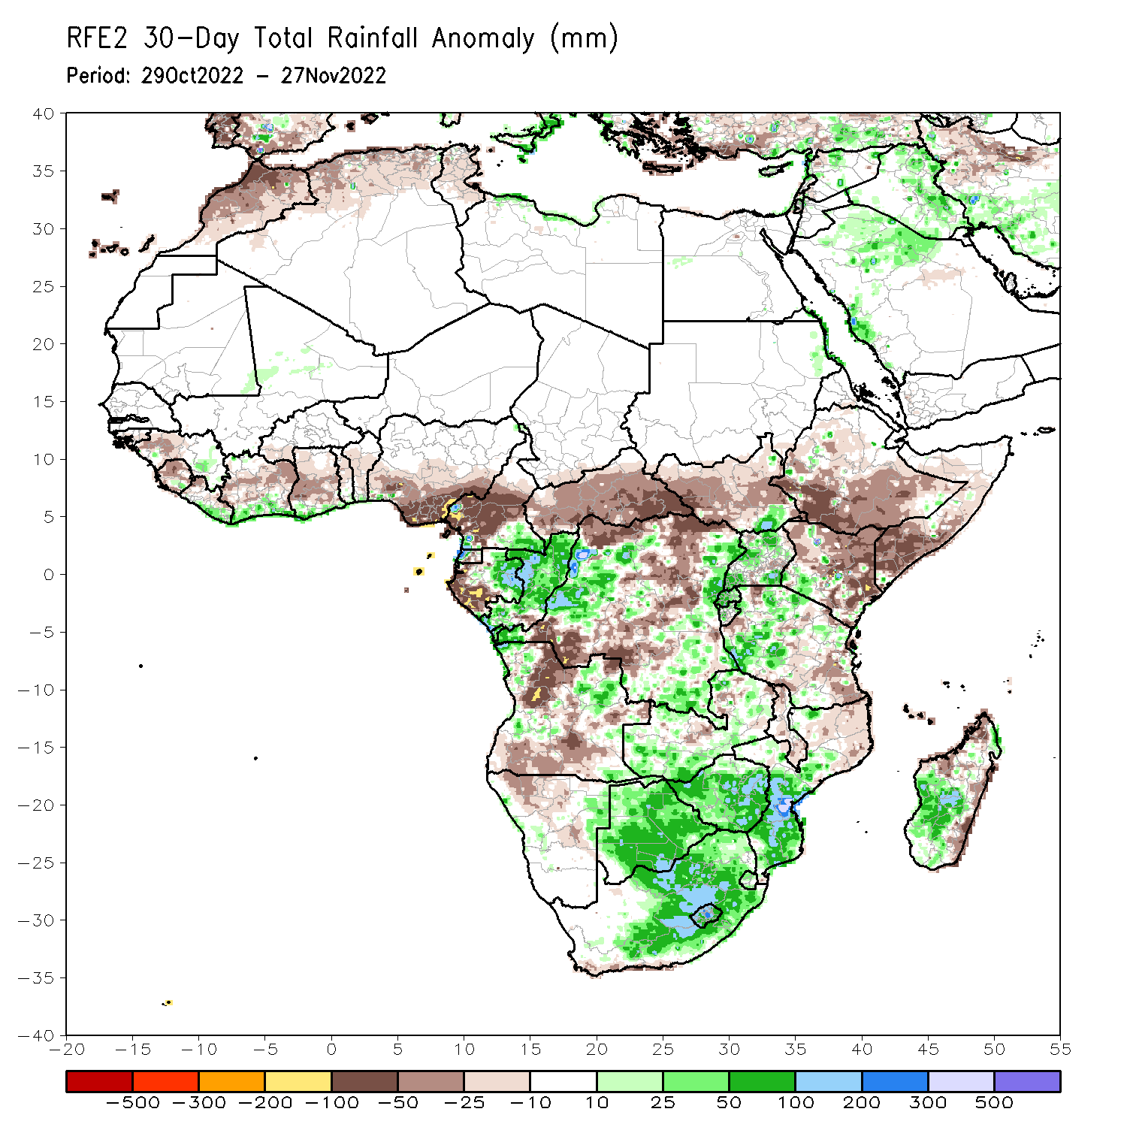
Rainfall Patterns: Last 30 Days
During the past 30 days, in East Africa, above-average rainfall was observed over parts of Uganda, pockets of southern Kenya and western Tanzania. Rainfall was below-average over much of South Sudan, central and southern Ethiopia, Somalia, Kenya, and eastern Tanzania. In Central Africa, rainfall was above-average over parts of southeastern Cameroon, central and eastern Gabon, much of Congo, and parts of western and eastern DRC. Rainfall was below-average over southwestern Gabon, western and northwestern Cameroon, CAR, and parts of northern, central and southwestern DRC. In West Africa, rainfall was above-average along coastal Liberia and Cote d’Ivoire. In contrast, below-average rainfall was observed over much of the Gulf of Guinea region. In southern Africa, above-average rainfall was observed over northwestern and northeastern Angola, the far eastern Namibia, Botswana, pockets of Zambia, Zimbabwe, central and eastern South Africa, Lesotho, Eswatini, southern Mozambique, and central and southern Madagascar. Below normal precipitation was observed over many parts of Angola, parts of Namibia and Zambia, Malawi, northern Mozambique and the far northern Madagascar.
Notes:
5

Slide 6
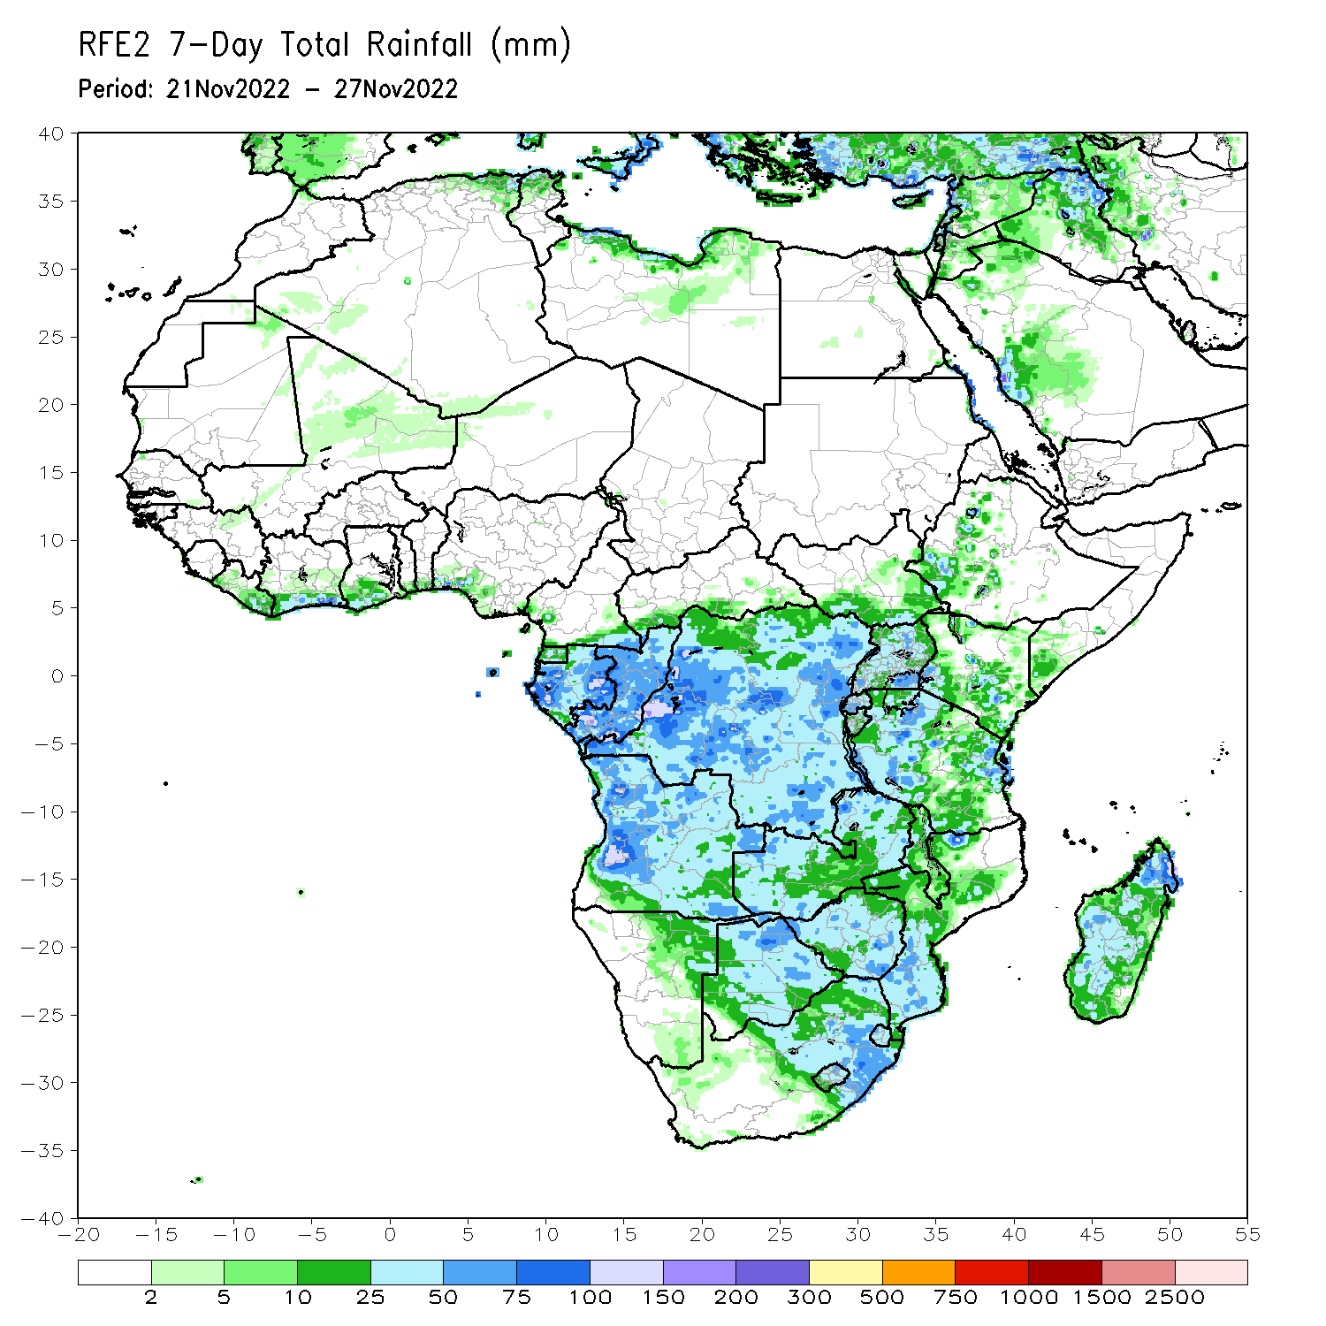
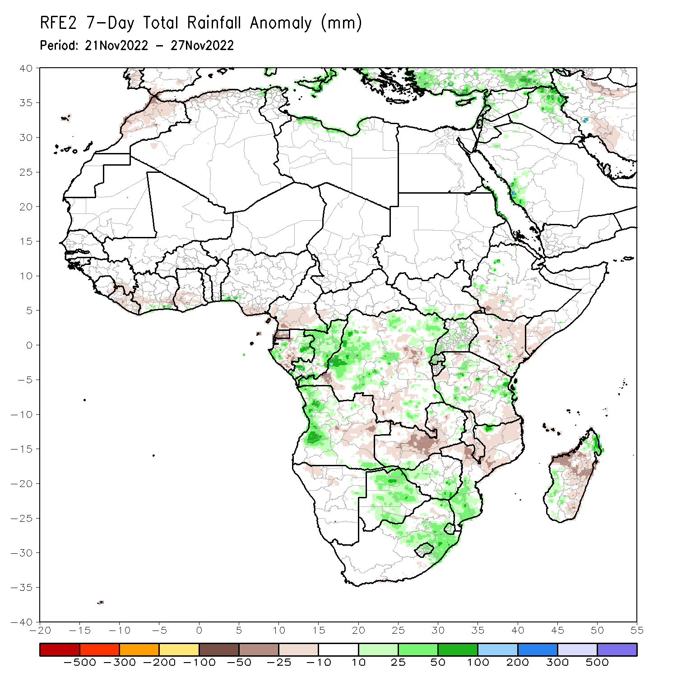
Rainfall Patterns: Last 7 Days
During the past 7 days, in East Africa, rainfall was above-average over pockets of western Ethiopia and Tanzania. Below-average rainfall was observed over parts of southern Ethiopia, Kenya, southern Somalia and parts of Tanzania. In Central Africa, rainfall was above-average over western and eastern Gabon, Congo, and many parts of DRC. Below-average rainfall was observed over parts of Cameroon, Equatorial Guinea, central Gabon, and pockets of eastern and southern DRC. In West Africa, below-average rainfall was observed along the Gulf of Guinea coast. In southern Africa, rainfall was above-average over western Angola, Botswana, eastern South Africa and southern Mozambique. In contrast, rainfall was below-average over eastern Angola, Zambia, Zimbabwe, Malawi, central and northern Mozambique and many parts of Madagascar.

Slide 7
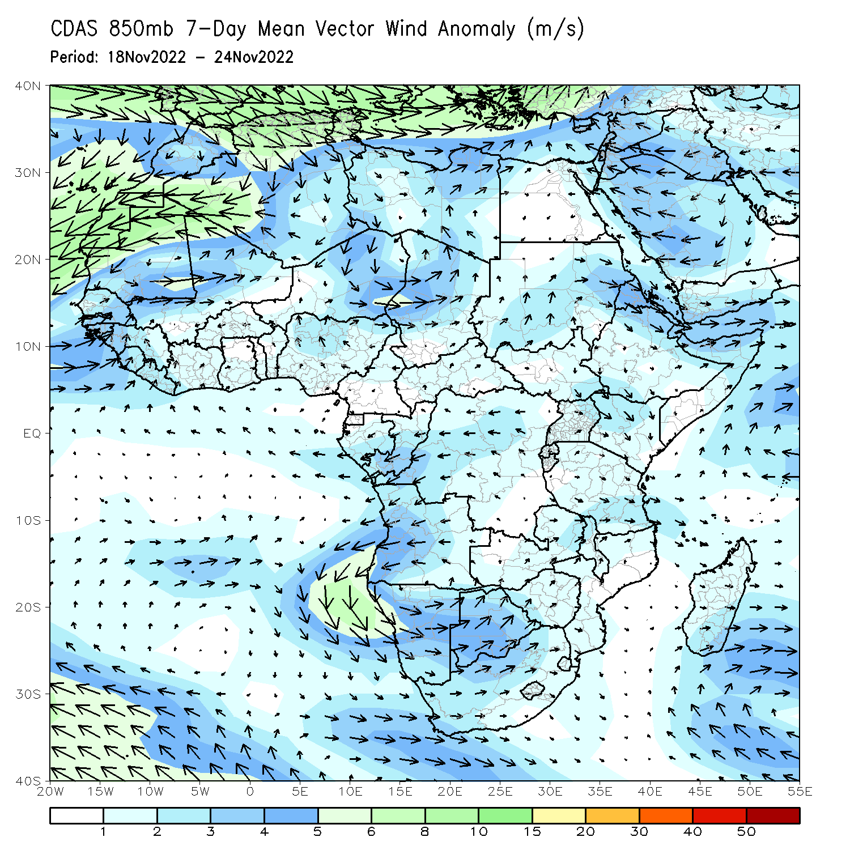
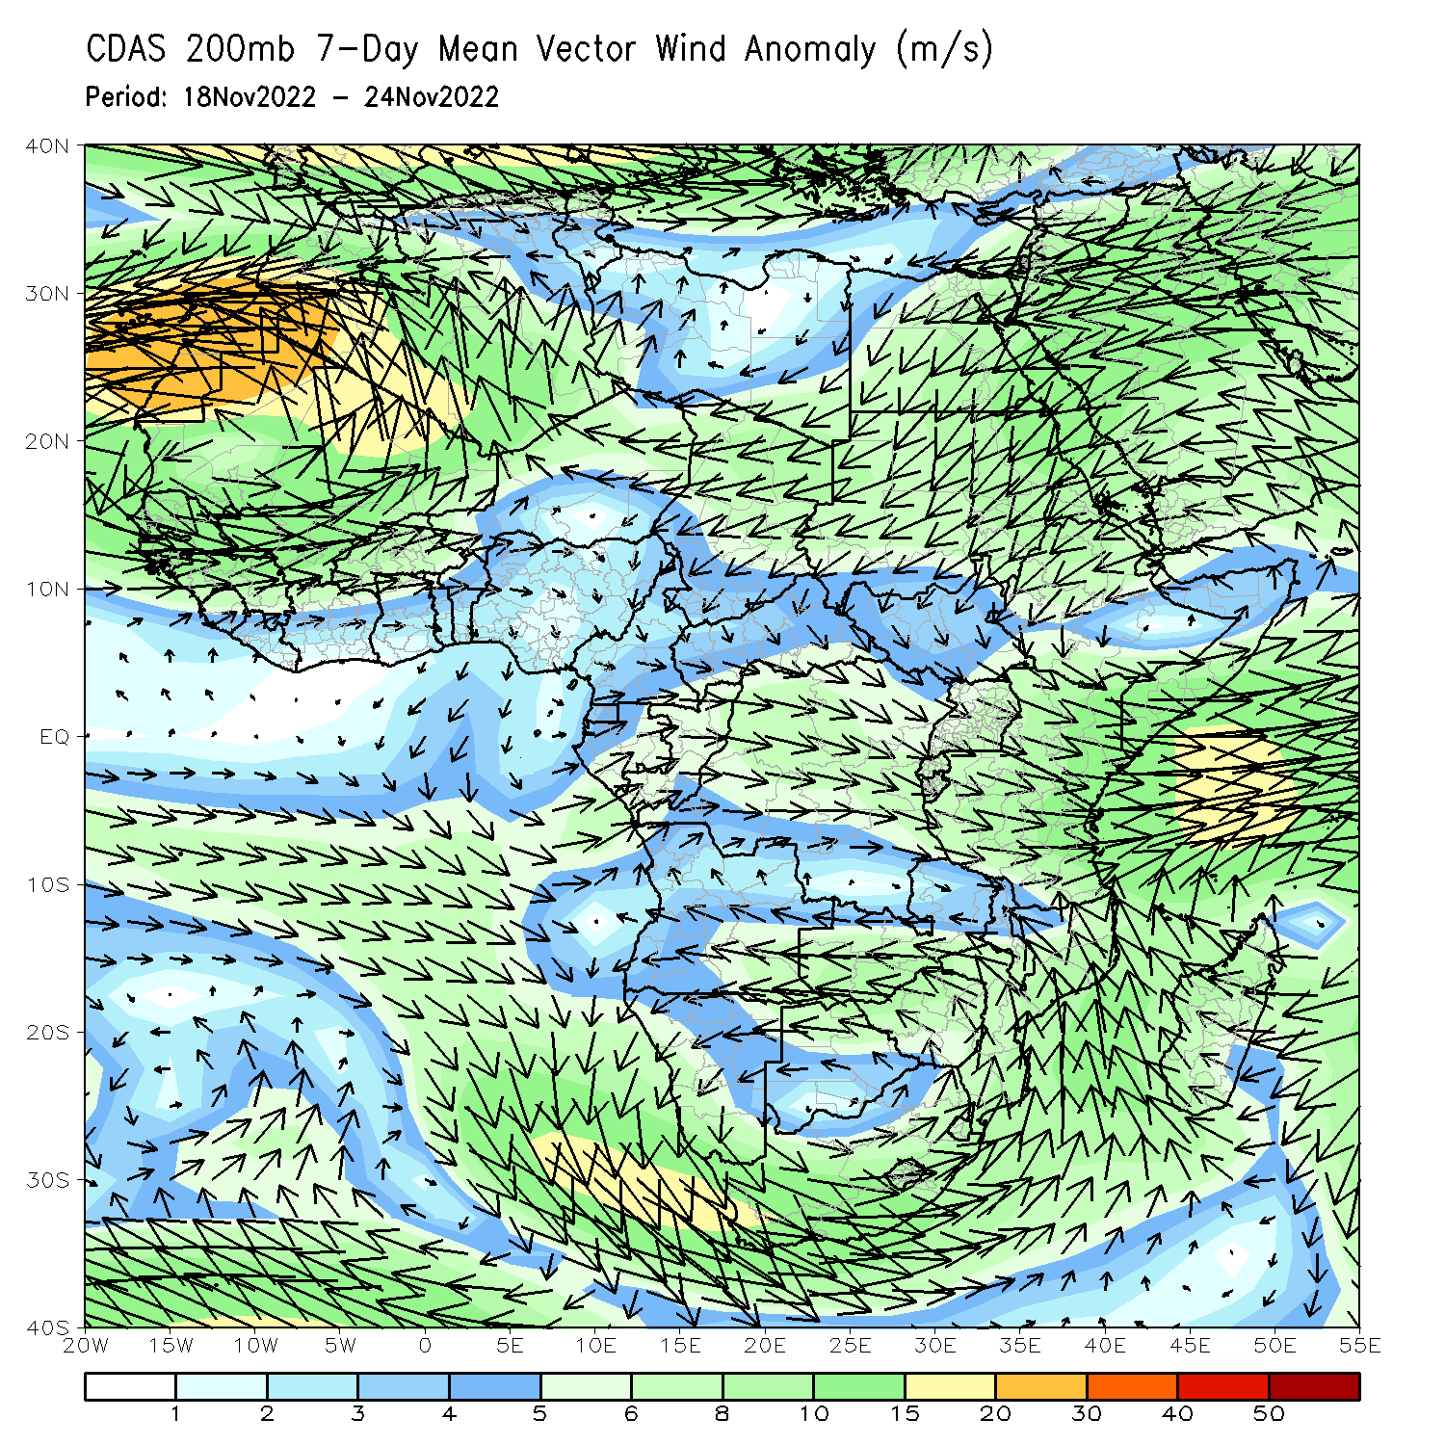
Atmospheric Circulation: Last 7 Days
At 850-hPa level (right panel), the wind anomalies were anti-cyclonic in the western portion of Southern Africa..

Slide 8
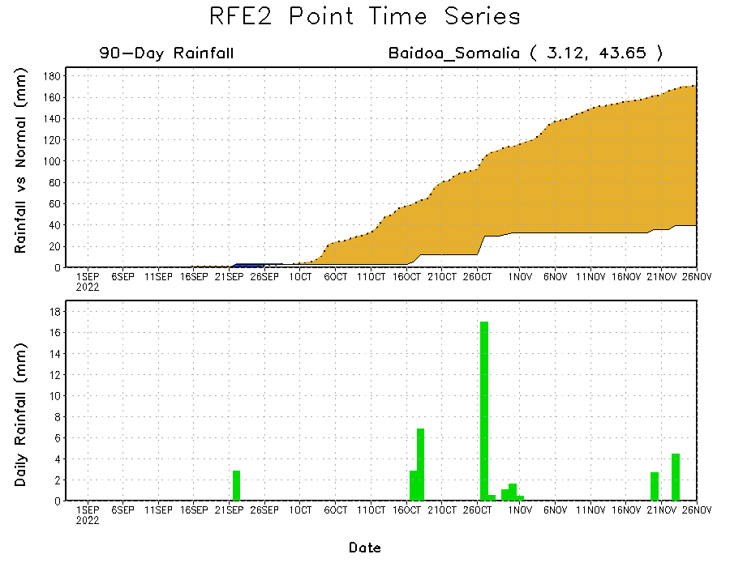
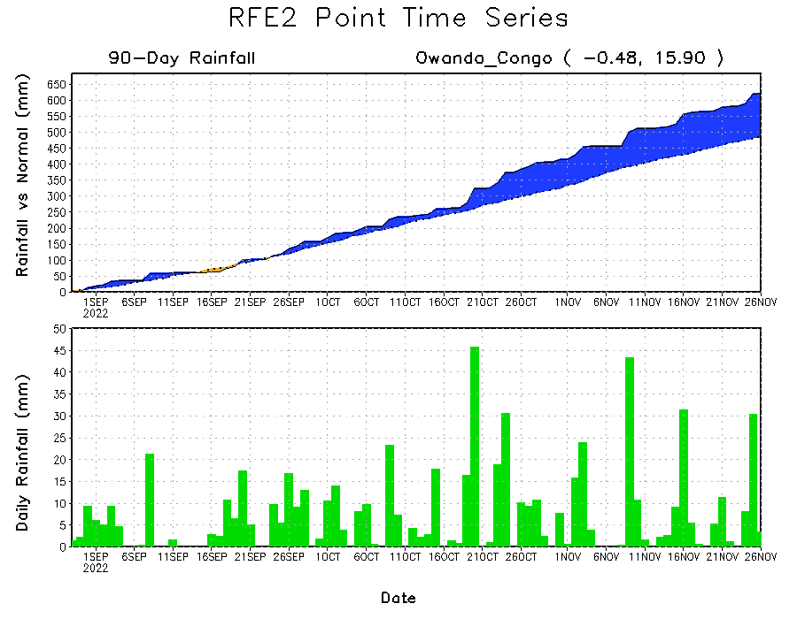
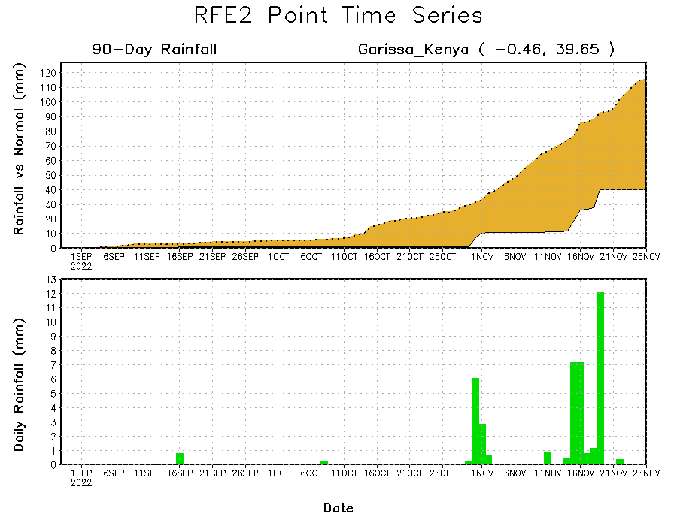
Rainfall Evolution
Daily evolution of rainfall over the last 90 days at selected locations shows continuing moisture surpluses over parts of Congo (bottom left). Rainfall deficits continue over eastern Kenya (bottom right) and southern Somalia (top right).

Slide 9
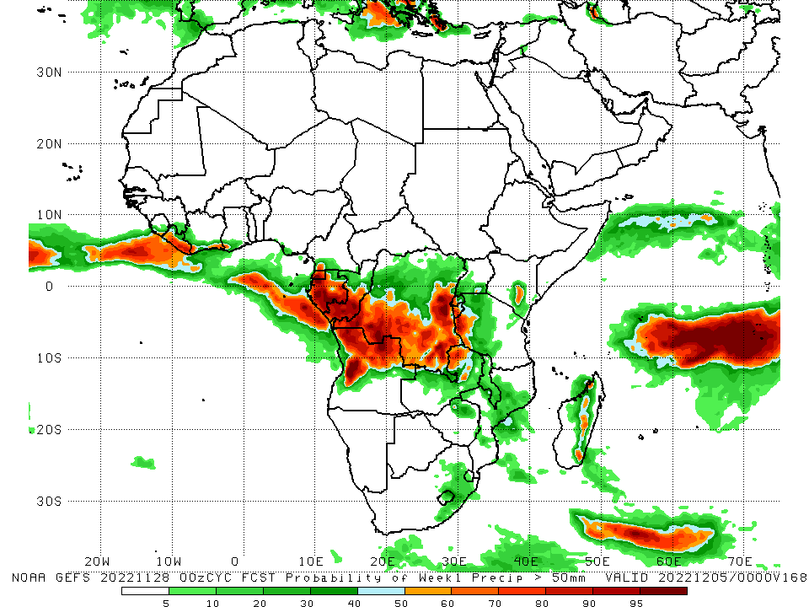
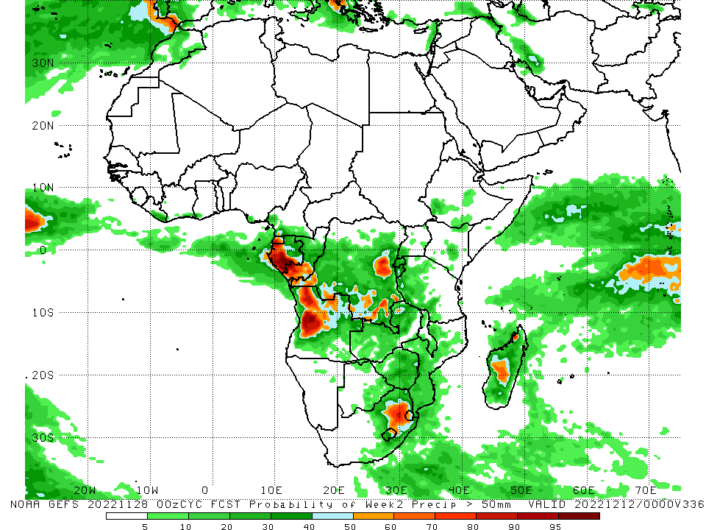
NCEP GEFS Model Forecasts Non-Bias Corrected Probability of precipitation exceedance
Week-1, Valid: 29 Nov – 05 Dec 2022
Week-2, Valid: 06 – 12 Dec 2022
For week-1 (left panel), the NCEP GEFS forecasts indicate a moderate to high chance (over 70%) for rainfall to exceed 50 mm over portions of Central Africa. For week-2 (right panel), higher probability of exceedances are expected to confine over Equatorial Guinea, southern Congo, western and eastern DRC, and the eastern portion of South Africa.
Notes:
9

Slide 10
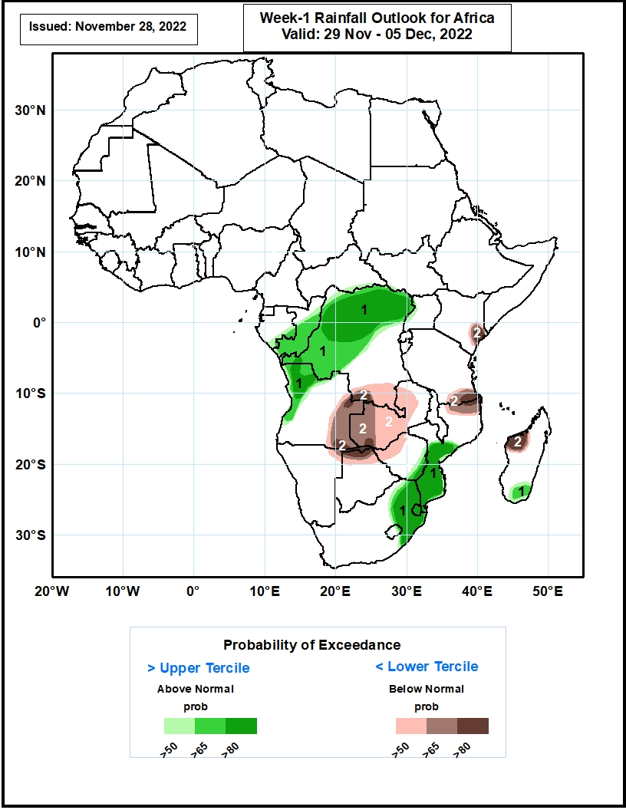
Week-1 Precipitation Outlooks
29 Nov – 05 Dec, 2022
The forecasts suggest above 50% chance for weekly rainfall to be above-normal (above the upper tercile) over southern Gabon, central and southern parts of Congo, northern and central parts of DR Congo, western Angola, eastern Zimbabwe, central and southern parts of Mozambique, northern South Africa, much of Eswatini, and southern Madagascar. In particular, there is above 80% chance for rainfall to be above-normal over northern parts of DR Congo, northwestern Angola, southern Mozambique, northern South Africa and much of Eswatini.
The consolidated probabilistic forecasts suggest above 50% chance for weekly total rainfall to be below-normal (below the lower tercile) over southern DR Congo, eastern Angola, much of Zambia, northeastern Namibia, northern Botswana and Zimbabwe, northern Mozambique, southern Tanzania, southeastern Kenya, and northwestern parts of Madagascar. In particular, there is above 80% chance for rainfall to be below normal over southern DR Congo, northern Botswana, southeastern Tanzania, and northwestern Madagascar.
Notes:
10

Slide 11
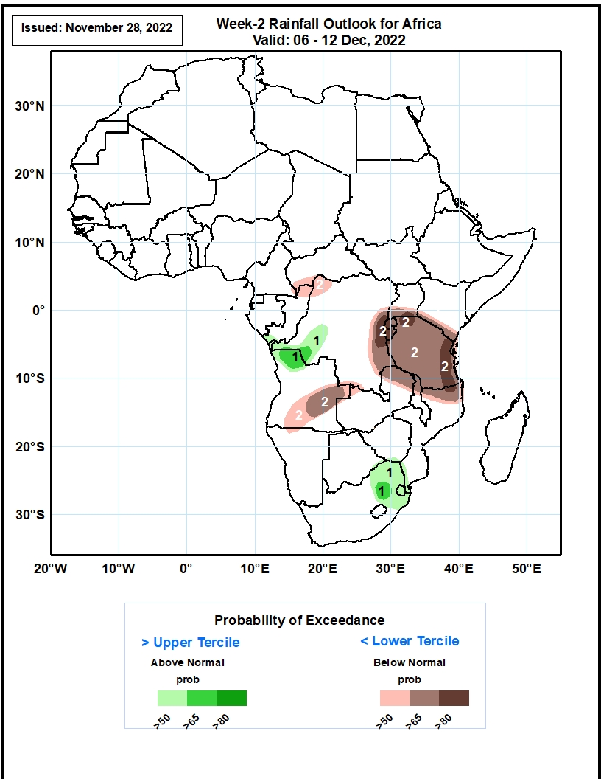
Week-2 Precipitation Outlooks
06 – 12 Dec, 2022
The forecasts suggest above 50% chance for weekly rainfall to be above-normal (above the upper tercile) over southern Congo, western DR Congo, northern Angola and South Africa, and much of Eswatini. In particular, there is above 65% chance for rainfall to be above-normal over northern Angola and South Africa.
The consolidated probabilistic forecasts suggest above 50% chance for weekly total rainfall to be below-normal (below the lower tercile) over southwestern CAR, northern Congo, northwestern and eastern DR Congo, southern Uganda and Kenya, much of Tanzania, northern Zambia, Malawi and Mozambique, central and southern parts of Angola. In particular, there is above 80% chance for rainfall to be below normal over eastern DR Congo, southern Uganda, northwestern and eastern parts of Tanzania.
Notes:
11

Slide 12
Summary
During the past 30 days, in East Africa, above-average rainfall was observed over parts of Uganda, pockets of southern Kenya and western Tanzania. Rainfall was below-average over much of South Sudan, central and southern Ethiopia, Somalia, Kenya, and eastern Tanzania. In Central Africa, rainfall was above-average over parts of southeastern Cameroon, central and eastern Gabon, much of Congo, and parts of western and eastern DRC. Rainfall was below-average over southwestern Gabon, western and northwestern Cameroon, CAR, and parts of northern, central and southwestern DRC. In West Africa, rainfall was above-average along coastal Liberia and Cote d’Ivoire. In contrast, below-average rainfall was observed over much of the Gulf of Guinea region. In southern Africa, above-average rainfall was observed over northwestern and northeastern Angola, the far eastern Namibia, Botswana, pockets of Zambia, Zimbabwe, central and eastern South Africa, Lesotho, Eswatini, southern Mozambique, and central and southern Madagascar. Below normal precipitation was observed over many parts of Angola, parts of Namibia and Zambia, Malawi, northern Mozambique and the far northern Madagascar.
During the past 7 days, in East Africa, rainfall was above-average over pockets of western Ethiopia and Tanzania. Below-average rainfall was observed over parts of southern Ethiopia, Kenya, southern Somalia and parts of Tanzania. In Central Africa, rainfall was above-average over western and eastern Gabon, Congo, and many parts of DRC. Below-average rainfall was observed over parts of Cameroon, Equatorial Guinea, central Gabon, and pockets of eastern and southern DRC. In West Africa, below-average rainfall was observed along the Gulf of Guinea coast. In southern Africa, rainfall was above-average over western Angola, Botswana, eastern South Africa and southern Mozambique. In contrast, rainfall was below-average over eastern Angola, Zambia, Zimbabwe, Malawi, central and northern Mozambique and many parts of Madagascar.
Week-1 outlooks call for an increased chance for above-average rainfall across southern Congo, western and northern Angola, western and northern DRC, and the eastern portion of South Africa, southern Mozambique and southern Madagascar. In contrast, there is an increased chance for below-average rainfall over eastern Angola, western Zambia, and western Madagascar. Week-2 outlooks call for an increased chance for above-average rainfall over western DRC, northern Angola, and the eastern portion of South Africa. In contrast, there is an increased chance for below-average rainfall over central and southern Angola, much of Tanzania, and northern Mozambique.

