Slide 1
The African Monsoon Recent Evolution and Current Status Include Week-1 and Week-2 Outlooks
Update prepared by Justin Hicks
09 January 2023
For more information, visit:
http://www.cpc.ncep.noaa.gov/products/Global_Monsoons/African_Monsoons/precip_monitoring.shtml

Slide 2
Outline
Highlights
Recent Evolution and Current Conditions
NCEP GEFS Forecasts
Summary

Slide 3
Highlights: Last 7 Days
During the past 7 days, in East Africa, rainfall was above-average over pockets of northern Ethiopia, central and southern Kenya, western Eritrea, and a small portion of northeastern Tanzania. Below-average rainfall was observed over southwestern Kenya, southern Uganda, Rwanda, Burundi, and most of Tanzania. In Central Africa, rainfall was above-average over Congo and western, central, and southern DRC. Below-average rainfall was observed over southwestern and central Gabon, and northern and eastern DRC. In West Africa, rainfall was near average across most of the region. In Southern Africa, rainfall was above-average over pockets of central, western, and northern Angola, western Lesotho, Eswatini, eastern South Africa, southern Mozambique, central, western, and southern Zambia, eastern Botswana, southern Zimbabwe, and pockets of central Madagascar. In contrast, rainfall was below-average over southeastern Angola, central and northeastern Namibia (including the Caprivi Strip), eastern Zambia, northwestern Botswana, northeastern Zimbabwe, Malawi, north-central South Africa, central and northern Mozambique, and northern and southern Madagascar.
Week-1 outlook calls for above-average rainfall over central and southern Congo, southern and central Gabon, Equatorial Guinea, central, southeastern, and southwestern DRC, Rwanda, Burundi, most of Tanzania, Zambia, Zimbabwe, Malawi, northern Mozambique, most of Angola, and southern and central Madagascar. In contrast, below-average rainfall is expected from Liberia to southern Nigeria, over a small portion of southeastern Tanzania, southeastern Angola, northeastern Namibia, central and eastern South Africa, Lesotho, Eswatini, Botswana, central and southern Zimbabwe, southern Mozambique, and northern Madagascar. Week-2 outlooks suggest an increased chance for above-average rainfall over portions of eastern DRC, eastern and southeastern Angola, western Mozambique, central and southern Zambia, central and southern Malawi, central and southern Tanzania, portions of eastern and northwestern Madagascar, Zimbabwe, most of Botswana, central, southern, and northeastern Namibia, South Africa, Lesotho, and Eswatini. Below-average rainfall is likely over eastern Gabon, central Congo, southern Uganda, northern Tanzania, southwestern Kenya, western Angola, Rwanda, Burundi, eastern Mozambique, central, western, and northeastern Madagascar, and along coastal Sierra Leone and Liberia.

Slide 4
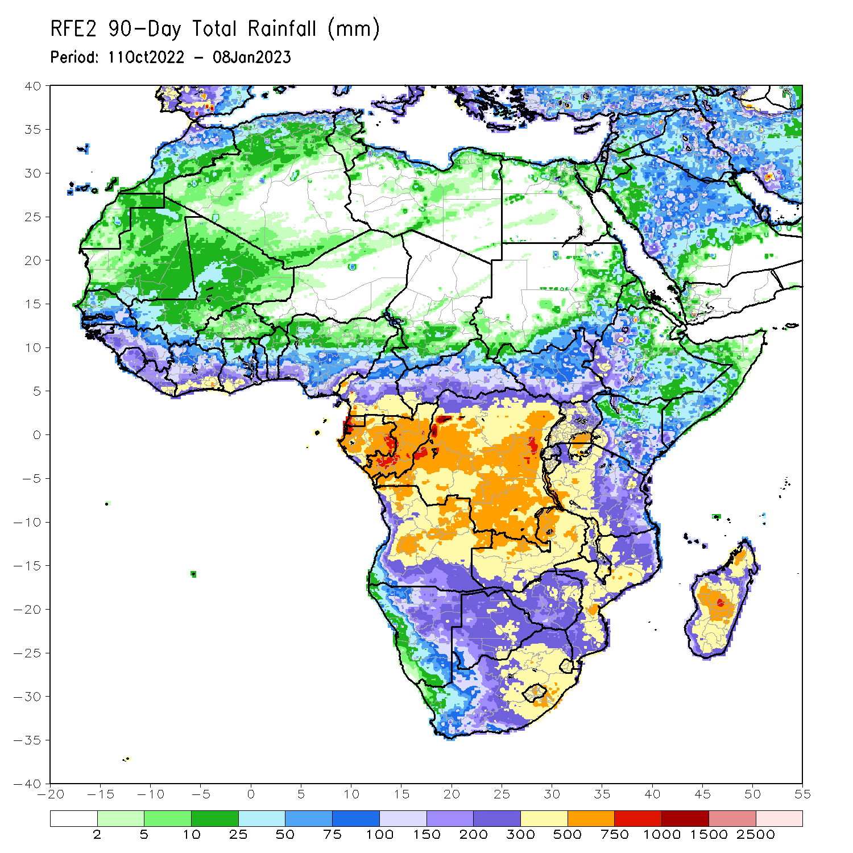
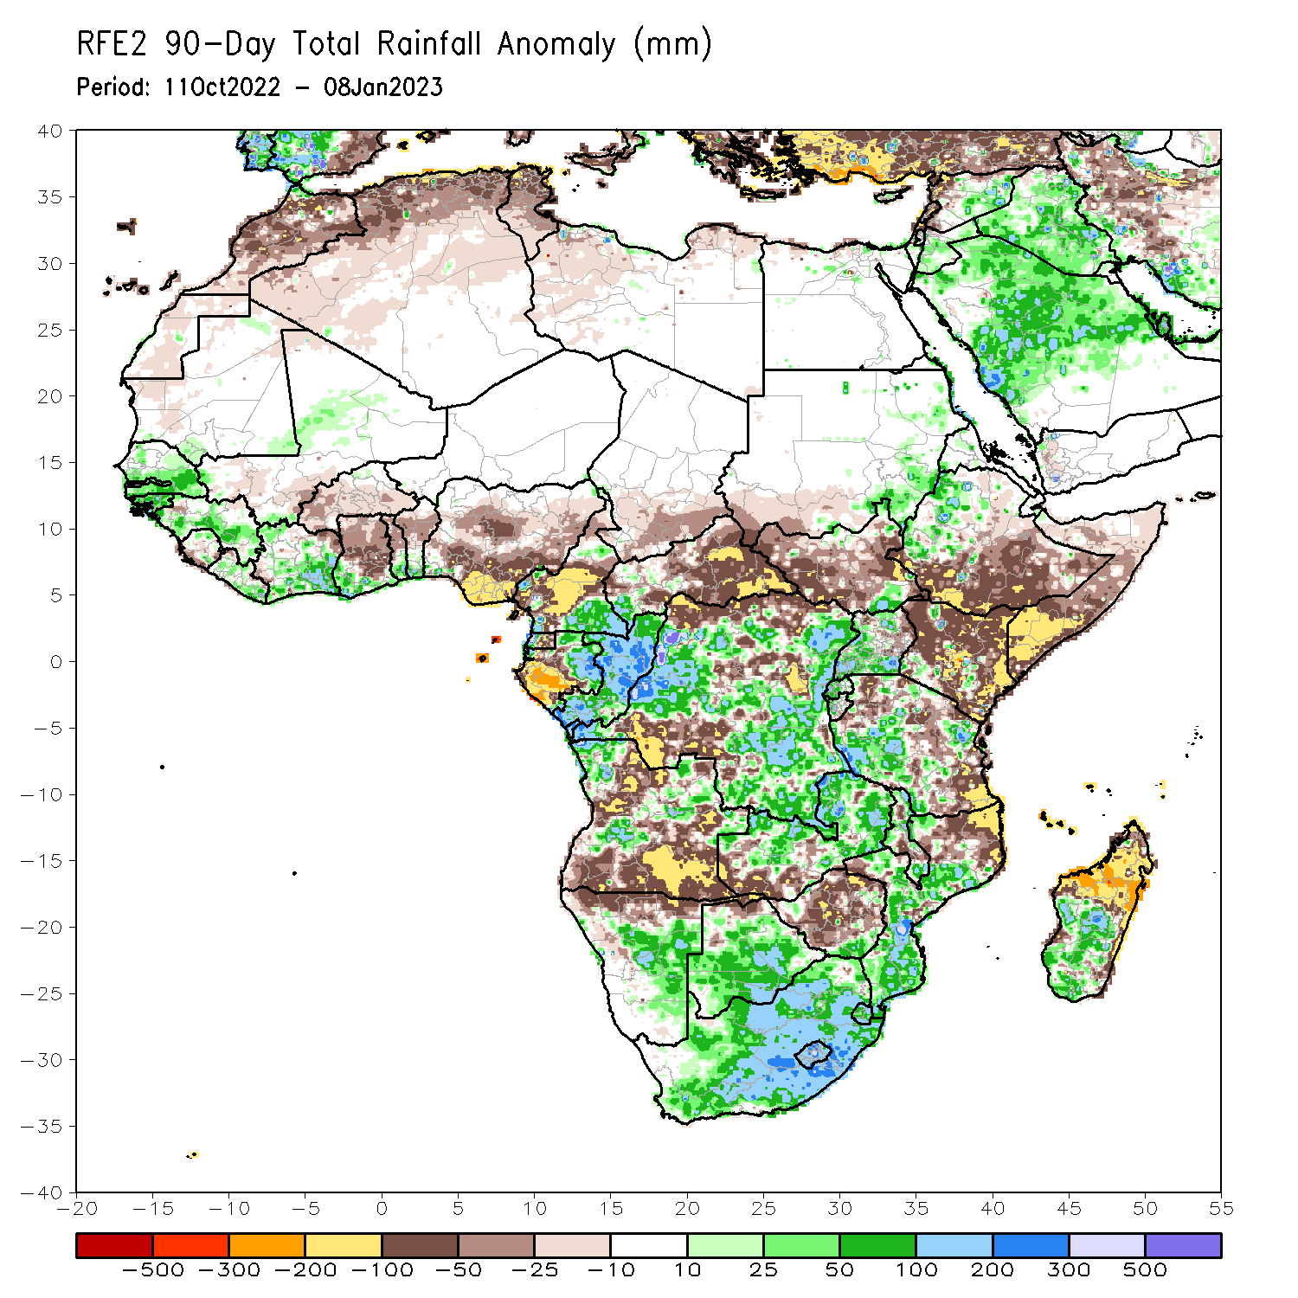
Rainfall Patterns: Last 90 Days
Over the past 90 days, in East Africa, above-average rainfall was observed over the eastern parts of Sudan, pockets of southeastern South Sudan, western Ethiopia, northern and western Eritrea, northern, western, and southern Uganda, Rwanda, western Burundi, and pockets of southwestern and western Tanzania. Rainfall was below-average over southern, central, and eastern Ethiopia, throughout much of Somalia, most of Kenya, northwest, southwest, central, and eastern South Sudan, and northern and eastern Tanzania. In southern Africa, above-average rainfall was observed over central and southern Botswana, South Africa, Lesotho, Eswatini, southern Zimbabwe, eastern and northern Zambia, central and southern Mozambique, northwestern and portions of central Angola, central and eastern Namibia, and southern and central parts of Madagascar. Below-average rainfall was observed much of northern, central, and southern Angola, southwestern Zambia, northern Namibia, central and northern Zimbabwe, northeastern Mozambique, central Malawi, and northern Madagascar. In Central Africa, rainfall was above-average over southeastern Cameroon, southwestern CAR, eastern and northern Gabon, much of Congo, and parts of western and eastern DRC. Rainfall was below-average over northern and central Cameroon, southwestern Gabon, Equatorial Guinea, eastern and central CAR, southern Chad, and parts of northern, central and southwestern DRC. In West Africa, rainfall was above-average over southern Mauritania, southern and eastern Senegal, Gambia, Guinea-Bissau, Guinea, Liberia, Cote D’Ivoire, southern parts of Ghana and Togo, southern Benin, central Mali, and western Nigeria. In contrast, below-average rainfall was observed over northern and western Mauritania, southwestern Mali, western and central Sierra Leone, central and northern Ghana, most of Burkina Faso, northern Togo, northern Benin, and southern, central, and eastern Nigeria.
Notes:
‹#›

Slide 5
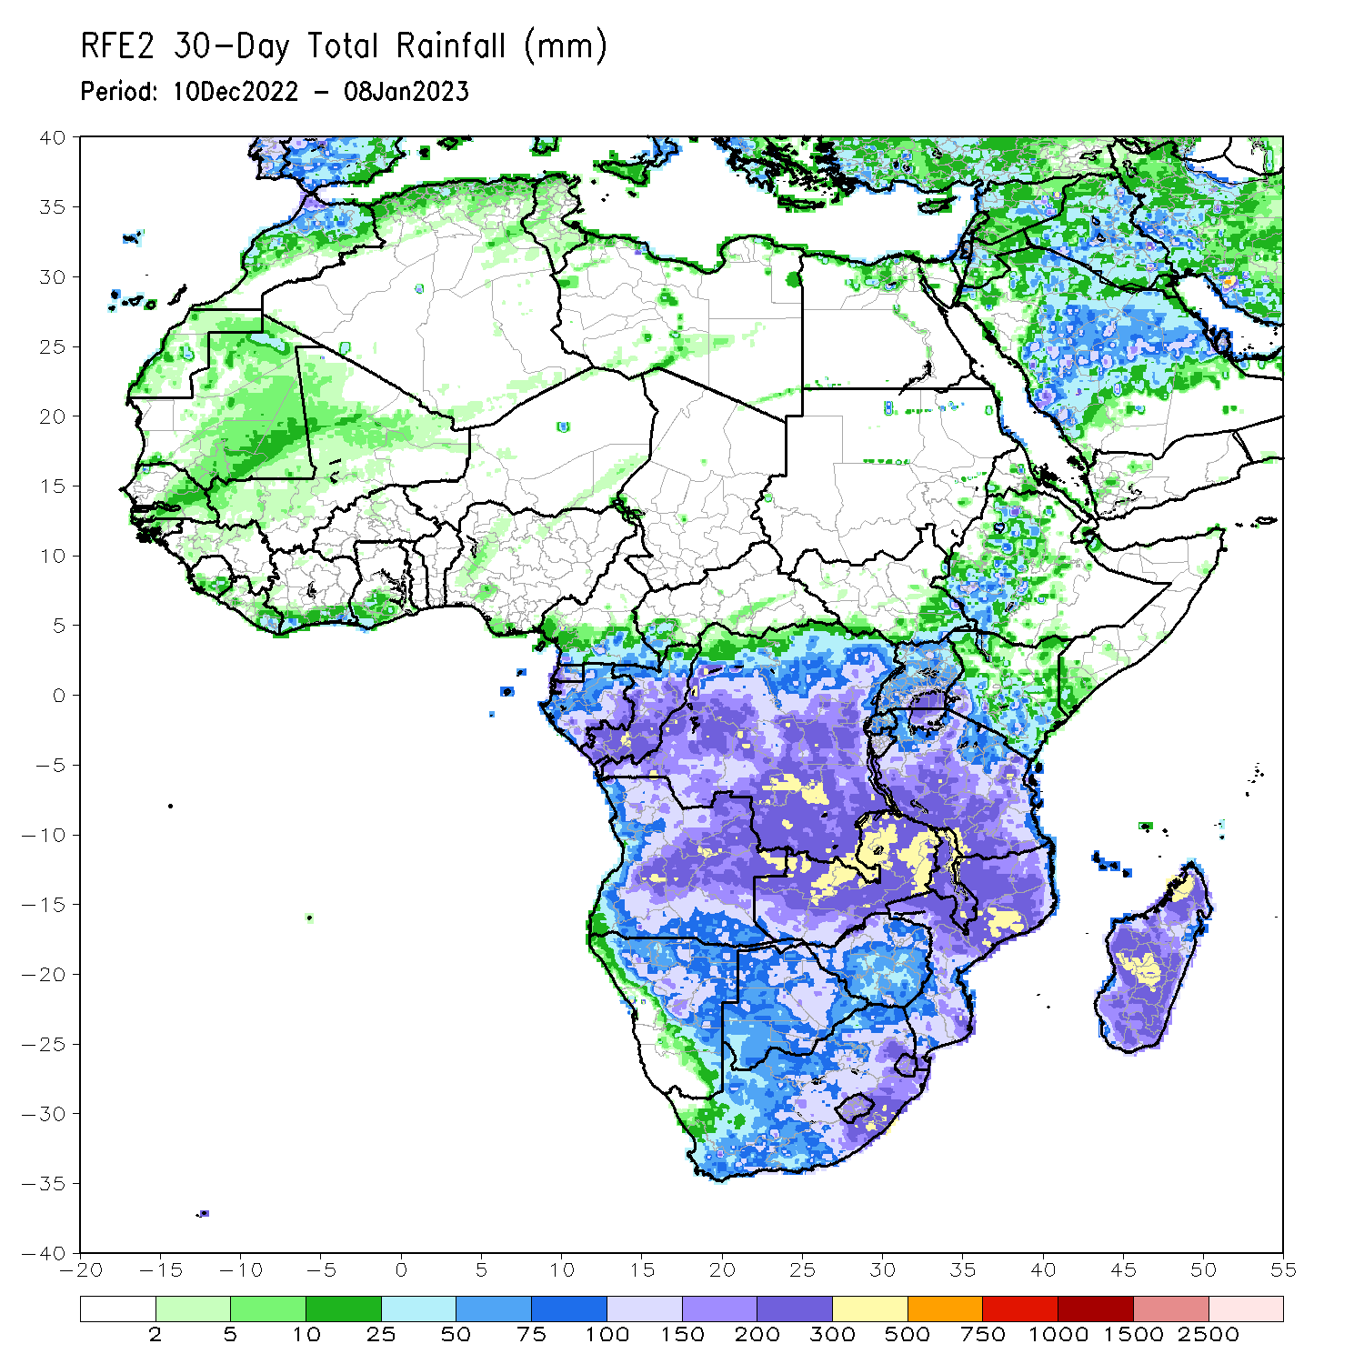
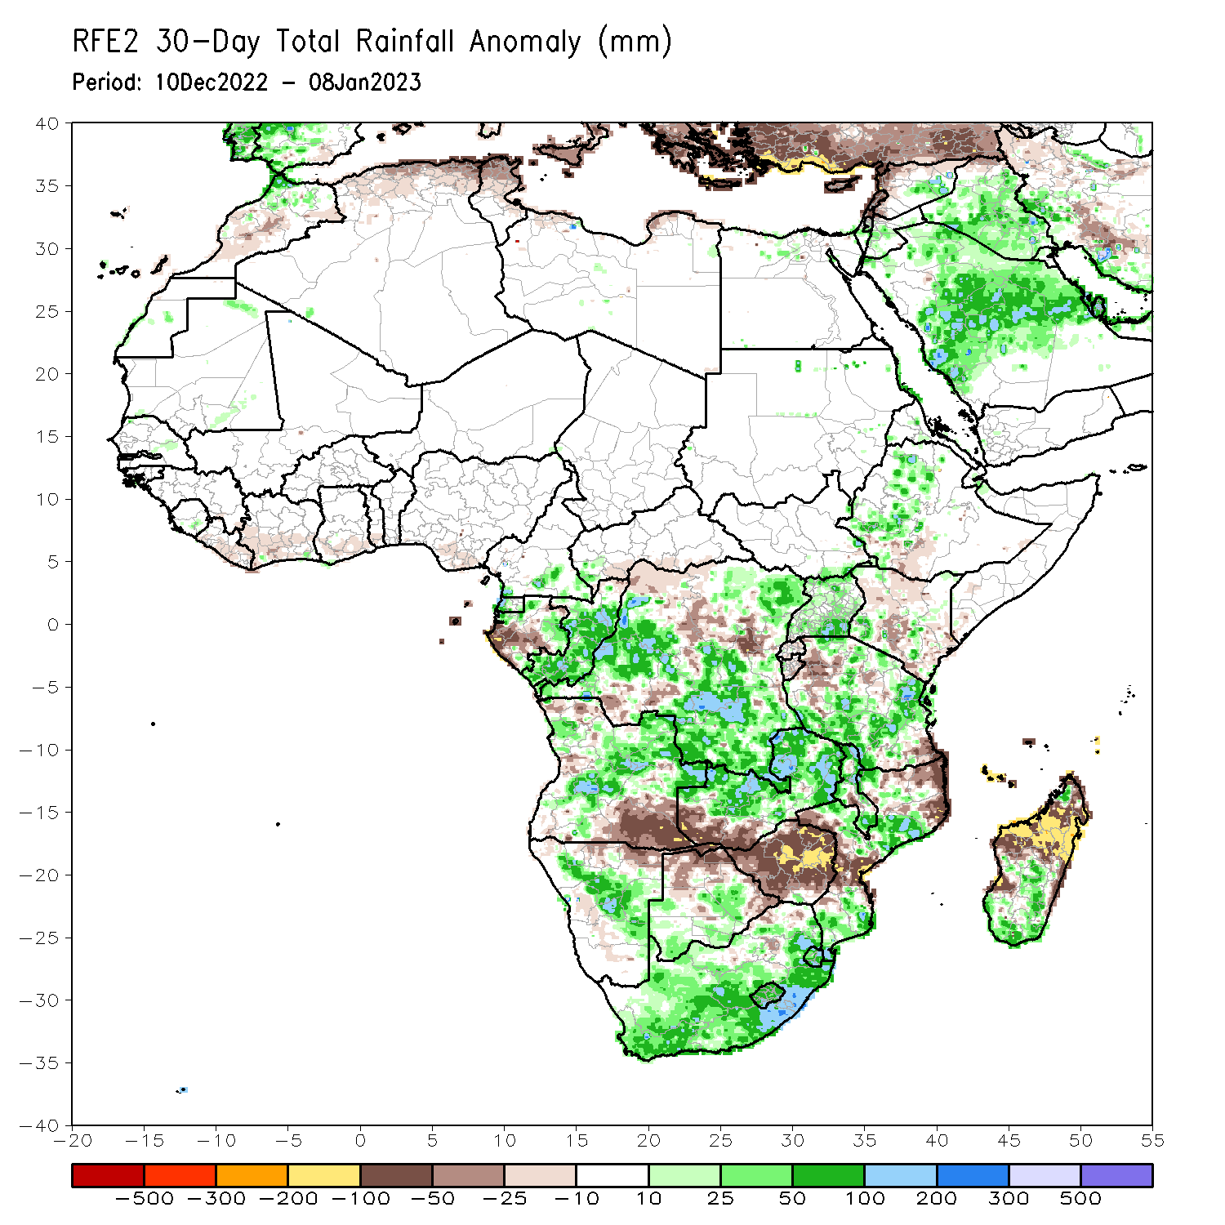
Rainfall Patterns: Last 30 Days
During the past 30 days, in East Africa, above-average rainfall was observed over Uganda, pockets of central Kenya, western Ethiopia, central and northern Tanzania, and southeastern South Sudan. Rainfall was below-average over a small portion of southwestern Ethiopia, northern and southern Kenya, and parts of northwestern and southeastern Tanzania. In Central Africa, rainfall was above-average over northeastern Gabon, western Equatorial Guinea, southern Cameroon, southwestern CAR, most of Congo, and southern, eastern, and west-central DRC. Rainfall was below-average over western and southern Gabon, southern CAR, pockets of northern Congo, and pockets of central, southwestern, and northwestern DRC. In West Africa, rainfall was above-average over southern Sierra Leone. In contrast, below-average rainfall was observed from Liberia to southern Nigeria. In southern Africa, above-average rainfall was observed over central and northeastern Angola, South Africa, Lesotho, Eswatini, central Namibia, central and southern Mozambique, northern and southern Malawi, northern and central Zambia, southern and central Botswana, and southern and parts of central Madagascar. Below normal precipitation was observed over southern and northwestern Angola, northern Namibia, southwestern Zambia, central parts of Malawi, parts of central and northeastern Mozambique, most of Zimbabwe, northern and eastern Botswana, and northern and central Madagascar.
Notes:
‹#›

Slide 6
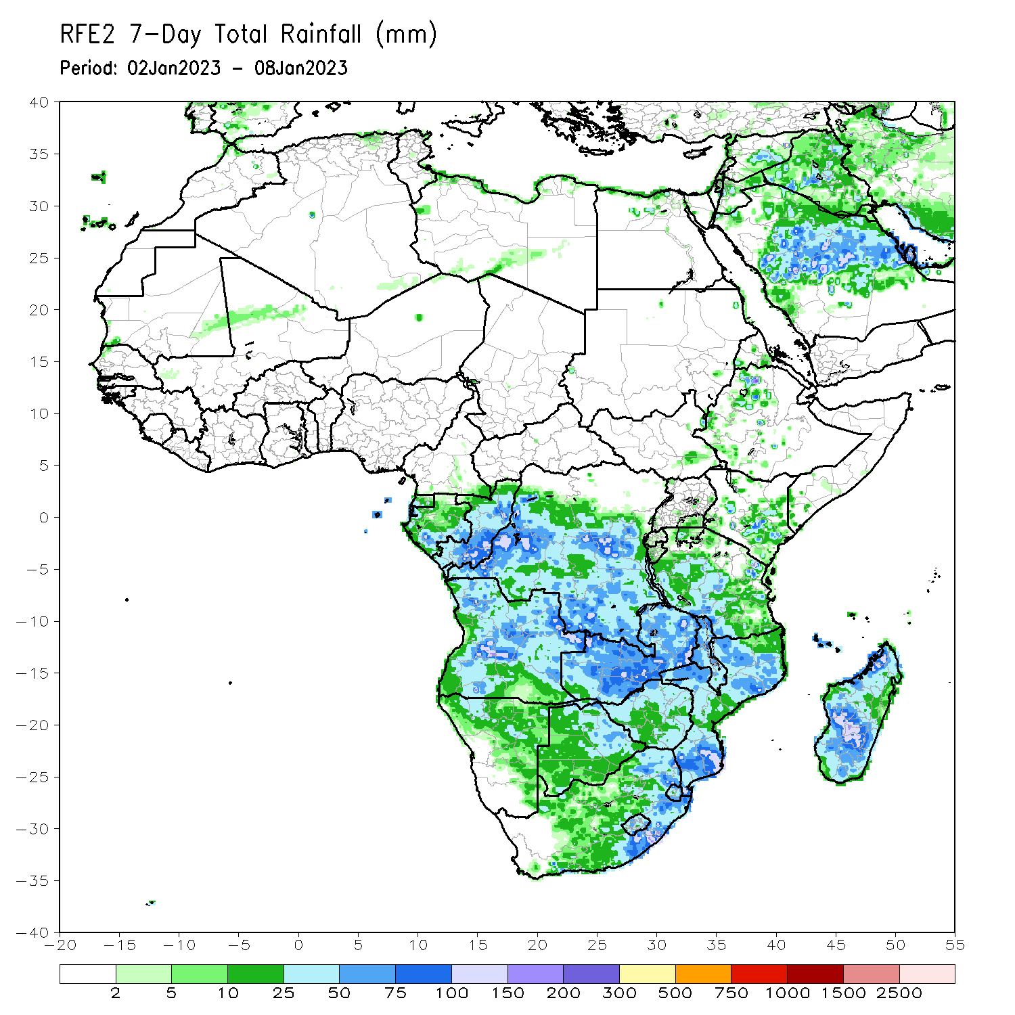
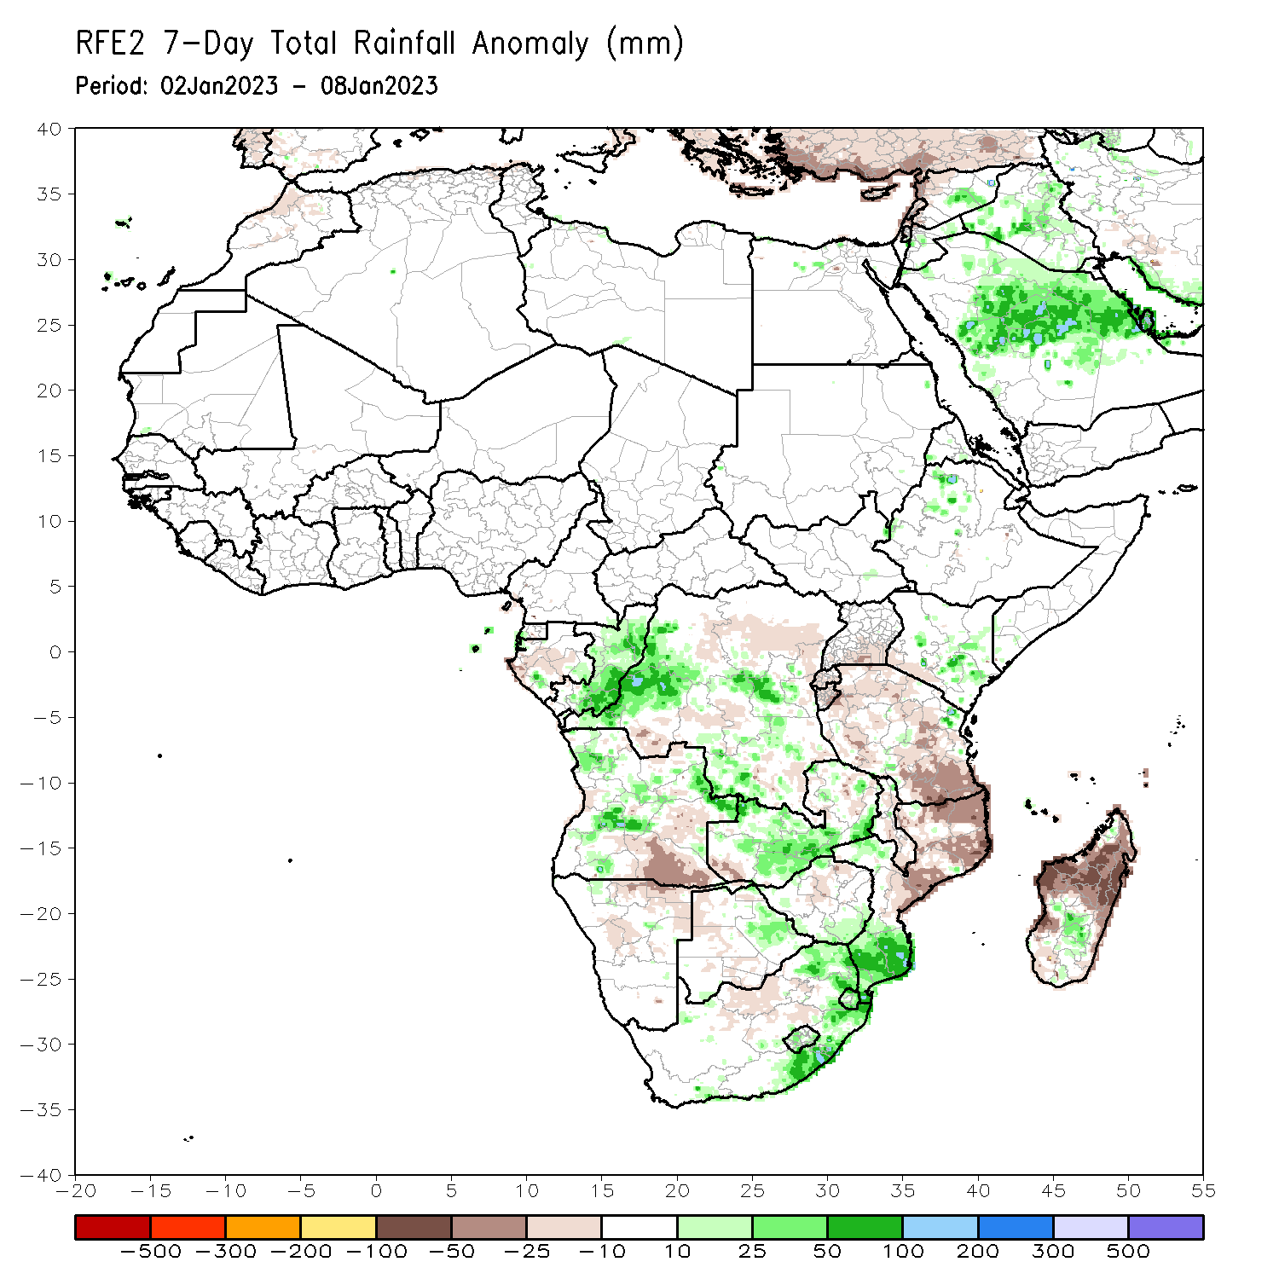
Rainfall Patterns: Last 7 Days
During the past 7 days, in East Africa, rainfall was above-average over pockets of northern Ethiopia, central and southern Kenya, western Eritrea, and a small portion of northeastern Tanzania. Below-average rainfall was observed over southwestern Kenya, southern Uganda, Rwanda, Burundi, and most of Tanzania. In Central Africa, rainfall was above-average over Congo and western, central, and southern DRC. Below-average rainfall was observed over southwestern and central Gabon, and northern and eastern DRC. In West Africa, rainfall was near average across most of the region. In Southern Africa, rainfall was above-average over pockets of central, western, and northern Angola, western Lesotho, Eswatini, eastern South Africa, southern Mozambique, central, western, and southern Zambia, eastern Botswana, southern Zimbabwe, and pockets of central Madagascar. In contrast, rainfall was below-average over southeastern Angola, central and northeastern Namibia (including the Caprivi Strip), eastern Zambia, northwestern Botswana, northeastern Zimbabwe, Malawi, north-central South Africa, central and northern Mozambique, and northern and southern Madagascar.

Slide 7
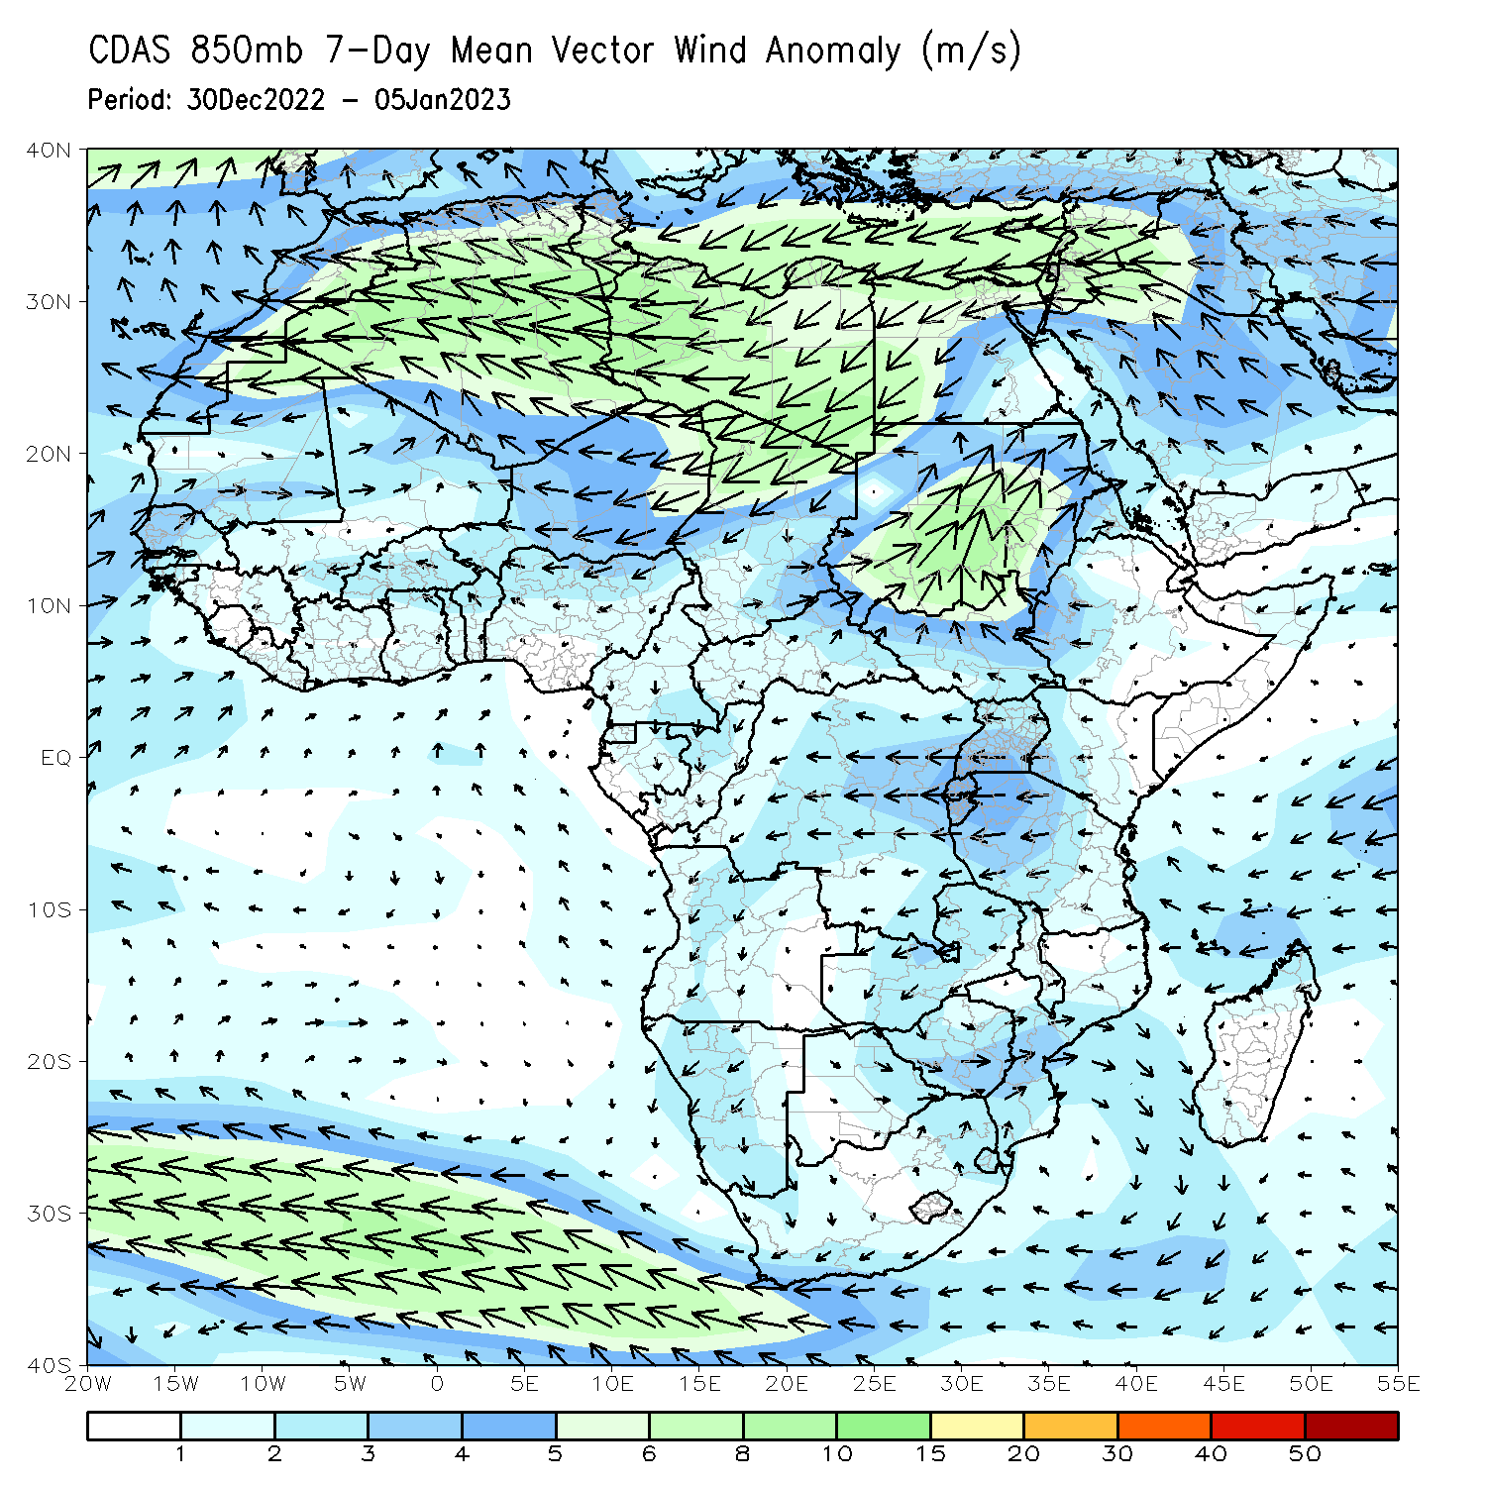
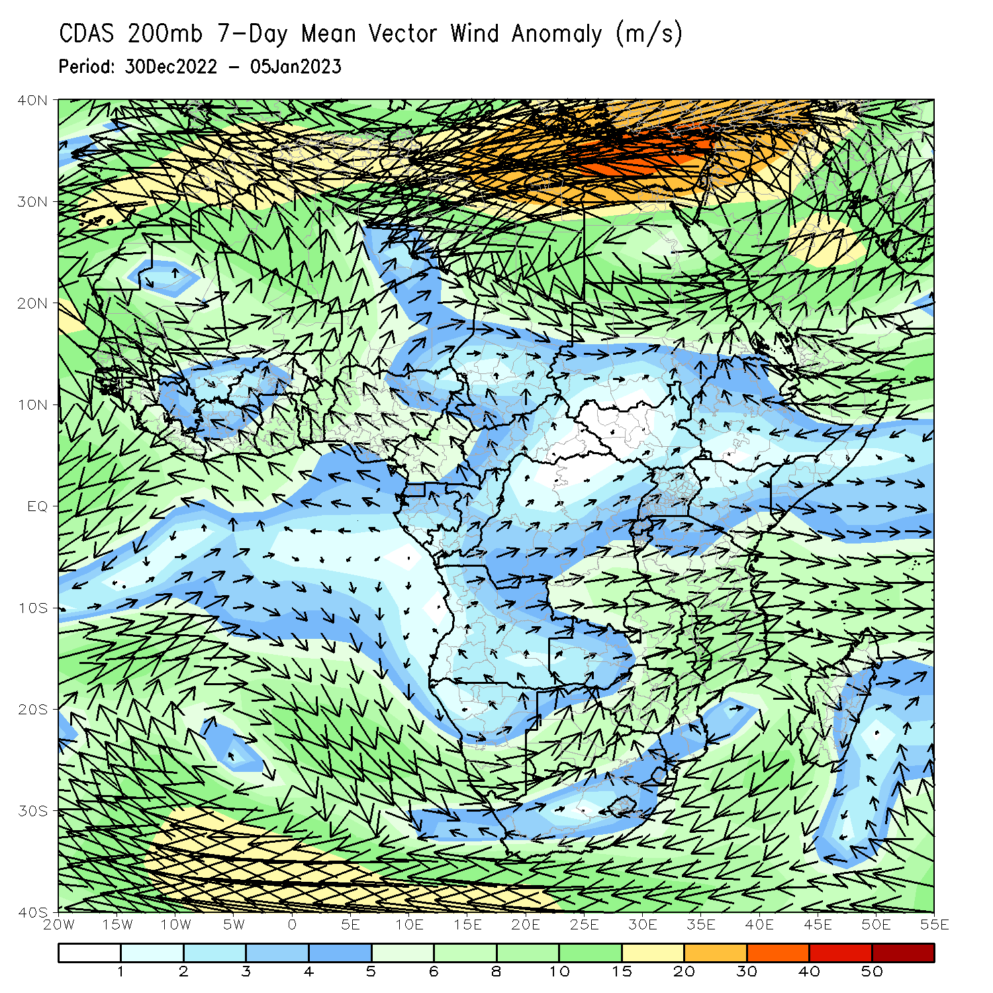
Atmospheric Circulation: Last 7 Days
At 850-hPa level (left panel), anomalous wind convergence may have contributed to the observed rainfall increases across Angola, Mozambique, and DRC. Anomalous upper level divergence at 200-hPa (right panel) in the same region complemented the lower level dynamics.

Slide 8
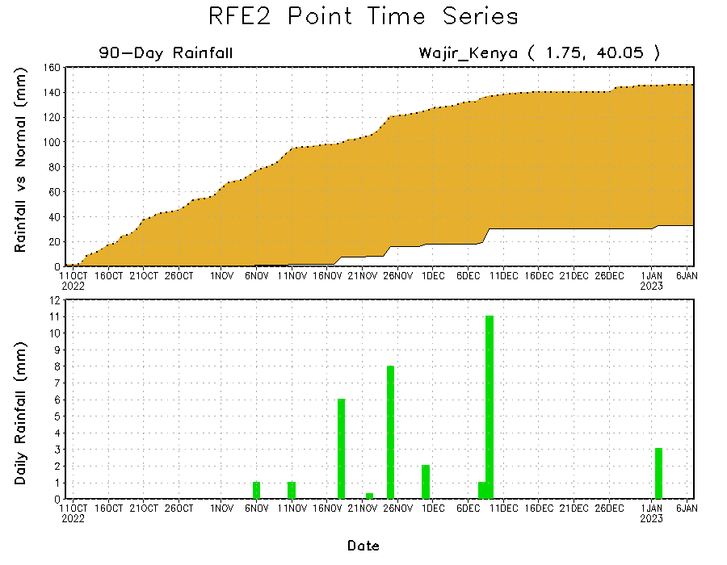
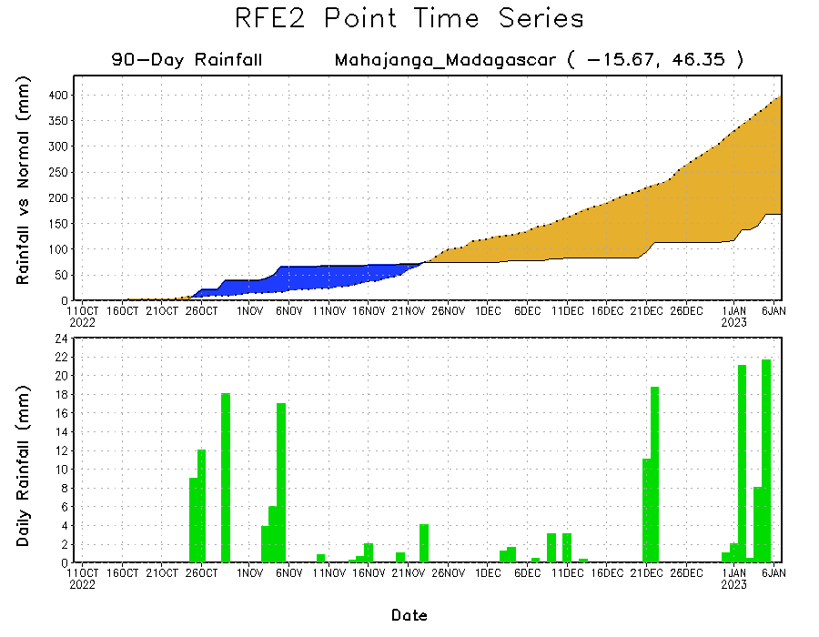
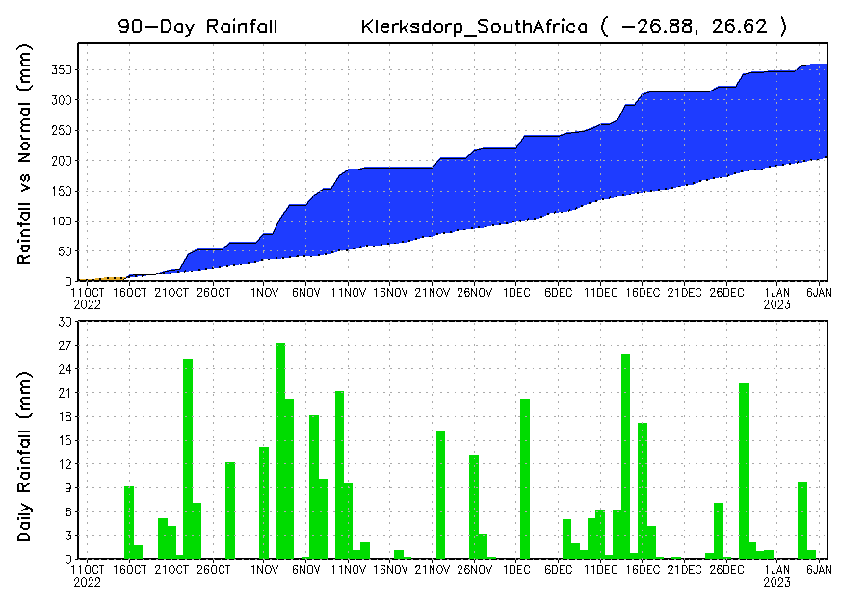
Rainfall Evolution
Daily evolution of rainfall over the last 90 days at selected locations shows continuing moisture surpluses over parts of South Africa (bottom left). Rainfall deficits continue over eastern Kenya (top right) and northeastern Madagascar (bottom right).

Slide 9
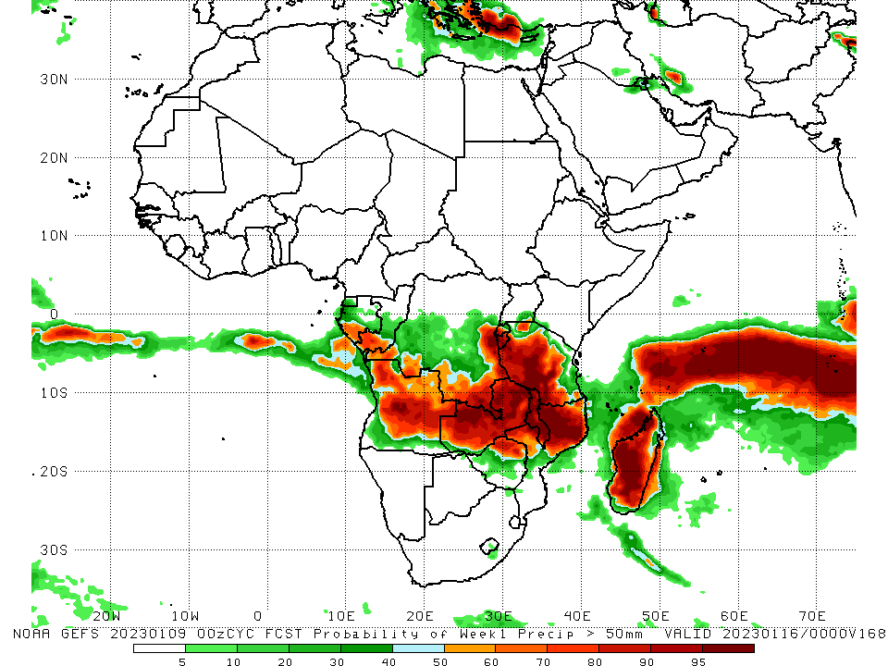
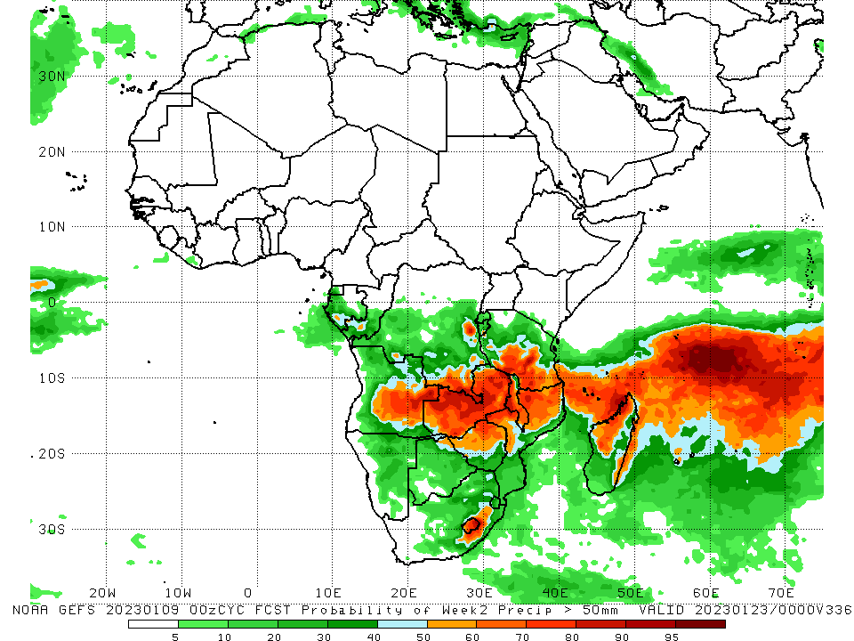
NCEP GEFS Model Forecasts Non-Bias Corrected Probability of precipitation exceedance
Week-1, Valid: 10 – 16 Jan 2023
Week-2, Valid: 17 – 23 Jan 2023
For week-1 (left panel), the NCEP GEFS forecasts indicate a moderate to high chance (over 70%) for rainfall to exceed 50 mm over southern parts of Gabon and Congo, southeastern and eastern DRC, western Rwanda, most of Burundi, central and western Tanzania, Malawi, northern Mozambique, northwestern and central Angola, central and northern Zambia, parts of northern Zimbabwe, and most of Madagascar. For week-2 (right panel), the NCEP GEFS forecasts indicate a moderate to high chance (over 70%) for rainfall to exceed 50 mm over southeastern parts of DRC, portions of central and eastern Angola, northern and central Zambia, northern parts of Zimbabwe, northern Mozambique, central and southern Tanzania, most of Malawi, Lesotho, parts of eastern South Africa, and northern and parts of central Madagascar.
Notes:
‹#›

Slide 10
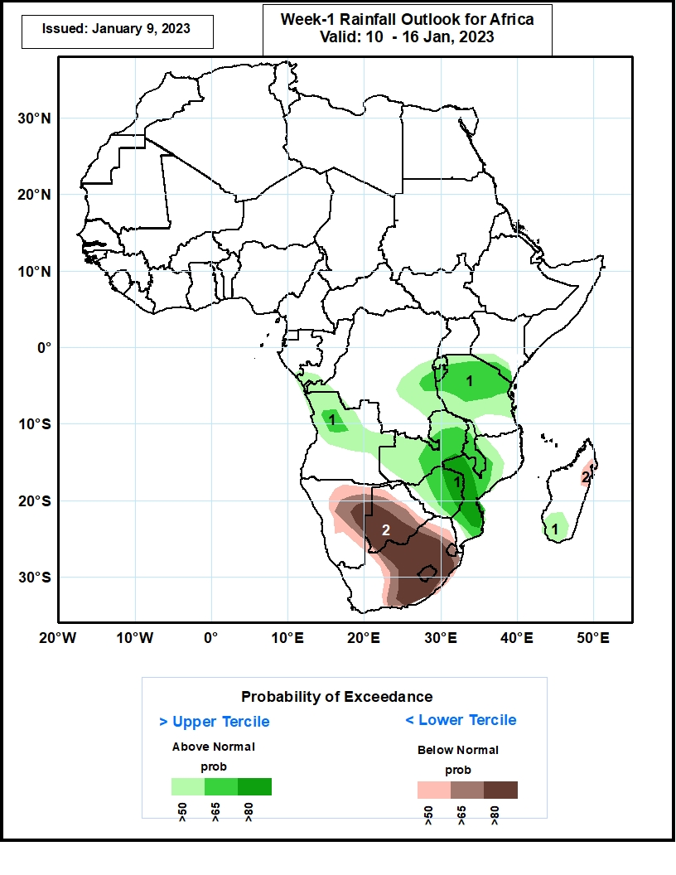
Week-1 Precipitation Outlooks
10 – 16 Jan, 2023
The forecasts suggest above 50% chance for weekly rainfall to be above-normal (above the upper tercile) over southern Congo, western and eastern parts of DRC, southern Kenya, northern and central Tanzania, Rwanda, Burundi, Malawi, central and southern Mozambique, northwestern and central parts of Angola, Zambia, Zimbabwe, and southern Madagascar. In particular, there is above 80% chance for rainfall to be above-normal over west-central and southern Mozambique and eastern Zimbabwe.
The consolidated probabilistic forecasts suggest above 50% chance for weekly total rainfall to be below-normal (below the lower tercile) over central and eastern Namibia, most of Botswana, Lesotho, Eswatini, central and eastern South Africa, and northwestern Madagascar. In particular, there is above 80% chance for rainfall to be below-normal over eastern Namibia, southwestern Botswana, central and southeastern South Africa, and Lesotho.
Notes:
‹#›

Slide 11
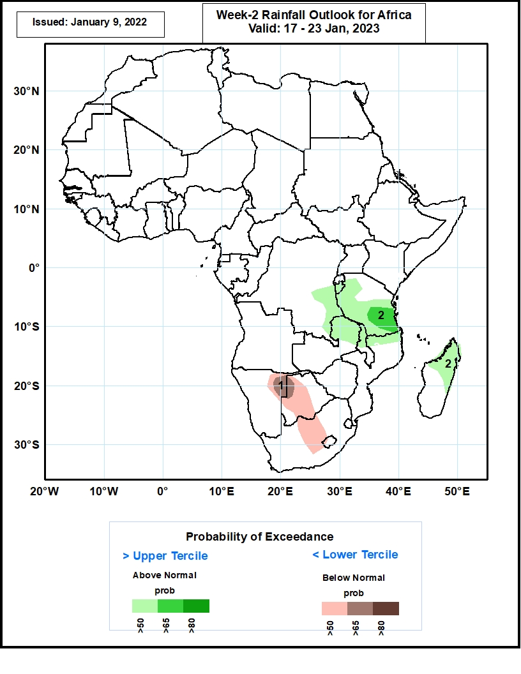
Week-2 Precipitation Outlooks
17 – 23 Jan, 2023
The forecasts suggest above 50% chance for weekly rainfall to be above-normal (above the upper tercile) over southeastern DRC, Burundi, western, central, and southern Tanzania, northeastern Zambia, northern Malawi, and northern Madagascar. In particular, there is above 65% chance for rainfall to be above-normal over southeastern Tanzania.
The consolidated probabilistic forecasts suggest above 50% chance for weekly total rainfall to be below-normal (below the lower tercile) over northeastern Namibia, western and central Botswana, central South Africa, and western Lesotho. In particular, there is above 65% chance for rainfall to be below-normal in northeastern Namibia and northwestern Botswana.
Notes:
‹#›

Slide 12
Summary
During the past 30 days, in East Africa, above-average rainfall was observed over Uganda, pockets of central Kenya, western Ethiopia, central and northern Tanzania, and southeastern South Sudan. Rainfall was below-average over a small portion of southwestern Ethiopia, northern and southern Kenya, and parts of northwestern and southeastern Tanzania. In Central Africa, rainfall was above-average over northeastern Gabon, western Equatorial Guinea, southern Cameroon, southwestern CAR, most of Congo, and southern, eastern, and west-central DRC. Rainfall was below-average over western and southern Gabon, southern CAR, pockets of northern Congo, and pockets of central, southwestern, and northwestern DRC. In West Africa, rainfall was above-average over southern Sierra Leone. In contrast, below-average rainfall was observed from Liberia to southern Nigeria. In southern Africa, above-average rainfall was observed over central and northeastern Angola, South Africa, Lesotho, Eswatini, central Namibia, central and southern Mozambique, northern and southern Malawi, northern and central Zambia, southern and central Botswana, and southern and parts of central Madagascar. Below normal precipitation was observed over southern and northwestern Angola, northern Namibia, southwestern Zambia, central parts of Malawi, parts of central and northeastern Mozambique, most of Zimbabwe, northern and eastern Botswana, and northern and central Madagascar.
During the past 7 days, in East Africa, rainfall was above-average over pockets of northern Ethiopia, central and southern Kenya, western Eritrea, and a small portion of northeastern Tanzania. Below-average rainfall was observed over southwestern Kenya, southern Uganda, Rwanda, Burundi, and most of Tanzania. In Central Africa, rainfall was above-average over Congo and western, central, and southern DRC. Below-average rainfall was observed over southwestern and central Gabon, and northern and eastern DRC. In West Africa, rainfall was near average across most of the region. In Southern Africa, rainfall was above-average over pockets of central, western, and northern Angola, western Lesotho, Eswatini, eastern South Africa, southern Mozambique, central, western, and southern Zambia, eastern Botswana, southern Zimbabwe, and pockets of central Madagascar. In contrast, rainfall was below-average over southeastern Angola, central and northeastern Namibia (including the Caprivi Strip), eastern Zambia, northwestern Botswana, northeastern Zimbabwe, Malawi, north-central South Africa, central and northern Mozambique, and northern and southern Madagascar
Week-1 outlook calls for above-average rainfall over central and southern Congo, southern and central Gabon, Equatorial Guinea, central, southeastern, and southwestern DRC, Rwanda, Burundi, most of Tanzania, Zambia, Zimbabwe, Malawi, northern Mozambique, most of Angola, and southern and central Madagascar. In contrast, below-average rainfall is expected from Liberia to southern Nigeria, over a small portion of southeastern Tanzania, southeastern Angola, northeastern Namibia, central and eastern South Africa, Lesotho, Eswatini, Botswana, central and southern Zimbabwe, southern Mozambique, and northern Madagascar. Week-2 outlooks suggest an increased chance for above-average rainfall over portions of eastern DRC, eastern and southeastern Angola, western Mozambique, central and southern Zambia, central and southern Malawi, central and southern Tanzania, portions of eastern and northwestern Madagascar, Zimbabwe, most of Botswana, central, southern, and northeastern Namibia, South Africa, Lesotho, and Eswatini. Below-average rainfall is likely over eastern Gabon, central Congo, southern Uganda, northern Tanzania, southwestern Kenya, western Angola, Rwanda, Burundi, eastern Mozambique, central, western, and northeastern Madagascar, and along coastal Sierra Leone and Liberia.

