Slide 1
The African Monsoon Recent Evolution and Current Status Include Week-1 and Week-2 Outlooks
Update prepared by Justin Hicks
17 January 2023
For more information, visit:
http://www.cpc.ncep.noaa.gov/products/Global_Monsoons/African_Monsoons/precip_monitoring.shtml

Slide 2
Outline
Highlights
Recent Evolution and Current Conditions
NCEP GEFS Forecasts
Summary

Slide 3
Highlights: Last 7 Days
During the past 7 days, in East Africa, rainfall was above-average over pockets of northern Ethiopia, southeastern Kenya, pockets of central Eritrea, eastern Rwanda, around the Lake Victoria region, and northwestern, western, and northeastern Tanzania. Below-average rainfall was observed over southwestern Kenya, southwestern Rwanda, western Burundi, and pockets of north-central and southeastern Tanzania. In Central Africa, rainfall was above-average over central Congo, eastern and northwestern Gabon, south-central Equatorial Guinea, and western, east-central (west of Rwanda), and southeastern DRC. Below-average rainfall was observed over western Gabon, eastern Equatorial Guinea, pockets of northeastern, south-central, and east-central DRC (west of Burundi), and Sao Tome and Principe. In West Africa, rainfall was near average across most of the region, except for a small region of above-average rainfall in southeastern Cote d’Ivoire and southwestern Ghana and a small region of below-average rainfall in southwestern Cote d’Ivoire and southeastern Liberia. In Southern Africa, rainfall was above-average over central, northwestern, and southwestern Angola, northwestern, north-central, and pockets of southern Mozambique, northern and central Zambia, southeastern Zimbabwe, northern and pockets of central Malawi, and central, southeastern, and pockets of northern Madagascar. In contrast, rainfall was below-average over southeastern and northeastern Angola, central and northeastern Namibia (including the Caprivi Strip), south-central and southwestern Zambia, most of Botswana, western, northern, and central Zimbabwe, pockets of southern Malawi, central and eastern South Africa, Comoros, Lesotho, Eswatini, central, northeastern, and most of coastal southern Mozambique, and northwestern and a small part of southwestern Madagascar.
Week-1 outlook calls for above-average rainfall over central and southern Congo, southern and central Gabon, central DRC, southern Burundi, central and southern Tanzania, central and southern Zambia, northern and central Zimbabwe, most of Malawi, northern Mozambique, northwestern and southern Angola, northern Namibia, northern Botswana, south-central South Africa, most of Lesotho, and northern and eastern Madagascar. In contrast, below-average rainfall is expected in pockets of southern Cote d’Ivoire and southern Nigeria, southern Cameroon, northern and southwestern Gabon, northwestern Congo, central Ethiopia, southern Uganda, southern Kenya, northern Tanzania, central Angola, east-central and southeastern Namibia, southeastern DRC, western and eastern South Africa, Eswatini, southeastern Botswana, southern Zimbabwe, southern and central Mozambique, northwestern Zambia, and southern Madagascar. Week-2 outlooks suggest an increased chance for above-average rainfall over portions of northern, central, and southeastern DRC, Rwanda, Burundi, Equatorial Guinea, western, northern, and eastern Gabon, Congo, eastern and southern Angola, central and southern Mozambique, western Zambia, southern Malawi, central and northern Tanzania, southwestern Kenya, portions of eastern and northern Madagascar, northern and eastern Zimbabwe, northern Botswana, central and northern Namibia, pockets of south-central South Africa, southern Lesotho, and Comoros. Below-average rainfall is likely over southwestern Tanzania, northern and central Malawi, west-central Angola, northern Mozambique, southwestern Zimbabwe, eastern Botswana, northeastern South Africa, western Eswatini, and west-central and southwestern Madagascar.

Slide 4
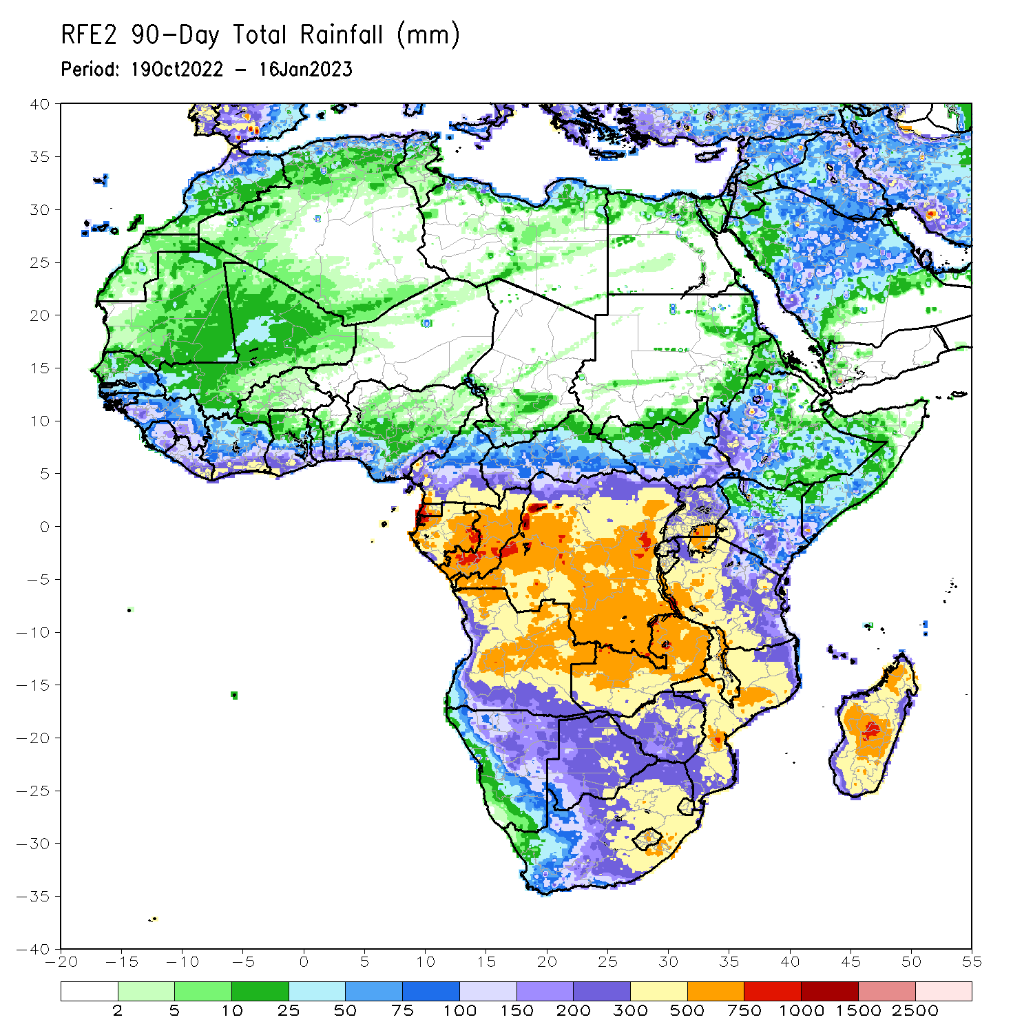
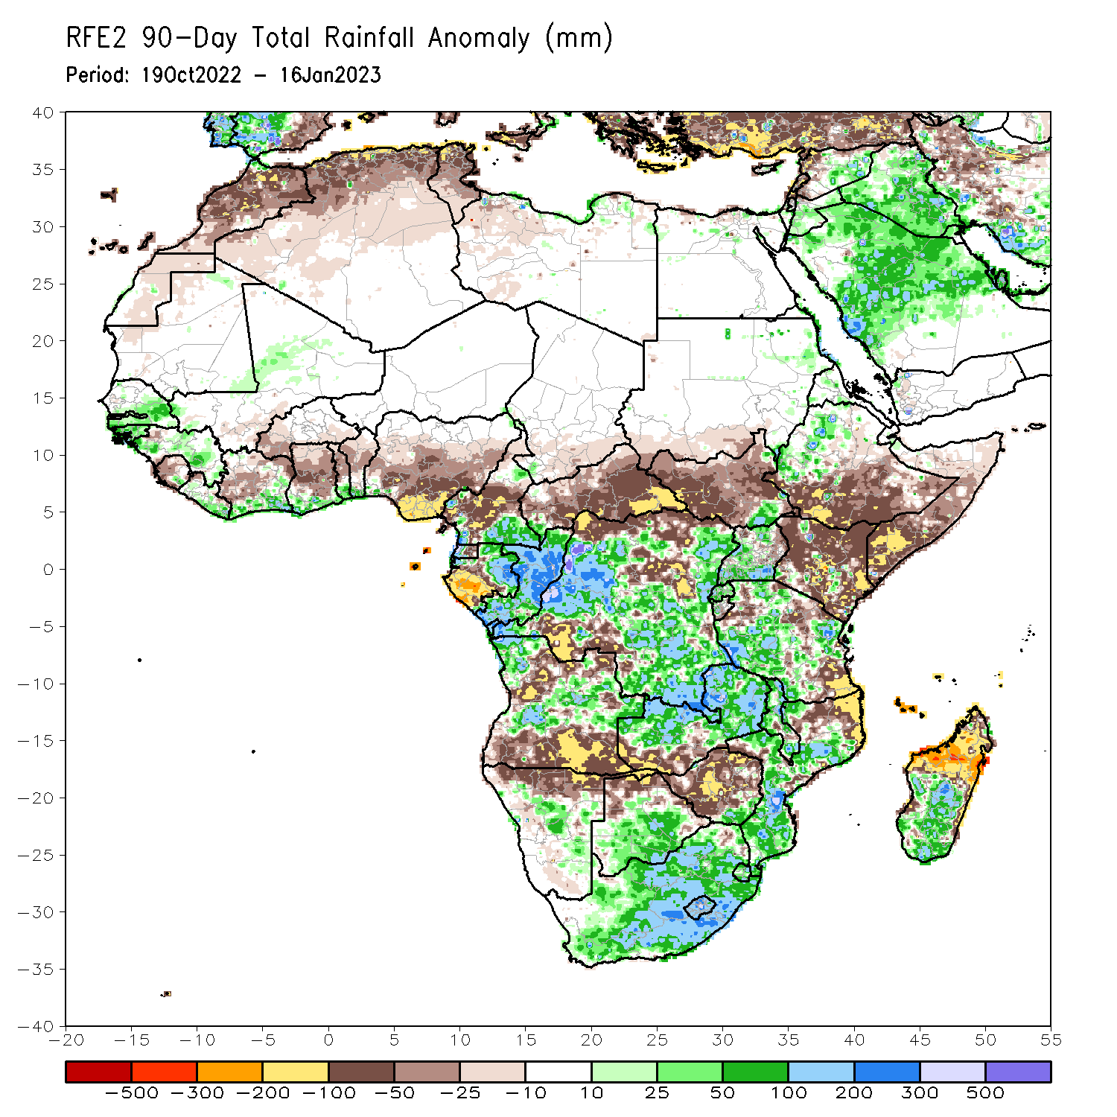
Rainfall Patterns: Last 90 Days
Over the past 90 days, in East Africa, above-average rainfall was observed over the eastern parts of Sudan, pockets of southeastern and northeastern South Sudan, western Ethiopia, northern and western Eritrea, northern, western, and southern Uganda, Rwanda, western Burundi, and pockets of southwestern, west-central, and northeastern Tanzania. Rainfall was below-average over southern, central, and eastern Ethiopia, throughout much of Somalia, most of Kenya, northwest, southwest, central, and eastern South Sudan, and pockets of northern and southeastern Tanzania. In southern Africa, above-average rainfall was observed over central and southern Botswana, South Africa, Lesotho, Eswatini, southern Zimbabwe, central and northern Zambia, central, southern, and northwestern Mozambique, northwestern and portions of central Angola, central and eastern Namibia, northern and southern Malawi, and southern and central parts of Madagascar. Below-average rainfall was observed much of north-central, northeastern, and southern Angola, southwestern Zambia, northern Namibia, central and northern Zimbabwe, northeastern Mozambique, pockets of central Malawi, Comoros, and northern and eastern Madagascar. In Central Africa, rainfall was above-average over southeastern Cameroon, southwestern CAR, eastern and northern Gabon, western Equatorial Guinea, much of Congo, and parts of western, eastern, and southeastern DRC. Rainfall was below-average over northern and central Cameroon, southwestern Gabon, eastern Equatorial Guinea, Sao Tome and Principe, eastern and central CAR, southern Chad, and parts of northern, central and southwestern DRC. In West Africa, rainfall was above-average over southeastern Mauritania, southern and eastern Senegal, Gambia, Guinea-Bissau, central Guinea, southern Liberia, southern Cote D’Ivoire, southern Ghana, southern Togo, southern Benin, central Mali, and southwestern Nigeria. In contrast, below-average rainfall was observed over northern and western Mauritania, southwestern Mali, northwestern Guinea, western and central Sierra Leone, northwestern Liberia, central and northern Cote d’Ivoire, central and northern Ghana, western and southern Burkina Faso, northern and central Togo, northern and central Benin, and southern, central, and eastern Nigeria.
Notes:
‹#›

Slide 5
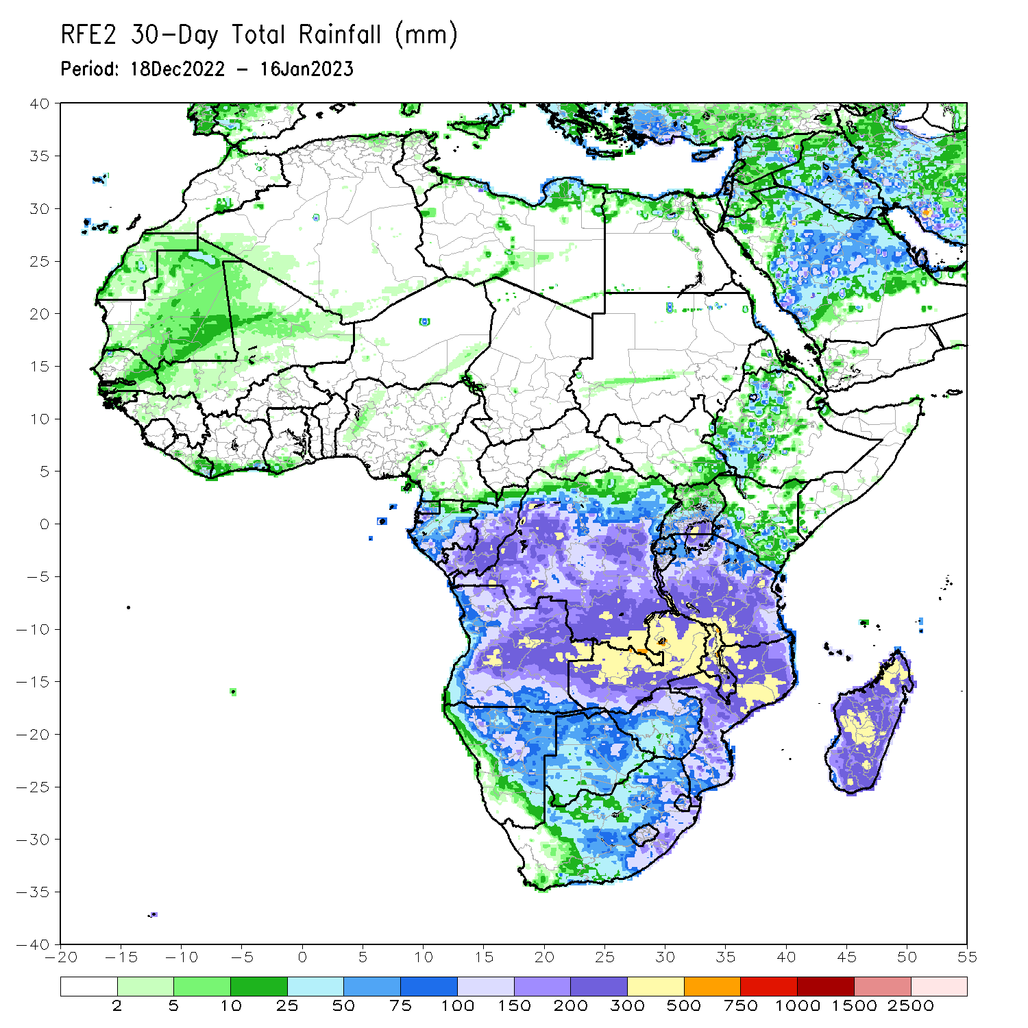
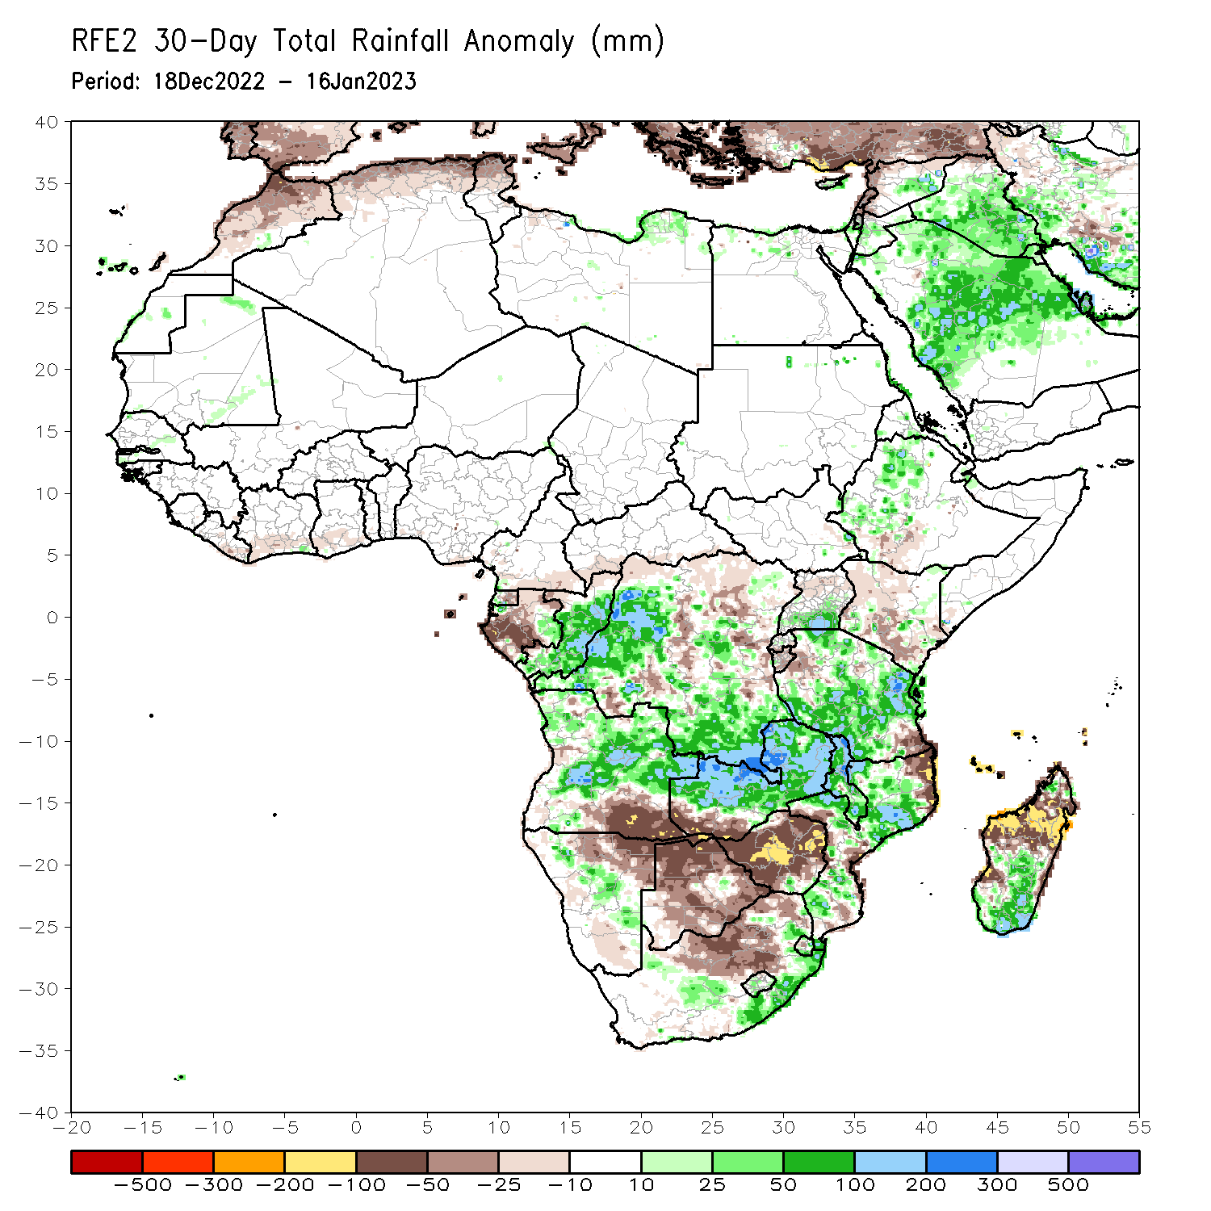
Rainfall Patterns: Last 30 Days
During the past 30 days, in East Africa, above-average rainfall was observed over southern Uganda, pockets of central Kenya, western Ethiopia, and central and northern Tanzania. Rainfall was below-average over a small portion of southwestern Ethiopia, most of northwestern and southern Kenya, southern Rwanda, most of Burundi, and parts of northwestern and southeastern Tanzania. In Central Africa, rainfall was above-average over eastern and a small portion of northwestern Gabon, western Equatorial Guinea, central and southern Congo, and southeastern and west-central DRC. Rainfall was below-average over western, northern, and central Gabon, southern CAR, northern Congo, Sao Tome and Principe, and pockets of central, southwestern, and northwestern DRC. In West Africa, rainfall was above-average over pockets of central and southwestern Senegal and a small pocket of southeastern Cote d’Ivoire. In contrast, below-average rainfall was observed in southeastern Liberia, most of southern Cote d’Ivoire, southern Ghana, and pockets of southern Nigeria. In southern Africa, above-average rainfall was observed over central and most of northern Angola, eastern South Africa, most of Lesotho, eastern Eswatini, pockets of central Namibia, northwestern, central, and southern Mozambique, most of Malawi, northern and central Zambia, and southern, central, and pockets of northwestern Madagascar. Below normal precipitation was observed over southeastern Angola, northern and southern Namibia, southwestern Zambia, pockets of central, northeastern, and southern Mozambique, most of Zimbabwe, most of Botswana, Comoros, north-central South Africa, western Eswatini, and northern and eastern Madagascar.
Notes:
‹#›

Slide 6
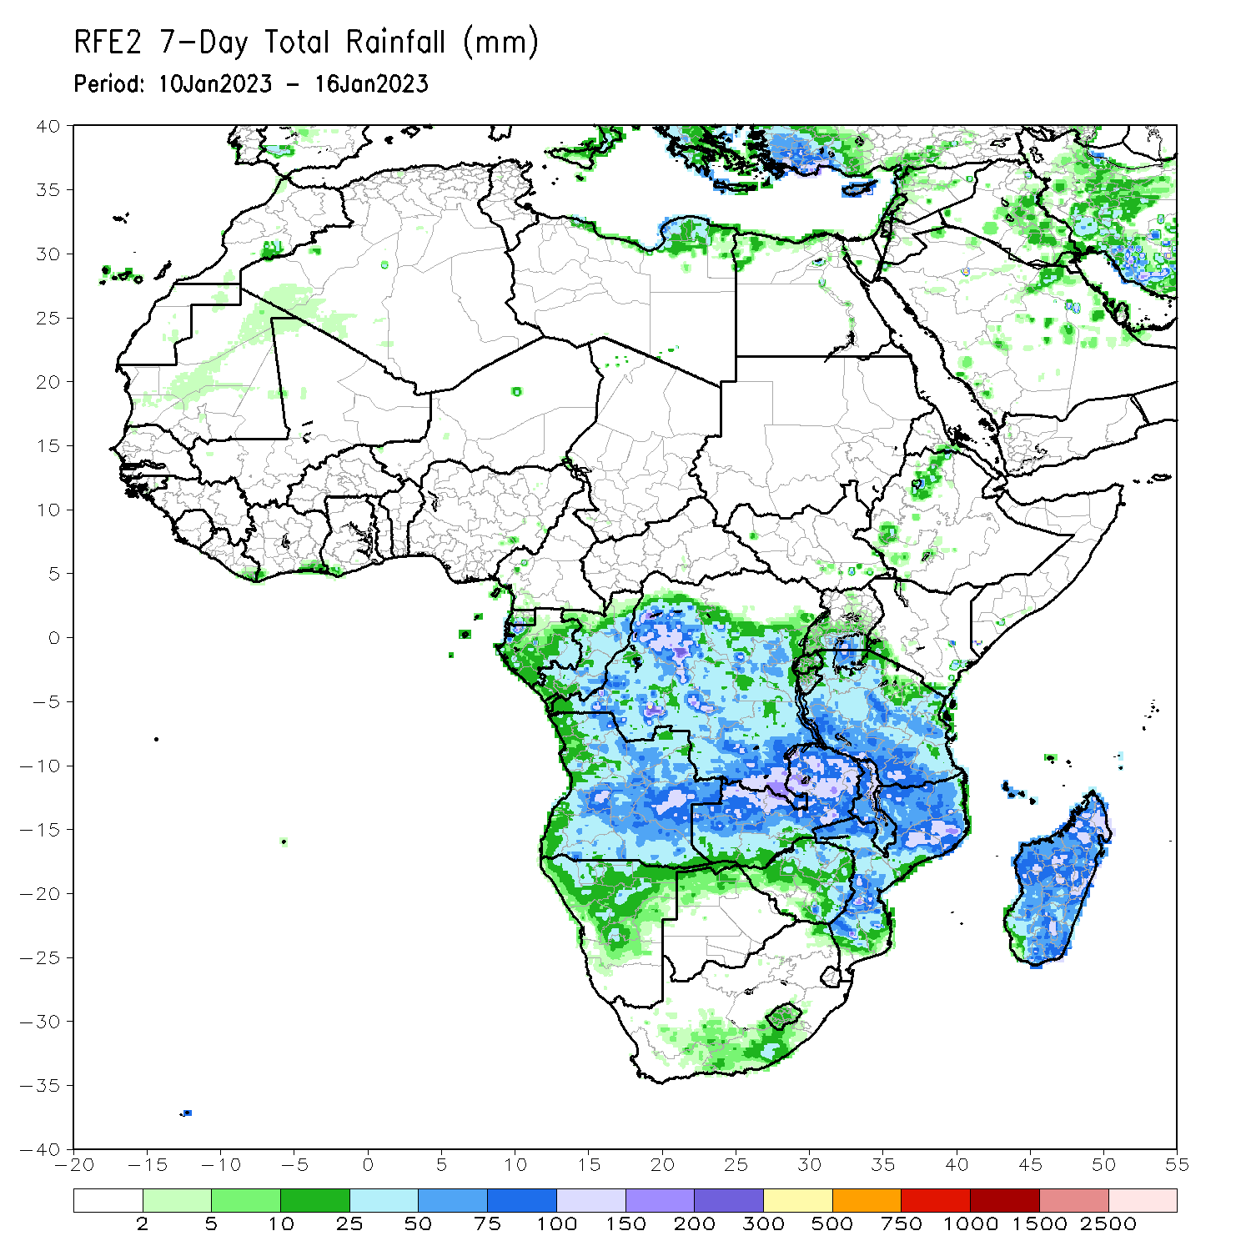
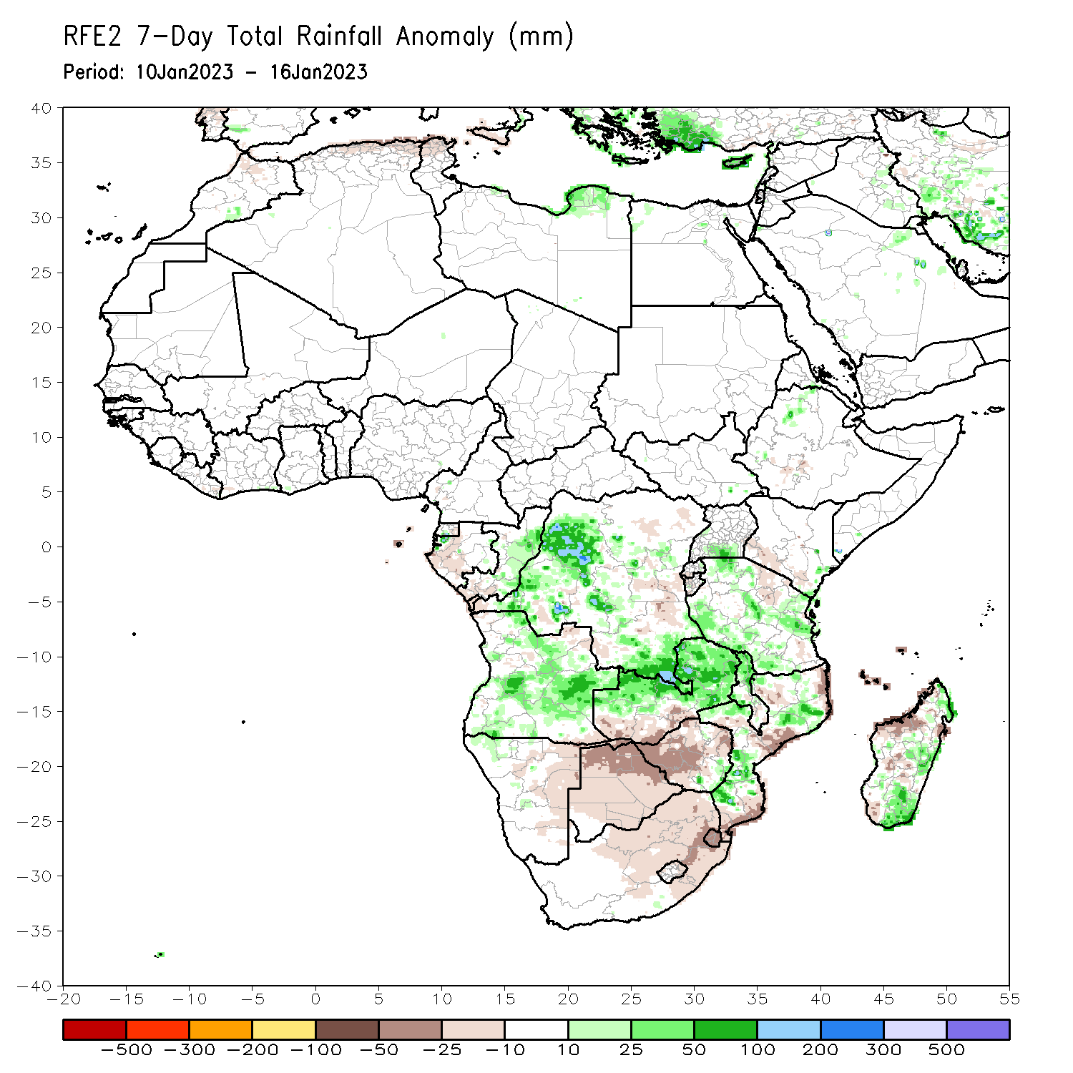
Rainfall Patterns: Last 7 Days
During the past 7 days, in East Africa, rainfall was above-average over pockets of northern Ethiopia, southeastern Kenya, pockets of central Eritrea, eastern Rwanda, around the Lake Victoria region, and northwestern, western, and northeastern Tanzania. Below-average rainfall was observed over southwestern Kenya, southwestern Rwanda, western Burundi, and pockets of north-central and southeastern Tanzania. In Central Africa, rainfall was above-average over central Congo, eastern and northwestern Gabon, south-central Equatorial Guinea, and western, east-central (west of Rwanda), and southeastern DRC. Below-average rainfall was observed over western Gabon, eastern Equatorial Guinea, pockets of northeastern, south-central, and east-central DRC (west of Burundi), and Sao Tome and Principe. In West Africa, rainfall was near average across most of the region, except for a small region of above-average rainfall in southeastern Cote d’Ivoire and southwestern Ghana and a small region of below-average rainfall in southwestern Cote d’Ivoire and southeastern Liberia. In Southern Africa, rainfall was above-average over central, northwestern, and southwestern Angola, northwestern, north-central, and pockets of southern Mozambique, northern and central Zambia, southeastern Zimbabwe, northern and pockets of central Malawi, and central, southeastern, and pockets of northern Madagascar. In contrast, rainfall was below-average over southeastern and northeastern Angola, central and northeastern Namibia (including the Caprivi Strip), south-central and southwestern Zambia, most of Botswana, western, northern, and central Zimbabwe, pockets of southern Malawi, central and eastern South Africa, Comoros, Lesotho, Eswatini, central, northeastern, and most of coastal southern Mozambique, and northwestern and a small part of southwestern Madagascar.

Slide 7
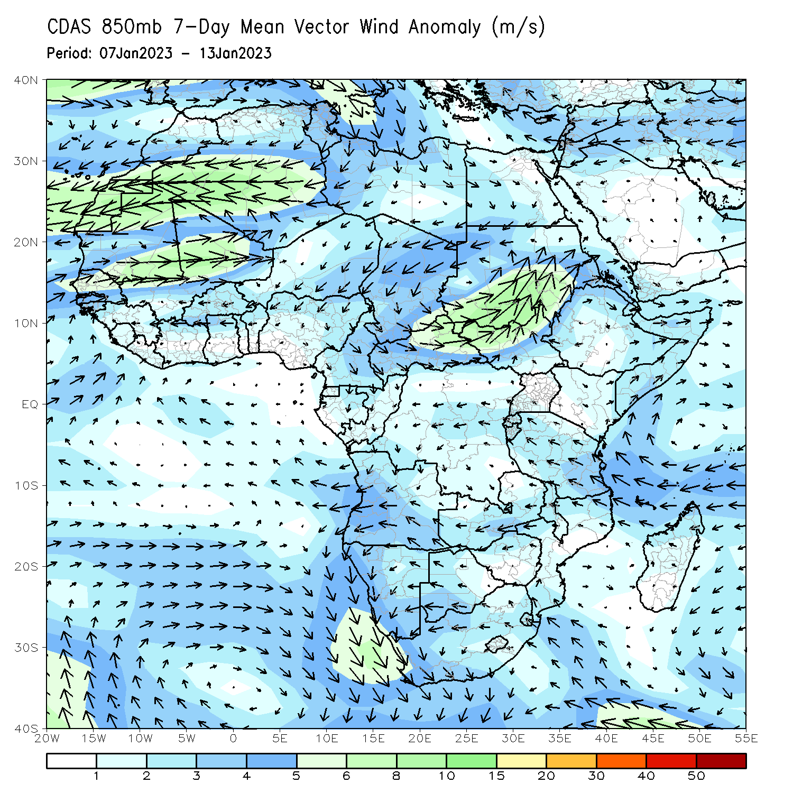
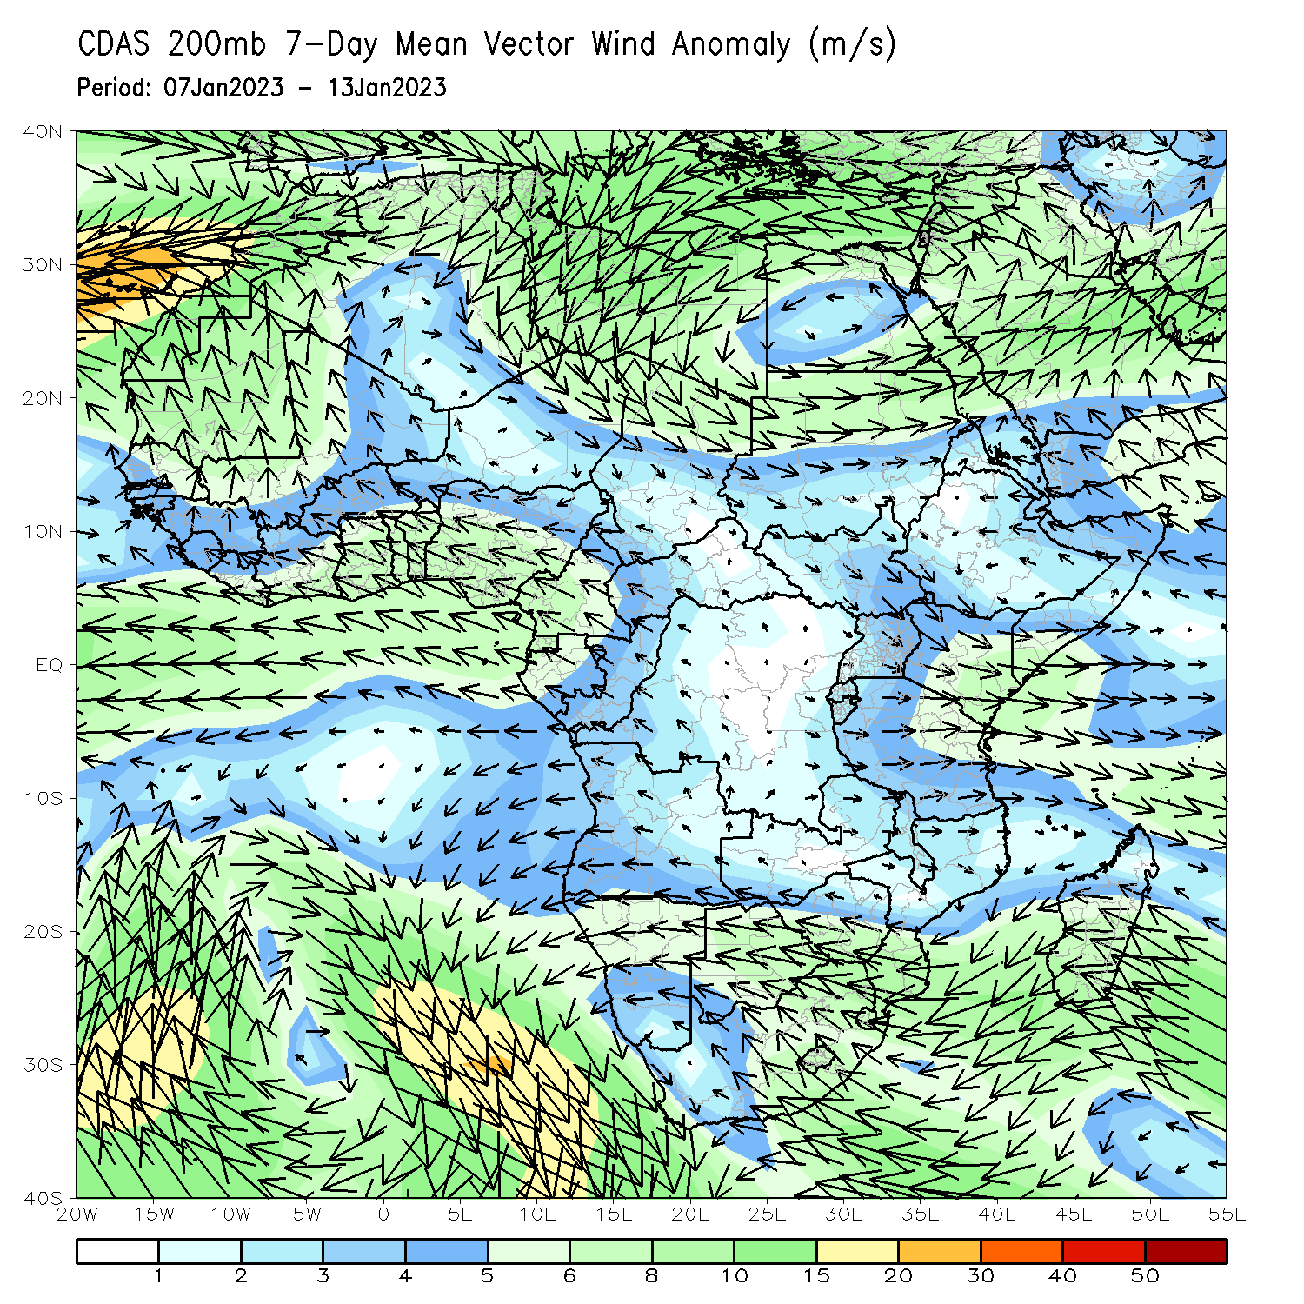
Atmospheric Circulation: Last 7 Days
At 850-hPa level (left panel), anomalous wind convergence may have contributed to the observed rainfall increases across Angola, Zambia, and DRC. Anomalous upper level divergence at 200-hPa (right panel) in the same region complemented the lower level dynamics.

Slide 8
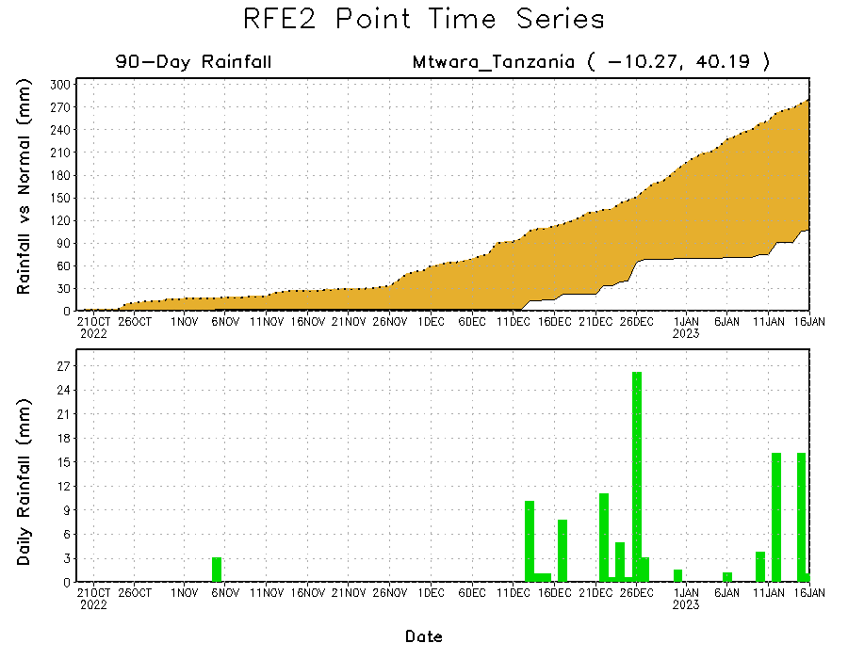
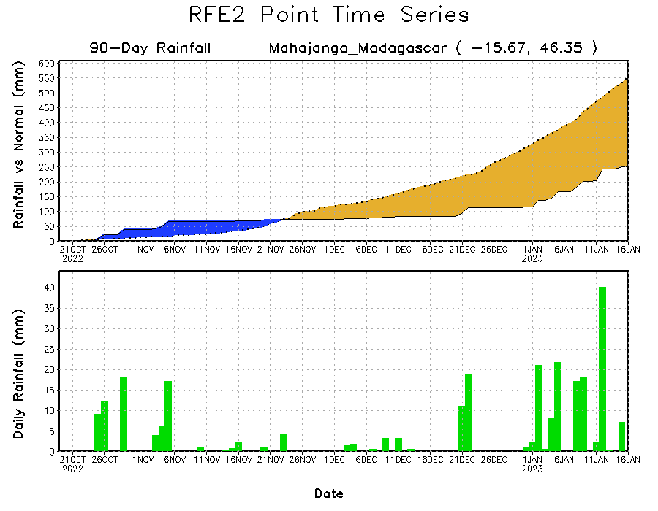
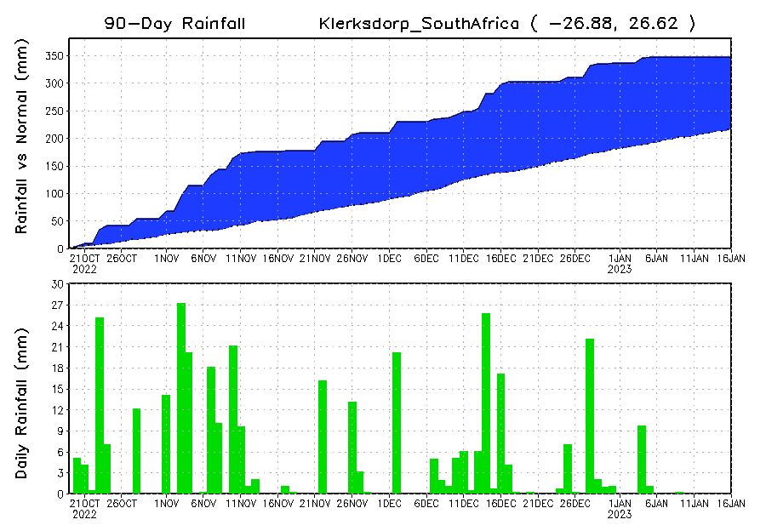
Rainfall Evolution
Daily evolution of rainfall over the last 90 days at selected locations shows continuing moisture surpluses over parts of South Africa (bottom left) despite little rainfall over the last week. Rainfall deficits continue over southeastern Tanzania (top right) and northwestern Madagascar (bottom right).

Slide 9
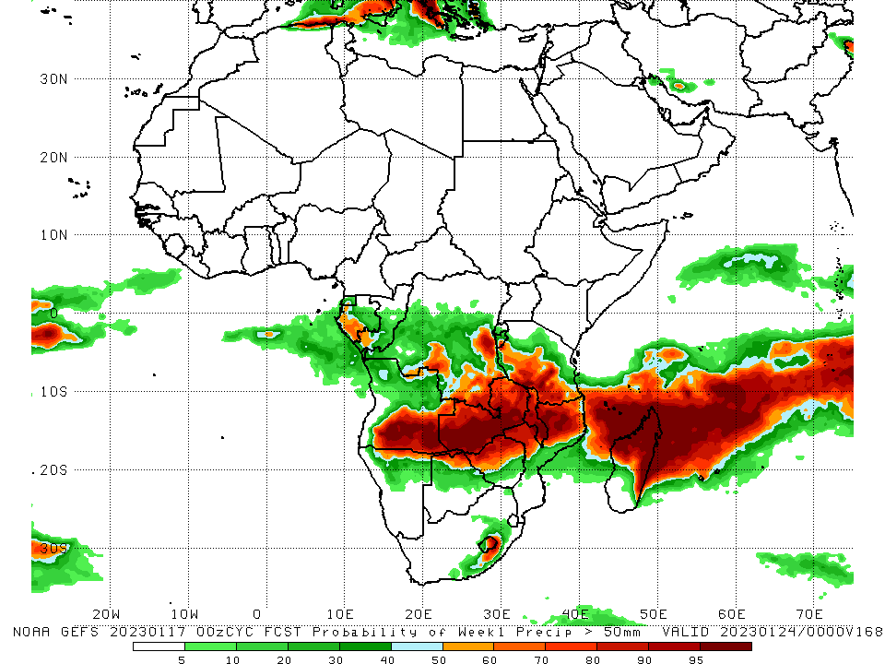
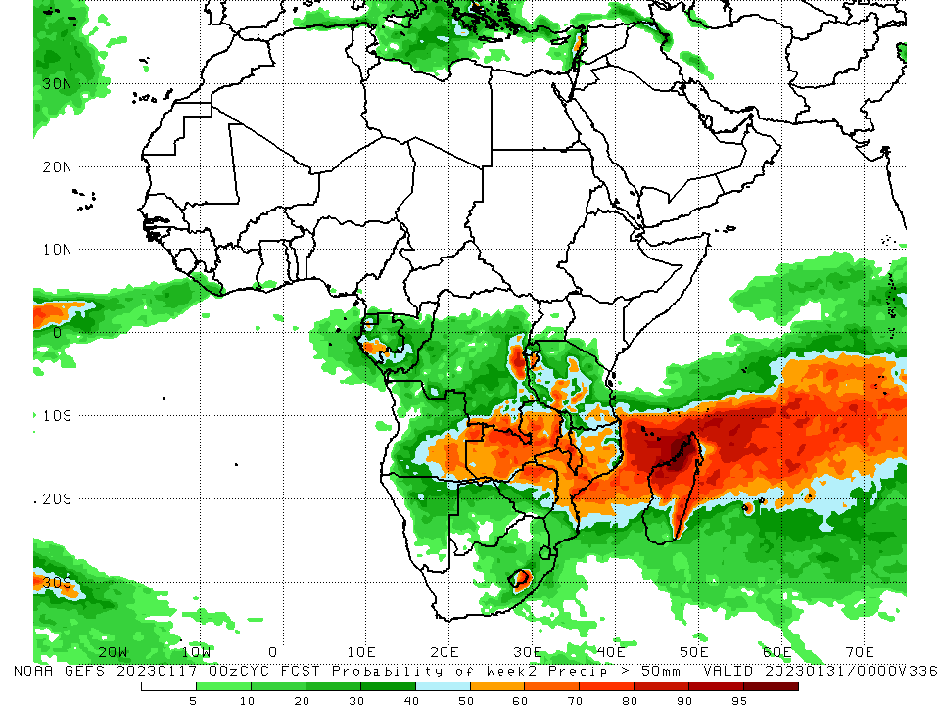
NCEP GEFS Model Forecasts Non-Bias Corrected Probability of precipitation exceedance
Week-1, Valid: 18 – 24 Jan 2023
Week-2, Valid: 25 – 31 Jan 2023
For week-1 (left panel), the NCEP GEFS forecasts indicate a moderate to high chance (over 70%) for rainfall to exceed 50 mm over southeastern, east-central, and south-central DRC, southeastern Burundi, southwestern Tanzania, Malawi, northwestern Mozambique, southeastern and south-central Angola, central and southern Zambia, northern Zimbabwe, eastern Lesotho, Comoros, and northern and eastern Madagascar. For week-2 (right panel), the NCEP GEFS forecasts indicate a moderate to high chance (over 70%) for rainfall to exceed 50 mm over southeastern and east-central DRC, portions of east-central Angola, northern and central Zambia, northern parts of Zimbabwe, central Mozambique, central Malawi, eastern Lesotho, Comoros, and northern, central, and eastern Madagascar.
Notes:
‹#›

Slide 10
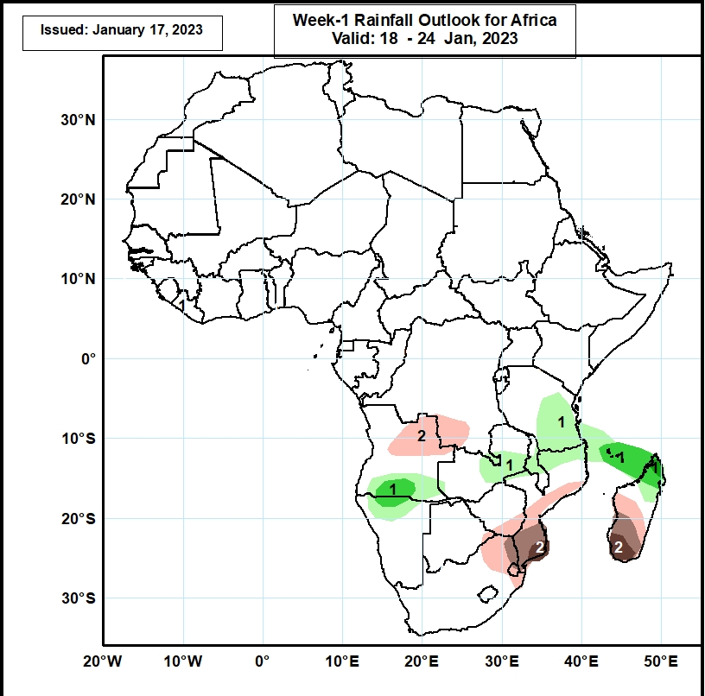
Week-1 Precipitation Outlooks
18 – 24 Jan, 2023
The forecasts suggest above 50% chance for weekly rainfall to be above-normal (above the upper tercile) over southern Angola, northern Namibia, east-central Zambia, central Malawi, northern Mozambique, southern Tanzania, Comoros, and northern Madagascar. In particular, there is above 65% chance for rainfall to be above-normal over south-central Angola, north-central Namibia, northern Madagascar, and Comoros. There is above 80% chance for rainfall to be above-normal for northern Madagascar.
The consolidated probabilistic forecasts suggest above 50% chance for weekly total rainfall to be below-normal (below the lower tercile) over northeastern Angola, south-central DRC, southern Zimbabwe, eastern Botswana, central and southern Mozambique, northeastern South Africa, Eswatini, and central and southern Madagascar. In particular, there is above 65% chance for rainfall to be below-normal in northeastern South Africa, northern Eswatini, southern Mozambique, and southern Madagascar. There is above 80% chance for rainfall to be below-normal in southern Mozambique and southern Madagascar.
Notes:
‹#›

Slide 11
Week-2 Precipitation Outlooks
25 – 31 Jan, 2023
The forecasts suggest above 50% chance for weekly rainfall to be above-normal (above the upper tercile) over central DRC, western, southeastern Tanzania, northeastern Mozambique, Comoros, central South Africa, and Lesotho. In particular, there is above 65% chance for rainfall to be above-normal over central South Africa and western Lesotho.
The consolidated probabilistic forecasts suggest above 50% chance for weekly total rainfall to be below-normal (below the lower tercile) over central and southern Zimbabwe and small portions of eastern Botswana, northeastern South Africa, and southwestern Mozambique.
Notes:
‹#›

Slide 12
Summary
During the past 30 days, in East Africa, above-average rainfall was observed over southern Uganda, pockets of central Kenya, western Ethiopia, and central and northern Tanzania. Rainfall was below-average over a small portion of southwestern Ethiopia, most of northwestern and southern Kenya, southern Rwanda, most of Burundi, and parts of northwestern and southeastern Tanzania. In Central Africa, rainfall was above-average over eastern and a small portion of northwestern Gabon, western Equatorial Guinea, central and southern Congo, and southeastern and west-central DRC. Rainfall was below-average over western, northern, and central Gabon, southern CAR, northern Congo, Sao Tome and Principe, and pockets of central, southwestern, and northwestern DRC. In West Africa, rainfall was above-average over pockets of central and southwestern Senegal and a small pocket of southeastern Cote d’Ivoire. In contrast, below-average rainfall was observed in southeastern Liberia, most of southern Cote d’Ivoire, southern Ghana, and pockets of southern Nigeria. In southern Africa, above-average rainfall was observed over central and most of northern Angola, eastern South Africa, most of Lesotho, eastern Eswatini, pockets of central Namibia, northwestern, central, and southern Mozambique, most of Malawi, northern and central Zambia, and southern, central, and pockets of northwestern Madagascar. Below normal precipitation was observed over southeastern Angola, northern and southern Namibia, southwestern Zambia, pockets of central, northeastern, and southern Mozambique, most of Zimbabwe, most of Botswana, Comoros, north-central South Africa, western Eswatini, and northern and eastern Madagascar.
During the past 7 days, in East Africa, rainfall was above-average over pockets of northern Ethiopia, southeastern Kenya, pockets of central Eritrea, eastern Rwanda, around the Lake Victoria region, and northwestern, western, and northeastern Tanzania. Below-average rainfall was observed over southwestern Kenya, southwestern Rwanda, western Burundi, and pockets of north-central and southeastern Tanzania. In Central Africa, rainfall was above-average over central Congo, eastern and northwestern Gabon, south-central Equatorial Guinea, and western, east-central (west of Rwanda), and southeastern DRC. Below-average rainfall was observed over western Gabon, eastern Equatorial Guinea, pockets of northeastern, south-central, and east-central DRC (west of Burundi), and Sao Tome and Principe. In West Africa, rainfall was near average across most of the region, except for a small region of above-average rainfall in southeastern Cote d’Ivoire and southwestern Ghana and a small region of below-average rainfall in southwestern Cote d’Ivoire and southeastern Liberia. In Southern Africa, rainfall was above-average over central, northwestern, and southwestern Angola, northwestern, north-central, and pockets of southern Mozambique, northern and central Zambia, southeastern Zimbabwe, northern and pockets of central Malawi, and central, southeastern, and pockets of northern Madagascar. In contrast, rainfall was below-average over southeastern and northeastern Angola, central and northeastern Namibia (including the Caprivi Strip), south-central and southwestern Zambia, most of Botswana, western, northern, and central Zimbabwe, pockets of southern Malawi, central and eastern South Africa, Comoros, Lesotho, Eswatini, central, northeastern, and most of coastal southern Mozambique, and northwestern and a small part of southwestern Madagascar.
Week-1 outlook calls for above-average rainfall over central and southern Congo, southern and central Gabon, central DRC, southern Burundi, central and southern Tanzania, central and southern Zambia, northern and central Zimbabwe, most of Malawi, northern Mozambique, northwestern and southern Angola, northern Namibia, northern Botswana, south-central South Africa, most of Lesotho, and northern and eastern Madagascar. In contrast, below-average rainfall is expected in pockets of southern Cote d’Ivoire and southern Nigeria, southern Cameroon, northern and southwestern Gabon, northwestern Congo, central Ethiopia, southern Uganda, southern Kenya, northern Tanzania, central Angola, east-central and southeastern Namibia, southeastern DRC, western and eastern South Africa, Eswatini, southeastern Botswana, southern Zimbabwe, southern and central Mozambique, northwestern Zambia, and southern Madagascar. Week-2 outlooks suggest an increased chance for above-average rainfall over portions of northern, central, and southeastern DRC, Rwanda, Burundi, Equatorial Guinea, western, northern, and eastern Gabon, Congo, eastern and southern Angola, central and southern Mozambique, western Zambia, southern Malawi, central and northern Tanzania, southwestern Kenya, portions of eastern and northern Madagascar, northern and eastern Zimbabwe, northern Botswana, central and northern Namibia, pockets of south-central South Africa, southern Lesotho, and Comoros. Below-average rainfall is likely over southwestern Tanzania, northern and central Malawi, west-central Angola, northern Mozambique, southwestern Zimbabwe, eastern Botswana, northeastern South Africa, western Eswatini, and west-central and southwestern Madagascar.

