Slide 1
The African Monsoon Recent Evolution and Current Status Include Week-1 and Week-2 Outlooks
Update prepared by Justin Hicks
23 January 2023
For more information, visit:
http://www.cpc.ncep.noaa.gov/products/Global_Monsoons/African_Monsoons/precip_monitoring.shtml

Slide 2
Outline
Highlights
Recent Evolution and Current Conditions
NCEP GEFS Forecasts
Summary

Slide 3
Highlights: Last 7 Days
During the past 7 days, in East Africa, rainfall was above-average over western Burundi, south-central Uganda, and northwestern, central, and southern Tanzania. Below-average rainfall was observed over pockets of southwestern Ethiopia, southeastern Uganda, southwestern Kenya, western Burundi, Rwanda, and northwestern and north-central Tanzania. In Central Africa, rainfall was above-average over most of northwestern and central portions of coastal Gabon, south-central Equatorial Guinea, southwestern Congo, and most of western, east-central (west of Rwanda), and pockets of southeastern DRC. Below-average rainfall was observed over the southwestern coast, central, and southern portions of Gabon, northern, western, and eastern Equatorial Guinea, southwestern and northwestern Congo, southern Cameroon, pockets of northeastern, northwestern, southern, and central DRC, and Sao Tome and Principe. In West Africa, rainfall was near average across most of the region, except for small regions of below-average rainfall in southwestern and northeastern Cote d’Ivoire, southeastern Liberia, northwestern Ghana, north-central Togo, northwestern Benin, and southwestern and southeastern pockets of coastal Nigeria. In contrast, rainfall was above average only in a small south-central pocket of coastal Nigeria. In Southern Africa, rainfall was above-average over southern, northwestern, and pockets of central Angola, northwestern, northwestern, northeastern, and pockets of southwestern Mozambique, western, eastern, and south-central Zambia, southeastern Zimbabwe, north-central to southern Malawi, southwestern Botswana, most of northern (including the eastern portion of the Caprivi Strip) and central Namibia, portions of central and south-central South Africa, Lesotho, central and eastern Comoros, and northern, central, and most of the east coast of Madagascar. In contrast, rainfall was below-average over west-central and northeastern Angola, pockets of northeastern Namibia (including the western portion of the Caprivi Strip), portions of north--central and pockets of northeastern Zambia, most of northern, central, and eastern Botswana, most of western, northern, and southern Zimbabwe, pockets of northern Malawi, northeastern and eastern South Africa, Eswatini, central and eastern/southern portions of coastal Mozambique, and most of southern Madagascar.
Week-1 outlook calls for above-average rainfall over the western portion of the Gulf of Guinea (from Sierra Leone to Ghana), southern Congo, southern and central Gabon, central DRC, Burundi, central and western Tanzania, western Zambia, east-central and southeastern portions of coastal Mozambique, northwestern and southern Angola, northwestern Namibia, and northern and most of western, east-central, and southwestern Madagascar. In contrast, below-average rainfall is expected in pockets of southern Nigeria, Sao Tome and Principe, southern Cameroon, western Gabon, Equatorial Guinea, pockets of southwestern Ethiopia, southeastern Uganda, southern Kenya, northern, eastern, and southern Tanzania, central Angola, east-central and northeastern and central Namibia, southeastern DRC, central and eastern South Africa, Eswatini, Lesotho, Botswana, Zimbabwe, northern and western Mozambique, pockets of northern and eastern Zambia, Malawi, Comoros, Seychelles, and pockets of northeastern and central Madagascar. Week-2 outlooks suggest above-average rainfall over portions of central DRC, Equatorial Guinea, Gabon, central and southern Congo, southwestern and northwestern Angola, central and southern Mozambique, southern Malawi, portions of central Madagascar, and central and eastern Zimbabwe. Below-average rainfall is likely over northern and southern Tanzania, southeastern Uganda, southwestern Kenya, northern and central Malawi, northeastern Angola, northern Mozambique, southern Botswana, eastern Zambia, pockets of eastern Namibia, central and southeastern South Africa, Lesotho, Comoros, Seychelles, and northwestern and eastern Madagascar.

Slide 4
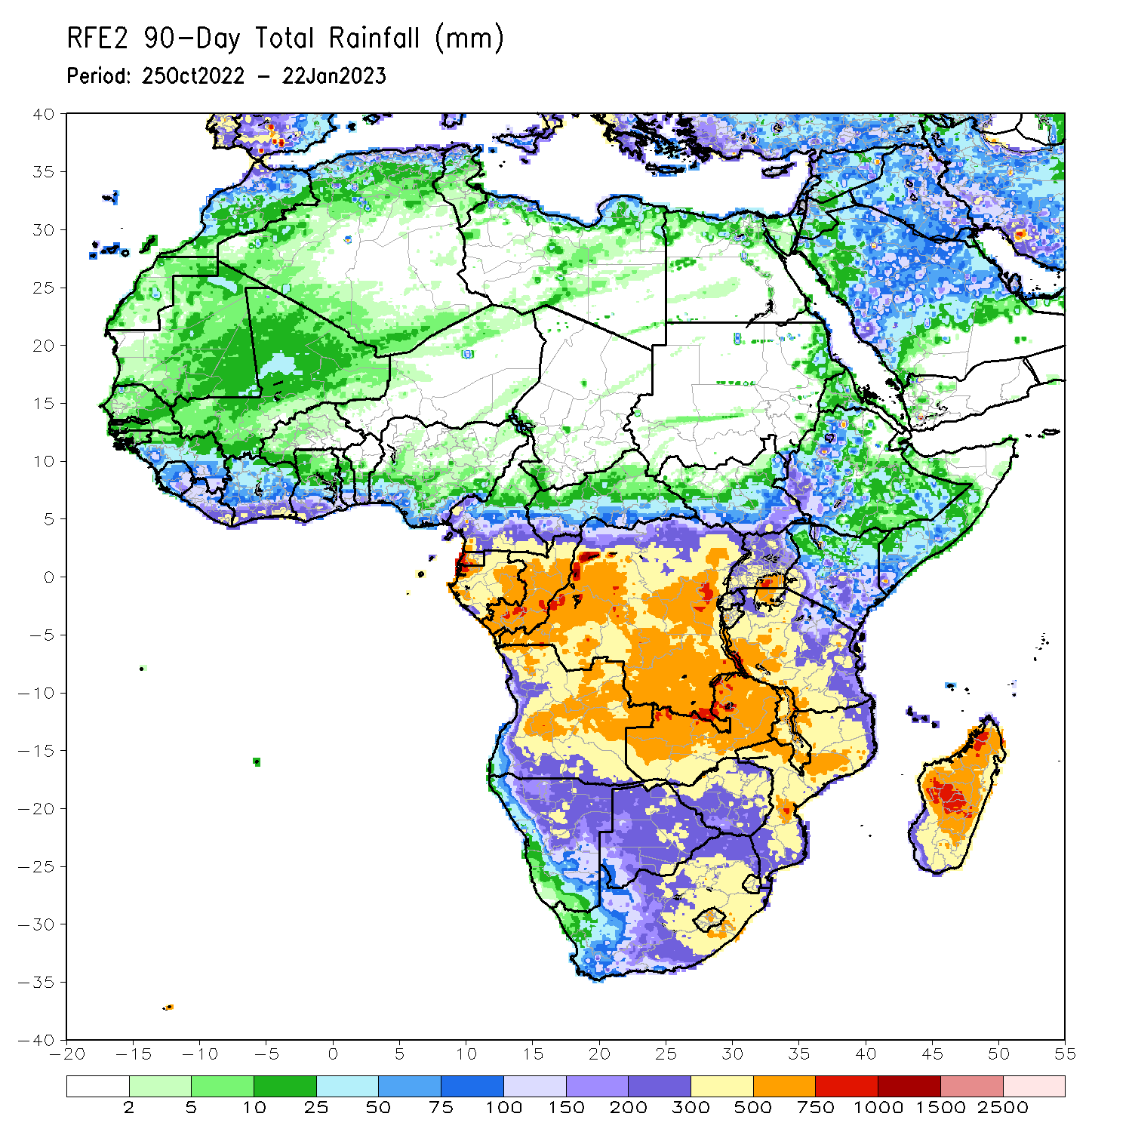
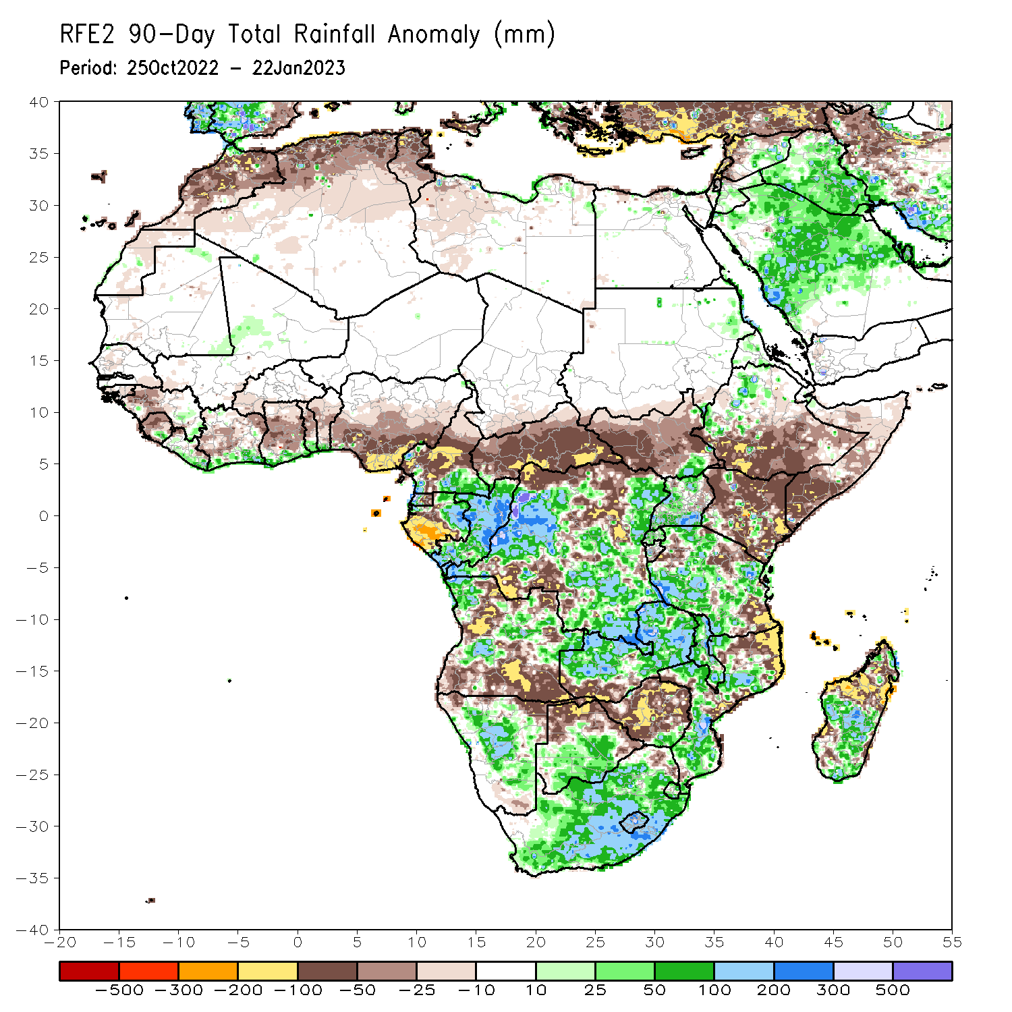
Rainfall Patterns: Last 90 Days
Over the past 90 days, in East Africa, above-average rainfall was observed over the eastern parts of Sudan, pockets of southeastern and northeastern South Sudan, western Ethiopia, northern and western Eritrea, northern, western, and southern Uganda, Rwanda, western Burundi, pockets of southwestern Kenya, and pockets of southwestern, central, and northwestern Tanzania. Rainfall was below-average over southern, central, and eastern Ethiopia, throughout much of Somalia, most of northern, southern, and eastern Kenya, northwestern, southwestern, central, and eastern South Sudan, and pockets of northern and southeastern Tanzania. In southern Africa, above-average rainfall was observed over central and southern Botswana, most of South Africa, Lesotho, Eswatini, southern Zimbabwe, central and northern Zambia, central, southern, and northwestern Mozambique, northwestern and portions of central Angola, central and east-central Namibia, most of Malawi, and southern and central parts of Madagascar. Below-average rainfall was observed much of west-central, northeastern, and southern Angola, southwestern Zambia, northern Namibia, central and northern Zimbabwe, northeastern Mozambique, Comoros, and northern and eastern Madagascar. In Central Africa, rainfall was above-average over southeastern Cameroon, southwestern CAR, eastern and northern Gabon, western Equatorial Guinea, much of Congo, and parts of western, eastern, and southeastern DRC. Rainfall was below-average over northern and central Cameroon, southwestern Gabon, eastern Equatorial Guinea, Sao Tome and Principe, eastern and central CAR, southern Chad, and parts of northern, central and southwestern DRC. In West Africa, rainfall was above-average over southeastern Mauritania, southeastern Guinea, southern Liberia, southern Cote D’Ivoire, southern Ghana, southern Togo, southern Benin, west-central Mali, and pockets of southwestern Nigeria. In contrast, below-average rainfall was observed over pockets of northern and western Mauritania, pockets of southwestern Mali, northern and southwestern Senegal, Guinea-Bissau, western Guinea, western and central Sierra Leone, northwestern Liberia, central and northern Cote d’Ivoire, central and northern Ghana, western and southern Burkina Faso, northern and central Togo, northern and central Benin, and southern, central, and eastern Nigeria.
Notes:
‹#›

Slide 5
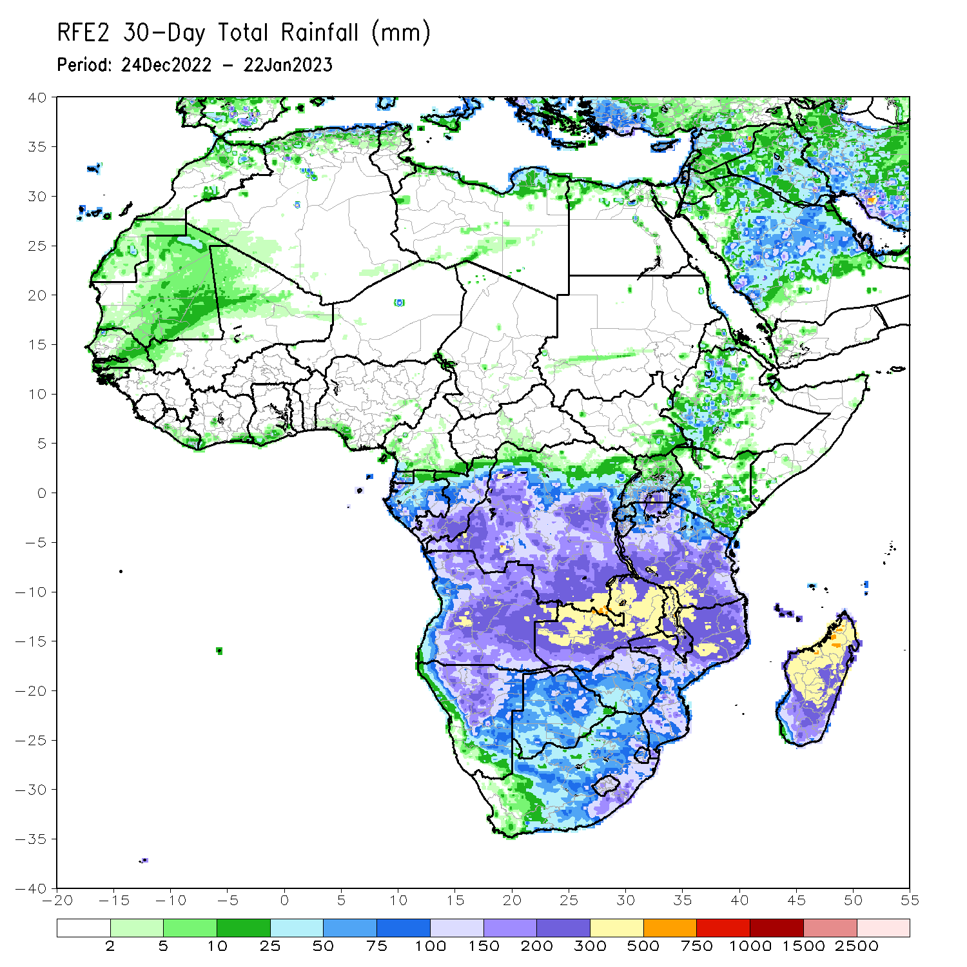
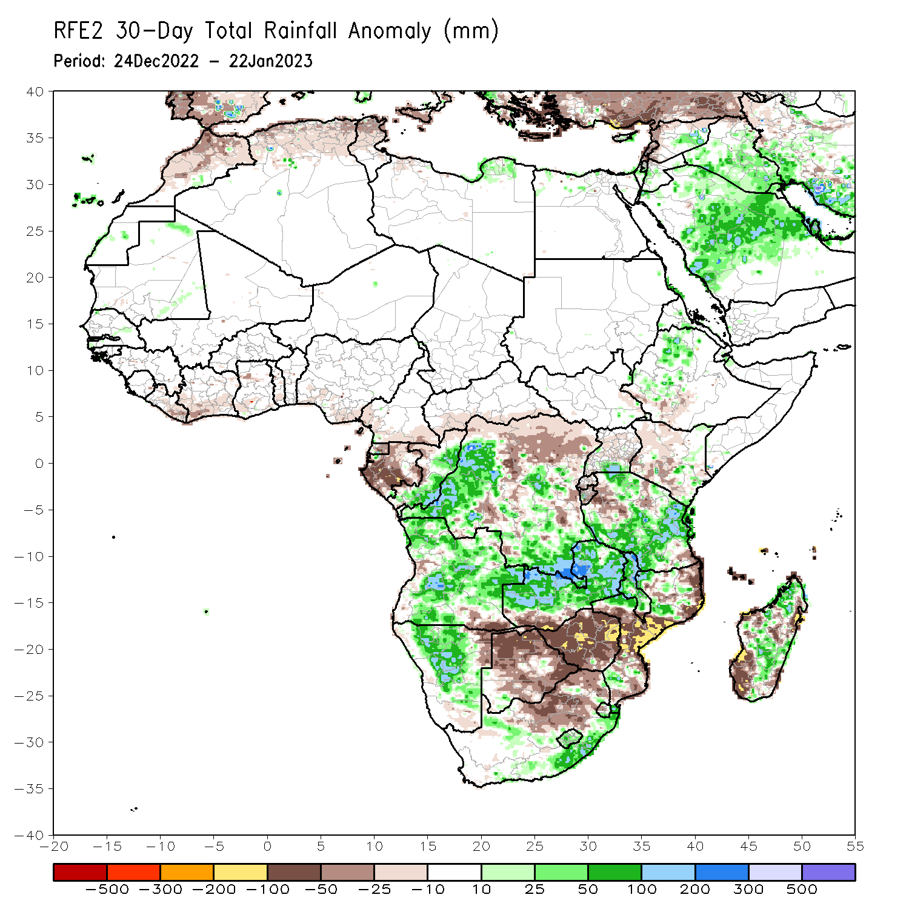
Rainfall Patterns: Last 30 Days
During the past 30 days, in East Africa, above-average rainfall was observed over southeastern Uganda, pockets of central and southeastern Kenya, western Ethiopia, west-central Burundi, and central, northern, and southwestern Tanzania. Rainfall was below-average over a small portion of southwestern Ethiopia, most of northwestern and southwestern Kenya, southern Rwanda, eastern Burundi, and parts of west-central and southeastern Tanzania. In Central Africa, rainfall was above-average over central and southern Congo, and southeastern and most of western DRC. Rainfall was below-average over western, eastern, and central Gabon, southern CAR, northern Congo, Sao Tome and Principe, and pockets of central, eastern, and northern DRC. In West Africa, rainfall was above-average over pockets of central and southwestern Senegal. In contrast, below-average rainfall was observed in southeastern Liberia, most of southern Cote d’Ivoire, southern Ghana, southern Togo, and pockets of southern Nigeria. In southern Africa, above-average rainfall was observed over central, south-central, and most of northern Angola, southeastern South Africa, most of Lesotho, eastern Eswatini, central and north-central Namibia, northwestern and south-central Mozambique, most of Malawi, northern and central Zambia, and central and northwestern Madagascar. Below normal precipitation was observed over southeastern Angola, northeastern Namibia, southwestern Zambia, pockets of central, northeastern, and southern Mozambique, most of Zimbabwe, most of Botswana, Comoros, north-central and northeastern South Africa, western Eswatini, and northeastern and southwestern Madagascar.
Notes:
‹#›

Slide 6
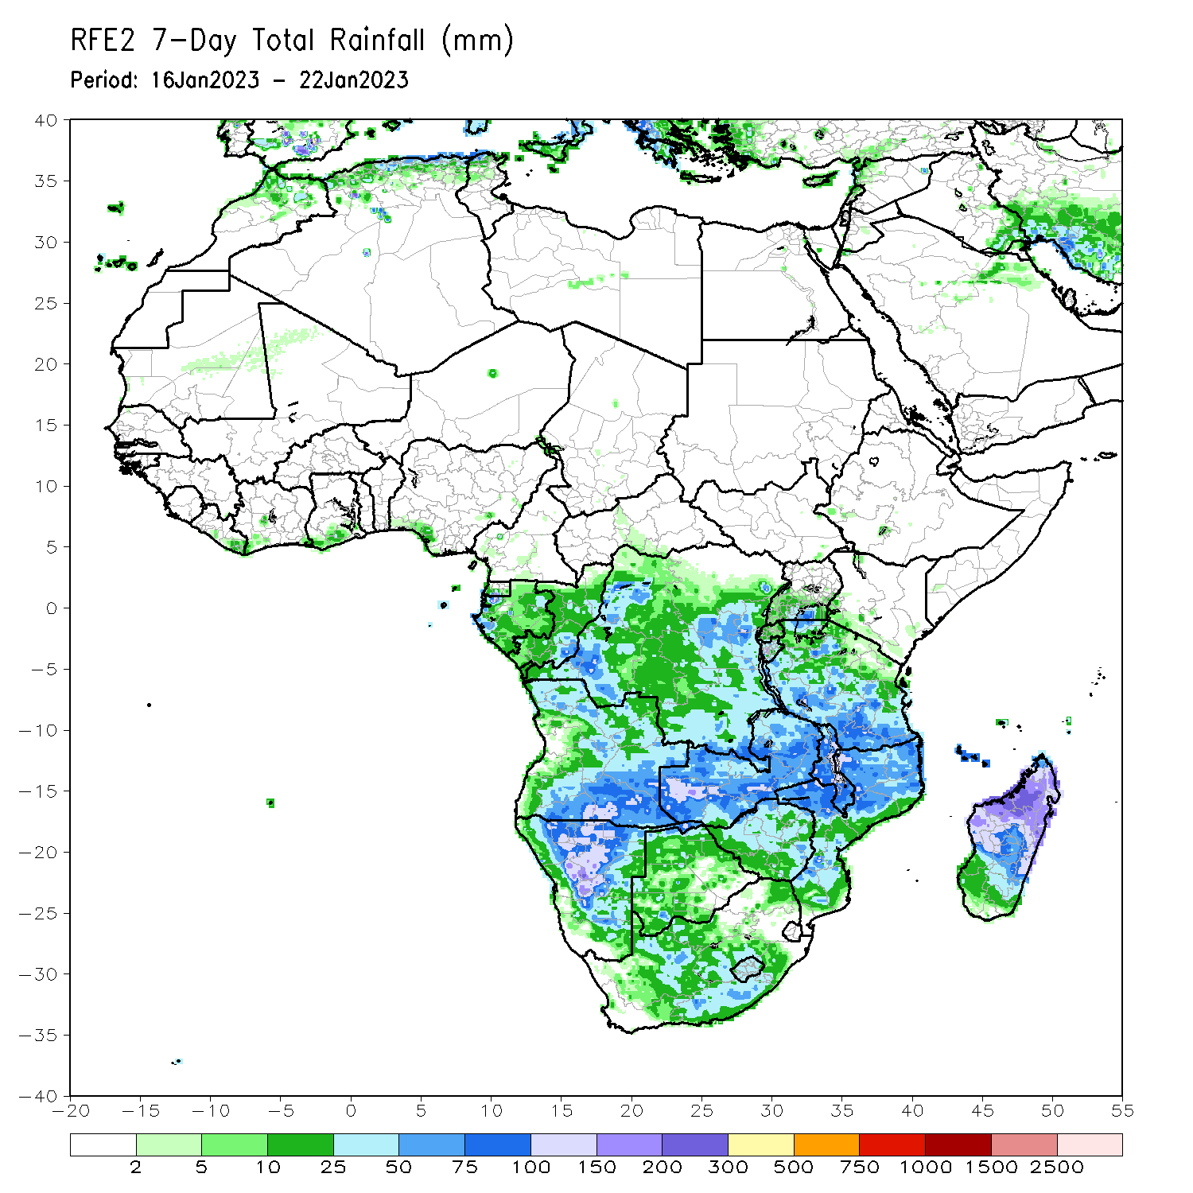
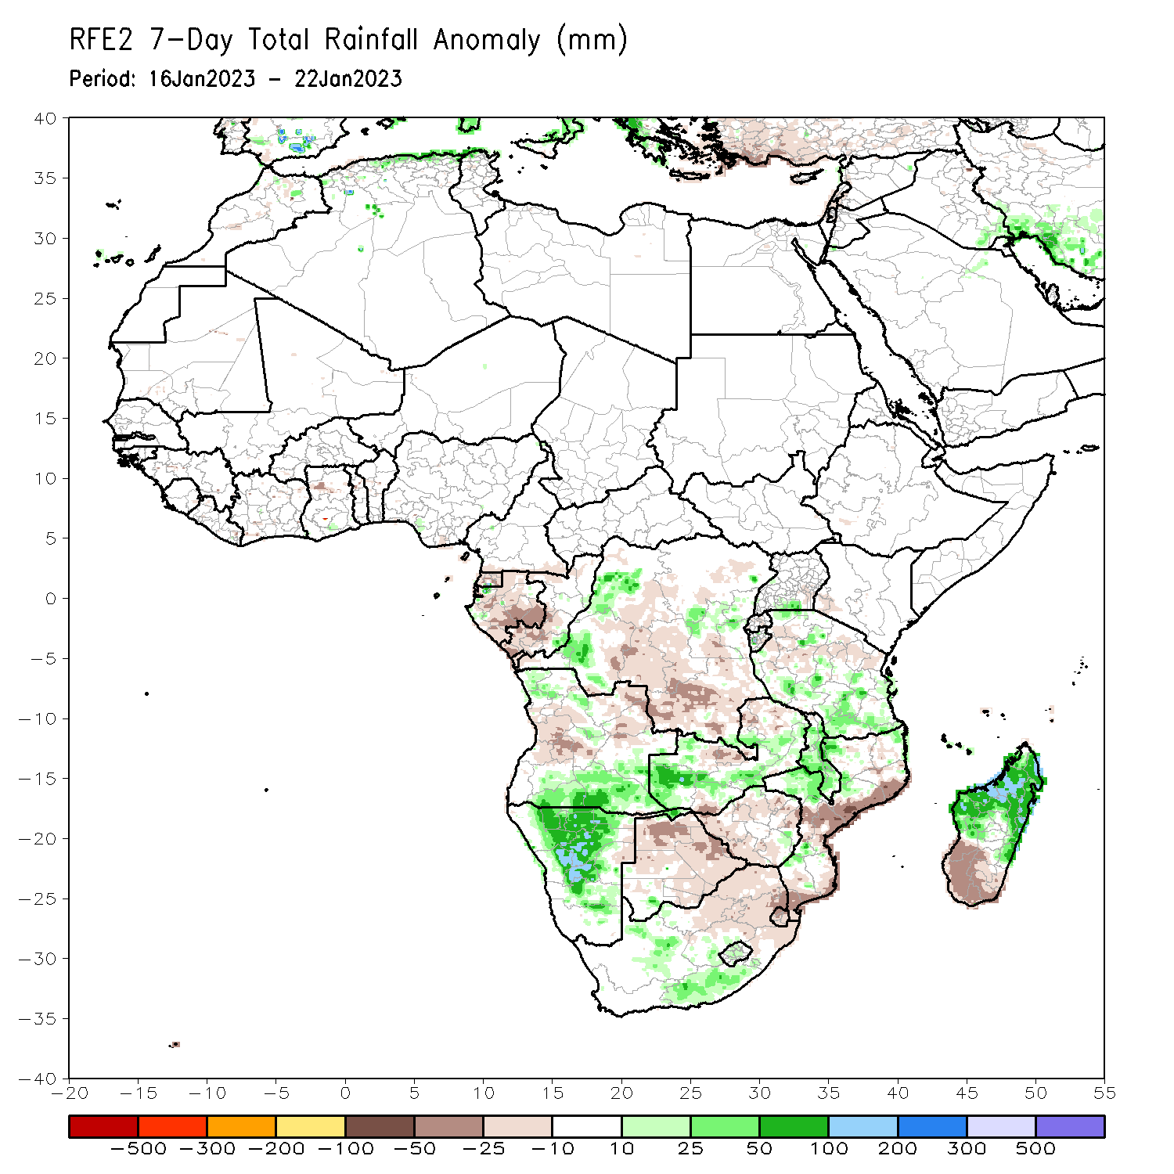
Rainfall Patterns: Last 7 Days
During the past 7 days, in East Africa, rainfall was above-average over western Burundi, south-central Uganda, and northwestern, central, and southern Tanzania. Below-average rainfall was observed over pockets of southwestern Ethiopia, southeastern Uganda, southwestern Kenya, western Burundi, Rwanda, and northwestern and north-central Tanzania. In Central Africa, rainfall was above-average over most of northwestern and central portions of coastal Gabon, south-central Equatorial Guinea, southwestern Congo, and most of western, east-central (west of Rwanda), and pockets of southeastern DRC. Below-average rainfall was observed over the southwestern coast, central, and southern portions of Gabon, northern, western, and eastern Equatorial Guinea, southwestern and northwestern Congo, southern Cameroon, pockets of northeastern, northwestern, southern, and central DRC, and Sao Tome and Principe. In West Africa, rainfall was near average across most of the region, except for small regions of below-average rainfall in southwestern and northeastern Cote d’Ivoire, southeastern Liberia, northwestern Ghana, north-central Togo, northwestern Benin, and southwestern and southeastern pockets of coastal Nigeria. In contrast, rainfall was above average only in a small south-central pocket of coastal Nigeria. In Southern Africa, rainfall was above-average over southern, northwestern, and pockets of central Angola, northwestern, northwestern, northeastern, and pockets of southwestern Mozambique, western, eastern, and south-central Zambia, southeastern Zimbabwe, north-central to southern Malawi, southwestern Botswana, most of northern (including the eastern portion of the Caprivi Strip) and central Namibia, portions of central and south-central South Africa, Lesotho, central and eastern Comoros, and northern, central, and most of the east coast of Madagascar. In contrast, rainfall was below-average over west-central and northeastern Angola, pockets of northeastern Namibia (including the western portion of the Caprivi Strip), portions of north--central and pockets of northeastern Zambia, most of northern, central, and eastern Botswana, most of western, northern, and southern Zimbabwe, pockets of northern Malawi, northeastern and eastern South Africa, Eswatini, central and eastern/southern portions of coastal Mozambique, and most of southern Madagascar.

Slide 7
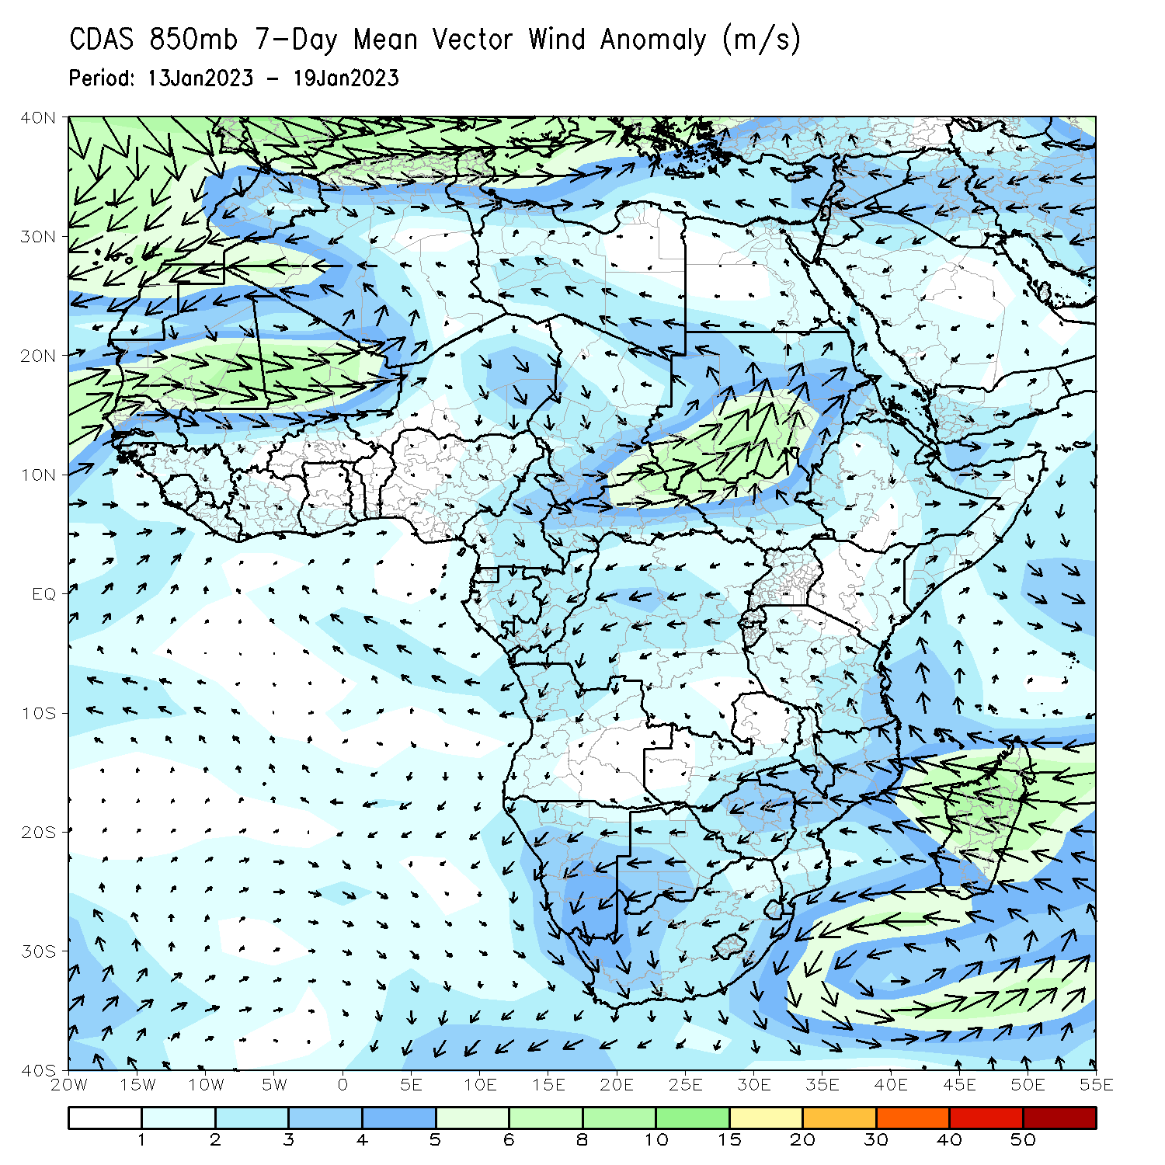
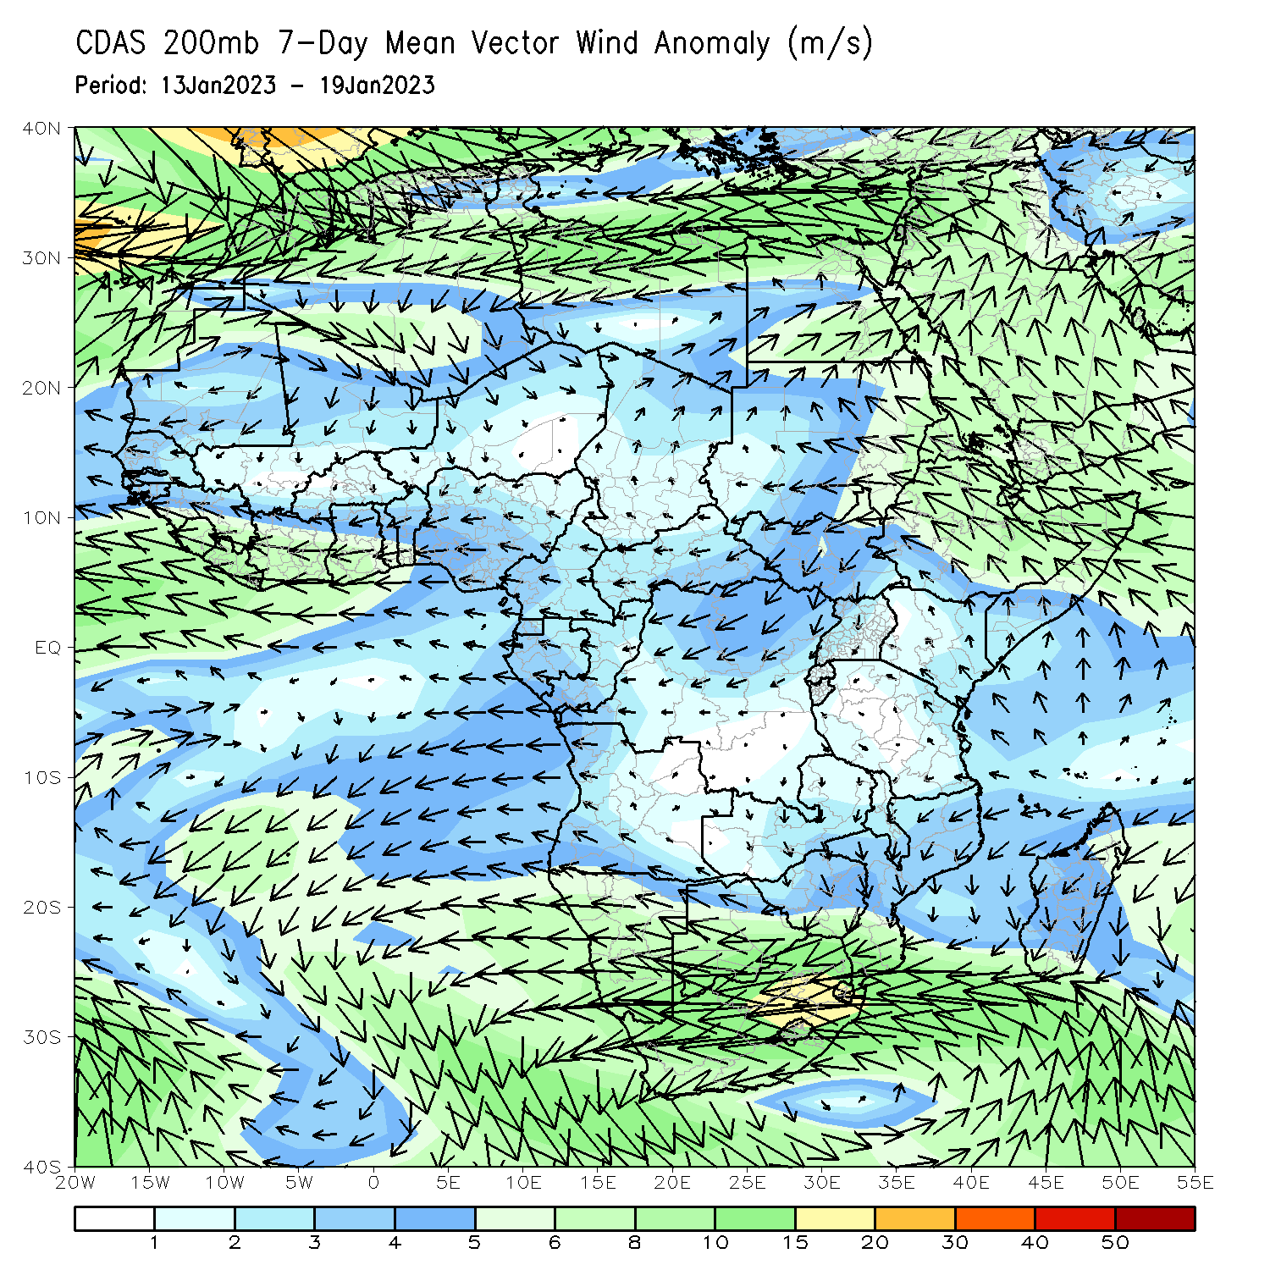
Atmospheric Circulation: Last 7 Days
At 850-hPa level (left panel), anomalous wind convergence may have contributed to the observed rainfall increases across Angola, Zambia, Malawi, and portions of Mozambique and Tanzania. Anomalous upper level divergence at 200-hPa (right panel) likely enhanced precipitation in Angola, Malawi, and Zambia.

Slide 8
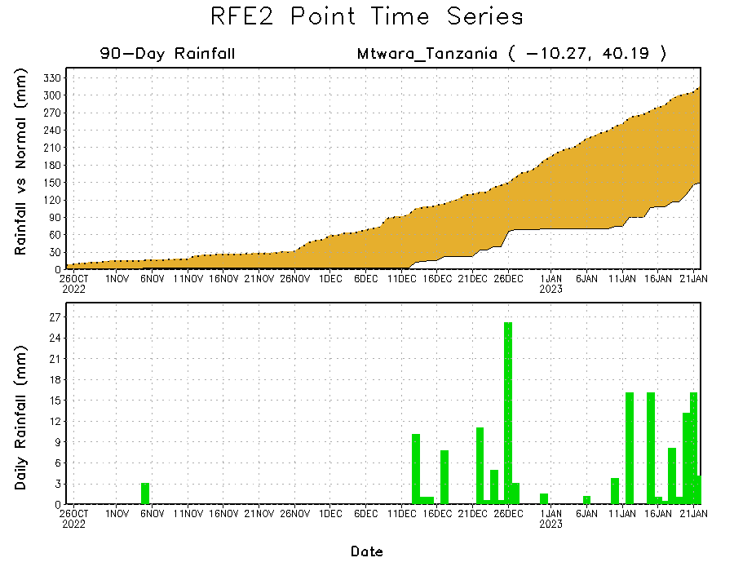
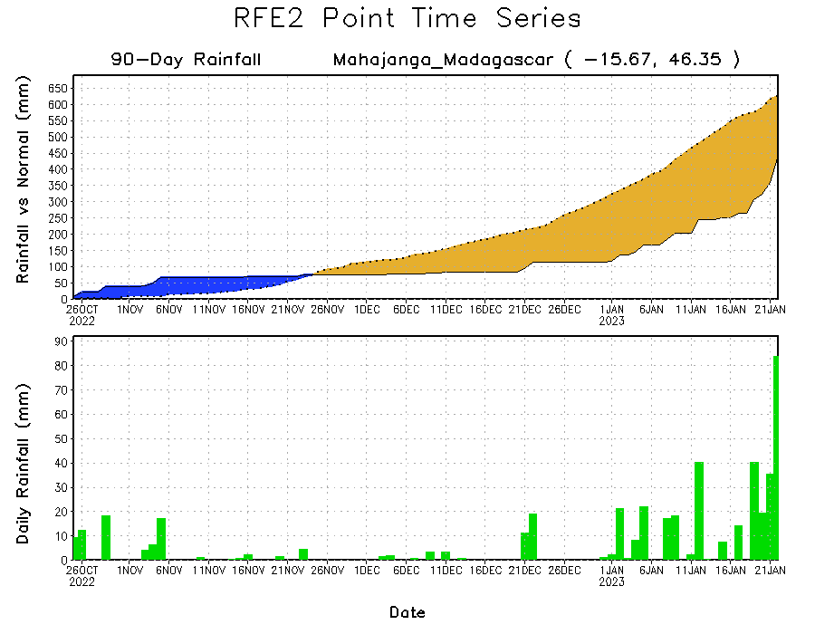
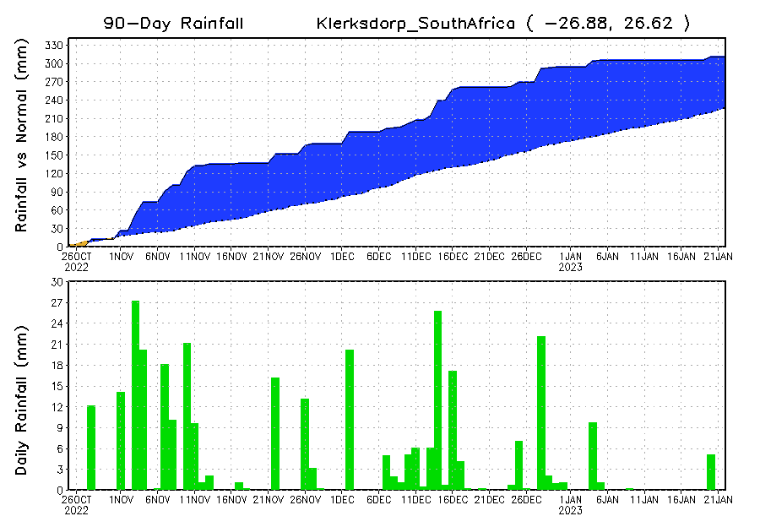
Rainfall Evolution
Daily evolution of rainfall over the last 90 days at selected locations shows continuing, yet lessening moisture surpluses over parts of South Africa (bottom left). Rainfall deficits persist over southeastern Tanzania (top right) and northwestern Madagascar (bottom right), the latter of which has received substantial rainfall over the last week.

Slide 9
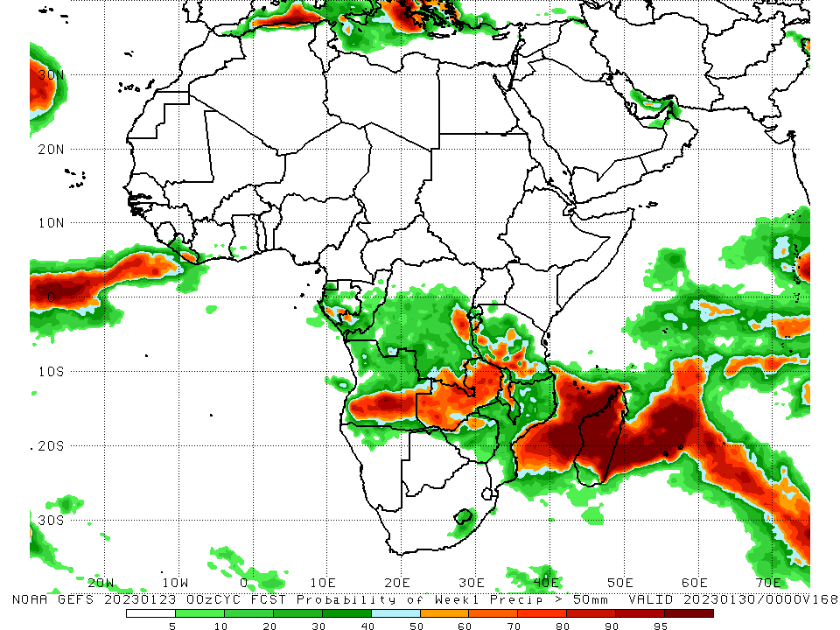
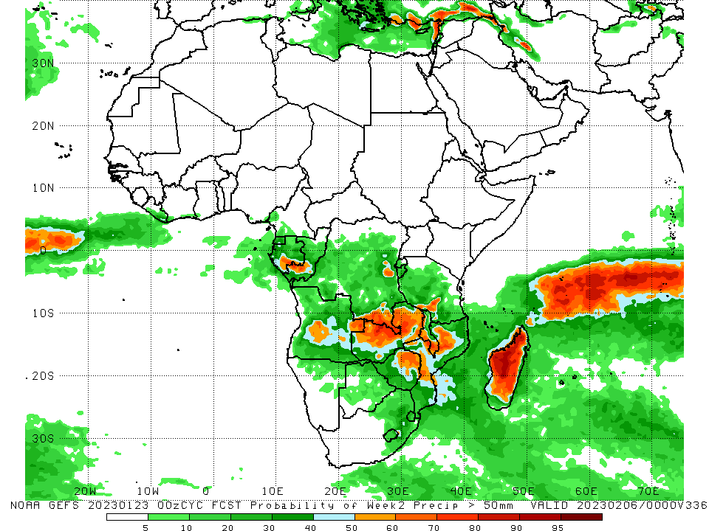
NCEP GEFS Model Forecasts Non-Bias Corrected Probability of precipitation exceedance
Week-1, Valid: 24 – 30 Jan 2023
Week-2, Valid: 31 Jan – 06 Feb 2023
For week-1 (left panel), the GEFS forecasts indicate a moderate to high chance (over 70%) for rainfall to exceed 50 mm over southern Angola, western and northern portions of Zambia, east-central DRC (to the west of Burundi), southwestern Tanzania, portions of central Malawi, Comoros, and most of Madagascar outside of southern portions. For week-2 (right panel), the GEFS forecasts indicate a moderate to high chance (over 70%) for rainfall to exceed 50 mm over portions of south-central Gabon, southwestern Congo, east-central Angola, southeastern DRC, northern Zambia, southern Malawi, portions of northwestern Mozambique, and most of Madagascar outside of southern portions.
Notes:
‹#›

Slide 10
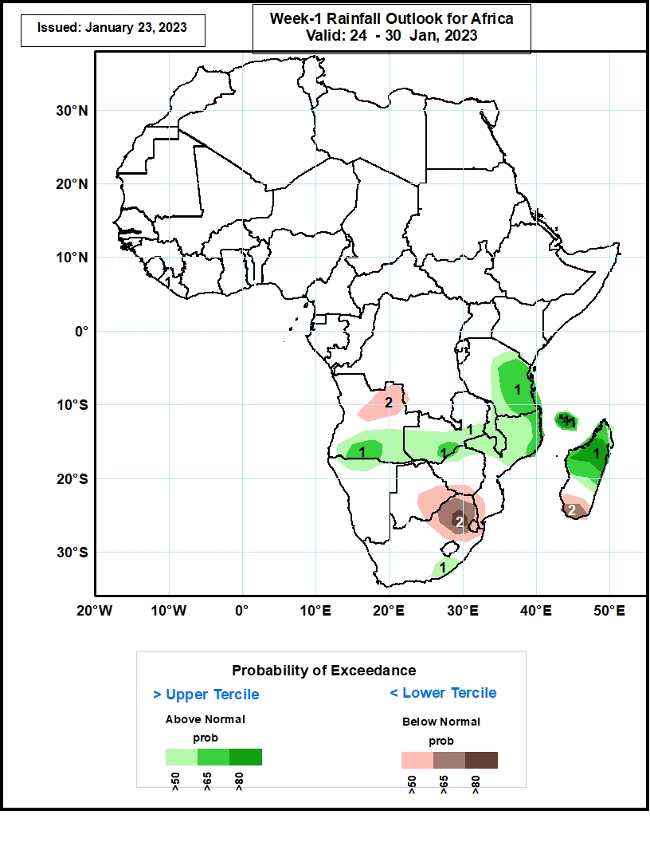
Week-1 Precipitation Outlooks
24 – 30 Jan, 2023
The forecasts suggest above 50% chance for weekly rainfall to be above-normal (above the upper tercile) over southern Angola, southern Zambia, Malawi, southern and eastern Tanzania, northern Namibia, northern Mozambique, south-central South Africa, Comoros, and northern and central Madagascar. In particular, there is above 80% chance for rainfall to be above-normal over Comoros and north-central Madagascar.
The consolidated probabilistic forecasts suggest above 50% chance for weekly total rainfall to be below-normal (below the lower tercile) over northwestern Angola, southeastern Botswana, southern Zimbabwe, northeastern South Africa, Eswatini, southwestern Mozambique, and southern Madagascar. In particular, there is above 80% chance for rainfall to be below-normal in northeastern South Africa.
Notes:
‹#›

Slide 11
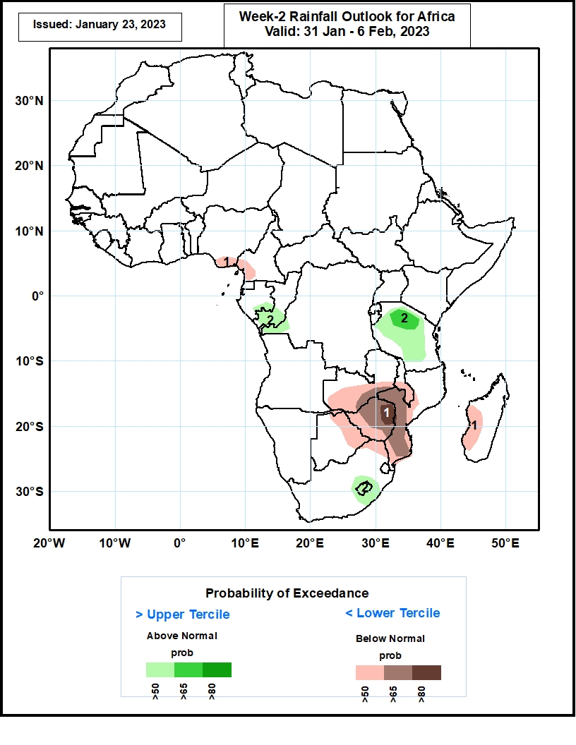
Week-2 Precipitation Outlooks
31 Jan - 6 Feb 2023
The forecasts suggest above 50% chance for weekly rainfall to be above-normal (above the upper tercile) over southeastern Gabon, southern Congo, northern and central Tanzania, Lesotho, and a portion of southeastern South Africa. In particular, there is above 65% chance for rainfall to be above-normal over northern Tanzania.
The consolidated probabilistic forecasts suggest above 50% chance for weekly total rainfall to be below-normal (below the lower tercile) over southeastern Nigeria, southwestern Cameroon, southern Zambia, eastern Botswana, Zimbabwe, southern Malawi, western and southern Mozambique, northeastern South Africa, and west-central Madagascar. In particular, there is above 80% chance for rainfall to be below-normal over northeastern Zimbabwe.
Notes:
‹#›

Slide 12
Summary
During the past 30 days, in East Africa, above-average rainfall was observed over southeastern Uganda, pockets of central and southeastern Kenya, western Ethiopia, west-central Burundi, and central, northern, and southwestern Tanzania. Rainfall was below-average over a small portion of southwestern Ethiopia, most of northwestern and southwestern Kenya, southern Rwanda, eastern Burundi, and parts of west-central and southeastern Tanzania. In Central Africa, rainfall was above-average over central and southern Congo, and southeastern and most of western DRC. Rainfall was below-average over western, eastern, and central Gabon, southern CAR, northern Congo, Sao Tome and Principe, and pockets of central, eastern, and northern DRC. In West Africa, rainfall was above-average over pockets of central and southwestern Senegal. In contrast, below-average rainfall was observed in southeastern Liberia, most of southern Cote d’Ivoire, southern Ghana, southern Togo, and pockets of southern Nigeria. In southern Africa, above-average rainfall was observed over central, south-central, and most of northern Angola, southeastern South Africa, most of Lesotho, eastern Eswatini, central and north-central Namibia, northwestern and south-central Mozambique, most of Malawi, northern and central Zambia, and central and northwestern Madagascar. Below normal precipitation was observed over southeastern Angola, northeastern Namibia, southwestern Zambia, pockets of central, northeastern, and southern Mozambique, most of Zimbabwe, most of Botswana, Comoros, north-central and northeastern South Africa, western Eswatini, and northeastern and southwestern Madagascar.
During the past 7 days, in East Africa, rainfall was above-average over western Burundi, south-central Uganda, and northwestern, central, and southern Tanzania. Below-average rainfall was observed over pockets of southwestern Ethiopia, southeastern Uganda, southwestern Kenya, western Burundi, Rwanda, and northwestern and north-central Tanzania. In Central Africa, rainfall was above-average over most of northwestern and central portions of coastal Gabon, south-central Equatorial Guinea, southwestern Congo, and most of western, east-central (west of Rwanda), and pockets of southeastern DRC. Below-average rainfall was observed over the southwestern coast, central, and southern portions of Gabon, northern, western, and eastern Equatorial Guinea, southwestern and northwestern Congo, southern Cameroon, pockets of northeastern, northwestern, southern, and central DRC, and Sao Tome and Principe. In West Africa, rainfall was near average across most of the region, except for small regions of below-average rainfall in southwestern and northeastern Cote d’Ivoire, southeastern Liberia, northwestern Ghana, north-central Togo, northwestern Benin, and southwestern and southeastern pockets of coastal Nigeria. In contrast, rainfall was above average only in a small south-central pocket of coastal Nigeria. In Southern Africa, rainfall was above-average over southern, northwestern, and pockets of central Angola, northwestern, northwestern, northeastern, and pockets of southwestern Mozambique, western, eastern, and south-central Zambia, southeastern Zimbabwe, north-central to southern Malawi, southwestern Botswana, most of northern (including the eastern portion of the Caprivi Strip) and central Namibia, portions of central and south-central South Africa, Lesotho, central and eastern Comoros, and northern, central, and most of the east coast of Madagascar. In contrast, rainfall was below-average over west-central and northeastern Angola, pockets of northeastern Namibia (including the western portion of the Caprivi Strip), portions of north--central and pockets of northeastern Zambia, most of northern, central, and eastern Botswana, most of western, northern, and southern Zimbabwe, pockets of northern Malawi, northeastern and eastern South Africa, Eswatini, central and eastern/southern portions of coastal Mozambique, and most of southern Madagascar.
Week-1 outlook calls for above-average rainfall over the western portion of the Gulf of Guinea (from Sierra Leone to Ghana), southern Congo, southern and central Gabon, central DRC, Burundi, central and western Tanzania, western Zambia, east-central and southeastern portions of coastal Mozambique, northwestern and southern Angola, northwestern Namibia, and northern and most of western, east-central, and southwestern Madagascar. In contrast, below-average rainfall is expected in pockets of southern Nigeria, Sao Tome and Principe, southern Cameroon, western Gabon, Equatorial Guinea, pockets of southwestern Ethiopia, southeastern Uganda, southern Kenya, northern, eastern, and southern Tanzania, central Angola, east-central and northeastern and central Namibia, southeastern DRC, central and eastern South Africa, Eswatini, Lesotho, Botswana, Zimbabwe, northern and western Mozambique, pockets of northern and eastern Zambia, Malawi, Comoros, Seychelles, and pockets of northeastern and central Madagascar. Week-2 outlooks suggest above-average rainfall over portions of central DRC, Equatorial Guinea, Gabon, central and southern Congo, southwestern and northwestern Angola, central and southern Mozambique, southern Malawi, portions of central Madagascar, and central and eastern Zimbabwe. Below-average rainfall is likely over northern and southern Tanzania, southeastern Uganda, southwestern Kenya, northern and central Malawi, northeastern Angola, northern Mozambique, southern Botswana, eastern Zambia, pockets of eastern Namibia, central and southeastern South Africa, Lesotho, Comoros, Seychelles, and northwestern and eastern Madagascar.

