Slide 1
The African Monsoon Recent Evolution and Current Status Include Week-1 and Week-2 Outlooks
Update prepared by Justin Hicks
30 January 2023
For more information, visit:
http://www.cpc.ncep.noaa.gov/products/Global_Monsoons/African_Monsoons/precip_monitoring.shtml

Slide 2
Outline
Highlights
Recent Evolution and Current Conditions
NCEP GEFS Forecasts
Summary

Slide 3
Highlights: Last 7 Days
During the past 7 days, in East Africa, rainfall was above-average over east-central Tanzania. Below-average rainfall was observed over west-central Ethiopia, southeastern Uganda, southwestern Kenya, Burundi, western Rwanda, and northern, western, and southern Tanzania. In Central Africa, rainfall was above-average over southeastern Cameroon, southwestern and pockets of eastern Gabon, northern, central, and southeastern Congo, most of western and central DRC, and southern Sao Tome and Principe. Below-average rainfall was observed over pockets of northwestern and southern Gabon, southern and western Equatorial Guinea, southwestern Congo, eastern and southeastern DRC, and central Sao Tome and Principe. In West Africa, rainfall was above average across most of the regions along the Gulf of Guinea, including southeastern Guinea, central and eastern Liberia, southern Cote d’Ivoire, southern Ghana, southern Togo, and parts of southwestern Nigeria. In Southern Africa, rainfall was above-average over pockets of central and northwestern Angola, pockets of northern, northwestern, and east-central Mozambique, western and southern Zambia, pockets of north-central and southern Zimbabwe, pockets of central Malawi, central Namibia, pockets of central, southeastern, and northeastern South Africa, western Lesotho, eastern Eswatini, and western, central, and southern Madagascar (heavy rains due to Cyclone Cheneso). In contrast, rainfall was below-average over west-central and southeastern Angola, pockets of northeastern Namibia (including the western portion of the Caprivi Strip), portions of northern Zambia, most of Botswana, most of central, western, and eastern Zimbabwe, pockets of northern and southern Malawi, north-central and eastern South Africa, western Eswatini, central, northeastern, and southern portions of Mozambique, Comoros, and northeastern Madagascar.
Week-1 outlook calls for above-average rainfall over southern Cameroon, Equatorial Guinea, northern and southwestern Congo, most of Gabon, east-central and southeastern DRC, west-central Tanzania, northern and southwestern Zambia, northern Mozambique, northwestern, central, and most of southern Angola, central and northeastern Namibia, most of Botswana, western Zimbabwe, portions of central Malawi, north-central and eastern South Africa, Lesotho, Eswatini, portions of central and the east-central coast of Madagascar, and the Seychelles. In contrast, below-average rainfall is expected in pockets of southern Liberia, southern Uganda, southwestern Kenya, northern and pockets of southern Tanzania, west-central and northeastern Angola, southwestern DRC, Rwanda, Burundi, eastern Zimbabwe, central and southern Mozambique, southern Malawi, Comoros, and northern, western, and southern Madagascar. Week-2 outlooks suggest above-average rainfall over portions of southwestern DRC, southwestern Gabon, southwestern Congo, northwestern, eastern, and southeastern Angola, northwestern, central, and southern Zambia, most of Botswana, pockets of central and southern Tanzania, eastern Namibia, pockets of central and southern South Africa, Lesotho, central and northern Mozambique, central and southern Malawi, portions of southern Madagascar, most of Zimbabwe, and the Seychelles. Below-average rainfall is likely over southern Nigeria, southern Cameroon, northern and eastern Gabon, eastern Equatorial Guinea, northern Comgo, northern and central DRC, Rwanda, Burundi, southern Uganda, southern Kenya, pockets of northern and eastern Tanzania, west-central and southwestern Angola, northeastern Zambia, southeastern Mozambique, Comoros, and northwestern and central Madagascar.

Slide 4
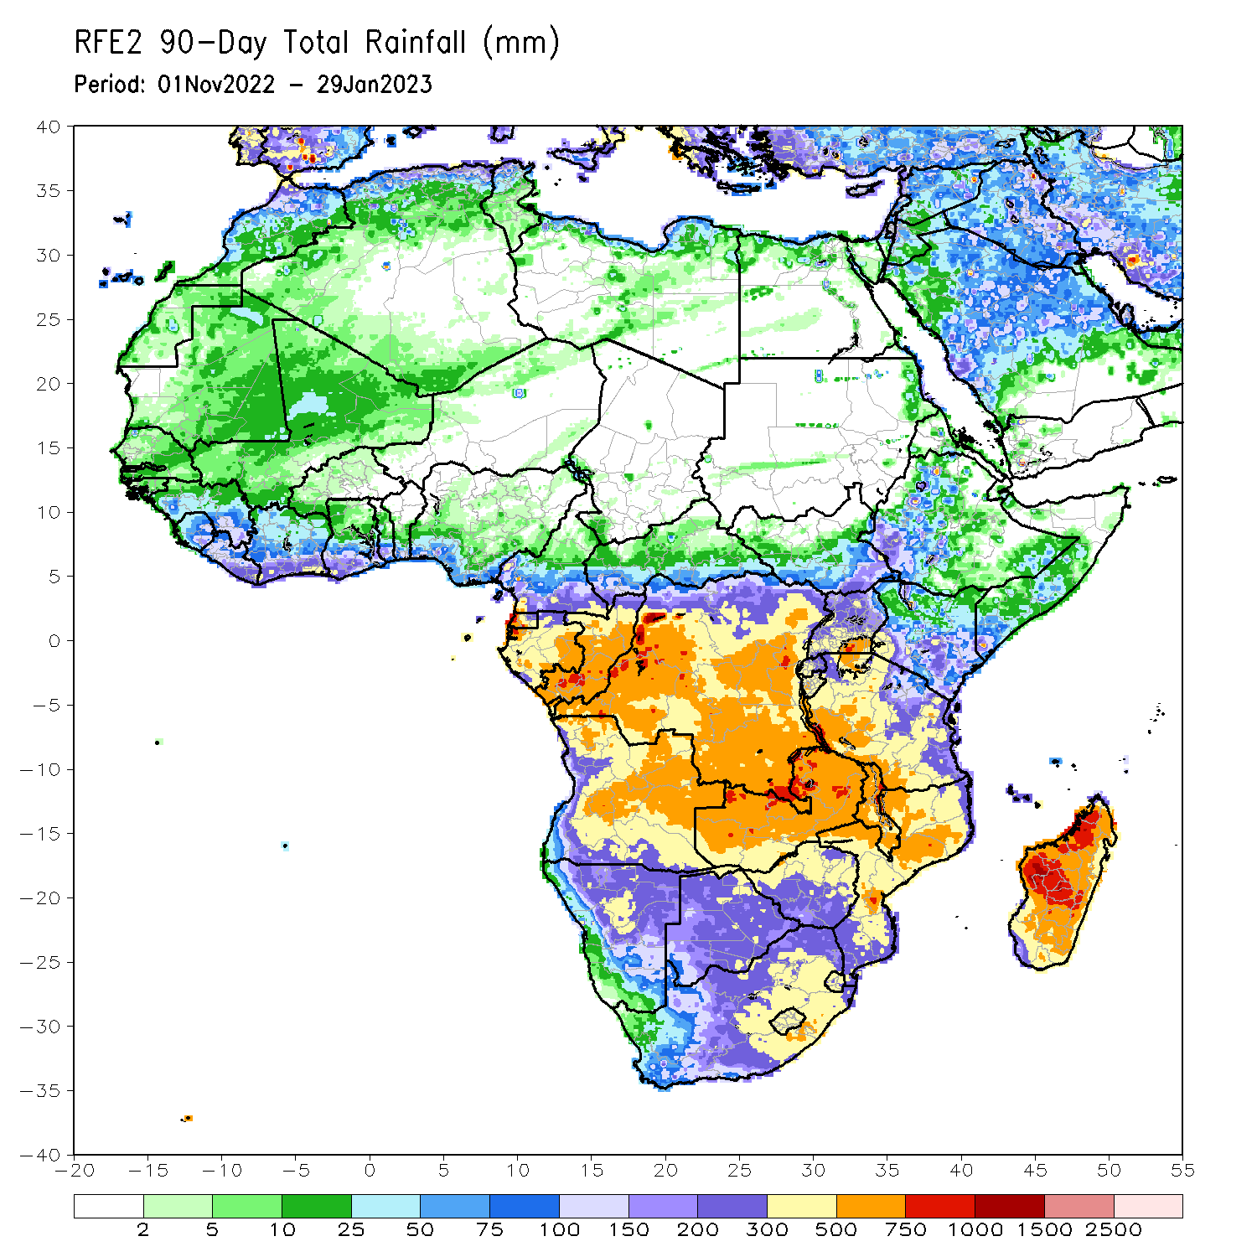
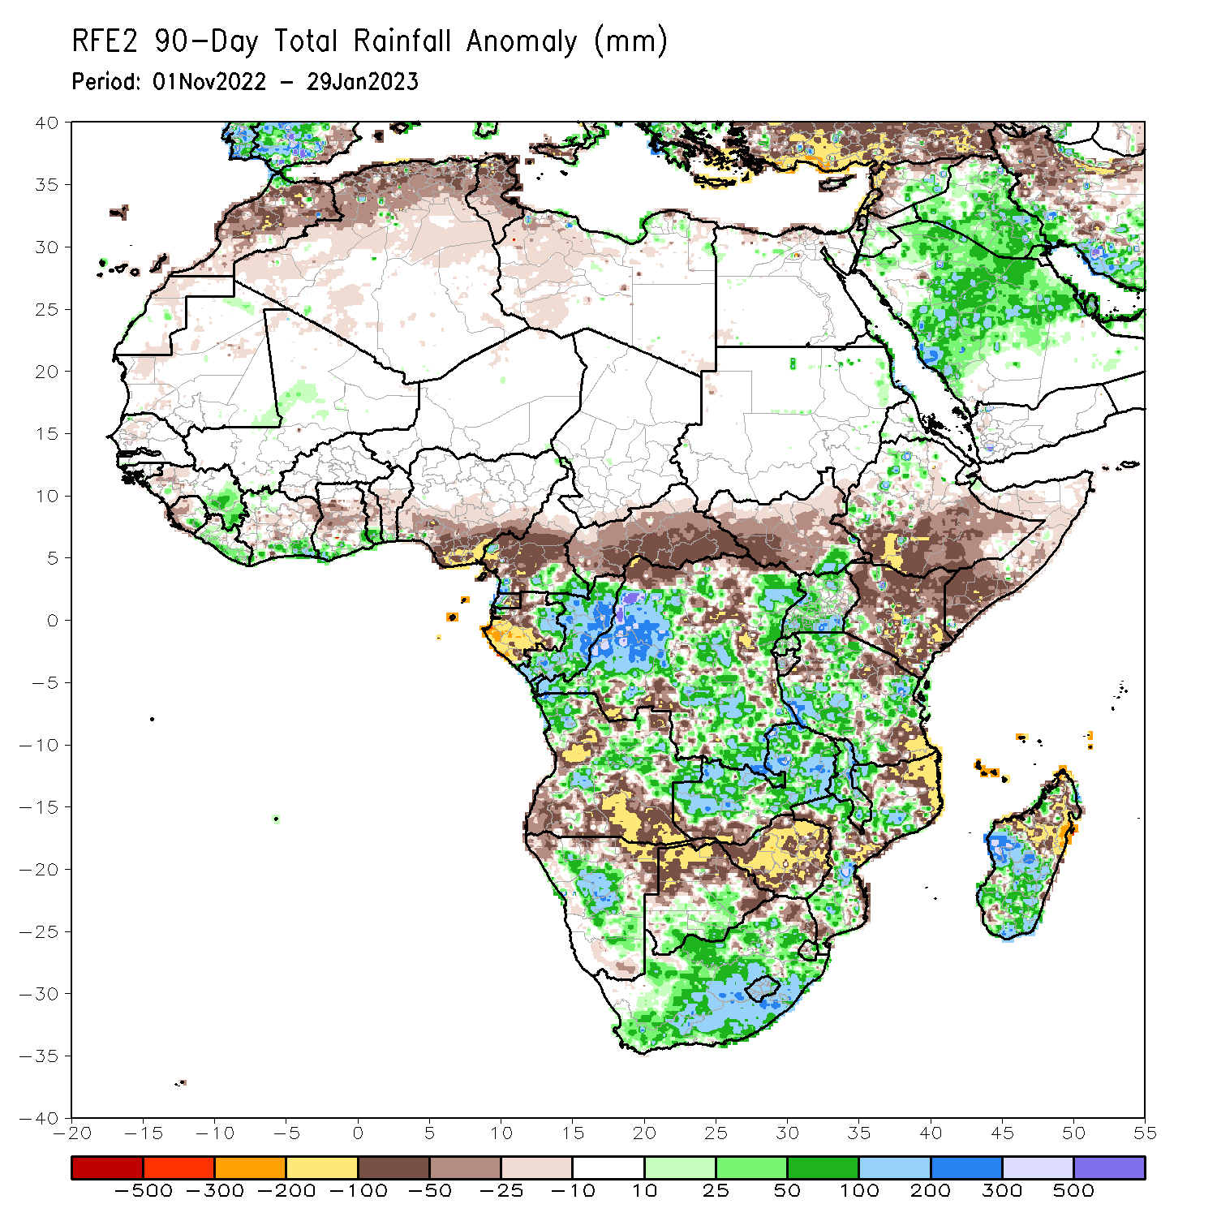
Rainfall Patterns: Last 90 Days
Over the past 90 days, in East Africa, above-average rainfall was observed over pockets of northeastern Sudan, pockets of southeastern South Sudan, pockets of western Ethiopia, pockets of southwestern Eritrea, eastern Djibouti, northern, western, and southern Uganda, Rwanda, western Burundi, pockets of southwestern and south-central Kenya, and southwestern, central, and north-central Tanzania. Rainfall was below-average over southern, central, and eastern Ethiopia, throughout much of Somalia, most of northern, southern, and eastern Kenya, western, northern, and central South Sudan, and pockets of northern and most of southeastern Tanzania. In southern Africa, above-average rainfall was observed over central and southern Botswana, most of South Africa, Lesotho, northern and southern Eswatini, southern Zimbabwe, central and northern Zambia, central, southern, and northwestern Mozambique, northwestern and portions of central and eastern Angola, central and east-central Namibia, most of Malawi, and southern and central parts of Madagascar. Below-average rainfall was observed much of west-central, northeastern, and southern Angola, southwestern Zambia, northern and southeastern Namibia, central and northern Zimbabwe, northeastern Mozambique, Comoros, Seychelles, and northern and eastern Madagascar. In Central Africa, rainfall was above-average over southeastern Cameroon, southwestern CAR, eastern Gabon, western Equatorial Guinea, much of Congo, and parts of western, eastern, central, and southeastern DRC. Rainfall was below-average over much of southwestern and central Cameroon, southwestern and central Gabon, eastern Equatorial Guinea, Sao Tome and Principe, eastern, northern, and central CAR, portions of southern Chad, and parts of northern, north-central and southwestern DRC. In West Africa, rainfall was above-average over southeastern Mauritania, southeastern Guinea, southern and north-central Liberia, southern and northwestern Cote D’Ivoire, southern Ghana, southern Togo, southern Benin, west-central Mali, and pockets of southwestern Nigeria. In contrast, below-average rainfall was observed over pockets of western Mauritania, northern and Senegal, southern Guinea-Bissau, western Guinea, western and southern Sierra Leone, northwestern Liberia, central and northeastern Cote d’Ivoire, central Ghana, central Togo, central Benin, and most of southern and central Nigeria.
Notes:
‹#›

Slide 5
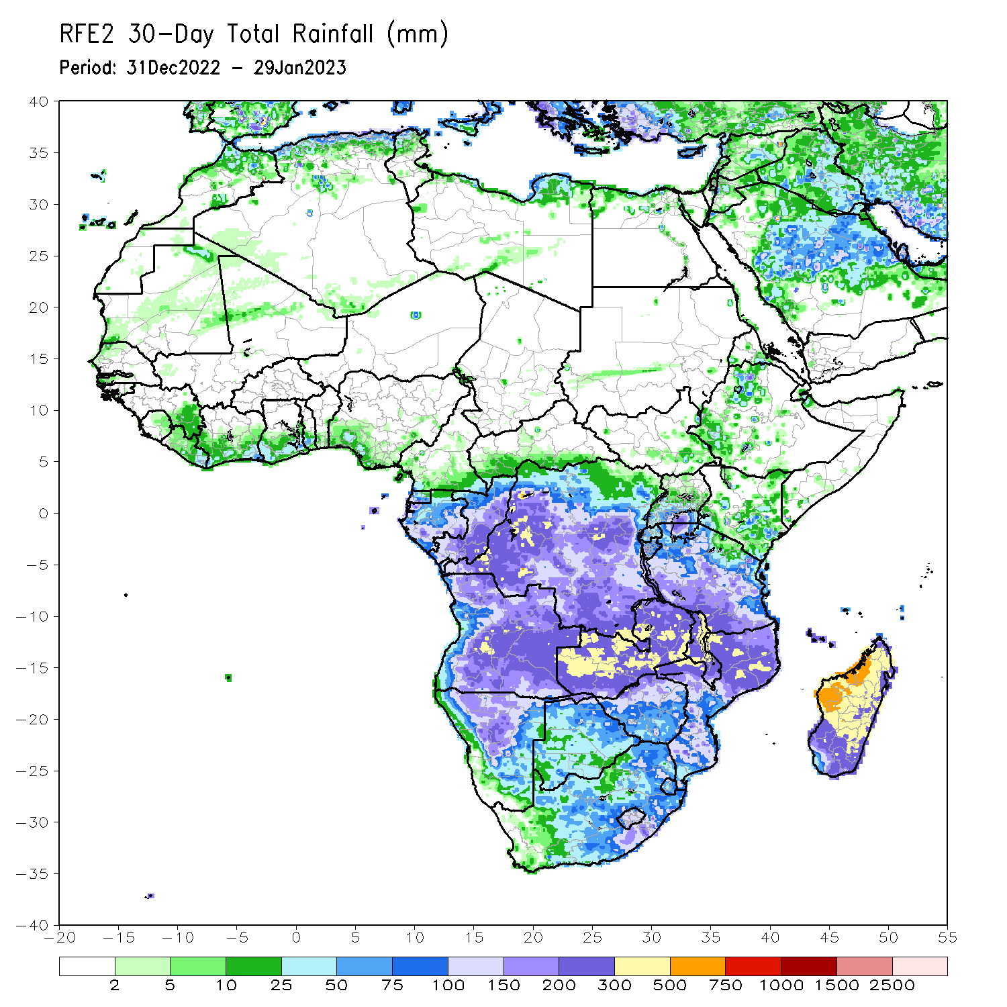
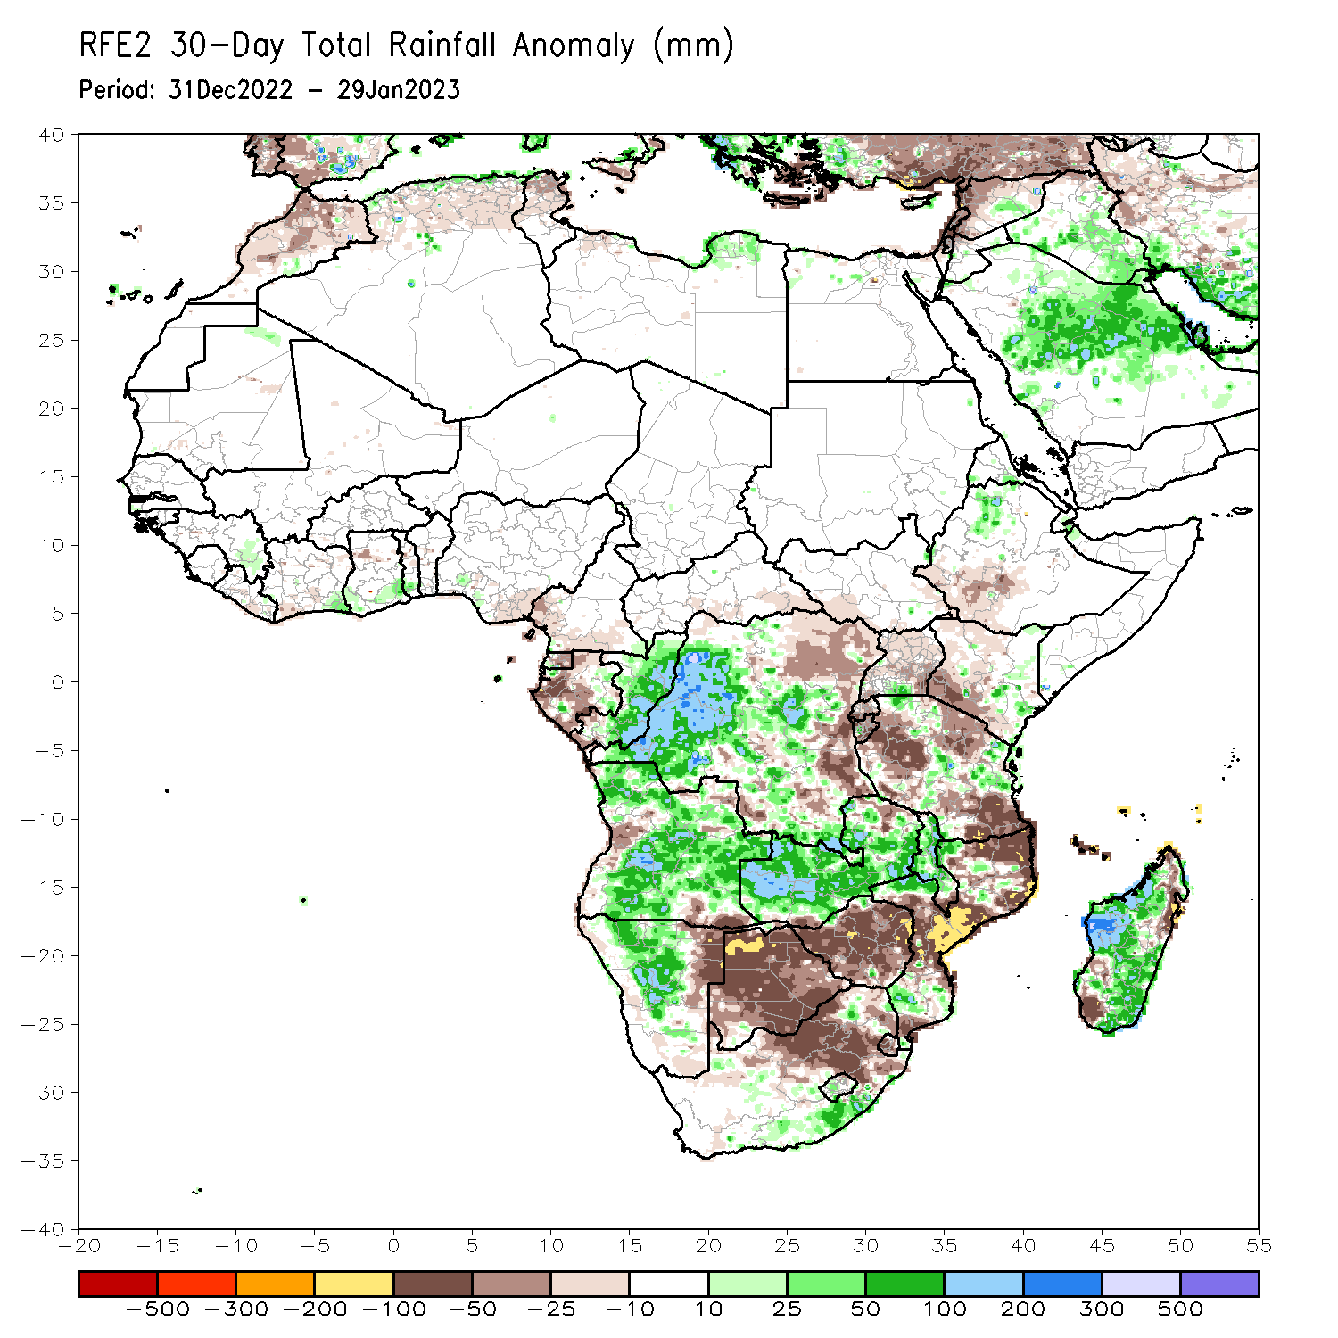
Rainfall Patterns: Last 30 Days
During the past 30 days, in East Africa, above-average rainfall was observed over south-central Uganda, pockets of central and southeastern Kenya, pockets of northwestern Ethiopia, west-central Burundi, and pockets of central, northwestern, and eastern Tanzania. Rainfall was below-average over southwestern Ethiopia, most of western and southwestern Kenya, Rwanda, eastern Burundi, and parts of west-central, northeastern, and southeastern Tanzania. In Central Africa, rainfall was above-average over northern, central, and southeastern Congo, and southeastern, central, and most of western DRC. Rainfall was below-average over western, northern, and central Gabon, southern CAR, southwestern Congo, Sao Tome and Principe, and pockets of northeastern and eastern DRC. In West Africa, rainfall was above-average over eastern Guinea, southeastern Cote d’Ivoire, southern Ghana, southern Togo, and pockets of southwestern Nigeria. In contrast, below-average rainfall was observed in southeastern Liberia, southwestern Cote d’Ivoire, central Ghana, central Togo, central Benin, and southeastern Nigeria. In southern Africa, above-average rainfall was observed over much of central, south-central, and most of northern Angola, southeastern South Africa, western Lesotho, central and north-central Namibia (as well as eastern portions of the Caprivi Strip), northwestern and south-central Mozambique, central and northern Malawi, most of Zambia, and central, northwestern, and southeastern Madagascar. Below normal precipitation was observed over southeastern and west-central Angola, northeastern, western, and southeastern Namibia, pockets of southwestern and northeastern Zambia, pockets of central, eastern, and southwestern Mozambique, most of Zimbabwe, most of Botswana, Comoros, Seychelles, north-central and eastern South Africa, Eswatini, eastern Lesotho, and northeastern and southwestern Madagascar.
Notes:
‹#›

Slide 6
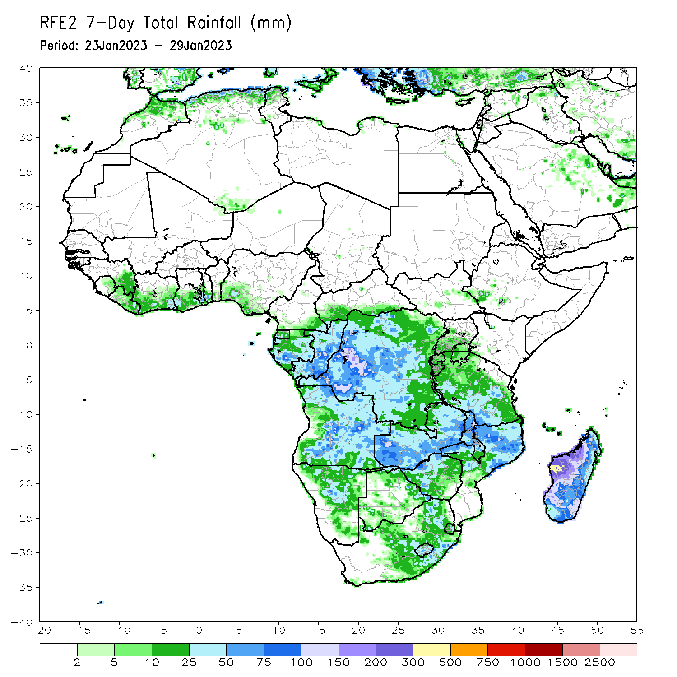
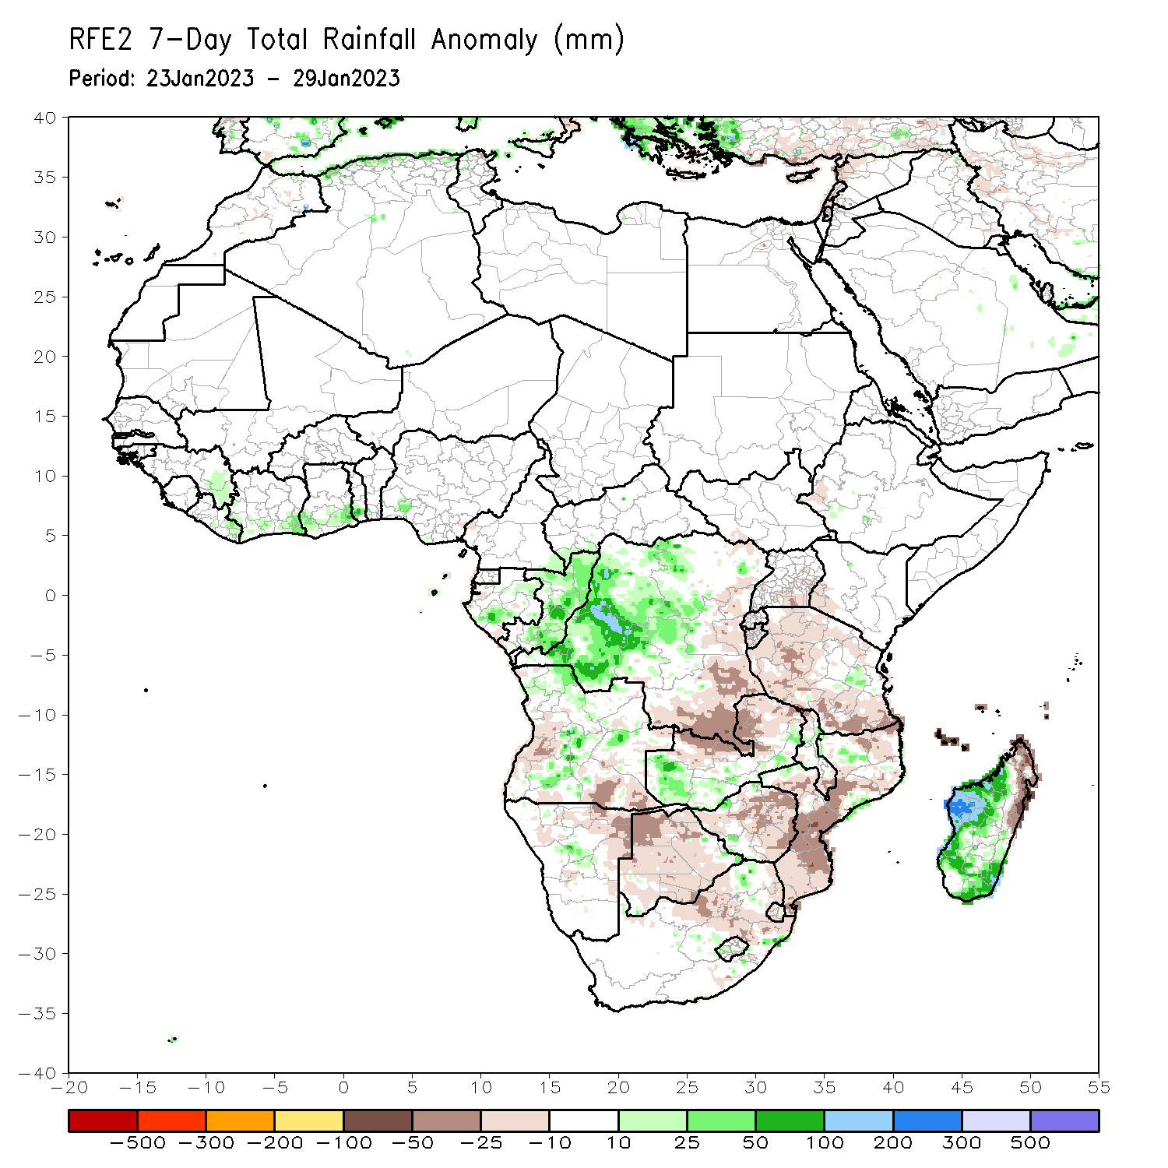
Rainfall Patterns: Last 7 Days
During the past 7 days, in East Africa, rainfall was above-average over east-central Tanzania. Below-average rainfall was observed over west-central Ethiopia, southeastern Uganda, southwestern Kenya, Burundi, western Rwanda, and northern, western, and southern Tanzania. In Central Africa, rainfall was above-average over southeastern Cameroon, southwestern and pockets of eastern Gabon, northern, central, and southeastern Congo, most of western and central DRC, and southern Sao Tome and Principe. Below-average rainfall was observed over pockets of northwestern and southern Gabon, southern and western Equatorial Guinea, southwestern Congo, eastern and southeastern DRC, and central Sao Tome and Principe. In West Africa, rainfall was above average across most of the regions along the Gulf of Guinea, including southeastern Guinea, central and eastern Liberia, southern Cote d’Ivoire, southern Ghana, southern Togo, and parts of southwestern Nigeria. In Southern Africa, rainfall was above-average over pockets of central and northwestern Angola, pockets of northern, northwestern, and east-central Mozambique, western and southern Zambia, pockets of north-central and southern Zimbabwe, pockets of central Malawi, central Namibia, pockets of central, southeastern, and northeastern South Africa, western Lesotho, eastern Eswatini, and western, central, and southern Madagascar (heavy rains due to Cyclone Cheneso). In contrast, rainfall was below-average over west-central and southeastern Angola, pockets of northeastern Namibia (including the western portion of the Caprivi Strip), portions of northern Zambia, most of Botswana, most of central, western, and eastern Zimbabwe, pockets of northern and southern Malawi, north-central and eastern South Africa, western Eswatini, central, northeastern, and southern portions of Mozambique, Comoros, and northeastern Madagascar.

Slide 7
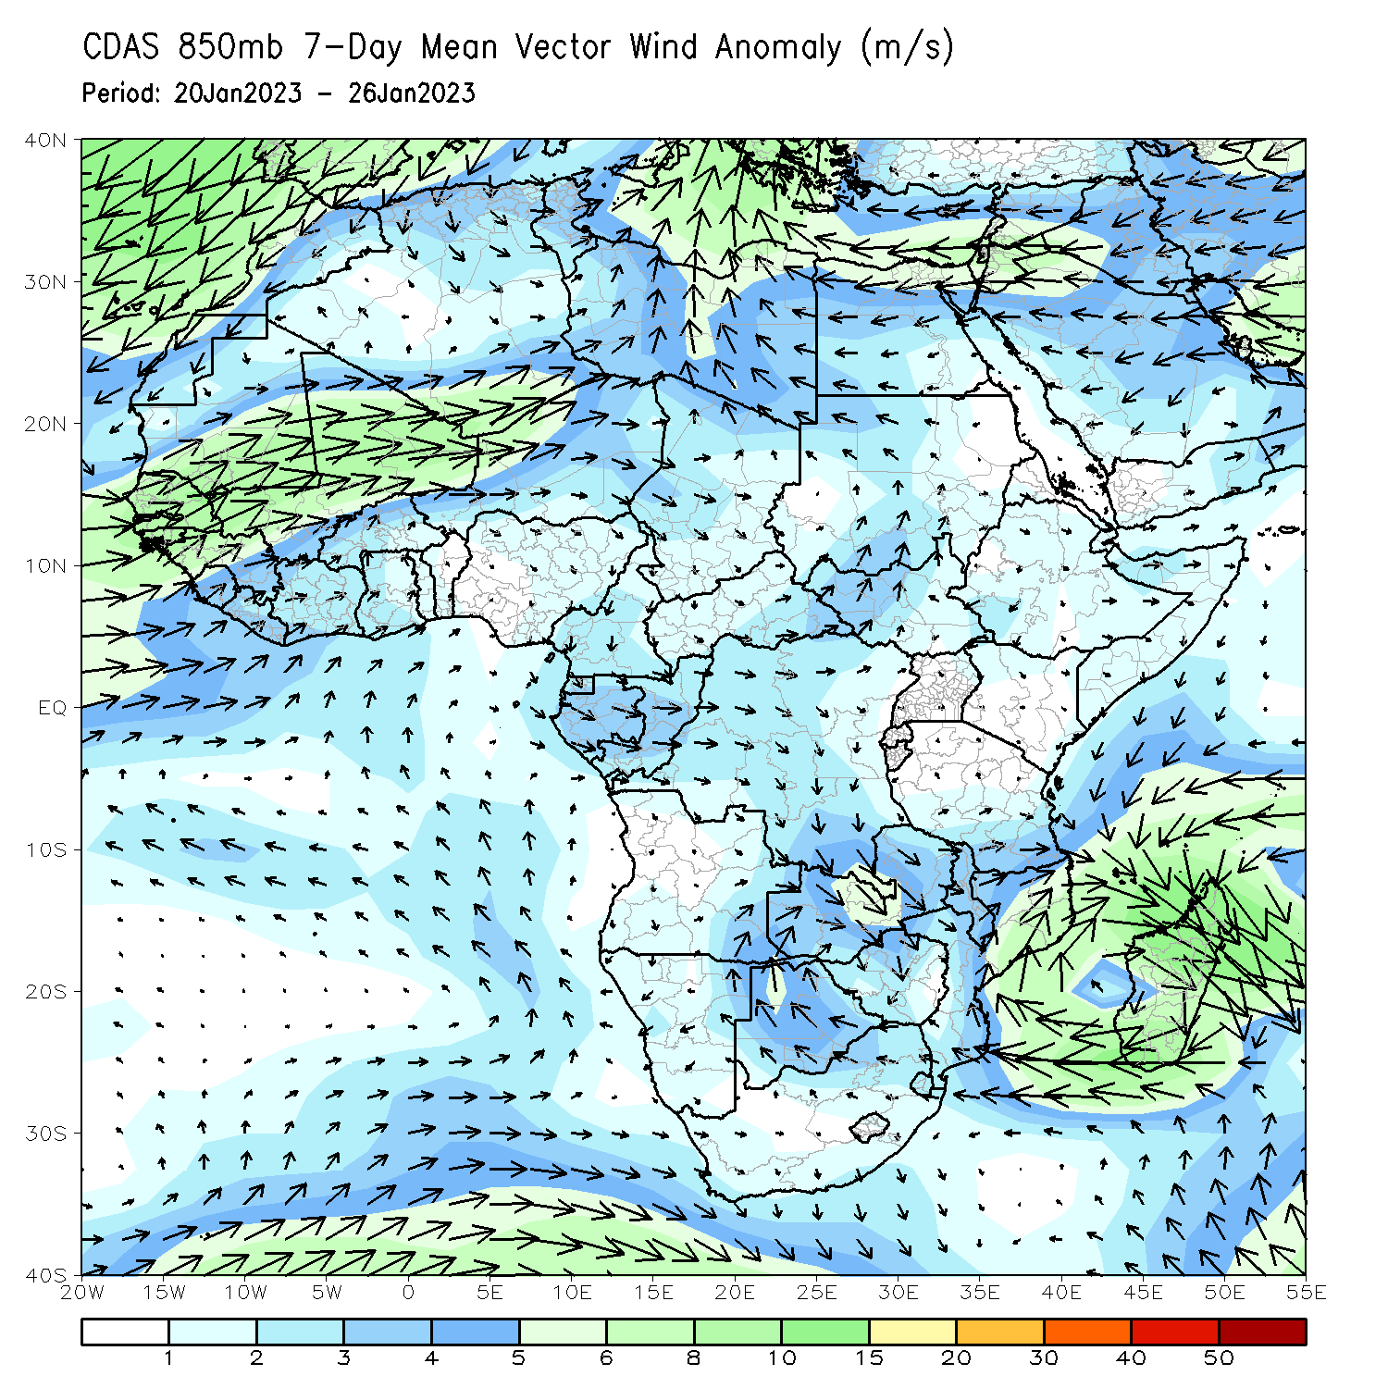
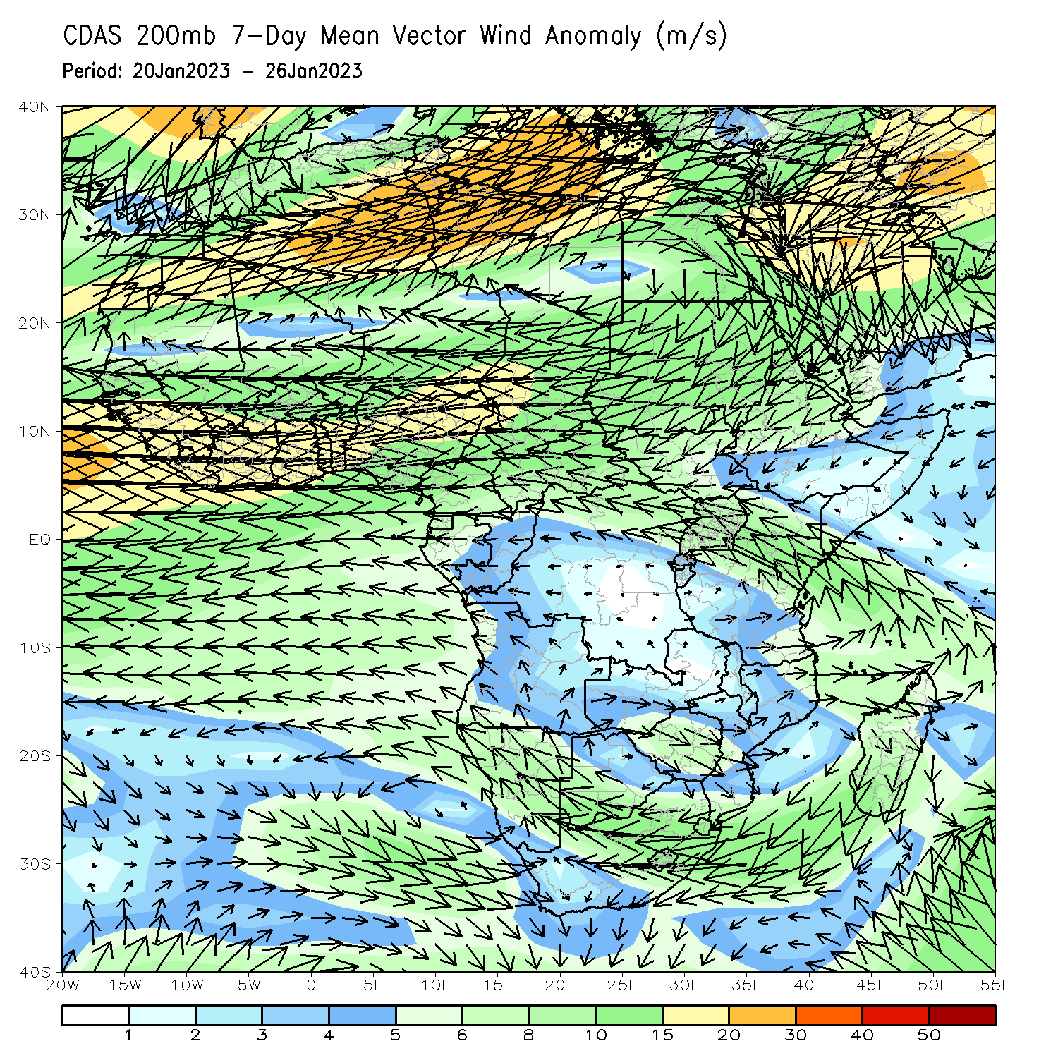
Atmospheric Circulation: Last 7 Days
At 850-hPa level (left panel), anomalous wind convergence may have contributed to the observed enhanced rainfall across Congo and western DRC, as well as southern Zambia. Anomalous upper level divergence at 200-hPa (right panel) likely enhanced precipitation in these aforementioned regions as well.

Slide 8
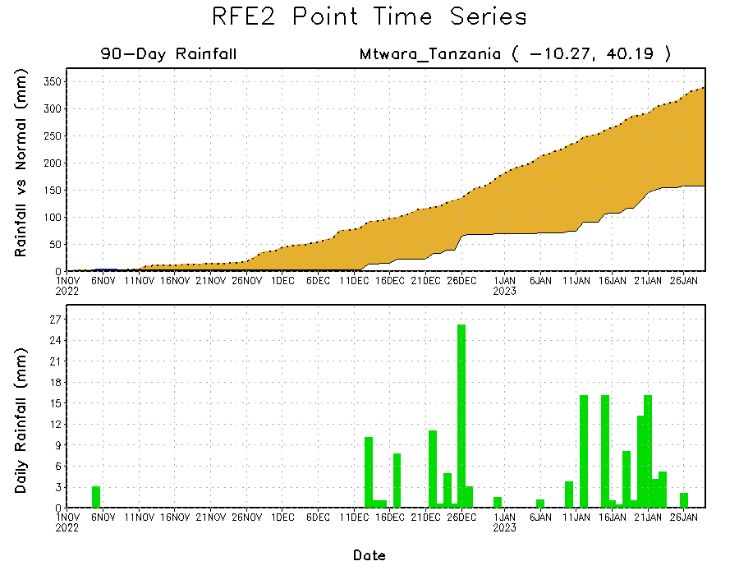
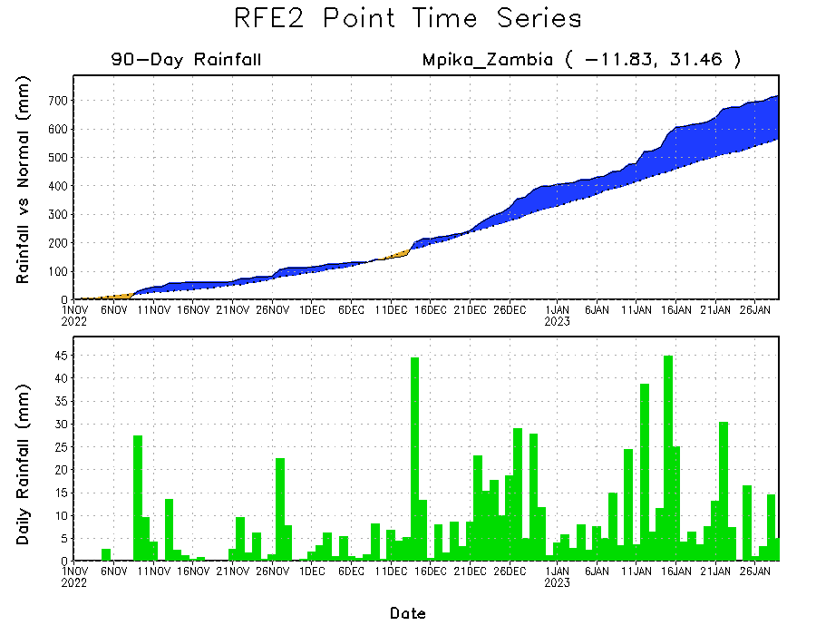
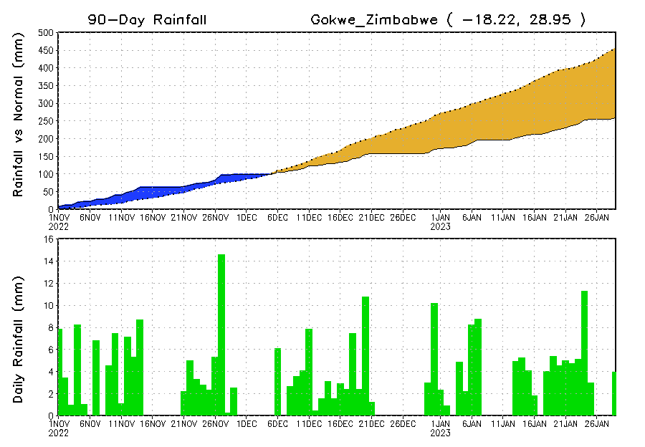
Rainfall Evolution
Daily evolution of rainfall over the last 90 days at selected locations shows worsening moisture defecits over parts of central Zimbabwe (bottom left). Rainfall deficits persist over southeastern Tanzania (top right). Eastern Zambia (bottom right) has received a copious amount of rainfall over the last few weeks, which has resulted in flooding.

Slide 9
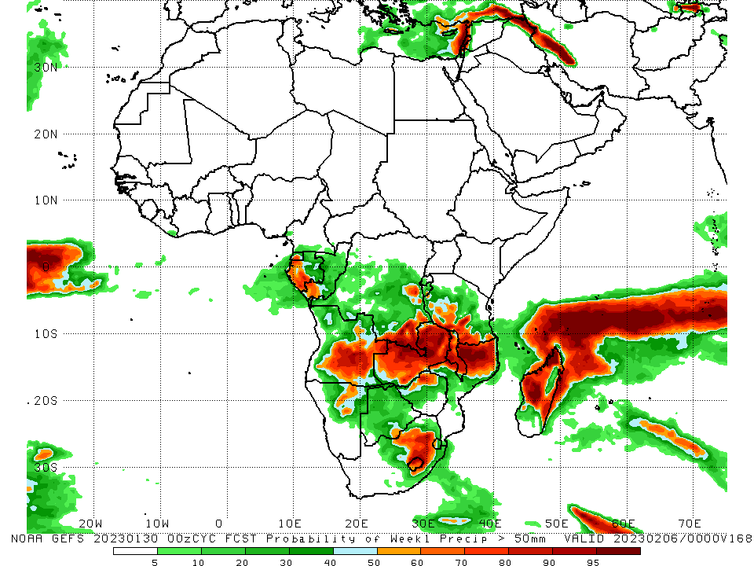
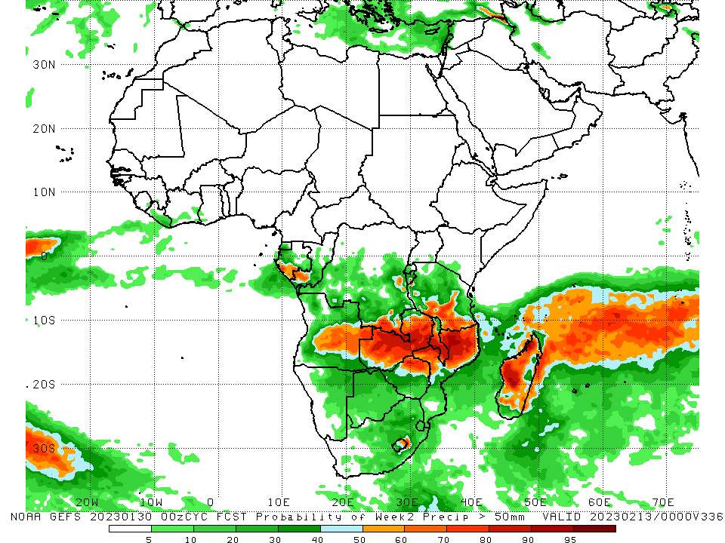
NCEP GEFS Model Forecasts Non-Bias Corrected Probability of precipitation exceedance
Week-1, Valid: 31 Jan – 06 Feb 2023
Week-2, Valid: 07 – 13 Feb 2023
For week-1 (left panel), the GEFS forecasts indicate a moderate to high chance (over 70%) for rainfall to exceed 50 mm over southwestern Gabon, parts of southwestern Congo, central and east-central Angola, northern, central, and eastern portions of Zambia, east-central DRC (to the west of Burundi), southwestern Tanzania, northern and northwestern Mozambique, northern Zimbabwe, central and southern Malawi, Seychelles, and most of northern, west-central, and eastern Madagascar. For week-2 (right panel), the GEFS forecasts indicate a moderate to high chance (over 70%) for rainfall to exceed 50 mm over a small portion of southwestern Gabon, localized areas of southwestern Congo, central and east-central Angola, southeastern DRC, northern, central, and eastern Zambia, southern and central Malawi, portions of northern and northwestern Mozambique, northern Zimbabwe, portions of southwestern Tanzania, and northwestern and west-central Madagascar.
Notes:
‹#›

Slide 10
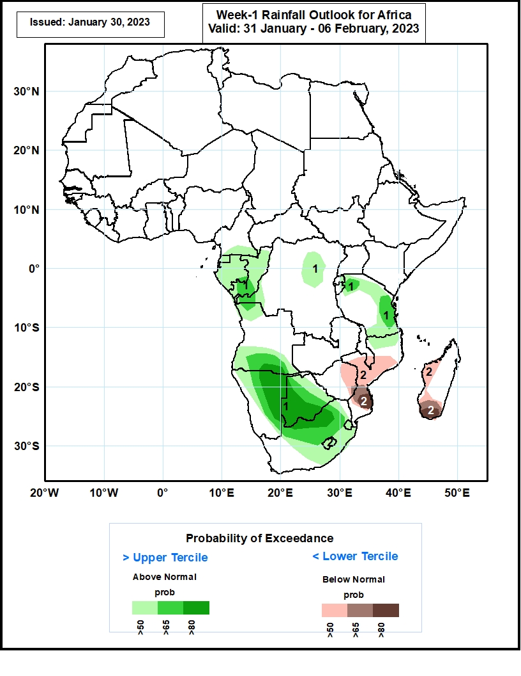
Week-1 Precipitation Outlooks
31 Jan – 06 Feb, 2023
The consolidated forecasts call for above 50%
chance for weekly rainfall to be above-normal
(above the upper tercile) over Equatorial Guinea,
Gabon, Congo, parts of DRC and Tanzania, the far
northern and southern Angola, and portions of
Namibia, Botswana and South Africa. High chances
exceeding 80% are indicated over eastern Namibia,
western and southern Botswana and northern
South Africa.
The forecasts call for above 50% chance for weekly total rainfall to be below-normal (below the lower tercile) over eastern Zimbabwe, central and southern Mozambique, southern Malawi, and western and southern Madagascar. High chances exceeding 80% are indicated over southern
Mozambique and southern Madagascar.
Notes:
‹#›

Slide 11
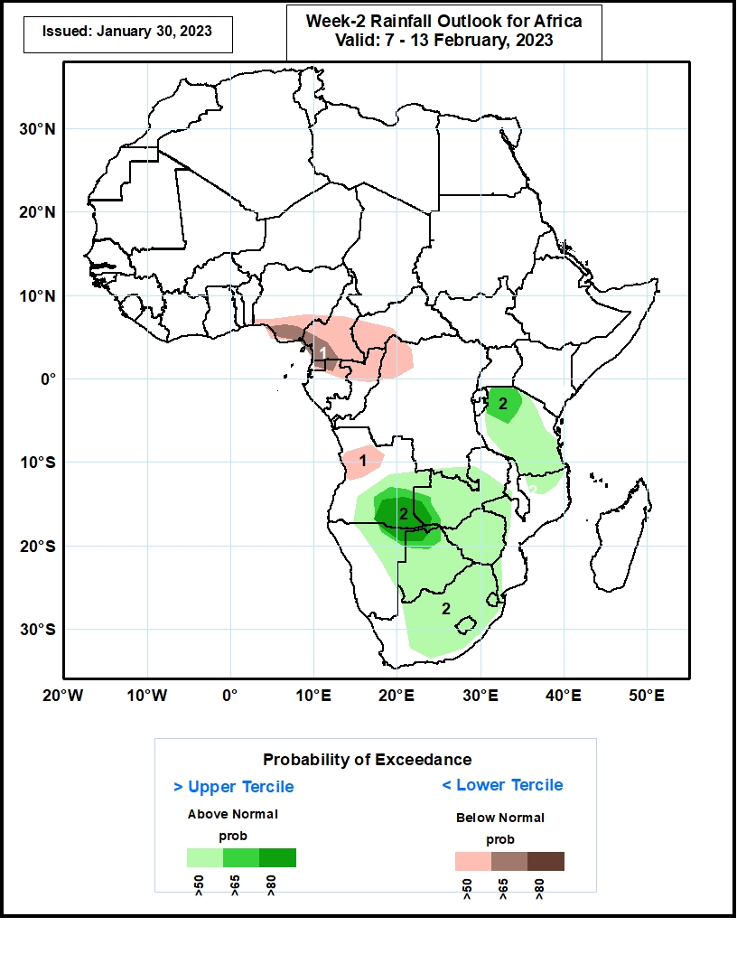
Week-2 Precipitation Outlooks
07 – 13 Feb 2023
The forecasts call for above 50% chance for weekly total rainfall to be above-normal (above the upper tercile) across much of Southern Africa, and Tanzania. High probabilities exceeding 80% are indicated over southeastern Angola and the neighboring areas of Namibia and Zambia.
The consolidated probabilistic forecasts call for above 50% chance for weekly rainfall to be below-normal (below the lower tercile) over southern Nigeria, Cameroon, western CAR, Equatorial Guinea, northern Gabon, northern Congo, northwestern DRC, and western Angola. Enhanced probabilities exceeding 65% are indicated along the coastal areas of Nigeria and Cameroon.
Notes:
‹#›

Slide 12
Summary
During the past 30 days, in East Africa, above-average rainfall was observed over south-central Uganda, pockets of central and southeastern Kenya, pockets of northwestern Ethiopia, west-central Burundi, and pockets of central, northwestern, and eastern Tanzania. Rainfall was below-average over southwestern Ethiopia, most of western and southwestern Kenya, Rwanda, eastern Burundi, and parts of west-central, northeastern, and southeastern Tanzania. In Central Africa, rainfall was above-average over northern, central, and southeastern Congo, and southeastern, central, and most of western DRC. Rainfall was below-average over western, northern, and central Gabon, southern CAR, southwestern Congo, Sao Tome and Principe, and pockets of northeastern and eastern DRC. In West Africa, rainfall was above-average over eastern Guinea, southeastern Cote d’Ivoire, southern Ghana, southern Togo, and pockets of southwestern Nigeria. In contrast, below-average rainfall was observed in southeastern Liberia, southwestern Cote d’Ivoire, central Ghana, central Togo, central Benin, and southeastern Nigeria. In southern Africa, above-average rainfall was observed over much of central, south-central, and most of northern Angola, southeastern South Africa, western Lesotho, central and north-central Namibia (as well as eastern portions of the Caprivi Strip), northwestern and south-central Mozambique, central and northern Malawi, most of Zambia, and central, northwestern, and southeastern Madagascar. Below normal precipitation was observed over southeastern and west-central Angola, northeastern, western, and southeastern Namibia, pockets of southwestern and northeastern Zambia, pockets of central, eastern, and southwestern Mozambique, most of Zimbabwe, most of Botswana, Comoros, Seychelles, north-central and eastern South Africa, Eswatini, eastern Lesotho, and northeastern and southwestern Madagascar.
During the past 7 days, in East Africa, rainfall was above-average over east-central Tanzania. Below-average rainfall was observed over west-central Ethiopia, southeastern Uganda, southwestern Kenya, Burundi, western Rwanda, and northern, western, and southern Tanzania. In Central Africa, rainfall was above-average over southeastern Cameroon, southwestern and pockets of eastern Gabon, northern, central, and southeastern Congo, most of western and central DRC, and southern Sao Tome and Principe. Below-average rainfall was observed over pockets of northwestern and southern Gabon, southern and western Equatorial Guinea, southwestern Congo, eastern and southeastern DRC, and central Sao Tome and Principe. In West Africa, rainfall was above average across most of the regions along the Gulf of Guinea, including southeastern Guinea, central and eastern Liberia, southern Cote d’Ivoire, southern Ghana, southern Togo, and parts of southwestern Nigeria. In Southern Africa, rainfall was above-average over pockets of central and northwestern Angola, pockets of northern, northwestern, and east-central Mozambique, western and southern Zambia, pockets of north-central and southern Zimbabwe, pockets of central Malawi, central Namibia, pockets of central, southeastern, and northeastern South Africa, western Lesotho, eastern Eswatini, and western, central, and southern Madagascar (heavy rains due to Cyclone Cheneso). In contrast, rainfall was below-average over west-central and southeastern Angola, pockets of northeastern Namibia (including the western portion of the Caprivi Strip), portions of northern Zambia, most of Botswana, most of central, western, and eastern Zimbabwe, pockets of northern and southern Malawi, north-central and eastern South Africa, western Eswatini, central, northeastern, and southern portions of Mozambique, Comoros, and northeastern Madagascar.
The consolidated forecasts call for above 50% chance for Week-1 rainfall to be above-normal (above the upper tercile) over Equatorial Guinea, Gabon, Congo, parts of DRC and Tanzania, the far northern and southern Angola, and portions of Namibia, Botswana and South Africa. High chances exceeding 80% are indicated over eastern Namibia, western and southern Botswana and northern South Africa. The forecasts call for above 50% chance for Week-1 total rainfall to be below-normal (below the lower tercile) over eastern Zimbabwe, central and southern Mozambique, southern Malawi, and western and southern Madagascar. High chances exceeding 80% are indicated over southern Mozambique and southern Madagascar. The forecasts call for above 50% chance for Week-2 total rainfall to be above-normal (above the upper tercile) across much of Southern Africa, and Tanzania. High probabilities exceeding 80% are indicated over southeastern Angola and the neighboring areas of Namibia and Zambia. The consolidated probabilistic forecasts call for above 50% chance for Week-2 rainfall to be below-normal (below the lower tercile) over southern Nigeria, Cameroon, western CAR, Equatorial Guinea, northern Gabon, northern Congo, northwestern DRC, and western Angola. Enhanced probabilities exceeding 65% are indicated along the coastal areas of Nigeria and Cameroon.

