Slide 1
The African Monsoon Recent Evolution and Current Status Include Week-1 and Week-2 Outlooks
Update prepared by Justin Hicks
13 February 2023
For more information, visit:
http://www.cpc.ncep.noaa.gov/products/Global_Monsoons/African_Monsoons/precip_monitoring.shtml

Slide 2
Outline
Highlights
Recent Evolution and Current Conditions
NCEP GEFS Forecasts
Summary

Slide 3
Highlights: Last 7 Days
During the past 7 days, in East Africa, rainfall was above-average over eastern Tanzania. Below-average rainfall was observed over parts of western Tanzania. In Central Africa, rainfall was above-average over the far northern Congo and the neighboring areas of northwestern DRC. Below-average rainfall was observed across Equatorial Guinea, Gabon, Congo and DRC. In West Africa, above-average rainfall was observed over pockets of eastern Guinea and Ghana. In southern Africa, rainfall was above-average over pockets of the far southern Angola, northeastern Namibia, pockets of Botswana, eastern South Africa, Lesotho, Eswatini, and many parts of Mozambique and Madagascar. In contrast, rainfall was below-average over many parts of Angola, western Namibia, much of Zambia, northern Botswana , Zimbabwe, and pockets of central Mozambique and central Madagascar.
Model forecasts call for an increased chance for week-1 rainfall to be below-normal along the Gulf of Guinea coast, portions of equatorial Central and East Africa, and the western portion of Southern Africa. There is an increased chance for above-normal rainfall over the eastern portion of Southern Africa. For week-2, there is an increased chance for below-normal rainfall over equatorial Central Africa and northern Madagascar.

Slide 4
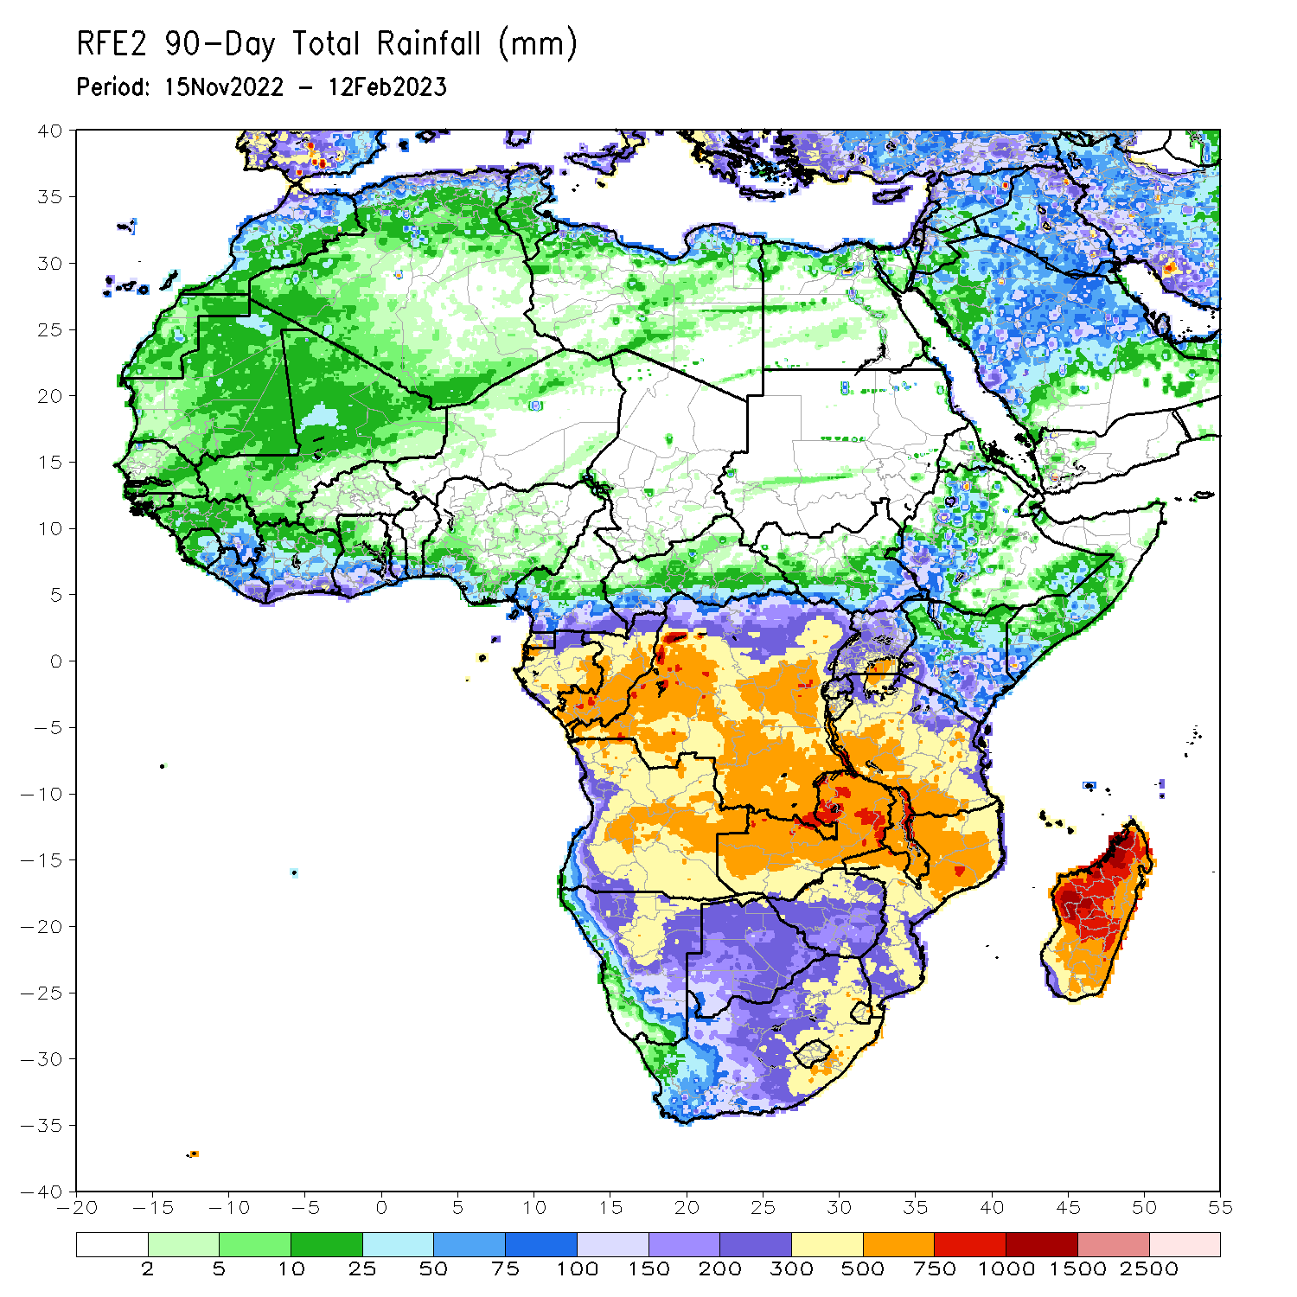
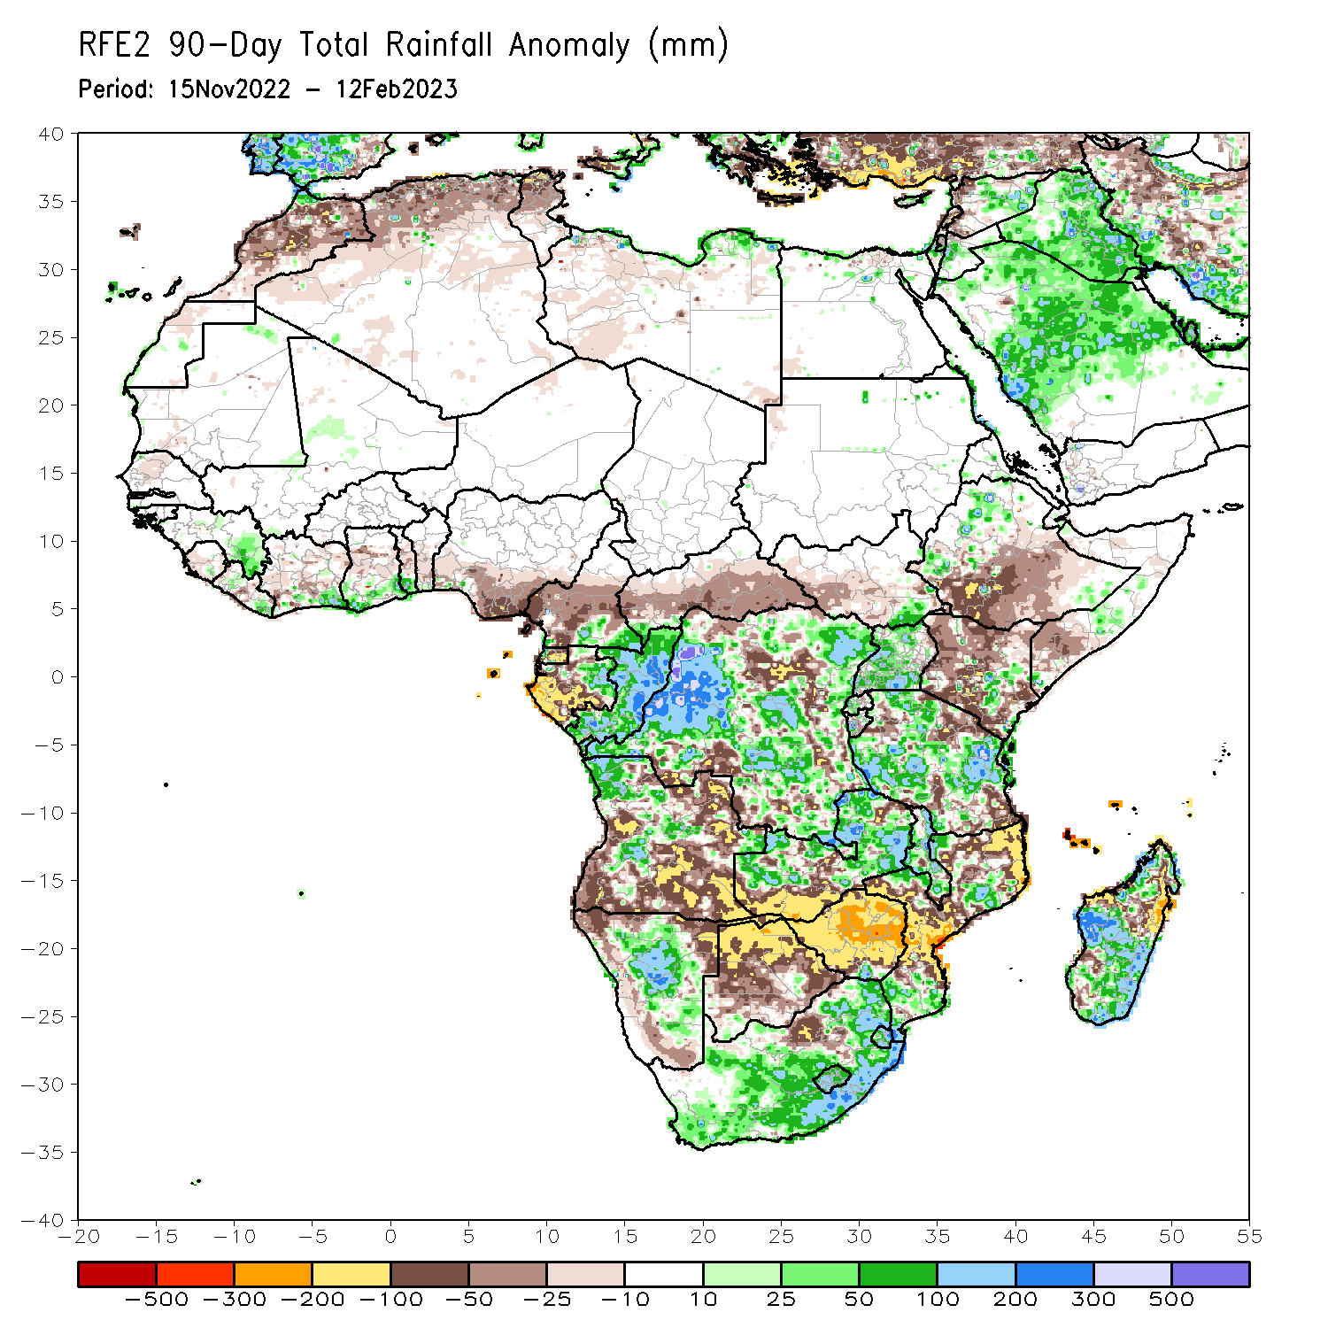
Rainfall Patterns: Last 90 Days
Over the past 90 days, in East Africa, above-average rainfall was observed over parts of western Ethiopia, and much of Uganda and Tanzania. Rainfall was below-average over southern Ethiopia, much of Kenya, southern Somalia, and pockets of Tanzania. In southern Africa, above-average rainfall was observed over parts of central and northern Angola, much of Zambia, Namibia, much of South Africa, Lesotho, Eswatini, Malawi, parts of Mozambique, and southern Madagascar. Below-average rainfall was observed over southern Angola, much of Botswana and Zimbabwe, pockets of Mozambique, and northern Madagascar. In Central Africa, rainfall was above-average over southeastern Cameroon, eastern Gabon, Congo, and much of DRC. Rainfall was below-average over western and central Cameroon, western and southern Gabon, Equatorial Guinea, and portions of northern, eastern and southern DRC. In West Africa, rainfall was above-average over parts of eastern Guinea, and coastal Cote d’Ivoire and Ghana. In contrast, below-average rainfall was observed over southern Nigeria.
Notes:
4

Slide 5
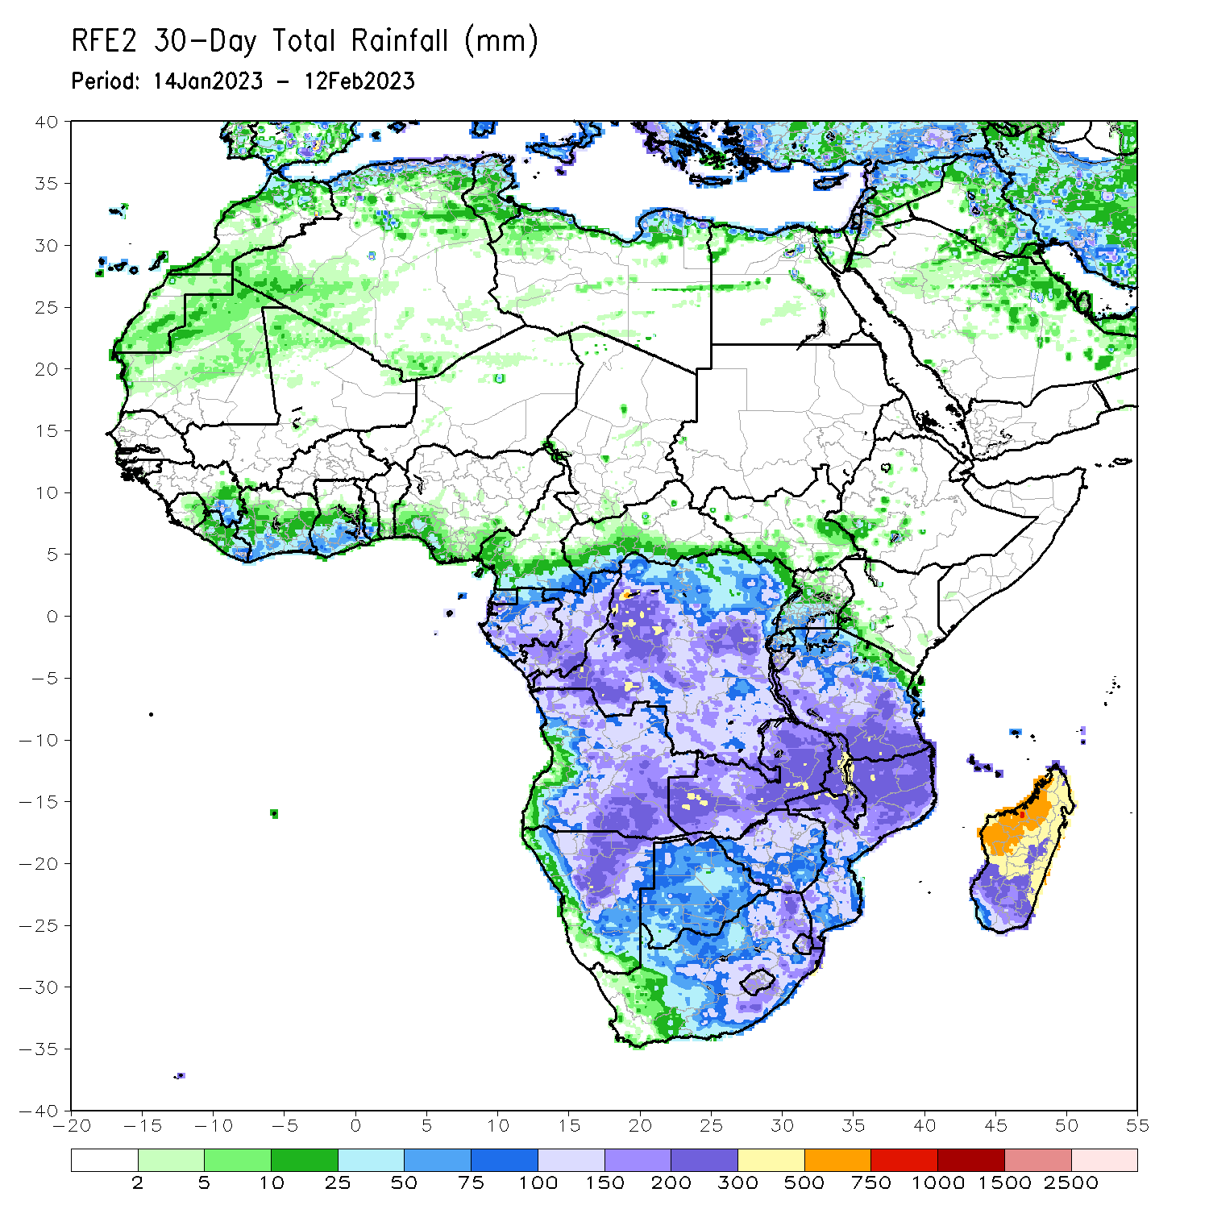
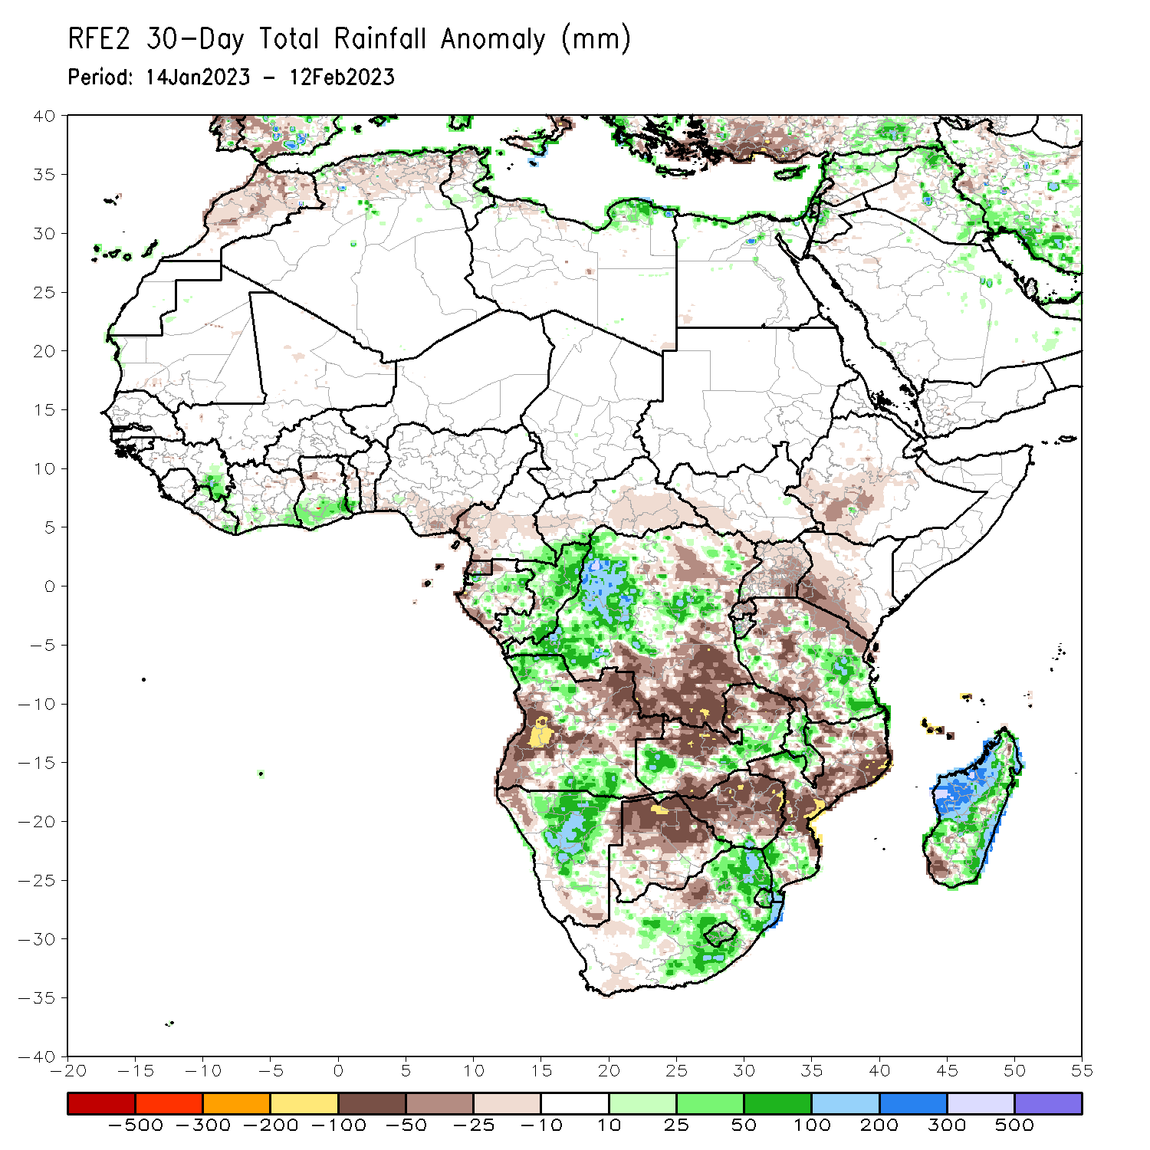
Rainfall Patterns: Last 30 Days
Over the past 30 days, in East Africa, above-average rainfall was observed over eastern Tanzania. Rainfall was below-average over southwestern Ethiopia, Kenya, Uganda, Rwanda, Burundi, and western Tanzania. In southern Africa, above-average rainfall was observed over northern and southern Angola, southern Zambia, Namibia, Malawi, and much of Madagascar. Below-average rainfall was observed over western and eastern Angola, much of Botswana and Zimbabwe, and parts of northern South Africa, and much of Mozambique. In Central Africa, rainfall was above-average over Congo, many parts of western and northern DRC. Rainfall was below-average over parts of southern and eastern DRC. In West Africa, rainfall was above-average over pockets of eastern Guinea, and coastal Ghana.
Notes:
5

Slide 6
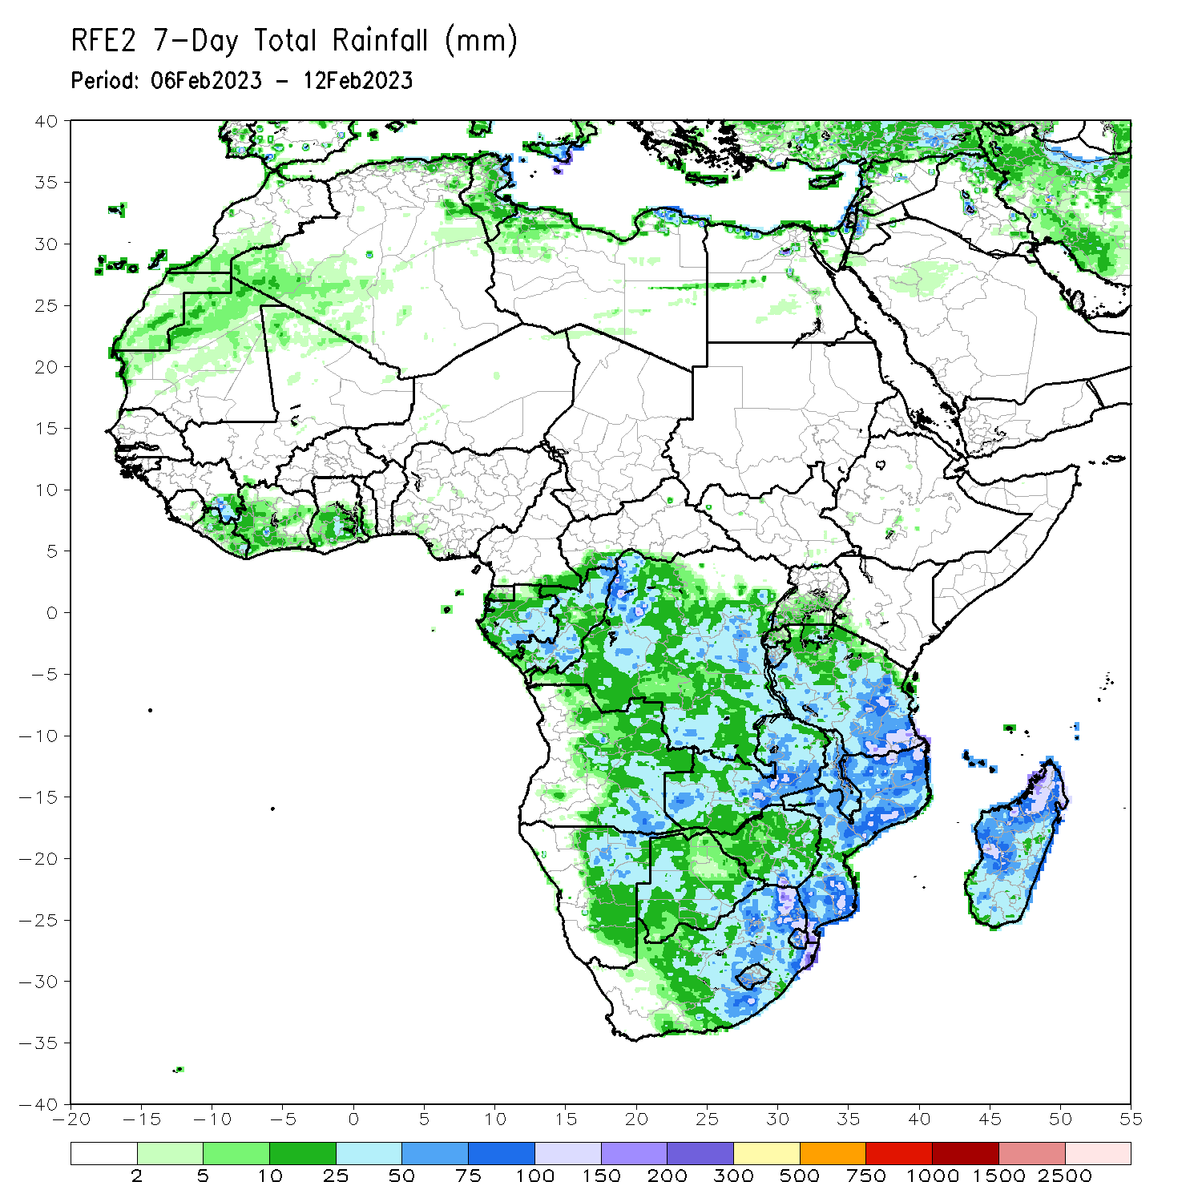
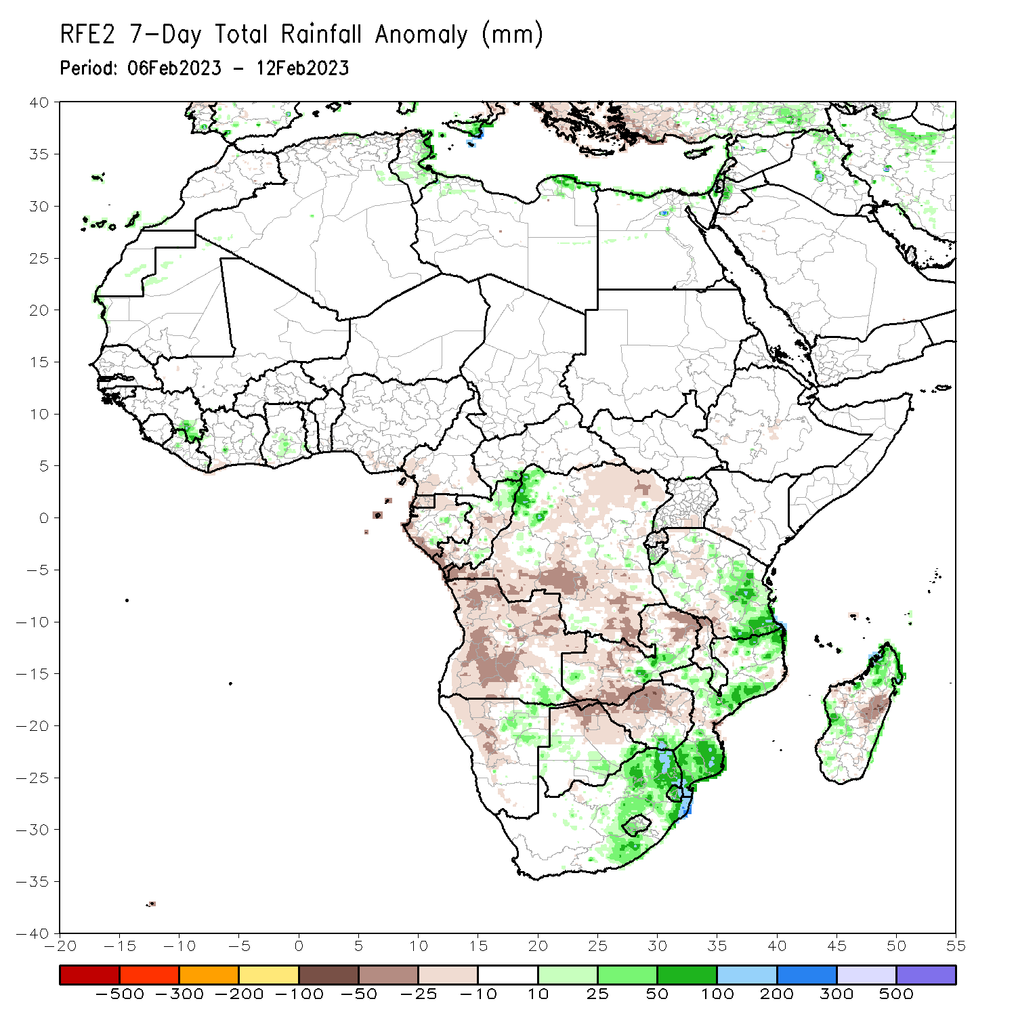
Rainfall Patterns: Last 7 Days
During the past 7 days, in East Africa, rainfall was above-average over eastern Tanzania. Below-average rainfall was observed over parts of western Tanzania. In Central Africa, rainfall was above-average over the far northern Congo and the neighboring areas of northwestern DRC. Below-average rainfall was observed across Equatorial Guinea, Gabon, Congo and DRC. In West Africa, above-average rainfall was observed over pockets of eastern Guinea and Ghana. In southern Africa, rainfall was above-average over pockets of the far southern Angola, northeastern Namibia, pockets of Botswana, eastern South Africa, Lesotho, Eswatini, and many parts of Mozambique and Madagascar. In contrast, rainfall was below-average over many parts of Angola, western Namibia, much of Zambia, northern Botswana , Zimbabwe, and pockets of central Mozambique and central Madagascar.

Slide 7
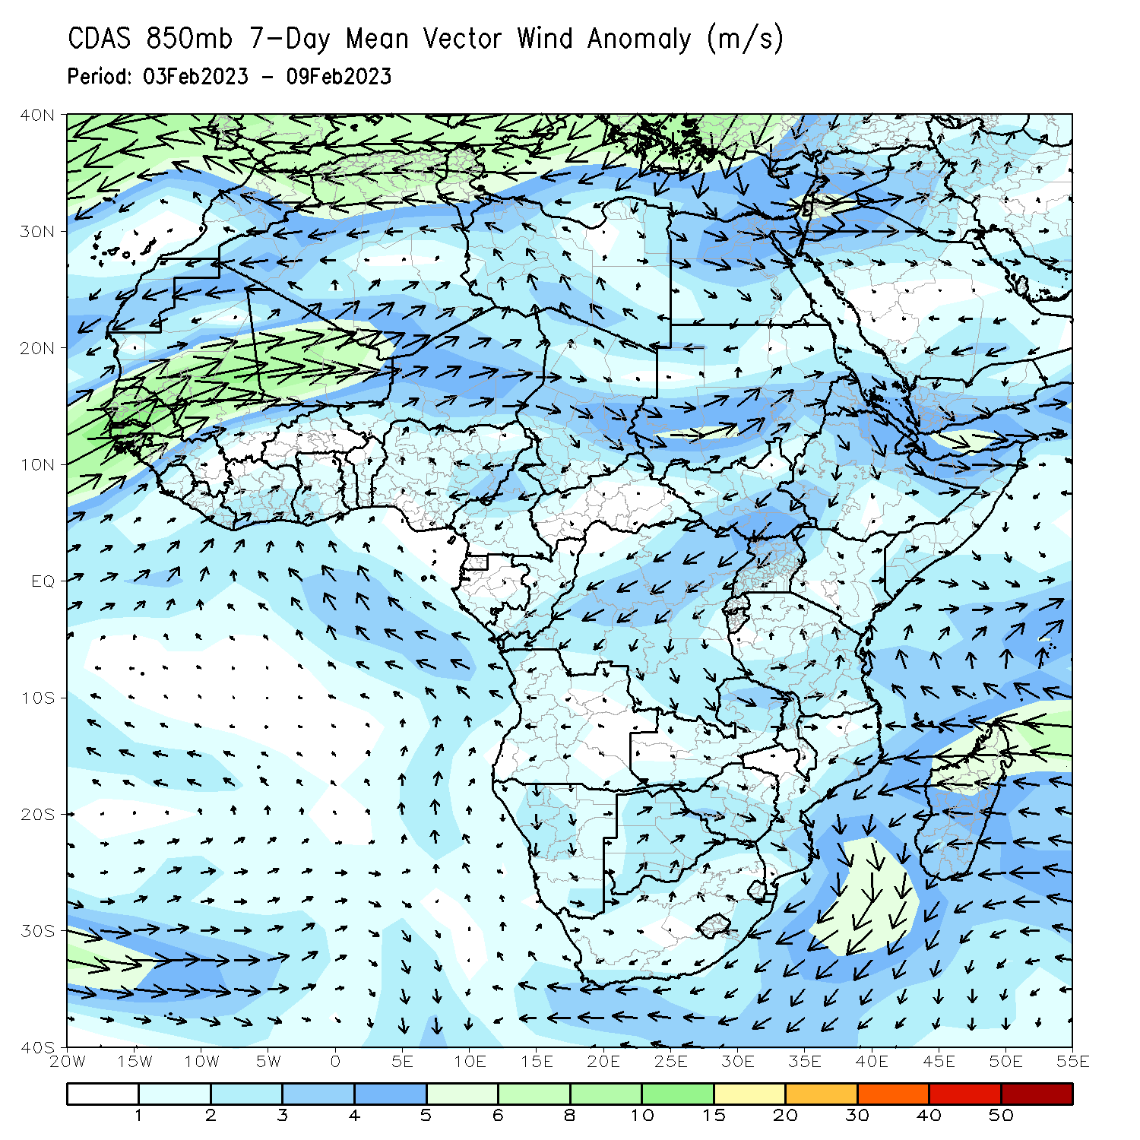
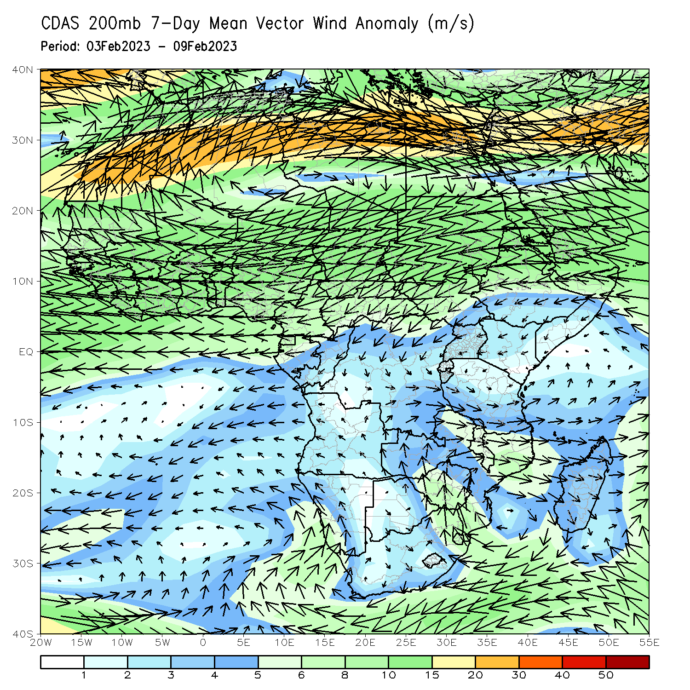
Atmospheric Circulation: Last 7 Days
Lower-level (850-hPa) cyclonic circulation across southeastern Africa may have contributed to the observed above-average rainfall in the region.

Slide 8
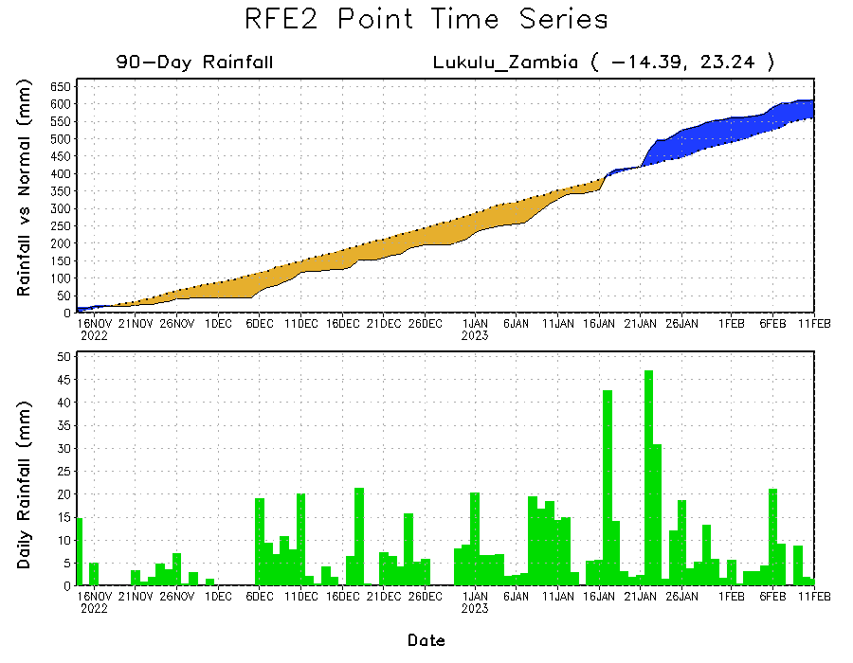
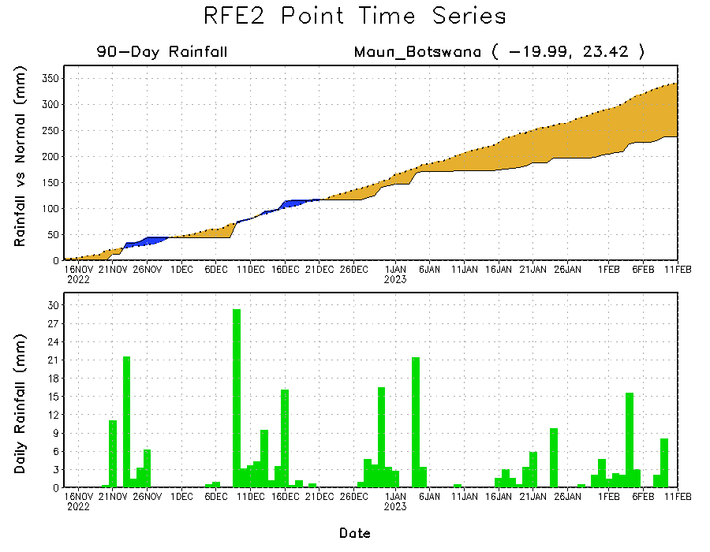
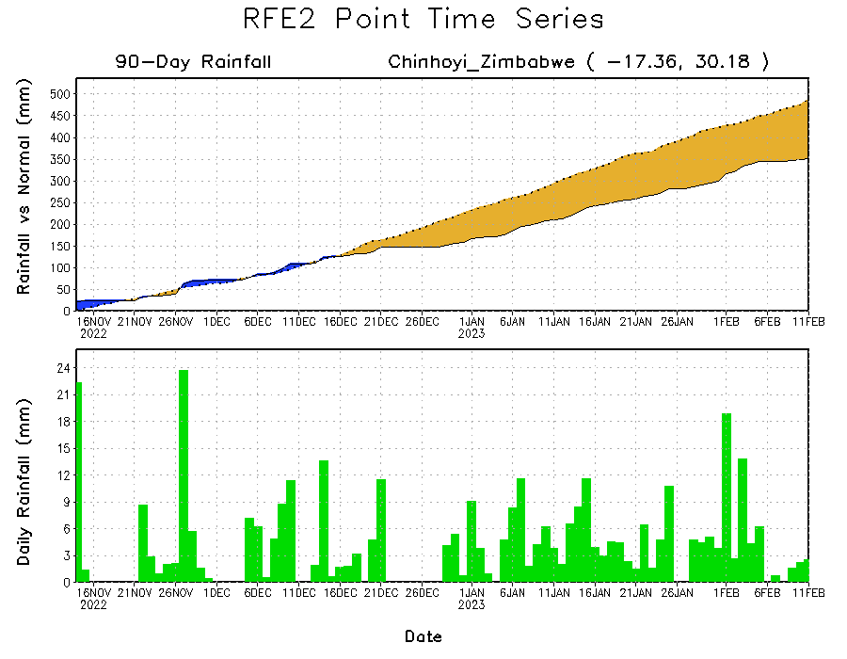
Rainfall Evolution
Daily evolution of rainfall over the last 90 days at selected locations shows worsening moisture deficits over parts of northern Botswana (bottom left) and central Zimbabwe (bottom right). Seasonal total rainfall remained above-average over western Zambia (top right).

Slide 9
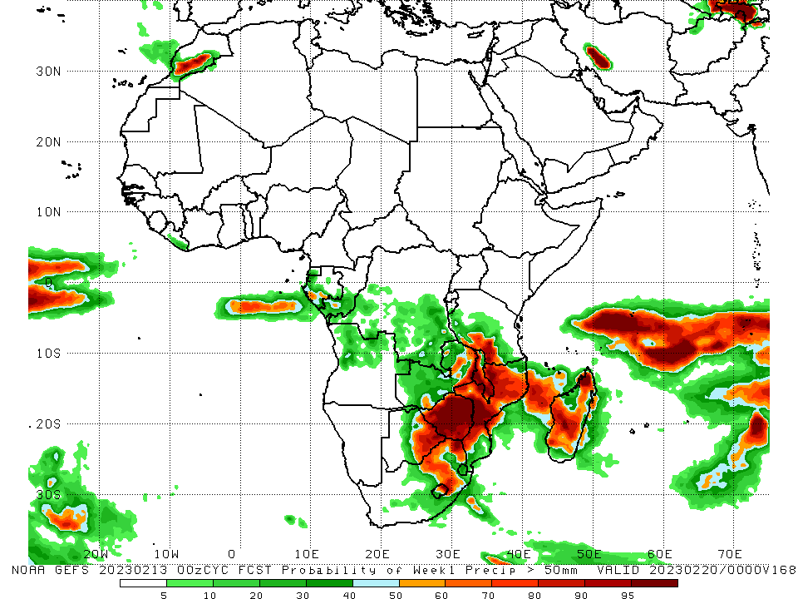
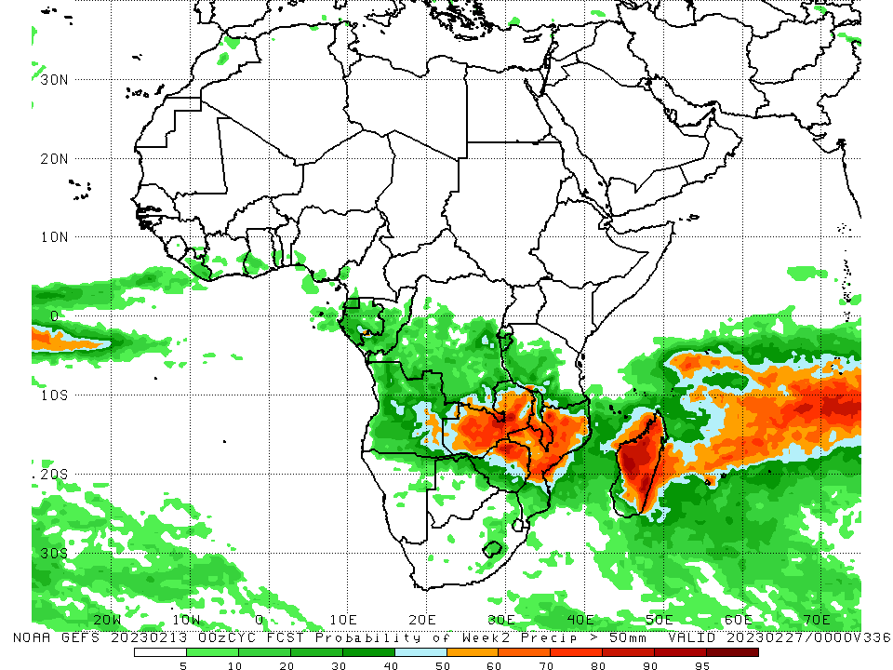
NCEP GEFS Model Forecasts Non-Bias Corrected Probability of precipitation exceedance
Week-1, Valid: 14 – 20 Feb 2023
Week-2, Valid: 21 – 27 Feb 2023
For week-1 (left panel), the GEFS forecasts indicate a moderate to high chance (over 70%) for rainfall to exceed 50 mm over eastern Botswana, Zimbabwe, southern Malawi, southern Tanzania, Mozambique, eastern South Africa and pockets of Madagascar. For week-2 (right panel), there is a moderate to high chance for rainfall to exceed 50mm across much of Zambia, northern Zimbabwe, Malawi, northern Mozambique, and much of Madagascar.
Notes:
9

Slide 10
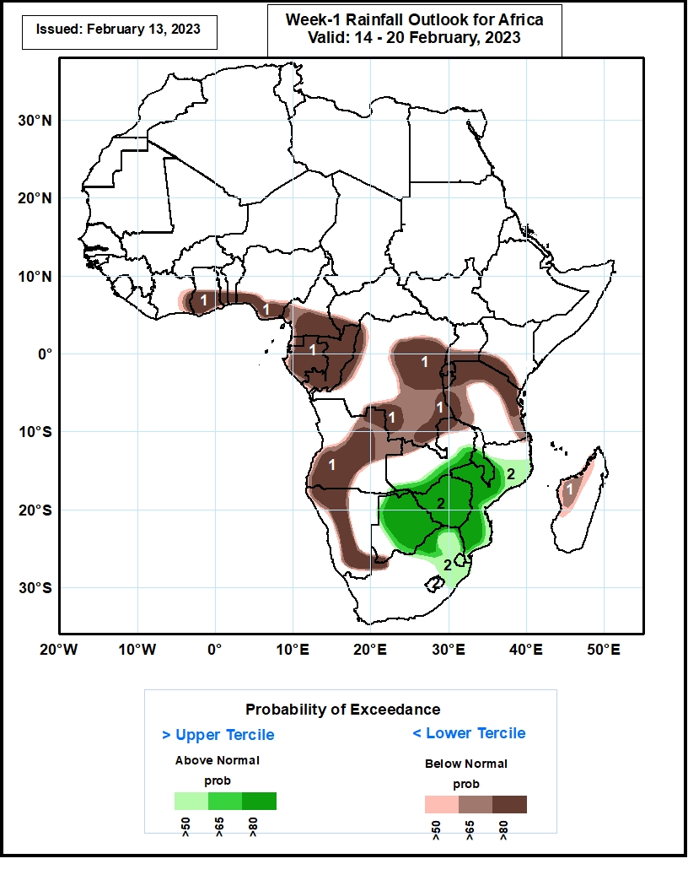
Week-1 Precipitation Outlooks
14 – 20 Feb 2023
The consolidated probabilistic forecasts suggest above 50% chance for weekly total rainfall to be below-normal (below the lower tercile) over eastern Cote d’Ivoire, central and southern parts of Ghana, southern Togo, Benin, Nigeria, Cameroon, much of Equatorial Guinea, Gabon and Congo, western eastern and southern parts of DR Congo, southern Uganda and Kenya, much of Rwanda and Burundi, northern, western and eastern parts of Tanzania, central and western parts of Angola, western and southern parts of Namibia, and western parts of Madagascar. In particular, there is above 80% chance for rainfall to be below normal over eastern Cote d’Ivoire, central and southern parts of Ghana, southern Togo, Benin, Nigeria, Cameroon, much of Equatorial Guinea, Gabon and Congo, western eastern and southern parts of DR Congo, southern Uganda and Kenya, much of Rwanda and Burundi, northern, western and eastern parts of Tanzania, central and western parts of Angola, western and southern parts of Namibia.
The forecasts suggest above 50% chance for weekly rainfall to be above-normal (above the upper tercile) over southern Zambia, central and southern parts of Malawi, central and eastern parts of Botswana, much of Zimbabwe and Mozambique, northern South Africa and much of Eswatini. In particular, there is above 80% chance for rainfall to be above-normal over southern Zambia, central and southern parts of Malawi, central and eastern parts of Botswana, much of Zimbabwe, northern and southern parts of Mozambique.
Notes:
10

Slide 11
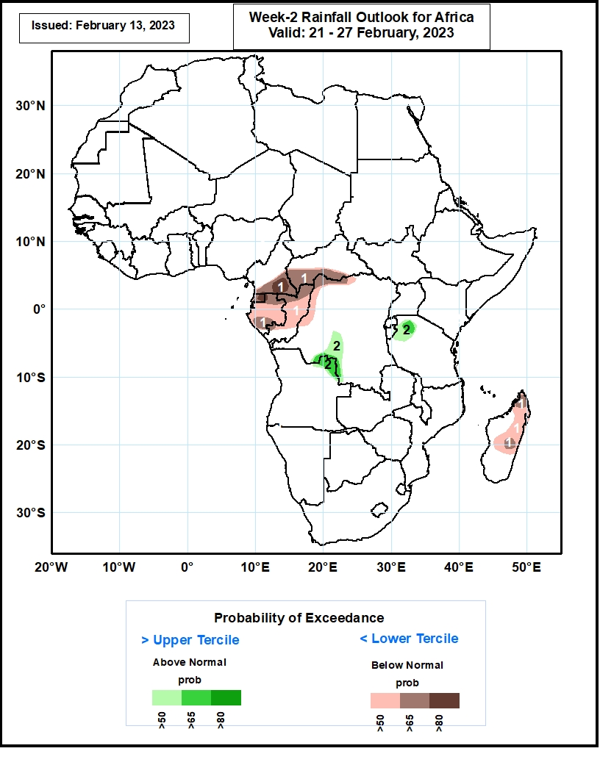
Week-2 Precipitation Outlooks
21 – 27 Feb 2023
The consolidated probabilistic forecasts suggest above 50% chance for weekly total rainfall to be below-normal (below the lower tercile) over southern Cameroon and CAR, much of Equatorial Guinea, Gabon and Congo, northern and western parts of DR Congo, northern and central parts of Madagascar. In particular, there is above 80% chance for rainfall to be below normal over southern Cameroon and eastern Equatorial Guinea.
The forecasts suggest above 50% chance for weekly rainfall to be above-normal (above the upper tercile) over southwestern DR Congo, northeastern Angola, and northwestern Tanzania. In particular, there is above 65% chance for rainfall to be above-normal over northeastern Angola, and northwestern Tanzania.
Notes:
11

Slide 12
Summary
Over the past 30 days, in East Africa, above-average rainfall was observed over eastern Tanzania. Rainfall was below-average over southwestern Ethiopia, Kenya, Uganda, Rwanda, Burundi, and western Tanzania. In southern Africa, above-average rainfall was observed over northern and southern Angola, southern Zambia, Namibia, Malawi, and much of Madagascar. Below-average rainfall was observed over western and eastern Angola, much of Botswana and Zimbabwe, and parts of northern South Africa, and much of Mozambique. In Central Africa, rainfall was above-average over Congo, many parts of western and northern DRC. Rainfall was below-average over parts of southern and eastern DRC. In West Africa, rainfall was above-average over pockets of eastern Guinea, and coastal Ghana.
During the past 7 days, in East Africa, rainfall was above-average over eastern Tanzania. Below-average rainfall was observed over parts of western Tanzania. In Central Africa, rainfall was above-average over the far northern Congo and the neighboring areas of northwestern DRC. Below-average rainfall was observed across Equatorial Guinea, Gabon, Congo and DRC. In West Africa, above-average rainfall was observed over pockets of eastern Guinea and Ghana. In southern Africa, rainfall was above-average over pockets of the far southern Angola, northeastern Namibia, pockets of Botswana, eastern South Africa, Lesotho, Eswatini, and many parts of Mozambique and Madagascar. In contrast, rainfall was below-average over many parts of Angola, western Namibia, much of Zambia, northern Botswana , Zimbabwe, and pockets of central Mozambique and central Madagascar.
Model forecasts call for an increased chance for week-1 rainfall to be below-normal along the Gulf of Guinea coast, portions of equatorial Central and East Africa, and the western portion of Southern Africa. There is an increased chance for above-normal rainfall over the eastern portion of Southern Africa. For week-2, there is an increased chance for below-normal rainfall over equatorial Central Africa and northern Madagascar.

