Slide 1
The African Monsoon Recent Evolution and Current Status Include Week-1 and Week-2 Outlooks
Update prepared
21 February 2023
For more information, visit:
http://www.cpc.ncep.noaa.gov/products/Global_Monsoons/African_Monsoons/precip_monitoring.shtml

Slide 2
Outline
Highlights
Recent Evolution and Current Conditions
NCEP GEFS Forecasts
Summary

Slide 3
Highlights: Last 7 Days
During the past 7 days, in East Africa, rainfall was above-average over southwestern Tanzania. Below-average rainfall was observed throughout the rest of Tanzania, Rwanda, Burundi, southern Uganda, southwestern Kenya and parts of southwestern Ethiopia. In Central Africa, rainfall was above-average over parts of southwestern Gabon, southwestern Congo, and some pockets of southeastern DRC. Below-average rainfall was observed across Equatorial Guinea, the rest of Gabon/Congo/DRC, and southern Cameroon. In West Africa, above-average rainfall was observed over pockets of eastern Liberia, and below average rainfall was observed over in southern and central Cote d’Ivoire, central and southern Ghana, southern Togo, southern Benin, and southern Nigeria. In southern Africa, rainfall was above-average over portions of southern Zambia, central and eastern Botswana, eastern South Africa, Lesotho, western and east-central Mozambique, central and southern Malawi, northern and southern Zimbabwe, and parts of central Madagascar. In contrast, rainfall was below-average over many parts of Angola, northern, central, and western Namibia, northern Zambia, central Zimbabwe, northeastern and southeastern Mozambique, pockets of central South Africa, and the rest of Madagascar.
Model forecasts call for an increased chance for week-1 rainfall to be below-normal along the Gulf of Guinea coast, portions of equatorial Central and East Africa, the western and central portions of southern Africa and in Madagascar. There is an increased chance for above-normal rainfall over the eastern portion of southern Africa, as well as from northern Angola to southern Zambia and western Tanzania. For week-2, there is an increased chance for below-normal rainfall over equatorial eastern African northern DRC, southern Angola, and northern and central Namibia. There is an increased chance for above-normal rainfall in the Gulf of Guinea region, over the eastern portion of southern Africa, and in Madagascar.

Slide 4
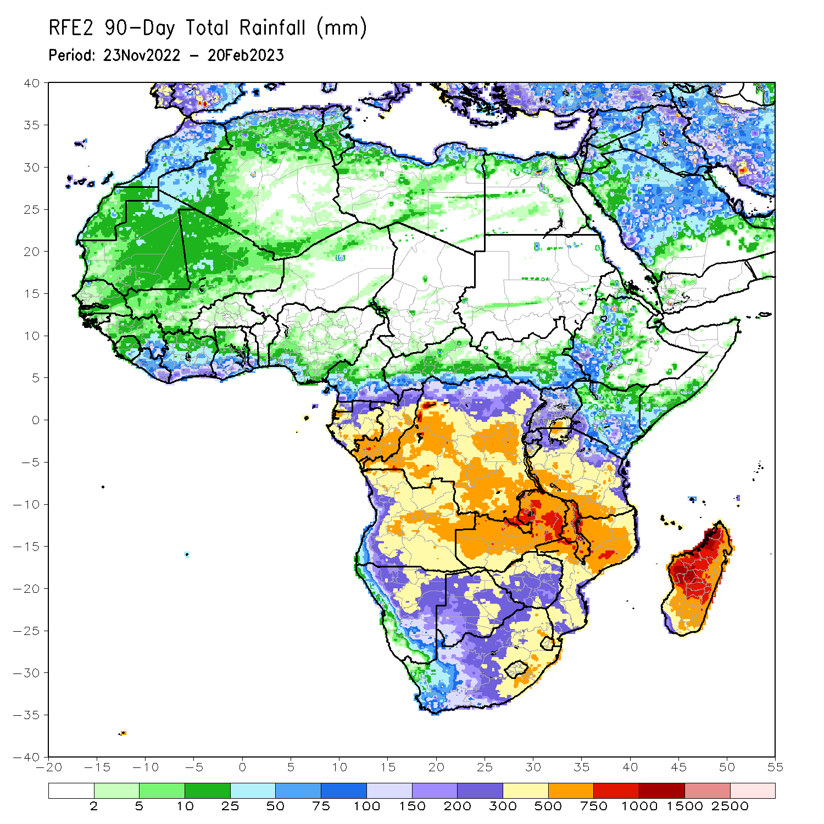
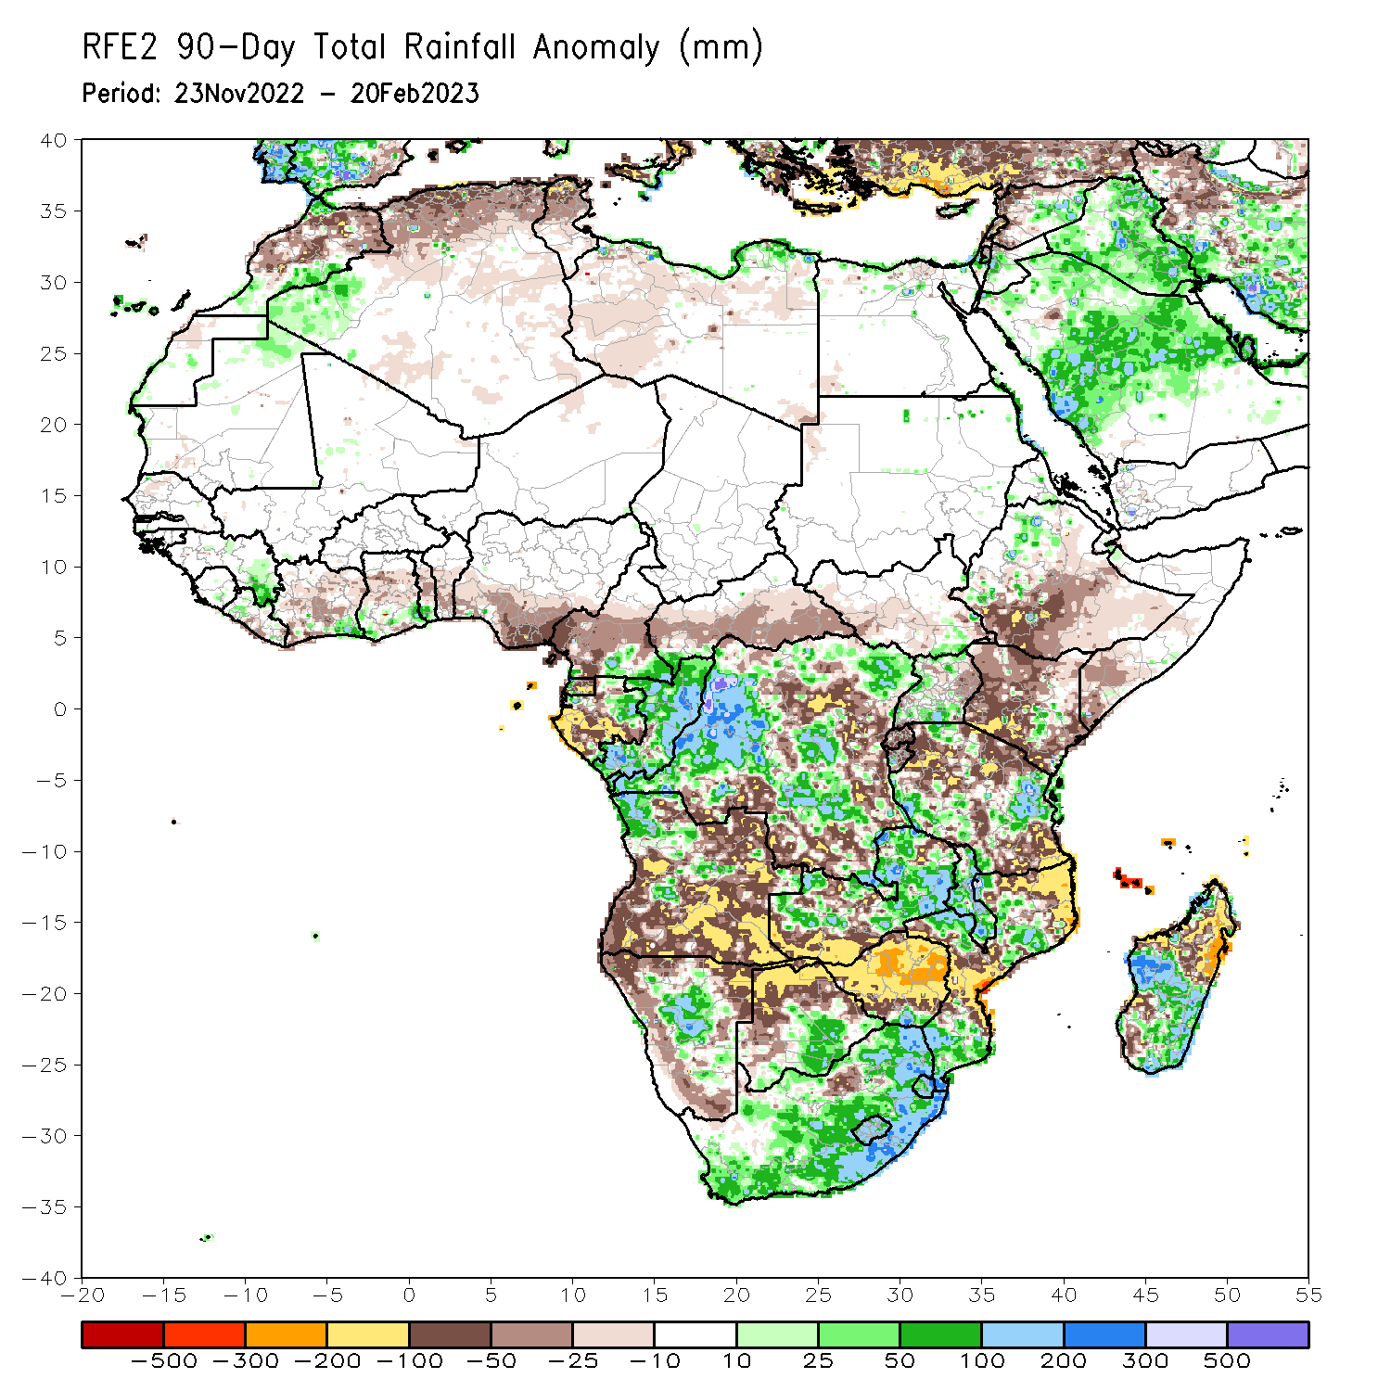
Rainfall Patterns: Last 90 Days
Over the past 90 days, in East Africa, above-average rainfall was observed over parts of western Ethiopia, parts of central Kenya, western Burundi, northern and southern Uganda, and western/eastern Tanzania. Rainfall was below-average over southern Ethiopia, much of Kenya, Rwanda, eastern Burundi, southern Somalia, and central/southern Tanzania. In southern Africa, above-average rainfall was observed over parts of central and northern Angola, much of Zambia, central Namibia, much of South Africa, Lesotho, Eswatini, Malawi, parts of north-central and southern Mozambique, southern Botswana, southern Zimbabwe, and central/southern Madagascar. Below-average rainfall was observed over southern/eastern Angola, northern Botswana, northern/central Zimbabwe, northern/central Mozambique, northern Namibia, Comoros, and northern Madagascar. In Central Africa, rainfall was above-average over southeastern Cameroon, eastern Gabon, Congo, and northern/western/central DRC. Rainfall was below-average over western and central Cameroon, western and southern Gabon, Equatorial Guinea, and portions of north-central, eastern, and southern DRC. In West Africa, rainfall was above-average over parts of eastern Guinea, coastal Cote d’Ivoire, coastal Ghana, and coastal Togo. In contrast, below-average rainfall was observed over coastal Liberia, northern/central Cote d’Ivoire, central Ghana, central Togo, central/southern Benin, and southern Nigeria.
Notes:
‹#›

Slide 5
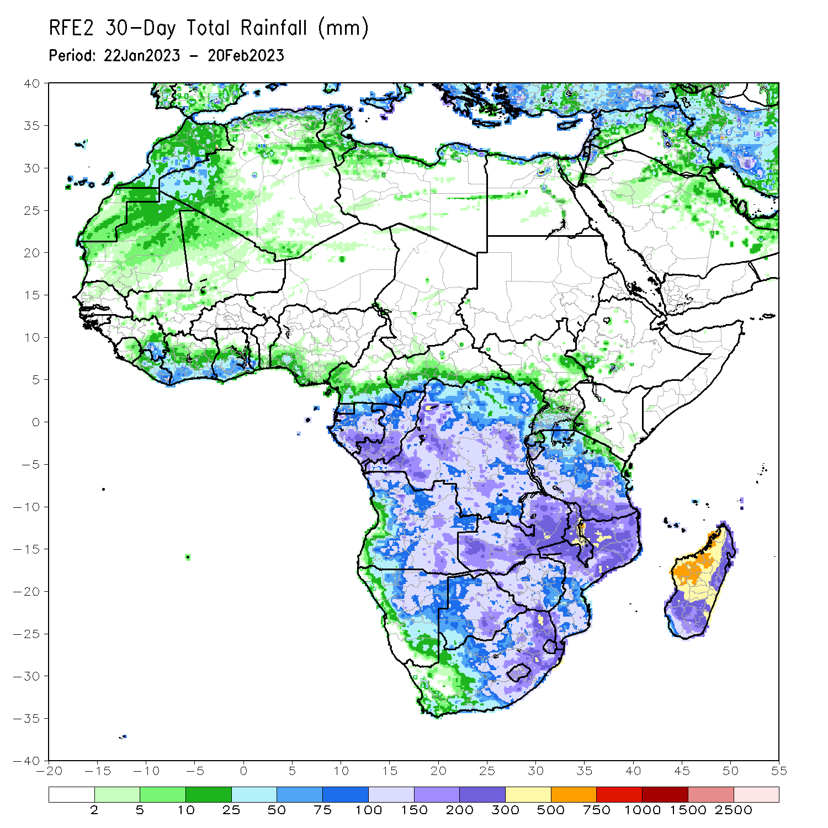
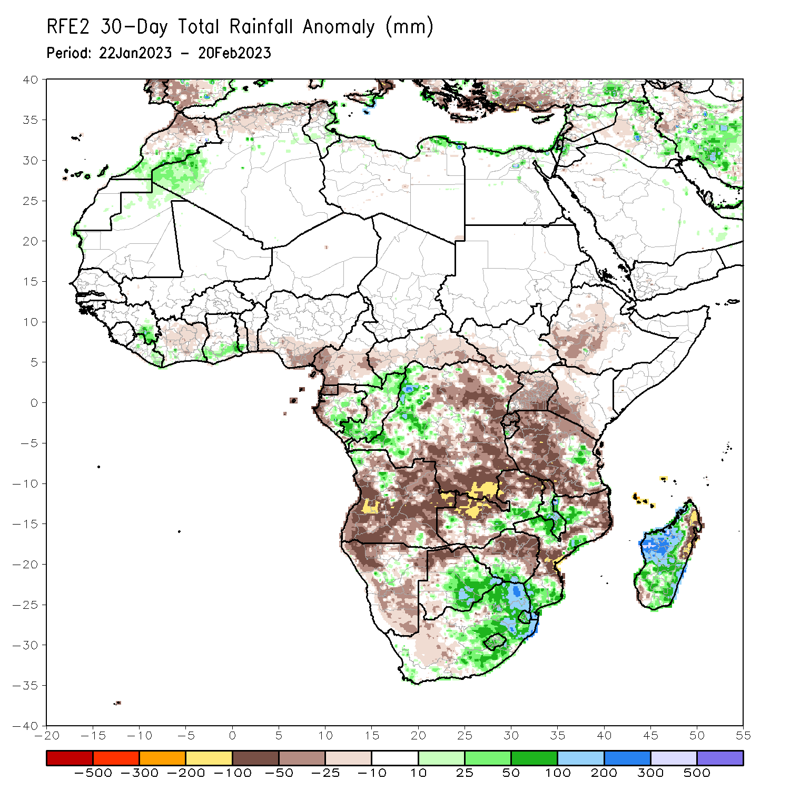
Rainfall Patterns: Last 30 Days
Over the past 30 days, in East Africa, above-average rainfall was observed over eastern Tanzania and western Burundi. Rainfall was below-average over southwestern/central Ethiopia, southwestern Kenya, Uganda, Rwanda, eastern Burundi, Rwanda, and the rest of Tanzania. In southern Africa, above-average rainfall was observed over pockets of northwestern Angola, southeastern Zambia, pockets of central Namibia, central/southern Malawi, central/southern Mozambique, eastern Botswana, southern Zimbabwe, central/eastern South Africa, Lesotho, Eswatini, and much of Madagascar. Below-average rainfall was observed over the rest of Angola, northern Botswana, northern/central Zimbabwe, parts of west-central South Africa, the rest of Namibia, northern Zambia, Comoros, much of northern/south-central Mozambique, and northeastern Madagascar. In Central Africa, rainfall was above-average over most of Congo, many parts of western DRC, and parts of central Gabon. Rainfall was below-average over parts of southern, northern, and eastern DRC, northern/western Gabon, and Equatorial Guinea. In West Africa, rainfall was above-average over pockets of southeastern Guinea, eastern Liberia, southern Togo, and coastal Ghana. Rainfall was below-average in northern/central Cote d’Ivoire, central Togo, southern Benin, and southern Nigeria.
Notes:
‹#›

Slide 6
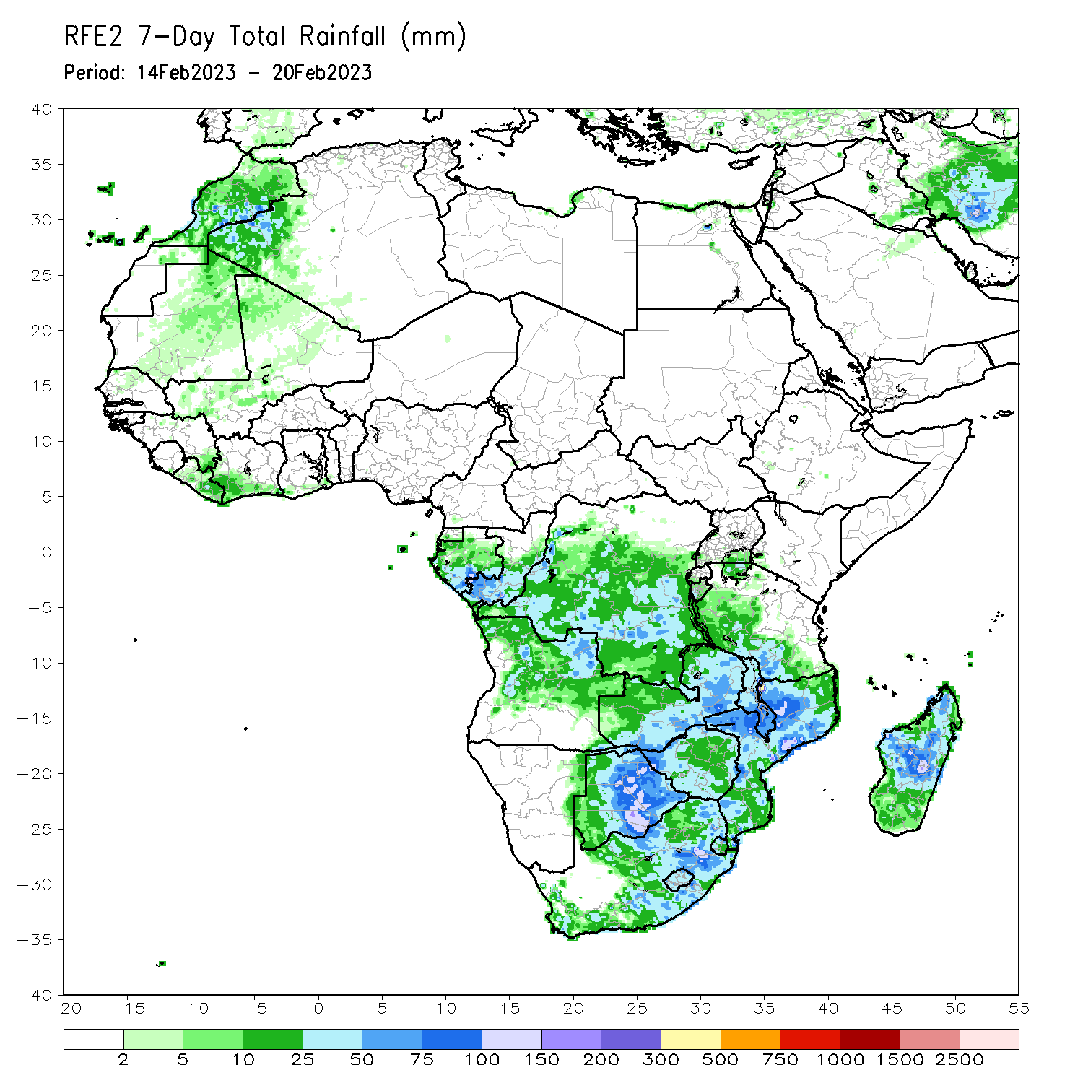
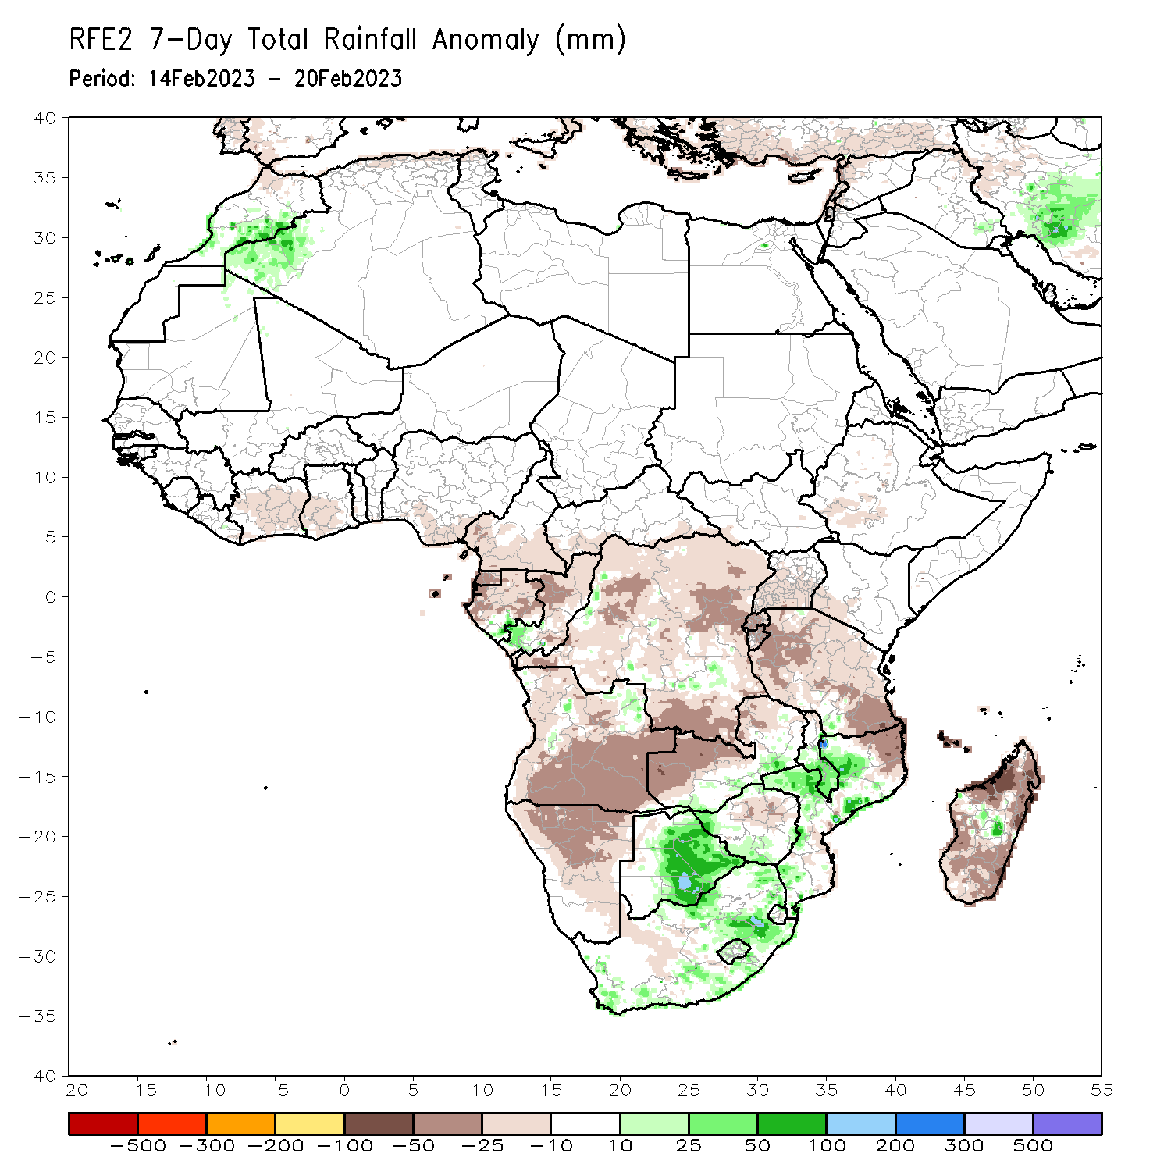
Rainfall Patterns: Last 7 Days
During the past 7 days, in East Africa, rainfall was above-average over southwestern Tanzania. Below-average rainfall was observed throughout the rest of Tanzania, Rwanda, Burundi, southern Uganda, southwestern Kenya and parts of southwestern Ethiopia. In Central Africa, rainfall was above-average over parts of southwestern Gabon, southwestern Congo, and some pockets of southeastern DRC. Below-average rainfall was observed across Equatorial Guinea, the rest of Gabon/Congo/DRC, and southern Cameroon. In West Africa, above-average rainfall was observed over pockets of eastern Liberia, and below average rainfall was observed over in southern and central Cote d’Ivoire, central and southern Ghana, southern Togo, southern Benin, and southern Nigeria. In southern Africa, rainfall was above-average over portions of southern Zambia, central and eastern Botswana, eastern South Africa, Lesotho, western and east-central Mozambique, central and southern Malawi, northern and southern Zimbabwe, and parts of central Madagascar. In contrast, rainfall was below-average over many parts of Angola, northern, central, and western Namibia, northern Zambia, central Zimbabwe, northeastern and southeastern Mozambique, pockets of central South Africa, and the rest of Madagascar.

Slide 7
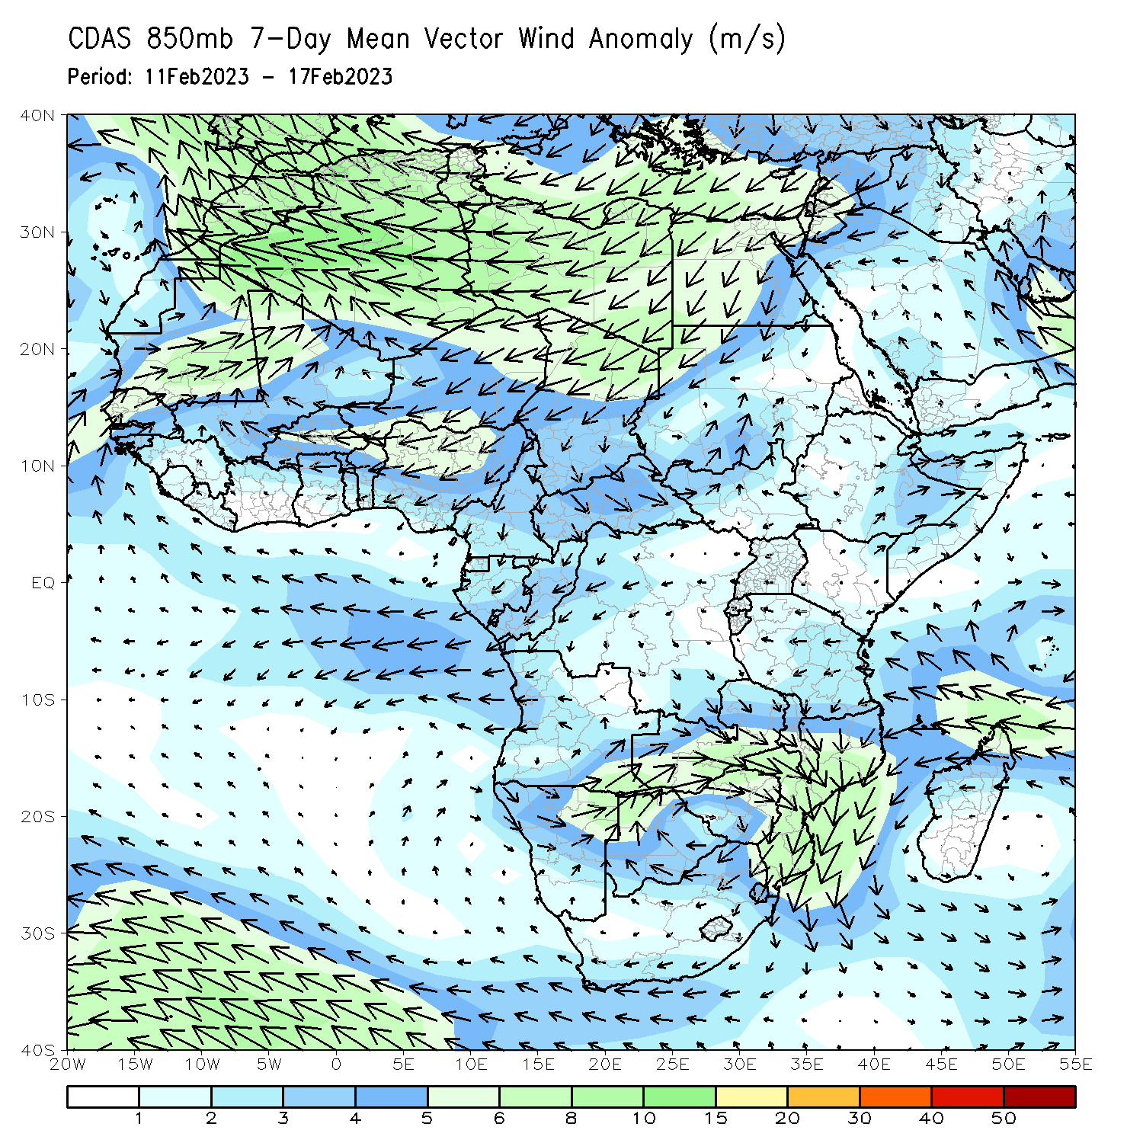
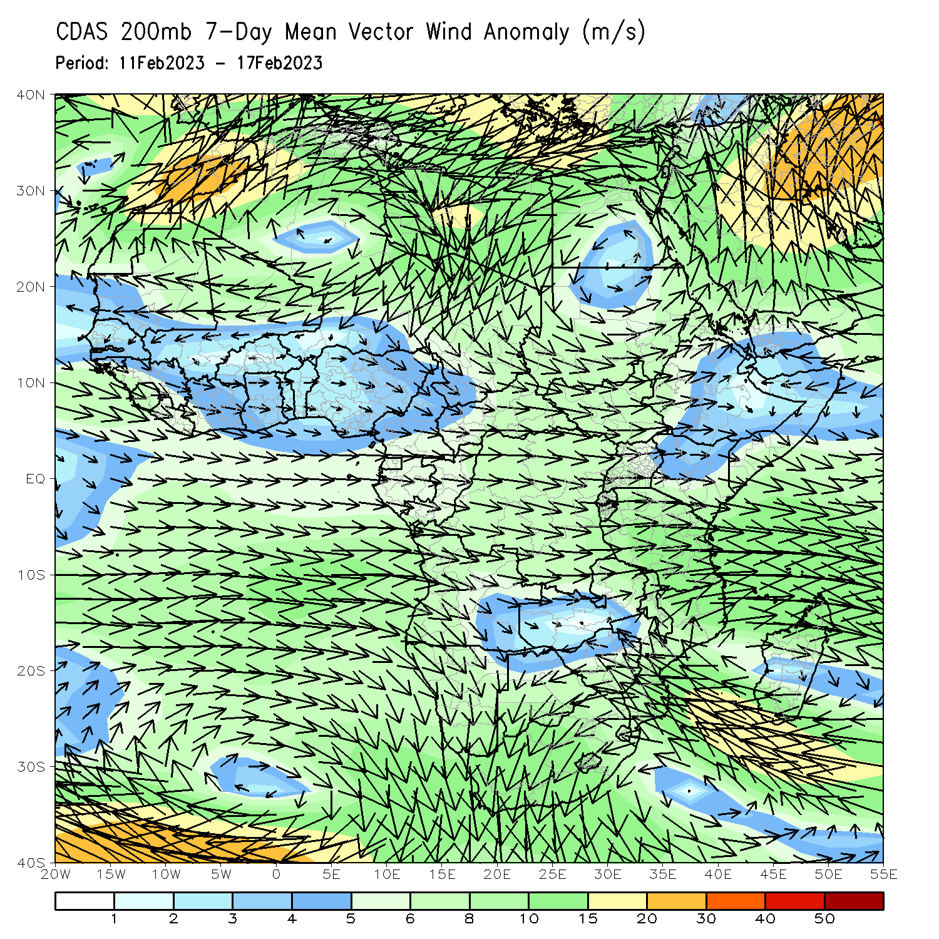
Atmospheric Circulation: Last 7 Days
Lower-level (850-hPa) cyclonic circulation across southeastern Africa may have contributed to the observed above-average rainfall in the region. Lower-level (850-hPa) divergence and upper-level (200-hPa) convergence over Angola and Namibia may have contributed to the below-normal rainfall in the region.

Slide 8
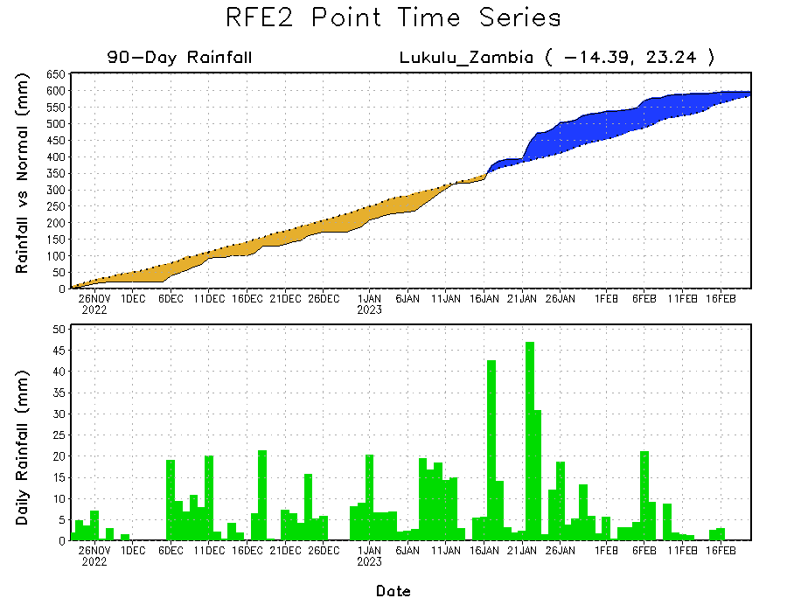
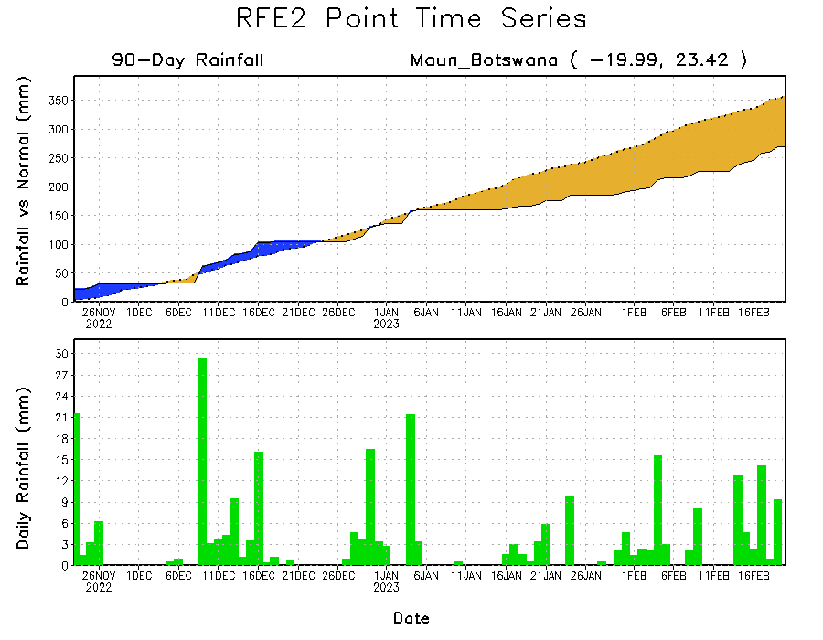
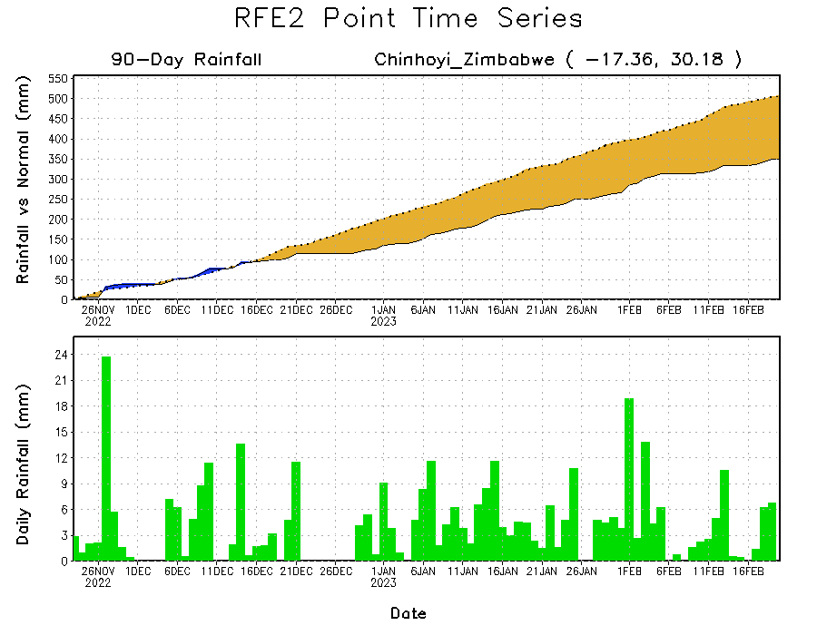
Rainfall Evolution
Daily evolution of rainfall over the last 90 days at selected locations shows worsening moisture deficits over parts of northern Botswana (bottom left) and central Zimbabwe (bottom right). Seasonal total rainfall remained above-average over western Zambia (top right), although the recent lack of rainfall has eliminated much of these surpluses..

Slide 9
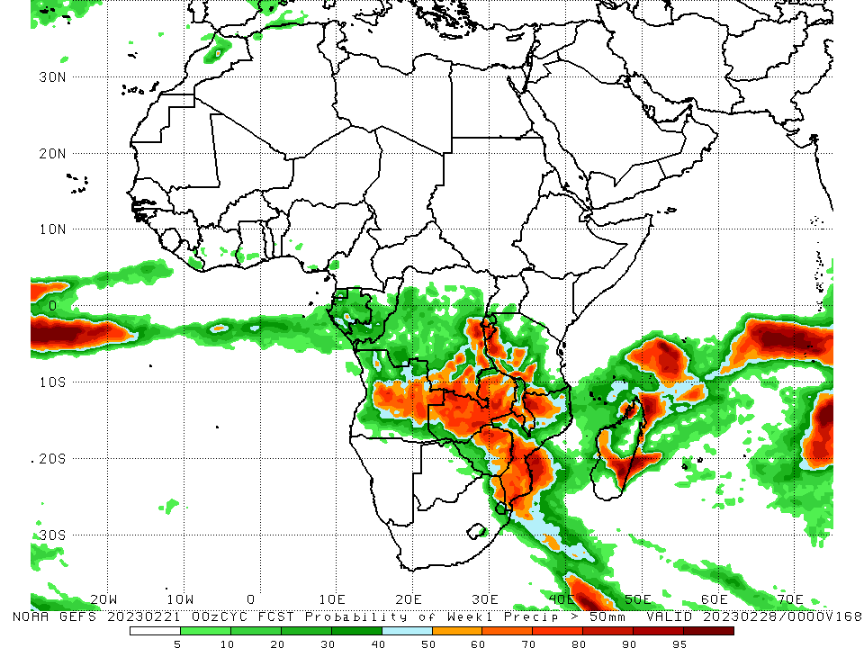
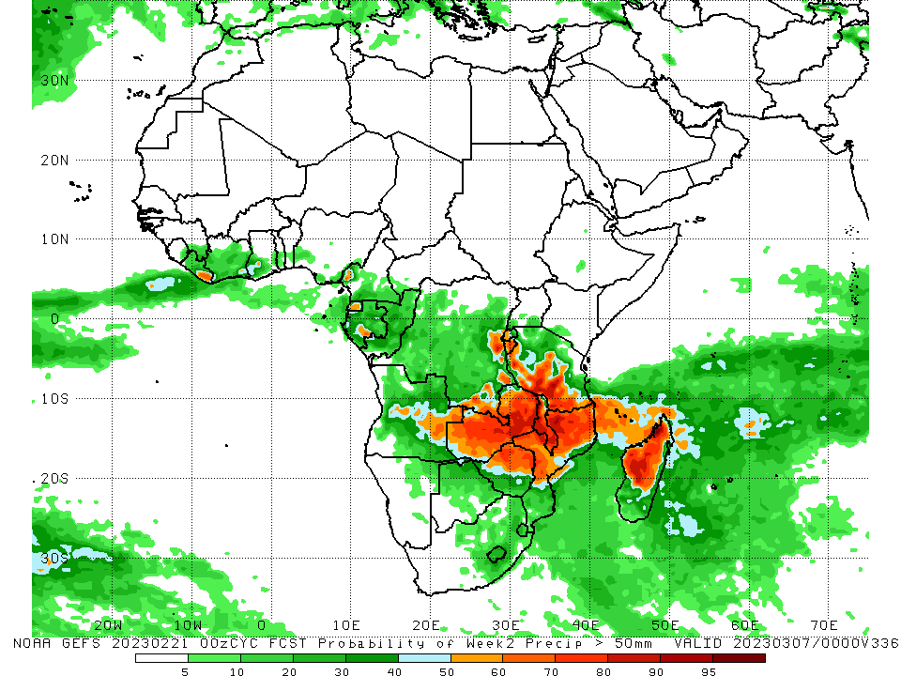
NCEP GEFS Model Forecasts Non-Bias Corrected Probability of precipitation exceedance
Week-1, Valid: 22 – 28 Feb 2023
Week-2, Valid: 01 – 07 Mar 2023
For week-1 (left panel), the GEFS forecasts indicate a moderate to high chance (over 70%) for rainfall to exceed 50 mm over northern Zimbabwe, central Malawi, western/southern Tanzania, southwestern Rwanda, Burundi, east-central/southeastern/southern DRC, northwestern/southern Mozambique, central/eastern Angola, most of Zambia, and pockets of northern/southeastern Madagascar (due to Tropical Cyclone Freddy). For week-2 (right panel), there is a moderate to high chance for rainfall to exceed 50 mm across east-central/southeastern DRC, Burundi, most of Zambia, most of Malawi, southwestern Tanzania, northern/west-central Mozambique, northern Zimbabwe, and central/northern Madagascar.
Notes:
‹#›

Slide 10
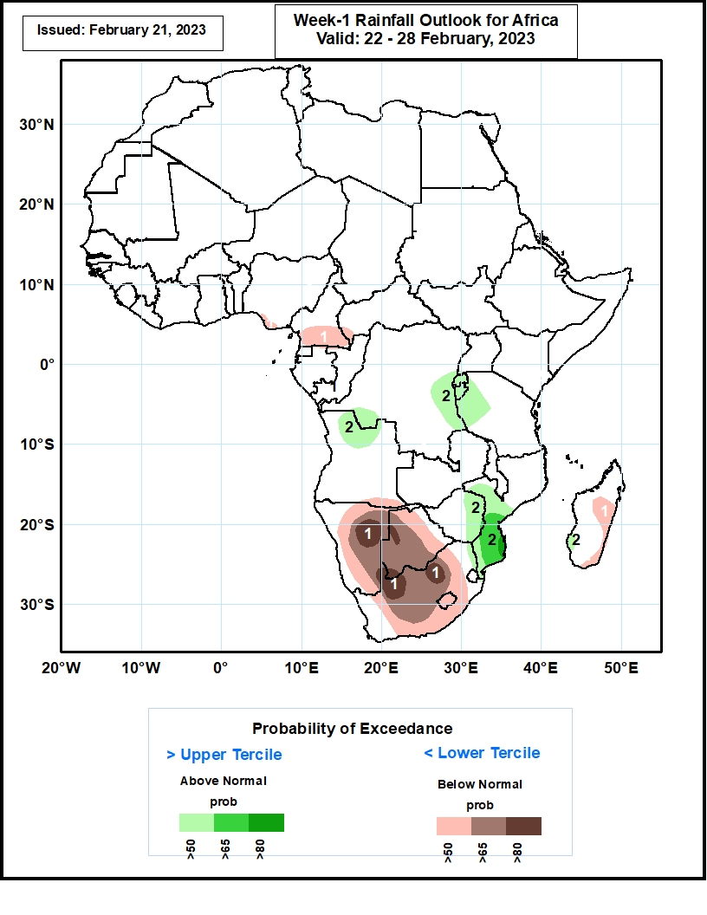
Week-1 Precipitation Outlooks
22 – 28 Feb 2023
The consolidated probabilistic forecasts suggest above 50% chance for weekly total rainfall to be below-normal (below the lower tercile) over southern Nigeria and Cameroon, southeastern Angola, much of Namibia, Botswana, South Africa and Lesotho, and eastern portions of Madagascar. In particular, there is above 80% chance for rainfall to be below normal over northern and southeastern parts of Namibia, northern and southwestern parts of Botswana, and northern portions of South Africa.
The forecasts suggest above 50% chance for weekly
rainfall to be above-normal (above the upper tercile)
over western and eastern parts of DR Congo, northern
Angola, much of Rwanda and Burundi, western
Tanzania, eastern Zimbabwe, central and southern
parts of Mozambique, and southwestern Madagascar.
In particular, there is above 80% chance for rainfall to
be above-normal due to impact of TC Freddy over
southeastern Mozambique.
Notes:
‹#›

Slide 11
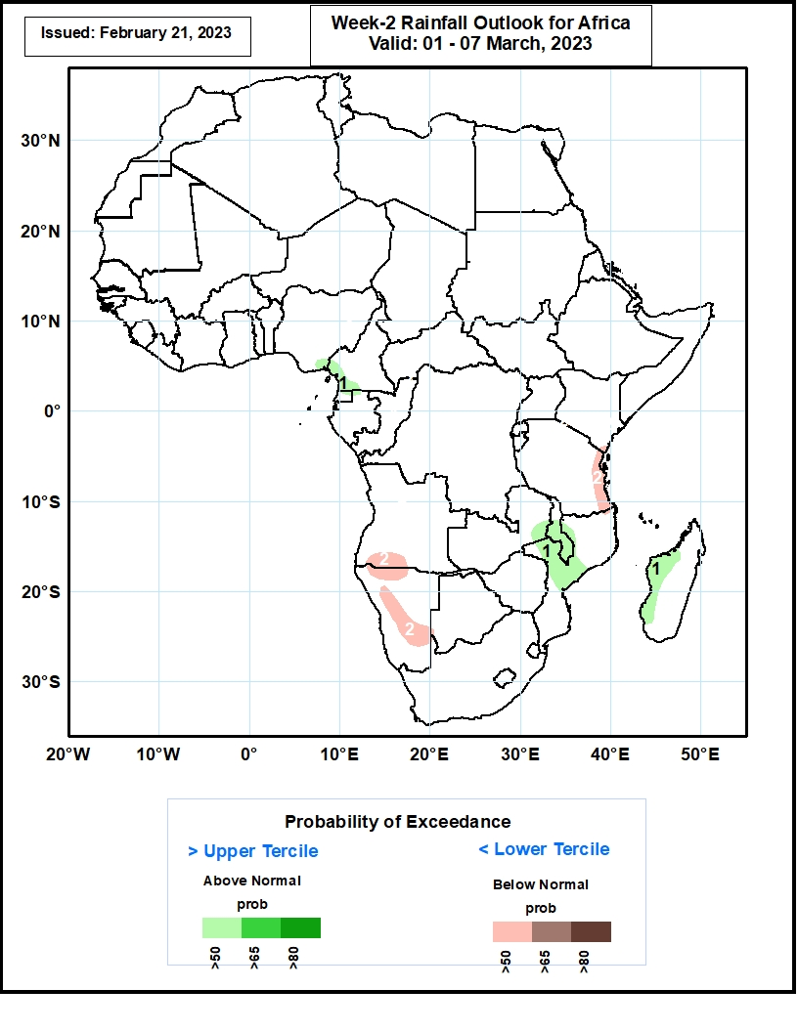
Week-2 Precipitation Outlooks
01 – 07 Mar 2023
The forecasts suggest above 50% chance for weekly
rainfall to be above-normal (above the upper tercile)
over southeastern Nigeria, southern Cameroon,
eastern Zambia, central and southern parts of Malawi,
central Mozambique, and western parts of
Madagascar.
The consolidated probabilistic forecasts suggest
above 50% chance for weekly total rainfall to be
below-normal (below the lower tercile) over eastern
Tanzania, southern Angola, northern, central and
eastern parts of Namibia.
Notes:
‹#›

Slide 12
Summary
Over the past 30 days, in East Africa, above-average rainfall was observed over eastern Tanzania and western Burundi. Rainfall was below-average over southwestern/central Ethiopia, southwestern Kenya, Uganda, Rwanda, eastern Burundi, Rwanda, and the rest of Tanzania. In southern Africa, above-average rainfall was observed over pockets of northwestern Angola, southeastern Zambia, pockets of central Namibia, central/southern Malawi, central/southern Mozambique, eastern Botswana, southern Zimbabwe, central/eastern South Africa, Lesotho, Eswatini, and much of Madagascar. Below-average rainfall was observed over the rest of Angola, northern Botswana, northern/central Zimbabwe, parts of west-central South Africa, the rest of Namibia, northern Zambia, Comoros, much of northern/south-central Mozambique, and northeastern Madagascar. In Central Africa, rainfall was above-average over most of Congo, many parts of western DRC, and parts of central Gabon. Rainfall was below-average over parts of southern, northern, and eastern DRC, northern/western Gabon, and Equatorial Guinea. In West Africa, rainfall was above-average over pockets of southeastern Guinea, eastern Liberia, southern Togo, and coastal Ghana. Rainfall was below-average in northern/central Cote d’Ivoire, central Togo, southern Benin, and southern Nigeria.
During the past 7 days, in East Africa, rainfall was above-average over southwestern Tanzania. Below-average rainfall was observed throughout the rest of Tanzania, Rwanda, Burundi, southern Uganda, southwestern Kenya and parts of southwestern Ethiopia. In Central Africa, rainfall was above-average over parts of southwestern Gabon, southwestern Congo, and some pockets of southeastern DRC. Below-average rainfall was observed across Equatorial Guinea, the rest of Gabon/Congo/DRC, and southern Cameroon. In West Africa, above-average rainfall was observed over pockets of eastern Liberia, and below average rainfall was observed over in southern and central Cote d’Ivoire, central and southern Ghana, southern Togo, southern Benin, and southern Nigeria. In southern Africa, rainfall was above-average over portions of southern Zambia, central and eastern Botswana, eastern South Africa, Lesotho, western and east-central Mozambique, central and southern Malawi, northern and southern Zimbabwe, and parts of central Madagascar. In contrast, rainfall was below-average over many parts of Angola, northern, central, and western Namibia, northern Zambia, central Zimbabwe, northeastern and southeastern Mozambique, pockets of central South Africa, and the rest of Madagascar.
Model forecasts call for an increased chance for week-1 rainfall to be below-normal along the Gulf of Guinea coast, portions of equatorial Central and East Africa, the western and central portions of southern Africa and in Madagascar. There is an increased chance for above-normal rainfall over the eastern portion of southern Africa, as well as from northern Angola to southern Zambia and western Tanzania. For week-2, there is an increased chance for below-normal rainfall over equatorial eastern African northern DRC, southern Angola, and northern and central Namibia. There is an increased chance for above-normal rainfall in the Gulf of Guinea region, over the eastern portion of southern Africa, and in Madagascar.

