Slide 1
The African Monsoon Recent Evolution and Current Status Include Week-1 and Week-2 Outlooks
Update prepared
27 February 2023
For more information, visit:
http://www.cpc.ncep.noaa.gov/products/Global_Monsoons/African_Monsoons/precip_monitoring.shtml

Slide 2
Outline
Highlights
Recent Evolution and Current Conditions
NCEP GEFS Forecasts
Summary

Slide 3
Highlights: Last 7 Days
During the past 7 days, in East Africa, rainfall was above-average over pockets of east-central Ethiopia, southwestern Tanzania, and western Burundi. Below-average rainfall was observed throughout the rest of Tanzania, Rwanda, most of Uganda, pockets of southwestern Kenya, southern South Sudan, and parts of southwestern Ethiopia. In Central Africa, rainfall was above-average over parts of eastern Gabon, parts of southern and central Congo, pockets of southeastern Cameroon, and some pockets of southeastern and southwestern DRC. Below-average rainfall was observed across Equatorial Guinea, the western and central Gabon, parts of northern and southwestern Congo, most of DRC, most of southern Cameroon, and western CAR. In West Africa, above-average rainfall was observed over southeastern Liberia, southwestern and west-central Cote d’Ivoire, pockets of southeastern Guinea, pockets of southern Ghana, parts of southern Benin, and south-central Nigeria. Below average rainfall was observed over eastern Liberia, south-central and central Cote d’Ivoire, pockets of central Ghana, south-central Togo, and southwestern and southeastern Nigeria. In southern Africa, rainfall was above-average over pockets of northeastern Zambia, pockets of eastern Botswana, pockets of southwestern South Africa, southern and south-central Mozambique (due to Tropical Cyclone Freddy), small portions of central and southern Malawi, east-central Zimbabwe, pockets of northern Angola, and parts of east-central Madagascar. In contrast, rainfall was below-average over the rest of Angola, northern, central, and eastern Namibia, the rest of Zambia/Zimbabwe/Botswana, most of northern Mozambique, the rest of South Africa, Lesotho, Eswatini, Comoros, northern and south-central Malawi, and the rest of Madagascar.
Model forecasts call for an increased chance for week-1 rainfall to be below-normal along portions of equatorial Central and East Africa, and the western and central portions of southern Africa. There is an increased chance for above-normal rainfall over the Gulf of Guinea coast, eastern portions of southern Africa, and in Madagascar. For week-2, there is an increased chance for below-normal rainfall over equatorial eastern African, and northern portions of southern Africa. There is an increased chance for above-normal rainfall in the Gulf of Guinea region, over equatorial central Africa, and in parts of Madagascar.

Slide 4
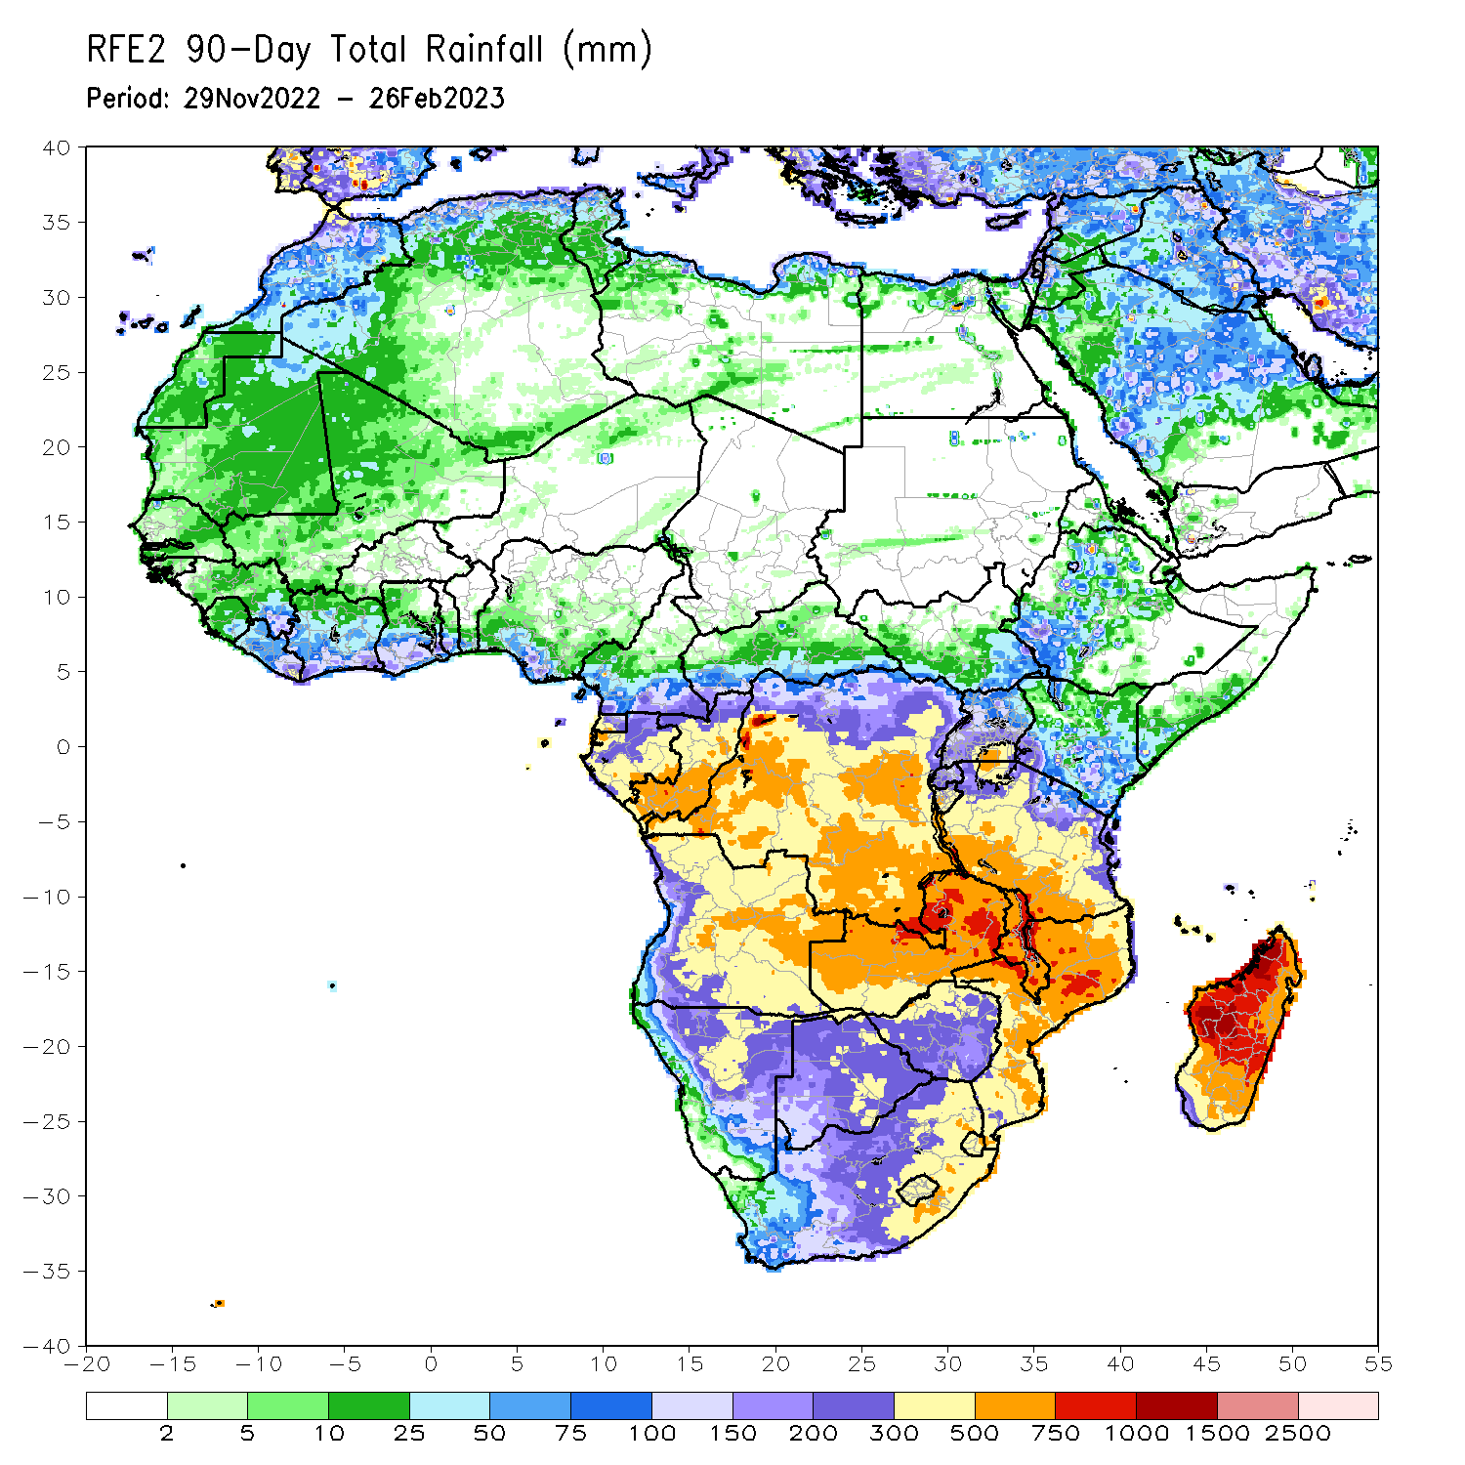
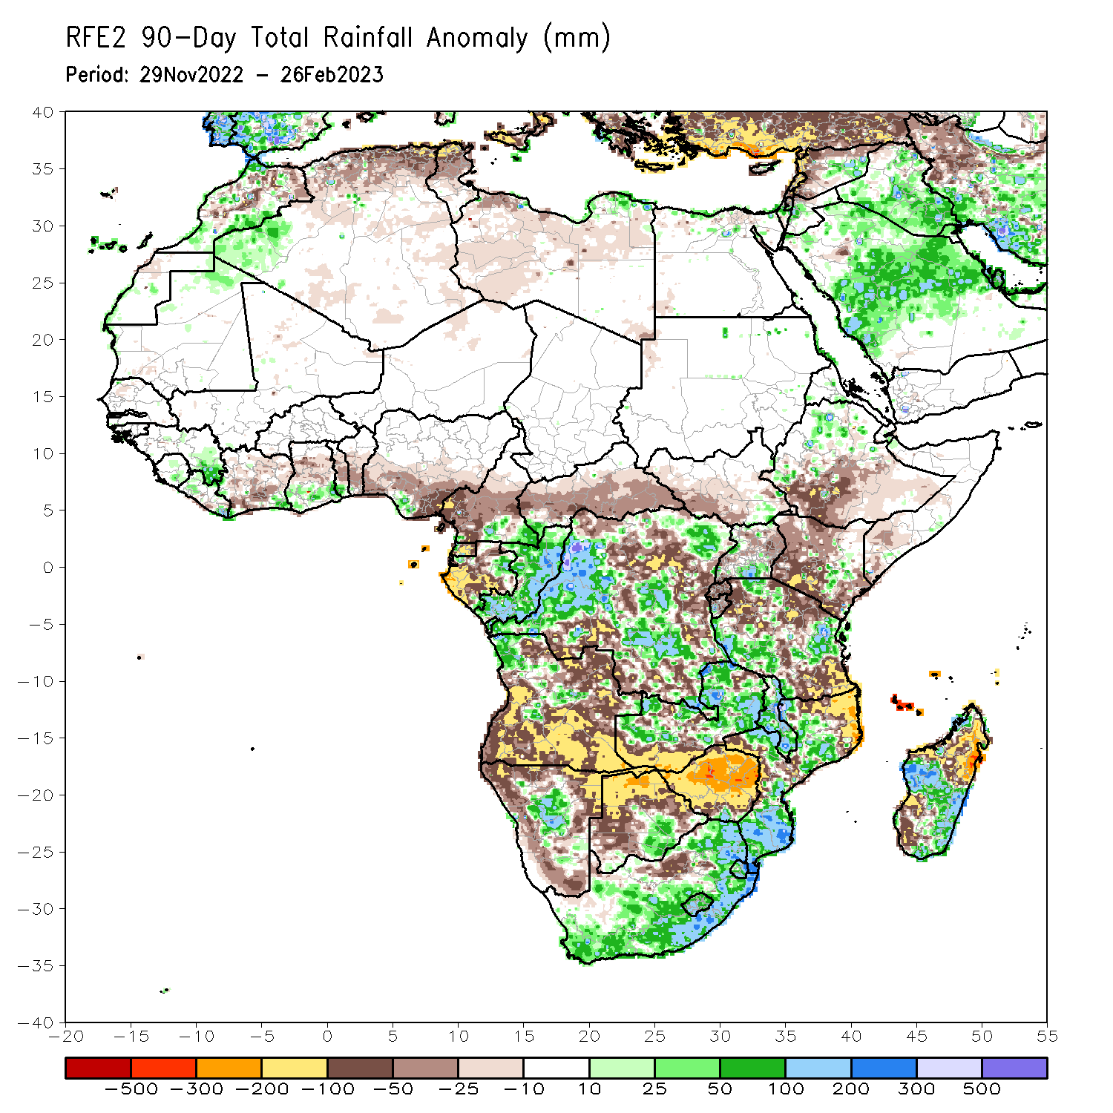
Rainfall Patterns: Last 90 Days
Over the past 90 days, in East Africa, above-average rainfall was observed over parts of western and northern Ethiopia, parts of east-central Kenya, western Burundi, pockets of northern and southern Uganda, and western/eastern Tanzania. Rainfall was below-average over southern Ethiopia, much of Kenya, Rwanda, eastern Burundi, southern Somalia, and north-central/southern Tanzania. In southern Africa, above-average rainfall was observed over parts of central and northwestern Angola, much of northern and central Zambia, central Namibia, much of South Africa, Lesotho, Eswatini, Malawi, parts of north-central and southern Mozambique, southern Botswana, southern Zimbabwe, and central/southeastern Madagascar. Below-average rainfall was observed over southern/eastern Angola, northern Botswana, northern/central Zimbabwe, northern/central Mozambique, northern/western Namibia, Comoros, and northeastern/southwestern Madagascar. In Central Africa, rainfall was above-average over southeastern Cameroon, eastern Gabon, Congo, and northeastern/western/central DRC. Rainfall was below-average over western and central Cameroon, western and southern Gabon, Equatorial Guinea, and portions of north-central, eastern, and southern DRC. In West Africa, rainfall was above-average over parts of eastern Guinea, southeastern Liberia, coastal Cote d’Ivoire, coastal Ghana, coastal Togo, and parts of south-central Nigeria. In contrast, below-average rainfall was observed over south-central Liberia, northern/central Cote d’Ivoire, central Ghana, central Togo, central/southern Benin, and most of southern Nigeria.
Notes:
‹#›

Slide 5
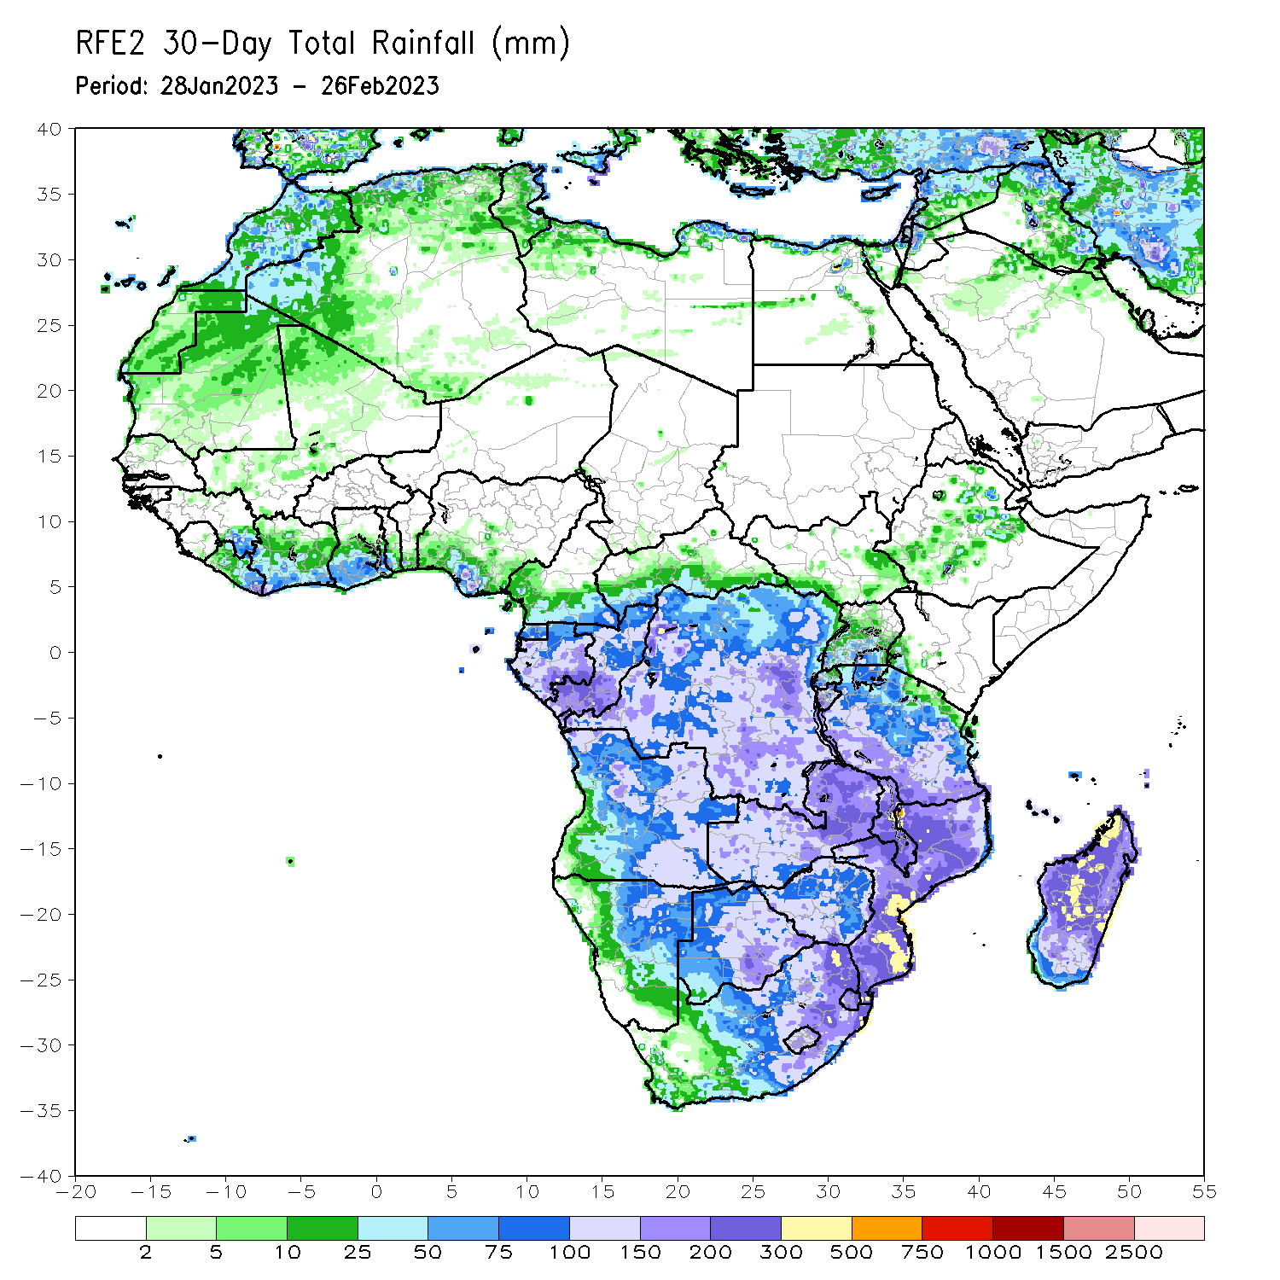
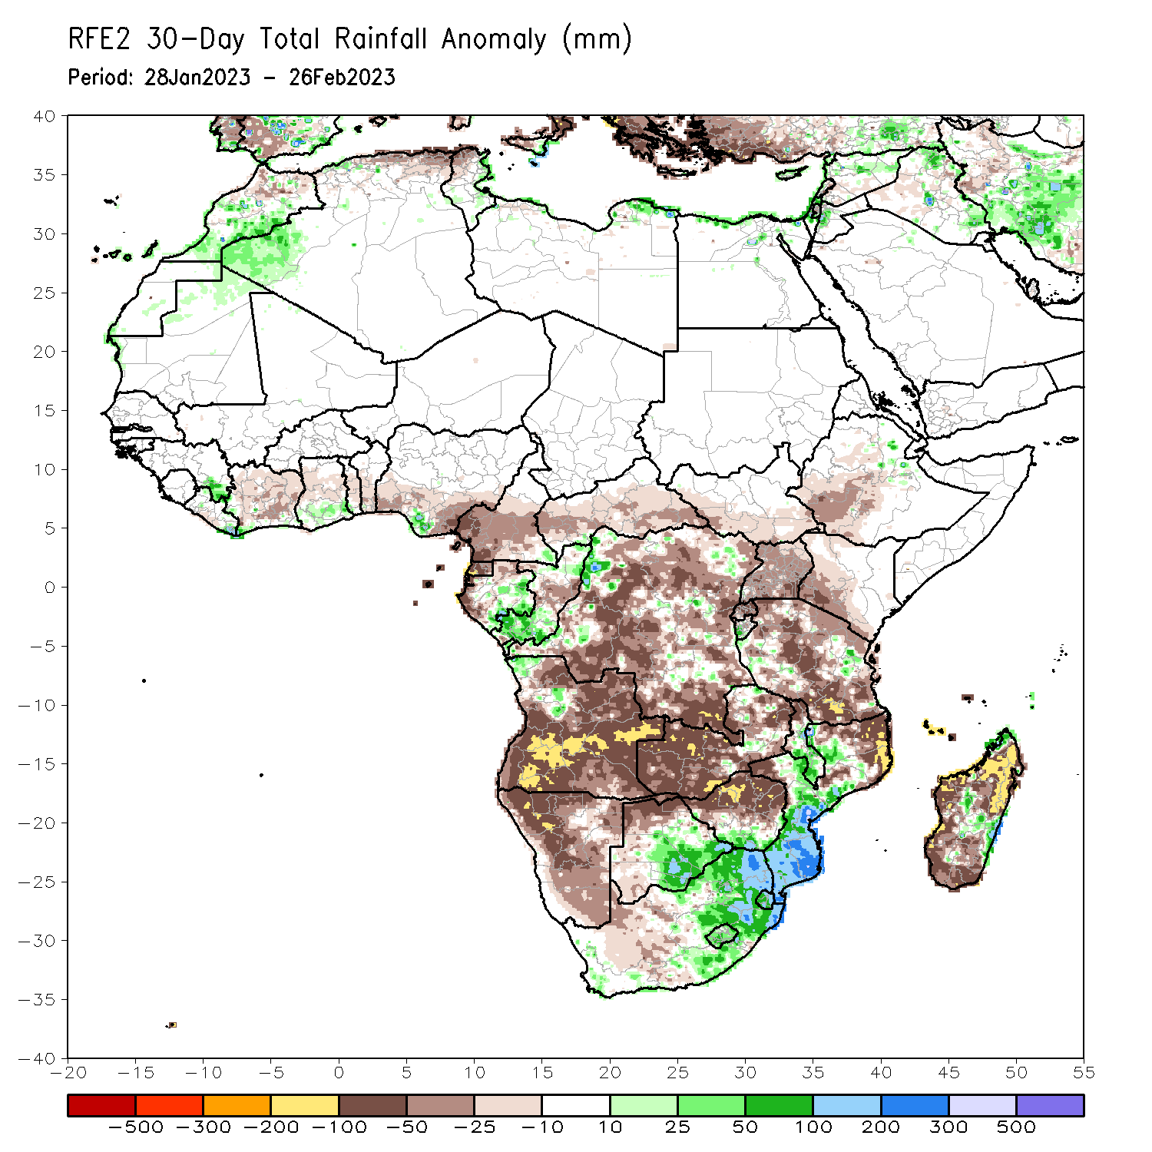
Rainfall Patterns: Last 30 Days
Over the past 30 days, in East Africa, above-average rainfall was observed over east-central/west-central Tanzania, pockets of northeastern Ethiopia, and western Burundi. Rainfall was below-average over southwestern/central Ethiopia, southwestern Kenya, Uganda, Rwanda, eastern Burundi, Rwanda, and the rest of Tanzania. In southern Africa, above-average rainfall was observed over pockets of northwestern Angola, southeastern Zambia, central/southern Malawi, central/southern Mozambique, eastern Botswana, southern Zimbabwe, central/eastern South Africa, Lesotho, Eswatini, and east-central Madagascar. Below-average rainfall was observed over the rest of Angola, northern/western Botswana, northern/central Zimbabwe, parts of west-central South Africa, Namibia, western Zambia, Comoros, much of northern Mozambique, and the rest of Madagascar. In Central Africa, rainfall was above-average over northern/southern Congo, western and pockets of eastern DRC, and parts of central/eastern Gabon. Rainfall was below-average over parts of southern, northern, and central DRC, northern/western Gabon, and Equatorial Guinea. In West Africa, rainfall was above-average over pockets of southeastern Guinea, southeastern Liberia, south-central Nigeria, and coastal Ghana. Rainfall was below-average in northern/central Cote d’Ivoire, central Togo, south-central Liberia, central/southern Benin, and the rest of southern Nigeria.
Notes:
‹#›

Slide 6
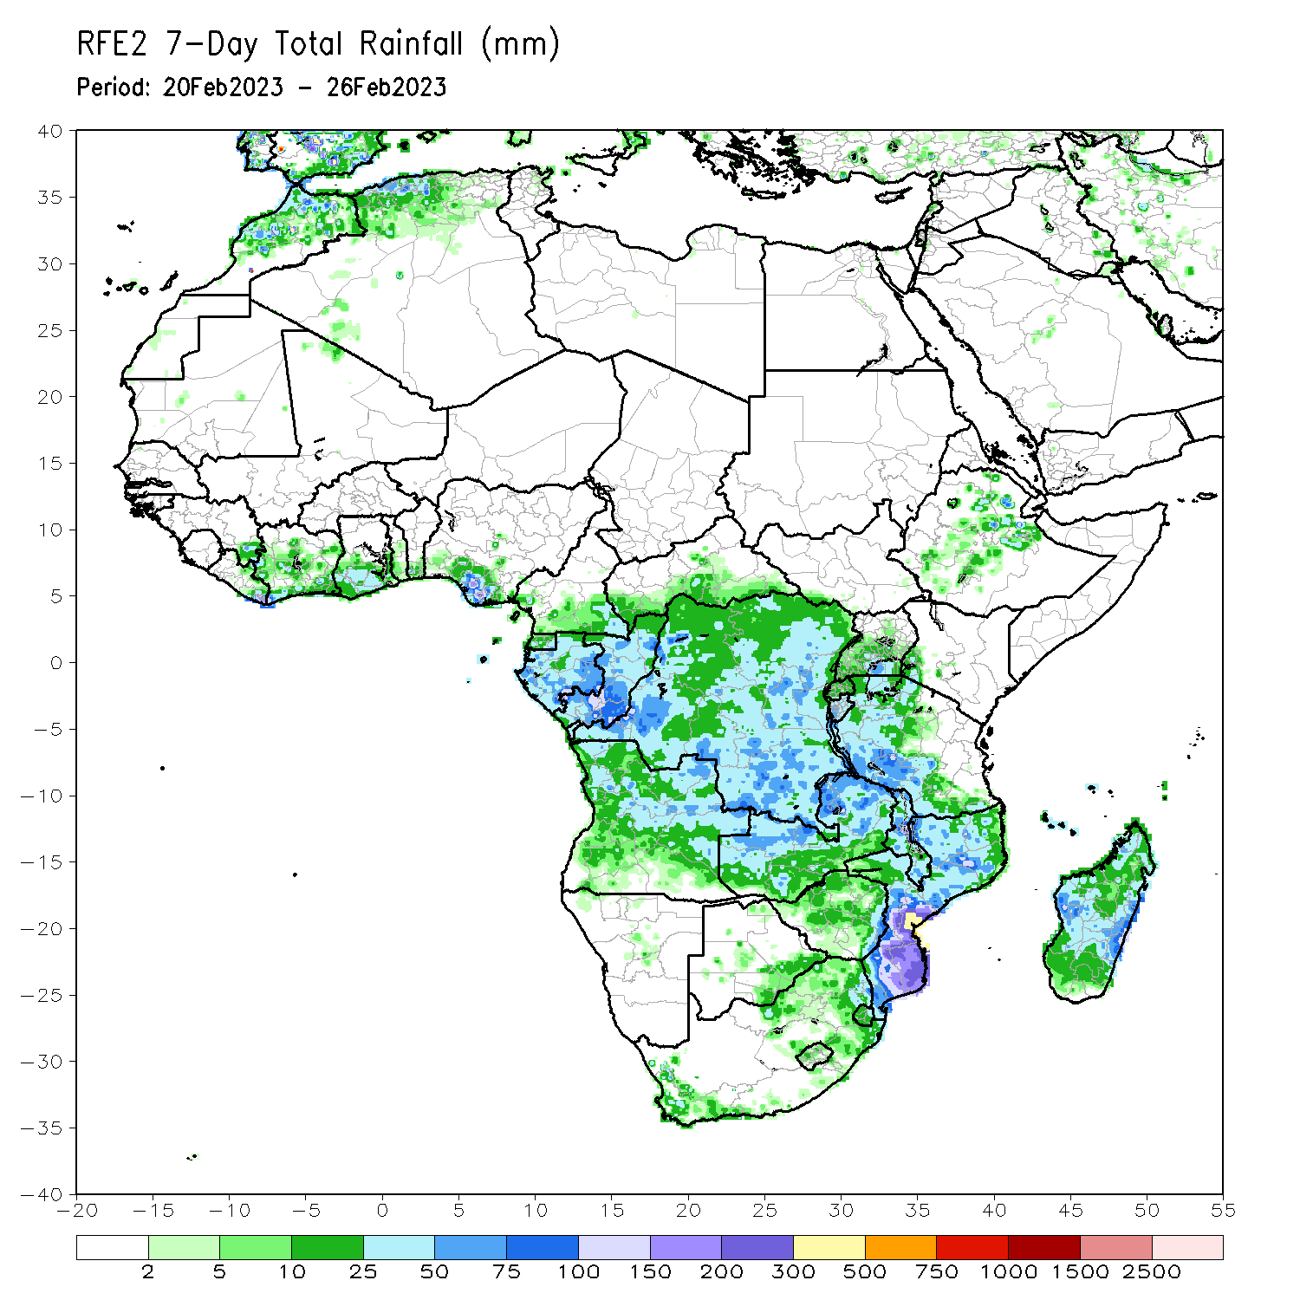
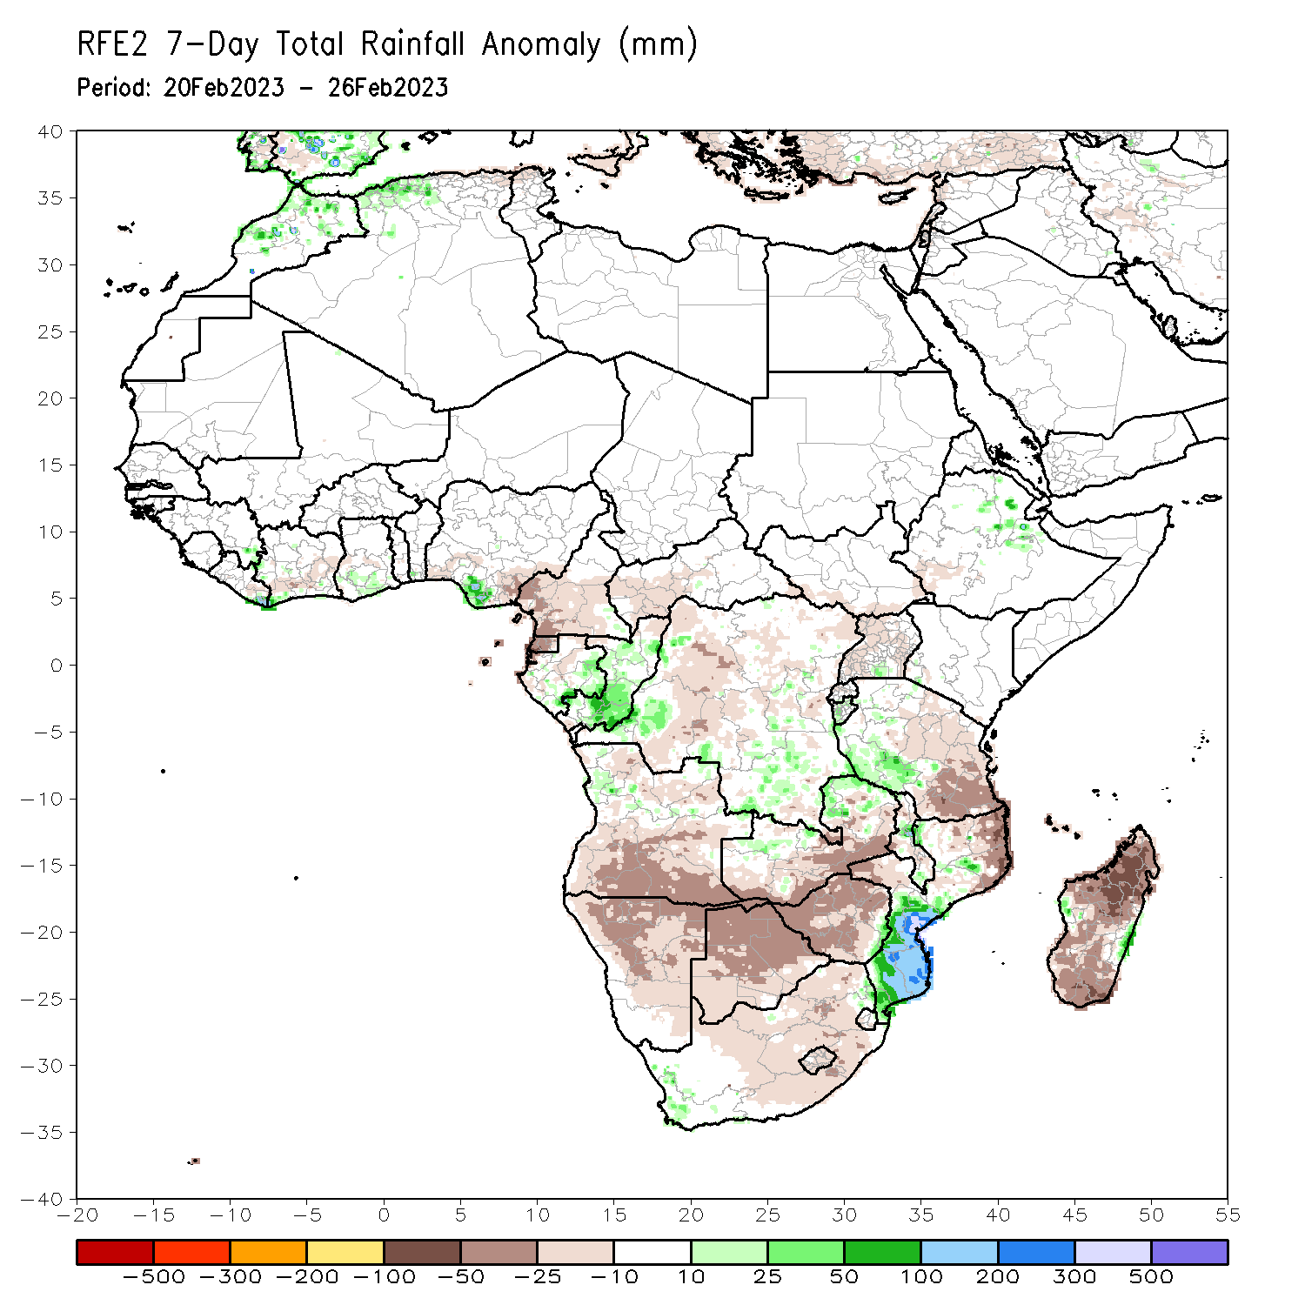
Rainfall Patterns: Last 7 Days
During the past 7 days, in East Africa, rainfall was above-average over pockets of east-central Ethiopia, southwestern Tanzania, and western Burundi. Below-average rainfall was observed throughout the rest of Tanzania, Rwanda, most of Uganda, pockets of southwestern Kenya, southern South Sudan, and parts of southwestern Ethiopia. In Central Africa, rainfall was above-average over parts of eastern Gabon, parts of southern and central Congo, pockets of southeastern Cameroon, and some pockets of southeastern and southwestern DRC. Below-average rainfall was observed across Equatorial Guinea, the western and central Gabon, parts of northern and southwestern Congo, most of DRC, most of southern Cameroon, and western CAR. In West Africa, above-average rainfall was observed over southeastern Liberia, southwestern and west-central Cote d’Ivoire, pockets of southeastern Guinea, pockets of southern Ghana, parts of southern Benin, and south-central Nigeria. Below average rainfall was observed over eastern Liberia, south-central and central Cote d’Ivoire, pockets of central Ghana, south-central Togo, and southwestern and southeastern Nigeria. In southern Africa, rainfall was above-average over pockets of northeastern Zambia, pockets of eastern Botswana, pockets of southwestern South Africa, southern and south-central Mozambique (due to Tropical Cyclone Freddy), small portions of central and southern Malawi, east-central Zimbabwe, pockets of northern Angola, and parts of east-central Madagascar. In contrast, rainfall was below-average over the rest of Angola, northern, central, and eastern Namibia, the rest of Zambia/Zimbabwe/Botswana, most of northern Mozambique, the rest of South Africa, Lesotho, Eswatini, Comoros, northern and south-central Malawi, and the rest of Madagascar.

Slide 7
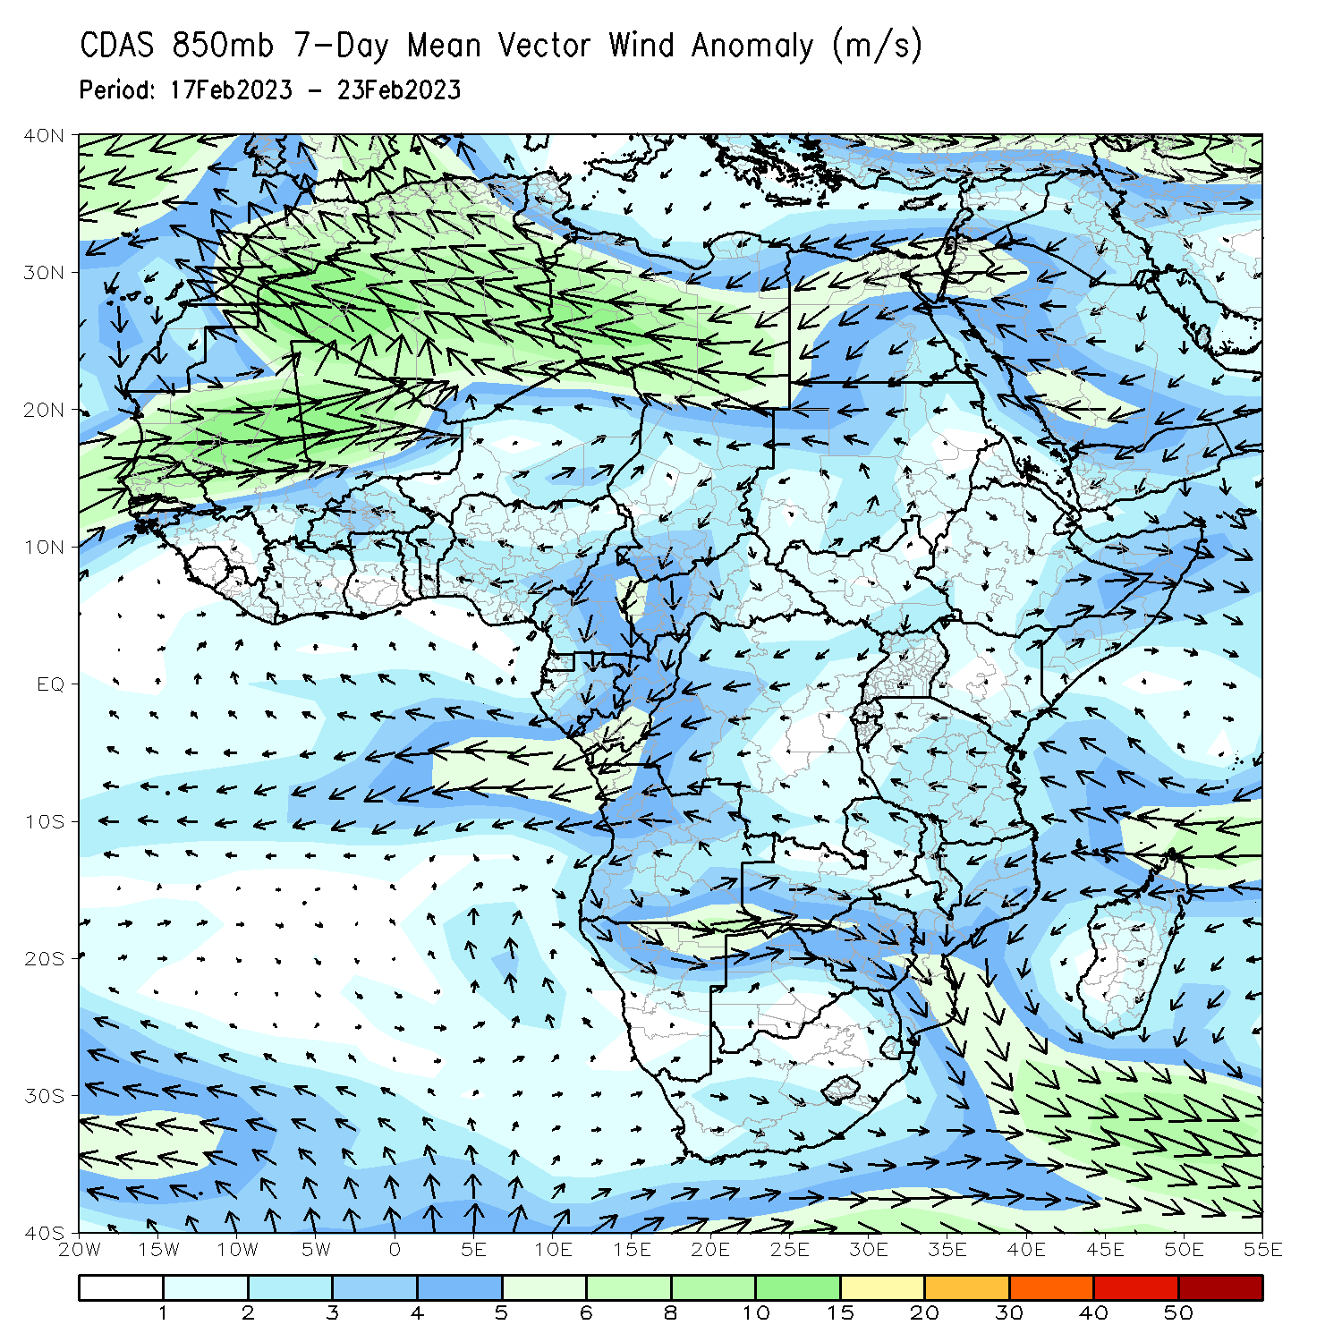
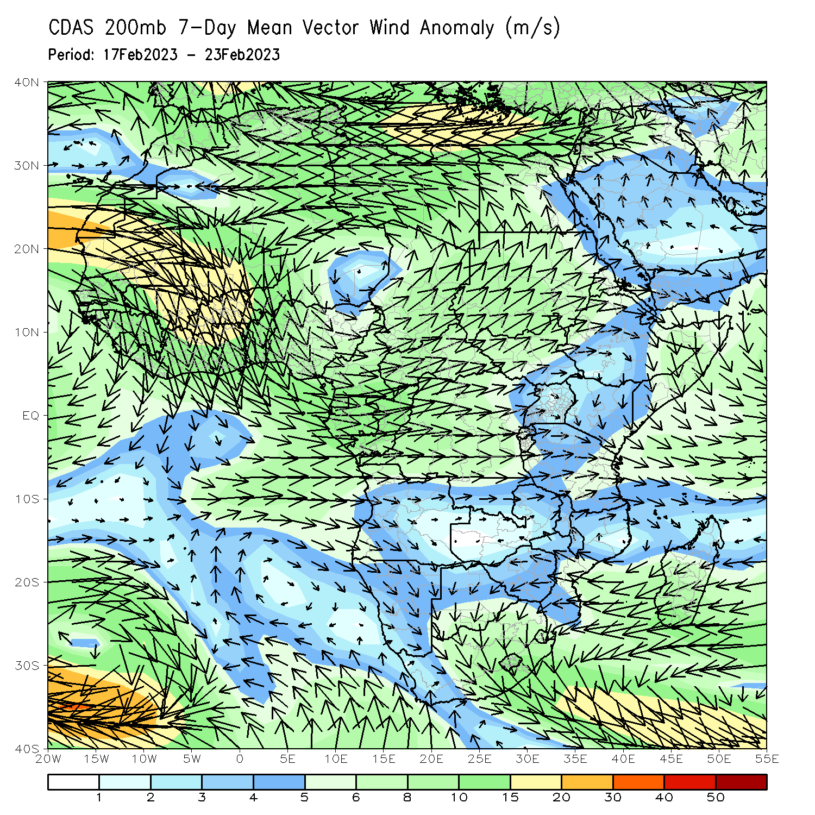
Atmospheric Circulation: Last 7 Days
Lower-level (850-hPa) confluence across west-central and southeastern Africa may have contributed to the observed above-average rainfall in the region (primarily in Congo/Mozambique, the latter of which was also impacted by TC Freddy). Lower-level (850-hPa) divergence and upper-level (200-hPa) convergence over Angola and Namibia may have contributed to the below-normal rainfall in the region.

Slide 8
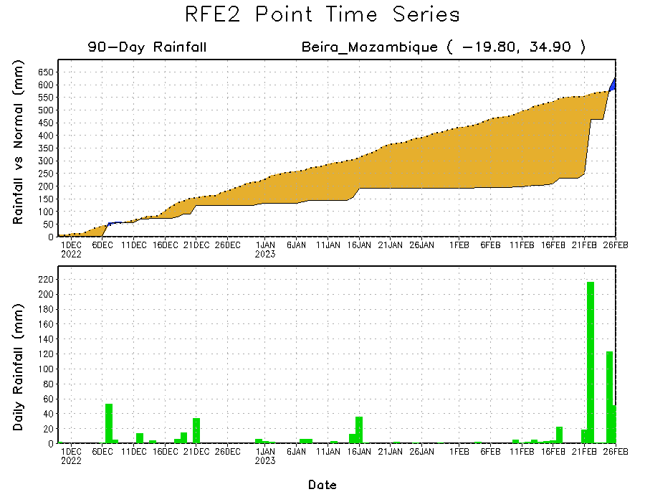
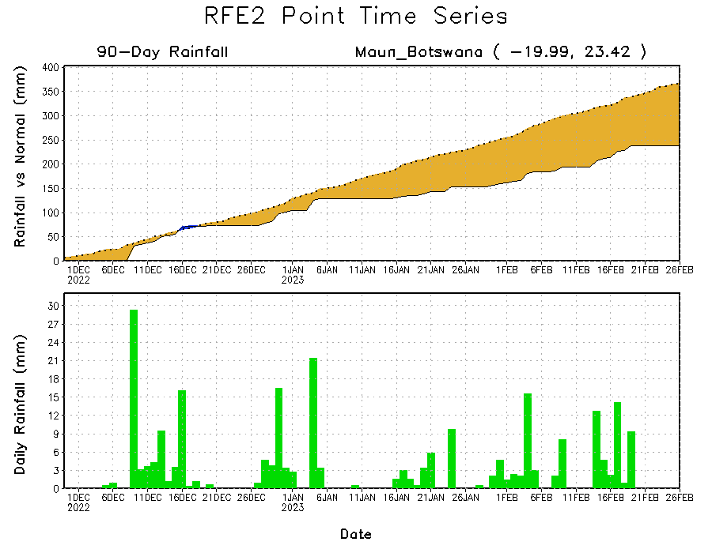
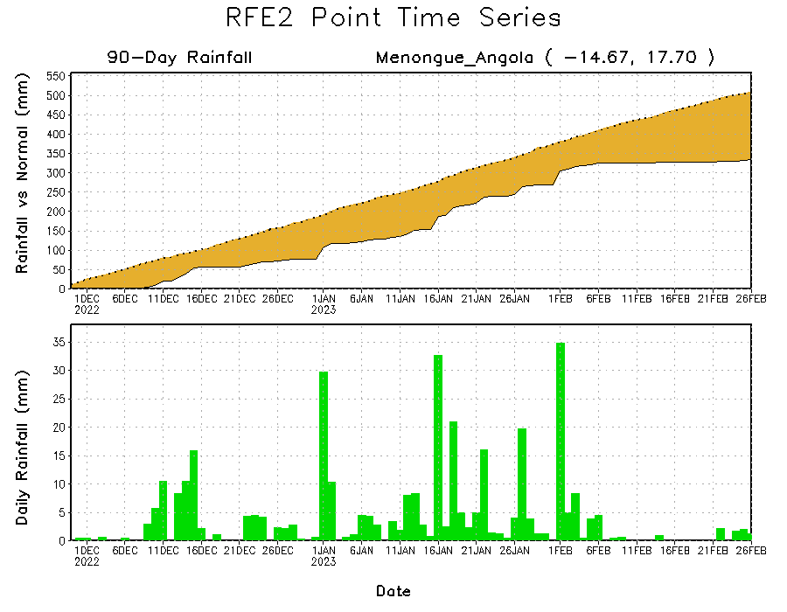
Rainfall Evolution
Daily evolution of rainfall over the last 90 days at selected locations shows worsening moisture deficits over parts of northern Botswana (bottom left) and central Angola (bottom right). Total rainfall transitioned from a seasonal deficit to a seasonal surplus in southern Mozambique due to TC Freddy’s landfall.

Slide 9
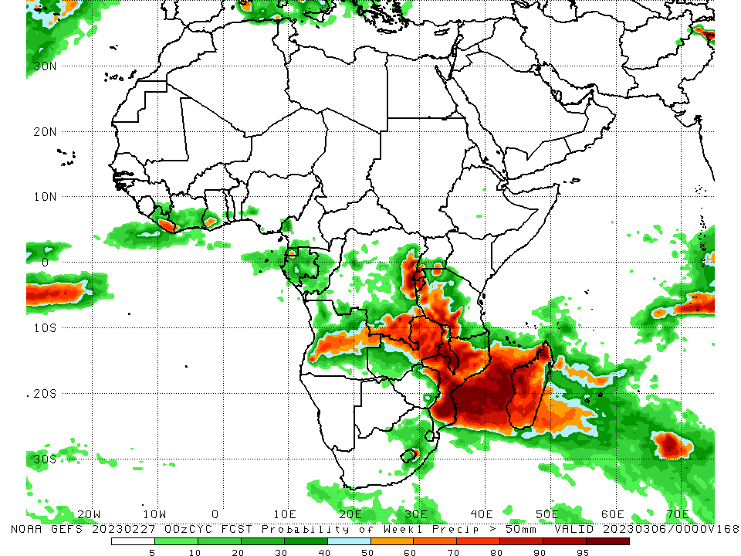
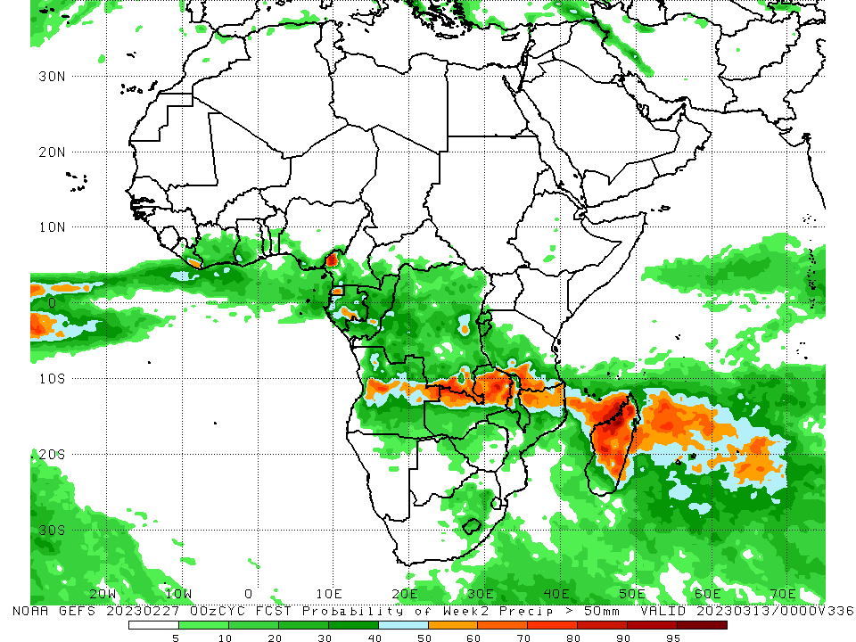
NCEP GEFS Model Forecasts Non-Bias Corrected Probability of precipitation exceedance
Week-1, Valid: 28 Feb – 06 Mar 2023
Week-2, Valid: 07 – 13 Mar 2023
For week-1 (left panel), the GEFS forecasts indicate a moderate to high chance (over 70%) for rainfall to exceed 50 mm over southeastern Liberia, northeastern Zimbabwe, central/southern Malawi, southwestern Tanzania, Rwanda, Burundi, east-central/southeastern DRC, most of Mozambique, central Angola, eastern Zambia, and most of Madagascar. For week-2 (right panel), there is a moderate to high chance for rainfall to exceed 50 mm across southeastern DRC, northern Zambia, southwestern Tanzania, west-central Cameroon, and central/northern Madagascar.
Notes:
‹#›

Slide 10
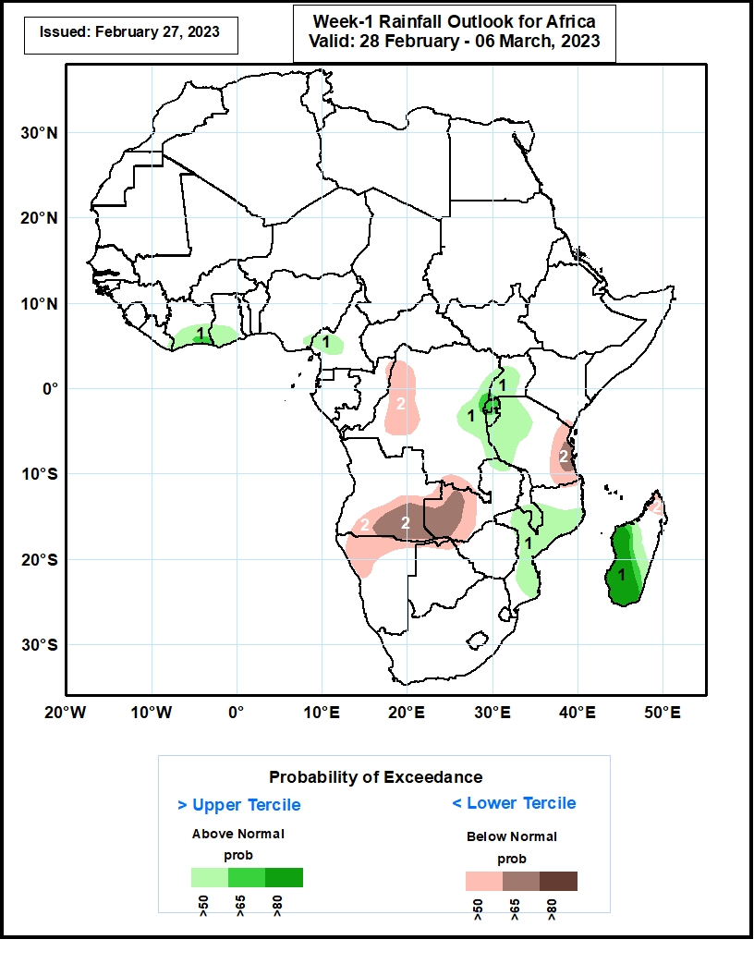
Week-1 Precipitation Outlooks
28 Feb – 06 Mar 2023
The consolidated probabilistic forecasts suggest above 50% chance for weekly total rainfall to be below-normal (below the lower tercile) over western and southern parts of DR Congo, southern and eastern parts of Angola, western Zambia, eastern Tanzania, northern parts of Namibia, Botswana and Madagascar. In particular, there is above 65% chance for rainfall to be below normal over eastern Tanzania, southern Angola, and western Zambia.
The forecasts suggest above 50% chance for weekly rainfall to be above-normal (above the upper tercile) over southern Cote d’Ivoire, Ghana, western Cameroon, eastern DR Congo, western and central parts of Uganda, much of Rwanda and Burundi, western and central parts of Tanzania, southern Malawi, central and southern parts of Mozambique and Madagascar. In particular, there is above 80% chance for rainfall to be above-normal over central and southern Madagascar. The above-normal rainfall is also due to the remnant of TC Freddy.
Notes:
‹#›

Slide 11
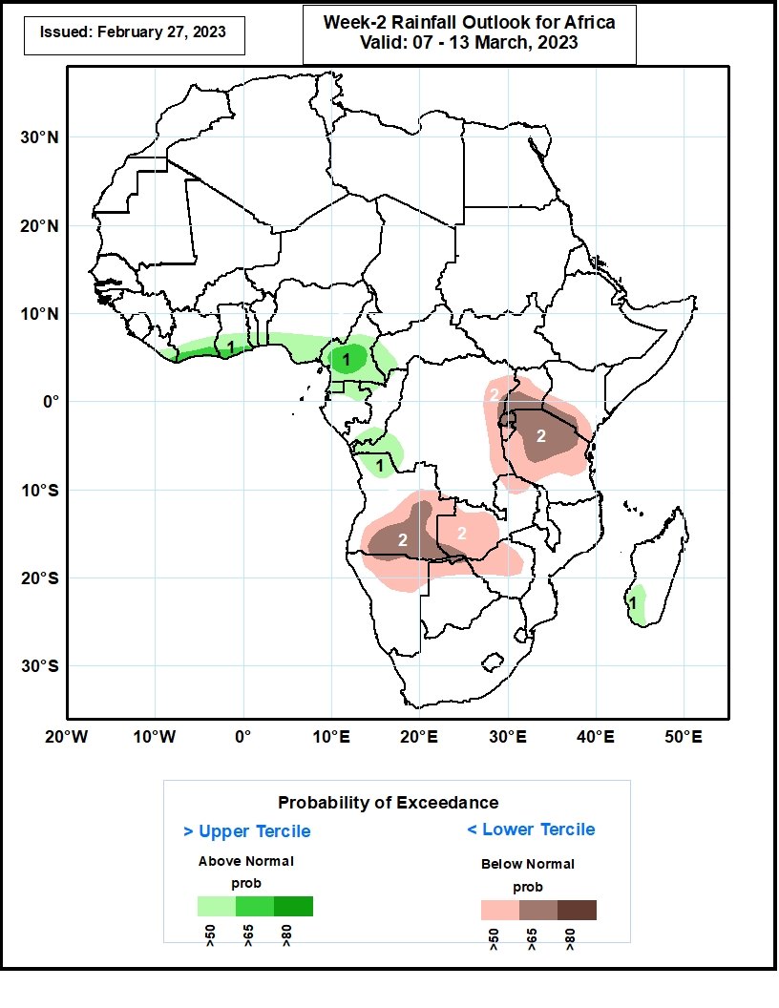
Week-2 Precipitation Outlooks
07 – 13 Mar 2023
The consolidated probabilistic forecasts suggest above 50% chance for weekly total rainfall to be below-normal (below the lower tercile) over eastern DR Congo, central and southern parts of Uganda, southern Kenya, much of Rwanda and Burundi, northern and central parts of Tanzania, central and southern portions of Angola, northern and western parts of Zambia, northern portions of Namibia and Botswana, western and central parts of Zimbabwe. In particular, there is above 65% chance for rainfall to be below normal over southern Uganda, southern Kenya, much of Rwanda, northern and central Tanzania, central and southern parts of Angola.
The forecasts suggest above 50% chance for weekly rainfall to be above-normal (above the upper tercile) over eastern Liberia, southern Cote d’Ivoire, Ghana, Togo, Benin and Nigeria, central and southern parts of Cameroon, western CAR, much of Equatorial Guinea, northern Gabon, northern and southern parts of Congo, western DR Congo, northwestern Angola and southwestern Madagascar. In particular, there is above 65% chance for rainfall to be above-normal over southern Cote d’Ivoire and Ghana, central and southern parts of Cameroon.
Notes:
‹#›

Slide 12
Summary
Over the past 30 days, in East Africa, above-average rainfall was observed over east-central/west-central Tanzania, pockets of northeastern Ethiopia, and western Burundi. Rainfall was below-average over southwestern/central Ethiopia, southwestern Kenya, Uganda, Rwanda, eastern Burundi, Rwanda, and the rest of Tanzania. In southern Africa, above-average rainfall was observed over pockets of northwestern Angola, southeastern Zambia, central/southern Malawi, central/southern Mozambique, eastern Botswana, southern Zimbabwe, central/eastern South Africa, Lesotho, Eswatini, and east-central Madagascar. Below-average rainfall was observed over the rest of Angola, northern/western Botswana, northern/central Zimbabwe, parts of west-central South Africa, Namibia, western Zambia, Comoros, much of northern Mozambique, and the rest of Madagascar. In Central Africa, rainfall was above-average over northern/southern Congo, western and pockets of eastern DRC, and parts of central/eastern Gabon. Rainfall was below-average over parts of southern, northern, and central DRC, northern/western Gabon, and Equatorial Guinea. In West Africa, rainfall was above-average over pockets of southeastern Guinea, southeastern Liberia, south-central Nigeria, and coastal Ghana. Rainfall was below-average in northern/central Cote d’Ivoire, central Togo, south-central Liberia, central/southern Benin, and the rest of southern Nigeria.
During the past 7 days, in East Africa, rainfall was above-average over pockets of east-central Ethiopia, southwestern Tanzania, and western Burundi. Below-average rainfall was observed throughout the rest of Tanzania, Rwanda, most of Uganda, pockets of southwestern Kenya, southern South Sudan, and parts of southwestern Ethiopia. In Central Africa, rainfall was above-average over parts of eastern Gabon, parts of southern and central Congo, pockets of southeastern Cameroon, and some pockets of southeastern and southwestern DRC. Below-average rainfall was observed across Equatorial Guinea, the western and central Gabon, parts of northern and southwestern Congo, most of DRC, most of southern Cameroon, and western CAR. In West Africa, above-average rainfall was observed over southeastern Liberia, southwestern and west-central Cote d’Ivoire, pockets of southeastern Guinea, pockets of southern Ghana, parts of southern Benin, and south-central Nigeria. Below average rainfall was observed over eastern Liberia, south-central and central Cote d’Ivoire, pockets of central Ghana, south-central Togo, and southwestern and southeastern Nigeria. In southern Africa, rainfall was above-average over pockets of northeastern Zambia, pockets of eastern Botswana, pockets of southwestern South Africa, southern and south-central Mozambique (due to Tropical Cyclone Freddy), small portions of central and southern Malawi, east-central Zimbabwe, pockets of northern Angola, and parts of east-central Madagascar. In contrast, rainfall was below-average over the rest of Angola, northern, central, and eastern Namibia, the rest of Zambia/Zimbabwe/Botswana, most of northern Mozambique, the rest of South Africa, Lesotho, Eswatini, Comoros, northern and south-central Malawi, and the rest of Madagascar.
Model forecasts call for an increased chance for week-1 rainfall to be below-normal along portions of equatorial Central and East Africa, and the western and central portions of southern Africa. There is an increased chance for above-normal rainfall over the Gulf of Guinea coast, eastern portions of southern Africa, and in Madagascar. For week-2, there is an increased chance for below-normal rainfall over equatorial eastern African, and northern portions of southern Africa. There is an increased chance for above-normal rainfall in the Gulf of Guinea region, over equatorial central Africa, and in parts of Madagascar.

