Slide 1
The African Monsoon Recent Evolution and Current Status Include Week-1 and Week-2 Outlooks
Update prepared by Justin Hicks
20 March 2023
For more information, visit:
http://www.cpc.ncep.noaa.gov/products/Global_Monsoons/African_Monsoons/precip_monitoring.shtml

Slide 2
Outline
Highlights
Recent Evolution and Current Conditions
NCEP GEFS Forecasts
Summary

Slide 3
Highlights: Last 7 Days
During the past 7 days, in East Africa, rainfall was above-average over central, eastern and southern Ethiopia, much of Uganda, western Kenya and the far southern South Sudan. Below-average rainfall was observed over parts of southeastern Tanzania. In Central Africa, rainfall was above-average over much of Congo and parts of western and eastern DRC. Below-average rainfall was observed much of Gabon, and parts of central DRC. In West Africa, above-average rainfall was observed over pockets of northern Cote d’Ivoire and southern Nigeria. Below-average rainfall was observed over parts of southern Cote d’Ivoire and Ghana. In southern Africa, rainfall was above-average over western Angola, eastern Zambia, Malawi, and northern Mozambique. In contrast, rainfall was below-average over central and southern Angola, western Zambia, Namibia, Botswana, Zimbabwe, much of South Africa and northern Madagascar.
Model forecasts call for an increased chance for week-1 rainfall to be above-normal across the central and eastern portions of the Gulf of Guinea region, southern CAR, southern and eastern DRC, much of equatorial East Africa, parts of Angola and western Zambia. In contrast, there is an increased chance for below-normal rainfall over southeastern Africa, including northern Madagascar. For week-2, there is an increased chance for above-normal rainfall over pockets of the Gulf of Guinea region, southern and eastern DRC, parts of Angola, northern Namibia, northern Botswana, and many places in the Greater Horn of Africa. In contrast, there is an increased chance for below-normal rainfall over parts of Southeastern Africa.

Slide 4
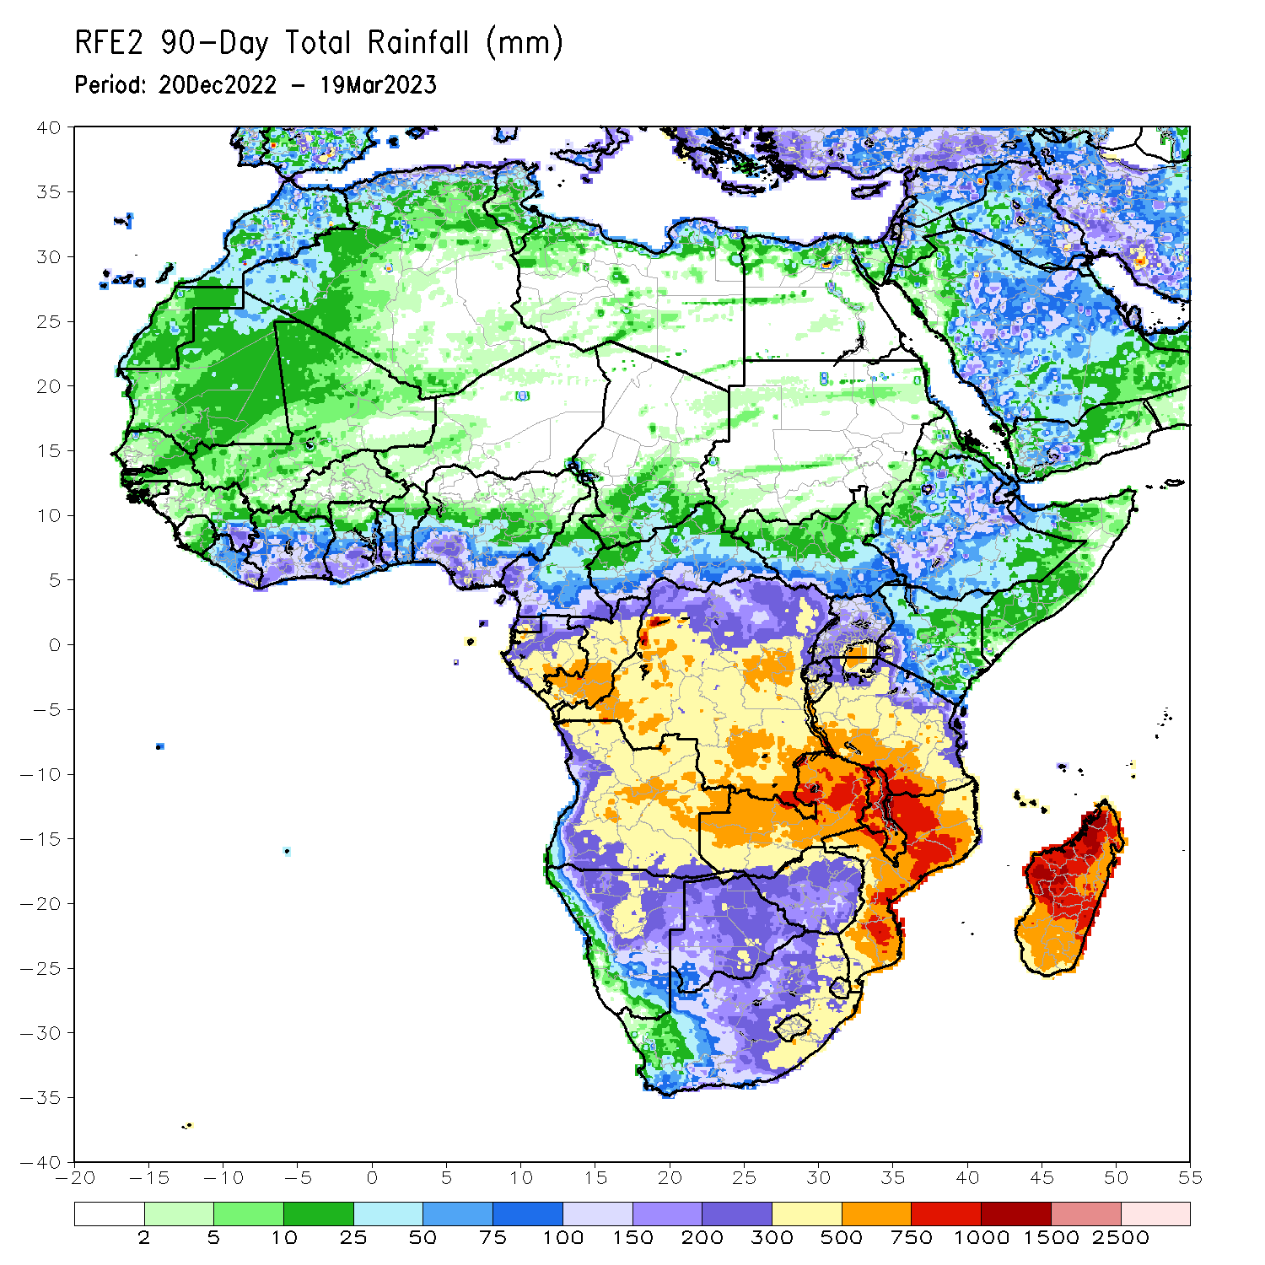
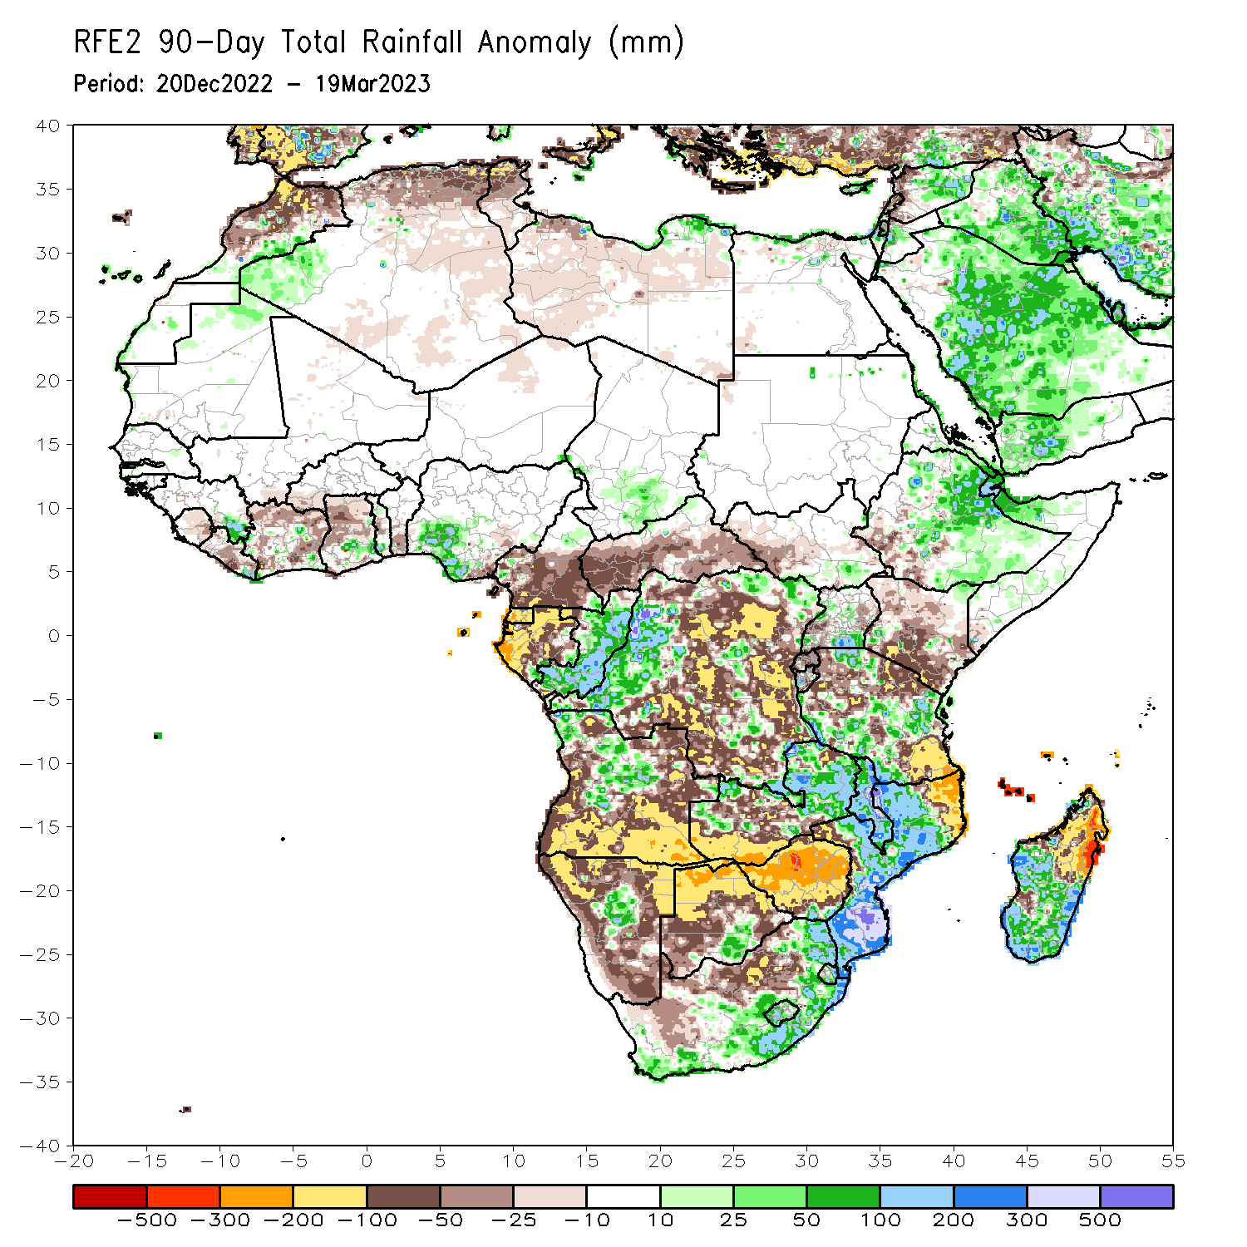
Rainfall Patterns: Last 90 Days
Over the past 90 days, in East Africa, above-average rainfall was observed over parts of central, northern and eastern Ethiopia, local areas in southern Uganda, and parts of Tanzania. Rainfall was below-average over parts of South Sudan and Uganda, southwestern Ethiopia, Kenya and northern southeastern Tanzania. In southern Africa, above-average rainfall was observed over parts of northern and central Angola, northern and eastern Zambia, Malawi, much of Mozambique, pockets of Namibia and Botswana, southern and eastern South Africa, Lesotho, Eswatini, and central and southern Madagascar. Below-average rainfall was observed over southern and eastern Angola, much of Namibia and Botswana, Zimbabwe, western and northern South Africa, the far northern Mozambique, and northern Madagascar. In Central Africa, rainfall was above-average over much Congo and western DRC. Rainfall was below-average over southern Cameroon, CAR, Equatorial Guinea, Gabon, and many parts of DRC. In West Africa, rainfall was above-average over pockets of eastern Guinea, Ghana and Nigeria. In contrast, below-average rainfall was observed over parts of Liberia, Cote d’Ivoire and western Ghana.
Notes:
4

Slide 5
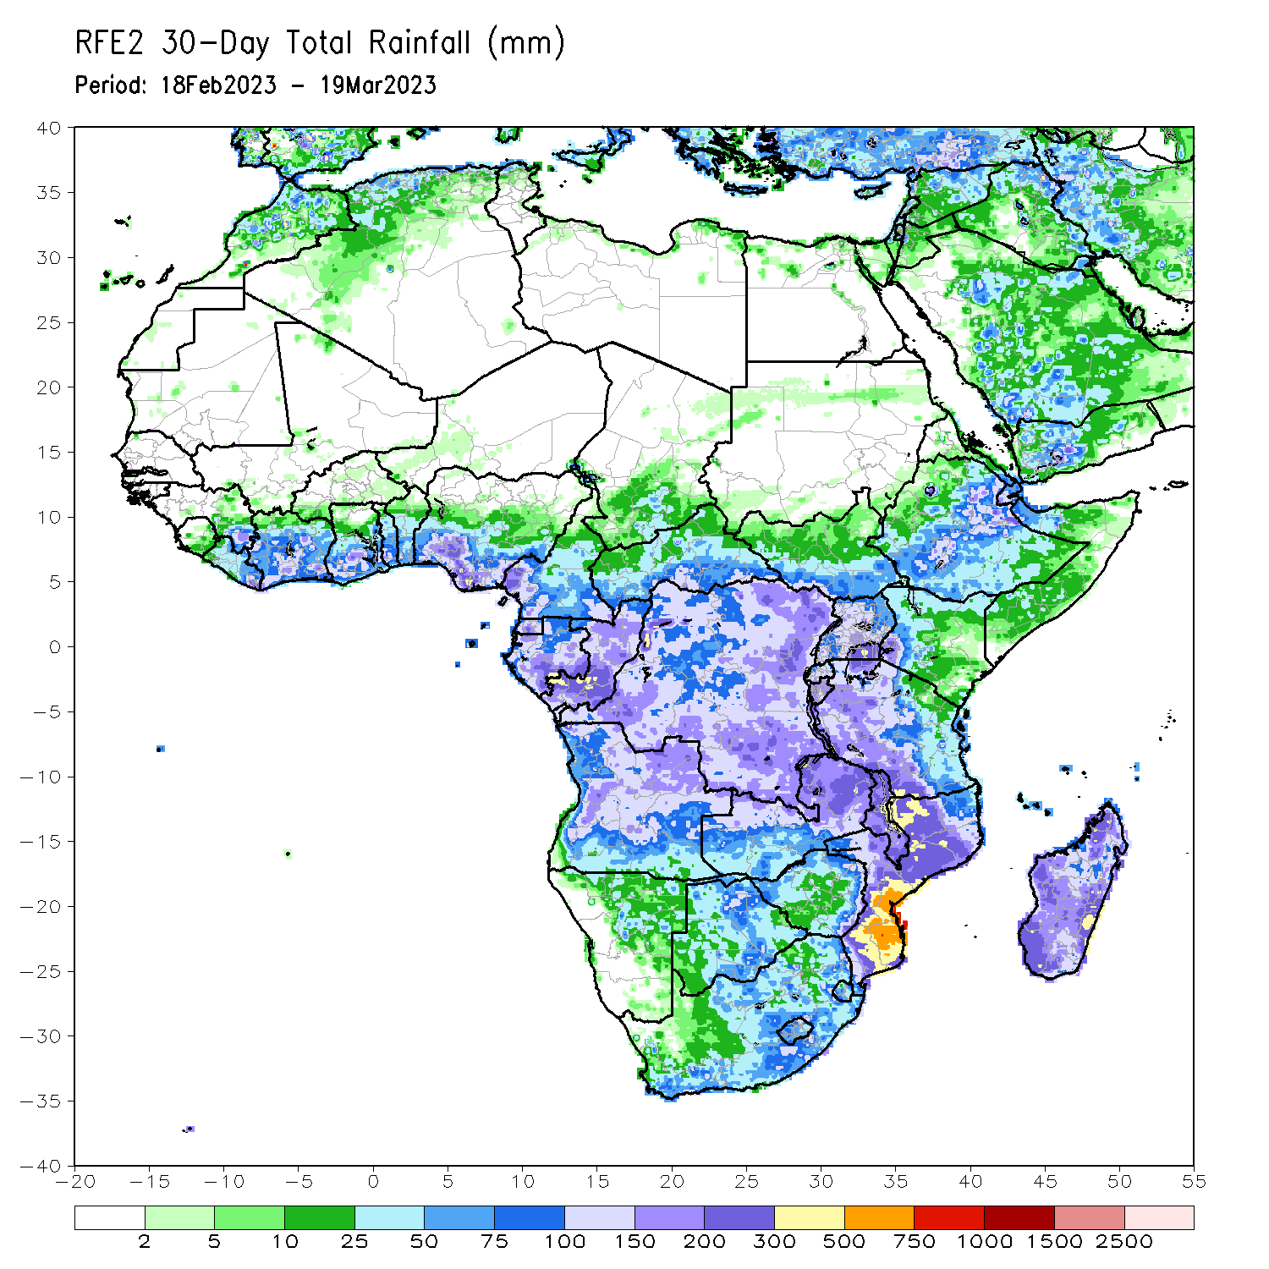
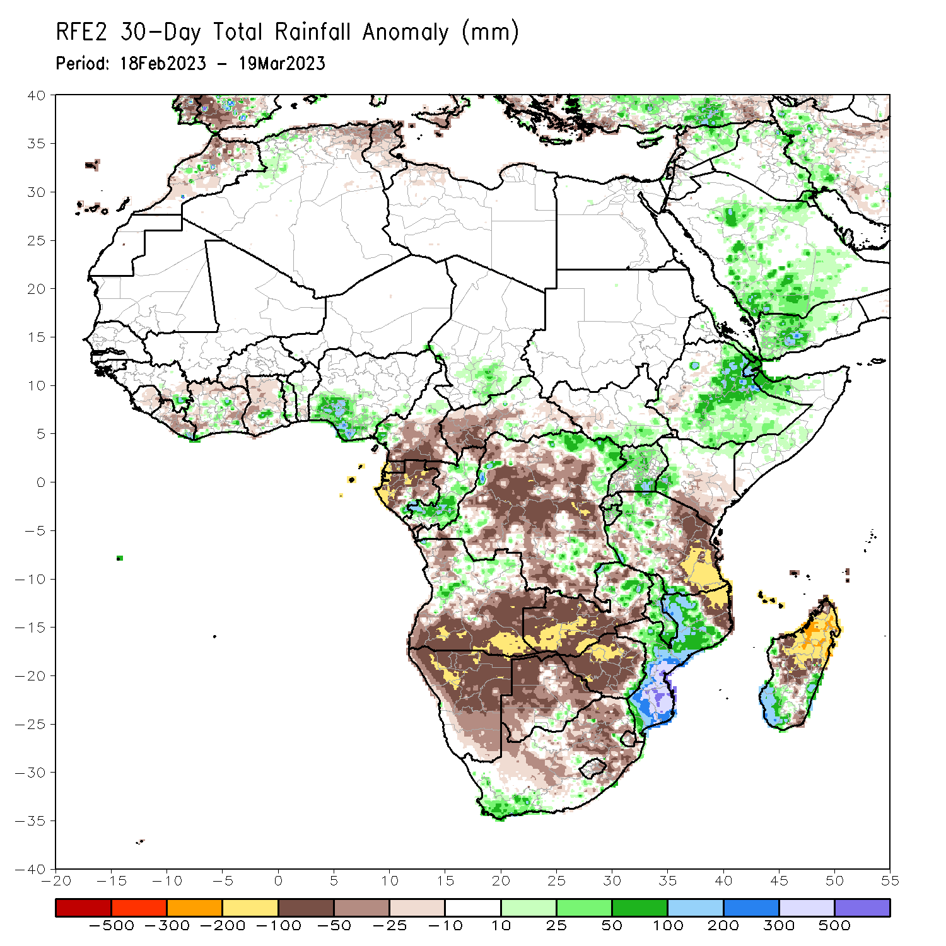
Rainfall Patterns: Last 30 Days
Over the past 30 days, in East Africa, above-average rainfall was observed over central and eastern Ethiopia, Uganda, and pockets of northern Tanzania. Rainfall was below-average over eastern Tanzania. In southern Africa, above-average rainfall was observed over parts of eastern Zambia, much of Mozambique, coastal South Africa and southern Madagascar. Below-average rainfall was observed over many parts of Angola, Namibia, western and central Zambia, Botswana, Zimbabwe, much of South Africa, the far northern Mozambique and northern Madagascar. In Central Africa, rainfall was above-average over parts of Congo and the far northern DRC. Rainfall was below-average over southern Cameroon, CAR, Equatorial Guinea, Gabon, and much of DRC. In West Africa, rainfall was above-average over pocket areas along the Gulf of Guinea coast.
Notes:
5

Slide 6
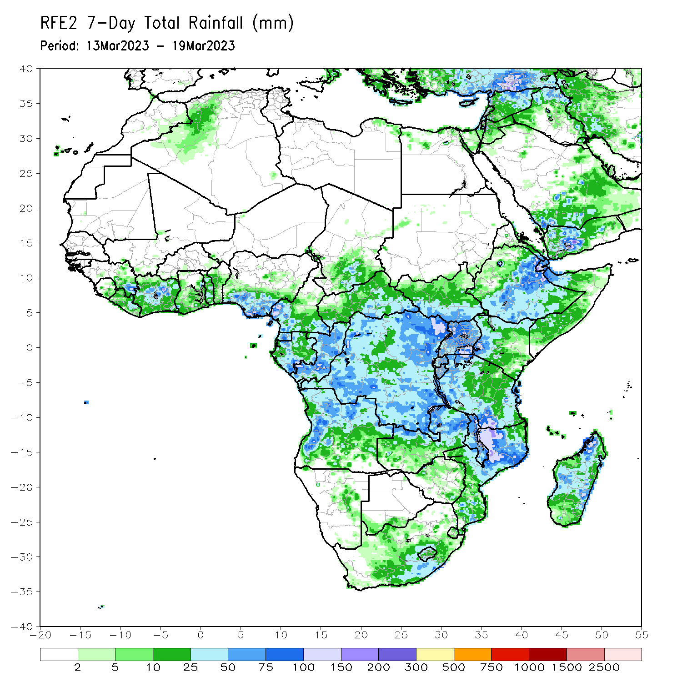
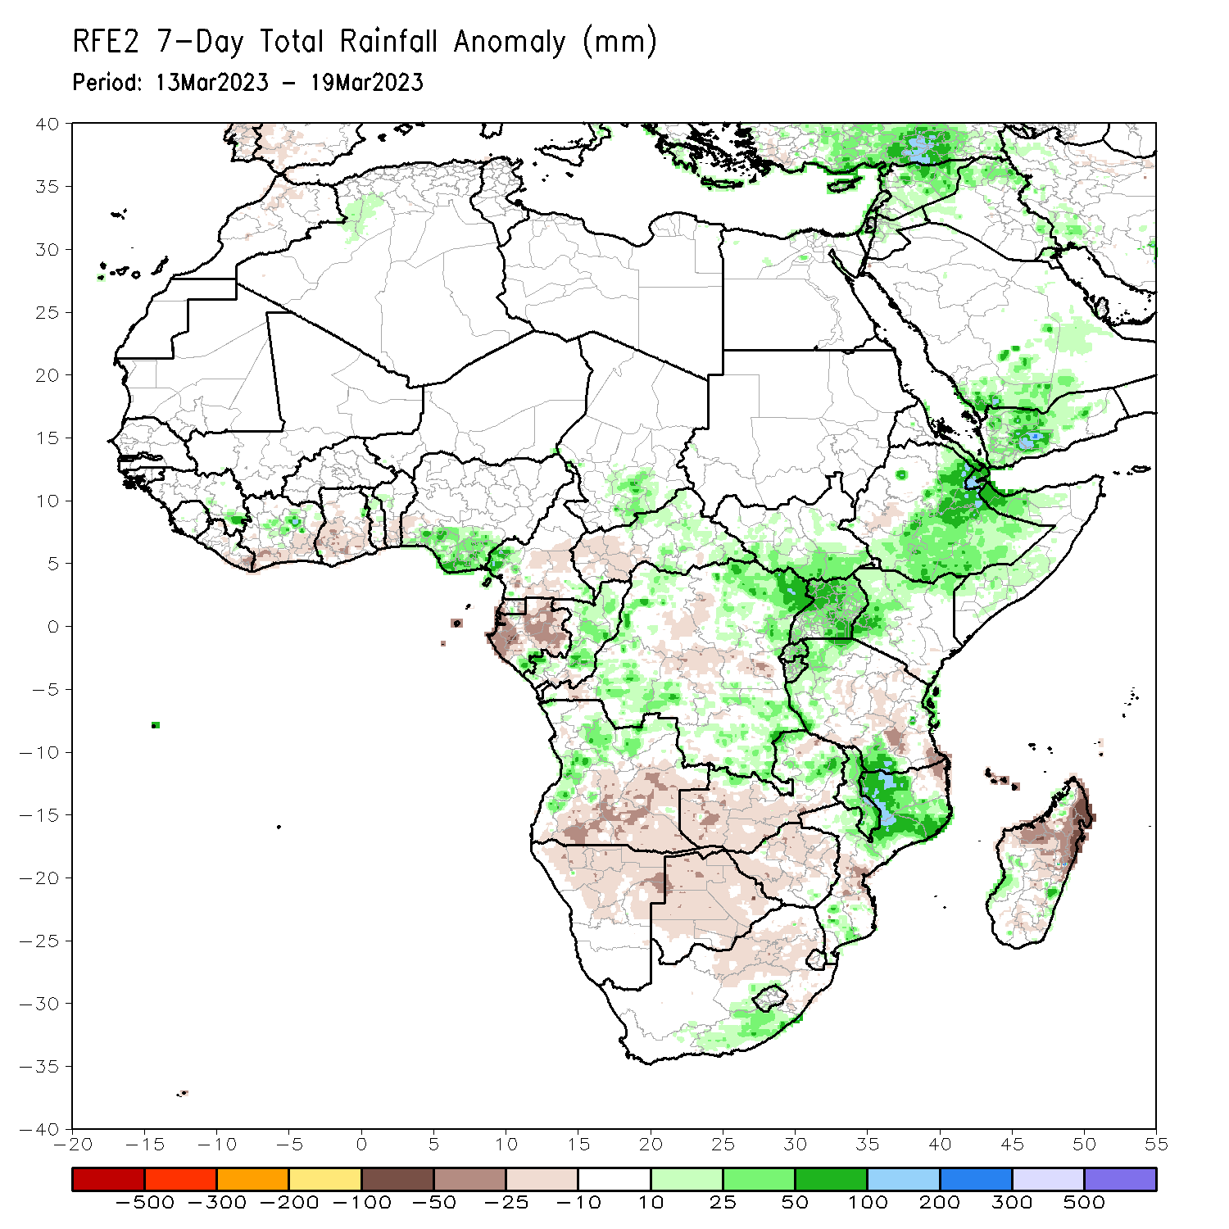
Rainfall Patterns: Last 7 Days
During the past 7 days, in East Africa, rainfall was above-average over central, eastern and southern Ethiopia, much of Uganda, western Kenya and the far southern South Sudan. Below-average rainfall was observed over parts of southeastern Tanzania. In Central Africa, rainfall was above-average over much of Congo and parts of western and eastern DRC. Below-average rainfall was observed much of Gabon, and parts of central DRC. In West Africa, above-average rainfall was observed over pockets of northern Cote d’Ivoire and southern Nigeria. Below-average rainfall was observed over parts of southern Cote d’Ivoire and Ghana. In southern Africa, rainfall was above-average over western Angola, eastern Zambia, Malawi, and northern Mozambique. In contrast, rainfall was below-average over central and southern Angola, western Zambia, Namibia, Botswana, Zimbabwe, much of South Africa and northern Madagascar.

Slide 7
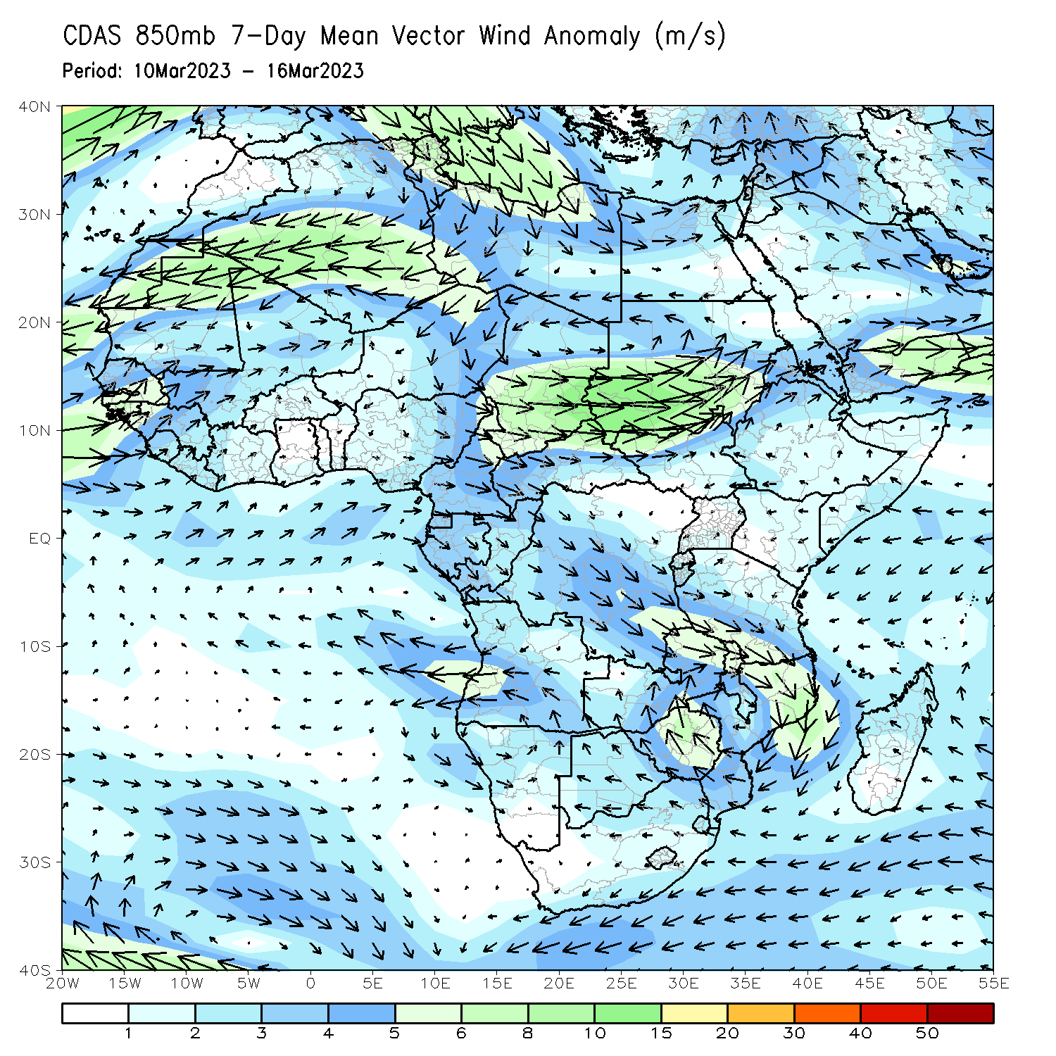
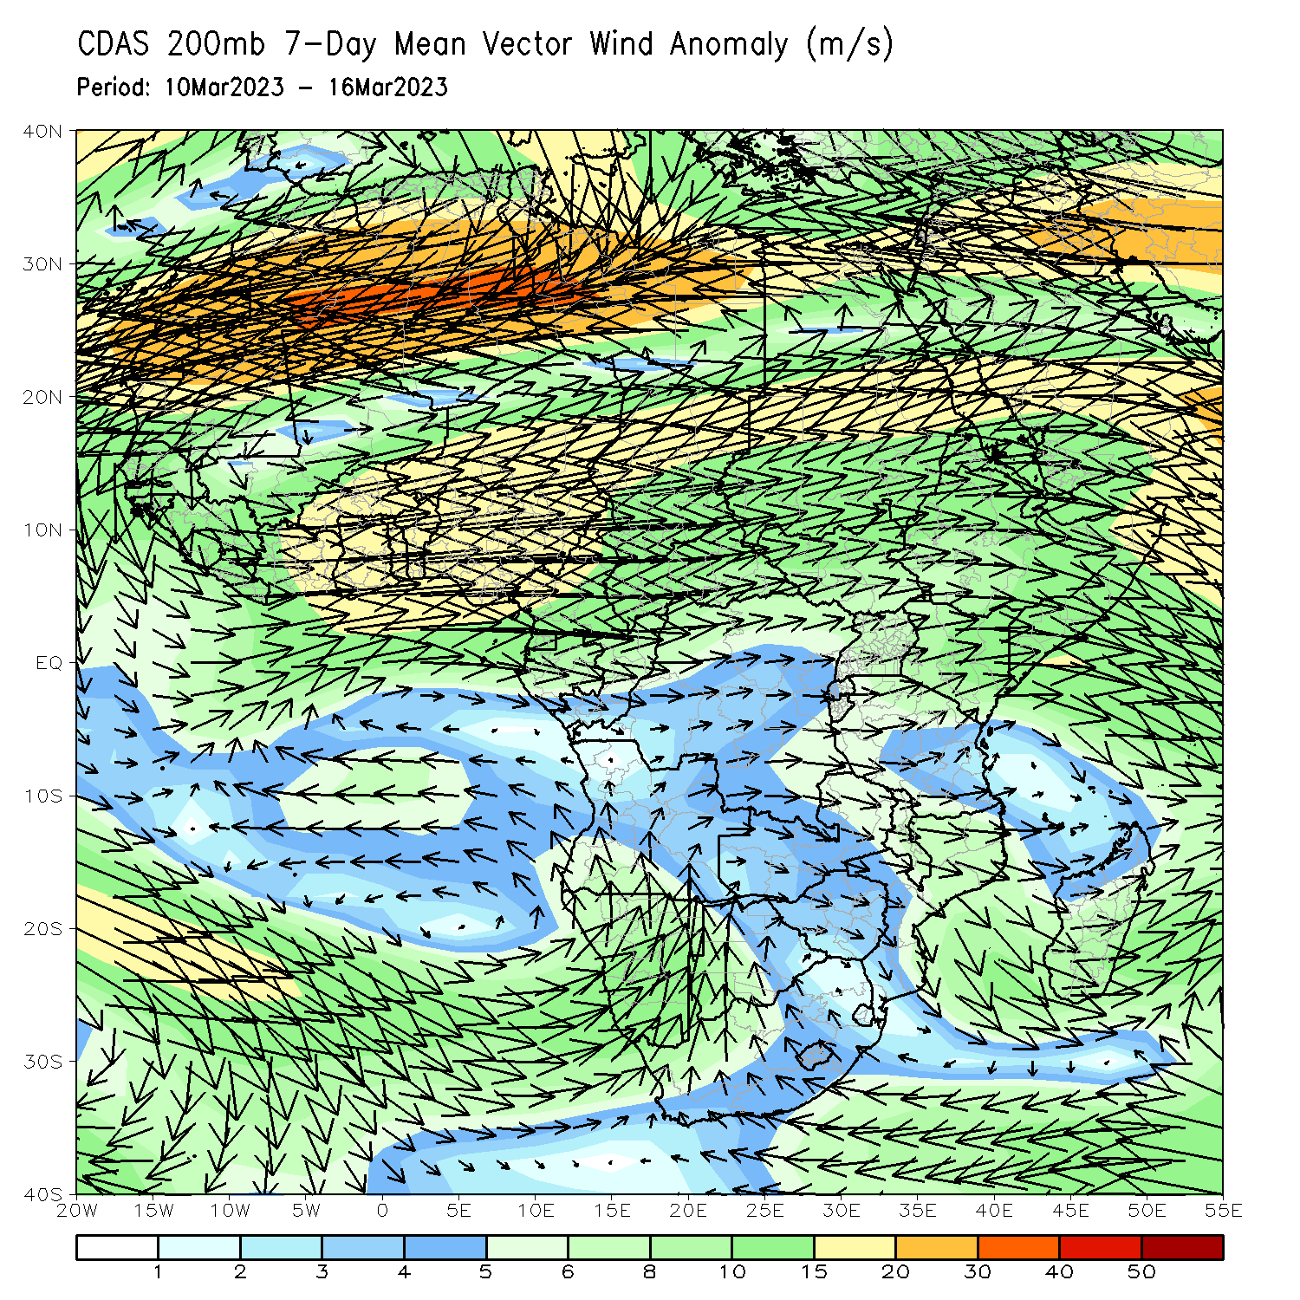
Atmospheric Circulation: Last 7 Days
Lower-level (850-hPa) cyclonic circulation across southeastern Africa may have contributed to the observed above-average rainfall in the region.

Slide 8
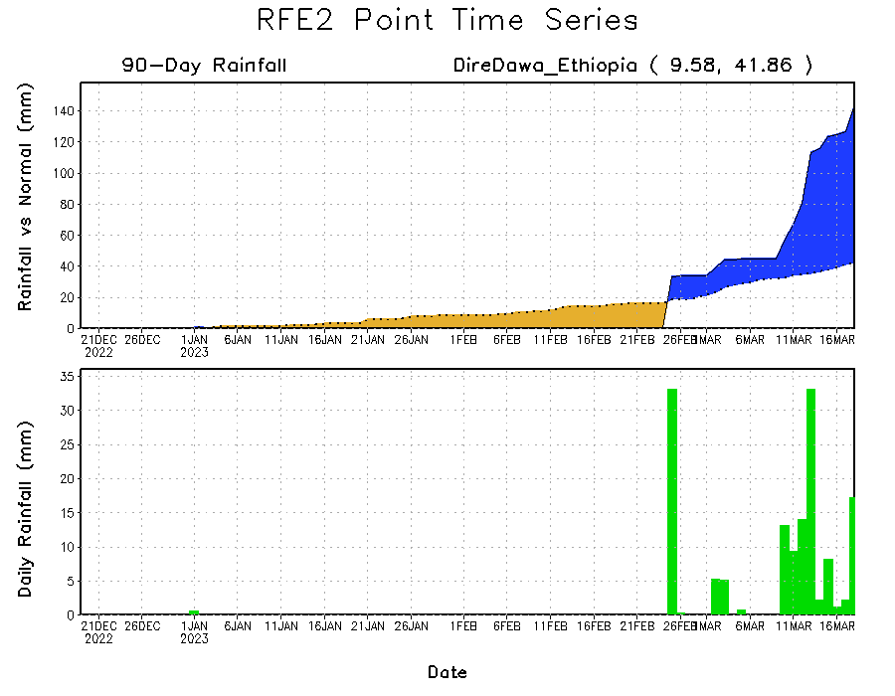
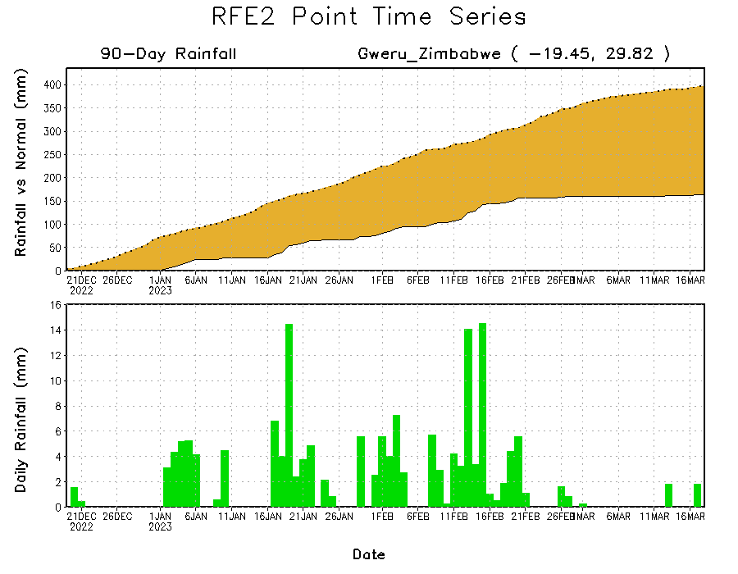
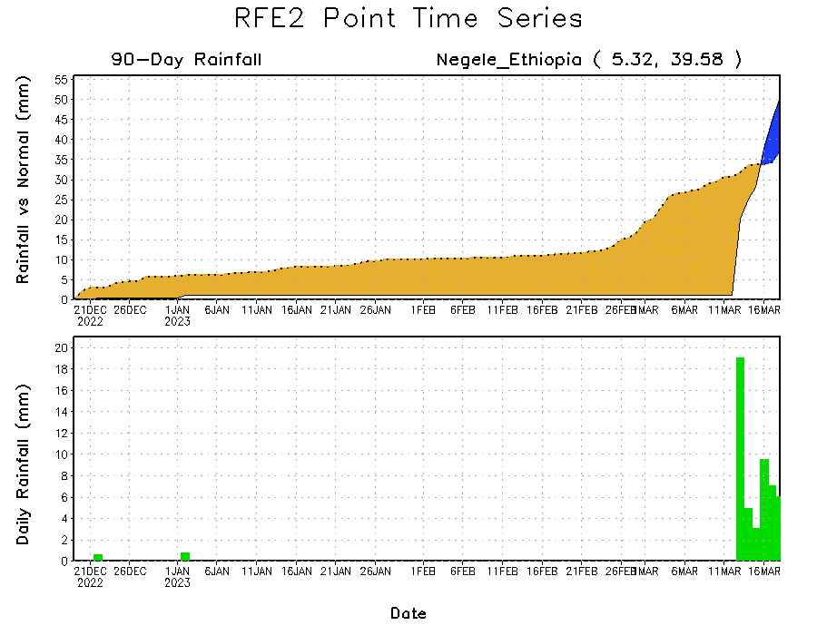
Rainfall Evolution
Daily evolution of rainfall over the last 90 days at selected locations shows worsening moisture deficits over parts of Zimbabwe ((bottom left)). Recent moderate to heavy rains helped to offset accumulated rainfall deficits over parts of southern Ethiopia (bottom right). Moderate to locally heavy rainfall also resulted in moisture surpluses over parts of eastern and northeastern Ethiopia (top right)

Slide 9
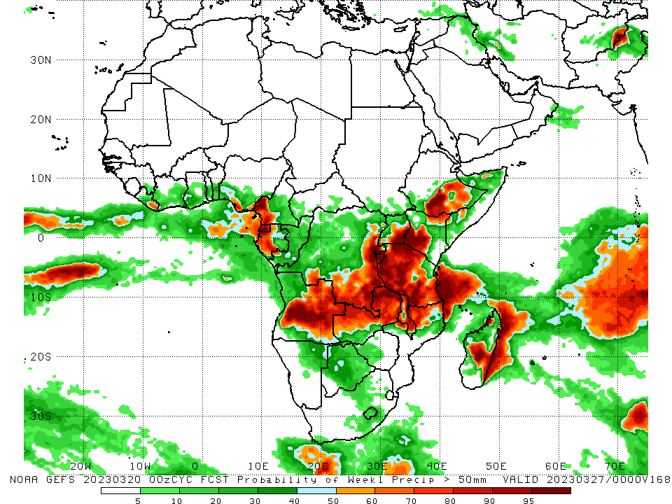
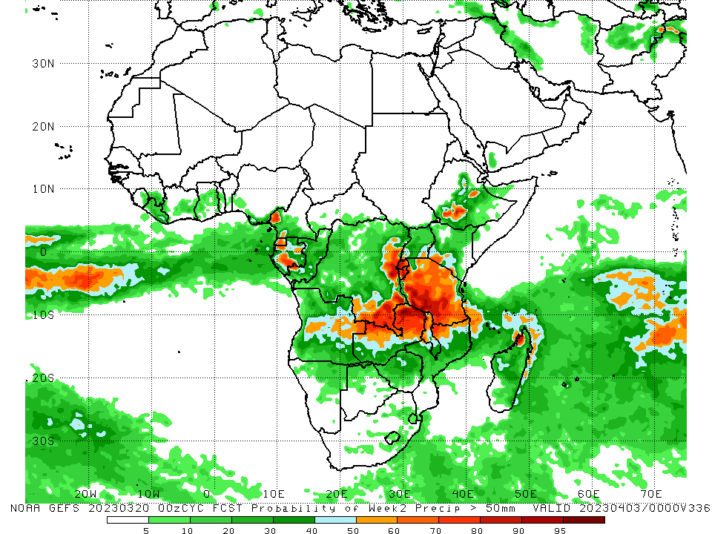
NCEP GEFS Model Forecasts Non-Bias Corrected Probability of precipitation exceedance
Week-1, Valid: 21 – 27 March 2023
Week-2, Valid: 28 March – 03 April 2023
For week-1 (left panel) and wessk-2 (right panel), the GEFS forecasts indicate a moderate to high chance (over 70%) for rainfall to exceed 50 mm over southwestern Cameroon, western Gabon, southern and eastern Angola, southern and eastern DRC, Zambia, Rwanda, Burundi, eastern Uganda, western Kenya, much of Tanzania, southeastern Ethiopia, and northern Mozambique.
Notes:
9

Slide 10
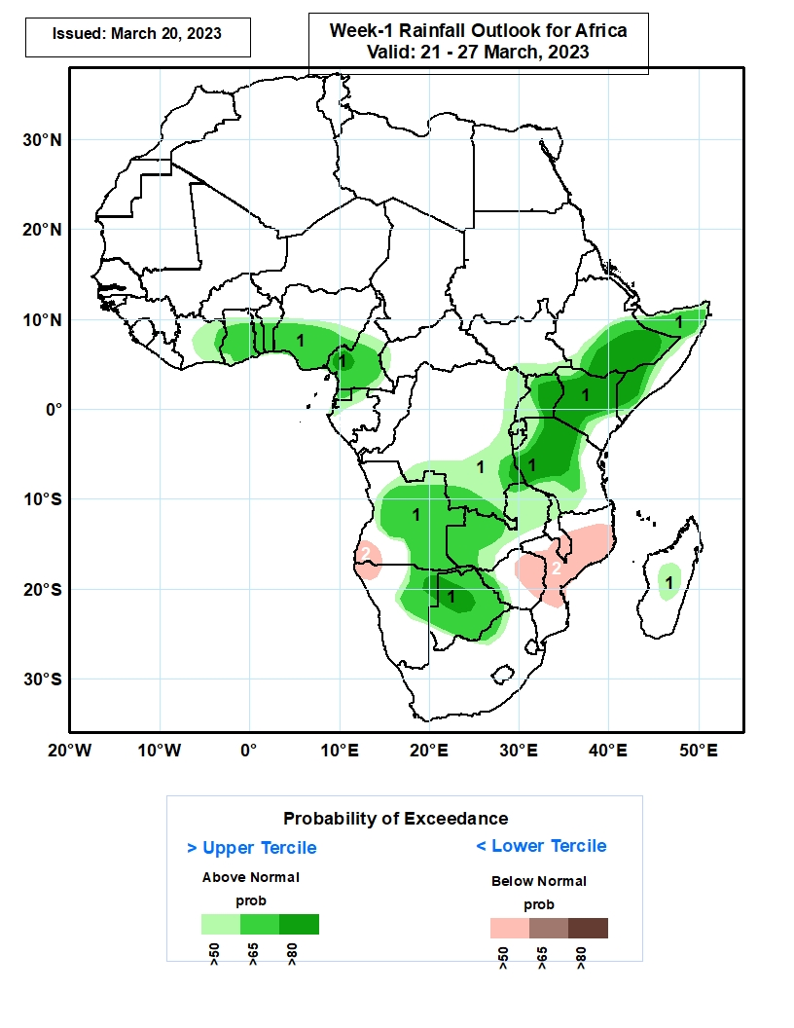
Week-1 Precipitation Outlooks
21 – 27 March 2023
The forecasts suggest above 50% chance for weekly rainfall to be above-normal (above the upper tercile) over central and eastern Cote d’Ivoire, much of Ghana, Togo and Benin, central and southern Nigeria and Cameroon, much of Equatorial Guinea, northern Gabon, eastern and southern parts of DR Congo, southern South Sudan, central and eastern Ethiopia, northern and southern parts of Somalia, much of Uganda, Kenya, Rwanda, Burundi, Tanzania, Zambia and Botswana, central and eastern portions of Angola, northern Malawi, eastern Namibia, western Zimbabwe, northern South Africa and central Madagascar. In particular, there is above 80% chance for rainfall to be above-normal over western Cameroon, southern and eastern Ethiopia, southern Somalia, eastern Uganda, northern and central portions of Kenya, western and central portions of Tanzania, northeastern Namibia and western Botswana.
The consolidated probabilistic forecasts suggest above 50% chance for weekly total rainfall to be below-normal (below the lower tercile) over southwestern Angola, northwestern Namibia, eastern Zimbabwe, southern Malawi, northern and central portions of Mozambique.
Notes:
10

Slide 11
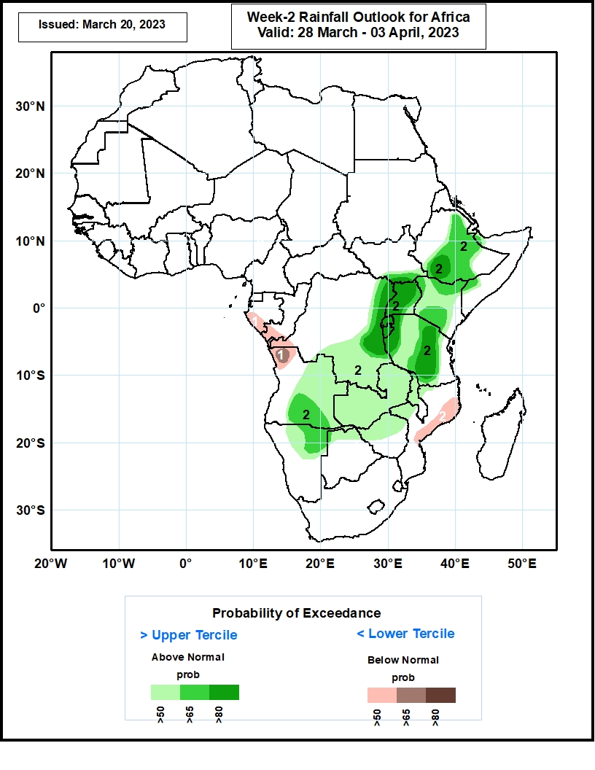
Week-2 Precipitation Outlooks
28 March – 03 April 2023
The consolidated probabilistic forecasts suggest above 50% chance for weekly total rainfall to be below-normal (below the lower tercile) over southern Gabon and Congo, western DR Congo, northwestern Angola, and eastern portions of Mozambique. In particular, there is an above 65% chance for rainfall to be below-normal over northwestern Angola.
The forecasts suggest above 50% chance for weekly rainfall to be above-normal (above the upper tercile) over central and eastern portions of Ethiopia, eastern and southern DR Congo, much of Uganda, Kenya, Rwanda, Burundi, Tanzania and Zambia, southwestern Somalia, central and eastern Angola, northern Namibia, Botswana and Zimbabwe, northern and central Malawi. In particular, there is an above 80% chance for rainfall to be above-normal over southern Ethiopia, eastern DR Congo, much of Uganda, Rwanda and Burundi, western and central portions of Tanzania.
Notes:
11

Slide 12
Summary
Over the past 30 days, in East Africa, above-average rainfall was observed over central and eastern Ethiopia, Uganda, and pockets of northern Tanzania. Rainfall was below-average over eastern Tanzania. In southern Africa, above-average rainfall was observed over parts of eastern Zambia, much of Mozambique, coastal South Africa and southern Madagascar. Below-average rainfall was observed over many parts of Angola, Namibia, western and central Zambia, Botswana, Zimbabwe, much of South Africa, the far northern Mozambique and northern Madagascar. In Central Africa, rainfall was above-average over parts of Congo and the far northern DRC. Rainfall was below-average over southern Cameroon, CAR, Equatorial Guinea, Gabon, and much of DRC. In West Africa, rainfall was above-average over pocket areas along the Gulf of Guinea coast.
During the past 7 days, in East Africa, rainfall was above-average over central, eastern and southern Ethiopia, much of Uganda, western Kenya and the far southern South Sudan. Below-average rainfall was observed over parts of southeastern Tanzania. In Central Africa, rainfall was above-average over much of Congo and parts of western and eastern DRC. Below-average rainfall was observed much of Gabon, and parts of central DRC. In West Africa, above-average rainfall was observed over pockets of northern Cote d’Ivoire and southern Nigeria. Below-average rainfall was observed over parts of southern Cote d’Ivoire and Ghana. In southern Africa, rainfall was above-average over western Angola, eastern Zambia, Malawi, and northern Mozambique. In contrast, rainfall was below-average over central and southern Angola, western Zambia, Namibia, Botswana, Zimbabwe, much of South Africa and northern Madagascar.
Model forecasts call for an increased chance for week-1 rainfall to be above-normal across the central and eastern portions of the Gulf of Guinea region, southern CAR, southern and eastern DRC, much of equatorial East Africa, parts of Angola and western Zambia. In contrast, there is an increased chance for below-normal rainfall over southeastern Africa, including northern Madagascar. For week-2, there is an increased chance for above-normal rainfall over pockets of the Gulf of Guinea region, southern and eastern DRC, parts of Angola, northern Namibia, northern Botswana, and many places in the Greater Horn of Africa. In contrast, there is an increased chance for below-normal rainfall over parts of Southeastern Africa.

