Slide 1
The African Monsoon Recent Evolution and Current Status Include Week-1 and Week-2 Outlooks
Update prepared
03 April 2023
For more information, visit:
http://www.cpc.ncep.noaa.gov/products/Global_Monsoons/African_Monsoons/precip_monitoring.shtml

Slide 2
Outline
Highlights
Recent Evolution and Current Conditions
NCEP GEFS Forecasts
Summary

Slide 3
Highlights: Last 7 Days
During the past 7 days, in East Africa, rainfall was above-average over southern, central, and eastern Ethiopia, parts of southwestern and northern Somalia, southern Djibouti, eastern Eritrea, central and southern Uganda, Rwanda, Burundi, parts of eastern Kenya, western, central, and southern Tanzania, and parts of southern South Sudan. Below-average rainfall was observed across western and southeastern Kenya, parts of western South Sudan, and parts of southern Somalia. In Central Africa, rainfall was above-average over south-central and southwestern CAR, southern Cameroon, northern and southern Congo, most of DRC, eastern and central Equatorial Guinea, and pockets of northern Gabon. Below-average rainfall was observed across western and southeastern Gabon, parts of northern, central, a small portion of east-central DRC, northwestern and southeastern CAR, and central Cameroon. In West Africa, above-average rainfall was observed over pockets of northern and southeastern Cote d’Ivoire, central and southwestern Ghana, southern Guinea, parts of central Togo, southwestern and southeastern Nigeria, and parts of eastern Sierra Leone. Below average rainfall was observed over eastern Liberia, southwestern Cote d’Ivoire, a small portion of coastal south-central Ghana, and southwestern Nigeria. In southern Africa, rainfall was above-average over northern and pockets of southern Mozambique, most of Malawi, northern and eastern Zambia, northern, central, and southwestern Angola, northeastern Namibia (Caprivi Strip), pockets of eastern Botswana, northeastern South Africa, Eswatini, Comoros, and northern, central, southern, and eastern Madagascar. In contrast, rainfall was below-average over central Mozambique, central Zimbabwe, central and southeastern South Africa, parts of west-central and southeastern Angola, southern Zambia, central and western Botswana, central Namibia, and pockets of coastal northwestern Madagascar.
The Week-1 outlook calls for an increased chance for above-average rainfall over central and northeastern Ethiopia, northwestern Somalia, eastern Kenya, southern Burundi, most of Tanzania, Equatorial Guinea, Gabon, Congo, Liberia, central and southern Cote d’Ivoire, central and southern Ghana, southern Cameroon, southern and most of western DRC, northern parts of Zambia, northern Mozambique, northern and central Angola, Comoros, and Madagascar. In contrast, there is an increased chance for below-average rainfall over parts of central Sierra Leone, central and southern Nigeria, east-central Cameroon, southeastern CAR, southern South Sudan, western and southern Ethiopia, southwestern Somalia, western and southern Zambia, southern Angola, most of Namibia, Botswana, Zimbabwe, southern Malawi, central and western Mozambique, Uganda, southwestern Kenya, parts of northern Tanzania, and much of northern and central South Africa. The Week-2 outlook suggests an increased chance for above-average rainfall over central, northern, and southeastern Ethiopia, eastern South Sudan, Equatorial Guinea, western Gabon, southwestern parts of Congo, central and southern Cameroon, southern Tanzania, eastern Zambia, northern Angola, northern Madagascar, eastern South Africa, Lesotho, Eswatini, northern Malawi, and most of the Gulf of Guinea region. Below-average rainfall is likely over much of central Africa (especially eastern DRC, Uganda, Rwanda, Burundi, northern Tanzania, and southern Kenya), as well as southwestern Angola, east-central Mozambique, and southeastern Madagascar.

Slide 4
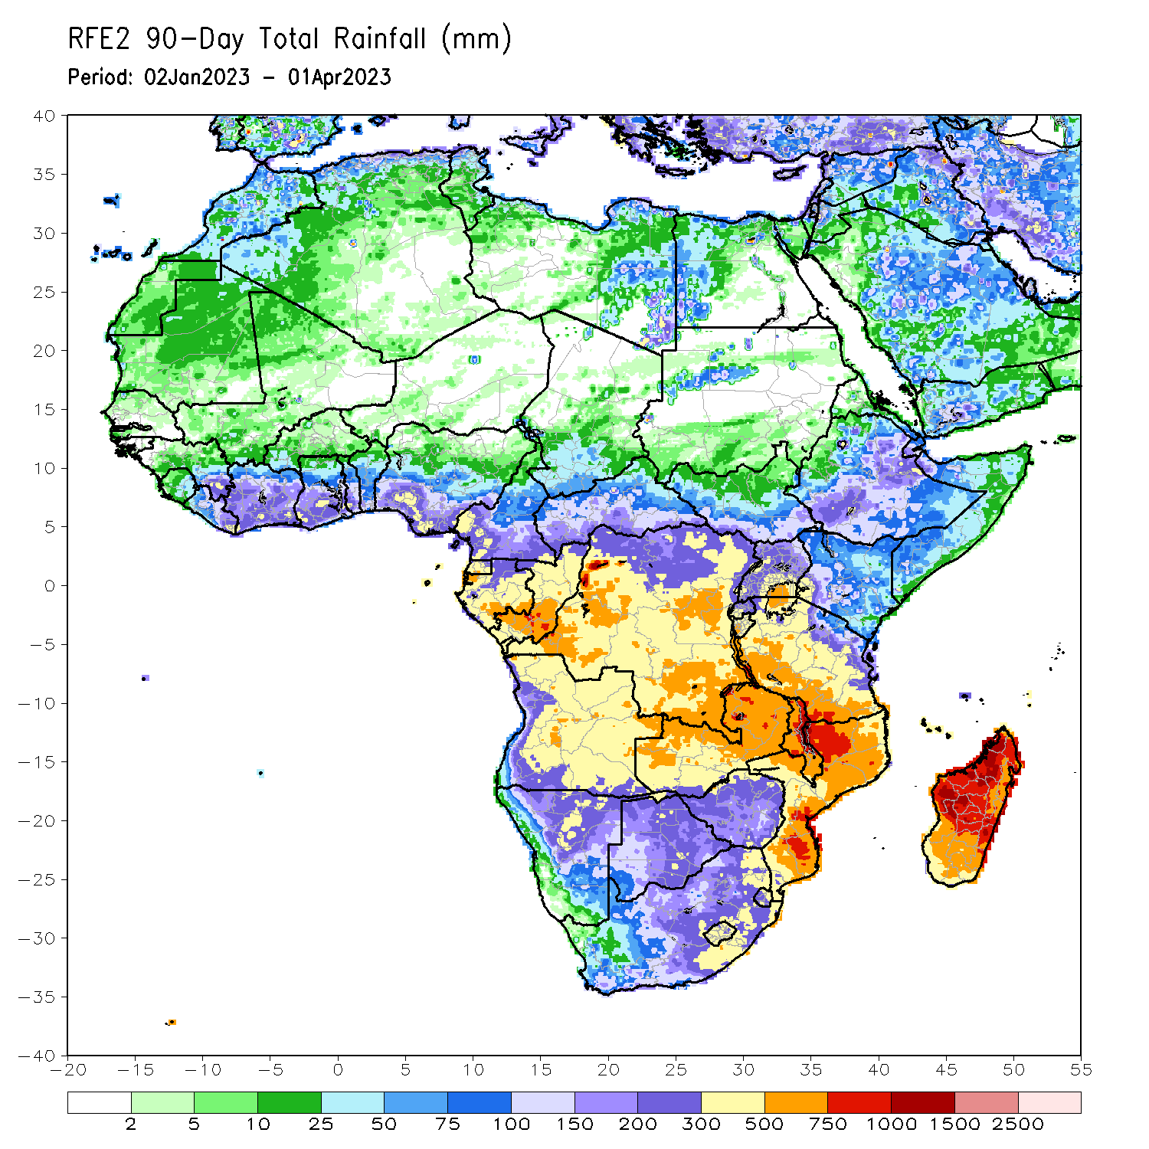
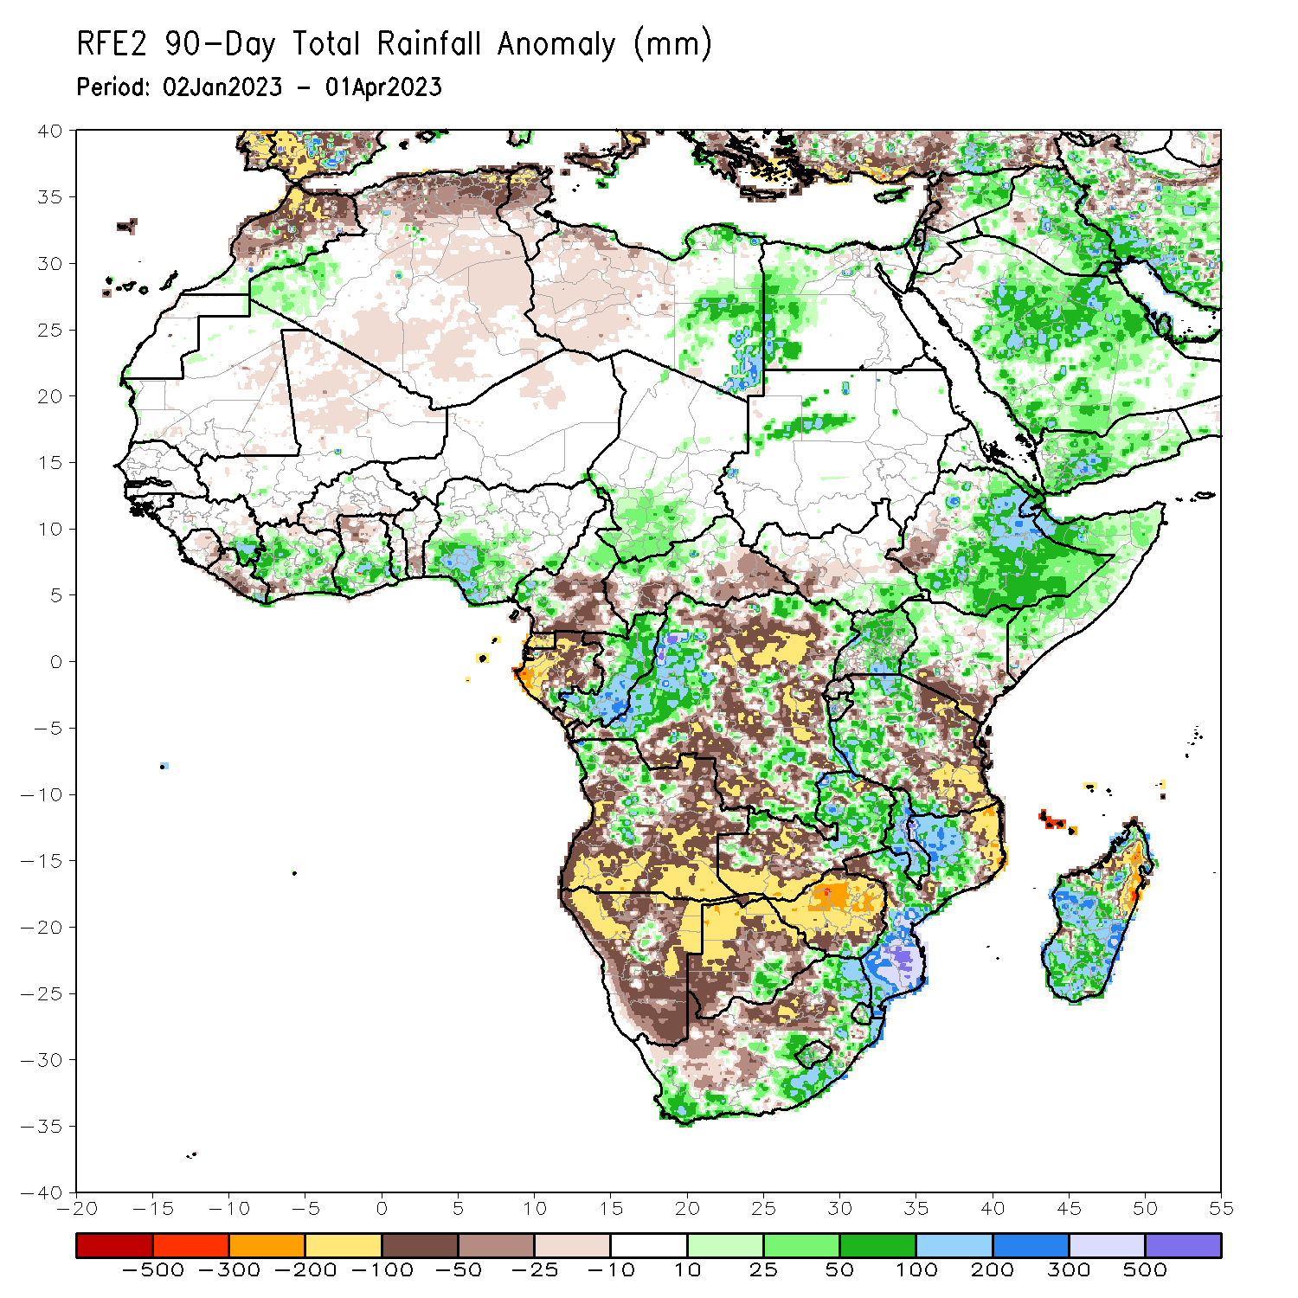
Rainfall Patterns: Last 90 Days
Over the past 90 days, in East Africa, above-average rainfall was observed over parts of central, eastern and southern Ethiopia, many parts of Somalia, Djibouti, southeastern Eritrea, pockets of northeastern and western Kenya, northern, central and southeastern Uganda, western Tanzania, Burundi, parts of eastern and western Rwanda, southeastern South Sudan, and parts of northwestern Sudan. Rainfall was below-average over parts of west-central Ethiopia, southwestern Uganda, must of western and central South Sudan, southern Kenya, eastern and parts of central Tanzania, and northern Rwanda. In southern Africa, above-average rainfall was observed over parts of northwest, central and southern Mozambique, much of Malawi, northern and eastern Zambia, pockets of central and northwestern Angola, pockets of central Namibia, south-central Botswana, southern Zimbabwe, northern, eastern and southern South Africa, western and central Lesotho, eastern and southern Eswatini, and parts of western, central, southern and southeastern Madagascar. Below-average rainfall was observed over western, southern and eastern Angola, western, northern, eastern and southern Namibia, western, northern and eastern Botswana, much of Zimbabwe, southwestern Zambia, northeastern and west-central Mozambique, northeastern Madagascar, and much of northern South Africa, eastern Lesotho, and Comoros. In Central Africa, rainfall was above-average over much of Congo, parts western, southeastern, and northeastern DRC, central and western Cameroon, southern Chad, and northern CAR. Rainfall was below-average over southern Cameroon, Gabon, Equatorial Guinea, southern CAR, and portions of northern, central, eastern, and southern DRC. In West Africa, rainfall was above-average over parts of southeastern Guinea and Liberia, southeastern and central Cote d’Ivoire, southern parts of Ghana and Togo, parts of southern and central Nigeria, and northern and western Mauritania. In contrast, below-average rainfall was observed over eastern Sierra Leone, western and central Liberia, northern parts of Cote d’Ivoire and Ghana, southern Benin, northern Togo, eastern Mauritania, and southern Burkina Faso.
Notes:
‹#›

Slide 5
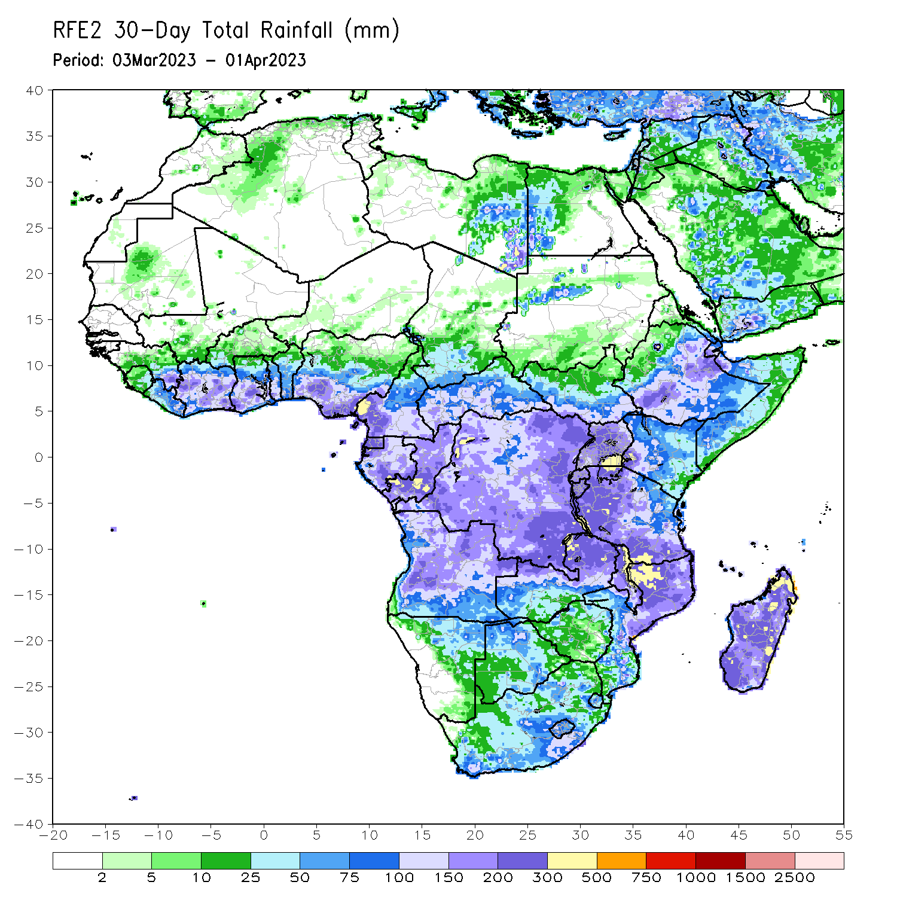
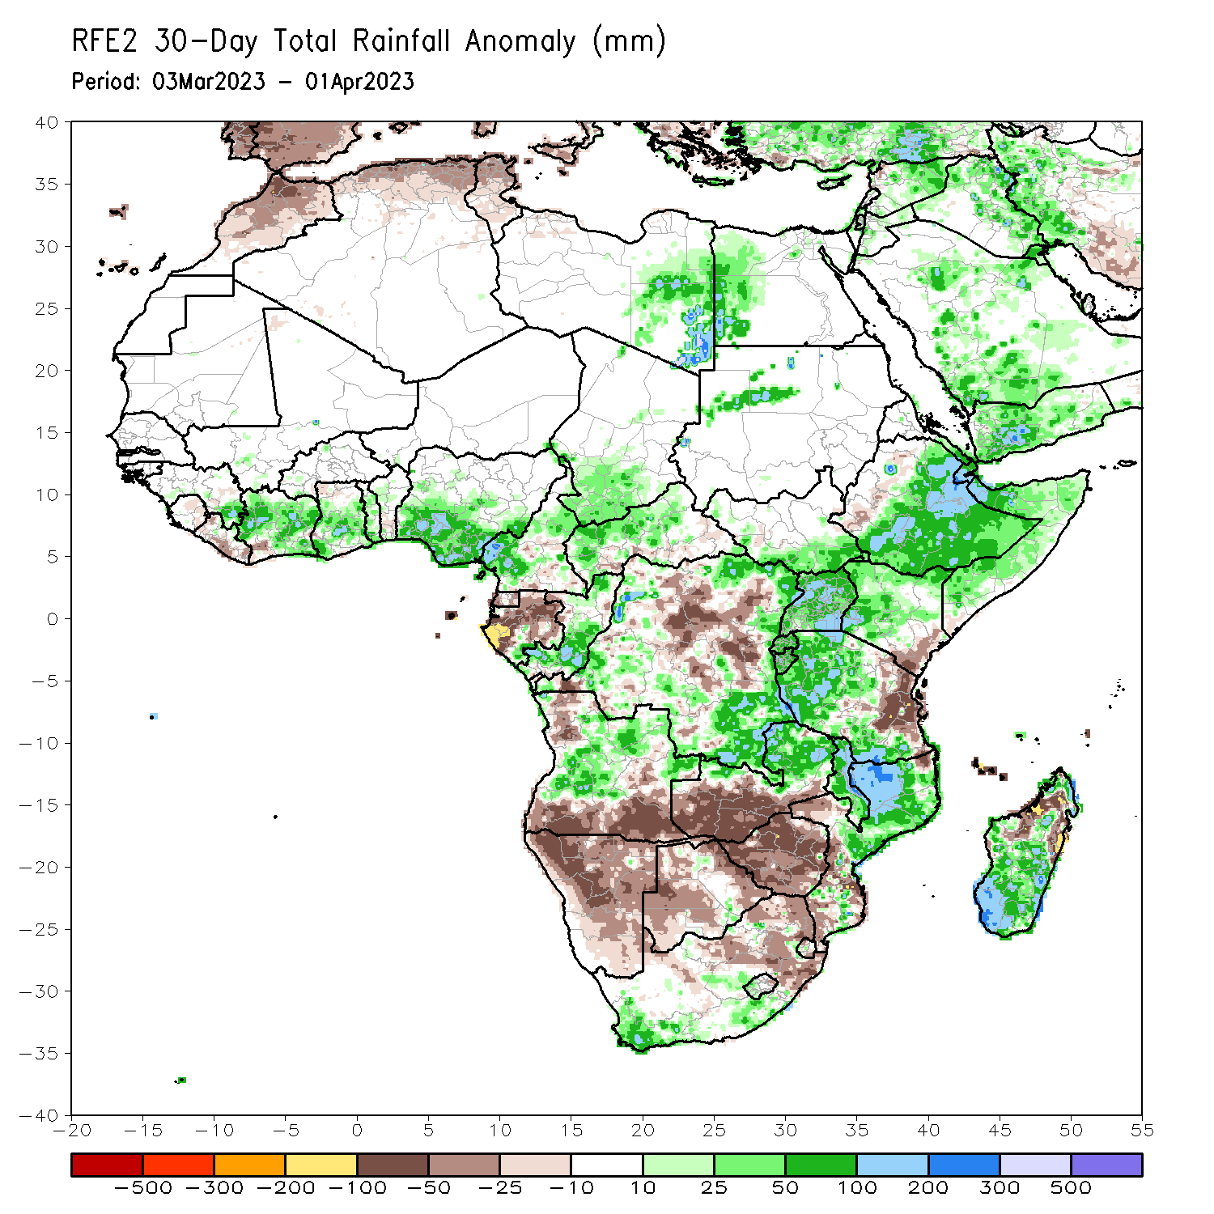
Rainfall Patterns: Last 30 Days
Over the past 30 days, in East Africa, above-average rainfall was observed over central, southern, and eastern Ethiopia, much of Somalia, Djibouti, southeastern Eritrea, western, northern and central Kenya, central, western, and southern Tanzania, Rwanda, Burundi, Uganda, southern and western South Sudan, and pockets of northwestern Sudan. Rainfall was below-average over southeastern Kenya, eastern Tanzania, and parts of western Ethiopia. In southern Africa, above-average rainfall was observed over northwest, central, and pockets of southern Mozambique, Malawi, northern Zambia, west-central and northeastern Angola, southern and parts of central South Africa, western Lesotho, and southern, central, and coastal northern Madagascar. Below-average rainfall was observed over much of Namibia, northwestern, southern and east-central Angola, western and southern Zambia, many parts of Zimbabwe and Botswana, northern and eastern South Africa, northern and southern Eswatini, eastern Lesotho, Comoros, and parts of northeastern and northwestern Madagascar. In Central Africa, rainfall was above-average over parts of northern and southern Congo, central and western Cameroon, southern Chad, northern and central CAR, and eastern DRC. Rainfall was below-average over central DRC, Equatorial Guinea, western, central, and northern Gabon, parts of southern Cameroon, and southern CAR. In West Africa, rainfall was above-average over pockets of southeastern Guinea, north-central Liberia, many parts of Cote d’Ivoire, central and southern Ghana, Togo, central Benin, and southern and central Nigeria. Rainfall was below-average in eastern and northern Sierra Leone, central and southern Liberia, northern Ghana, and southern Benin.
Notes:
‹#›

Slide 6
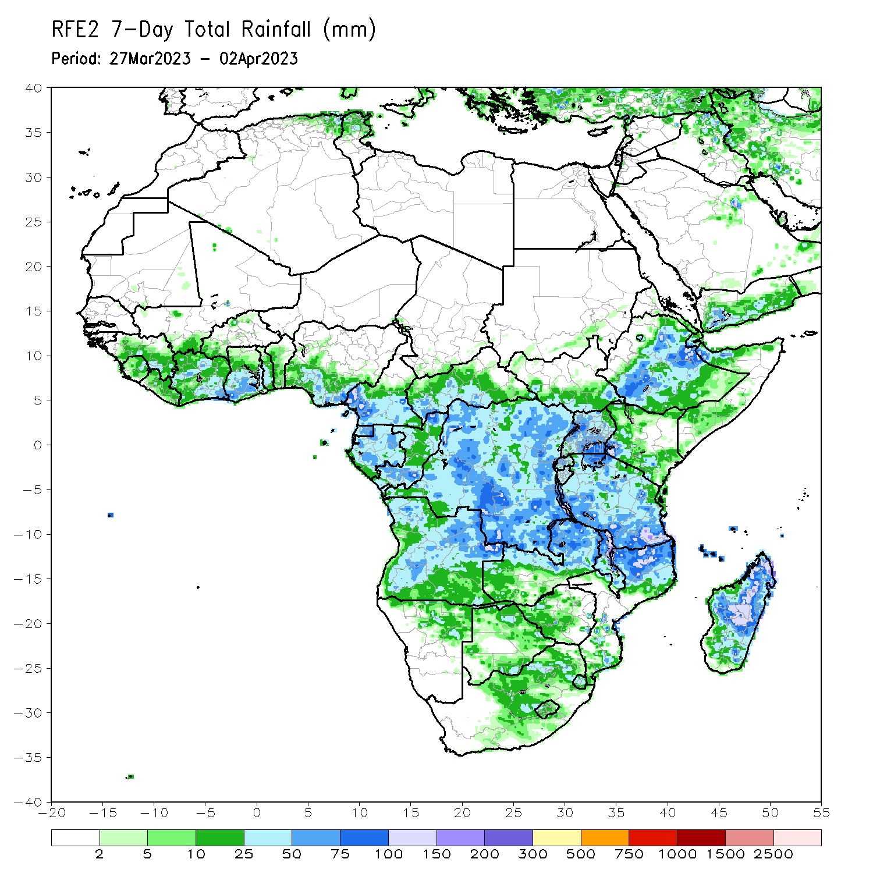
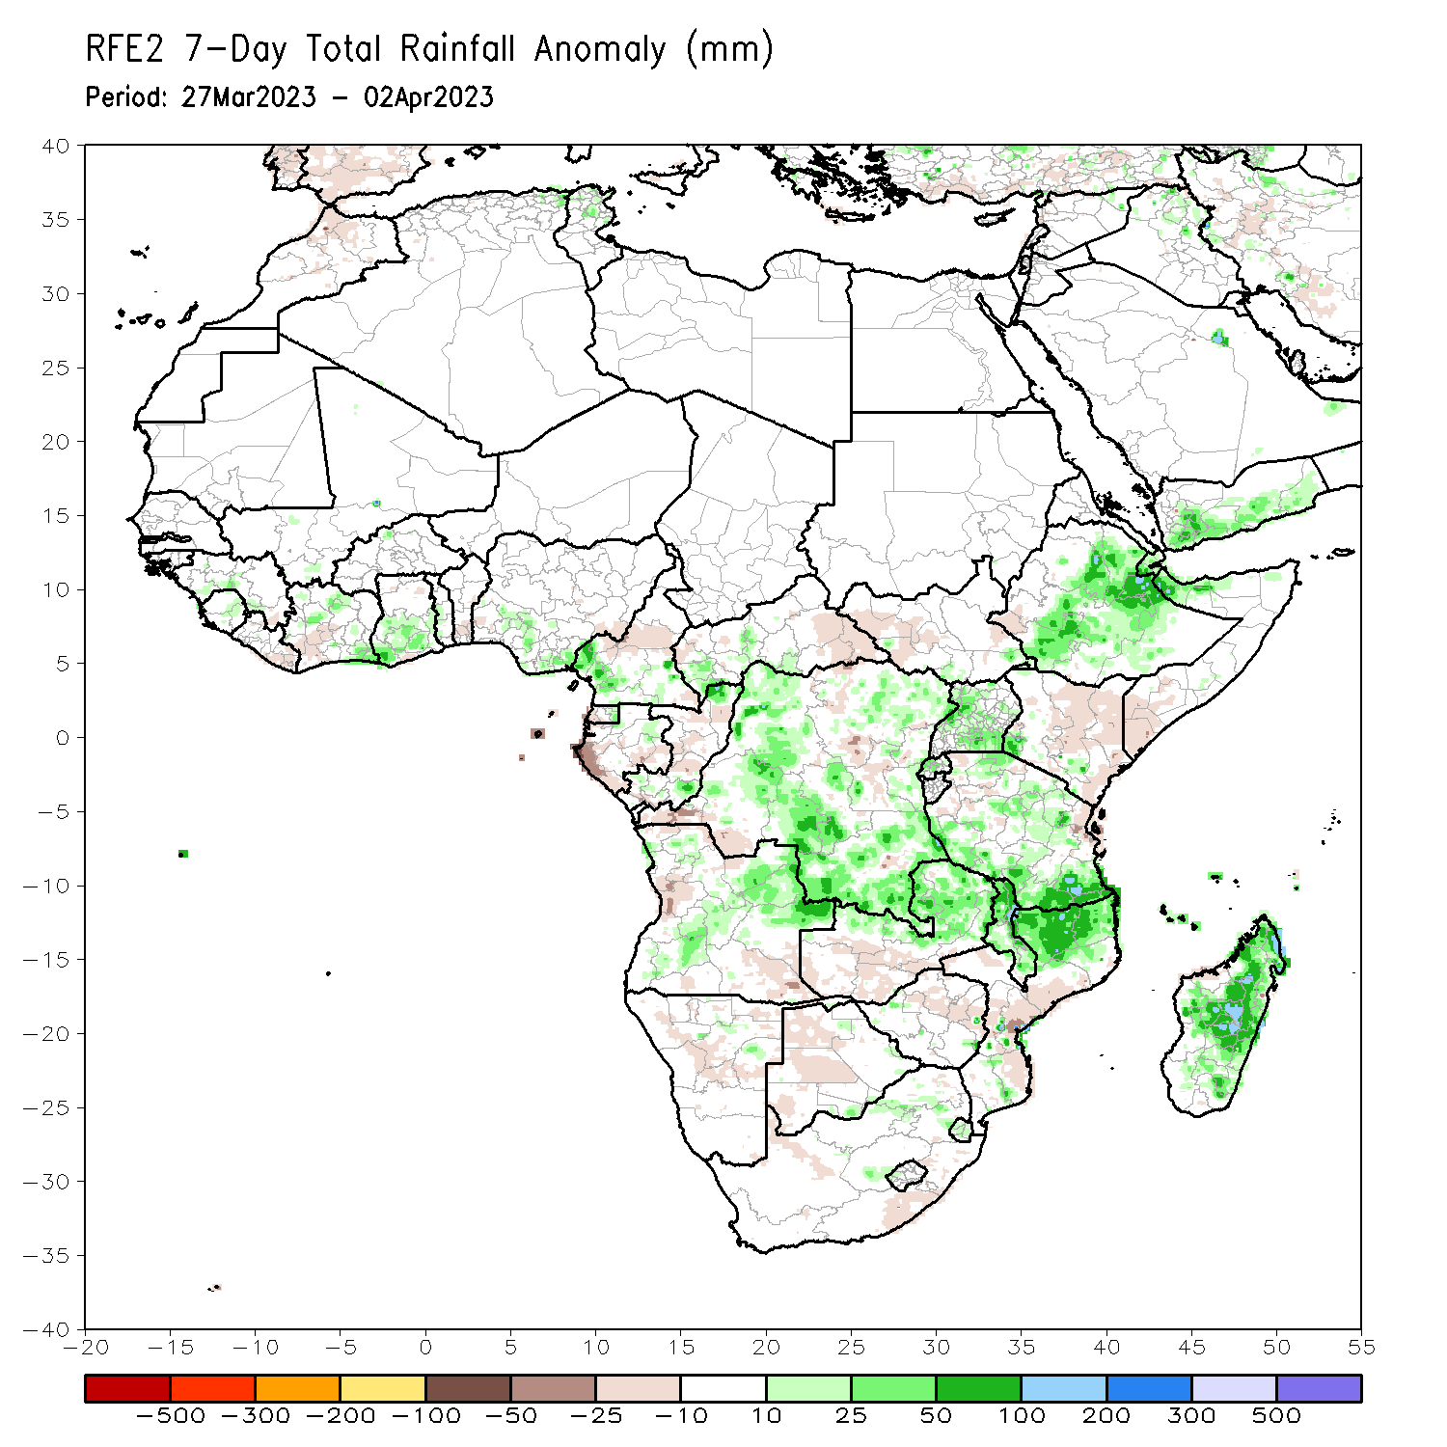
Rainfall Patterns: Last 7 Days
During the past 7 days, in East Africa, rainfall was above-average over southern, central, and eastern Ethiopia, parts of southwestern and northern Somalia, southern Djibouti, eastern Eritrea, central and southern Uganda, Rwanda, Burundi, parts of eastern Kenya, western, central, and southern Tanzania, and parts of southern South Sudan. Below-average rainfall was observed across western and southeastern Kenya, parts of western South Sudan, and parts of southern Somalia. In Central Africa, rainfall was above-average over south-central and southwestern CAR, southern Cameroon, northern and southern Congo, most of DRC, eastern and central Equatorial Guinea, and pockets of northern Gabon. Below-average rainfall was observed across western and southeastern Gabon, parts of northern, central, a small portion of east-central DRC, northwestern and southeastern CAR, and central Cameroon. In West Africa, above-average rainfall was observed over pockets of northern and southeastern Cote d’Ivoire, central and southwestern Ghana, southern Guinea, parts of central Togo, southwestern and southeastern Nigeria, and parts of eastern Sierra Leone. Below average rainfall was observed over eastern Liberia, southwestern Cote d’Ivoire, a small portion of coastal south-central Ghana, and southwestern Nigeria. In southern Africa, rainfall was above-average over northern and pockets of southern Mozambique, most of Malawi, northern and eastern Zambia, northern, central, and southwestern Angola, northeastern Namibia (Caprivi Strip), pockets of eastern Botswana, northeastern South Africa, Eswatini, Comoros, and northern, central, southern, and eastern Madagascar. In contrast, rainfall was below-average over central Mozambique, central Zimbabwe, central and southeastern South Africa, parts of west-central and southeastern Angola, southern Zambia, central and western Botswana, central Namibia, and pockets of coastal northwestern Madagascar.

Slide 7
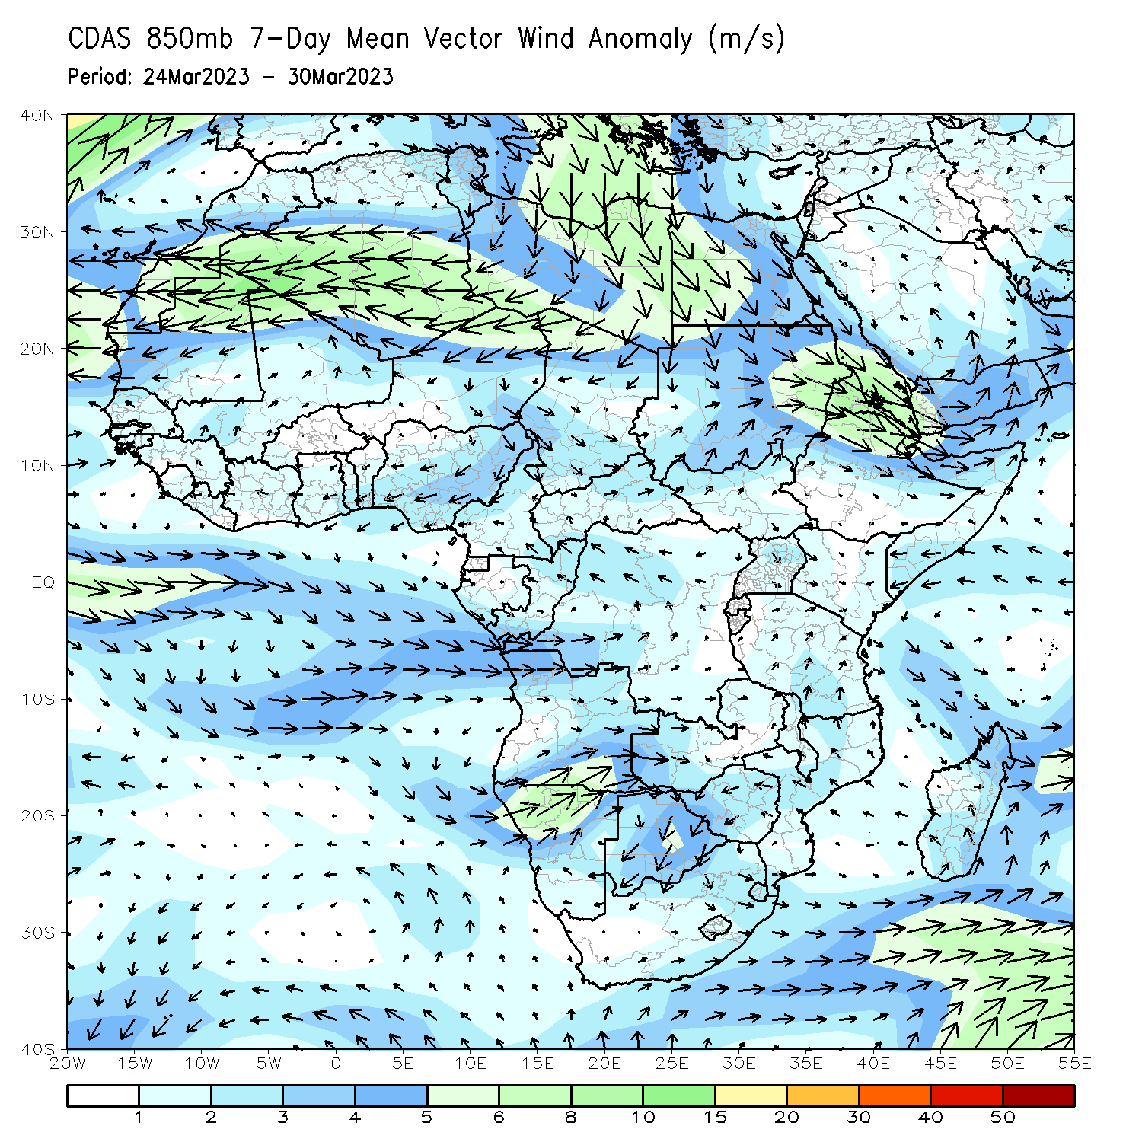
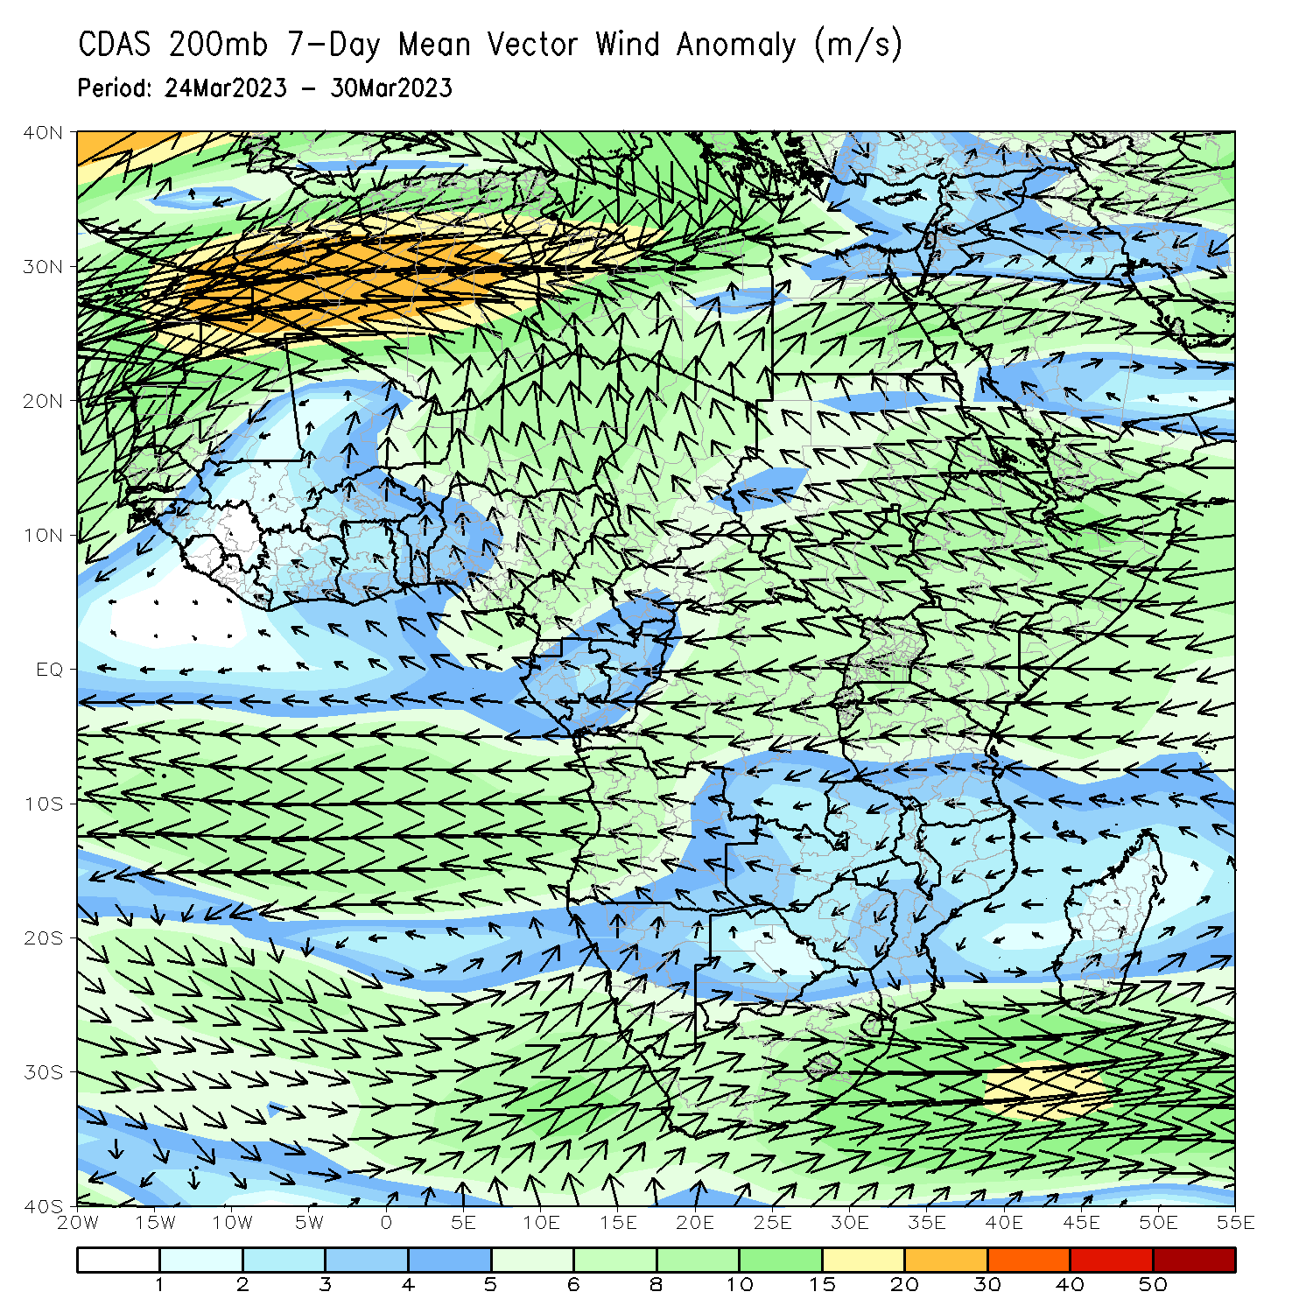
Atmospheric Circulation: Last 7 Days
At 850-hPa level (left panel), anomalous westerly and southerly flow and resulting confluence/convergence was observed from southeastern DRC to eastern Tanzania, contributing to above normal rainfall. Anomalous wind low-level convergence across Ethiopia may have contributed to the observed above-average rainfall across the region. Upper-level divergence was present at 200-hPa (right panel) across these two regions as well.

Slide 8
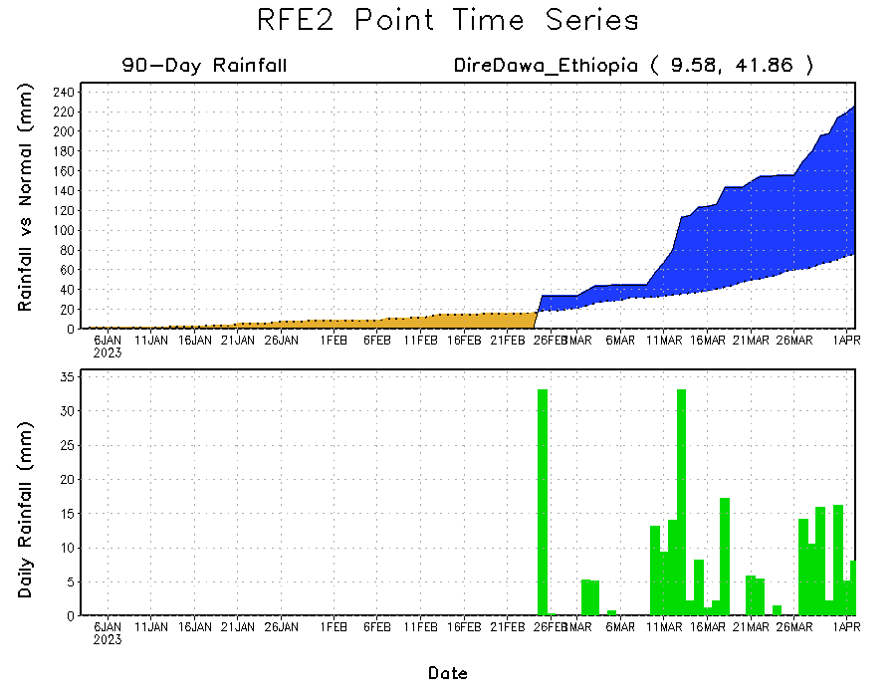
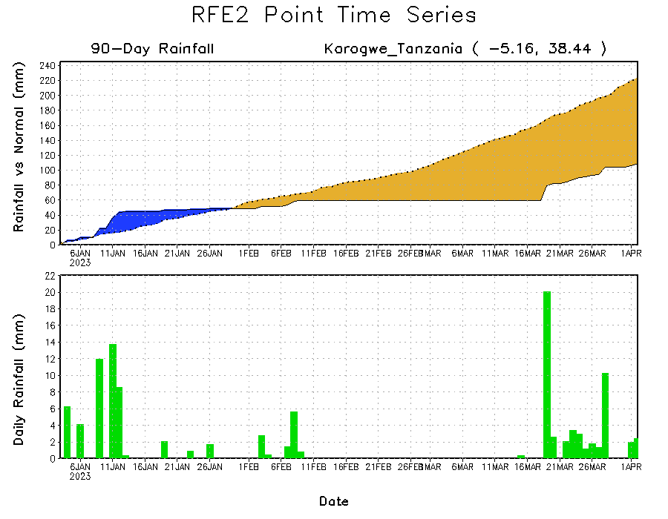
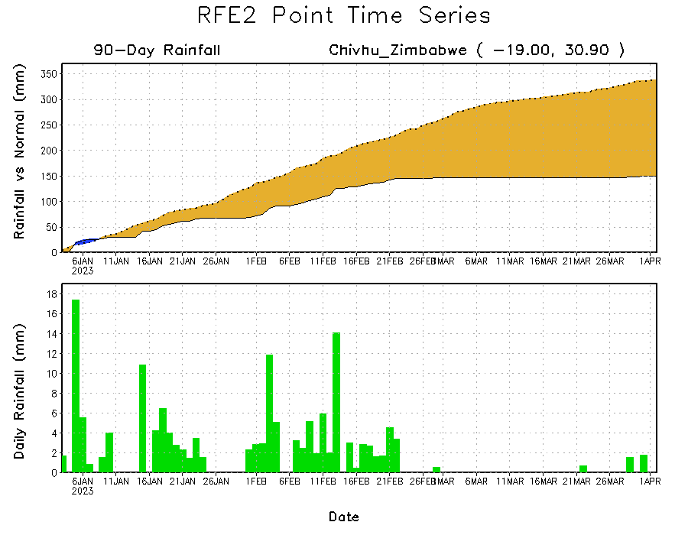
Rainfall Evolution
Daily evolution of rainfall over the last 90 days at selected locations shows worsening moisture deficits over parts of northeastern Tanzania (bottom left) and central Zimbabwe (bottom right). Moderate to locally heavy rainfall also resulted in moisture surpluses over parts of eastern and northeastern Ethiopia (top right).

Slide 9
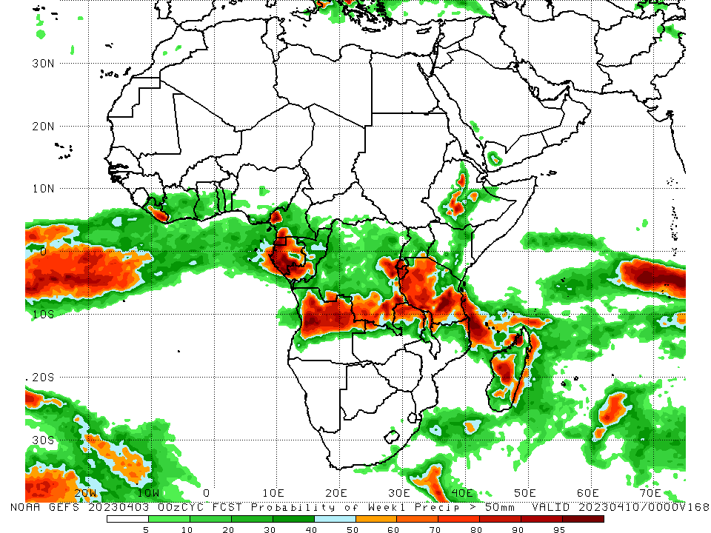
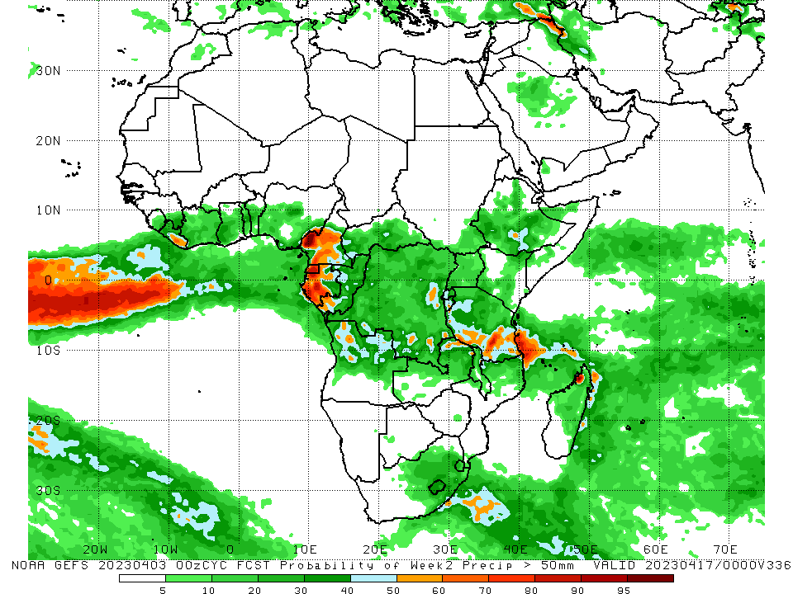
NCEP GEFS Model Forecasts Non-Bias Corrected Probability of precipitation exceedance
Week-1, Valid: 04 – 10 April 2023
Week-2, Valid: 11 – 17 Apr 2023
For week-1 (left panel), the NCEP GEFS forecasts indicate a moderate to high chance (over 70%) for rainfall to exceed 50 mm over central and southern Ethiopia, Equatorial Guinea, much of Gabon, southern Congo, southeastern and east-central DRC, Rwanda, Burundi, southwestern Cameroon, eastern Liberia, Tanzania, central and northern Angola, northern parts of Zambia, Malawi, and Mozambique, and northwestern and central Madagascar. For week-2 (right panel), the NCEP GEFS forecasts indicate a moderate to high chance (over 70%) for rainfall to exceed 50 mm over Equatorial Guinea, western and southern Gabon, pockets of western and central Cameroon, south-central and southeastern Tanzania, and a small area of northwestern Madagascar.
Notes:
‹#›

Slide 10
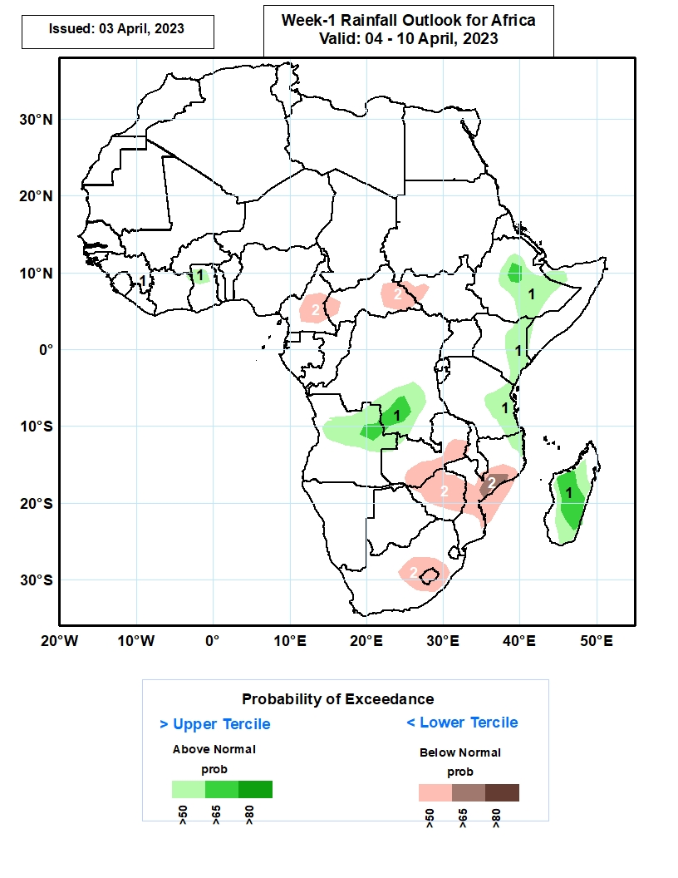
Week-1 Precipitation Outlooks
04 Mar – 10 Apr 2023
The forecasts suggest above 50% chance for weekly rainfall to be above-normal (above the upper tercile) over northern Ghana, central, eastern and southern Ethiopia, eastern Kenya, eastern Tanzania, southern DRC extending into northeastern Angola, and much of Madagascar. In particular, there is enhanced probabilities
exceeding 65% for rainfall to be above-normal over central Ethiopia, few localities in northeastern Angola and bordering DRC, and central portions of
Madagascar.
The consolidated probabilistic forecasts suggest above 50% chance for weekly total rainfall to be below-normal (below the lower tercile) over central Mozambique, Zimbabwe, and south-eastern Zambia, and Lesotho and bordering South Africa. Enhanced probabilities exceeding 65% is indicated for weekly rainfall total to be
below normal over east-central Mozambique.
Notes:
‹#›

Slide 11
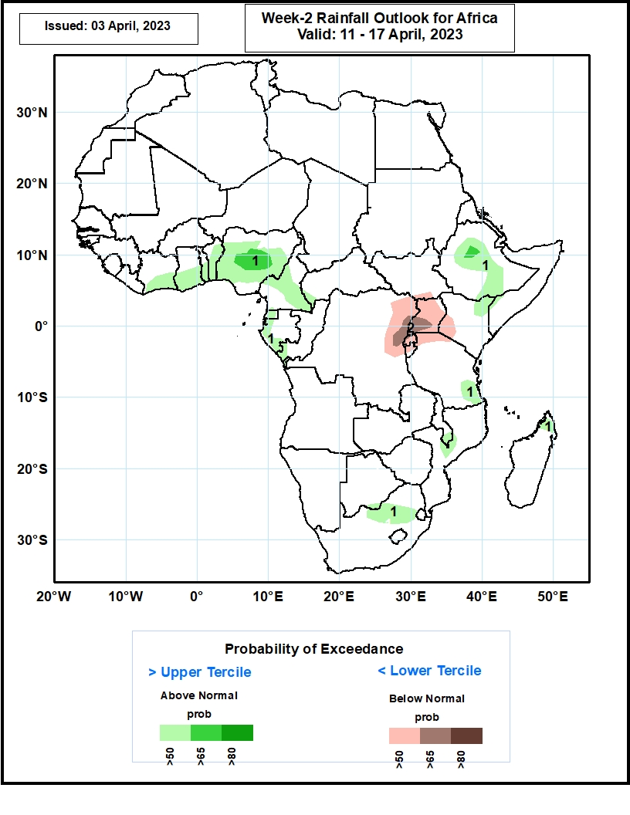
Week-2 Precipitation Outlooks
11 – 17 Apr 2023
The consolidated probabilistic forecasts suggest above 50% chance for weekly total rainfall to be above-normal (above the upper tercile) over southern Cote D’Ivoire, southern Ghana, Southern Togo, Benin, Central Nigeria, parts of Cameroon, Equatorial Guinea costal Gabon, western and southern Ethiopia, southeastern Tanzania, a few locations in central Mozambique and northeastern South Africa, and northern Madagascar. In particular, there is enhanced probabilities of > 65% for rainfall to be above-normal
over central Nigeria and western Ethiopia.
The forecasts indicate above 50% chance for weekly rainfall to be below-normal (below the lower tercile) over Uganda, northeastern DRC, Rwanda and northern Burundi, and Lake Victoria regions. There is enhanced probabilities > 65% for rainfall to be below normal over southwestern Uganda and bordering areas of DRC.
Notes:
‹#›

Slide 12
Summary
Over the past 30 days, in East Africa, above-average rainfall was observed over central, southern, and eastern Ethiopia, much of Somalia, Djibouti, southeastern Eritrea, western, northern and central Kenya, central, western, and southern Tanzania, Rwanda, Burundi, Uganda, southern and western South Sudan, and pockets of northwestern Sudan. Rainfall was below-average over southeastern Kenya, eastern Tanzania, and parts of western Ethiopia. In southern Africa, above-average rainfall was observed over northwest, central, and pockets of southern Mozambique, Malawi, northern Zambia, west-central and northeastern Angola, southern and parts of central South Africa, western Lesotho, and southern, central, and coastal northern Madagascar. Below-average rainfall was observed over much of Namibia, northwestern, southern and east-central Angola, western and southern Zambia, many parts of Zimbabwe and Botswana, northern and eastern South Africa, northern and southern Eswatini, eastern Lesotho, Comoros, and parts of northeastern and northwestern Madagascar. In Central Africa, rainfall was above-average over parts of northern and southern Congo, central and western Cameroon, southern Chad, northern and central CAR, and eastern DRC. Rainfall was below-average over central DRC, Equatorial Guinea, western, central, and northern Gabon, parts of southern Cameroon, and southern CAR. In West Africa, rainfall was above-average over pockets of southeastern Guinea, north-central Liberia, many parts of Cote d’Ivoire, central and southern Ghana, Togo, central Benin, and southern and central Nigeria. Rainfall was below-average in eastern and northern Sierra Leone, central and southern Liberia, northern Ghana, and southern Benin.
During the past 7 days, in East Africa, rainfall was above-average over southern, central, and eastern Ethiopia, parts of southwestern and northern Somalia, southern Djibouti, eastern Eritrea, central and southern Uganda, Rwanda, Burundi, parts of eastern Kenya, western, central, and southern Tanzania, and parts of southern South Sudan. Below-average rainfall was observed across western and southeastern Kenya, parts of western South Sudan, and parts of southern Somalia. In Central Africa, rainfall was above-average over south-central and southwestern CAR, southern Cameroon, northern and southern Congo, most of DRC, eastern and central Equatorial Guinea, and pockets of northern Gabon. Below-average rainfall was observed across western and southeastern Gabon, parts of northern, central, a small portion of east-central DRC, northwestern and southeastern CAR, and central Cameroon. In West Africa, above-average rainfall was observed over pockets of northern and southeastern Cote d’Ivoire, central and southwestern Ghana, southern Guinea, parts of central Togo, southwestern and southeastern Nigeria, and parts of eastern Sierra Leone. Below average rainfall was observed over eastern Liberia, southwestern Cote d’Ivoire, a small portion of coastal south-central Ghana, and southwestern Nigeria. In southern Africa, rainfall was above-average over northern and pockets of southern Mozambique, most of Malawi, northern and eastern Zambia, northern, central, and southwestern Angola, northeastern Namibia (Caprivi Strip), pockets of eastern Botswana, northeastern South Africa, Eswatini, Comoros, and northern, central, southern, and eastern Madagascar. In contrast, rainfall was below-average over central Mozambique, central Zimbabwe, central and southeastern South Africa, parts of west-central and southeastern Angola, southern Zambia, central and western Botswana, central Namibia, and pockets of coastal northwestern Madagascar.
The Week-1 outlook calls for an increased chance for above-average rainfall over central and northeastern Ethiopia, northwestern Somalia, eastern Kenya, southern Burundi, most of Tanzania, Equatorial Guinea, Gabon, Congo, Liberia, central and southern Cote d’Ivoire, central and southern Ghana, southern Cameroon, southern and most of western DRC, northern parts of Zambia, northern Mozambique, northern and central Angola, Comoros, and Madagascar. In contrast, there is an increased chance for below-average rainfall over parts of central Sierra Leone, central and southern Nigeria, east-central Cameroon, southeastern CAR, southern South Sudan, western and southern Ethiopia, southwestern Somalia, western and southern Zambia, southern Angola, most of Namibia, Botswana, Zimbabwe, southern Malawi, central and western Mozambique, Uganda, southwestern Kenya, parts of northern Tanzania, and much of northern and central South Africa. The Week-2 outlook suggests an increased chance for above-average rainfall over central, northern, and southeastern Ethiopia, eastern South Sudan, Equatorial Guinea, western Gabon, southwestern parts of Congo, central and southern Cameroon, southern Tanzania, eastern Zambia, northern Angola, northern Madagascar, eastern South Africa, Lesotho, Eswatini, northern Malawi, and most of the Gulf of Guinea region. Below-average rainfall is likely over much of central Africa (especially eastern DRC, Uganda, Rwanda, Burundi, northern Tanzania, and southern Kenya), as well as southwestern Angola, east-central Mozambique, and southeastern Madagascar.

