Slide 1
The African Monsoon Recent Evolution and Current Status Include Week-1 and Week-2 Outlooks
Update prepared
01 May 2023
For more information, visit:
http://www.cpc.ncep.noaa.gov/products/Global_Monsoons/African_Monsoons/precip_monitoring.shtml

Slide 2
Outline
Highlights
Recent Evolution and Current Conditions
NCEP GEFS Forecasts
Summary

Slide 3
Highlights: Last 7 Days
During the past 7 days, in East Africa, rainfall was above-average over much of South Sudan, Ethiopia, Uganda, Kenya, and parts of southern Sudan and southern Somalia. Below-average rainfall was observed over pockets of southeastern Ethiopia central Somalia. In Central Africa, rainfall was above-average over central CAR, and many parts of DRC. Below-average rainfall was observed over much of Cameroon, Equatorial Guinea, Gabon, central Congo, eastern CAR, and pockets of northern DRC. In West Africa, above-average rainfall was observed over eastern Liberia, eastern Cote d’Ivoire, southern Ghana, Togo, Benin, and southern Nigeria. Below average rainfall was observed over western Cote d’Ivoire.
The Week-1 outlook calls for above-normal rainfall over much of Sierra Leone, and the neighboring areas of Guinea, southern Congo, southern and eastern DRC, much of Uganda, southeastern South Sudan, northwestern Kenya, and central, southern and eastern Ethiopia. In contrast, there is an increased chance for below-normal rainfall over southern and eastern Cote d’Ivoire, parts of CAR, the western, central and northern portions of South Sudan and western Ethiopia, The Week-2 outlook suggests below-normal rainfall over pockets of CAR, northeastern DRC, south Sudan and southeastern Sudan. There is also an increased chance for below-normal rainfall over southeastern Ethiopia, central Somalia, and coastal Kenya and Tanzania.

Slide 4
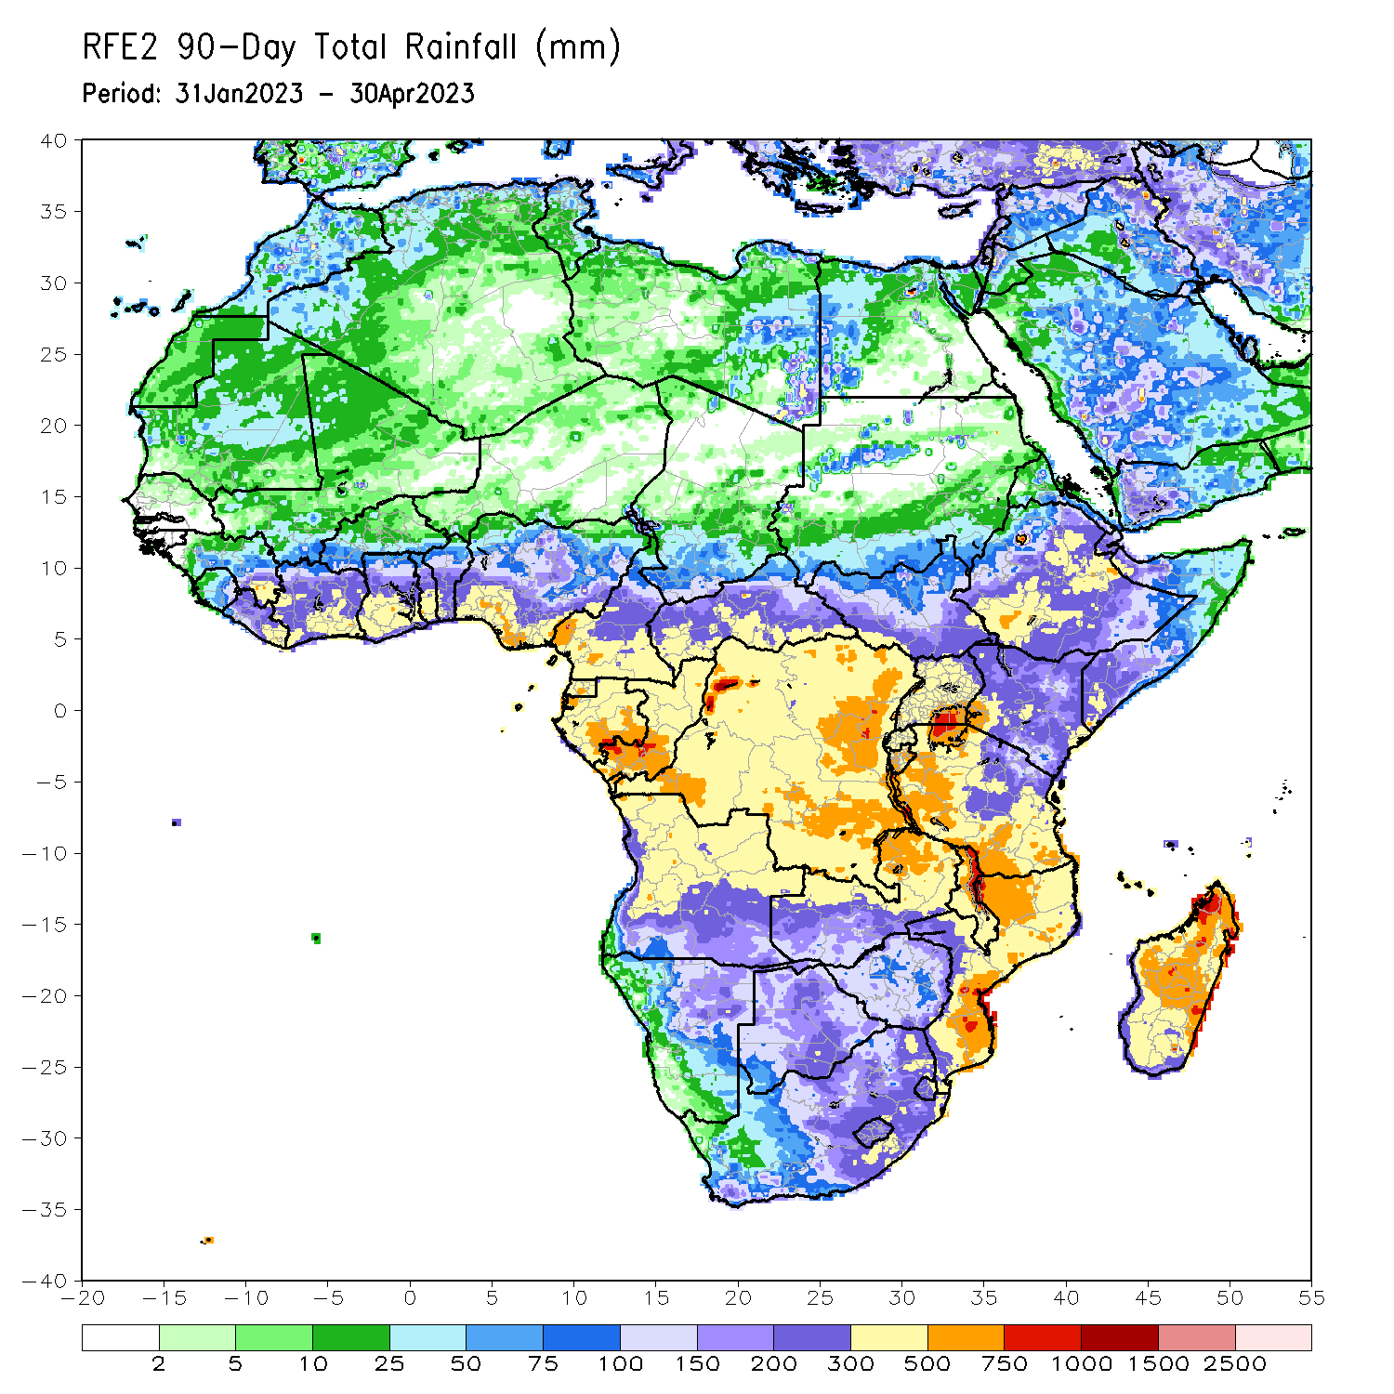
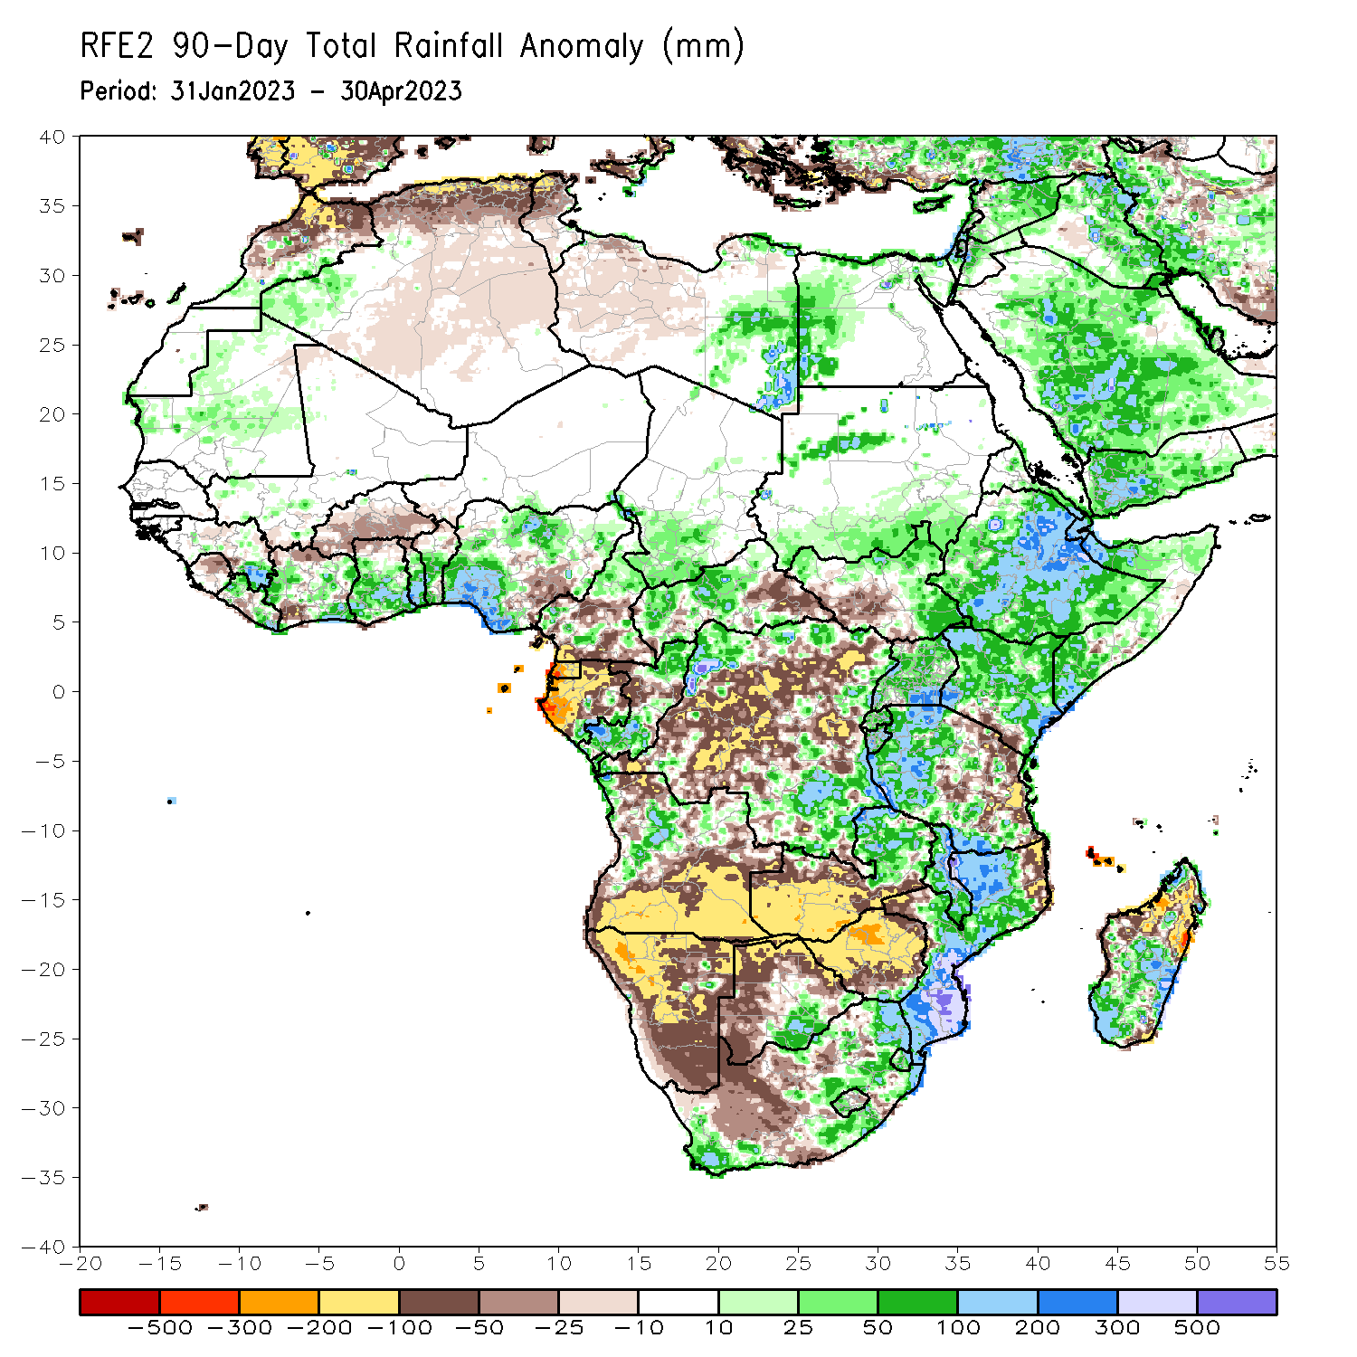
Rainfall Patterns: Last 90 Days
Over the past 90 days, in East Africa, above-average rainfall was observed over much Ethiopia, many parts of Somalia, Djibouti, parts of Eritrea, Kenya, Uganda, western Tanzania, Burundi, Rwanda, and northern southeastern South Sudan. Rainfall was below-average over southwestern South Sudan and eastern Tanzania. In southern Africa, above-average rainfall was observed over parts of northern Angola, eastern Zambia, southern Botswana, eastern South Africa, Lesotho, Eswatini, much of Mozambique and southern Madagascar. Below-average rainfall was observed over southern Angola, western Zambia, much of Namibia, western and northern Botswana, western South Africa, Zimbabwe, pockets of northeastern Mozambique and northern Madagascar. In Central Africa, rainfall was above-average over many parts of Cameroon and CAR, Congo, and the far northern and southern DRC. In West Africa, rainfall was above-average near Liberia/Guinea border, and over parts of Cote d’Ivoire, Ghana, Togo, Benin and many parts of Nigeria. Below-average rainfall was observed over parts of Sierra Leone and Cote d’Ivoire, Burkina Faso and eastern Nigeria.
Notes:
4

Slide 5
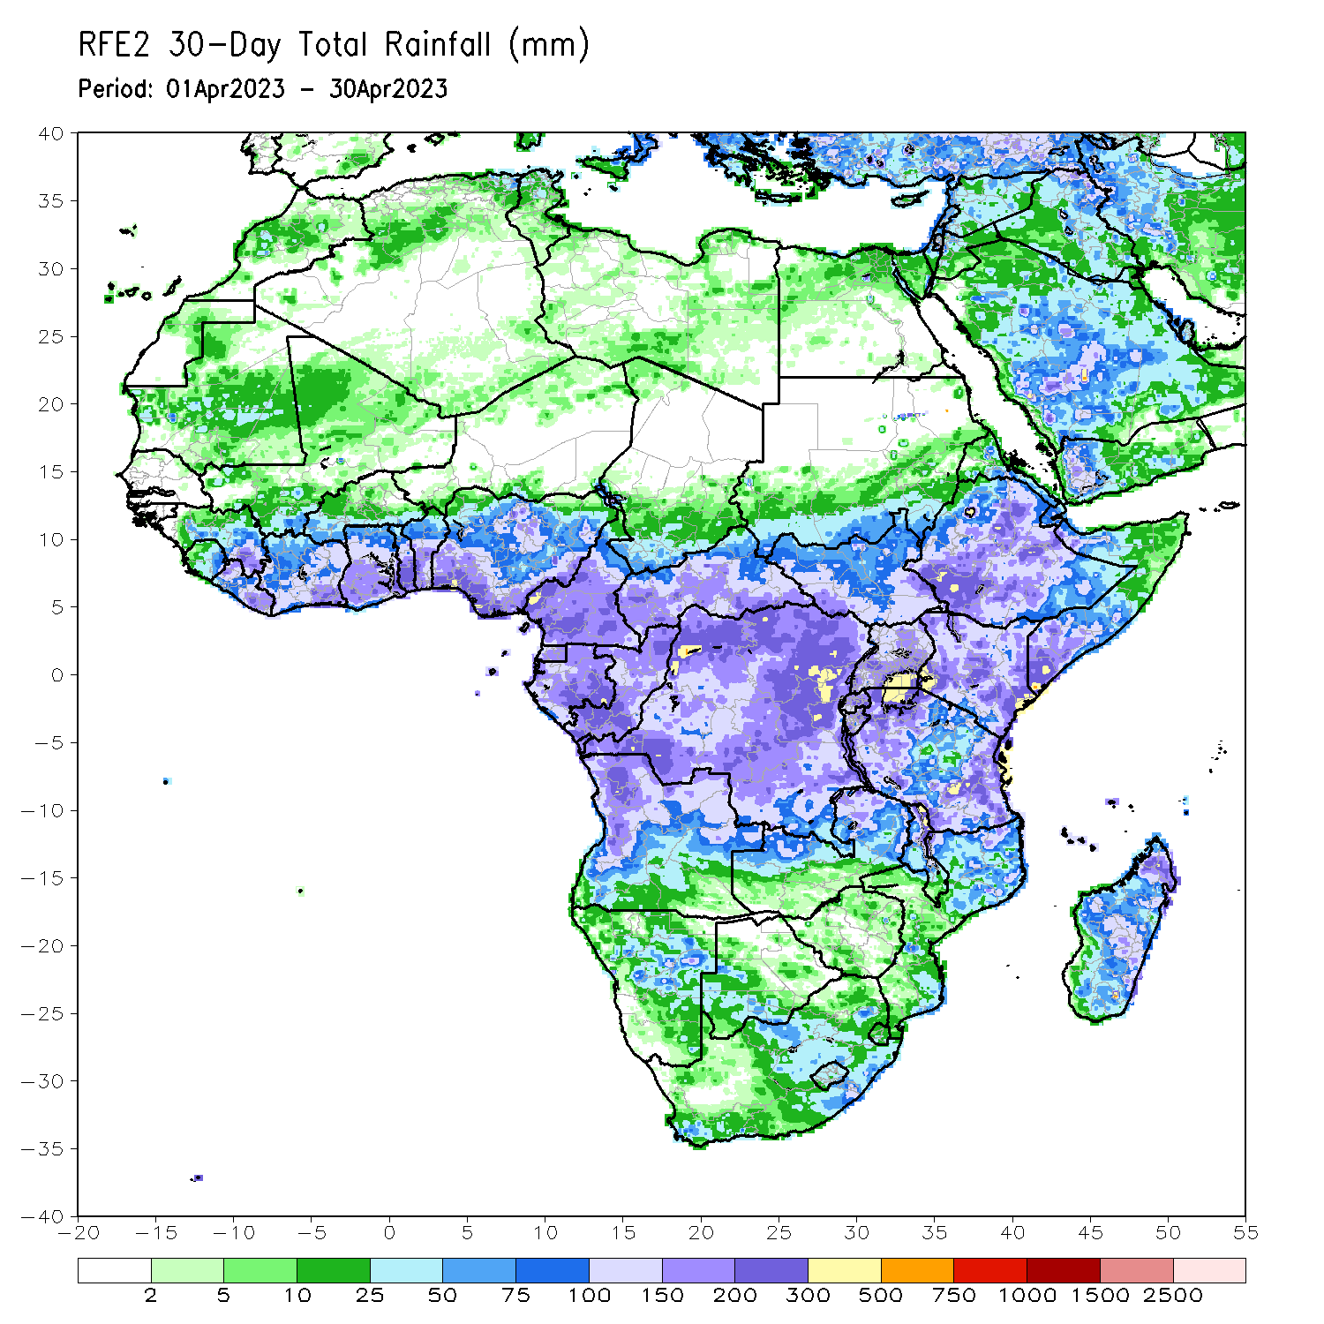
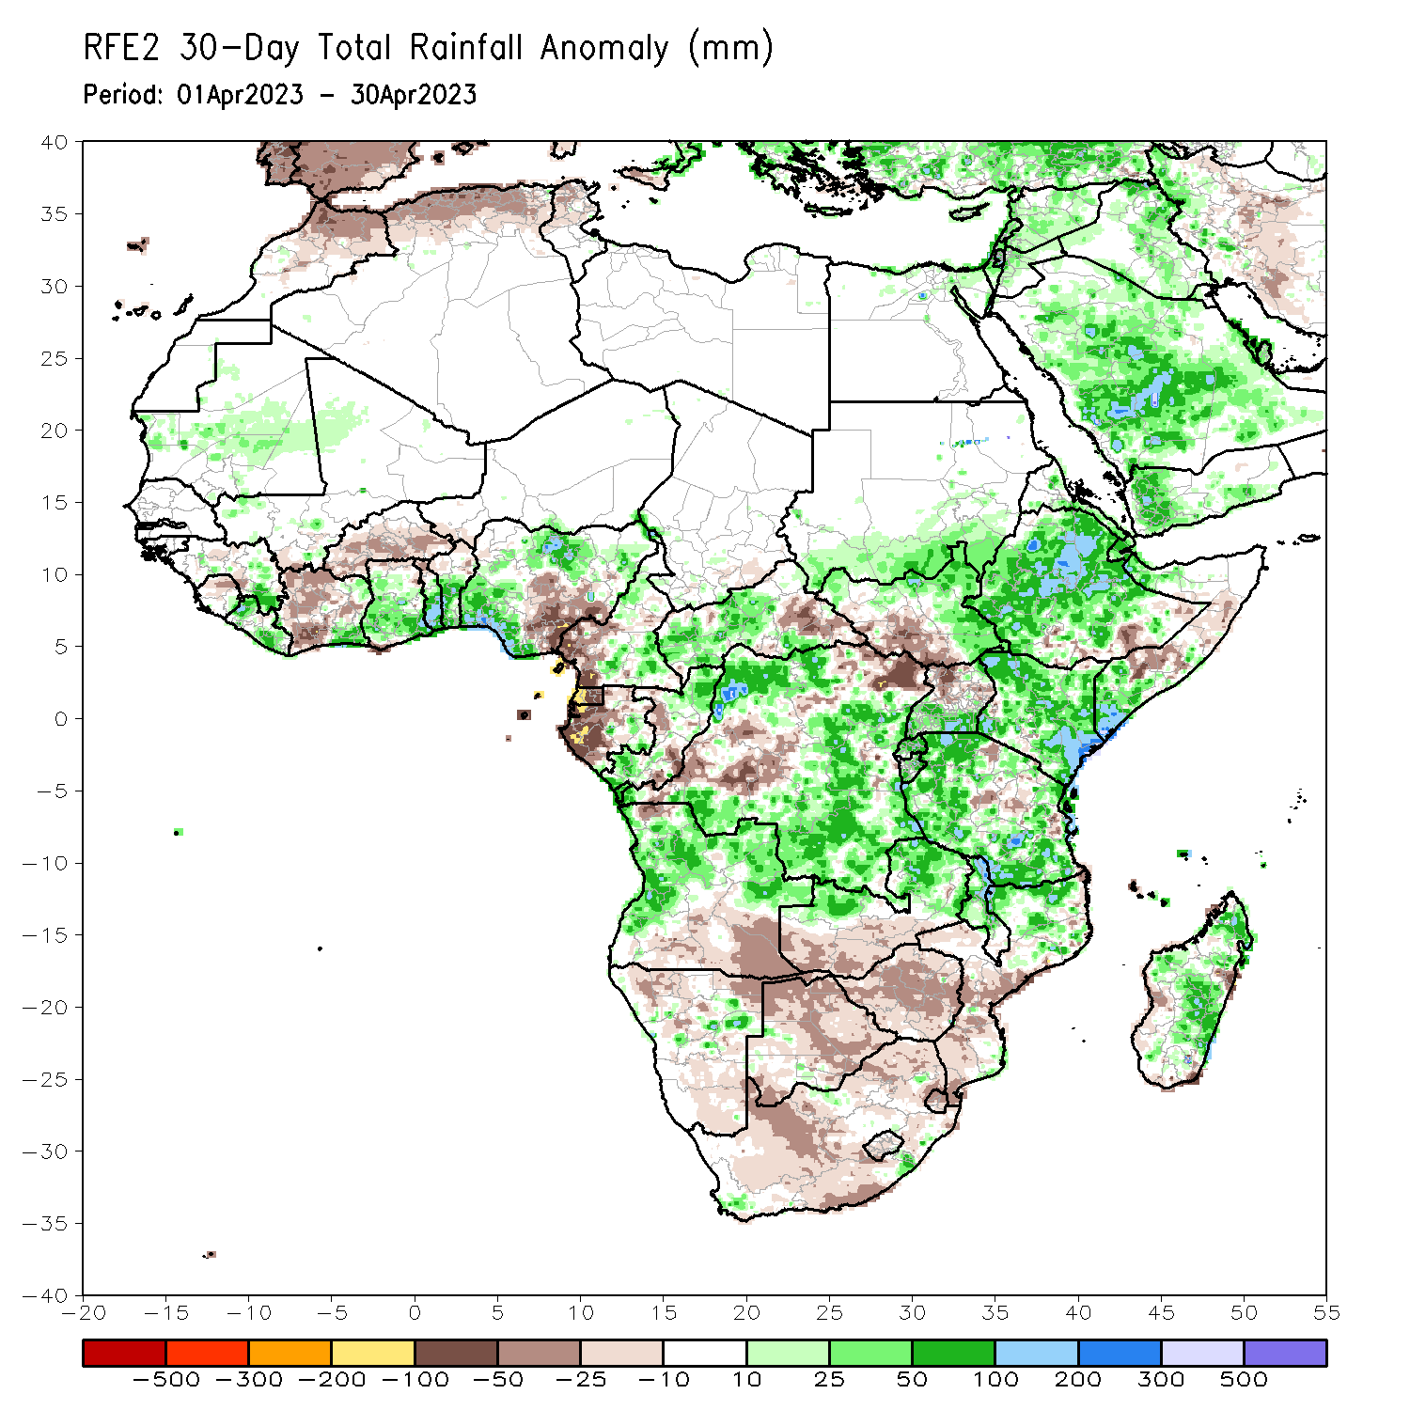
Rainfall Patterns: Last 30 Days
Over the past 30 days, in East Africa, above-average rainfall was observed over much Ethiopia, southern Somalia, Djibouti, eastern Eritrea, Kenya, southern Uganda, many parts Tanzania, Burundi, Rwanda, and northern and eastern South Sudan. Rainfall was below-average over the southern portion of South Sudan, southeastern Ethiopia, central Somalia and parts of central Tanzania. In southern Africa, above-average rainfall was observed over parts of western and northern Angola, northern and eastern Zambia, and northern Mozambique and Madagascar. Below-average rainfall was observed over southern Angola, southern Zambia, much of Namibia, Botswana, Zimbabwe, South Africa, Lesotho, Eswatini, and central and southern Mozambique. In Central Africa, rainfall was above-average over pockets of Cameroon, western CAR, southern and northern Congo, and many parts of DRC. Below-average rainfall was observed over western Cameroon, western Gabon, parts of western DRC, and eastern CAR. In West Africa, rainfall was above-average near Liberia/Guinea border, over southeastern Cote d’Ivoire, Ghana, Togo, Benin and western and northern Nigeria. Below-average rainfall was observed over parts of much of Cote d’Ivoire, Burkina Faso and southeastern Nigeria.
Notes:
5

Slide 6
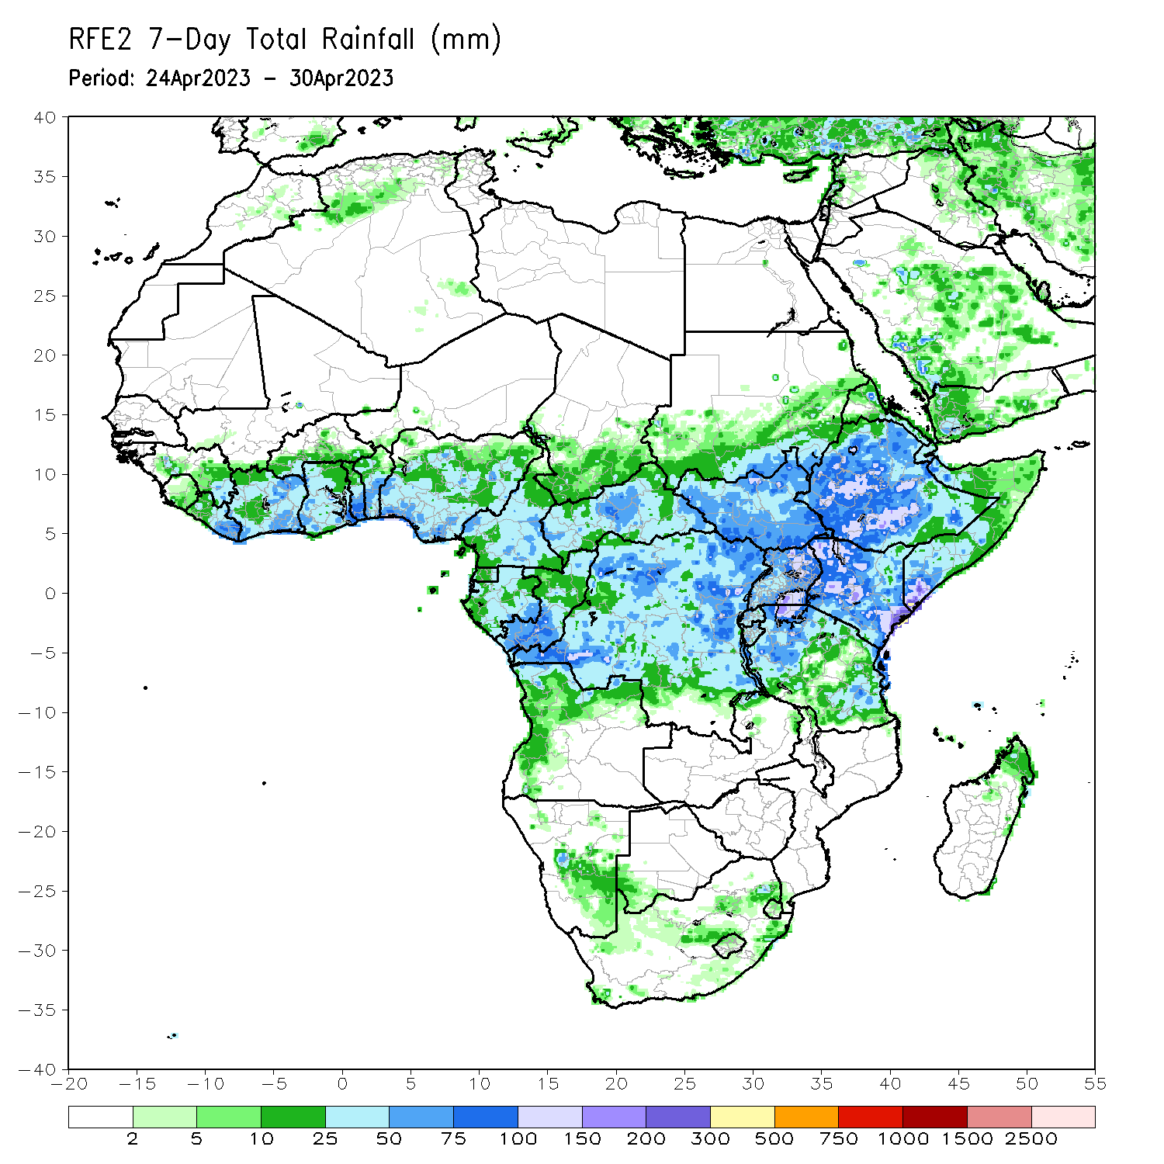
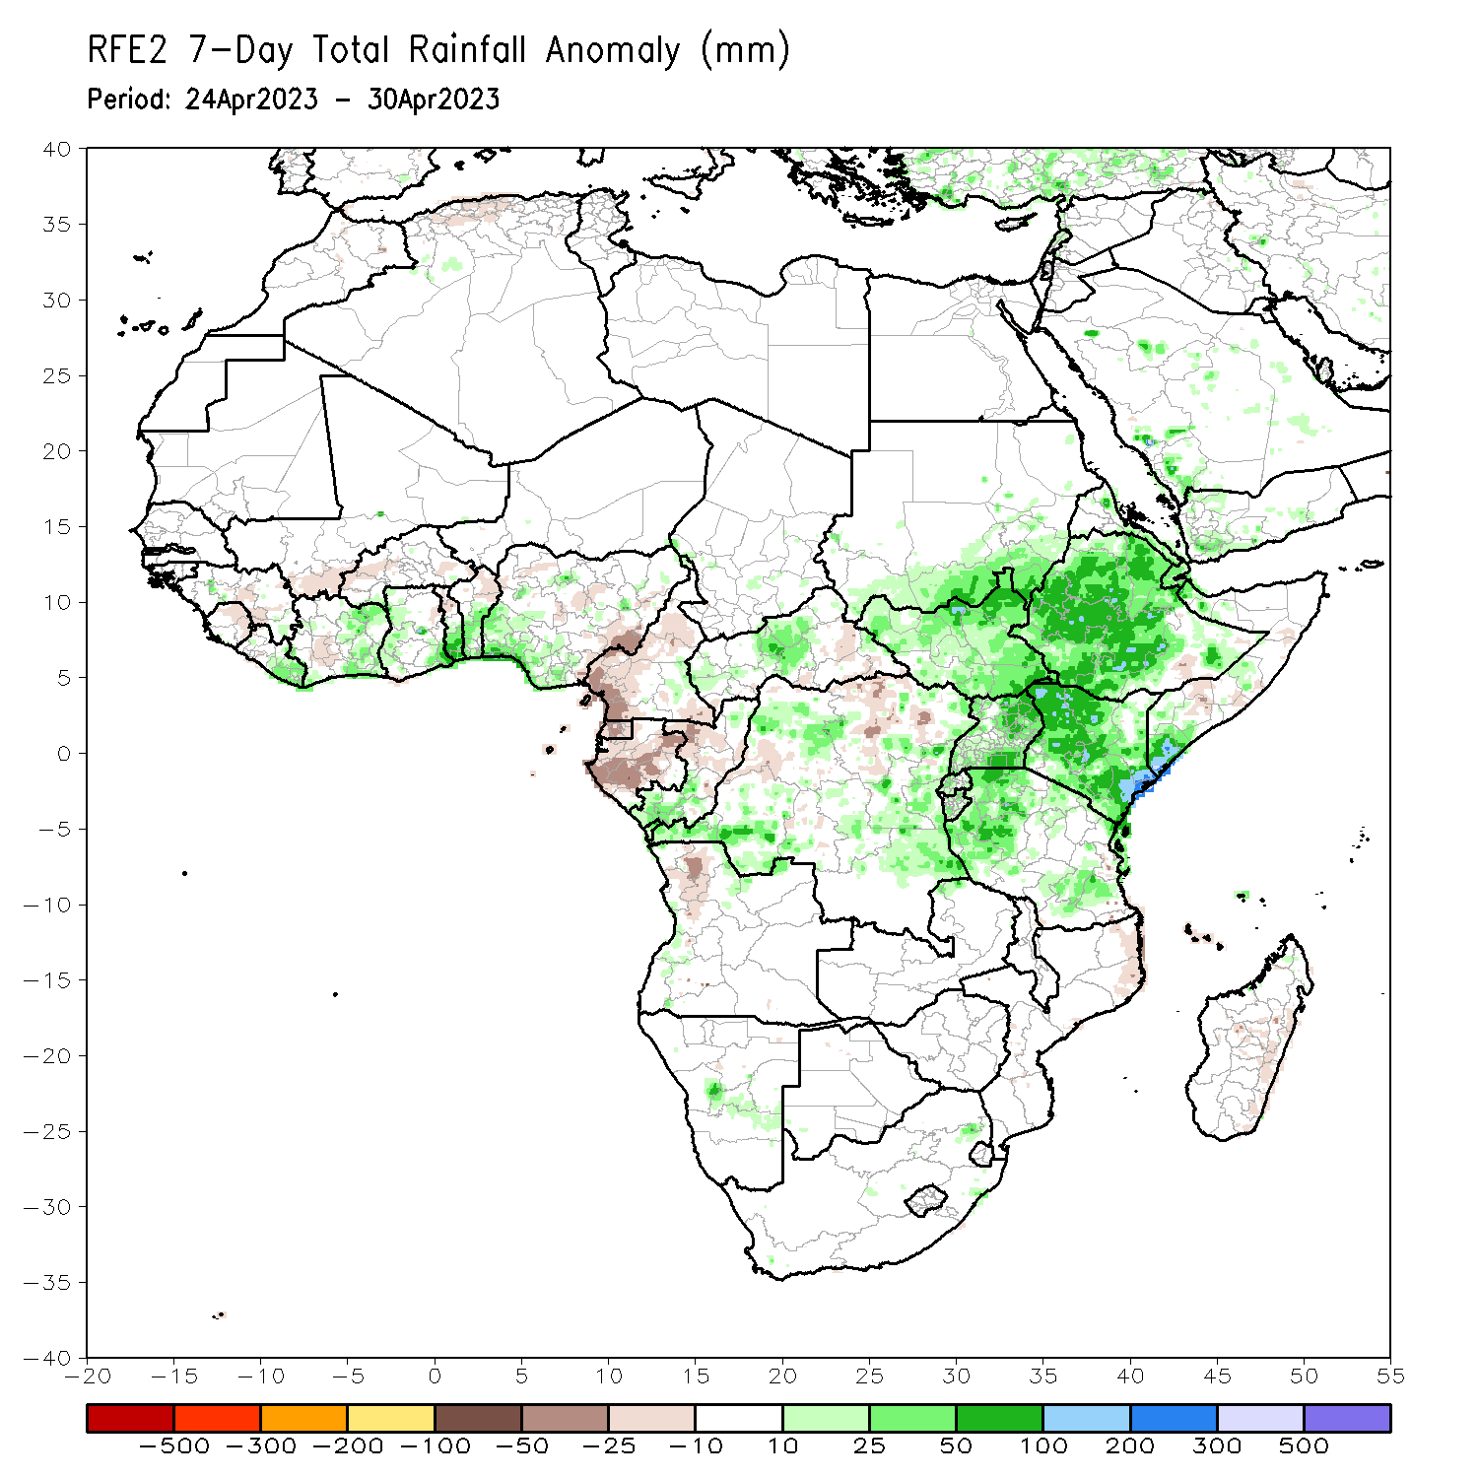
Rainfall Patterns: Last 7 Days
During the past 7 days, in East Africa, rainfall was above-average over much of South Sudan, Ethiopia, Uganda, Kenya, and parts of southern Sudan and southern Somalia. Below-average rainfall was observed over pockets of southeastern Ethiopia central Somalia. In Central Africa, rainfall was above-average over central CAR, and many parts of DRC. Below-average rainfall was observed over much of Cameroon, Equatorial Guinea, Gabon, central Congo, eastern CAR, and pockets of northern DRC. In West Africa, above-average rainfall was observed over eastern Liberia, eastern Cote d’Ivoire, southern Ghana, Togo, Benin, and southern Nigeria. Below average rainfall was observed over western Cote d’Ivoire.

Slide 7
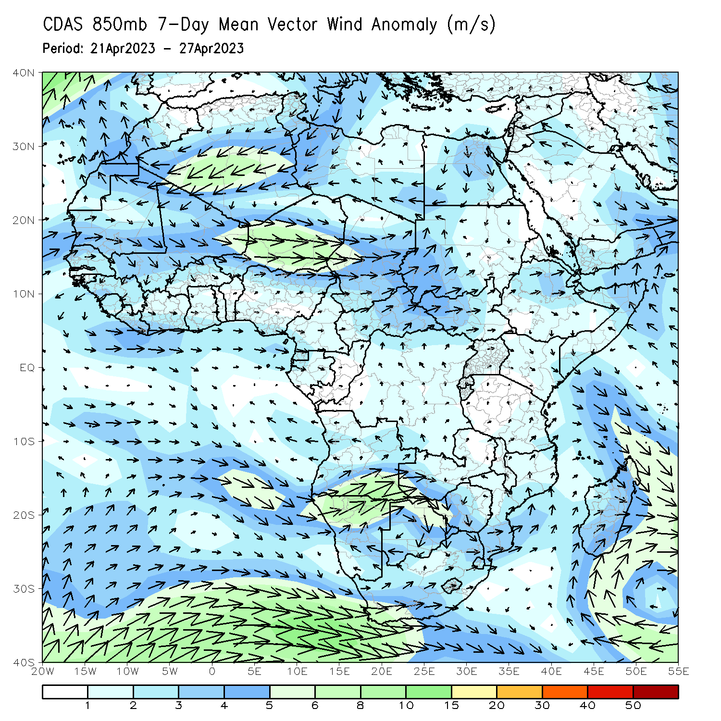
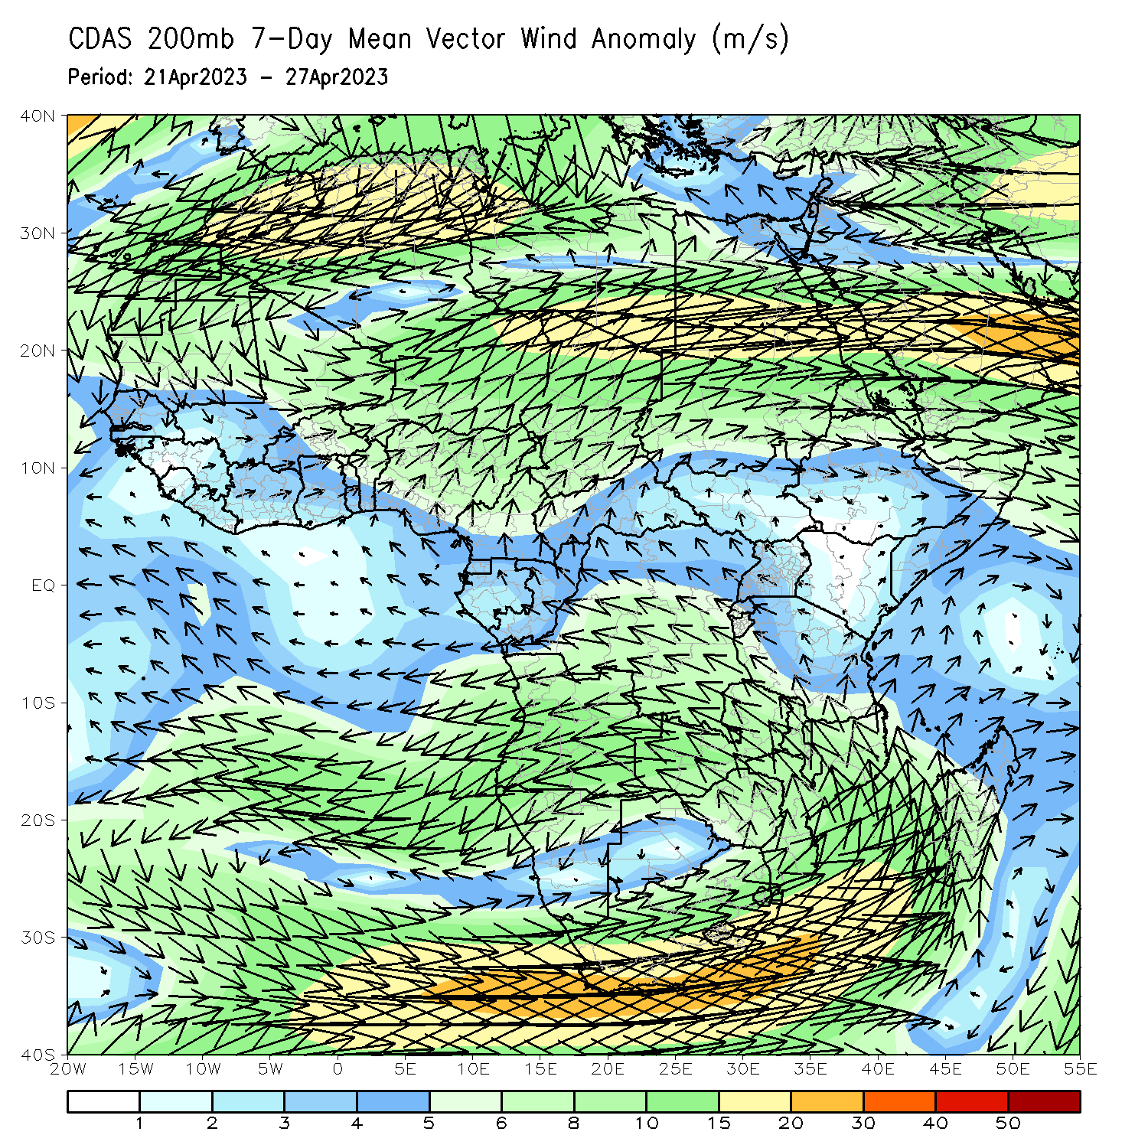
Atmospheric Circulation: Last 7 Days
At 850-hPa level (left panel), An area of anomalous westerly flow with its associated lower-level wind convergence may have contributed to the observed above-average rainfall in the Greater Horn of Africa.

Slide 8
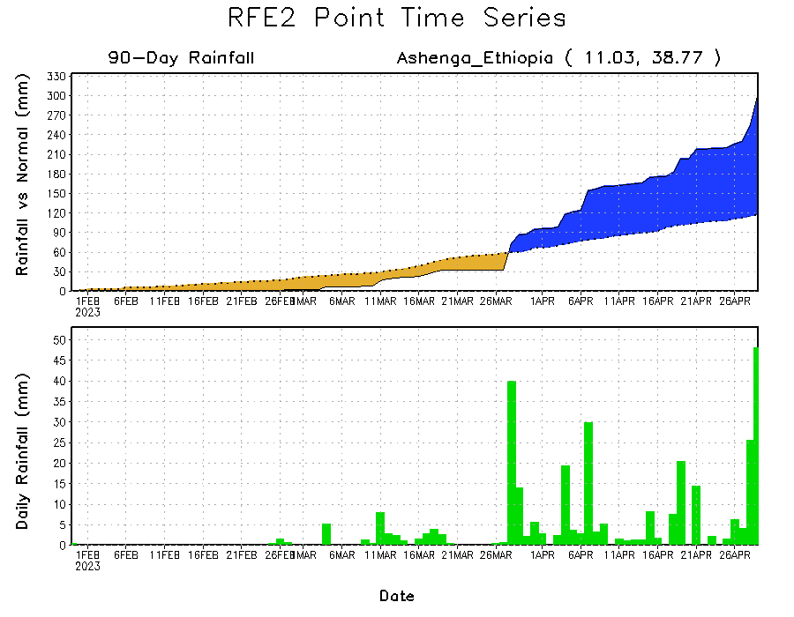
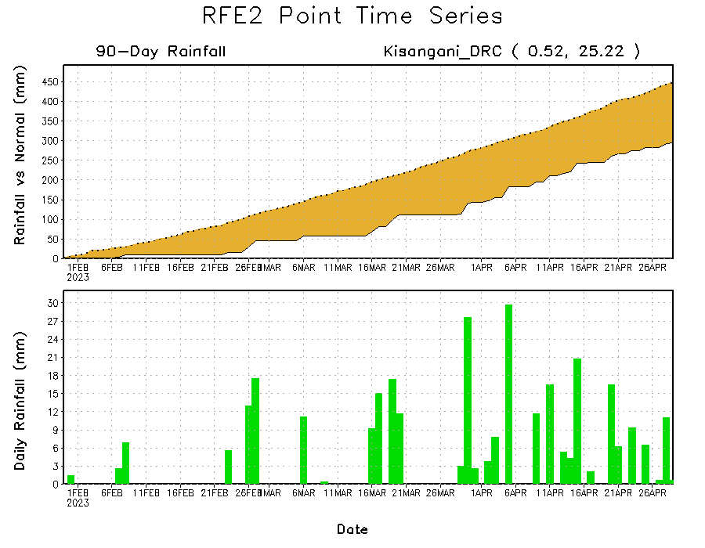
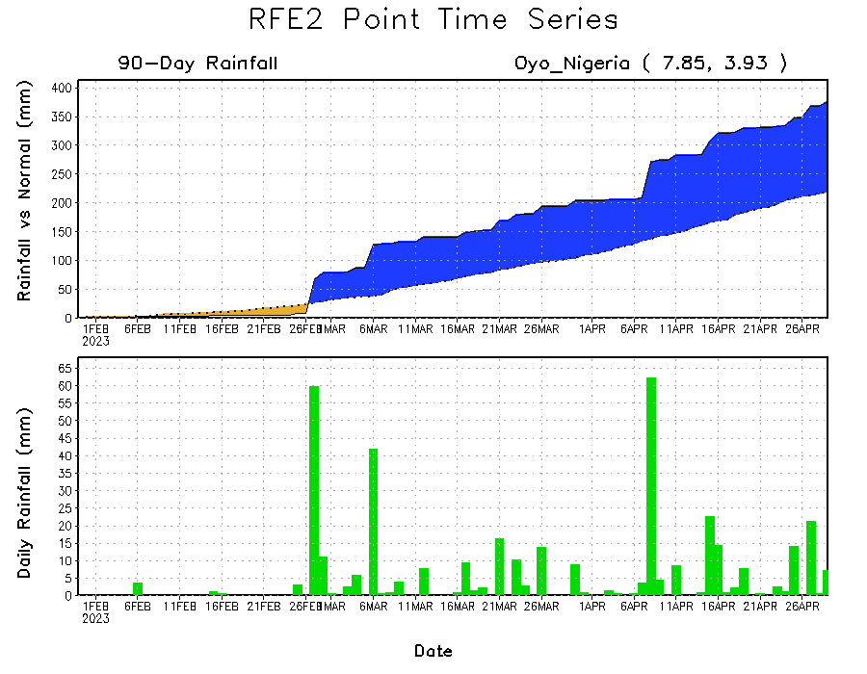
Rainfall Evolution
Daily evolution of rainfall over the last 90 days at selected locations shows that moderate to heavy rains sustained rainfall surpluses over parts of southern Nigeria (bottom left) and Ethiopia (top right). The seasonal total rainfall remained below-average over parts of central DRC (bottom right).

Slide 9
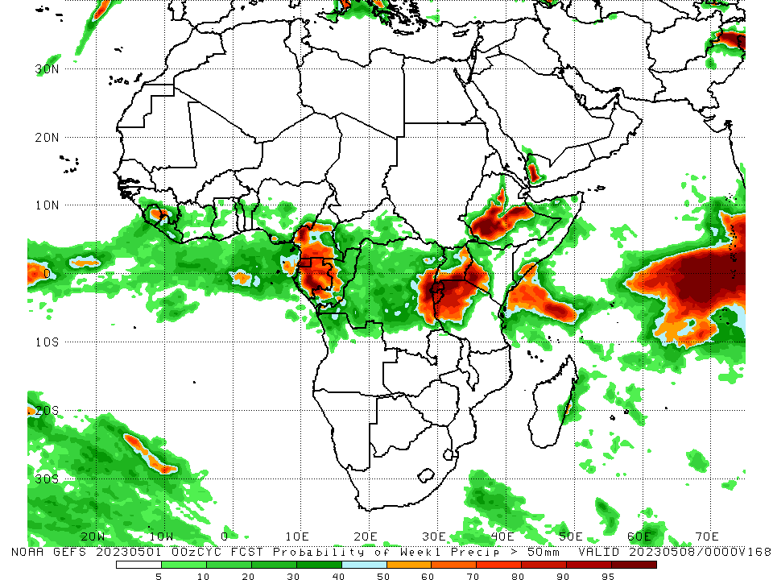
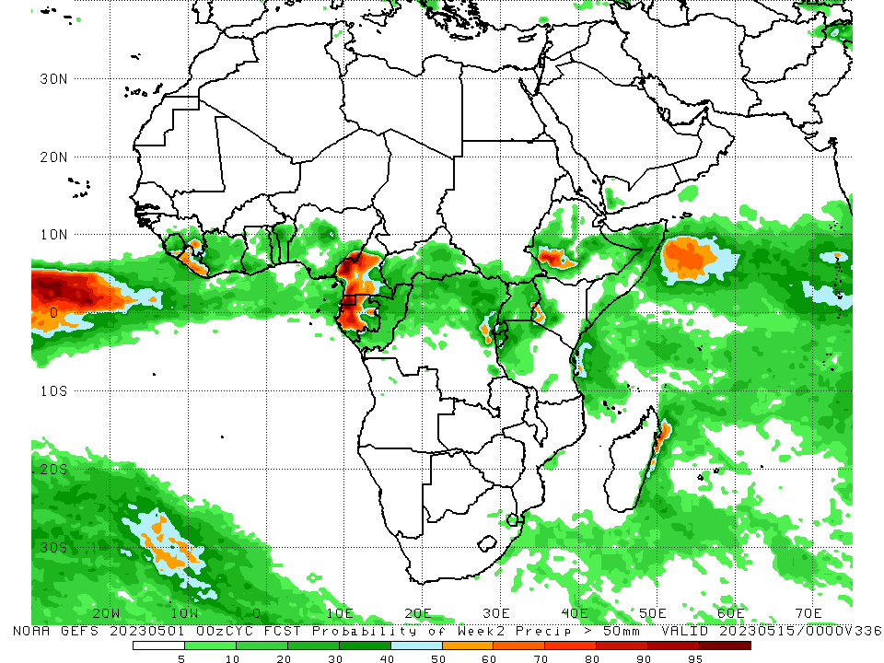
NCEP GEFS Model Forecasts Non-Bias Corrected Probability of precipitation exceedance
Week-1, Valid: 02 – 08 May 2023
Week-2, Valid: 09 – 15 May 2023
For week-1 (left panel), the GEFS forecasts indicate a moderate to high chance (over 70%) for rainfall to exceed 50 mm over much of Sierra Leone, parts of Cameroon, Equatorial Guinea, western Gabon, eastern DRC, Rwanda, Burundi, western Tanzania, southwestern Kenya, and portions of Ethiopia (left panel). For week-2, there is a moderate to high chance for weekly rainfall to exceed 50mm over Sierra Leone, parts of Cameroon, Equatorial Guinea, western Gabon, and southwestern Ethiopia. (right panel)
Notes:
9

Slide 10
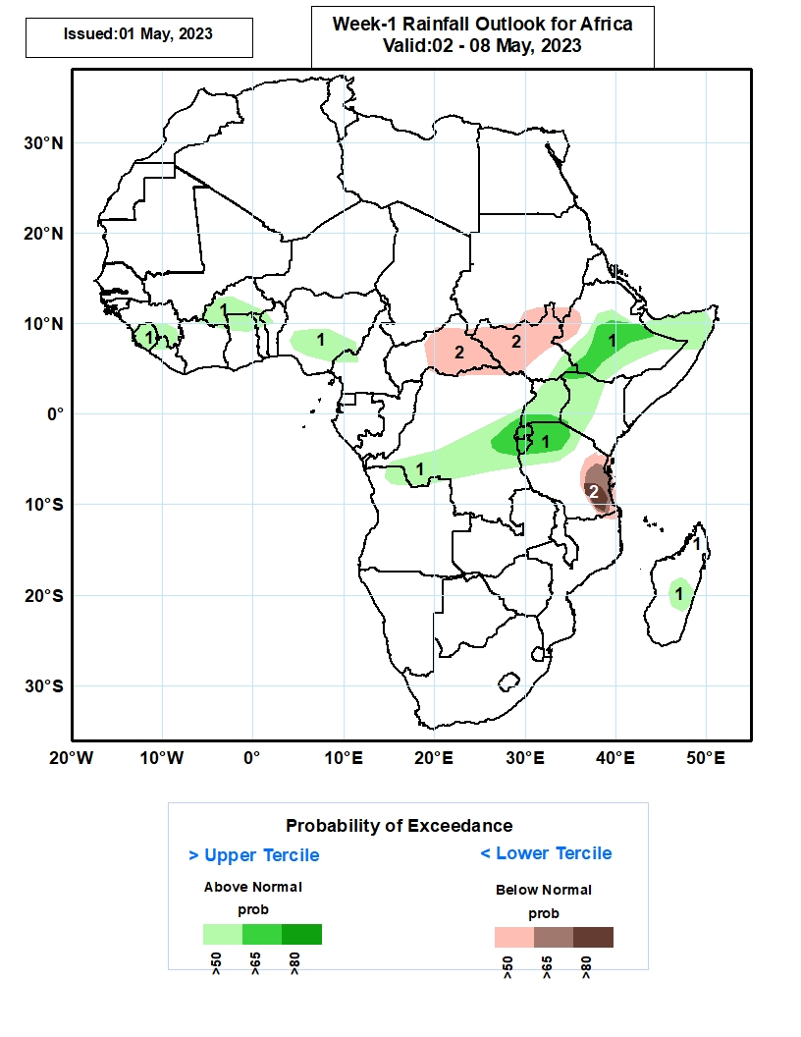
Week-1 Precipitation Outlooks
02 – 08 May 2023
The consolidated probabilistic forecasts call for above 50% chance for weekly rainfall to be below-normal (below the lower tercile) over southern Nigeria, central CAR, northeastern South Sudan, western Ethiopia, southeastern Ethiopia, parts of central Somalia and coastal Tanzania.
The forecasts call for above 50% chance for weekly total rainfall to be above-normal (above the upper tercile) over pockets of DRC and Somalia.
Notes:
10

Slide 11
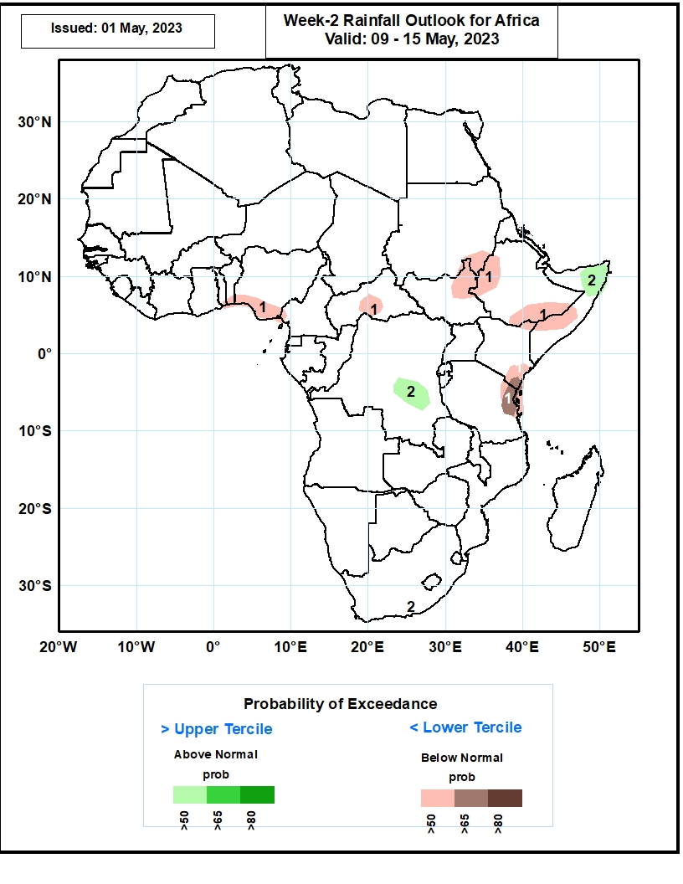
Week-2 Precipitation Outlooks
09 – 15 May 2023
The consolidated probabilistic forecasts indicate a continuation of increased rainfall activity from central to eastern Africa. Accordingly, the forecasts suggest above 50% chance for weekly total rainfall to be wetter than normal (above the upper tercile) from Congo Brazzaville through DRC, Burundi, Rwanda, Uganda, south Sudan, Ethiopia, and northern Somalia. In particular, the forecasts suggest enhanced probability exceeding 80% for rainfall to be above normal across central DRC, and western Uganda. Enhanced chance of rainfall (>60%) also expected across southern parts of South Sudan extending to Ethiopia.
The consolidated probabilistic forecasts suggest above 50% chance for weekly total rainfall to be drier than normal (below the lower tercile) over Sierra Leone, and coastal areas of southeastern Tanzania.
Notes:
11

Slide 12
Summary
Over the past 30 days, in East Africa, above-average rainfall was observed over much Ethiopia, southern Somalia, Djibouti, eastern Eritrea, Kenya, southern Uganda, many parts Tanzania, Burundi, Rwanda, and northern and eastern South Sudan. Rainfall was below-average over the southern portion of South Sudan, southeastern Ethiopia, central Somalia and parts of central Tanzania. In southern Africa, above-average rainfall was observed over parts of western and northern Angola, northern and eastern Zambia, and northern Mozambique and Madagascar. Below-average rainfall was observed over southern Angola, southern Zambia, much of Namibia, Botswana, Zimbabwe, South Africa, Lesotho, Eswatini, and central and southern Mozambique. In Central Africa, rainfall was above-average over pockets of Cameroon, western CAR, southern and northern Congo, and many parts of DRC. Below-average rainfall was observed over western Cameroon, western Gabon, parts of western DRC, and eastern CAR. In West Africa, rainfall was above-average near Liberia/Guinea border, over southeastern Cote d’Ivoire, Ghana, Togo, Benin and western and northern Nigeria. Below-average rainfall was observed over parts of much of Cote d’Ivoire, Burkina Faso and southeastern Nigeria.
During the past 7 days, in East Africa, rainfall was above-average over much of South Sudan, Ethiopia, Uganda, Kenya, and parts of southern Sudan and southern Somalia. Below-average rainfall was observed over pockets of southeastern Ethiopia central Somalia. In Central Africa, rainfall was above-average over central CAR, and many parts of DRC. Below-average rainfall was observed over much of Cameroon, Equatorial Guinea, Gabon, central Congo, eastern CAR, and pockets of northern DRC. In West Africa, above-average rainfall was observed over eastern Liberia, eastern Cote d’Ivoire, southern Ghana, Togo, Benin, and southern Nigeria. Below average rainfall was observed over western Cote d’Ivoire.
The Week-1 outlook calls for above-normal rainfall over much of Sierra Leone, and the neighboring areas of Guinea, southern Congo, southern and eastern DRC, much of Uganda, southeastern South Sudan, northwestern Kenya, and central, southern and eastern Ethiopia. In contrast, there is an increased chance for below-normal rainfall over southern and eastern Cote d’Ivoire, parts of CAR, the western, central and northern portions of South Sudan and western Ethiopia, The Week-2 outlook suggests below-normal rainfall over pockets of CAR, northeastern DRC, south Sudan and southeastern Sudan. There is also an increased chance for below-normal rainfall over southeastern Ethiopia, central Somalia, and coastal Kenya and Tanzania.

