Slide 1
The African Monsoon Recent Evolution and Current Status Include Week-1 and Week-2 Outlooks
Update prepared
22 May 2023
For more information, visit:
http://www.cpc.ncep.noaa.gov/products/Global_Monsoons/African_Monsoons/precip_monitoring.shtml

Slide 2
Outline
Highlights
Recent Evolution and Current Conditions
NCEP GEFS Forecasts
Summary

Slide 3
Highlights: Last 7 Days
During the past 7 days, in East Africa, rainfall was above-average over parts of central and northeast Ethiopia, western South Sudan, southern Eritrea and pockets of southeast Tanzania and northwest Somalia. Below-average rainfall was observed over eastern, northeast and southeast South Sudan, western Ethiopia, Uganda, Rwanda, Burundi, northwest Tanzania, pockets of southwest and eastern Kenya and parts of southeast Somalia. In Central Africa, rainfall was above-average over southern Chad, many parts of CAR, parts of central, southwest and northern DRC, and pockets of southern Congo. Below-average rainfall was observed over central and southern Cameroon, Gabon, central and northern Congo, parts of western and eastern DRC. In West Africa, above-average rainfall was observed over parts of southern, central and eastern Guinea, Sierra Leone, Liberia, many parts of Cote d’Ivoire and Ghana, southern Mali, Togo, Benin, pockets of southern Burkina Faso, and parts of southwest, central and northeast Nigeria. Below-average rainfall was observed over pockets of northwest Guinea and pockets of eastern Nigeria. In Southern Africa, above-average rainfall was observed over parts of northern and eastern South Africa, Lesotho, central Botswana, and pockets of southeast Zimbabwe.
The Week-1 outlook calls for above-average rainfall primarily over much of the western Gulf of Guinea region (west of Ghana), as well as eastern Africa. This includes regions from Sierra Leone to Cote d’Ivoire, and from central Ethiopia to northern Somalia. In contrast, there is an increased chance for below-average rainfall from northern Guinea to Burkina Faso, as well as in most of central Africa. This includes regions such as southern Nigeria, southern Cameroon, CAR, South Sudan, central and northeastern DRC, Rwanda, Burundi, Uganda, southwestern Kenya, northwestern Tanzania, southern Somalia, and northwestern Ethiopia. The Week-2 outlook suggests above-average rainfall over Nigeria, southern parts of Chad and Sudan, western Cameroon, central and northern Ethiopia, southeast Kenya and northeast Tanzania, Lesotho, and eastern South Africa. Below-average rainfall is likely over parts of southern Mali, Burkina Faso, Sierra Leone, parts of central and northern Sierra Leone and Ghana, Togo, eastern Gabon, southern CAR, South Sudan, northeastern DRC, Uganda, western Kenya, and parts of northwest Tanzania.

Slide 4
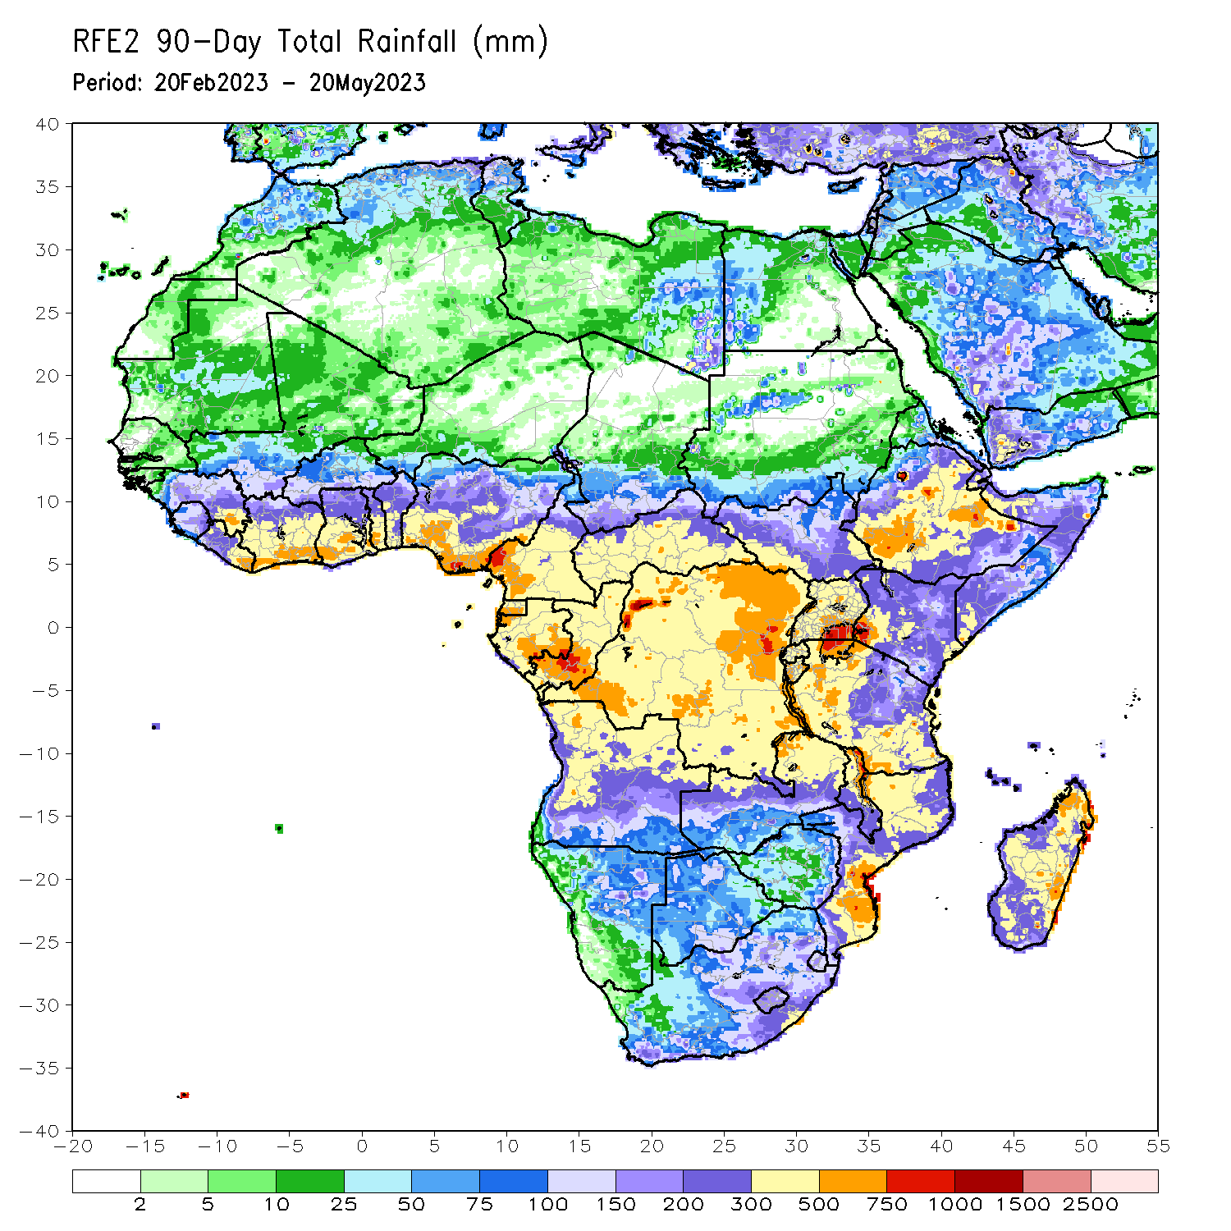
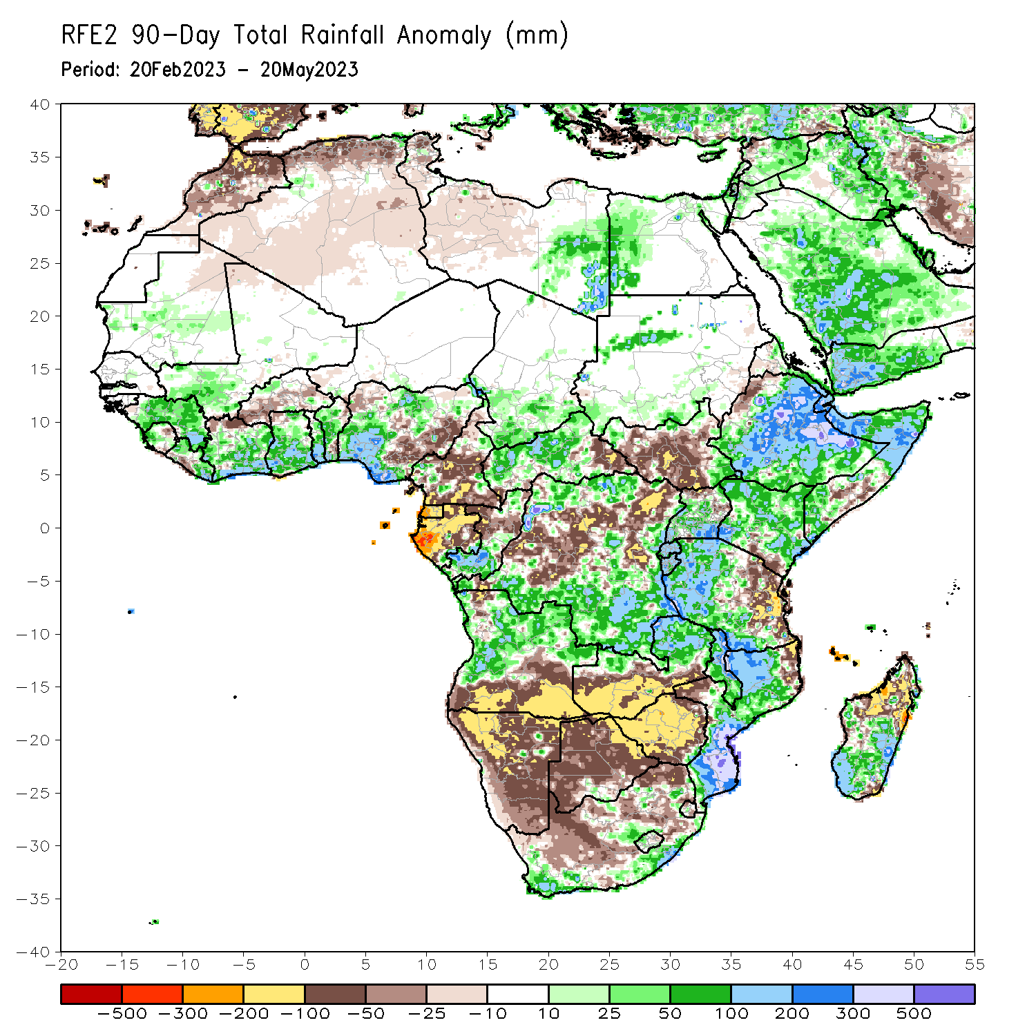
Rainfall Patterns: Last 90 Days
Over the past 90 days, in East Africa, above-average rainfall was observed over much Ethiopia, many parts of Kenya, northern and southern Somalia, Djibouti, parts of central and southern Eritrea, parts of southern and west-central Sudan, Uganda, western and southern Tanzania, Burundi, Rwanda, and the far northern and southeastern South Sudan. Rainfall was below-average over many parts of South Sudan, parts of central Somalia, eastern Tanzania, and pockets of southeast Kenya and northwest Ethiopia. In southern Africa, above-average rainfall was observed over western and northern Angola, northern Zambia, of eastern and southern South Africa, western Lesotho, central Eswatini, much of Mozambique, and central and southern Madagascar. Below-average rainfall was observed over southern Angola, western and southern Zambia, many parts of Namibia and Botswana, western South Africa, Zimbabwe, pockets of northeastern Mozambique and northern Madagascar. In Central Africa, rainfall was above-average over southern Chad, western and central CAR, northern and southern DRC, and southern Congo. Rainfall was below-average over Equatorial Guinea, many parts of Gabon and Cameroon, central Congo, parts of CAR, and parts of western, central and northeast DRC. In West Africa, rainfall was above-average over much of Guinea, western Sierra Leone, northern and eastern Liberia, central, southern and eastern parts of Cote d’Ivoire and Ghana, Togo, Benin, southern Mali, and parts of southwest, southern and northern Nigeria. Below-average rainfall was observed over parts of northeast Sierra Leone, southwest Liberia, northern Cote d’Ivoire, central and southern parts of Burkina Faso, and eastern Nigeria.
Notes:
4

Slide 5
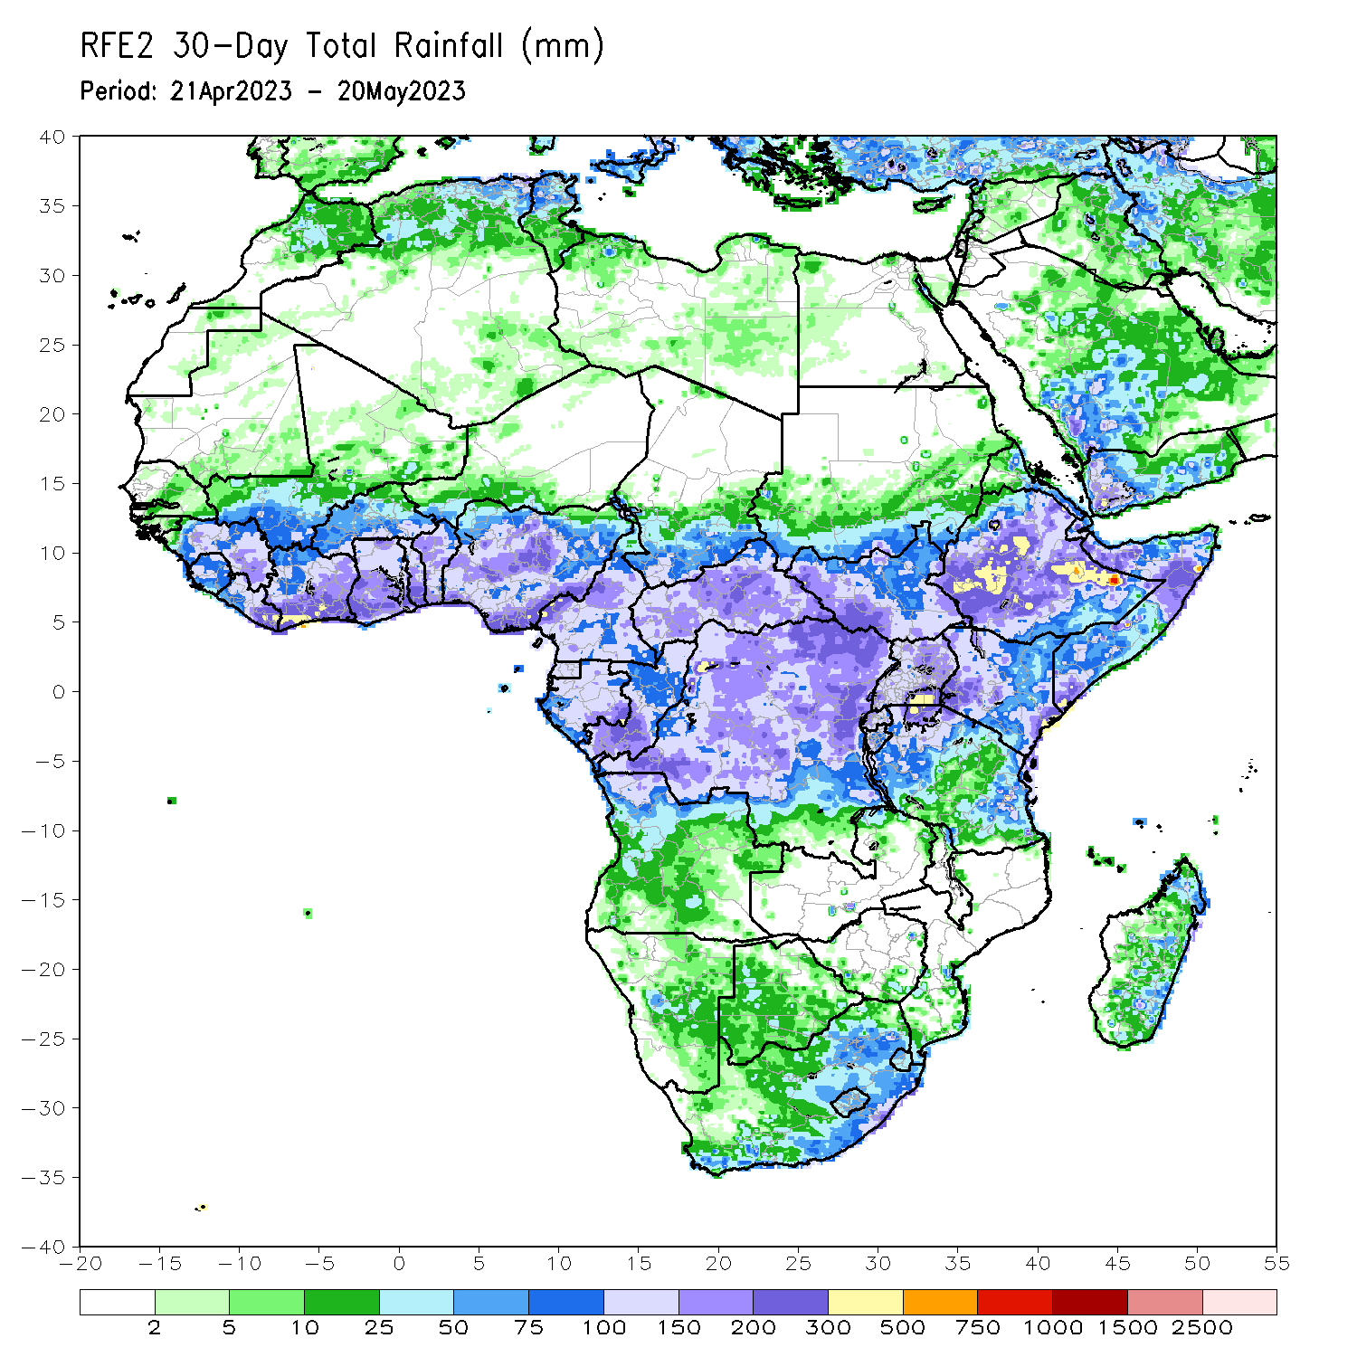
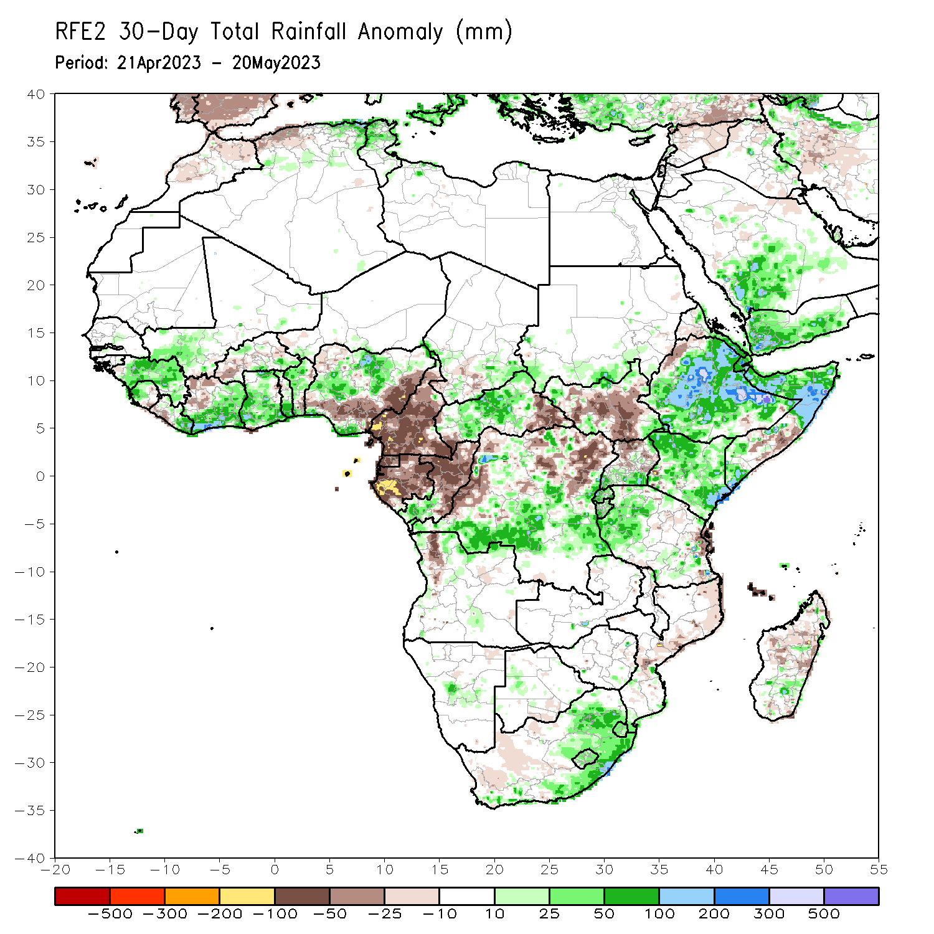
Rainfall Patterns: Last 30 Days
Over the past 30 days, in East Africa, above-average rainfall was observed over much of Ethiopia and Kenya, Djibouti, southern Eritrea, northern and southern Somalia, southern parts of Uganda and Sudan, parts of western, northern and southeast Tanzania, Burundi, Rwanda, and pockets of southeast and northeast South Sudan. Rainfall was below-average over many parts of South Sudan, pockets of northwest Ethiopia, central Somalia, and eastern-central Tanzania. In southern Africa, rainfall was above-average over parts of northeast Angola, central Namibia, western Botswana, central and eastern South Africa, Lesotho, Eswatini, and southeastern Madagascar. Below-average rainfall was observed over central and northeast Mozambique, southwest South Africa, parts of northwest Angola, and parts of central and northern Madagascar. In Central Africa, rainfall was above-average over southern Congo, central and northern CAR, parts of southeast Chad, and parts of southern, eastern and central DRC. Below-average rainfall was observed over much of Cameroon, Equatorial Guinea, Gabon, northern and central parts of Congo, parts of western and northeast DRC, and southeastern CAR. In West Africa, rainfall was above-average over much of Guinea, western Sierra Leone, eastern Liberia, southern and eastern Cote d’Ivoire, Ghana, many parts of Togo and Benin, parts of southern Mali and southeast Burkina Faso, and parts of western-central, northern and southeast Nigeria. Below-average rainfall was observed over eastern Sierra Leone, southwest Liberia, western and northwest Cote d’Ivoire, western and central parts of Burkina Faso, and southeastern Nigeria.
Notes:
5

Slide 6
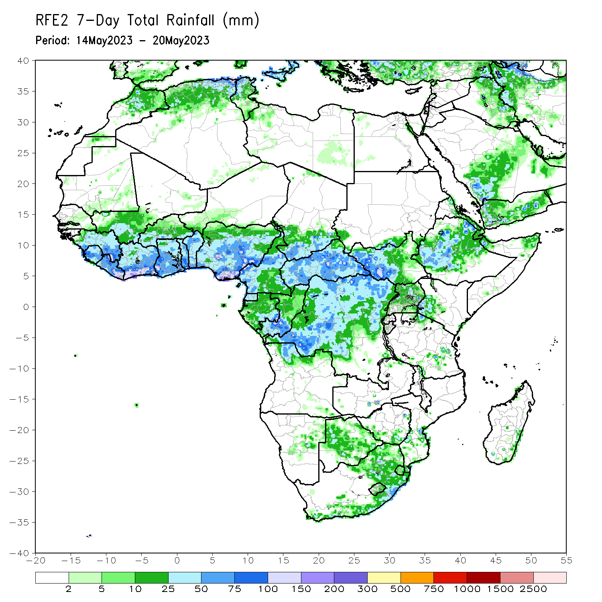
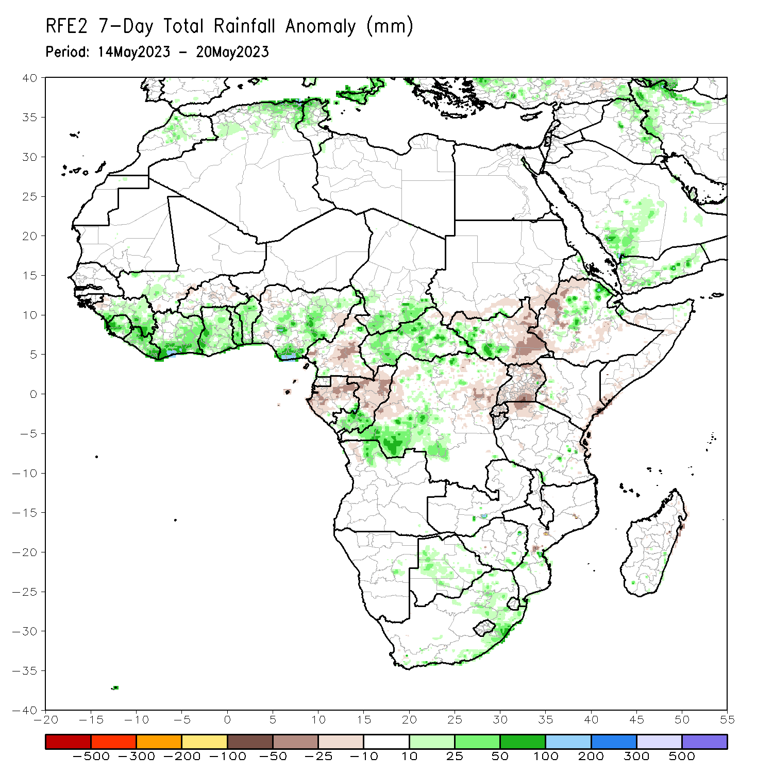
Rainfall Patterns: Last 7 Days
During the past 7 days, in East Africa, rainfall was above-average over parts of central and northeast Ethiopia, western South Sudan, southern Eritrea and pockets of southeast Tanzania and northwest Somalia. Below-average rainfall was observed over eastern, northeast and southeast South Sudan, western Ethiopia, Uganda, Rwanda, Burundi, northwest Tanzania, pockets of southwest and eastern Kenya and parts of southeast Somalia. In Central Africa, rainfall was above-average over southern Chad, many parts of CAR, parts of central, southwest and northern DRC, and pockets of southern Congo. Below-average rainfall was observed over central and southern Cameroon, Gabon, central and northern Congo, parts of western and eastern DRC. In West Africa, above-average rainfall was observed over parts of southern, central and eastern Guinea, Sierra Leone, Liberia, many parts of Cote d’Ivoire and Ghana, southern Mali, Togo, Benin, pockets of southern Burkina Faso, and parts of southwest, central and northeast Nigeria. Below-average rainfall was observed over pockets of northwest Guinea and pockets of eastern Nigeria. In Southern Africa, above-average rainfall was observed over parts of northern and eastern South Africa, Lesotho, central Botswana, and pockets of southeast Zimbabwe.

Slide 7
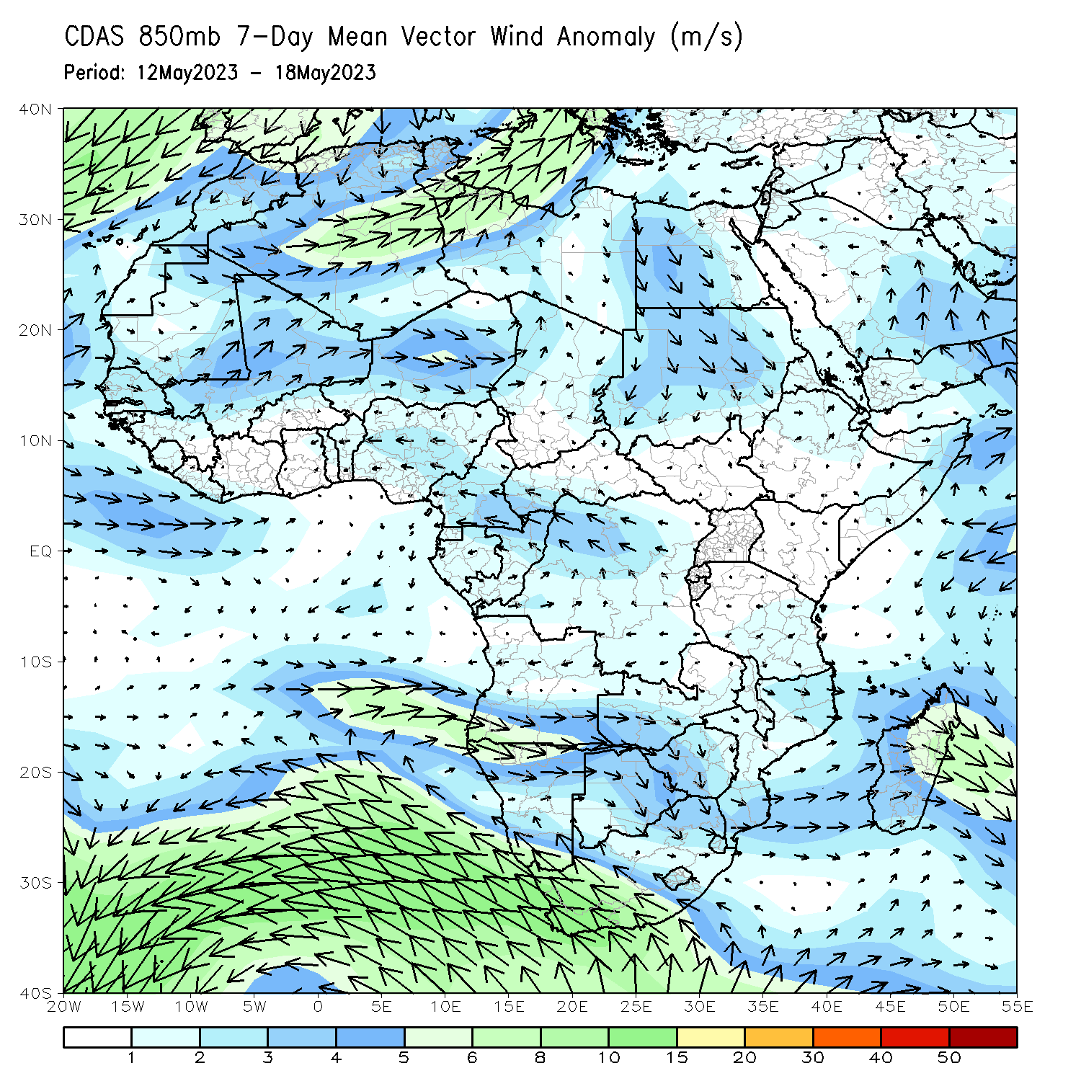
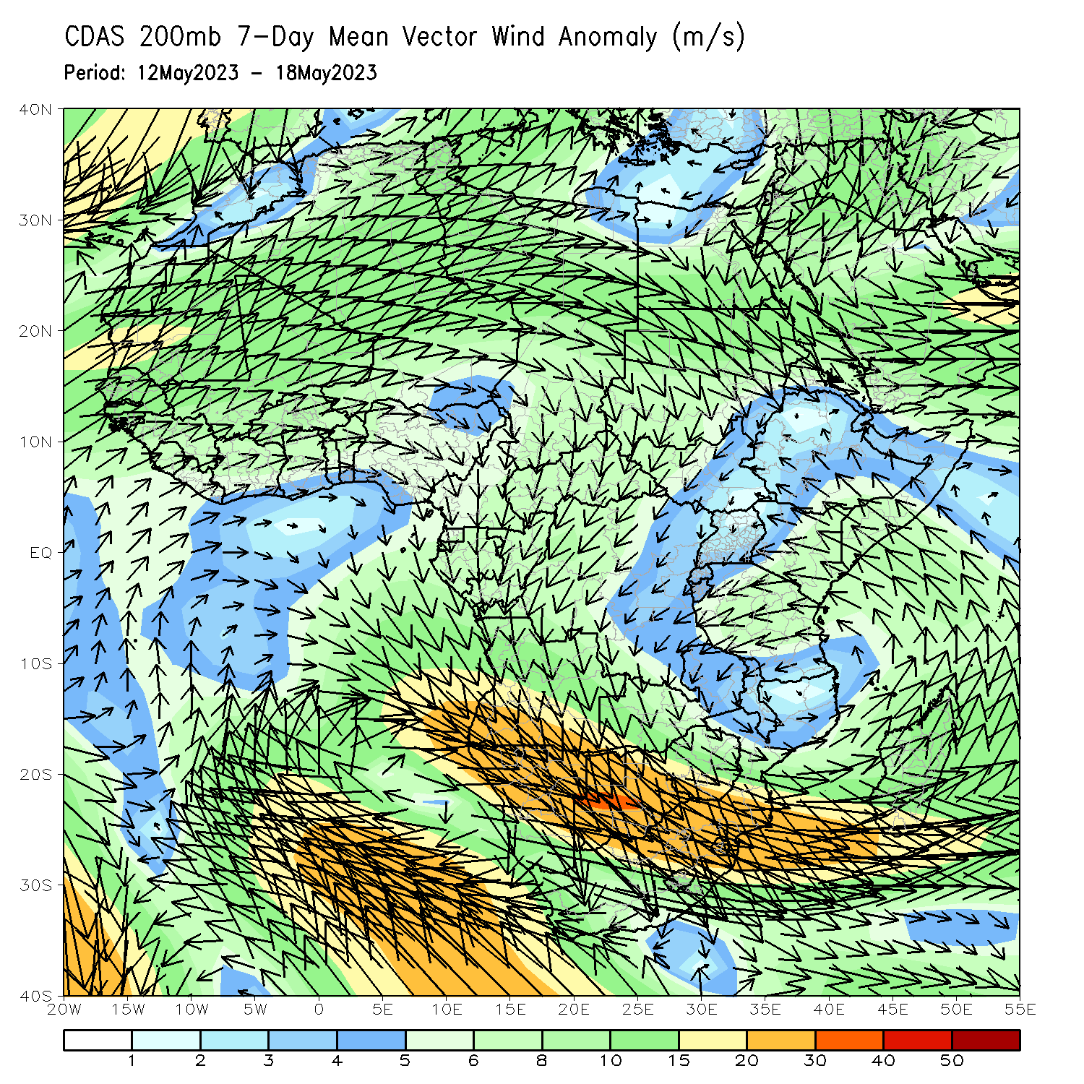
Atmospheric Circulation: Last 7 Days
At 850-hPa level (left panel), anomalous westerly flow was observed across western Africa and anomalous onshore flow across the Gulf of Guinea countries has contributed to enhanced rainfall in Gulf of Guinea countries. At 200-hPa level (right panel), an area of anomalous upper-level wind divergence was observed across western Africa, which may have contributed to the observed above-average rainfall in the Gulf of Guinea countries.

Slide 8
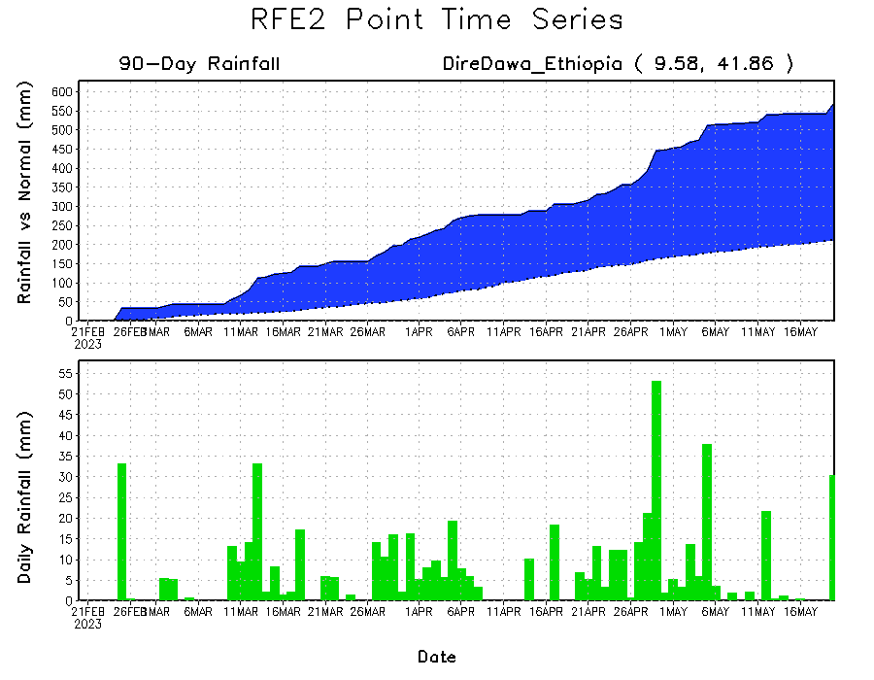
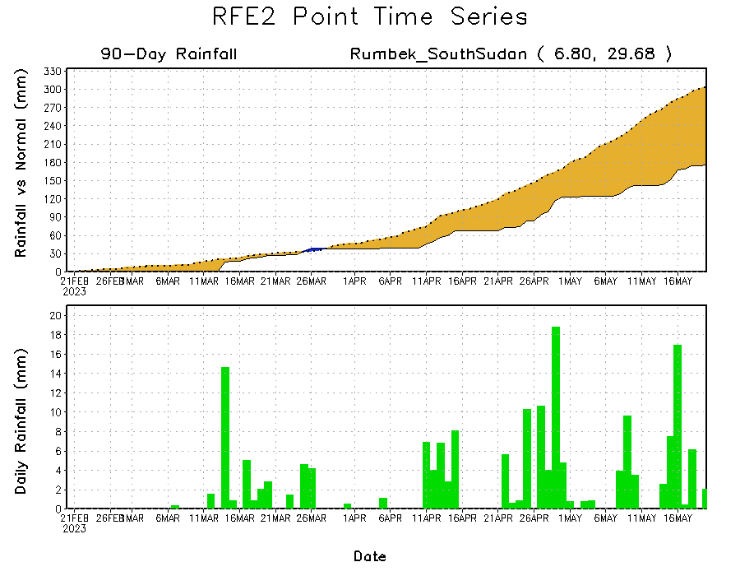
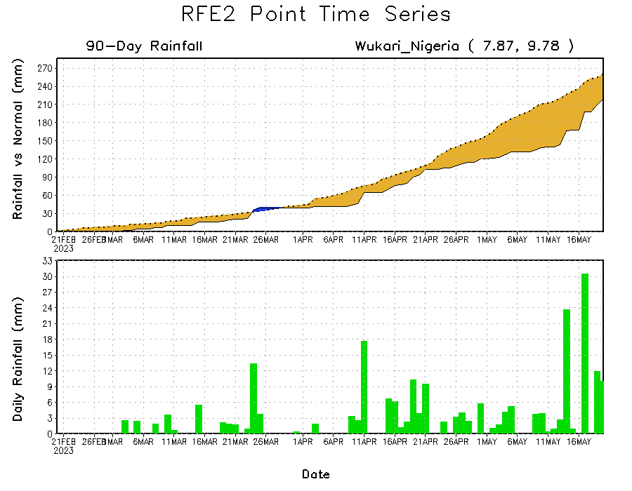
Rainfall Evolution
Daily evolution of rainfall over the last 90 days at selected locations shows a growing dryness over parts of southeastern Nigeria (bottom left) and South Sudan (bottom right). Moderate to local heavy rainfall sustained moisture surpluses over parts of eastern Ethiopia (top right).

Slide 9
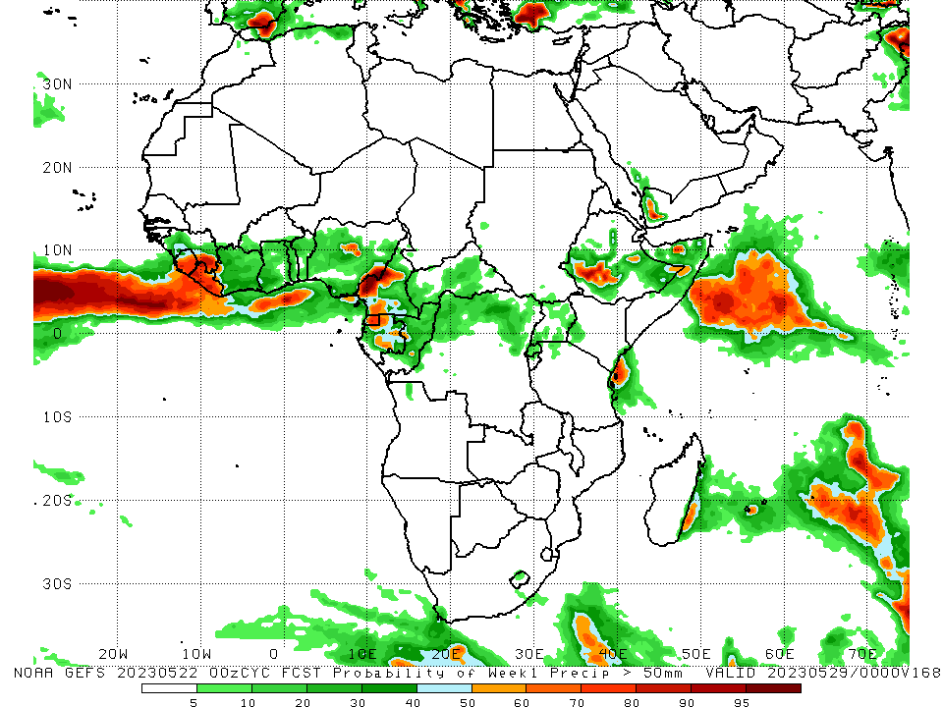
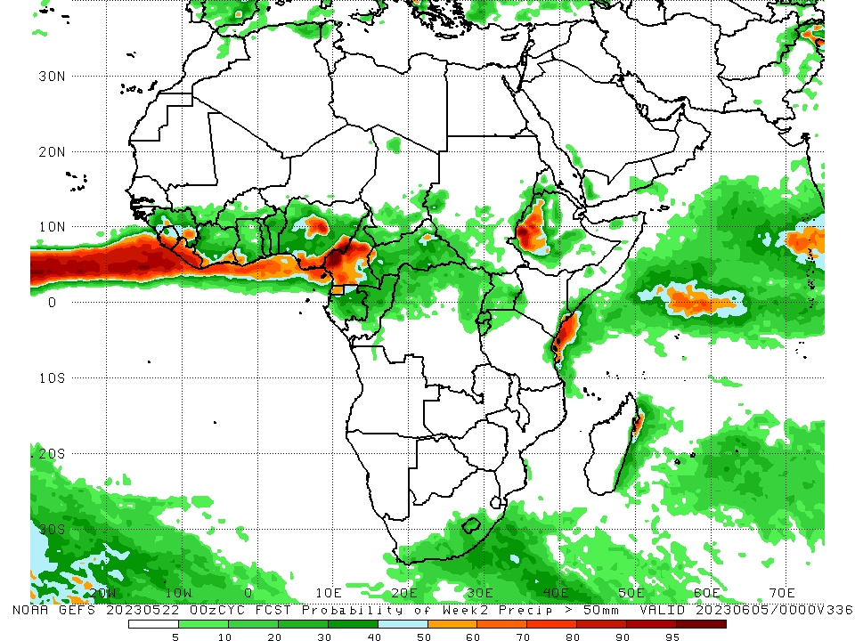
NCEP GEFS Model Forecasts Non-Bias Corrected Probability of precipitation exceedance
Week-1, Valid: 23 – 29 May 2023
Week-2, Valid: 30 May – 05 Jun 2023
For week-1 (left panel) the NCEP GEFS indicates a moderate to high chance (over 70%) for rainfall to exceed 50 mm over Sierra Leone, Liberia, southeast Guinea, western Cameroon, Equatorial Guinea, northern Gabon, pockets of eastern Nigeria, and southwest Ethiopia. For week-2 (right panel), NCEP GEFS indicates a moderate to high chance (over 70%) for rainfall to exceed 50 mm over southern and eastern Sierra Leone, Liberia, southeast Guinea, central and southeast Nigeria, central and western Cameroon, and western Ethiopia.
Notes:
9

Slide 10
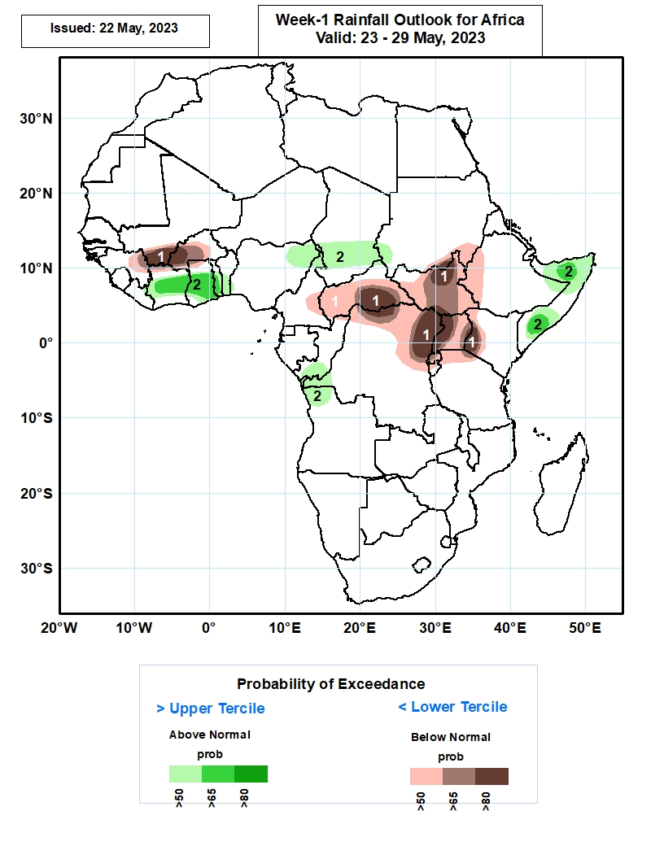
Week-1 Precipitation Outlooks
23 – 29 May 2023
The forecasts call for above 50% chance for weekly total rainfall to be below-normal (below the lower tercile) over northeastern Guinea, southern Mali, much of Burkina Faso, eastern Cameroon, much of CAR, South Sudan and Uganda, northern and eastern parts of DR Congo, southern Sudan, and western portions of Ethiopia and Kenya. In particular, there is above 80% chance for rainfall to be below-normal over southern Mali, western Burkina Faso, southern CAR, northern South Sudan, northern and eastern parts of DR Congo, western Uganda, and southwestern Kenya.
The probabilistic forecasts call for above 50% chance for weekly rainfall to be above-normal (above the upper tercile) over much of Cote d’Ivoire, Ghana and Togo, central and southern portions of Benin, northeastern Nigeria, southern Chad, southwestern Sudan, southern Congo, western DR Congo, northwestern Angola, and northern and southern portions of Somalia. In particular, there is above 65% chance for rainfall to be above-normal over central Cote d’Ivoire, central and southern parts of Ghana and Togo, and northern and southern parts of Somalia.
Notes:
10

Slide 11
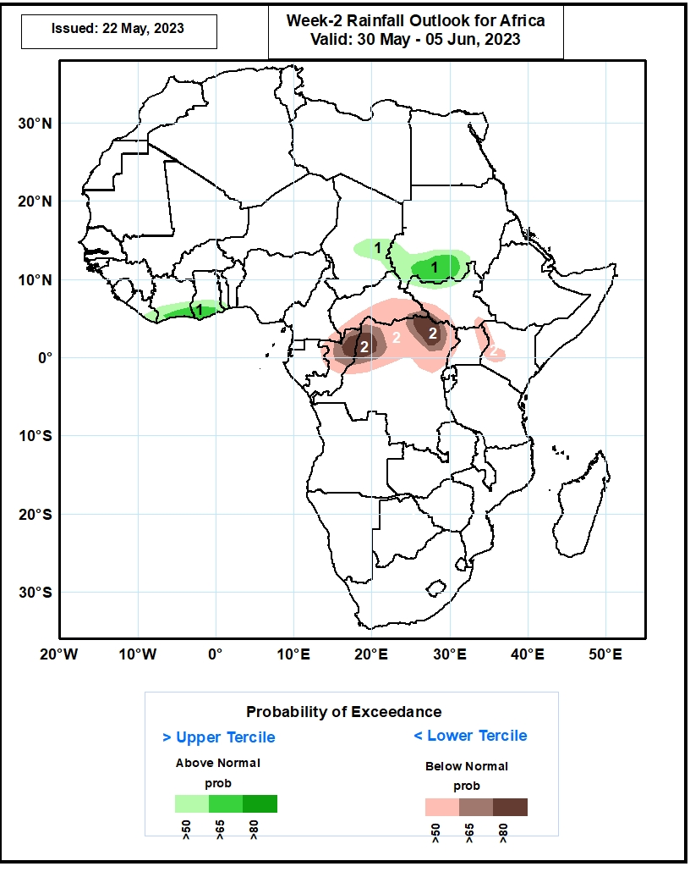
Week-2 Precipitation Outlooks
30 May – 05 June 2023
The probabilistic forecasts call for above 50% chance for weekly rainfall to be above-normal (above the upper tercile) over southeastern Liberia, southern Cote d’Ivoire and Ghana, eastern Chad, southern portions of Sudan, and northern South Sudan. In particular, there is above 65% chance for rainfall to be above-normal over southern Cote d’Ivoire, Ghana, and Sudan.
The forecasts call for above 50% chance for weekly total rainfall to be below-normal (below the lower tercile) over northern and central Congo, southern CAR, northern portions of DR Congo, southwestern South Sudan, western and eastern parts of Uganda, and western Kenya. In particular, there is above 80% chance for rainfall to be below-normal over northern portions of Congo and DR Congo.
Notes:
11

Slide 12
Summary
Over the past 30 days, in East Africa, above-average rainfall was observed over much of Ethiopia and Kenya, Djibouti, southern Eritrea, northern and southern Somalia, southern parts of Uganda and Sudan, parts of western, northern and southeast Tanzania, Burundi, Rwanda, and pockets of southeast and northeast South Sudan. Rainfall was below-average over many parts of South Sudan, pockets of northwest Ethiopia, central Somalia, and eastern-central Tanzania. In southern Africa, rainfall was above-average over parts of northeast Angola, central Namibia, western Botswana, central and eastern South Africa, Lesotho, Eswatini, and southeastern Madagascar. Below-average rainfall was observed over central and northeast Mozambique, southwest South Africa, parts of northwest Angola, and parts of central and northern Madagascar. In Central Africa, rainfall was above-average over southern Congo, central and northern CAR, parts of southeast Chad, and parts of southern, eastern and central DRC. Below-average rainfall was observed over much of Cameroon, Equatorial Guinea, Gabon, northern and central parts of Congo, parts of western and northeast DRC, and southeastern CAR. In West Africa, rainfall was above-average over much of Guinea, western Sierra Leone, eastern Liberia, southern and eastern Cote d’Ivoire, Ghana, many parts of Togo and Benin, parts of southern Mali and southeast Burkina Faso, and parts of western-central, northern and southeast Nigeria. Below-average rainfall was observed over eastern Sierra Leone, southwest Liberia, western and northwest Cote d’Ivoire, western and central parts of Burkina Faso, and southeastern Nigeria.
During the past 7 days, in East Africa, rainfall was above-average over parts of central and northeast Ethiopia, western South Sudan, southern Eritrea and pockets of southeast Tanzania and northwest Somalia. Below-average rainfall was observed over eastern, northeast and southeast South Sudan, western Ethiopia, Uganda, Rwanda, Burundi, northwest Tanzania, pockets of southwest and eastern Kenya and parts of southeast Somalia. In Central Africa, rainfall was above-average over southern Chad, many parts of CAR, parts of central, southwest and northern DRC, and pockets of southern Congo. Below-average rainfall was observed over central and southern Cameroon, Gabon, central and northern Congo, parts of western and eastern DRC. In West Africa, above-average rainfall was observed over parts of southern, central and eastern Guinea, Sierra Leone, Liberia, many parts of Cote d’Ivoire and Ghana, southern Mali, Togo, Benin, pockets of southern Burkina Faso, and parts of southwest, central and northeast Nigeria. Below-average rainfall was observed over pockets of northwest Guinea and pockets of eastern Nigeria. In Southern Africa, above-average rainfall was observed over parts of northern and eastern South Africa, Lesotho, central Botswana, and pockets of southeast Zimbabwe.
The Week-1 outlook calls for above-average rainfall primarily over much of the western Gulf of Guinea region (west of Ghana), as well as eastern Africa. This includes regions from Sierra Leone to Cote d’Ivoire, and from central Ethiopia to northern Somalia. In contrast, there is an increased chance for below-average rainfall from northern Guinea to Burkina Faso, as well as in most of central Africa. This includes regions such as southern Nigeria, southern Cameroon, CAR, South Sudan, central and northeastern DRC, Rwanda, Burundi, Uganda, southwestern Kenya, northwestern Tanzania, southern Somalia, and northwestern Ethiopia. The Week-2 outlook suggests above-average rainfall over Nigeria, southern parts of Chad and Sudan, western Cameroon, central and northern Ethiopia, southeast Kenya and northeast Tanzania, Lesotho, and eastern South Africa. Below-average rainfall is likely over parts of southern Mali, Burkina Faso, Sierra Leone, parts of central and northern Sierra Leone and Ghana, Togo, eastern Gabon, southern CAR, South Sudan, northeastern DRC, Uganda, western Kenya, and parts of northwest Tanzania.

