Slide 1
The African Monsoon Recent Evolution and Current Status Include Week-1 and Week-2 Outlooks
Update prepared
30 May 2023
For more information, visit:
http://www.cpc.ncep.noaa.gov/products/Global_Monsoons/African_Monsoons/precip_monitoring.shtml

Slide 2
Outline
Highlights
Recent Evolution and Current Conditions
NCEP GEFS Forecasts
Summary

Slide 3
Highlights: Last 7 Days
During the past 7 days, in East Africa, rainfall was above-average over many parts of Ethiopia and western South Sudan. Below-average rainfall was observed over parts of eastern South Sudan, and the far western Ethiopia. In Central Africa, rainfall was above-average over northern Cameroon and southern Congo, and parts of western DRC. Below-average rainfall was observed over western Cameroon, Equatorial Guinea, and parts of central and northcentral DRC. In West Africa, above-average rainfall was observed over the western portion of the Gulf of Guinea region, while rainfall was below-average across the central and eastern portions of the Gulf of Guinea region. In Southern Africa, above-average rainfall was observed over parts of central and southern South Africa.
The Week-1 outlook calls for above-normal rainfall over eastern Guinea, northeastern Nigeria, southern Chad, southwestern Cameroon, Equatorial Guinea, Gabon, northern Ethiopia and eastern Soth Africa. In contrast, there is an increased chance for below-normal rainfall in the Lake Victoria region. For week-2, there is an increased chance for above-normal rainfall across the central and eastern portions of the Gulf of Guinea region and the neighboring areas of Central Africa, and southern Sudan. In contrast, there is an increased chance for below-normal rainfall in the Lake Victoria region.

Slide 4
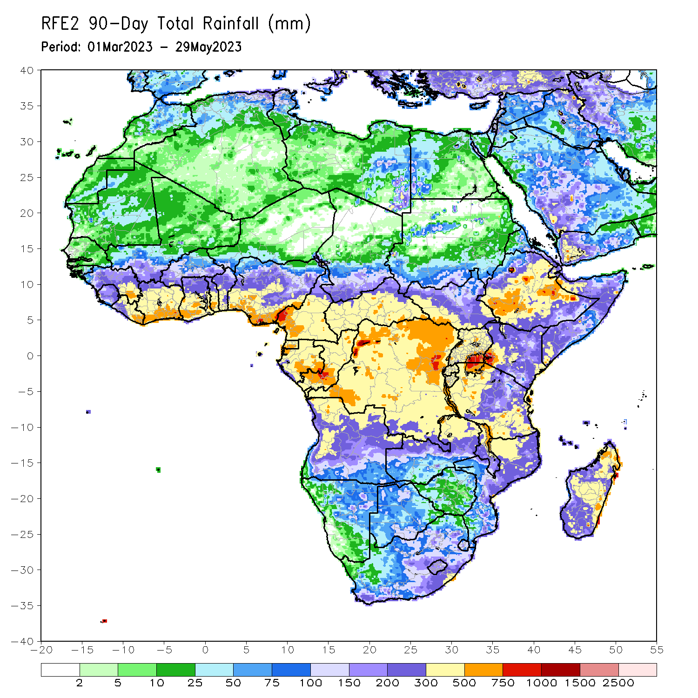
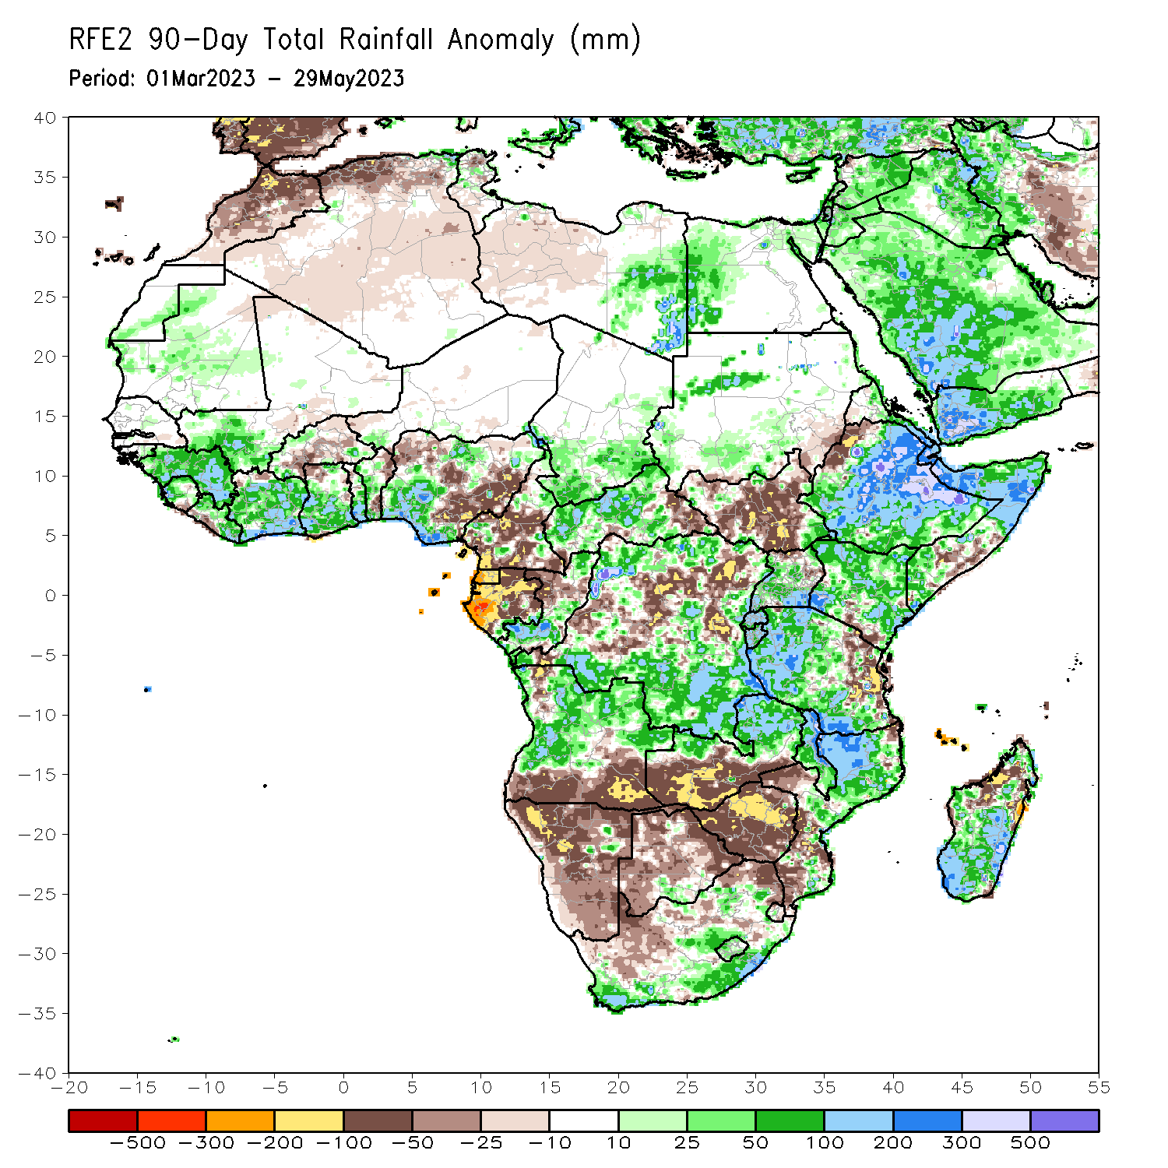
Rainfall Patterns: Last 90 Days
Over the past 90 days, in East Africa, above-average rainfall was observed over much Ethiopia, many parts of Somalia and Kenya, Djibouti, parts of Eritrea, Uganda, western and central Tanzania, Burundi, Rwanda, and pockets of South Sudan. Rainfall was below-average over much of South Sudan, the far western Ethiopia, parts of southern Somalia, the far southern Kenya and eastern Tanzania. In southern Africa, above-average rainfall was observed over many parts of Angola, northern and eastern Zambia, parts of eastern and southern South Africa, Lesotho, much of Mozambique, and much of Madagascar. Below-average rainfall was observed over the southern Angola, western and southern Zambia, much of Namibia, much of Botswana, western and South Africa, Zimbabwe, pockets of northeastern Mozambique and northern Madagascar. In Central Africa, rainfall was above-average over pockets of Cameroon, western and central CAR, much of Congo, and northern and southern DRC. Rainfall was below-average over many parts of Cameroon, Equatorial Guinea, Gabon, parts of eastern CAR, and western and central DRC. In West Africa, rainfall was above-average over much of Guinea, Liberia, Cote d’Ivoire, southwestern Mali, Ghana, Togo, northern, Benin, and western and northern Nigeria. Below-average rainfall was observed over parts of Burkina Faso, and northern and southeastern Nigeria.
Notes:
4

Slide 5
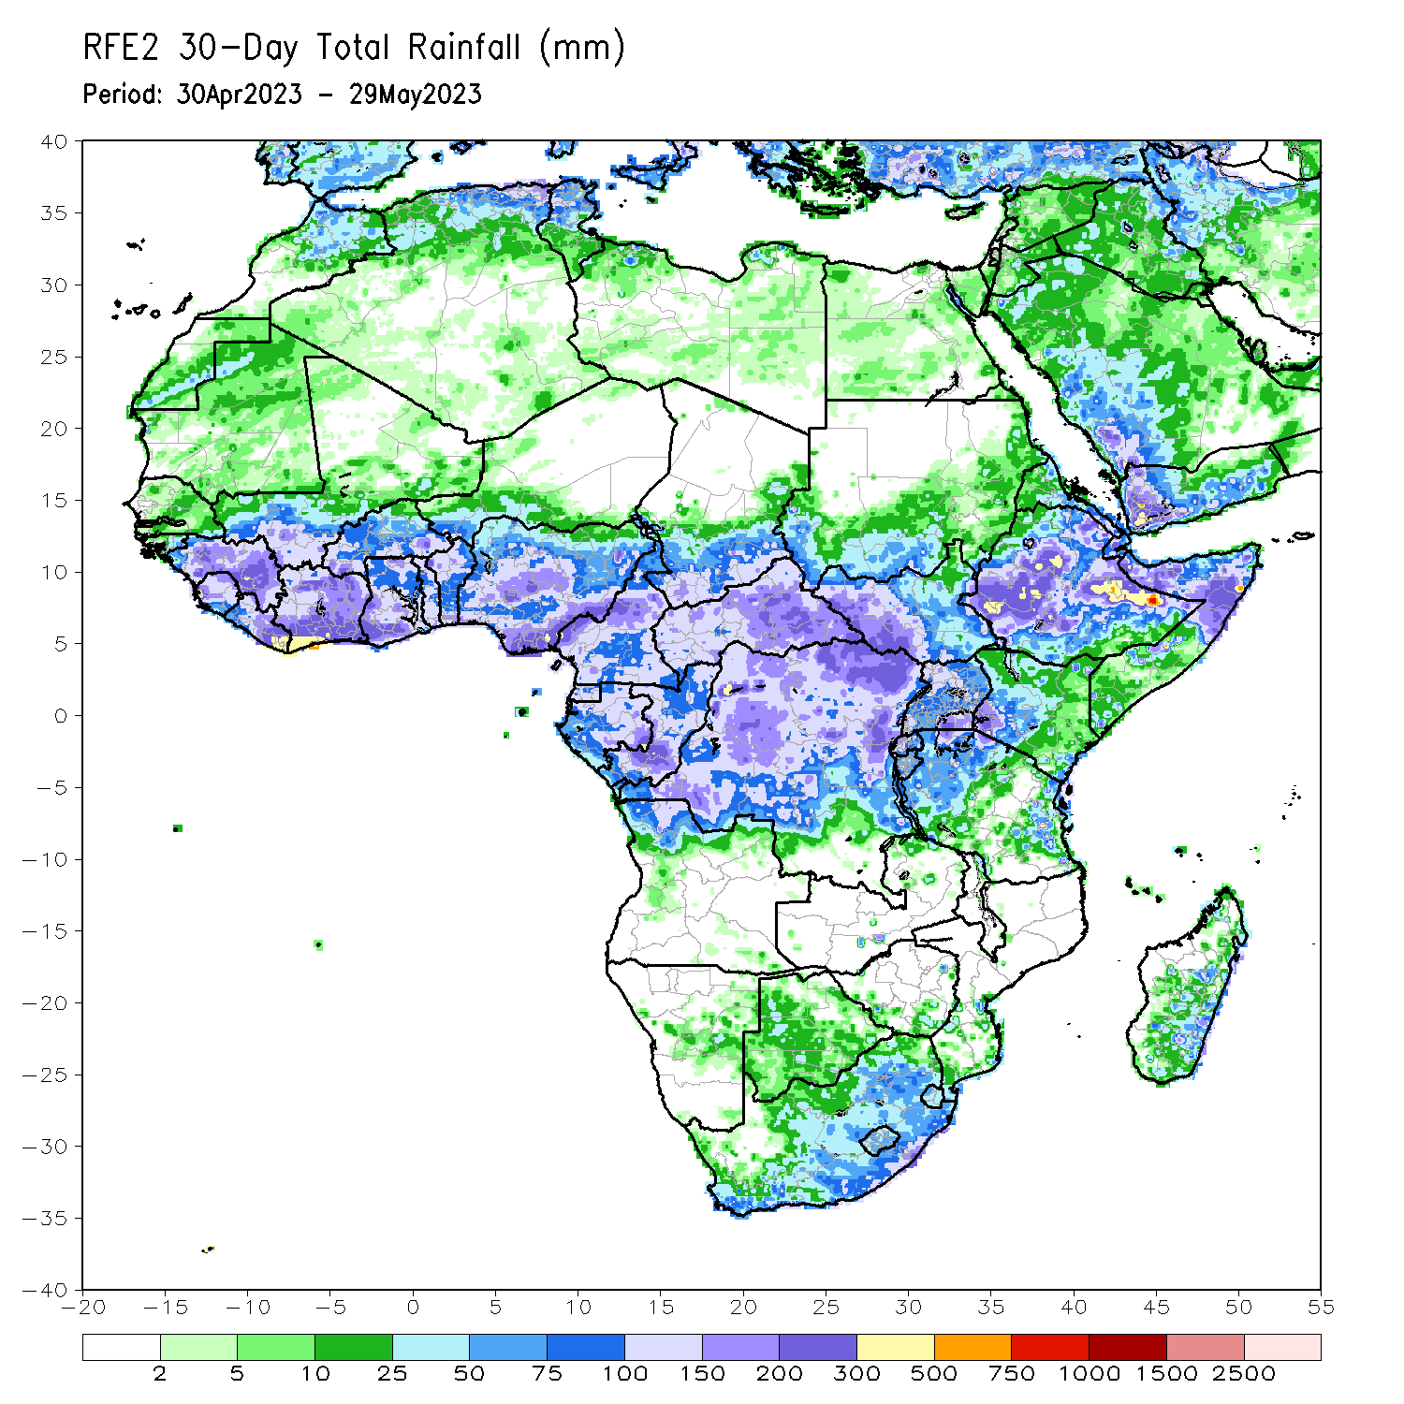
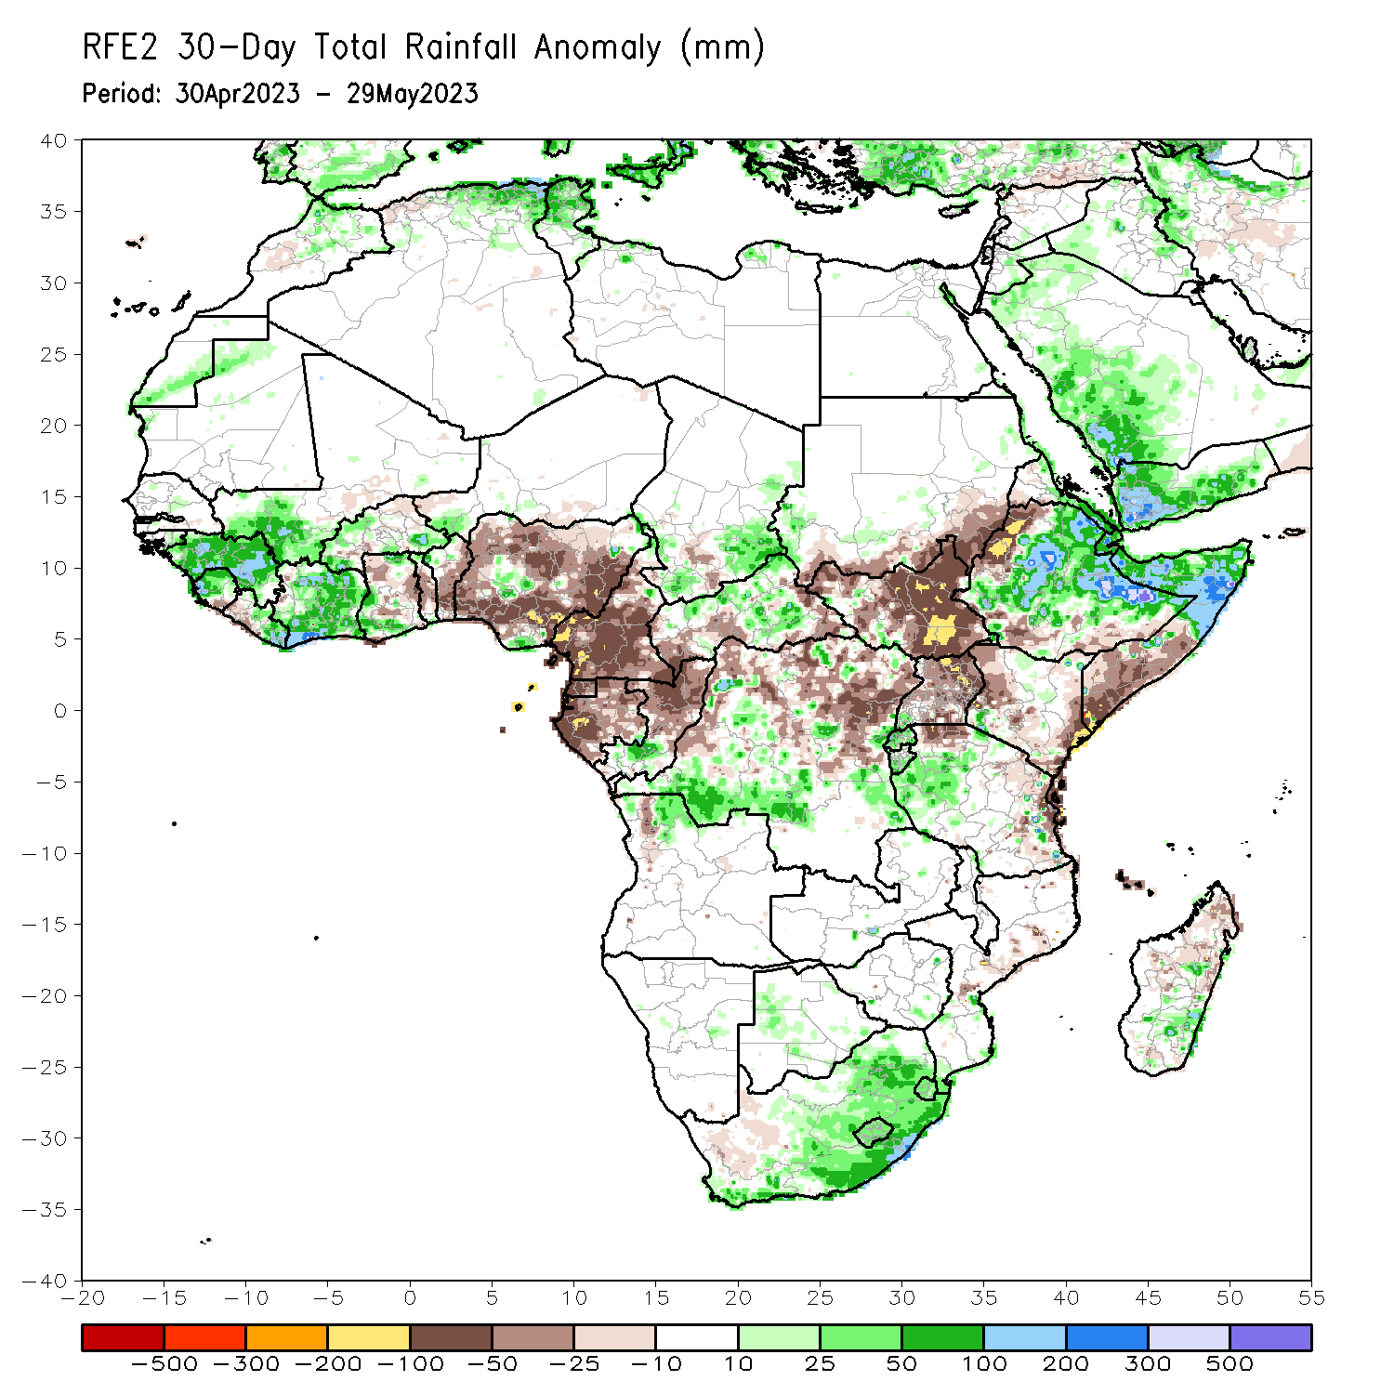
Rainfall Patterns: Last 30 Days
Over the past 30 days, in East Africa, above-average rainfall was observed over much Ethiopia, northwestern Kenya, Djibouti, northern and central Somalia, parts western Tanzania, Burundi and Rwanda. Rainfall was below-average over many parts of South Sudan, the far western Ethiopia and southern Somalia, and coastal Tanzania. In southern Africa, rainfall was above-average over the eastern portion of South Africa, Lesotho, Eswatini, and pockets of Madagascar. In Central Africa, rainfall was above-average over the far southern Congo, parts of CAR, and southern and eastern DRC. Below-average rainfall was observed over much of Cameroon, Equatorial Guinea, Gabon, parts of western and northern DRC, and pockets of CAR. In West Africa, rainfall was above-average over much of Guinea, southwestern Mali, Sierra Leone, Liberia, Cote d’Ivoireand parts of Burkina Faso. Below-average rainfall was observed over many parts of Nigeria.
Notes:
5

Slide 6
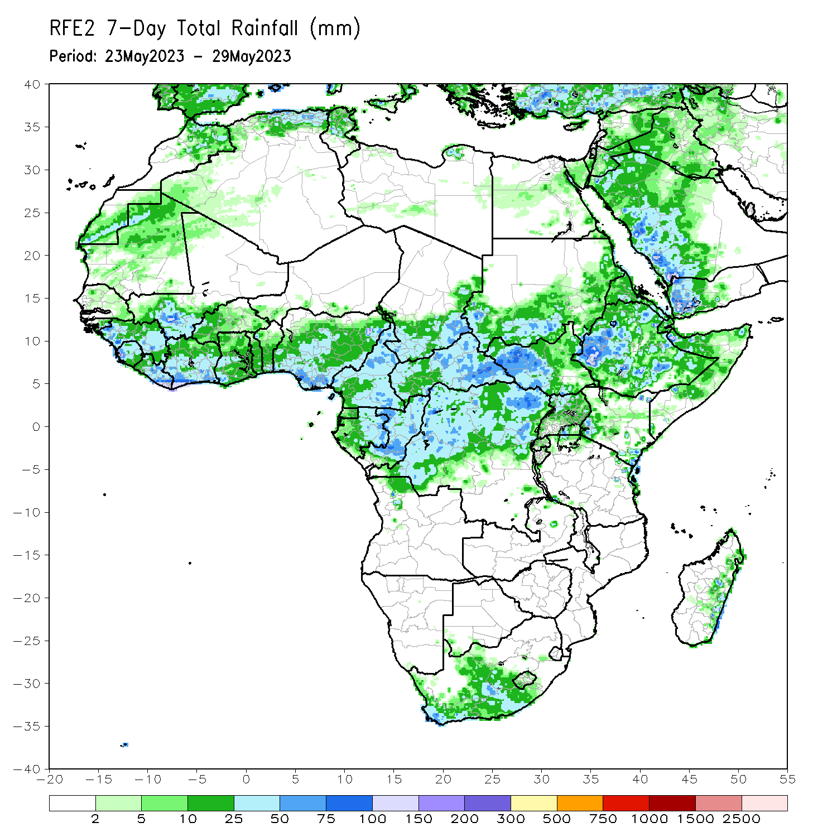
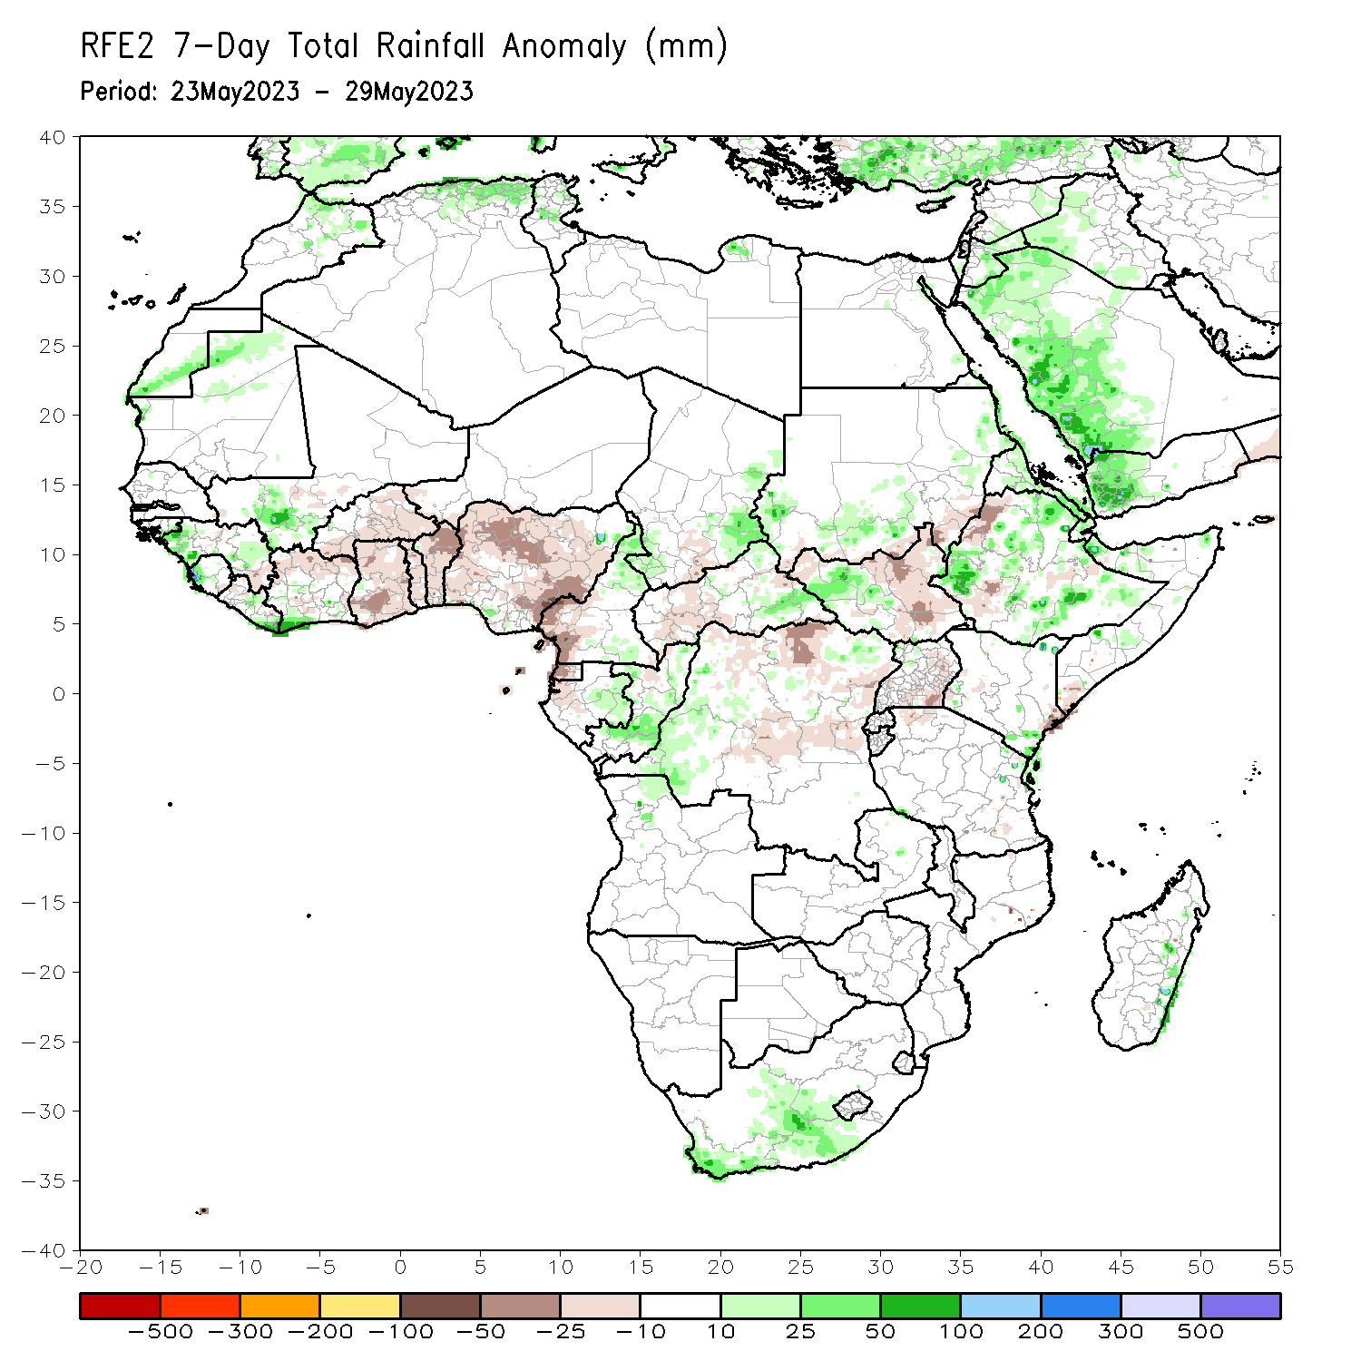
Rainfall Patterns: Last 7 Days
During the past 7 days, in East Africa, rainfall was above-average over many parts of Ethiopia and western South Sudan. Below-average rainfall was observed over parts of eastern South Sudan, and the far western Ethiopia. In Central Africa, rainfall was above-average over northern Cameroon and southern Congo, and parts of western DRC. Below-average rainfall was observed over western Cameroon, Equatorial Guinea, and parts of central and northcentral DRC. In West Africa, above-average rainfall was observed over the western portion of the Gulf of Guinea region, while rainfall was below-average across the central and eastern portions of the Gulf of Guinea region. In Southern Africa, above-average rainfall was observed over parts of central and southern South Africa.

Slide 7
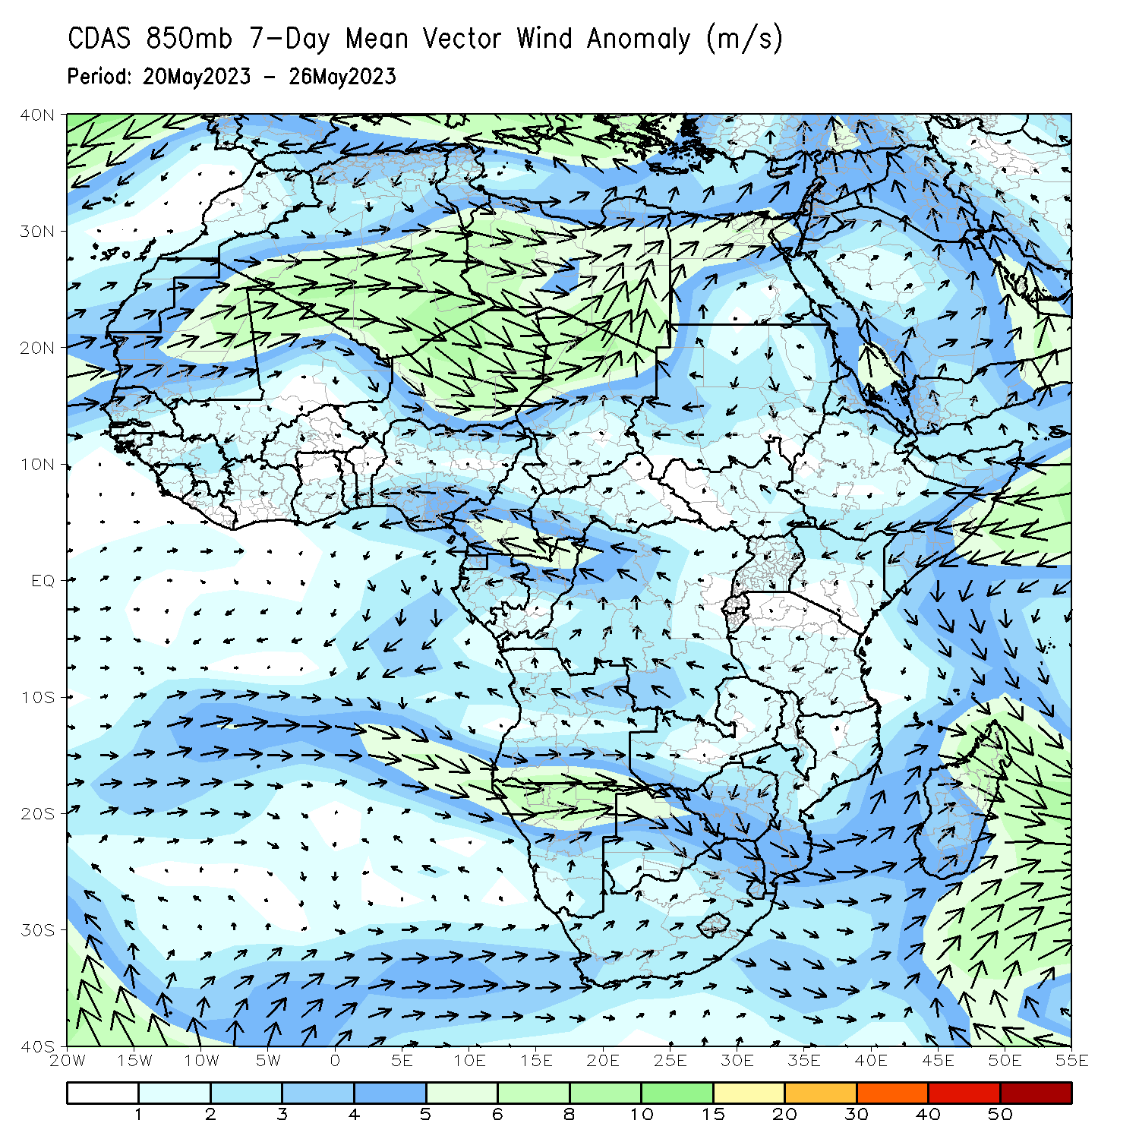
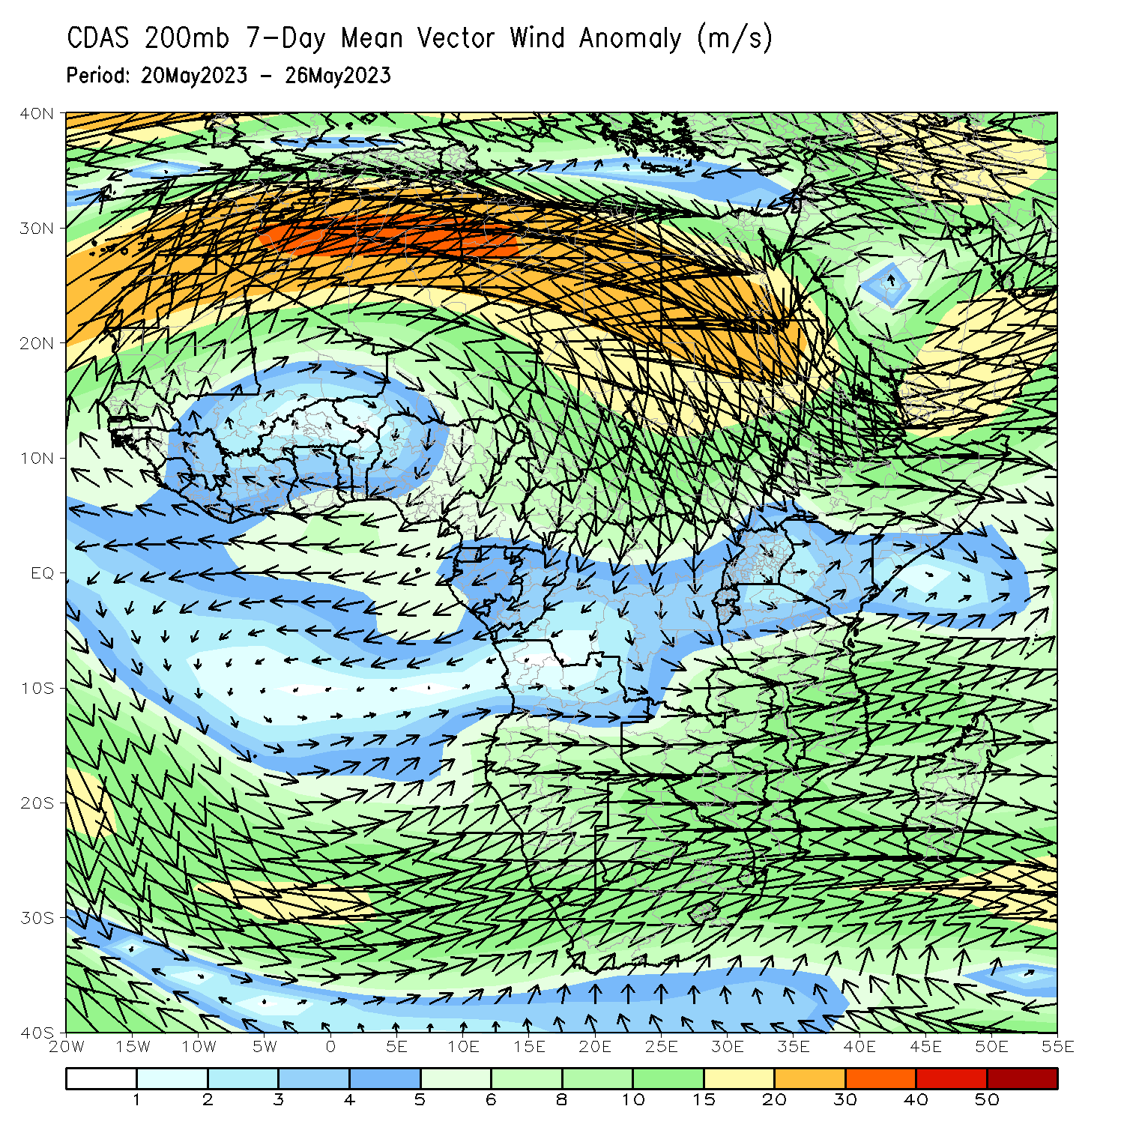
Atmospheric Circulation: Last 7 Days
At 200-hPa level (right panel), interaction between mid-latitude and tropical systems in the Red Sea region may have contributed to the obsrved above-average rainfall over Ethiopia and the neighboring areas.

Slide 8
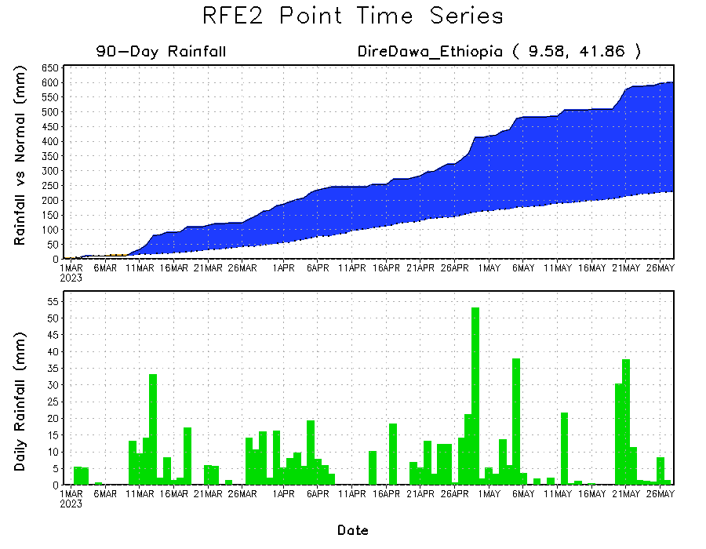
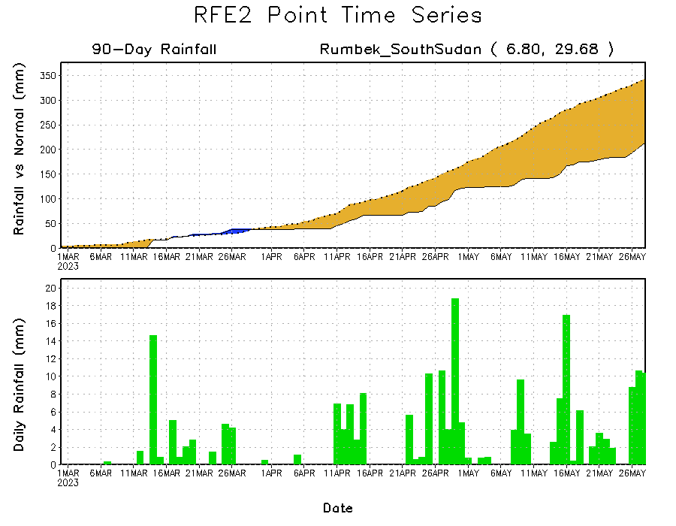
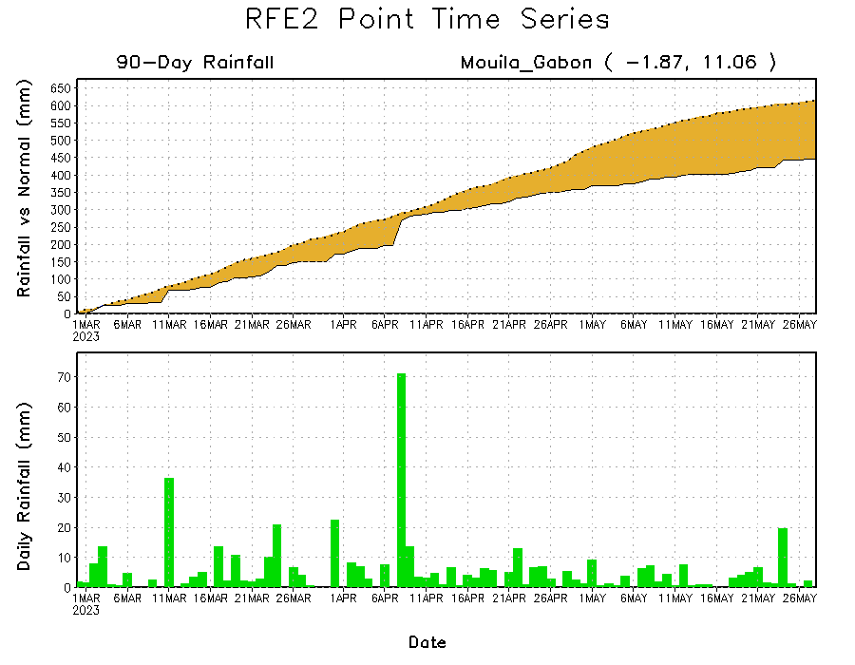
Rainfall Evolution
Daily evolution of rainfall over the last 90 days at selected locations shows a growing dryness over parts of Gabon (bottom left) and South Sudan (bottom right). Moderate to local heavy rainfall sustained moisture surpluses over parts of eastern Ethiopia (top right).

Slide 9
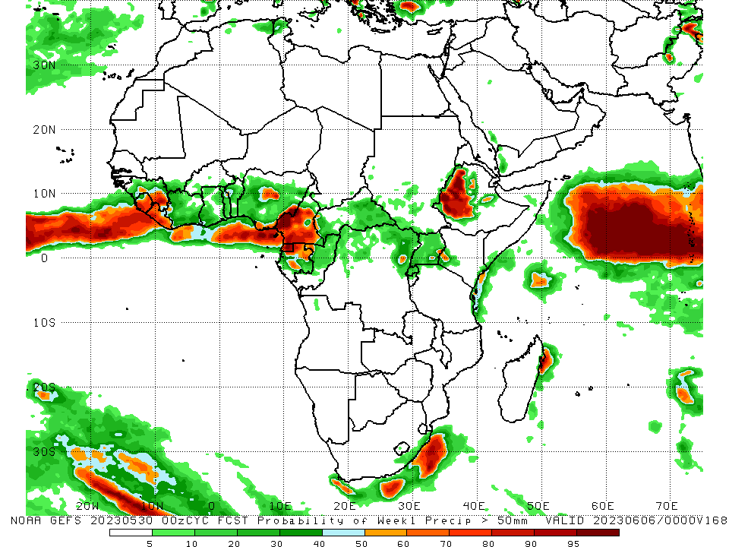
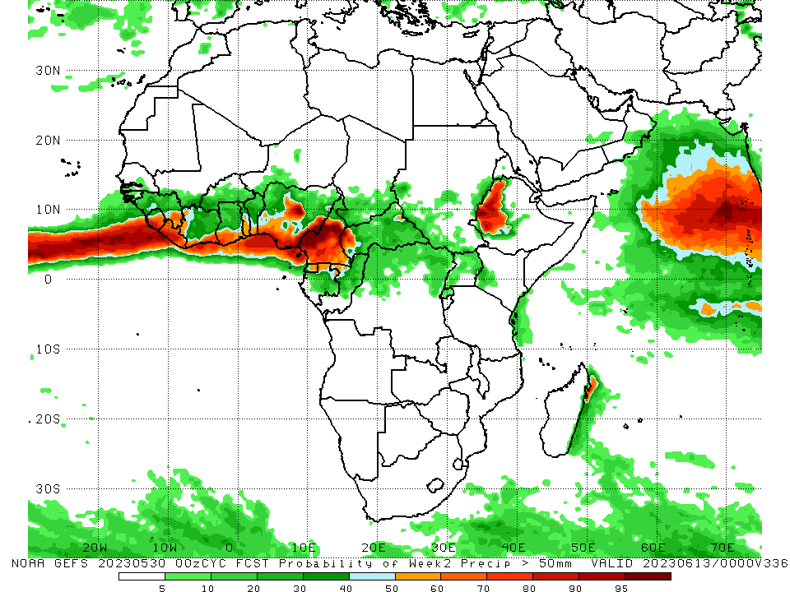
NCEP GEFS Model Forecasts Non-Bias Corrected Probability of precipitation exceedance
Week-1, Valid: 31 May – 06 June 2023
Week-2, Valid: 07 – 13 June 2023
For week-1 (left panel) and week-2 (right panel), the GEFS forecasts indicate a moderate to high chance (over 70%) for rainfall to exceed 50 mm along the Gulf of Guinea coast, and western Ethiopia.
Notes:
9

Slide 10
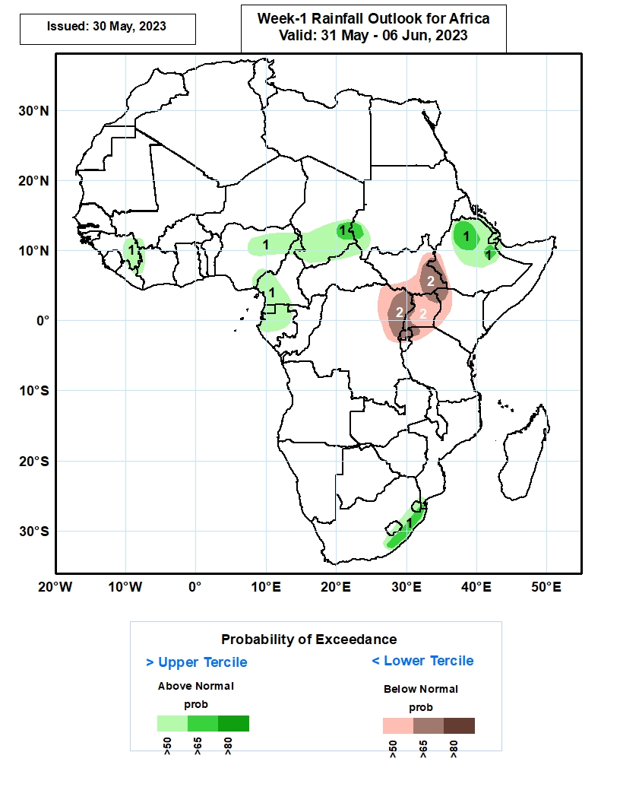
Week-1 Precipitation Outlooks
31 May – 06 June2023
The probabilistic forecasts call for above 50% chance for weekly rainfall to be above-normal (above the upper tercile) over eastern Guinea, western Cote d’Ivoire, northern and southeastern parts of Nigeria, northern and southern Cameroon, southern Chad, southwestern Sudan, much of Equatorial Guinea, northern and central parts of Gabon, northern and central parts of Ethiopia, southern Eritrea, much of Djibouti, eastern part of South Africa, and much of Lesotho and Eswatini. In particular, there is above 65% chance for rainfall to be above-normal over southeastern Chad, southwestern Sudan, northern and central parts of Ethiopia, and eastern parts of South Africa.
The forecasts call for above 50% chance for weekly total rainfall to be below-normal (below the lower tercile) over northeastern DR Congo, central and southern portions of South Sudan, western Ethiopia, much of Uganda and Rwanda, northern Burundi and Tanzania, and western portions of Kenya. In particular, there is above 65% chance for rainfall to be below-normal over eastern South Sudan, southwestern Ethiopia, northeastern DR Congo, western and northern portions of Uganda, much of Rwanda and northwestern Tanzania.
Notes:
10

Slide 11
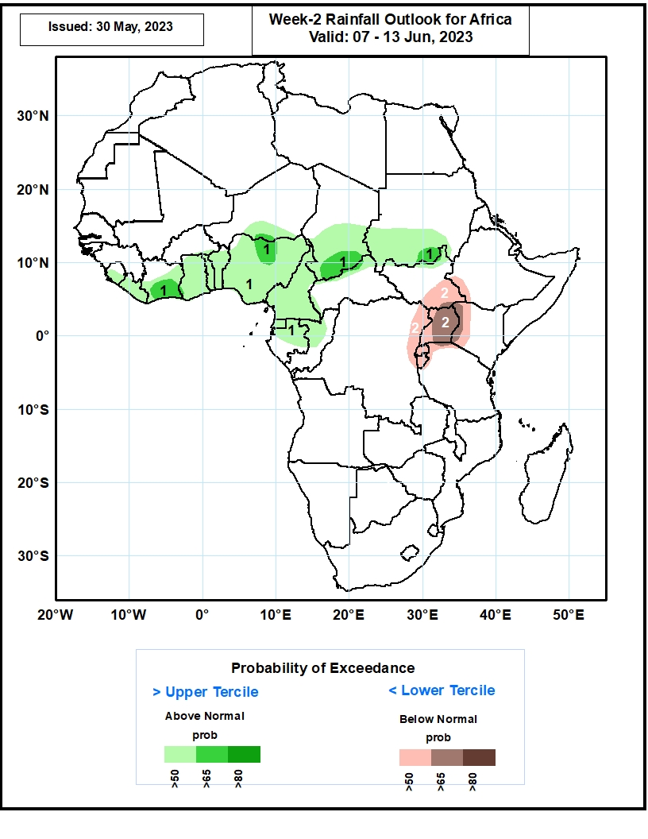
Week-2 Precipitation Outlooks
07 – 13 June 2023
The probabilistic forecasts call for above 50% chance for weekly rainfall to be above-normal (above the upper tercile) over much of Sierra Leone, Liberia, Cote d’Ivoire, Ghana, Togo, Benin, Nigeria, Cameroon and Equatorial Guinea, southern Niger, central and southern parts of Chad, southern Sudan, northern South Sudan, northern and central parts of Gabon, and western Congo. In particular, there is above 65% chance for rainfall to be above-normal over southern Cote d’Ivoire, north-central Nigeria, southern portions of Chad and Sudan.
The forecasts call for above 50% chance for weekly total rainfall to be below-normal (below the lower tercile) over southern South Sudan, southwestern Ethiopia, northeastern DR Congo, much of Rwanda and Burundi, northern Tanzania, much of Uganda, and western Kenya. In particular, there is above 65% chance for rainfall to be below-normal over much of Uganda, and western Kenya.
Notes:
11

Slide 12
Summary
Over the past 30 days, in East Africa, above-average rainfall was observed over much Ethiopia, northwestern Kenya, Djibouti, northern and central Somalia, parts western Tanzania, Burundi and Rwanda. Rainfall was below-average over many parts of South Sudan, the far western Ethiopia and southern Somalia, and coastal Tanzania. In southern Africa, rainfall was above-average over the eastern portion of South Africa, Lesotho, Eswatini, and pockets of Madagascar. In Central Africa, rainfall was above-average over the far southern Congo, parts of CAR, and southern and eastern DRC. Below-average rainfall was observed over much of Cameroon, Equatorial Guinea, Gabon, parts of western and northern DRC, and pockets of CAR. In West Africa, rainfall was above-average over much of Guinea, southwestern Mali, Sierra Leone, Liberia, Cote d’Ivoireand parts of Burkina Faso. Below-average rainfall was observed over many parts of Nigeria.
During the past 7 days, in East Africa, rainfall was above-average over many parts of Ethiopia and western South Sudan. Below-average rainfall was observed over parts of eastern South Sudan, and the far western Ethiopia. In Central Africa, rainfall was above-average over northern Cameroon and southern Congo, and parts of western DRC. Below-average rainfall was observed over western Cameroon, Equatorial Guinea, and parts of central and northcentral DRC. In West Africa, above-average rainfall was observed over the western portion of the Gulf of Guinea region, while rainfall was below-average across the central and eastern portions of the Gulf of Guinea region. In Southern Africa, above-average rainfall was observed over parts of central and southern South Africa.
The Week-1 outlook calls for above-normal rainfall over eastern Guinea, northeastern Nigeria, southern Chad, southwestern Cameroon, Equatorial Guinea, Gabon, northern Ethiopia and eastern Soth Africa. In contrast, there is an increased chance for below-normal rainfall in the Lake Victoria region. For week-2, there is an increased chance for above-normal rainfall across the central and eastern portions of the Gulf of Guinea region and the neighboring areas of Central Africa, and southern Sudan. In contrast, there is an increased chance for below-normal rainfall in the Lake Victoria region.

