Slide 1
The African Monsoon Recent Evolution and Current Status Include Week-1 and Week-2 Outlooks
Update prepared
06 June 2023
For more information, visit:
http://www.cpc.ncep.noaa.gov/products/Global_Monsoons/African_Monsoons/precip_monitoring.shtml

Slide 2
Outline
Highlights
Recent Evolution and Current Conditions
NCEP GEFS Forecasts
Summary

Slide 3
Highlights: Last 7 Days
During the past 7 days, in East Africa, rainfall was above-average over northern Ethiopia, Eritrea, parts of western and eastern southern Sudan, South Sudan, and pockets of eastern Tanzania. Below-average rainfall was observed over parts of central South Sudan, and southwestern Ethiopia. In Central Africa, rainfall was above-average over western and eastern CAR. Below-average rainfall was observed over much of Cameroon, Equatorial Guinea, Gabon, Congo, and central and northern DRC. In West Africa, above-average rainfall was observed over portions of Guinea, Sierra Leone, southern Cote d’Ivoire, Burkina Faso, and central Ghana. Rainfall was below-average over over the far southern Ghana, southern Benin, and much of Nigeria. In Southern Africa, above-average rainfall was observed over parts of central and southern South Africa.
The Week-1 outlook calls for above-normal rainfall across the eastern portions of West Africa, and much of Central Africa. In contrast there is an increased chance for below-normal rainfall over the far western Gulf of Guinea region. For week-2, there is an increased chance for above-normal rainfall over many parts of the Gulf of Guinea region, and much of Central Africa, South Sudan and parts of southern Sudan and western Ethiopia.

Slide 4
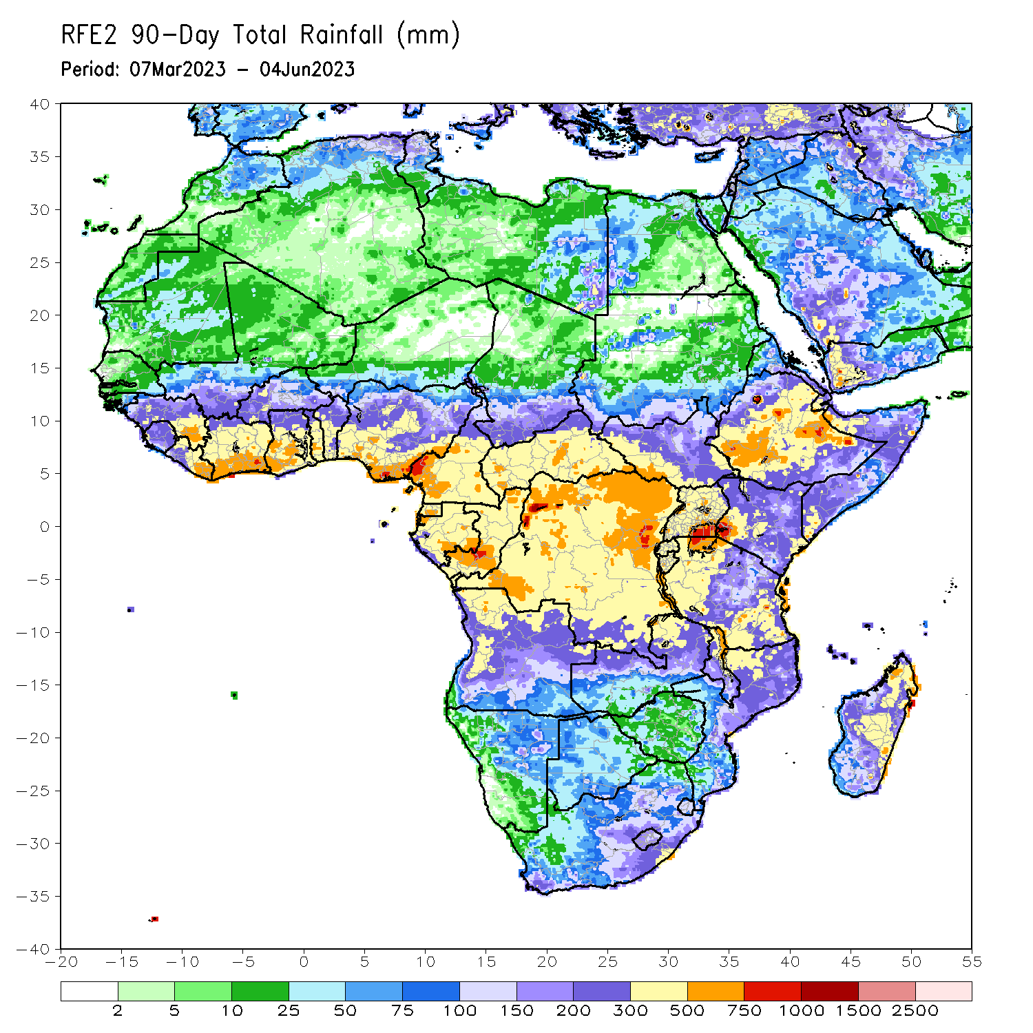
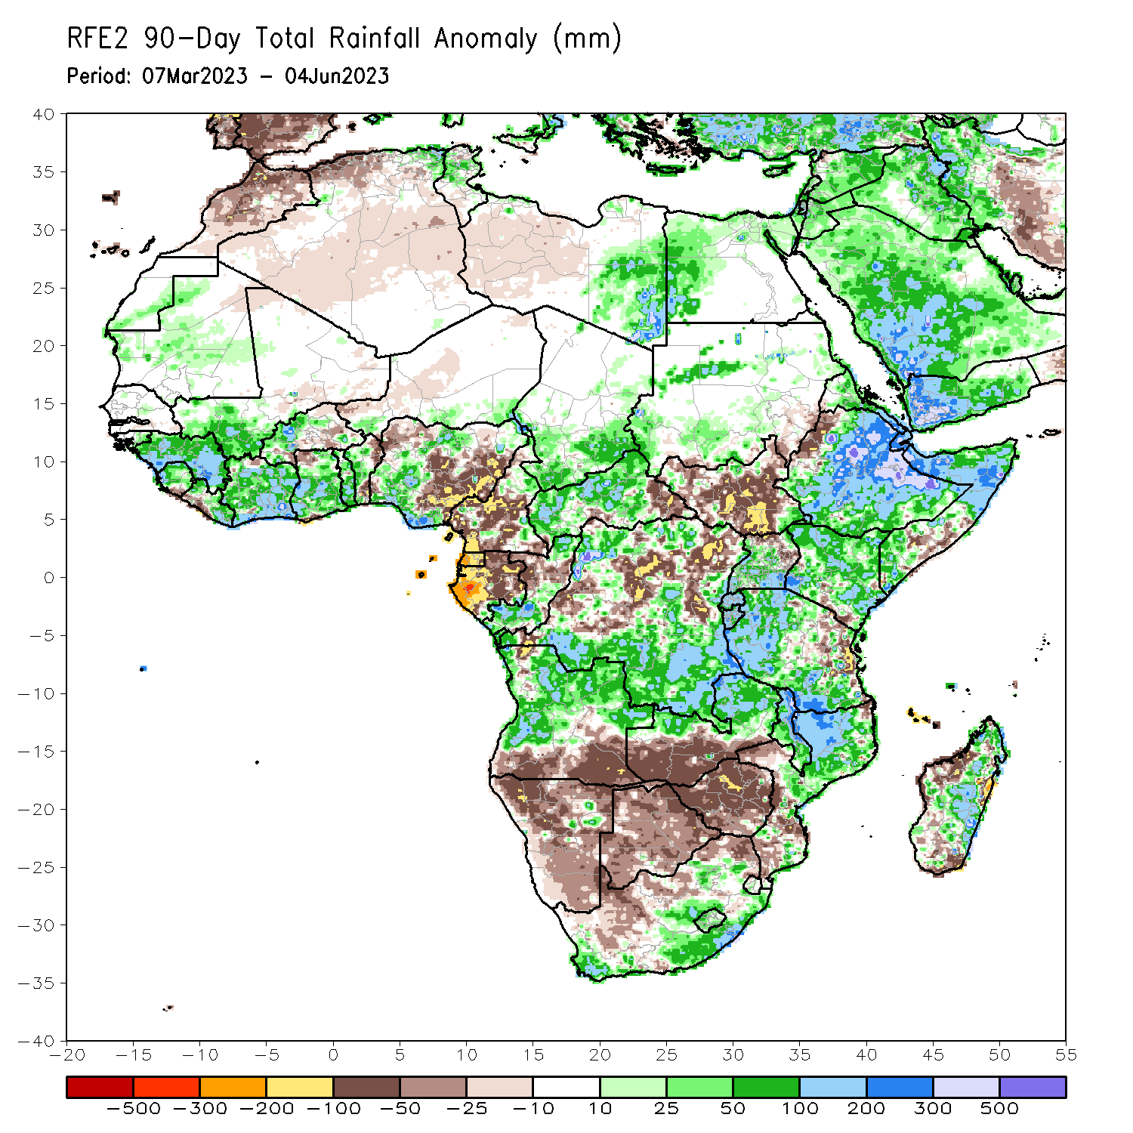
Rainfall Patterns: Last 90 Days
Over the past 90 days, in East Africa, above-average rainfall was observed over many parts of Eritrea, Ethiopia, Somalia, Kenya, Djibouti, Uganda, western and central Tanzania, Burundi, Rwanda, and pockets of South Sudan. Rainfall was below-average over much of South Sudan, the far western Ethiopia, parts of southern Somalia, the far southern Kenya and eastern Tanzania. In southern Africa, above-average rainfall was observed over central and northern Angola, northern and eastern Zambia, parts of eastern and southern South Africa, Lesotho, northern Mozambique, and much of Madagascar. Below-average rainfall was observed over the southern Angola, western and southern Zambia, much of Namibia, much of Botswana, western and South Africa, Zimbabwe, Malawi, pockets of southern Mozambique and northern Madagascar. In Central Africa, rainfall was above-average over pockets of Cameroon, western and central CAR, much of Congo, and pats of northern and much of southern DRC. Rainfall was below-average over many parts of Cameroon, Equatorial Guinea, Gabon, parts of eastern CAR, and western and central DRC. In West Africa, rainfall was above-average over much of Guinea, Sierra Leone, Liberia, Cote d’Ivoire, southwestern Mali, Ghana, Togo, northern, Benin, and western and northern Nigeria. Below-average rainfall was observed over parts of Burkina Faso, and northern and southeastern Nigeria.
Notes:
4

Slide 5
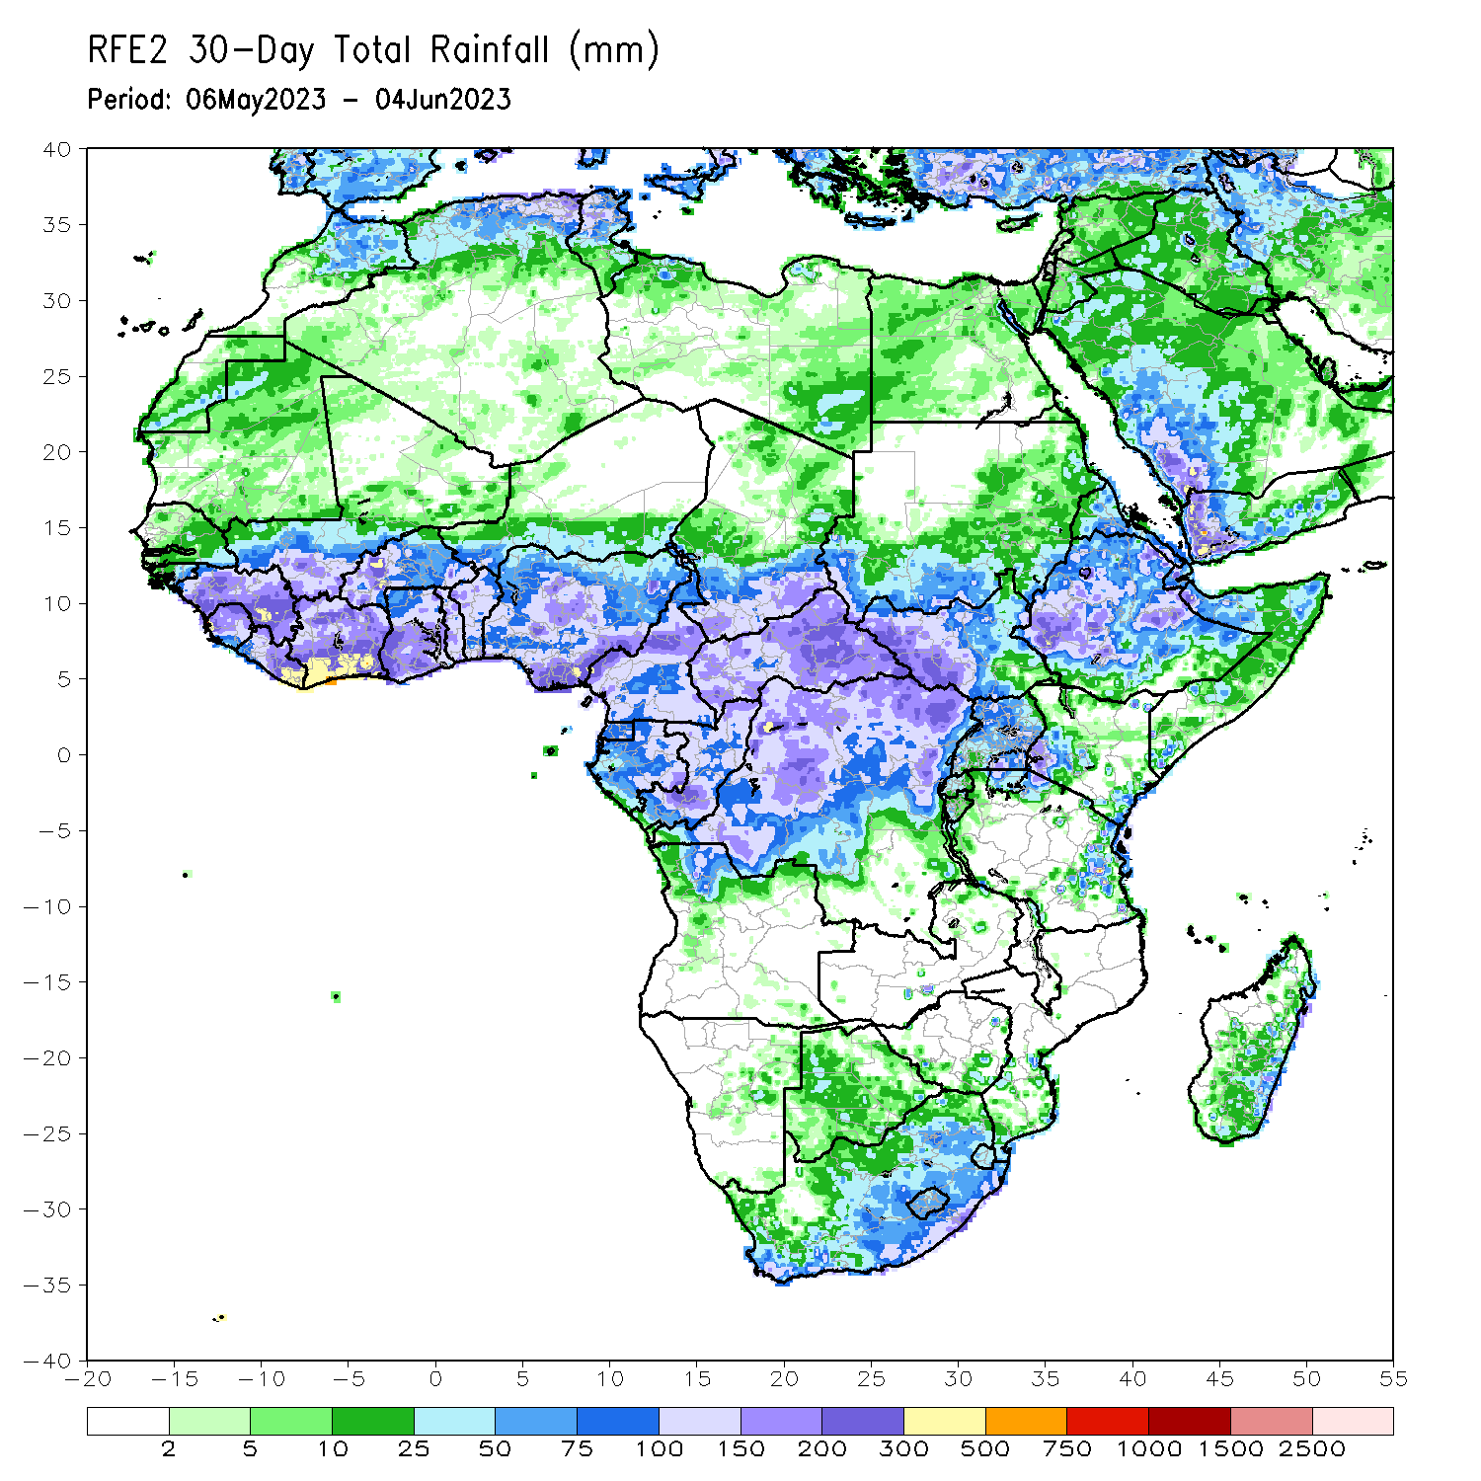
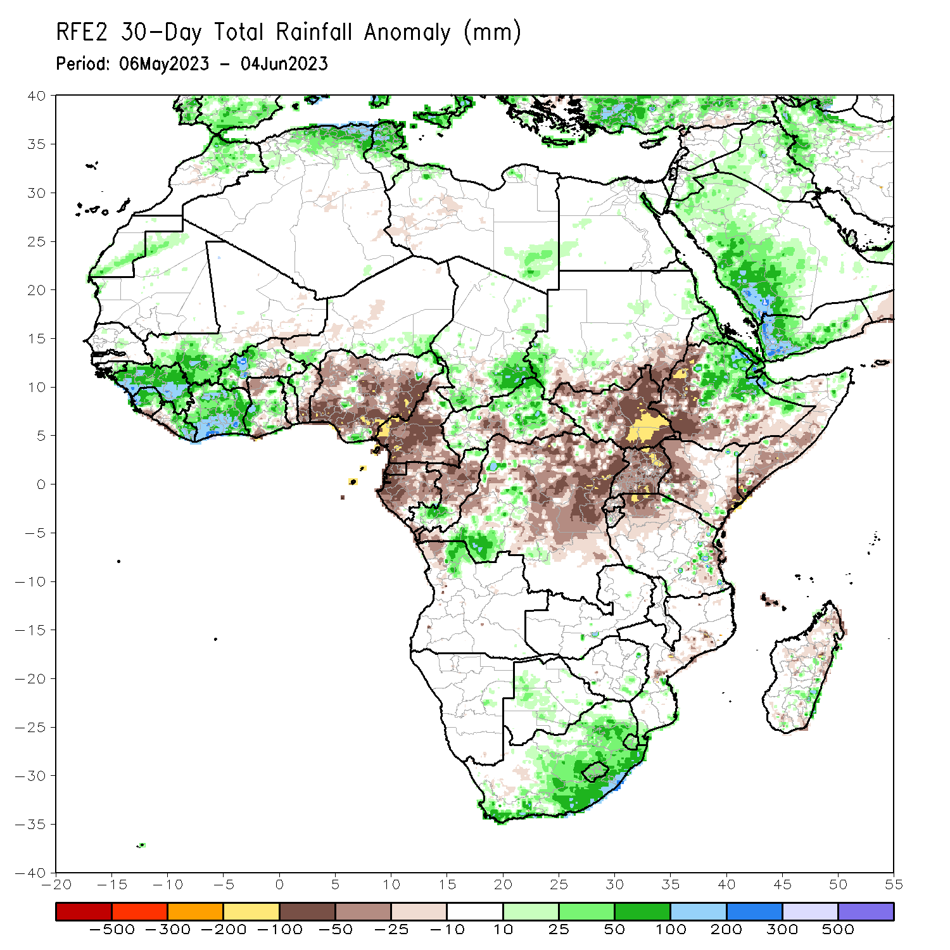
Rainfall Patterns: Last 30 Days
Over the past 30 days, in East Africa, above-average rainfall was observed over much Ethiopia, Eritrea, Djibouti, and northern and central Somalia. Rainfall was below-average over much of South Sudan, the far western Ethiopia and southern Somalia, Uganda, Rwanda, and the far northern Tanzania, coastal Tanzania. In southern Africa, rainfall was above-average over the central and eastern portions of South Africa, Lesotho, Eswatini, and pockets of Madagascar. In Central Africa, rainfall was above-average over the far southern Congo, parts of CAR, and southwestern DRC. Below-average rainfall was observed over much of Cameroon, Equatorial Guinea, Gabon, many parts of DRC, and pockets of central CAR. In West Africa, rainfall was above-average over much of Guinea, southwestern Mali, Sierra Leone, Liberia, and Cote d’Ivoire. Below-average rainfall was observed over parts of Burkina Faso, central, northern Ghana, and many parts of Nigeria.
Notes:
5

Slide 6
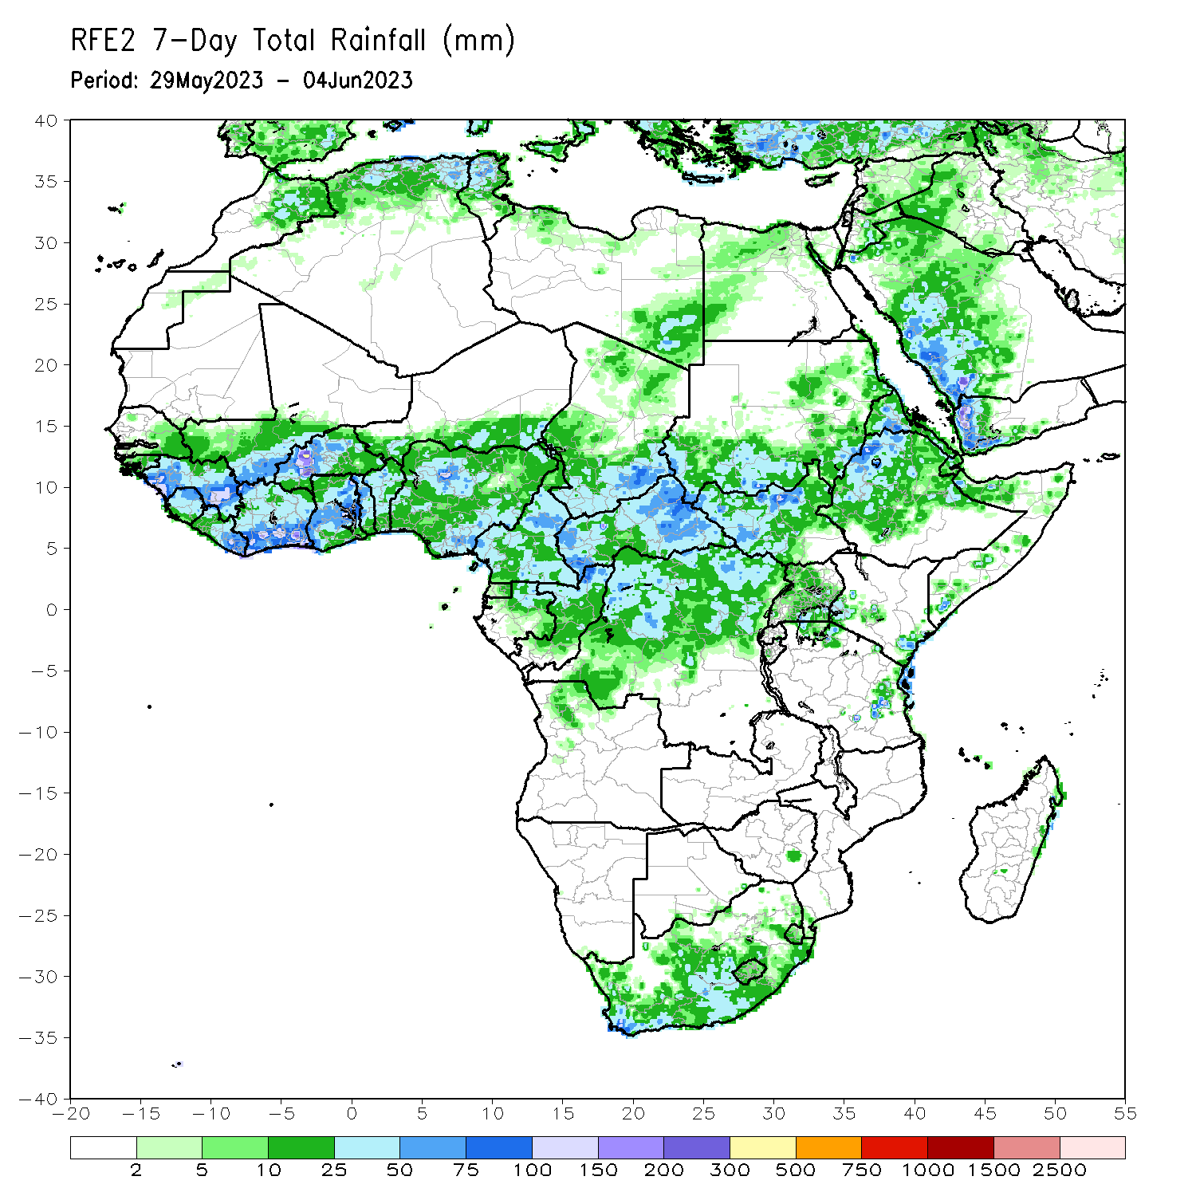
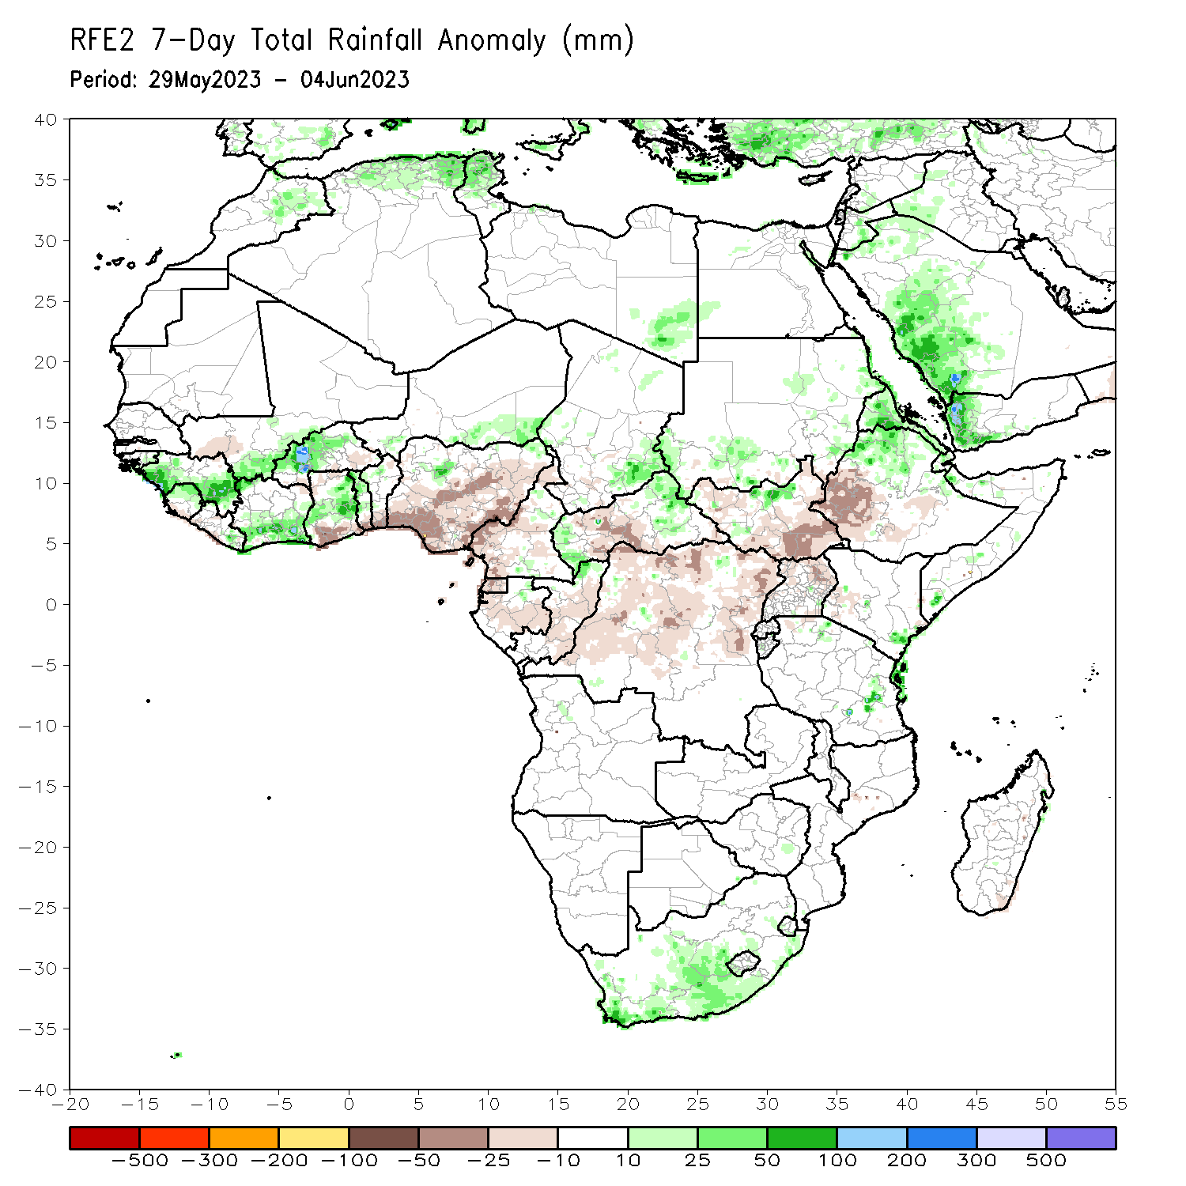
Rainfall Patterns: Last 7 Days
During the past 7 days, in East Africa, rainfall was above-average over northern Ethiopia, Eritrea, parts of western and eastern southern Sudan, South Sudan, and pockets of eastern Tanzania. Below-average rainfall was observed over parts of central South Sudan, and southwestern Ethiopia. In Central Africa, rainfall was above-average over western and eastern CAR. Below-average rainfall was observed over much of Cameroon, Equatorial Guinea, Gabon, Congo, and central and northern DRC. In West Africa, above-average rainfall was observed over portions of Guinea, Sierra Leone, southern Cote d’Ivoire, Burkina Faso, and central Ghana. Rainfall was below-average over over the far southern Ghana, southern Benin, and much of Nigeria. In Southern Africa, above-average rainfall was observed over parts of central and southern South Africa.

Slide 7
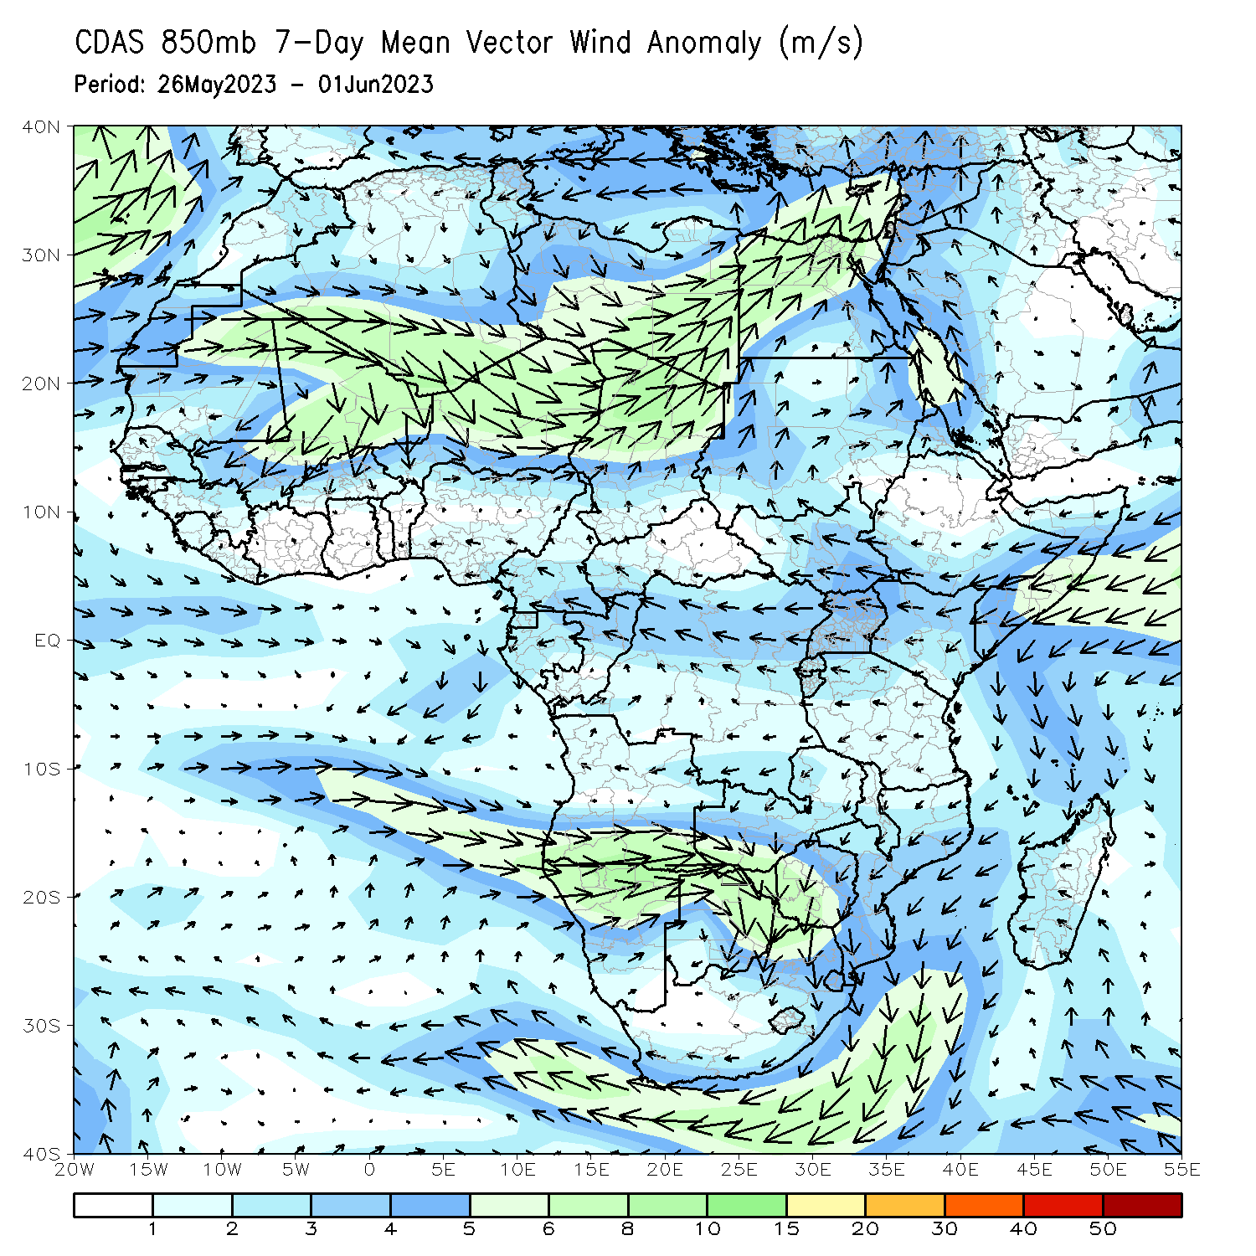
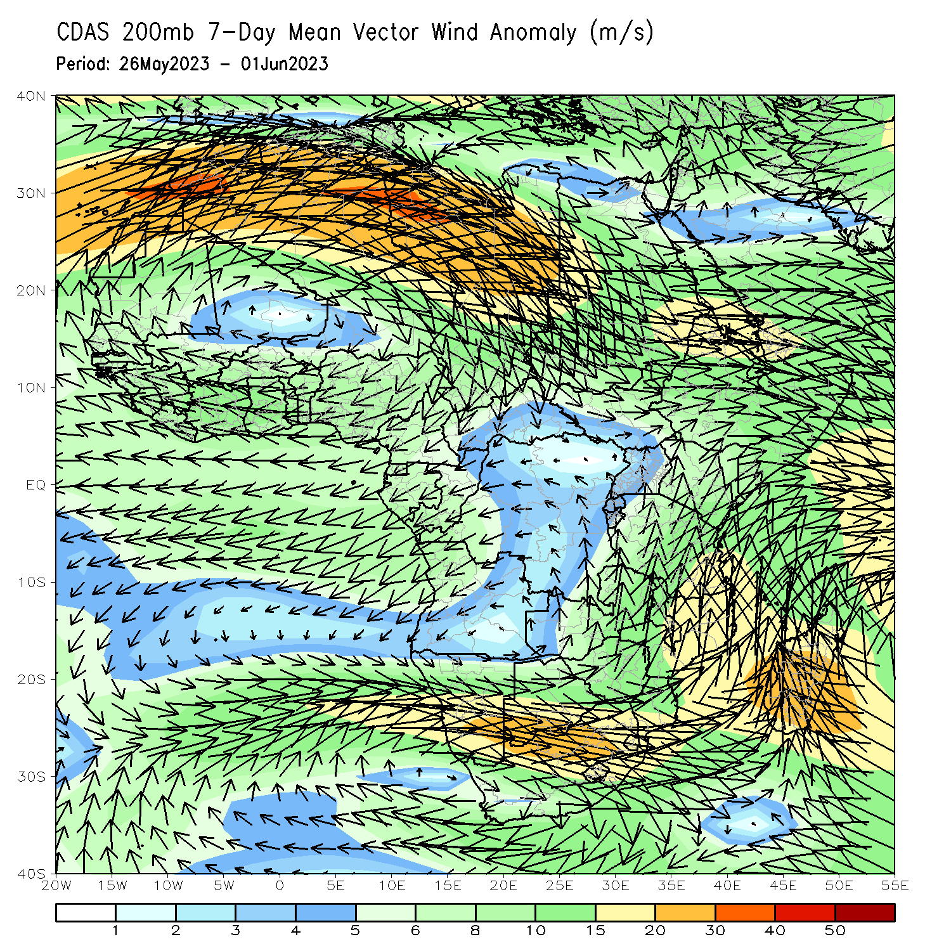
Atmospheric Circulation: Last 7 Days
At 850-hPa level (left panel), anomalous circulation flow across the far Southern Africa may have contributed to the observed above-average rainfall over parts of South Africa.

Slide 8
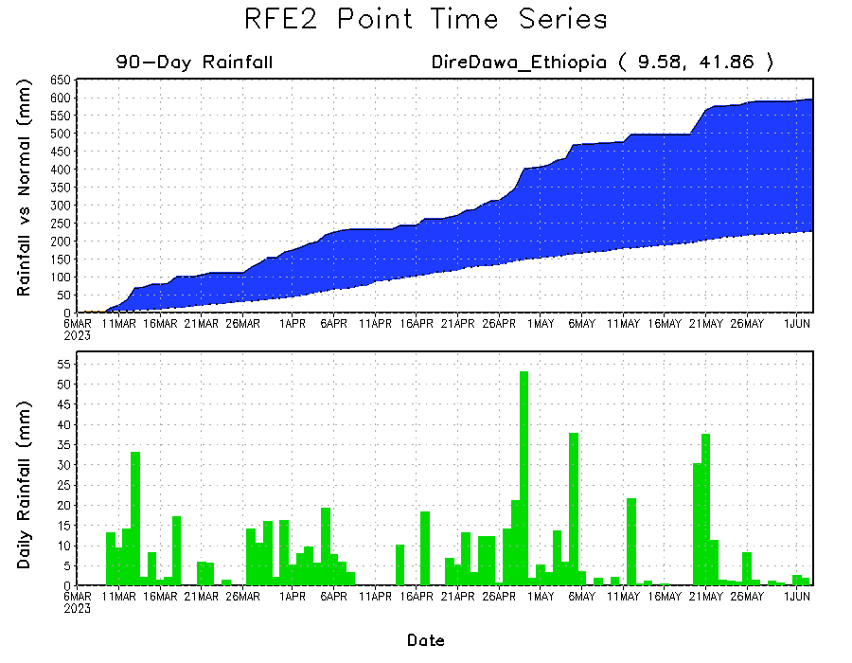
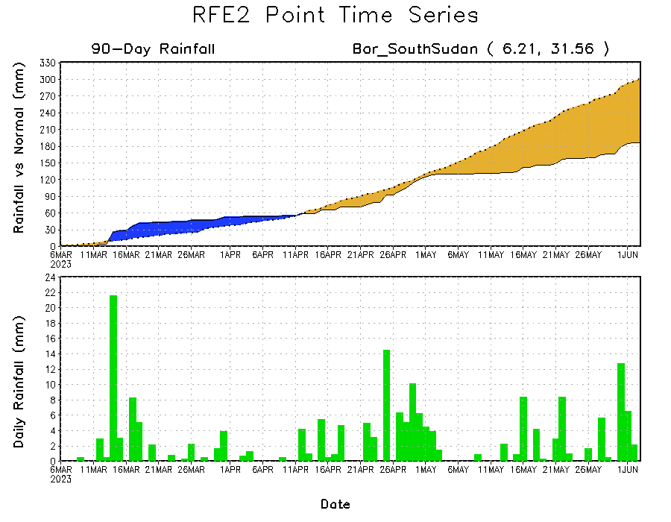
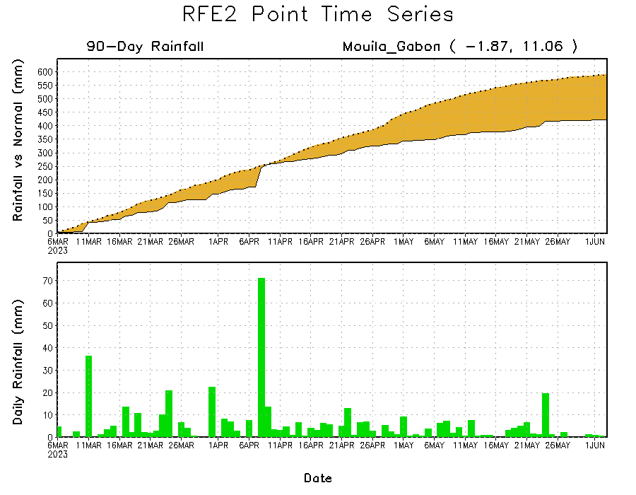
Rainfall Evolution
Daily evolution of rainfall over the last 90 days at selected locations shows a growing dryness over parts of Gabon (bottom left) and South Sudan (bottom right). Moderate to local heavy rainfall sustained moisture surpluses over parts of eastern Ethiopia (top right).

Slide 9
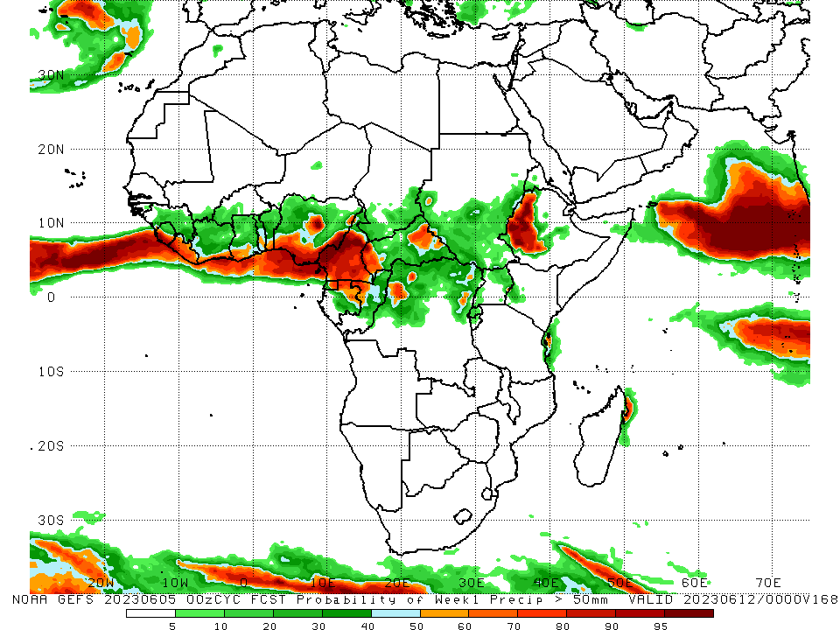
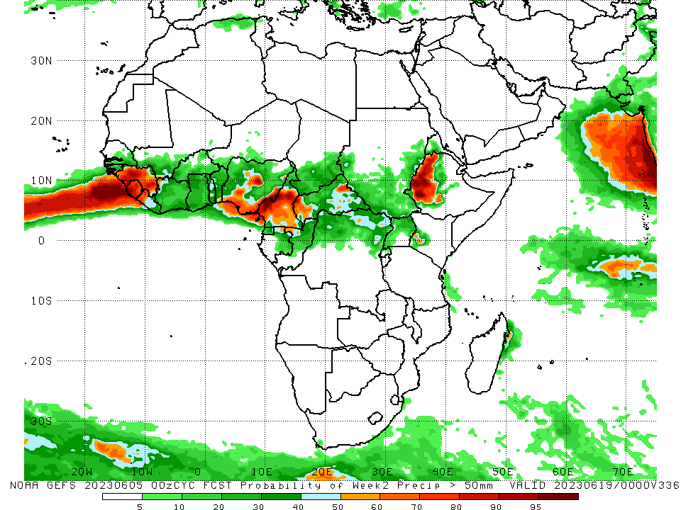
NCEP GEFS Model Forecasts Non-Bias Corrected Probability of precipitation exceedance
Week-1, Valid: 06 – 12 June 2023
Week-2, Valid: 13 – 19 June 2023
For week-1 (left panel), the GEFS forecasts indicate a moderate to high chance (over 70%) for rainfall to exceed 50 mm along the Gulf of Guinea coast, pockets of Central Africa and western Ethiopia. For week-2 (right panel), higher probability of exceedances are expected to be confined mainly over the far western and eastern Gulf of Guinea region, and western Ethiopia.
Notes:
9

Slide 10
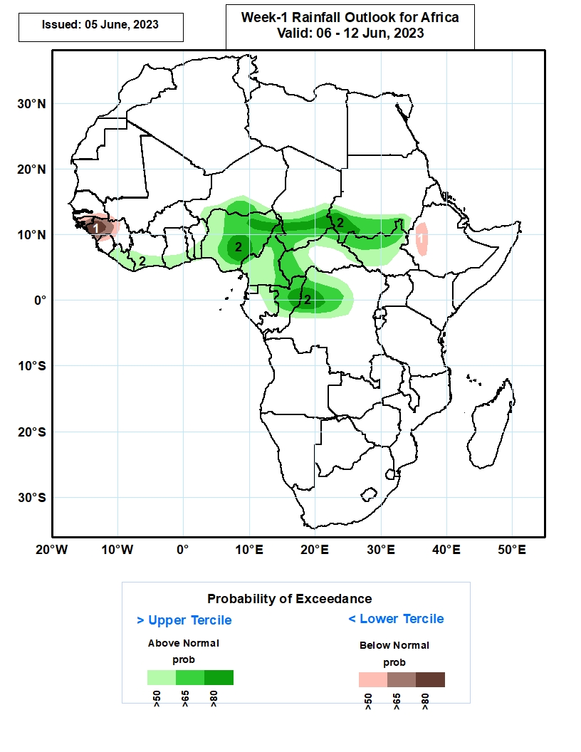
Week-1 Precipitation Outlooks
06 – 12 June2023
The forecasts call for above 50% chance for weekly total rainfall to be below-normal (below the lower tercile) over southern Senegal, much of Guinea-Bissau, western and northern portions of Guinea, and western Ethiopia. In particular, there is above 80% chance for rainfall to be below-normal over western Guinea.
The probabilistic forecasts call for above 50% chance for weekly rainfall to be above-normal (above the upper tercile) over much of Liberia, southern Cote d’Ivoire, Ghana, Togo and Benin, much of Nigeria, Cameroon and Equatorial Guinea, southern Niger, Chad and Sudan, western and eastern portions of CAR, northern and central CAR northern Gabon and Congo, and western and central parts of DR Congo. In particular, there is above 80% chance for rainfall to be above-normal over northern and eastern parts of Nigeria, southern Chad, southwestern Sudan, northern Congo, and northwestern DR Congo.
Notes:
10

Slide 11
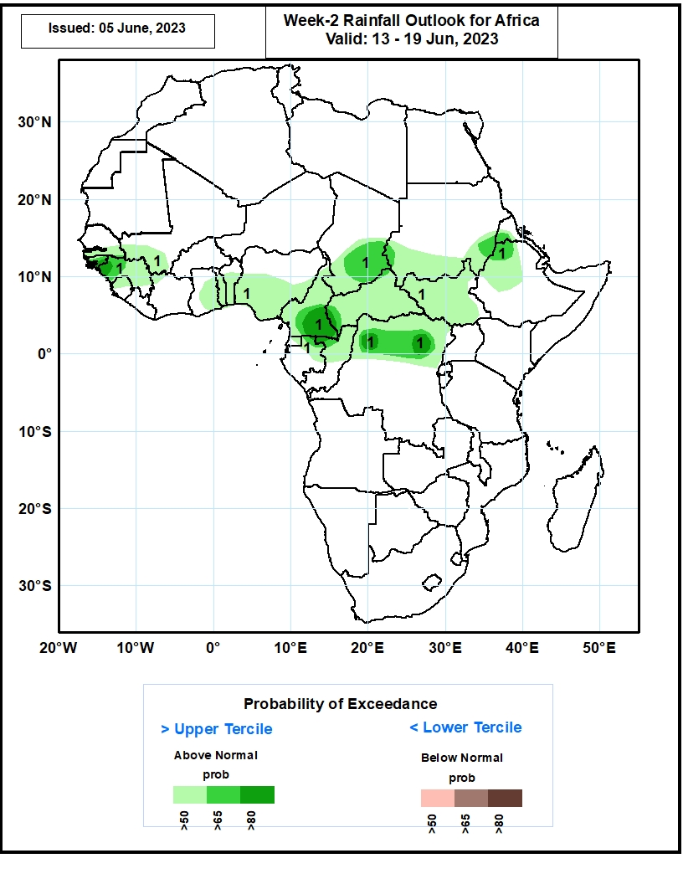
Week-2 Precipitation Outlooks
13 – 19 June 2023
The probabilistic forecasts call for above 50% chance for weekly rainfall to be above-normal (above the upper tercile) over southern Senegal and Mali, much of Guinea-Bissau and Guinea, northern Sierra Leone, much of Ghana, Togo and Benin, central and southern portions of Nigeria, much of Cameroon, CAR, South Sudan and Equatorial Guinea, northern portions of Gabon, Congo and DR Congo, southern Chad and South Sudan, northern Eritrea, and northern and western parts of Ethiopia. In particular, there is above 80% chance for rainfall to be above-normal over western Guinea, southern Cameroon, and northern parts of DR Congo.
Notes:
11

Slide 12
Summary
Over the past 30 days, in East Africa, above-average rainfall was observed over much Ethiopia, Eritrea, Djibouti, and northern and central Somalia. Rainfall was below-average over much of South Sudan, the far western Ethiopia and southern Somalia, Uganda, Rwanda, and the far northern Tanzania, coastal Tanzania. In southern Africa, rainfall was above-average over the central and eastern portions of South Africa, Lesotho, Eswatini, and pockets of Madagascar. In Central Africa, rainfall was above-average over the far southern Congo, parts of CAR, and southwestern DRC. Below-average rainfall was observed over much of Cameroon, Equatorial Guinea, Gabon, many parts of DRC, and pockets of central CAR. In West Africa, rainfall was above-average over much of Guinea, southwestern Mali, Sierra Leone, Liberia, and Cote d’Ivoire. Below-average rainfall was observed over parts of Burkina Faso, central, northern Ghana, and many parts of Nigeria.
During the past 7 days, in East Africa, rainfall was above-average over northern Ethiopia, Eritrea, parts of western and eastern southern Sudan, South Sudan, and pockets of eastern Tanzania. Below-average rainfall was observed over parts of central South Sudan, and southwestern Ethiopia. In Central Africa, rainfall was above-average over western and eastern CAR. Below-average rainfall was observed over much of Cameroon, Equatorial Guinea, Gabon, Congo, and central and northern DRC. In West Africa, above-average rainfall was observed over portions of Guinea, Sierra Leone, southern Cote d’Ivoire, Burkina Faso, and central Ghana. Rainfall was below-average over over the far southern Ghana, southern Benin, and much of Nigeria. In Southern Africa, above-average rainfall was observed over parts of central and southern South Africa.
The Week-1 outlook calls for above-normal rainfall across the eastern portions of West Africa, and much of Central Africa. In contrast there is an increased chance for below-normal rainfall over the far western Gulf of Guinea region. For week-2, there is an increased chance for above-normal rainfall over many parts of the Gulf of Guinea region, and much of Central Africa, South Sudan and parts of southern Sudan and western Ethiopia.

