Slide 1
The African Monsoon Recent Evolution and Current Status Include Week-1 and Week-2 Outlooks
Update prepared
12 June 2023
For more information, visit:
http://www.cpc.ncep.noaa.gov/products/Global_Monsoons/African_Monsoons/precip_monitoring.shtml

Slide 2
Outline
Highlights
Recent Evolution and Current Conditions
NCEP GEFS Forecasts
Summary

Slide 3
Highlights: Last 7 Days
During the past 7 days, in East Africa, rainfall was above-average over northern Ethiopia, Eritrea, Djibouti, southern and central Sudan, northern and western South Sudan, and eastern Tanzania. Below-average rainfall was observed over parts of southeastern South Sudan, southwestern Ethiopia, and parts of western Uganda. In Central Africa, rainfall was above-average over western and northern CAR, southern and eastern Chad, western and pockets of central/northern DRC, central and southern Cameroon, eastern Gabon, and eastern Equatorial Guinea. Below-average rainfall was observed over parts of northern Cameroon, northeastern DRC, parts of central CAR, and parts of south-central Chad. In West Africa, above-average rainfall was observed over southern and northeastern Nigeria, portions of northeastern Guinea, southern Cote d’Ivoire, western and central Burkina Faso, southern Ghana, parts of central Togo and Benin, southeastern Niger, and parts of central Senegal. Rainfall was below-average over southeastern Senegal, southwestern Mali, eastern Guinea Bissau, western and parts of southeastern Guinea, Sierra Leone, western Liberia, parts of central Cote d’Ivoire, central Ghana, northern and southern Togo, northern and southern Benin, and parts of eastern Nigeria. In Southern Africa, above-average rainfall was observed over parts of southwestern South Africa.
The week-1 outlook calls for above-normal rainfall across Guinea, Sierra Leone, southwestern Mali, southwestern Burkina Faso, southern and central Nigeria, most of Central Africa, western Ethiopia, western Eritrea, and southwestern South Africa. In contrast there is an increased chance for below-normal rainfall from Liberia to southern Benin, coastal southern Somalia to Tanzania, and eastern Madagascar. For week-2, there is an increased chance for above-normal rainfall over Guinea, Sierra Leone, western Liberia, Burkina Faso, much of Central Africa, and western Ethiopia. In contrast there is an increased chance for below-normal rainfall in coastal regions from southeastern Liberia to Benin, north-central Ethiopia, coastal regions from southern Somalia to Tanzania, and eastern Madagascar.

Slide 4
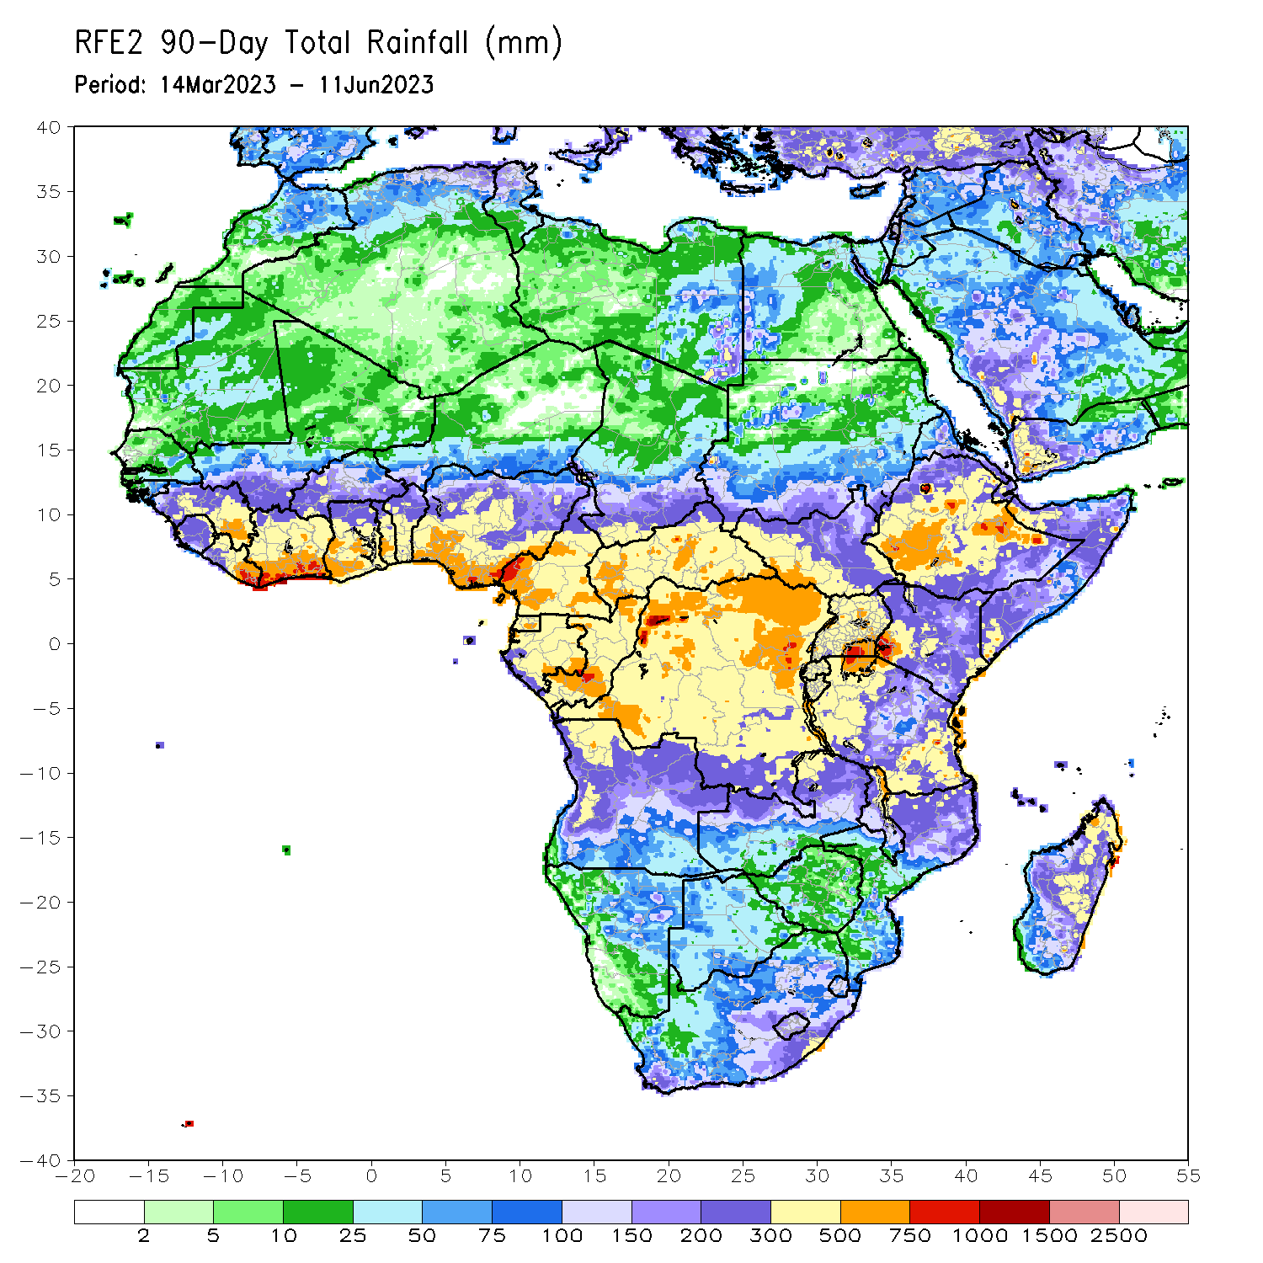
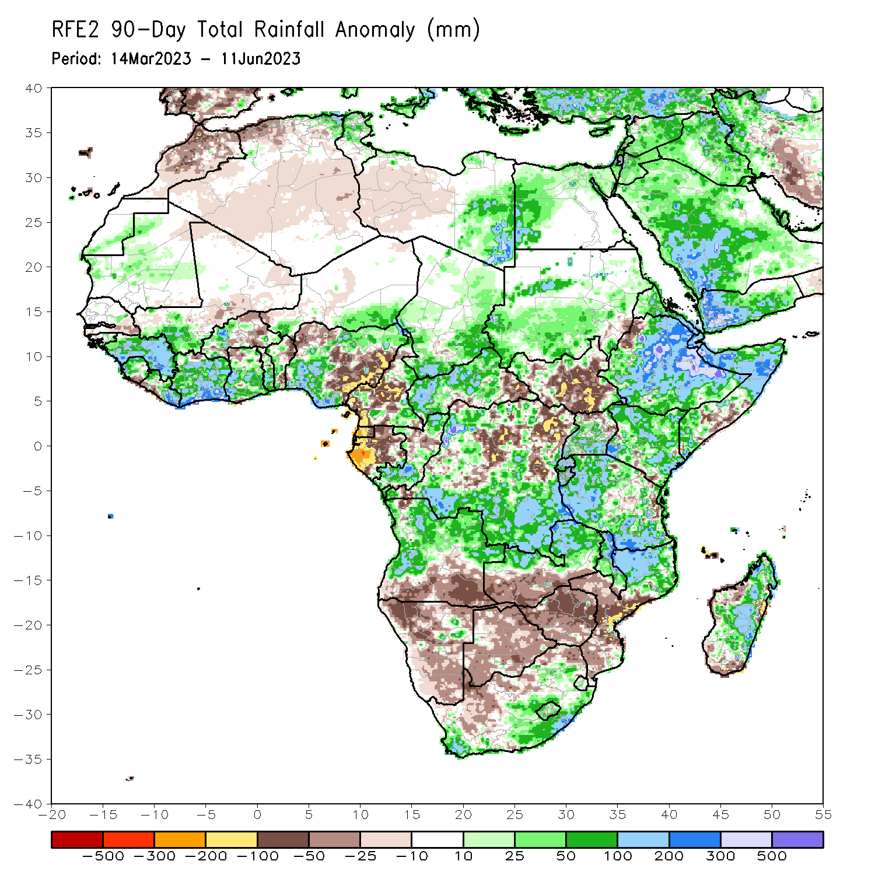
Rainfall Patterns: Last 90 Days
Over the past 90 days, in East Africa, above-average rainfall was observed over many parts of Eritrea, Ethiopia, northern and southern Somalia, Kenya, Djibouti, most of Uganda, western and southern Tanzania, Burundi, Rwanda, pockets of western, northern, and southeastern South Sudan, and central and southern Sudan. Rainfall was below-average over much of central and southern South Sudan, northwestern Ethiopia, parts of south-central Somalia, pockets of far southern Kenya, parts of eastern Tanzania, and northern Uganda. In southern Africa, above-average rainfall was observed over central and northern Angola, northern and eastern Zambia, parts of eastern and southern South Africa, Lesotho, northern Mozambique, Malawi, and much of Madagascar. Below-average rainfall was observed over southern Angola, western and southern Zambia, much of Namibia, much of Botswana, northern South Africa, Zimbabwe, central and southern Mozambique, and northwestern and southern Madagascar. In Central Africa, rainfall was above-average over pockets of eastern and northern Cameroon, western and central CAR, much of Congo, southern Chad, southern Gabon, and parts of northern and much of southern DRC. Rainfall was below-average over central Cameroon, Equatorial Guinea, most of Gabon, parts of southeastern CAR, and northeastern and central DRC. In West Africa, rainfall was above-average over much of Guinea, Sierra Leone, Liberia, Cote d’Ivoire, southwestern Mali, Ghana, Togo, northwestern and central Benin, western Burkina Faso, southeastern Niger, and southwestern and northeastern Nigeria. Below-average rainfall was observed over eastern Burkina Faso, northeastern Benin, and northwestern and southeastern Nigeria.
Notes:
4

Slide 5
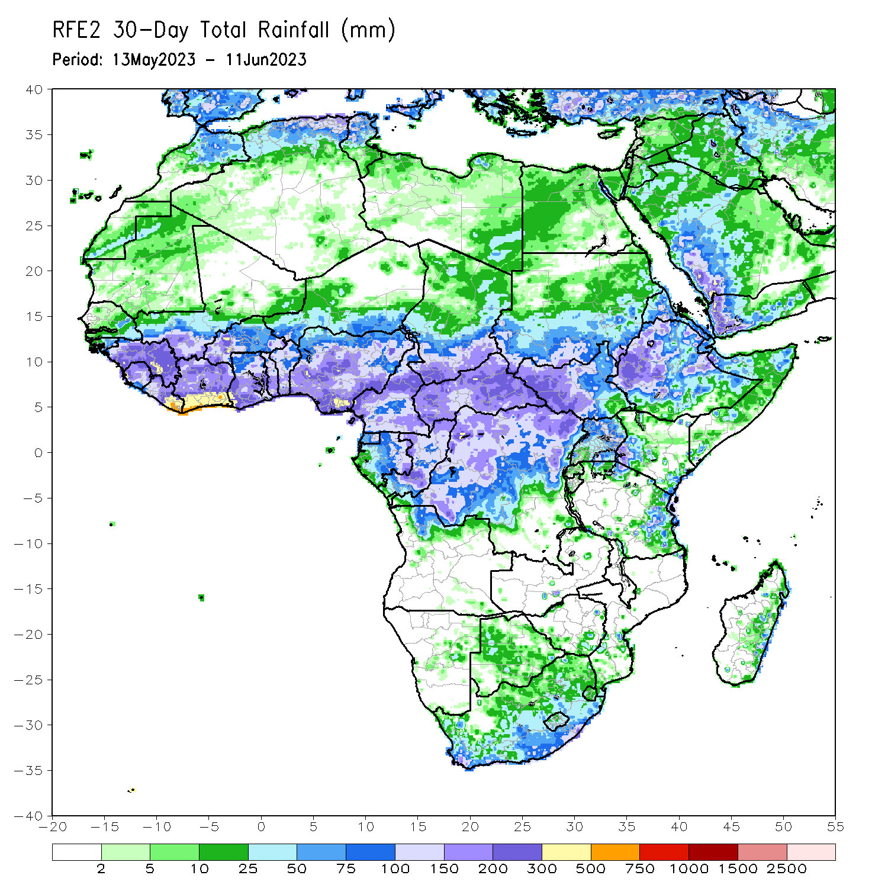
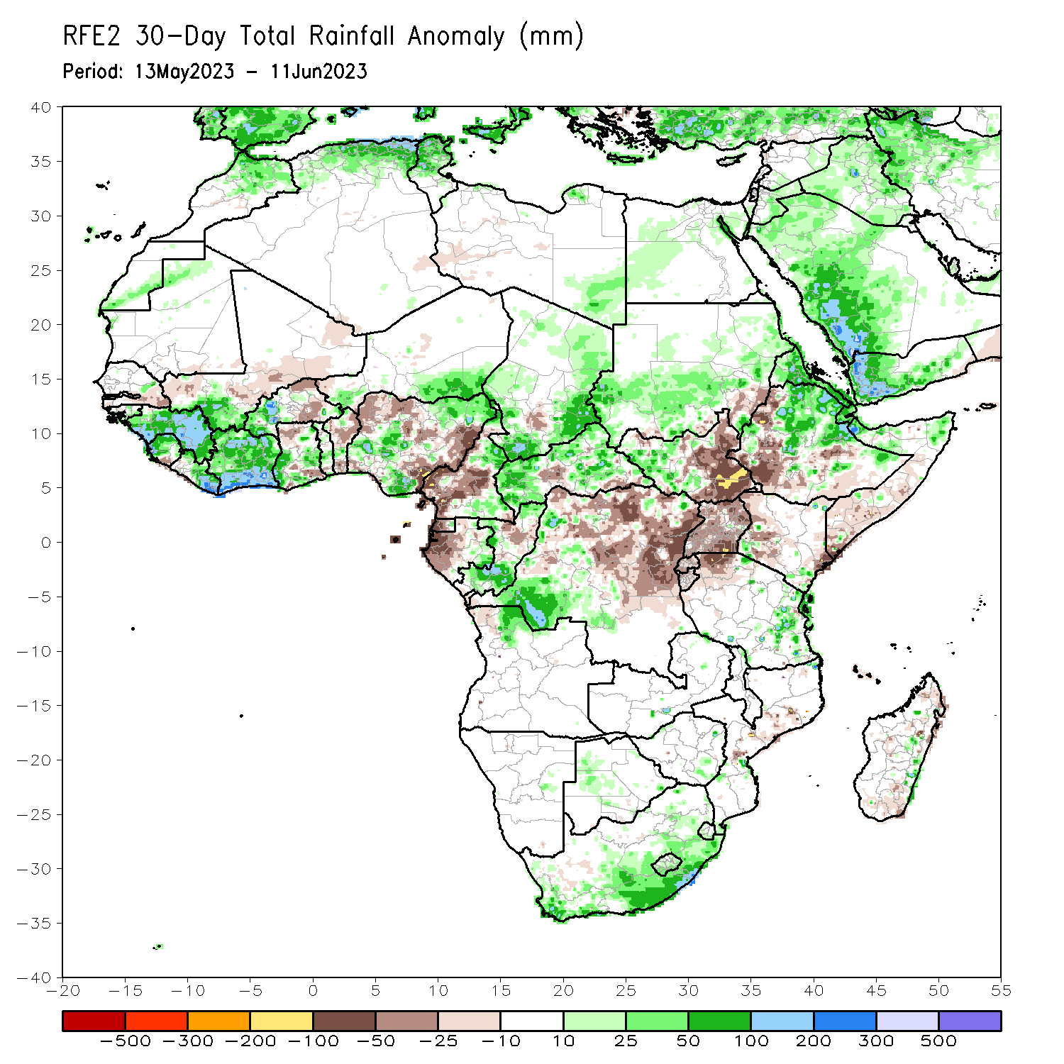
Rainfall Patterns: Last 30 Days
Over the past 30 days, in East Africa, above-average rainfall was observed over much of northern and eastern Ethiopia, Eritrea, Djibouti, northern Somalia, southern Sudan, western South Sudan, and eastern Tanzania. Rainfall was below-average over much of eastern South Sudan, western Ethiopia, central and southern Somalia, Uganda, Rwanda, Burundi, and far northwestern Tanzania. In southern Africa, rainfall was above-average over the central and eastern portions of South Africa, Lesotho, Eswatini, and pockets of east-central Madagascar. In Central Africa, rainfall was above-average over southern and northern Congo, western and eastern CAR, southern Chad, eastern and northern Cameroon, eastern Gabon, and southwestern DRC. Below-average rainfall was observed over much of western Cameroon, Equatorial Guinea, western Gabon, many parts of central and northwestern DRC, and pockets of central CAR. In West Africa, rainfall was above-average over much of Guinea, southwestern Mali, Sierra Leone, Liberia, Cote d’Ivoire, parts of southern and central Ghana, southwestern and northeastern Nigeria, southwestern Niger, and western Burkina Faso. Below-average rainfall was observed over parts of eastern Burkina Faso, southeastern and northern Ghana, much of Benin, and northwestern and southeastern Nigeria.
Notes:
5

Slide 6
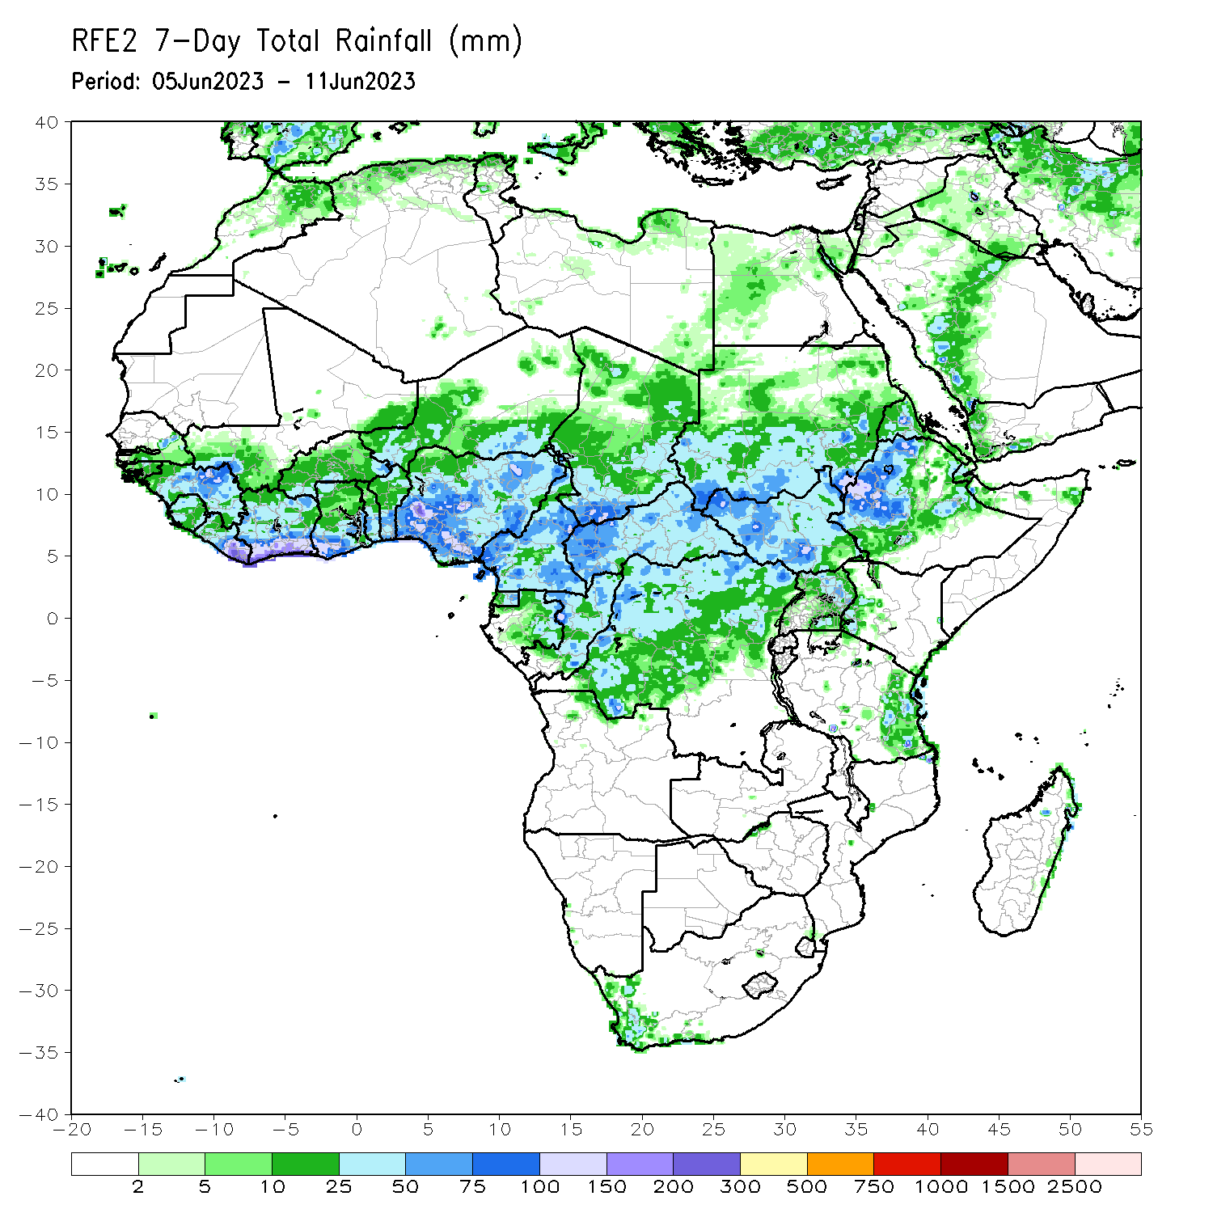
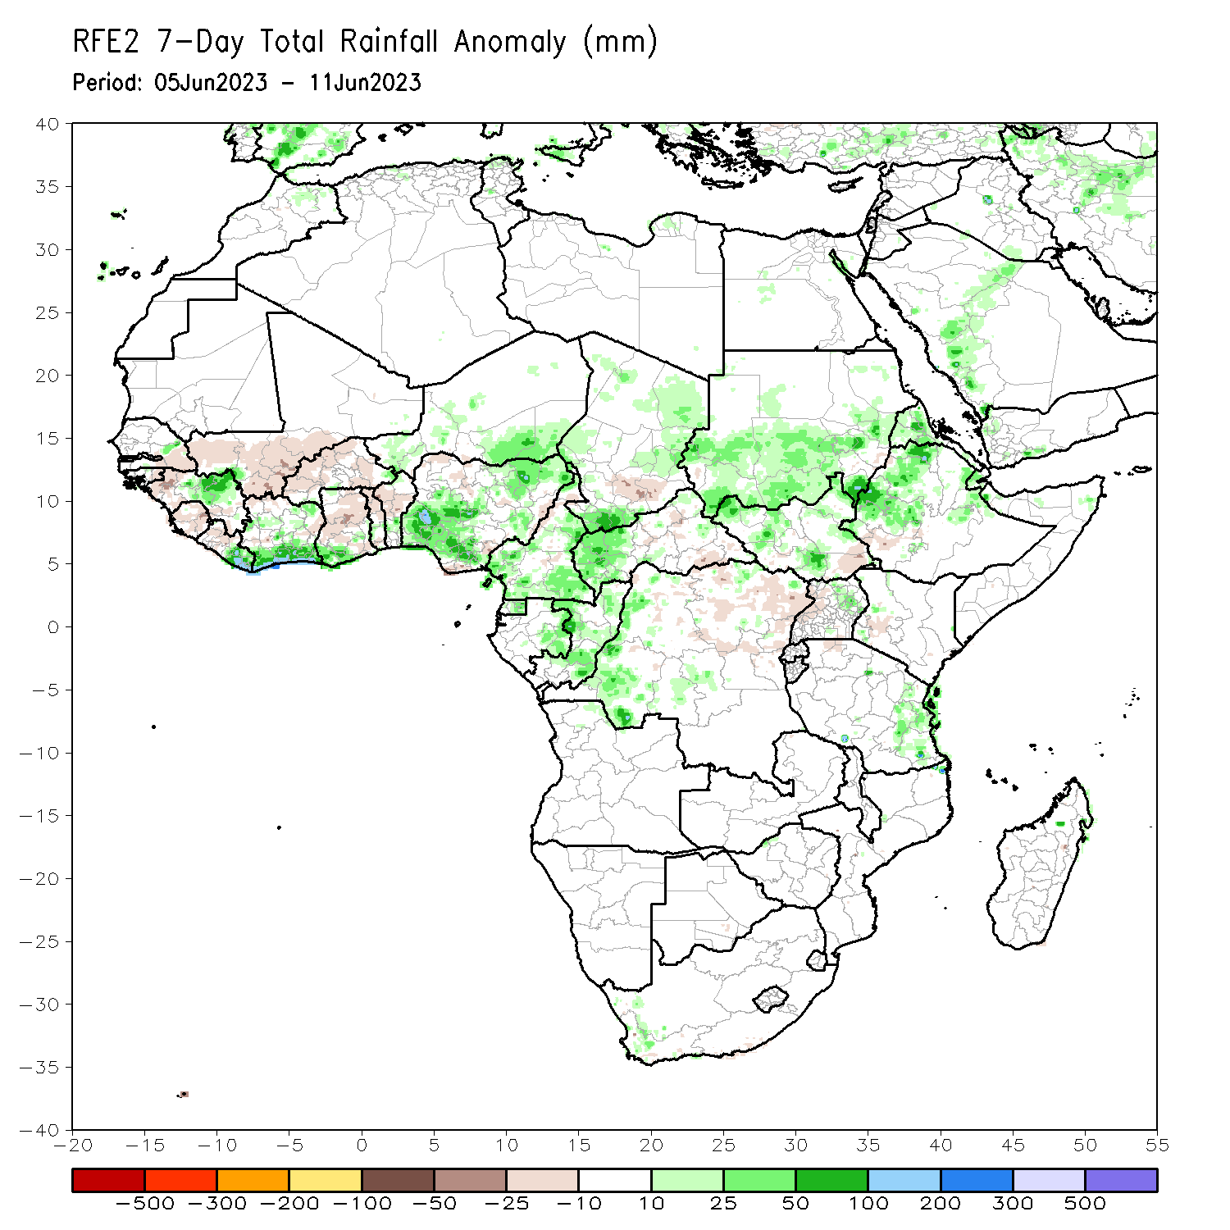
Rainfall Patterns: Last 7 Days
During the past 7 days, in East Africa, rainfall was above-average over northern Ethiopia, Eritrea, Djibouti, southern and central Sudan, northern and western South Sudan, and eastern Tanzania. Below-average rainfall was observed over parts of southeastern South Sudan, southwestern Ethiopia, and parts of western Uganda. In Central Africa, rainfall was above-average over western and northern CAR, southern and eastern Chad, western and pockets of central/northern DRC, central and southern Cameroon, eastern Gabon, and eastern Equatorial Guinea. Below-average rainfall was observed over parts of northern Cameroon, northeastern DRC, parts of central CAR, and parts of south-central Chad. In West Africa, above-average rainfall was observed over southern and northeastern Nigeria, portions of northeastern Guinea, southern Cote d’Ivoire, western and central Burkina Faso, southern Ghana, parts of central Togo and Benin, southeastern Niger, and parts of central Senegal. Rainfall was below-average over southeastern Senegal, southwestern Mali, eastern Guinea Bissau, western and parts of southeastern Guinea, Sierra Leone, western Liberia, parts of central Cote d’Ivoire, central Ghana, northern and southern Togo, northern and southern Benin, and parts of eastern Nigeria. In Southern Africa, above-average rainfall was observed over parts of southwestern South Africa.

Slide 7
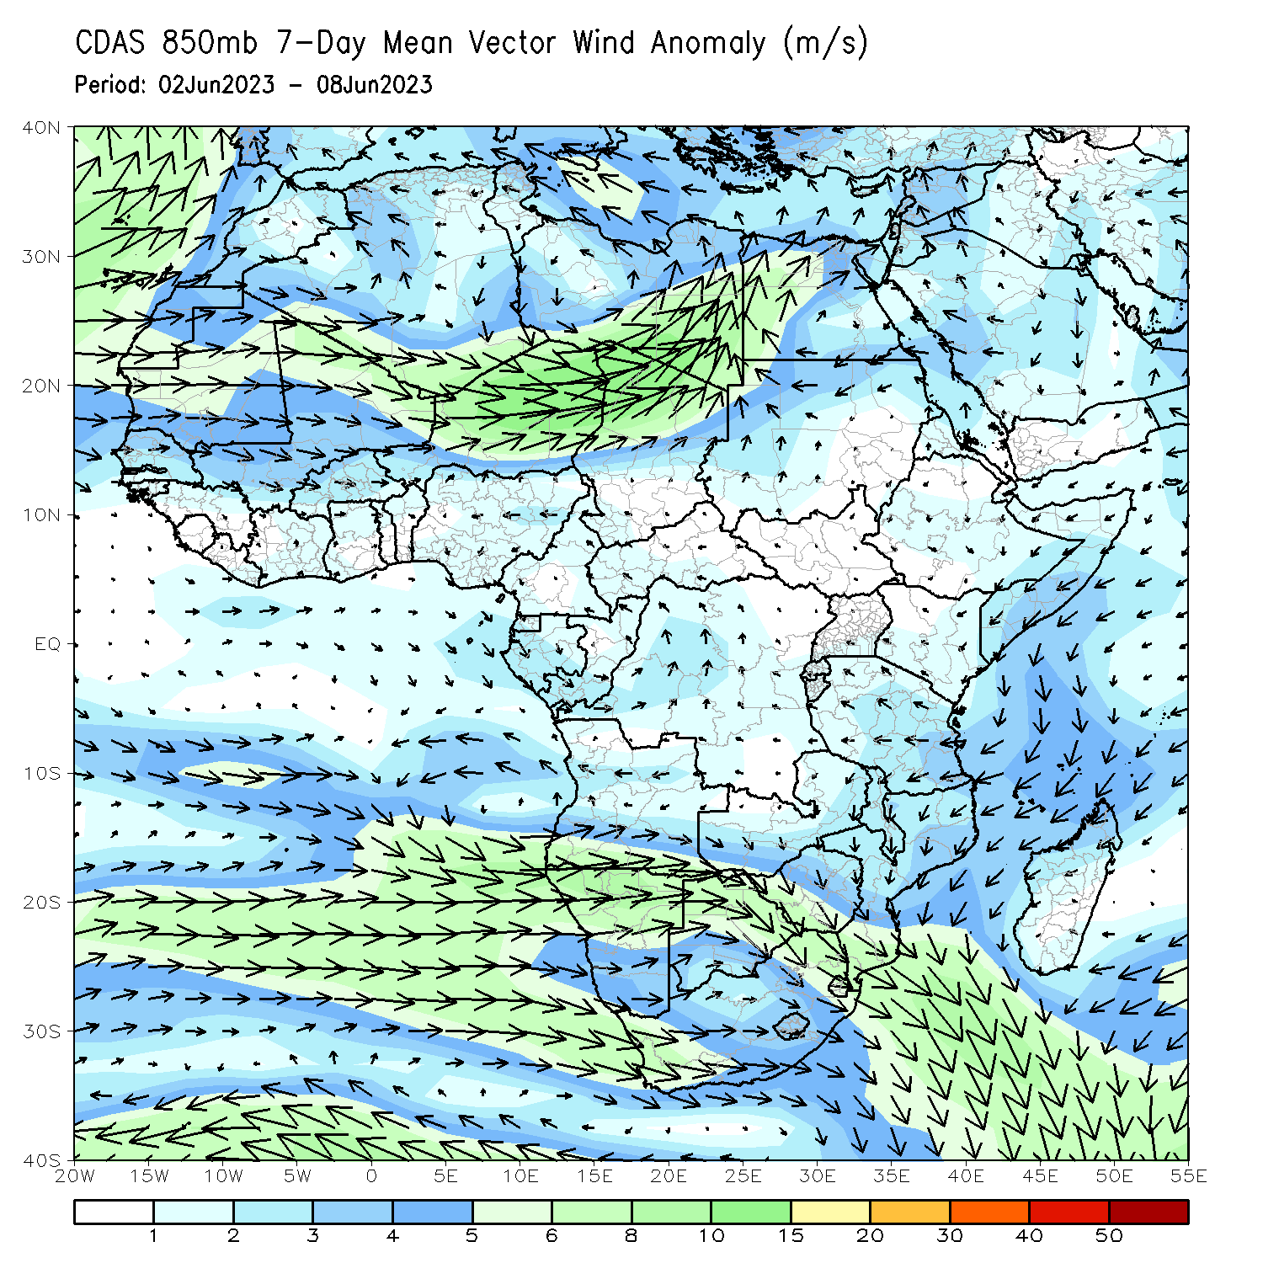
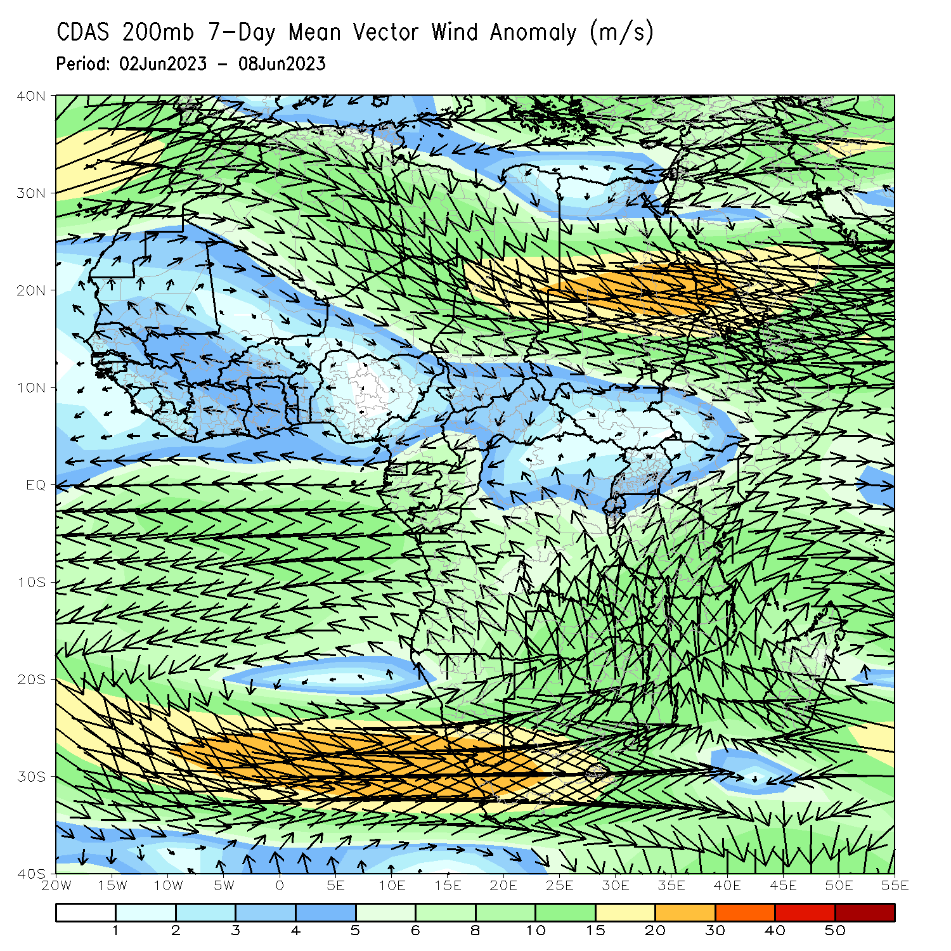
Atmospheric Circulation: Last 7 Days
At 850-hPa level (left panel), anomalous circulation flow across the far Southern Africa may have contributed to the observed above-average rainfall over parts of South Africa. At the 200-hPa level (right panel), anomalous divergence across parts of the Gulf of Guinea and CAR, as well as in South Africa may have contributed to the observed above-average rainfall.

Slide 8
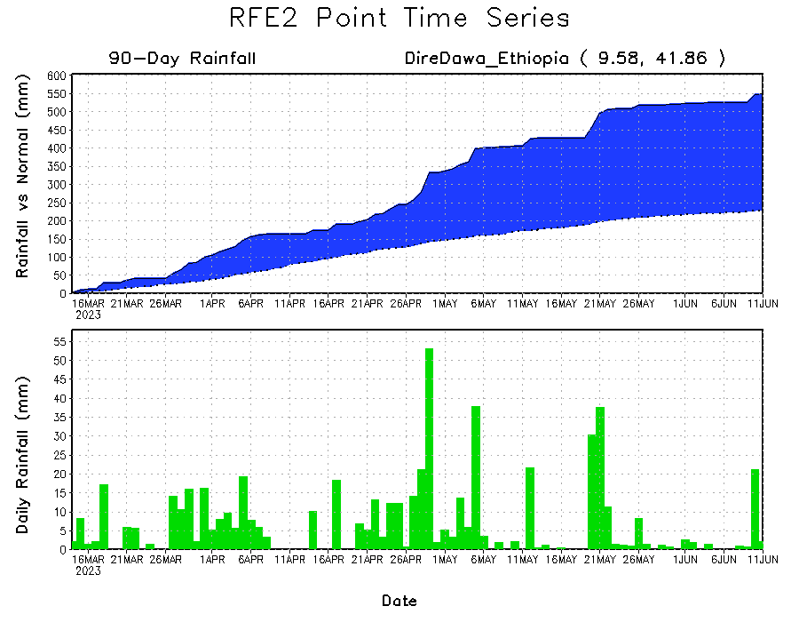
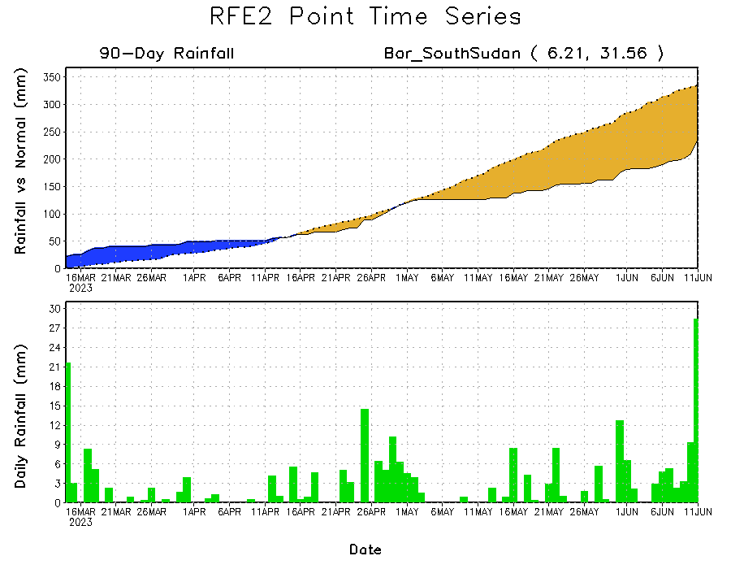
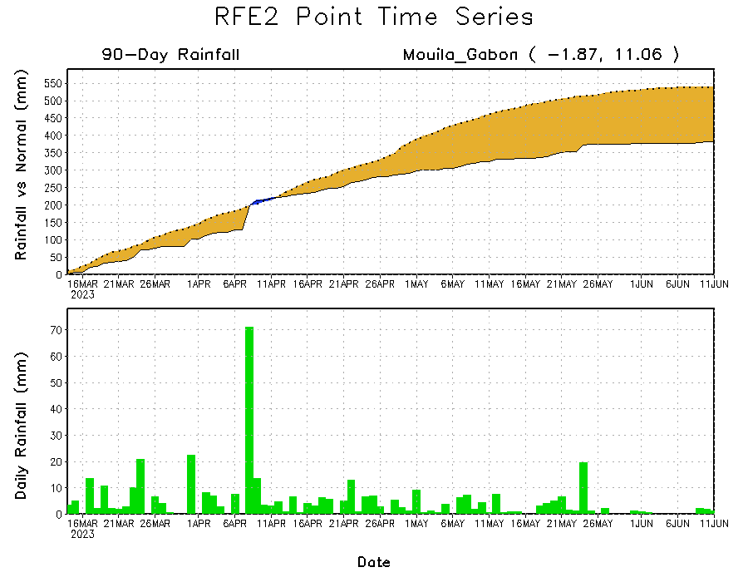
Rainfall Evolution
Daily evolution of rainfall over the last 90 days at selected locations shows a growing dryness over parts of Gabon (bottom left) and continued (yet slightly lower) deficits in South Sudan (bottom right). Moderate to local heavy rainfall sustained moisture surpluses over parts of eastern Ethiopia (top right).

Slide 9
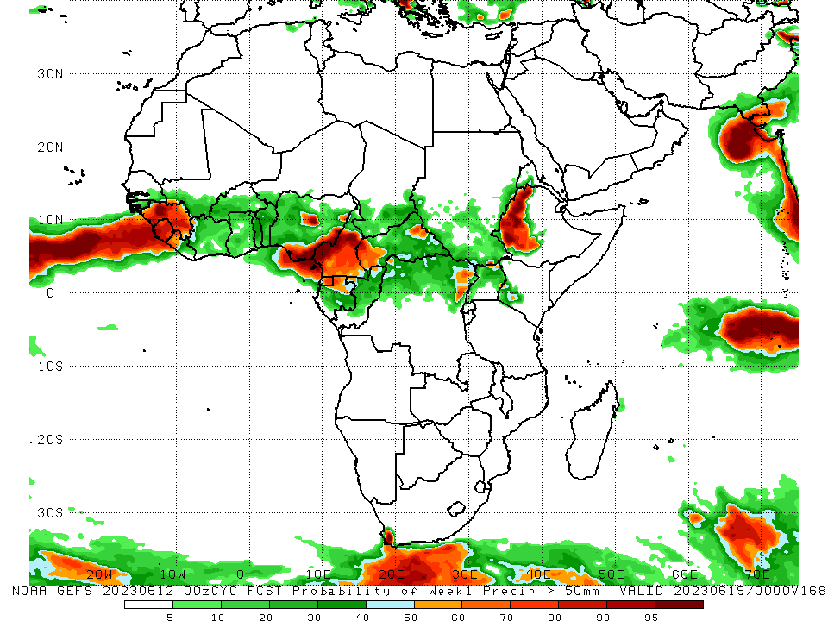
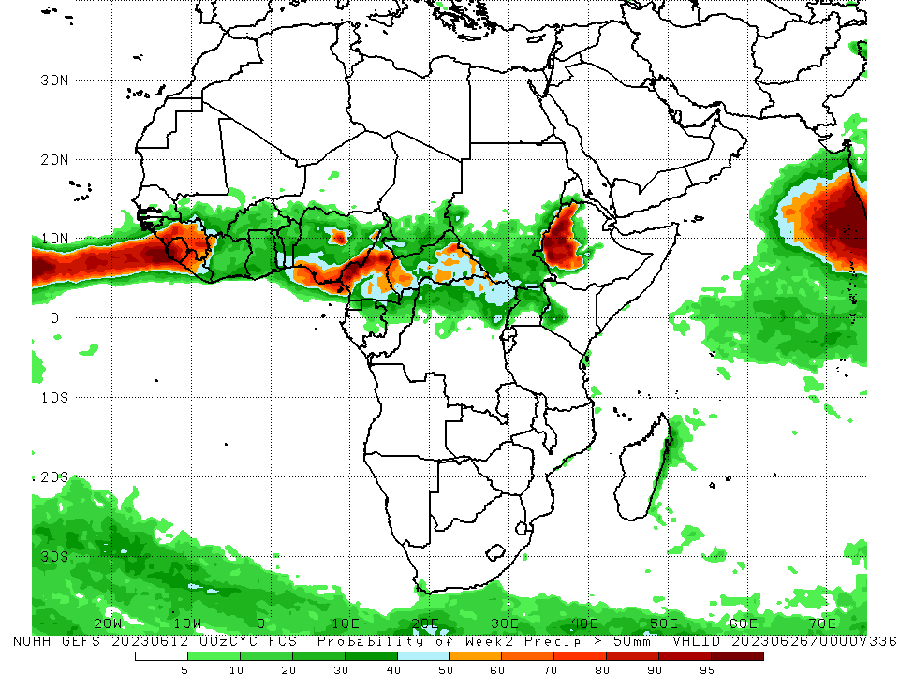
NCEP GEFS Model Forecasts Non-Bias Corrected Probability of precipitation exceedance
Week-1, Valid: 13 – 19 June 2023
Week-2, Valid: 20 – 26 June 2023
For week-1 (left panel), the GEFS forecasts indicate a moderate to high chance (over 70%) for rainfall to exceed 50 mm along the eastern (southern Nigeria) and western (Burkina Faso, Sierra Leone, western Liberia) Gulf of Guinea coast, pockets of Central Africa (western CAR, central and southern Cameroon), southwestern South Africa, and western Ethiopia. For week-2 (right panel), higher probability of exceedances are expected to be confined mainly over the far western and eastern Gulf of Guinea region, central Cameroon, parts of western and eastern CAR, and western Ethiopia.
Notes:
9

Slide 10
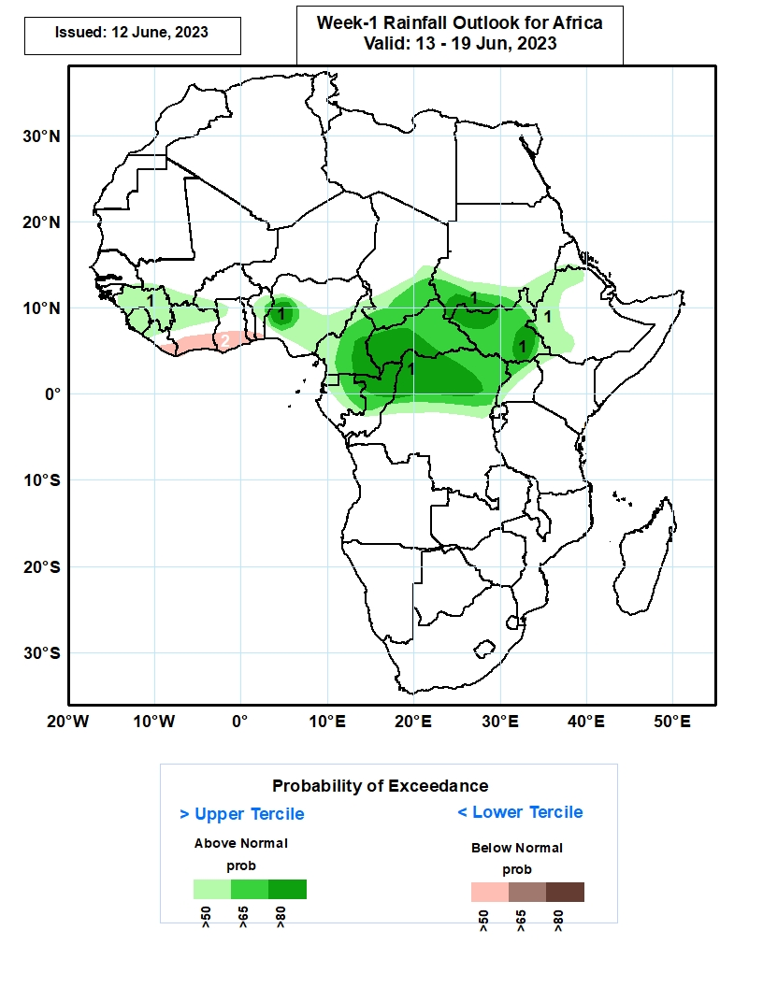
Week-1 Precipitation Outlooks
13 – 19 June 2023
1. The probabilistic forecasts call for above 50% chance for weekly rainfall to be above-normal (above the upper tercile) over much of Guinea and Sierra Leone, southern Mali, northern Liberia and Cote d’Ivoire, southwestern Burkina Faso, northwestern Ghana, northern Benin, central and southern portions of Nigeria, southern Chad and Sudan, western and northern portions of Ethiopia, much of Cameron, CAR, South Sudan and Equatorial Guinea, northern and central parts of Gabon and Congo, northern and central portions of DR Congo, and northern and western portions of Uganda. In particular, there is an above 80% chance for rainfall to be above-normal over western Nigeria, eastern Cameroon, western CAR, southern Sudan, northern and eastern portions of South Sudan, northern portions of Congo and DR Congo.
2. The forecasts call for above 50% chance for weekly total rainfall to be below-normal (below the lower tercile) over eastern Liberia, southern portions of Cote d’Ivoire, Ghana, Togo and Benin.
Notes:
10

Slide 11
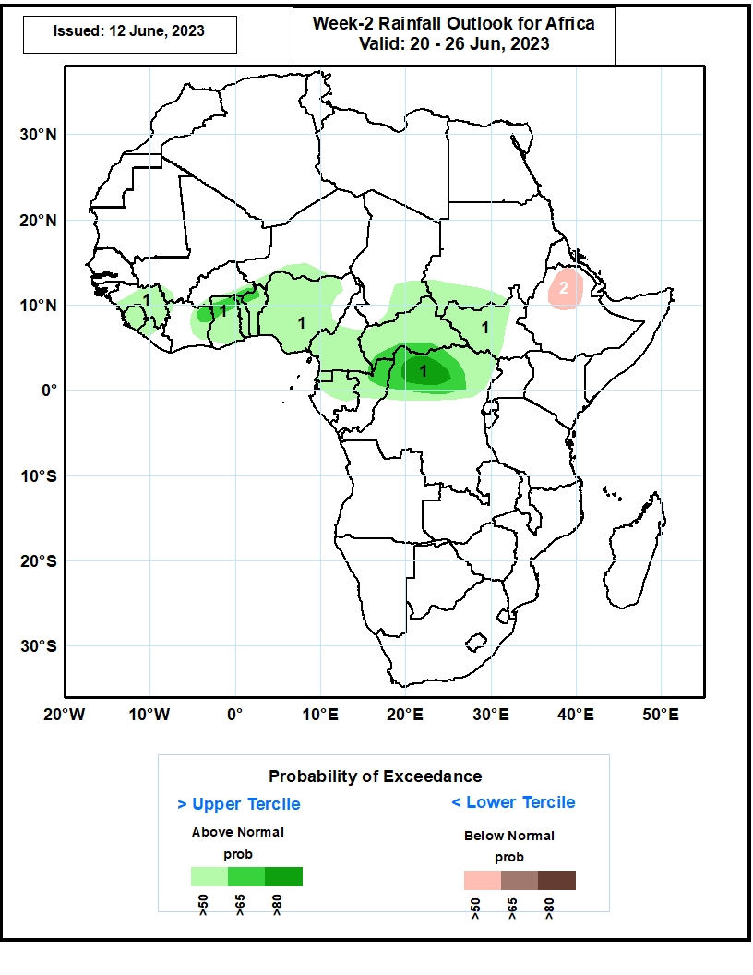
Week-2 Precipitation Outlooks
20 – 26 June 2023
1. The probabilistic forecasts call for above 50% chance for weekly rainfall to be above-normal (above the upper tercile) over much of Guinea and Sierra Leone, western Liberia, eastern Cote d’Ivoire, much of Ghana, Togo, Benin, Nigeria, Cameroon, CAR, and Equatorial Guinea, southern Burkina Faso, Niger, Chad and Sudan, western and central parts of South Sudan, northern and central parts of Gabon and Congo, and northern portions of DR Congo. In particular, there is an above 80% chance for rainfall to be above-normal over northern portions of DR Congo.
2. The forecasts call for above 50% chance for weekly total rainfall to be below-normal (below the lower tercile) over northern portions of Ethiopia.
Notes:
11

Slide 12
Summary
Over the past 30 days, in East Africa, above-average rainfall was observed over much of northern and eastern Ethiopia, Eritrea, Djibouti, northern Somalia, southern Sudan, western South Sudan, and eastern Tanzania. Rainfall was below-average over much of eastern South Sudan, western Ethiopia, central and southern Somalia, Uganda, Rwanda, Burundi, and far northwestern Tanzania. In southern Africa, rainfall was above-average over the central and eastern portions of South Africa, Lesotho, Eswatini, and pockets of east-central Madagascar. In Central Africa, rainfall was above-average over southern and northern Congo, western and eastern CAR, southern Chad, eastern and northern Cameroon, eastern Gabon, and southwestern DRC. Below-average rainfall was observed over much of western Cameroon, Equatorial Guinea, western Gabon, many parts of central and northwestern DRC, and pockets of central CAR. In West Africa, rainfall was above-average over much of Guinea, southwestern Mali, Sierra Leone, Liberia, Cote d’Ivoire, parts of southern and central Ghana, southwestern and northeastern Nigeria, southwestern Niger, and western Burkina Faso. Below-average rainfall was observed over parts of eastern Burkina Faso, southeastern and northern Ghana, much of Benin, and northwestern and southeastern Nigeria.
During the past 7 days, in East Africa, rainfall was above-average over northern Ethiopia, Eritrea, Djibouti, southern and central Sudan, northern and western South Sudan, and eastern Tanzania. Below-average rainfall was observed over parts of southeastern South Sudan, southwestern Ethiopia, and parts of western Uganda. In Central Africa, rainfall was above-average over western and northern CAR, southern and eastern Chad, western and pockets of central/northern DRC, central and southern Cameroon, eastern Gabon, and eastern Equatorial Guinea. Below-average rainfall was observed over parts of northern Cameroon, northeastern DRC, parts of central CAR, and parts of south-central Chad. In West Africa, above-average rainfall was observed over southern and northeastern Nigeria, portions of northeastern Guinea, southern Cote d’Ivoire, western and central Burkina Faso, southern Ghana, parts of central Togo and Benin, southeastern Niger, and parts of central Senegal. Rainfall was below-average over southeastern Senegal, southwestern Mali, eastern Guinea Bissau, western and parts of southeastern Guinea, Sierra Leone, western Liberia, parts of central Cote d’Ivoire, central Ghana, northern and southern Togo, northern and southern Benin, and parts of eastern Nigeria. In Southern Africa, above-average rainfall was observed over parts of southwestern South Africa.
The week-1 outlook calls for above-normal rainfall across Guinea, Sierra Leone, southwestern Mali, southwestern Burkina Faso, southern and central Nigeria, most of Central Africa, western Ethiopia, western Eritrea, and southwestern South Africa. In contrast there is an increased chance for below-normal rainfall from Liberia to southern Benin, coastal southern Somalia to Tanzania, and eastern Madagascar. For week-2, there is an increased chance for above-normal rainfall over Guinea, Sierra Leone, western Liberia, Burkina Faso, much of Central Africa, and western Ethiopia. In contrast there is an increased chance for below-normal rainfall in coastal regions from southeastern Liberia to Benin, north-central Ethiopia, coastal regions from southern Somalia to Tanzania, and eastern Madagascar.

