Slide 1
The African Monsoon Recent Evolution and Current Status Include Week-1 and Week-2 Outlooks
Update prepared
20 June 2023
For more information, visit:
http://www.cpc.ncep.noaa.gov/products/Global_Monsoons/African_Monsoons/precip_monitoring.shtml

Slide 2
Outline
Highlights
Recent Evolution and Current Conditions
NCEP GEFS Forecasts
Summary

Slide 3
Highlights: Last 7 Days
During the past 7 days, in East Africa, rainfall was above-average over western Ethiopia, Eritrea, parts of southern Sudan, eastern South Sudan, and many parts of Uganda. Below-average rainfall was observed over parts of western and central South Sudan. In Central Africa, rainfall was above-average over northern Congo, and pockets of DRC. Below-average rainfall was observed over pockets of Cameroon. In West Africa, above-average rainfall was observed over eastern Senegal, portions of Guinea, Sierra Leone, western and southern Mali, western Burkina Faso, eastern Niger and southern Nigeria. Rainfall was below-average over much of Liberia, Cote d’Ivoire and parts of southern Ghana. In Southern Africa, above-average rainfall was observed over the far southern South Africa.
The Week-1 outlook calls for above-normal rainfall across much of the Gulf Guinea region, and many places in the Central Africa. In contrast there is an increased chance for below-normal rainfall over Equatorial Guinea, parts of Gabon, and pockets of northern Ethiopia. For week-2, there is an increased chance for above-normal rainfall along the Gulf of Guinea coast, and the western portion of Central Africa and near Sudan/Ethiopia border. In contrast there is an increased chance for below-normal rainfall in the Lake Victoria region, and parts of northeastern, central and southwestern Ethiopia.

Slide 4
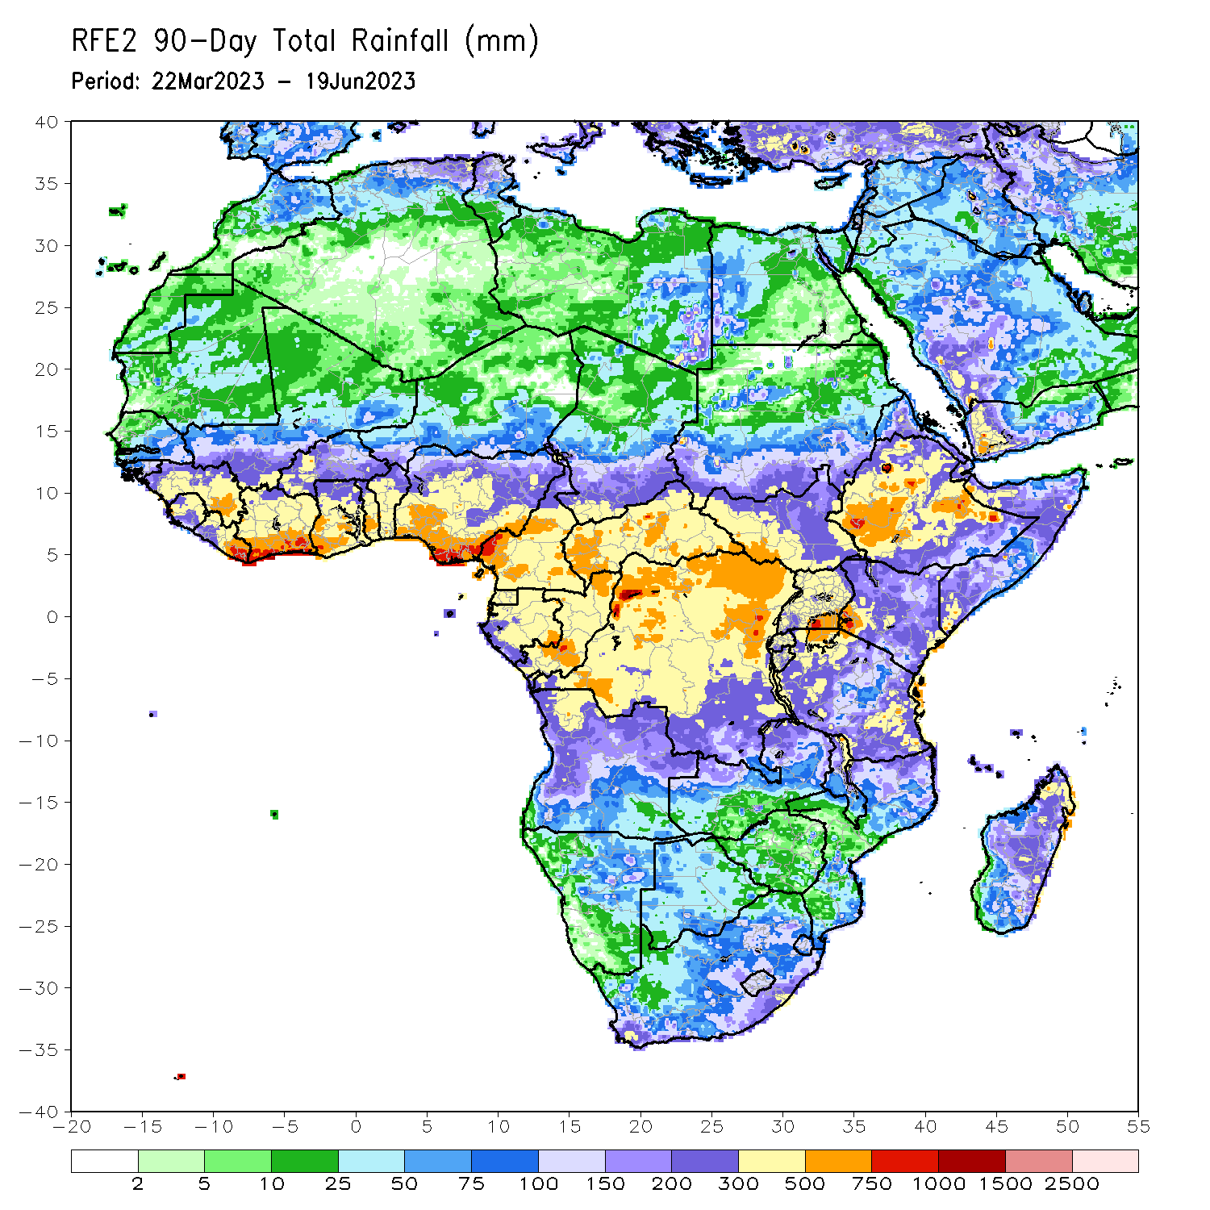
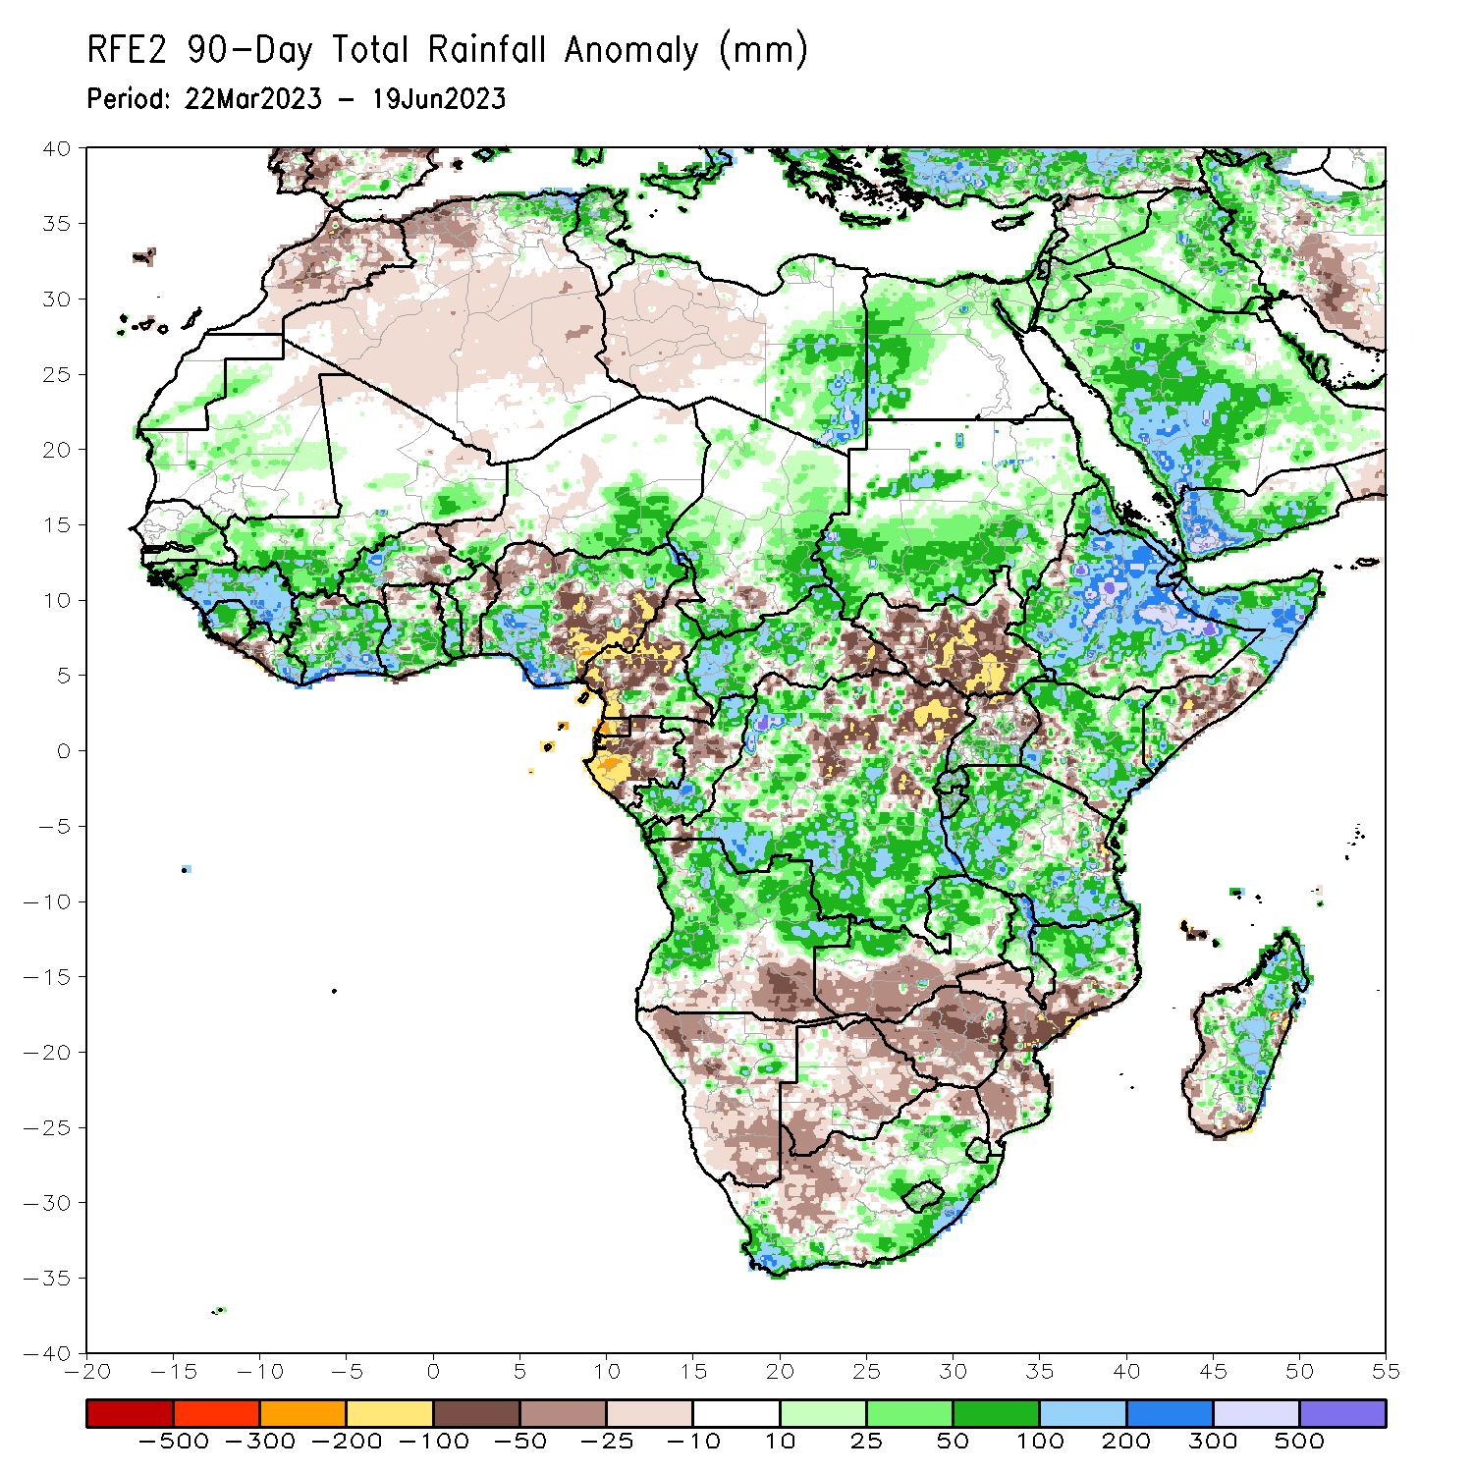
Rainfall Patterns: Last 90 Days
Over the past 90 days, in East Africa, above-average rainfall was observed over much of Eritrea, Ethiopia, northern and central Somalia, Kenya, Djibouti, central and southern Uganda, Tanzania, Burundi, Rwanda, and pockets of southern Sudan. Rainfall was below-average over much of South Sudan, pockets of the far western Ethiopia, parts of southern Somalia, the far western Kenya and northern Uganda. In southern Africa, above-average rainfall was observed over central and northern Angola, northern and eastern Zambia, parts of eastern and southern South Africa, Lesotho, Eswatini, northern Mozambique, and much of Madagascar. Below-average rainfall was observed over the southern Angola, western and southern Zambia, much of Namibia, much of Botswana, western South Africa, Zimbabwe, Malawi, and southern Mozambique. In Central Africa, rainfall was above-average over parts of eastern Cameroon, western and central CAR, many parts of Congo, and parts of western and southern DRC. Rainfall was below-average over many parts of Cameroon, Equatorial Guinea, much of Gabon, parts of eastern CAR, and central and eastern DRC. In West Africa, rainfall was above-average over parts of eastern Senegal, much of Guinea, Sierra Leone, Liberia, Cote d’Ivoire, southwestern Mali, western Burkina Faso, Ghana, Togo, Benin, and western and northern Nigeria. Below-average rainfall was observed over parts of eastern Burkina Faso, and northern and eastern Nigeria.
Notes:
4

Slide 5
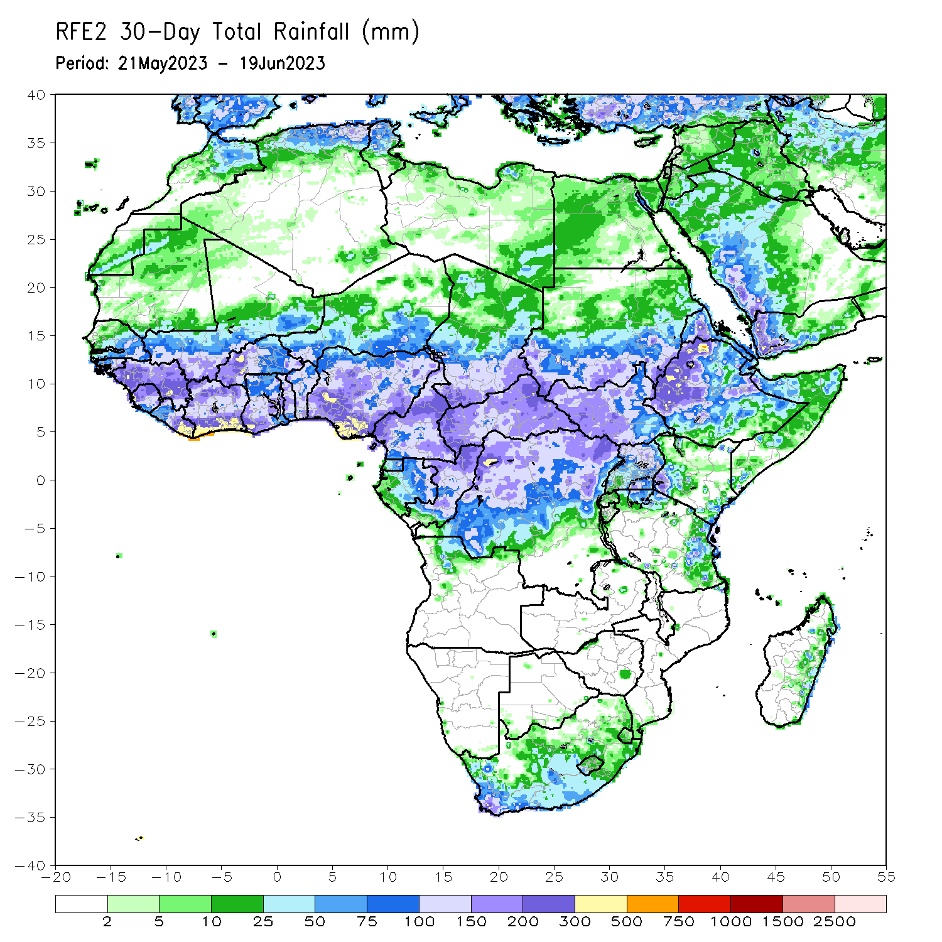
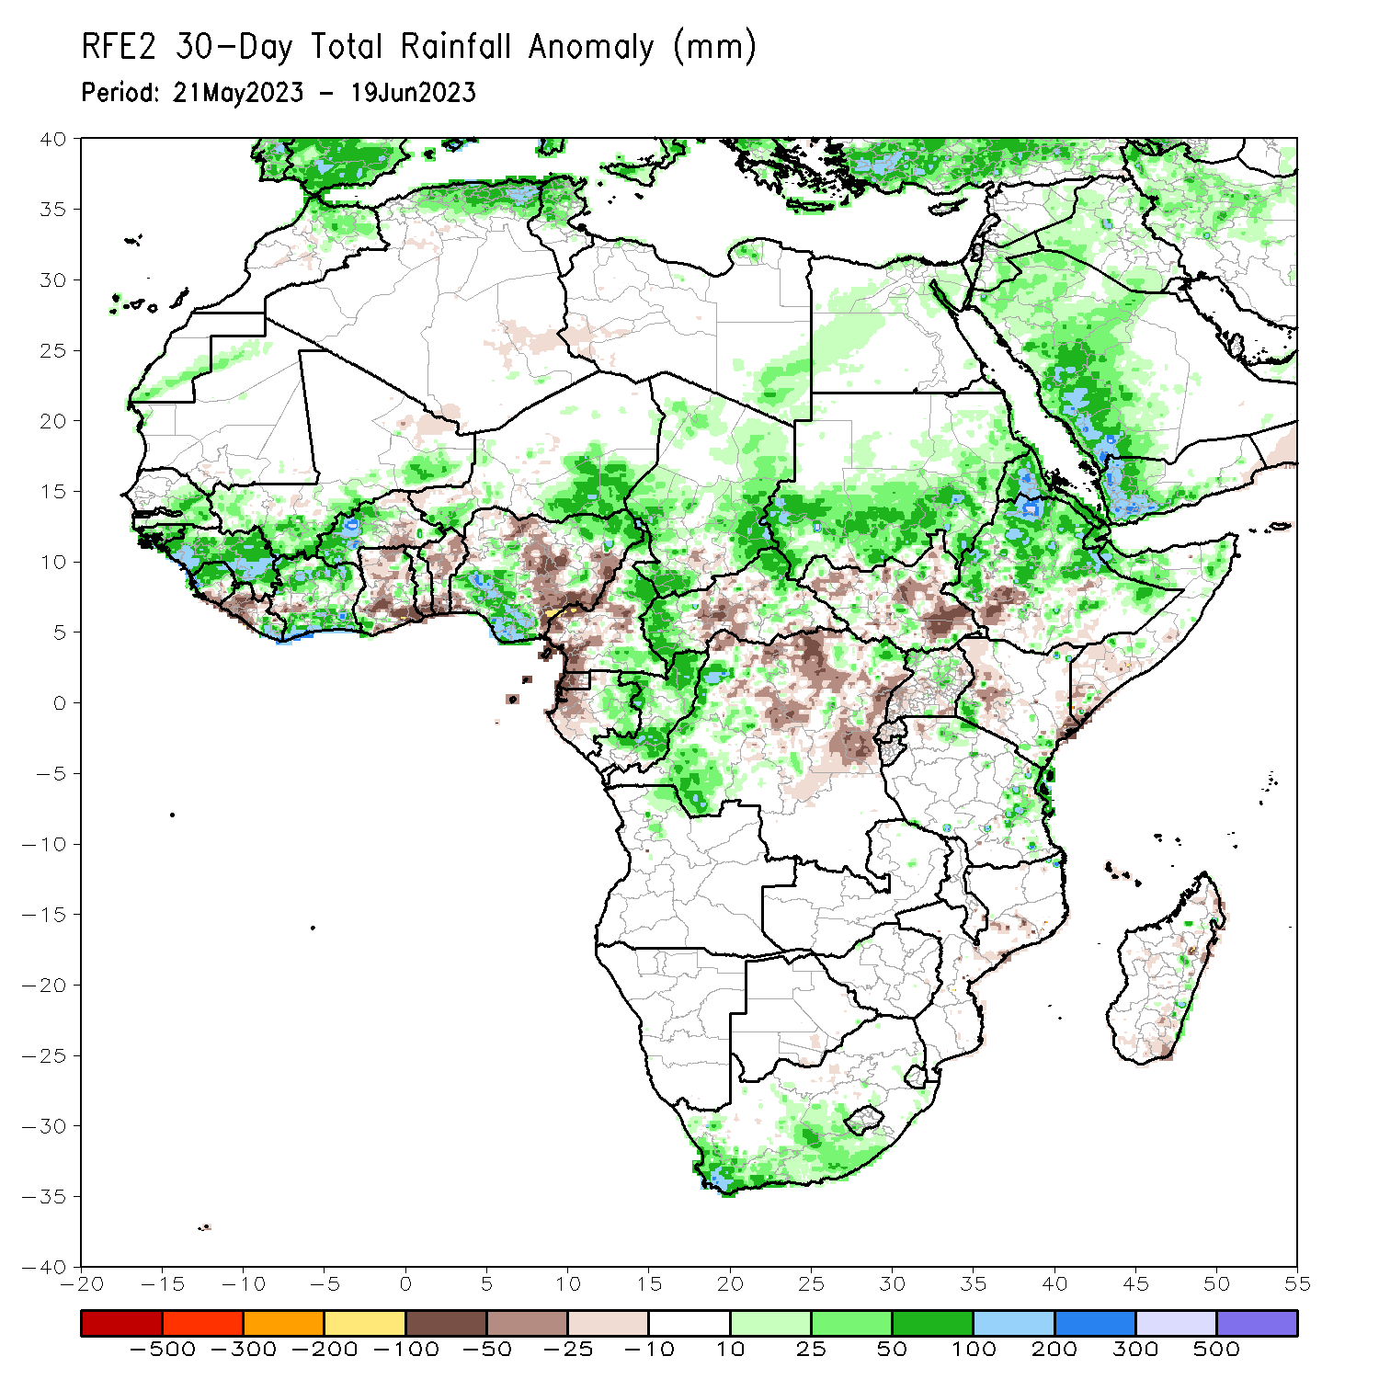
Rainfall Patterns: Last 30 Days
Over the past 30 days, in East Africa, above-average rainfall was observed over central and northern Ethiopia, Eritrea, Djibouti, pockets of northern Somalia, and southern Sudan. Rainfall was below-average over much of South Sudan, pockets of southwestern Ethiopia, and parts of Kenya and southern Somalia, Uganda and Rwanda. In southern Africa, rainfall was above-average over the southern portion of South Africa. In Central Africa, rainfall was above-average over eastern Gabon, southern and northern Congo, parts of western CAR, and western DRC. Below-average rainfall was observed over western and central Cameroon, Equatorial Guinea, western Gabon, central and northern DRC, and central and eastern CAR. In West Africa, rainfall was above-average over eastern Senegal, much of Guinea, southwestern Mali, Sierra Leone, Cote d’Ivoire, western Burkina Faso, and parts of southern and northeastern Nigeria, and southeastern Niger. Below-average rainfall was observed over parts of Liberia, eastern Burkina Faso, Ghana, Togo, Benin, and northern and eastern Nigeria.
Notes:
5

Slide 6
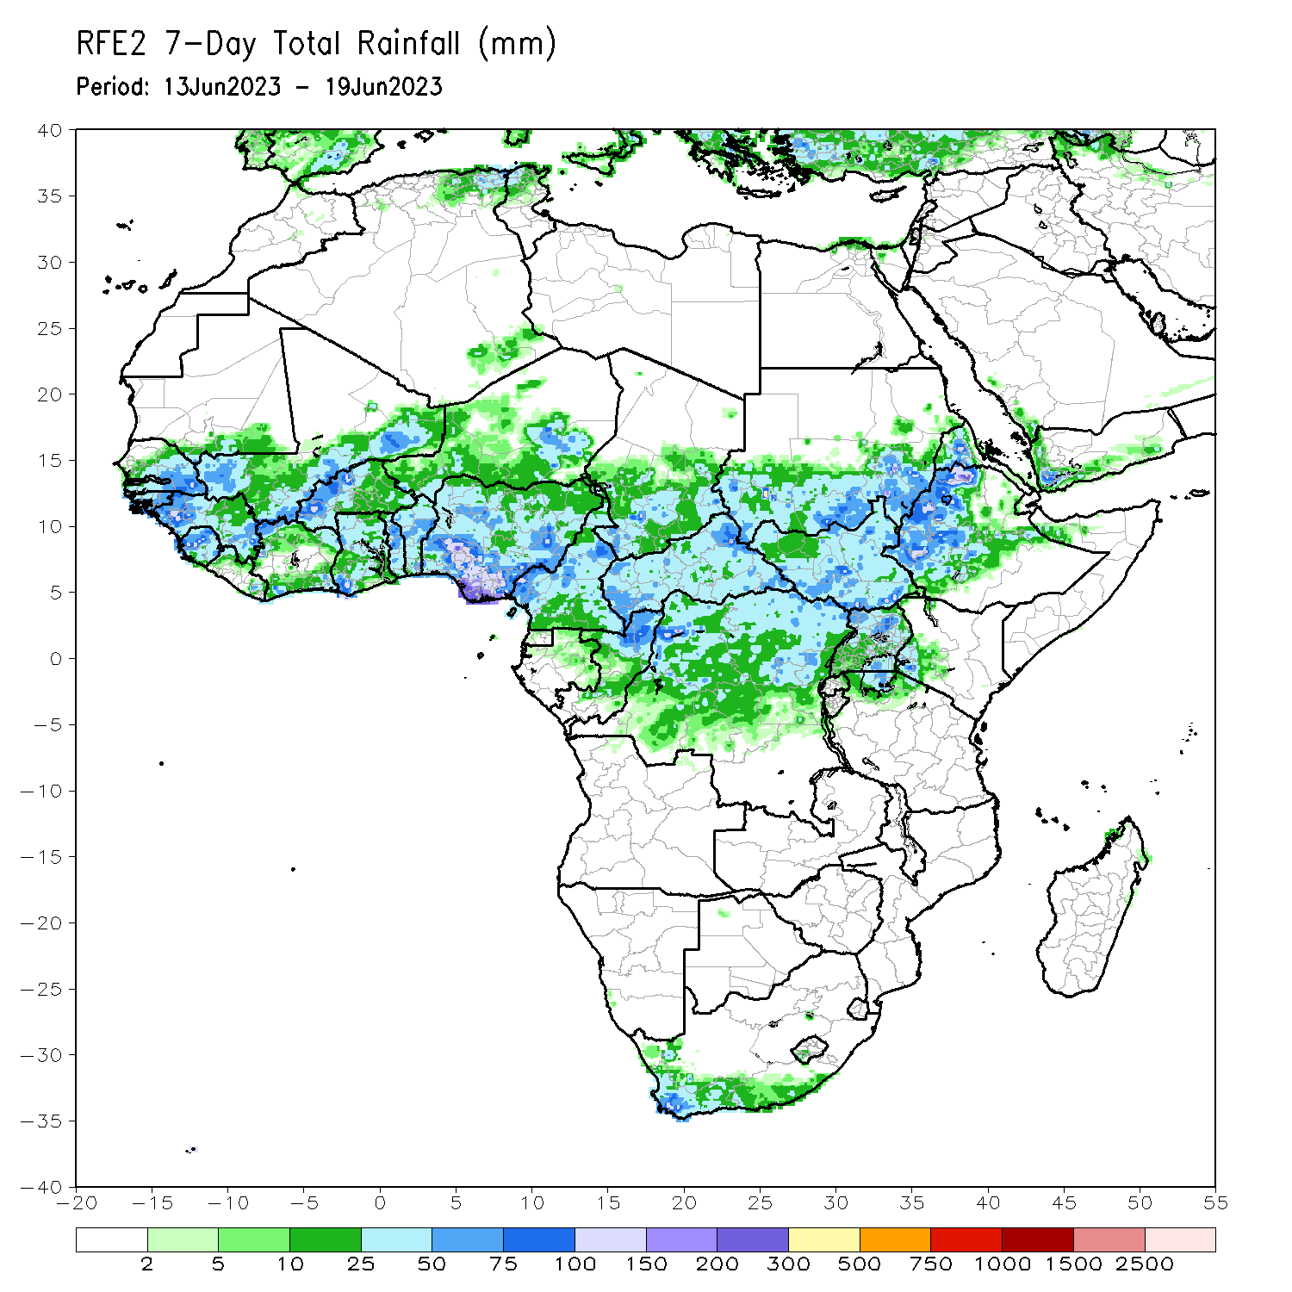
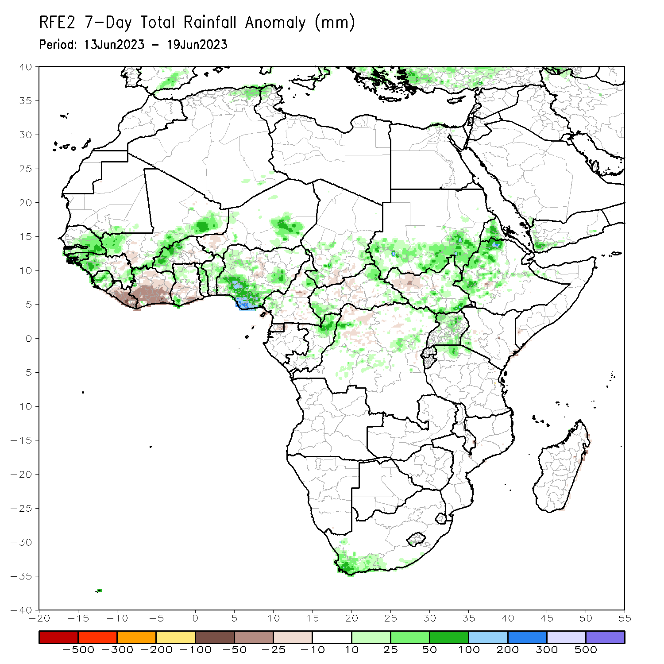
Rainfall Patterns: Last 7 Days
During the past 7 days, in East Africa, rainfall was above-average over western Ethiopia, Eritrea, parts of southern Sudan, eastern South Sudan, and many parts of Uganda. Below-average rainfall was observed over parts of western and central South Sudan. In Central Africa, rainfall was above-average over northern Congo, and pockets of DRC. Below-average rainfall was observed over pockets of Cameroon. In West Africa, above-average rainfall was observed over eastern Senegal, portions of Guinea, Sierra Leone, western and southern Mali, western Burkina Faso, eastern Niger and southern Nigeria. Rainfall was below-average over much of Liberia, Cote d’Ivoire and parts of southern Ghana. In Southern Africa, above-average rainfall was observed over the far southern South Africa.

Slide 7
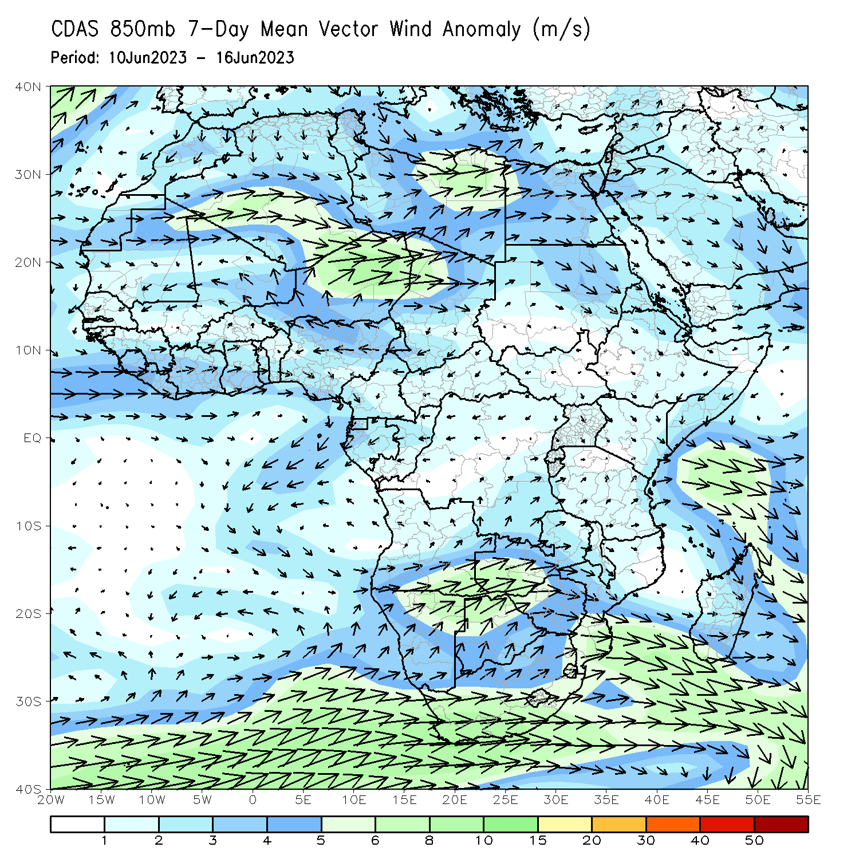
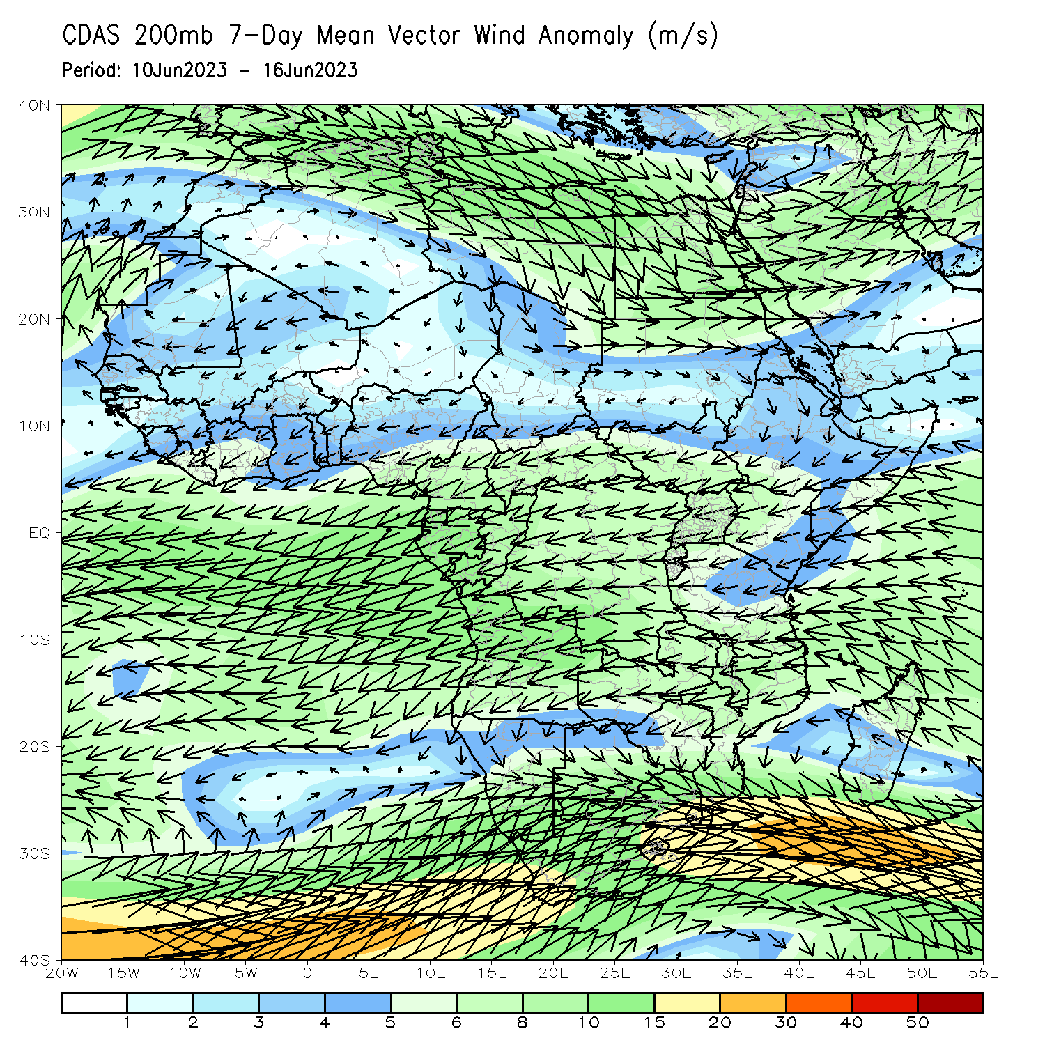
Atmospheric Circulation: Last 7 Days
At 850-hPa level (left panel), anomalous lower-level convergence between westerlies and easterlies in the Gulf of Guinea region, and anomalous cyclonic circulation across Southern Africa may have contributed to the observed above-average rainfall in the areas.

Slide 8
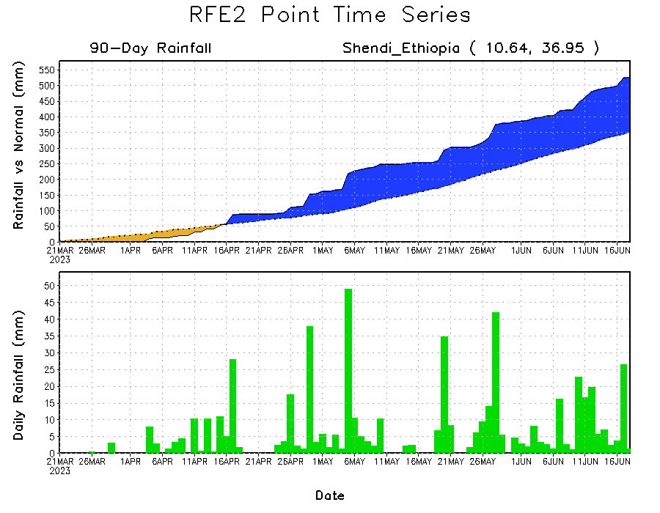
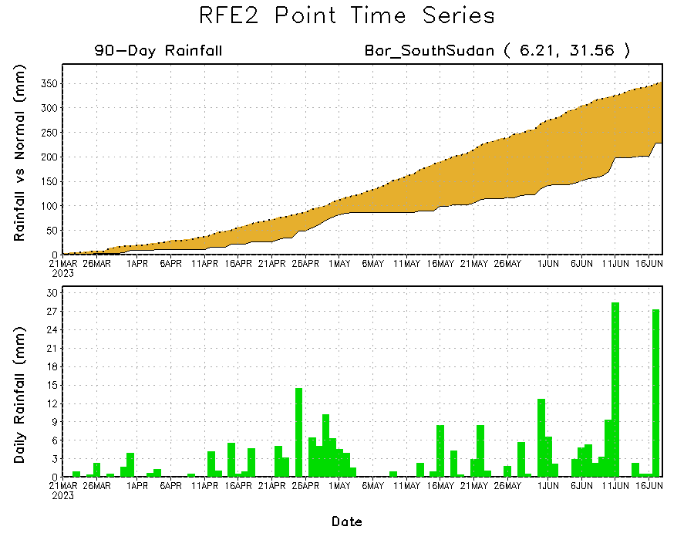
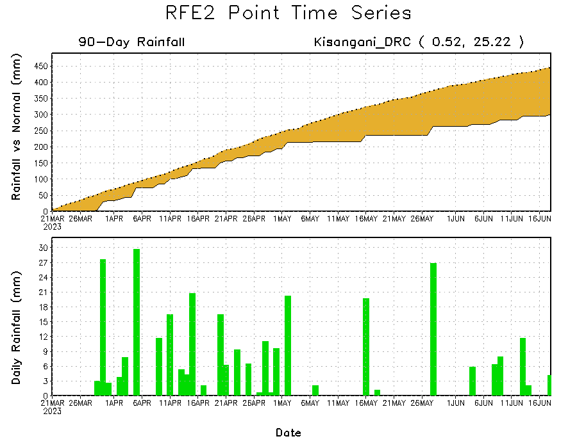
Rainfall Evolution
Daily evolution of rainfall over the last 90 days at selected locations shows suppressed rainfall over parts of northeastern DRC (bottom left) and South Sudan (bottom right). Moderate to local heavy rainfall sustained moisture surpluses over parts of eastern Ethiopia (top right).

Slide 9
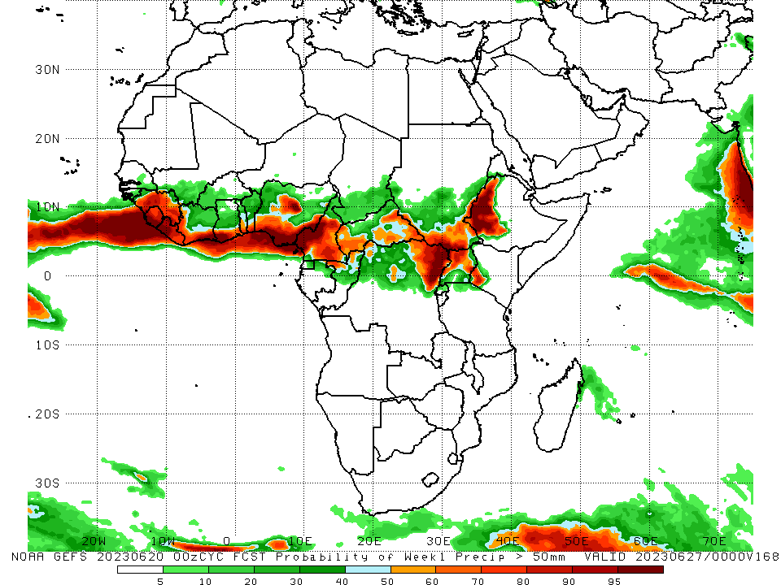
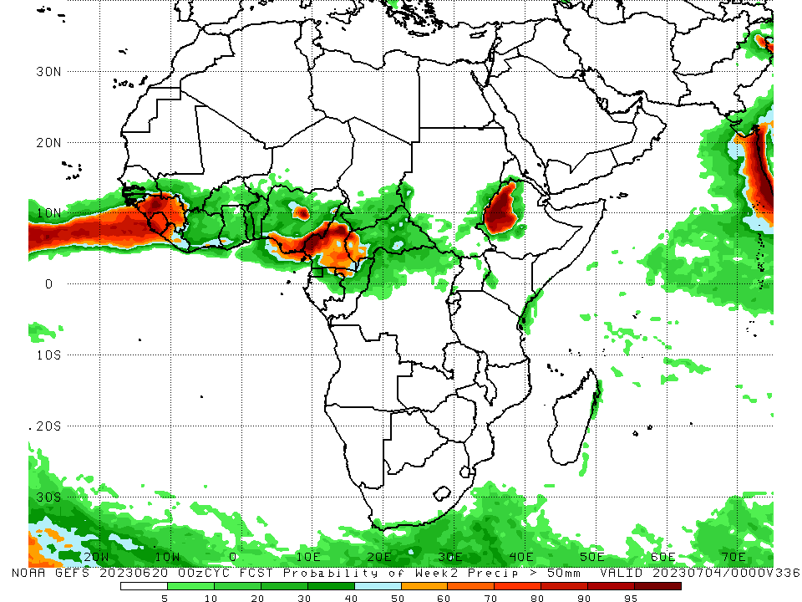
NCEP GEFS Model Forecasts Non-Bias Corrected Probability of precipitation exceedance
Week-1, Valid: 21 – 27 June 2023
Week-2, Valid: 28 June – 04 July 2023
For week-1 (left panel), the GEFS forecasts indicate a moderate to high chance (over 70%) for rainfall to exceed 50 mm along the Gulf of Guinea coast, parts of Central Africa and western Ethiopia. For week-2 (right panel), higher probability of exceedances are expected to be confined mainly over the far western and eastern Gulf of Guinea region, and western Ethiopia.
Notes:
9

Slide 10
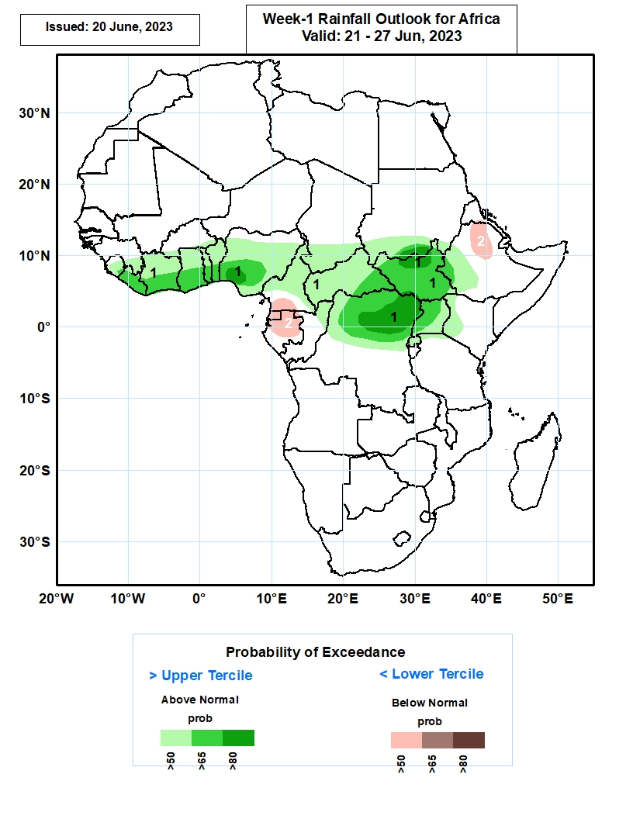
Week-1 Precipitation Outlooks
21 – 27 June2023
The probabilistic forecasts call for above 50% chance for weekly rainfall to be above-normal (above the upper tercile) over southeastern Guinea, much of Sierra Leone, Liberia, Cote d’Ivoire, Ghana, Togo, Benin, Nigeria, Cameroon, CAR, South Sudan, Uganda and Rwanda, southern Burkina Faso, Chad and Sudan, northern Congo, northern and central portions of DR Congo, and western parts of Ethiopia and Kenya. In particular, there is an above 80% chance for rainfall to be above-normal over southwestern Nigeria, south-central Sudan, north-central South Sudan, and northern portions of DR Congo.
The forecasts call for above 50% chance for weekly total rainfall to be below-normal (below the lower tercile) over north-central Ethiopia, southern Cameroon, much of Equatorial Guinea, and northern and central parts of Gabon.
Notes:
10

Slide 11
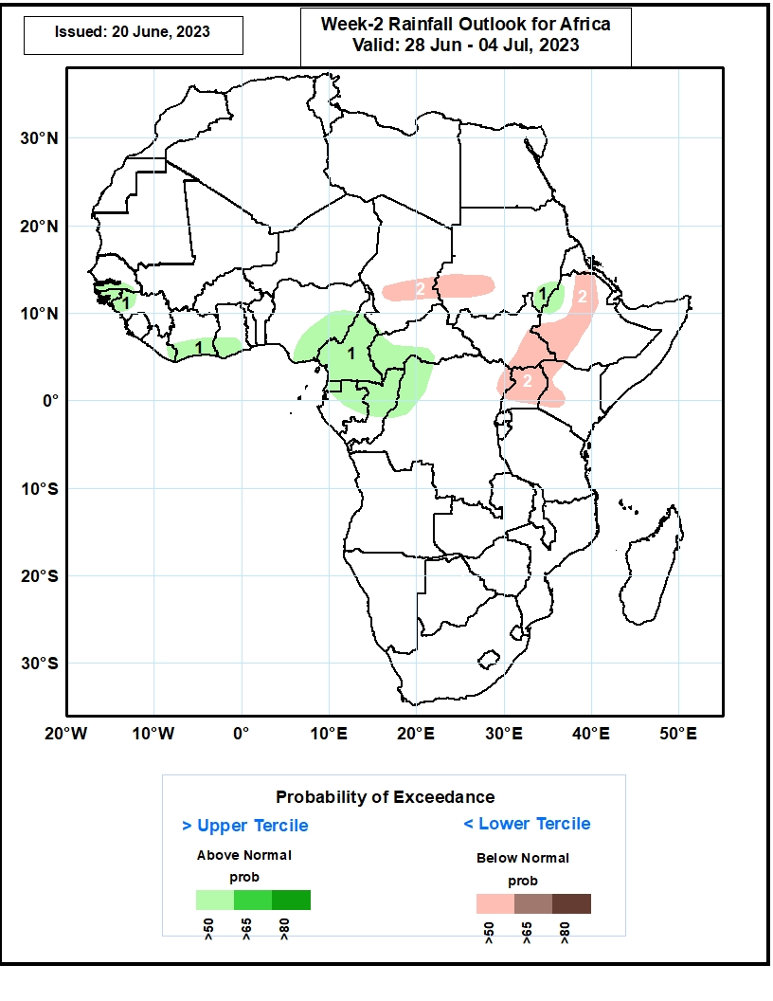
Week-2 Precipitation Outlooks
28 June – 04 July 2023
The probabilistic forecasts call for above 50% chance for weekly rainfall to be above-normal (above the upper tercile) over southern Senegal, much of The Gambia and Guinea-Bissau, northwestern Guinea, southern Cote d’Ivoire and Ghana, eastern portions of Nigeria, much of Cameroon and Equatorial Guinea, northern and central parts of Gabon and Congo, western CAR, northwestern DR Congo, southeastern Sudan, and northwestern Ethiopia.
The forecasts call for above 50% chance for weekly total rainfall to be below-normal (below the lower tercile) over southern Chad, southwestern Sudan, northern and western parts of Ethiopia, eastern South Sudan, northeastern DR Congo, much of Uganda and western portions of Kenya.
Notes:
11

Slide 12
Summary
Over the past 30 days, in East Africa, above-average rainfall was observed over central and northern Ethiopia, Eritrea, Djibouti, pockets of northern Somalia, and southern Sudan. Rainfall was below-average over much of South Sudan, pockets of southwestern Ethiopia, and parts of Kenya and southern Somalia, Uganda and Rwanda. In southern Africa, rainfall was above-average over the southern portion of South Africa. In Central Africa, rainfall was above-average over eastern Gabon, southern and northern Congo, parts of western CAR, and western DRC. Below-average rainfall was observed over western and central Cameroon, Equatorial Guinea, western Gabon, central and northern DRC, and central and eastern CAR. In West Africa, rainfall was above-average over eastern Senegal, much of Guinea, southwestern Mali, Sierra Leone, Cote d’Ivoire, western Burkina Faso, and parts of southern and northeastern Nigeria, and southeastern Niger. Below-average rainfall was observed over parts of Liberia, eastern Burkina Faso, Ghana, Togo, Benin, and northern and eastern Nigeria.
During the past 7 days, in East Africa, rainfall was above-average over western Ethiopia, Eritrea, parts of southern Sudan, eastern South Sudan, and many parts of Uganda. Below-average rainfall was observed over parts of western and central South Sudan. In Central Africa, rainfall was above-average over northern Congo, and pockets of DRC. Below-average rainfall was observed over pockets of Cameroon. In West Africa, above-average rainfall was observed over eastern Senegal, portions of Guinea, Sierra Leone, western and southern Mali, western Burkina Faso, eastern Niger and southern Nigeria. Rainfall was below-average over much of Liberia, Cote d’Ivoire and parts of southern Ghana. In Southern Africa, above-average rainfall was observed over the far southern South Africa.
The Week-1 outlook calls for above-normal rainfall across much of the Gulf Guinea region, and many places in the Central Africa. In contrast there is an increased chance for below-normal rainfall over Equatorial Guinea, parts of Gabon, and pockets of northern Ethiopia. For week-2, there is an increased chance for above-normal rainfall along the Gulf of Guinea coast, and the western portion of Central Africa and near Sudan/Ethiopia border. In contrast there is an increased chance for below-normal rainfall in the Lake Victoria region, and parts of northeastern, central and southwestern Ethiopia.

