Slide 1
The African Monsoon Recent Evolution and Current Status Include Week-1 and Week-2 Outlooks
Update prepared
03 July 2023
For more information, visit:
http://www.cpc.ncep.noaa.gov/products/Global_Monsoons/African_Monsoons/precip_monitoring.shtml

Slide 2
Outline
Highlights
Recent Evolution and Current Conditions
NCEP GEFS Forecasts
Summary

Slide 3
Highlights: Last 7 Days
During the past 7 days, in East Africa, rainfall was above-average over southeastern Sudan, western Ethiopia, northeastern and western South Sudan, northern and eastern Uganda, and southwestern Kenya. Rainfall was below average over parts of central Ethiopia and north-central and south-central South Sudan. In Central Africa, rainfall was above-average over southwestern, central, and eastern Cameroon, western CAR, southwestern Chad, and parts of central and northwestern DRC. Below-average rainfall was observed over pockets of west-central Cameroon, central Congo, central CAR, northeastern DRC, and south-central Chad. In West Africa, above-average rainfall was observed over most of Guinea, northern Sierra Leone, southeastern Cote d’Ivoire, western and central Burkina Faso, southwestern Mali, and central and parts of south-central Nigeria. Rainfall was below-average over parts of southern Sierra Leone, northern and southern Benin, northern and southern Togo, most of Ghana, western Cote d’Ivoire, most of Liberia, and most of northern and central Nigeria. In Southern Africa, rainfall was above-average over western and much of southern South Africa.
The Week-1 outlook calls for above-normal rainfall over northwestern Nigeria, southern Cameroon, eastern Equatorial Guinea, northern Gabon, northwestern Congo, northeastern DRC, southeastern CAR, south-central South Sudan, northern Uganda, and northwestern Ethiopia. In contrast, there is an increased chance for below-normal rainfall over much of the Gulf of Guinea and Sahel regions, as well as much of north-central Ethiopia. For week-2, there is an increased chance for above-normal rainfall over southern Senegal, The Gambia, central and eastern Guinea, Guinea-Bissau, southwestern Mali, eastern Nigeria, southern Cameroon, northern Gabon, northwestern Ethiopia, coastal Mozambique, and the east coast of Madagascar. In contrast, there is an increased chance for below-normal rainfall over much of coastal Guinea, coastal Sierra Leone, parts of coastal Liberia, southwestern Nigeria, southern Chad, northern Cameroon, CAR, South Sudan, southern Sudan, western Eritrea, and north-central and central Ethiopia.

Slide 4
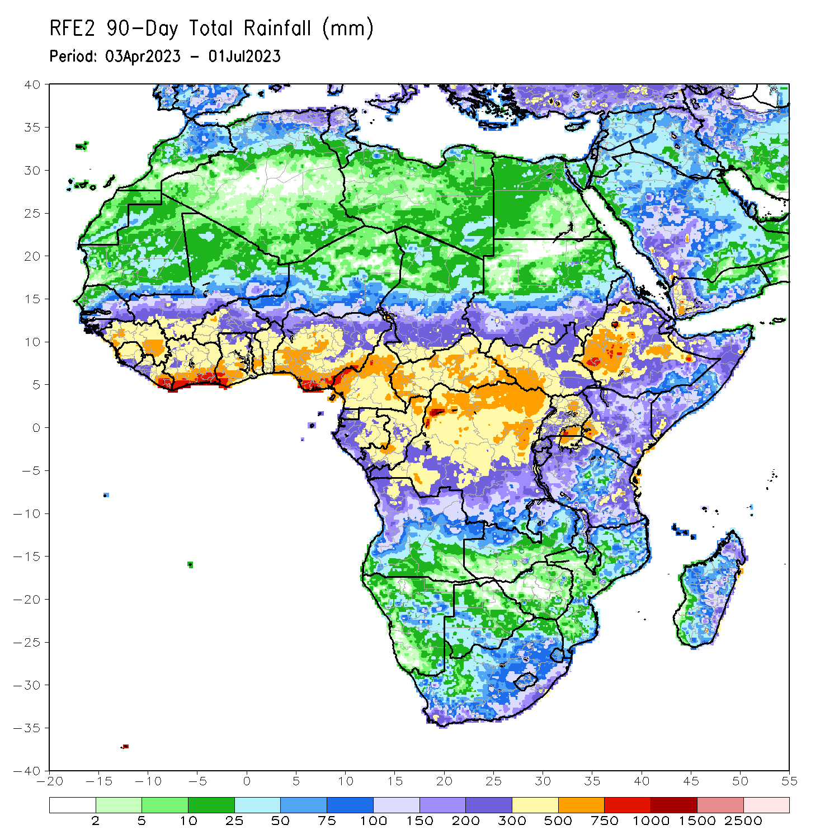
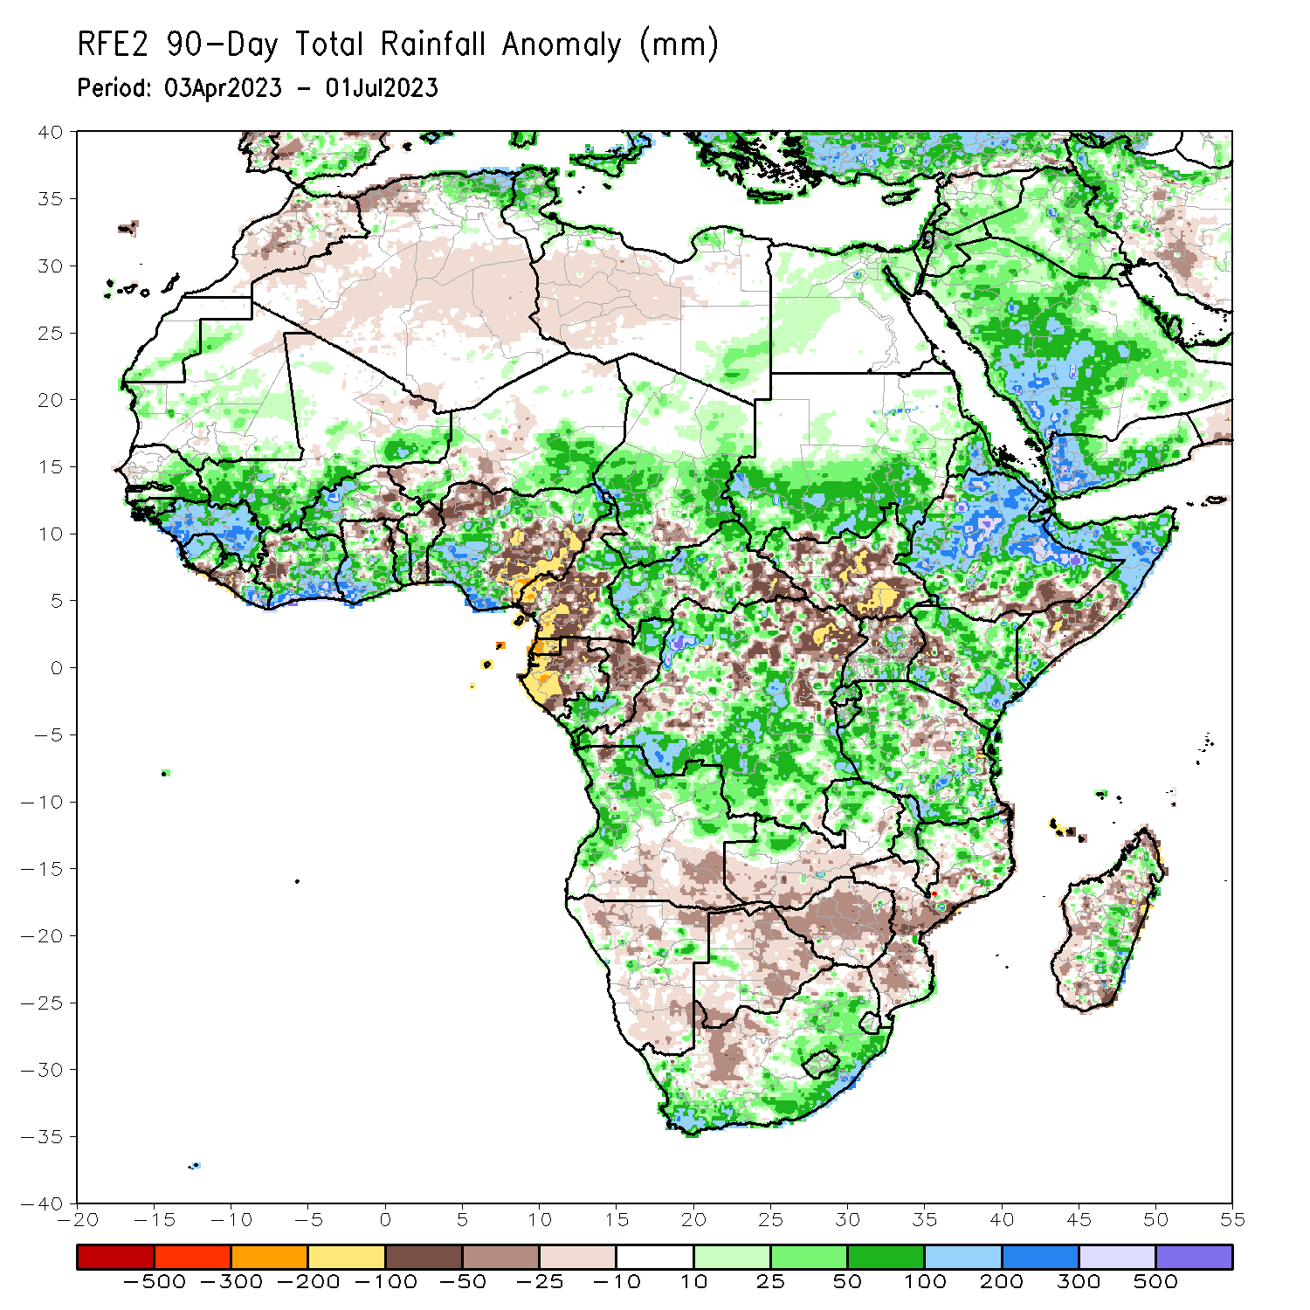
Rainfall Patterns: Last 90 Days
Over the past 90 days, in East Africa, above-average rainfall was observed over much of Eritrea, Ethiopia, northern and parts of far southern Somalia, northern, southwestern, and eastern Kenya, Djibouti, central and southern Uganda, most of Tanzania, Burundi, Rwanda, southern Sudan, and far northwestern and northeastern South Sudan. Rainfall was below-average over much of central and southern South Sudan, parts of central and southern Somalia, parts of western Kenya, northern Uganda, and southern Ethiopia. In southern Africa, above-average rainfall was observed over central and northern Angola, northern and eastern Zambia, parts of eastern, western, and southern South Africa, Lesotho, Eswatini, northern and central Malawi, northern Mozambique, and northern and parts of southeastern Madagascar. Below-average rainfall was observed over the southern portion of Angola, western and southern Zambia, much of Namibia, most of Botswana, northern South Africa, Zimbabwe, southern Malawi, southern and central Mozambique, and parts of western and southern Madagascar. In Central Africa, rainfall was above-average over parts of eastern and far northern Cameroon, western and central CAR, far southern and northern Congo, much of southern and central Chad, and southern, parts of central, and northwestern DRC. Rainfall was below-average over parts of central and southwestern Cameroon, Equatorial Guinea, much of Gabon, central Congo, parts of southeastern CAR, and parts of central and northeastern DRC. In West Africa, rainfall was above-average over parts of eastern and southern Senegal, much of Guinea, Guinea-Bissau, northern and central Sierra Leone, northwestern and eastern Liberia, most of Cote d’Ivoire, southern Mali, western Burkina Faso, central and southern Ghana, southern Togo, central Benin, southeastern Niger, and southwestern and northeastern Nigeria. Below-average rainfall was observed over parts of eastern Burkina Faso, northwestern and southeastern Nigeria, northern and southern Benin, northern Togo, northern Ghana, west-central Cote d’Ivoire, central Liberia, and southern Sierra Leone.
Notes:
4

Slide 5
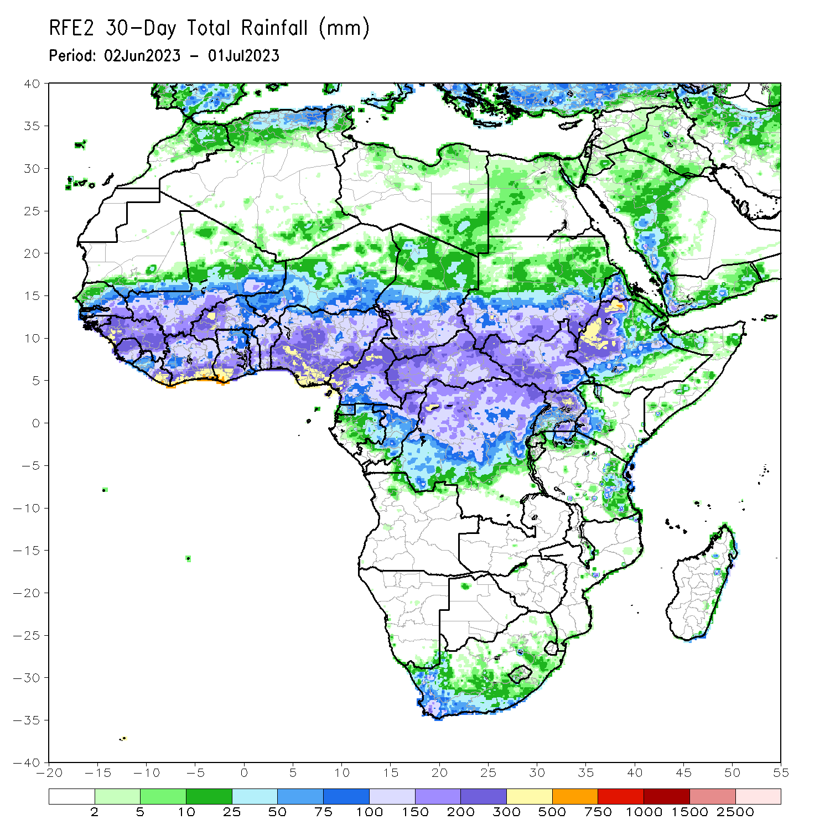
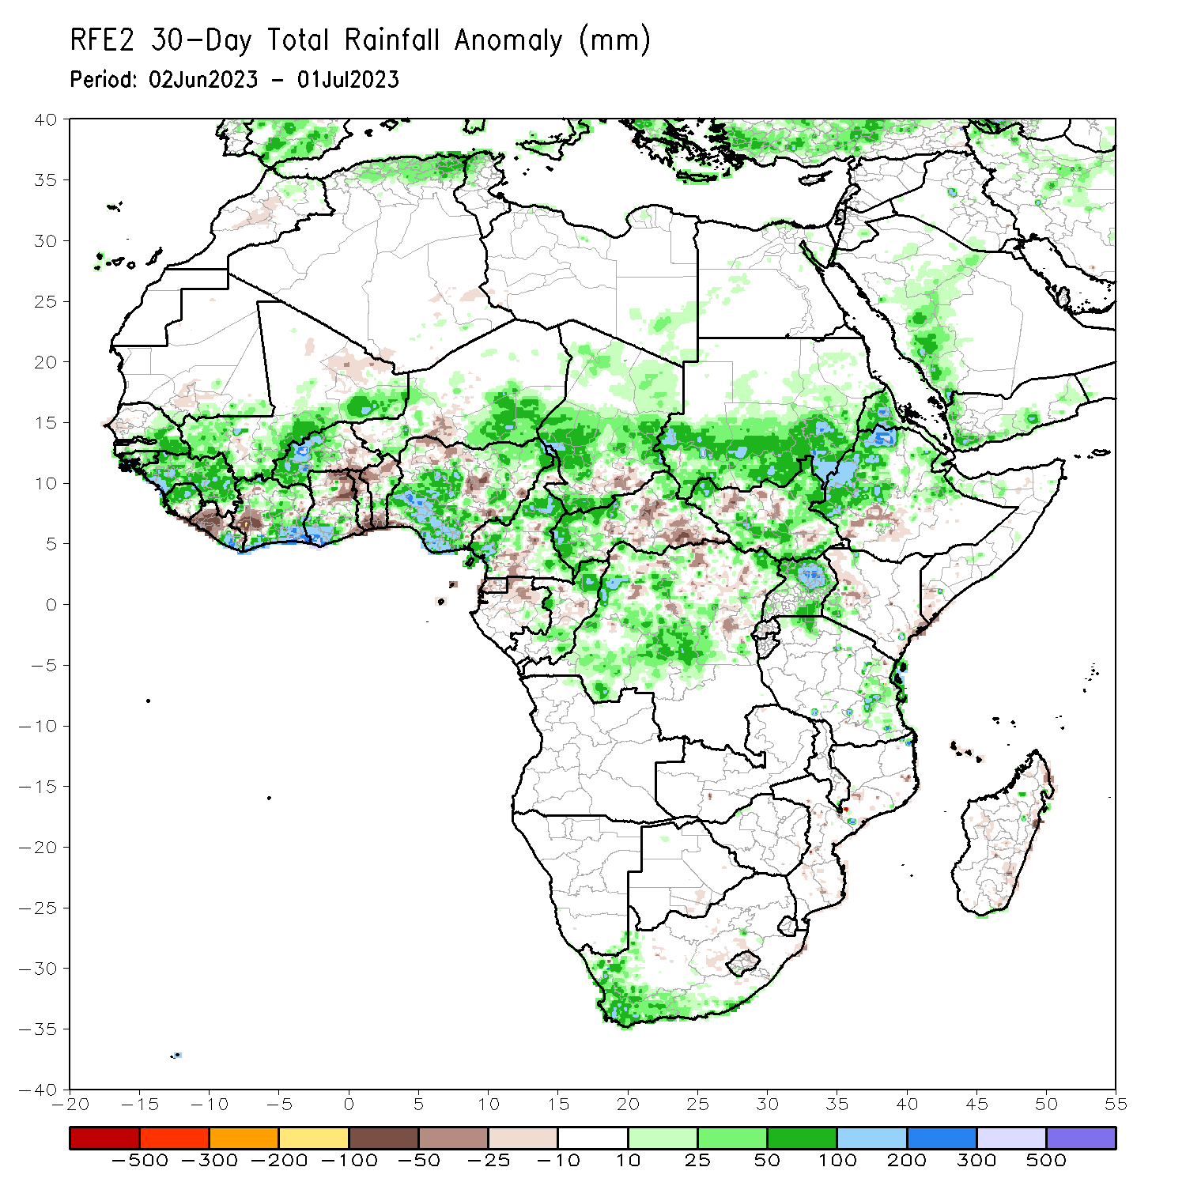
Rainfall Patterns: Last 30 Days
Over the past 30 days, in East Africa, above-average rainfall was observed over southern Sudan, central and northern Ethiopia, Eritrea, Djibouti, southern, northeastern, and northwestern South Sudan, southwestern Kenya, and northern and eastern Uganda. Rainfall was below-average over pockets of southeastern and north-central South Sudan, southwestern Ethiopia, and pockets of west-central Kenya. In southern Africa, rainfall was above-average over the southern and western portions of South Africa. In Central Africa, rainfall was above-average over northern, eastern, and western Cameroon, eastern Gabon, southern and northern Congo, parts of western and northeastern CAR, central and southwestern Chad, and western and central DRC. Below-average rainfall was observed over pockets of south-central Cameroon, Equatorial Guinea, northern Gabon, pockets of central and northern DRC, south-central Chad, and parts of central and southeastern CAR. In West Africa, rainfall was above-average over southern and eastern Senegal, much of Guinea, Guinea-Bissau, southern Mali, northern Sierra Leone, eastern Liberia, southern and northern Cote d’Ivoire, western and central Burkina Faso, southwestern Ghana, southern, central, and northeastern Nigeria, central Togo, central Benin, and southeastern Niger. Below-average rainfall was observed over western Liberia, west-central Cote d’Ivoire, eastern Burkina Faso, northern and southern Togo, northern and southern Benin, northeastern and southeastern Ghana, and parts of northwestern and central Nigeria.
Notes:
5

Slide 6
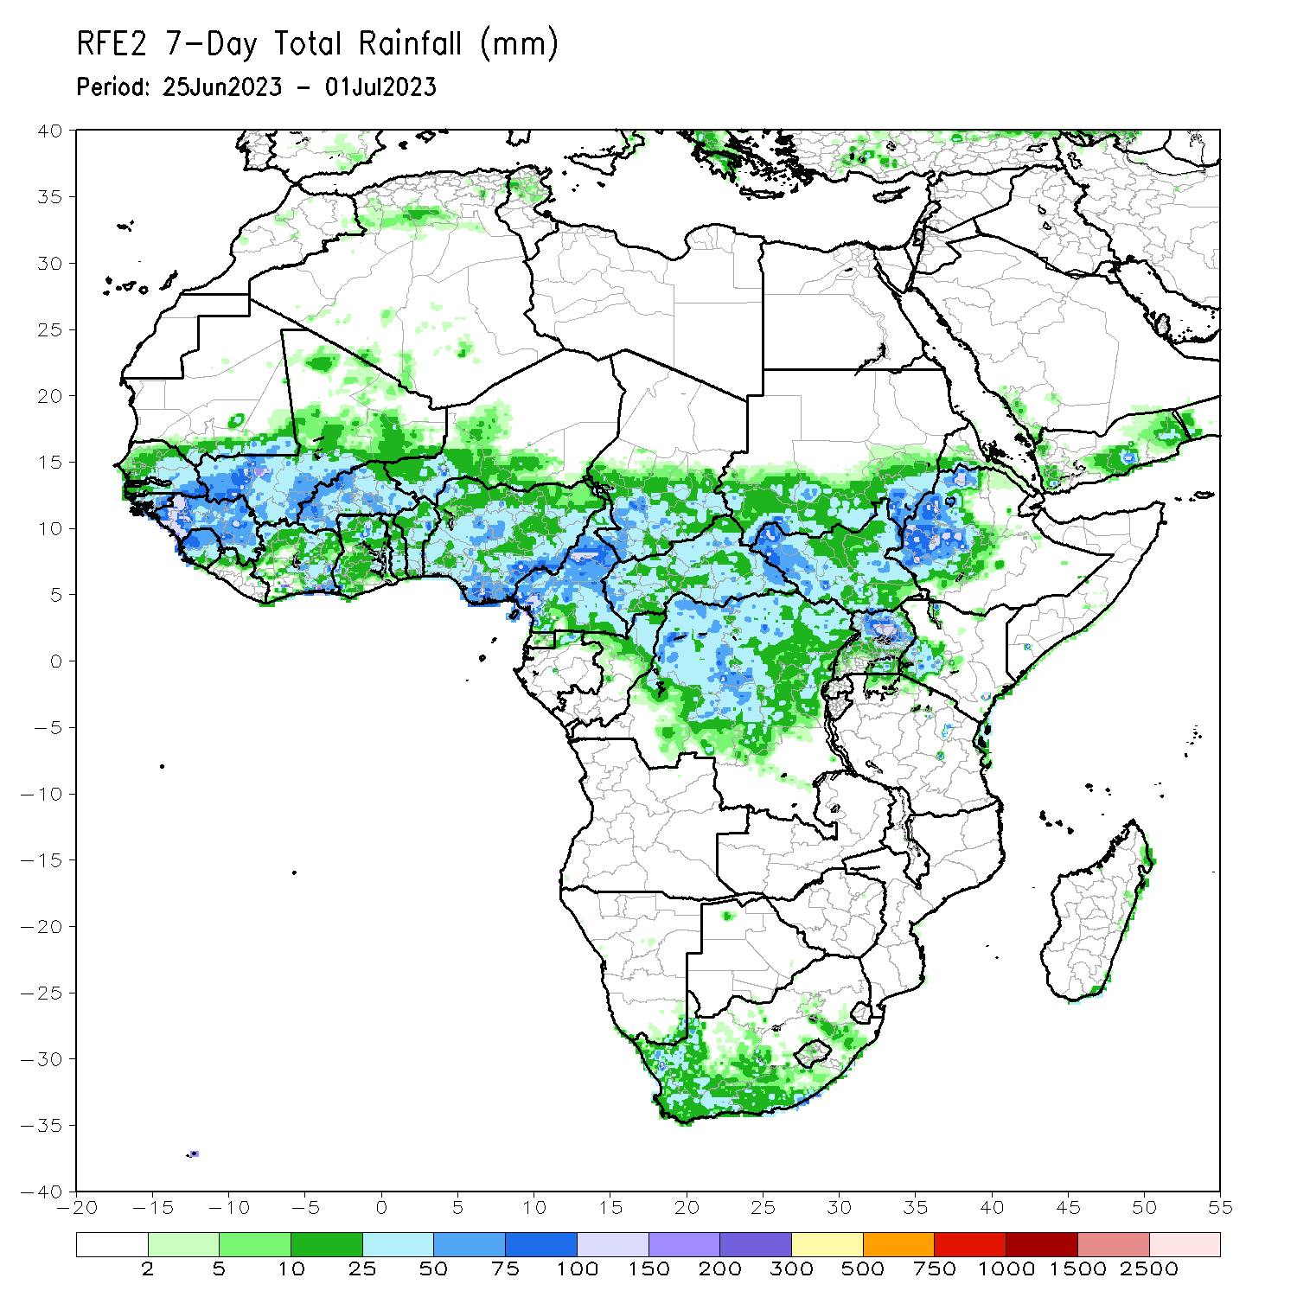
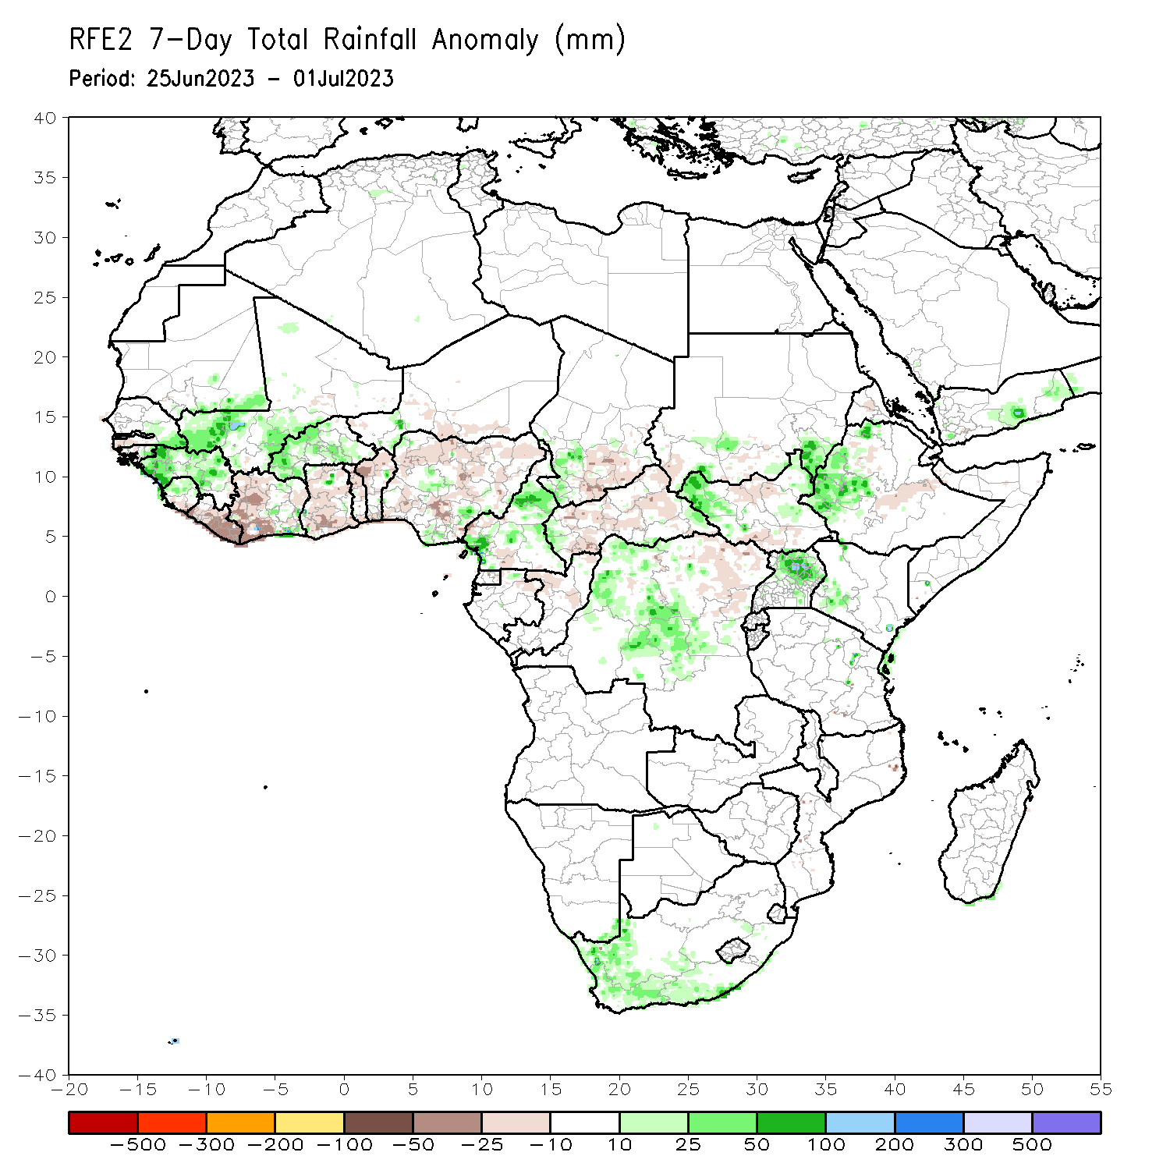
Rainfall Patterns: Last 7 Days
During the past 7 days, in East Africa, rainfall was above-average over southeastern Sudan, western Ethiopia, northeastern and western South Sudan, northern and eastern Uganda, and southwestern Kenya. Rainfall was below average over parts of central Ethiopia and north-central and south-central South Sudan. In Central Africa, rainfall was above-average over southwestern, central, and eastern Cameroon, western CAR, southwestern Chad, and parts of central and northwestern DRC. Below-average rainfall was observed over pockets of west-central Cameroon, central Congo, central CAR, northeastern DRC, and south-central Chad. In West Africa, above-average rainfall was observed over most of Guinea, northern Sierra Leone, southeastern Cote d’Ivoire, western and central Burkina Faso, southwestern Mali, and central and parts of south-central Nigeria. Rainfall was below-average over parts of southern Sierra Leone, northern and southern Benin, northern and southern Togo, most of Ghana, western Cote d’Ivoire, most of Liberia, and most of northern and central Nigeria. In Southern Africa, rainfall was above-average over western and much of southern South Africa.

Slide 7
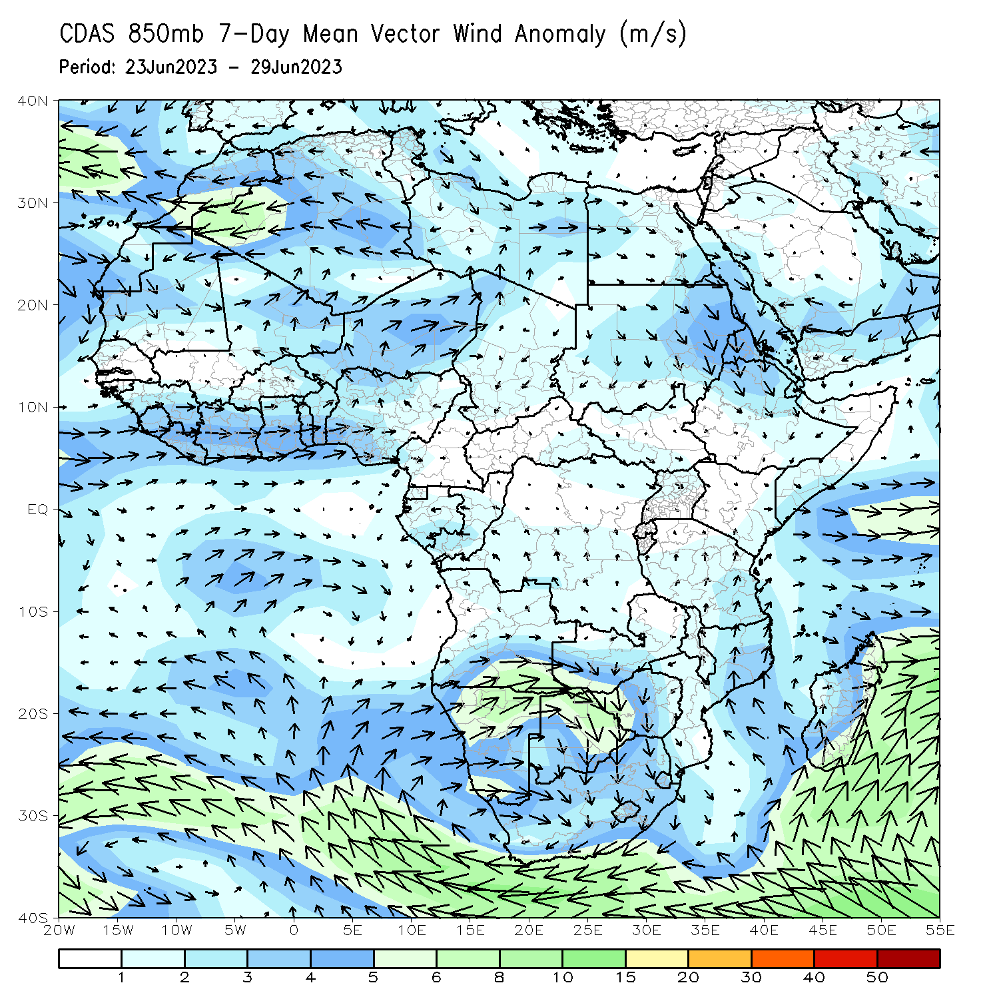
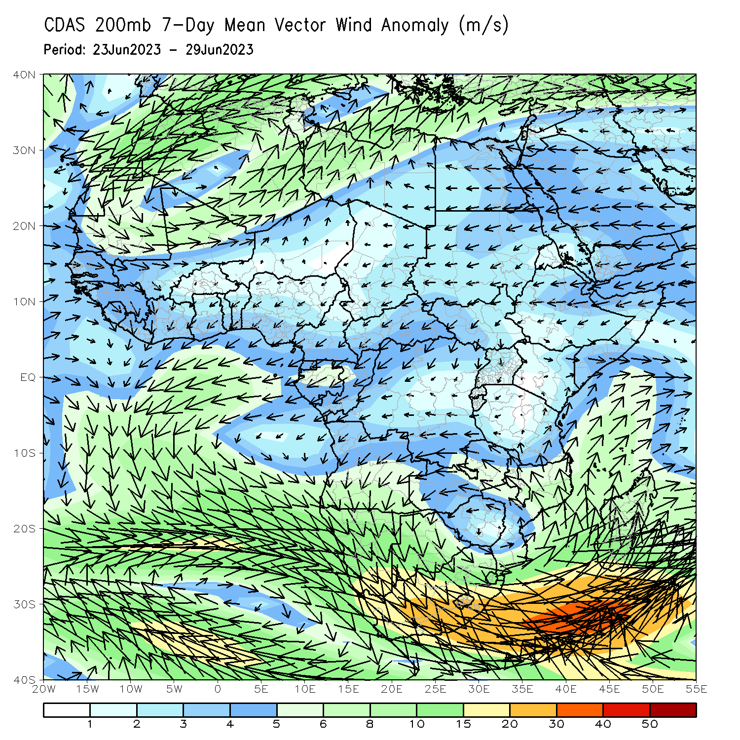
Atmospheric Circulation: Last 7 Days
At 850-hPa (left panel), anomalous lower-level convergence in Cameroon and northern/central DRC may have contributed to the observed above-average rainfall in the region. At 200-hPa (right panel), anomalous confluence in the western Gulf of Guinea region may have contributed to below-average rainfall.

Slide 8
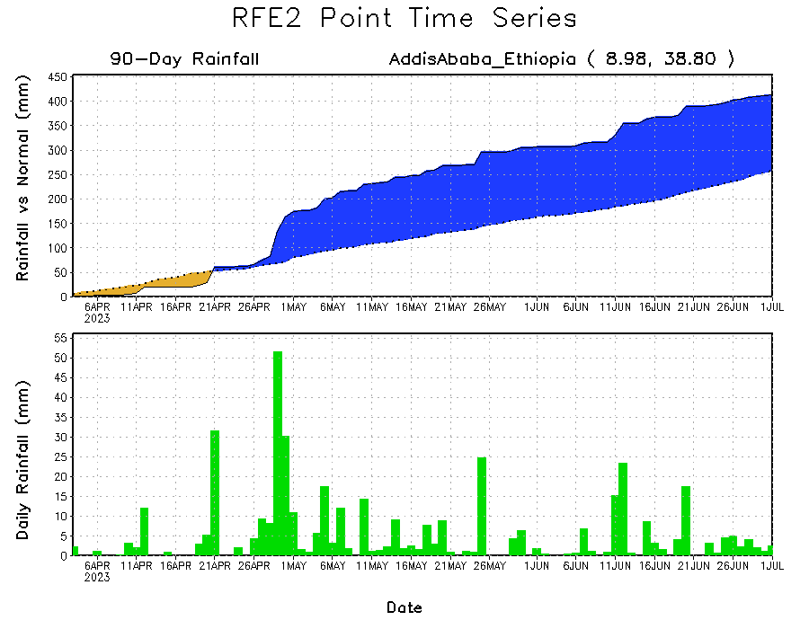
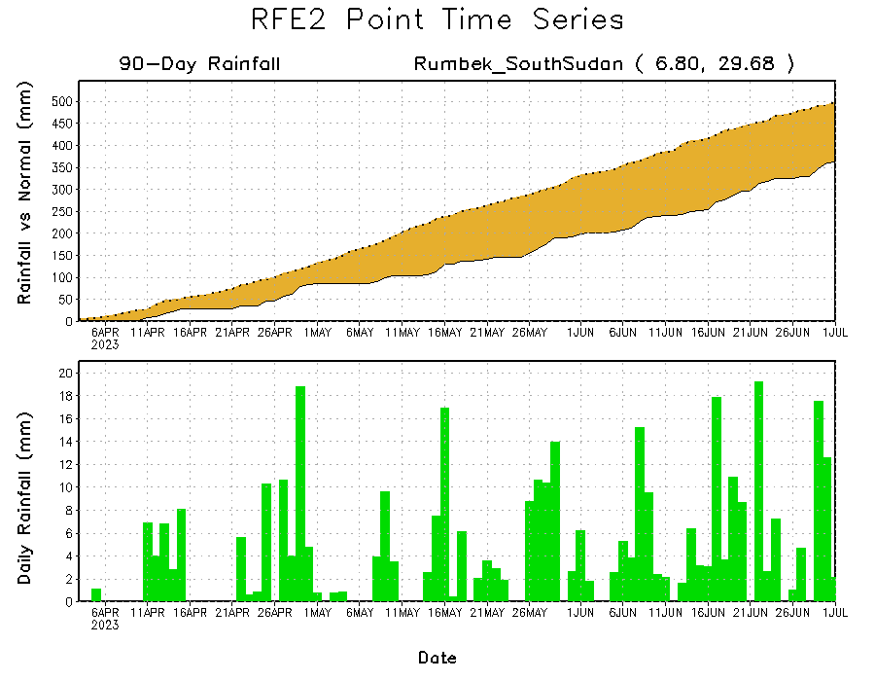
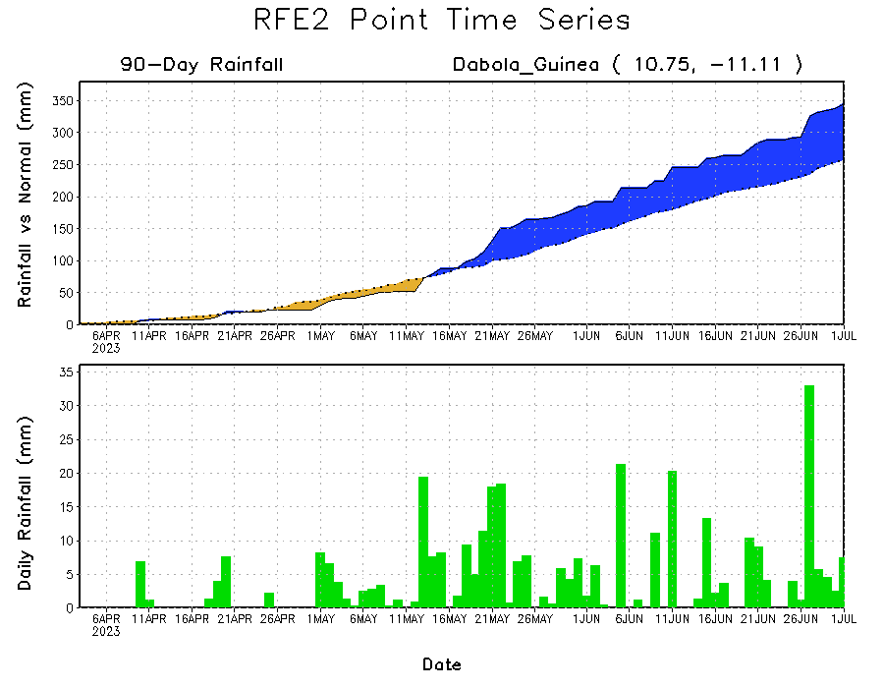
Rainfall Evolution
Daily evolution of rainfall over the last 90 days at selected locations shows moderate to local heavy rainfall increased moisture surpluses over parts of Guinea (bottom left), and light rain maintained surpluses in central Ethiopia (top right). Seasonal total rainfall remained below-average over parts of South Sudan (bottom right), although deficits in central South Sudan have decreased slightly over the last week.

Slide 9
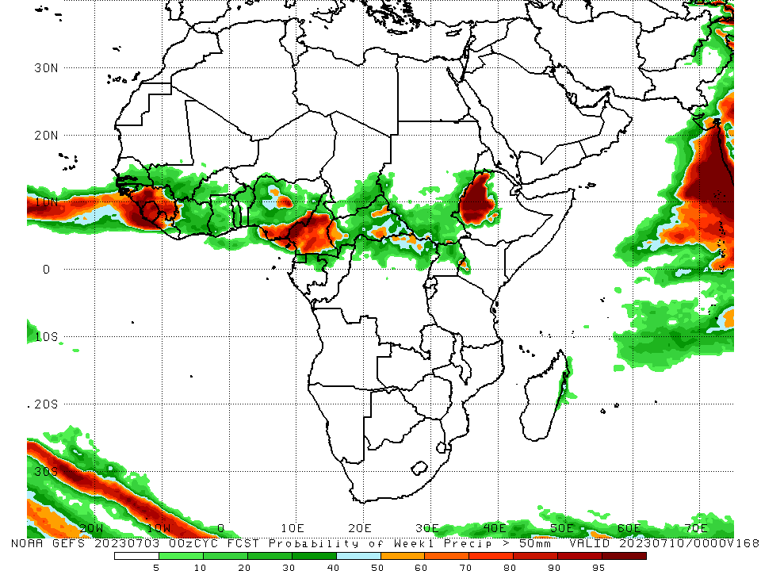
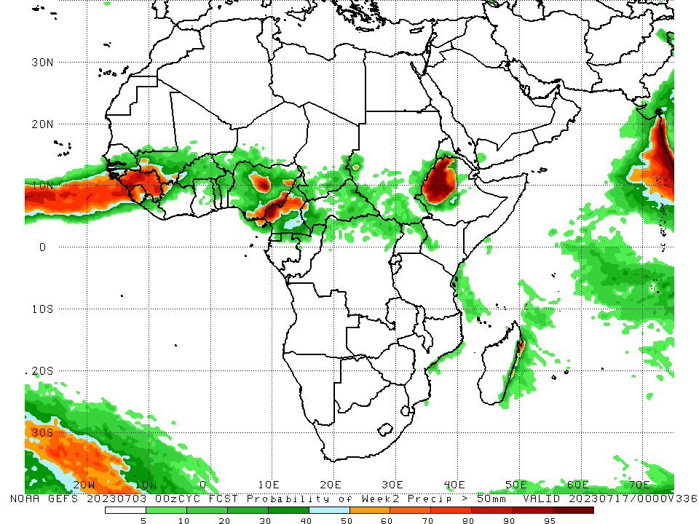
NCEP GEFS Model Forecasts Non-Bias Corrected Probability of precipitation exceedance
Week-1, Valid: 04 June – 10 July 2023
Week-2, Valid: 11 – 17 July 2023
For week-1 (left panel), the GEFS forecasts indicate a moderate to high chance (over 70%) for rainfall to exceed 50 mm over much of Guinea, Sierra Leone, western Liberia, central and southeastern Nigeria, central and southern Cameroon, and western Ethiopia. For week-2 (right panel), the GEFS forecasts indicate a moderate to high chance (over 70%) for rainfall to exceed 50 mm over much of Guinea, parts of western and eastern Sierra Leone, central and southeastern Nigeria, central Cameroon, and western Ethiopia.
Notes:
9

Slide 10
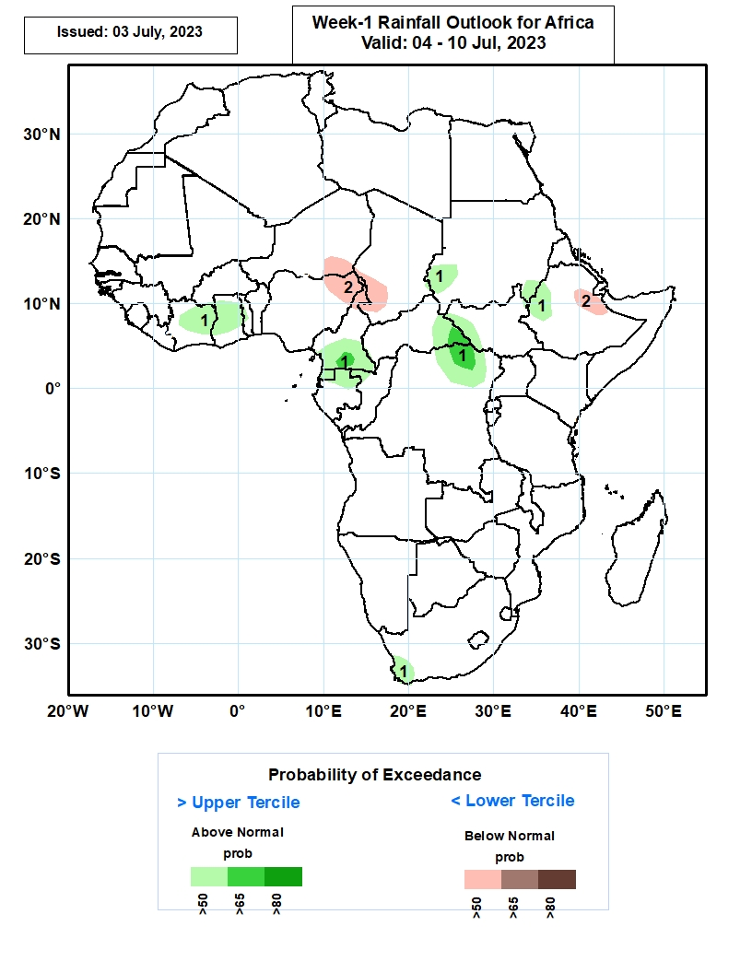
Week-1 Precipitation Outlooks
04 – 10 July 2023
1. The probabilistic forecasts call for above 50% chance for weekly rainfall to be above-normal (above the upper tercile) over central and eastern Cote d’Ivoire, Ghana, southern Cameroon, Equatorial Guinea, northern Gabon, the far western Sudan, eastern CAR, northeastern DRC, western Ethiopia, southeastern Sudan, and part of coastal South Africa.. There above 65% chance for rainfall to be above-normal over parts of southern Cameroon, southeastern Car and northeastern DRC.
2. The forecasts call for above 50% chance for weekly total rainfall to be below-normal (below the lower tercile) over parts of southeastern Niger, northern Cameroon, western Chad and northeastern Ethiopia.
Notes:
10

Slide 11
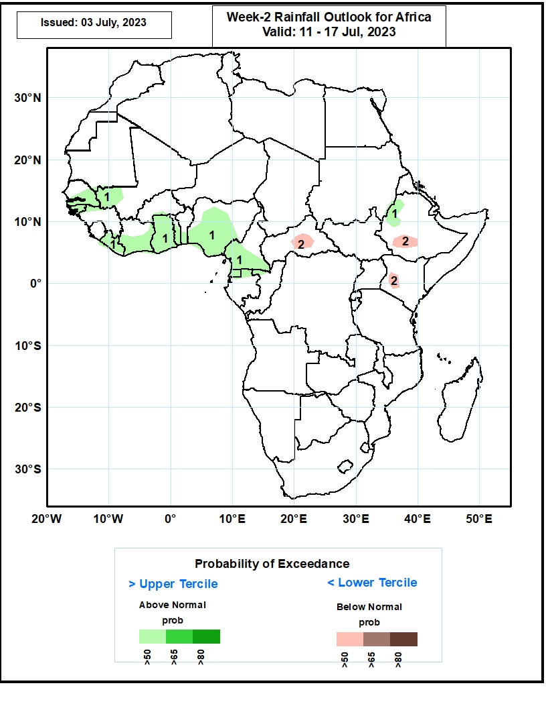
Week-2 Precipitation Outlooks
11 – 17 July 2023
1. The consolidated probabilistic forecasts call for above 50% chance for weekly rainfall to be above-normal (above the upper tercile) over southern Senegal, Guinea-Bissau, western Mali, Liberia, southern Cote d’Ivoire, much of Ghana, southern Togo, southern Benin, Nigeria, southern Cameroon, Equatorial Guinea and northern Gabon, and part of western Ethiopia.
2. The forecasts call for above 50% chance for weekly total rainfall to be below-normal (below the lower tercile) over pockets of CAR, southern Ethiopia and western Kenya.
Notes:
11

Slide 12
Summary
Over the past 30 days, in East Africa, above-average rainfall was observed over southern Sudan, central and northern Ethiopia, Eritrea, Djibouti, southern, northeastern, and northwestern South Sudan, southwestern Kenya, and northern and eastern Uganda. Rainfall was below-average over pockets of southeastern and north-central South Sudan, southwestern Ethiopia, and pockets of west-central Kenya. In southern Africa, rainfall was above-average over the southern and western portions of South Africa. In Central Africa, rainfall was above-average over northern, eastern, and western Cameroon, eastern Gabon, southern and northern Congo, parts of western and northeastern CAR, central and southwestern Chad, and western and central DRC. Below-average rainfall was observed over pockets of south-central Cameroon, Equatorial Guinea, northern Gabon, pockets of central and northern DRC, south-central Chad, and parts of central and southeastern CAR. In West Africa, rainfall was above-average over southern and eastern Senegal, much of Guinea, Guinea-Bissau, southern Mali, northern Sierra Leone, eastern Liberia, southern and northern Cote d’Ivoire, western and central Burkina Faso, southwestern Ghana, southern, central, and northeastern Nigeria, central Togo, central Benin, and southeastern Niger. Below-average rainfall was observed over western Liberia, west-central Cote d’Ivoire, eastern Burkina Faso, northern and southern Togo, northern and southern Benin, northeastern and southeastern Ghana, and parts of northwestern and central Nigeria.
During the past 7 days, in East Africa, rainfall was above-average over southeastern Sudan, western Ethiopia, northeastern and western South Sudan, northern and eastern Uganda, and southwestern Kenya. Rainfall was below average over parts of central Ethiopia and north-central and south-central South Sudan. In Central Africa, rainfall was above-average over southwestern, central, and eastern Cameroon, western CAR, southwestern Chad, and parts of central and northwestern DRC. Below-average rainfall was observed over pockets of west-central Cameroon, central Congo, central CAR, northeastern DRC, and south-central Chad. In West Africa, above-average rainfall was observed over most of Guinea, northern Sierra Leone, southeastern Cote d’Ivoire, western and central Burkina Faso, southwestern Mali, and central and parts of south-central Nigeria. Rainfall was below-average over parts of southern Sierra Leone, northern and southern Benin, northern and southern Togo, most of Ghana, western Cote d’Ivoire, most of Liberia, and most of northern and central Nigeria. In Southern Africa, rainfall was above-average over western and much of southern South Africa.
The Week-1 outlook calls for above-normal rainfall over northwestern Nigeria, southern Cameroon, eastern Equatorial Guinea, northern Gabon, northwestern Congo, northeastern DRC, southeastern CAR, south-central South Sudan, northern Uganda, and northwestern Ethiopia. In contrast, there is an increased chance for below-normal rainfall over much of the Gulf of Guinea and Sahel regions, as well as much of north-central Ethiopia. For week-2, there is an increased chance for above-normal rainfall over southern Senegal, The Gambia, central and eastern Guinea, Guinea-Bissau, southwestern Mali, eastern Nigeria, southern Cameroon, northern Gabon, northwestern Ethiopia, coastal Mozambique, and the east coast of Madagascar. In contrast, there is an increased chance for below-normal rainfall over much of coastal Guinea, coastal Sierra Leone, parts of coastal Liberia, southwestern Nigeria, southern Chad, northern Cameroon, CAR, South Sudan, southern Sudan, western Eritrea, and north-central and central Ethiopia.

