Slide 1
The African Monsoon Recent Evolution and Current Status Include Week-1 and Week-2 Outlooks
Update prepared
07 August 2023
For more information, visit:
http://www.cpc.ncep.noaa.gov/products/Global_Monsoons/African_Monsoons/precip_monitoring.shtml

Slide 2
Outline
Highlights
Recent Evolution and Current Conditions
NCEP GEFS Forecasts
Summary

Slide 3
Highlights: Last 7 Days
During the past 7 days, in East Africa, rainfall was above-average over the far western and eastern Sudan, and southern South Sudan, and central and northern Ethiopia. Below-average rainfall was observed over parts of central Sudan, and northcentral South Sudan. In Central Africa, rainfall was above-average over parts of northern Cameron, central Chad, pockets of northern DRC, and many parts of CAR. Below-average rainfall was observed over southern Cameroon, southern Chad, and central and eastern DRC. In West Africa, above-average rainfall was observed over Sierra Leone, Liberia, parts of Cote d’Ivoire, Ghana, Togo, Benin, and the far western Nigeria. Rainfall was below-average over much of Senegal, western and southern Mali, Guinea-Bissau, parts of Guinea, Burkina Faso, and central and eastern Nigeria.
The Week-1 outlook calls for above-normal rainfall across the central and eastern portions of the Sahel region, including southern and eastern Sudan, western Ethiopia, South Sudan and northern DRC. In contrast, there is an increased chance for below-normal rainfall over parts of Senegal and southern Mauritania, southeastern Nigeria, southwestern Cameroon, and eastern Cameroon. For week-2, there is an increased chance for above-normal rainfall over the western portion of the Sahel region, the eastern parts of the Gulf of Guinea region, parts of Central Africa, and eastern Sudan, and northern Ethiopia. In contrast, there is an increased chance for below-normal rainfall in the Lake Victoria region, and southwestern and central Ethiopia.

Slide 4
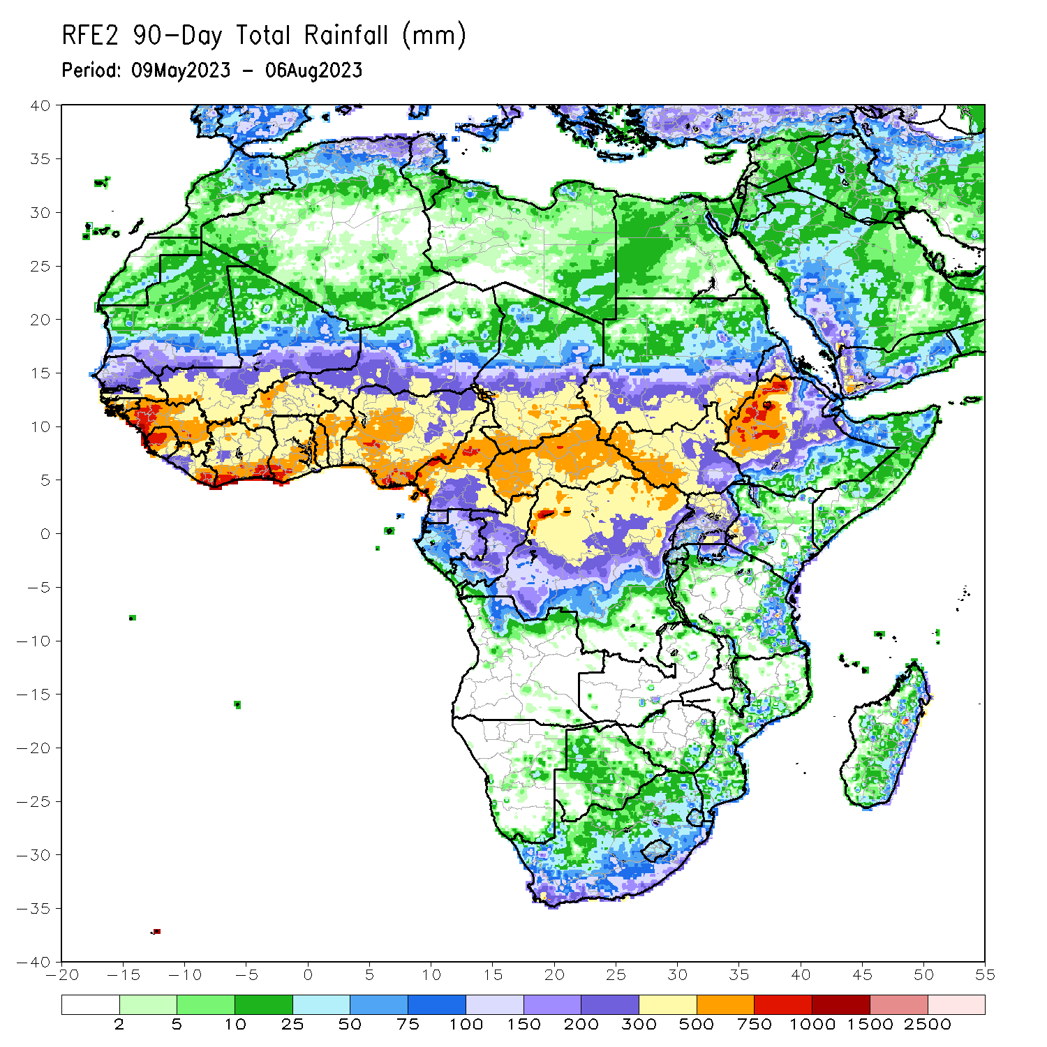
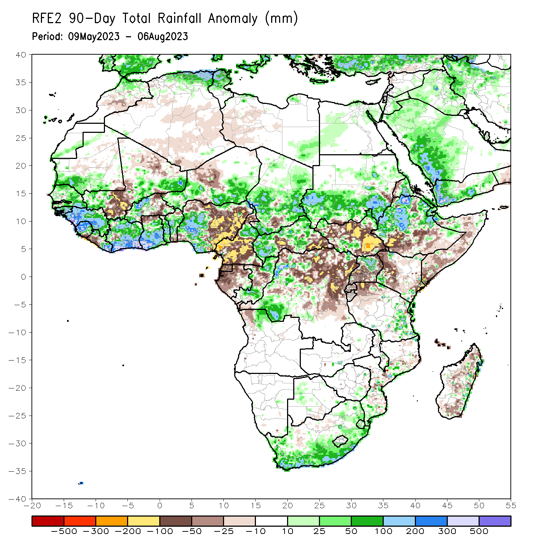
Rainfall Patterns: Last 90 Days
Over the past 90 days, in East Africa, above-average rainfall was observed over southern and eastern Sudan, much of Eritrea, many parts of Ethiopia, parts of northern Somalia, part of southwestern Kenya, the far southern South Sudan, Djibouti, and northern Uganda. Rainfall was below-average over much of South Sudan, central and southern Somalia, northwestern and central Kenya, and central and southern Uganda. In southern Africa, above-average rainfall was observed over many parts of South Africa, including Lesotho and Eswatini. Below-average rainfall was observed over parts of Madagascar. In Central Africa, rainfall was above-average over part of northern Cameroon, many parts of CAR, the far southern and northern Congo, southern Chad, and parts of western DRC. Rainfall was below-average over central and southern Cameroon, Equatorial Guinea, Gabon, central Congo, pockets of Chad and CAR, and parts of northern and eastern DRC. In West Africa, rainfall was above-average over much of Senegal, southern Mauritania, Guinea-Bissau, Guinea, Sierra Leone, eastern Liberia, southwestern and eastern Mali, much of Cote d’Ivoire, parts of Burkina Faso, much of Ghana, northern Togo, northern Benin, western and southern Niger, and western and southern Nigeria. Below-average rainfall was observed over western Liberia, parts of southern Mali, pockets of Cote d’Ivoire and Burkina Faso, southern Benin, northern and eastern Nigeria.
Notes:
4

Slide 5
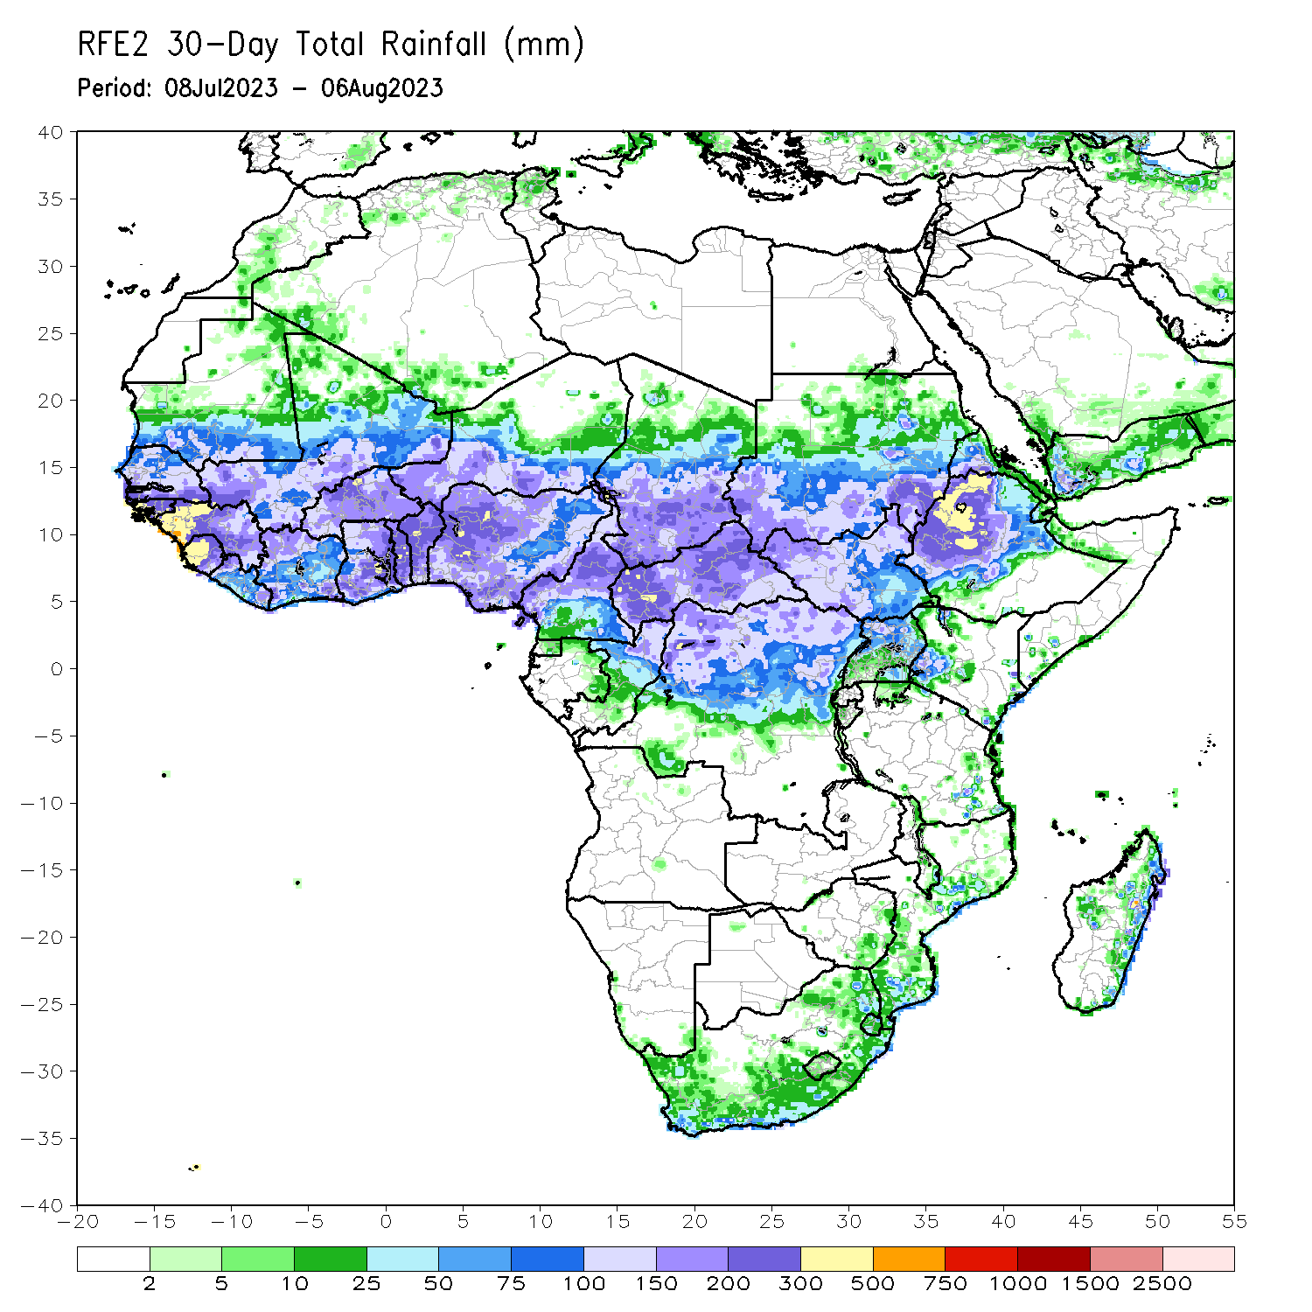
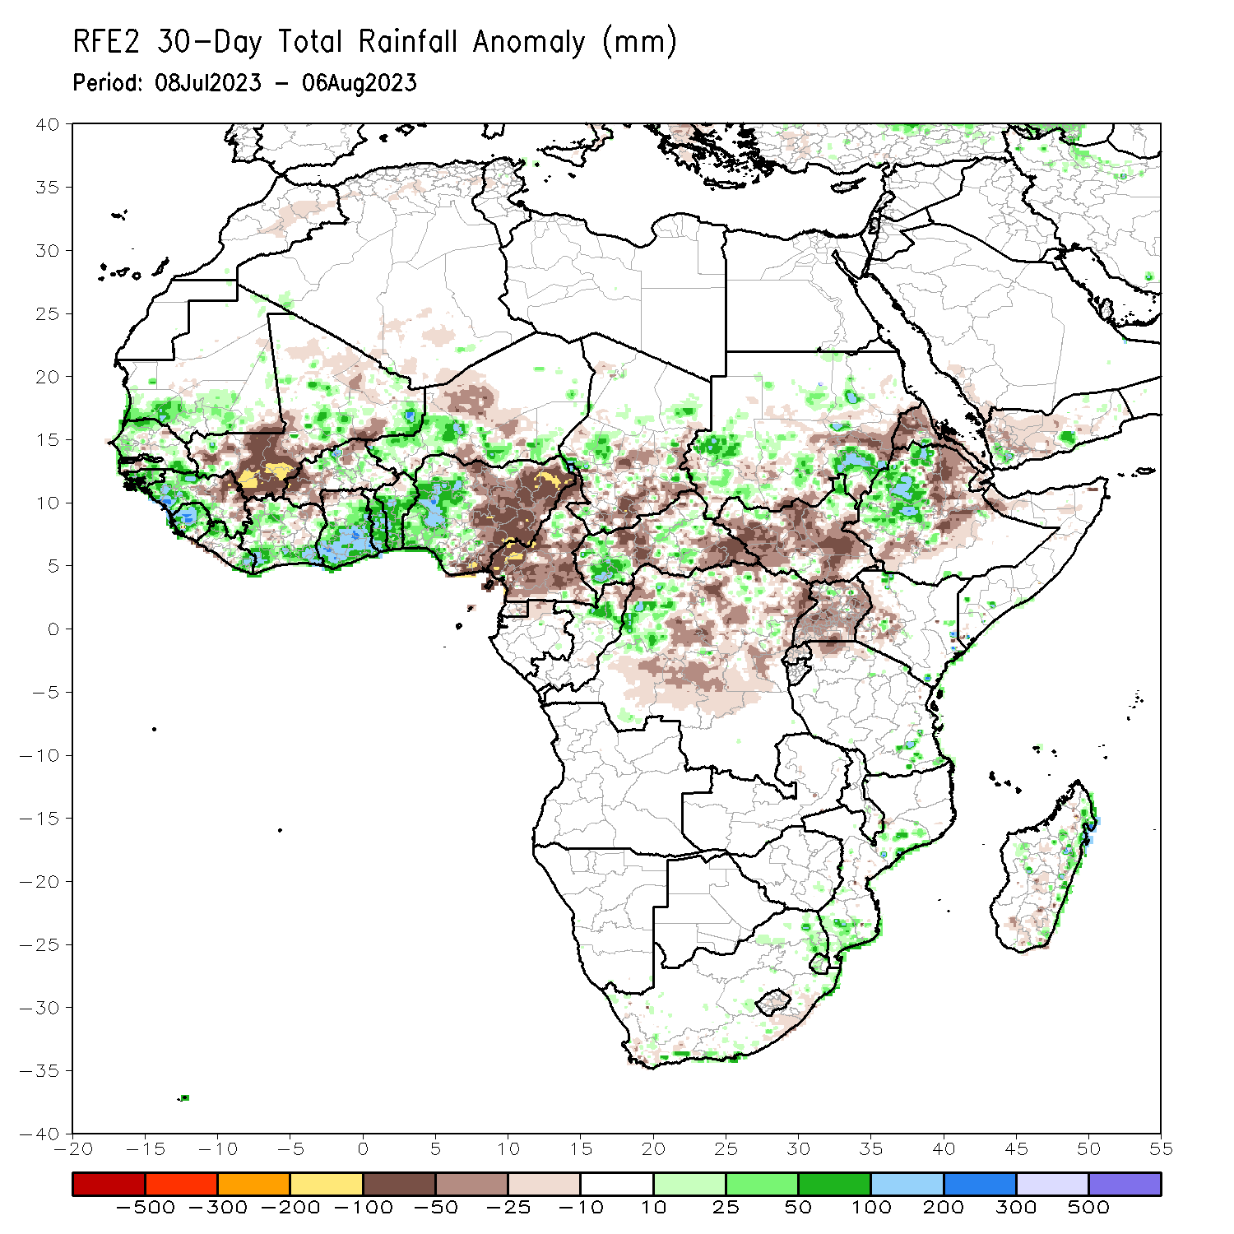
Rainfall Patterns: Last 30 Days
Over the past 30 days, in East Africa, above-average rainfall was observed over parts of southern and eastern Sudan, and western Ethiopia. Rainfall was below-average over much of South Sudan, pockets of Sudan, Eritrea, eastern and southern Ethiopia, and Uganda. In Central Africa, rainfall was above-average over northern Congo and pockets of CAR, and northwestern DRC. Below-average rainfall was observed over much of Cameroon, central and eastern CAR, portions of Chad, and central and eastern DRC. In West Africa, rainfall was above-average over southern Mauritania, much of Senegal, Guinea-Bissau, western Guinea, Sierra Leone, the far western and eastern Mali, Cote d’Ivoire, much of Ghana, pockets of Burkina Faso, western Niger, Togo, Benin, and western Nigeria. Below-average rainfall was observed over eastern Guinea, Liberia, southern and central Mali, pockets of Cote d’Ivoire, western Burkina Faso, and eastern Nigeria.
Notes:
5

Slide 6
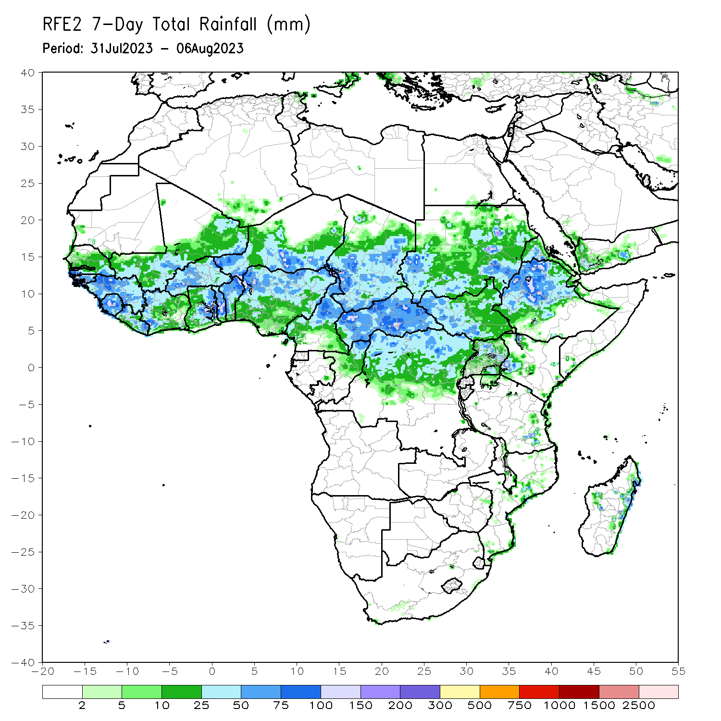
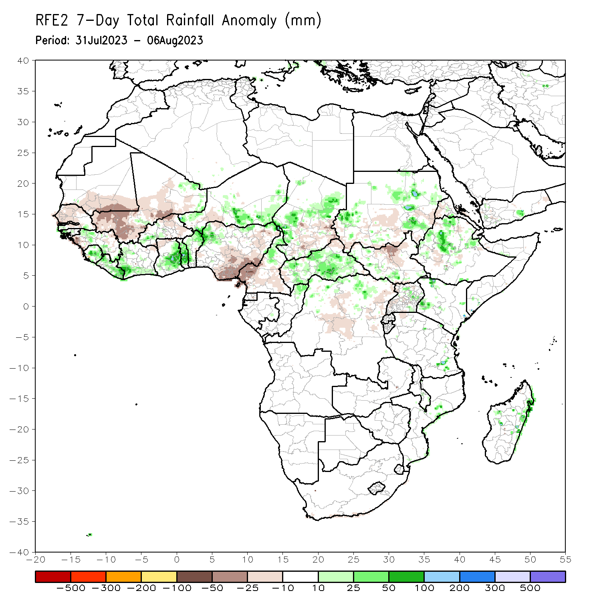
Rainfall Patterns: Last 7 Days
During the past 7 days, in East Africa, rainfall was above-average over the far western and eastern Sudan, and southern South Sudan, and central and northern Ethiopia. Below-average rainfall was observed over parts of central Sudan, and northcentral South Sudan. In Central Africa, rainfall was above-average over parts of northern Cameron, central Chad, pockets of northern DRC, and many parts of CAR. Below-average rainfall was observed over southern Cameroon, southern Chad, and central and eastern DRC. In West Africa, above-average rainfall was observed over Sierra Leone, Liberia, parts of Cote d’Ivoire, Ghana, Togo, Benin, and the far western Nigeria. Rainfall was below-average over much of Senegal, western and southern Mali, Guinea-Bissau, parts of Guinea, Burkina Faso, and central and eastern Nigeria.

Slide 7
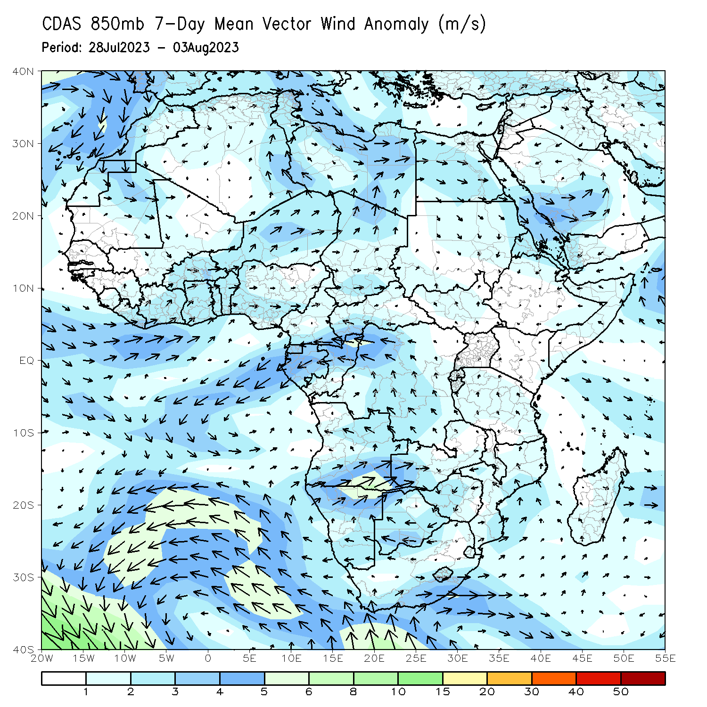
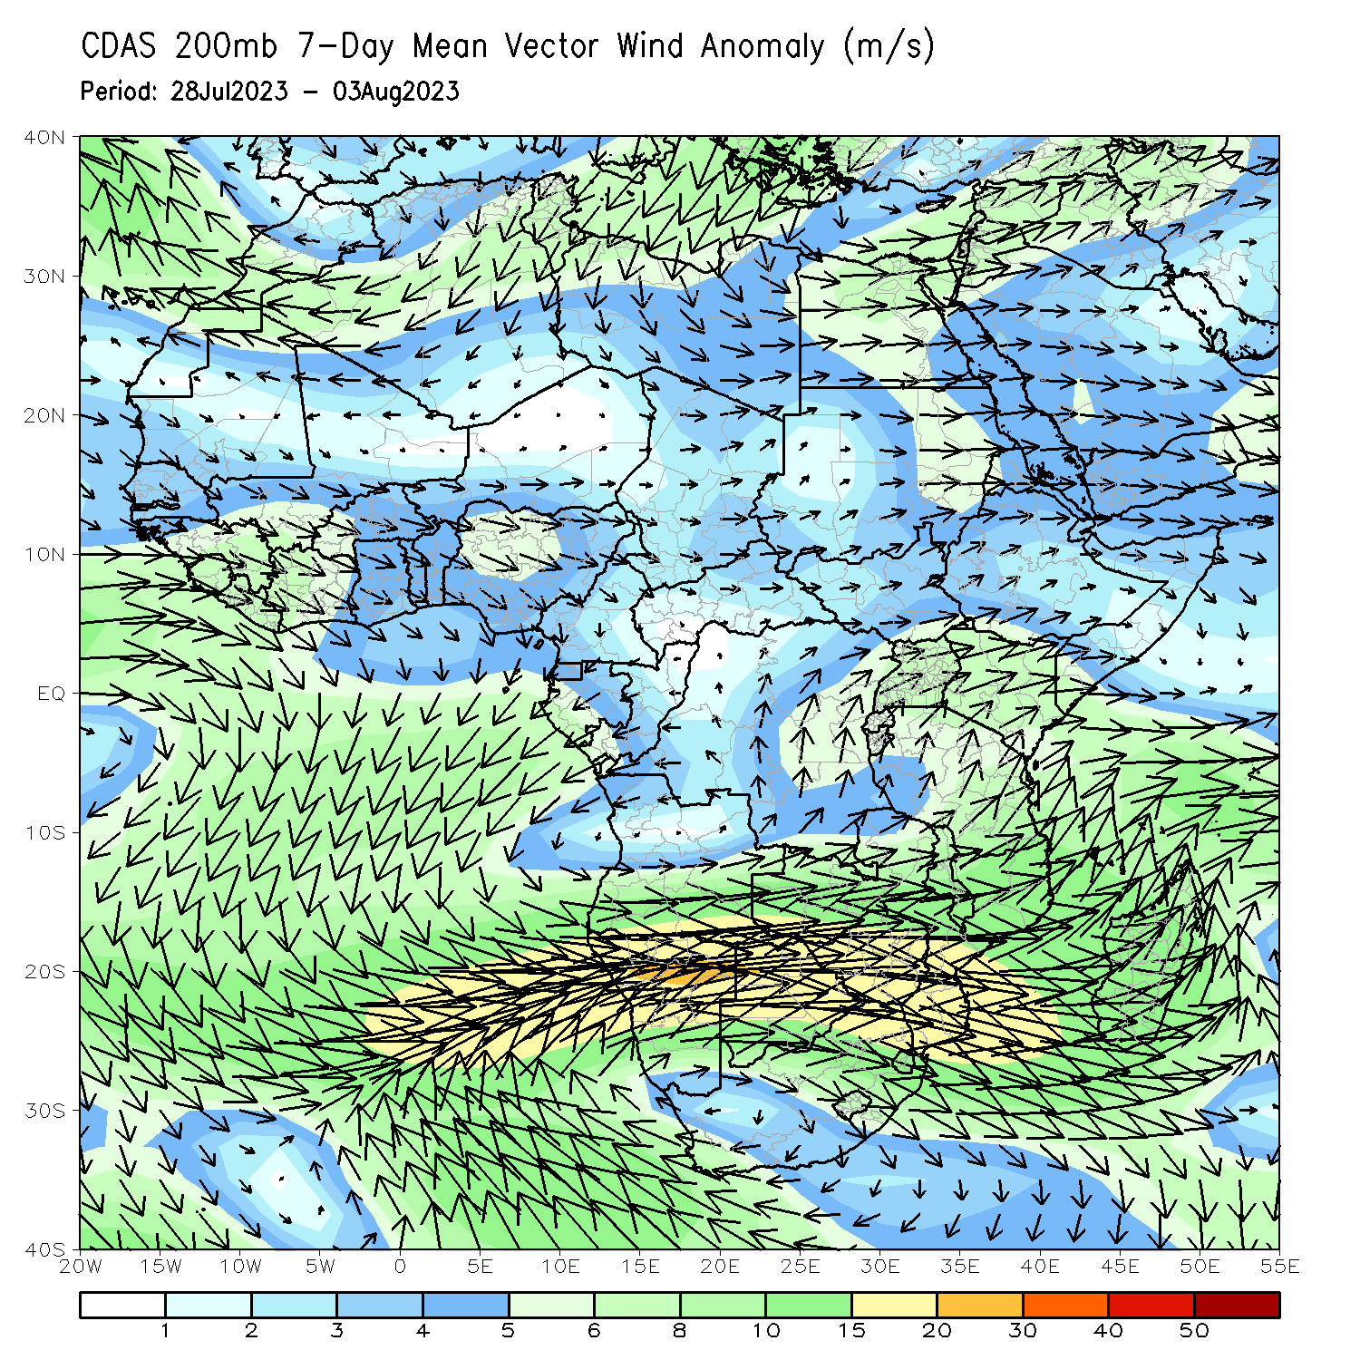
Atmospheric Circulation: Last 7 Days
At 850-hPa level (left panel), stronger than normal flow along the Gulf of Guinea region may have contributed to the observed wetter than normal condition in the region.

Slide 8
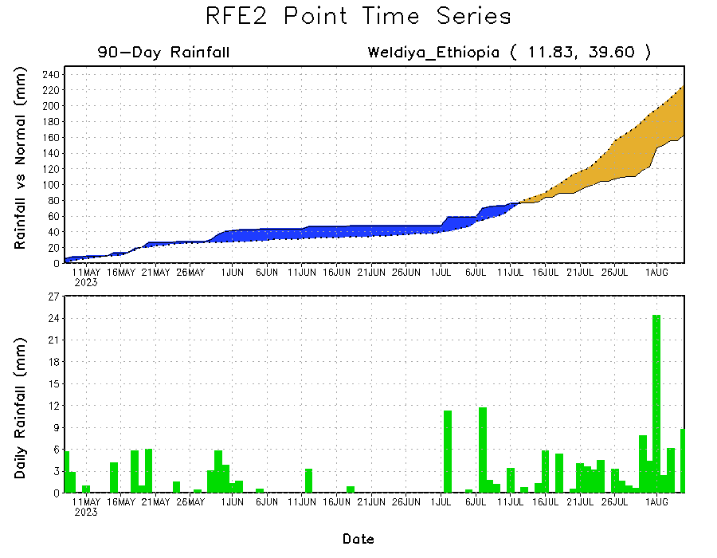
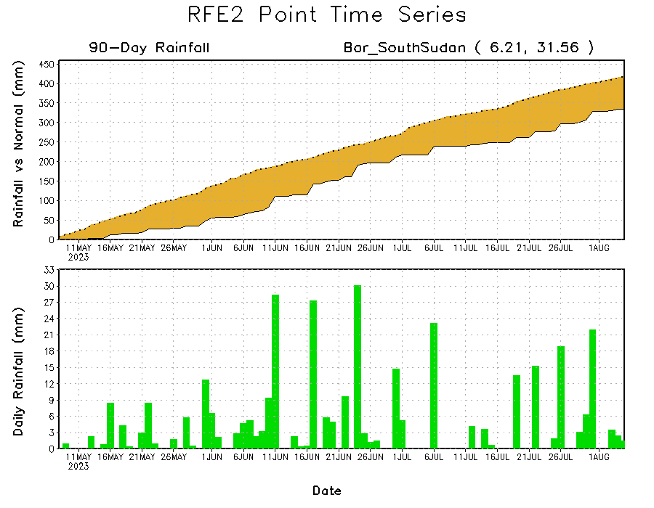
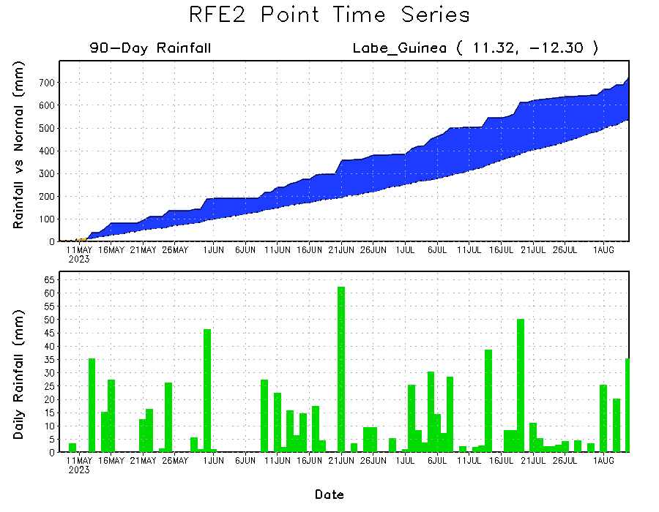
Rainfall Evolution
Daily evolution of rainfall over the last 90 days at selected locations shows moderate to heavy rainfall sustained moisture surpluses over parts of Guinea (bottom left). Seasonal total rainfall remained below-average over parts of South Sudan (bottom right) and northeastern Ethiopia (top right).

Slide 9
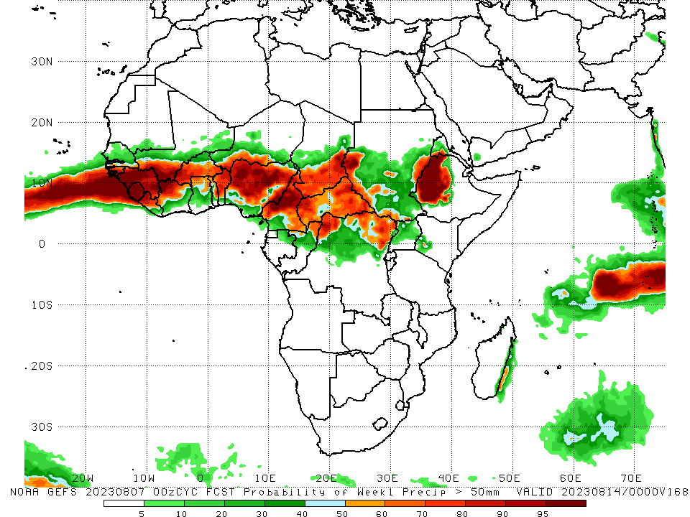
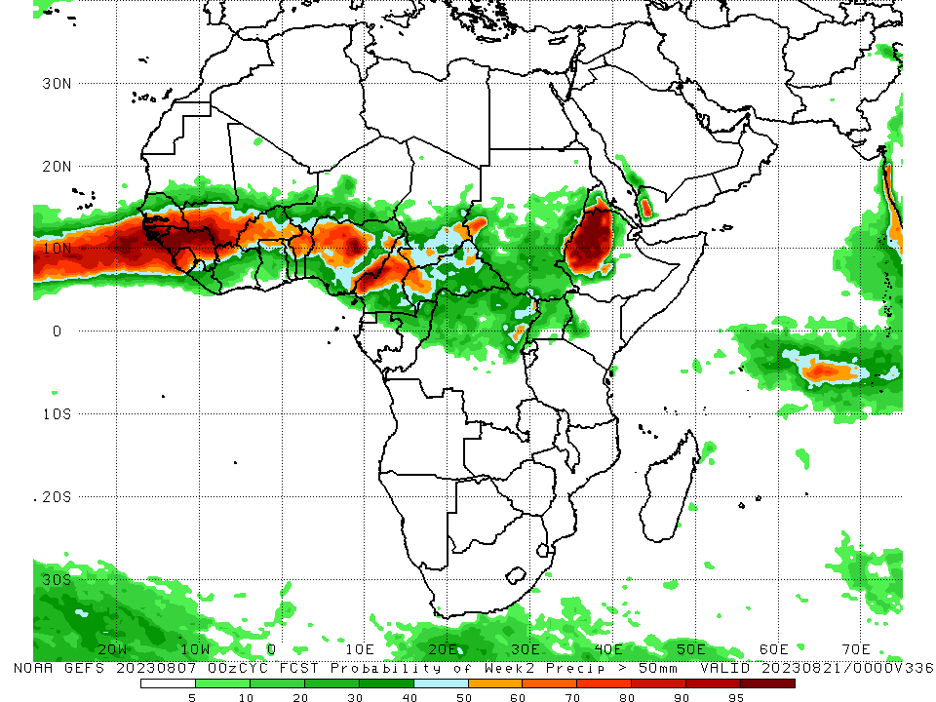
NCEP GEFS Model Forecasts Non-Bias Corrected Probability of precipitation exceedance
Week-1, Valid: 08 – 14 August 2023
Week-2, Valid: 09 – 15 August 2023
For week-1 (left panel), the GEFS forecasts indicate a moderate to high chance (over 70%) for rainfall to exceed 50 mm over many parts of West and Central Africa, and western Ethiopia. For week-2 (right panel), there is a high chance for the weekly total rainfall to exceed 50mm over the far western and eastern Gulf of Guinea, and much of the Sahel region, and western Ethiopia.
Notes:
9

Slide 10
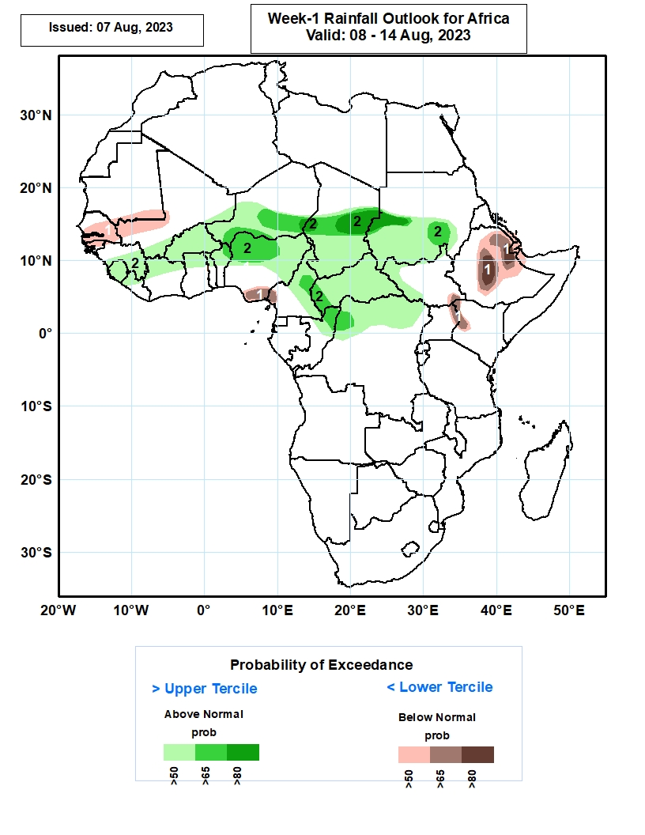
Week-1 Precipitation Outlooks
08 – 14 August 2023
The forecasts call for above 50% chance for weekly total rainfall to be below-normal (below the lower tercile) over much of Senegal, The Gambia and Guinea-Bissau, southern Mauritania, southwestern Mali, southeastern Nigeria, southwestern Cameroon, southeastern South Sudan, northeastern Uganda, western Kenya, central and eastern parts of Ethiopia, much of Djibouti, southern Eritrea, and northwestern Somali. There is above 80% chance for rainfall to be below-normal over central and eastern parts of Ethiopia.
The probabilistic forecasts call for above 50% chance for weekly rainfall to be above-normal (above the upper tercile) over central and southern Guinea-Conakry, much of Sierra Leone, northern Liberia, eastern and southern parts of Mali, much of Burkina Faso, northern Cote d’Ivoire, Ghana, Togo and Benin, northern and central parts of Nigeria and Cameroon, much of CAR, northern Congo and DR Congo, central and southern parts of Niger, Chad, and Sudan, and western South Sudan. There is above 80% chance for rainfall to be above-normal over central parts of Chad and Sudan.
Notes:
10

Slide 11
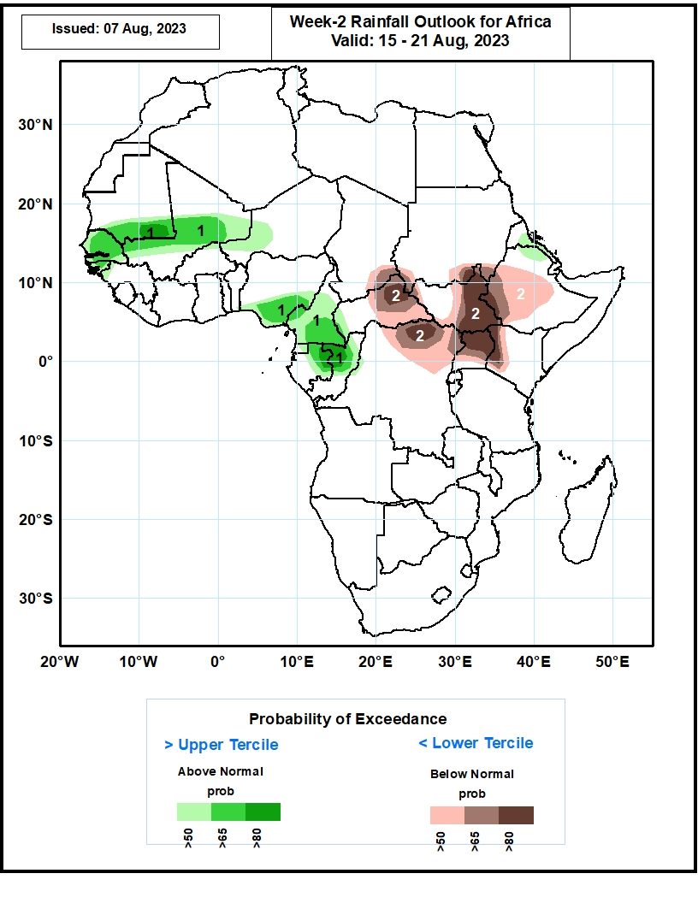
Week-2 Precipitation Outlooks
15 – 21 August 2023
The probabilistic forecasts call for above 50% chance for weekly rainfall to be above-normal (above the upper tercile) over much of Senegal, The Gambia and Guinea-Bissau, western Guinea-Conakry, southern Mauritania, central and southern parts of Mali, southwestern Niger, central and southern parts of Nigeria, much of Cameroon and Equatorial Guinea, northern and eastern parts of Gabon, northern and central Congo, central Eritrea, and north-central Ethiopia. There is above 80% chance for rainfall to be above-normal over southeastern Mauritania, and central Congo.
The forecasts call for above 50% chance for weekly total rainfall to be below-normal (below the lower tercile) over southeastern Chad, central and eastern parts of CAR, southern parts of Sudan, much of South Sudan except northwestern part, western and central parts of Ethiopia, northern DR Congo, much of Uganda, and western Kenya. There is above 80% chance for rainfall to be below-normal over northeastern CAR, north-central DR Congo, eastern South Sudan, northern Uganda, and western Kenya.
Notes:
11

Slide 12
Summary
Over the past 30 days, in East Africa, above-average rainfall was observed over parts of southern and eastern Sudan, and western Ethiopia. Rainfall was below-average over much of South Sudan, pockets of Sudan, Eritrea, eastern and southern Ethiopia, and Uganda. In Central Africa, rainfall was above-average over northern Congo and pockets of CAR, and northwestern DRC. Below-average rainfall was observed over much of Cameroon, central and eastern CAR, portions of Chad, and central and eastern DRC. In West Africa, rainfall was above-average over southern Mauritania, much of Senegal, Guinea-Bissau, western Guinea, Sierra Leone, the far western and eastern Mali, Cote d’Ivoire, much of Ghana, pockets of Burkina Faso, western Niger, Togo, Benin, and western Nigeria. Below-average rainfall was observed over eastern Guinea, Liberia, southern and central Mali, pockets of Cote d’Ivoire, western Burkina Faso, and eastern Nigeria.
During the past 7 days, in East Africa, rainfall was above-average over the far western and eastern Sudan, and southern South Sudan, and central and northern Ethiopia. Below-average rainfall was observed over parts of central Sudan, and northcentral South Sudan. In Central Africa, rainfall was above-average over parts of northern Cameron, central Chad, pockets of northern DRC, and many parts of CAR. Below-average rainfall was observed over southern Cameroon, southern Chad, and central and eastern DRC. In West Africa, above-average rainfall was observed over Sierra Leone, Liberia, parts of Cote d’Ivoire, Ghana, Togo, Benin, and the far western Nigeria. Rainfall was below-average over much of Senegal, western and southern Mali, Guinea-Bissau, parts of Guinea, Burkina Faso, and central and eastern Nigeria.
The Week-1 outlook calls for above-normal rainfall across the central and eastern portions of the Sahel region, including southern and eastern Sudan, western Ethiopia, South Sudan and northern DRC. In contrast, there is an increased chance for below-normal rainfall over parts of Senegal and southern Mauritania, southeastern Nigeria, southwestern Cameroon, and eastern Cameroon. For week-2, there is an increased chance for above-normal rainfall over the western portion of the Sahel region, the eastern parts of the Gulf of Guinea region, parts of Central Africa, and eastern Sudan, and northern Ethiopia. In contrast, there is an increased chance for below-normal rainfall in the Lake Victoria region, and southwestern and central Ethiopia.

