Slide 1
The African Monsoon Recent Evolution and Current Status Include Week-1 and Week-2 Outlooks
Update prepared
14 August 2023
For more information, visit:
http://www.cpc.ncep.noaa.gov/products/Global_Monsoons/African_Monsoons/precip_monitoring.shtml

Slide 2
Outline
Highlights
Recent Evolution and Current Conditions
NCEP GEFS Forecasts
Summary

Slide 3
Highlights: Last 7 Days
During the past 7 days, in East Africa, rainfall was above-average over many parts of Sudan, western Eritrea, western and northern South Sudan, and parts of western Ethiopia. Below-average rainfall was observed over southeastern southern Sudan, pockets of Sudan and eastern Ethiopia. In Central Africa, rainfall was above-average over parts of Cameroon and central Chad, much of CAR, northern Congo, and northern DRC. Below-average rainfall was observed over pockets of northern Cameron and southwestern Chad. In West Africa, above-average rainfall was observed over parts of Guinea, Sierra Leone, northern Cote d’Ivoire, parts of Niger, pockets of northern Ghana, northern Benin, and pockets of northwestern Nigeria. Rainfall was below-average over parts of Senegal, western and central Mali, southwestern Niger, and many parts of Nigeria.
The Week-1 outlook calls for above-normal rainfall over southern Mauritania, Senegal, central Cote d’Ivoire and Ghana, southern Cameroon, and parts of Eritrea and northern Ethiopia. In Contrast, there is an increased chance for below-normal rainfall across northern Nigeria, central and southern Chad, eastern and southern CAR, western and southern Sudan, much of South Sudan, northeastern DRC, Uganda, western Kenya and southwestern Ethiopia. For week-2, there is an increased chance for above-normal rainfall over Sierra Leone, Liberia, eastern Guinea, and western Cote d’Ivoire, pockets of Mali, southern Cameroon, northern Gabon, central Congo and central Chad. In contrast, there is an increased chance for below-normal rainfall across central and eastern CAR, much of South Sudan, northeastern DRC, southern Ethiopia, Uganda and western Kenya.

Slide 4
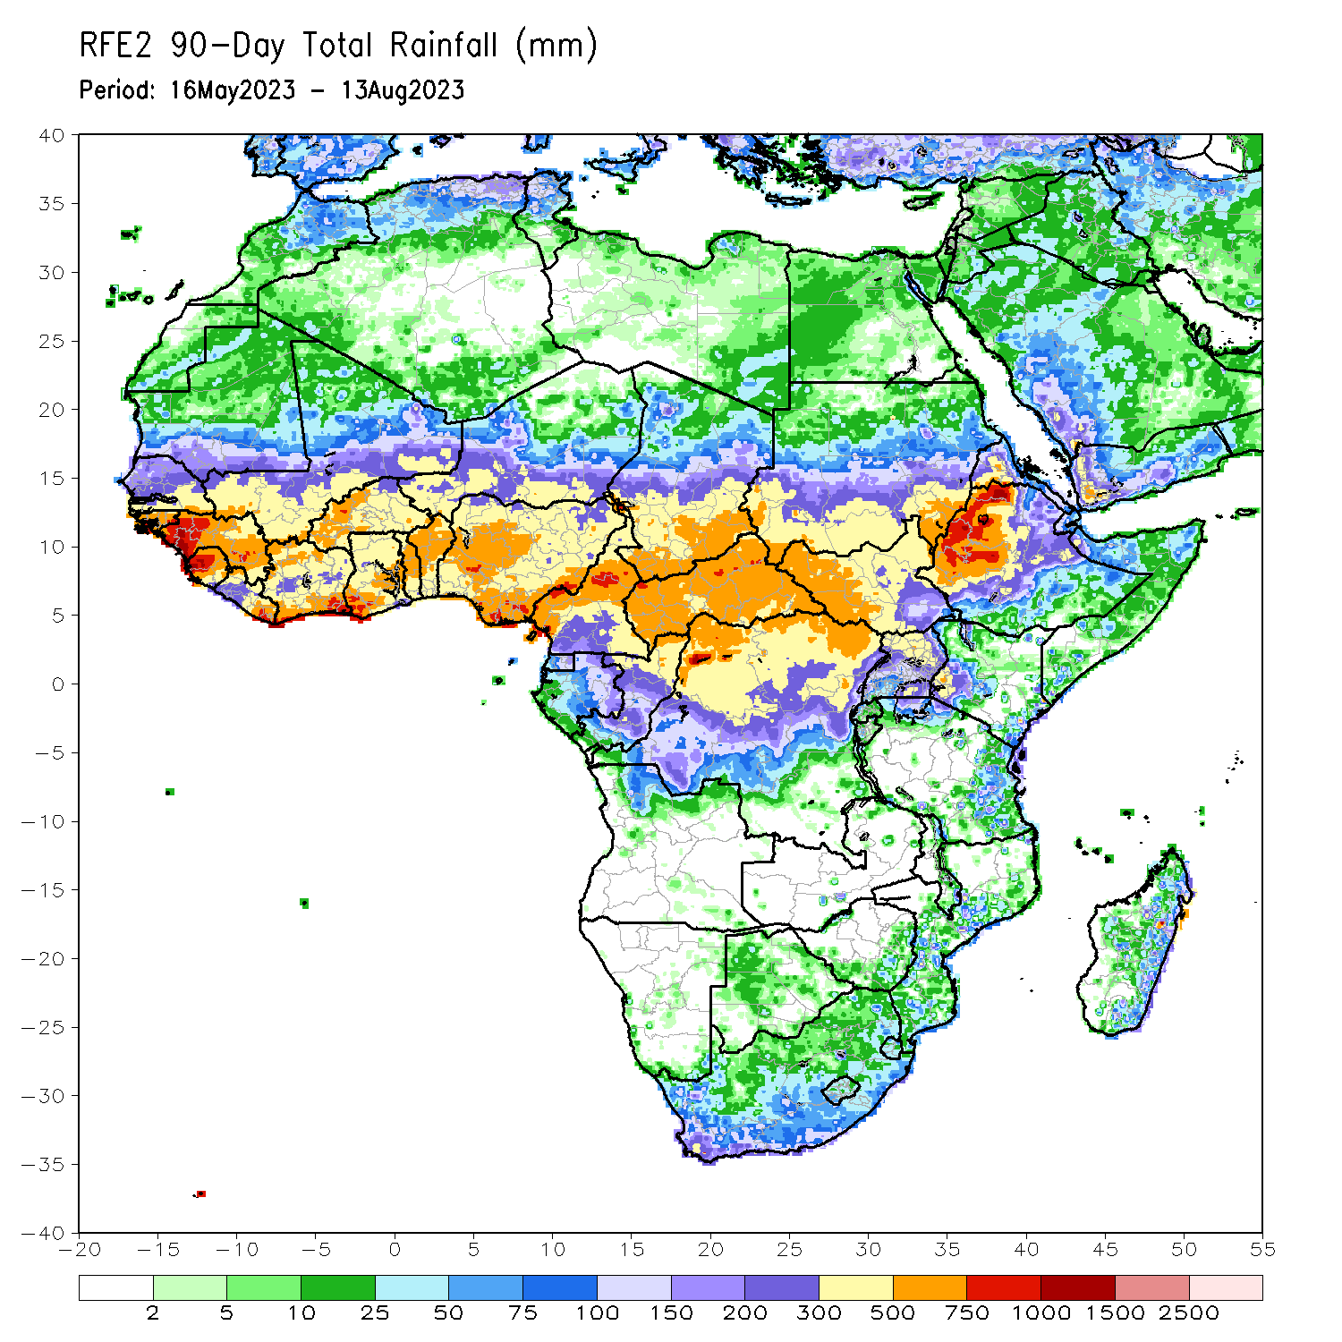
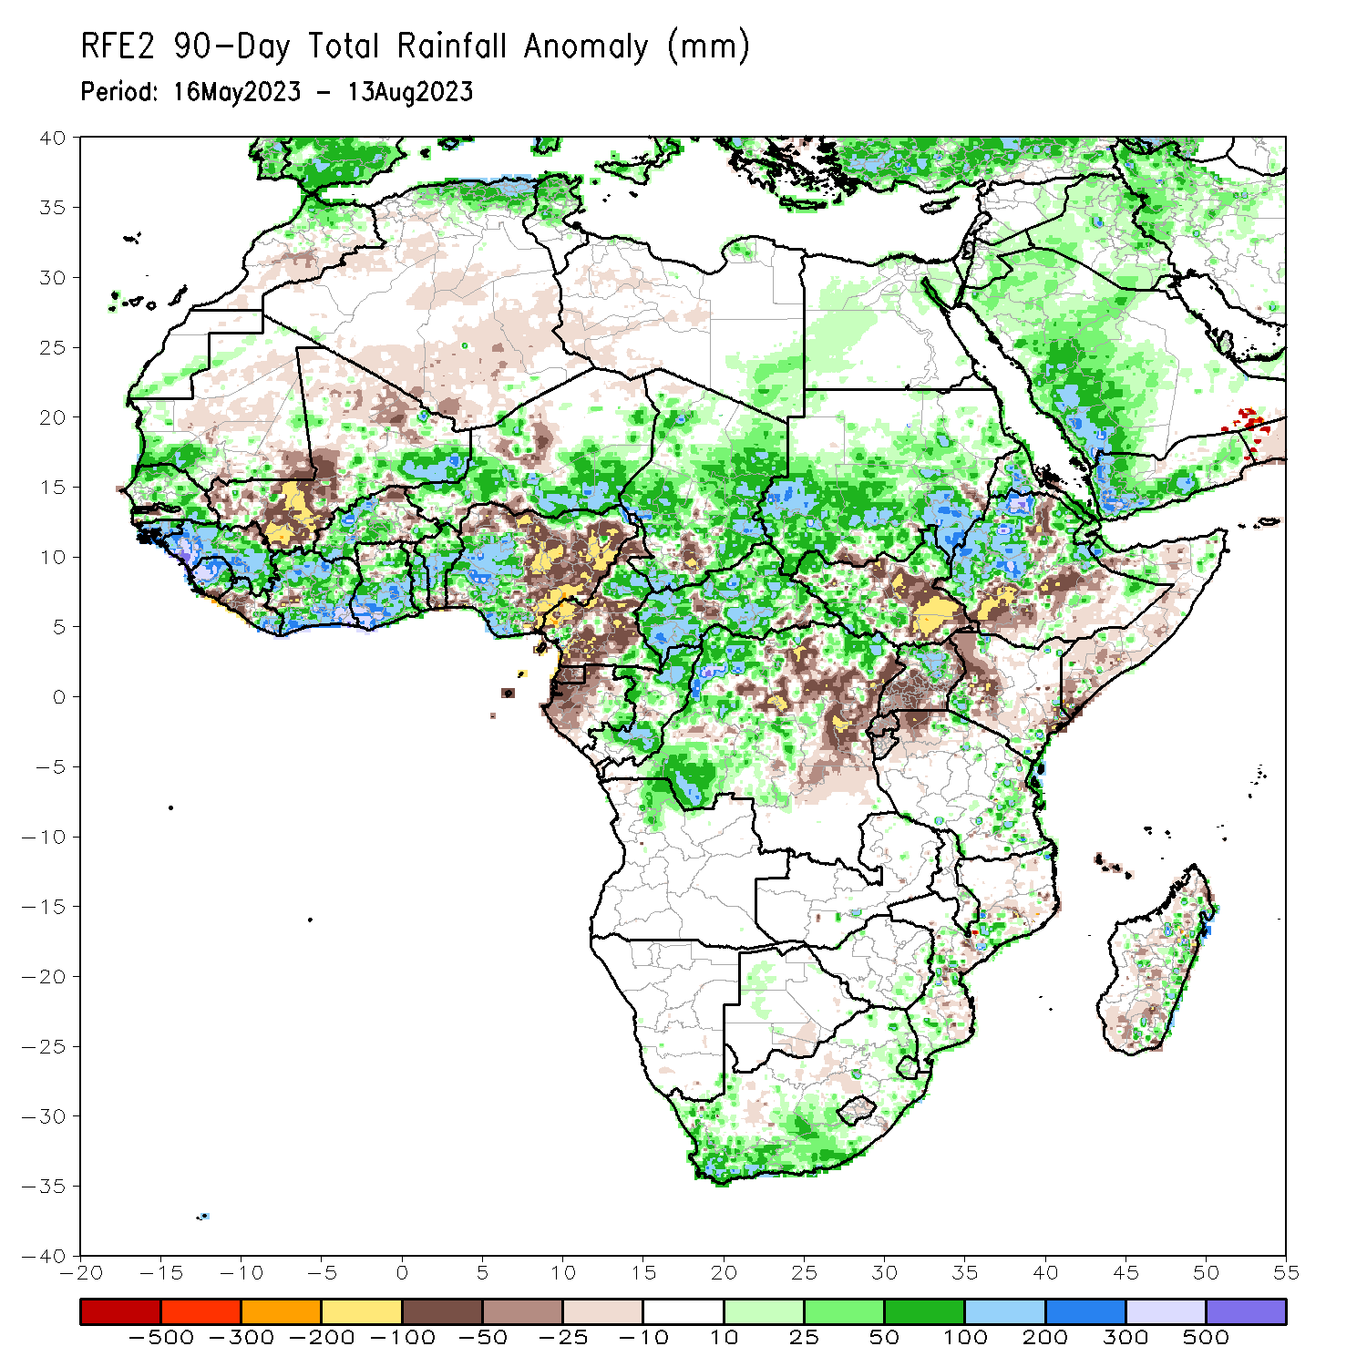
Rainfall Patterns: Last 90 Days
Over the past 90 days, in East Africa, above-average rainfall was observed over many parts of Sudan and Ethiopia, much of Eritrea, part of southwestern Kenya, western, central and northeastern South Sudan, Djibouti, and northern Uganda and southeastern Tanzania. Rainfall was below-average over southeastern South Sudan, central and southern Somalia, northwestern and central Kenya, and central and southern Uganda. In southern Africa, above-average rainfall was observed over many parts of South Africa. Below-average rainfall was observed over parts of Madagascar. In Central Africa, rainfall was above-average over part of northern Cameroon, much of CAR, Congo, Chad, and parts of western DRC. Rainfall was below-average over central and southern Cameroon, Equatorial Guinea, Gabon, parts of central and eastern DRC, and pockets of Congo, Chad and CAR. In West Africa, rainfall was above-average over much of Senegal, southern Mauritania, Guinea-Bissau, Guinea, Sierra Leone, eastern Liberia, eastern Mali, much of Cote d’Ivoire, western Burkina Faso, much of Ghana, Togo, Benin, western and southern Niger, and western and central Nigeria. Below-average rainfall was observed over western Liberia, western Mali, eastern Burkina Faso, and eastern Nigeria.
Notes:
4

Slide 5
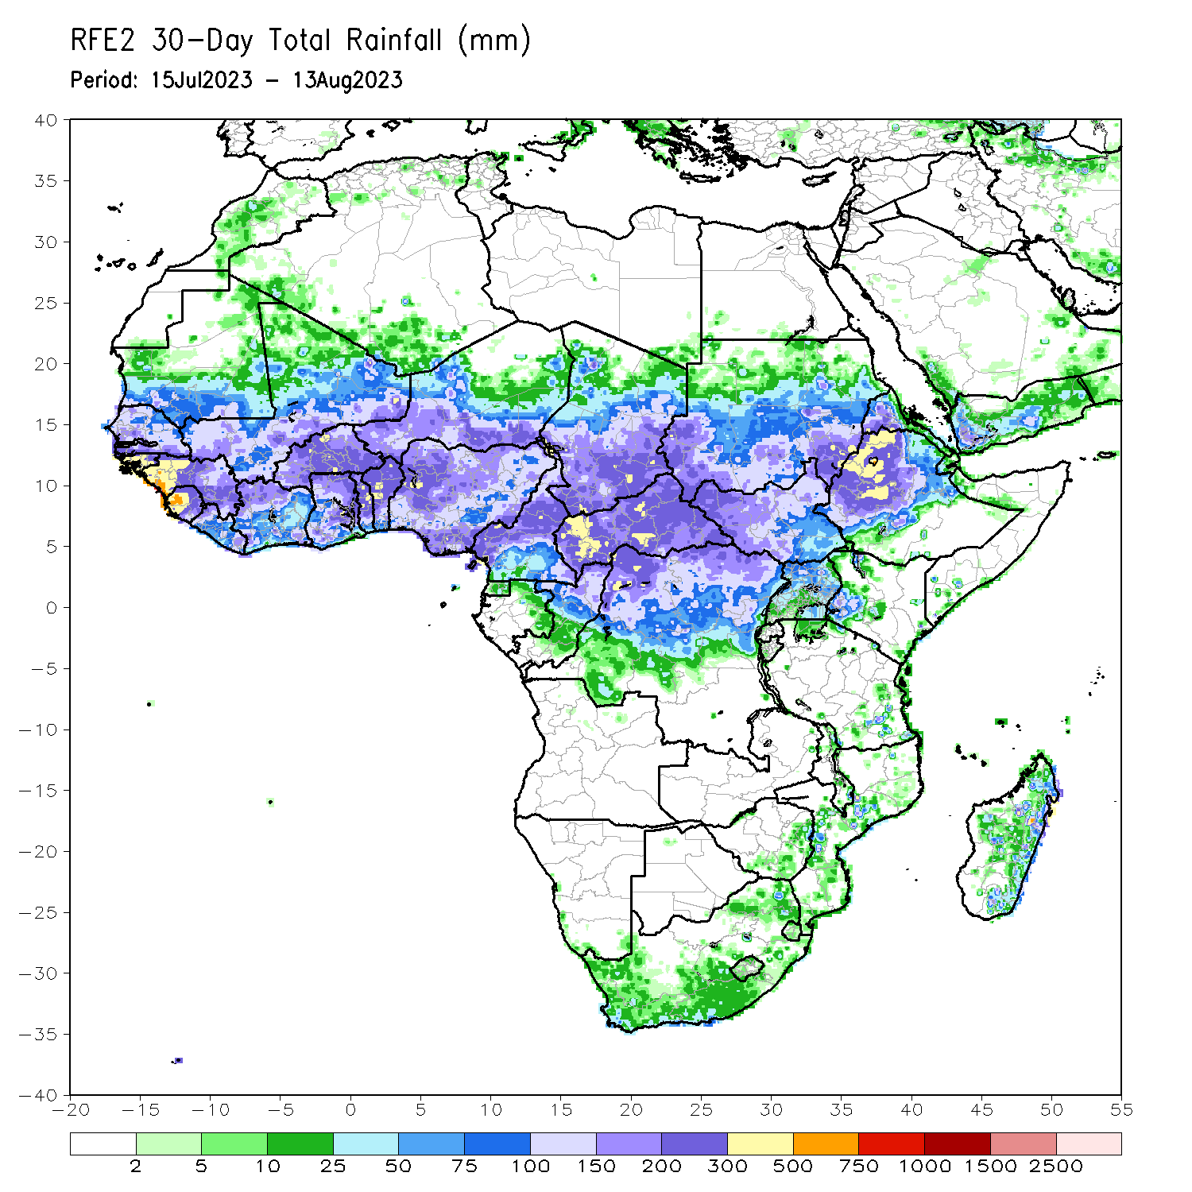
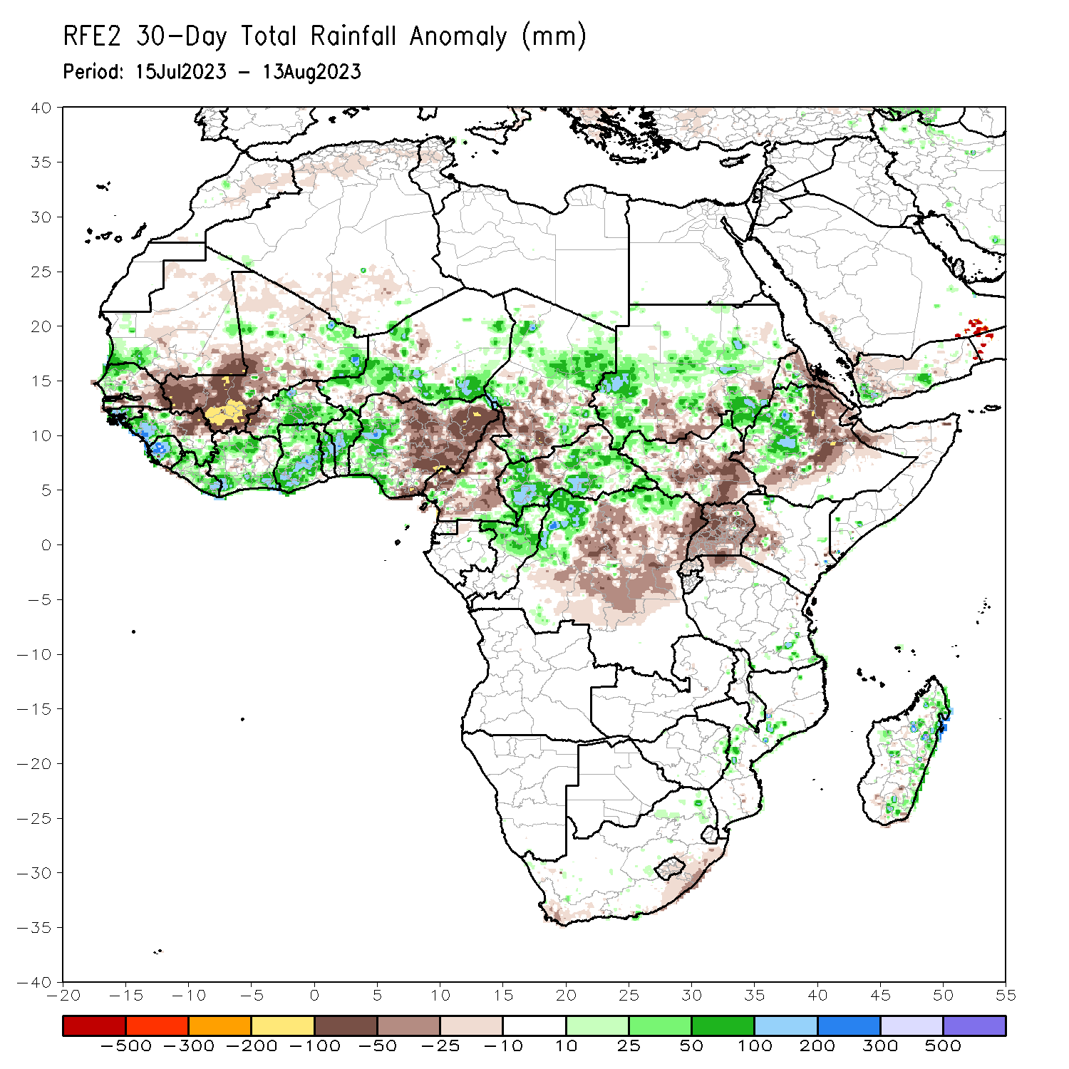
Rainfall Patterns: Last 30 Days
Over the past 30 days, in East Africa, above-average rainfall was observed over parts of Sudan, western and northeastern South Sudan, and western Ethiopia. Rainfall was below-average over pockets of Sudan, central and southeastern South Sudan, Eritrea, eastern and southern Ethiopia, and Uganda and western Kenya. In Central Africa, rainfall was above-average over northern Congo much of CAR, parts of Chad, and northwestern and northern DRC. Below-average rainfall was observed over much of Cameroon, portions of Chad, and central and eastern DRC. In West Africa, rainfall was above-average over pockets of southern Mauritania, western Senegal, western Guinea, Sierra Leone, Liberia, pockets of northern Mali, Cote d’Ivoire, Ghana, central and eastern Burkina Faso, western and southern Niger, Togo, Benin, and western Nigeria. Below-average rainfall was observed over eastern Senegal, western and central Mali, eastern Guinea,, western Burkina Faso, and central and eastern Nigeria.
Notes:
5

Slide 6
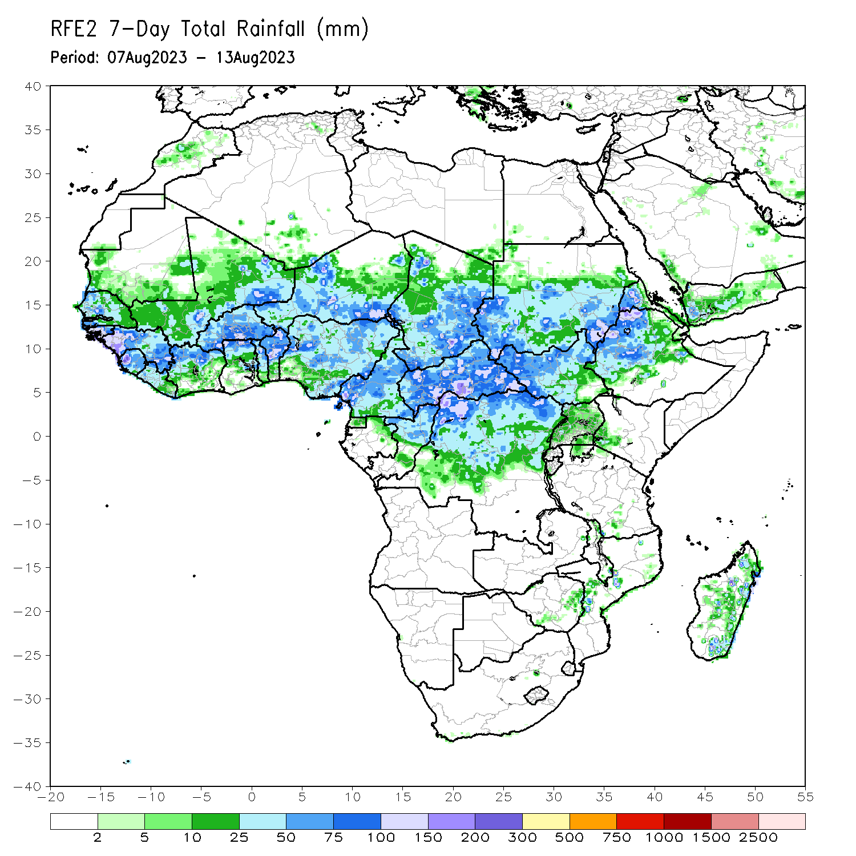
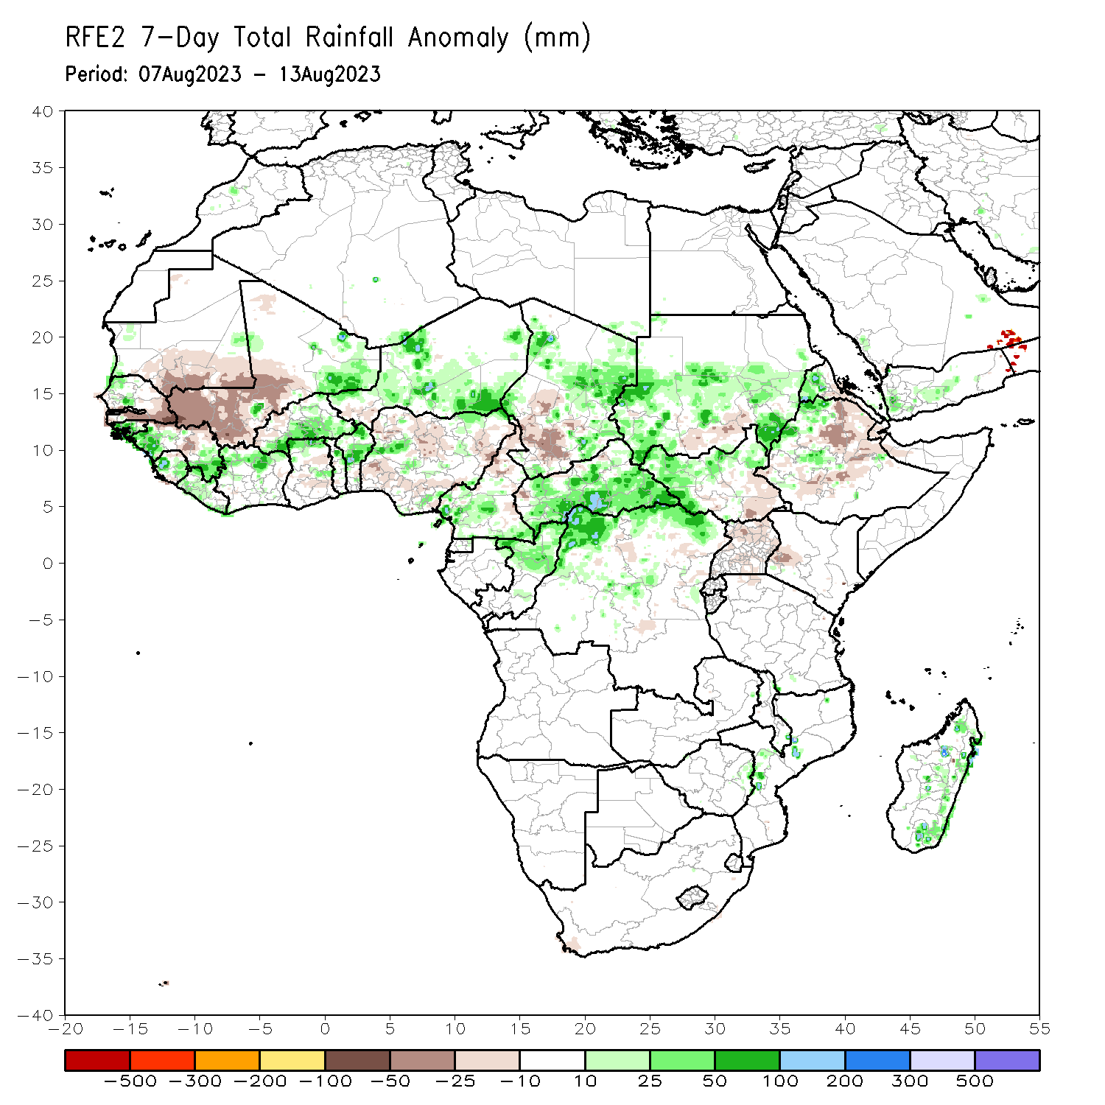
Rainfall Patterns: Last 7 Days
During the past 7 days, in East Africa, rainfall was above-average over many parts of Sudan, western Eritrea, western and northern South Sudan, and parts of western Ethiopia. Below-average rainfall was observed over southeastern southern Sudan, pockets of Sudan and eastern Ethiopia. In Central Africa, rainfall was above-average over parts of Cameroon and central Chad, much of CAR, northern Congo, and northern DRC. Below-average rainfall was observed over pockets of northern Cameron and southwestern Chad. In West Africa, above-average rainfall was observed over parts of Guinea, Sierra Leone, northern Cote d’Ivoire, parts of Niger, pockets of northern Ghana, northern Benin, and pockets of northwestern Nigeria. Rainfall was below-average over parts of Senegal, western and central Mali, southwestern Niger, and many parts of Nigeria.

Slide 7
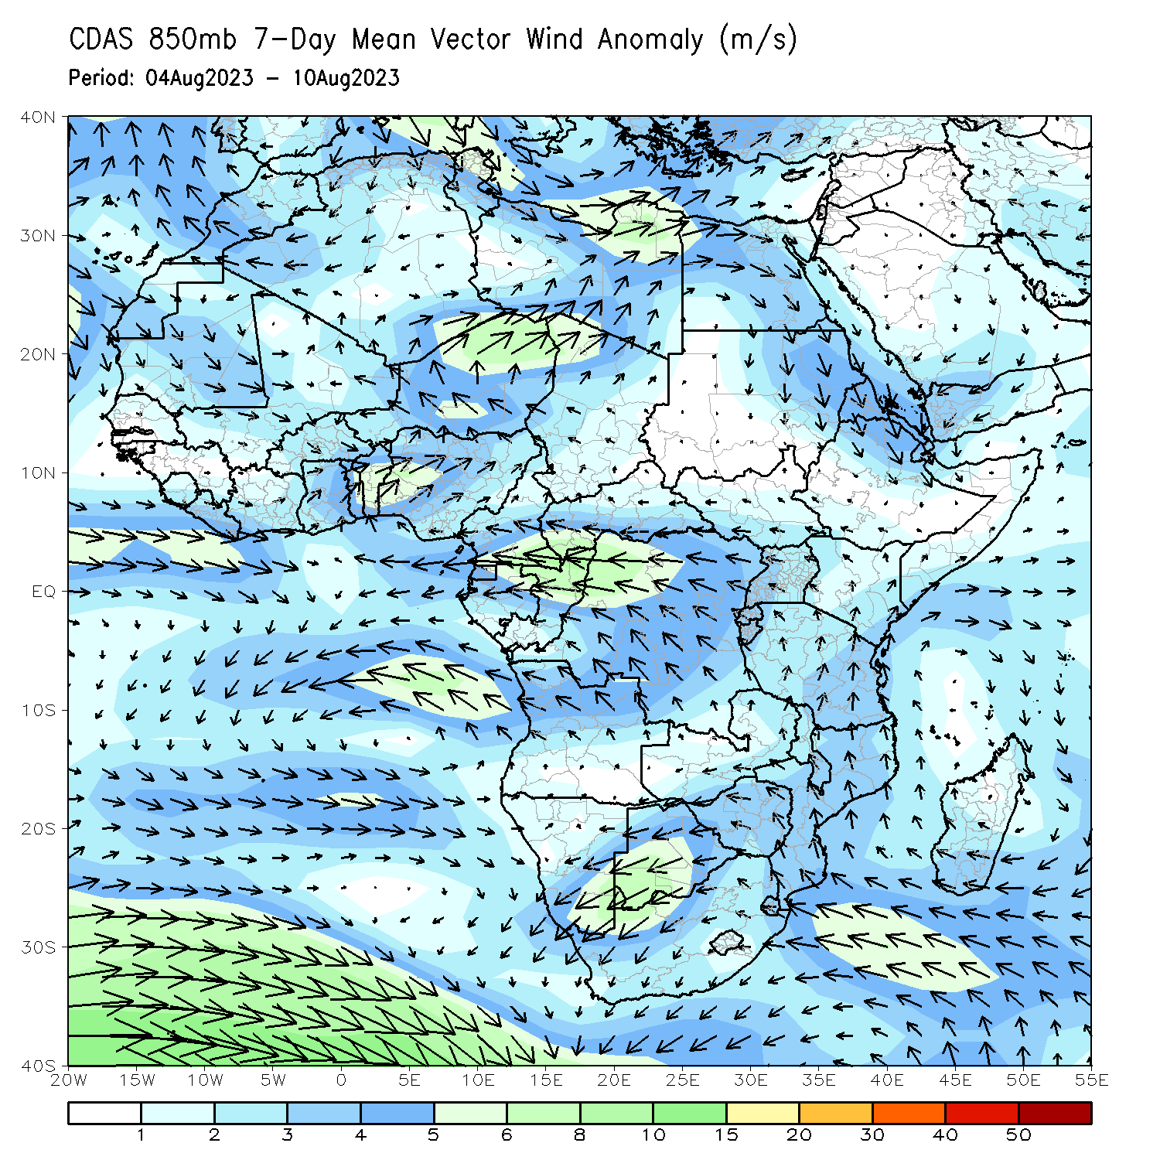
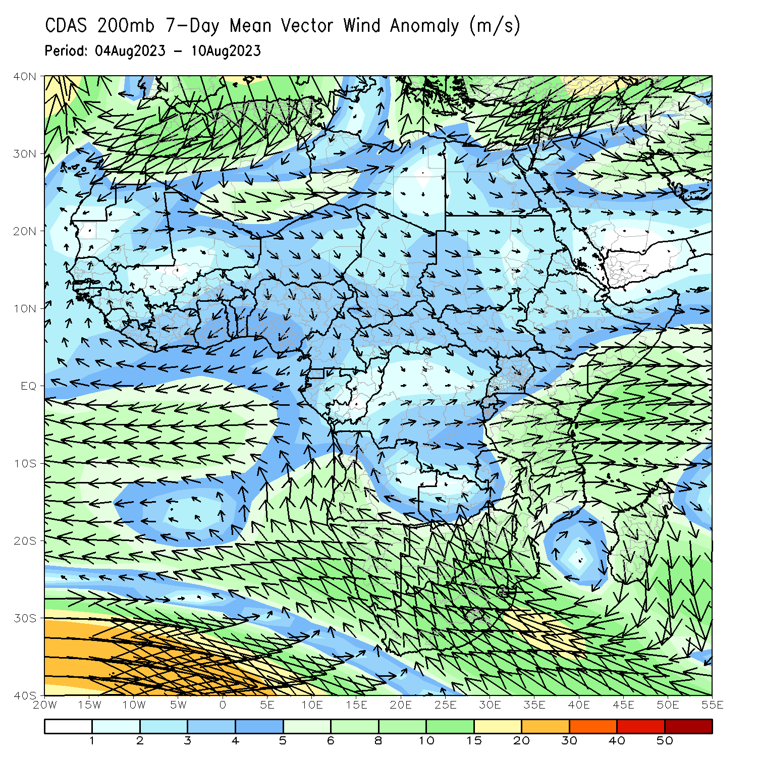
Atmospheric Circulation: Last 7 Days
At 850-hPa level (left panel), stronger than normal onshore flow was observed across parts of West Africa.

Slide 8
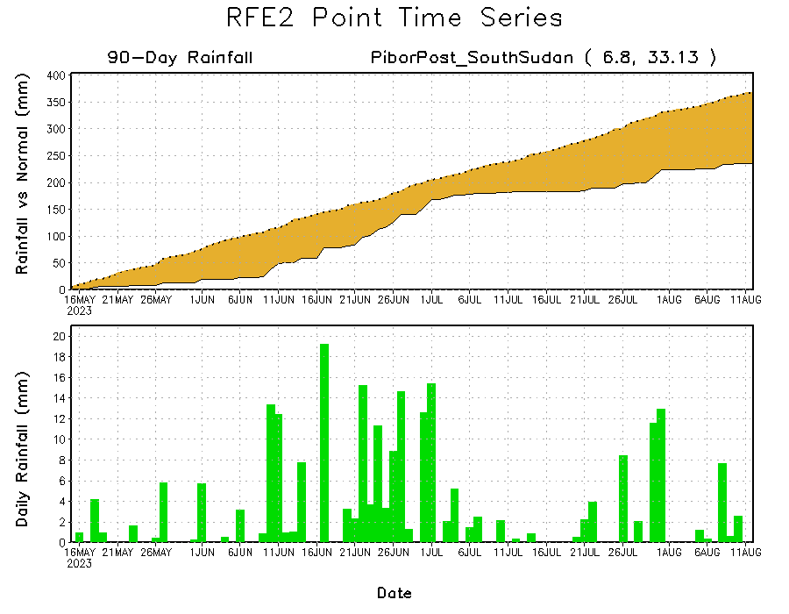
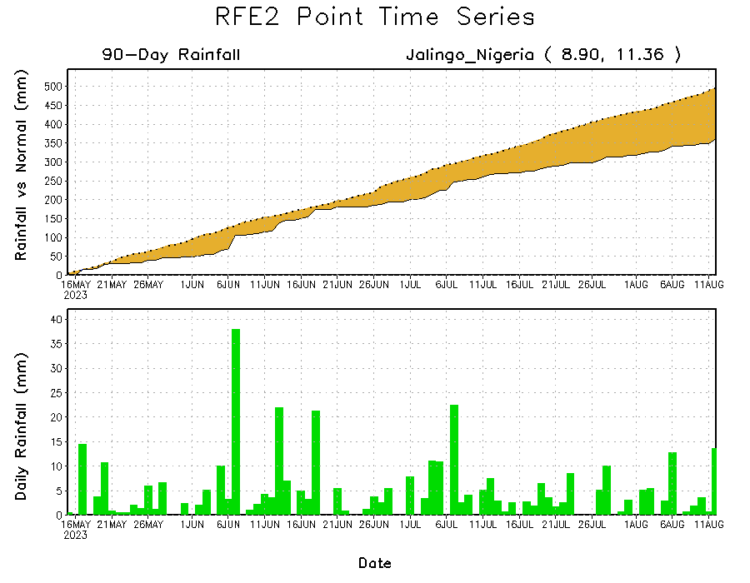
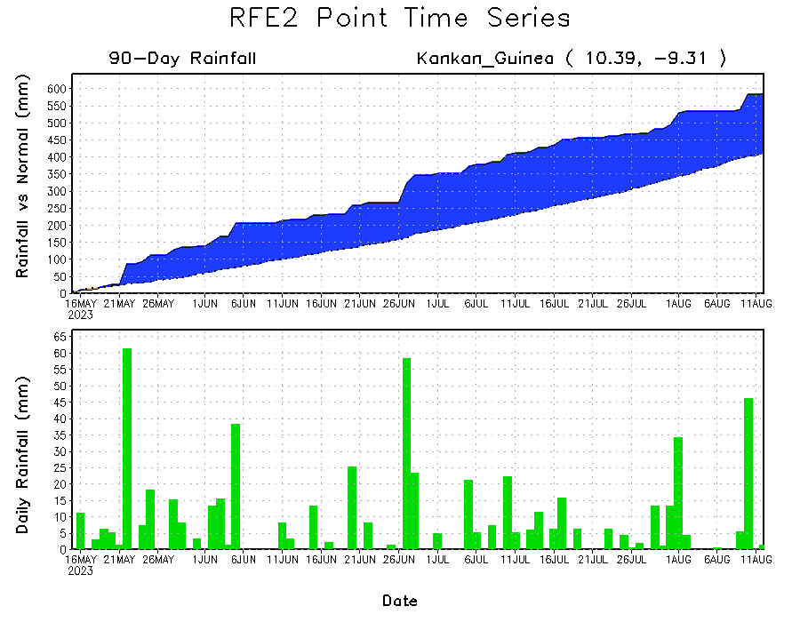
Rainfall Evolution
Daily evolution of rainfall over the last 90 days at selected locations shows moderate to heavy rainfall sustained moisture surpluses over parts of Guinea (bottom left). Seasonal total rainfall remained below-average over parts of eastern Nigeria (bottom right) and eastern South Sudan (top right).

Slide 9
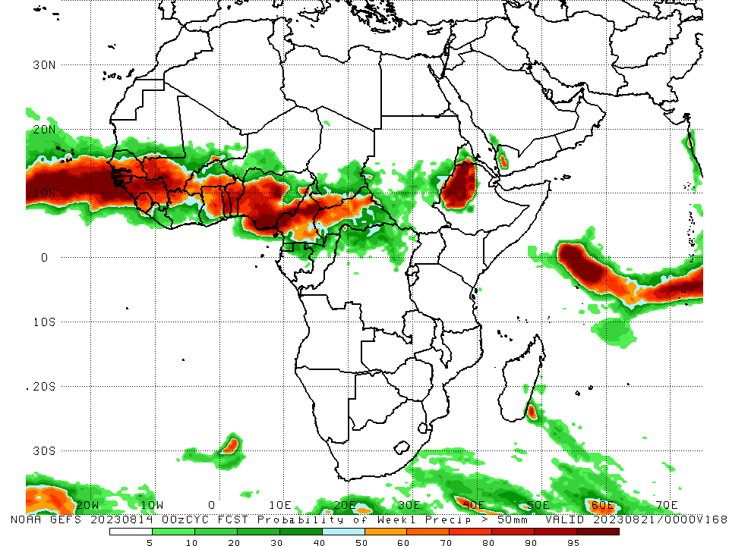
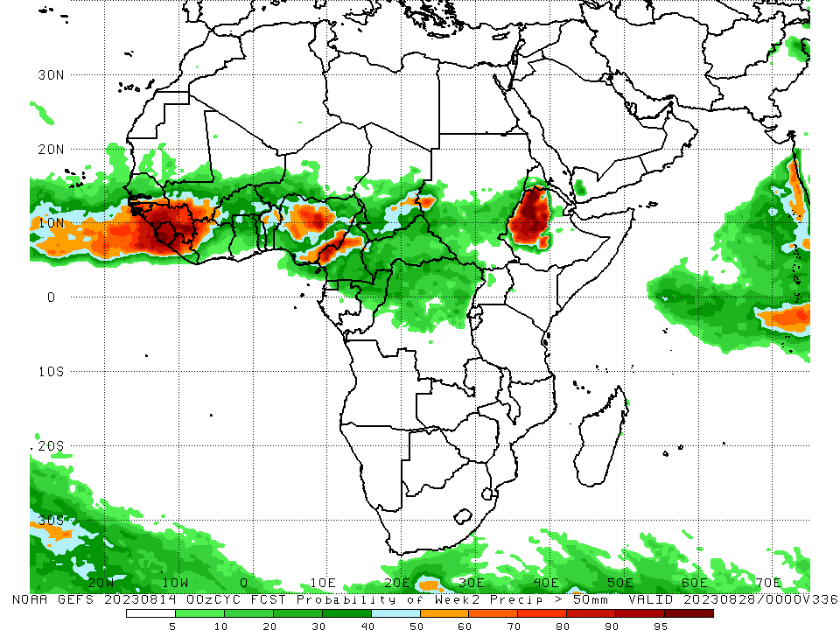
NCEP GEFS Model Forecasts Non-Bias Corrected Probability of precipitation exceedance
Week-1, Valid: 15 – 21 August 2023
Week-2, Valid: 22 – 28 August 2023
For week-1 (left panel), the GEFS forecasts indicate a moderate to high chance (over 70%) for rainfall to exceed 50 mm over many parts of West Africa and the neighboring areas of Central Africa, and western Ethiopia. For week-2 (right panel), there is a high chance for the weekly total rainfall to exceed 50mm over the far western and eastern Gulf of Guinea, and western Ethiopia.
Notes:
9

Slide 10
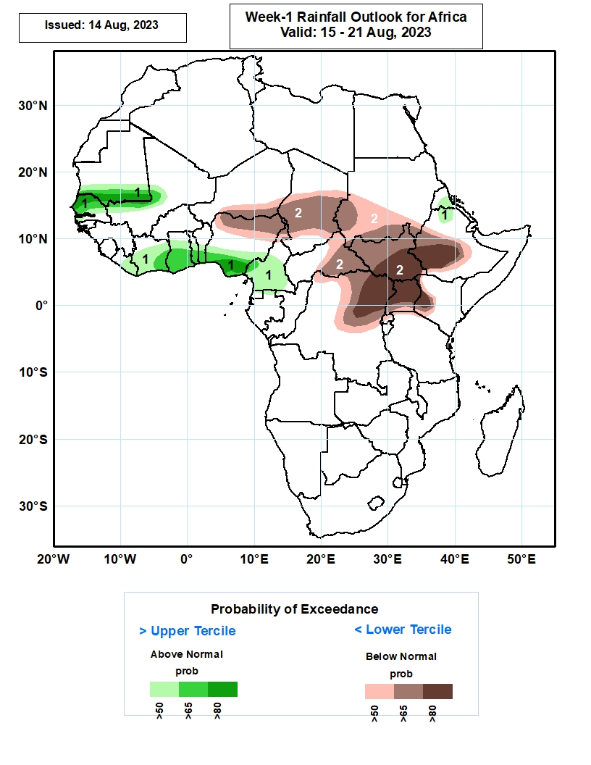
Week-1 Precipitation Outlooks
15 – 21 August 2023
The probabilistic forecasts call for above 50% chance for weekly rainfall to be above-normal (above the upper tercile) over southern Mauritania, western Mali, northern and central part of Senegal, much of Liberia, Cote d’Ivoire, Ghana and Togo, central and southern parts of Benin, Nigeria and Cameroon, central Eritrea, and north-central Ethiopia. There is above 80% chance for rainfall to be above-normal over northern Senegal, southern parts of Mauritania and Nigeria.
The forecasts call for above 50% chance for weekly total rainfall to be below-normal (below the lower tercile) over southern Niger, northern Nigeria, central and southern parts of Chad and Sudan, central and eastern parts of CAR, much of South Sudan, western and central parts of Ethiopia, northern and central parts of DR Congo, much of Uganda and southwestern Kenya. There is above 80% chance for rainfall to be below-normal over central and southern parts of South Sudan, southwestern Ethiopia, northeastern DR Congo, much of Uganda, and southwestern Kenya.
Notes:
10

Slide 11
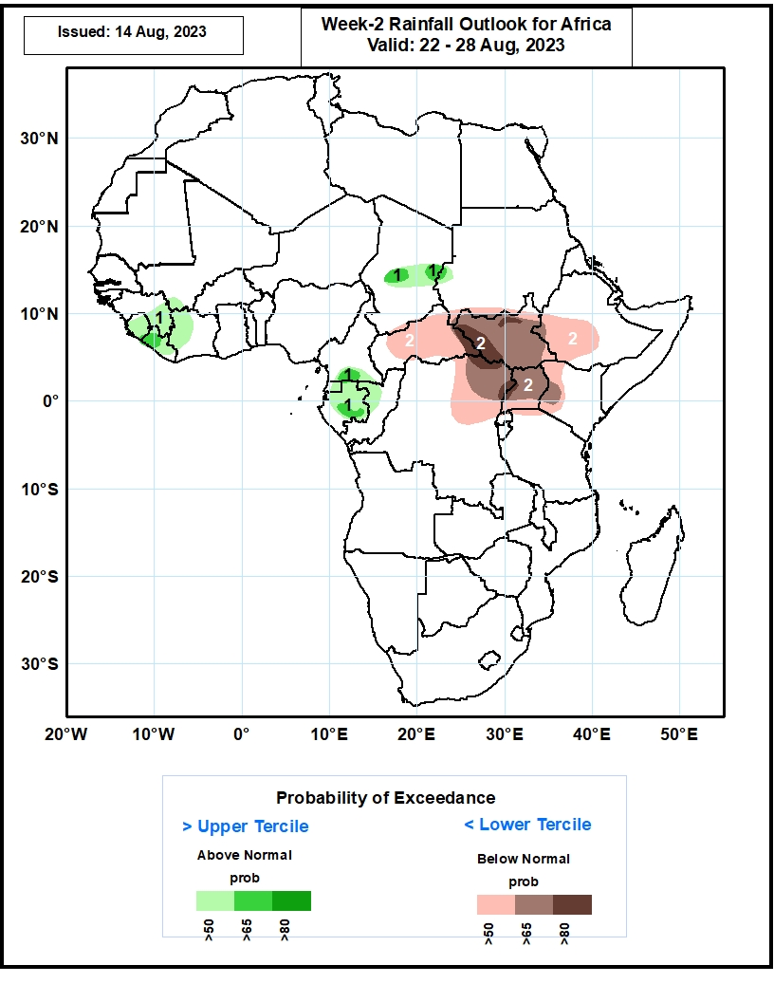
Week-2 Precipitation Outlooks
22 – 28 August 2023
The probabilistic forecasts call for above 50% chance for weekly rainfall to be above-normal (above the upper tercile) over much of Sierra Leone and Liberia, eastern Guinea-Conakry, western Cote d’Ivoire, southern Mali, central part of Chad, southern Cameroon, much of Equatorial Guinea and Gabon, and northern Congo. There is above 65% chance for rainfall to be above-normal over western Liberia, central part of Chad, southern Cameroon and Gabon.
The forecasts call for above 50% chance for weekly total rainfall to be below-normal (below the lower tercile) over much of CAR, South Sudan and Uganda, western Ethiopia, northeastern DR Congo and western Kenya. There is above 80% chance for rainfall to be below-normal over eastern CAR, western South Sudan, and northeastern DR Congo.
Notes:
11

Slide 12
Summary
Over the past 30 days, in East Africa, above-average rainfall was observed over parts of Sudan, western and northeastern South Sudan, and western Ethiopia. Rainfall was below-average over pockets of Sudan, central and southeastern South Sudan, Eritrea, eastern and southern Ethiopia, and Uganda and western Kenya. In Central Africa, rainfall was above-average over northern Congo much of CAR, parts of Chad, and northwestern and northern DRC. Below-average rainfall was observed over much of Cameroon, portions of Chad, and central and eastern DRC. In West Africa, rainfall was above-average over pockets of southern Mauritania, western Senegal, western Guinea, Sierra Leone, Liberia, pockets of northern Mali, Cote d’Ivoire, Ghana, central and eastern Burkina Faso, western and southern Niger, Togo, Benin, and western Nigeria. Below-average rainfall was observed over eastern Senegal, western and central Mali, eastern Guinea,, western Burkina Faso, and central and eastern Nigeria.
During the past 7 days, in East Africa, rainfall was above-average over many parts of Sudan, western Eritrea, western and northern South Sudan, and parts of western Ethiopia. Below-average rainfall was observed over southeastern southern Sudan, pockets of Sudan and eastern Ethiopia. In Central Africa, rainfall was above-average over parts of Cameroon and central Chad, much of CAR, northern Congo, and northern DRC. Below-average rainfall was observed over pockets of northern Cameron and southwestern Chad. In West Africa, above-average rainfall was observed over parts of Guinea, Sierra Leone, northern Cote d’Ivoire, parts of Niger, pockets of northern Ghana, northern Benin, and pockets of northwestern Nigeria. Rainfall was below-average over parts of Senegal, western and central Mali, southwestern Niger, and many parts of Nigeria.
The Week-1 outlook calls for above-normal rainfall over southern Mauritania, Senegal, central Cote d’Ivoire and Ghana, southern Cameroon, and parts of Eritrea and northern Ethiopia. In Contrast, there is an increased chance for below-normal rainfall across northern Nigeria, central and southern Chad, eastern and southern CAR, western and southern Sudan, much of South Sudan, northeastern DRC, Uganda, western Kenya and southwestern Ethiopia. For week-2, there is an increased chance for above-normal rainfall over Sierra Leone, Liberia, eastern Guinea, and western Cote d’Ivoire, pockets of Mali, southern Cameroon, northern Gabon, central Congo and central Chad. In contrast, there is an increased chance for below-normal rainfall across central and eastern CAR, much of South Sudan, northeastern DRC, southern Ethiopia, Uganda and western Kenya.

