Slide 1
The African Monsoon Recent Evolution and Current Status Include Week-1 and Week-2 Outlooks
Update prepared
21 August 2023
For more information, visit:
http://www.cpc.ncep.noaa.gov/products/Global_Monsoons/African_Monsoons/precip_monitoring.shtml

Slide 2
Outline
Highlights
Recent Evolution and Current Conditions
NCEP GEFS Forecasts
Summary

Slide 3
Highlights: Last 7 Days
During the past 7 days, in East Africa, rainfall was above-average over the far southern and eastern Sudan, and pockets of northern Ethiopia. Below-average rainfall was observed over many parts of South Sudan, central Ethiopia, western Kenya and Uganda. In Central Africa, rainfall was above-average over southeastern Chad, central and northern CAR, and pockets of northwestern DRC. Below-average rainfall was observed over northern Cameron, the far western and eastern Chad, the far western and eastern CAR, and northeastern DRC. In West Africa, above-average rainfall was observed over much of Senegal, Guinea-Bissau, western Guinea, eastern Liberia, southern Cote d’Ivoire, southern Ghana, Benin, and western and central Nigeria. Rainfall was below-average over eastern Guinea, southwestern Mali, western Burkina Faso, southern Niger, and northern Nigeria.
The Week-1 outlook calls for above-normal rainfall over Sierra Leone, western Liberia, northern Burkina Faso, western Niger, and parts of Eritrea and northern Ethiopia. In Contrast, there is an increased chance for below-normal rainfall across northern Cameroon, CAR, northern and eastern DRC, South Sudan Uganda, western Kenya, and western and central Ethiopia. For week-2, there is an increased chance for above-normal rainfall over parts of Mali and Burkina Faso, northwestern and southeastern Nigeria, parts of central Chad and central Sudan, and parts of western DRC. In contrast, there is an increased chance for below-normal rainfall across southern Chad, much of CAR, South Sudan, Uganda, western Kenya and southwestern Ethiopia.

Slide 4
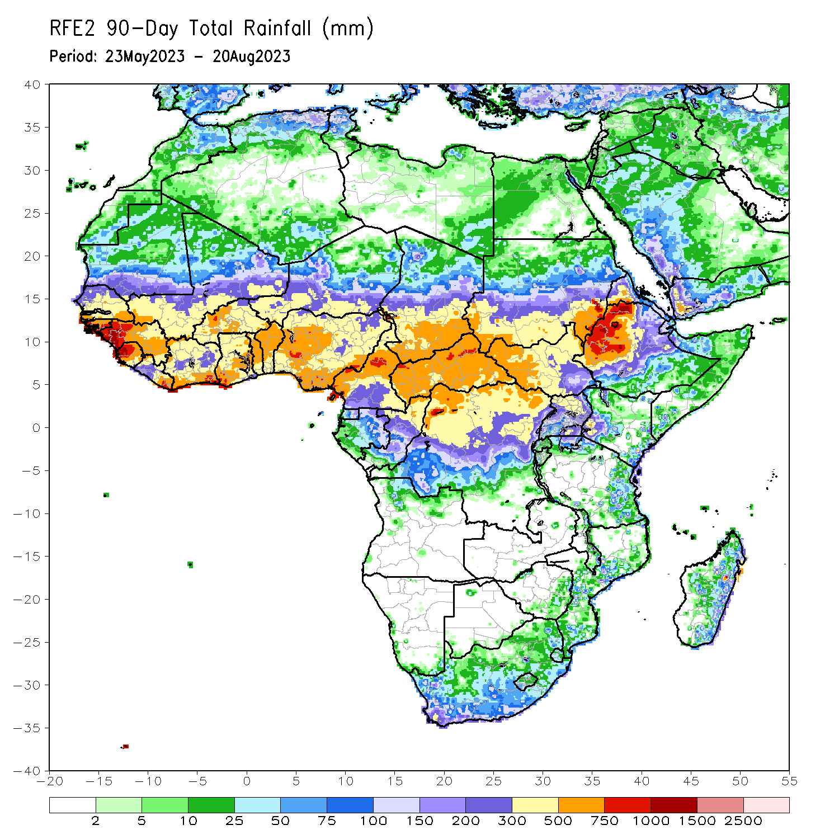
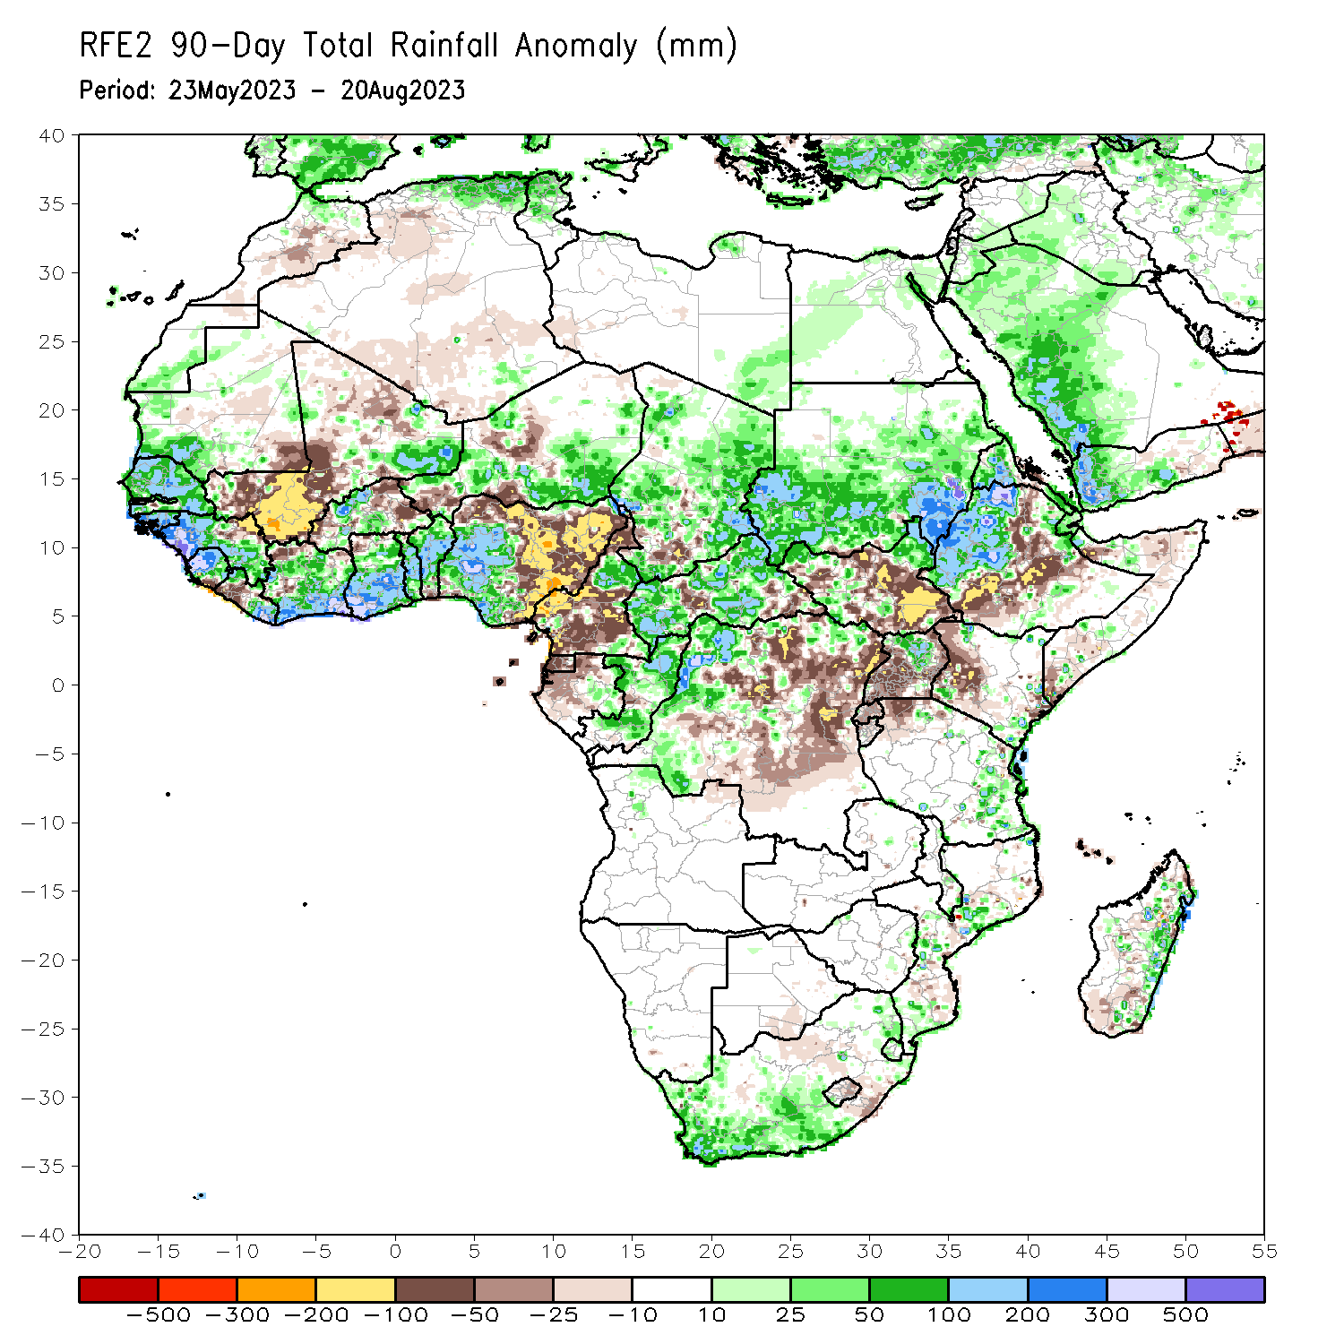
Rainfall Patterns: Last 90 Days
Over the past 90 days, in East Africa, above-average rainfall was observed over many parts of Sudan, western and central Ethiopia, much of Eritrea, part of southwestern Kenya, pockets of South Sudan, Djibouti, and northern Uganda and eastern Tanzania. Rainfall was below-average over many parts of South Sudan, the far southern Somalia, western Kenya Kenya, and southwestern Uganda. In southern Africa, above-average rainfall was observed over the southern portion of South Africa, and eastern Madagascar. Below-average rainfall was observed over pockets of southern Madagascar. In Central Africa, rainfall was above-average over northern Cameroon, much of CAR, Chad, Congo, Chad, and parts of western DRC. Rainfall was below-average over central and southern Cameroon, Equatorial Guinea, western Gabon, parts of central and eastern DRC, and pockets of Congo, Chad and CAR. In West Africa, rainfall was above-average over much of Senegal, southern Mauritania, Guinea-Bissau, Guinea, Sierra Leone, eastern Liberia, eastern Mali, much of Cote d’Ivoire, Burkina Faso, much of Ghana, Togo, Benin, western and southern Niger, and western and central Nigeria. Below-average rainfall was observed over, western Mali, pockets of eastern Burkina Faso and Niger, and eastern Nigeria.
Notes:
4

Slide 5
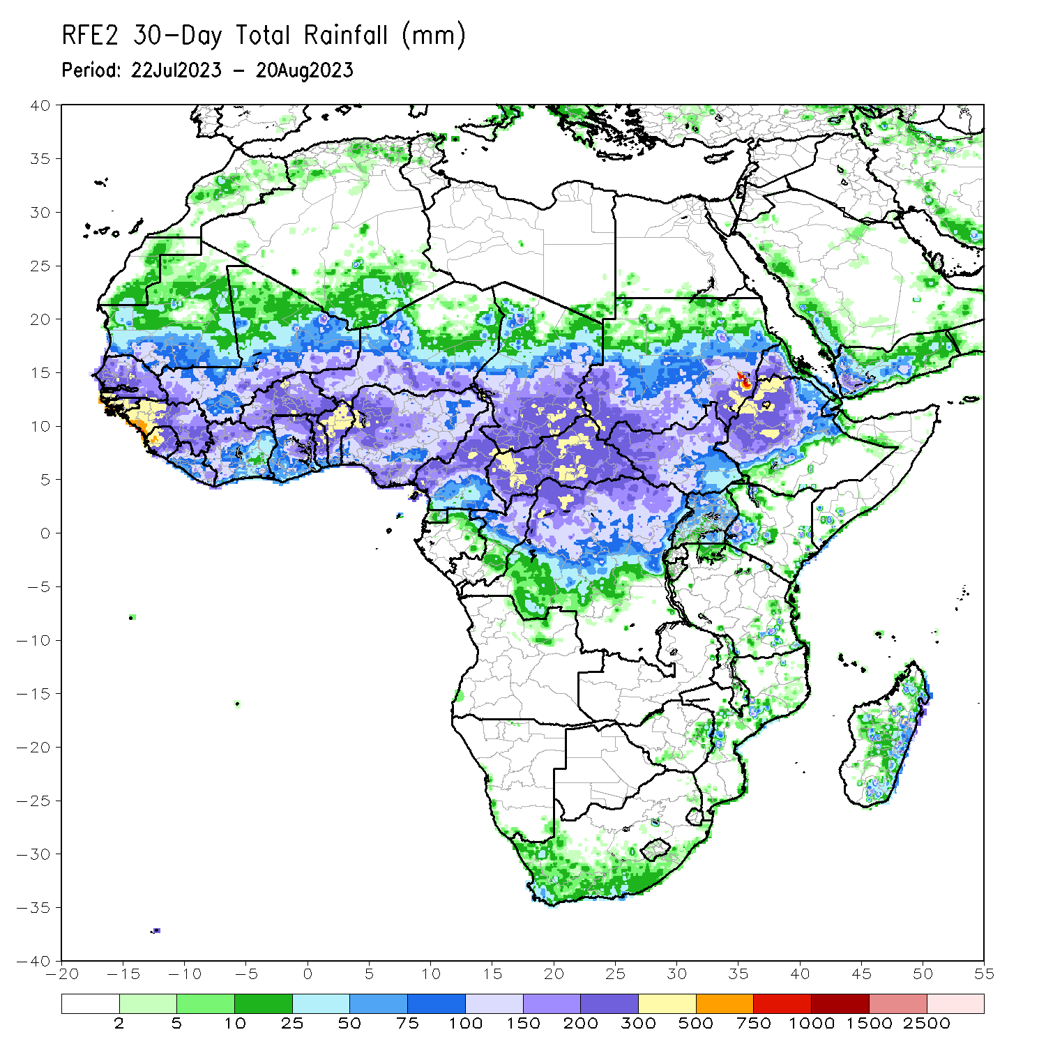
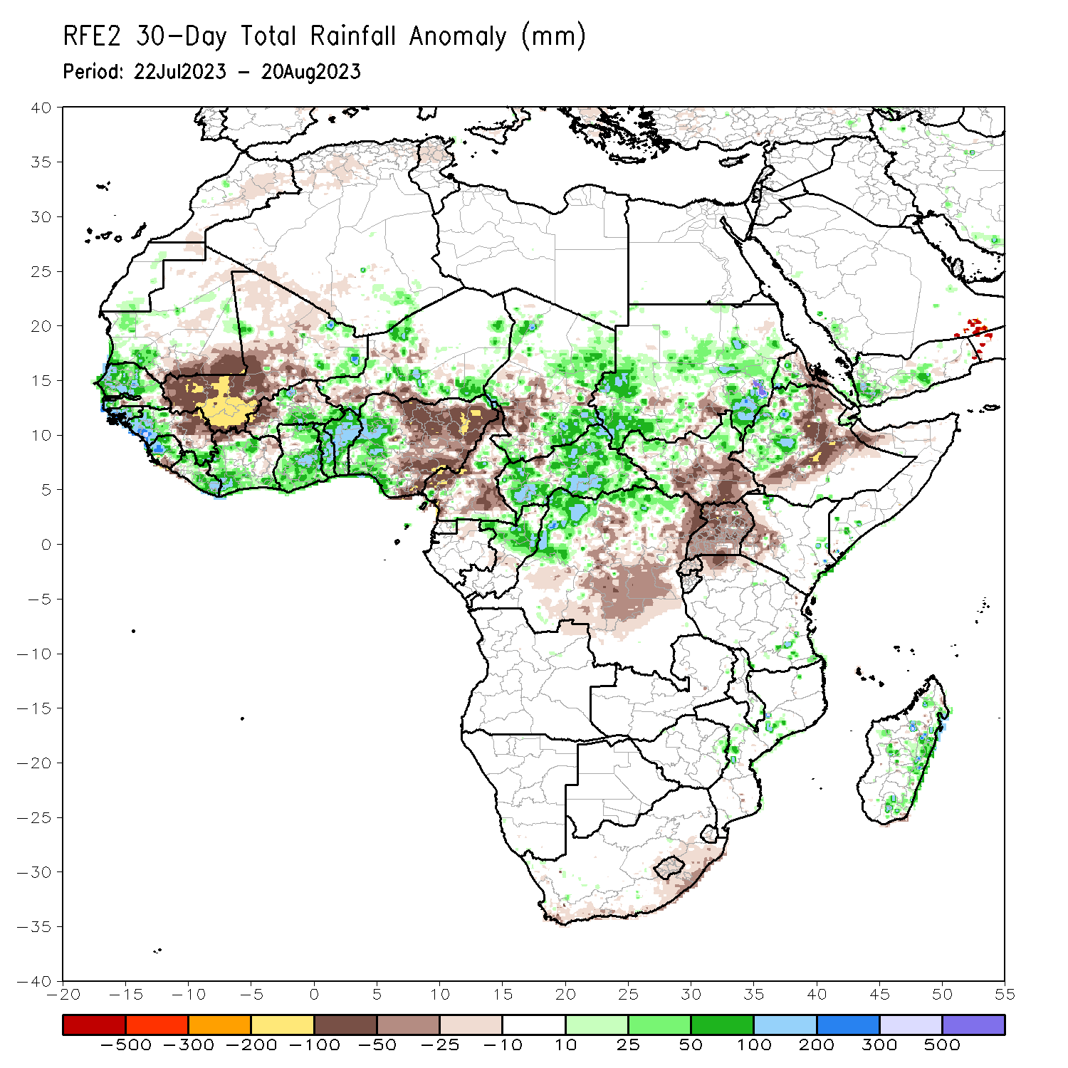
Rainfall Patterns: Last 30 Days
Over the past 30 days, in East Africa, above-average rainfall was observed over many parts of Sudan, western and northeastern South Sudan, and western Ethiopia. Rainfall was below-average over pockets of Sudan, central and southeastern South Sudan, eastern and southern Ethiopia, and Uganda and western Kenya. In Central Africa, rainfall was above-average over northern Congo, much of CAR, parts of Chad, and northwestern and northern DRC. Below-average rainfall was observed over parts of Cameroon, western Chad, and central and eastern DRC. In West Africa, rainfall was above-average over pockets of southern Mauritania, Senegal, western Guinea, Sierra Leone, Liberia, pockets of eastern Mali, Cote d’Ivoire, Ghana, central and eastern Burkina Faso, parts of Niger, Togo, Benin, and western Nigeria. Below-average rainfall was observed over western and central Mali, eastern Guinea, and western Burkina Faso, and central and eastern Nigeria.
Notes:
5

Slide 6
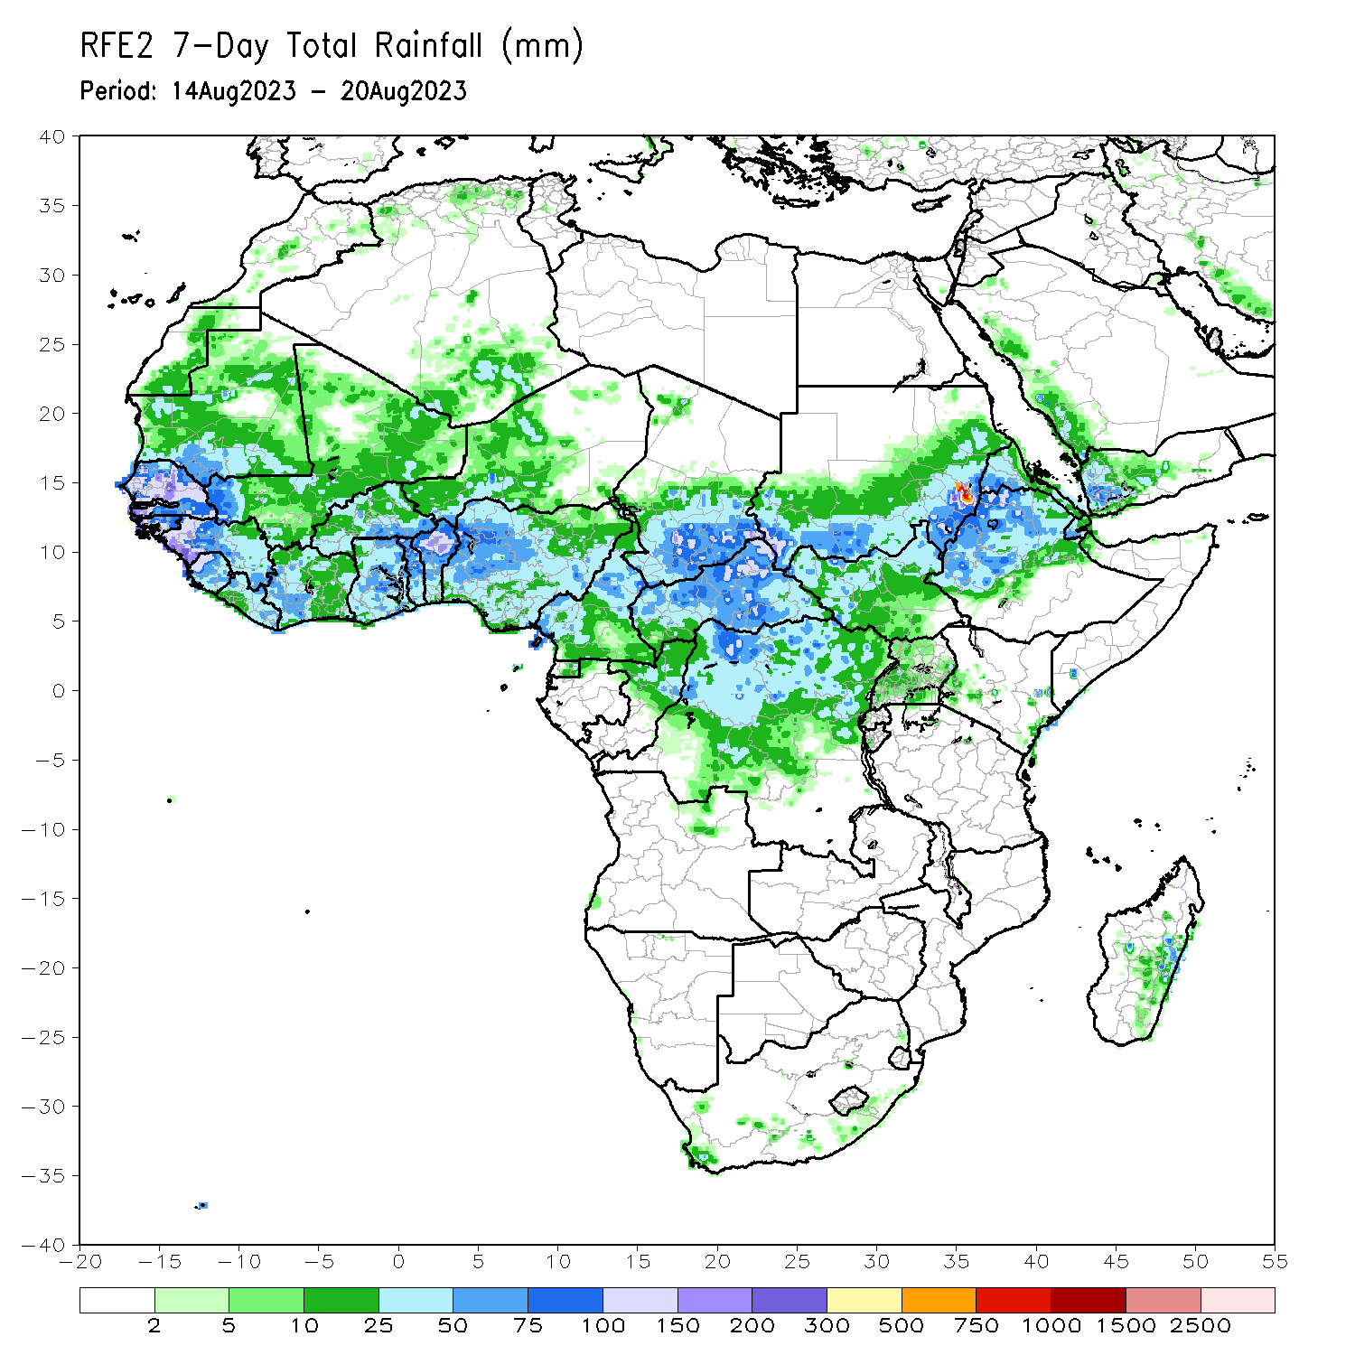
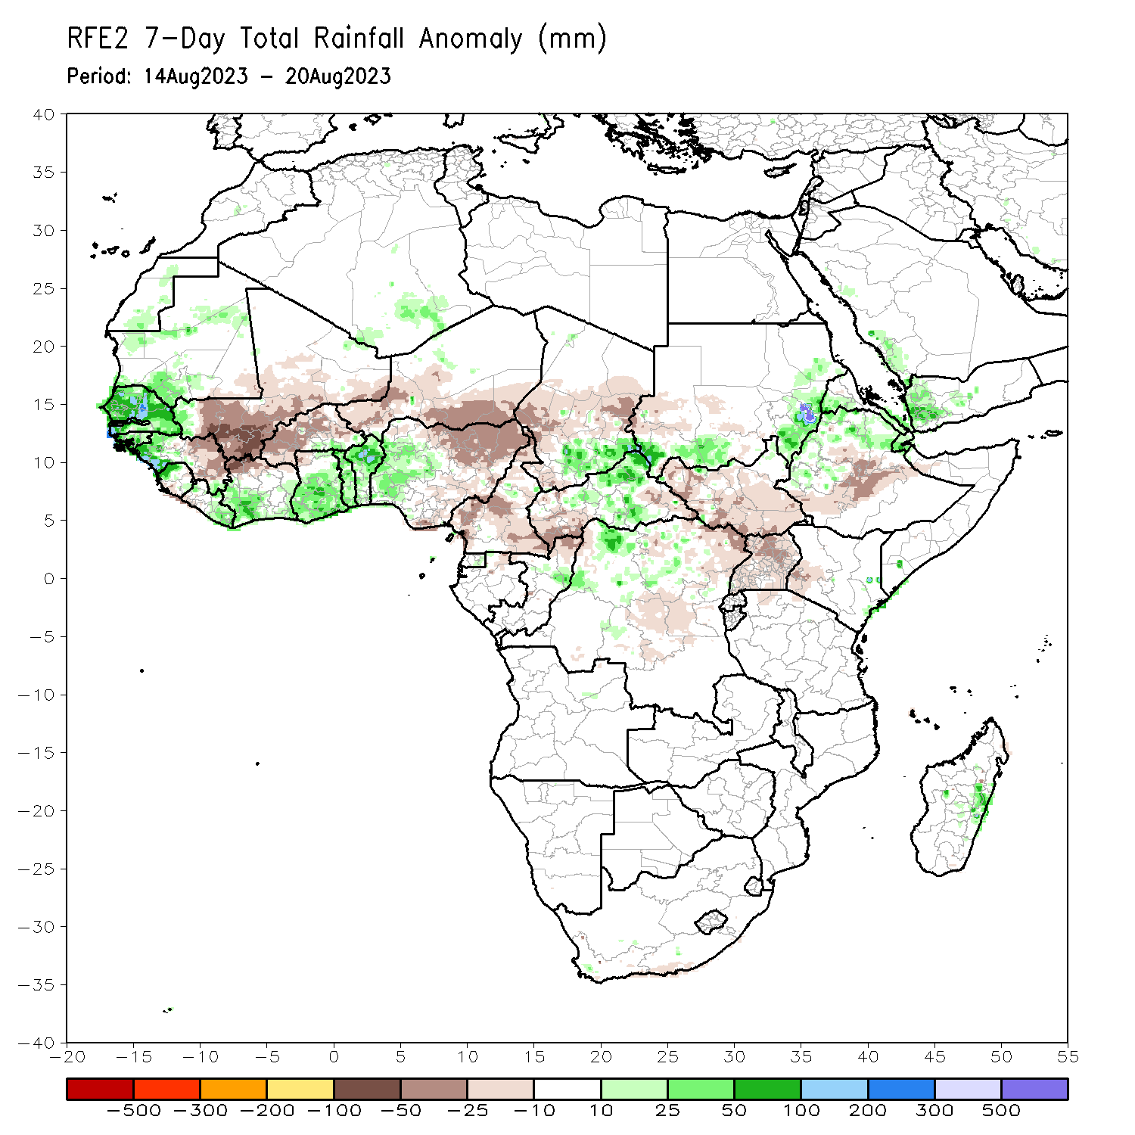
Rainfall Patterns: Last 7 Days
During the past 7 days, in East Africa, rainfall was above-average over the far southern and eastern Sudan, and pockets of northern Ethiopia. Below-average rainfall was observed over many parts of South Sudan, central Ethiopia, western Kenya and Uganda. In Central Africa, rainfall was above-average over southeastern Chad, central and northern CAR, and pockets of northwestern DRC. Below-average rainfall was observed over northern Cameron, the far western and eastern Chad, the far western and eastern CAR, and northeastern DRC. In West Africa, above-average rainfall was observed over much of Senegal, Guinea-Bissau, western Guinea, eastern Liberia, southern Cote d’Ivoire, southern Ghana, Benin, and western and central Nigeria. Rainfall was below-average over eastern Guinea, southwestern Mali, western Burkina Faso, southern Niger, and northern Nigeria.

Slide 7
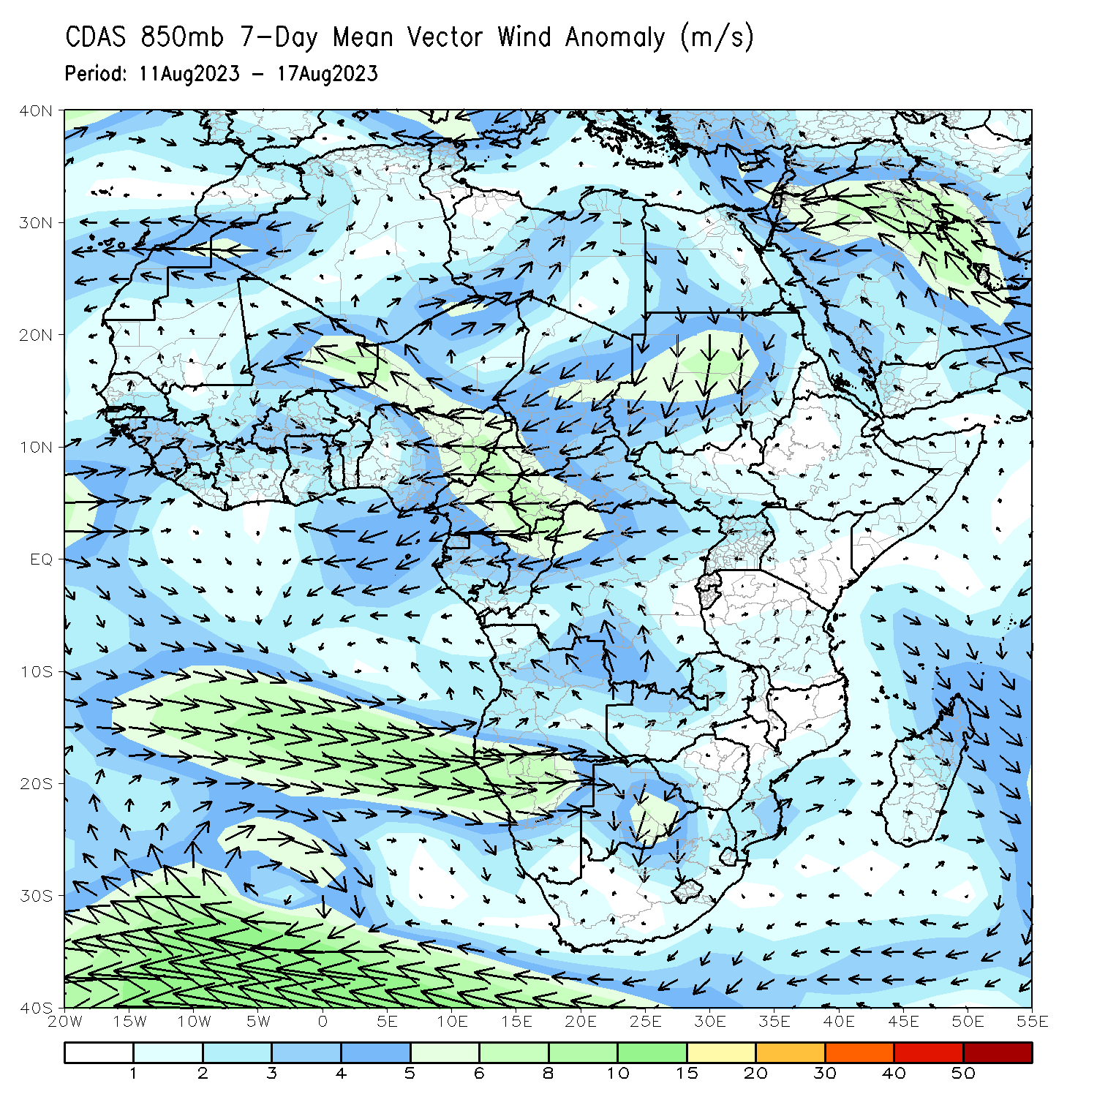
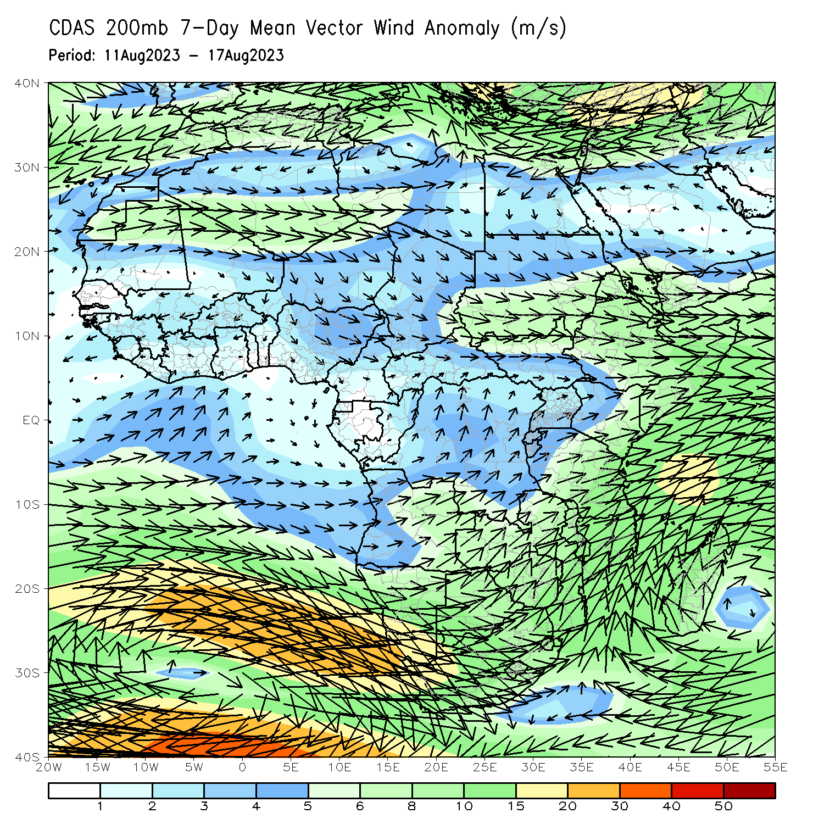
Atmospheric Circulation: Last 7 Days
At 850-hPa level (left panel), stronger than normal onshore flow was observed across the western part of the gulf of Guinea region, while anomalous easterly flow prevailed across Central Africa and the neighboring areas of the eastern Gulf of Guinea.

Slide 8
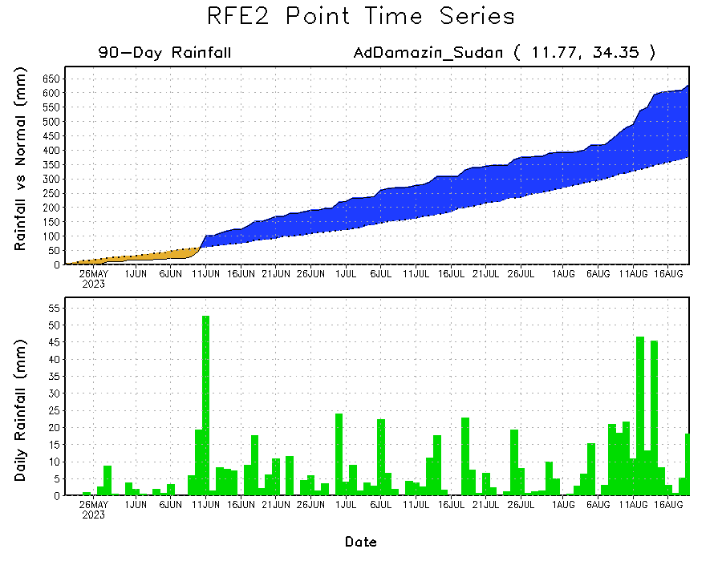
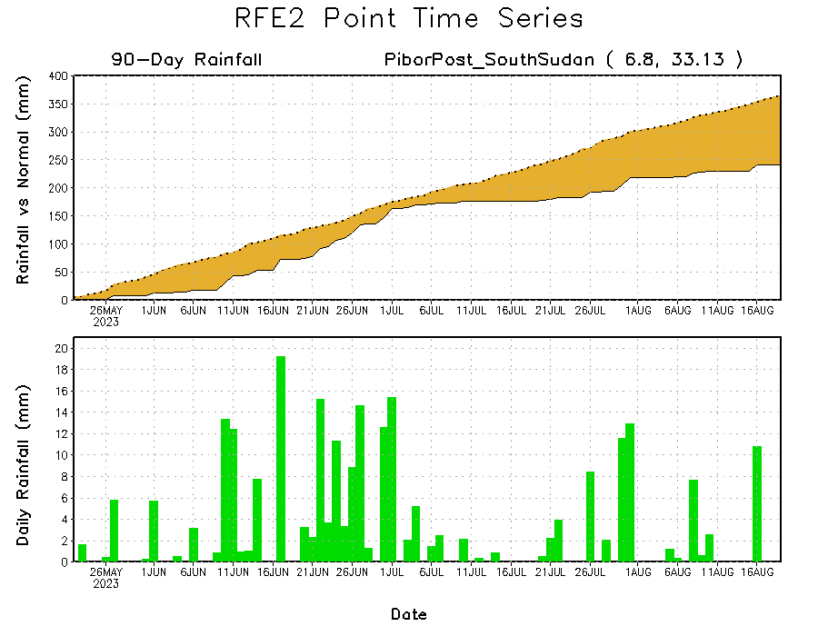
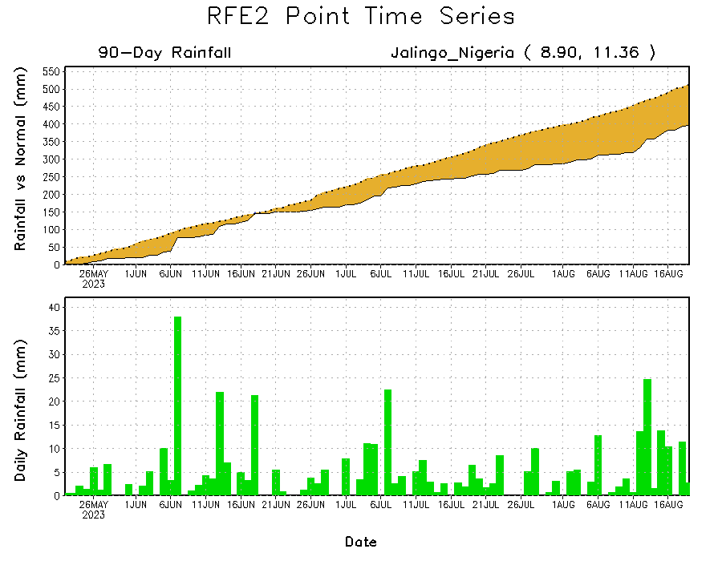
Rainfall Evolution
Daily evolution of rainfall over the last 90 days at selected locations shows moderate to heavy rainfall sustained moisture surpluses over parts of eastern Sudan (top right). Seasonal total rainfall remained below-average over parts of eastern Nigeria (bottom left) and eastern South Sudan (bottom right).

Slide 9
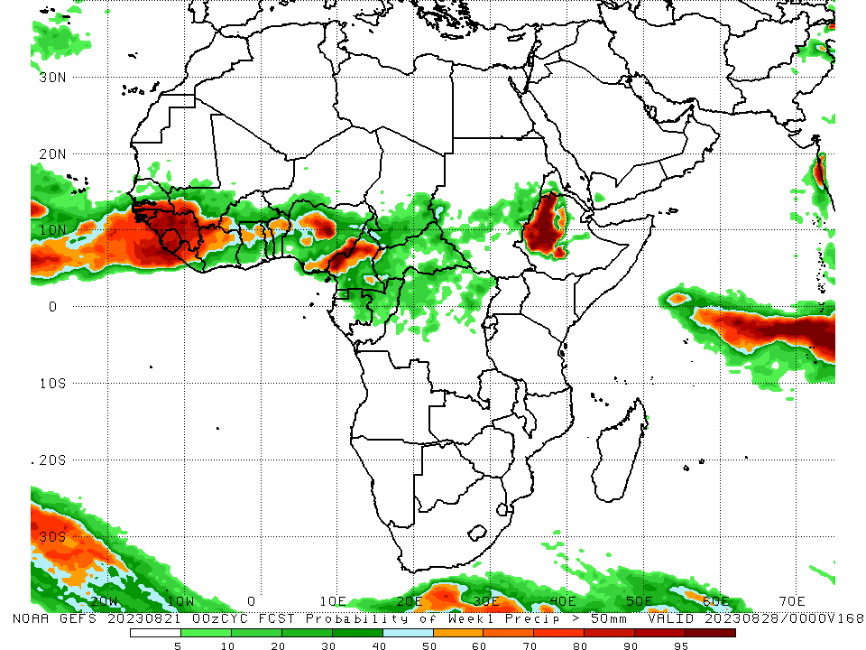
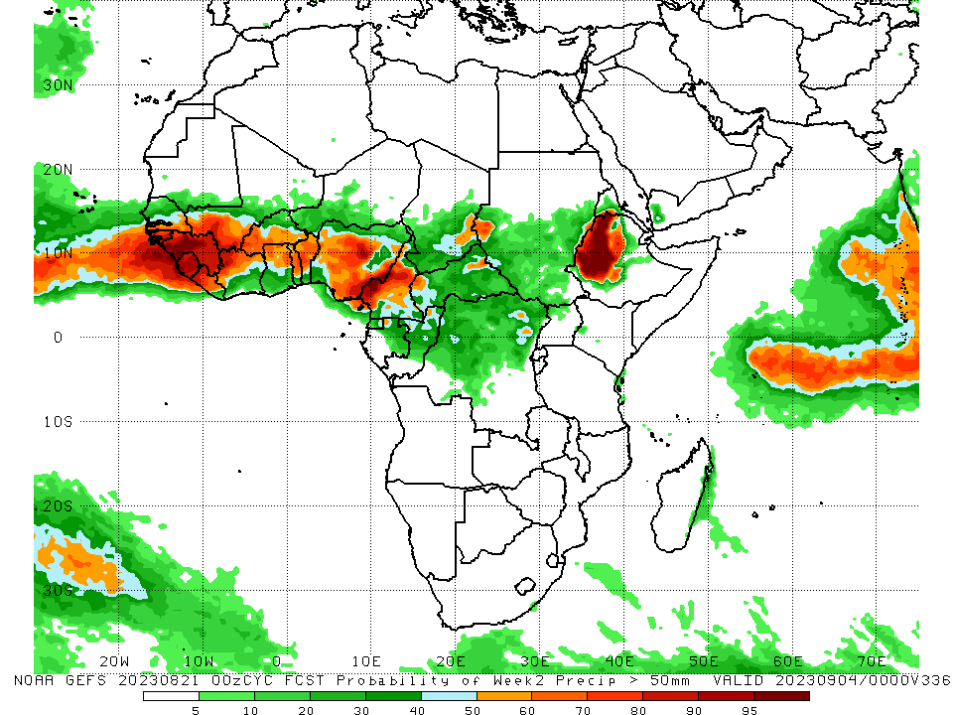
NCEP GEFS Model Forecasts Non-Bias Corrected Probability of precipitation exceedance
Week-1, Valid: 22 – 28 August 2023
Week-2, Valid: 29 Aug – 04 Sep 2023
For week-1 (left panel) and week-2 (right panel), the GEFS forecasts indicate a moderate to high chance (over 70%) for rainfall to exceed 50 mm over many parts of the Gulf of Guinea region, and western Ethiopia.
Notes:
9

Slide 10
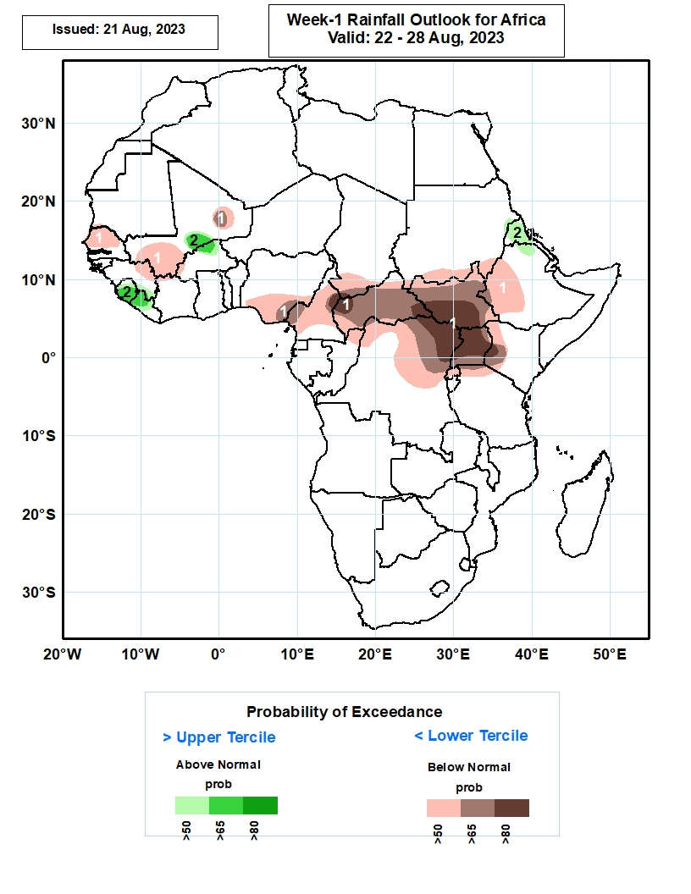
Week-1 Precipitation Outlooks
22 – 28 August 2023
The forecasts call for above 50% chance for weekly total rainfall to be below-normal (below the lower tercile) over northern and central Senegal, northern and southern parts of Mali, northern Guinea-Conakry, southern Nigeria, much of Cameroon, CAR, South Sudan, Uganda and Rwanda, southern parts of Chad and Sudan, western parts of Ethiopia and Kenya, northern Congo, northern and eastern parts of DR Congo, and northern Tanzania. There is above 80% chance for rainfall to be below-normal over northwestern and southeastern CAR, southern South Sudan, northeastern DR Congo, much of Uganda, and southwestern Kenya.
The probabilistic forecasts call for above 50% chance for weekly rainfall to be above-normal (above the upper tercile) over central part of Mali, northern Burkina Faso, much of Sierra Leone, western and central part of Liberia, northern parts of Eritrea and Ethiopia. There is above 65% chance for rainfall to be above-normal over central part of Mali, northern Burkina Faso, central and southern portions of Sierra Leone, and western Liberia.
Notes:
10

Slide 11
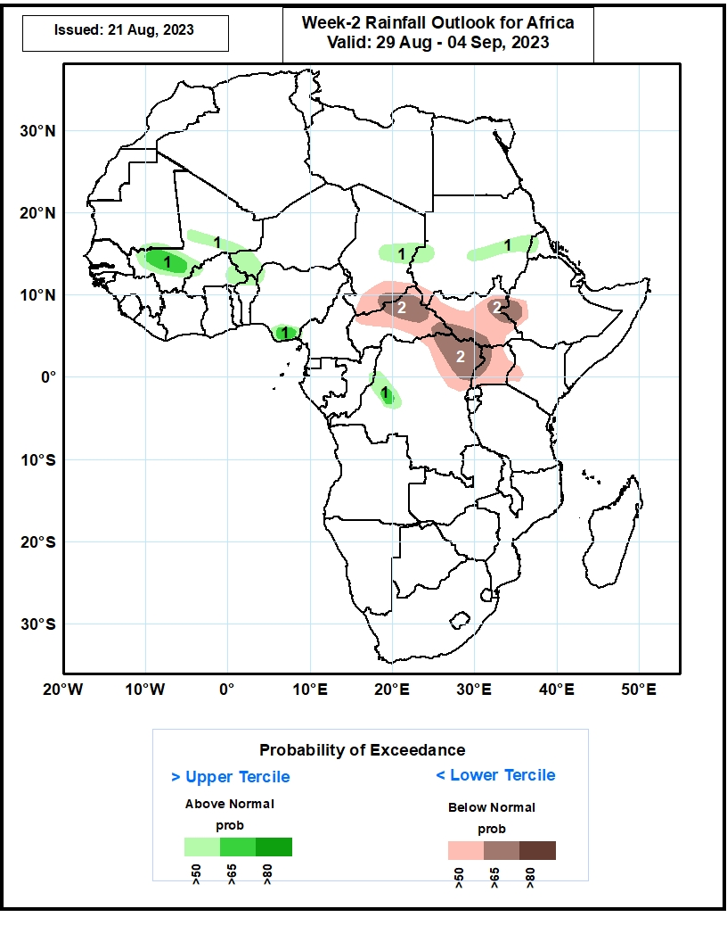
Week-2 Precipitation Outlooks
29 August – 04 September 2023
The probabilistic forecasts call for above 50% chance for weekly rainfall to be above-normal (above the upper tercile) over central and southern parts of Mali, eastern Burkina Faso, southwestern Niger, southeastern Nigeria, central parts of Chad and Sudan, and west-central DR Congo. There is above 65% chance for rainfall to be above-normal over southern Mali, southeastern Nigeria, and west-central DR Congo.
The forecasts call for above 50% chance for weekly total rainfall to be below-normal (below the lower tercile) over southern Chad, much of CAR, South Sudan and Uganda, northeastern DR Congo, and southwestern Ethiopia and Kenya. There is above 65% chance for rainfall to be below-normal over northern and eastern parts of CAR, southwestern and northeastern South Sudan, northeastern DR Congo, western Uganda, and southwestern Ethiopia.
Notes:
11

Slide 12
Summary
Over the past 30 days, in East Africa, above-average rainfall was observed over many parts of Sudan, western and northeastern South Sudan, and western Ethiopia. Rainfall was below-average over pockets of Sudan, central and southeastern South Sudan, eastern and southern Ethiopia, and Uganda and western Kenya. In Central Africa, rainfall was above-average over northern Congo, much of CAR, parts of Chad, and northwestern and northern DRC. Below-average rainfall was observed over parts of Cameroon, western Chad, and central and eastern DRC. In West Africa, rainfall was above-average over pockets of southern Mauritania, Senegal, western Guinea, Sierra Leone, Liberia, pockets of eastern Mali, Cote d’Ivoire, Ghana, central and eastern Burkina Faso, parts of Niger, Togo, Benin, and western Nigeria. Below-average rainfall was observed over western and central Mali, eastern Guinea, and western Burkina Faso, and central and eastern Nigeria.
During the past 7 days, in East Africa, rainfall was above-average over the far southern and eastern Sudan, and pockets of northern Ethiopia. Below-average rainfall was observed over many parts of South Sudan, central Ethiopia, western Kenya and Uganda. In Central Africa, rainfall was above-average over southeastern Chad, central and northern CAR, and pockets of northwestern DRC. Below-average rainfall was observed over northern Cameron, the far western and eastern Chad, the far western and eastern CAR, and northeastern DRC. In West Africa, above-average rainfall was observed over much of Senegal, Guinea-Bissau, western Guinea, eastern Liberia, southern Cote d’Ivoire, southern Ghana, Benin, and western and central Nigeria. Rainfall was below-average over eastern Guinea, southwestern Mali, western Burkina Faso, southern Niger, and northern Nigeria.
The Week-1 outlook calls for above-normal rainfall over Sierra Leone, western Liberia, northern Burkina Faso, western Niger, and parts of Eritrea and northern Ethiopia. In Contrast, there is an increased chance for below-normal rainfall across northern Cameroon, CAR, northern and eastern DRC, South Sudan Uganda, western Kenya, and western and central Ethiopia. For week-2, there is an increased chance for above-normal rainfall over parts of Mali and Burkina Faso, northwestern and southeastern Nigeria, parts of central Chad and central Sudan, and parts of western DRC. In contrast, there is an increased chance for below-normal rainfall across southern Chad, much of CAR, South Sudan, Uganda, western Kenya and southwestern Ethiopia.

