Slide 1
The African Monsoon Recent Evolution and Current Status Include Week-1 and Week-2 Outlooks
Update prepared
28 August 2023
For more information, visit:
http://www.cpc.ncep.noaa.gov/products/Global_Monsoons/African_Monsoons/precip_monitoring.shtml

Slide 2
Outline
Highlights
Recent Evolution and Current Conditions
NCEP GEFS Forecasts
Summary

Slide 3
Highlights: Last 7 Days
During the past 7 days, in East Africa, rainfall was above-average over pockets of eastern Sudan and southern Somalia. Below-average rainfall was observed over southwestern Sudan, much of South Sudan, Ethiopia, western Kenya and much of Uganda. In Central Africa, rainfall was above-average over pockets of eastern DRC. Below-average rainfall was observed over much of Cameron, Chad, CAR, and DRC. In West Africa, above-average rainfall was observed over western Senegal, Guinea-Bissau, and pockets of Guinea, Cote d’Ivoire and Niger. Rainfall was below-average over eastern Senegal, much of Mali, Sierra Leone, Liberia, much of Cote d’Ivoire, Burkina Faso, Ghana, Niger, Togo, Benin, and Nigeria.
The Week-1 outlook calls for above-normal rainfall over many places in West and Central Africa. In contrast, there is an increased chance for below-normal rainfall over northern Guinea, parts of CAR, eastern and southern South Sudan, northeastern DRC, Uganda, western Kenya, and central and southern Ethiopia. For week-2, there is an increased chance for above-normal rainfall over southern Mauritania, northern Senegal, southern Mali, Burkina Faso, northern Ghana, northern Togo, central Chad, southeastern South Sudan, and pockets of Sudan. In contrast, there is an increased chance for below-normal rainfall over western Guinea, Sierra Leone, Liberia, and parts of Cote d’Ivoire and Nigeria.

Slide 4
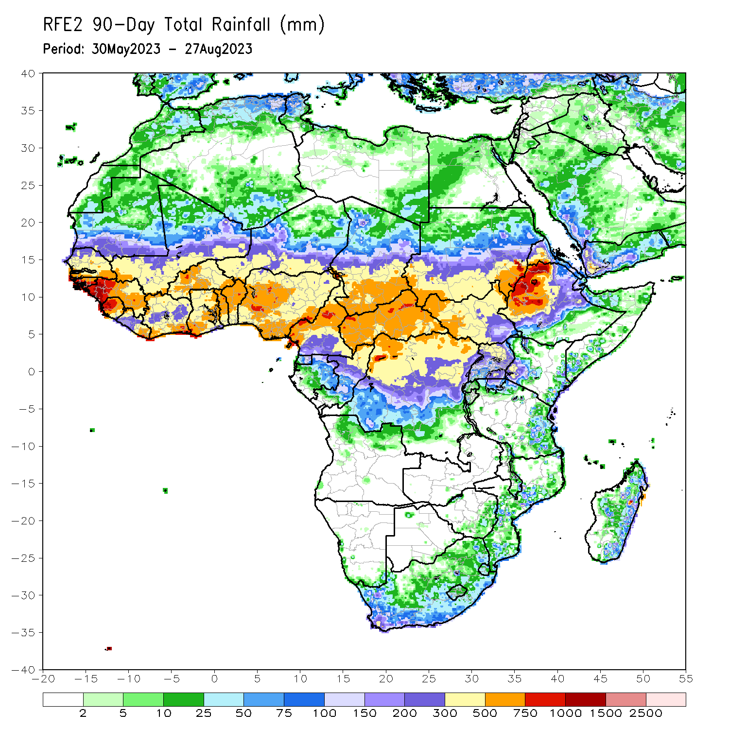
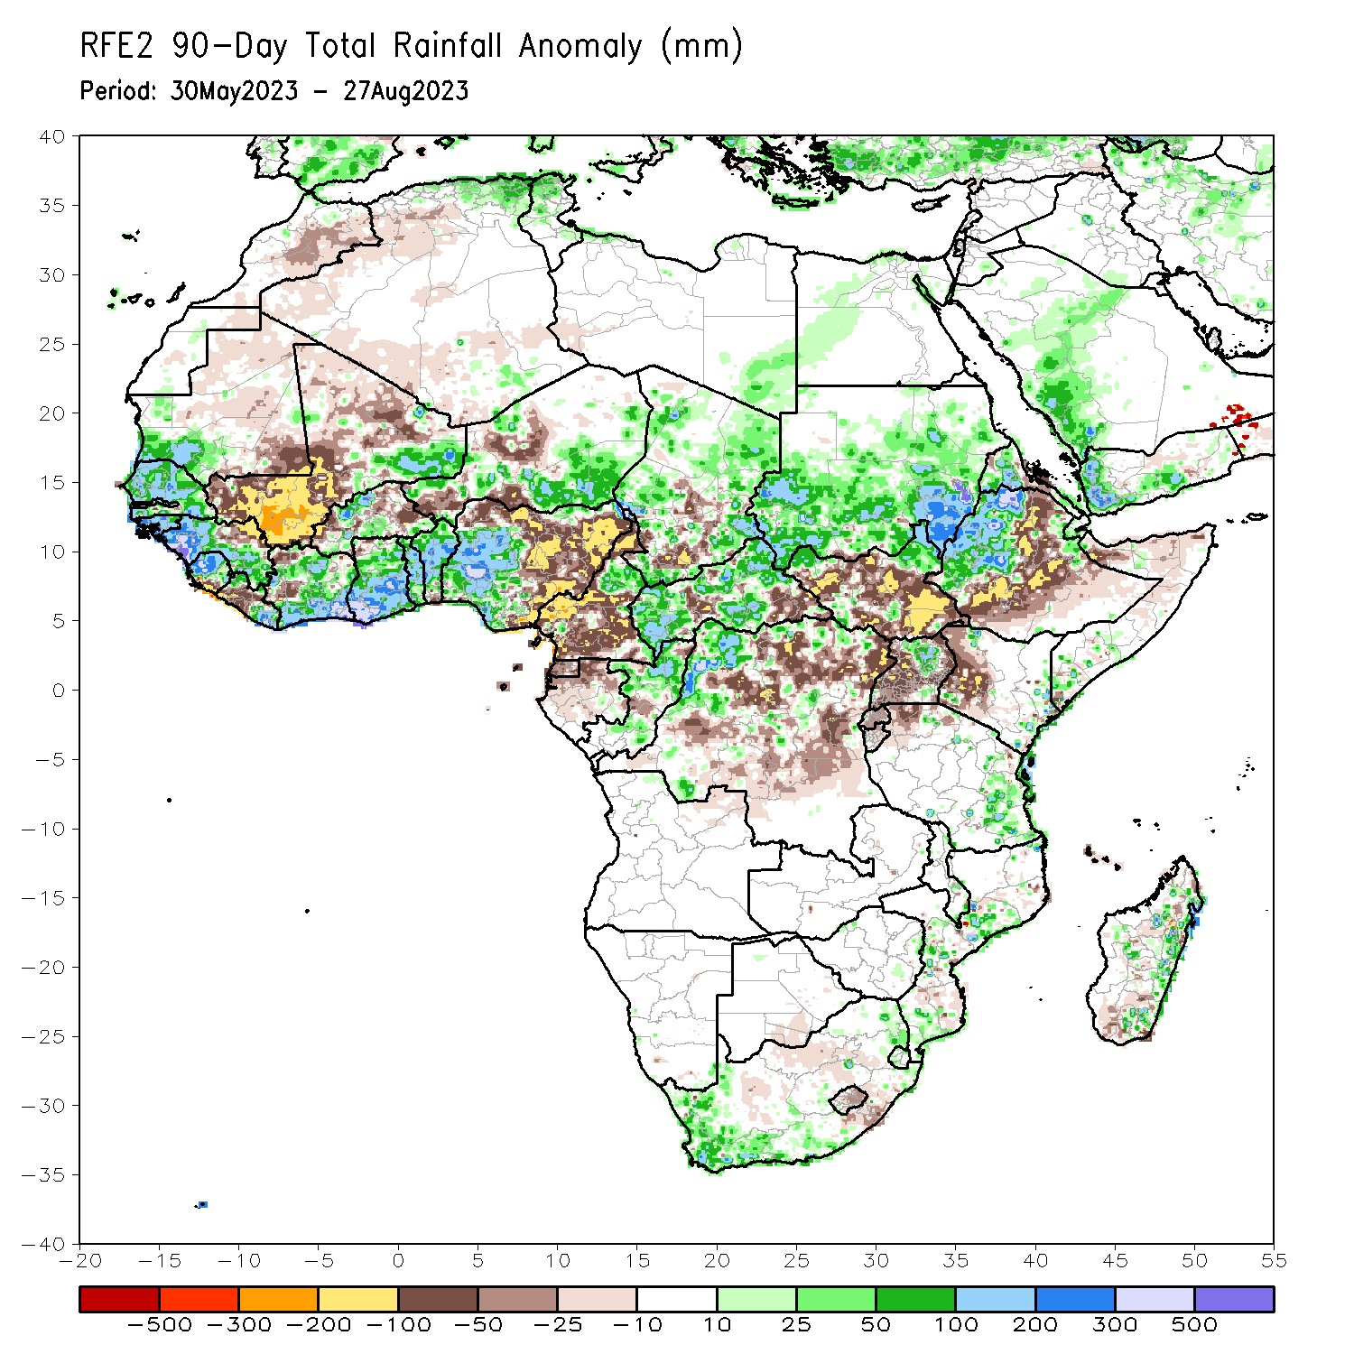
Rainfall Patterns: Last 90 Days
Over the past 90 days, in East Africa, above-average rainfall was observed over many parts of Sudan, western Ethiopia, much of Eritrea, the far northern South Sudan, Djibouti, and northern Uganda and coastal Tanzania. Rainfall was below-average over many parts of South Sudan, eastern and southern Ethiopia, parts of Somalia, western Kenya, and southern Uganda. In southern Africa, above-average rainfall was observed over the southern portion of South Africa, and eastern Madagascar. Below-average rainfall was observed over pockets of southern Madagascar. In Central Africa, rainfall was above-average over northern Cameroon, much of CAR, Chad, Congo, and parts of western DRC. Rainfall was below-average over central and southern Cameroon, Equatorial Guinea, western Gabon, parts of central and eastern DRC, and pockets of Congo, Chad and CAR. In West Africa, rainfall was above-average over much of Senegal, southern Mauritania, Guinea-Bissau, Guinea, Sierra Leone, eastern Liberia, eastern Mali, much of Cote d’Ivoire, pockets of Burkina Faso, much of Ghana, Togo, Benin, parts of western and southern Niger, and western and central Nigeria. Below-average rainfall was observed over, western and northern Mali, pockets of western Liberia and Cote d’Ivoire, eastern Burkina Faso, parts of Niger, and eastern Nigeria.
Notes:
4

Slide 5
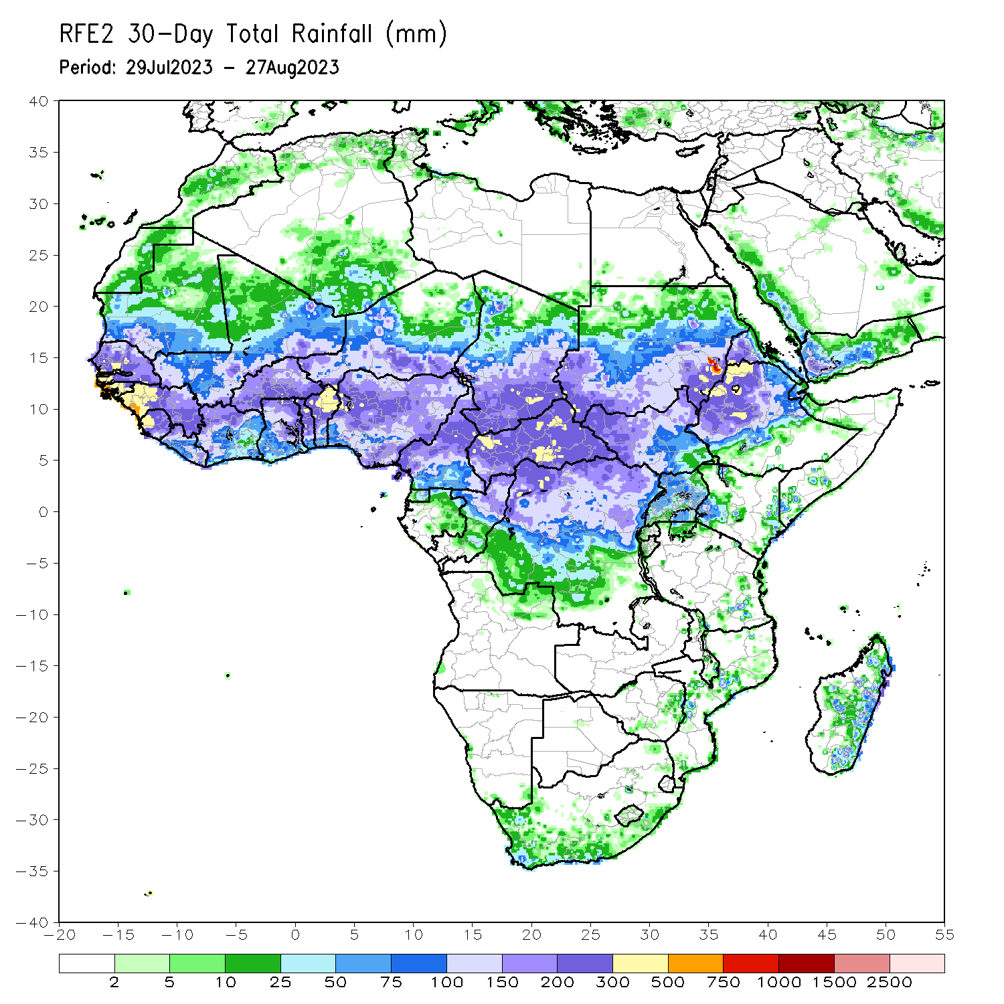
Rainfall Patterns: Last 30 Days
Over the past 30 days, in East Africa, above-average rainfall was observed over many parts of Sudan, western and northern South Sudan, and western Ethiopia. Rainfall was below-average over pockets of Sudan, central and southeastern South Sudan, eastern and southern Ethiopia, and Rwanda, Burundi, Uganda and western Kenya. In Central Africa, rainfall was above-average over northern Congo, much of CAR, parts of Chad, and northwestern and northern DRC. Below-average rainfall was observed over parts of Cameroon, western and central Chad, and central and eastern DRC. In West Africa, rainfall was above-average over pockets of southern Mauritania, Senegal, western and southern Guinea, Sierra Leone, Liberia, Cote d’Ivoire, Ghana, parts of Niger, Togo, Benin, and western Nigeria. Below-average rainfall was observed over much of Mali, northeastern Guinea, and Burkina Faso, parts of Niger and central and eastern Nigeria.
Notes:
5

Slide 6
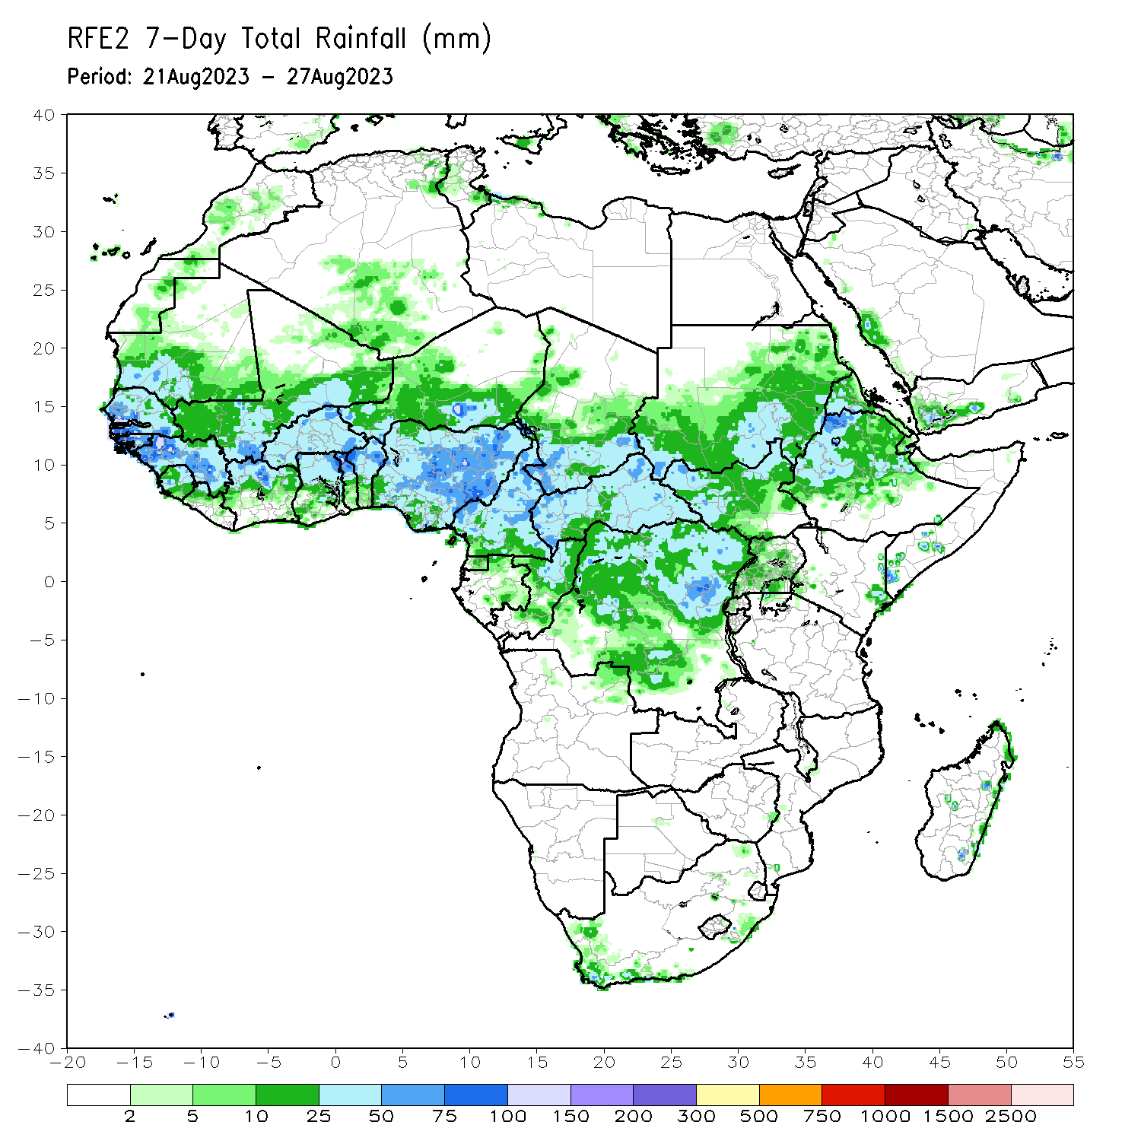
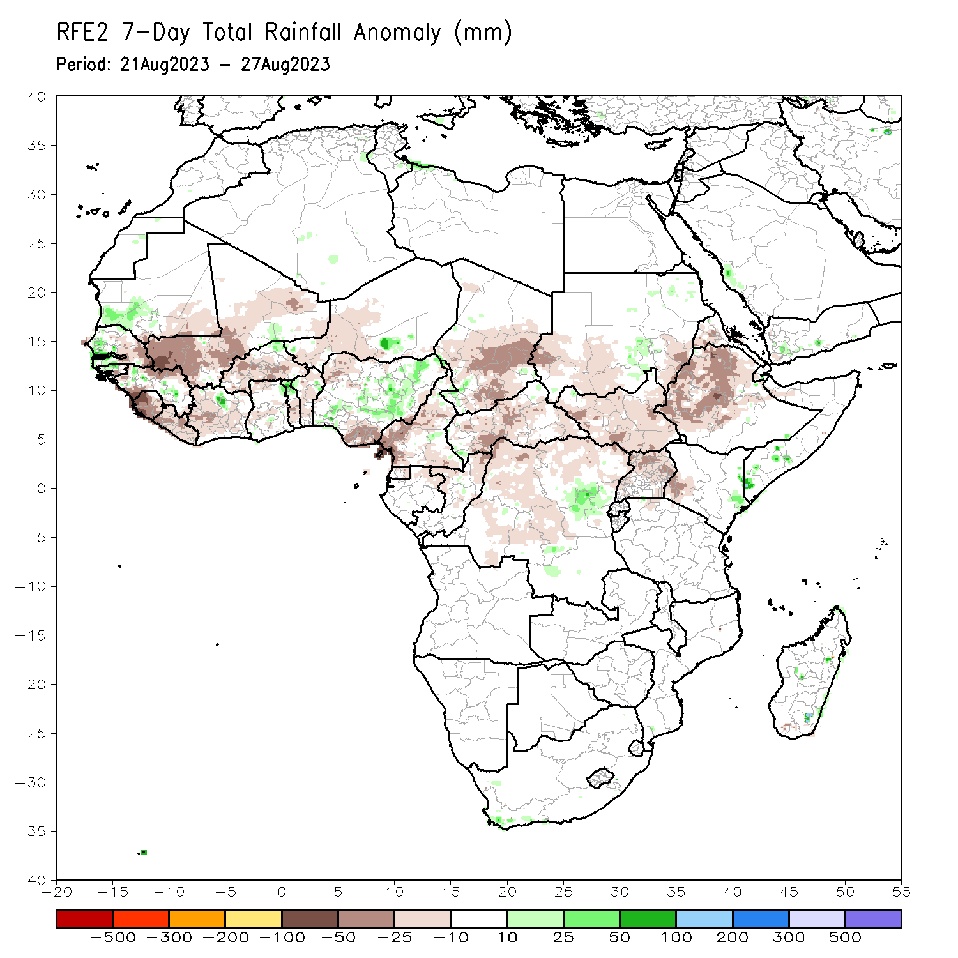
Rainfall Patterns: Last 7 Days
During the past 7 days, in East Africa, rainfall was above-average over pockets of eastern Sudan and southern Somalia. Below-average rainfall was observed over southwestern Sudan, much of South Sudan, Ethiopia, western Kenya and much of Uganda. In Central Africa, rainfall was above-average over pockets of eastern DRC. Below-average rainfall was observed over much of Cameron, Chad, CAR, and DRC. In West Africa, above-average rainfall was observed over western Senegal, Guinea-Bissau, and pockets of Guinea, Cote d’Ivoire and Niger. Rainfall was below-average over eastern Senegal, much of Mali, Sierra Leone, Liberia, much of Cote d’Ivoire, Burkina Faso, Ghana, Niger, Togo, Benin, and Nigeria.
.

Slide 7
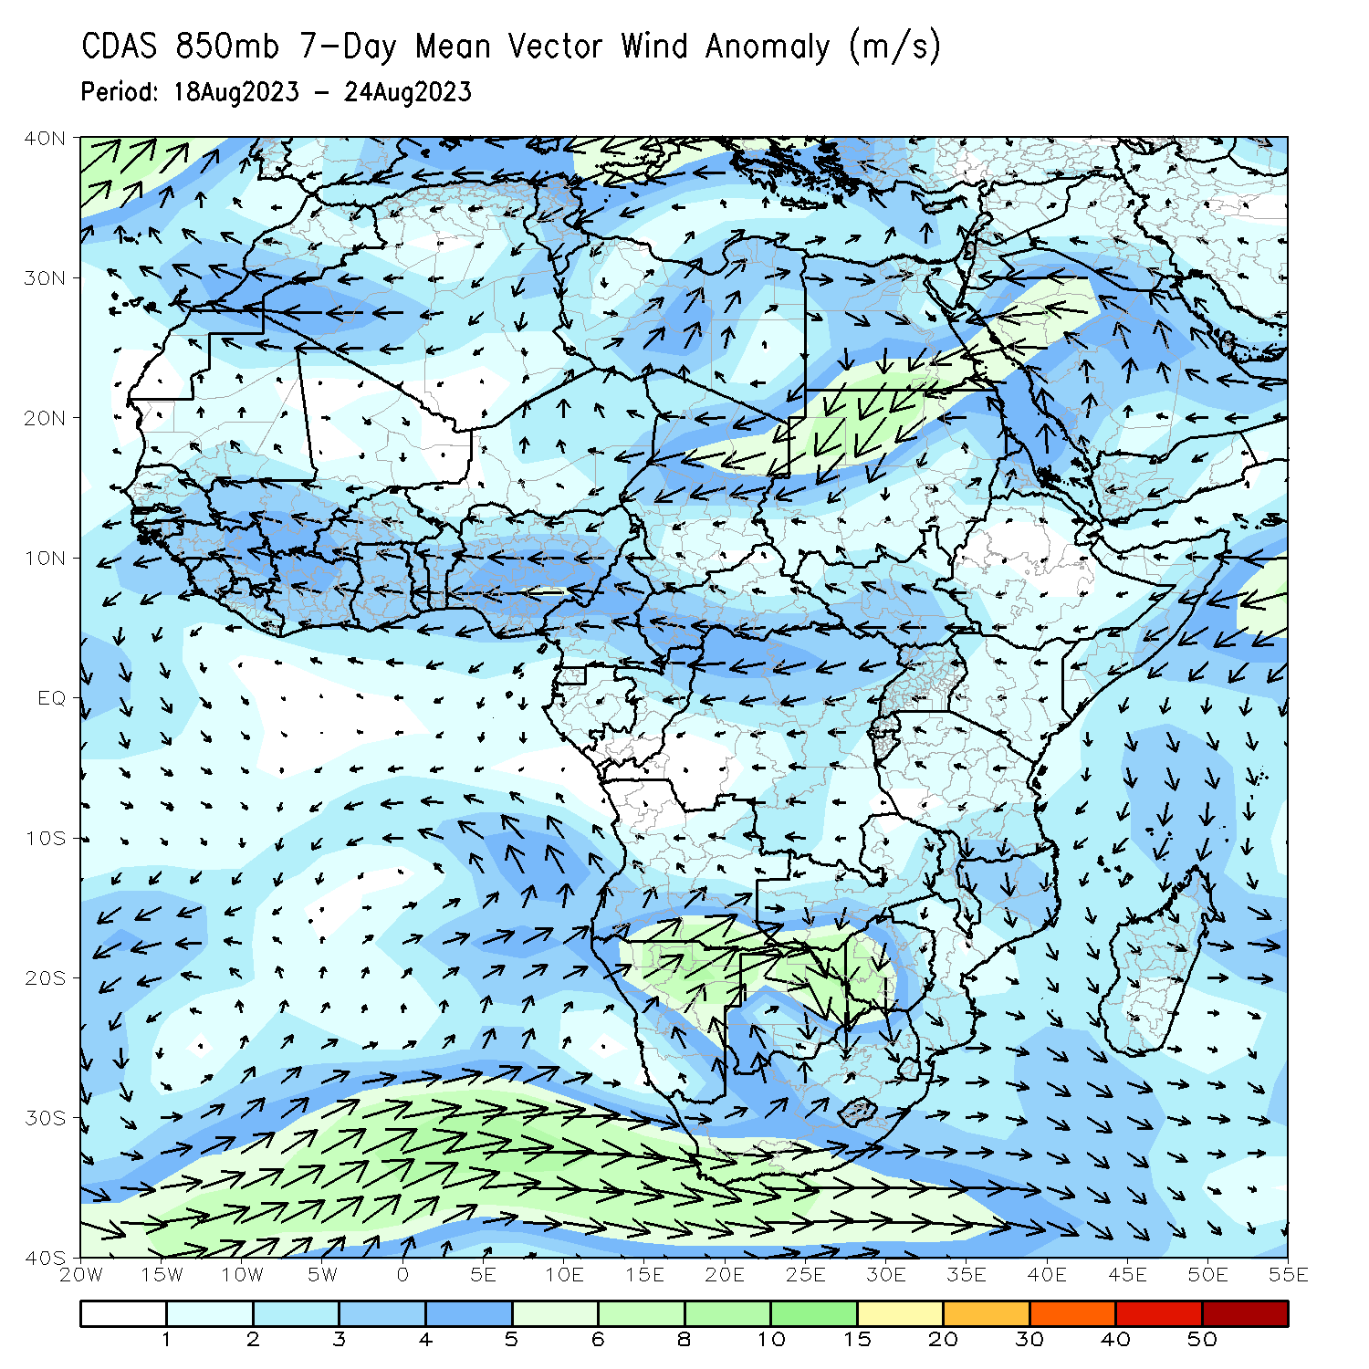
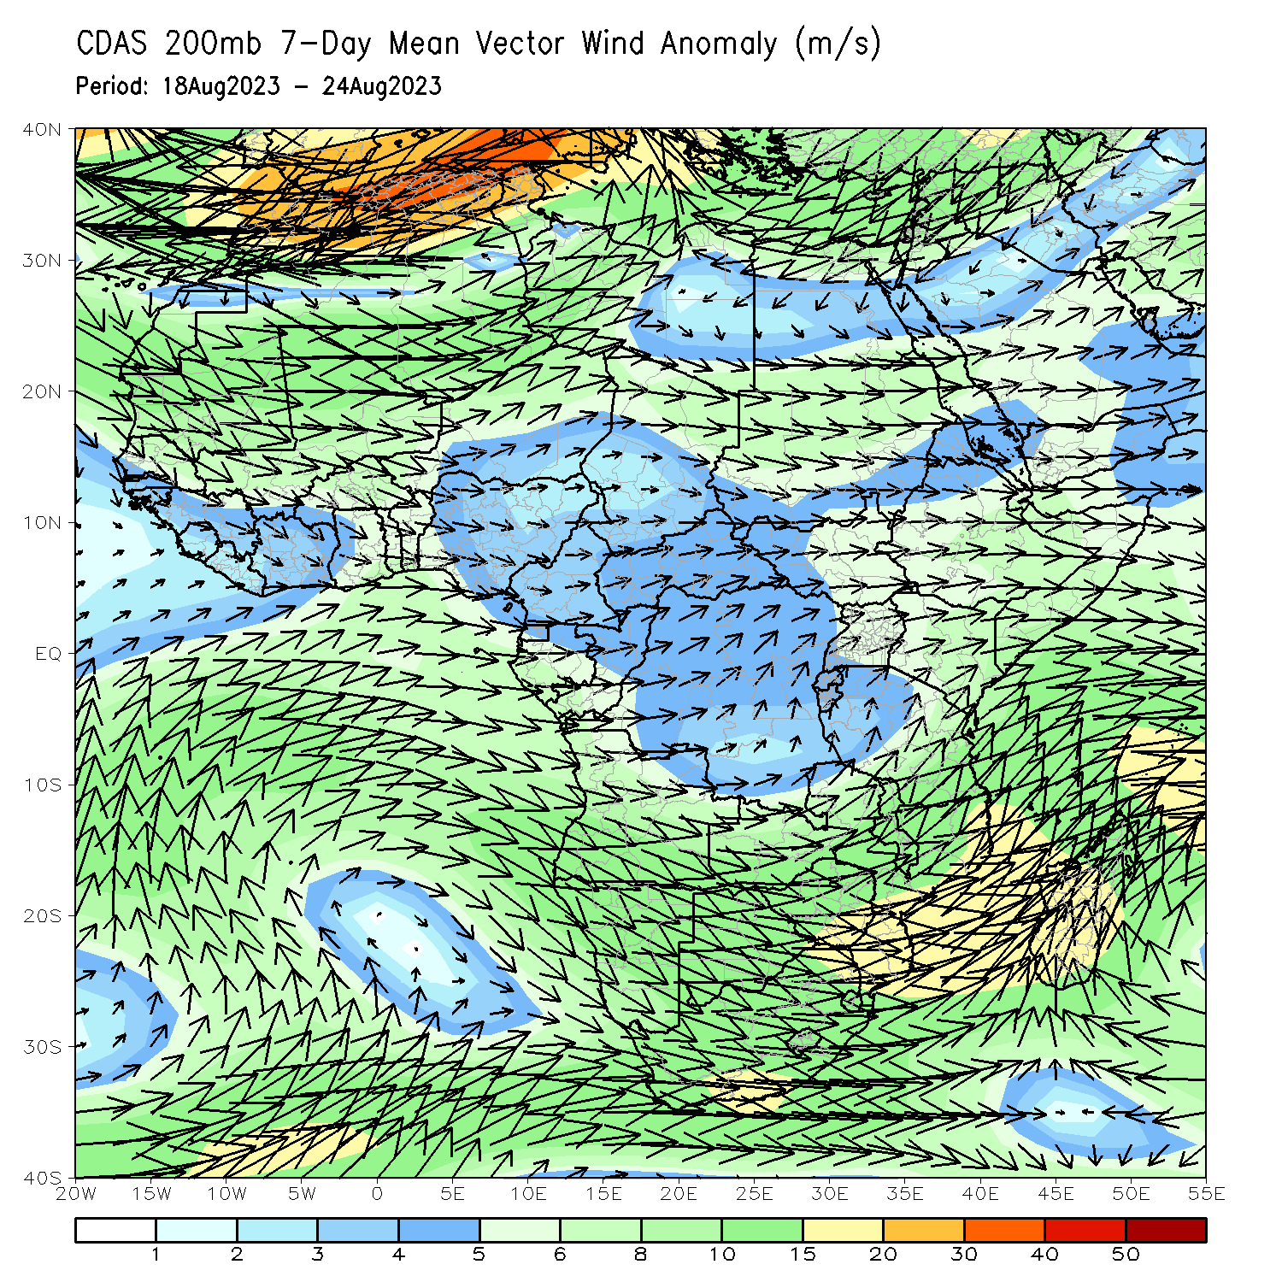
Atmospheric Circulation: Last 7 Days
At 850-hPa level (left panel), Anomalous easterly flow prevailed across much of the Gulf of Guinea region and the neighboring areas of Central Africa.

Slide 8
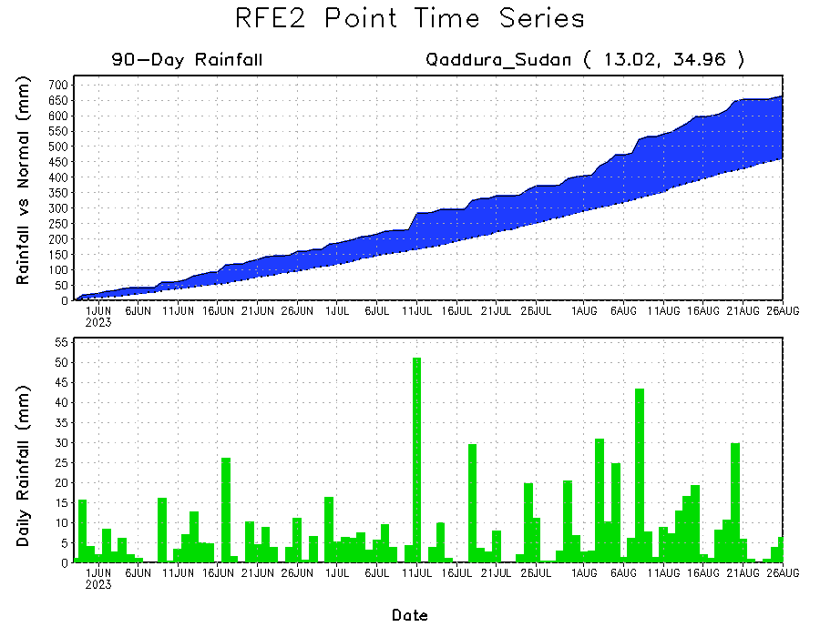
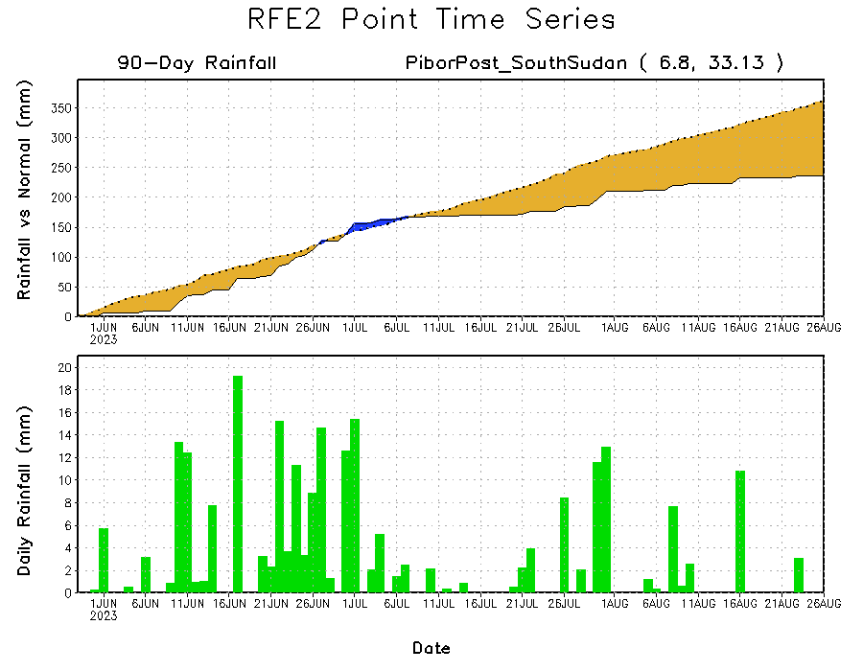
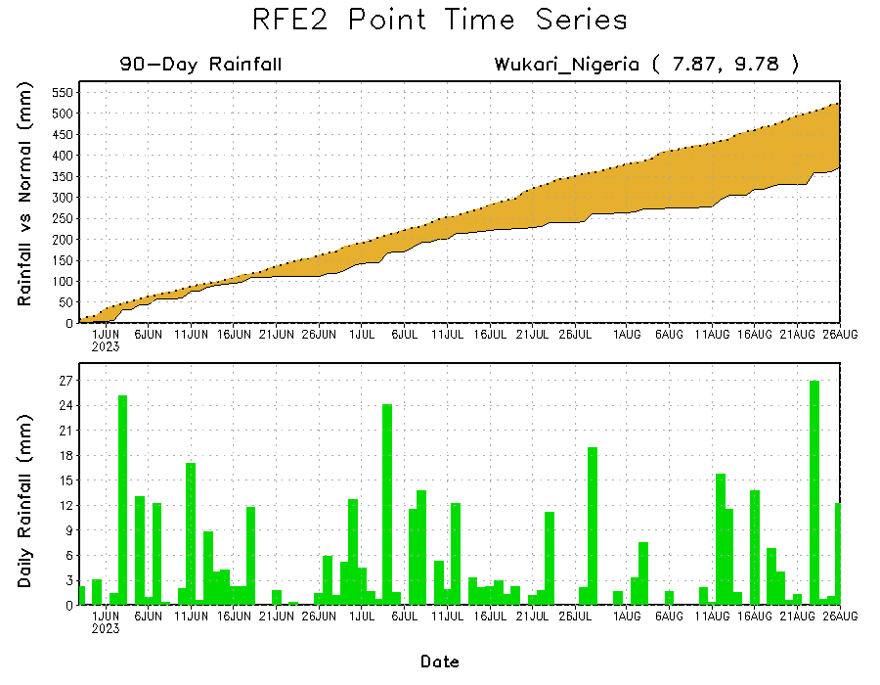
Rainfall Evolution
Daily evolution of rainfall over the last 90 days at selected locations shows moderate to heavy rainfall sustained moisture surpluses over parts of eastern Sudan (top right). Seasonal total rainfall remained below-average over parts of eastern Nigeria (bottom left) and eastern South Sudan (bottom right).

Slide 9
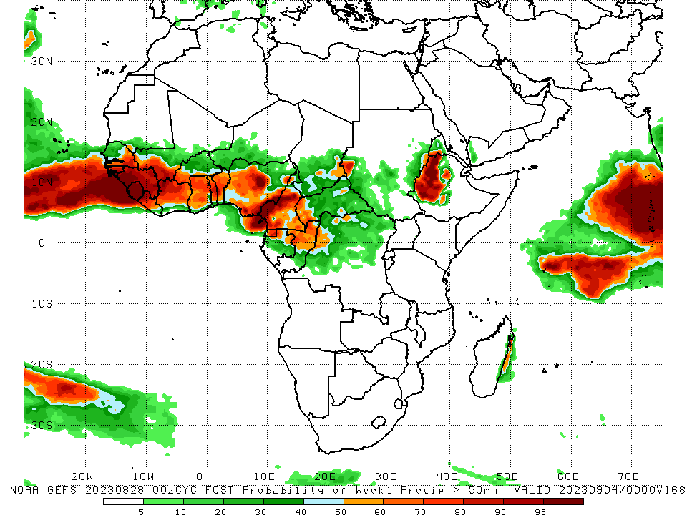
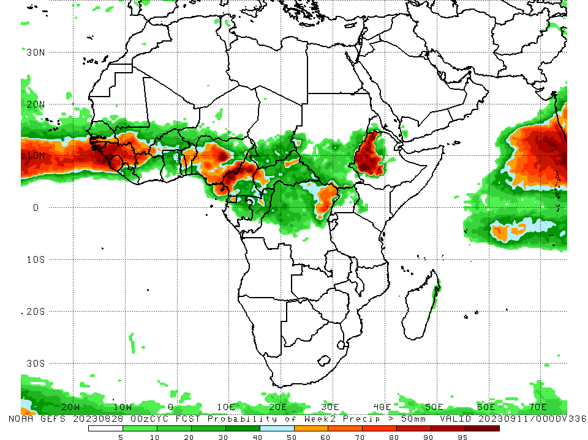
NCEP GEFS Model Forecasts Non-Bias Corrected Probability of precipitation exceedance
Week-1, Valid: 29 Aug – 04 Sep 2023
Week-2, Valid: 05 – 11 Sep 2023
For week-1 (left panel), the GEFS forecasts indicate a moderate to high chance (over 70%) for rainfall to exceed 50 mm over much of the Gulf of Guinea region, pockets of Central Africa, and western Ethiopia. For week-2 (right panel), there is an increased chance for the weekly total rainfall to exceed 50mm over the western and eastern parts of the Gulf of Guinea region, and northeastern DRC and western Ethiopia.
Notes:
9

Slide 10
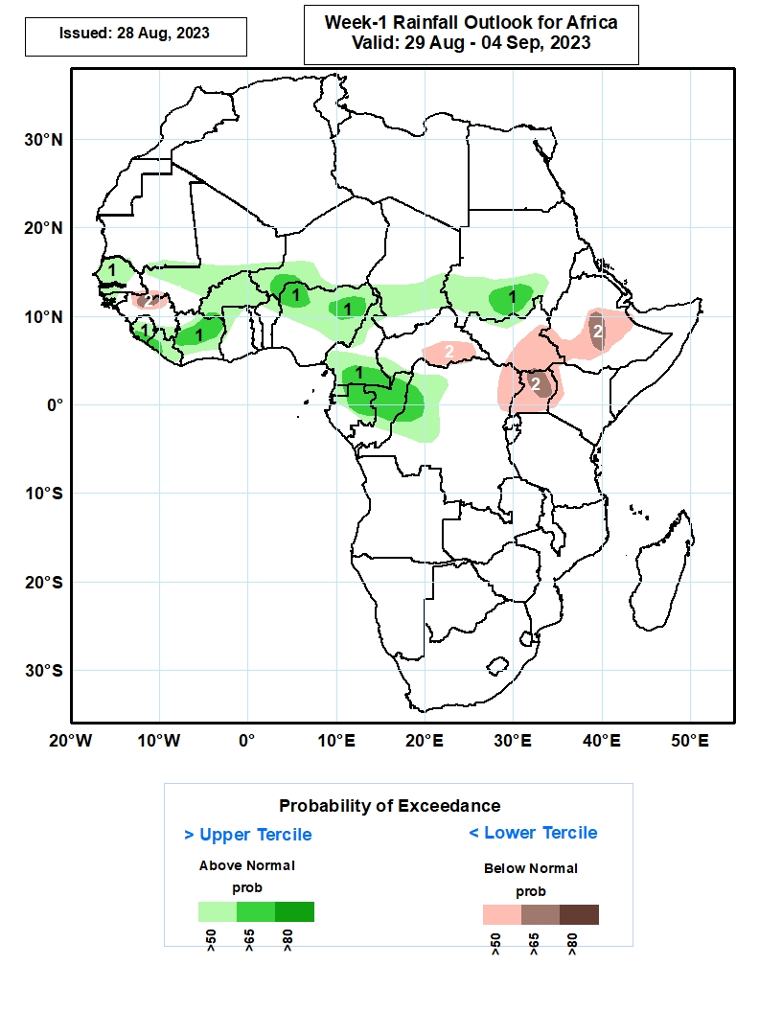
Week-1 Precipitation Outlooks
29 August – 04 September 2023
The probabilistic forecasts call for above 50% chance for weekly rainfall to be above-normal (above the upper tercile) over much of Senegal, The Gambia, Sierra Leone, Liberia, Cote d’Ivoire and Burkina Faso, southern Mali and Niger, northern and central parts of Nigeria, much of Cameroon and Equatorial Guinea, northern and central parts of Gabon and Congo, western DR Congo, and southern parts of Chad and Sudan. There is above 65% chance for rainfall to be above-normal over southern Sierra Leone and Liberia, northern and central parts of Cote d’Ivoire, southwestern Niger, northern portions of Nigeria, southern Cameroon, northern Gabon and Congo, northwestern DR Congo, and southern part of Sudan.
The forecasts call for above 50% chance for weekly total rainfall to be below-normal (below the lower tercile) over northern Guinea-Conakry, southern CAR, eastern South Sudan, central and southern parts of Ethiopia, northeastern DR Congo, much of Uganda, and western Kenya. There is above 65% chance for rainfall to be below-normal over northern Guinea-Conakry, northern and central part of Uganda, and central part of Ethiopia.
Notes:
10

Slide 11
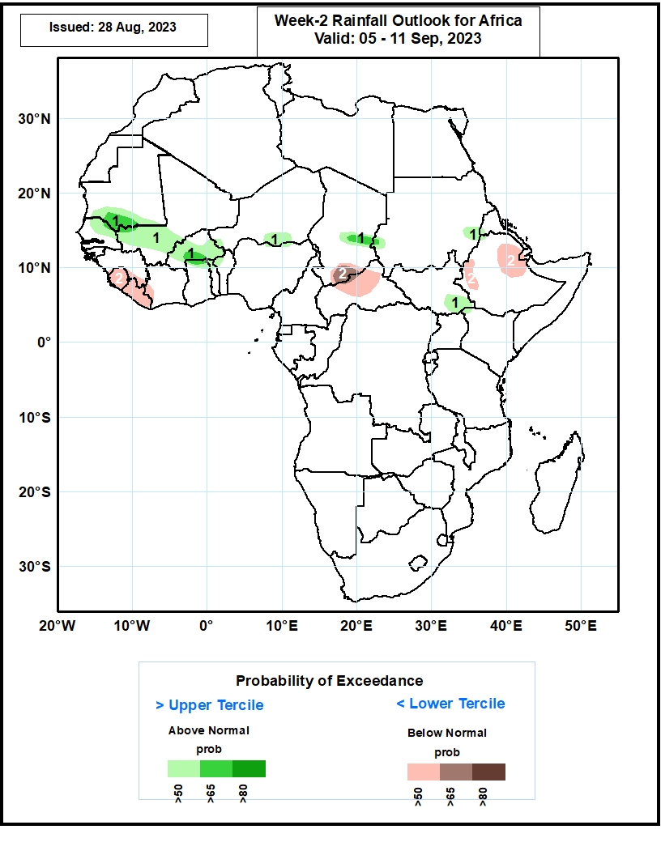
Week-2 Precipitation Outlooks
05 – 11 September 2023
The probabilistic forecasts call for above 50% chance for weekly rainfall to be above-normal (above the upper tercile) over southern Mauritania, northern Senegal, southern Mali, much of Burkina Faso, south-central Niger, central Chad, western and eastern parts of Sudan, and southeastern South Sudan. There is above 65% chance for rainfall to be above-normal over southern parts of Mauritania and Burkina Faso, and central part of Chad.
The forecasts call for above 50% chance for weekly total rainfall to be below-normal (below the lower tercile) over much of Sierra Leone and Liberia, southern Chad, northern and central part of CAR, and western and eastern parts of Ethiopia. There is above 65% chance for rainfall to be below-normal over south-central Chad.
Notes:
11

Slide 12
Summary
Over the past 30 days, in East Africa, above-average rainfall was observed over many parts of Sudan, western and northern South Sudan, and western Ethiopia. Rainfall was below-average over pockets of Sudan, central and southeastern South Sudan, eastern and southern Ethiopia, and Rwanda, Burundi, Uganda and western Kenya. In Central Africa, rainfall was above-average over northern Congo, much of CAR, parts of Chad, and northwestern and northern DRC. Below-average rainfall was observed over parts of Cameroon, western and central Chad, and central and eastern DRC. In West Africa, rainfall was above-average over pockets of southern Mauritania, Senegal, western and southern Guinea, Sierra Leone, Liberia, Cote d’Ivoire, Ghana, parts of Niger, Togo, Benin, and western Nigeria. Below-average rainfall was observed over much of Mali, northeastern Guinea, and Burkina Faso, parts of Niger and central and eastern Nigeria.
During the past 7 days, in East Africa, rainfall was above-average over pockets of eastern Sudan and southern Somalia. Below-average rainfall was observed over southwestern Sudan, much of South Sudan, Ethiopia, western Kenya and much of Uganda. In Central Africa, rainfall was above-average over pockets of eastern DRC. Below-average rainfall was observed over much of Cameron, Chad, CAR, and DRC. In West Africa, above-average rainfall was observed over western Senegal, Guinea-Bissau, and pockets of Guinea, Cote d’Ivoire and Niger. Rainfall was below-average over eastern Senegal, much of Mali, Sierra Leone, Liberia, much of Cote d’Ivoire, Burkina Faso, Ghana, Niger, Togo, Benin, and Nigeria.
The Week-1 outlook calls for above-normal rainfall over many places in West and Central Africa. In contrast, there is an increased chance for below-normal rainfall over northern Guinea, parts of CAR, eastern and southern South Sudan, northeastern DRC, Uganda, western Kenya, and central and southern Ethiopia. For week-2, there is an increased chance for above-normal rainfall over southern Mauritania, northern Senegal, southern Mali, Burkina Faso, northern Ghana, northern Togo, central Chad, southeastern South Sudan, and pockets of Sudan. In contrast, there is an increased chance for below-normal rainfall over western Guinea, Sierra Leone, Liberia, and parts of Cote d’Ivoire and Nigeria.

