Slide 1
The African Monsoon Recent Evolution and Current Status Include Week-1 and Week-2 Outlooks
Update prepared
05 September 2023
For more information, visit:
http://www.cpc.ncep.noaa.gov/products/Global_Monsoons/African_Monsoons/precip_monitoring.shtml

Slide 2
Outline
Highlights
Recent Evolution and Current Conditions
NCEP GEFS Forecasts
Summary

Slide 3
Highlights: Last 7 Days
During the past 7 days, in East Africa, rainfall was above-average over western Sudan, Eritrea and northeastern Ethiopia. Below-average rainfall was observed over parts of South Sudan, and central and western Ethiopia. In Central Africa, rainfall was above-average over southeastern Cameroon, central Chad, CAR, and western and northern DRC. Below-average rainfall was observed over much of Cameron and southern Chad. In West Africa, above-average rainfall was observed over much of Senegal and Guinea-Bissau, northern Cote d’Ivoire, Burkina Faso, pockets of Ghana, and western Nigeria. Rainfall was below-average over the far eastern Senegal, southern Mauritania, western and southern Mali, parts of Niger, and northern and eastern Nigeria.
The Week-1 outlook calls for above-normal rainfall in the Lake Victoria region, including parts of eastern DRC, South Sudan and southwestern Ethiopia. In contrast, there is an increased chance for below-normal rainfall across the Gulf of Guinea region, and the western portion of Central Africa, and pockets of eastern Africa. For week-2, there is an increased chance for above-normal rainfall across portions of the Sahel region and DRC. In contrast, there is an increased chance for below-normal rainfall along the Gulf of Guinea coast.

Slide 4
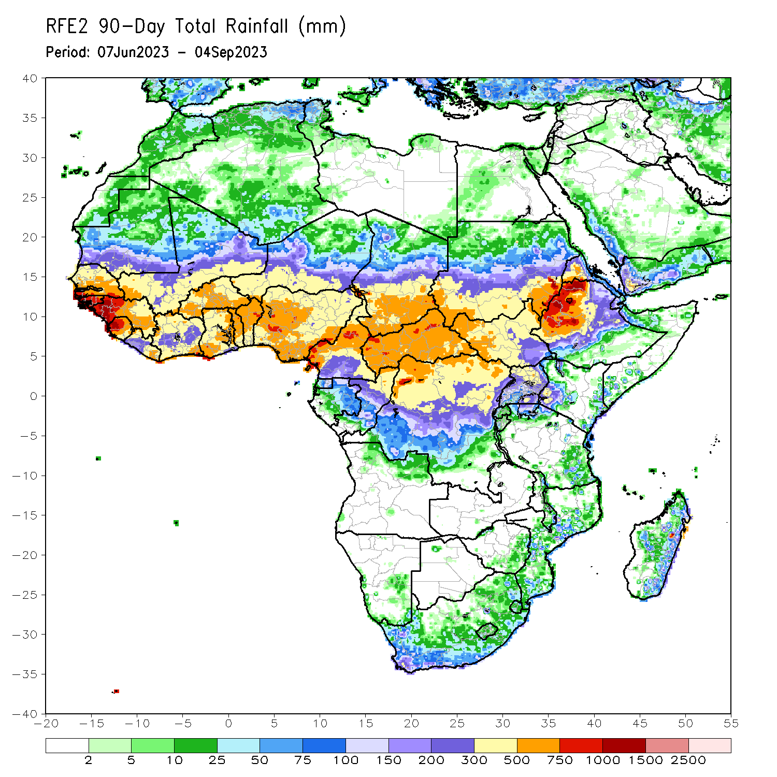
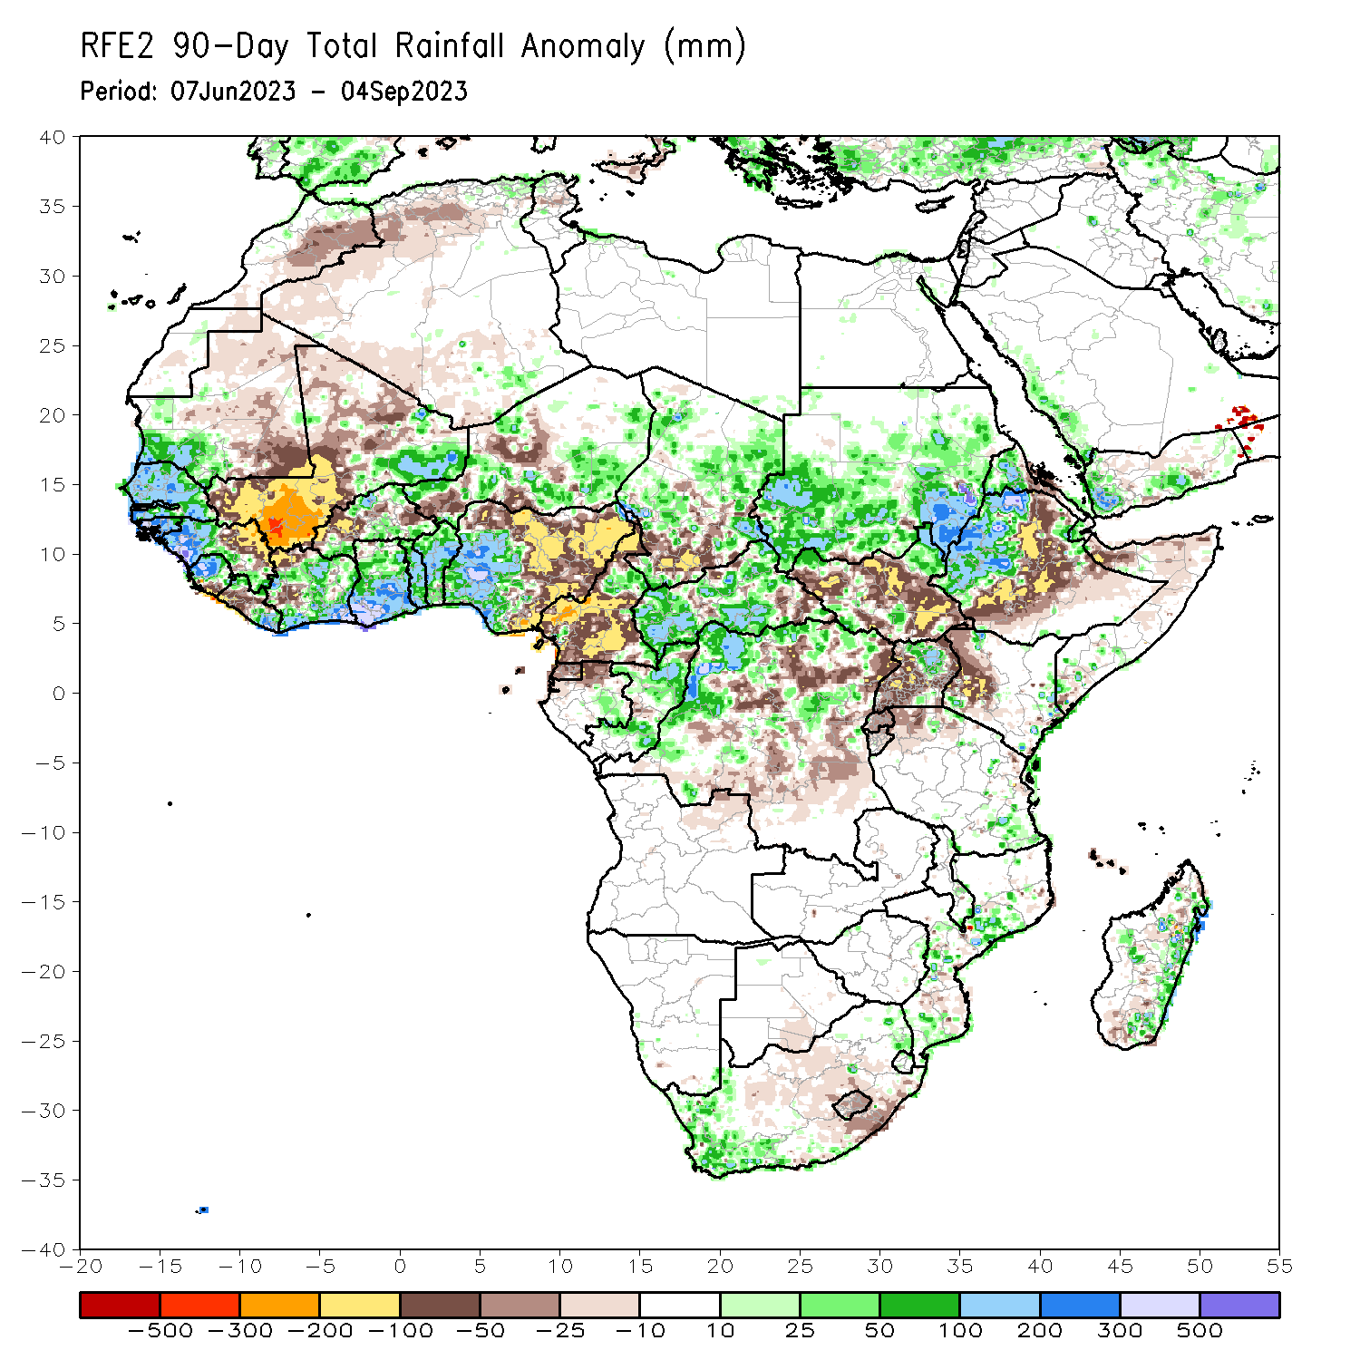
Rainfall Patterns: Last 90 Days
Over the past 90 days, in East Africa, above-average rainfall was observed over many parts of Sudan, western Ethiopia, much of Eritrea, the far northern South Sudan, Djibouti, and northern Uganda and coastal Tanzania. Rainfall was below-average over many parts of South Sudan, eastern and southern Ethiopia, parts of northern Somalia, western Kenya, and southern Uganda. In southern Africa, above-average rainfall was observed over the western portion of South Africa, and eastern Madagascar. Below-average rainfall was observed over pockets of eastern South Africa and southern Madagascar. In Central Africa, rainfall was above-average over the far northern Cameroon, many parts of CAR and Chad, Congo, and parts of western DRC. Rainfall was below-average over central and southern Cameroon, Equatorial Guinea, northern Gabon, parts of central and eastern DRC, and pockets of Chad and CAR. In West Africa, rainfall was above-average over much of Senegal, southern Mauritania, Guinea-Bissau, Guinea, Sierra Leone, eastern Liberia, northeastern Mali, much of Cote d’Ivoire, pockets of Burkina Faso, much of Ghana, Togo, Benin, parts of western and southern Niger, and western and central Nigeria. Below-average rainfall was observed over western, central and northern Mali, western Liberia, pockets of Burkina Faso, parts of Niger, and eastern Nigeria.
Notes:
4

Slide 5
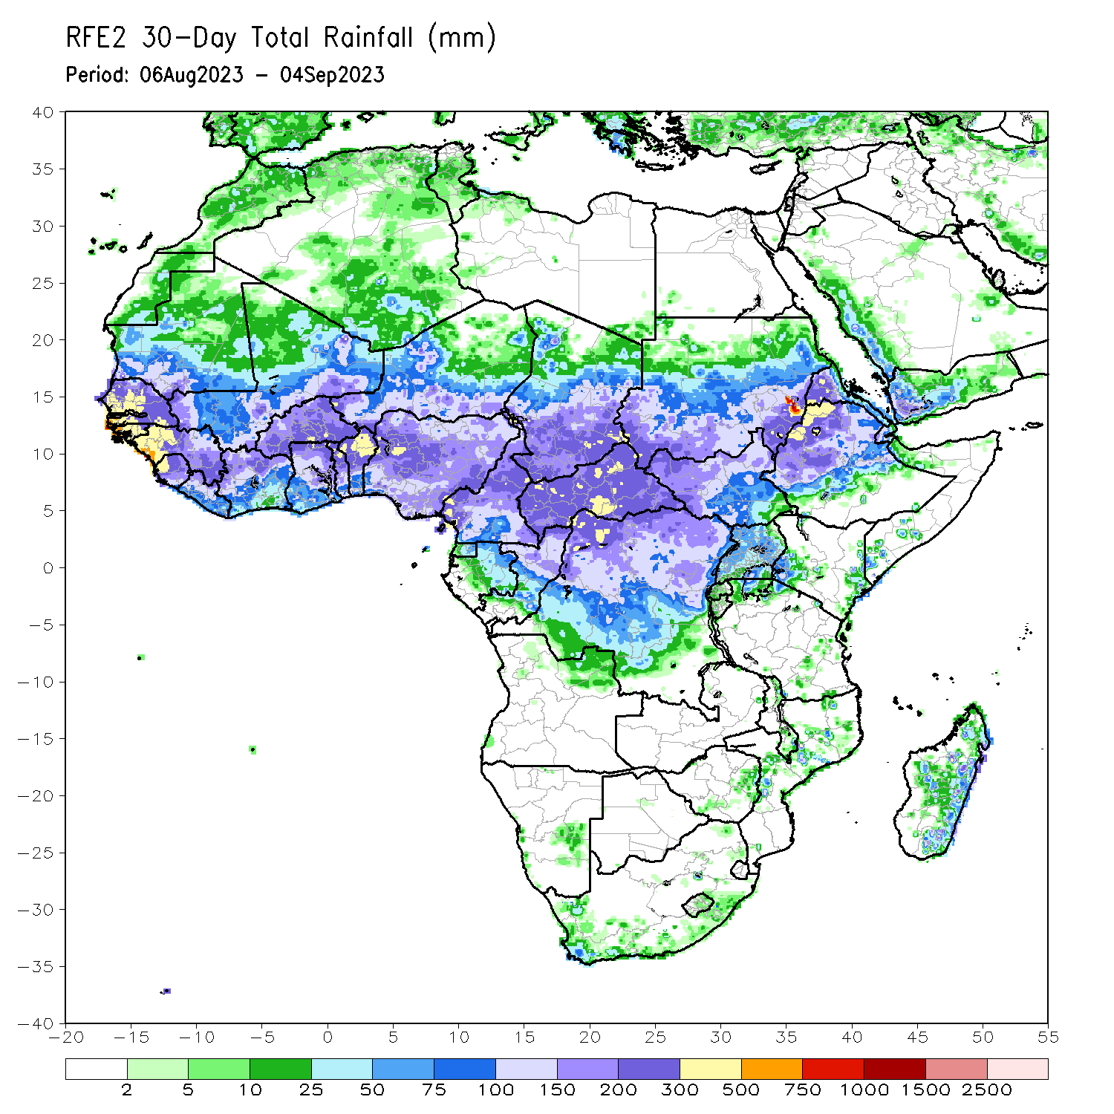
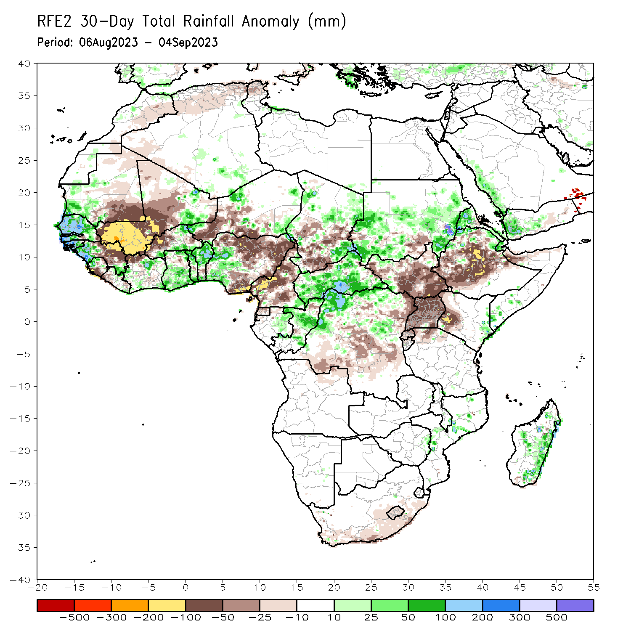
Rainfall Patterns: Last 30 Days
Over the past 30 days, in East Africa, above-average rainfall was observed over many parts of Sudan and Eritrea, and pockets of northern Ethiopia and coastal Kenya. Rainfall was below-average over the far southern Sudan, much South Sudan, central and southern Ethiopia, and Rwanda, Burundi, Uganda and western Kenya. In Central Africa, rainfall was above-average over northern Congo, much of CAR, pockets of Chad, and northwestern DRC. Below-average rainfall was observed over much of Cameroon, central and southern Chad, and central and eastern DRC. In West Africa, rainfall was above-average over pockets of southern Mauritania, Senegal, western Guinea, pockets of Cote d’Ivoire and Niger, parts of Ghana, Togo, Benin, and western Nigeria. Below-average rainfall was observed over much of Mali, northeastern Guinea, western Burkina Faso, parts of Niger, and northern, central and eastern Nigeria.
Notes:
5

Slide 6
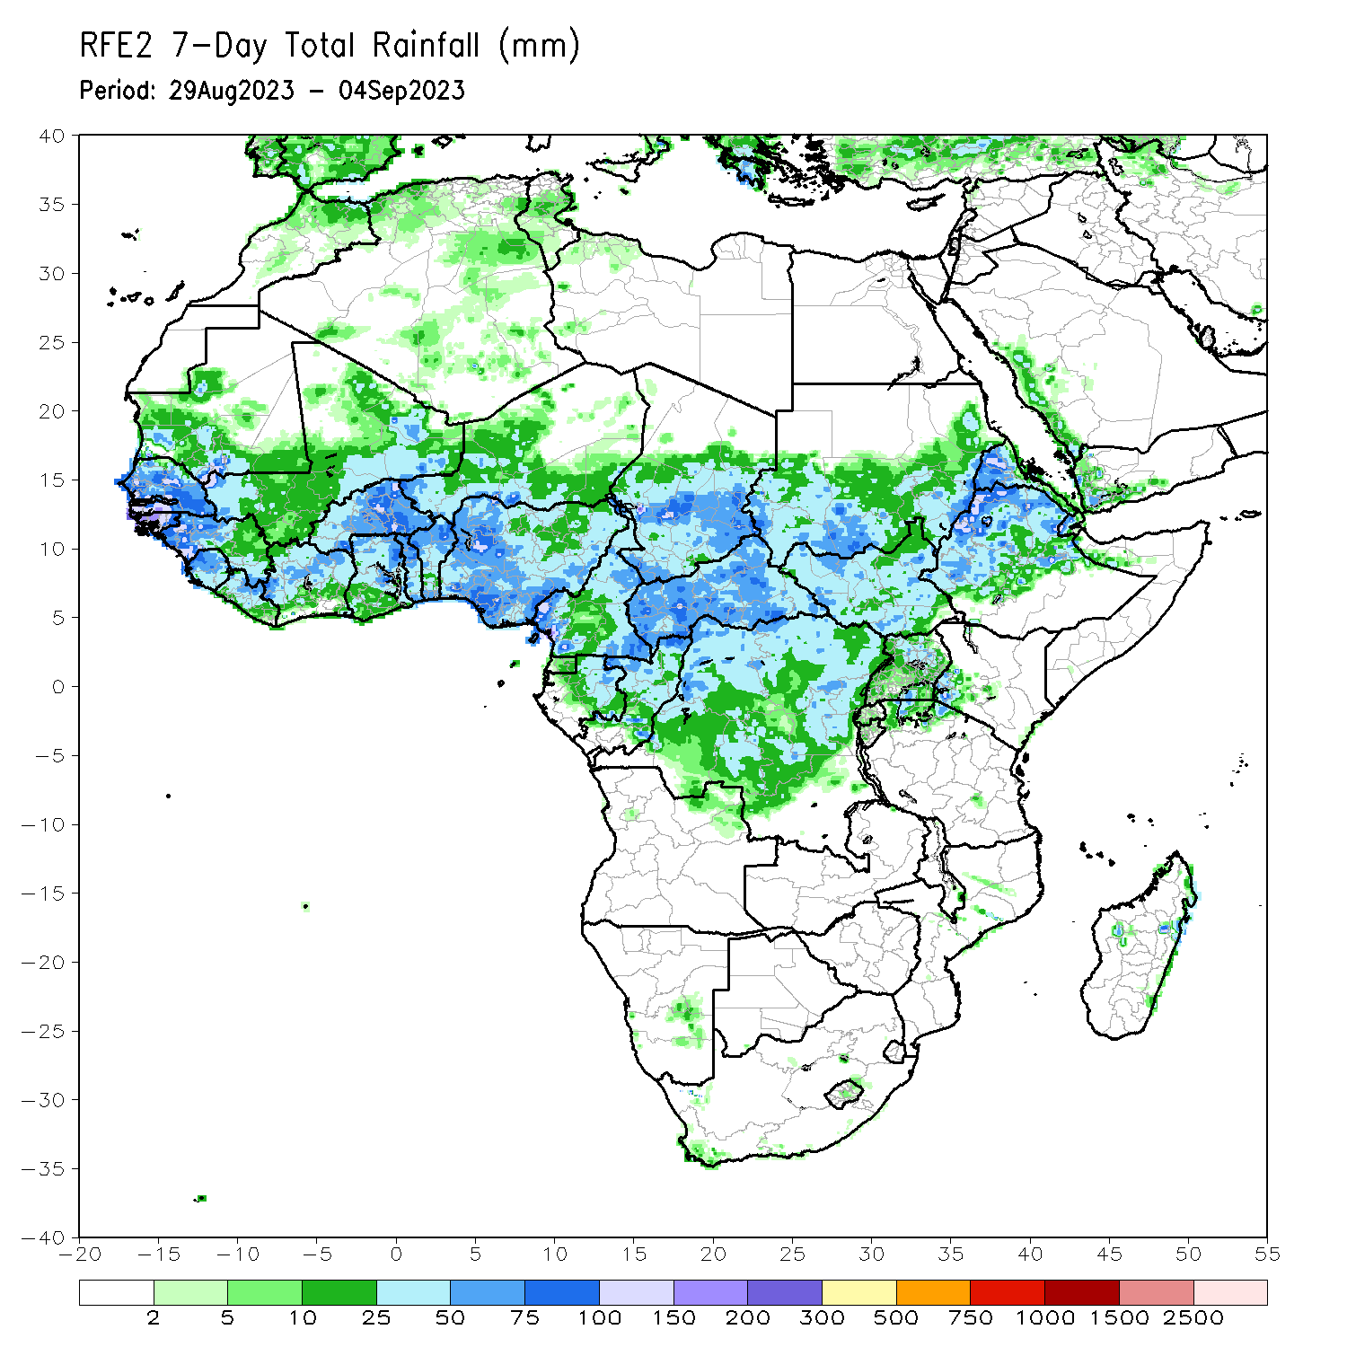
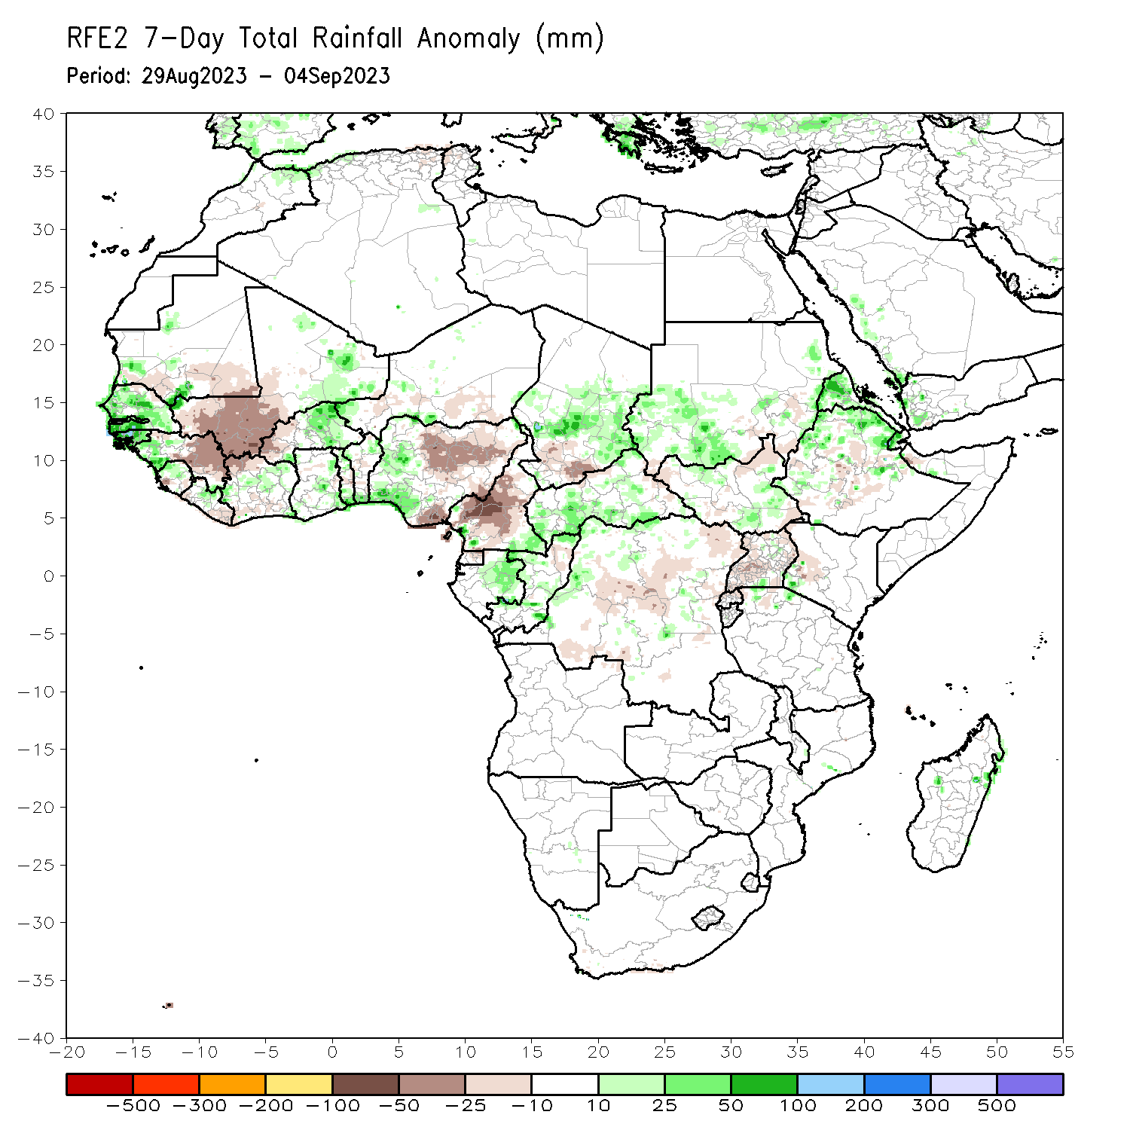
Rainfall Patterns: Last 7 Days
During the past 7 days, in East Africa, rainfall was above-average over parts of Sudan, Eritrea and northeastern Ethiopia. Below-average rainfall was observed over pockets of South Sudan and Ethiopia. In Central Africa, rainfall was above-average over southeastern Cameroon, central Chad, CAR, and western and northern DRC. Below-average rainfall was observed over much of Cameron, southern Chad, and parts of central DRC. In West Africa, above-average rainfall was observed over much of Senegal and Guinea-Bissau, northern Cote d’Ivoire, Burkina Faso, pockets of Ghana, and western Nigeria. Rainfall was below-average over western and southern Mali, parts of Niger, and northern and eastern Nigeria.

Slide 7
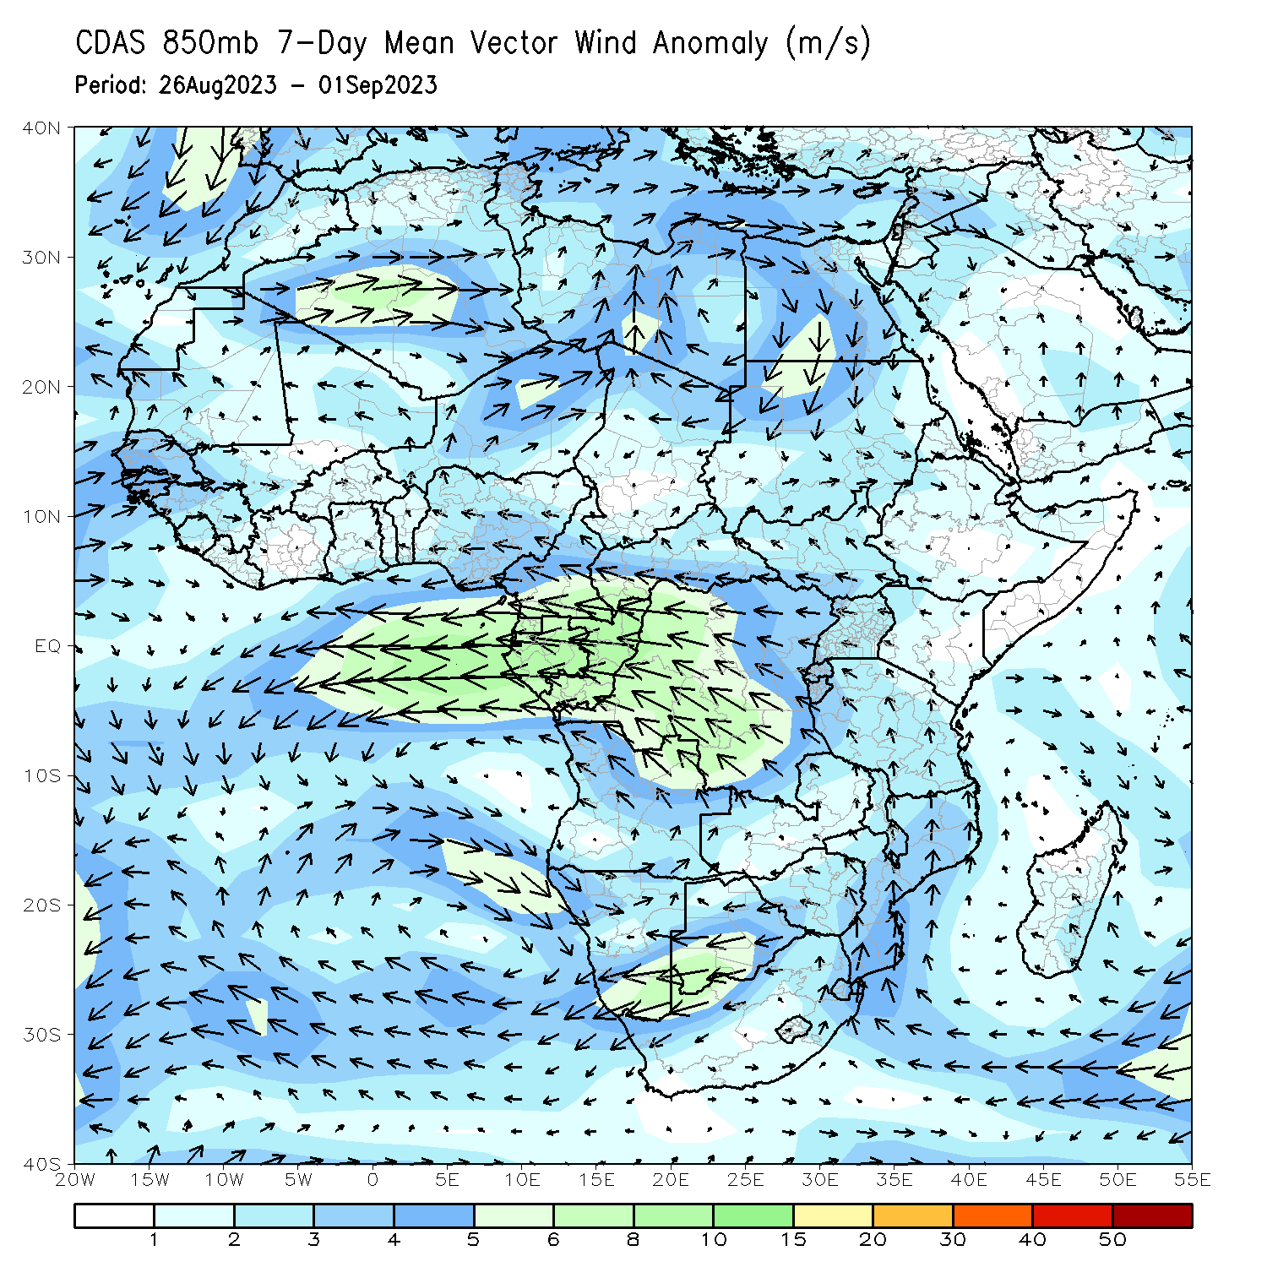
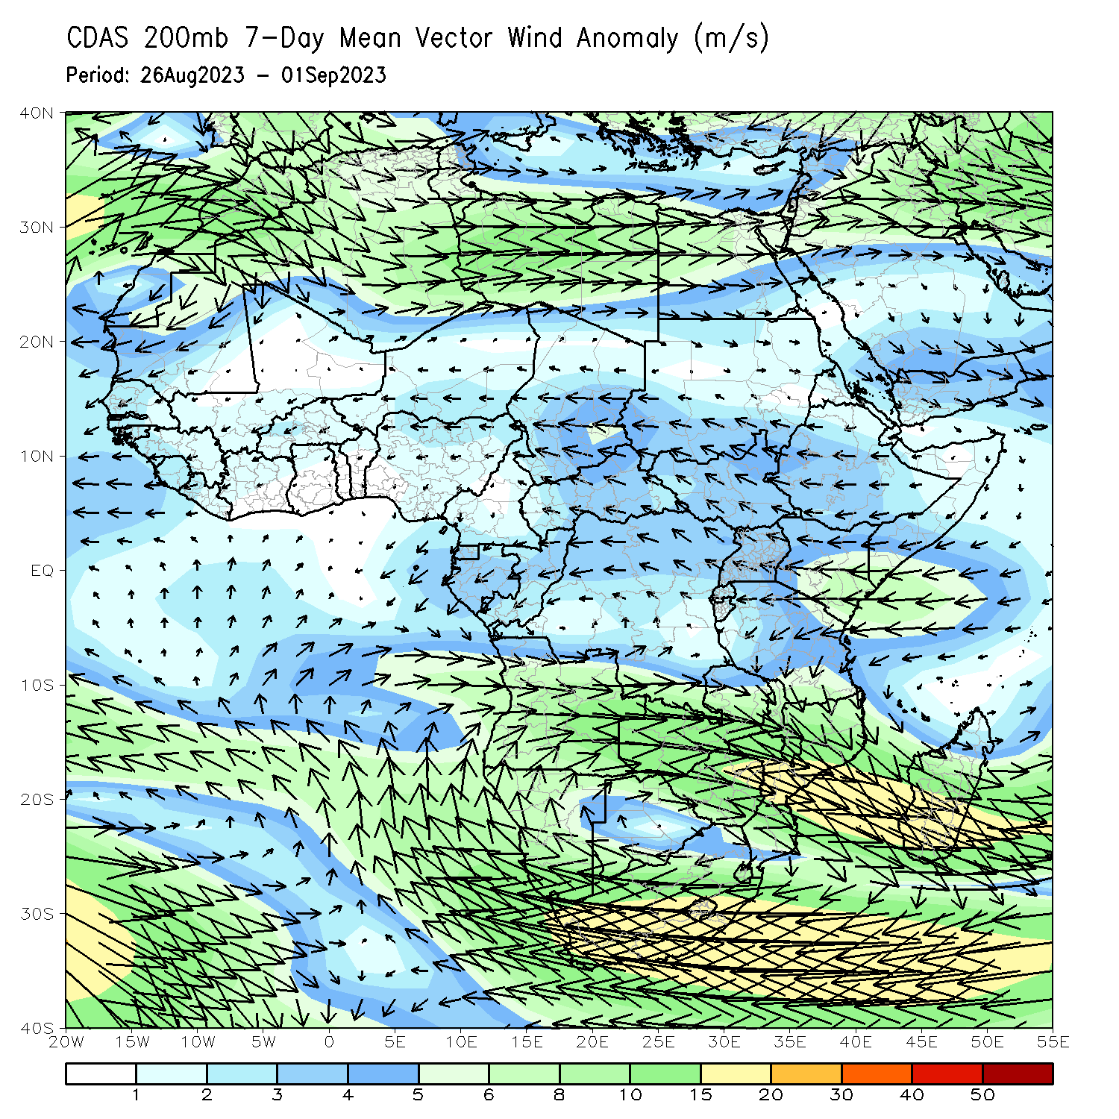
Atmospheric Circulation: Last 7 Days
At 850-hPa level (left panel), anomalous onshore flow was observed over the far western West Africa. In contrast, the lower-level anomalies were easterly across equatorial Africa.

Slide 8
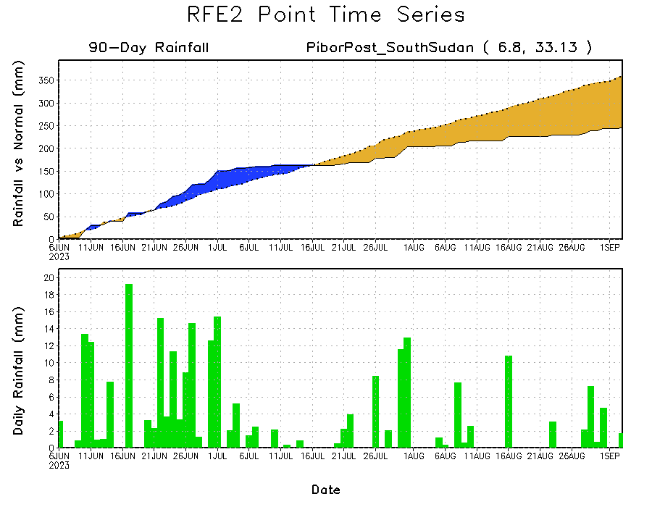
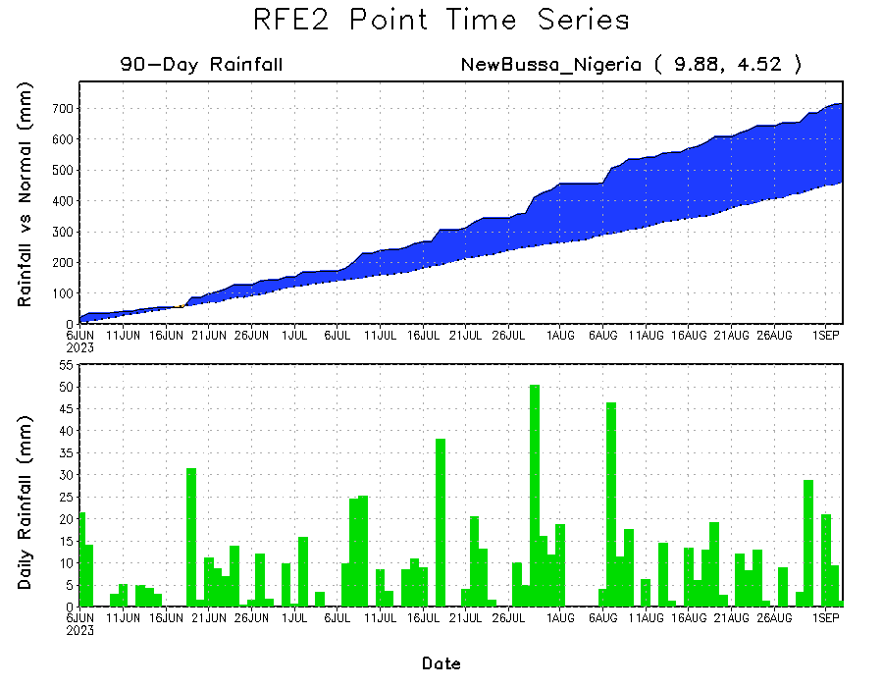
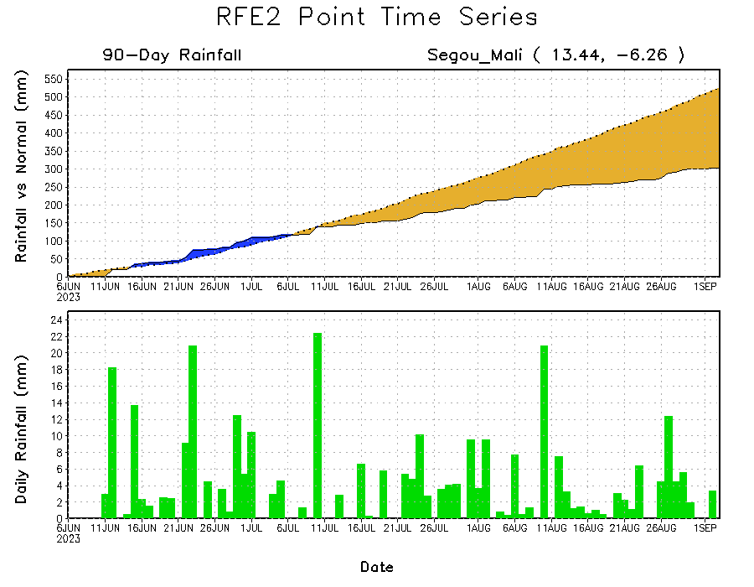
Rainfall Evolution
Daily evolution of rainfall over the last 90 days at selected locations shows moderate to heavy rainfall sustained moisture surpluses over parts of western Nigeria (bottom right). Seasonal total rainfall remained below-average over southwestern Mali (bottom left) and eastern South Sudan (top right).

Slide 9
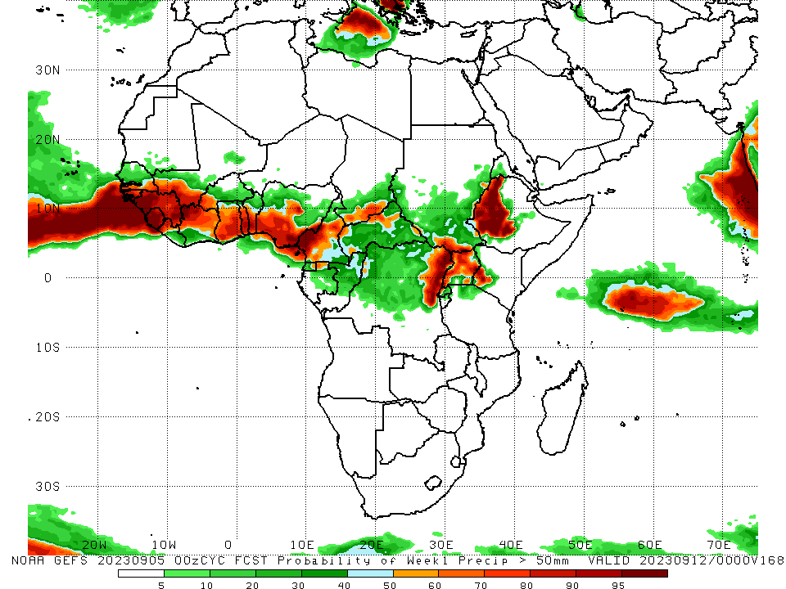
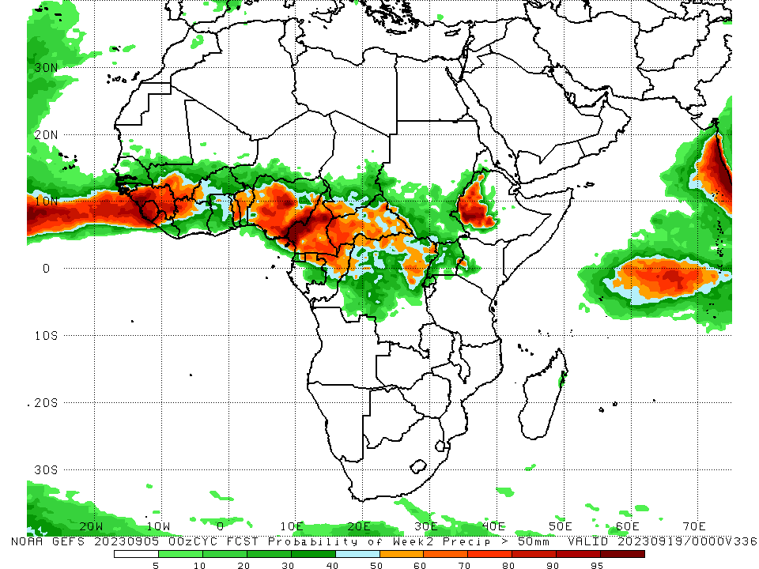
NCEP GEFS Model Forecasts Non-Bias Corrected Probability of precipitation exceedance
Week-1, Valid: 06 – 12 Sep 2023
Week-2, Valid: 13 – 19 Sep 2023
For week-1 (left panel) and week-2 (right panel), the GEFS forecasts indicate a moderate to high chance (over 70%) for rainfall to exceed 50 mm over much of the Gulf of Guinea region, parts of Central Africa and western Ethiopia.
Notes:
9

Slide 10
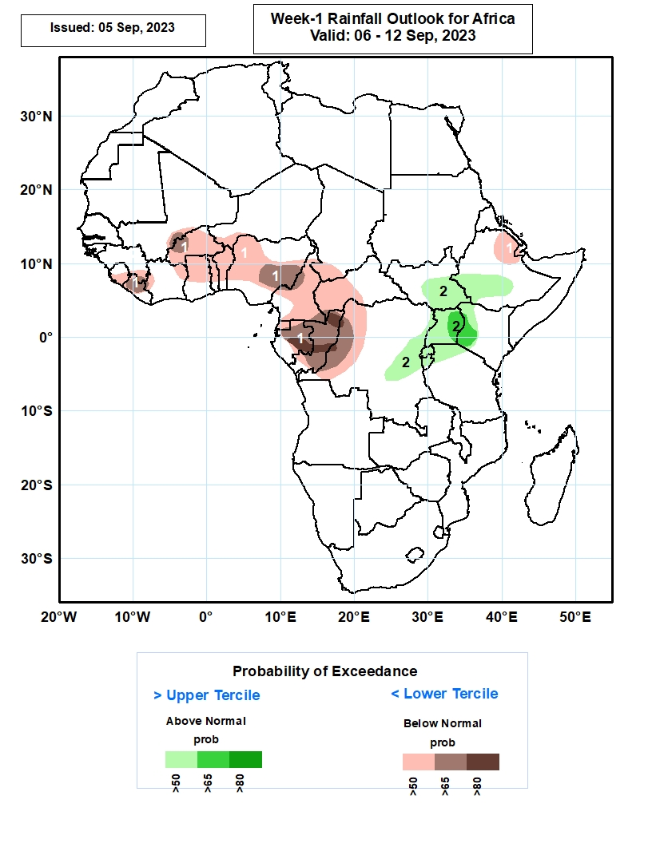
Week-1 Precipitation Outlooks
06 – 12 September 2023
The forecasts call for above 50% chance for weekly total rainfall to be below-normal (below the lower tercile) over much of Sierra Leone and Liberia, southeastern Guinea-Conakry, southeastern Mali, western and eastern parts of Cote d’Ivoire, much of Burkina Faso, northern and central parts of Ghana, Togo, Benin and Nigeria, southwestern Niger, much of Cameroon, southern Chad, west and central parts of CAR, much of Equatorial Guinea, Gabon and Congo, western part of DR Congo, northern Ethiopia, southern Eritrea, and much of Djibouti. There is above 80% chance for rainfall to be below-normal over central Gabon, and northern and central parts of Congo.
The probabilistic forecasts call for above 50% chance for weekly rainfall to be above-normal (above the upper tercile) over central and eastern parts of South Sudan, western and central parts of Ethiopia, central and eastern part of DR Congo, much of Rwanda, Burundi and Uganda, northern Tanzania, and western Kenya. There is above 65% chance for rainfall to be above-normal over eastern Uganda, and western Kenya.
Notes:
10

Slide 11
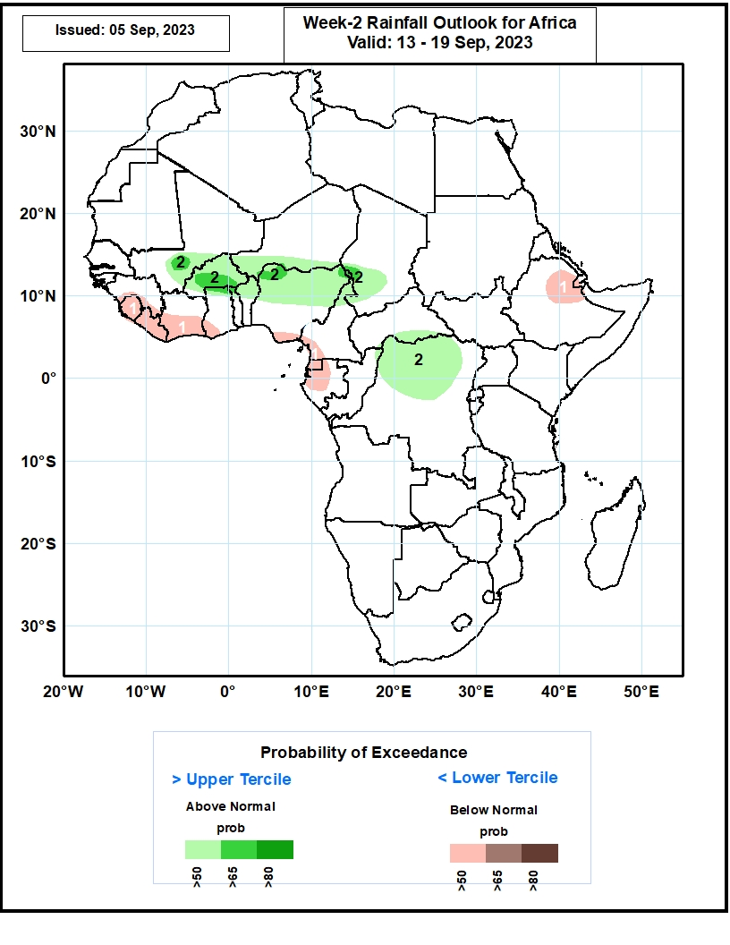
Week-2 Precipitation Outlooks
13 – 19 September 2023
The forecasts call for above 50% chance for weekly total rainfall to be below-normal (below the lower tercile) over southern Guinea-Conakry, much of Sierra Leone and Liberia, southern Cote d’Ivoire, southwestern Ghana, Nigeria and Cameroon, much of Equatorial Guinea, western and central parts of Gabon, central and eastern part of Ethiopia, and much of Djibouti.
The probabilistic forecasts call for above 50% chance for weekly rainfall to be above-normal (above the upper tercile) over central and southern parts of Mali, much of Burkina Faso, southern Niger, northern Ghana, Togo and Benin, northern and central parts of Nigeria, southwestern Chad, southern CAR, and northern and central parts of DR Congo. There is above 65% chance for rainfall to be above-normal over southern Mali and Burkina Faso, northern part of Nigeria, and southwestern Chad.
Notes:
11

Slide 12
Summary
Over the past 30 days, in East Africa, above-average rainfall was observed over many parts of Sudan and Eritrea, and pockets of northern Ethiopia and coastal Kenya. Rainfall was below-average over the far southern Sudan, much South Sudan, central and southern Ethiopia, and Rwanda, Burundi, Uganda and western Kenya. In Central Africa, rainfall was above-average over northern Congo, much of CAR, pockets of Chad, and northwestern DRC. Below-average rainfall was observed over much of Cameroon, central and southern Chad, and central and eastern DRC. In West Africa, rainfall was above-average over pockets of southern Mauritania, Senegal, western Guinea, pockets of Cote d’Ivoire and Niger, parts of Ghana, Togo, Benin, and western Nigeria. Below-average rainfall was observed over much of Mali, northeastern Guinea, western Burkina Faso, parts of Niger, and northern, central and eastern Nigeria.
During the past 7 days, in East Africa, rainfall was above-average over western Sudan, Eritrea and northeastern Ethiopia. Below-average rainfall was observed over parts of South Sudan, and central and western Ethiopia. In Central Africa, rainfall was above-average over southeastern Cameroon, central Chad, CAR, and western and northern DRC. Below-average rainfall was observed over much of Cameron and southern Chad. In West Africa, above-average rainfall was observed over much of Senegal and Guinea-Bissau, northern Cote d’Ivoire, Burkina Faso, pockets of Ghana, and western Nigeria. Rainfall was below-average over the far eastern Senegal, southern Mauritania, western and southern Mali, parts of Niger, and northern and eastern Nigeria.
The Week-1 outlook calls for above-normal rainfall in the Lake Victoria region, including parts of eastern DRC, South Sudan and southwestern Ethiopia. In contrast, there is an increased chance for below-normal rainfall across the Gulf of Guinea region, and the western portion of Central Africa, and pockets of eastern Africa. For week-2, there is an increased chance for above-normal rainfall across portions of the Sahel region and DRC. In contrast, there is an increased chance for below-normal rainfall along the Gulf of Guinea coast.

