Slide 1
The African Monsoon Recent Evolution and Current Status Include Week-1 and Week-2 Outlooks
Update prepared
11 September 2023
For more information, visit:
http://www.cpc.ncep.noaa.gov/products/Global_Monsoons/African_Monsoons/precip_monitoring.shtml

Slide 2
Outline
Highlights
Recent Evolution and Current Conditions
NCEP GEFS Forecasts
Summary

Slide 3
Highlights: Last 7 Days
During the past 7 days, in East Africa, rainfall was above-average over eastern Sudan, north-central and east-central South Sudan, western Ethiopia, eastern Uganda, southwestern Kenya, and northern Tanzania. Below-average rainfall was observed over parts of southern Sudan, southern, northeastern, and northwestern South Sudan, and central Ethiopia. In Central Africa, rainfall was above-average over parts of southeastern Cameroon, southeastern Chad, parts of central CAR, central Congo, eastern Gabon, and west-central and east-central DRC. Below-average rainfall was observed over much of Cameroon, southwestern Chad, northern Congo, northern and central DRC, and western and parts of southeastern CAR. In West Africa, above-average rainfall was observed over much of Senegal, western Guinea-Bissau, southwestern and southeastern Guinea, southwestern Mauritania, eastern Mali, northern Sierra Leone, central Liberia, northeastern Cote d’Ivoire, much of Ghana, northern and southern Togo, southern Benin, and south-central and parts of central Niger. Rainfall was below-average over southeastern Mauritania, southwestern Mali, Burkina Faso, central Guinea. Eastern Guinea-Bissau, southern Sierra Leone, western and eastern Liberia, western Cote d’Ivoire, central Togo, northern Benin, western Niger, and most of Nigeria.
The Week-1 outlook calls for above-normal rainfall in the central and eastern Gulf of Guinea region, as well as much of central Africa. This includes primarily eastern Guinea to southern Chad and CAR, as well as southern Sudan, western South Sudan, and western Ethiopia. In contrast, there is an increased chance for below-normal rainfall across parts of Senegal, Guinea-Bissau, Equatorial Guinea, Gabon, and the Lake Victoria region. For week-2, there is an increased chance for above-normal rainfall across portions of the Sahel, western and eastern Gulf of Guinea region, and northern and western Ethiopia. In contrast, there is an increased chance for below-normal rainfall in Equatorial Guinea, Gabon, and the Lake Victoria region.

Slide 4
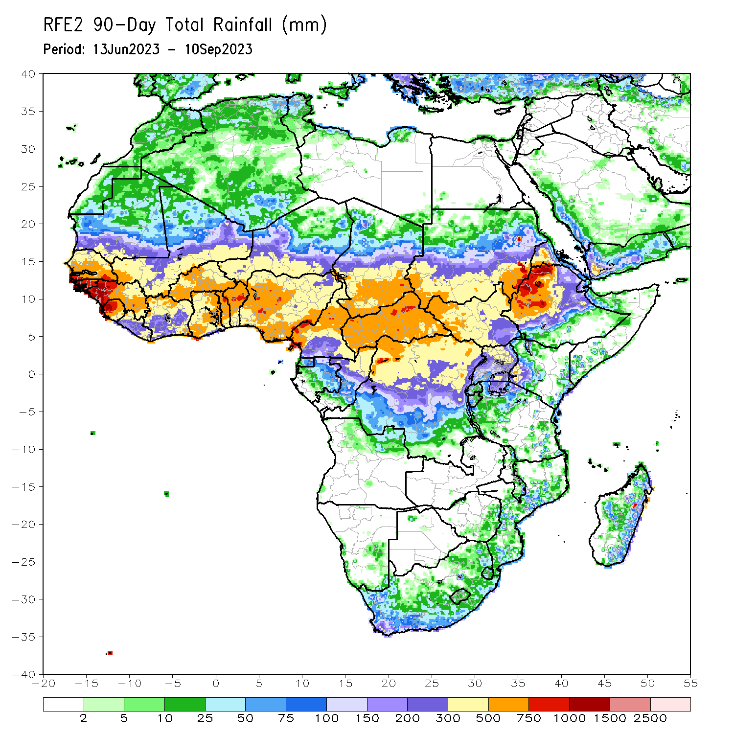
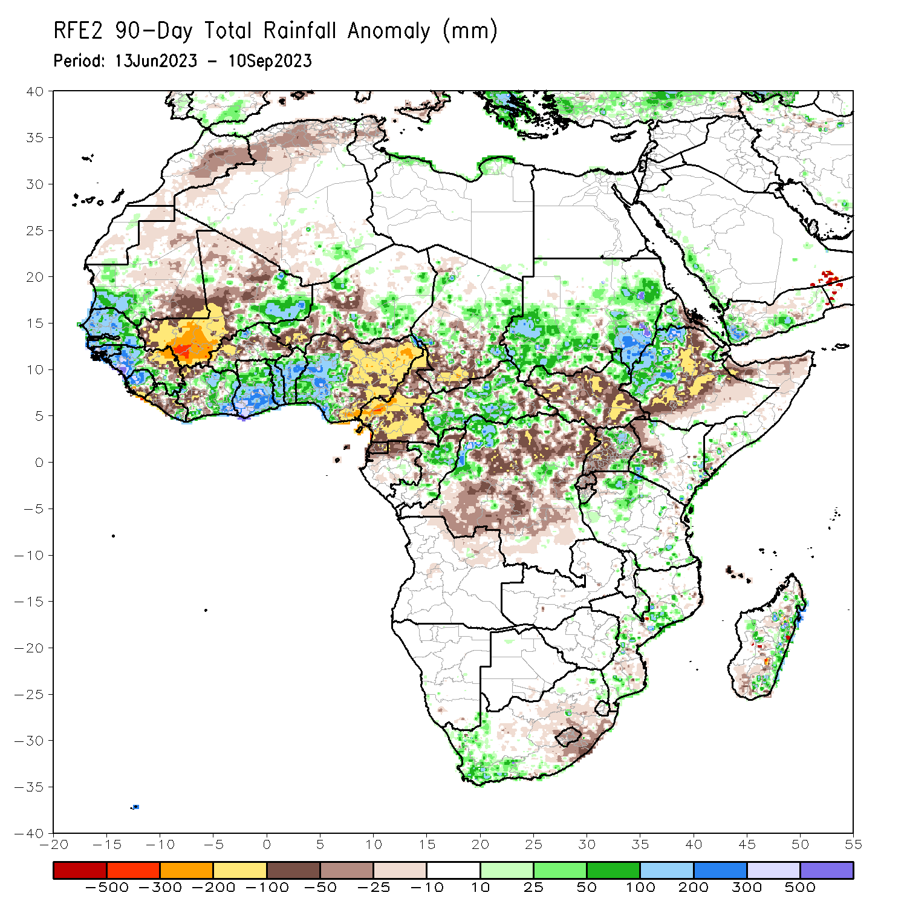
Rainfall Patterns: Last 90 Days
Over the past 90 days, in East Africa, above-average rainfall was observed over many parts of Sudan, western Ethiopia, western Eritrea, northeastern and northwestern South Sudan, Djibouti, northern and southeastern Uganda, parts of southwestern Kenya, and parts of northern Tanzania. Rainfall was below-average over many parts of South Sudan, eastern, central, and southern Ethiopia, parts of northern Somalia, western Kenya, and western Uganda. In southern Africa, above-average rainfall was observed over the western portion of South Africa, eastern Madagascar, and central Mozambique. Below-average rainfall was observed over pockets of eastern South Africa, Lesotho, and southern Madagascar. In Central Africa, rainfall was above-average over the far northern Cameroon, many parts of CAR, eastern Chad, parts of northern Congo, and parts of northwestern DRC. Rainfall was below-average over most of Cameroon, Equatorial Guinea, northern Gabon, most of central and northern DRC, southwestern Chad, and parts of northern and southeastern CAR. In West Africa, rainfall was above-average over much of Senegal, southwestern Mauritania, The Gambia, Guinea-Bissau, western and southern Guinea, northern Sierra Leone, eastern and northwestern Liberia, eastern Mali, much of Cote d’Ivoire, pockets of northern and southern Burkina Faso, much of Ghana, Togo, Benin, parts of western and southern Niger, and western and central Nigeria. Below-average rainfall was observed over western, central, and northern Mali, southwestern and central Liberia, central Burkina Faso, southern Sierra Leone, parts of western Cote d’Ivoire, southeastern Mauritania, parts of southwestern and central Niger, and eastern and central Nigeria.
Notes:
4

Slide 5
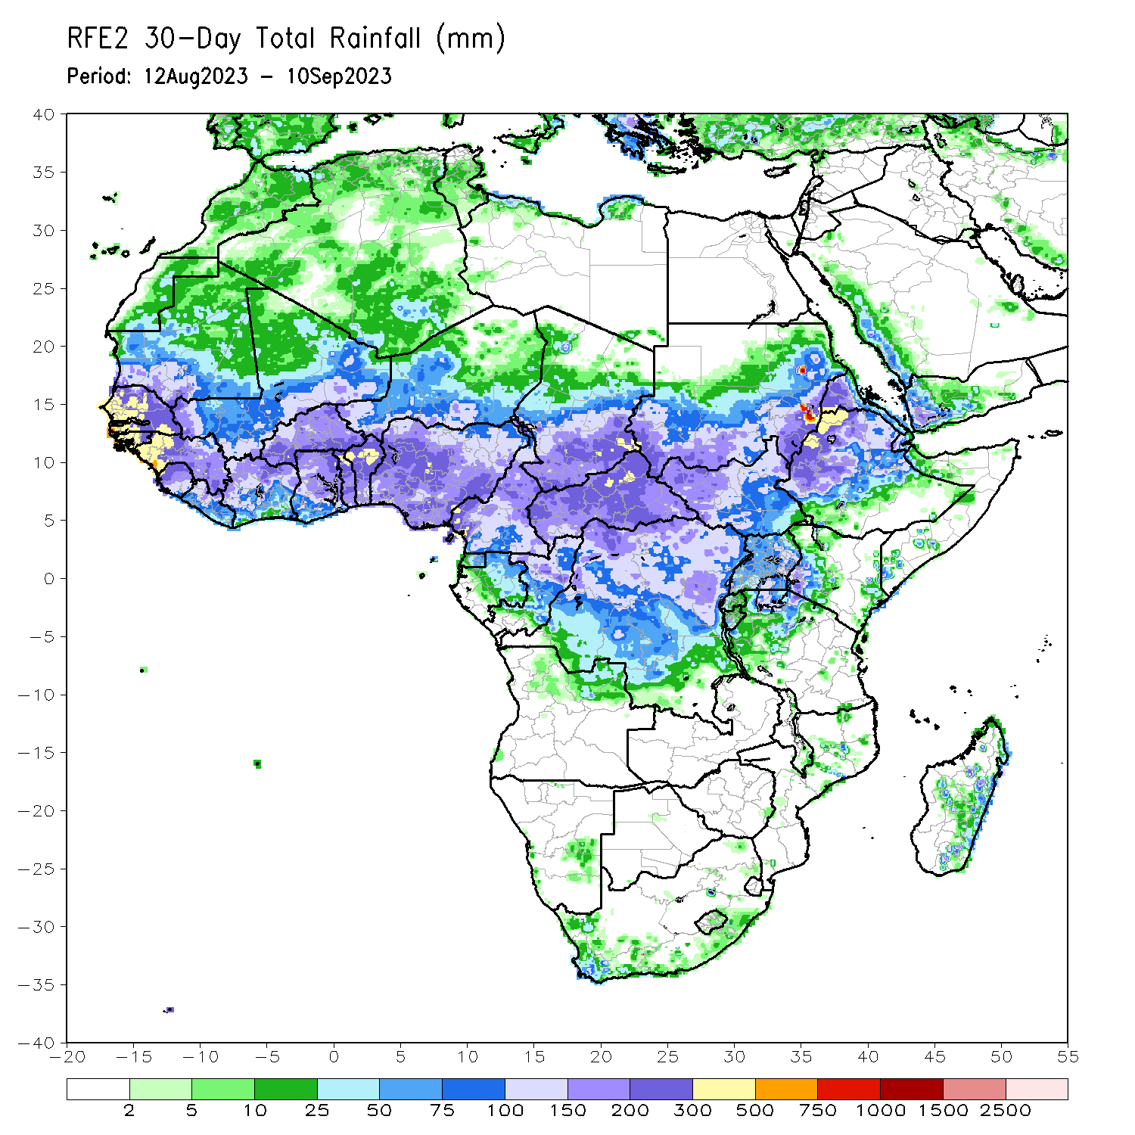
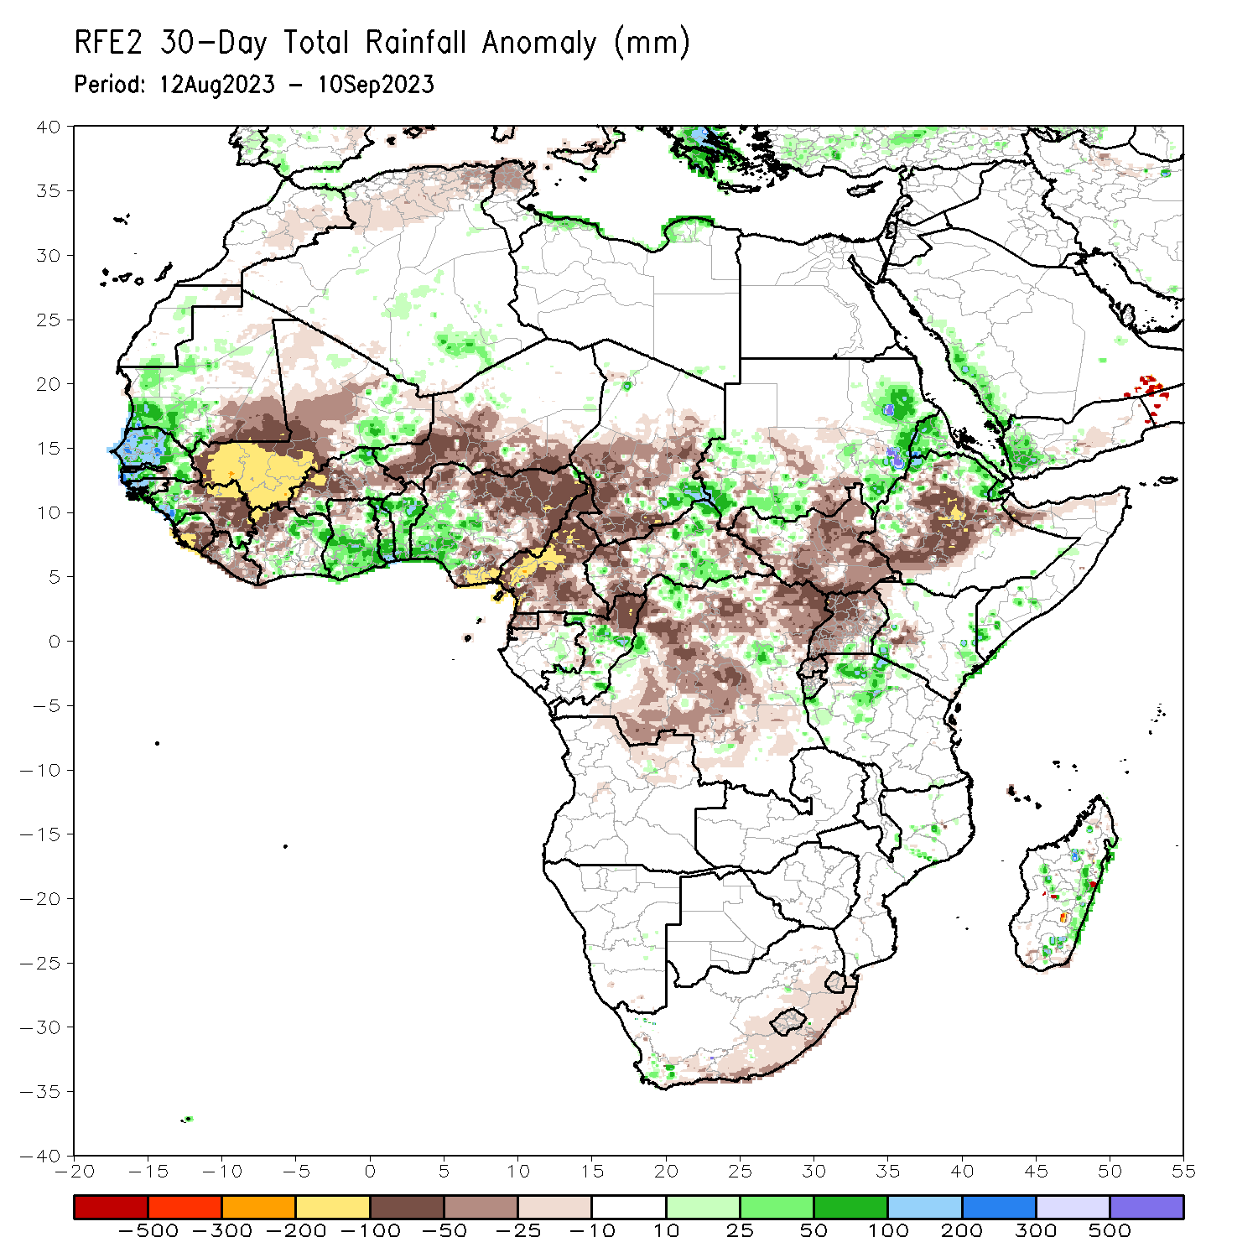
Rainfall Patterns: Last 30 Days
Over the past 30 days, in East Africa, above-average rainfall was observed over many parts of eastern and southwestern Sudan, Eritrea, and pockets of northern Ethiopia, coastal and southwestern Kenya, and northern Tanzania. Rainfall was below-average over south-central Sudan, much South Sudan, central and southern Ethiopia, Rwanda, Uganda, northern Somalia, and parts of western Kenya. In Southern Africa, rainfall was above average over eastern Madagascar and below average over much of southern South Africa, Lesotho, and Eswatini. In Central Africa, rainfall was above-average over central Congo, central CAR, pockets of southeastern Chad, and northwestern and east-central DRC. Below-average rainfall was observed over much of Cameroon, central and southwestern Chad, Equatorial Guinea, and central and northeastern DRC. In West Africa, rainfall was above-average over pockets of southwestern Mauritania, Senegal, western Guinea, Guinea-Bissau, northern Sierra Leone, northeastern Burkina Faso, pockets of eastern Cote d’Ivoire and western Niger, central and southern Ghana, Togo, Benin, and western Nigeria. Below-average rainfall was observed over much of Mali, central and eastern Guinea, western and central Burkina Faso, southern Niger, northern Ghana, central and southern Sierra Leone, most of Liberia, northwestern Cote d’Ivoire, and northern, central, and eastern Nigeria.
Notes:
5

Slide 6
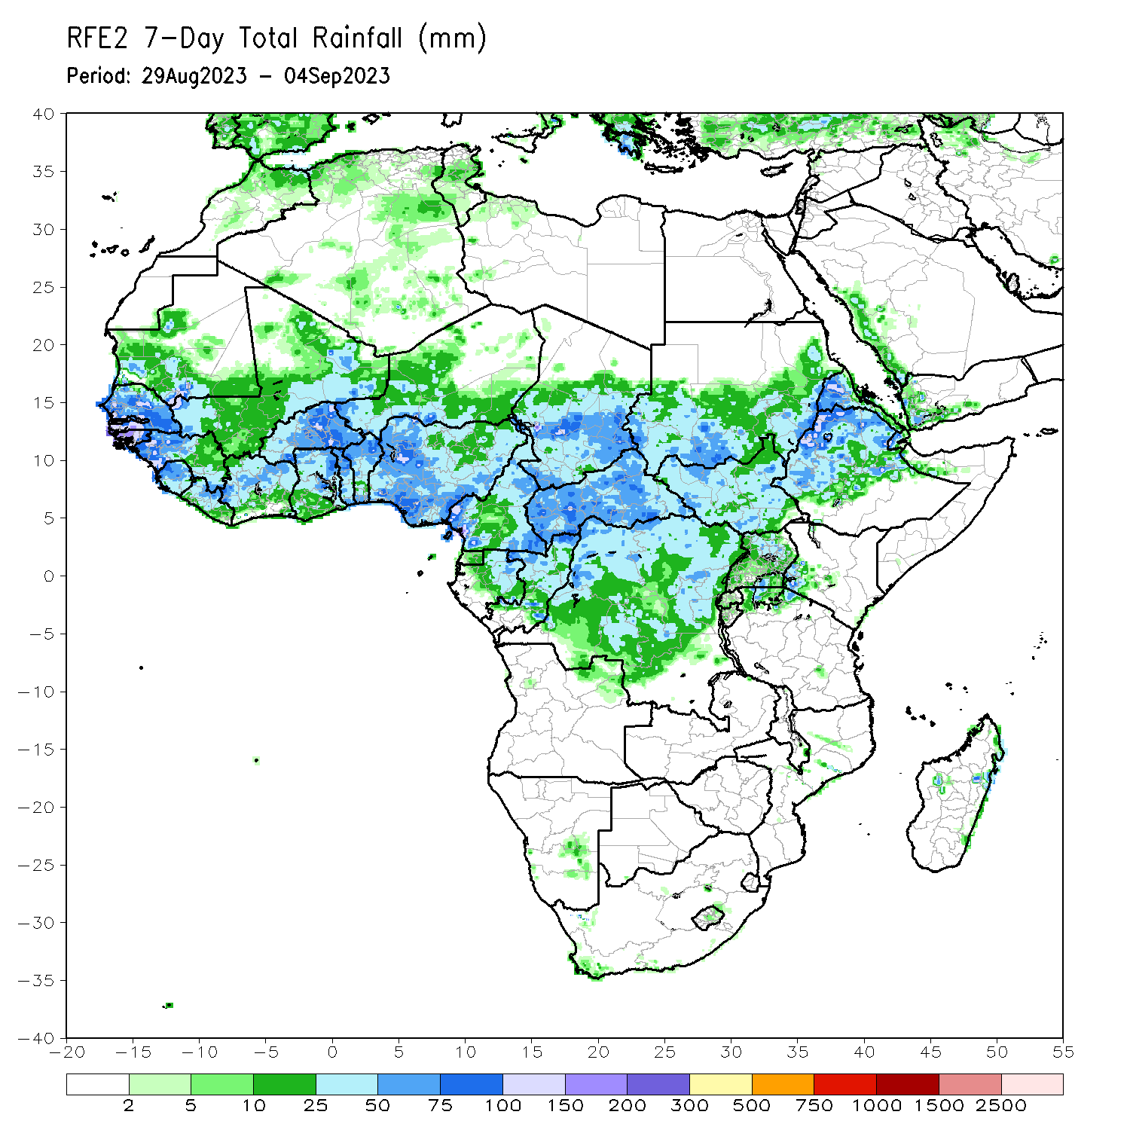
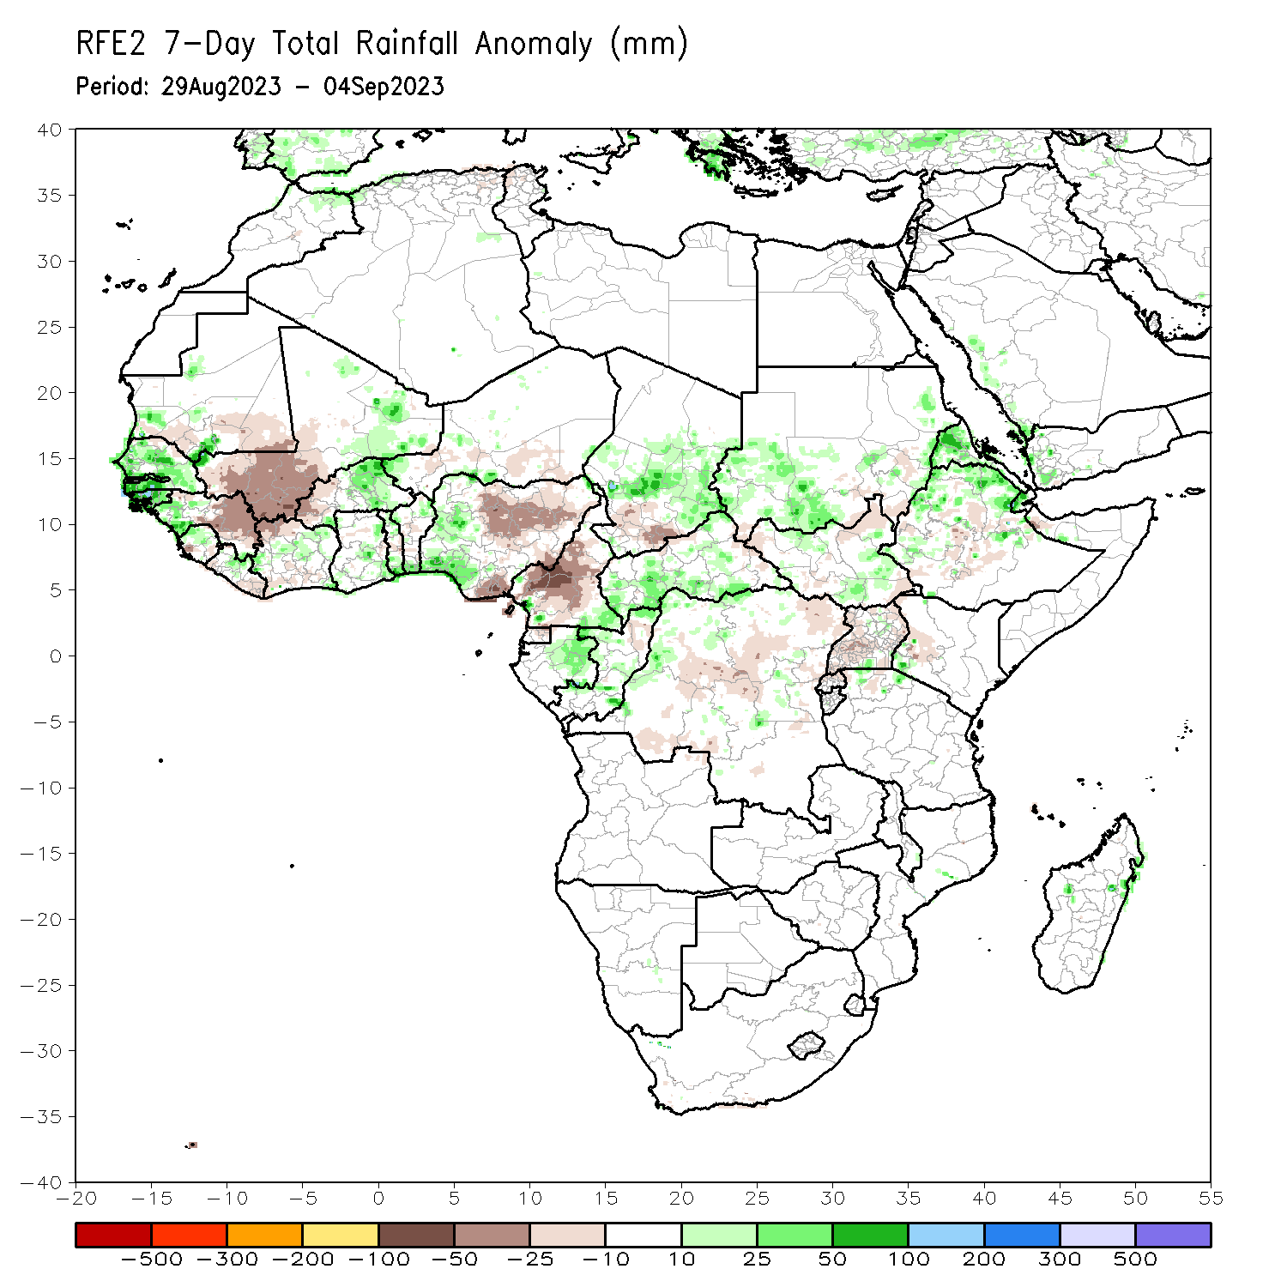
Rainfall Patterns: Last 7 Days
During the past 7 days, in East Africa, rainfall was above-average over eastern Sudan, north-central and east-central South Sudan, western Ethiopia, eastern Uganda, southwestern Kenya, and northern Tanzania. Below-average rainfall was observed over parts of southern Sudan, southern, northeastern, and northwestern South Sudan, and central Ethiopia. In Central Africa, rainfall was above-average over parts of southeastern Cameroon, southeastern Chad, parts of central CAR, central Congo, eastern Gabon, and west-central and east-central DRC. Below-average rainfall was observed over much of Cameroon, southwestern Chad, northern Congo, northern and central DRC, and western and parts of southeastern CAR. In West Africa, above-average rainfall was observed over much of Senegal, western Guinea-Bissau, southwestern and southeastern Guinea, southwestern Mauritania, eastern Mali, northern Sierra Leone, central Liberia, northeastern Cote d’Ivoire, much of Ghana, northern and southern Togo, southern Benin, and south-central and parts of central Niger. Rainfall was below-average over southeastern Mauritania, southwestern Mali, Burkina Faso, central Guinea. Eastern Guinea-Bissau, southern Sierra Leone, western and eastern Liberia, western Cote d’Ivoire, central Togo, northern Benin, western Niger, and most of Nigeria.

Slide 7
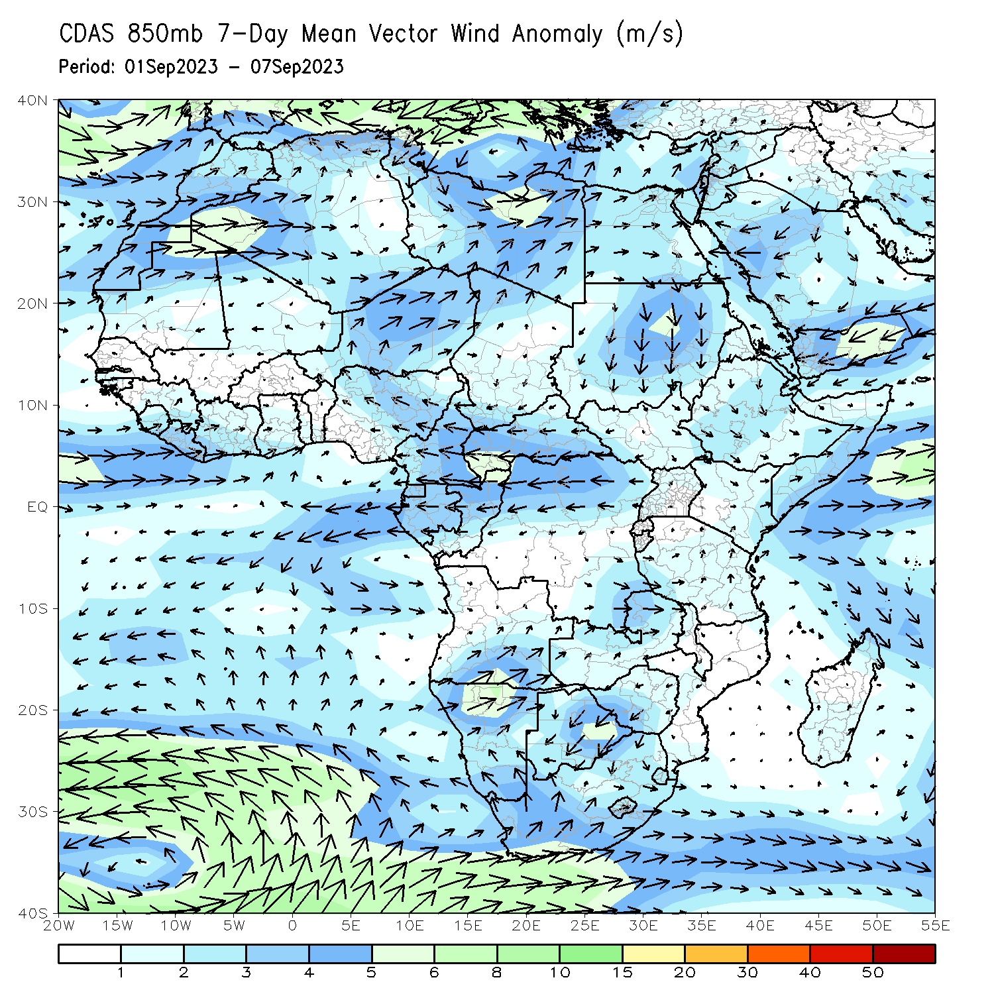
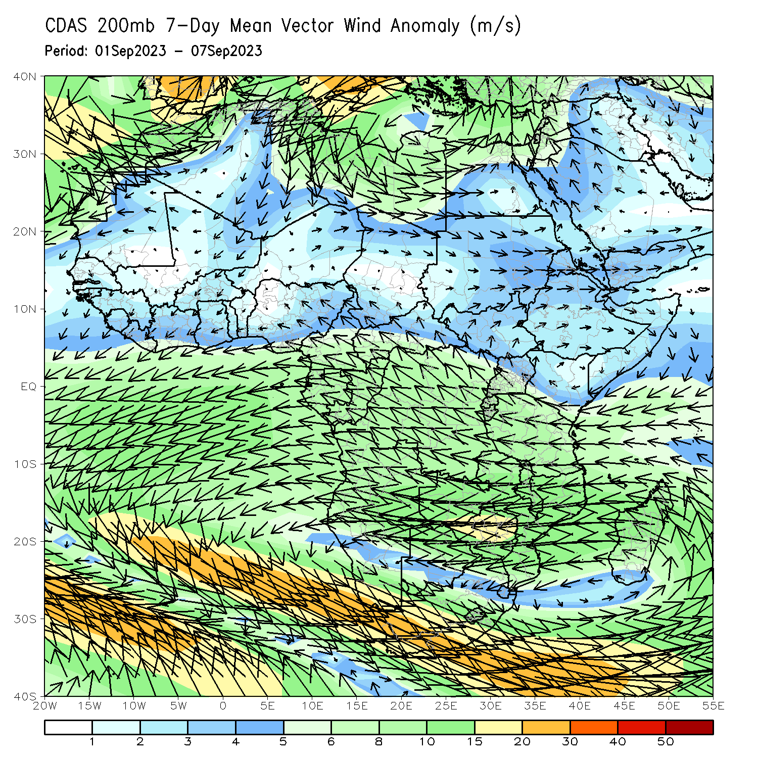
Atmospheric Circulation: Last 7 Days
At 850-hPa level (left panel), anomalous onshore flow and convergence was observed from castal Ghana to Nigeria. In contrast, the upper-level winds led to anomalous convergence in northwestern Nigeria, likely suppressing rainfall in that region.

Slide 8
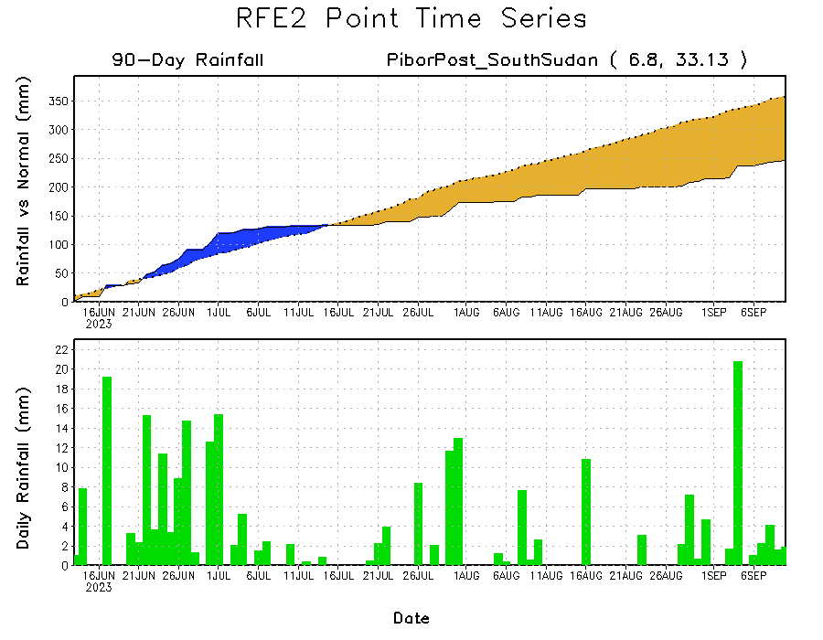
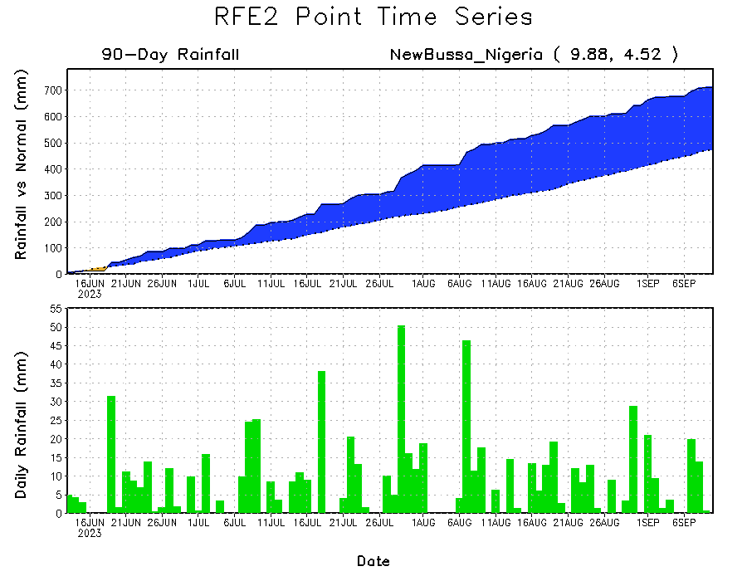
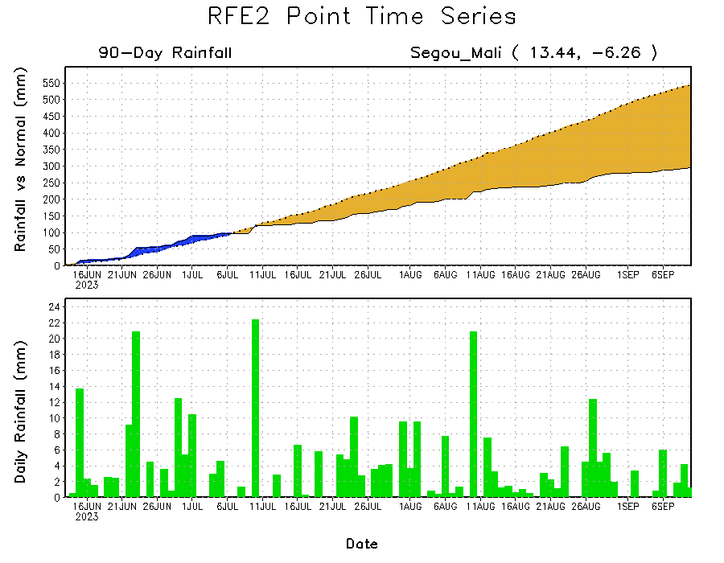
Rainfall Evolution
Daily evolution of rainfall over the last 90 days at selected locations shows moderate rainfall sustained moisture surpluses over parts of western Nigeria (bottom right). Seasonal total rainfall remained below-average over southwestern Mali (bottom left) and eastern South Sudan (top right).

Slide 9
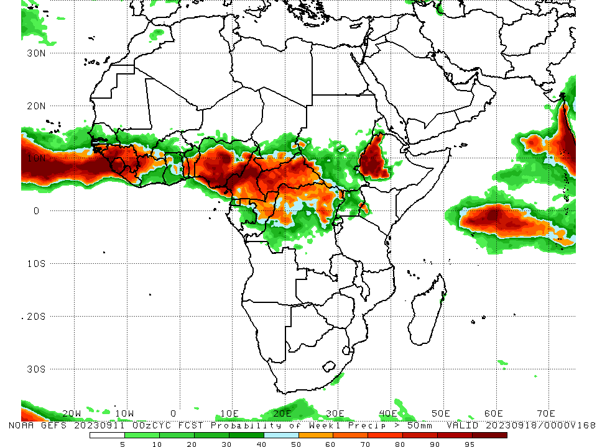
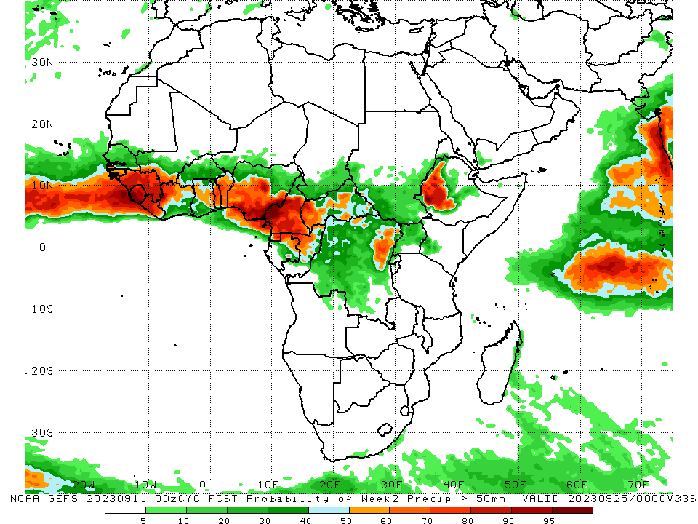
NCEP GEFS Model Forecasts Non-Bias Corrected Probability of precipitation exceedance
Week-1, Valid: 12 – 18 Sep 2023
Week-2, Valid: 19 – 25 Sep 2023
For week-1 (left panel) and week-2 (right panel), the GEFS forecasts indicate a moderate to high chance (over 70%) for rainfall to exceed 50 mm over much of the Gulf of Guinea region, parts of Central Africa (primarily Cameroon and parts of CAR and DRC), and western Ethiopia.
Notes:
9

Slide 10
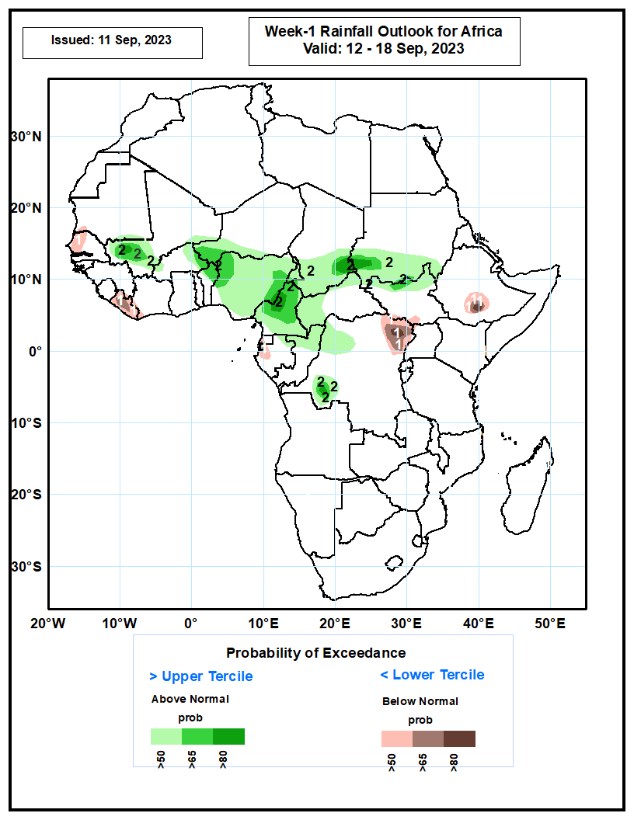
Week-1 Precipitation Outlooks
06 – 12 September 2023
The probabilistic forecasts call for above 50% chance for weekly total rainfall to be below-normal (below the lower tercile) over western Senegal, Liberia, southern Equatorial Guinea, western Gabon, northeast DRC, pockets of southwest South Sudan, and south-central Ethiopia. There is above 80% chance for rainfall to be below-normal over northeast DRC and south-central Ethiopia.
The probabilistic forecasts call for above 50% chance for weekly rainfall to be above-normal (above the upper tercile) over southern Mali, eastern Burkina Faso, southern Niger, many parts of Nigeria and Cameroon, southern Chad and Sudan, northern parts of South Sudan and Congo, northeast Gabon, western and northern CAR, northwest and southwest DRC. The probabilistic forecasts call for above 80% chance for weekly rainfall to be above-normal over pockets southern Mali and western Cameroon, southwest DRC, and near border of southern Chad and Sudan.
Notes:
10

Slide 11
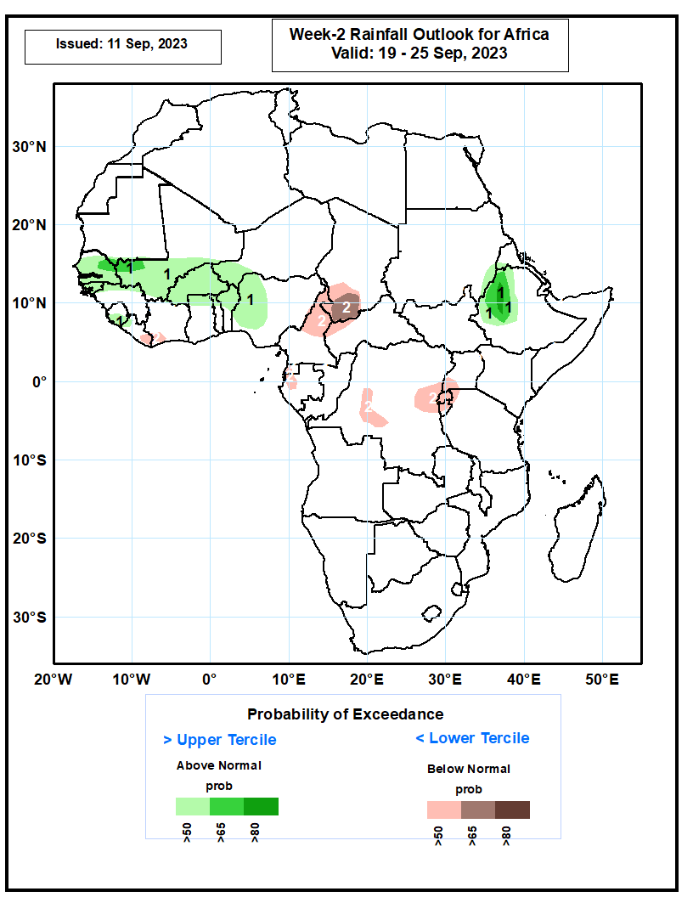
Week-2 Precipitation Outlooks
13 – 19 September 2023
The probabilistic forecasts call for above 50% chance for weekly rainfall to be above-normal (above the upper tercile) over Senegal, Guinea-Bissau, northern Guinea, southern Mali, Burkina Faso, northern parts of Ghana, Togo and Benin, southwest Niger, western Nigeria, western Ethiopia, pockets of southeast Sudan, and pockets of western Eritrea. The probabilistic forecasts call for above 80% chance for weekly rainfall to be above-normal over western Ethiopia.
The probabilistic forecasts call for above 50% chance for weekly total rainfall to be below-normal (below the lower tercile) over eastern Liberia, southwest Cote d’Ivoire, northern Cameroon, southern Chad, northwest CAR, western Equatorial Guinea, western Gabon, eastern and western-central DRC, Rwanda, Burundi, and southwest Uganda. There is above 65% chance for rainfall to be below-normal over southern Chad.
Notes:
11

Slide 12
Summary
Over the past 30 days, in East Africa, above-average rainfall was observed over many parts of eastern and southwestern Sudan, Eritrea, and pockets of northern Ethiopia, coastal and southwestern Kenya, and northern Tanzania. Rainfall was below-average over south-central Sudan, much South Sudan, central and southern Ethiopia, Rwanda, Uganda, northern Somalia, and parts of western Kenya. In Southern Africa, rainfall was above average over eastern Madagascar and below average over much of southern South Africa, Lesotho, and Eswatini. In Central Africa, rainfall was above-average over central Congo, central CAR, pockets of southeastern Chad, and northwestern and east-central DRC. Below-average rainfall was observed over much of Cameroon, central and southwestern Chad, Equatorial Guinea, and central and northeastern DRC. In West Africa, rainfall was above-average over pockets of southwestern Mauritania, Senegal, western Guinea, Guinea-Bissau, northern Sierra Leone, northeastern Burkina Faso, pockets of eastern Cote d’Ivoire and western Niger, central and southern Ghana, Togo, Benin, and western Nigeria. Below-average rainfall was observed over much of Mali, central and eastern Guinea, western and central Burkina Faso, southern Niger, northern Ghana, central and southern Sierra Leone, most of Liberia, northwestern Cote d’Ivoire, and northern, central, and eastern Nigeria.
During the past 7 days, in East Africa, rainfall was above-average over eastern Sudan, north-central and east-central South Sudan, western Ethiopia, eastern Uganda, southwestern Kenya, and northern Tanzania. Below-average rainfall was observed over parts of southern Sudan, southern, northeastern, and northwestern South Sudan, and central Ethiopia. In Central Africa, rainfall was above-average over parts of southeastern Cameroon, southeastern Chad, parts of central CAR, central Congo, eastern Gabon, and west-central and east-central DRC. Below-average rainfall was observed over much of Cameroon, southwestern Chad, northern Congo, northern and central DRC, and western and parts of southeastern CAR. In West Africa, above-average rainfall was observed over much of Senegal, western Guinea-Bissau, southwestern and southeastern Guinea, southwestern Mauritania, eastern Mali, northern Sierra Leone, central Liberia, northeastern Cote d’Ivoire, much of Ghana, northern and southern Togo, southern Benin, and south-central and parts of central Niger. Rainfall was below-average over southeastern Mauritania, southwestern Mali, Burkina Faso, central Guinea. Eastern Guinea-Bissau, southern Sierra Leone, western and eastern Liberia, western Cote d’Ivoire, central Togo, northern Benin, western Niger, and most of Nigeria.
The Week-1 outlook calls for above-normal rainfall in the central and eastern Gulf of Guinea region, as well as much of central Africa. This includes primarily eastern Guinea to southern Chad and CAR, as well as southern Sudan, western South Sudan, and western Ethiopia. In contrast, there is an increased chance for below-normal rainfall across parts of Senegal, Guinea-Bissau, Equatorial Guinea, Gabon, and the Lake Victoria region. For week-2, there is an increased chance for above-normal rainfall across portions of the Sahel, western and eastern Gulf of Guinea region, and northern and western Ethiopia. In contrast, there is an increased chance for below-normal rainfall in Equatorial Guinea, Gabon, and the Lake Victoria region.

