Slide 1
The African Monsoon Recent Evolution and Current Status Include Week-1 and Week-2 Outlooks
Update prepared
30 October 2023
For more information, visit:
http://www.cpc.ncep.noaa.gov/products/Global_Monsoons/African_Monsoons/precip_monitoring.shtml

Slide 2
Outline
Highlights
Recent Evolution and Current Conditions
NCEP GEFS Forecasts
Summary

Slide 3
Highlights: Last 7 Days
During the past 7 days, in East Africa, rainfall was above-average over parts of western, northern, central, and southern Ethiopia, western and central Eritrea, southern and central Somalia, southern Sudan, northern, central, and southwestern South Sudan, parts of northern and central Kenya, and parts of eastern Tanzania. Below-average rainfall was observed over Uganda, parts of central Kenya, parts of northern Tanzania, Rwanda, and far southeastern Somalia. In central Africa, above-average rainfall was observed over southeastern CAR, parts of northern, central, and western DRC, northern and central Congo, southern Gabon, and southwestern Cameroon. Rainfall was below-average over northern and western CAR, parts of northeastern DRC, northern and central Gabon, Equatorial Guinea, central and southeastern Cameroon, southern Chad, and parts of southern Congo. In West Africa, above-average rainfall was observed over parts of northwestern, southwestern, and southeastern Guinea, northern and central Sierra Leone, eastern Liberia, and parts of southern Cote d’Ivoire. Below-average rainfall was observed over parts of west-central Guinea, southern Sierra Leone, southwestern Liberia, northeastern Cote d’Ivoire, southwestern Burkina Faso, central and southern Ghana, Togo, central and southern Benin, and central and southern Nigeria. In southern Africa, rainfall was above-average over parts of north-central Angola, southeastern Zambia, west-central Mozambique, parts of eastern Zimbabwe, parts of west-central Malawi, southeastern South Africa, Eswatini, and parts of northern and central Madagascar. Rainfall was below-average over parts of east-central South Africa, south-central Madagascar, and pockets of northern and central Angola.
The Week-1 outlook calls for above-normal rainfall in most of the eastern Gulf of Guinea (southern Nigeria, central and southern Cameroon, Equatorial Guinea, and Gabon), all of central and eastern Africa (outside of parts of northeastern Ethiopia, central and eastern Eritrea, and much of Djibouti), northern Angola, northwestern Zambia, Botswana, central South Africa, Lesotho, and parts of central and eastern Madagascar. Southwestern Cameroon, northeastern DRC, and much of eastern Africa could see rainfall anomalies >50mm. In contrast, below-normal rainfall is expected across coastal portions of the western Gulf of Guinea region (Guinea to Liberia), southwestern Angola, northeastern Zambia, southwestern Tanzania, northern Malawi, southwestern South Africa, and parts of northeastern and western Madagascar. The Week-2 outlook calls for above-normal rainfall across the coastal Gulf of Guinea region, most of central and eastern Africa, eastern Angola, Zambia, Zimbabwe, southern Malawi, much of Mozambique, Eswatini, eastern South Africa, and much of eastern and northern Madagascar. Anomalies are expected to be largest (>50mm) across central Kenya. In contrast, below-normal rainfall is expected in parts of southwestern Gabon, southwestern Angola, and western Lesotho.

Slide 4
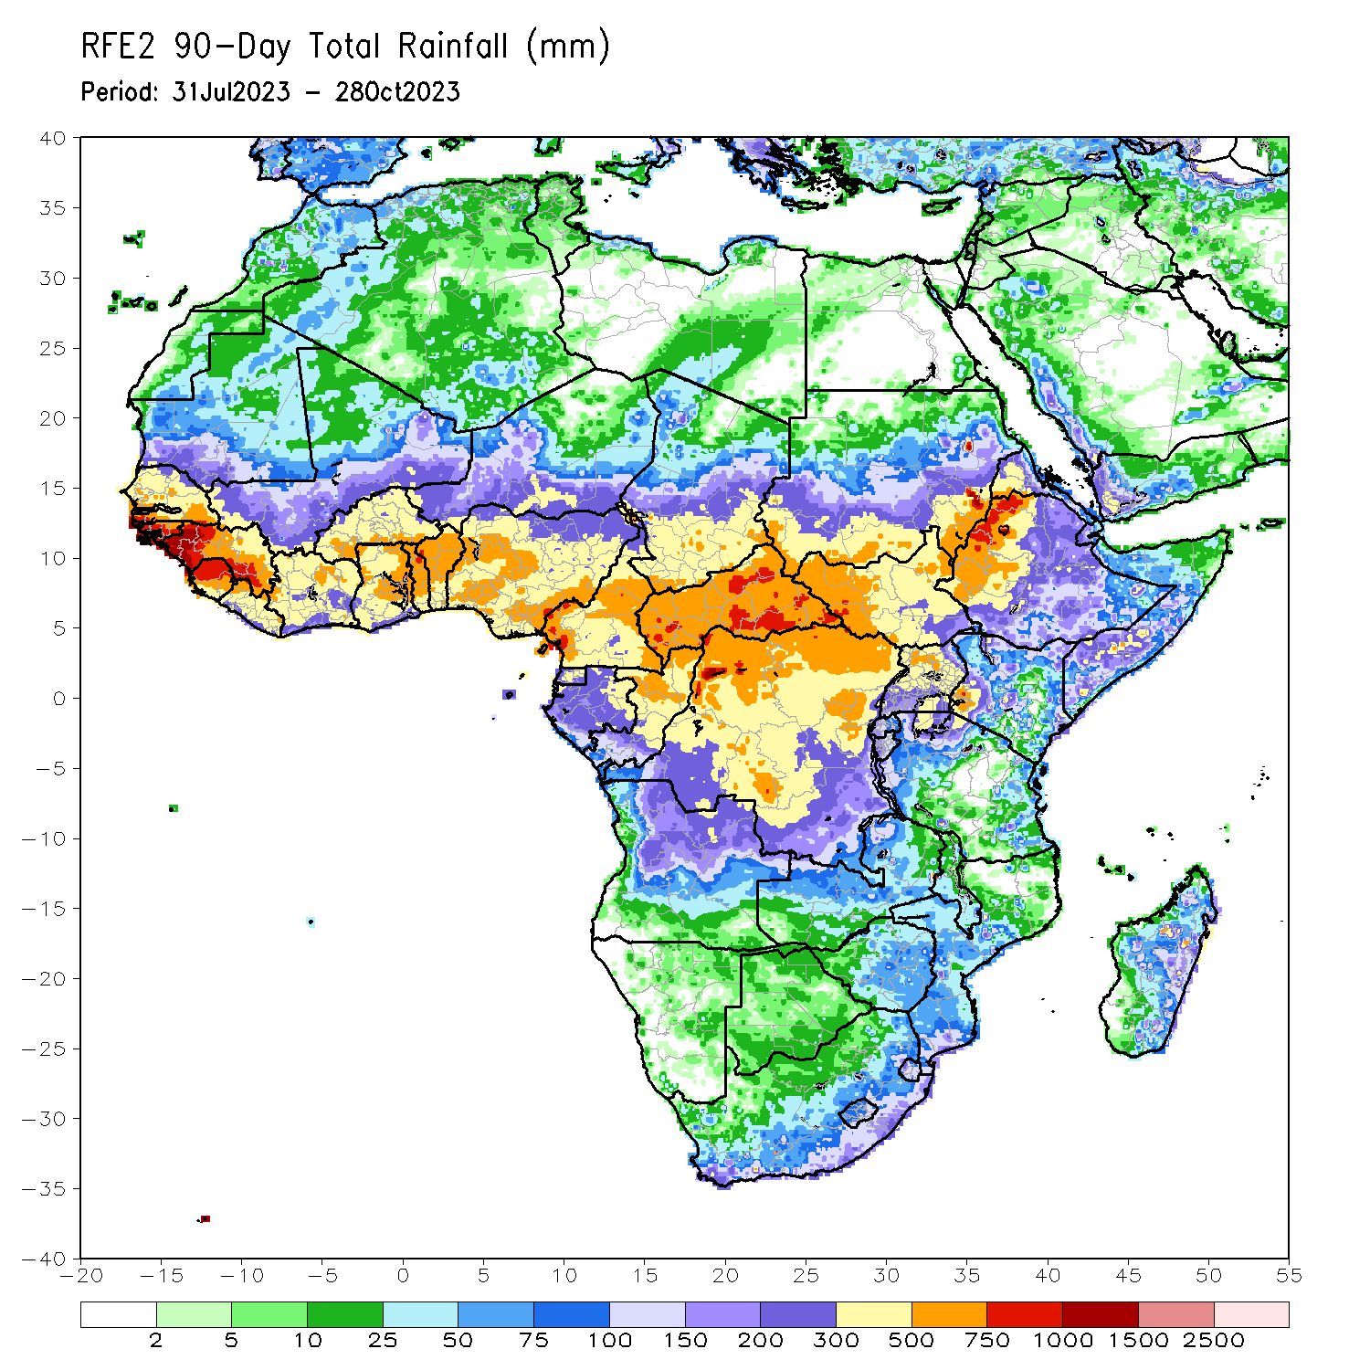
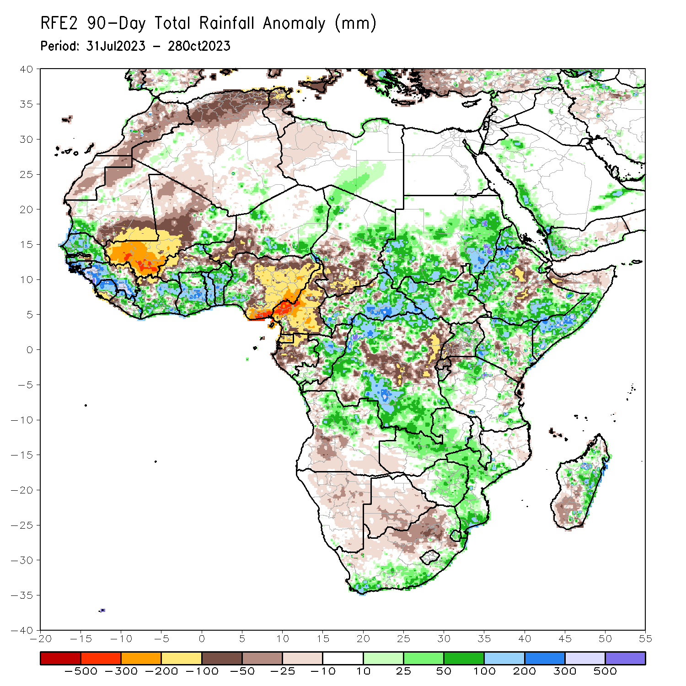
Rainfall Patterns: Last 90 Days
Over the past 90 days, in East Africa, above-average rainfall was observed over many parts of Sudan, western, northern, and southern Ethiopia, most of western and northeastern South Sudan, much of northern and central Uganda, Eritrea, western Djibouti, southern and central Somalia, parts of north-central and eastern Tanzania, western and southern Burundi, and parts of southwestern, southeastern, central, and northern Kenya. Rainfall was below-average over central and southeastern South Sudan, a small part of south-central Sudan, central Ethiopia, parts of northern Somalia, pockets of central and southern Kenya, Rwanda, northern Burundi, northwestern Tanzania, and southwestern Uganda. In southern Africa, above-average rainfall was observed over southern and eastern South Africa, Eswatini, southern and central Mozambique, much of northern Angola, northern and central Zambia, central and eastern Zimbabwe, central and southern Malawi, and parts of eastern and central Madagascar. Below-average rainfall was observed over northern South Africa, parts of central and southern Angola, Namibia, Botswana, southwestern Zambia, and southwestern Madagascar. In Central Africa, rainfall was above-average over many parts of CAR, eastern and northwestern Chad, much of central and far northern Congo, northeastern Gabon, far southeastern Cameroon, and northern, western, and much of southern DRC. Rainfall was below-average over much of Cameroon, Equatorial Guinea, most of Gabon, parts of northern and southern Congo, parts of central, northeastern, and southwestern DRC, pockets of northern and central CAR, and central and southwestern Chad. In West Africa, rainfall was above-average over much of Senegal, southwestern Mauritania, western and central portions of The Gambia, Guinea-Bissau, western and southern Guinea, northern and central Sierra Leone, eastern and northwestern Liberia, eastern Mali, much of Cote d’Ivoire, southern and northeastern Burkina Faso, much of Ghana, Togo, Benin, parts of northwestern and southeastern, and eastern Niger, and western Nigeria. Below-average rainfall was observed over western, central, and northern Mali, much of northeastern Guinea, southern Sierra Leone, southwestern Liberia, northwestern Cote d’Ivoire, western and central Burkina Faso, parts of southwestern and central Niger, southeastern and northern Mauritania, eastern portions of The Gambia, and central, northern, and eastern Nigeria.
Notes:
4

Slide 5
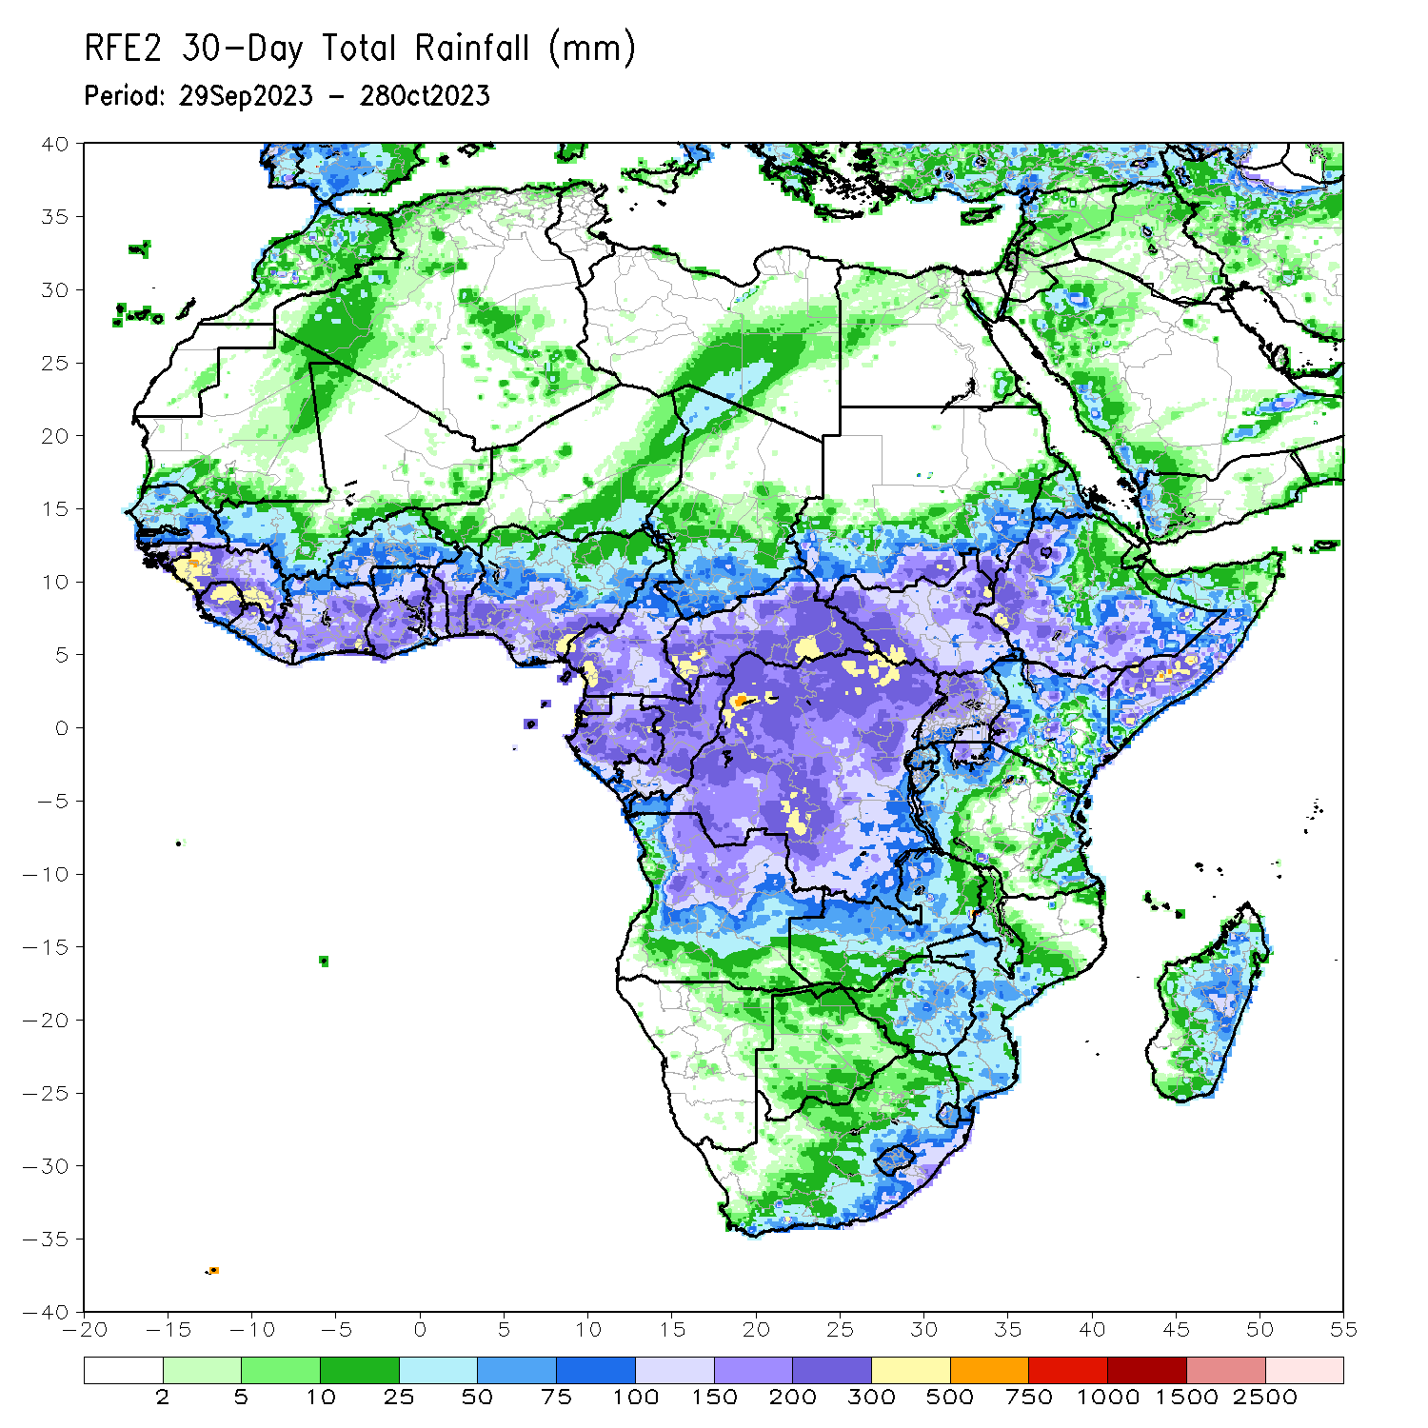
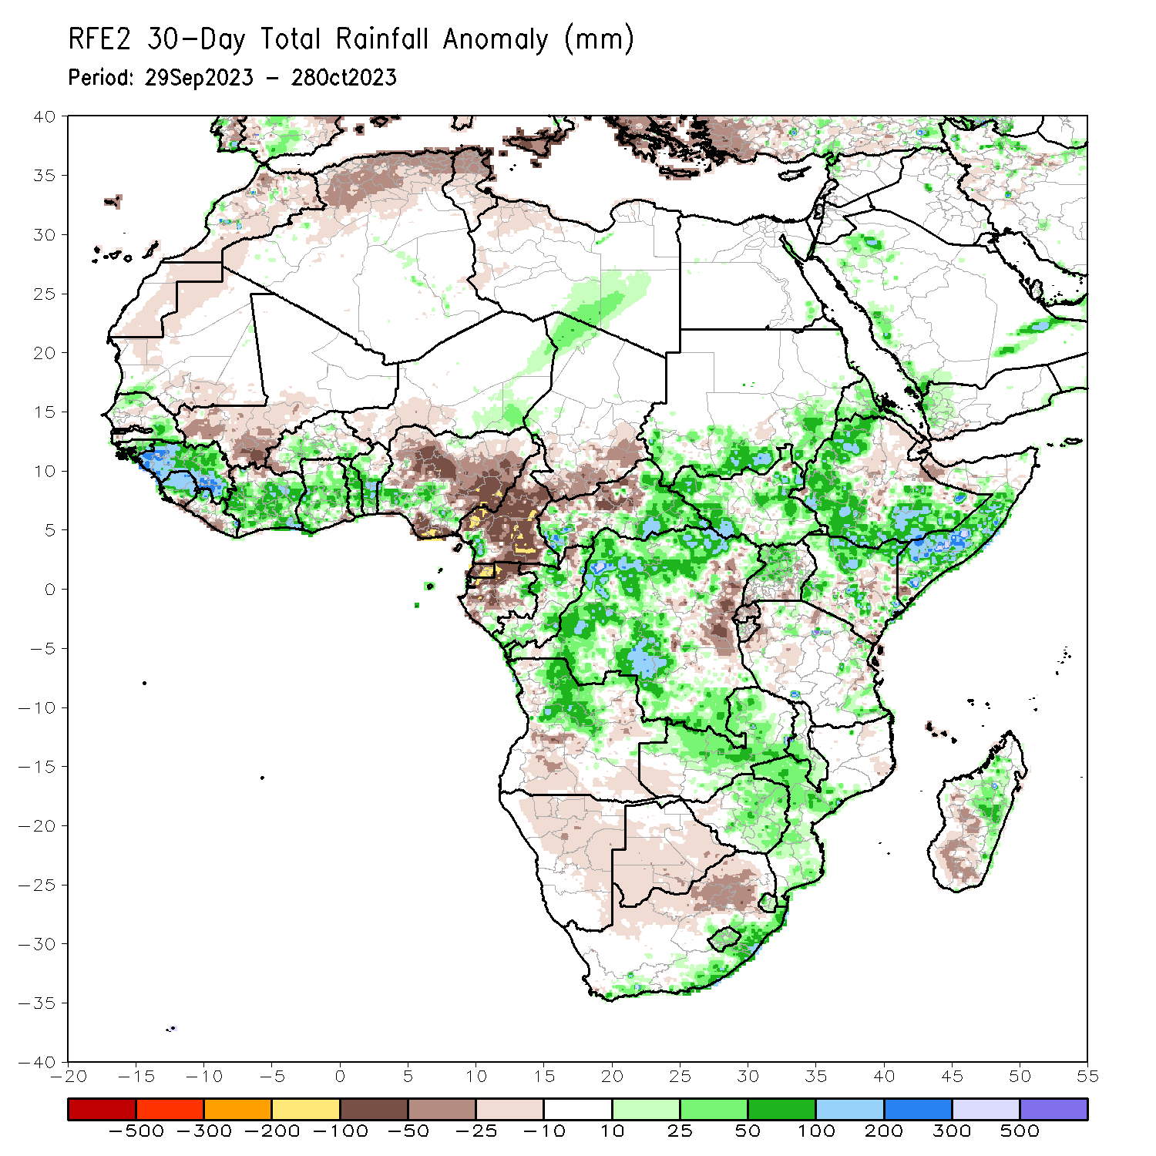
Rainfall Patterns: Last 30 Days
Over the past 30 days, in East Africa, above-average rainfall was observed over southern Sudan, most of western, eastern, and southern South Sudan, western Eritrea, northern, western, and southern Ethiopia, northern and central Uganda, northern, southwestern, and parts of central and southeastern Kenya, southern and central Somalia, western Burundi, and parts of northern and eastern Tanzania. Rainfall was below-average over much of central and eastern Ethiopia, southern Uganda, Rwanda, eastern and central Burundi, northwestern Somalia, eastern Djibouti, pockets of central and southern Kenya, and parts of northeastern South Sudan. In Central Africa, rainfall was above-average over much of Congo, parts of southeastern and southwestern Cameroon, parts of west-central and northwestern Chad, parts of eastern and southern Gabon, eastern, southern, and western CAR, and southern, northern, western, and central DRC. Below-average rainfall was observed over much of Cameroon, Equatorial Guinea, northern, central, and western Gabon, parts of northwestern Congo, southern Chad, northern and parts of central CAR, and east-central DRC. In West Africa, rainfall was above-average over pockets of northern and southern Senegal, Guinea, Guinea-Bissau, northern and central Sierra Leone, northwestern and parts of central and eastern Liberia, northeastern, central, and southern Cote d’Ivoire, parts of central and southern Burkina Faso, most of Ghana, Togo, most of Benin, parts of southern Nigeria, southeastern and northeastern Niger, and southwestern Mauritania. Below-average rainfall was observed over southeastern Mauritania, southwestern and central Mali, parts of southern Sierra Leone, northwestern Cote d’Ivoire, western Burkina Faso, western Niger, parts of southeastern Ghana, and central, eastern, and most of coastal Nigeria. In southern Africa, above-average rainfall was observed over much of northern Angola, northern and central Zambia, eastern and central Zimbabwe, Malawi, central and southern Mozambique, Lesotho, Eswatini, southern South Africa, and parts of eastern and central Madagascar. Rainfall was below-average over southern and eastern Angola, western Zambia, northern and eastern Namibia, Botswana, northern South Africa, and parts of central and southern Madagascar.
Notes:
5

Slide 6
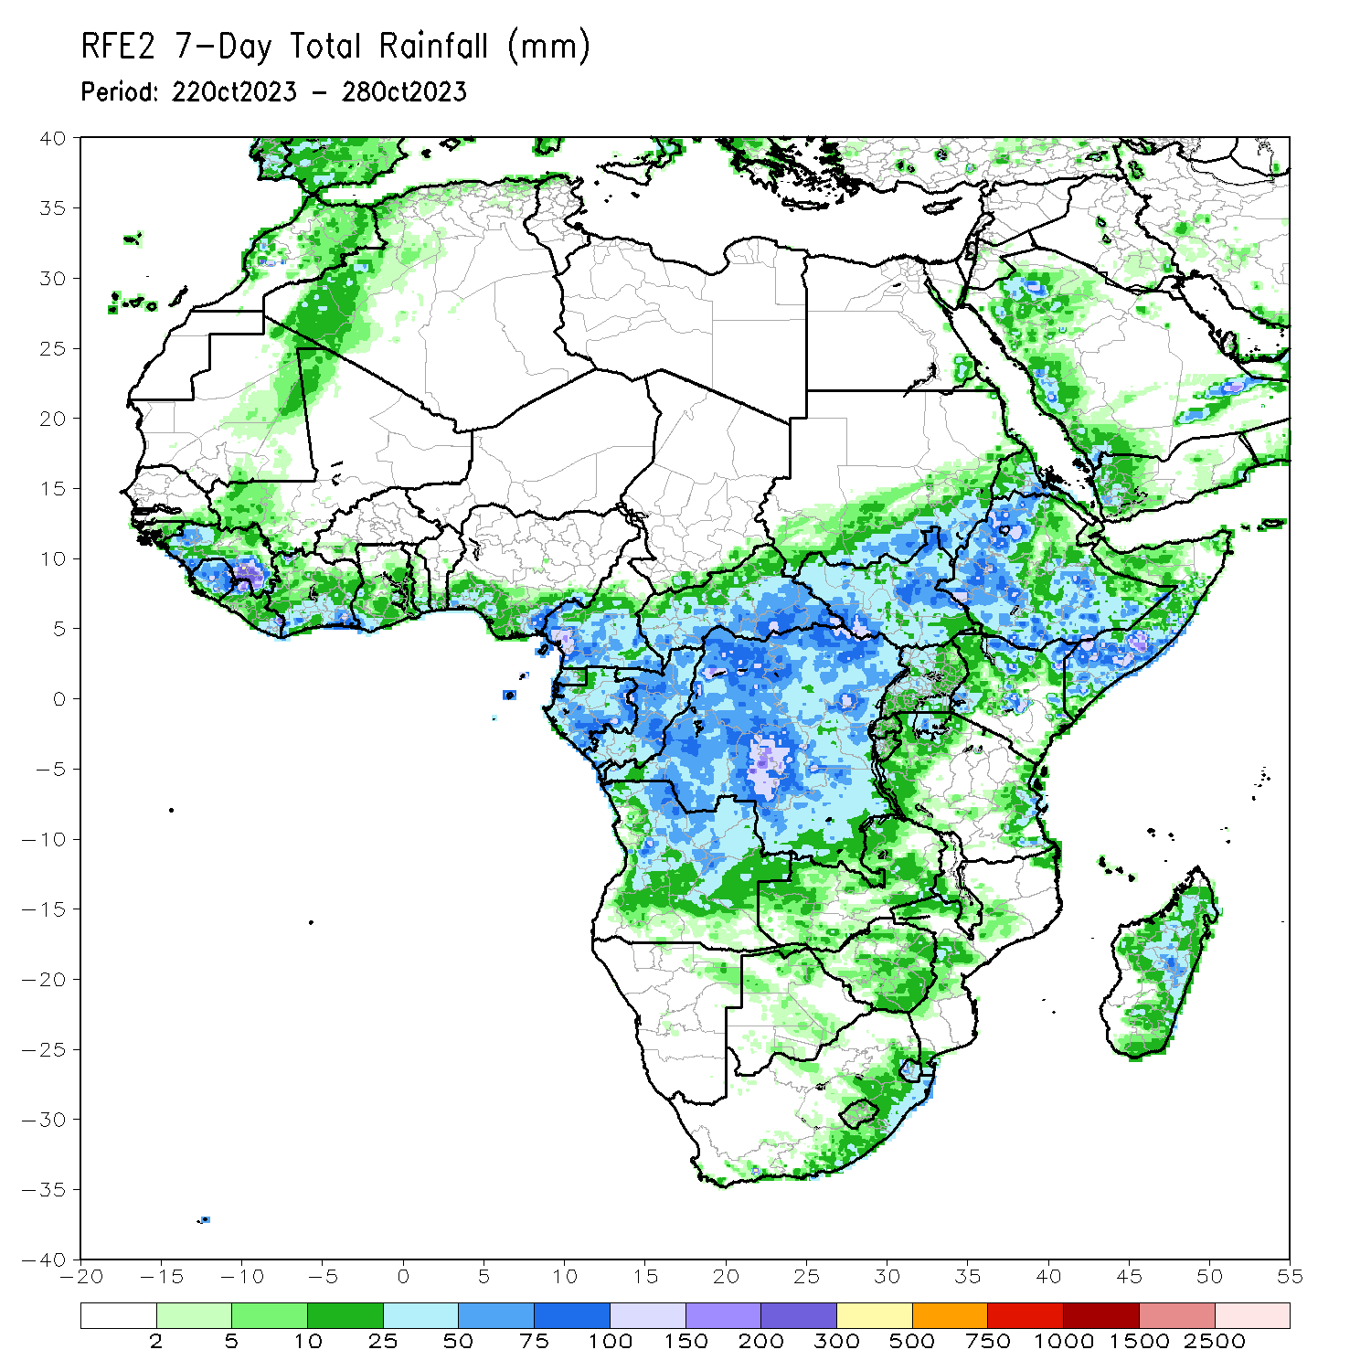
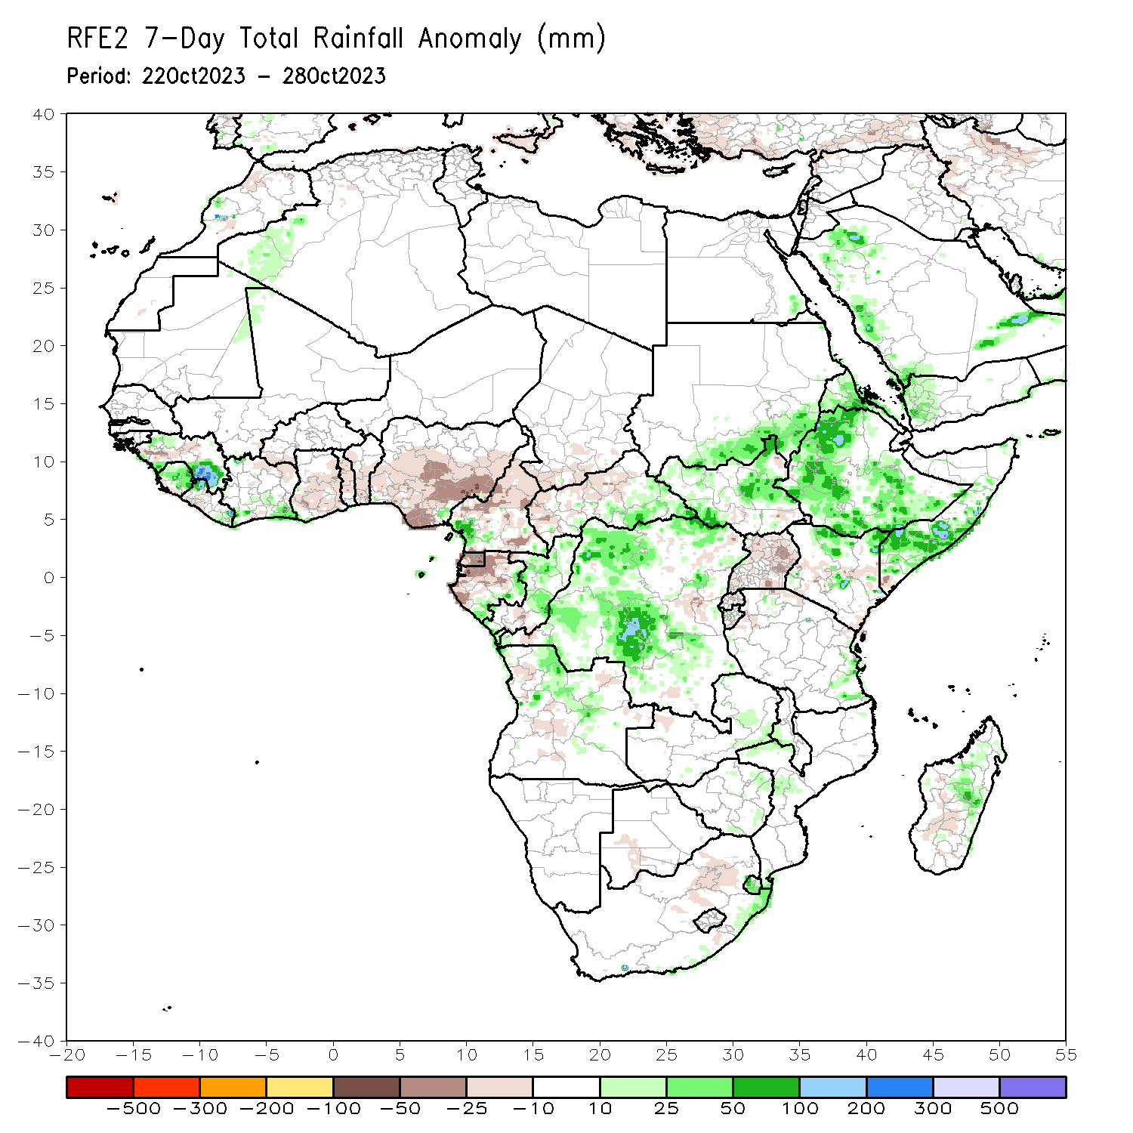
Rainfall Patterns: Last 7 Days
During the past 7 days, in East Africa, rainfall was above-average over parts of western and southern Ethiopia, southern Sudan, western and southern South Sudan, much of Uganda, southwestern Kenya, western Burundi, and parts of northwestern and southeastern Tanzania. Below-average rainfall was observed over southern Somalia, eastern Kenya, and northeastern South Sudan. In central Africa, above-average rainfall was observed over parts of south-central Chad, northwestern, southern, and eastern CAR, much of DRC, southern and eastern Congo, parts of western and eastern Gabon, and southwestern Cameroon. Rainfall was below-average over parts of southwestern CAR, central and northwestern Congo, northern and southeastern Gabon, Equatorial Guinea, and much of Cameroon. In West Africa, above-average rainfall was observed over parts of northwestern and southern Senegal, Guinea-Bissau, western and central Guinea, northern and central Sierra Leone, southern, central, and northeastern Cote d’Ivoire, parts of central Burkina Faso, southern and central Ghana, Togo, central and southern Benin, parts of southern and central Nigeria, and parts of southwestern Mali. Below-average rainfall was observed over parts of southwestern Mali, southern Sierra Leone, much of Liberia, northwestern Cote d’Ivoire, northeastern Benin, southwestern Burkina Faso, and central Nigeria. In southern Africa, rainfall was above-average over parts of south-central and central South Africa, Lesotho, northeastern and central Angola, northern Zambia, southern Zimbabwe, and parts of southern Mozambique.

Slide 7
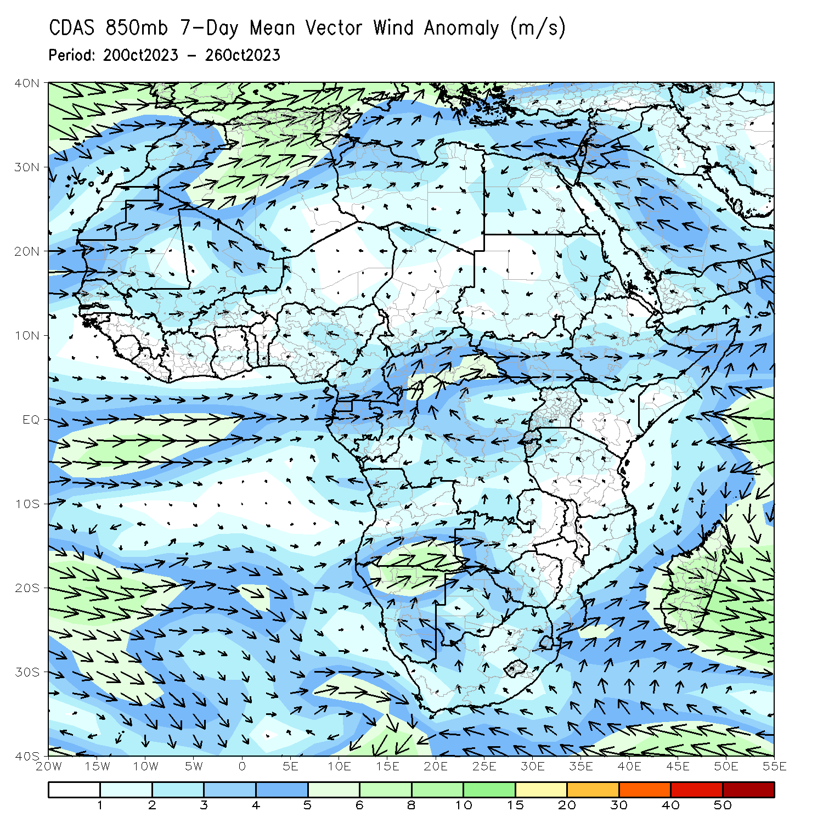
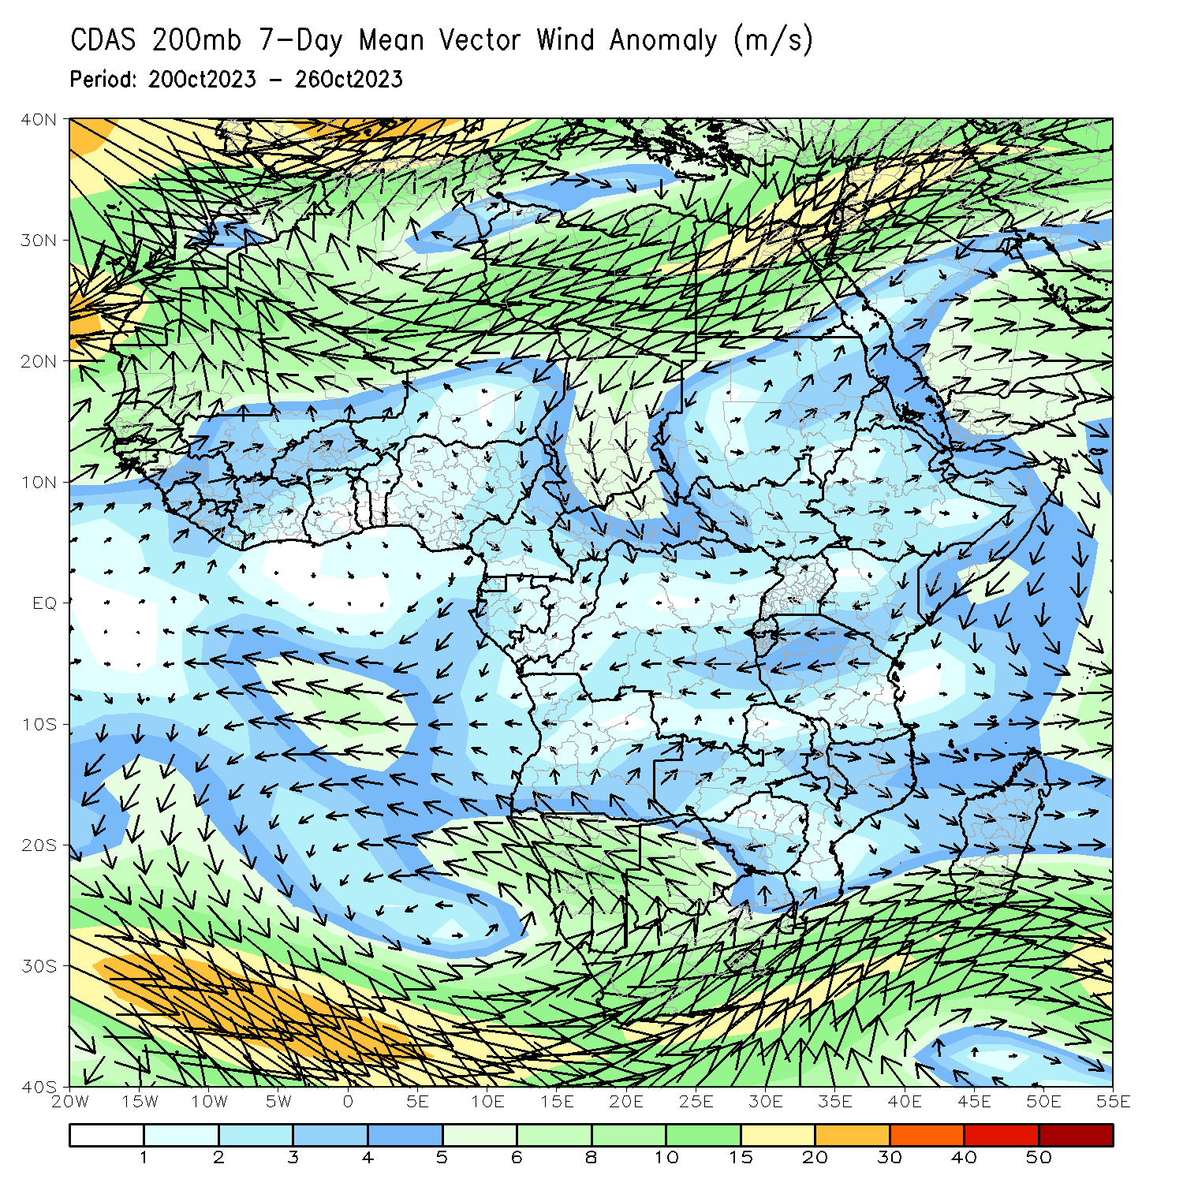
Atmospheric Circulation: Last 7 Days
At 850-hPa level (left panel), anomalous low-level convergence may have contributed to the observed above-average rainfall in DRC, Congo, Eritrea, and Ethiopia. At 200-hPa, anomalous upper level divergence likely contributed to the above average precipitation from Sudan to Ethiopia, while upper level convergence likely contributed to below-average precipitation in western Nigeria, central Cameroon, and western and central CAR.

Slide 8
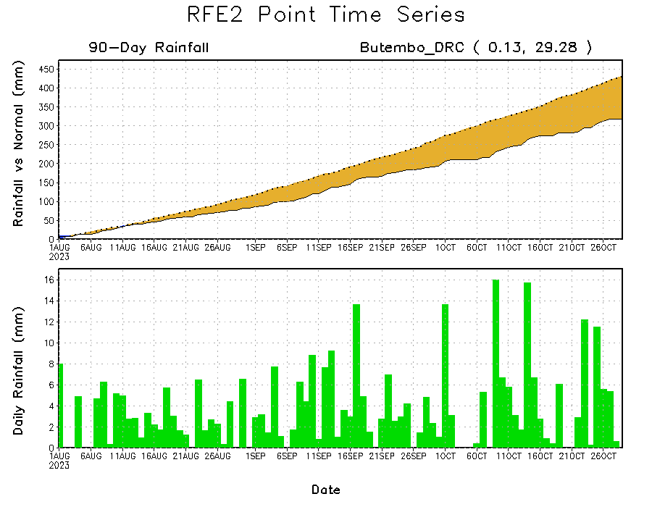
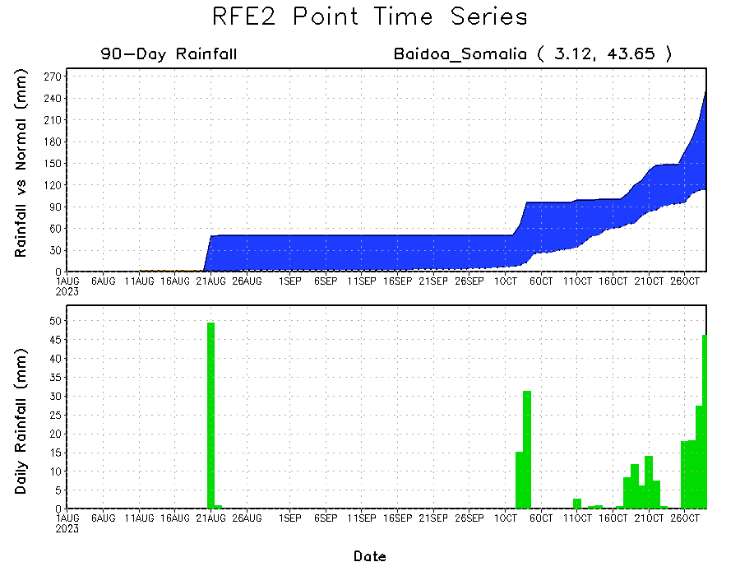
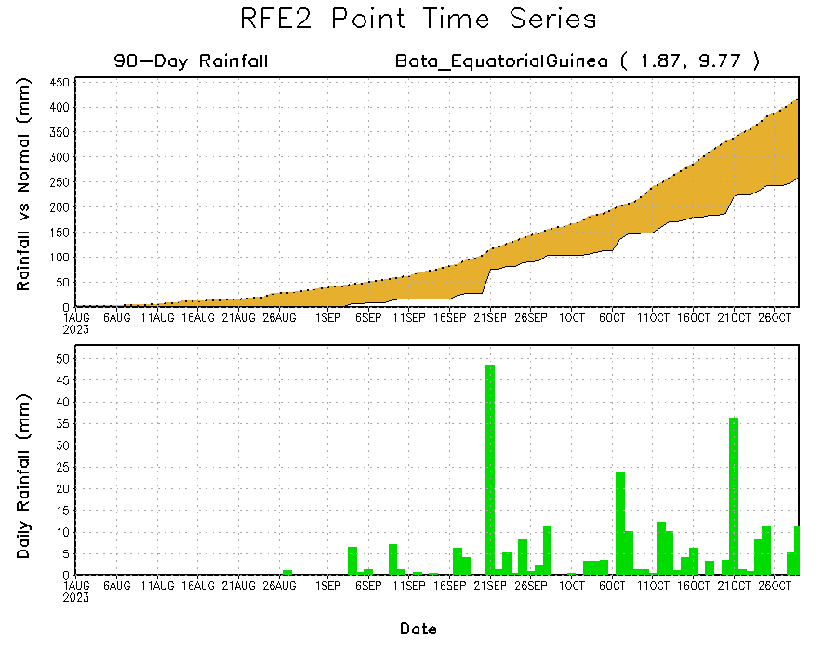
Rainfall Evolution
Daily evolution of rainfall over the last 90 days at selected locations shows light rainfall increased moisture deficits over parts of Equatorial Guinea (bottom left). Seasonal total rainfall remained below-average over northeastern DRC due to the recent below average rainfall (top right). The recent heavy rainfall also increased surpluses early in the rainfall season over southern Somalia (bottom right).

Slide 9
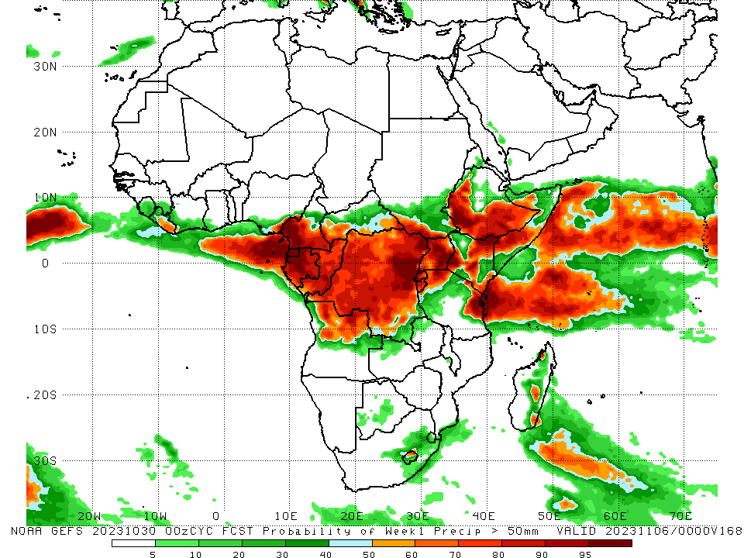
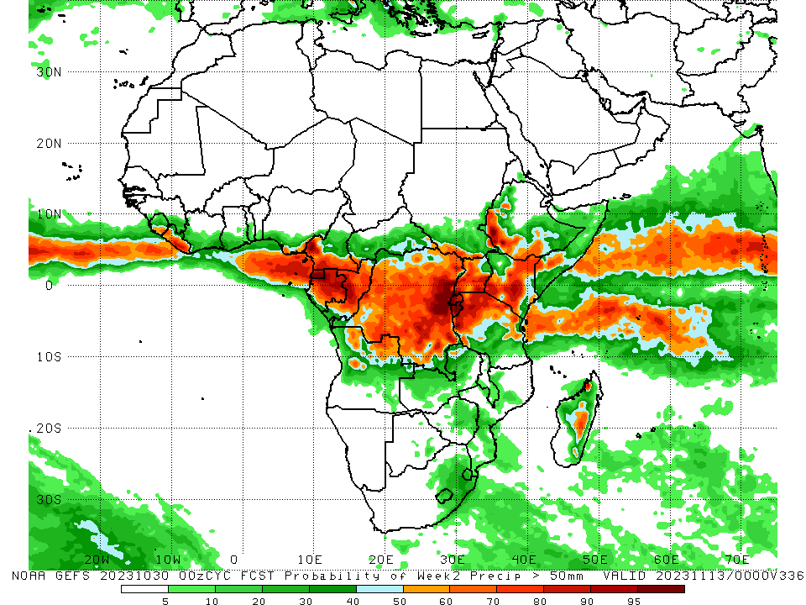
NCEP GEFS Model Forecasts Non-Bias Corrected Probability of precipitation exceedance
Week-1, Valid: 31 Oct – 06 Nov 2023
Week-2, Valid: 07 – 13 Nov 2023
For week-1 (left panel) the GEFS forecasts indicate a moderate to high chance (over 70%) for rainfall to exceed 50 mm over the eastern Gulf of Guinea region (southeastern Nigeria, southern Cameroon to Gabon), Congo, most of DRC (outside of far southeastern portions of the country), Rwanda, Burundi, Uganda, southern and northeastern South Sudan, southwestern and southeastern CAR, western and southern Ethiopia, parts of southern Somalia, southwestern, southeastern, central, and northeastern Kenya, parts of northwestern and northeastern Tanzania, much of northern Angola, and parts of southeastern and northwestern Madagascar. For week-2 (right panel), the GEFS forecasts indicate a moderate to high chance (over 70%) for rainfall to exceed 50 mm over much of southern Liberia, Equatorial Guinea, much of Gabon, central and parts of northern Congo, southern Cameroon, parts of central (especially east-central), southern, and northeastern DRC, Rwanda, Burundi, central and southern Uganda, northern Tanzania, northeastern Angola, southwestern, central, and northeastern Kenya, parts of southern Somalia, southwestern Ethiopia, and parts of central and northwestern Madagascar.
Notes:
9

Slide 10
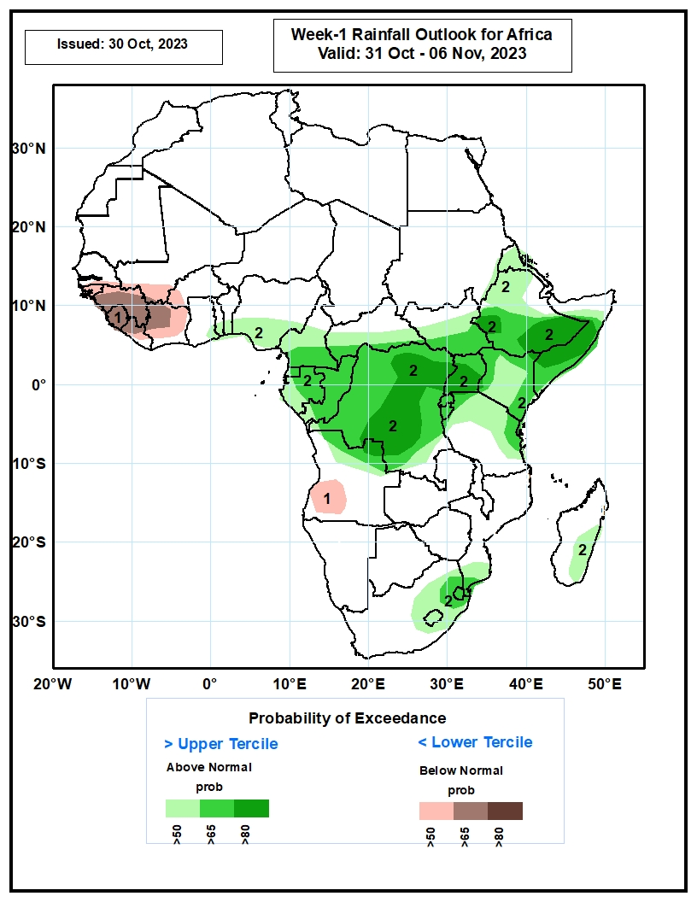
Week-1 Precipitation Outlooks
31 Oct – 06 Nov 2023
The probabilistic forecasts call for below 50% chance for weekly rainfall to be above-normal (below the lower tercile) over western portion of the Gulf of Guinea region. There is above 65% chance for below-normal rainfall over Guinea, Sierra Leone, northwestern Liberia and western Cote d’Ivoire.
The forecasts call for above 50% chance for weekly total rainfall to be above-normal (above the upper tercile) across the far eastern Gulf of Guinea region, many places in Central Africa, eastern South Africa, Eswatini, and eastern Madagascar. There is above 80% chance for above-normal rainfall over parts of central and eastern DRC, Uganda, southern Ethiopia and central Somalia.
Notes:
10

Slide 11
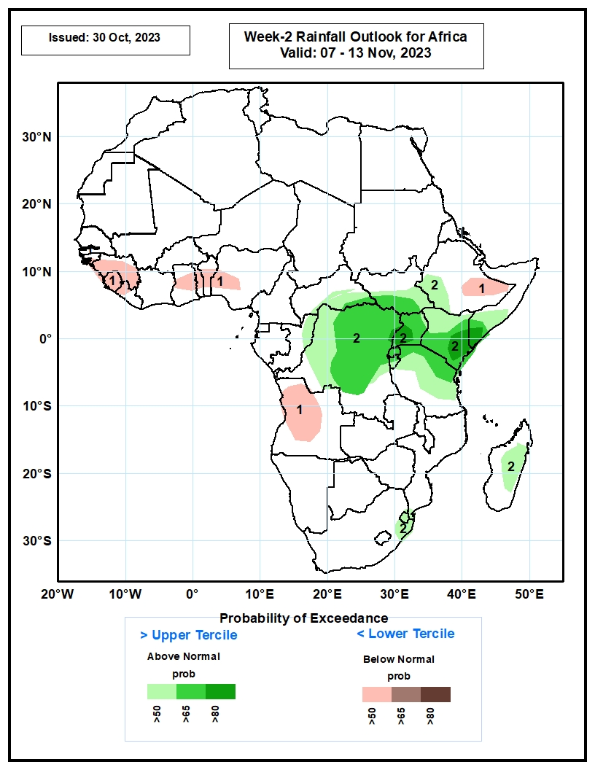
Week-2 Precipitation Outlooks
07 – 13 Nov 2023
The probabilistic forecasts call for above 50% chance for weekly rainfall to be below-normal (below the lower tercile) over portion of the Gulf of Guinea region, southeastern Ethiopia, and western Angola.
The forecasts call for above 50% chance for weekly total rainfall to be above-normal (above the upper tercile) over northern Congo, much of DRC, Rwanda, Burundi, Uganda, eastern South Sudan, southwestern Ethiopia, Kenya, Tanzania and southern Somalia. There is above 80% chance above-normal rainfall near Kenya/Somalia border.
Notes:
11

Slide 12
Summary
Over the past 30 days, in East Africa, above-average rainfall was observed over southern Sudan, most of western, eastern, and southern South Sudan, western Eritrea, northern, western, and southern Ethiopia, northern and central Uganda, northern, southwestern, and parts of central and southeastern Kenya, southern and central Somalia, western Burundi, and parts of northern and eastern Tanzania. Rainfall was below-average over much of central and eastern Ethiopia, southern Uganda, Rwanda, eastern and central Burundi, northwestern Somalia, eastern Djibouti, pockets of central and southern Kenya, and parts of northeastern South Sudan. In Central Africa, rainfall was above-average over much of Congo, parts of southeastern and southwestern Cameroon, parts of west-central and northwestern Chad, parts of eastern and southern Gabon, eastern, southern, and western CAR, and southern, northern, western, and central DRC. Below-average rainfall was observed over much of Cameroon, Equatorial Guinea, northern, central, and western Gabon, parts of northwestern Congo, southern Chad, northern and parts of central CAR, and east-central DRC. In West Africa, rainfall was above-average over pockets of northern and southern Senegal, Guinea, Guinea-Bissau, northern and central Sierra Leone, northwestern and parts of central and eastern Liberia, northeastern, central, and southern Cote d’Ivoire, parts of central and southern Burkina Faso, most of Ghana, Togo, most of Benin, parts of southern Nigeria, southeastern and northeastern Niger, and southwestern Mauritania. Below-average rainfall was observed over southeastern Mauritania, southwestern and central Mali, parts of southern Sierra Leone, northwestern Cote d’Ivoire, western Burkina Faso, western Niger, parts of southeastern Ghana, and central, eastern, and most of coastal Nigeria. In southern Africa, above-average rainfall was observed over much of northern Angola, northern and central Zambia, eastern and central Zimbabwe, Malawi, central and southern Mozambique, Lesotho, Eswatini, southern South Africa, and parts of eastern and central Madagascar. Rainfall was below-average over southern and eastern Angola, western Zambia, northern and eastern Namibia, Botswana, northern South Africa, and parts of central and southern Madagascar.
During the past 7 days, in East Africa, rainfall was above-average over parts of western and southern Ethiopia, southern Sudan, western and southern South Sudan, much of Uganda, southwestern Kenya, western Burundi, and parts of northwestern and southeastern Tanzania. Below-average rainfall was observed over southern Somalia, eastern Kenya, and northeastern South Sudan. In central Africa, above-average rainfall was observed over parts of south-central Chad, northwestern, southern, and eastern CAR, much of DRC, southern and eastern Congo, parts of western and eastern Gabon, and southwestern Cameroon. Rainfall was below-average over parts of southwestern CAR, central and northwestern Congo, northern and southeastern Gabon, Equatorial Guinea, and much of Cameroon. In West Africa, above-average rainfall was observed over parts of northwestern and southern Senegal, Guinea-Bissau, western and central Guinea, northern and central Sierra Leone, southern, central, and northeastern Cote d’Ivoire, parts of central Burkina Faso, southern and central Ghana, Togo, central and southern Benin, parts of southern and central Nigeria, and parts of southwestern Mali. Below-average rainfall was observed over parts of southwestern Mali, southern Sierra Leone, much of Liberia, northwestern Cote d’Ivoire, northeastern Benin, southwestern Burkina Faso, and central Nigeria. In southern Africa, rainfall was above-average over parts of south-central and central South Africa, Lesotho, northeastern and central Angola, northern Zambia, southern Zimbabwe, and parts of southern Mozambique.
The Week-1 outlook calls for above-normal rainfall in most of the eastern Gulf of Guinea (southern Nigeria, central and southern Cameroon, Equatorial Guinea, and Gabon), all of central and eastern Africa (outside of parts of northeastern Ethiopia, central and eastern Eritrea, and much of Djibouti), northern Angola, northwestern Zambia, Botswana, central South Africa, Lesotho, and parts of central and eastern Madagascar. Southwestern Cameroon, northeastern DRC, and much of eastern Africa could see rainfall anomalies >50mm. In contrast, below-normal rainfall is expected across coastal portions of the western Gulf of Guinea region (Guinea to Liberia), southwestern Angola, northeastern Zambia, southwestern Tanzania, northern Malawi, southwestern South Africa, and parts of northeastern and western Madagascar. The Week-2 outlook calls for above-normal rainfall across the coastal Gulf of Guinea region, most of central and eastern Africa, eastern Angola, Zambia, Zimbabwe, southern Malawi, much of Mozambique, Eswatini, eastern South Africa, and much of eastern and northern Madagascar. Anomalies are expected to be largest (>50mm) across central Kenya. In contrast, below-normal rainfall is expected in parts of southwestern Gabon, southwestern Angola, and western Lesotho.

