Slide 1
The African Monsoon Recent Evolution and Current Status Include Week-1 and Week-2 Outlooks
Update prepared
13 November 2023
For more information, visit:
http://www.cpc.ncep.noaa.gov/products/Global_Monsoons/African_Monsoons/precip_monitoring.shtml

Slide 2
Outline
Highlights
Recent Evolution and Current Conditions
NCEP GEFS Forecasts
Summary

Slide 3
Highlights: Last 7 Days
During the past 7 days, rainfall continued unabated in eastern Africa and intensified over parts of Central Africa and central portions of the Gulf of Guinea countries. In East Africa, rainfall was above-average over western Ethiopia extending from southwestern to northwestern regions, over southeastern Ethiopia, northeastern South Sudan, much of Kenya, southern and central Somalia, and western and eastern Tanzania. Locally heavy rainfall amounts in excess of 100 mm, even more at places, were observed in parts of southern Somalia, eastern Kenya and southwestern Ethiopia, which worsened the flooding conditions in Somalia. In central Africa, above-average rainfall was observed over much of CAR, eastern and northwestern DRC, eastern Equatorial Guinea, Gabon, northern Congo, and southwestern and southeastern Cameroon. Rainfall was below-average over parts of northwestern/northern Cameroon, pocket areas in southern Congo, and some parts of western and central DRC. In West Africa, above-average rainfall was observed over parts of eastern Guinea-Conakry, most parts of Cote d’Ivoire, southern parts of Ghana, Benin and Togo, and over pocket areas in Nigeria. In southern Africa, rainfall was above-average over parts of northern Angola, isolated places in northern Gambia, pocket areas in eastern Zimbabwe, central Mozambique, and central and northern Madagascar. Although the rain covered most of the eastern half of South Africa, only a few places in central South Africa and Lesotho received above-average rainfall. Eastern South Africa, southern Mozambique, most of Zimbabwe, western half of Zambia, and southwestern Angola experienced drier than average rainfall conditions.
Week-1 forecasts show enhanced probabilities for heavy rainfall exceeding 55mm over Central Africa, southern Somalia, and parts of southwestern and southeastern Ethiopia. The Week-1 outlook calls for above-normal rainfall along the coasts of West Africa extending from eastern Liberia to coasts of Nigeria, southern Cameroon, Equatorial Guinea, Gabon, Congo, northern Angola, southern CAR, western and northern DRC, southern borders of South Sudan, parts of southwestern and southeastern Ethiopia, southern Somalia, Uganda, eastern Kenya, eastern Tanzania, northern Mozambique, and eastern Madagascar. Rainfall is expected to be below-normal in Burundi, Rwanda and neighboring northeastern DRC, and across southern Africa including southeastern Angola, western Zambia, eastern Botswana and western Zimbabwe, southern and central Mozambique, southern Malawi, southern and eastern South Africa, and western Madagascar. The Week-2 outlook calls for above-normal rainfall in most of Central African countries listed above and over northern Angola, most of DRC, northern Zambia, southwestern Ethiopia, southern Somalia, most of Uganda, Kenya, Rwanda, parts of Burundi, Tanzania, Eswatini, and parts of northeastern South Africa. Rainfall is expected to be below-normal over south-central South Africa and Lesotho, northern Mozambique, and most parts of Madagascar.

Slide 4
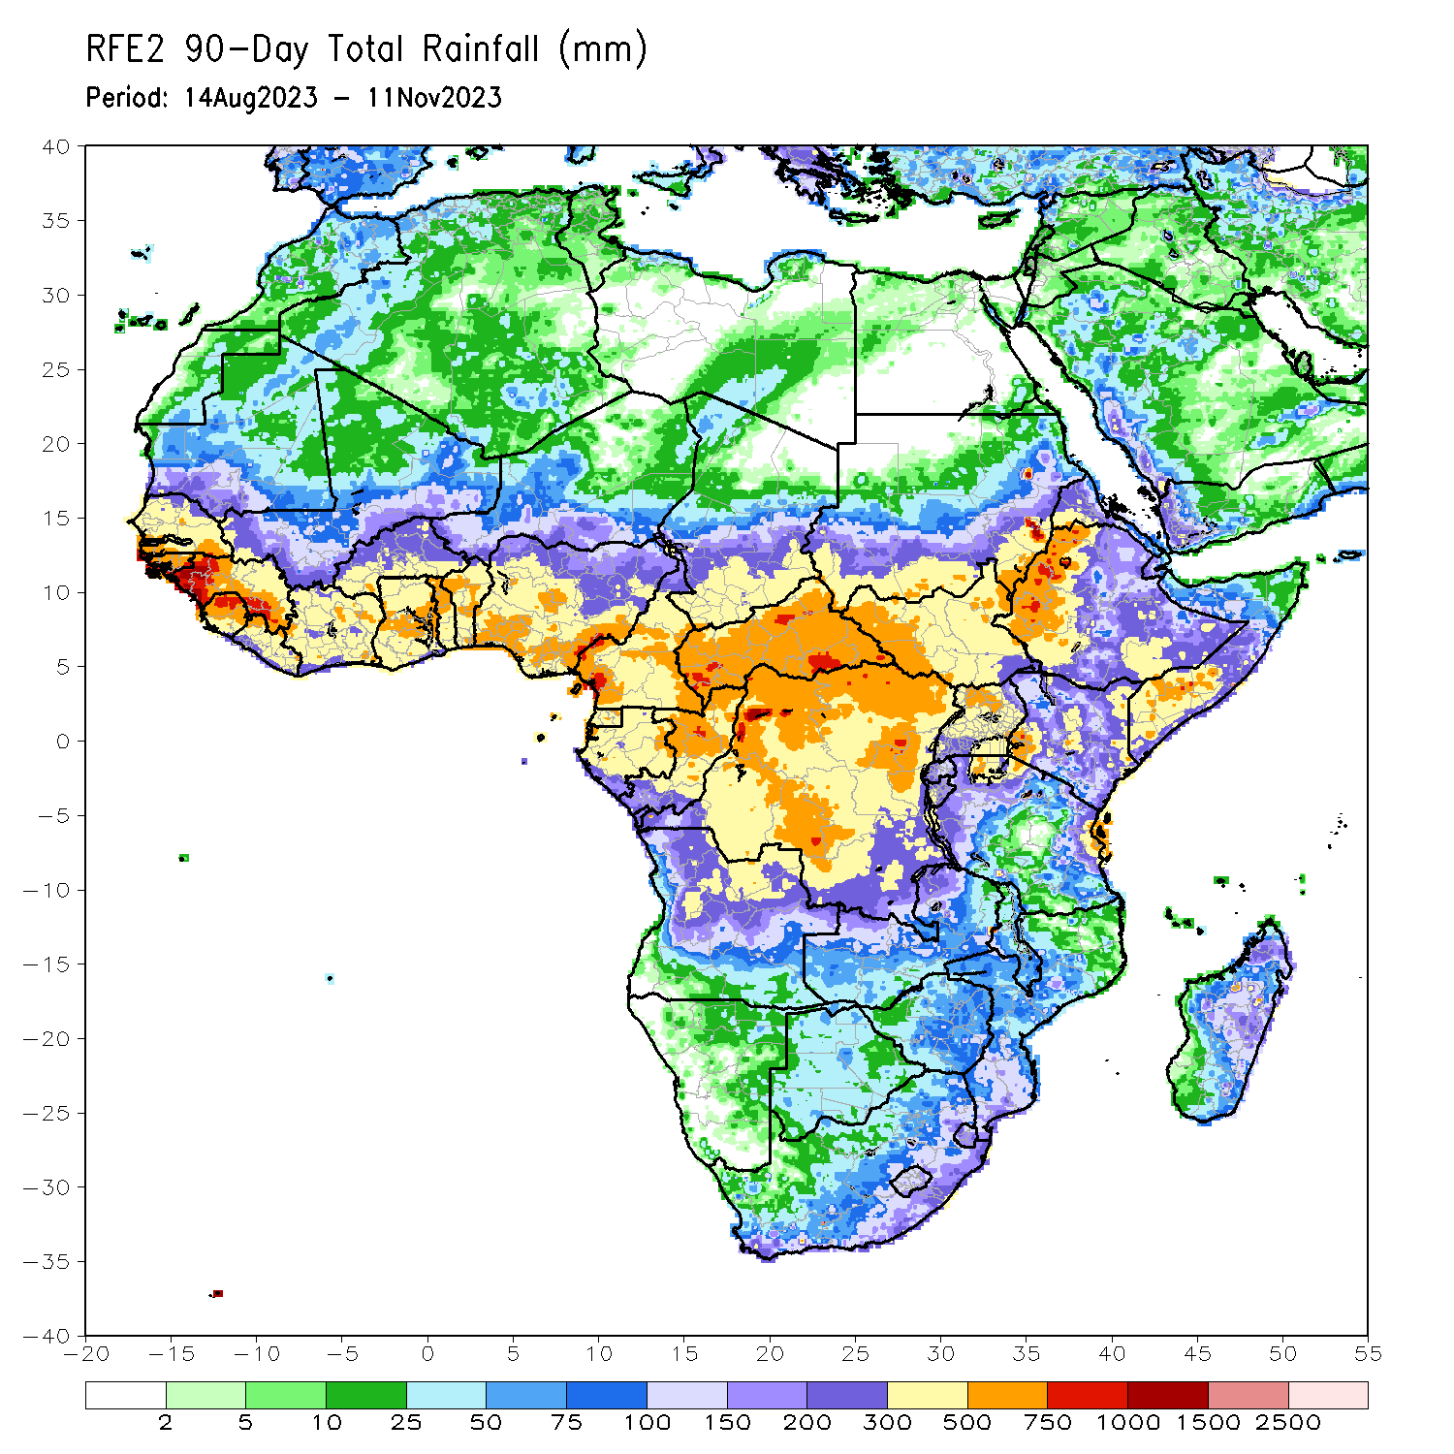
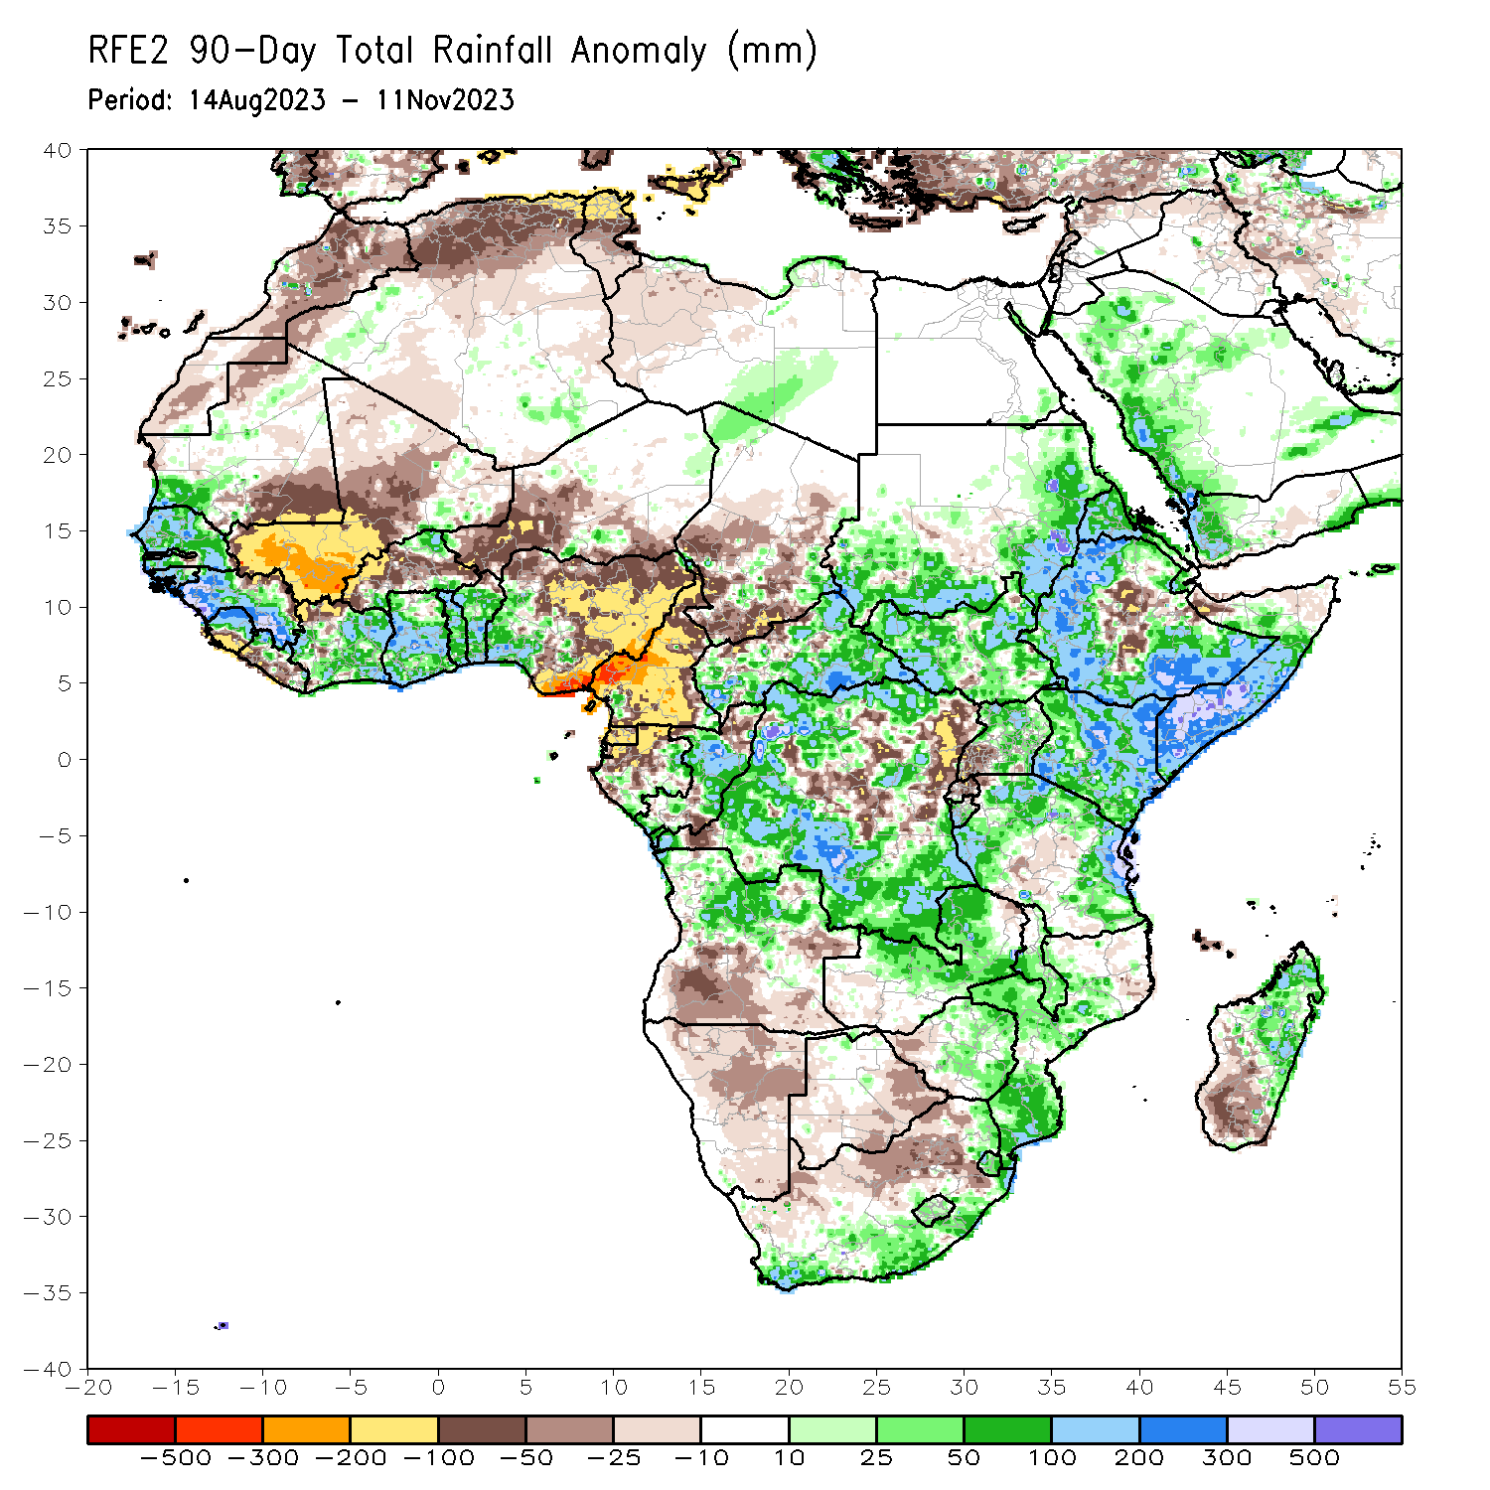
Rainfall Patterns: Last 90 Days
Over the past 90 days, in East Africa, above-average rainfall was observed over many parts of Sudan, western, northern, southern and southeastern Ethiopia, most of western and northeastern South Sudan, much of northern and central Uganda, Eritrea, Djibouti, southern and central Somalia, Kenya, Burundi, and parts of north-central and eastern Tanzania. Rainfall was below-average over isolated areas in southeastern Sudan and isolated pockets in south-central South Sudan, over central Rift Valley and its escarpments in Ethiopia, over parts of northern Somalia, southwestern Uganda, Rwanda, northern Burundi, and northwestern Tanzania. In Central Africa, rainfall was above-average over many parts of CAR, eastern and central Chad, much of central and far northern Congo, parts of western and northeastern Gabon, far southwestern Cameroon, and northern, western, and much of southern DRC. Rainfall was below-average over much of Cameroon, Equatorial Guinea, northern Gabon, parts of northern Congo, parts of central and northeastern DRC, northern borders of CAR, and central and southeastern Chad. In southern Africa, above-average rainfall was observed over southern and eastern South Africa, Lesotho, Eswatini, southern and central Mozambique, much of northern Angola, northern and central Zambia, central and eastern Zimbabwe, central and southern Malawi, isolated pockets in western and northern Botswana, and parts of central and northeastern Madagascar. Below-average rainfall was observed over parts of central and southern Angola, Namibia, southern and eastern parts of Botswana, northern South Africa, and southwestern Madagascar. In West Africa, rainfall was above-average over southwestern Mauritania, much of Senegal, Gambia, Guinea-Bissau, western and southern Guinea, northern and central Sierra Leone, eastern and northwestern Liberia, eastern Mali, southern and northeastern Burkina Faso, much of Cote d’Ivoire, much of Ghana, Togo, Benin, parts of northwestern, southeastern, and eastern Niger, and southwestern Nigeria. Below-average rainfall was observed over most parts of Mali, southern Sierra Leone, southwestern Liberia, northwestern Cote d’Ivoire, western and central Burkina Faso, parts of southeastern and central Niger, southeastern and parts of northeastern Mauritania, and central, northern, and eastern Nigeria.
Notes:
4

Slide 5
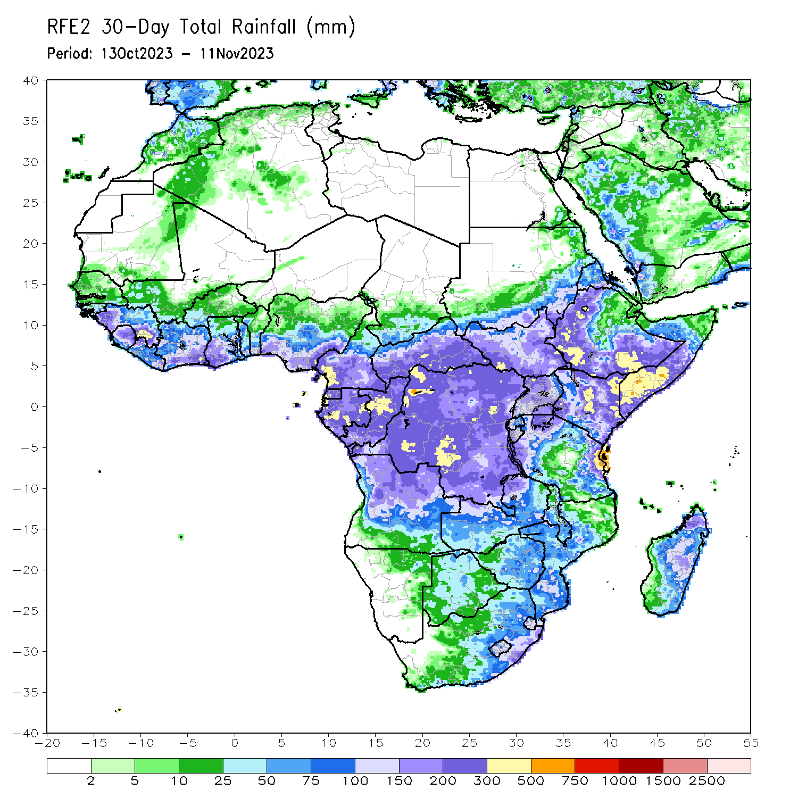
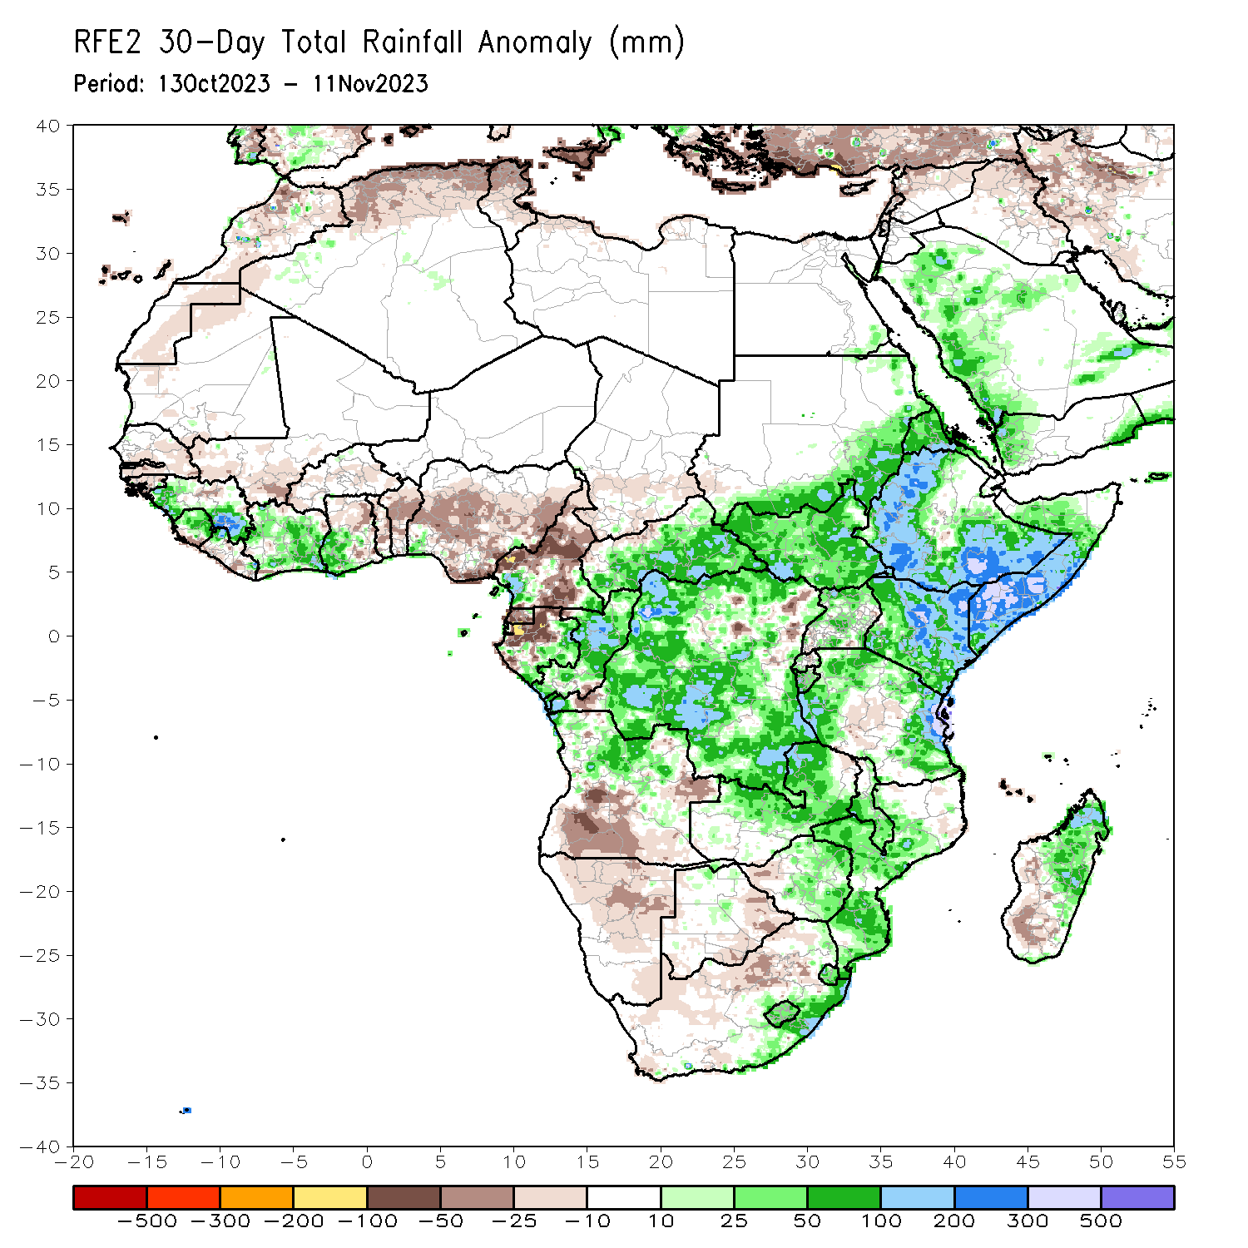
Rainfall Patterns: Last 30 Days
Over the past 30 days, in East Africa, above-average rainfall was observed over southern and eastern Sudan, South Sudan, most of Eritrea, northern, western and southeastern Ethiopia, northern and central Uganda, most of Kenya, southern and central Somalia, Burundi, and parts of northern, western and eastern Tanzania. Rainfall anomalies exceeded their long-term 30-day averages by more than 100mm in Somalia, Kenya and Ethiopia. Rainfall was below-average in parts of central Tanzania and parts of southern Uganda and Rwanda. In Central Africa, rainfall was above-average over parts of western Cameroon, much of Congo, CAR excluding its northern borders, and most of DRC excluding isolated pockets in the northeast and southwest regions. Below-average rainfall was observed over much of Cameroon, Equatorial Guinea, and northwestern/northern Gabon. In West Africa, rainfall was above-average over Guinea-Conakry, northern and central Sierra Leone, parts of northern Liberia, much of Cote d’Ivoire, southwestern Ghana, and pocket areas in Nigeria. Below-average rainfall was observed over Senegal, Gambia, Guinea-Bissau, southern Mali, Burkina Faso, southeastern Sierra Leone and coastal areas of Liberia, most of Togo and Benin, and over most of Nigeria. In southern Africa, above-average rainfall was observed over much of northern Angola, northern and central Zambia, central-north Botswana, eastern and central Zimbabwe, Malawi, central and southern Mozambique, Lesotho, Eswatini, southeastern South Africa, and northeastern Madagascar. Rainfall was below-average over southern and eastern Angola, northern and eastern Namibia, eastern Botswana, northern and western South Africa, and parts of central and southern Madagascar.
Notes:
5

Slide 6
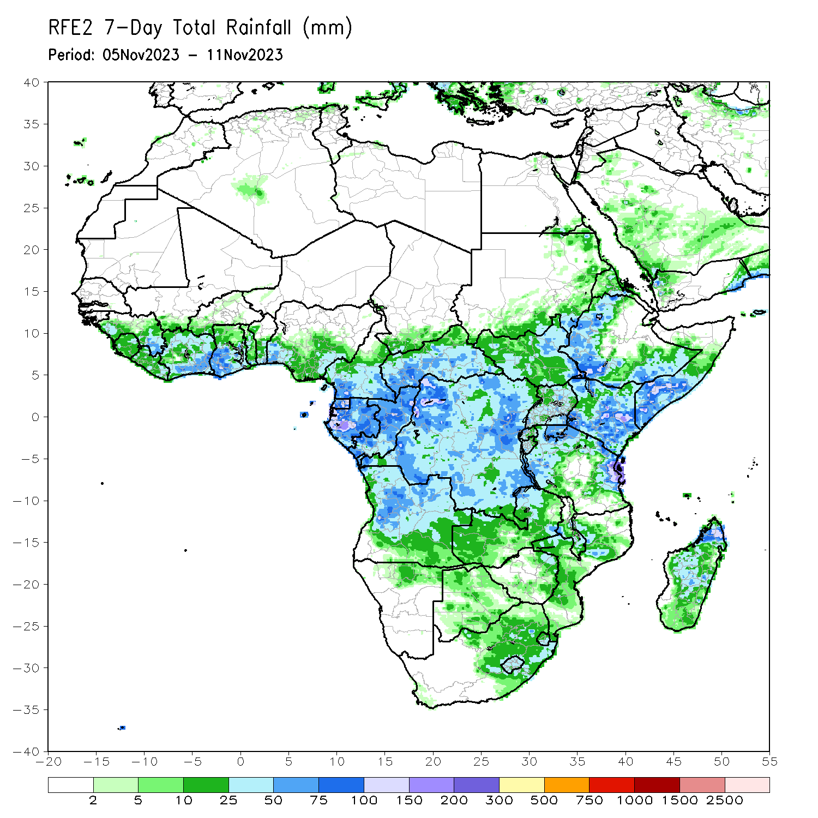
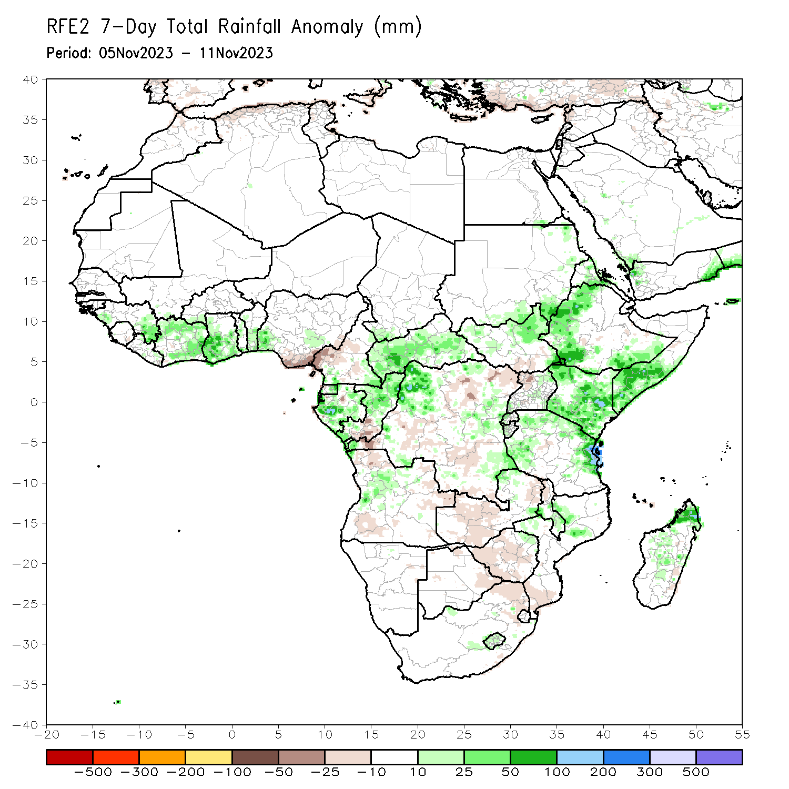
Rainfall Patterns: Last 7 Days
During the past 7 days, rainfall continued unabated in eastern Africa and intensified over parts of Central Africa and central portions of the Gulf of Guinea countries. In East Africa, rainfall was above-average over western Ethiopia extending from southwestern to northwestern regions, over southeastern Ethiopia, northeastern South Sudan, much of Kenya, southern and central Somalia, and western and eastern Tanzania. Locally heavy rainfall amounts in excess of 100 mm, even more at places, were observed in parts of southern Somalia, eastern Kenya and southwestern Ethiopia, which worsened the flooding conditions especially in Somalia. In central Africa, above-average rainfall was observed over much of CAR, eastern and northwestern DRC, eastern Equatorial Guinea, Gabon, northern Congo, and southwestern and southeastern Cameroon. Rainfall was below-average over parts of northwestern/northern Cameroon, pocket areas in southern Congo, and some parts of western and central DRC. In West Africa, above-average rainfall was observed over parts of eastern Guinea Conakry, most parts of Cote d’Ivoire, southern parts of Ghana, Benin and Togo, and over pocket areas in Nigeria. In southern Africa, rainfall was above-average over parts of northern Angola, isolated places in northern Gambia, pocket areas in eastern Zimbabwe, central Mozambique, and central and northern Madagascar. Although the rain covered most of the eastern half of South Africa, only a few places in central South Africa and Lesotho received above-average rainfall. Eastern South Africa, southern Mozambique, most of Zimbabwe, western half of Zambia, and southwestern Angola experienced drier than average rainfall conditions.

Slide 7
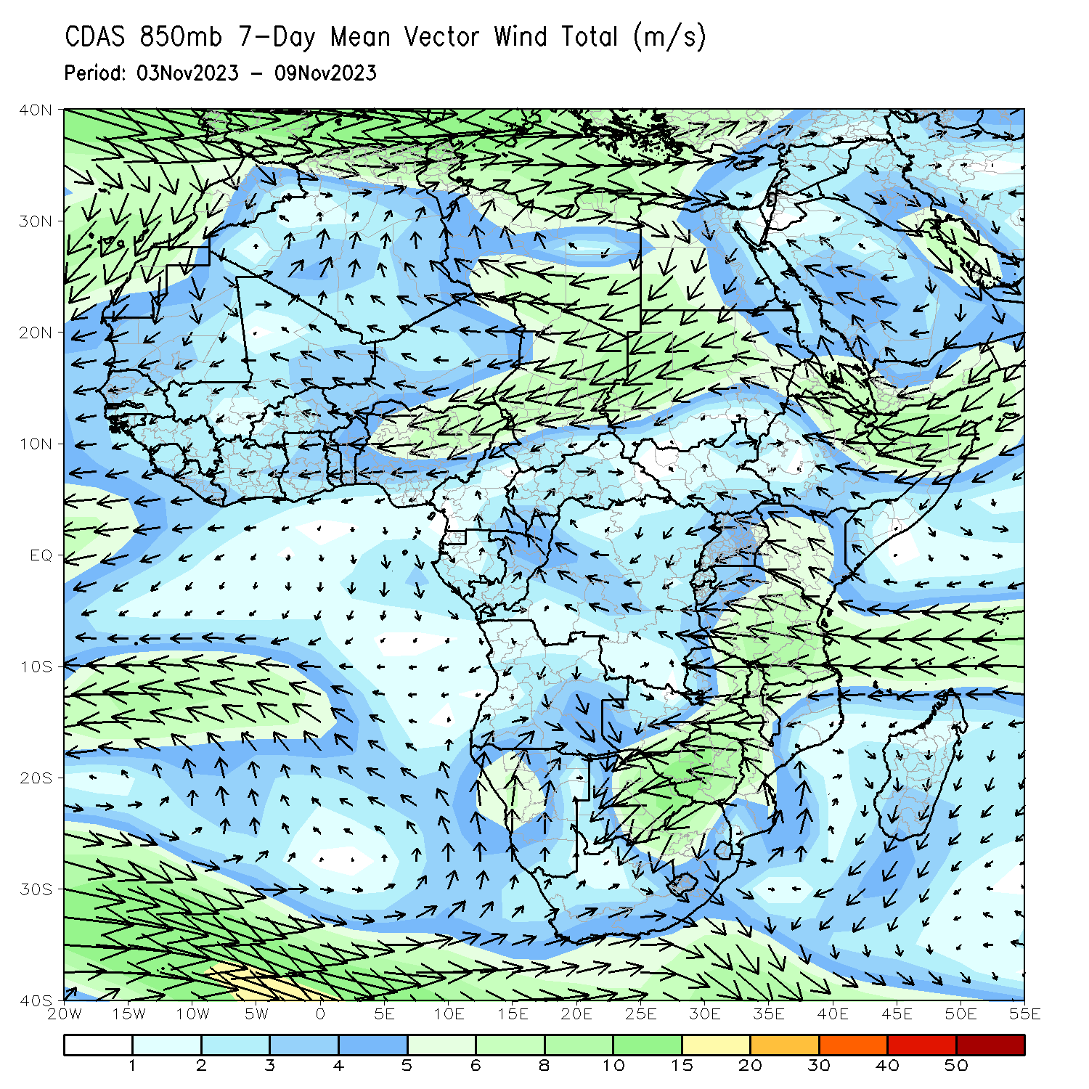
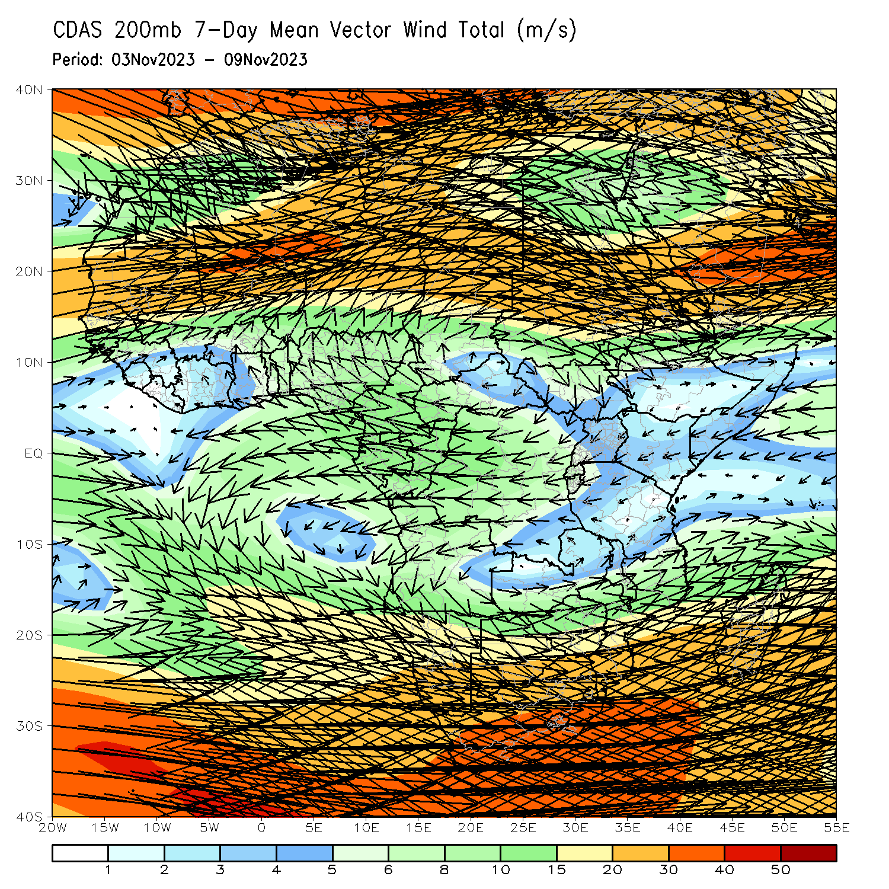
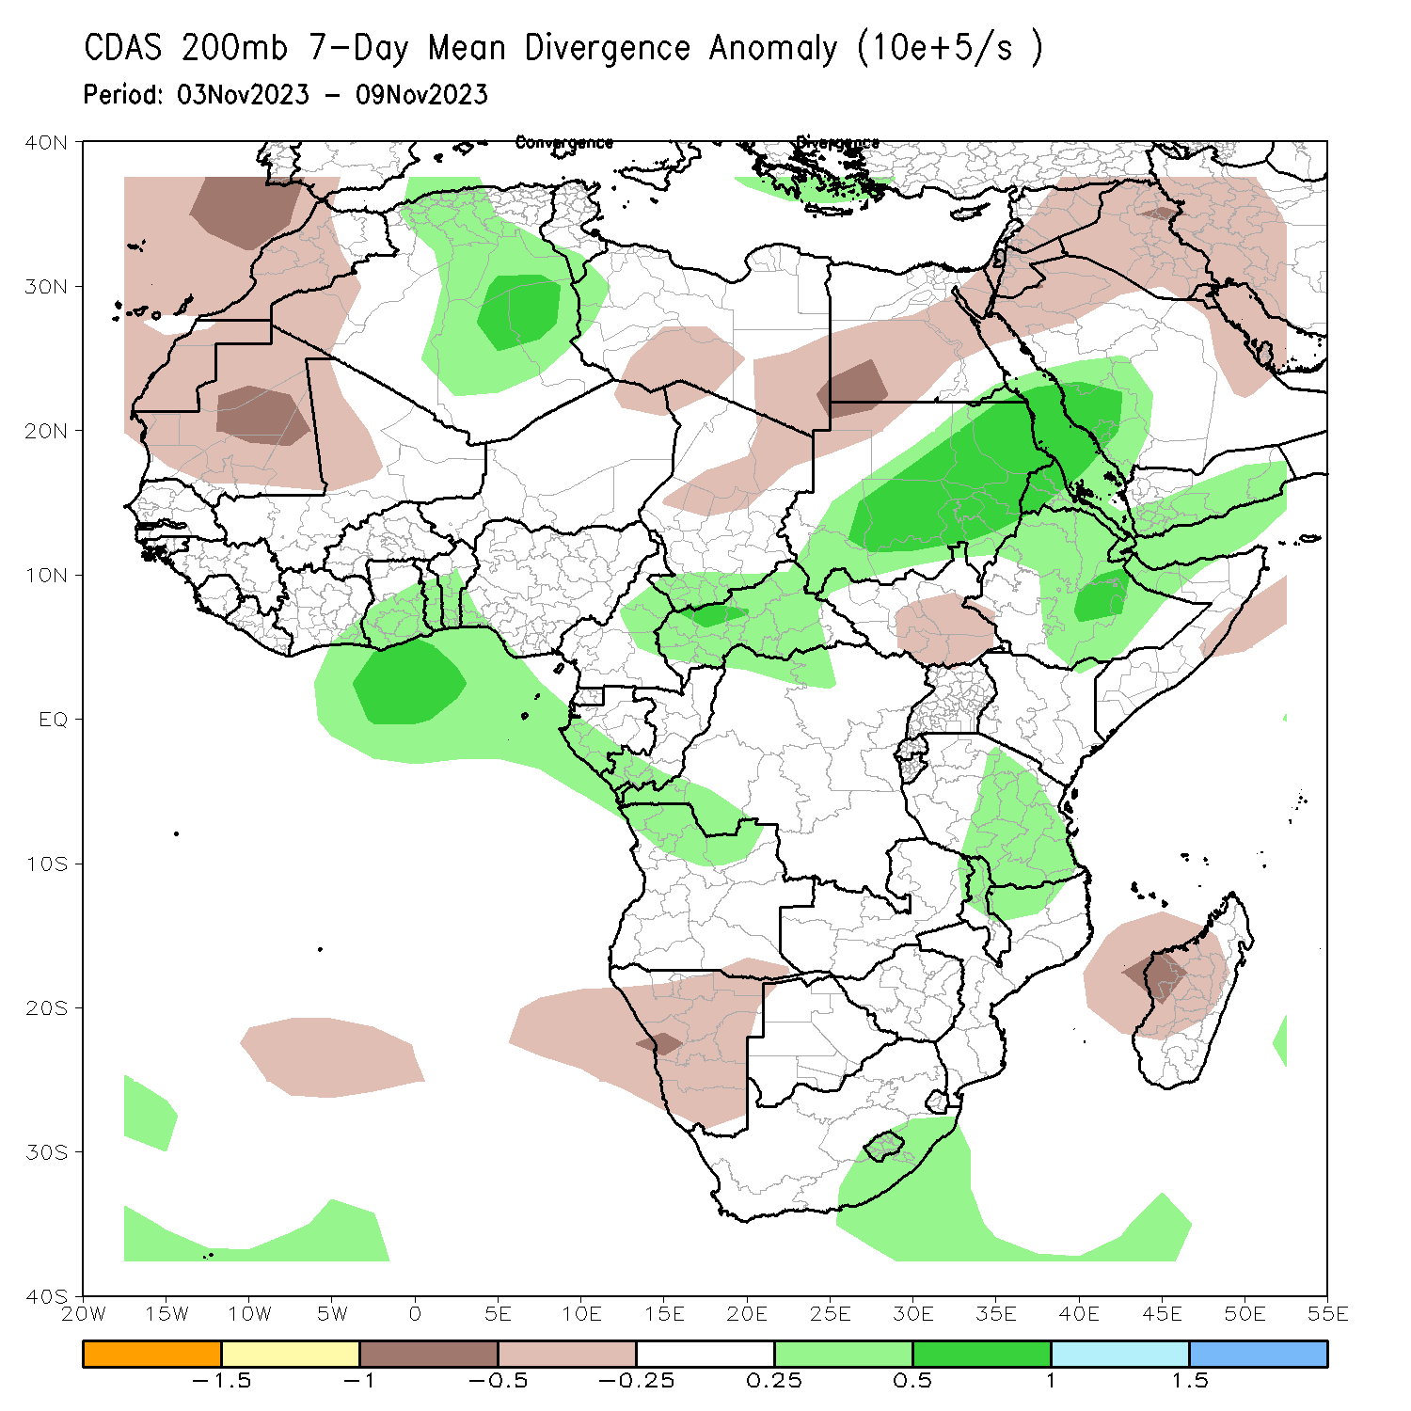
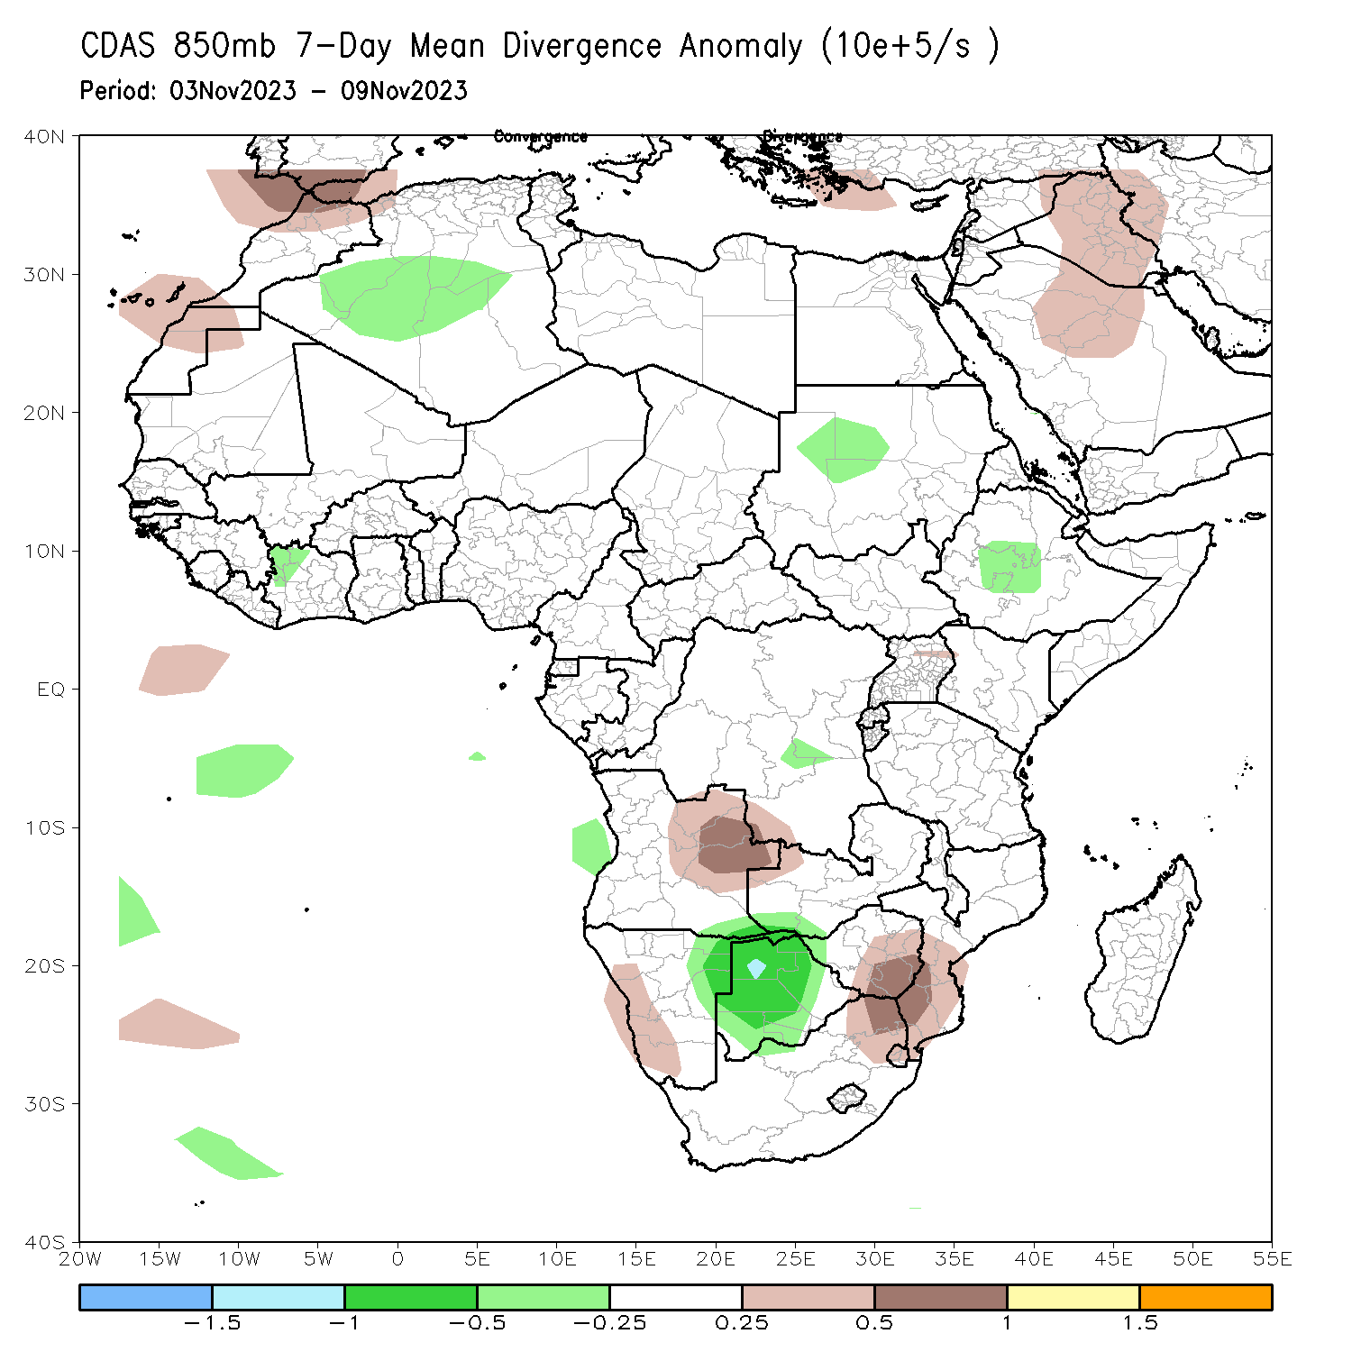
Atmospheric Circulation: Last 7 Days
At 850-hPa level (left panel), perturbation in the easterlies in the equatorial eastern Africa and a pronounced trough in the easterlies over Ethiopia (east of the trough line) favored enhanced rainfall in the region. At 200-hPa, the trough in the westerlies (top-middle) and an upper-level divergence (top-right) contributed to the above average precipitation covering parts of Sudan, Ethiopia, Kenya, Somalia, and eastern Tanzania. Low-level divergence in southern Mozambique/northeastern South Africa contributed to a depressed rainfall in that region (bottom-right).

Slide 8
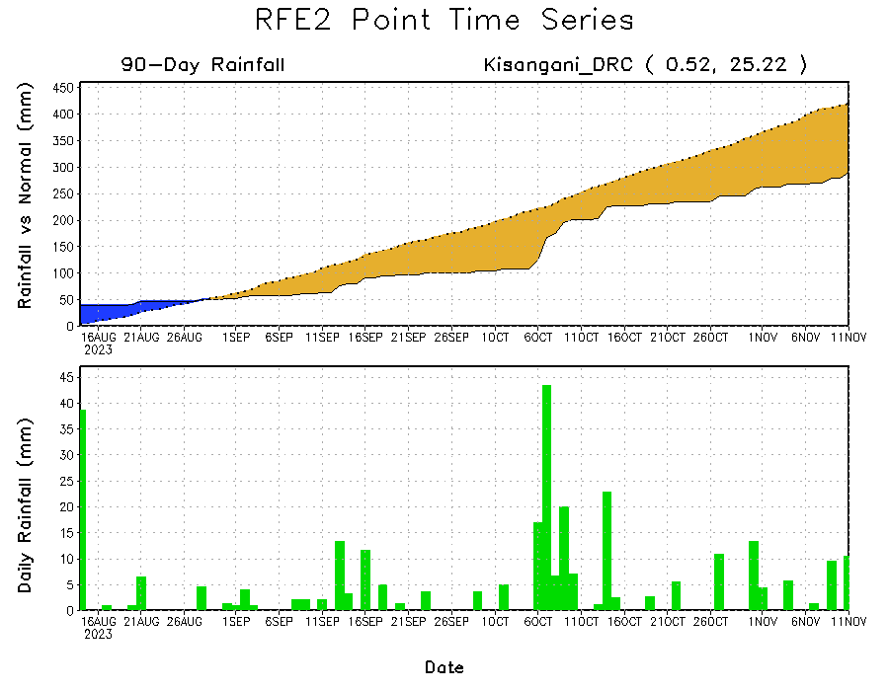
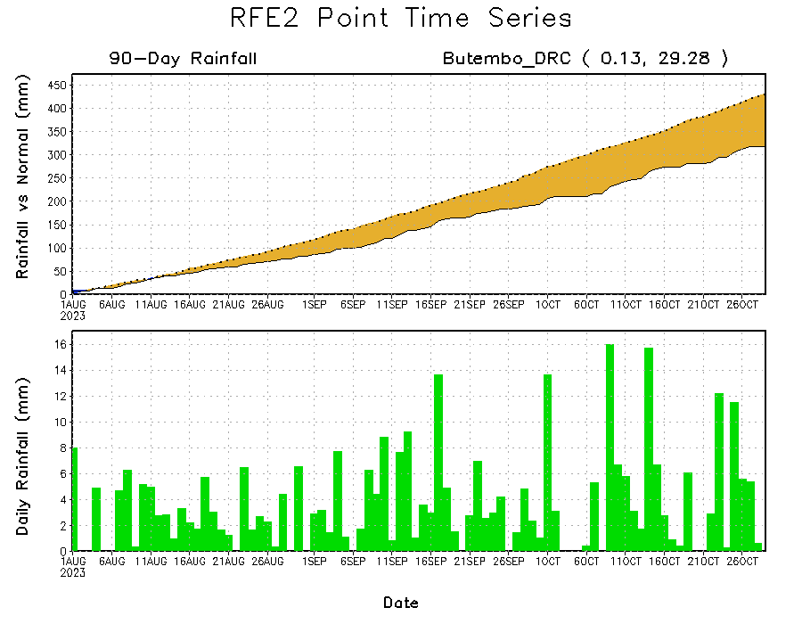
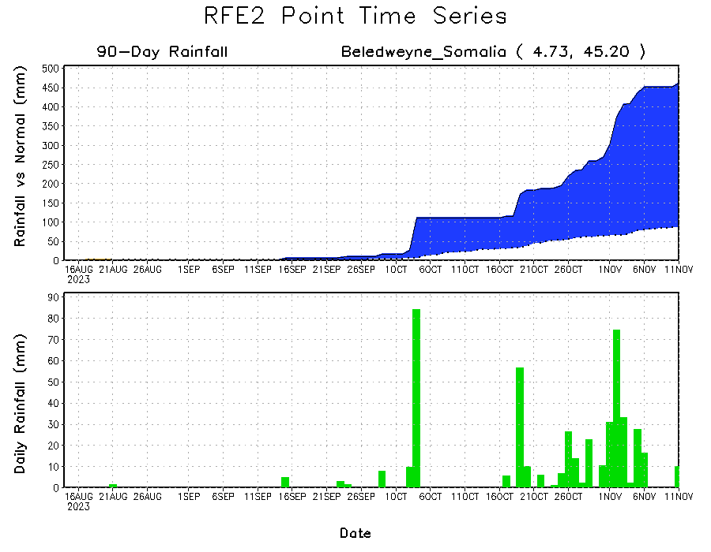
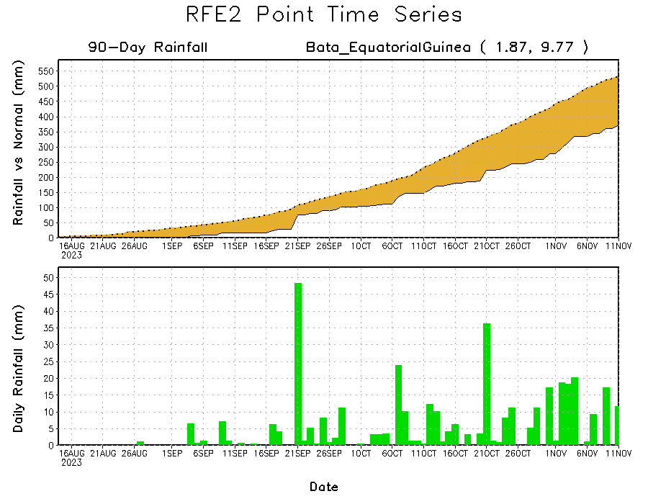
Rainfall Evolution
Daily evolution of rainfall over the last 90 days at selected locations shows light rainfall increased moisture deficits over parts of Equatorial Guinea (bottom left). Seasonal total rainfall remained below-average over northeastern DRC due to the recent below average rainfall (top right). The recent heavy rainfall also increased surpluses early in the rainfall season over southern Somalia (bottom right).

Slide 9
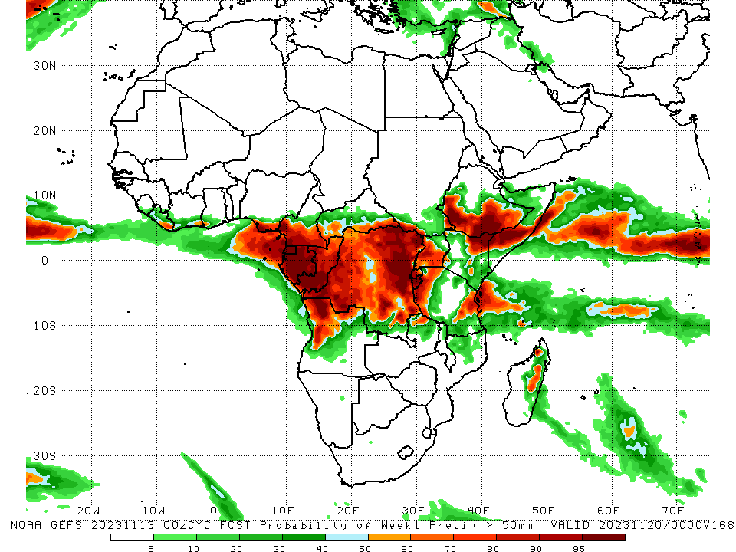
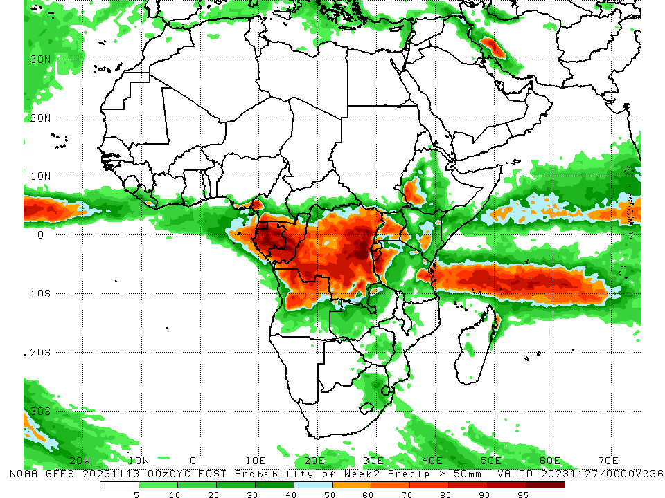
NCEP GEFS Model Forecasts Non-Bias Corrected Probability of precipitation exceedance
Week-1, Valid: 14 – 20 Nov 2023
Week-2, Valid: 21 – 27 Nov 2023
The GEFS ensemble forecasts indicate enhanced probabilities for heavy rainfall (> 55mm) over Central Africa, southern Somalia, and southwestern, southern and southeastern Ethiopia. For Week-1 (left-panel), there is moderate to high chance (over 80%) for rainfall to exceed 50 mm over Equatorial Guinea, southern Cameron, Gabon, western Congo, eastern DRC, northeastern Tanzania, southern Somalia, and southwestern, southern and southeastern Ethiopia. For week-2 (right panel), the GEFS model predicts a continuation of moderate to high chance (over 70%) for rainfall to exceed 50 mm over much of Central Africa countries listed above. On the other hand, the enhanced probabilities predicted for week 1 over southern Somalia and southern and southeastern Ethiopia are expected to drop appreciably, indicating a lull in rainfall in those regions for week 2.
Notes:
9

Slide 10
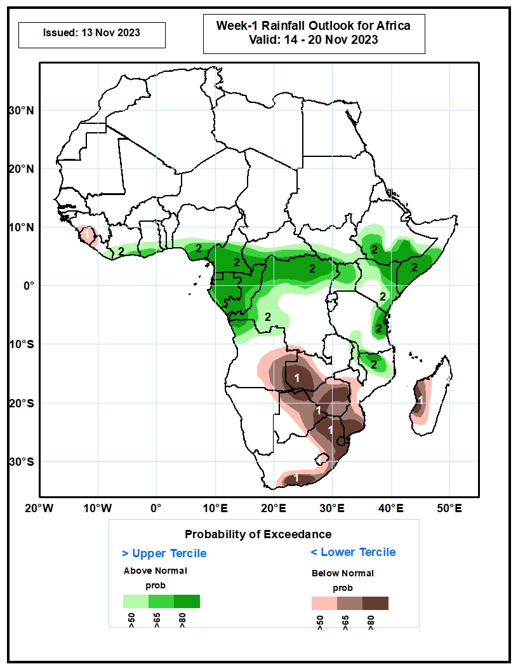
Week-1 Precipitation Outlooks
The probabilistic forecasts call for above 50% chance for weekly total rainfall to be below-average (below the lower tercile) over much of Sierra Leone, western Liberia, central and eastern Angola, western and central Zambia, central and eastern Botswana, much of Zimbabwe, central and southern Mozambique, eastern and southern South Africa, much of Lesotho and Eswatini, and western Madagascar. There is above 80% chance for below-average rainfall over western Zambia, northern and southeastern Botswana, central Zimbabwe, southern Mozambique, northern and south-central South Africa, Eswatini, and west-central Madagascar.
The probabilistic forecasts call for above 50% chance for weekly rainfall to be above-average (above the upper tercile) over the eastern Liberia, southern parts of Cote d’Ivoire, Ghana, Togo, Benin, and Nigeria, much of Cameroon, Equatorial Guinea, Gabon and Congo, southern CAR, northern and central parts of DR Congo, northern Angola, southern South Sudan, central and southern Ethiopia and Somali, much of Uganda and Kenya, eastern and southern parts of Tanzania, and northern portions of Malawi and Mozambique. There is above 80% chance for above-average rainfall over southern Nigeria, Cameroon and CAR, much of Equatorial Guinea, Gabon and Congo, northern and western part of DR Congo, northwestern Angola, southern Ethiopia and Somali, northeastern Kenya and Tanzania, and north-central Mozambique.
14 – 20 Nov 2023
Notes:
10

Slide 11
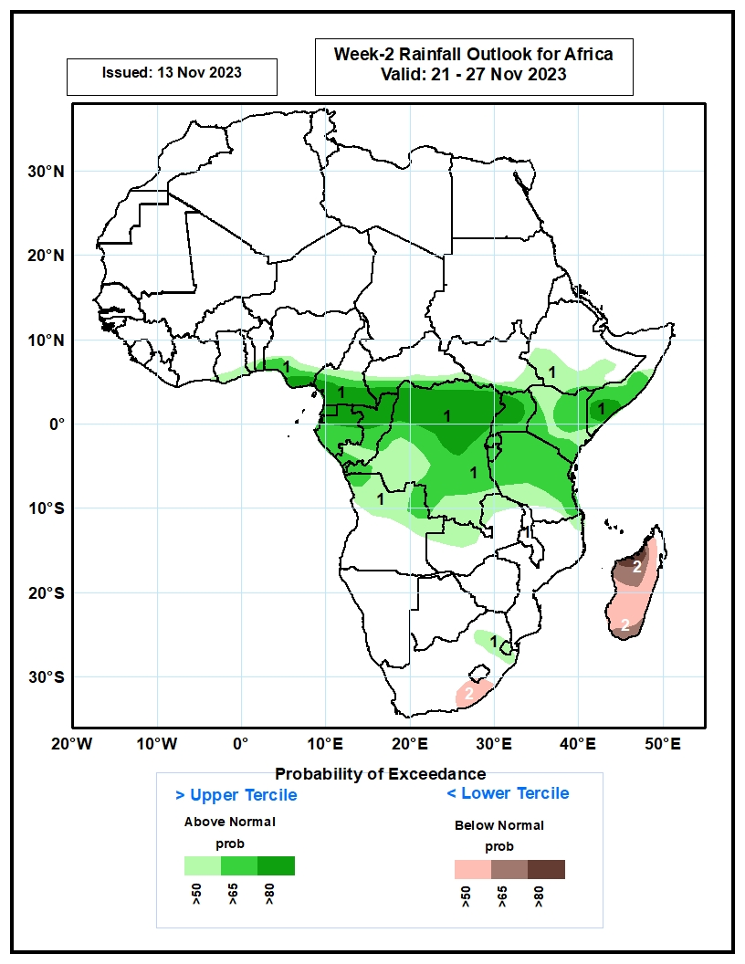
Week-2 Precipitation Outlooks
21 – 27 Nov 2023
The probabilistic forecasts call for above 50% chance for weekly rainfall to be above-average (above the upper tercile) over southern parts of Ghana, Togo, Benin and Nigeria, central and southern Cameroon, southern parts of CAR and South Sudan, central and southern part of Ethiopia and Somali, much of Equatorial Guinea, Gabon, Congo, DR Congo, Uganda, Kenya, Rwanda, Burundi and Tanzania, northern Angola and Zambia, northeastern Mozambique and South Africa, and much of Eswatini. There is above 80% chance for above-average rainfall over southeastern Nigeria, southern Cameroon, southwestern CAR, much of Equatorial Guinea, northern Gabon and Congo, northern and central parts of DR Congo, western and central parts of Uganda, and southern Somalia.
The probabilistic forecasts call for above 50% chance for weekly total rainfall to be below-average (below the lower tercile) over south-central South Africa and much of Madagascar. There is above 80% chance for below-average rainfall over northwestern Madagascar.
Notes:
11

Slide 12
Summary
Over the past 30 days, in East Africa, above-average rainfall was observed over southern and eastern Sudan, South Sudan, most of Eritrea, northern, western and southeastern Ethiopia, northern and central Uganda, most of Kenya, southern and central Somalia, Burundi, and parts of northern, western and eastern Tanzania. Rainfall anomalies exceeded their long-term 30-day averages by more than 100mm in Somalia, Kenya and Ethiopia. Rainfall was below-average in parts of central Tanzania and parts of southern Uganda and Rwanda. In Central Africa, rainfall was above-average over parts of western Cameroon, much of Congo, CAR excluding its northern borders, and most of DRC excluding isolated pockets in the northeast and southwest regions. Below-average rainfall was observed over much of Cameroon, Equatorial Guinea, and northwestern/northern Gabon. In West Africa, rainfall was above-average over Guinea-Conakry, northern and central Sierra Leone, parts of northern Liberia, much of Cote d’Ivoire, southwestern Ghana, and pocket areas in Nigeria. Below-average rainfall was observed over Senegal, Gambia, Guinea-Bissau, southern Mali, Burkina Faso, southeastern Sierra Leone and coastal areas of Liberia, most of Togo and Benin, and over most of Nigeria. In southern Africa, above-average rainfall was observed over much of northern Angola, northern and central Zambia, central-north Botswana, eastern and central Zimbabwe, Malawi, central and southern Mozambique, Lesotho, Eswatini, southeastern South Africa, and northeastern Madagascar. Rainfall was below-average over southern and eastern Angola, northern and eastern Namibia, eastern Botswana, northern and western South Africa, and parts of central and southern Madagascar.
During the past 7 days, rainfall continued unabated in eastern Africa and intensified over parts of Central Africa and central portions of the Gulf of Guinea countries. In East Africa, rainfall was above-average over western Ethiopia extending from southwestern to northwestern regions, over southeastern Ethiopia, northeastern South Sudan, much of Kenya, southern and central Somalia, and western and eastern Tanzania. Locally heavy rainfall amounts in excess of 100 mm, even more at places, were observed in parts of southern Somalia, eastern Kenya and southwestern Ethiopia, which worsened the flooding conditions especially in Somalia. In central Africa, above-average rainfall was observed over much of CAR, eastern and northwestern DRC, eastern Equatorial Guinea, Gabon, northern Congo, and southwestern and southeastern Cameroon. Rainfall was below-average over parts of northwestern/northern Cameroon, pocket areas in southern Congo, and some parts of western and central DRC. In West Africa, above-average rainfall was observed over parts of eastern Guinea Conakry, most parts of Cote d’Ivoire, southern parts of Ghana, Benin and Togo, and over pocket areas in Nigeria. In southern Africa, rainfall was above-average over parts of northern Angola, isolated places in northern Gambia, pocket areas in eastern Zimbabwe, central Mozambique, and central and northern Madagascar. Although the rain covered most of the eastern half of South Africa, only a few places in central South Africa and Lesotho received above-average rainfall. Eastern South Africa, southern Mozambique, most of Zimbabwe, western half of Zambia, and southwestern Angola experienced drier than average rainfall conditions.
Week-1 forecasts show enhanced probabilities for heavy rainfall exceeding 55mm over Central Africa, southern Somalia, and parts of southwestern and southeastern Ethiopia. The Week-1 outlook calls for above-normal rainfall along the coasts of West Africa extending from eastern Liberia to coasts of Nigeria, southern Cameroon, Equatorial Guinea, Gabon, Congo, northern Angola, southern CAR, western and northern DRC, southern borders of South Sudan, parts of southwestern and southeastern Ethiopia, southern Somalia, Uganda, eastern Kenya, eastern Tanzania, northern Mozambique, and eastern Madagascar. Rainfall is expected to be below-normal in Burundi, Rwanda and neighboring northeastern DRC, and across southern Africa including southeastern Angola, western Zambia, eastern Botswana and western Zimbabwe, southern and central Mozambique, southern Malawi, southern and eastern South Africa, and western Madagascar. The Week-2 outlook calls for above-normal rainfall in most of Central African countries listed above and over northern Angola, most of DRC, northern Zambia, southwestern Ethiopia, southern Somalia, most of Uganda, Kenya, Rwanda, parts of Burundi, Tanzania, Eswatini, and parts of northeastern South Africa. Rainfall is expected to be below-normal over south-central South Africa and Lesotho, northern Mozambique, and most parts of Madagascar.

