Slide 1
The African Monsoon Recent Evolution and Current Status Include Week-1 and Week-2 Outlooks
Update prepared
27 November 2023
For more information, visit:
http://www.cpc.ncep.noaa.gov/products/Global_Monsoons/African_Monsoons/precip_monitoring.shtml

Slide 2
Outline
Highlights
Recent Evolution and Current Conditions
NCEP GEFS Forecasts
Summary

Slide 3
Highlights: Last 7 Days
During the past 7 days, in East Africa, rainfall has substantially decreased over most areas. Rainfall was above-average at isolated places in western and southern Ethiopia, over western and eastern South Sudan, southern and central Somalia, central and eastern Kenya, northwestern and southeastern Uganda, and northern, western, and eastern Tanzania. Anomalies in excess of 100 mm or more were observed only in parts of east-central Kenya and at isolated locations in Lake Victoria regions. In central Africa, above-average rainfall was observed over southeastern Cameroon, parts of Equatorial Guinea, southern and eastern CAR, southern Gabon and northern Congo, and western, northern, and eastern parts of DRC. Anomalies in excess of 100 mm or more were observed in parts of northeastern DRC and central Congo. Rainfall was below-average over parts of southeastern Congo extending into parts of western DRC and over eastern-central and southern DRC. In West Africa, above-average rainfall was observed over parts of northwestern Guinea-Conakry and a few places in south-central Cote d’Ivoire, southwestern parts of Ghana, northern Benin, and over west-central Nigeria. Rainfall was slightly below average in Liberia and over parts of central Cote d’Ivoire. In southern Africa, rainfall was above-average over parts of northwestern and southwestern Angola, north-central Namibia, and northeastern Zambia and northern borders of Zimbabwe. Southeastern and northeastern Angola, much of Zambia and Zimbabwe, central and southern Mozambique, eastern parts of Botswana, northeastern and eastern South Africa, Lesotho, and much of Madagascar received below average rainfall.
Week-1 forecasts show enhanced probabilities for heavy rainfall exceeding 50mm over Liberia, Equatorial Guinea, Gabon, Congo, much of DRC, western and northern Angola, northern Zambia, western Tanzania, and northeastern Madagascar. Most of these areas are expected to experience wetter than average rainfall conditions. Rainfall is expected to be below-normal over southwestern DRC and bordering areas of Angola, southwestern Ethiopia, southern Somalia and bordering northeastern Kenya, east-central Kenya, southern Zimbabwe, southern Mozambique, south-central South Africa, and southwestern Madagascar. The Week-2 outlook calls for above-normal rainfall in most of Central Africa regions extending from Southern Cameroon to Equatorial Guinea, Gabon, northern Congo, much of DRC, and western Angola. Northern Tanzania, Burundi, Rwanda and southern Uganda are also expected to receive above-average rainfall. Rainfall is expected to be below-normal in northeastern parts of South Africa, over isolated areas in southern Somalia and at a few places in southwestern Madagascar.

Slide 4
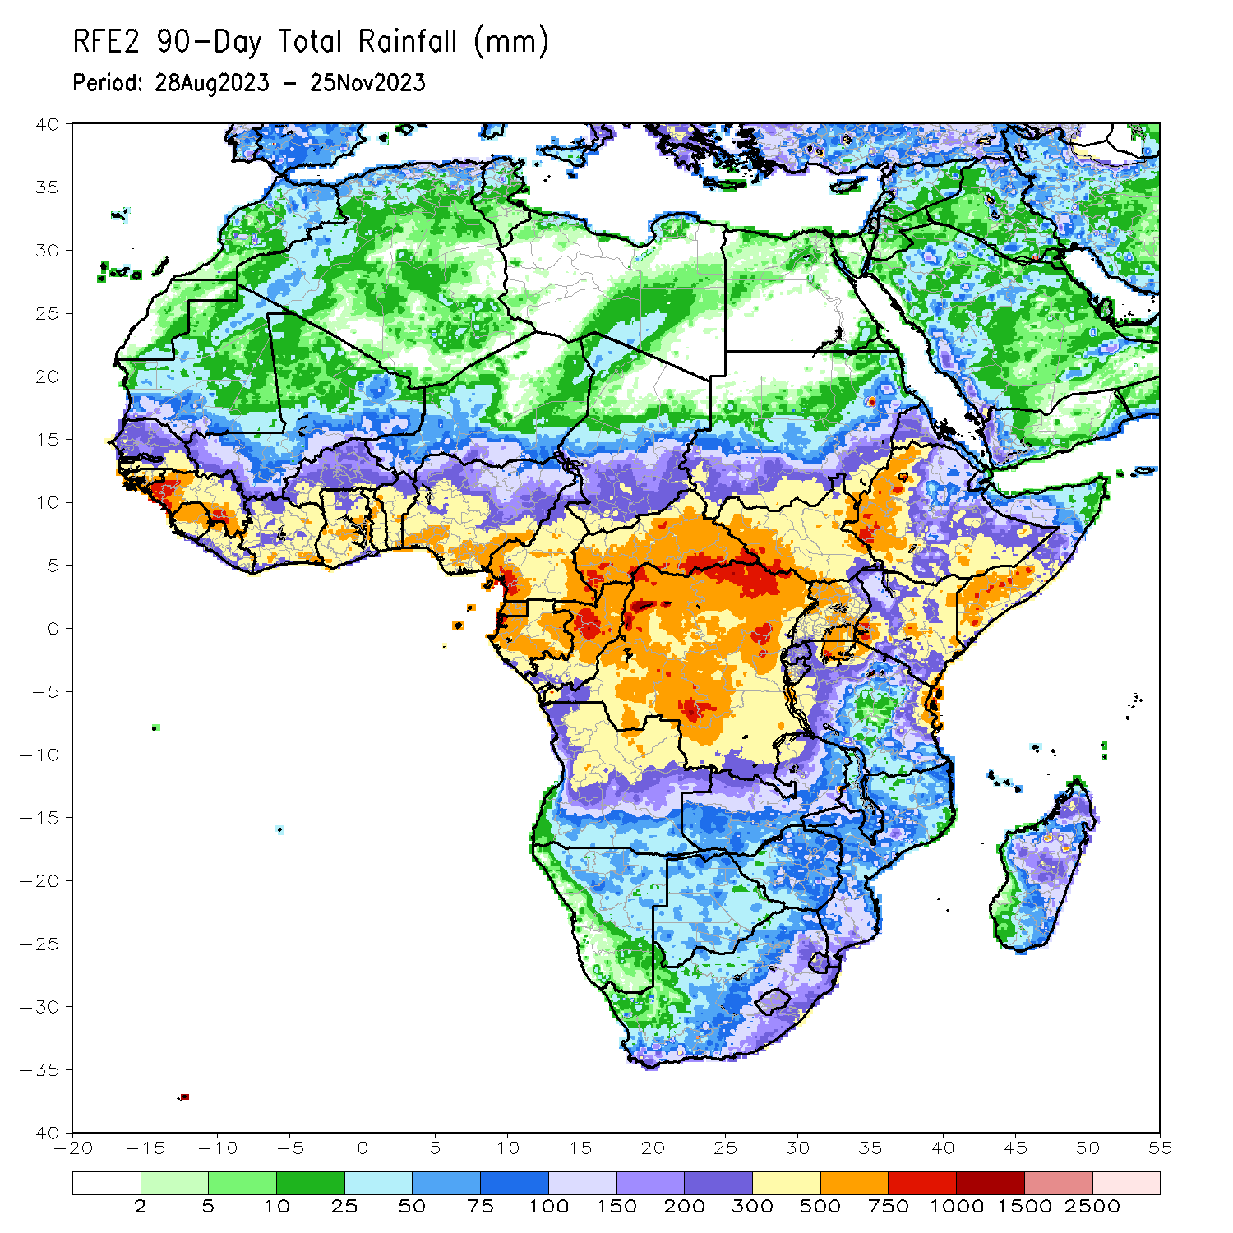
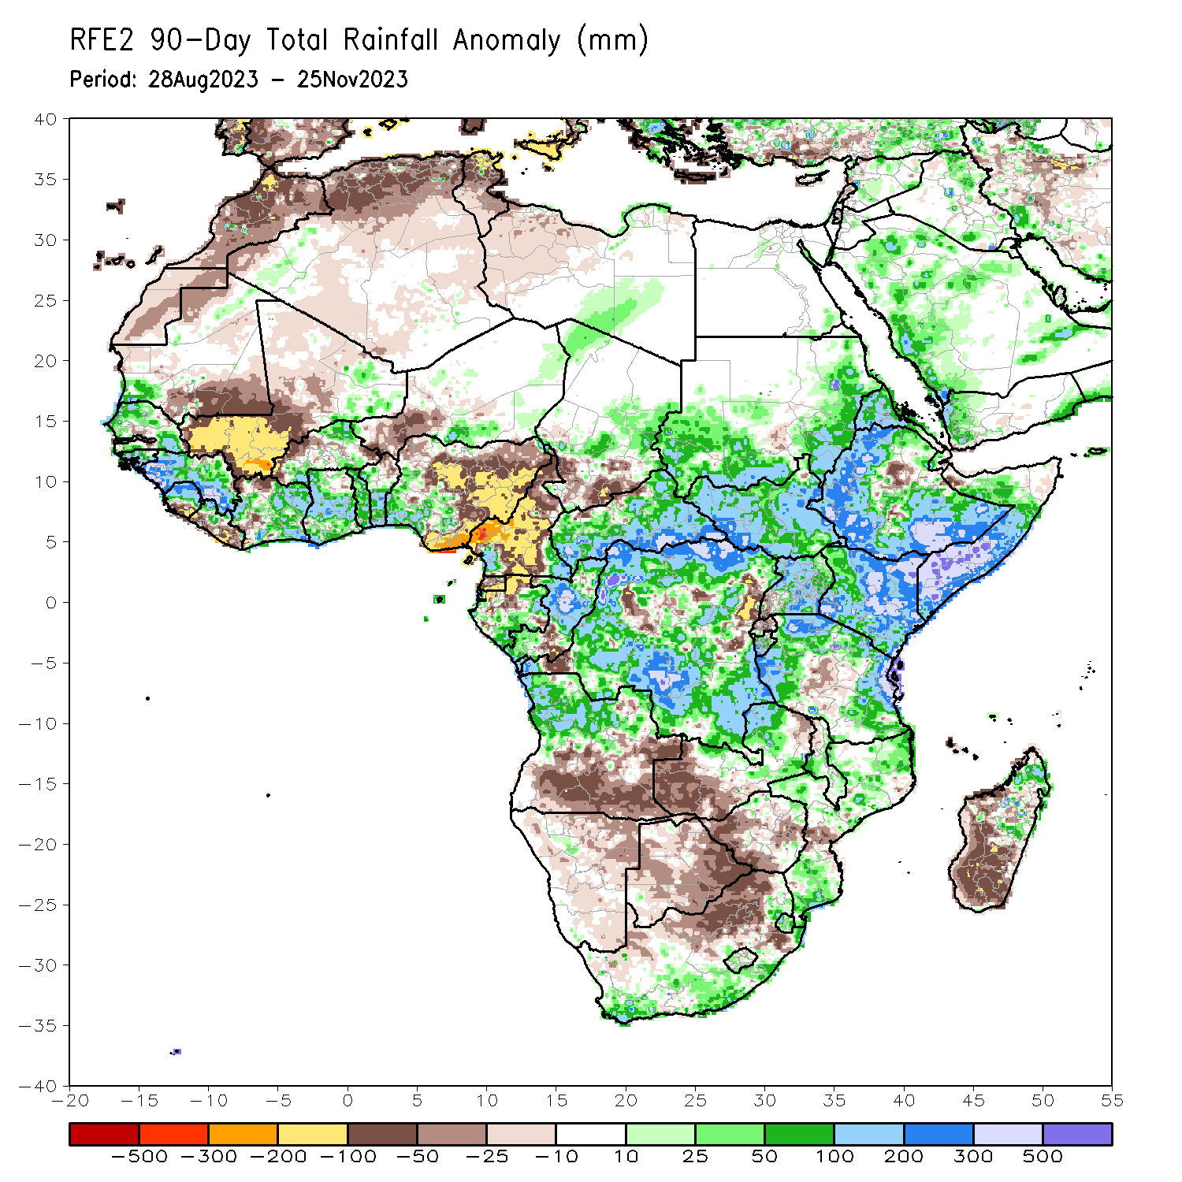
Rainfall Patterns: Last 90 Days
Over the past 90 days, in East Africa, above-average rainfall was observed over eastern and southern Sudan, western, northern, and southern Ethiopia, most of South Sudan, much of northern, central, and eastern Uganda, western and central Eritrea, western Djibouti, parts of northern, southern, and central Somalia, Kenya, Burundi, and northern, western, and eastern Tanzania. Seasonal rainfall exceeded 500mm over western South Sudan, northwestern Uganda, Lake Victoria region, southwestern Ethiopia, southern and central Somalia, isolated areas in central and eastern Kenya and over eastern Tanzania. Rainfall was below-average over central Rift Valley and its escarpments in Ethiopia, over parts of northern Somalia, southwestern Uganda, central and eastern Rwanda, and central Tanzania. In Central Africa, rainfall was above-average over many parts of CAR, eastern and parts of central Chad, much of central, southwestern, and far northern Congo, parts of southern and northeastern Gabon, far southwestern and southeastern Cameroon, and northern, western, and much of southern DRC. Rainfall was below-average over much of Cameroon, Equatorial Guinea, northern and central Gabon, parts of northern and southeastern Congo, parts of central, northeastern, and southwestern DRC, northern borders of CAR, and central and much of southern Chad. In southern Africa, above-average rainfall was observed over southern and eastern South Africa, Lesotho, Eswatini, southern, parts of central, and northern Mozambique, much of northern Angola, isolated areas in northwestern Namibia, northern and central Zambia, isolated areas in eastern and northern borders of Zimbabwe, northeastern, central, and southern Malawi, and parts of central and northeastern Madagascar. Below-average rainfall was observed over parts of central and southern Angola, much of Namibia, Botswana, northern South Africa, western Zimbabwe, western Zambia, and southern and central Madagascar. In West Africa, rainfall was above-average over southwestern Mauritania, much of Senegal, parts of western Gambia, Guinea-Bissau, western and southern Guinea, northern and central Sierra Leone, northwestern Liberia, eastern Mali, southern and northeastern Burkina Faso, much of Cote d’Ivoire, much of Ghana, Togo, Benin, parts of northwestern, southern, and eastern Niger, and southwestern and far northeastern Nigeria. Below-average rainfall was observed over most parts of Mali, southern Sierra Leone, southern Liberia, northwestern and western-central Cote d’Ivoire, northeastern Guinea, central Senegal, eastern Gambia, northeastern Benin, western, central and eastern Burkina Faso, parts of southwestern and central Niger, southeastern, central, and northwestern Mauritania, and central, northern, and eastern Nigeria.
Notes:
4

Slide 5
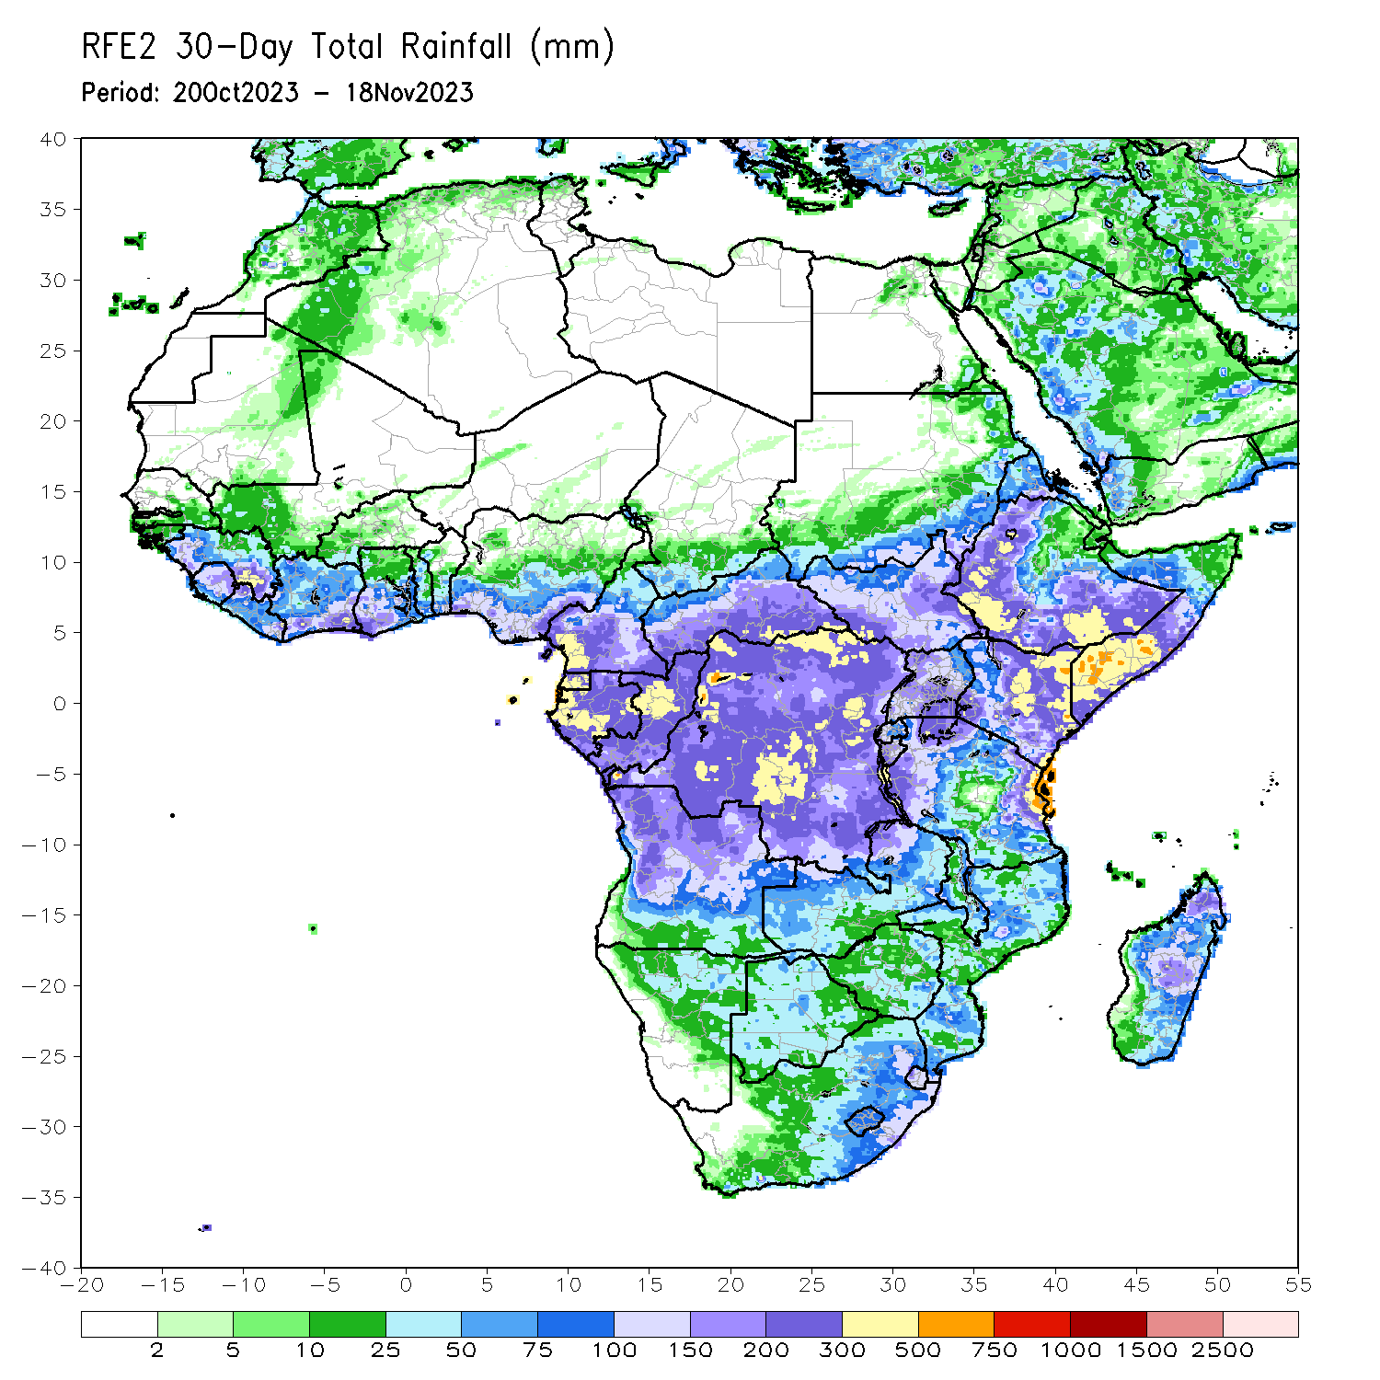
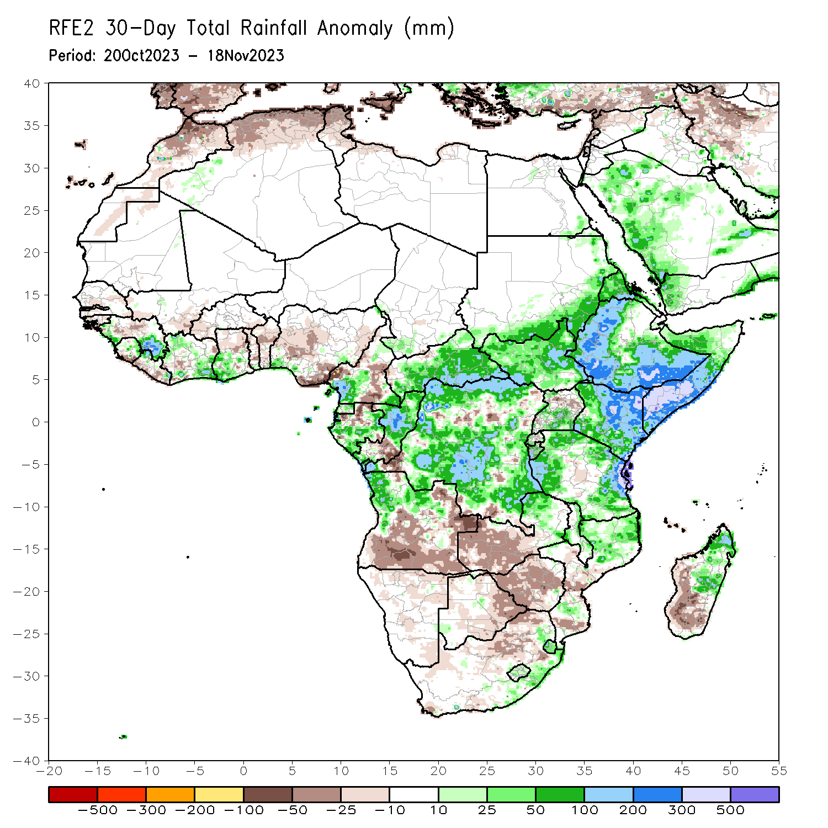
Rainfall Patterns: Last 30 Days
Over the past 30 days, in East Africa, above-average rainfall was observed over southern and eastern Sudan, South Sudan, western and central Eritrea, northern, western, and southern Ethiopia, northwestern, central, and southeastern Uganda, most of Kenya, southern, central, and northwestern Somalia, Burundi, southern and eastern Rwanda, and parts of northern, western, and eastern Tanzania. Rainfall anomalies exceeded their long-term 30-day averages by more than 300mm in southern Somalia, central and northeastern Kenya, parts of southwestern and southern Ethiopia, and parts of northeastern Tanzania. Rainfall was below-average in parts of central Tanzania, parts of eastern Uganda, and central Rwanda. In Central Africa, rainfall was above-average over parts of southwestern and southeastern Cameroon, southwestern and northern half of Congo, most of CAR, most of Gabon excluding northern and southeastern areas, Equatorial Guinea, and most of DRC excluding isolated pockets in the northeast, southwest, central, and southeast regions. Below-average rainfall was observed over much of south-central, east-central, and west-central Cameroon, northern Gabon, central, and southeastern Congo. In West Africa, rainfall was above-average over western and southeastern Guinea-Conakry, central Sierra Leone, northwestern and eastern Liberia, northern, southern and eastern Cote d’Ivoire, southwestern Ghana, and southwestern, central and eastern Nigeria. Below-average rainfall was observed over central Guinea-Conakry, southern Sierra Leone, western and southern Burkina Faso, southern Sierra Leone, most areas of Liberia excluding northwestern and eastern regions, west-central Cote d’Ivoire, south-central Togo, northern Benin, and over coastal and eastern regions of Nigeria. In southern Africa, above-average rainfall was observed over much of northern Angola, northern Zambia, parts of northern and central Malawi, northern and south-central Mozambique, Lesotho and surrounding areas of South Africa, isolated areas in northern Namibia and southwestern Botswana, and northeastern and central Madagascar. Rainfall was below-average over southern and eastern Angola, northeastern Namibia, eastern Botswana, northern and southwestern South Africa, much of Zimbabwe, western half and northeastern parts of Zambia, central and southern Mozambique, and west-central and southern Madagascar.
Notes:
5

Slide 6
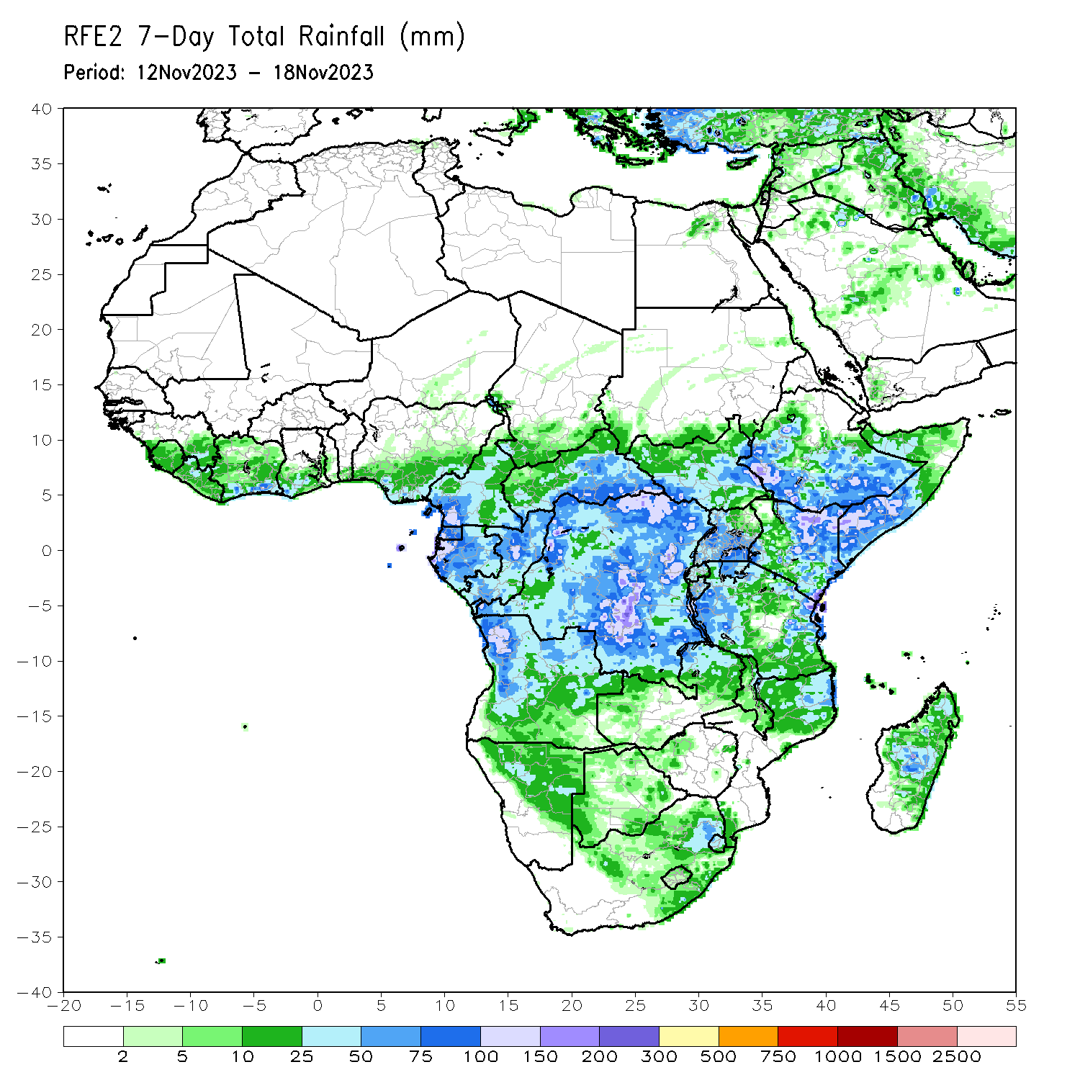
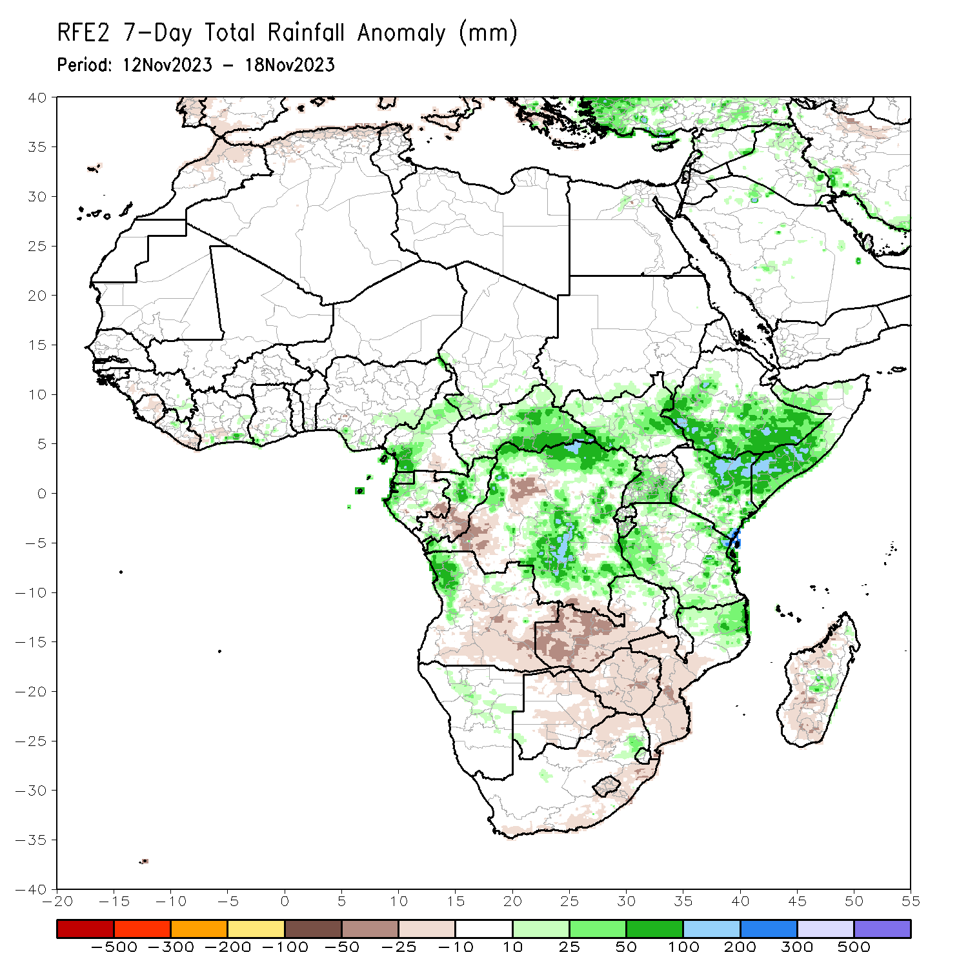
Rainfall Patterns: Last 7 Days
During the past 7 days, in East Africa, rainfall has substantially reduced over most areas. Rainfall was above-average at isolated places in western and southern Ethiopia, over western and eastern South Sudan, southern and central Somalia, central and eastern Kenya, northwestern and southeastern Uganda, and northern, western, and eastern Tanzania. Anomalies in excess of 100 mm or more were observed only in parts of east-central Kenya and at isolated locations in Lake Victoria regions. In central Africa, above-average rainfall was observed over southeastern Cameroon, parts of Equatorial Guinea, southern and eastern CAR, southern Gabon and northern Congo, and western, northern, and eastern parts of DRC. Anomalies in excess of 100 mm or more were observed in parts of northeastern DRC and central Congo. Rainfall was below-average over parts of southeastern Congo extending into parts of western DRC and over eastern-central and southern DRC. In West Africa, above-average rainfall was observed over parts of northwestern Guinea-Conakry and a few places in south-central Cote d’Ivoire, southwestern parts of Ghana, northern Benin, and over west-central Nigeria. Rainfall was slightly below average in Liberia and over parts of central Cote d’Ivoire. In southern Africa, rainfall was above-average over parts of northwestern and southwestern Angola, north-central Namibia, and northeastern Zambia and northern borders of Zimbabwe. Southeastern and northeastern Angola, much of Zambia and Zimbabwe, central and southern Mozambique, eastern parts of Botswana, northeastern and eastern South Africa, Lesotho, and much of Madagascar received below average rainfall.

Slide 7
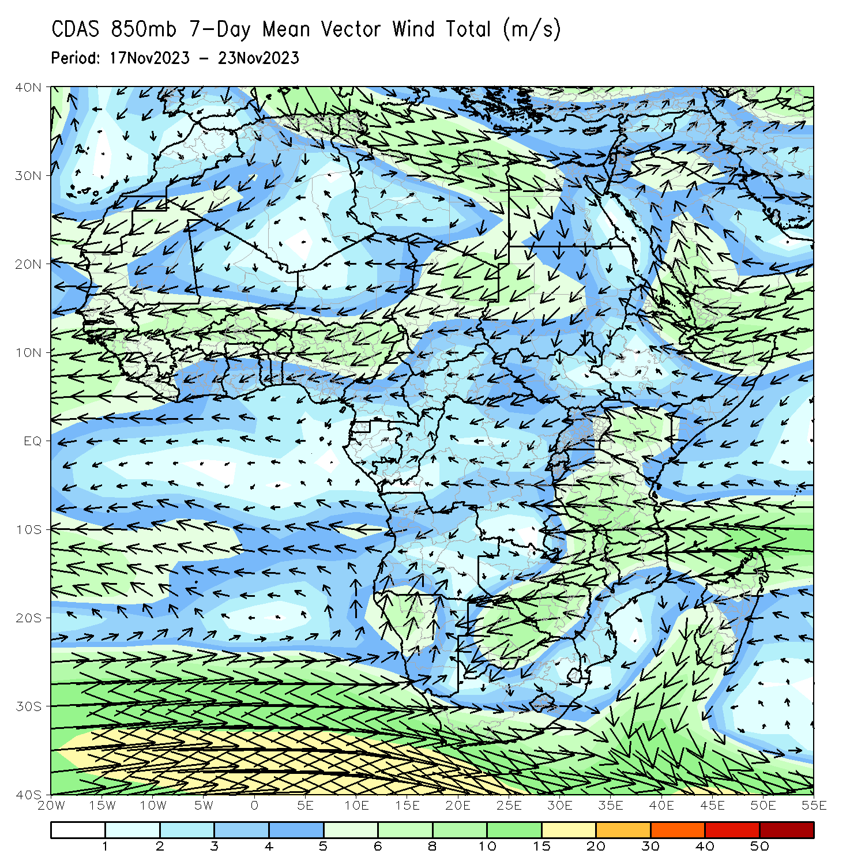
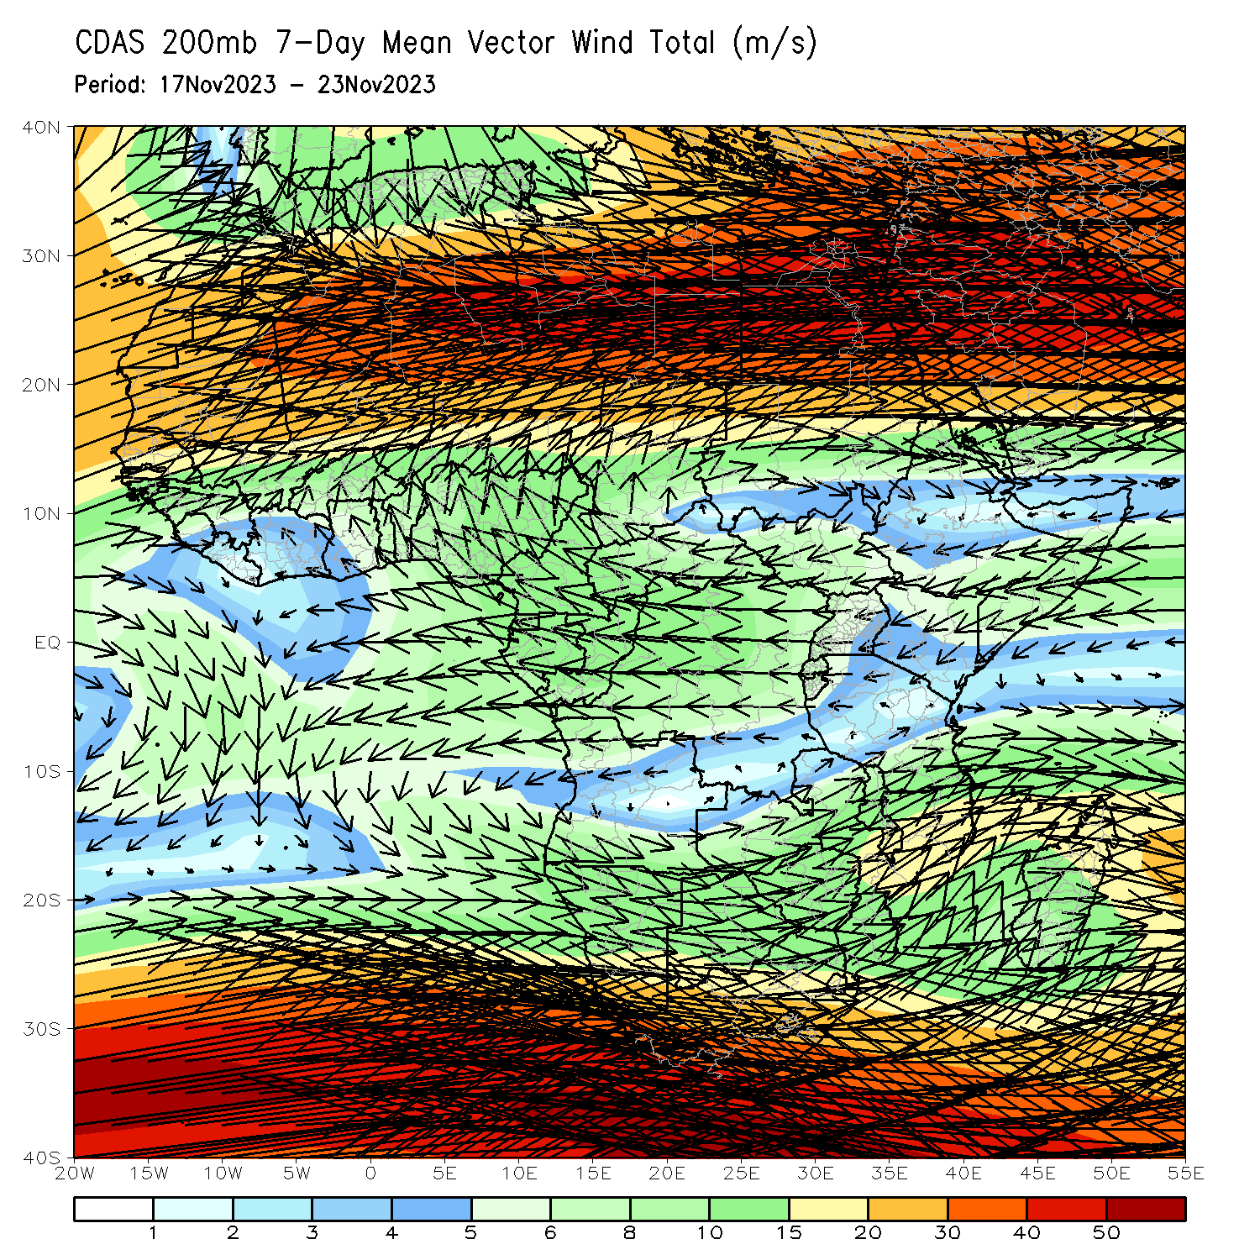
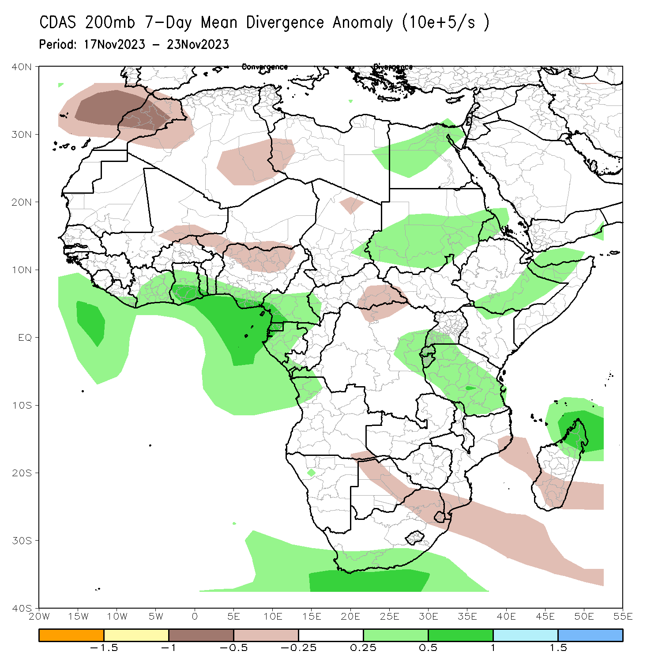
Atmospheric Circulation: Last 7 Days
There is no clear circulation forcing ascribed to the observed rainfall, but an enhanced moisture inflow at 850 hPa (left panel) across eastern and central Africa has contributed to the increased rainfall in Tanzania and the DRC. At 200-hPa, upper-level divergence (bottom-right) located in Tanzania and eastern DRC and that over southern Ethiopia contributed to the above average precipitation in these regions.

Slide 8
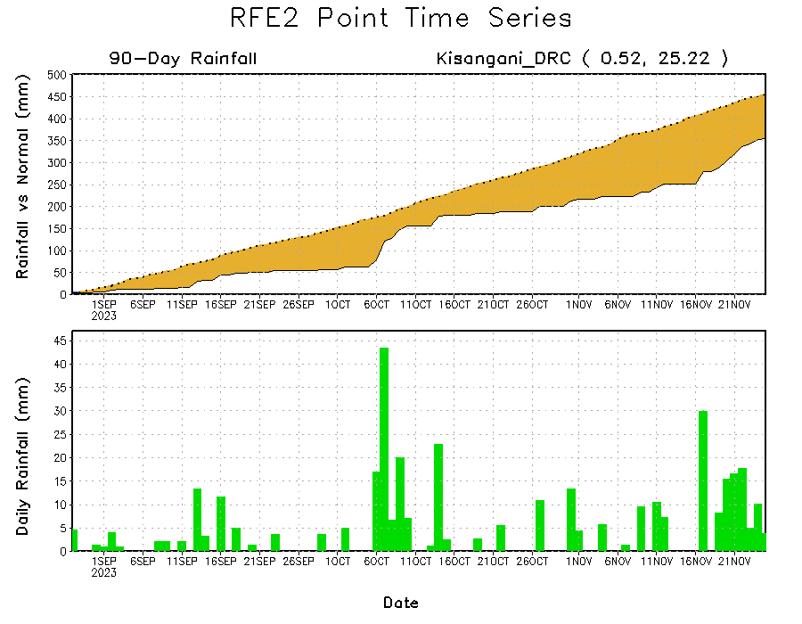
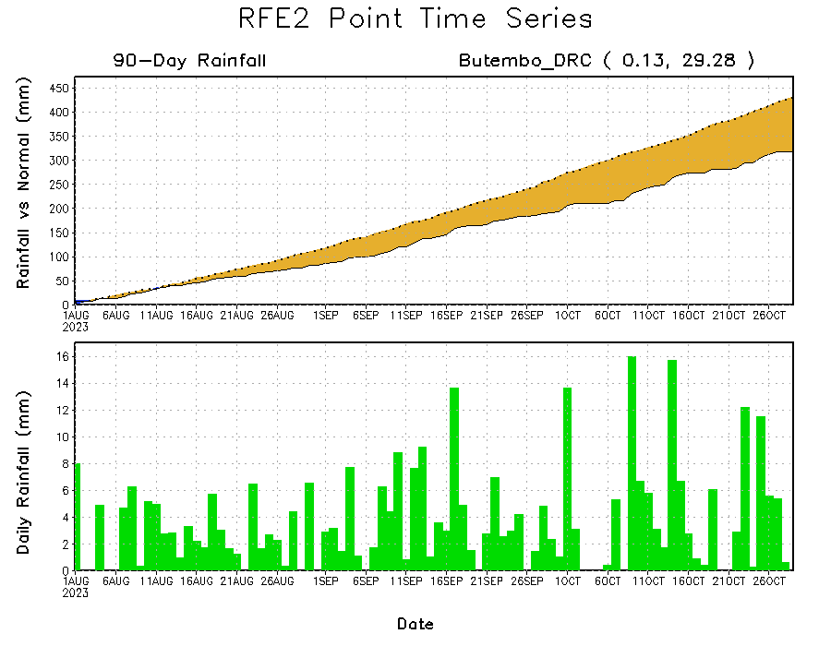
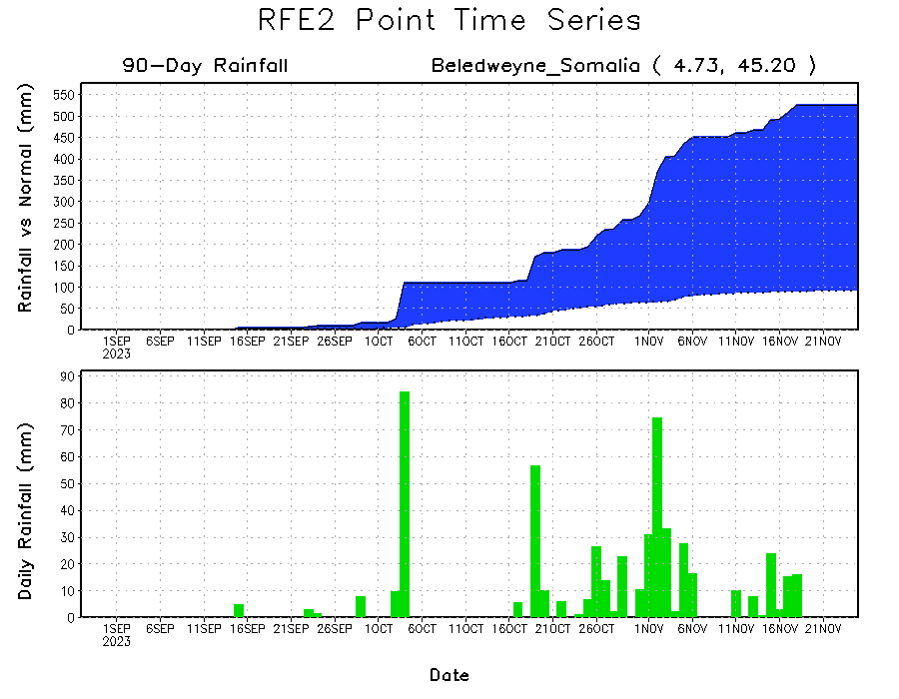
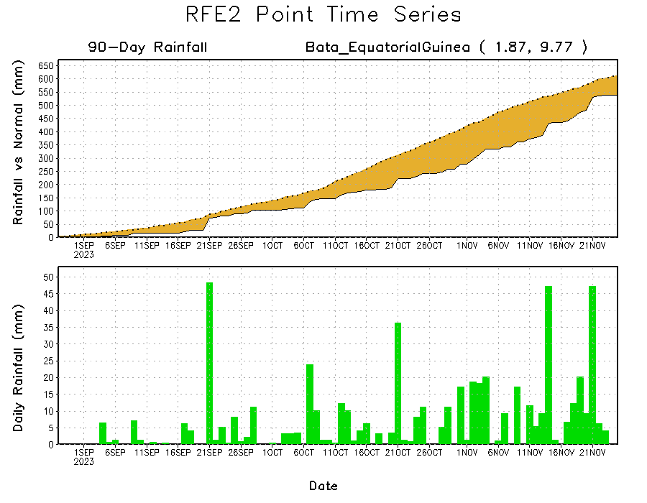
Rainfall Evolution
Daily evolution of rainfall over the last 90 days at selected locations shows light rainfall increased moisture deficits over parts of Equatorial Guinea (bottom left). Seasonal total rainfall remained below-average over northeastern DRC due to the recent below average rainfall (top right). The recent heavy rainfall also increased surpluses early in the rainfall season over southern Somalia (bottom right).

Slide 9
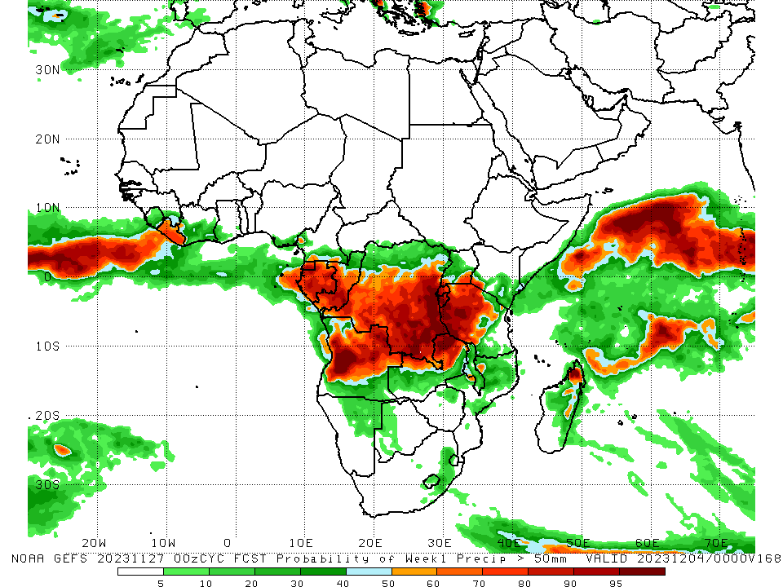
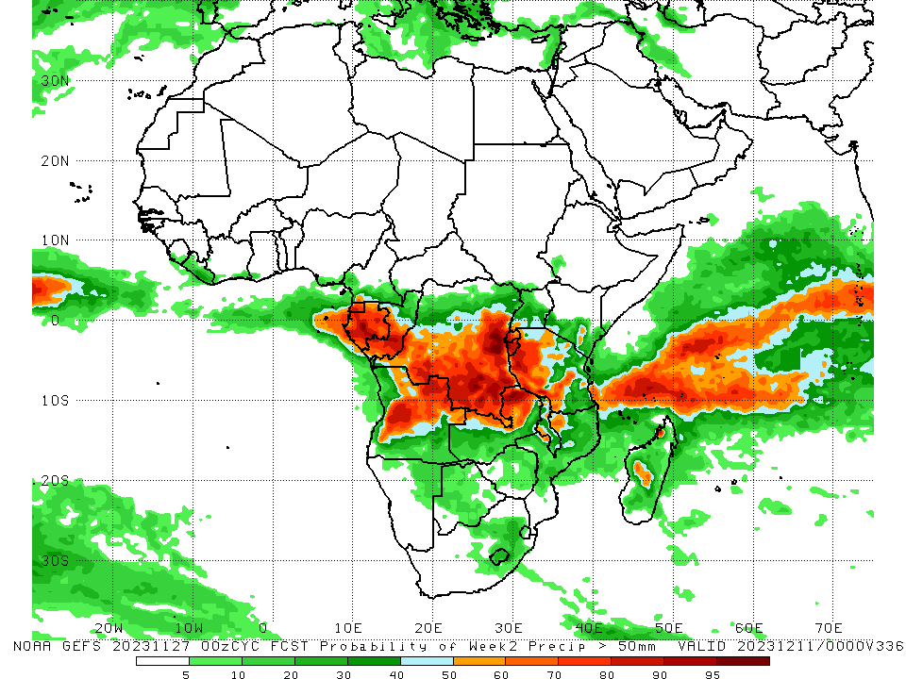
NCEP GEFS Model Forecasts Non-Bias Corrected Probability of precipitation exceedance
Week-1, Valid: 28 Nov – 04 Dec 2023
Week-2, Valid: 05 – 11 Dec 2023
For Week-1 (left-panel), there is moderate to high chance (over 70%) for rainfall to exceed 50 mm over western Tanzania, Lake Victoria regions, Rwanda, Burundi, over Liberia and parts of Gabon and Congo, Equatorial Guinea, eastern and southern DRC, parts of northern and western Angola, northern Zambia, and northeastern Madagascar. For week-2 (right panel), the GEFS model predicts a continuation of moderate to high chance (over 70%) for rainfall to exceed 50 mm over Equatorial Guinea, Gabon, southern Congo, southern and east-central DRC, Rwanda, Burundi, western and northeastern Angola, northern Zambia, and western Tanzania.
Notes:
9

Slide 10
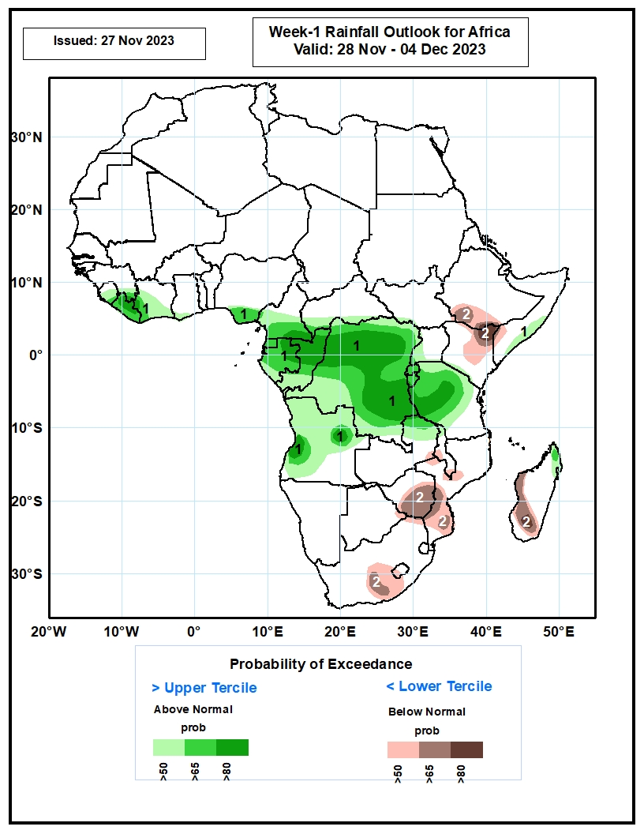
Week-1 Precipitation Outlooks
The probabilistic forecasts call for above 50% chance for weekly rainfall to be above-average (above the upper tercile) over much of Sierra Leone, southeastern Guinea, Liberia, western and southern Cote d’Ivoire, southwestern Ghana, southern Nigeria, central and southern Cameroon, southern CAR, Equatorial Guinea, Gabon, Congo, much of DR Congo, Rwanda, Burundi, western Uganda, much of Angola, northern Zambia, southern Somalia, much of Tanzania, and northern part of Madagascar. There is above 80% chance for above-average rainfall over northern Liberia, southwestern Cote d’Ivoire, southeastern Cameroon, northern Gabon, northern and central Congo, northern and eastern portions of DR Congo, central Tanzania, and western and eastern parts of Angola.
The probabilistic forecasts call for above 50% chance for weekly total rainfall to be below-average (below the lower tercile) over southern part of Ethiopia, northeastern and central Kenya, southern part of Somalia, southeastern Zambia, central and southern part of Malawi, central and southern Mozambique, central and eastern Zimbabwe, south-central South Africa, western Lesotho, and western and southern parts of Madagascar. There is above 80% chance for below-average rainfall over south-central Ethiopia and northeastern Kenya.
28 Nov – 04 Dec 2023
Notes:
10

Slide 11
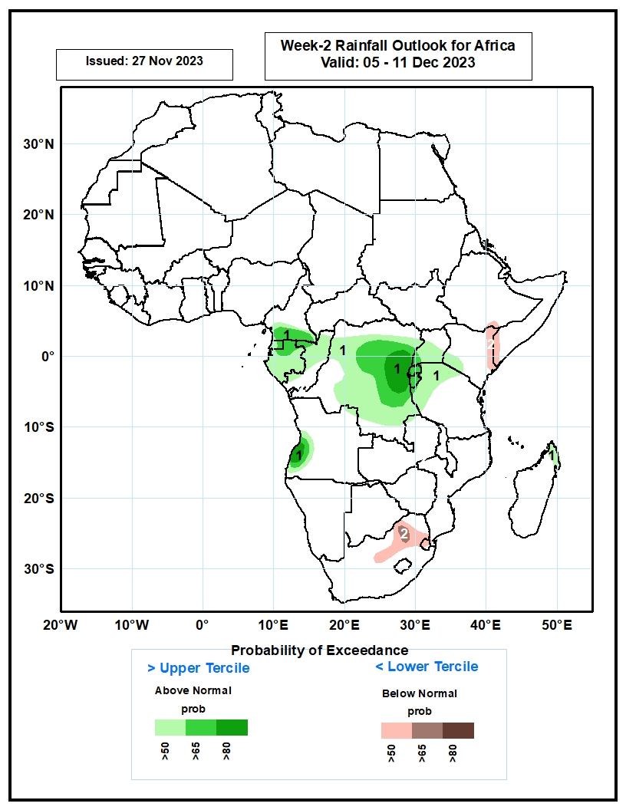
Week-2 Precipitation Outlooks
05 – 11 Dec 2023
The probabilistic forecasts call for above 50% chance for weekly rainfall to be above-average (above the upper tercile) over southern Cameroon, Equatorial Guinea, Gabon, much of Congo, much of DR Congo, Rwanda, Burundi, central and southern Uganda, southwestern Kenya, western and northern parts of Tanzania, southwestern Angola, and northern Madagascar. There is above 80% chance for above-average rainfall over east-central DR Congo, and southwestern Angola.
The probabilistic forecasts call for above 50% chance for weekly total rainfall to be below-average (below the lower tercile) over south-central Ethiopia, eastern Kenya, southern Somalia, northern part of South Africa, and much of Eswatini. There is above 65% chance for below-average rainfall over northern part of South Africa.
Notes:
11

Slide 12
Summary
Over the past 30 days, in East Africa, above-average rainfall was observed over southern and eastern Sudan, South Sudan, western and central Eritrea, northern, western, and southern Ethiopia, northwestern, central, and southeastern Uganda, most of Kenya, southern, central, and northwestern Somalia, Burundi, southern and eastern Rwanda, and parts of northern, western, and eastern Tanzania. Rainfall anomalies exceeded their long-term 30-day averages by more than 300mm in southern Somalia, central and northeastern Kenya, parts of southwestern and southern Ethiopia, and parts of northeastern Tanzania. Rainfall was below-average in parts of central Tanzania, parts of eastern Uganda, and central Rwanda. In Central Africa, rainfall was above-average over parts of southwestern and southeastern Cameroon, southwestern and northern half of Congo, most of CAR, most of Gabon excluding northern and southeastern areas, Equatorial Guinea, and most of DRC excluding isolated pockets in the northeast, southwest, central, and southeast regions. Below-average rainfall was observed over much of south-central, east-central, and west-central Cameroon, northern Gabon, central, and southeastern Congo. In West Africa, rainfall was above-average over western and southeastern Guinea-Conakry, central Sierra Leone, northwestern and eastern Liberia, northern, southern and eastern Cote d’Ivoire, southwestern Ghana, and southwestern, central and eastern Nigeria. Below-average rainfall was observed over central Guinea-Conakry, southern Sierra Leone, western and southern Burkina Faso, southern Sierra Leone, most areas of Liberia excluding northwestern and eastern regions, west-central Cote d’Ivoire, south-central Togo, northern Benin, and over coastal and eastern regions of Nigeria. In southern Africa, above-average rainfall was observed over much of northern Angola, northern Zambia, parts of northern and central Malawi, northern and south-central Mozambique, Lesotho and surrounding areas of South Africa, isolated areas in northern Namibia and southwestern Botswana, and northeastern and central Madagascar. Rainfall was below-average over southern and eastern Angola, northeastern Namibia, eastern Botswana, northern and southwestern South Africa, much of Zimbabwe, western half and northeastern parts of Zambia, central and southern Mozambique, and west-central and southern Madagascar.
During the past 7 days, in East Africa, rainfall has substantially decreased over most areas. Rainfall was above-average at isolated places in western and southern Ethiopia, over western and eastern South Sudan, southern and central Somalia, central and eastern Kenya, northwestern and southeastern Uganda, and northern, western, and eastern Tanzania. Anomalies in excess of 100 mm or more were observed only in parts of east-central Kenya and at isolated locations in Lake Victoria regions. In central Africa, above-average rainfall was observed over southeastern Cameroon, parts of Equatorial Guinea, southern and eastern CAR, southern Gabon and northern Congo, and western, northern, and eastern parts of DRC. Anomalies in excess of 100 mm or more were observed in parts of northeastern DRC and central Congo. Rainfall was below-average over parts of southeastern Congo extending into parts of western DRC and over eastern-central and southern DRC. In West Africa, above-average rainfall was observed over parts of northwestern Guinea-Conakry and a few places in south-central Cote d’Ivoire, southwestern parts of Ghana, northern Benin, and over west-central Nigeria. Rainfall was slightly below average in Liberia and over parts of central Cote d’Ivoire. In southern Africa, rainfall was above-average over parts of northwestern and southwestern Angola, north-central Namibia, and northeastern Zambia and northern borders of Zimbabwe. Southeastern and northeastern Angola, much of Zambia and Zimbabwe, central and southern Mozambique, eastern parts of Botswana, northeastern and eastern South Africa, Lesotho, and much of Madagascar received below average rainfall.
For Week-1, there is moderate to high chance (over 70%) for rainfall to exceed 50 mm over western Tanzania, Lake Victoria regions, Rwanda, Burundi, Liberia and parts of Gabon and Congo, Equatorial Guinea, eastern and southern DRC, parts of northern and western Angola, northern Zambia, and northeastern Madagascar. For week-2, the GEFS model predicts a continuation of moderate to high chance (over 70%) for rainfall to exceed 50 mm over Equatorial Guinea, Gabon, southern Congo, southern and east-central DRC, Rwanda, Burundi, western and northeastern Angola, northern Zambia, and western Tanzania.

