Slide 1
The African Monsoon Recent Evolution and Current Status Include Week-1 and Week-2 Outlooks
Update prepared
11 December 2023
For more information, visit:
http://www.cpc.ncep.noaa.gov/products/Global_Monsoons/African_Monsoons/precip_monitoring.shtml

Slide 2
Outline
Highlights
Recent Evolution and Current Conditions
NCEP GEFS Forecasts
Summary

Slide 3
Highlights: Last 7 Days
During the past 7 days, in East Africa, rainfall was above-average in many parts of Tanzania and Rwanda, central and eastern Burundi, northern, southern and central-eastern Uganda, and pockets of southwest South Sudan and southeast Kenya. Below-average rainfall was observed over southwest Ethiopia, southern Somalia, and southern, central and central-eastern Kenya. In central Africa, above-average rainfall was observed over western, central and southern CAR, southern Cameroon, central and northern Equatorial Guinea, northern, central and southeast Gabon, southern Congo, and northern, northwest, southwest and southeast DRC. Rainfall was below-average over western Gabon, central and eastern Congo, central, eastern, and southern DRC, and near the border of northern Angola and in for western DRC. In West Africa, above-average rainfall was observed over southeast Cote d’Ivoire and southern Togo. In southern Africa, rainfall was above-average over southwest Angola, northern parts of Zambia and Malawi, Lesotho, Eswatini, central-eastern South Africa, pockets of northwest and southern Mozambique, and pockets of northwest Madagascar. Below-average rainfall was observed over northern, western-central, eastern and southeast Angola, northern and northeast Namibia, western, central, southern and eastern Zambia, Zimbabwe, western, northern and eastern Botswana, central and southern Mozambique, western South Africa, and western, central, eastern, northeast and southeast Madagascar.
The Week-1 outlook calls for above-average rainfall in central and southern parts of Gabon and Uganda, southern Congo, western, central, southern and eastern DRC, Rwanda, Burundi, southern Kenya, northern and western Tanzania, northern and central Angola, Botswana, southern and eastern Zimbabwe, southern Mozambique, northern and northeast South Africa, Lesotho and Eswatini. In contrast, there is an increased chance for below-average in many parts of Zambia, Malawi, Madagascar and Equatorial Guinea, and southern parts of Angola, Tanzania, Ethiopia and Cameroon, northern Mozambique, central South Africa, Liberia, and southern parts of Cote d’Ivoire and Ghana. The Week-2 outlook calls for above-normal rainfall in many parts of DRC, Angola and Zimbabwe, Rwanda, Burundi, Lesotho, Eswatini, northern and southern Gabon, central and southern Congo, western and northwest Tanzania, southern and southeast Kenya, northern and eastern Botswana, northern, central, northwest and eastern South Africa, and southern Mozambique. In contrast, there is an increased chance for below-average in Malawi, central and eastern Zambia, southern parts of Tanzania and Ethiopia, central and northeast Namibia, western, central and northern Madagascar, Liberia, and southern parts of Cote d’Ivoire and Ghana.

Slide 4
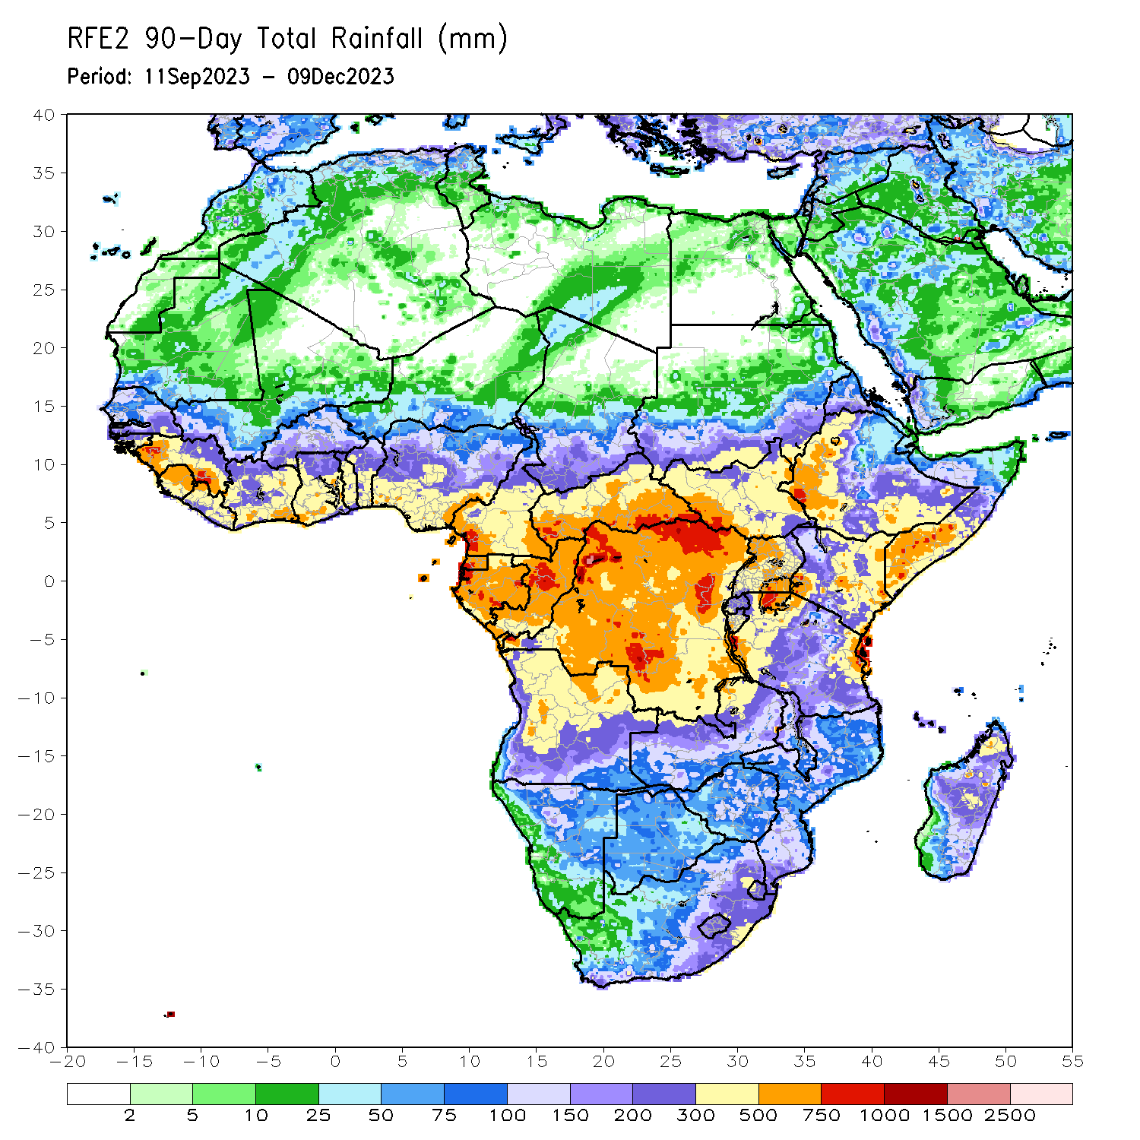
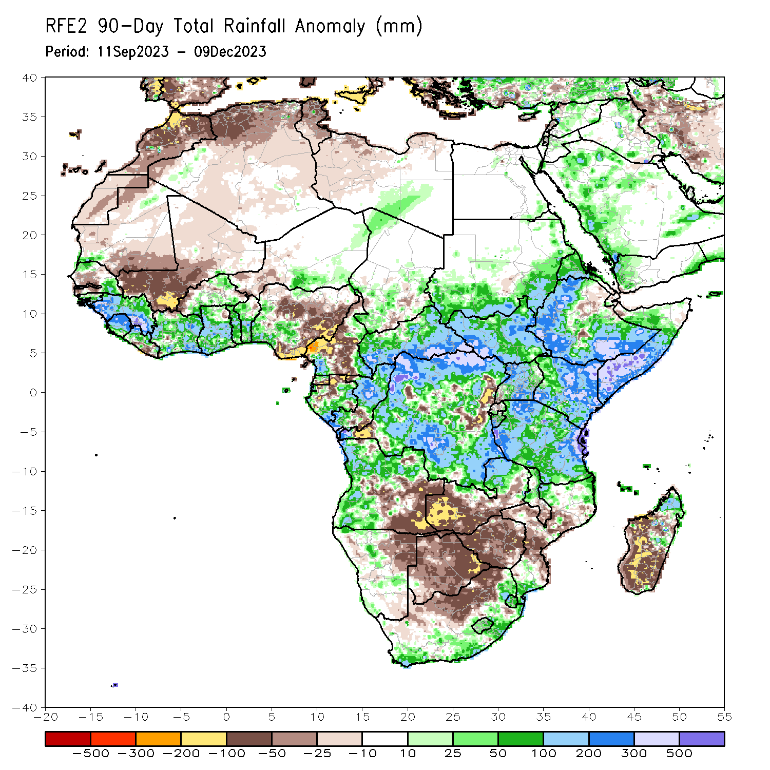
Rainfall Patterns: Last 90 Days
Over the past 90 days, in East Africa, above-average rainfall was observed in many parts of South Sudan, Kenya, Tanzania, Burundi and Uganda, southwest, southern, central and eastern Sudan, northern and central Eritrea, northern, western, southern and eastern Ethiopia, and southern, central, eastern and northwest Somalia. Rainfall was below-average over central-eastern Ethiopia, southern Eritrea, northern Djibouti, central and northern Burundi, and pockets of southwest Uganda. In Central Africa, rainfall was above-average in many parts of CAR, northern, western, southern, southeast and central DRC, northern and central Congo, eastern and southeast Gabon, northwest southwest Chad, and pockets of southwest and southeast Cameroon. Rainfall was below-average over northern, central, western and southern Cameroon, southern Equatorial Guinea, northern Gabon, central Congo, southern Chad, and pockets of southwest and eastern DRC. In West Africa, rainfall was above-average over northern and southeast Senegal, southern and eastern Guinea-Bissau, Gabon, Sierra Leone, northern Liberia, many parts of Cote d’Ivoire, Ghana and Togo, central and southern Benin, northern and southern Burkina Faso, southeast Niger, and southwest Nigeria. Below-average rainfall was observed over southwest Senegal, Gambia, southeast Mauritania, western Mali, western Burkina Faso, eastern Liberia, southwest Niger, and central, eastern and southeast Nigeria. In southern Africa, above-average rainfall was observed over northern, western and southwest Angola, north-central Namibia, northern Zambia, central and northern Malawi, pockets of northern and southern Mozambique, southeast, eastern and northeast South Africa, Eswatini, Lesotho, and northern Madagascar. Below-average rainfall was observed over southeast Angola, northeast Namibia, western and southern Zambia, many parts of Botswana and Zimbabwe, western and central-western South Africa, central Mozambique, southern Malawi, and western, southern and southeast Madagascar.
Notes:
4

Slide 5
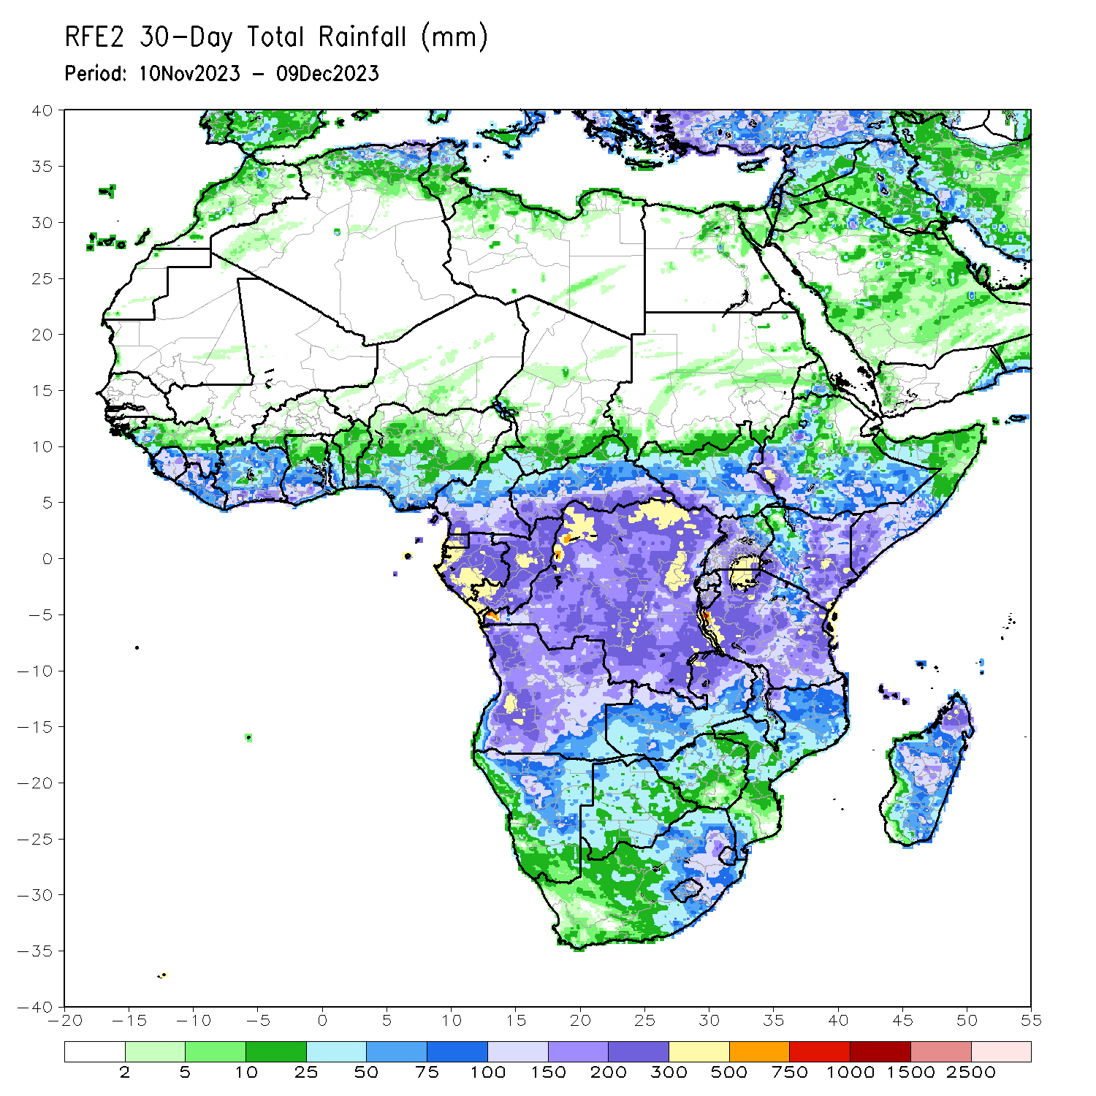
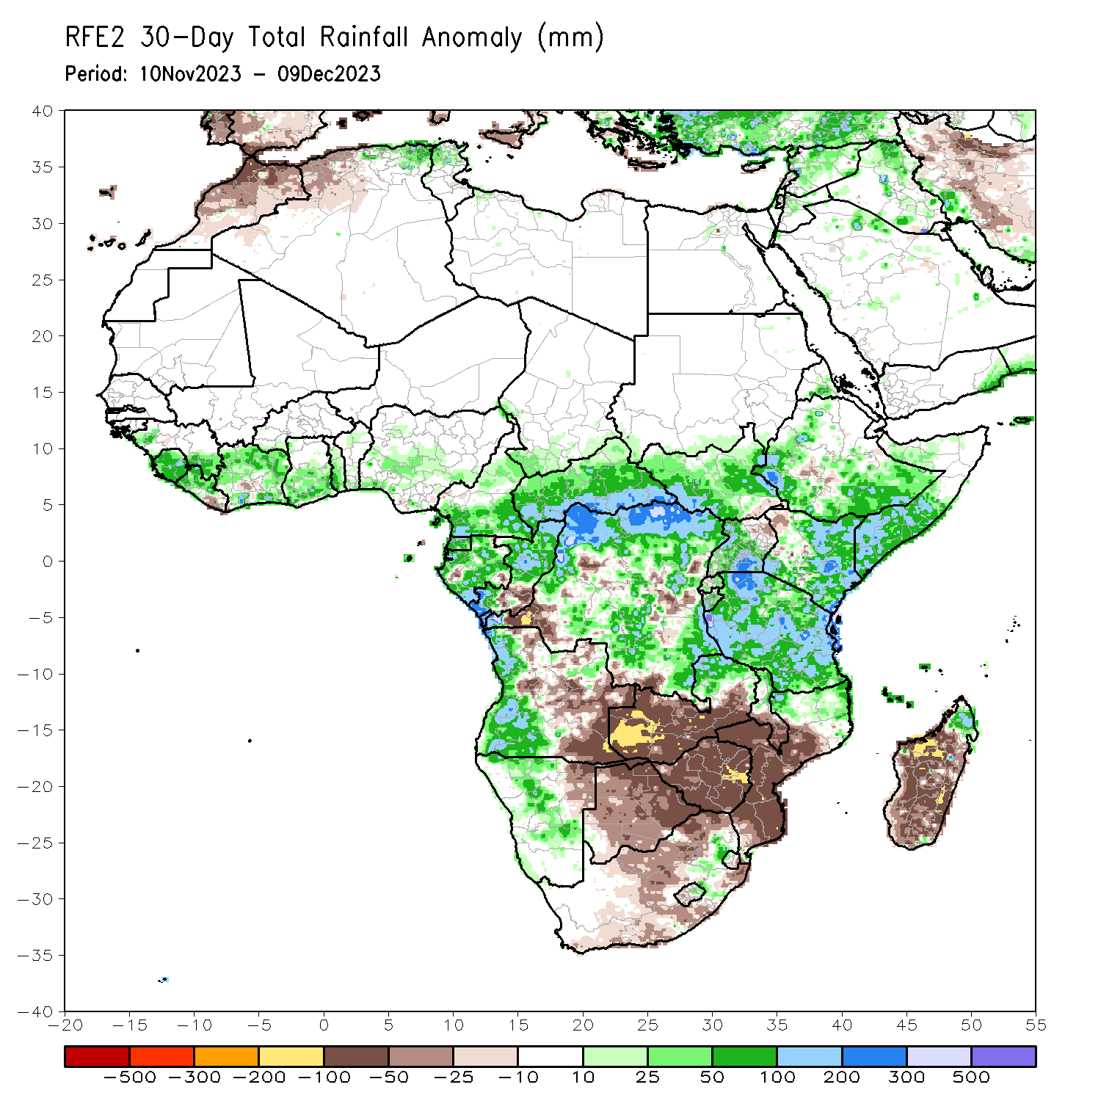
Rainfall Patterns: Last 30 Days
Over the past 30 days, in East Africa, above-average rainfall was observed in many parts of South Sudan, Kenya, Tanzania and Burundi, western and eastern Rwanda, western, southern, central and northwest Uganda, southern and eastern Sudan, northern, western, southern and eastern Ethiopia, northern and central Eritrea, and central, southern and northwest Somalia. Rainfall was below-average over pockets of southern South Sudan and central Ethiopia. In Central Africa, rainfall was above-average across CAR and Equatorial Guinea, many parts of Gabon and Cameroon, southern Chad, northern and southern Congo, and northern, northwest, central-southern, northeast and southeast DRC. Below-average rainfall was observed in central Congo, pockets of southwest and southern DRC, and pockets of southeast Gabon and southwest Cameroon. In West Africa, rainfall was above-average over western and southeast Senegal, Sierra Leone, western and northern Liberia, western, northern, eastern and southern Cote d’Ivoire, central and southern Ghana, southern Burkina Faso, Togo, central and southern Benin, and western, central and southern Nigeria. Below-average rainfall was observed over eastern Liberia and pockets of central Cote d’Ivoire and southeast Nigeria. In southern Africa, above-average rainfall was observed in western, northern and southwest Angola, northern, central and southeast Namibia, northern parts of Zambia, Malawi, Mozambique and Madagascar, southwest Botswana, and near border of western Eswatini and South Africa. Below-average rainfall was observed over central and southeast Angola, northeast Namibia, western, southern and central Zambia, western, northern, central and eastern Botswana, Zimbabwe, southern Malawi, central and southern Mozambique, northern, western, central and eastern South Africa, Lesotho, eastern Eswatini, and western, southern and southeast Madagascar.
Notes:
5

Slide 6
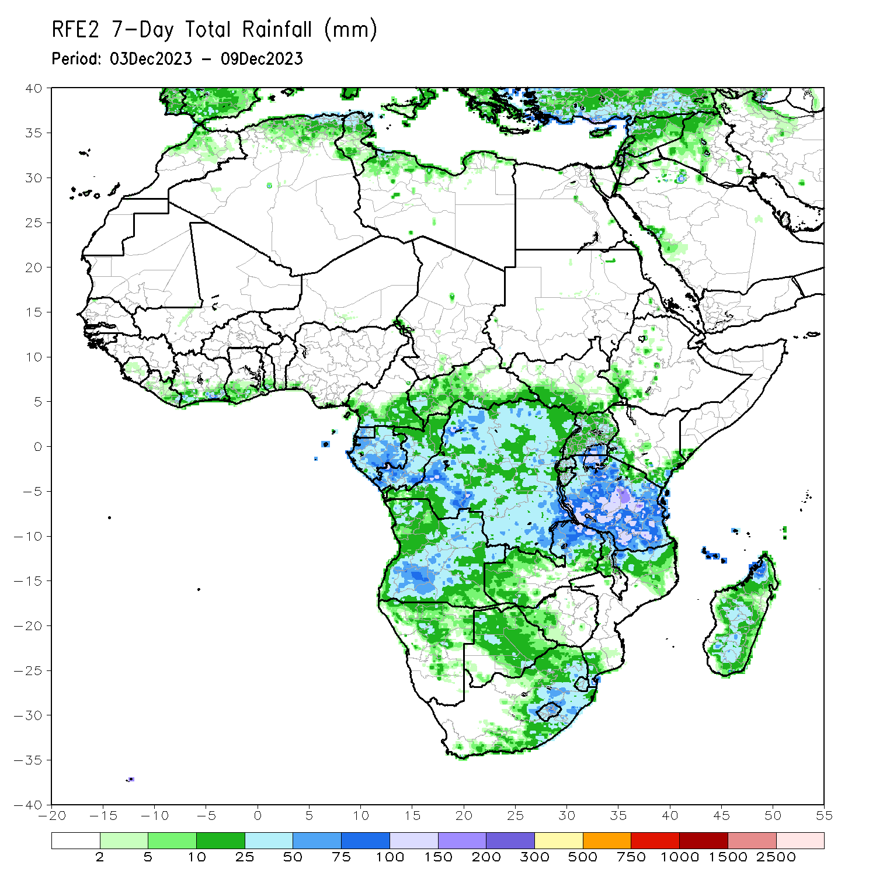
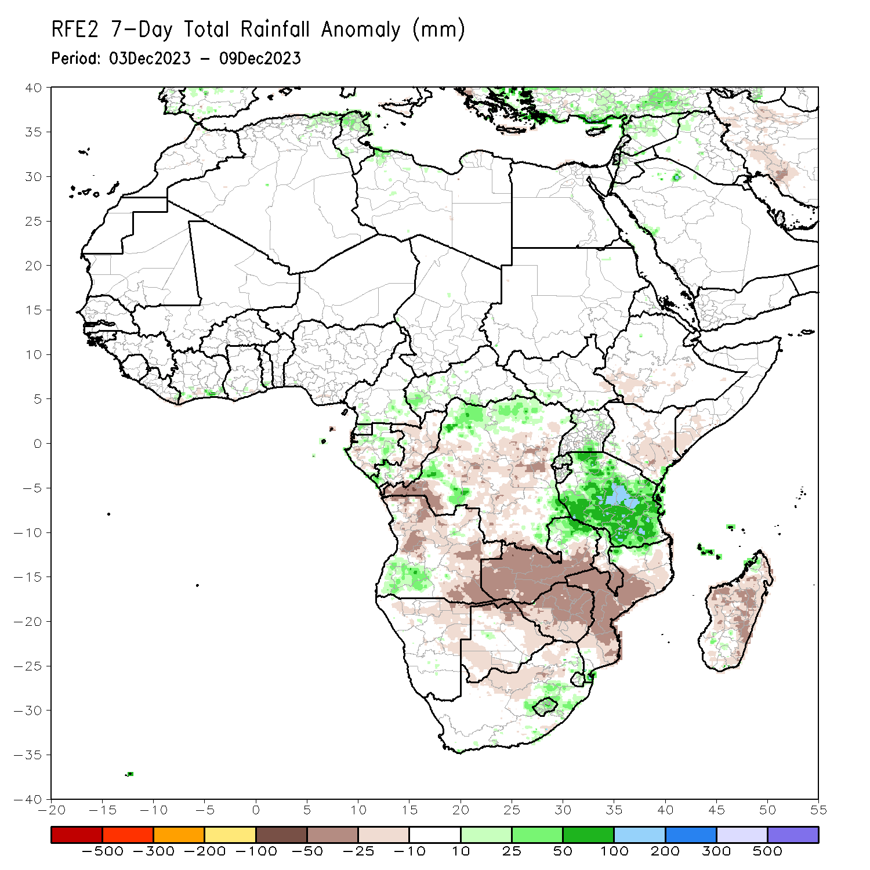
Rainfall Patterns: Last 7 Days
During the past 7 days, in East Africa, rainfall was above-average in many parts of Tanzania and Rwanda, central and eastern Burundi, northern, southern and central-eastern Uganda, and pockets of southwest South Sudan and southeast Kenya. Below-average rainfall was observed over southwest Ethiopia, southern Somalia, and southern, central and central-eastern Kenya. In central Africa, above-average rainfall was observed over western, central and southern CAR, southern Cameroon, central and northern Equatorial Guinea, northern, central and southeast Gabon, southern Congo, and northern, northwest, southwest and southeast DRC. Rainfall was below-average over western Gabon, central and eastern Congo, central, eastern, and southern DRC, and near the border of northern Angola and in for western DRC. In West Africa, above-average rainfall was observed over southeast Cote d’Ivoire and southern Togo. In southern Africa, rainfall was above-average over southwest Angola, northern parts of Zambia and Malawi, Lesotho, Eswatini, central-eastern South Africa, pockets of northwest and southern Mozambique, and pockets of northwest Madagascar. Below-average rainfall was observed over northern, western-central, eastern and southeast Angola, northern and northeast Namibia, western, central, southern and eastern Zambia, Zimbabwe, western, northern and eastern Botswana, central and southern Mozambique, western South Africa, and western, central, eastern, northeast and southeast Madagascar.

Slide 7
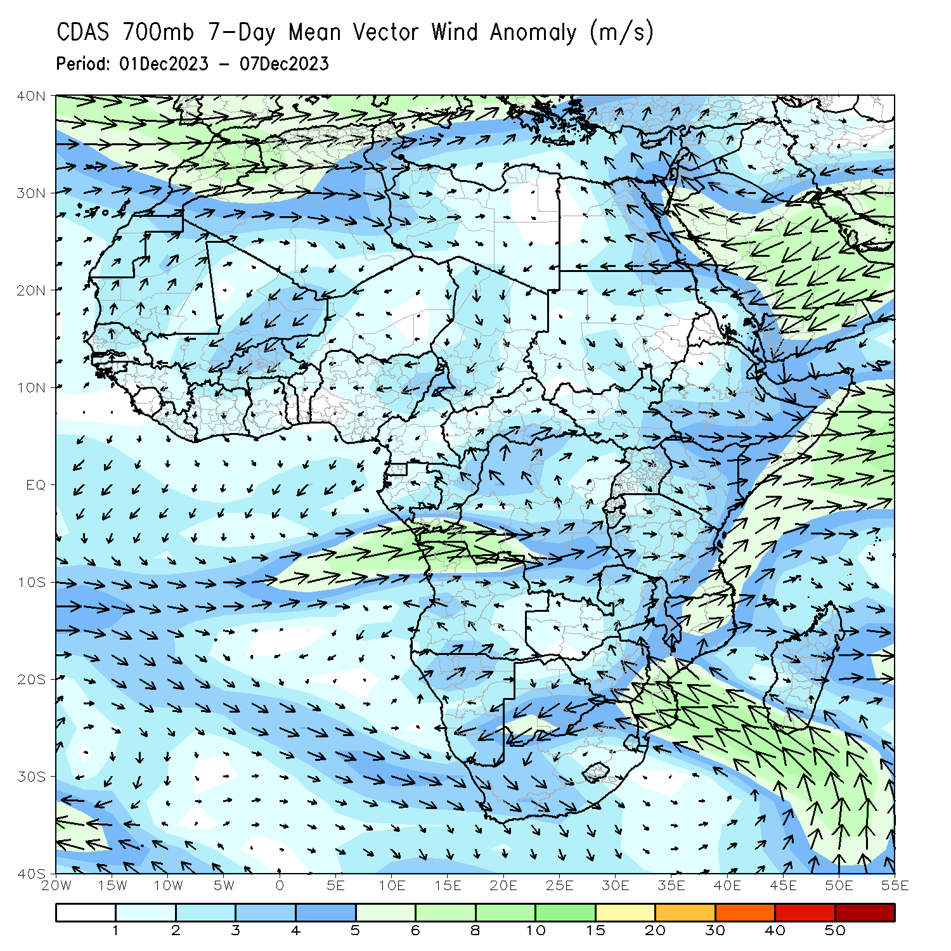
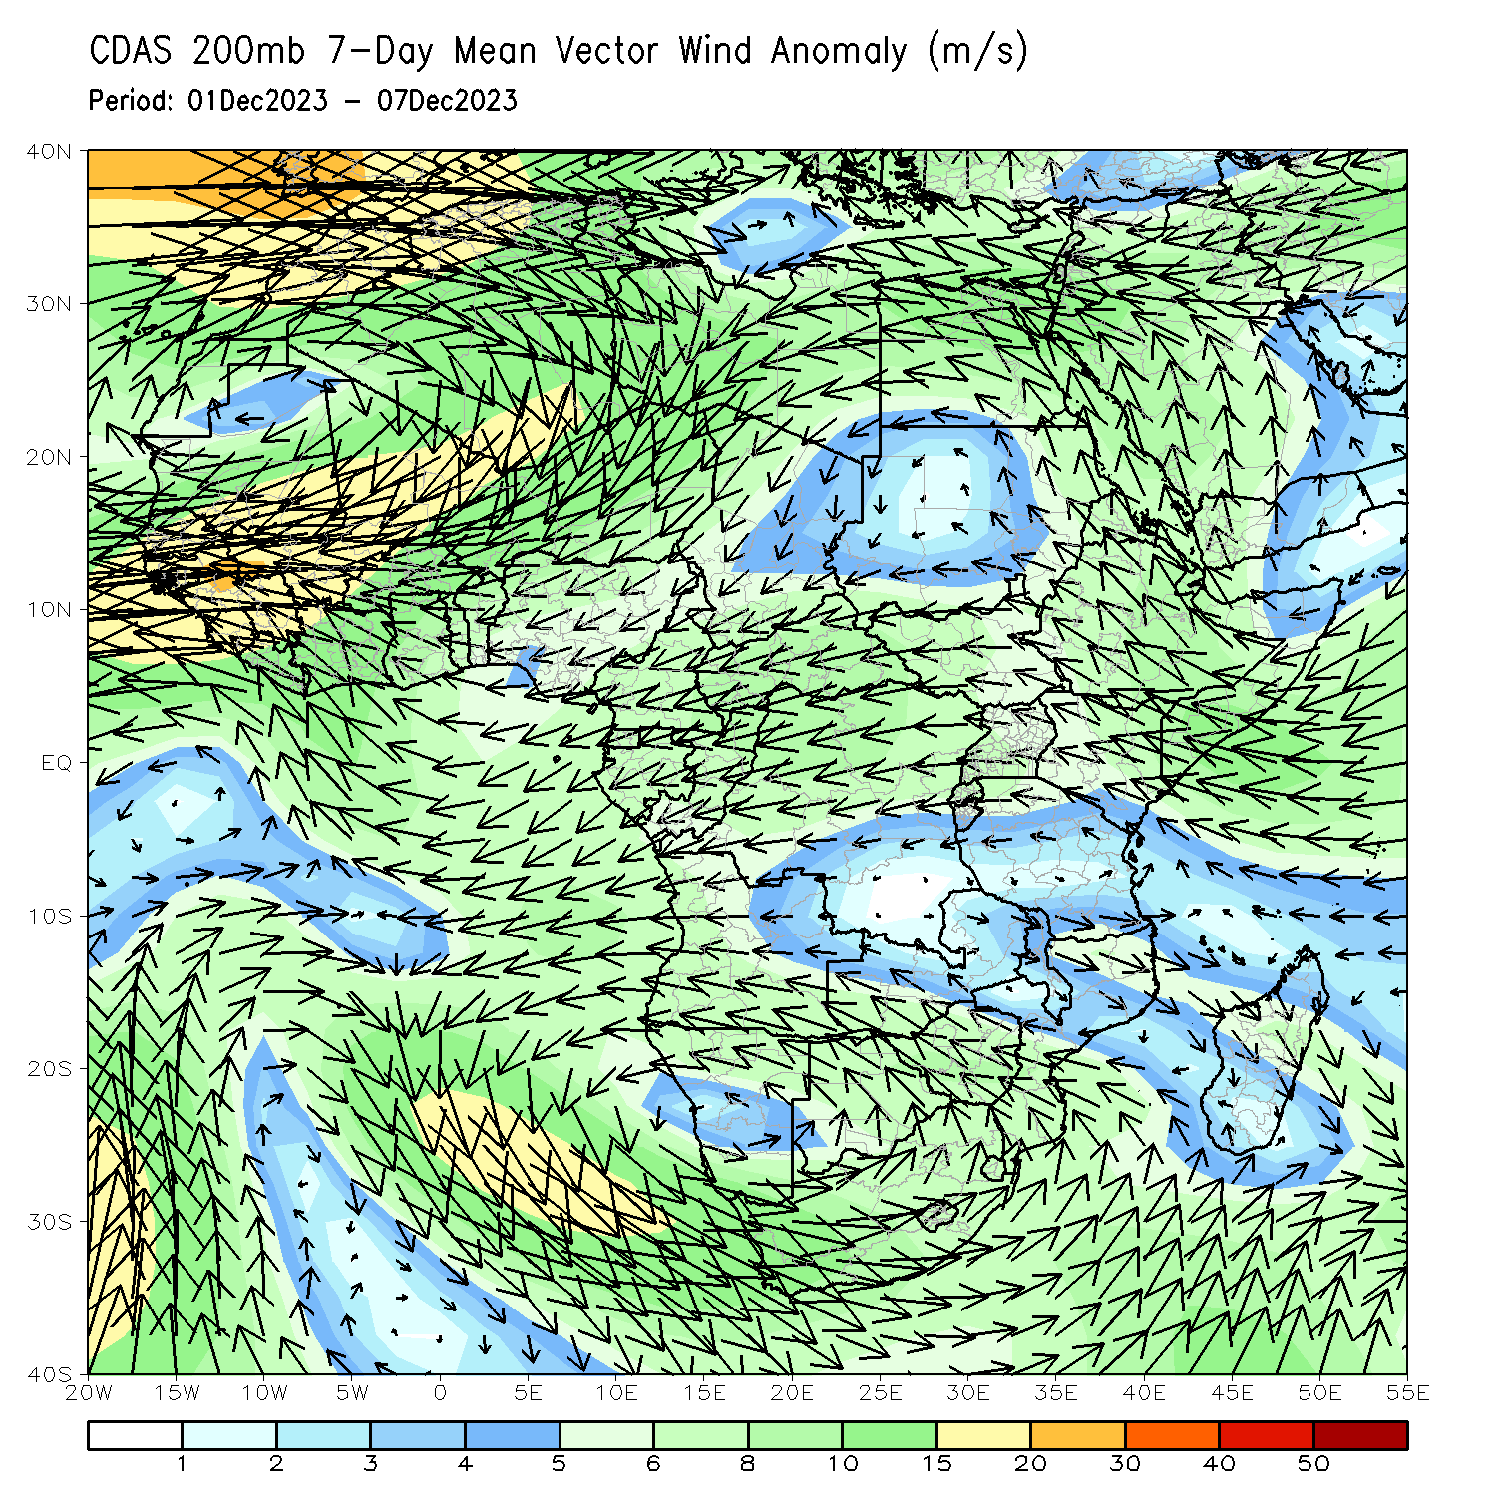
Atmospheric Circulation: Last 7 Days
At 850-hPa level (left panel), Anomalous lower-level convergence was present across Tanzania, likely contributing to the above-average precipitation in Tanzania.

Slide 8
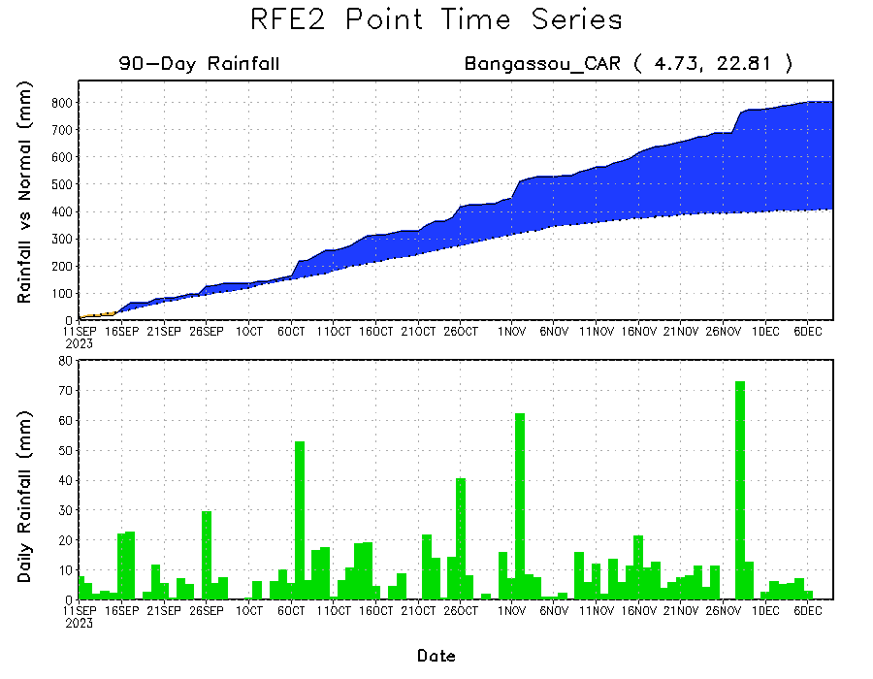
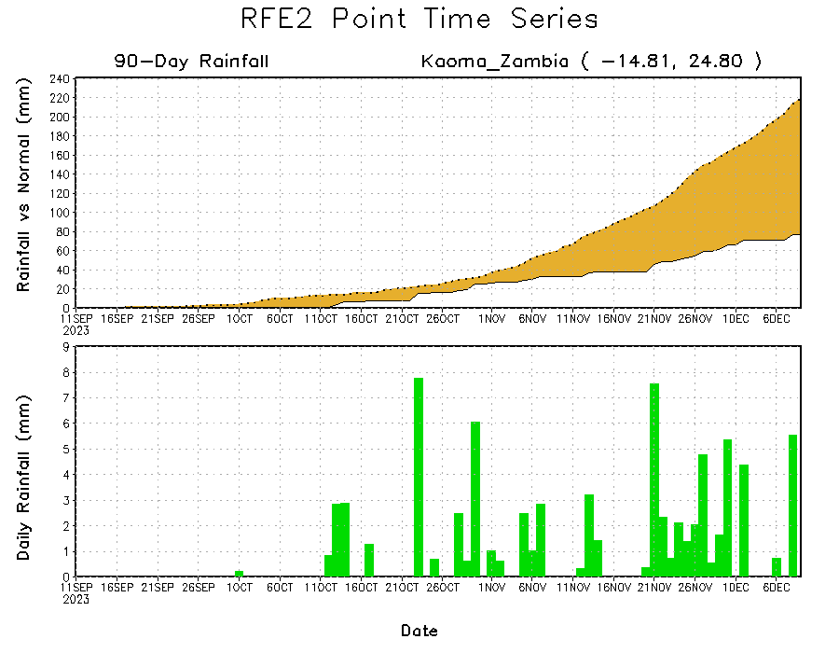
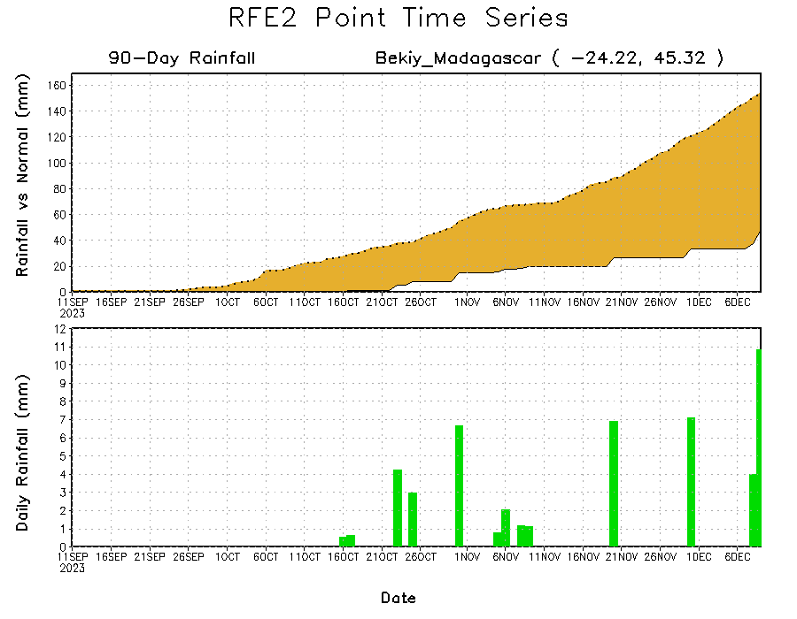
Rainfall Evolution
Daily evolution of rainfall over the last 90 days at selected locations shows a growing dryness over parts of western Zambia (bottom left) and southwest Madagascar (bottom right). Seasonal total rainfall remained above-average over southern CAR due to the moderate to heavy rainfall fell in southern CAR during last 2 months (top right).

Slide 9
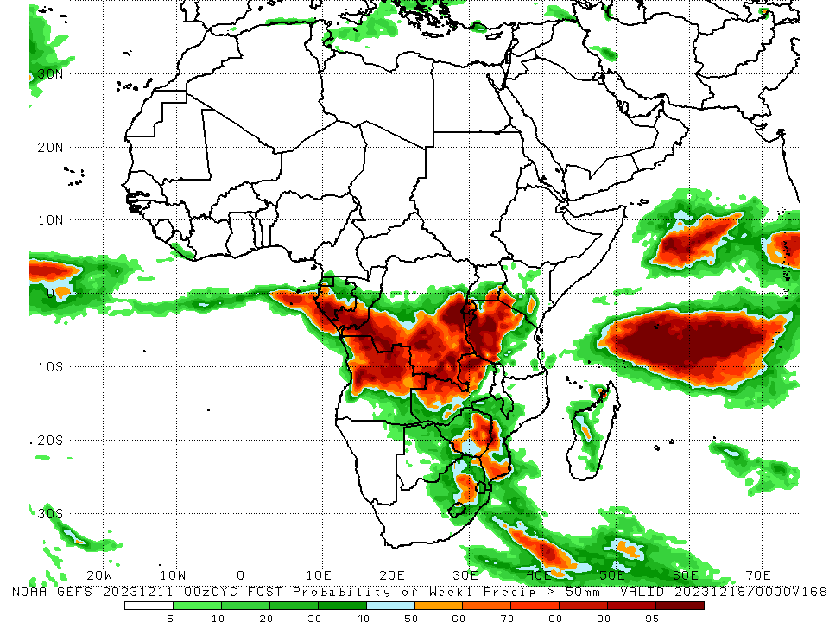
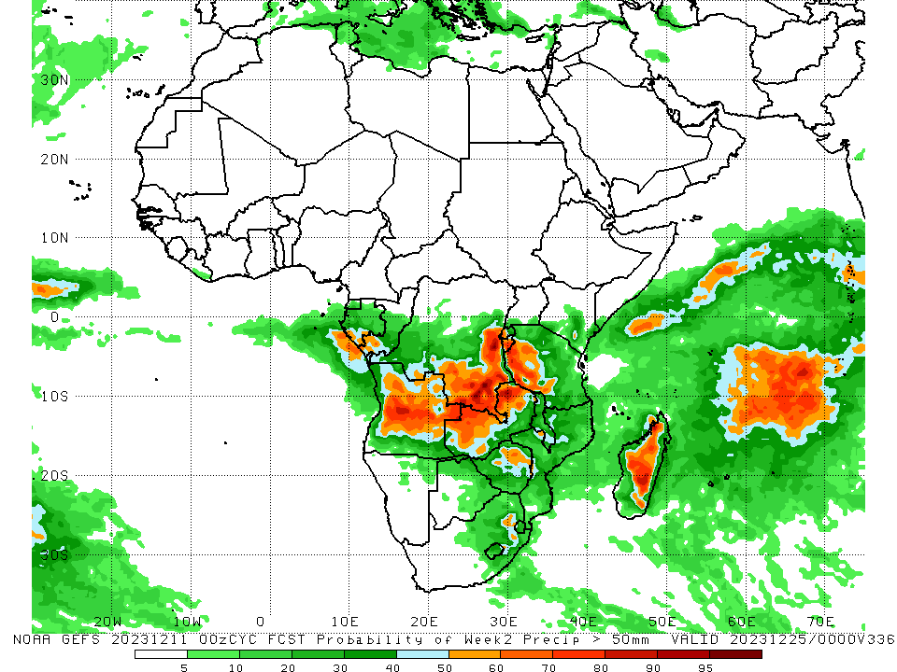
NCEP GEFS Model Forecasts Non-Bias Corrected Probability of precipitation exceedance
Week-1, Valid: 12 – 18 Dec 2023
Week-2, Valid: 19 – 25 Dec 2023
For week-1 (left panel) the GEFS forecasts indicate a moderate to high chance (over 70%) for rainfall to exceed 50 mm over western and southern Gabon, southern Congo, southwest, central-southern, southern, and eastern DRC, Rwanda, Burundi, western, central and northern Tanzania, northern, central, eastern and western Angola, northern and northwest Zambia, eastern Zimbabwe, southern Mozambique, and pockets of southeast Uganda and southwest Kenya. For week-2 (right panel), the GEFS forecasts indicate a moderate to high chance (over 70%) for rainfall to exceed 50 mm over central and central-eastern Angola, southern and eastern DRC, Burundi, western Rwanda, western Tanzania, northwest and northern Zambia, and northwest and central Madagascar.
Notes:
9

Slide 10
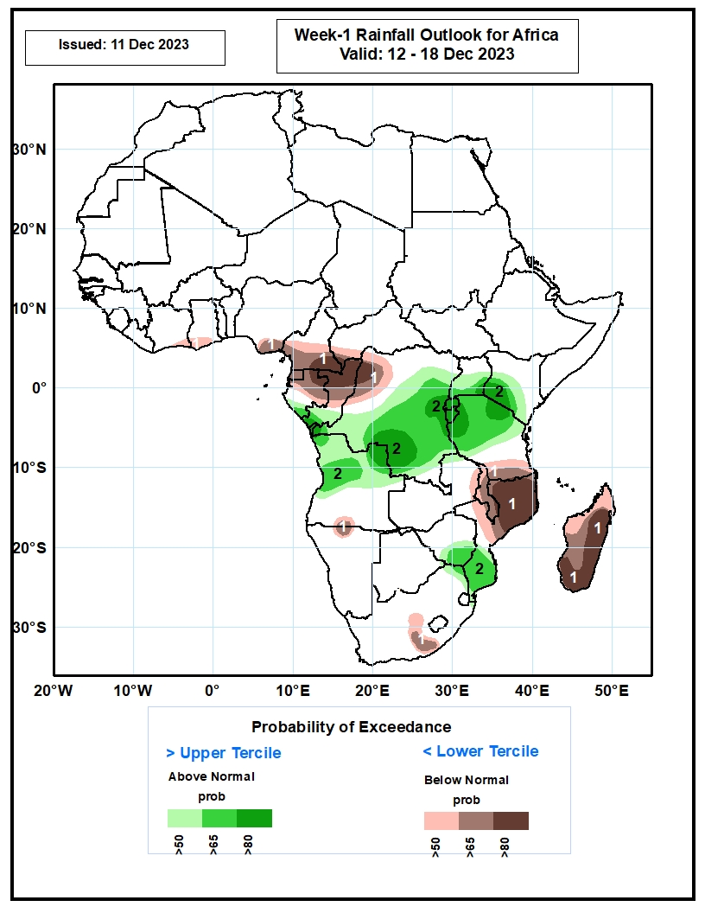
Week-1 Precipitation Outlooks
12 – 18 Dec 2023
The probabilistic forecasts call for above 50% chance for weekly total rainfall to be below-average (below the lower tercile) over southeastern Cote d’Ivoire, southern Ghana, southern Nigeria, central and southern Cameroon, southwestern CAR, Equatorial Guinea, much of Gabon and Congo, northwestern DR Congo, south-central Angola, north-central Namibia, eastern Zambia, Malawi, southern Tanzania, northern and central parts of Mozambique, south-central South Africa, and Madagascar. There is above 80% chance for below-average rainfall over southeastern Cameroon, northeastern Gabon, southwestern CAR, northern Congo, northwestern DR Congo, northern and central parts of Mozambique, and eastern and southern parts of Madagascar.
The probabilistic forecasts call for above 50% chance for weekly rainfall to be above-average (above the upper tercile) over southern Gabon, southern Congo, much of DR Congo, northern and central Angola, Rwanda, Burundi, much of Uganda, western and central parts of Kenya, northern and central portions of Tanzania, southern Zimbabwe, southern Mozambique, and northern part of South Africa. There is above 80% chance for above-average rainfall over southern Congo, eastern and southern parts of DR Congo, Rwanda, Burundi, southwestern Uganda, southwestern Kenya, and western and northern parts of Tanzania
Notes:
10

Slide 11
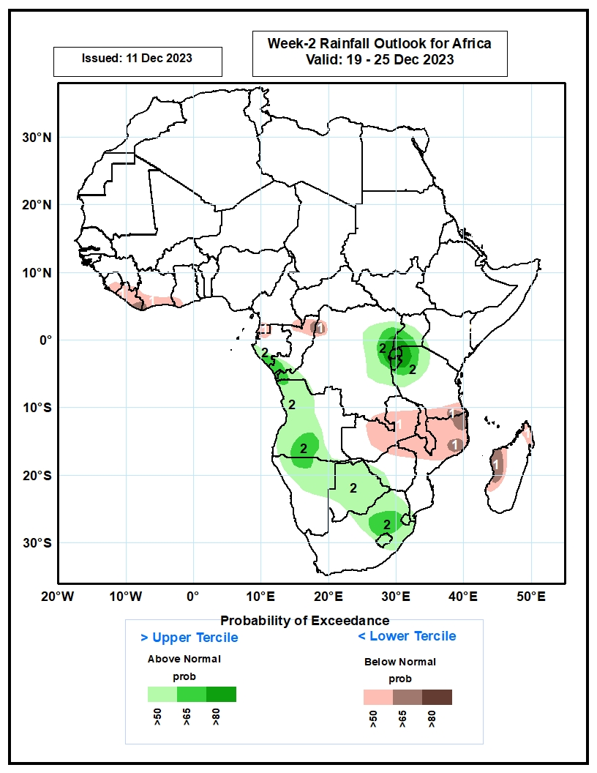
Week-2 Precipitation Outlooks
19 – 25 Dec 2023
The probabilistic forecasts call for above 50% chance for weekly total rainfall to be below-average (below the lower tercile) over eastern Sierra Leone, Liberia, southern Cote d’Ivoire, southwestern Ghana, southeastern Cameroon, Equatorial Guinea, northwestern Gabon, northern Congo, northwestern and southern parts of DR Congo, eastern and central parts of Zambia, Malawi, southern Tanzania, northern and central Mozambique, and northern and western parts of Madagascar. There is above 65% chance for below-average rainfall over eastern Liberia, northern Congo, northwestern DR Congo, southeastern part of Tanzania, northeastern and eastern parts of Mozambique, and western part of Madagascar.
The probabilistic forecasts call for above 50% chance for weekly rainfall to be above-average (above the upper tercile) over southern Gabon, southern Congo, western and eastern parts of DR Congo, Rwanda, Burundi, central and southern Uganda, northwestern Tanzania, western and central parts of Angola, northern and central Namibia, much of Botswana, western Zimbabwe, northern and central parts of South Africa, Lesotho and Eswatini. There is above 80% chance for above-average rainfall over northeastern DR Congo, southwestern Uganda, Rwanda, much of Burundi, and northwestern Tanzania.
Notes:
11

Slide 12
Summary
Over the past 30 days, in East Africa, above-average rainfall was observed in many parts of South Sudan, Kenya, Tanzania and Burundi, western and eastern Rwanda, western, southern, central and northwest Uganda, southern and eastern Sudan, northern, western, southern and eastern Ethiopia, northern and central Eritrea, and central, southern and northwest Somalia. Rainfall was below-average over pockets of southern South Sudan and central Ethiopia. In Central Africa, rainfall was above-average across CAR and Equatorial Guinea, many parts of Gabon and Cameroon, southern Chad, northern and southern Congo, and northern, northwest, central-southern, northeast and southeast DRC. Below-average rainfall was observed in central Congo, pockets of southwest and southern DRC, and pockets of southeast Gabon and southwest Cameroon. In West Africa, rainfall was above-average over western and southeast Senegal, Sierra Leone, western and northern Liberia, western, northern, eastern and southern Cote d’Ivoire, central and southern Ghana, southern Burkina Faso, Togo, central and southern Benin, and western, central and southern Nigeria. Below-average rainfall was observed over eastern Liberia and pockets of central Cote d’Ivoire and southeast Nigeria. In southern Africa, above-average rainfall was observed in western, northern and southwest Angola, northern, central and southeast Namibia, northern parts of Zambia, Malawi, Mozambique and Madagascar, southwest Botswana, and near border of western Eswatini and South Africa. Below-average rainfall was observed over central and southeast Angola, northeast Namibia, western, southern and central Zambia, western, northern, central and eastern Botswana, Zimbabwe, southern Malawi, central and southern Mozambique, northern, western, central and eastern South Africa, Lesotho, eastern Eswatini, and western, southern and southeast Madagascar.
During the past 7 days, in East Africa, rainfall was above-average in many parts of Tanzania and Rwanda, central and eastern Burundi, northern, southern and central-eastern Uganda, and pockets of southwest South Sudan and southeast Kenya. Below-average rainfall was observed over southwest Ethiopia, southern Somalia, and southern, central and central-eastern Kenya. In central Africa, above-average rainfall was observed over western, central and southern CAR, southern Cameroon, central and northern Equatorial Guinea, northern, central and southeast Gabon, southern Congo, and northern, northwest, southwest and southeast DRC. Rainfall was below-average over western Gabon, central and eastern Congo, central, eastern, and southern DRC, and near the border of northern Angola and in for western DRC. In West Africa, above-average rainfall was observed over southeast Cote d’Ivoire and southern Togo. In southern Africa, rainfall was above-average over southwest Angola, northern parts of Zambia and Malawi, Lesotho, Eswatini, central-eastern South Africa, pockets of northwest and southern Mozambique, and pockets of northwest Madagascar. Below-average rainfall was observed over northern, western-central, eastern and southeast Angola, northern and northeast Namibia, western, central, southern and eastern Zambia, Zimbabwe, western, northern and eastern Botswana, central and southern Mozambique, western South Africa, and western, central, eastern, northeast and southeast Madagascar.
The Week-1 outlook calls for above-average rainfall in central and southern parts of Gabon and Uganda, southern Congo, western, central, southern and eastern DRC, Rwanda, Burundi, southern Kenya, northern and western Tanzania, northern and central Angola, Botswana, southern and eastern Zimbabwe, southern Mozambique, northern and northeast South Africa, Lesotho and Eswatini. In contrast, there is an increased chance for below-average in many parts of Zambia, Malawi, Madagascar and Equatorial Guinea, and southern parts of Angola, Tanzania, Ethiopia and Cameroon, northern Mozambique, central South Africa, Liberia, and southern parts of Cote d’Ivoire and Ghana. The Week-2 outlook calls for above-normal rainfall in many parts of DRC, Angola and Zimbabwe, Rwanda, Burundi, Lesotho, Eswatini, northern and southern Gabon, central and southern Congo, western and northwest Tanzania, southern and southeast Kenya, northern and eastern Botswana, northern, central, northwest and eastern South Africa, and southern Mozambique. In contrast, there is an increased chance for below-average in Malawi, central and eastern Zambia, southern parts of Tanzania and Ethiopia, central and northeast Namibia, western, central and northern Madagascar, Liberia, and southern parts of Cote d’Ivoire and Ghana

