Slide 1
The African Monsoon Recent Evolution and Current Status Include Week-1 and Week-2 Outlooks
Update prepared
16 January 2024
For more information, visit:
http://www.cpc.ncep.noaa.gov/products/Global_Monsoons/African_Monsoons/precip_monitoring.shtml

Slide 2
Outline
Highlights
Recent Evolution and Current Conditions
NCEP GEFS Forecasts
Summary

Slide 3
Highlights: Last 7 Days
During the past 7 days, in East Africa, rainfall was above-average in southeastern Uganda, southwestern Kenya, Rwanda, northern Burundi, and far northern, central, and southwestern Tanzania. Below-average rainfall was observed over parts of southeastern Tanzania. In central Africa, above-average rainfall was observed over pockets of north-central and far southeastern DRC. Rainfall was below-average over much of central and southern DRC, southern Congo, western and southeastern Gabon, and parts of southern Equatorial Guinea. In West Africa, rainfall was above normal in eastern Liberia, southern Cote d’Ivoire, southwestern Ghana, and pockets of south-central Nigeria. In southern Africa, rainfall was above-average over southeastern Angola, northern, central, eastern, and southwestern Zambia, most of Malawi, northwestern and west-central Mozambique, north-central and northeastern Namibia, northern, eastern, and parts of central and southern Botswana, north-central and southeastern South Africa, Lesotho, southern Eswatini, northern, parts of central, and southwestern Zimbabwe, and coastal portions of far northern and east-central Madagascar. Below-average rainfall was observed over northern, east-central, central, and western Angola, northwestern Zambia, northeastern, central, and southern Mozambique, eastern Zimbabwe, northwestern and parts of central Namibia, Comoros, and most of northern, central, western, and southern Madagascar.
The Week-1 outlook calls for above-average rainfall in southern (and especially southwestern) Kenya, most of (and especially northeastern) Tanzania, eastern Rwanda, eastern Burundi, northern and central Malawi, eastern Zambia, parts of southeastern DRC, southern, western, and central Zimbabwe, northern and southwestern Mozambique, eastern Botswana, eastern South Africa, Eswatini, central Ethiopia, Comoros, and northern and parts of central Madagascar. In contrast, there is an increased chance for below-average rainfall across the Lake Victoria region, central, most of western, and parts of southeastern DRC, western Zambia, central Mozambique, northern, parts of central, and southern Angola, Congo, Gabon, Equatorial Guinea, southern Cameroon, southern Nigeria, southwestern Ghana, southern Cote d’Ivoire, eastern Liberia, northern and parts of central and southern Namibia, northwestern and parts of central Botswana, central South Africa, Lesotho, and southern Madagascar. The Week-2 outlook calls for above-normal rainfall in much of central Africa, including northern and central Angola, southeastern and east-central DRC, northwestern and northeastern Zambia, far northern Malawi, Rwanda, Burundi, Tanzania, southwestern Uganda, and southern and parts of central Kenya. In contrast, there is an increased chance for below-average rainfall in much of southern Africa and parts of the Gulf of Guinea region, including eastern Liberia, southeastern Cote d’Ivoire, southwestern Ghana, parts of southern Nigeria, southwestern Cameroon, parts of western and southern Gabon, central Congo, southeastern Angola, central and southern Zambia, northwestern and central Namibia, Botswana, Zimbabwe, Lesotho, Eswatini, eastern South Africa, central and southern Malawi, most of Mozambique, Comoros, and Madagascar.

Slide 4
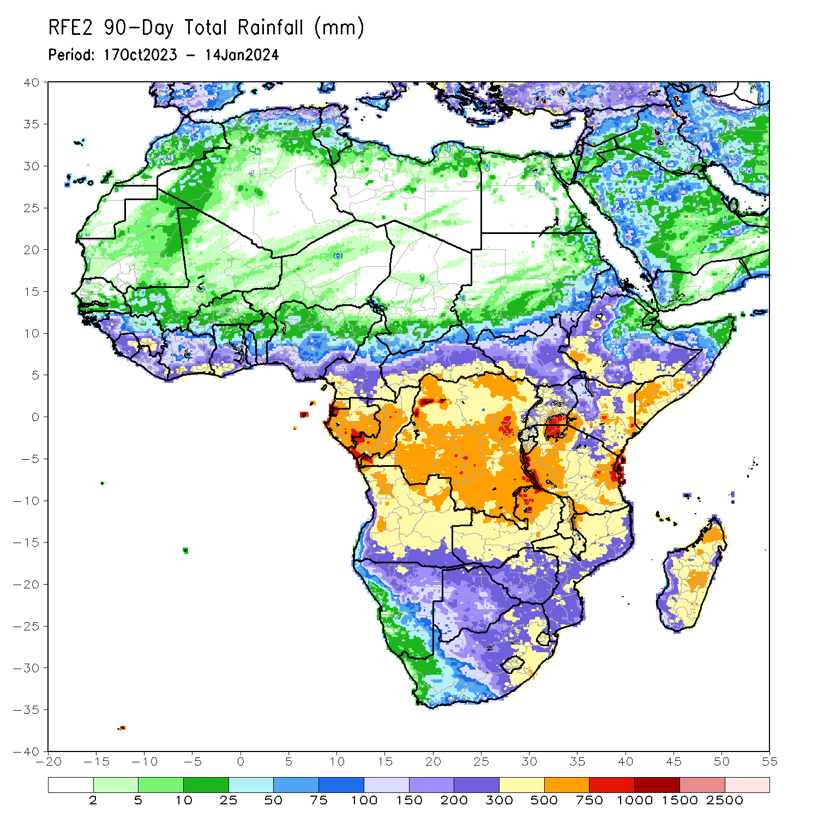
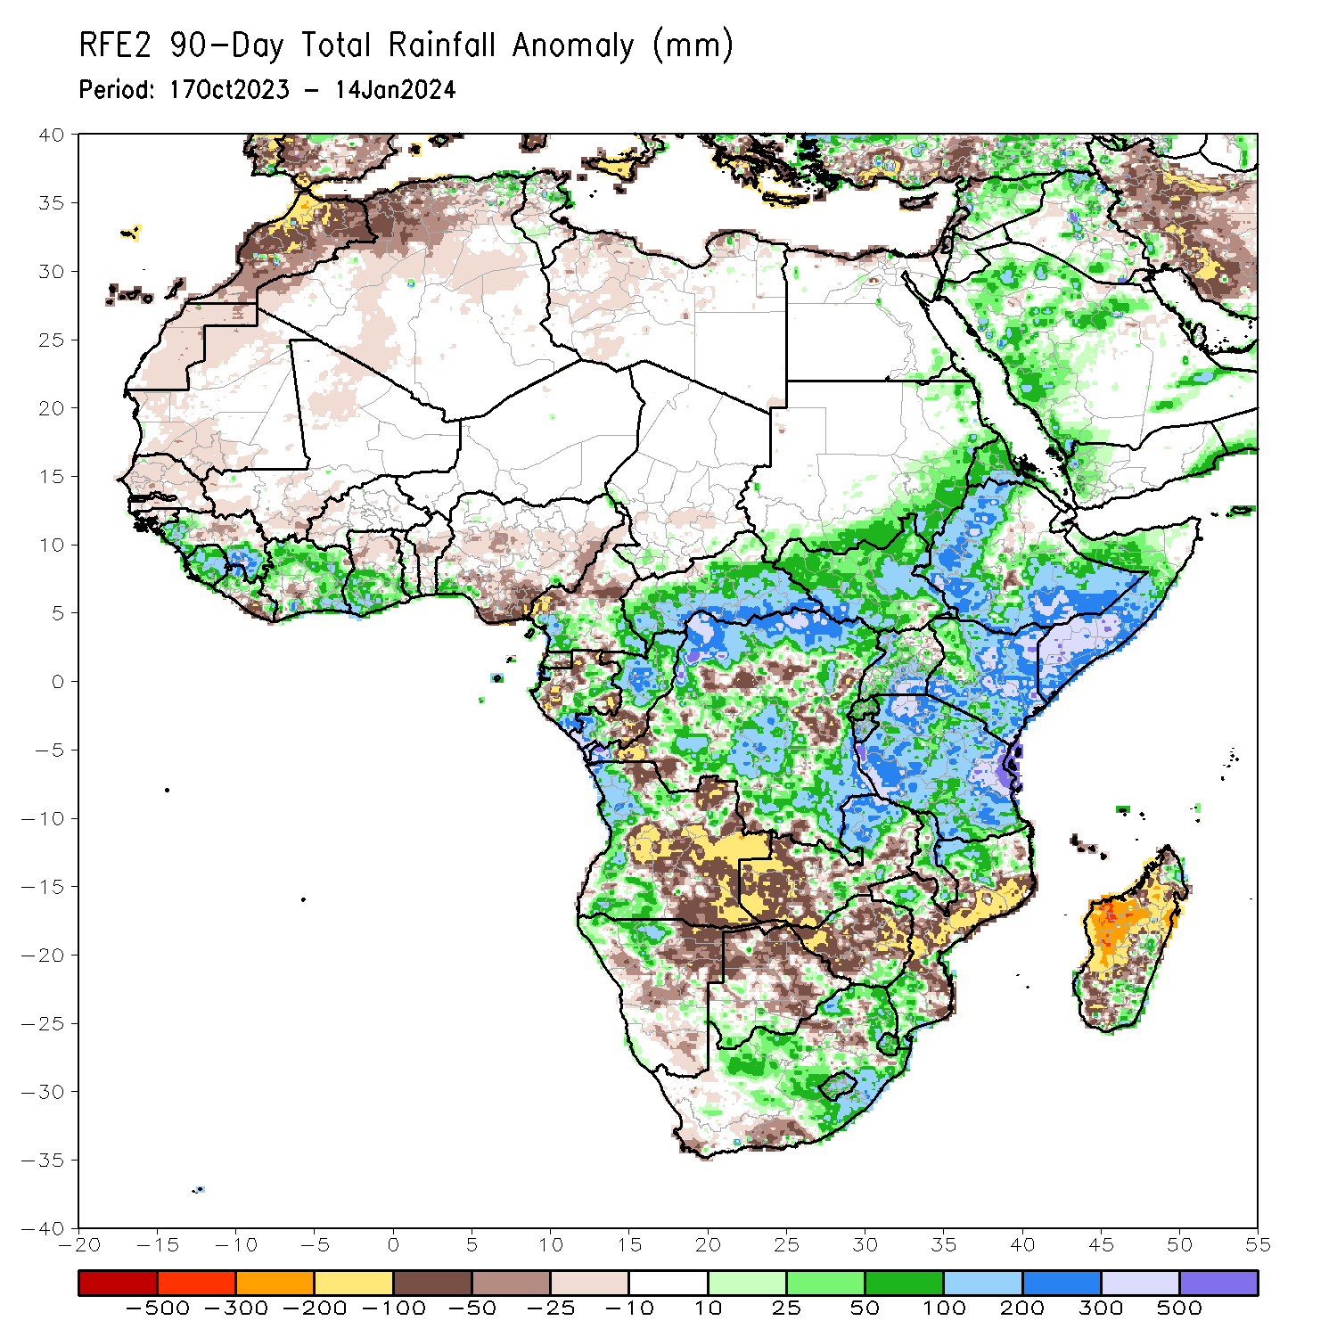
Rainfall Patterns: Last 90 Days
Over the past 90 days, in East Africa, above-average rainfall was observed in many parts of southern and eastern Sudan, South Sudan, Kenya, Tanzania, Burundi, Rwanda, Uganda, western and central Eritrea, northern, western, parts of central, and southern Ethiopia, and southern, central, and western Somalia. Rainfall was below-average over parts of central Ethiopia and southeastern South Sudan. In Central Africa, rainfall was above-average in many parts of CAR, most of DRC, most of Congo, east-central, western, and south-central Gabon, western and northern Equatorial Guinea, and pockets of southwestern and southeastern Cameroon. Rainfall was below-average over northern, central, and south-central Cameroon, southern Equatorial Guinea, northern, west-central, and southeastern Gabon, south-central and northwestern Congo, and pockets of southwestern and central DRC. In West Africa, rainfall was above-average over southeastern Guinea-Bissau, western and southeastern Guinea, Sierra Leone, western and northern Liberia, many parts of Cote d’Ivoire, southern and west-central Togo, far southern Benin, central and southern Ghana, and southwestern Nigeria. Below-average rainfall was observed over Senegal, Gambia, southwestern and northern Mauritania, western Mali, western Burkina Faso, far southwestern and northeastern Cote d’Ivoire, central Guinea, south-central and southeastern Liberia, northern Ghana, central Benin, and central, eastern, and south-central Nigeria. In southern Africa, above-average rainfall was observed over western and parts of northern Angola, northwestern Namibia, northeastern and parts of central Zambia, southeastern and parts of northwestern and northeastern Zimbabwe, southwestern and southeastern Botswana, southern, west-central, and northern Mozambique, eastern and parts of central South Africa, Eswatini, Lesotho, northern and parts of central and southern Malawi, and coastal pockets of northeastern, east-central, southeastern, and southwestern Madagascar. Below-average rainfall was observed over much of eastern and parts of central and northern Angola, northeastern and central Namibia, western and southeastern Zambia, much of central and northern Botswana, much of western, central, and eastern Zimbabwe, southwestern and parts of north-central South Africa, central and southeastern Mozambique, parts of southern Malawi, Comoros, and much of western, southern, and central Madagascar.
Notes:
4

Slide 5
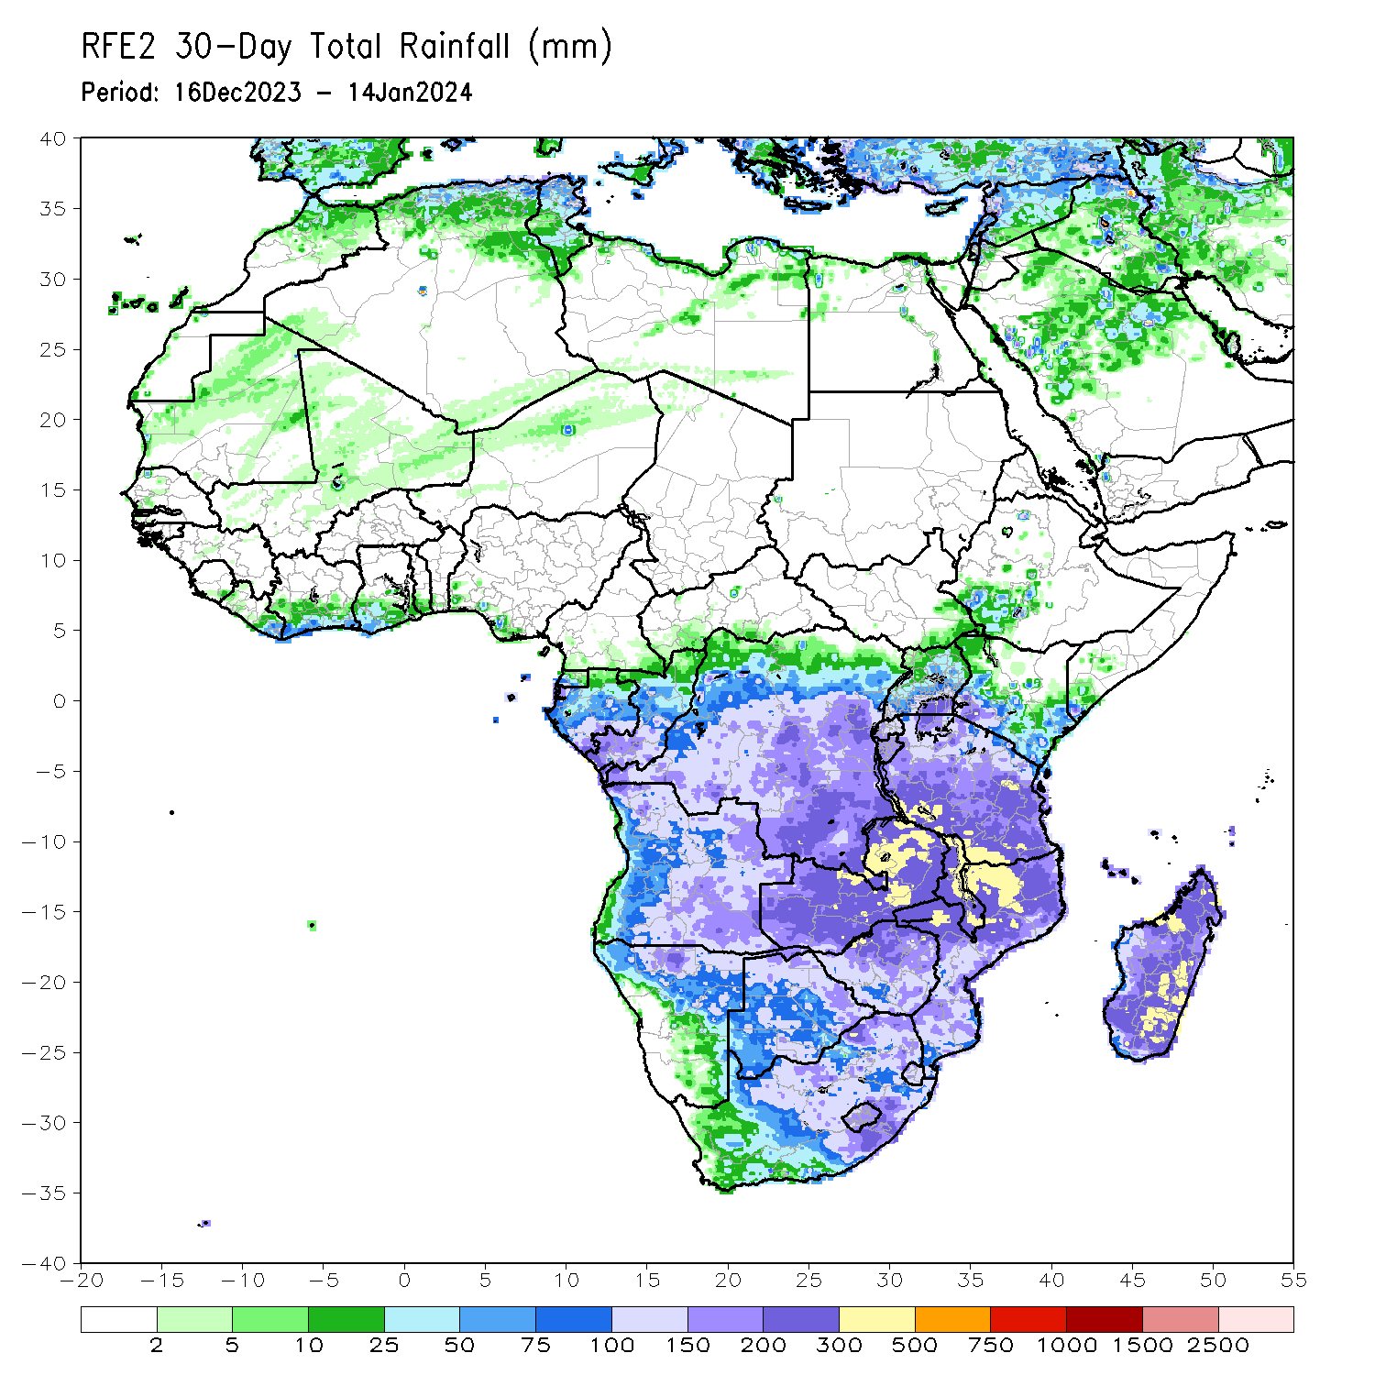
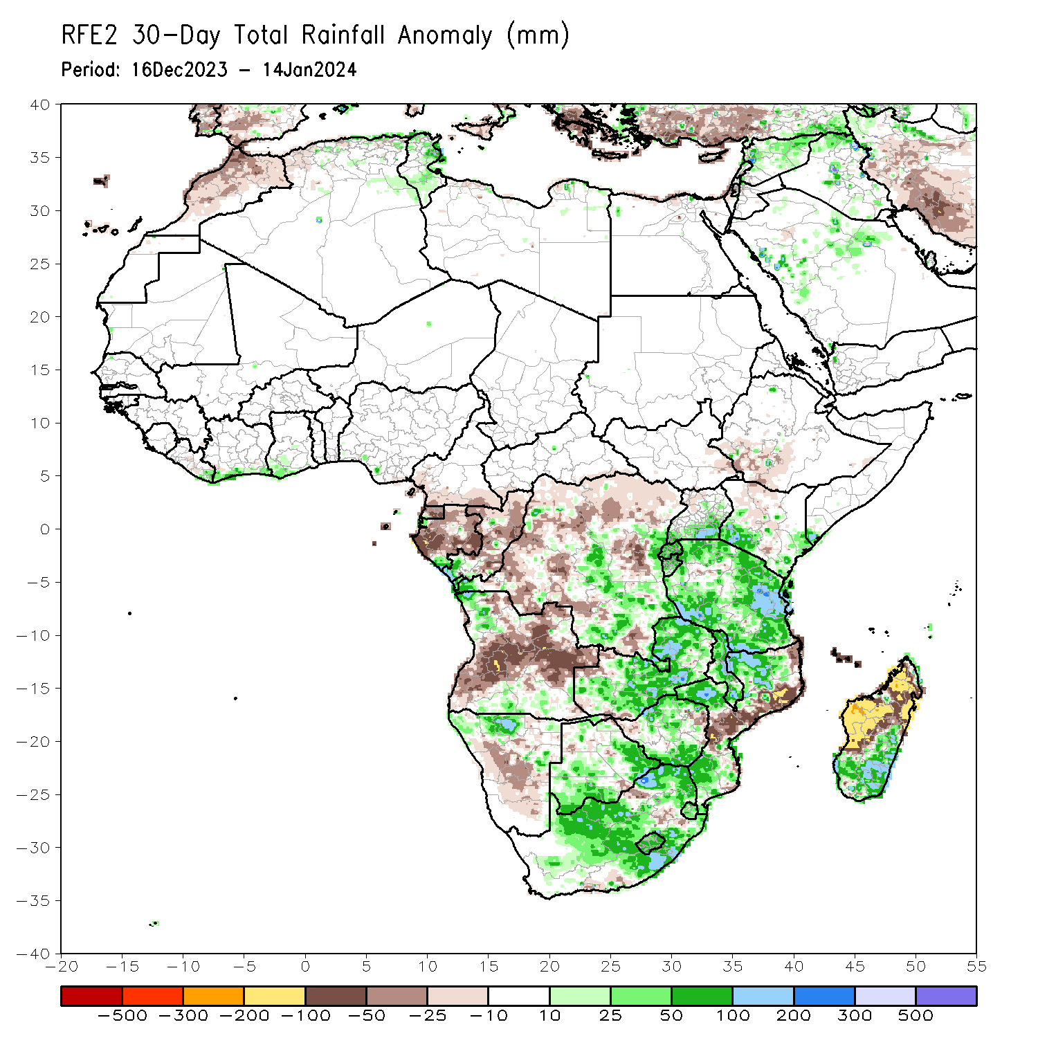
Rainfall Patterns: Last 30 Days
Over the past 30 days, in East Africa, above-average rainfall was observed in many parts of Tanzania, parts of east-central and southern Uganda, southwestern and southeastern Kenya, Burundi, Rwanda, and far southeastern Somalia. Rainfall was below-average over southwestern Ethiopia, parts of central Kenya, southeastern South Sudan, and parts of northwestern Uganda. In Central Africa, rainfall was above-average across southwestern, central, southeastern, and east-central DRC, southwestern Gabon, and southwestern Congo. Below-average rainfall was observed in central and eastern Equatorial Guinea, western, central, northern, and eastern Gabon, parts of northern and central Congo, much of northern and parts of central DRC, southwestern CAR, and southern Cameroon. In West Africa, rainfall was above-average from coastal areas of eastern Liberia to southwestern Ghana. Rainfall was below average in coastal parts of central Liberia and south-central Nigeria. In southern Africa, above-average rainfall was observed in northwestern and south-central Angola, northwestern, parts of northeastern, and east-central Namibia, west-central, central, and eastern Zambia, southern, west-central, and parts of northern Mozambique, southern and northern Zimbabwe, southern, east-central, and north-central Botswana, Lesotho, Eswatini, eastern and central South Africa, Malawi, and southern and east-central Madagascar. Below-average rainfall was observed in central, southwestern, north-central, and northeastern Angola, northwestern and southwestern Zambia, western and eastern Zimbabwe, far northeastern and parts of southeastern Botswana, far northeastern and central Namibia, central and northeastern Mozambique, parts of south-central and east-central South Africa, Comoros, and west-central and northern Madagascar.
Notes:
5

Slide 6
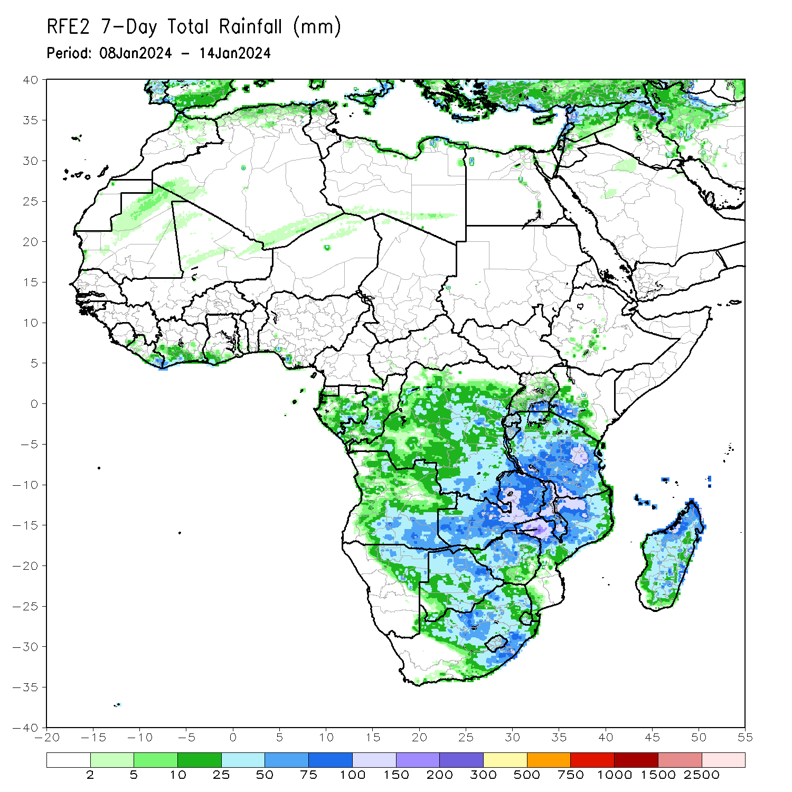
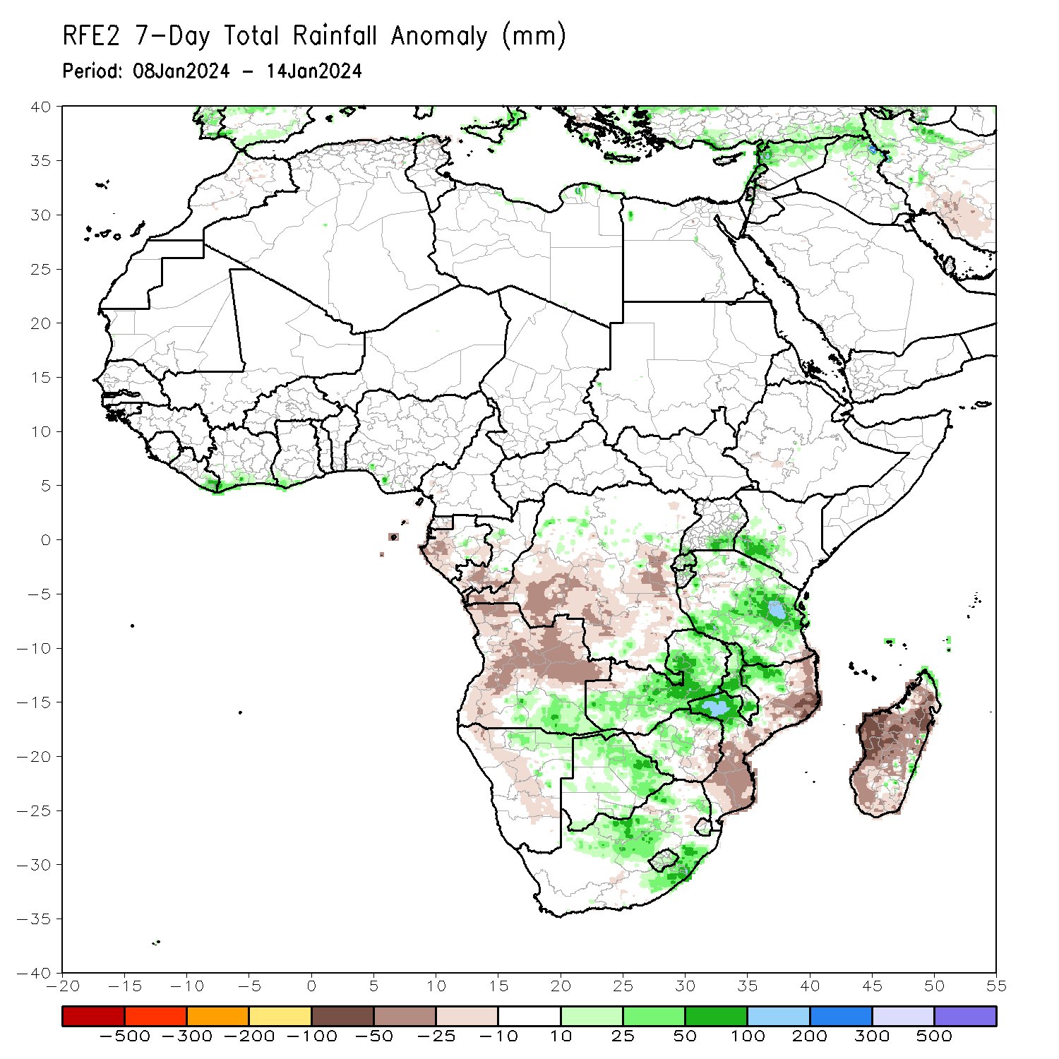
Rainfall Patterns: Last 7 Days
During the past 7 days, in East Africa, rainfall was above-average in southeastern Uganda, southwestern Kenya, Rwanda, northern Burundi, and far northern, central, and southwestern Tanzania. Below-average rainfall was observed over parts of southeastern Tanzania. In central Africa, above-average rainfall was observed over pockets of north-central and far southeastern DRC. Rainfall was below-average over much of central and southern DRC, southern Congo, western and southeastern Gabon, and parts of southern Equatorial Guinea. In West Africa, rainfall was above normal in eastern Liberia, southern Cote d’Ivoire, southwestern Ghana, and pockets of south-central Nigeria. In southern Africa, rainfall was above-average over southeastern Angola, northern, central, eastern, and southwestern Zambia, most of Malawi, northwestern and west-central Mozambique, north-central and northeastern Namibia, northern, eastern, and parts of central and southern Botswana, north-central and southeastern South Africa, Lesotho, southern Eswatini, northern, parts of central, and southwestern Zimbabwe, and coastal portions of far northern and east-central Madagascar. Below-average rainfall was observed over northern, east-central, central, and western Angola, northwestern Zambia, northeastern, central, and southern Mozambique, eastern Zimbabwe, northwestern and parts of central Namibia, Comoros, and most of northern, central, western, and southern Madagascar.

Slide 7
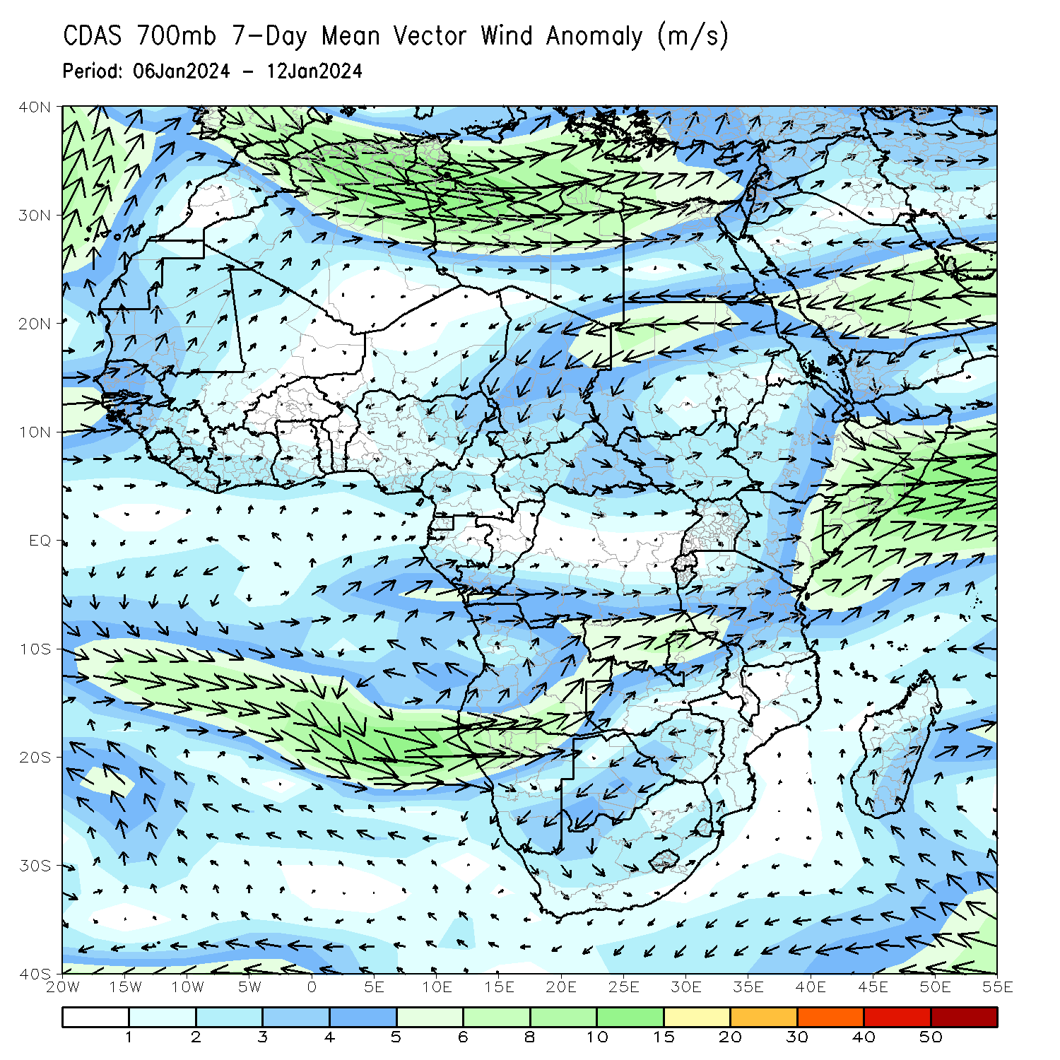
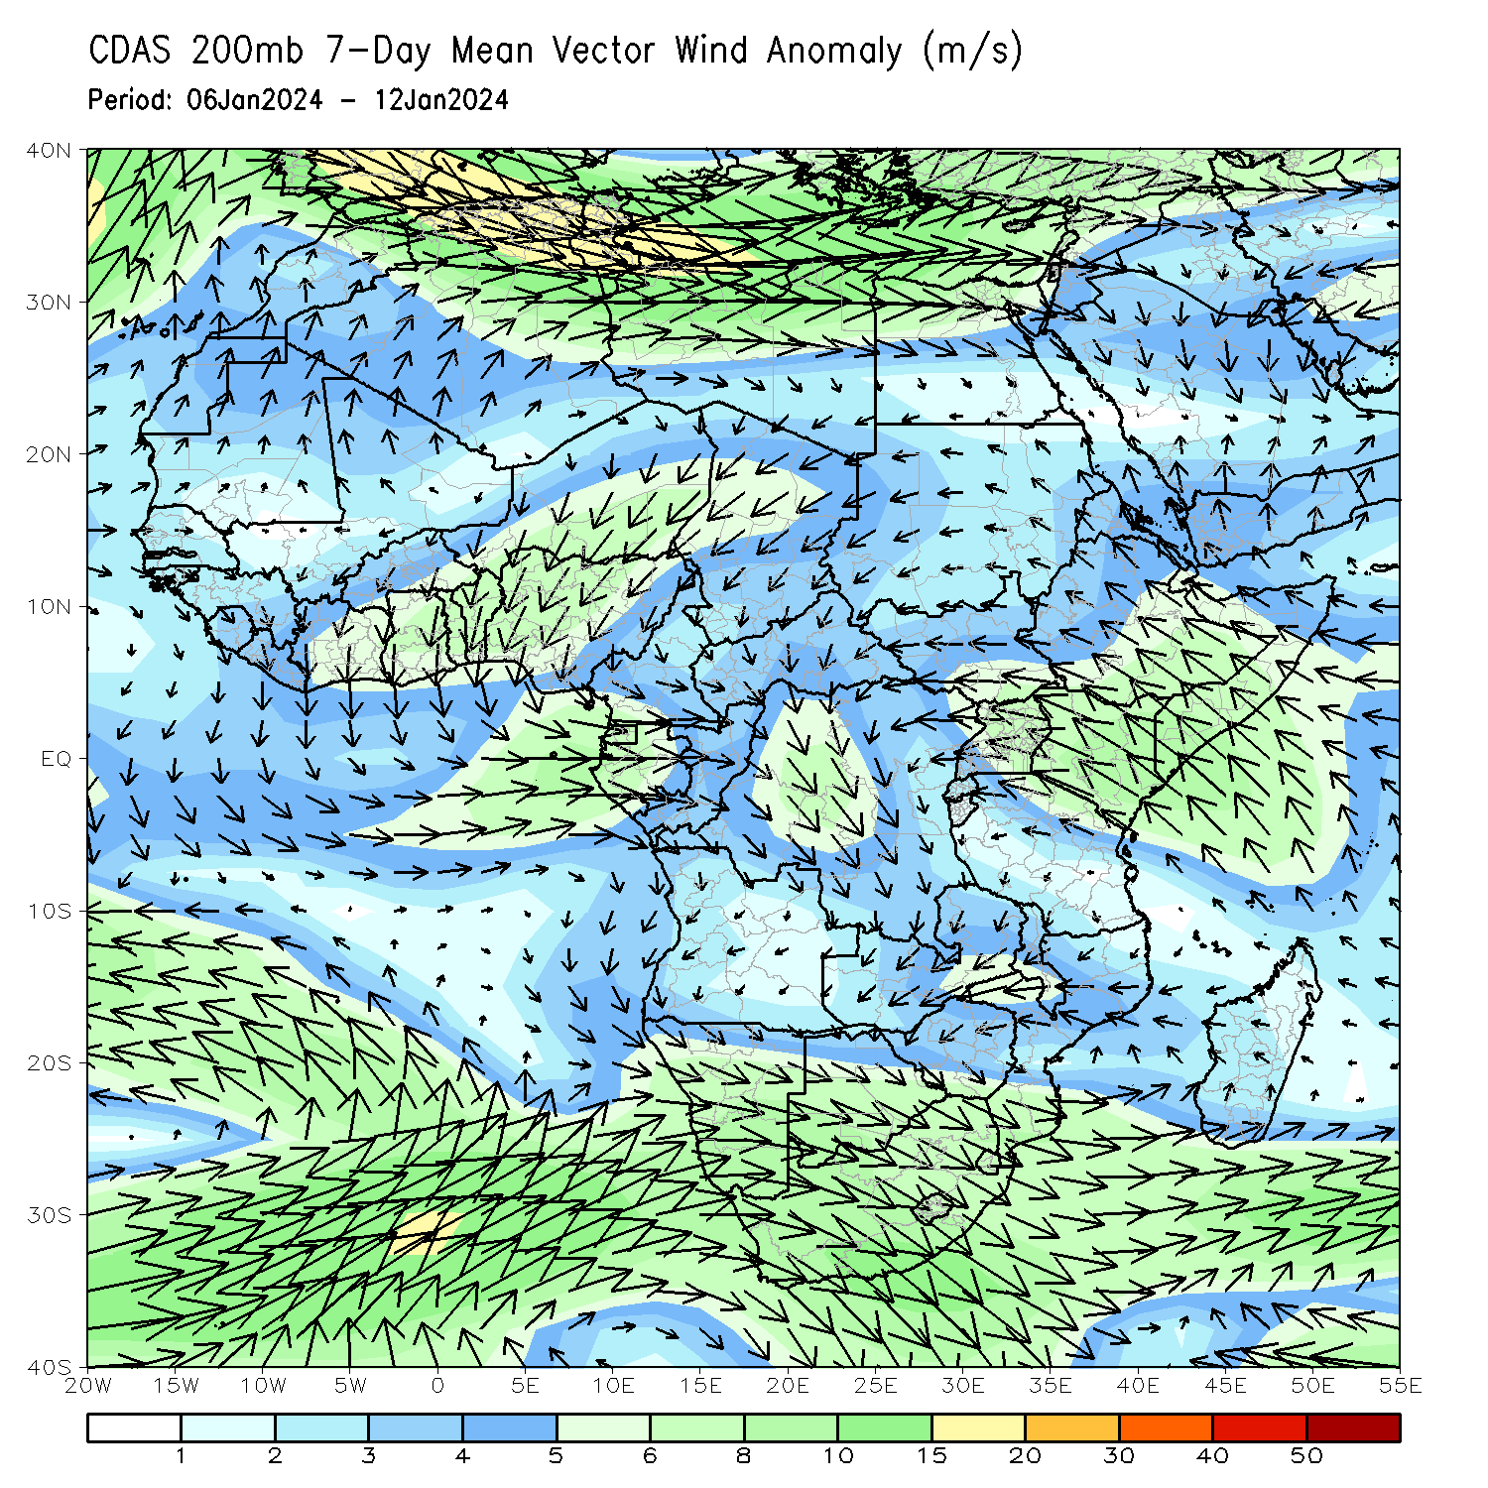
Atmospheric Circulation: Last 7 Days
At 700-hPa level (left panel), the anomalous lower-level convergence near Tanzania may have contributed to the observed above-average rainfall in the region. At 200-hPa level (right panel), anomalous upper-level divergence near Tanzania may have further contributed to the observed above-average rainfall in that region. In addition, anomalous upper-level convergence near Gabon/central DRC may have contributed to the below-average rainfall in the region.

Slide 8
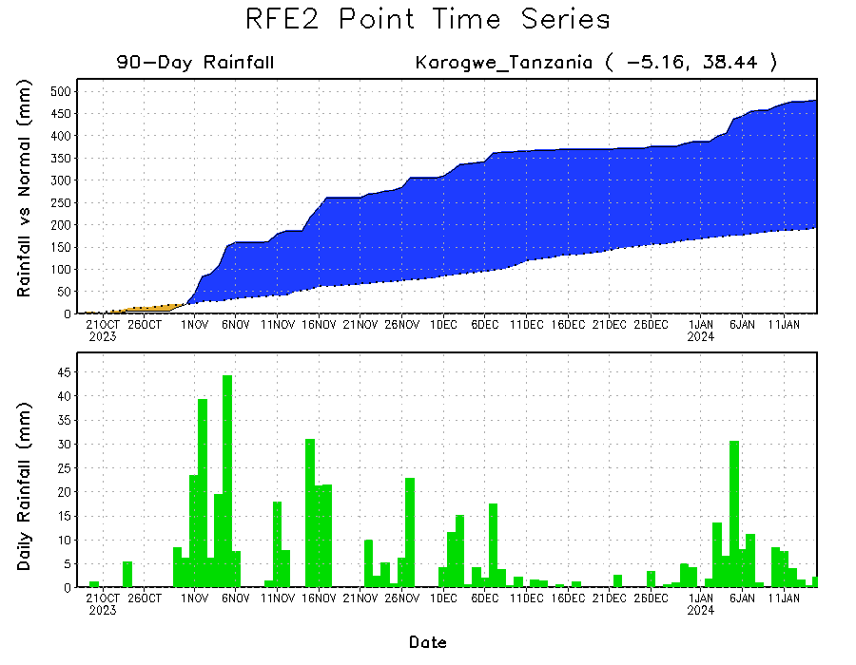
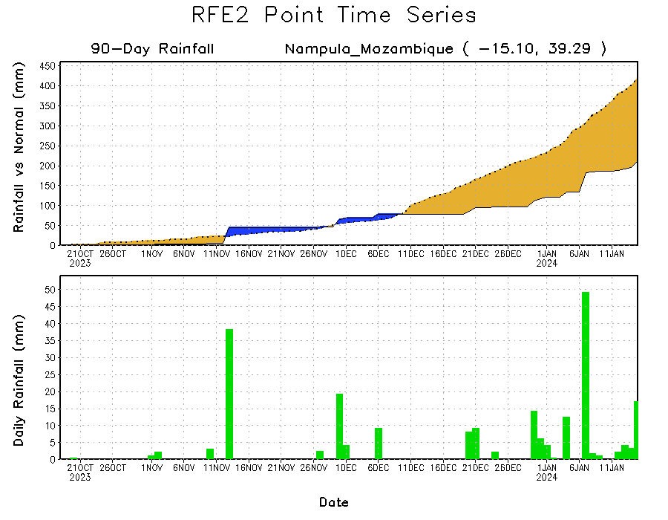
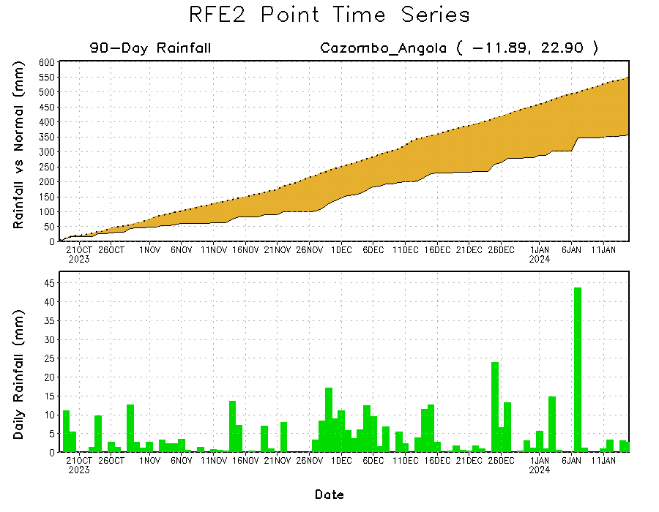
Rainfall Evolution
Daily evolution of rainfall over the last 90 days at selected locations shows a growing deficits over parts of east-central Angola (bottom left) and northeastern Mozambique (bottom right). Seasonal total rainfall remained much above-average over northeastern Tanzania due to the recent moderate rainfall (top right).

Slide 9
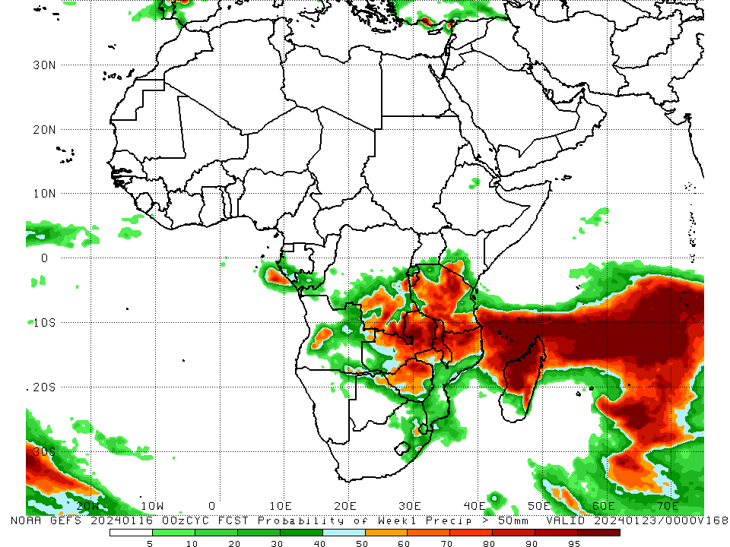
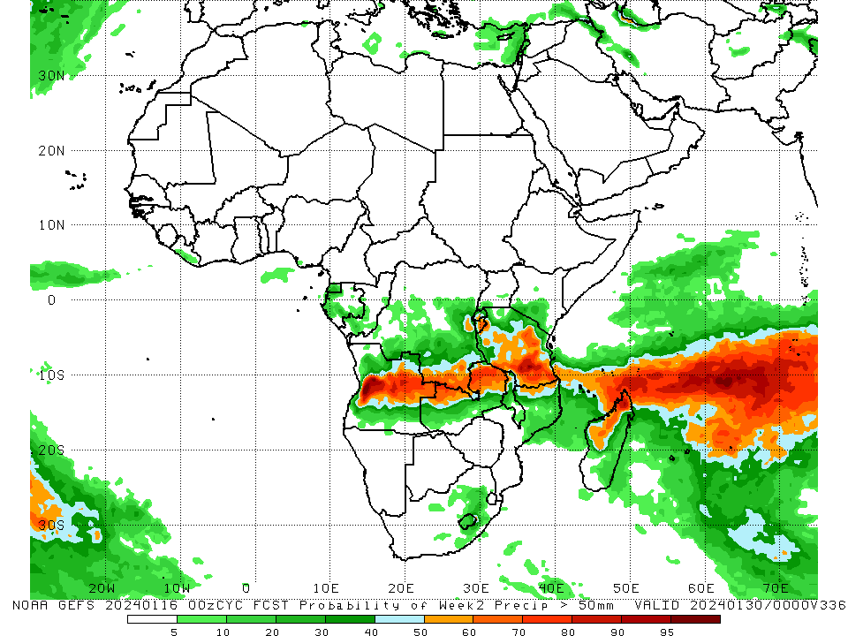
NCEP GEFS Model Forecasts Non-Bias Corrected Probability of precipitation exceedance
Week-1, Valid: 17 – 23 Jan 2024
Week-2, Valid: 24 – 30 Jan 2024
For week-1 (left panel) the GEFS forecasts indicate a moderate to high chance (over 70%) for rainfall to exceed 50 mm over Burundi, southwestern Kenya, central, northeastern, and southern Tanzania, southeastern and parts of east-central DRC, parts of west-central Angola, northwestern, central, and eastern Zambia, northern and west-central Mozambique, northern Zimbabwe, most of Malawi, northern, central, and parts of southeastern Madagascar, and Comoros. For week-2 (right panel), the GEFS forecasts indicate a moderate to high chance (over 70%) for rainfall to exceed 50 mm over southern Tanzania, northeastern and northwestern Zambia, parts of southeastern DRC, central Angola, and far northern Madagascar.
Notes:
9

Slide 10
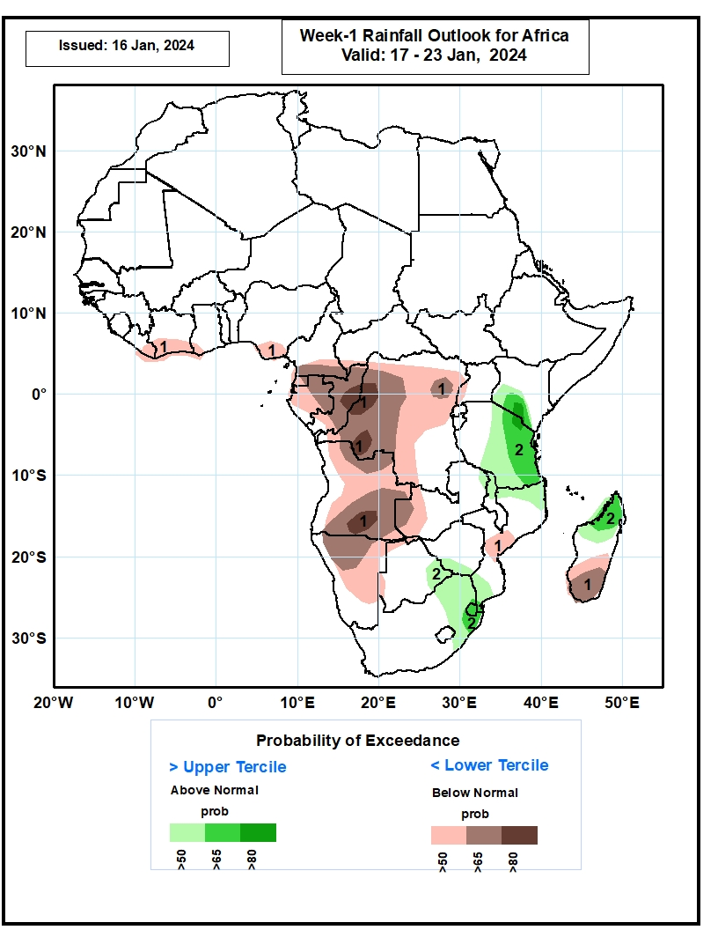
Week-1 Precipitation Outlooks
17 – 23 Jan 2024
1. The probabilistic forecasts call for above 50% chance for weekly total rainfall to be below-normal (below the lower tercile) over Coastal Cote D’Ivoire and Nigeria, southern Cameroon, Gabon, Congo, much of DRC, Angola, Namibia, western Zambia, central Mozambique, and southern Madagascar. There is above 80% chance for below-normal rainfall over pockets of DRC, and Angola.
2. The probabilistic forecasts call for above 50% chance for weekly rainfall to be above-normal (above the upper tercile) over southern Kenya, central and eastern Tanzania, eastern Botswana, eastern South Africa, Eswatini, and northern Madagascar. There is above 65% chance for above-normal rainfall over southern Kenya, eastern Tanzania and northern Madagascar.
Notes:
10

Slide 11
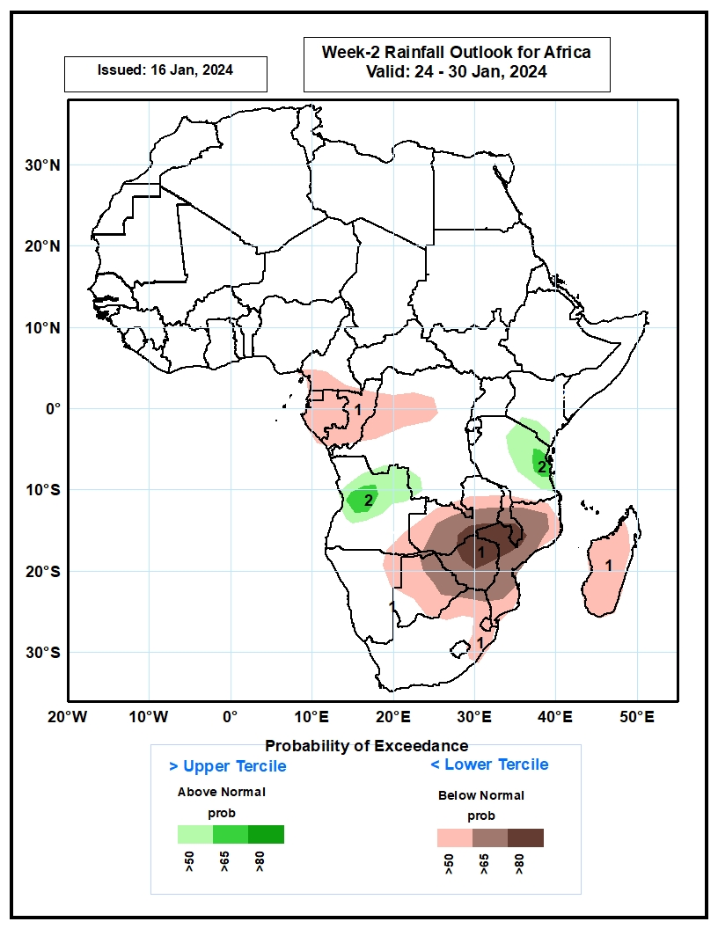
Week-2 Precipitation Outlooks
24 – 30 Jan 2024
1. The probabilistic forecasts call for above 50% chance for weekly total rainfall to be below-normal (below the lower tercile) over southern Cameroon, Equatorial Guinea, Gabon, Congo, western DRC, southeastern Angola, northeastern Namibia, Zambia, Botswana, Zimbabwe, northern and eastern South Africa, Eswatini, Mozambique and Madagascar. There is above 80% chance for below-normal rainfall over northern Zimbabwe, northwestern Mozambique and southern Malawi.
2. The probabilistic forecasts call for above 50% chance for weekly rainfall to be above-normal (above the upper tercile) over northern Angola and eastern Tanzania. There is above 65% chance for above normal rainfall over pockets of Angola and eastern Tanzania.
Notes:
11

Slide 12
Summary
Over the past 30 days, in East Africa, above-average rainfall was observed in many parts of Tanzania, parts of east-central and southern Uganda, southwestern and southeastern Kenya, Burundi, Rwanda, and far southeastern Somalia. Rainfall was below-average over southwestern Ethiopia, parts of central Kenya, southeastern South Sudan, and parts of northwestern Uganda. In Central Africa, rainfall was above-average across southwestern, central, southeastern, and east-central DRC, southwestern Gabon, and southwestern Congo. Below-average rainfall was observed in central and eastern Equatorial Guinea, western, central, northern, and eastern Gabon, parts of northern and central Congo, much of northern and parts of central DRC, southwestern CAR, and southern Cameroon. In West Africa, rainfall was above-average from coastal areas of eastern Liberia to southwestern Ghana. Rainfall was below average in coastal parts of central Liberia and south-central Nigeria. In southern Africa, above-average rainfall was observed in northwestern and south-central Angola, northwestern, parts of northeastern, and east-central Namibia, west-central, central, and eastern Zambia, southern, west-central, and parts of northern Mozambique, southern and northern Zimbabwe, southern, east-central, and north-central Botswana, Lesotho, Eswatini, eastern and central South Africa, Malawi, and southern and east-central Madagascar. Below-average rainfall was observed in central, southwestern, north-central, and northeastern Angola, northwestern and southwestern Zambia, western and eastern Zimbabwe, far northeastern and parts of southeastern Botswana, far northeastern and central Namibia, central and northeastern Mozambique, parts of south-central and east-central South Africa, Comoros, and west-central and northern Madagascar.
During the past 7 days, in East Africa, rainfall was above-average in southeastern Uganda, southwestern Kenya, Rwanda, northern Burundi, and far northern, central, and southwestern Tanzania. Below-average rainfall was observed over parts of southeastern Tanzania. In central Africa, above-average rainfall was observed over pockets of north-central and far southeastern DRC. Rainfall was below-average over much of central and southern DRC, southern Congo, western and southeastern Gabon, and parts of southern Equatorial Guinea. In West Africa, rainfall was above normal in eastern Liberia, southern Cote d’Ivoire, southwestern Ghana, and pockets of south-central Nigeria. In southern Africa, rainfall was above-average over southeastern Angola, northern, central, eastern, and southwestern Zambia, most of Malawi, northwestern and west-central Mozambique, north-central and northeastern Namibia, northern, eastern, and parts of central and southern Botswana, north-central and southeastern South Africa, Lesotho, southern Eswatini, northern, parts of central, and southwestern Zimbabwe, and coastal portions of far northern and east-central Madagascar. Below-average rainfall was observed over northern, east-central, central, and western Angola, northwestern Zambia, northeastern, central, and southern Mozambique, eastern Zimbabwe, northwestern and parts of central Namibia, Comoros, and most of northern, central, western, and southern Madagascar.
The Week-1 outlook calls for above-average rainfall in southern (and especially southwestern) Kenya, most of (and especially northeastern) Tanzania, eastern Rwanda, eastern Burundi, northern and central Malawi, eastern Zambia, parts of southeastern DRC, southern, western, and central Zimbabwe, northern and southwestern Mozambique, eastern Botswana, eastern South Africa, Eswatini, central Ethiopia, Comoros, and northern and parts of central Madagascar. In contrast, there is an increased chance for below-average rainfall across the Lake Victoria region, central, most of western, and parts of southeastern DRC, western Zambia, central Mozambique, northern, parts of central, and southern Angola, Congo, Gabon, Equatorial Guinea, southern Cameroon, southern Nigeria, southwestern Ghana, southern Cote d’Ivoire, eastern Liberia, northern and parts of central and southern Namibia, northwestern and parts of central Botswana, central South Africa, Lesotho, and southern Madagascar. The Week-2 outlook calls for above-normal rainfall in much of central Africa, including northern and central Angola, southeastern and east-central DRC, northwestern and northeastern Zambia, far northern Malawi, Rwanda, Burundi, Tanzania, southwestern Uganda, and southern and parts of central Kenya. In contrast, there is an increased chance for below-average rainfall in much of southern Africa and parts of the Gulf of Guinea region, including eastern Liberia, southeastern Cote d’Ivoire, southwestern Ghana, parts of southern Nigeria, southwestern Cameroon, parts of western and southern Gabon, central Congo, southeastern Angola, central and southern Zambia, northwestern and central Namibia, Botswana, Zimbabwe, Lesotho, Eswatini, eastern South Africa, central and southern Malawi, most of Mozambique, Comoros, and Madagascar.

