Slide 1
The African Monsoon Recent Evolution and Current Status Include Week-1 and Week-2 Outlooks
Update prepared
22 January 2024
For more information, visit:
http://www.cpc.ncep.noaa.gov/products/Global_Monsoons/African_Monsoons/precip_monitoring.shtml

Slide 2
Outline
Highlights
Recent Evolution and Current Conditions
NCEP GEFS Forecasts
Summary

Slide 3
Highlights: Last 7 Days
During the past 7 days, in East Africa, rainfall was above-average in southwestern Uganda, southwestern, parts of central, southeastern, and parts of northwestern Kenya, north-central Rwanda, central Burundi, central and eastern Tanzania, southeastern Somalia, and parts of southwestern Ethiopia. In central Africa, above-average rainfall was observed over pockets of west-central and southeastern DRC, southeastern Congo, and far northwestern Gabon. Rainfall was below-average over much of eastern, western, and southern DRC, central and southwestern Congo, most of Gabon, parts of far southern Cameroon, and Equatorial Guinea. In West Africa, rainfall was above normal in southeastern Liberia and a small portion of southeastern Cote d’Ivoire. Rainfall was below average in parts of east-central Liberia, southwestern Cote d’Ivoire, north-central Ghana, Togo, and Benin, and coastal parts of southwestern and south-central Nigeria. In southern Africa, rainfall was above-average over a small portion of south-central Angola, central, eastern, and southern Zambia, most of Malawi, far northwestern, northeastern, west-central, east-central, and southeastern Mozambique, far northeastern Namibia, eastern Botswana, northeastern and southeastern South Africa, northeastern Lesotho, northern, parts of central, and southwestern Zimbabwe, and northern, central, Comoros, and coastal portions of southeastern Madagascar. Below-average rainfall was observed over most of Angola, northwestern and northeastern Zambia, parts of northeastern, central, and southern Mozambique, southeastern Zimbabwe, much of northern and central Namibia, northwestern and central Botswana, central and east-central South Africa, western Lesotho, northern and central Eswatini, and most of southern Madagascar.
The Week-1 outlook calls for above-average rainfall in central and southwestern Angola, most of Rwanda and Burundi, northern, parts of central, and eastern Tanzania, southwestern Kenya, and parts of northern and central Madagascar. In contrast, there is an increased chance for below-average rainfall across coastal portions of the Gulf of Guinea region, Equatorial Guinea, Gabon, Congo, parts of central and southeastern DRC, east-central and southeastern Angola, Zambia, Malawi, southwestern Tanzania, Zimbabwe, Mozambique, Botswana, southern, central, and eastern South Africa, Lesotho, Eswatini, parts of central and northeastern Namibia, Comoros, and much of western, eastern, and southern Madagascar. The Week-2 outlook calls for above-normal rainfall in western, parts of central, and northern Angola, southern and east-central DRC, southwestern Congo, Rwanda, Burundi, Tanzania, northern Malawi, far northwestern Mozambique, northwestern Zambia, southwestern and parts of central Kenya, parts of central and southwestern Ethiopia, and a small portion of central Madagascar. In contrast, there is an increased chance for below-average rainfall in coastal portions of the Gulf of Guinea region, southwestern Cameroon, southeastern Angola, western, central, and southern Zambia, northeastern Namibia, northern, central, and eastern Botswana, Zimbabwe, Lesotho, Eswatini, eastern and parts of central South Africa, central and southern Malawi, most of Mozambique, Comoros, and most of Madagascar.

Slide 4
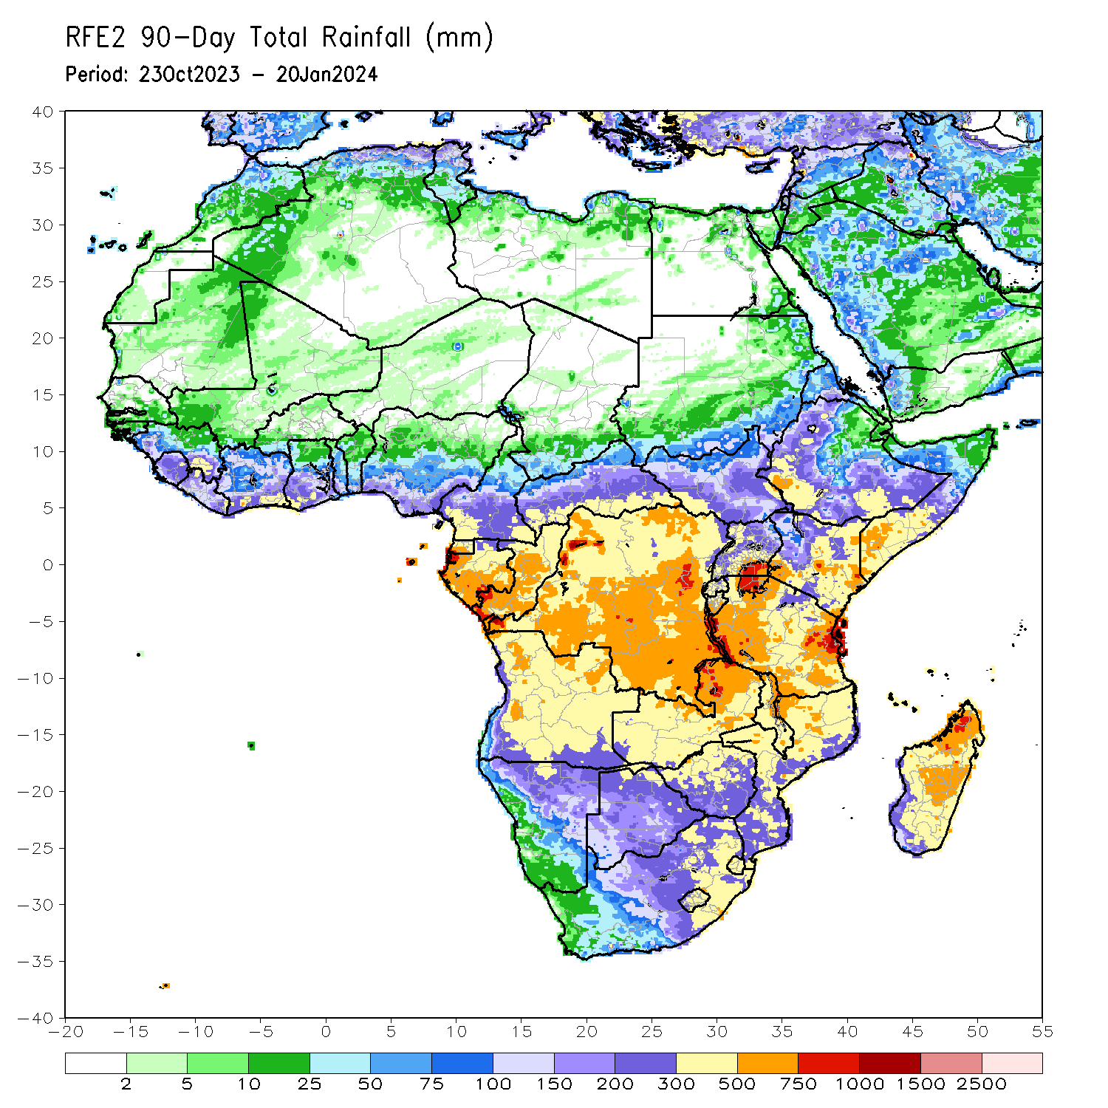
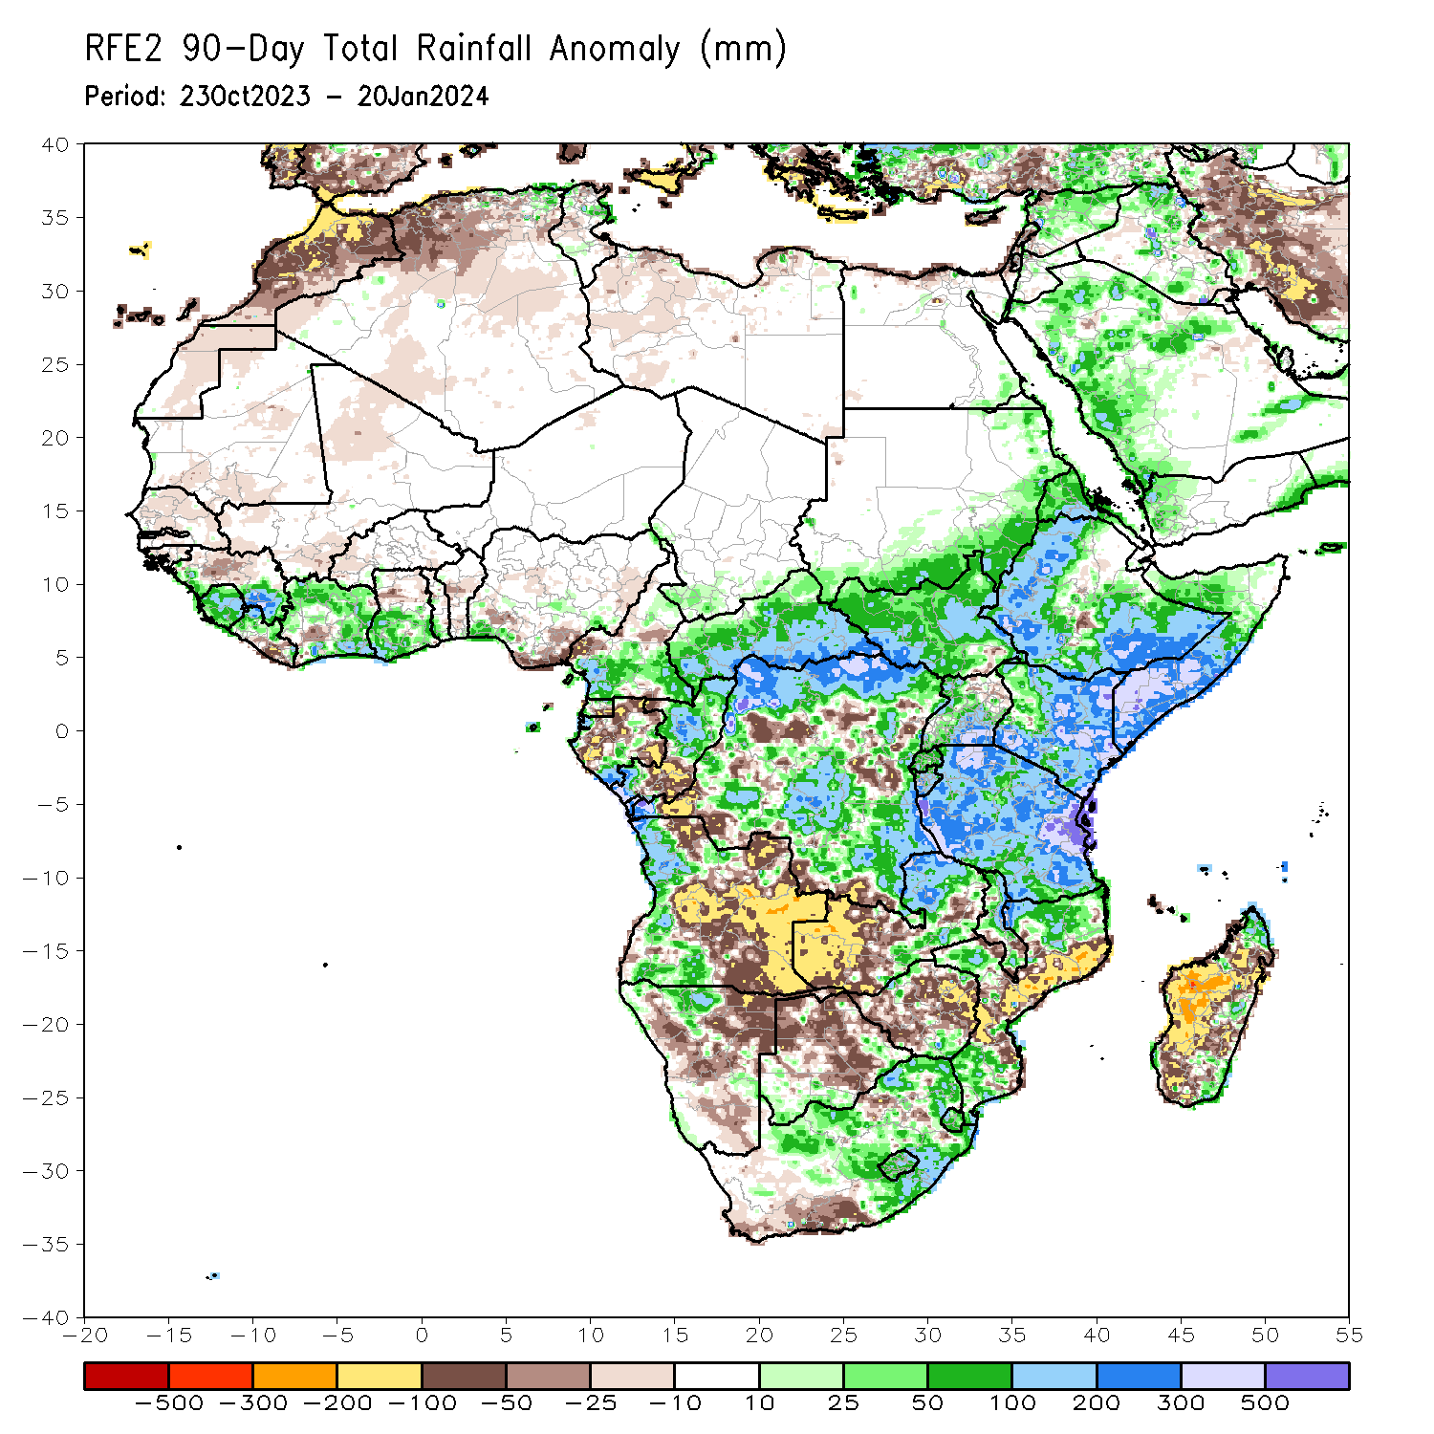
Rainfall Patterns: Last 90 Days
Over the past 90 days, in East Africa, above-average rainfall was observed in many parts of southern and eastern Sudan, South Sudan, Kenya, Tanzania, Burundi, Rwanda, Uganda, western and central Eritrea, northern, western, parts of central, and southern Ethiopia, and southern, central, and western Somalia. Rainfall was below-average over parts of central Ethiopia, northeastern Uganda, and southeastern South Sudan. In Central Africa, rainfall was above-average in many parts of CAR, much of northern and central DRC, northern, central, and southwestern Congo, east-central, northwestern, and south-central Gabon, western and northern Equatorial Guinea, and southwestern and southeastern Cameroon. Rainfall was below-average over central and south-central Cameroon, southern Equatorial Guinea, northern, west-central, and southeastern Gabon, south-central and northwestern Congo, and pockets of southern and central DRC. In West Africa, rainfall was above-average over western and southeastern Guinea, Sierra Leone, western and northern Liberia, many parts of Cote d’Ivoire, southern Togo, far southeastern Benin, central, southern, and parts of northwestern Ghana, and southwestern and parts of southeastern Nigeria. Below-average rainfall was observed over Senegal, Gambia, southwestern and northern Mauritania, western Mali, western Burkina Faso, southwestern Cote d’Ivoire, central Guinea, south-central and southeastern Liberia, northern Ghana, parts of central and southern Benin, and central and south-central Nigeria. In southern Africa, above-average rainfall was observed over western and parts of north-central Angola, northwestern Namibia, northeastern and southeastern Zambia, southeastern and parts of northwestern and northeastern Zimbabwe, southwestern and southeastern Botswana, southern, west-central, and northern Mozambique, eastern and parts of central South Africa, Eswatini, Lesotho, northern and parts of central and southern Malawi, and coastal pockets of northern, east-central, southeastern, and southwestern Madagascar. Below-average rainfall was observed over much of eastern, central, and parts of northern Angola, northeastern, central, and southeastern Namibia, western and east-central Zambia, much of central and northern Botswana, much of western, central, and eastern Zimbabwe, southwestern and parts of north-central South Africa, central and southeastern Mozambique, parts of southern Malawi, and much of western, southern, and central Madagascar.
Notes:
4

Slide 5
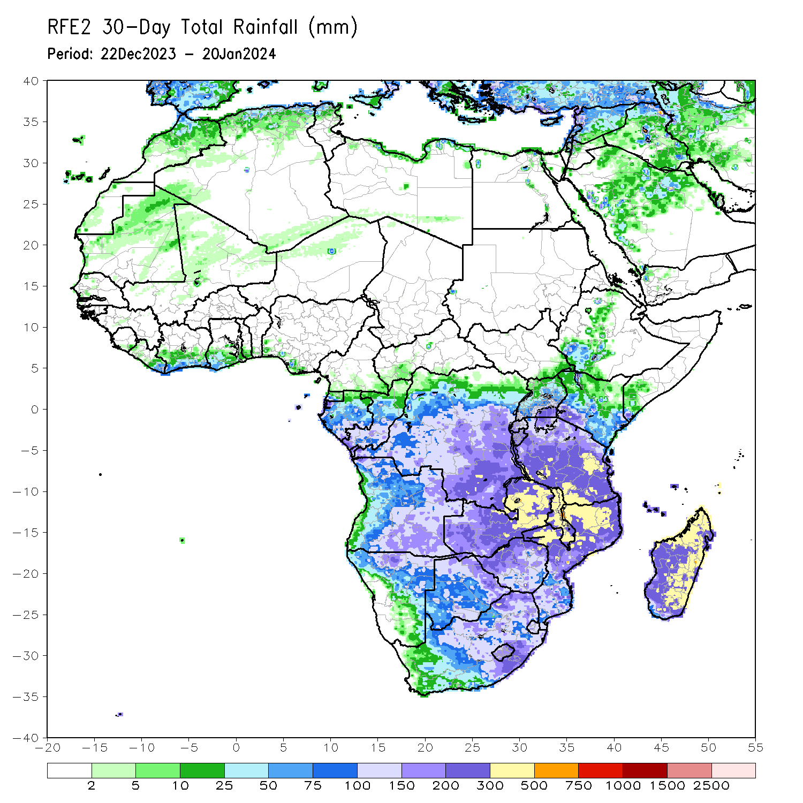
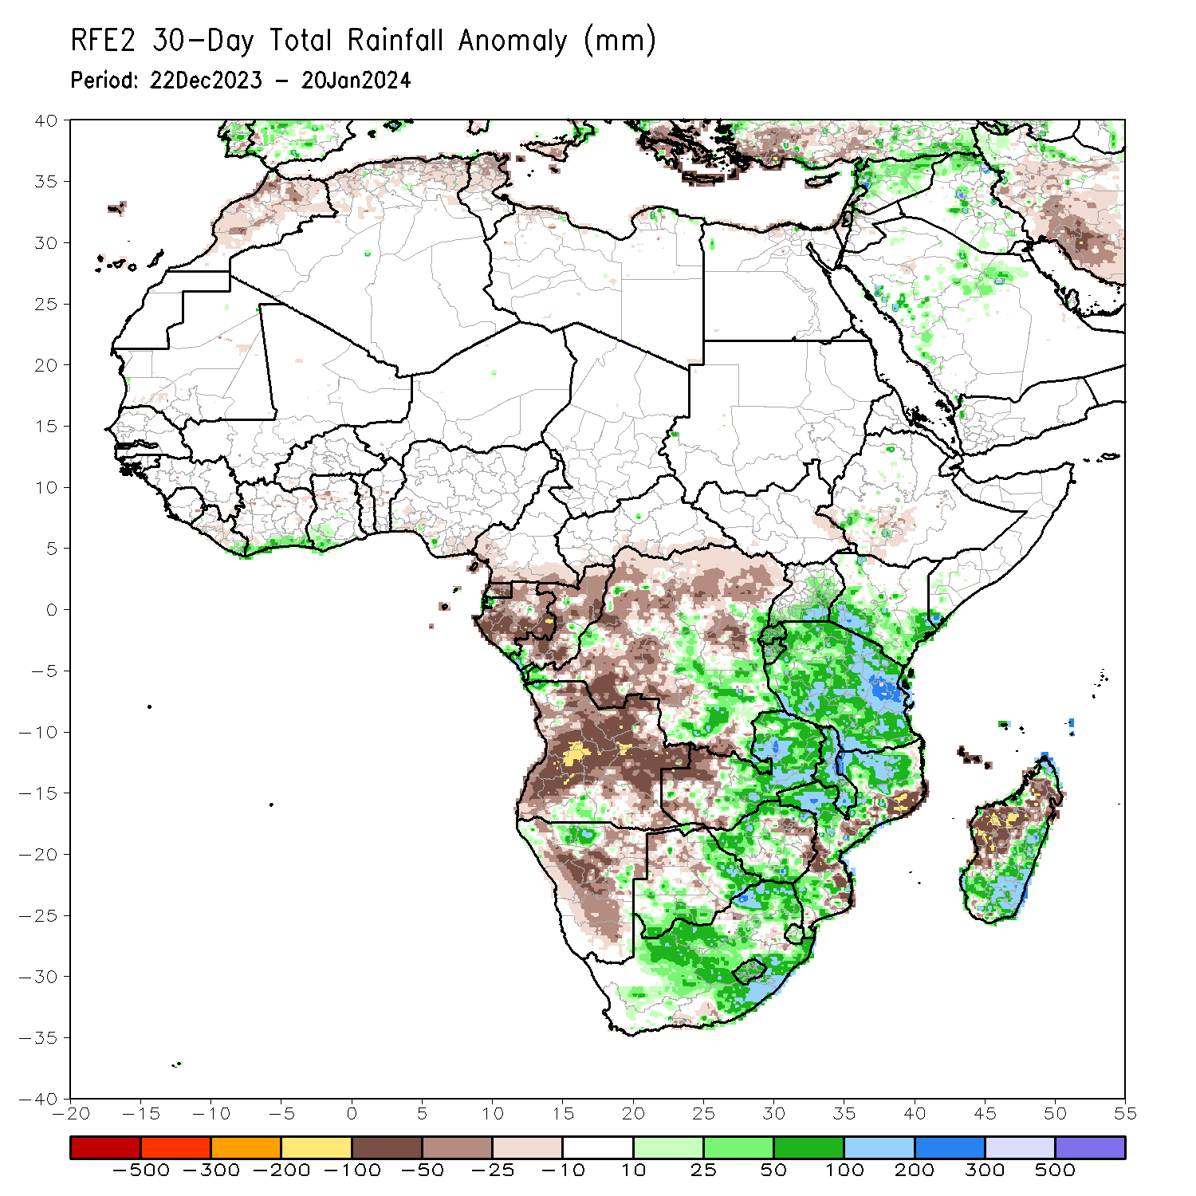
Rainfall Patterns: Last 30 Days
Over the past 30 days, in East Africa, above-average rainfall was observed in many parts of Tanzania, parts of east-central and southern Uganda, southern Kenya, Burundi, Rwanda, far southeastern Somalia, and a small portion of southwestern Ethiopia. Rainfall was below-average over southeastern South Sudan and parts of southwestern Ethiopia. In Central Africa, rainfall was above-average across far southwestern, parts of central, and southeastern DRC, far southwestern Gabon, and southwestern and east-central Congo. Below-average rainfall was observed in central and eastern Equatorial Guinea, most of Gabon, most of northern and central Congo, much of northern, parts of central, and much of southwestern DRC, southern CAR, and southern Cameroon. In West Africa, rainfall was above-average from coastal areas of eastern Liberia to southwestern Ghana. Rainfall was below average in coastal parts of central Liberia, northwestern Ghana, and south-central Nigeria. In southern Africa, above-average rainfall was observed in far northwestern and south-central Angola, northwestern, parts of northeastern, and pockets of east-central Namibia, central and eastern Zambia, southern, west-central, and parts of northern Mozambique, southern and northern Zimbabwe, southern and eastern Botswana, Lesotho, Eswatini, eastern and central South Africa, Malawi, and southern, east-central, and far northern Madagascar. Below-average rainfall was observed in central, southwestern, much of northern, and eastern Angola, northwestern and southwestern Zambia, eastern Zimbabwe, northwestern and central Botswana, northeastern and central Namibia, parts of central Mozambique, Comoros, and west-central and parts of northern Madagascar.
Notes:
5

Slide 6
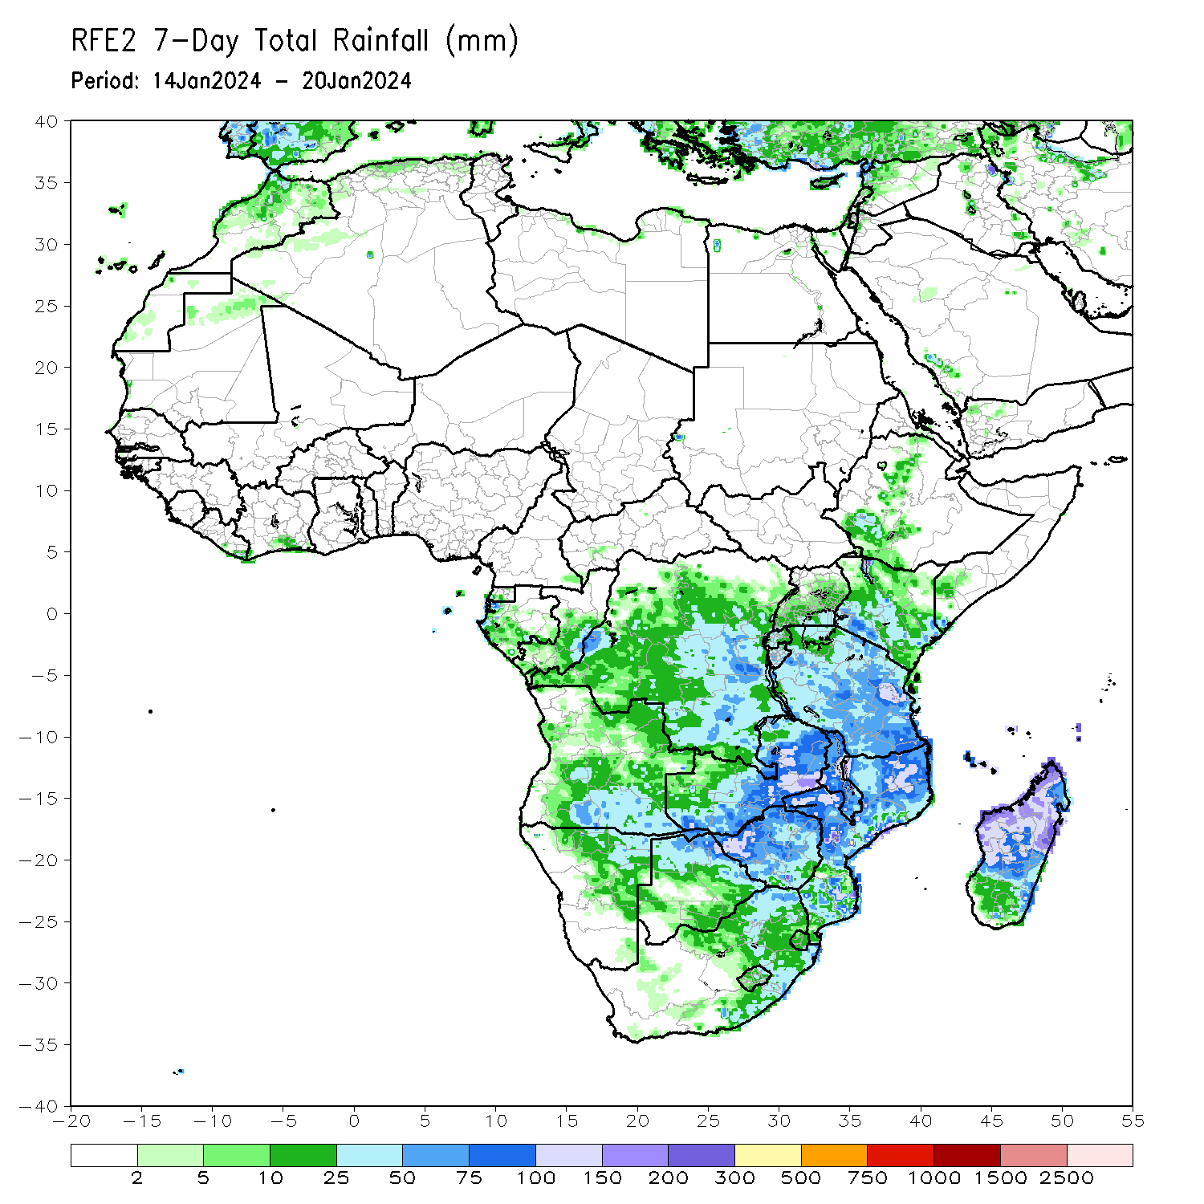
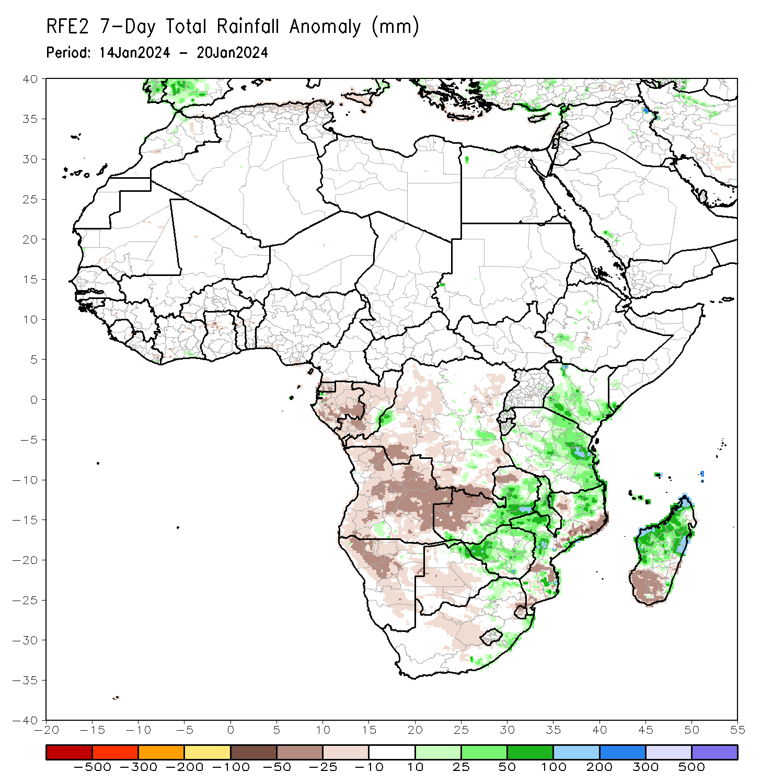
Rainfall Patterns: Last 7 Days
During the past 7 days, in East Africa, rainfall was above-average in southwestern Uganda, southwestern, parts of central, southeastern, and parts of northwestern Kenya, north-central Rwanda, central Burundi, central and eastern Tanzania, southeastern Somalia, and parts of southwestern Ethiopia. In central Africa, above-average rainfall was observed over pockets of west-central and southeastern DRC, southeastern Congo, and far northwestern Gabon. Rainfall was below-average over much of eastern, western, and southern DRC, central and southwestern Congo, most of Gabon, parts of far southern Cameroon, and Equatorial Guinea. In West Africa, rainfall was above normal in southeastern Liberia and a small portion of southeastern Cote d’Ivoire. Rainfall was below average in parts of east-central Liberia, southwestern Cote d’Ivoire, north-central Ghana, Togo, and Benin, and coastal parts of southwestern and south-central Nigeria. In southern Africa, rainfall was above-average over a small portion of south-central Angola, central, eastern, and southern Zambia, most of Malawi, far northwestern, northeastern, west-central, east-central, and southeastern Mozambique, far northeastern Namibia, eastern Botswana, northeastern and southeastern South Africa, northeastern Lesotho, northern, parts of central, and southwestern Zimbabwe, and northern, central, Comoros, and coastal portions of southeastern Madagascar. Below-average rainfall was observed over most of Angola, northwestern and northeastern Zambia, parts of northeastern, central, and southern Mozambique, southeastern Zimbabwe, much of northern and central Namibia, northwestern and central Botswana, central and east-central South Africa, western Lesotho, northern and central Eswatini, and most of southern Madagascar.

Slide 7
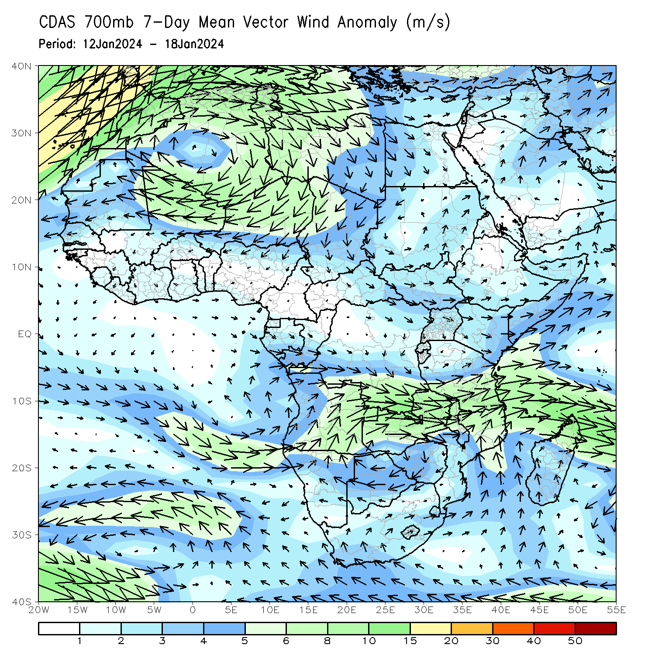
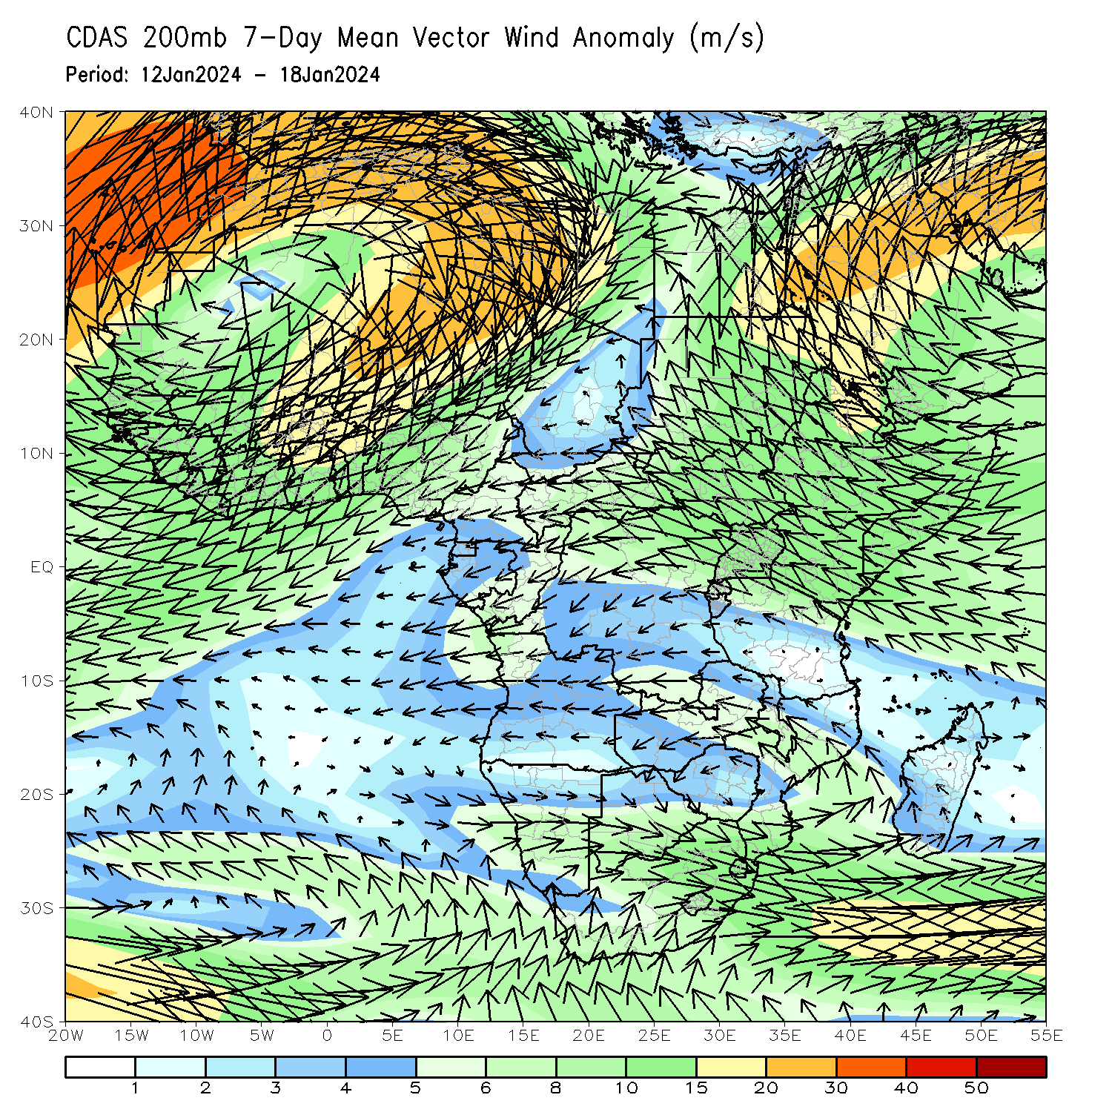
Atmospheric Circulation: Last 7 Days
At 700-hPa level (left panel), the anomalous lower-level convergence near Tanzania may have contributed to the observed above-average rainfall in the region. At 200-hPa level (right panel), anomalous upper-level divergence near Tanzania may have further contributed to the observed above-average rainfall in that region. In addition, anomalous upper-level convergence near Angola may have contributed to the below-average rainfall in the region.

Slide 8
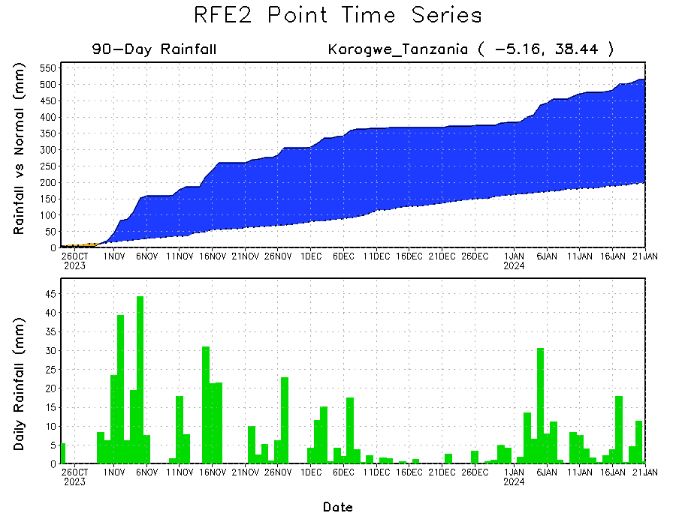
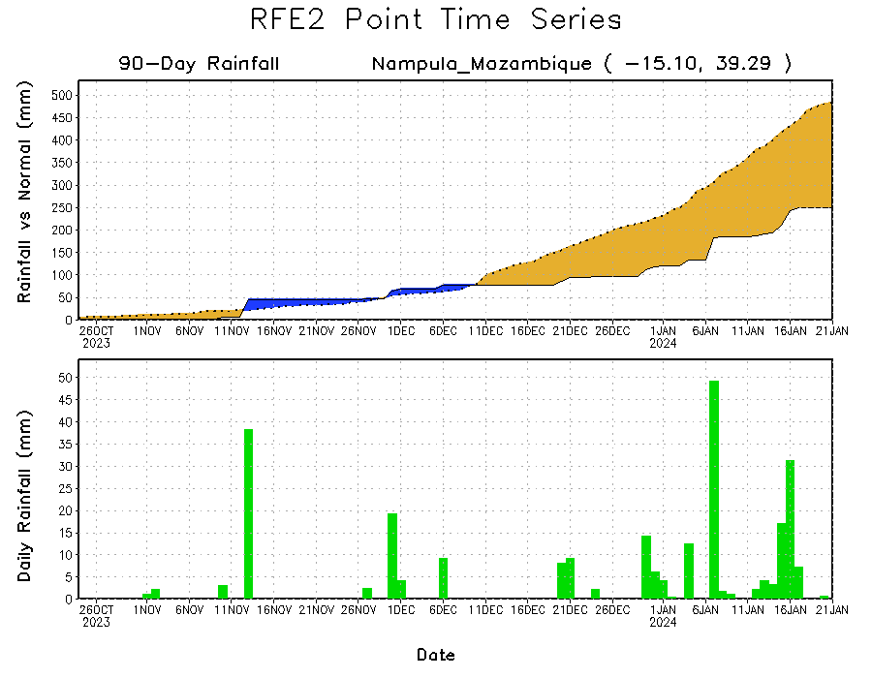
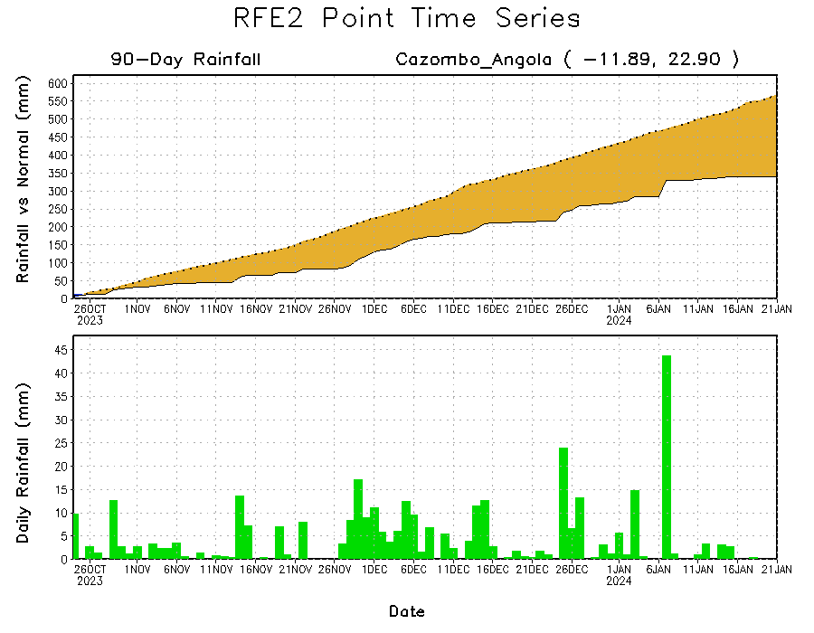
Rainfall Evolution
Daily evolution of rainfall over the last 90 days at selected locations shows a growing deficits over parts of east-central Angola (bottom left) and northeastern Mozambique (bottom right). Seasonal total rainfall remained much above-average over northeastern Tanzania due to the recent moderate rainfall (top right).

Slide 9
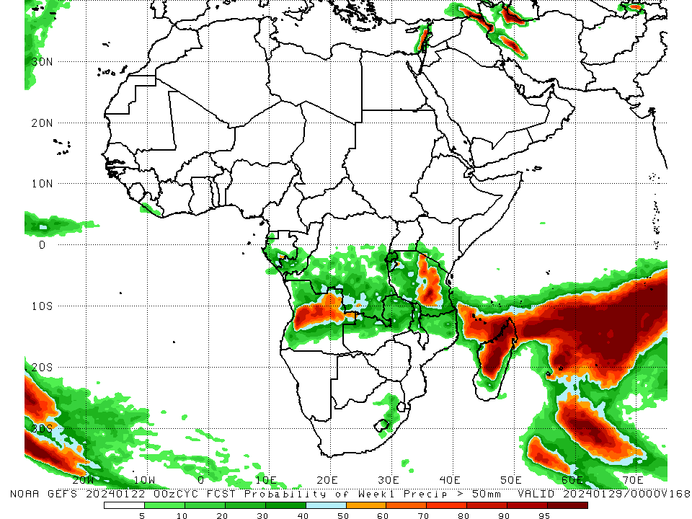
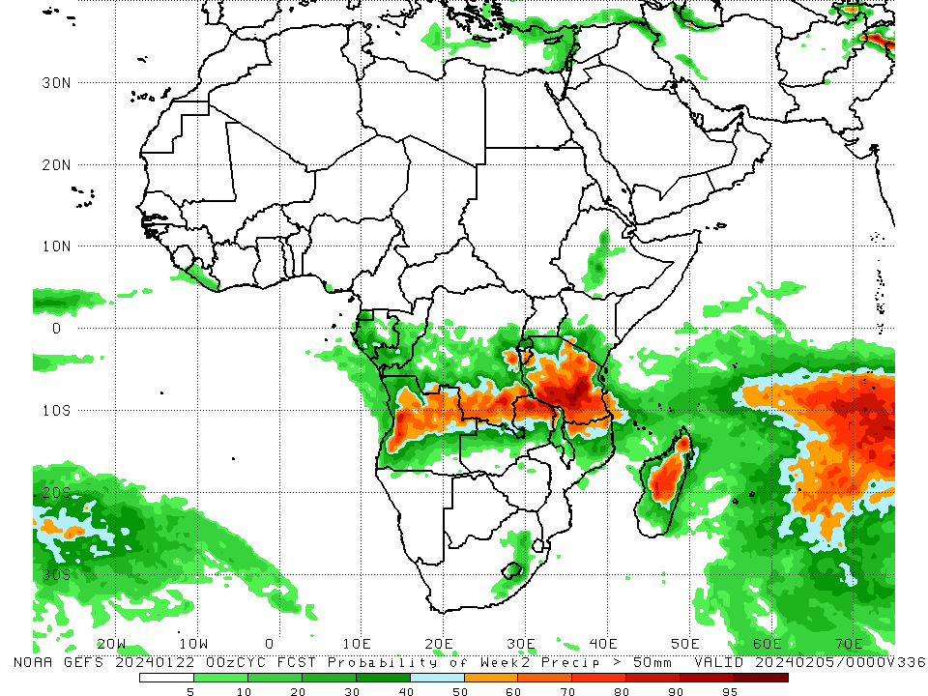
NCEP GEFS Model Forecasts Non-Bias Corrected Probability of precipitation exceedance
Week-1, Valid: 23 – 29 Jan 2024
Week-2, Valid: 30 Jan – 05 Feb 2024
For week-1 (left panel) the GEFS forecasts indicate a moderate to high chance (over 70%) for rainfall to exceed 50 mm over parts of central Tanzania, central Angola, Comoros, and northern and central Madagascar. For week-2 (right panel), the GEFS forecasts indicate a moderate to high chance (over 70%) for rainfall to exceed 50 mm over central and southern Tanzania, southeastern DRC, west-central Angola, northeastern Zambia, northwestern Malawi, and northern and central Madagascar.
Notes:
9

Slide 10
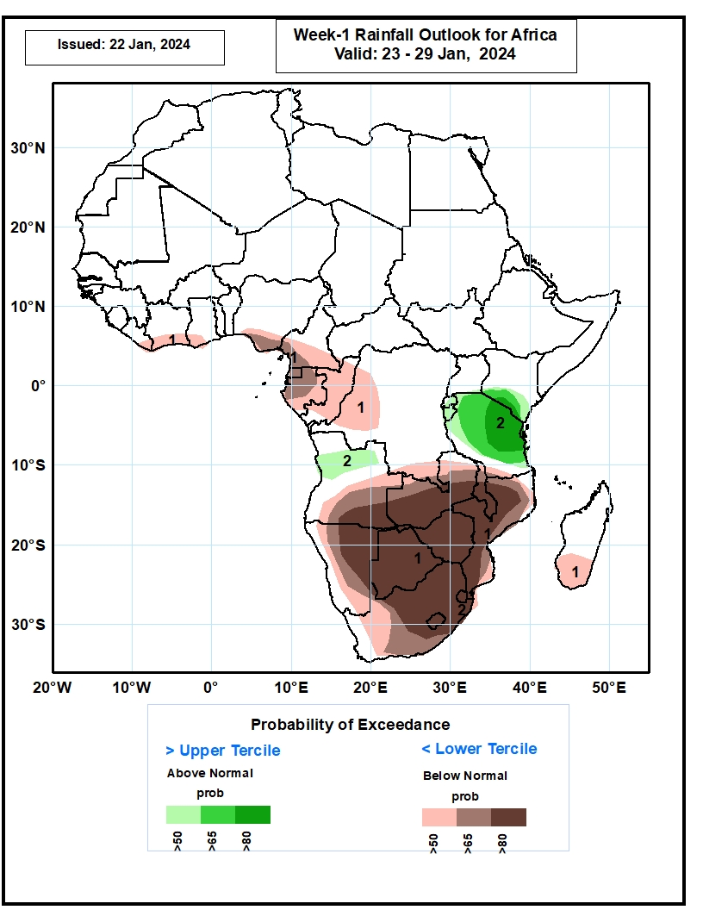
Week-1 Precipitation Outlooks
23 – 29 Jan 2024
1. The probabilistic forecasts call for above 50% chance for weekly total rainfall to be below-normal (below the lower tercile) along the Gulf of Guinea coast, and much of Southern Africa, including southern Madagascar There is above 80% chance for below-normal rainfall over southeastern Angola, eastern Namibia, southern Zambia, Botswana, Zimbabwe, eastern and northern South Africa, Lesotho, Eswatini, southern Malawi and Mozambique.
2. The probabilistic forecasts call for above 50% chance for weekly rainfall to be above-normal (above the upper tercile) over northern Angola, and much of Tanzania. There is above 80% chance for above-normal rainfall over eastern Tanzania.
Notes:
10

Slide 11
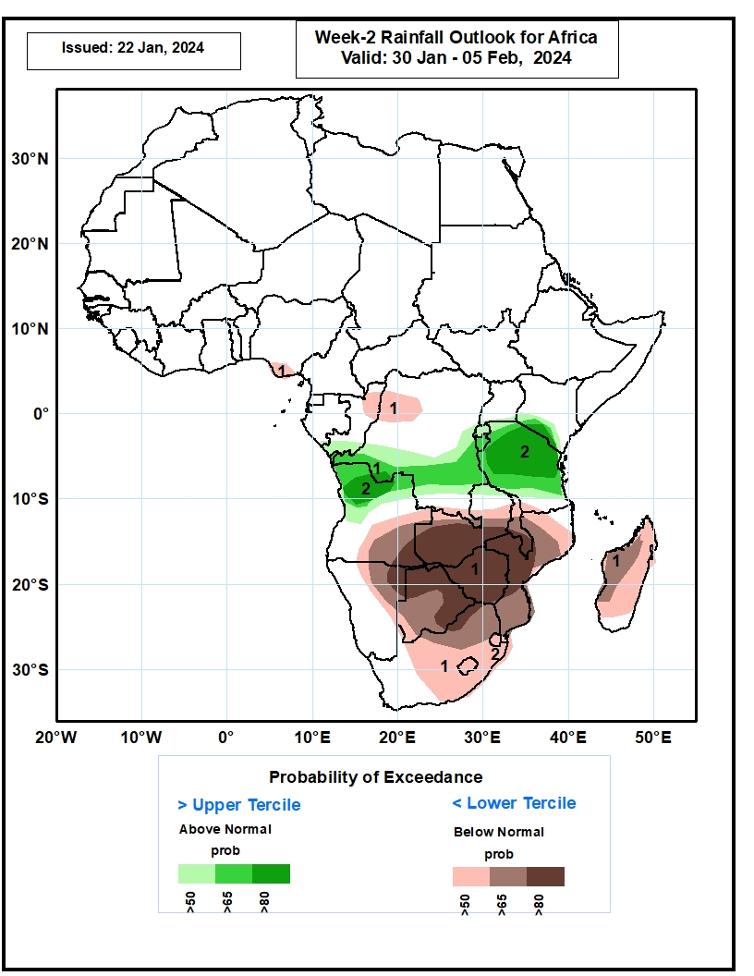
Week-2 Precipitation Outlooks
30 Jan – 05 Feb 2024
1. The probabilistic forecasts call for above 50% chance for weekly total rainfall to be below-normal (below the lower tercile) over pockets of southern Nigeria and northwestern DRC, and much of Southern Africa, including Madagascar. There is above 80% chance for below-normal rainfall over southeastern Angola, northeastern Namibia, southern Zambia, northern and eastern Botswana, Zimbabwe, southern Malawi, and central Mozambique.
2. The probabilistic forecasts call for above 50% chance for weekly rainfall to be above-normal (above the upper tercile) over southern DRC, northern Angola and much of Tanzania. There is above 65% chance for above normal rainfall over northern Angola and much of Tanzania.
Notes:
11

Slide 12
Summary
Over the past 30 days, in East Africa, above-average rainfall was observed in many parts of Tanzania, parts of east-central and southern Uganda, southern Kenya, Burundi, Rwanda, far southeastern Somalia, and a small portion of southwestern Ethiopia. Rainfall was below-average over southeastern South Sudan and parts of southwestern Ethiopia. In Central Africa, rainfall was above-average across far southwestern, parts of central, and southeastern DRC, far southwestern Gabon, and southwestern and east-central Congo. Below-average rainfall was observed in central and eastern Equatorial Guinea, most of Gabon, most of northern and central Congo, much of northern, parts of central, and much of southwestern DRC, southern CAR, and southern Cameroon. In West Africa, rainfall was above-average from coastal areas of eastern Liberia to southwestern Ghana. Rainfall was below average in coastal parts of central Liberia, northwestern Ghana, and south-central Nigeria. In southern Africa, above-average rainfall was observed in far northwestern and south-central Angola, northwestern, parts of northeastern, and pockets of east-central Namibia, central and eastern Zambia, southern, west-central, and parts of northern Mozambique, southern and northern Zimbabwe, southern and eastern Botswana, Lesotho, Eswatini, eastern and central South Africa, Malawi, and southern, east-central, and far northern Madagascar. Below-average rainfall was observed in central, southwestern, much of northern, and eastern Angola, northwestern and southwestern Zambia, eastern Zimbabwe, northwestern and central Botswana, northeastern and central Namibia, parts of central Mozambique, Comoros, and west-central and parts of northern Madagascar.
During the past 7 days, in East Africa, rainfall was above-average in southwestern Uganda, southwestern, parts of central, southeastern, and parts of northwestern Kenya, north-central Rwanda, central Burundi, central and eastern Tanzania, southeastern Somalia, and parts of southwestern Ethiopia. In central Africa, above-average rainfall was observed over pockets of west-central and southeastern DRC, southeastern Congo, and far northwestern Gabon. Rainfall was below-average over much of eastern, western, and southern DRC, central and southwestern Congo, most of Gabon, parts of far southern Cameroon, and Equatorial Guinea. In West Africa, rainfall was above normal in southeastern Liberia and a small portion of southeastern Cote d’Ivoire. Rainfall was below average in parts of east-central Liberia, southwestern Cote d’Ivoire, north-central Ghana, Togo, and Benin, and coastal parts of southwestern and south-central Nigeria. In southern Africa, rainfall was above-average over a small portion of south-central Angola, central, eastern, and southern Zambia, most of Malawi, far northwestern, northeastern, west-central, east-central, and southeastern Mozambique, far northeastern Namibia, eastern Botswana, northeastern and southeastern South Africa, northeastern Lesotho, northern, parts of central, and southwestern Zimbabwe, and northern, central, Comoros, and coastal portions of southeastern Madagascar. Below-average rainfall was observed over most of Angola, northwestern and northeastern Zambia, parts of northeastern, central, and southern Mozambique, southeastern Zimbabwe, much of northern and central Namibia, northwestern and central Botswana, central and east-central South Africa, western Lesotho, northern and central Eswatini, and most of southern Madagascar.
The Week-1 outlook calls for above-average rainfall in central and southwestern Angola, most of Rwanda and Burundi, northern, parts of central, and eastern Tanzania, southwestern Kenya, and parts of northern and central Madagascar. In contrast, there is an increased chance for below-average rainfall across coastal portions of the Gulf of Guinea region, Equatorial Guinea, Gabon, Congo, parts of central and southeastern DRC, east-central and southeastern Angola, Zambia, Malawi, southwestern Tanzania, Zimbabwe, Mozambique, Botswana, southern, central, and eastern South Africa, Lesotho, Eswatini, parts of central and northeastern Namibia, Comoros, and much of western, eastern, and southern Madagascar. The Week-2 outlook calls for above-normal rainfall in western, parts of central, and northern Angola, southern and east-central DRC, southwestern Congo, Rwanda, Burundi, Tanzania, northern Malawi, far northwestern Mozambique, northwestern Zambia, southwestern and parts of central Kenya, parts of central and southwestern Ethiopia, and a small portion of central Madagascar. In contrast, there is an increased chance for below-average rainfall in coastal portions of the Gulf of Guinea region, southwestern Cameroon, southeastern Angola, western, central, and southern Zambia, northeastern Namibia, northern, central, and eastern Botswana, Zimbabwe, Lesotho, Eswatini, eastern and parts of central South Africa, central and southern Malawi, most of Mozambique, Comoros, and most of Madagascar.

