Slide 1
The African Monsoon Recent Evolution and Current Status Include Week-1 and Week-2 Outlooks
Update prepared
29 January 2024
For more information, visit:
http://www.cpc.ncep.noaa.gov/products/Global_Monsoons/African_Monsoons/precip_monitoring.shtml

Slide 2
Outline
Highlights
Recent Evolution and Current Conditions
NCEP GEFS Forecasts
Summary

Slide 3
Highlights: Last 7 Days
During the past 7 days, in East Africa, rainfall was above-average in southeastern Uganda, southwestern Kenya, eastern Rwanda, and throughout much of Tanzania (especially west-central portions of the country). Rainfall was below average in southwestern Tanzania and west-central Ethiopia. In central Africa, above-average rainfall was observed over pockets of southeastern DRC, parts of west-central Gabon, and parts of north-central DRC. Rainfall was below-average over northwestern, central, and southern DRC, Congo, most of Gabon, Equatorial Guinea, and southern Cameroon. In West Africa, rainfall was near-normal over most of the region. In southern Africa, rainfall was above-average over pockets of northeastern Zambia, east-central Malawi, west-central Angola, south-central and southwestern Botswana, far northwestern Mozambique, and northern and west-central Madagascar. Below-average rainfall was observed over northern, most of central, and eastern Angola, most of Zambia, northern, western, and southern Malawi, Zimbabwe, northern and central Botswana, most of Mozambique, most of northern Namibia, Lesotho, Eswatini, parts of central and eastern South Africa, and parts of central and most of eastern and southern Madagascar.
The Week-1 outlook calls for above-average rainfall in central and southwestern Ethiopia, southeastern Uganda, southern Kenya, Rwanda, Burundi, Tanzania, parts of central and southern DRC, northern Zambia, northern Malawi, northern and southeastern Mozambique, northern, western, and parts of central Angola, northwestern, central, and southern Namibia, and western South Africa. In contrast, there is an increased chance for below-average rainfall across coastal portions of the Gulf of Guinea region, coastal Gabon and Cameroon, southeastern Angola, central and southern Zambia, central and southern Malawi, most of Zimbabwe, central Mozambique, northern and eastern Botswana, eastern South Africa, Lesotho, northeastern Namibia, Comoros, and much of Madagascar. The Week-2 outlook primarily calls for below-average rainfall, especially in coastal portions of the Gulf of Guinea region and most of southern Africa. Above average rainfall is expected in southern Congo, northern and parts of western Angola, northeastern Zambia, western Tanzania, south-central Kenya, and parts of northeastern South Africa.

Slide 4
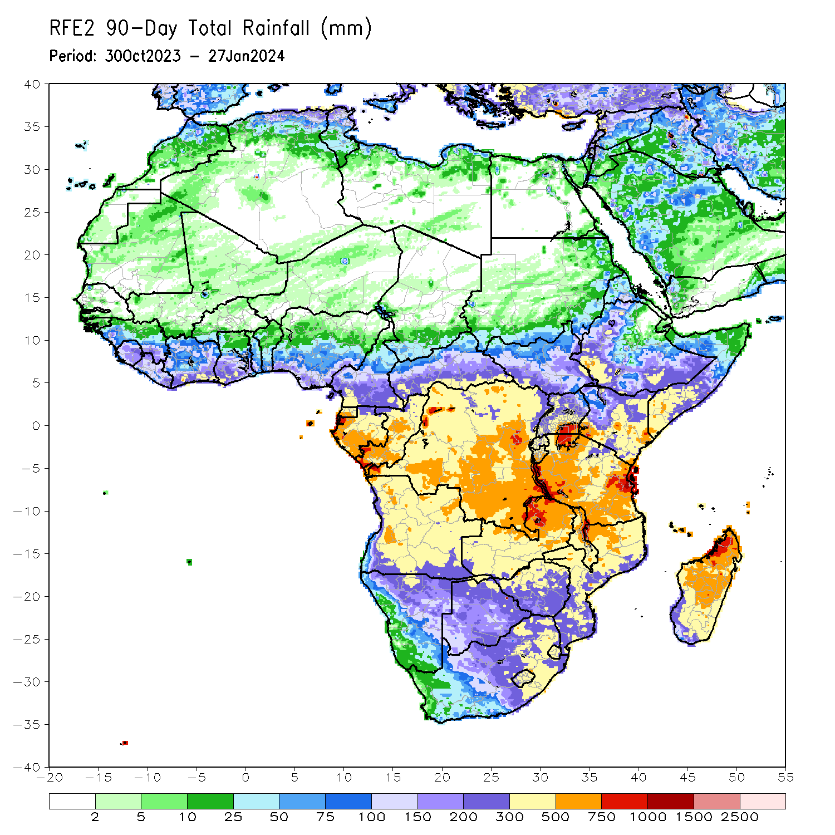
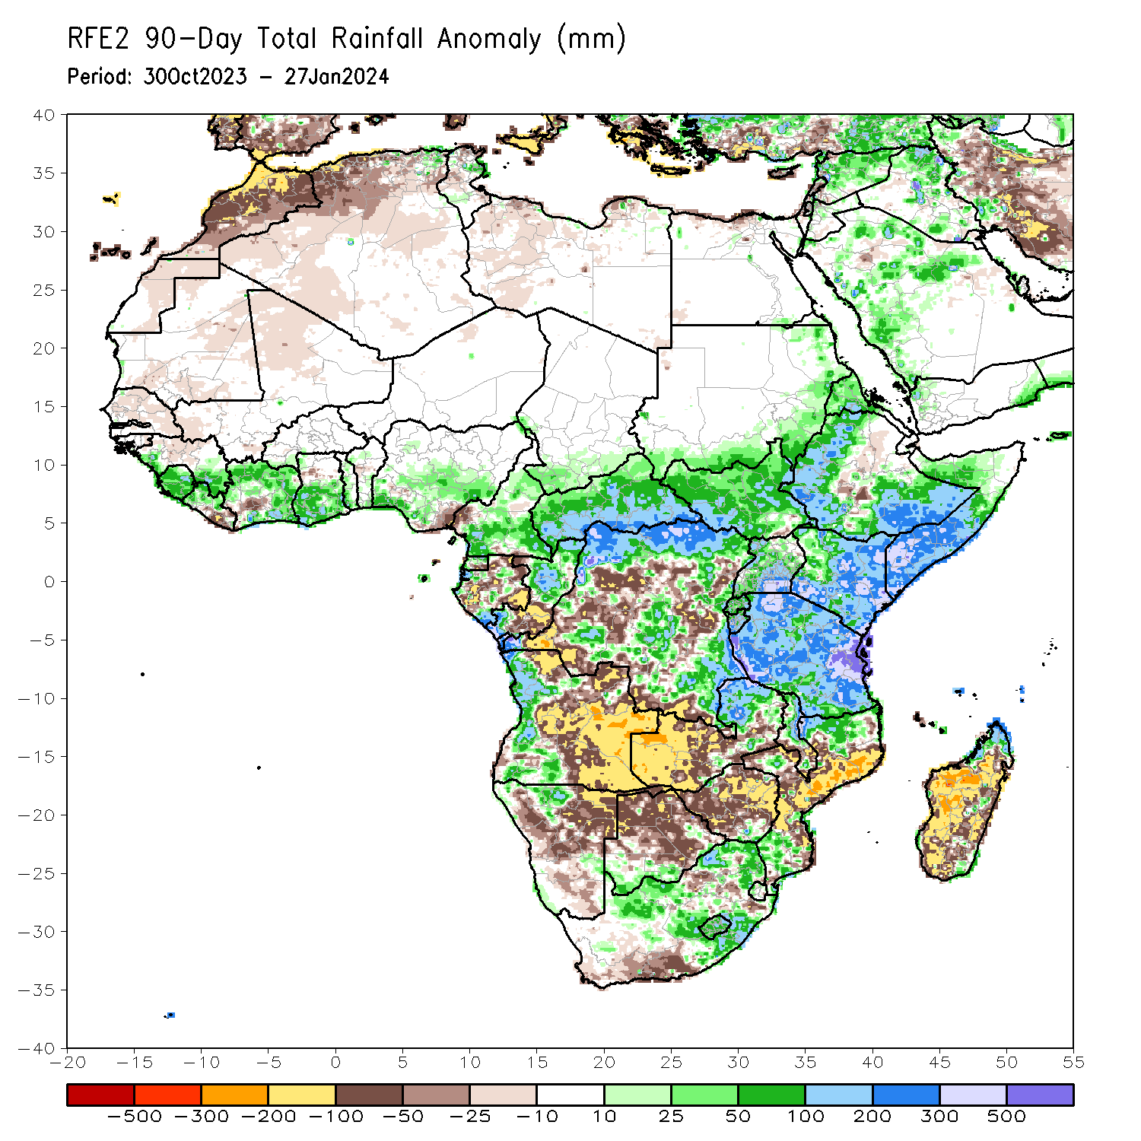
Rainfall Patterns: Last 90 Days
Over the past 90 days, in East Africa, above-average rainfall was observed in many parts of southern and eastern Sudan, South Sudan, Kenya, Tanzania, Burundi, Rwanda, Uganda, western and central Eritrea, northern, western, and southern Ethiopia, and southern, central, and western Somalia. Rainfall was below-average over parts of central Ethiopia and southeastern South Sudan. In Central Africa, rainfall was above-average in many parts of CAR, much of northern, eastern, and central DRC, northern, central, and southwestern Congo, parts of central, northwestern, and south-central Gabon, western and northern Equatorial Guinea, southern and west-central Chad, and most of southern and central Cameroon. Rainfall was below-average over west-central and south-central Cameroon, southern Equatorial Guinea, northern, west-central, and eastern Gabon, south-central and northwestern Congo, and pockets of southern and central DRC. In West Africa, rainfall was above-average over western and southeastern Guinea, Sierra Leone, western and north-central Liberia, many parts of Cote d’Ivoire, southwestern Burkina Faso, southern and much of western Togo, southern and northwestern Benin, central, southern, and parts of northwestern Ghana, and southwestern, central, parts of northeastern, and southeastern Nigeria. Below-average rainfall was observed over Senegal, Gambia, southern, east-central, and northern Mauritania, western Mali, parts of southwestern Cote d’Ivoire, central Guinea, south-central and southeastern Liberia, parts of west-central Ghana, parts of central Benin, and south-central Nigeria. In southern Africa, above-average rainfall was observed over most of western Angola, northwestern Namibia, northeastern and parts of southeastern Zambia, southeastern Zimbabwe, southwestern and southeastern Botswana, southern, parts of west-central, and northern Mozambique, eastern and parts of central South Africa, western Eswatini, Lesotho, northern, central, and parts of southern Malawi, and coastal pockets of northern and southeastern Madagascar. Below-average rainfall was observed over much of eastern, central, and parts of northern Angola, northeastern, central, and southeastern Namibia, western, central, and parts of southeastern Zambia, much of central and northern Botswana, most of Zimbabwe, southwestern and parts of northeastern South Africa, central and southeastern Mozambique, parts of southern Malawi, and much of southern and central Madagascar.
Notes:
4

Slide 5
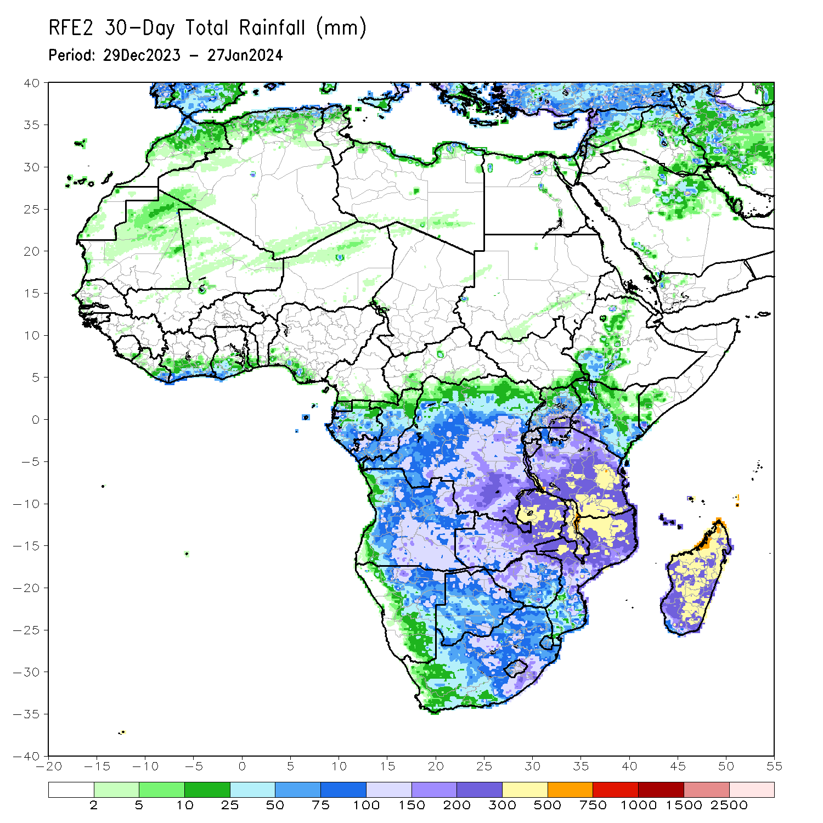
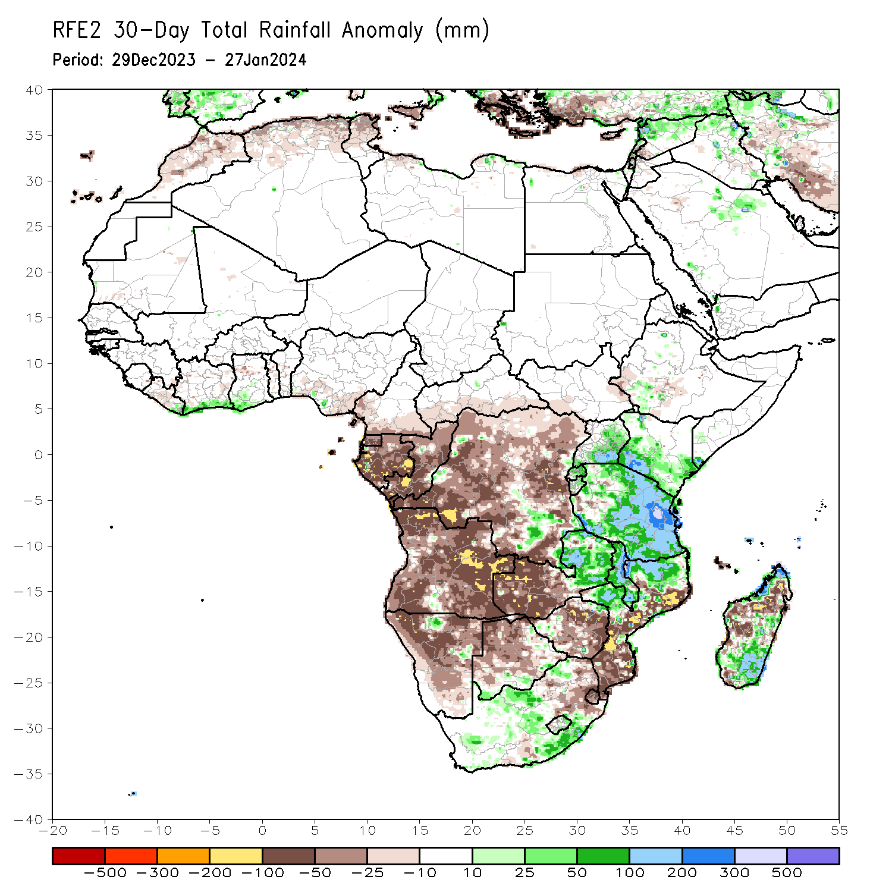
Rainfall Patterns: Last 30 Days
Over the past 30 days, in East Africa, above-average rainfall was observed in many parts of Tanzania, parts of east-central and southern Uganda, southern and northwestern Kenya, northern and central Burundi, Rwanda, far southeastern Somalia, and pockets of southwestern Ethiopia. Rainfall was below-average over east-central and southwestern South Sudan and parts of central and western Ethiopia. In Central Africa, rainfall was above-average across parts of southeastern DRC. Below-average rainfall was observed in Equatorial Guinea, most of Gabon, most of Congo, much DRC, southern CAR, and southern Cameroon. In West Africa, rainfall was above-average from coastal areas of eastern Liberia to southwestern Ghana. Rainfall was below average in central Liberia, parts of northwestern Ghana, and southwestern and south-central Nigeria. In southern Africa, above-average rainfall was observed in pockets of north-central and east-central Namibia, eastern Zambia, west-central and parts of northern Mozambique, northeastern Zimbabwe, parts of southern Botswana, eastern and southern Lesotho, southeastern and central South Africa, Malawi, and southern, east-central, and far northern Madagascar. Below-average rainfall was observed in Angola, western Zambia, most of Namibia, northern and central Botswana, central and eastern Zimbabwe, eastern South Africa, southern and central Mozambique, Eswatini, and far southwestern, west-central, and parts of northern Madagascar.
Notes:
5

Slide 6
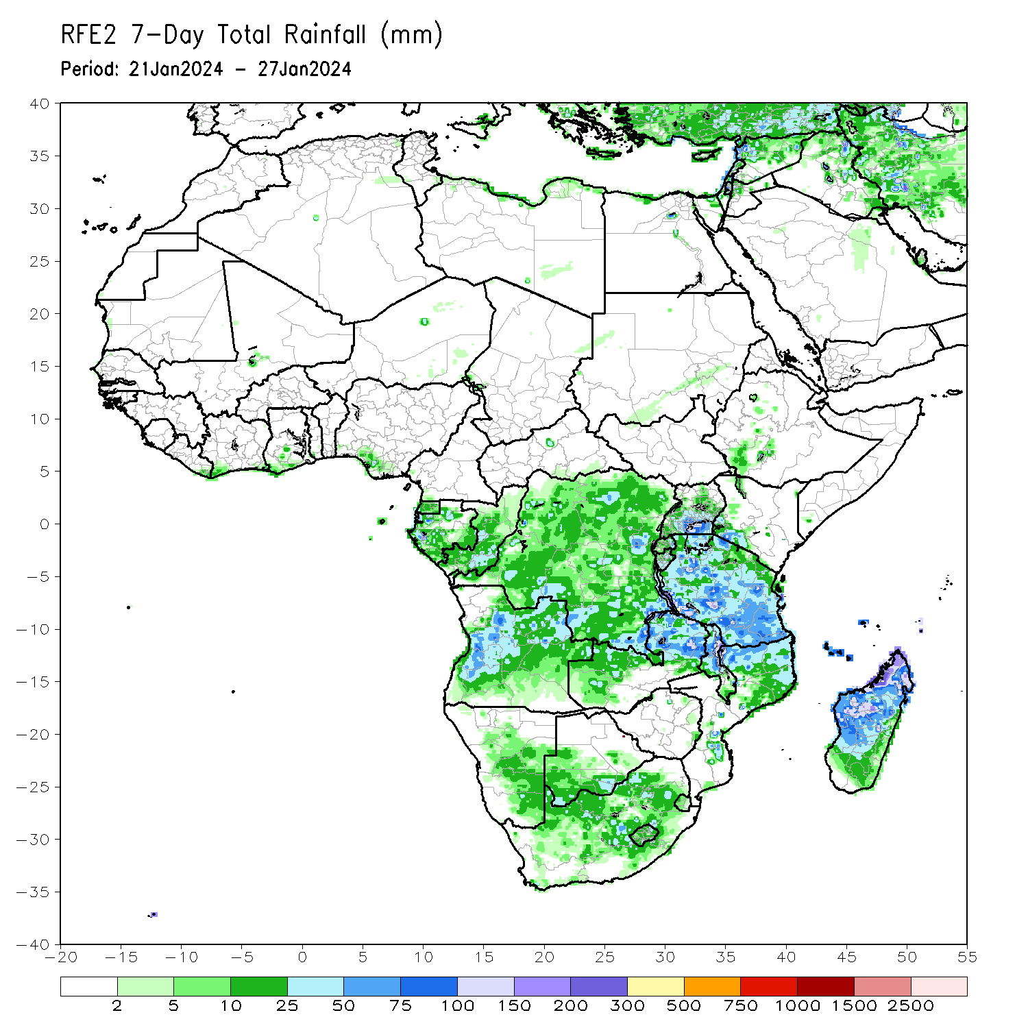
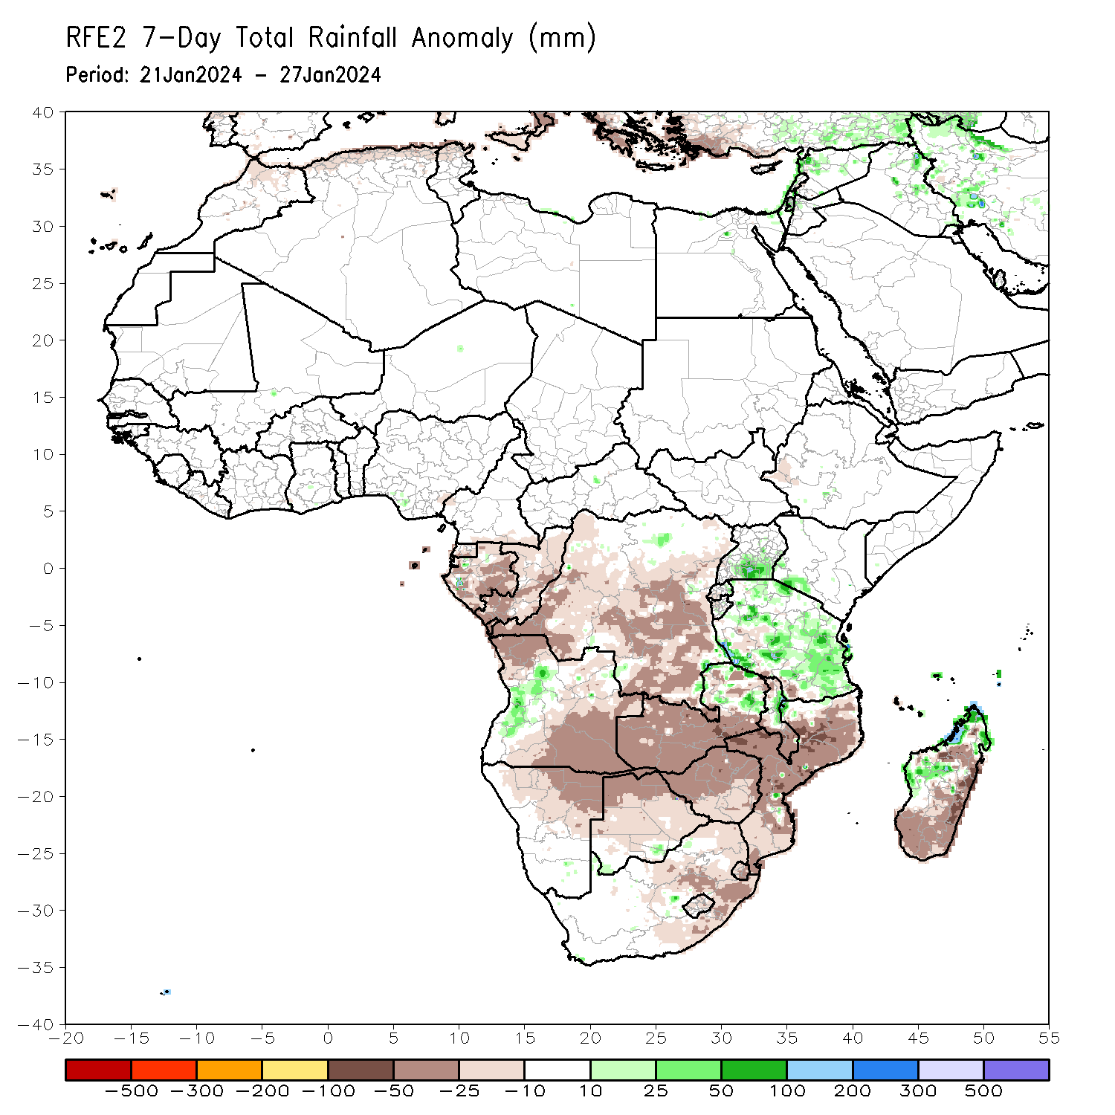
Rainfall Patterns: Last 7 Days
During the past 7 days, in East Africa, rainfall was above-average in southeastern Uganda, southwestern Kenya, eastern Rwanda, and throughout much of Tanzania (especially west-central portions of the country). Rainfall was below average in southwestern Tanzania and west-central Ethiopia. In central Africa, above-average rainfall was observed over pockets of southeastern DRC, parts of west-central Gabon, and parts of north-central DRC. Rainfall was below-average over northwestern, central, and southern DRC, Congo, most of Gabon, Equatorial Guinea, and southern Cameroon. In West Africa, rainfall was near-normal over most of the region. In southern Africa, rainfall was above-average over pockets of northeastern Zambia, east-central Malawi, west-central Angola, south-central and southwestern Botswana, far northwestern Mozambique, and northern and west-central Madagascar. Below-average rainfall was observed over northern, most of central, and eastern Angola, most of Zambia, northern, western, and southern Malawi, Zimbabwe, northern and central Botswana, most of Mozambique, most of northern Namibia, Lesotho, Eswatini, parts of central and eastern South Africa, and parts of central and most of eastern and southern Madagascar.

Slide 7
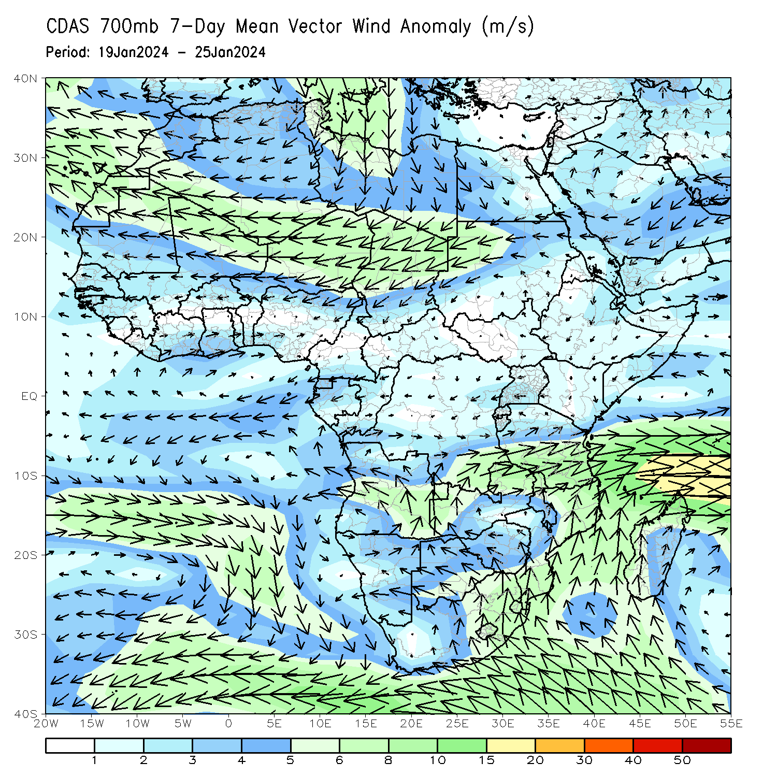
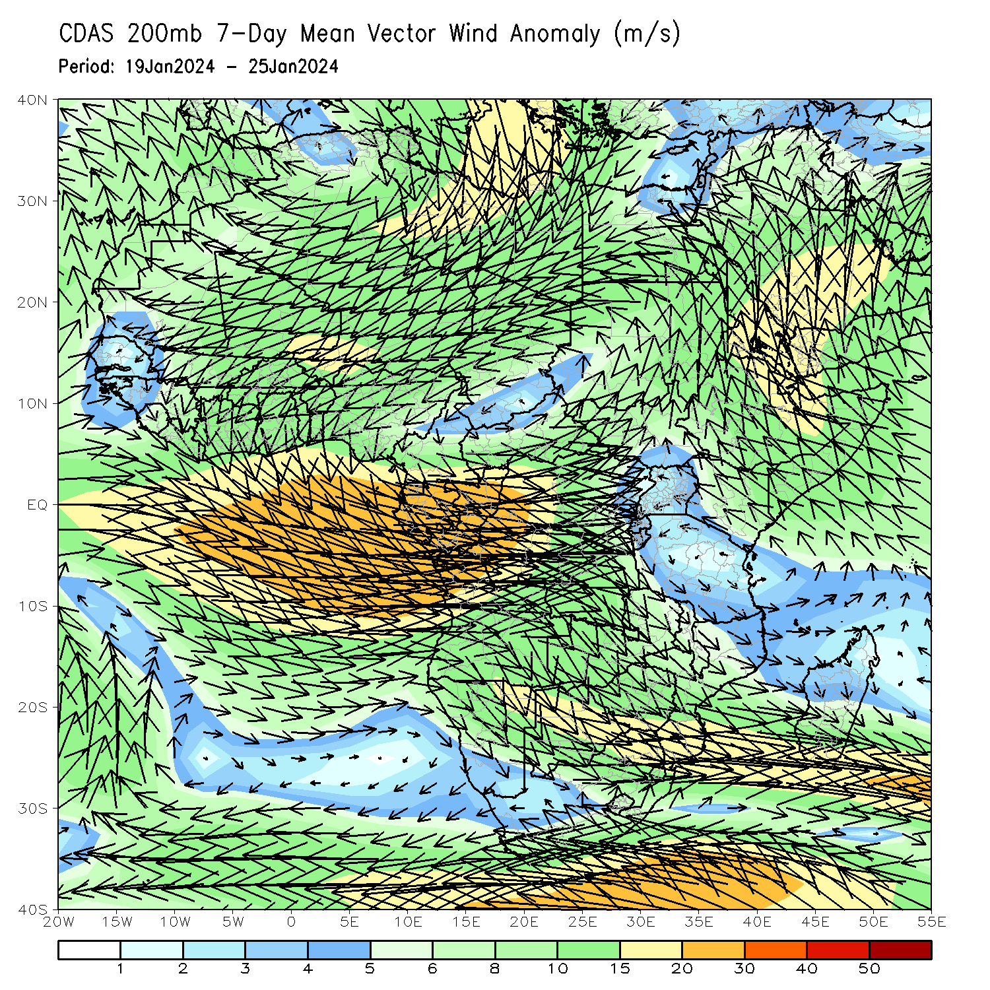
Atmospheric Circulation: Last 7 Days
At 700-hPa level (left panel), the anomalous lower-level convergence near Tanzania and western/northern Madagascar may have contributed to the observed above-average rainfall in the region. At 200-hPa level (right panel), anomalous upper-level convergence near DRC, Congo, Gabon, Angola, Zimbabwe, and South Africa may have contributed to the below-average rainfall in the region.

Slide 8
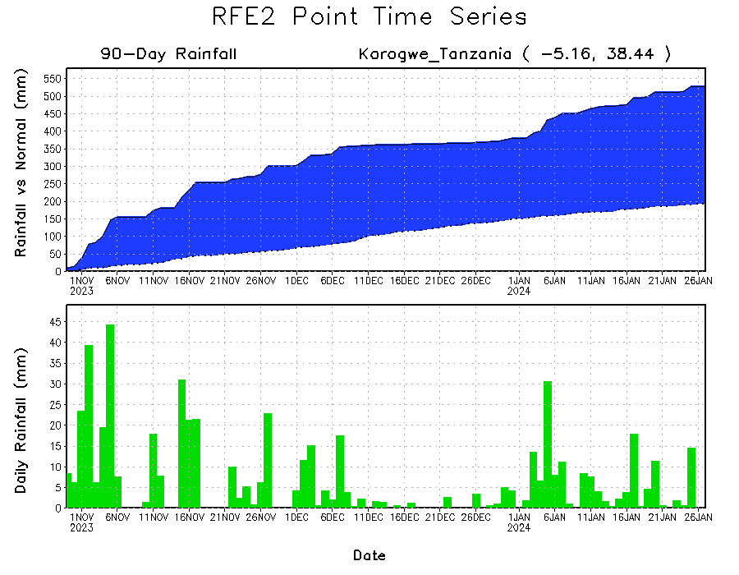
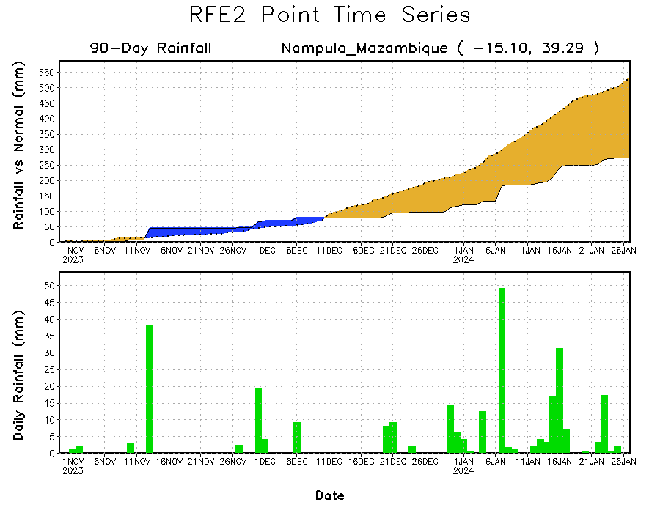
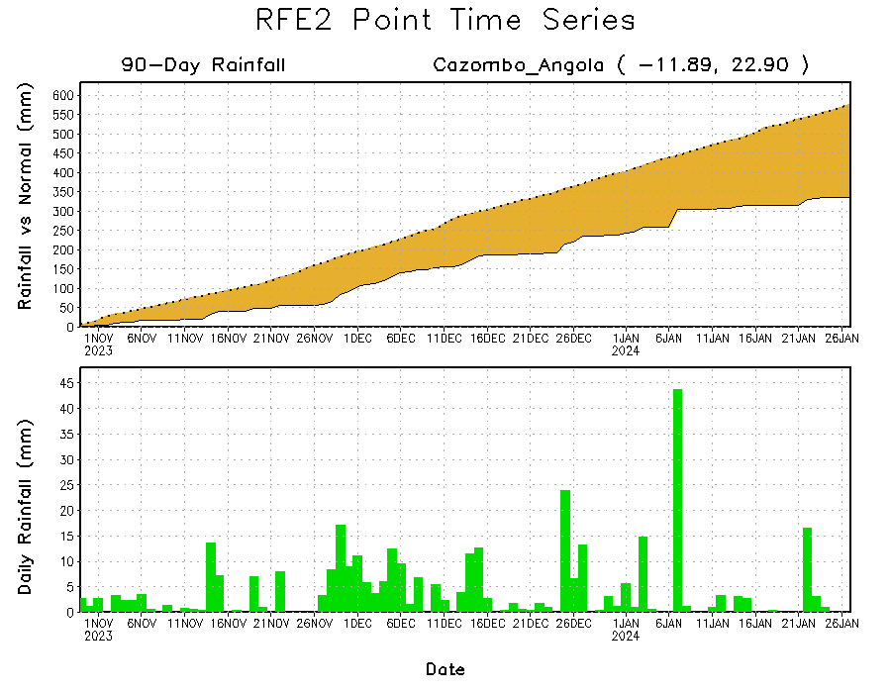
Rainfall Evolution
Daily evolution of rainfall over the last 90 days at selected locations shows a growing deficits over parts of east-central Angola (bottom left) and northeastern Mozambique (bottom right). Rainfall surpluses increased over northeastern Tanzania due to the recent moderate rainfall (top right).

Slide 9
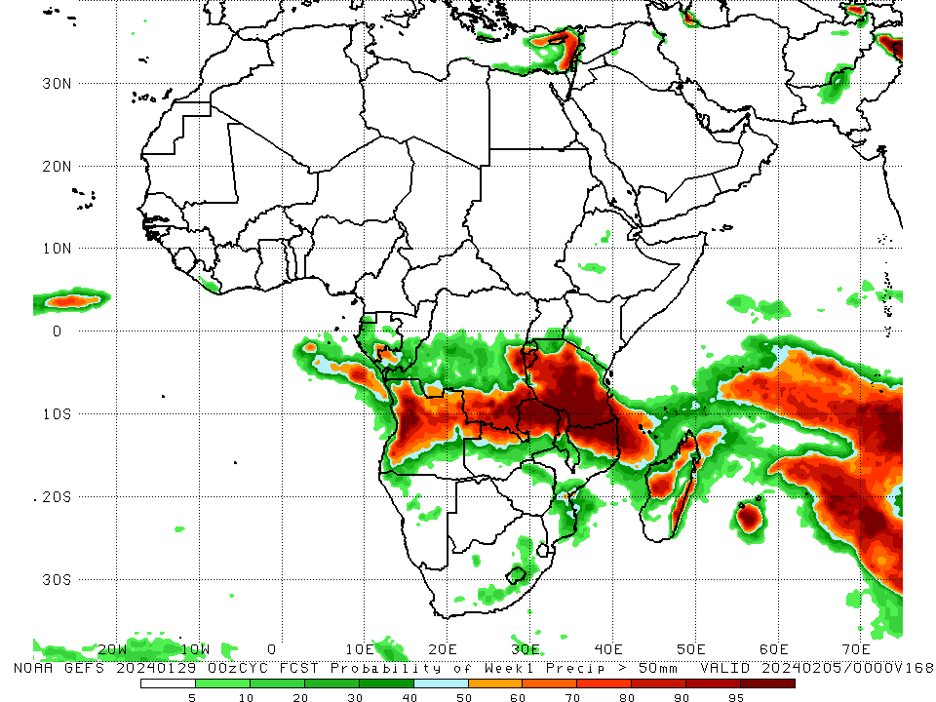
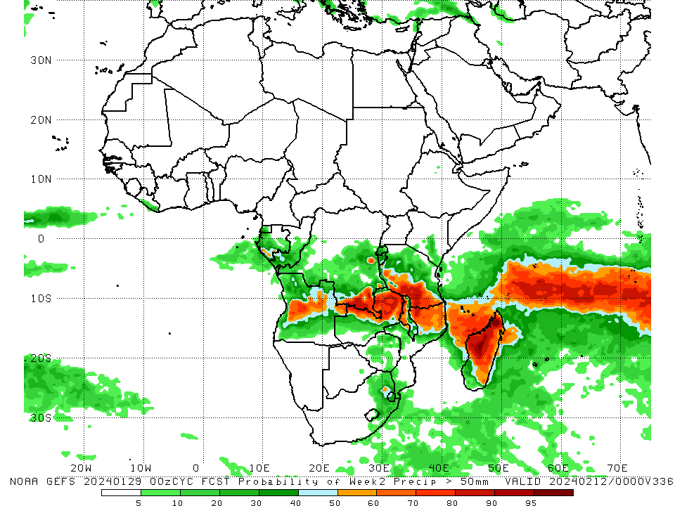
NCEP GEFS Model Forecasts Non-Bias Corrected Probability of precipitation exceedance
Week-1, Valid: 30 Jan – 05 Feb 2024
Week-2, Valid: 06 – 12 Feb 2024
For week-1 (left panel) the GEFS forecasts indicate a moderate to high chance (over 70%) for rainfall to exceed 50 mm over much of central and southern Tanzania, northern, central, and western Angola, south-central, southeastern, and east-central DRC, Burundi, southwestern Rwanda, northern Zambia, northern Mozambique, northern Malawi, and parts of northern, eastern, and west-central Madagascar. For week-2 (right panel), the GEFS forecasts indicate a moderate to high chance (over 70%) for rainfall to exceed 50 mm over parts of southern Tanzania, northern Mozambique, wester Malawi, northern and eastern Zambia, southeastern DRC, central Angola, and northern and central Madagascar.
Notes:
9

Slide 10
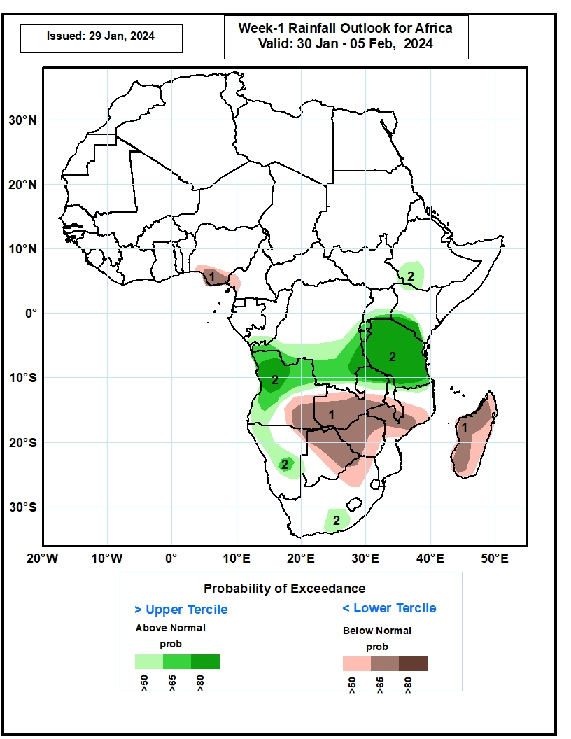
Week-1 Precipitation Outlooks
30 Jan – 05 Feb 2024
1. The probabilistic forecasts call for above 50% chance for weekly total rainfall to be below-normal (below the lower tercile) over coastal Nigeria and Cameroon, southeastern Angola, western and southern Zambia, Zimbabwe, Botswana, northeastern South Africa, southern Malawi, central Mozambique, and much of Madagascar. There is above 65% chance for below-normal rainfall over southeastern Angola, western and southern Zambia, parts of Zimbabwe and Botswana, southern Malawi, central Mozambique, and western Madagascar .
2. The probabilistic forecasts call for above 50% chance for weekly rainfall to be above-normal (above the upper tercile) over northern and western Angola, parts of southwestern Ethiopia, southern and eastern DRC, Rwanda, Burundi, much of Tanzania, western Namibia, eastern Zambia, and southeastern South Africa. There is above 65% chance for above-normal rainfall over parts of Angola, eastern DRC, Rwanda, Burundi and Tanzania.
Notes:
10

Slide 11
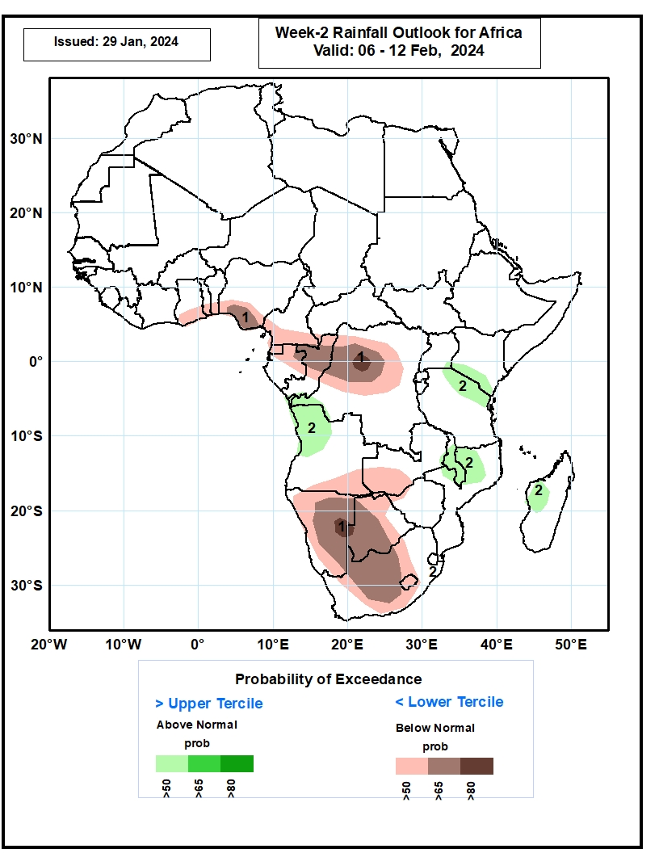
Week-2 Precipitation Outlooks
06 – 12 Feb 2024
1. The probabilistic forecasts call for above 50% chance for weekly total rainfall to be below-normal (below the lower tercile) over southern Ghana, southern Togo, southern Benin, southern Nigeria, southern Cameroon, Equatorial Guinea, northern Gabon, northern Congo, northwestern DRC, southern Angola, western Zambia, much of Namibia, Botswana, and parts of South Africa. There is above 65% chance for below-normal rainfall over southern Nigeria, northern Congo, northwestern DRC, southeastern Namibia, western Botswana and central South Africa.
2. The probabilistic forecasts call for above 50% chance for weekly rainfall to be above-normal (above the upper tercile) over northwestern Angola, northern Tanzania, southern Kenya, Malawi, northern Mozambique and western Madagascar.
Notes:
11

Slide 12
Summary
Over the past 30 days, in East Africa, above-average rainfall was observed in many parts of Tanzania, parts of east-central and southern Uganda, southern and northwestern Kenya, northern and central Burundi, Rwanda, far southeastern Somalia, and pockets of southwestern Ethiopia. Rainfall was below-average over east-central and southwestern South Sudan and parts of central and western Ethiopia. In Central Africa, rainfall was above-average across parts of southeastern DRC. Below-average rainfall was observed in Equatorial Guinea, most of Gabon, most of Congo, much DRC, southern CAR, and southern Cameroon. In West Africa, rainfall was above-average from coastal areas of eastern Liberia to southwestern Ghana. Rainfall was below average in central Liberia, parts of northwestern Ghana, and southwestern and south-central Nigeria. In southern Africa, above-average rainfall was observed in pockets of north-central and east-central Namibia, eastern Zambia, west-central and parts of northern Mozambique, northeastern Zimbabwe, parts of southern Botswana, eastern and southern Lesotho, southeastern and central South Africa, Malawi, and southern, east-central, and far northern Madagascar. Below-average rainfall was observed in Angola, western Zambia, most of Namibia, northern and central Botswana, central and eastern Zimbabwe, eastern South Africa, southern and central Mozambique, Eswatini, and far southwestern, west-central, and parts of northern Madagascar.
During the past 7 days, in East Africa, rainfall was above-average in southeastern Uganda, southwestern Kenya, eastern Rwanda, and throughout much of Tanzania (especially west-central portions of the country). Rainfall was below average in southwestern Tanzania and west-central Ethiopia. In central Africa, above-average rainfall was observed over pockets of southeastern DRC, parts of west-central Gabon, and parts of north-central DRC. Rainfall was below-average over northwestern, central, and southern DRC, Congo, most of Gabon, Equatorial Guinea, and southern Cameroon. In West Africa, rainfall was near-normal over most of the region. In southern Africa, rainfall was above-average over pockets of northeastern Zambia, east-central Malawi, west-central Angola, south-central and southwestern Botswana, far northwestern Mozambique, and northern and west-central Madagascar. Below-average rainfall was observed over northern, most of central, and eastern Angola, most of Zambia, northern, western, and southern Malawi, Zimbabwe, northern and central Botswana, most of Mozambique, most of northern Namibia, Lesotho, Eswatini, parts of central and eastern South Africa, and parts of central and most of eastern and southern Madagascar.
The Week-1 outlook calls for above-average rainfall in central and southwestern Ethiopia, southeastern Uganda, southern Kenya, Rwanda, Burundi, Tanzania, parts of central and southern DRC, northern Zambia, northern Malawi, northern and southeastern Mozambique, northern, western, and parts of central Angola, northwestern, central, and southern Namibia, and western South Africa. In contrast, there is an increased chance for below-average rainfall across coastal portions of the Gulf of Guinea region, coastal Gabon and Cameroon, southeastern Angola, central and southern Zambia, central and southern Malawi, most of Zimbabwe, central Mozambique, northern and eastern Botswana, eastern South Africa, Lesotho, northeastern Namibia, Comoros, and much of Madagascar. The Week-2 outlook primarily calls for below-average rainfall, especially in coastal portions of the Gulf of Guinea region and most of southern Africa. Above average rainfall is expected I southern Congo, northern and parts of western Angola, northeastern Zambia, western Tanzania, south-central Kenya, and parts of northeastern South Africa.

