Slide 1
The African Monsoon Recent Evolution and Current Status Include Week-1 and Week-2 Outlooks
Update prepared
12 February 2024
For more information, visit:
http://www.cpc.ncep.noaa.gov/products/Global_Monsoons/African_Monsoons/precip_monitoring.shtml

Slide 2
Outline
Highlights
Recent Evolution and Current Conditions
NCEP GEFS Forecasts
Summary

Slide 3
Highlights: Last 7 Days
During the past 7 days, in East Africa, rainfall was above-average across west-central Ethiopia, eastern Uganda, and pocket areas in western and central Tanzania. Rainfall was below average in parts of central and southern Tanzania. In central Africa, rainfall was above-average in southeastern Gabon, parts of western and central DRC. Rainfall was below-average in western Cameroon, southwestern Equatorial Guinea, northwestern Gabon, northern Congo, and many parts in northern and southern DRC. In West Africa, rainfall was near-average across most of the region. In southern Africa, rainfall was above-average over west-central and southwestern Angola, northwestern Namibia, northeastern South Africa, southern Mozambique, and much of Madagascar. Rainfall was below-average over part of northern and eastern Angola, eastern and south-central Namibia, much of Zambia, Botswana, central South Africa, Zimbabwe, western, central and northern Mozambique, and Malawi.
The Week-1 outlook calls for above-average rainfall in central and southwestern Ethiopia, southeastern South Sudan, Uganda, northwestern Kenya, much of DRC, parts of Congo, northwestern Angola, Rwanda, Burundi, much of Tanzania, northeastern Mozambique, and parts of northern and southeastern Madagascar. In contrast, there is an increased chance for below-average rainfall across much of southern Africa from southeastern Angola Namibia, Zambia, Botswana, Zimbabwe, much of South Africa, Lesotho, Eswatini, central and southern Mozambique. The Week-2 outlook primarily calls for below-average rainfall across southern Africa, including southern and eastern Angola, Namibia, Zambia, western and northern Botswana, Zimbabwe, Malawi, much of Mozambique, western South Africa, much of Madagascar, southern Nigeria, Equatorial Guinea, parts of northern Congo, southwestern CAR, and part of northern DRC. Above-average rainfall is expected in parts of southern Guinea-Conakry, central Cote d’Ivoire, southern Gabon, southwestern Congo, far western DRC, northwestern Angola, eastern DRC, Rwanda, Burundi, much of Tanzania, southern Kenya, and southwestern and central Ethiopia.

Slide 4
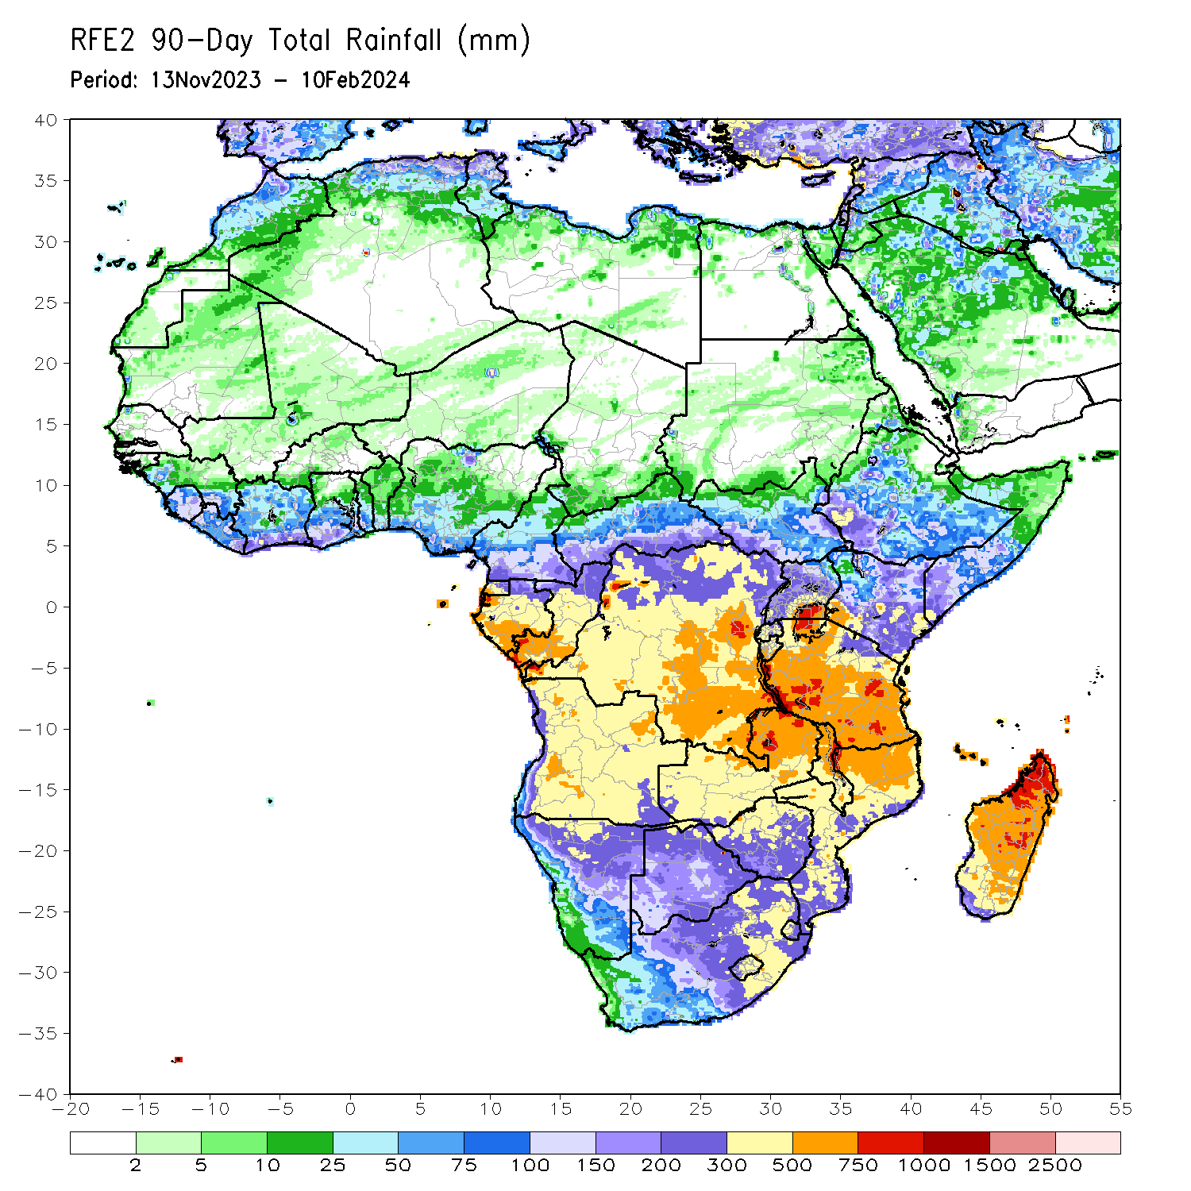
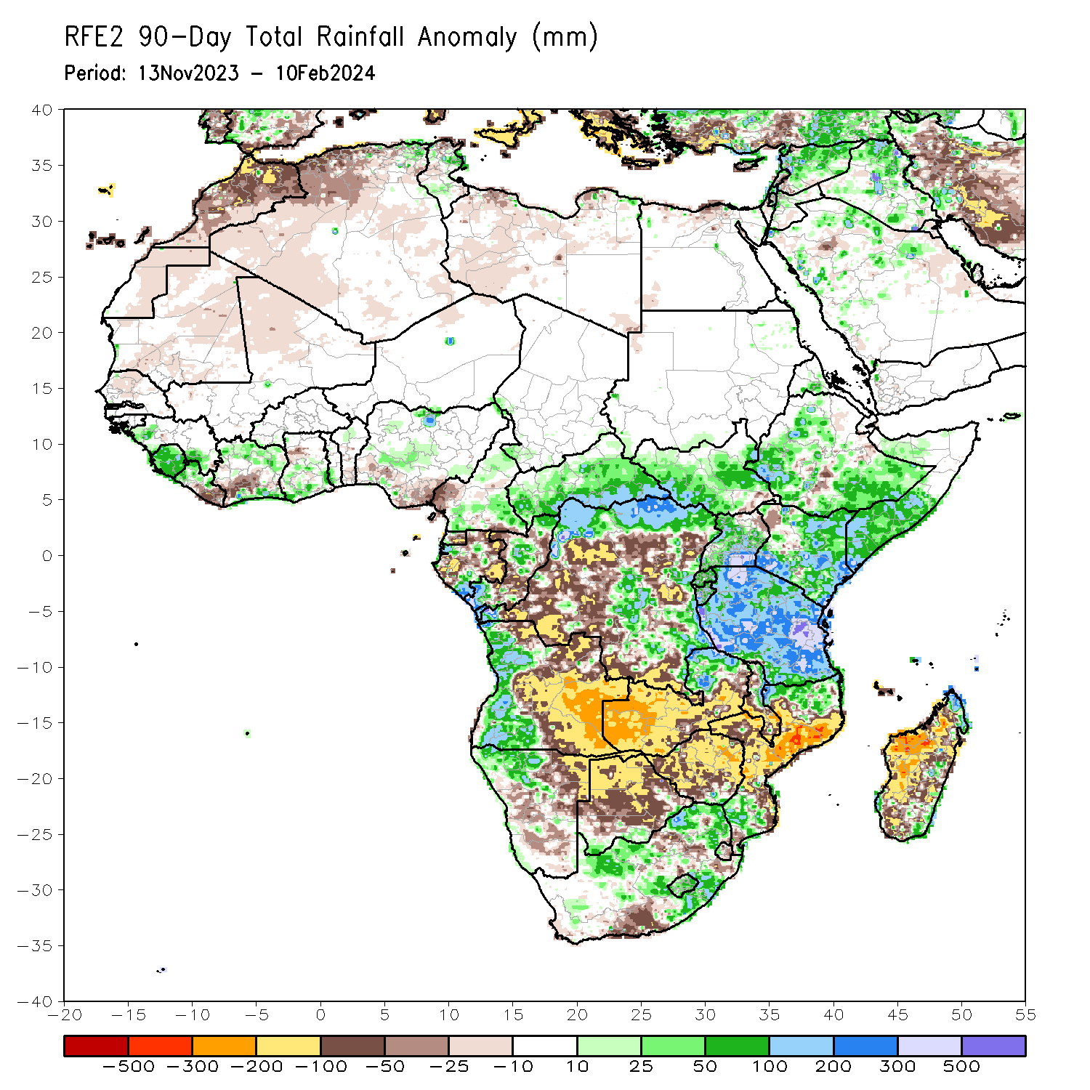
Rainfall Patterns: Last 90 Days
Over the past 90 days, in East Africa, rainfall was above-average in South Sudan, most parts in Ethiopia, Uganda, Kenya, southern Somalia, and Tanzania. In Central Africa, rainfall was above-average in southern CAR, northern, eastern, and central DRC, many parts in Congo, parts of Gabon, western Equatorial Guinea, and most of southern and north-central Cameroon. Rainfall was below-average over western Cameroon, southeastern Equatorial Guinea, northern and eastern Gabon, parts of Congo, and parts of western and central DRC. In West Africa, rainfall was above-average over western and southeastern Guinea, Sierra Leone, western Liberia, northern and southern Cote d’Ivoire, southern Ghana, southwestern Togo, north-central Benin, and many parts of central Nigeria. Rainfall was below-average in eastern Liberia, parts of southwestern Cote d’Ivoire, northwestern Ghana, southern Benin, and southern Nigeria. In southern Africa, rainfall was above-average over western Angola, northwestern Namibia, northeastern Zambia, southeastern Zimbabwe, northeastern Malawi, northern and southern Mozambique, parts of eastern, central, and northeastern South Africa, western Eswatini, Lesotho, northernmost and far southeastern Madagascar. Rainfall was below-average over central and eastern Angola, northeastern Namibia, western and southern Zambia, northern Botswana, Zimbabwe, parts of southern and east-central South Africa, central and southeastern Mozambique, southern Malawi, and much of western and southern Madagascar.
Notes:
4

Slide 5
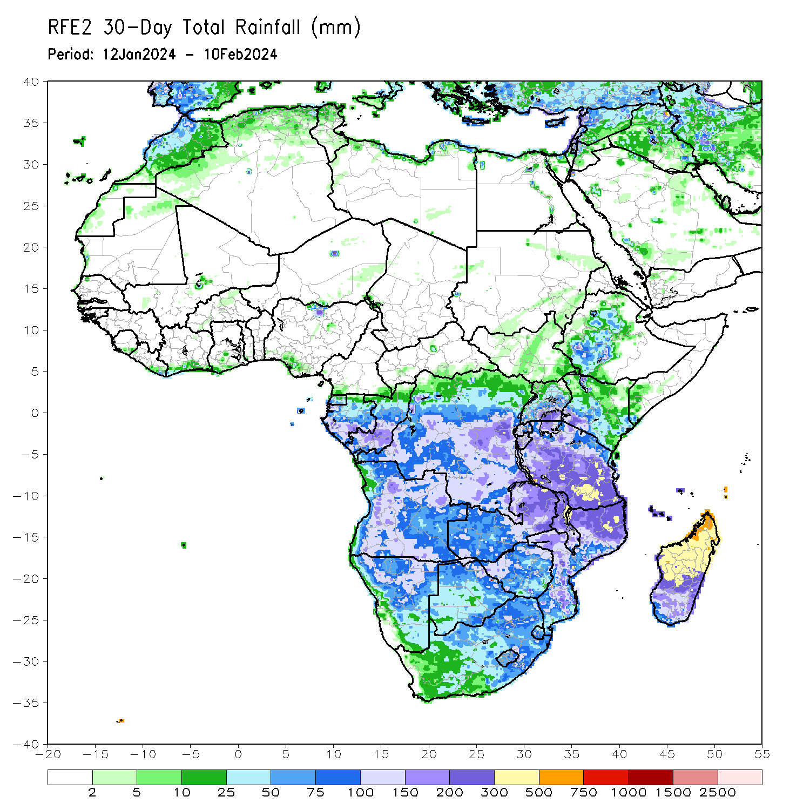
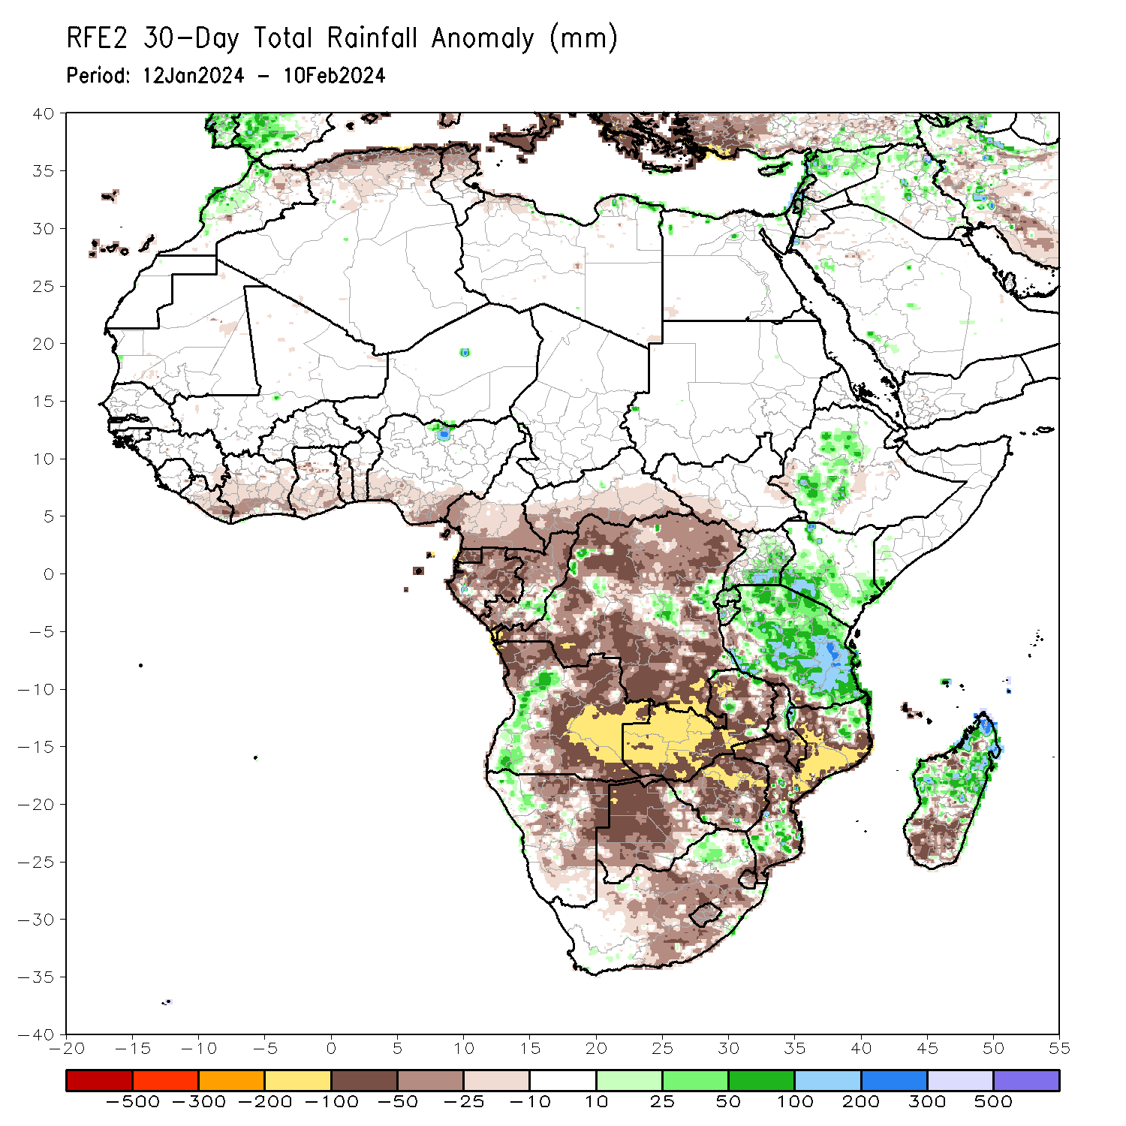
Rainfall Patterns: Last 30 Days
Over the past 30 days, in East Africa, rainfall was above-average in west-central Ethiopia, eastern Uganda, southern and central Kenya, much of Tanzania, most places in Rwanda and Burundi. Rainfall was slightly below-average in southwestern South Sudan, parts of central and western Ethiopia. In Central Africa, rainfall was above-average over parts of central and eastern DRC, part in western Gabon, and south-central Congo. Rainfall was below-average across southern Cameroon, Equatorial Guinea, most of Gabon, most of Congo, much of DRC, and southern CAR. In West Africa, rainfall was below average along the Gulf of Guinea from eastern Liberia to southern Nigeria. In southern Africa, rainfall was above-average in western Angola, northwestern and central Namibia, part of northeastern South Africa, northeastern Mozambique, central and northern Madagascar. Rainfall was below-average in northern and eastern Angola, western Zambia, northeastern Namibia, western Botswana, much of Zimbabwe, central South Africa, western and central Mozambique, Lesotho, Eswatini, and southern Madagascar.
Notes:
5

Slide 6
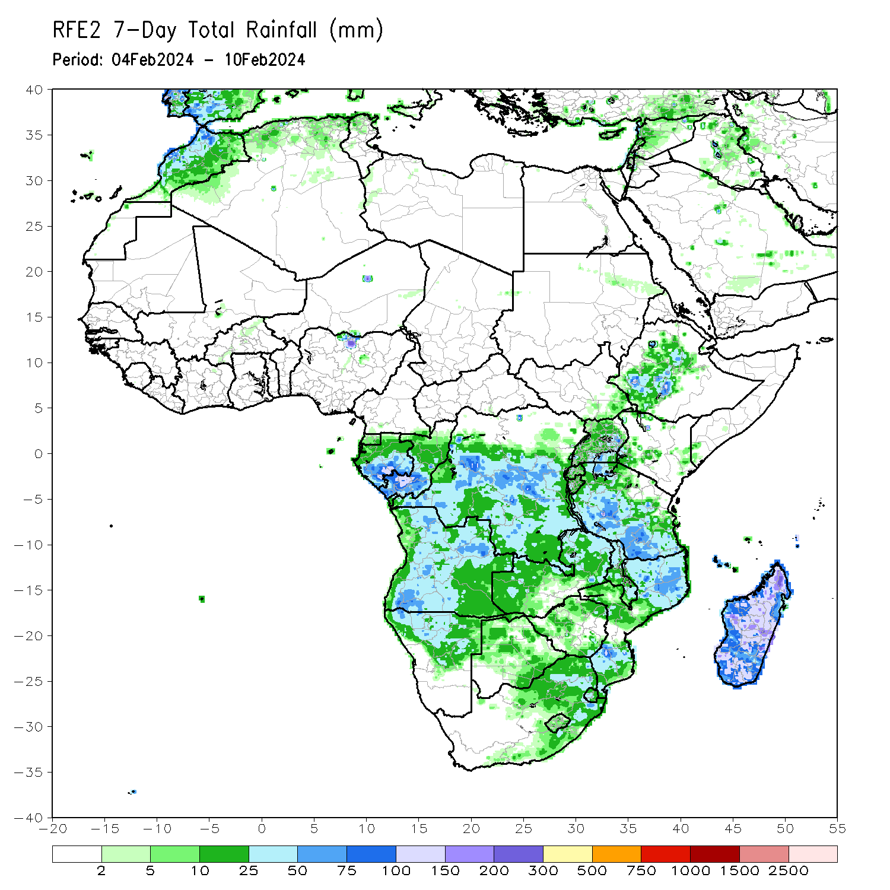
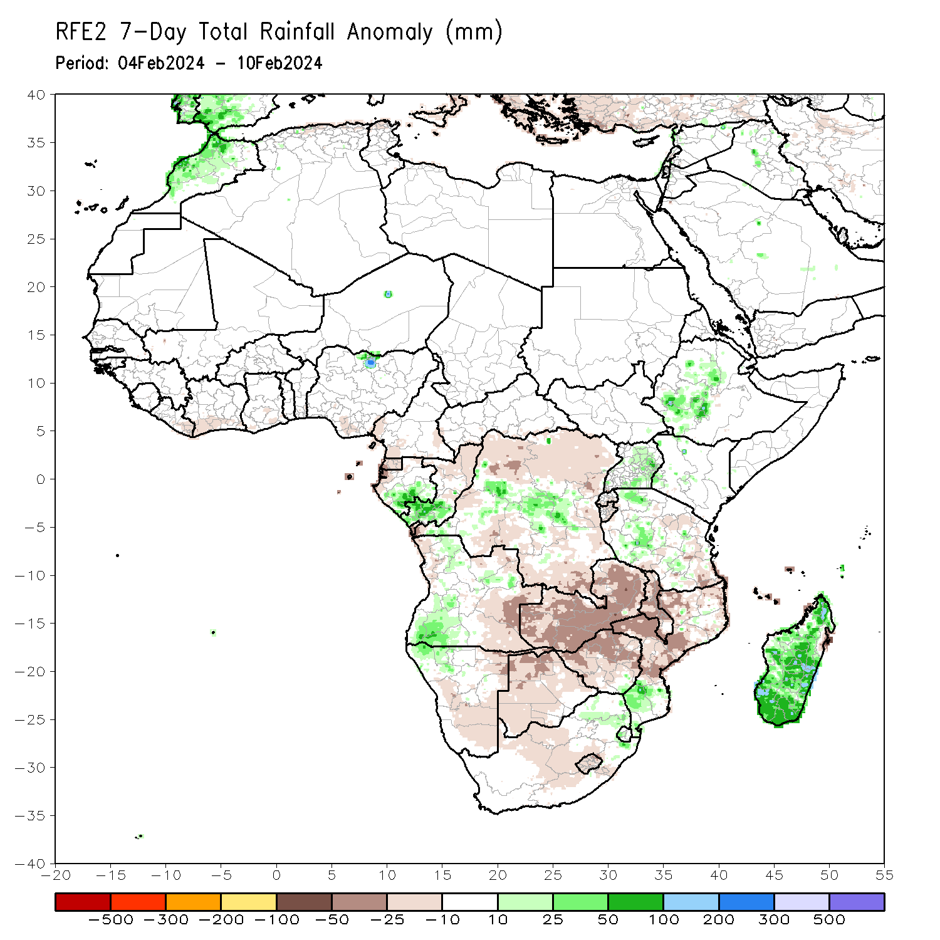
Rainfall Patterns: Last 7 Days
During the past 7 days, in East Africa, rainfall was above-average across west-central Ethiopia, eastern Uganda, and pocket areas in western and central Tanzania. Rainfall was below average in parts of central and southern Tanzania. In central Africa, rainfall was above-average in southeastern Gabon, parts of western and central DRC. Rainfall was below-average in western Cameroon, southwestern Equatorial Guinea, northwestern Gabon, northern Congo, and many parts in northern and southern DRC. In West Africa, rainfall was near-average across most of the region. In southern Africa, rainfall was above-average over west-central and southwestern Angola, northwestern Namibia, northeastern South Africa, southern Mozambique, and much of Madagascar. Rainfall was below-average over part of northern and eastern Angola, eastern and south-central Namibia, much of Zambia, Botswana, central South Africa, Zimbabwe, western, central and northern Mozambique, and Malawi.

Slide 7
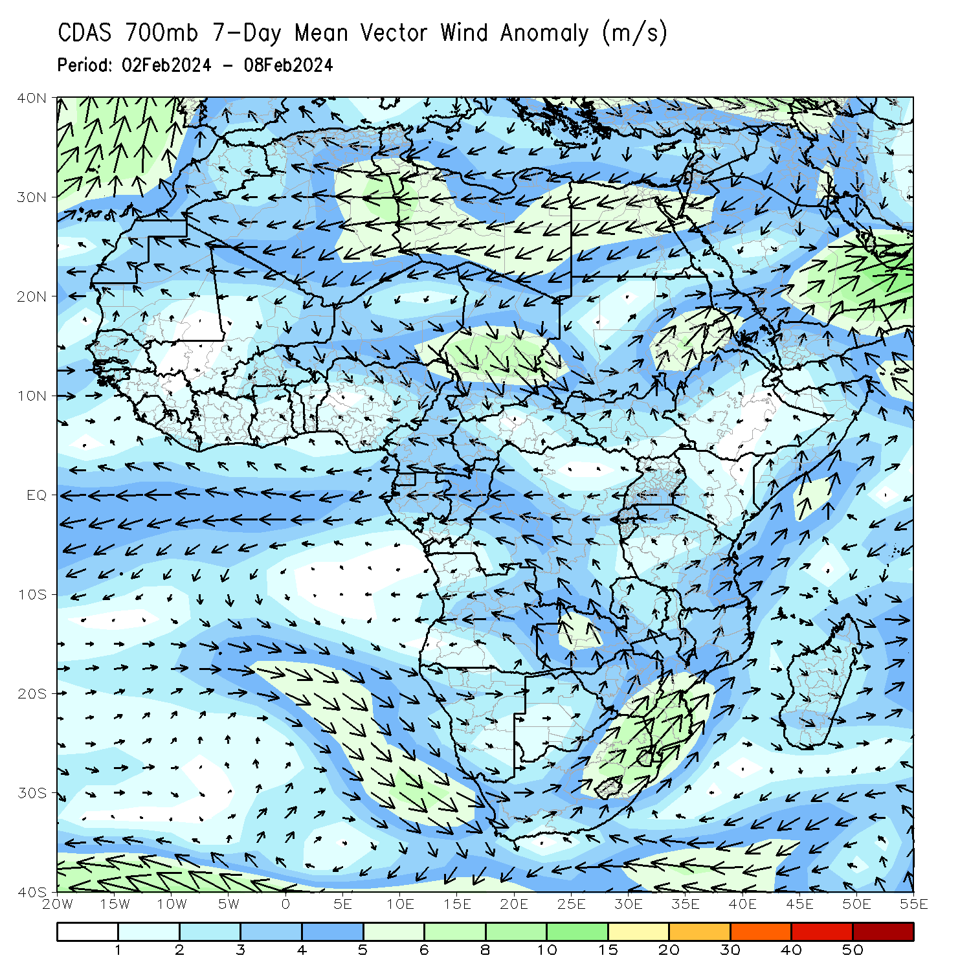
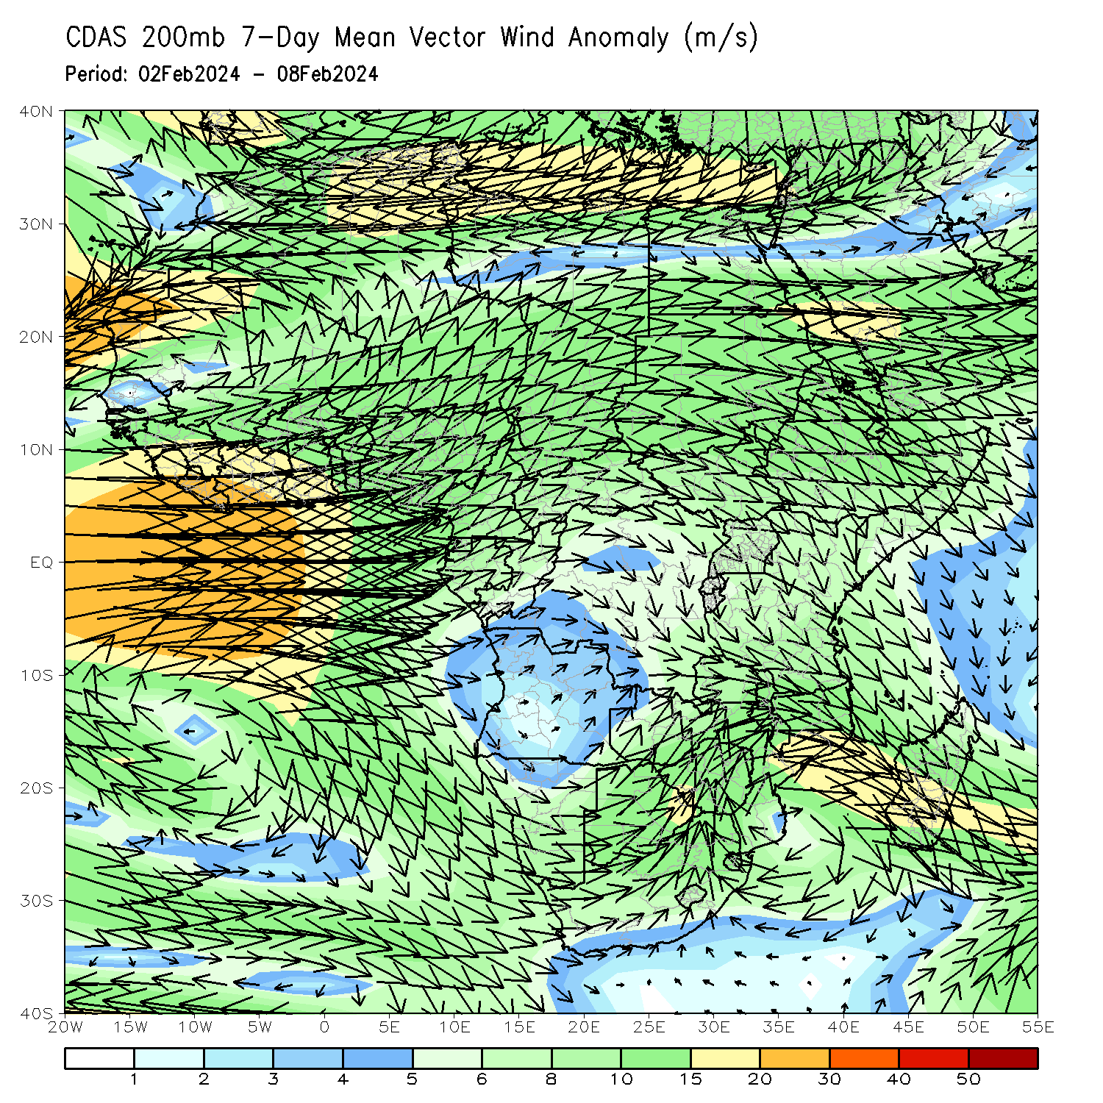
Atmospheric Circulation: Last 7 Days
At 700-hPa level (left panel), the anomalous lower-level convergence in southern Mozambique and over Madagascar may have contributed to the observed above-average rainfall in the region. At 200-hPa level (right panel), anomalous upper-level convergence over eastern Angola, Zambia, Botswana, Zimbabwe, and northern Mozambique may have contributed to the below-average rainfall in the region.

Slide 8
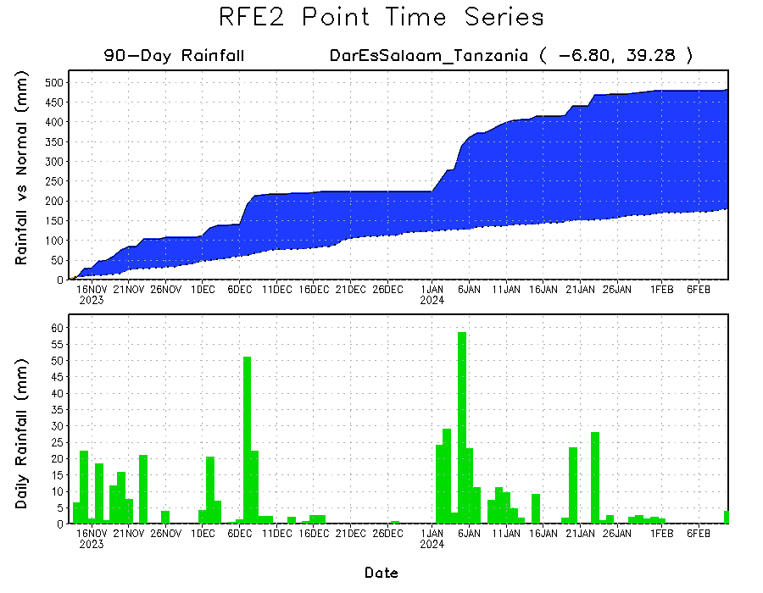
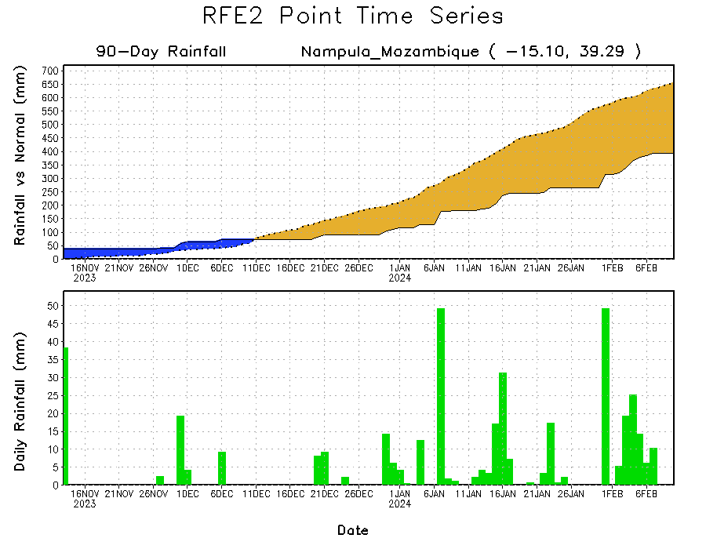
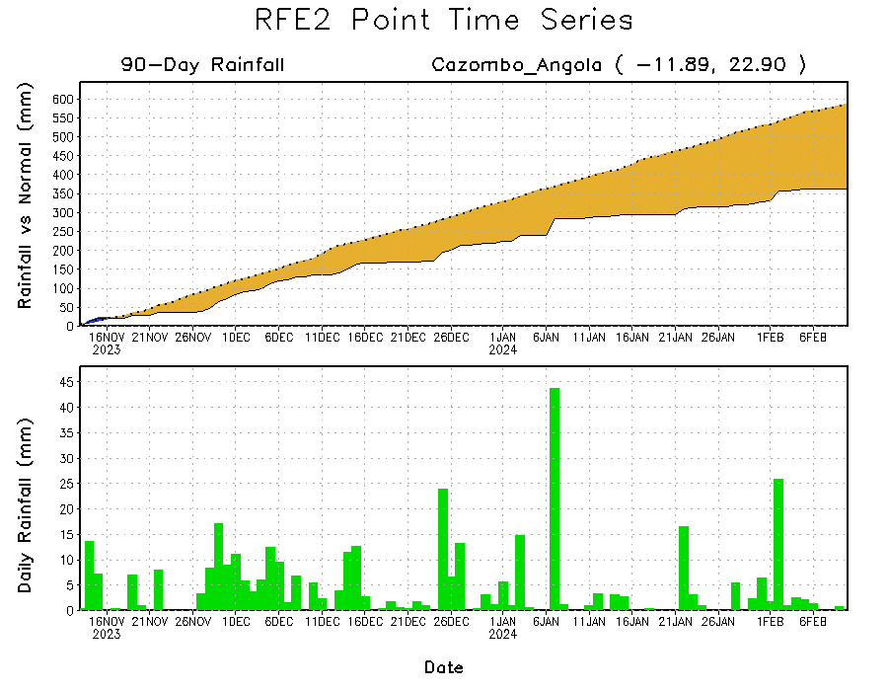
Rainfall Evolution
Daily evolution in rainfall at selected locations over the past 90 days shows growing deficits over parts of eastern Angola (bottom left) and northeastern Mozambique (bottom right). Rainfall surpluses persisted in northeastern Tanzania due to heavy and above-average rainfall during January (top right).

Slide 9
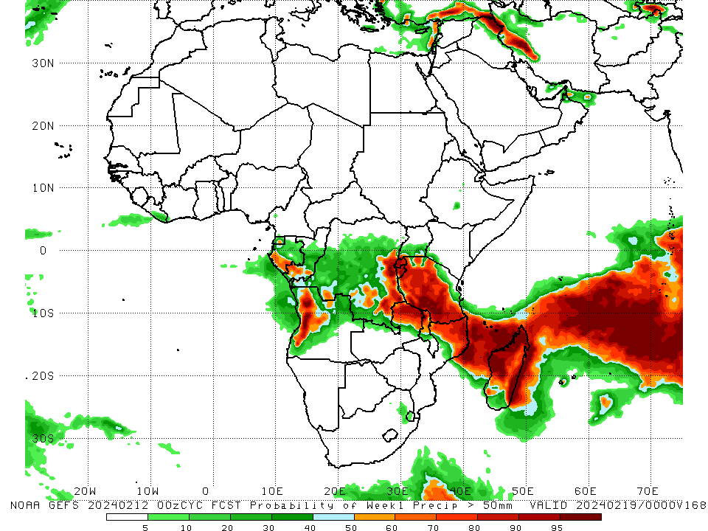
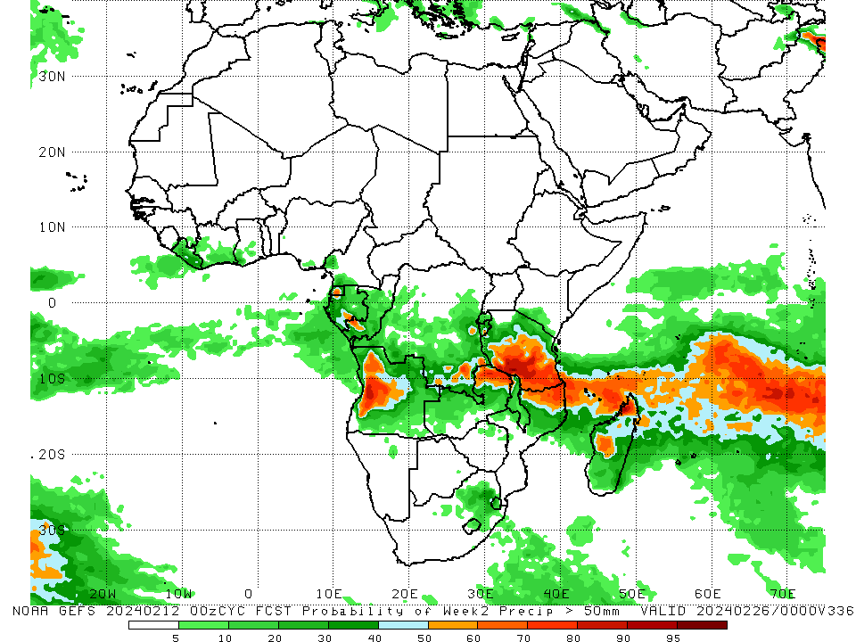
NCEP GEFS Model Forecasts Non-Bias Corrected Probability of precipitation exceedance
Week-1, Valid: 13 Feb – 19 Feb 2024
Week-2, Valid: 20 – 26 Feb 2024
For week-1 (left panel) the GEFS forecasts indicate a moderate to high chance (over 70%) for rainfall to exceed 50 mm over western Angola, eastern DRC, Rwanda, Burundi, much of Tanzania, northeastern Zambia, northern Malawi, northern Mozambique, and the northern two-thirds of Madagascar. For week-2 (right panel), the GEFS forecasts indicate a moderate to high chance (over 70%) for rainfall to exceed 50 mm over western Angola, southern Tanzania, northeastern Zambia, northern Mozambique, and pocket areas in northern and west-central Madagascar.
Notes:
9

Slide 10
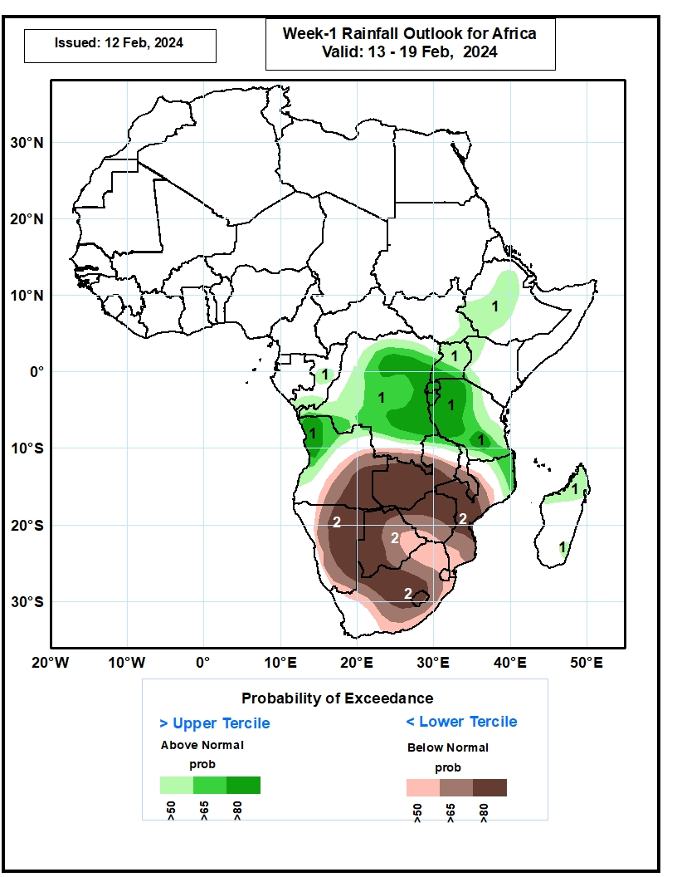
Week-1 Precipitation Outlooks
13 – 19 Feb 2024
1. The probabilistic forecasts call for above 50% chance for weekly total rainfall to be below-normal (below the lower tercile) over central and southern Congo, western and northern parts of Angola, much of DR Congo, Uganda, Rwanda, Burundi, much of Tanzania, southeastern South Sudan, central and southwestern parts of Ethiopia, western Kenya, northeastern Mozambique, and northern and southeastern parts of Madagascar. There is above 80% chance for above-normal rainfall over northwestern Angola, central and eastern parts of DR Congo, southern part of Uganda, Rwanda, Burundi, and western and southern parts of Tanzania.
2. The probabilistic forecasts call for above 50% chance for weekly rainfall to be above-normal (above the upper tercile) over central and eastern Angola, southern DR Congo, much of Zambia, central and southern Malawi, much of Mozambique, much of Namibia, Botswana, Zimbabwe, much of South Africa, Lesotho, and Eswatini. There is above 80% chance for below-normal rainfall over eastern
Angola, western and central Zambia, central Mozambique, central and eastern Namibia, western and northern Botswana, northern and central Zimbabwe, central South Africa, and Lesotho.
Notes:
10

Slide 11
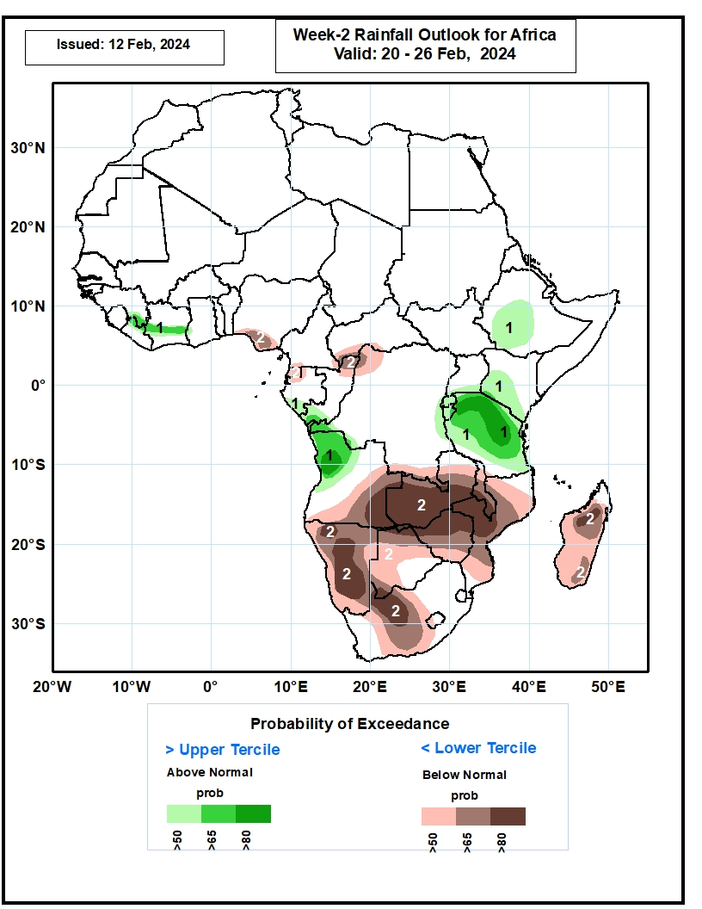
Week-2 Precipitation Outlooks
20 – 26 Feb 2024
1. The probabilistic forecasts call for above 50% chance for weekly total rainfall to be above-normal (above the upper tercile) over southeastern Guinea, northern Liberia, central Cote d’Ivoire, western part of Ghana, southern Gabon, southern Congo, western and eastern parts of DR Congo, western and northern parts of Angola, central and southwestern parts of Ethiopia, southern Uganda, southern and central parts of Kenya, Rwanda, Burundi, and much of Tanzania. There is above 80% chance for above-normal rainfall over northwestern Angola, and northern and central parts of Tanzania.
2. The probabilistic forecasts call for above 50% chance for weekly rainfall to be below-normal (below the lower tercile) over southern Nigeria, Equatorial Guinea, southwestern CAR, northern Congo, northwestern and southern parts of DR Congo, eastern and southern parts of Angola, much of Zambia, much of Malawi, much of Mozambique, Namibia, much of Botswana, Zimbabwe, western and central parts of South Africa, western Lesotho, and much of Madagascar. There is above 80% chance for below-normal rainfall over northern and central parts of Namibia, eastern Angola, western and central parts of Zambia, central Mozambique,
northern and southern parts of Botswana, northern and central parts of Zimbabwe, western part of South Africa, and northern part of Madagascar.
Notes:
11

Slide 12
Summary
Over the past 30 days, in East Africa, rainfall was above-average in west-central Ethiopia, eastern Uganda, southern and central Kenya, much of Tanzania, most places in Rwanda and Burundi. Rainfall was slightly below-average in southwestern South Sudan, parts of central and western Ethiopia. In Central Africa, rainfall was above-average over parts of central and eastern DRC, part in western Gabon, and south-central Congo. Rainfall was below-average across southern Cameroon, Equatorial Guinea, most of Gabon, most of Congo, much of DRC, and southern CAR. In West Africa, rainfall was below average along the Gulf of Guinea from eastern Liberia to southern Nigeria. In southern Africa, rainfall was above-average in western Angola, northwestern and central Namibia, part of northeastern South Africa, northeastern Mozambique, central and northern Madagascar. Rainfall was below-average in northern and eastern Angola, western Zambia, northeastern Namibia, western Botswana, much of Zimbabwe, central South Africa, western and central Mozambique, Lesotho, Eswatini, and southern Madagascar.
During the past 7 days, in East Africa, rainfall was above-average across west-central Ethiopia, eastern Uganda, and pocket areas in western and central Tanzania. Rainfall was below average in parts of central and southern Tanzania. In central Africa, rainfall was above-average in southeastern Gabon, parts of western and central DRC. Rainfall was below-average in western Cameroon, southwestern Equatorial Guinea, northwestern Gabon, northern Congo, and many parts in northern and southern DRC. In West Africa, rainfall was near-average across most of the region. In southern Africa, rainfall was above-average over west-central and southwestern Angola, northwestern Namibia, northeastern South Africa, southern Mozambique, and much of Madagascar. Rainfall was below-average over part of northern and eastern Angola, eastern and south-central Namibia, much of Zambia, Botswana, central South Africa, Zimbabwe, western, central and northern Mozambique, and Malawi.
The Week-1 outlook calls for above-average rainfall in central and southwestern Ethiopia, southeastern South Sudan, Uganda, northwestern Kenya, much of DRC, parts of Congo, northwestern Angola, Rwanda, Burundi, much of Tanzania, northeastern Mozambique, and parts of northern and southeastern Madagascar. In contrast, there is an increased chance for below-average rainfall across much of southern Africa from southeastern Angola Namibia, Zambia, Botswana, Zimbabwe, much of South Africa, Lesotho, Eswatini, central and southern Mozambique. The Week-2 outlook primarily calls for below-average rainfall across southern Africa, including southern and eastern Angola, Namibia, Zambia, western and northern Botswana, Zimbabwe, Malawi, much of Mozambique, western South Africa, much of Madagascar, southern Nigeria, Equatorial Guinea, parts of northern Congo, southwestern CAR, and part of northern DRC. Above-average rainfall is expected in parts of southern Guinea-Conakry, central Cote d’Ivoire, southern Gabon, southwestern Congo, far western DRC, northwestern Angola, eastern DRC, Rwanda, Burundi, much of Tanzania, southern Kenya, and southwestern and central Ethiopia.

